Slide 1
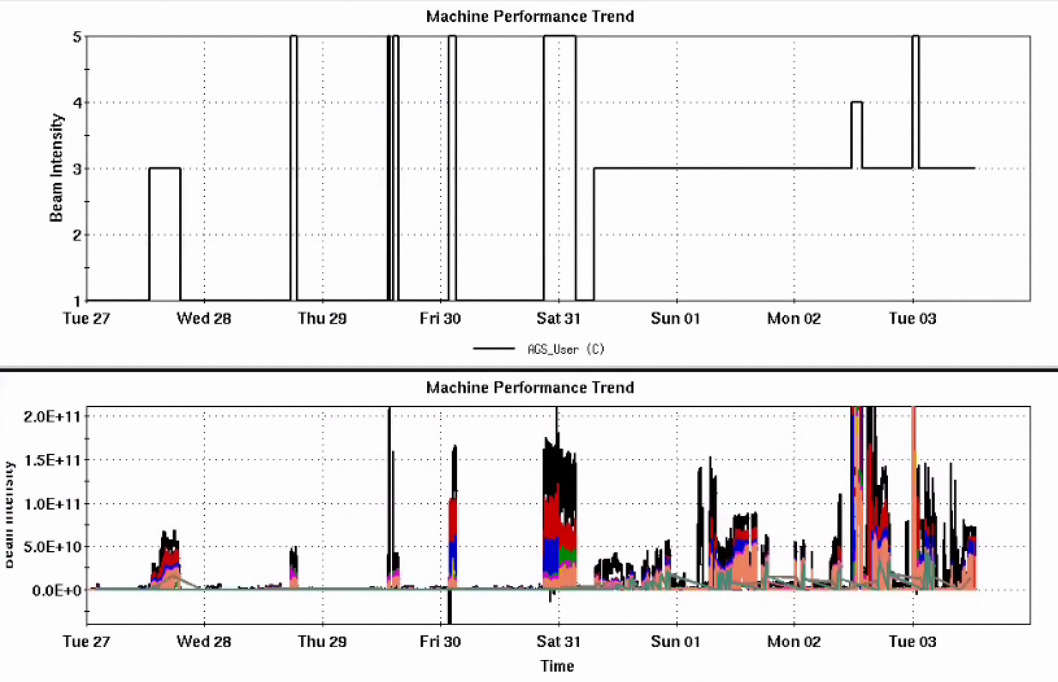
Injector Status: Time meeting 2/03/25
Delivering oxygen beam for RHIC
  Tandem working on energy/intensity stability
  RHIC required intensity only incrementally increasing from here
Some developments
  Molecular hydrogen to AGS extraction
  Proton machine – no snake
    Data for comparison after planned AGS main magnet realignment
Latest beam operation in AGS evening 2/8 (Sunday)
Injector Intensity (Au)
H2
p
O
O
AGS User
Au
Intensity

