Slide 1
sPHENIX Status
Kin Yip
sPHENIX Director of Operations
Time Meeting
Feb. 3, 2026

Slide 2
sPHENIX Status
Setup for for O+O collisions was quick and smooth. ~2:30 am (Sunday), we already started to take physics data with all subsystems.
  Trigger adjustments (on the 1st day) include jet thresholds to 8/10/12/15 GeV, rejection factors and MBD/ZDC ratios.
  Monday (Feb. 2): a vernier scan was performed and we optimized crossing angle choice with a systematic study.
MVTX have seen very few auto-
recoveries and it’s running in streaming
mode.
Reminder: beam use proposal goal is
13/nb O+O with two weeks of beam time.

Slide 3
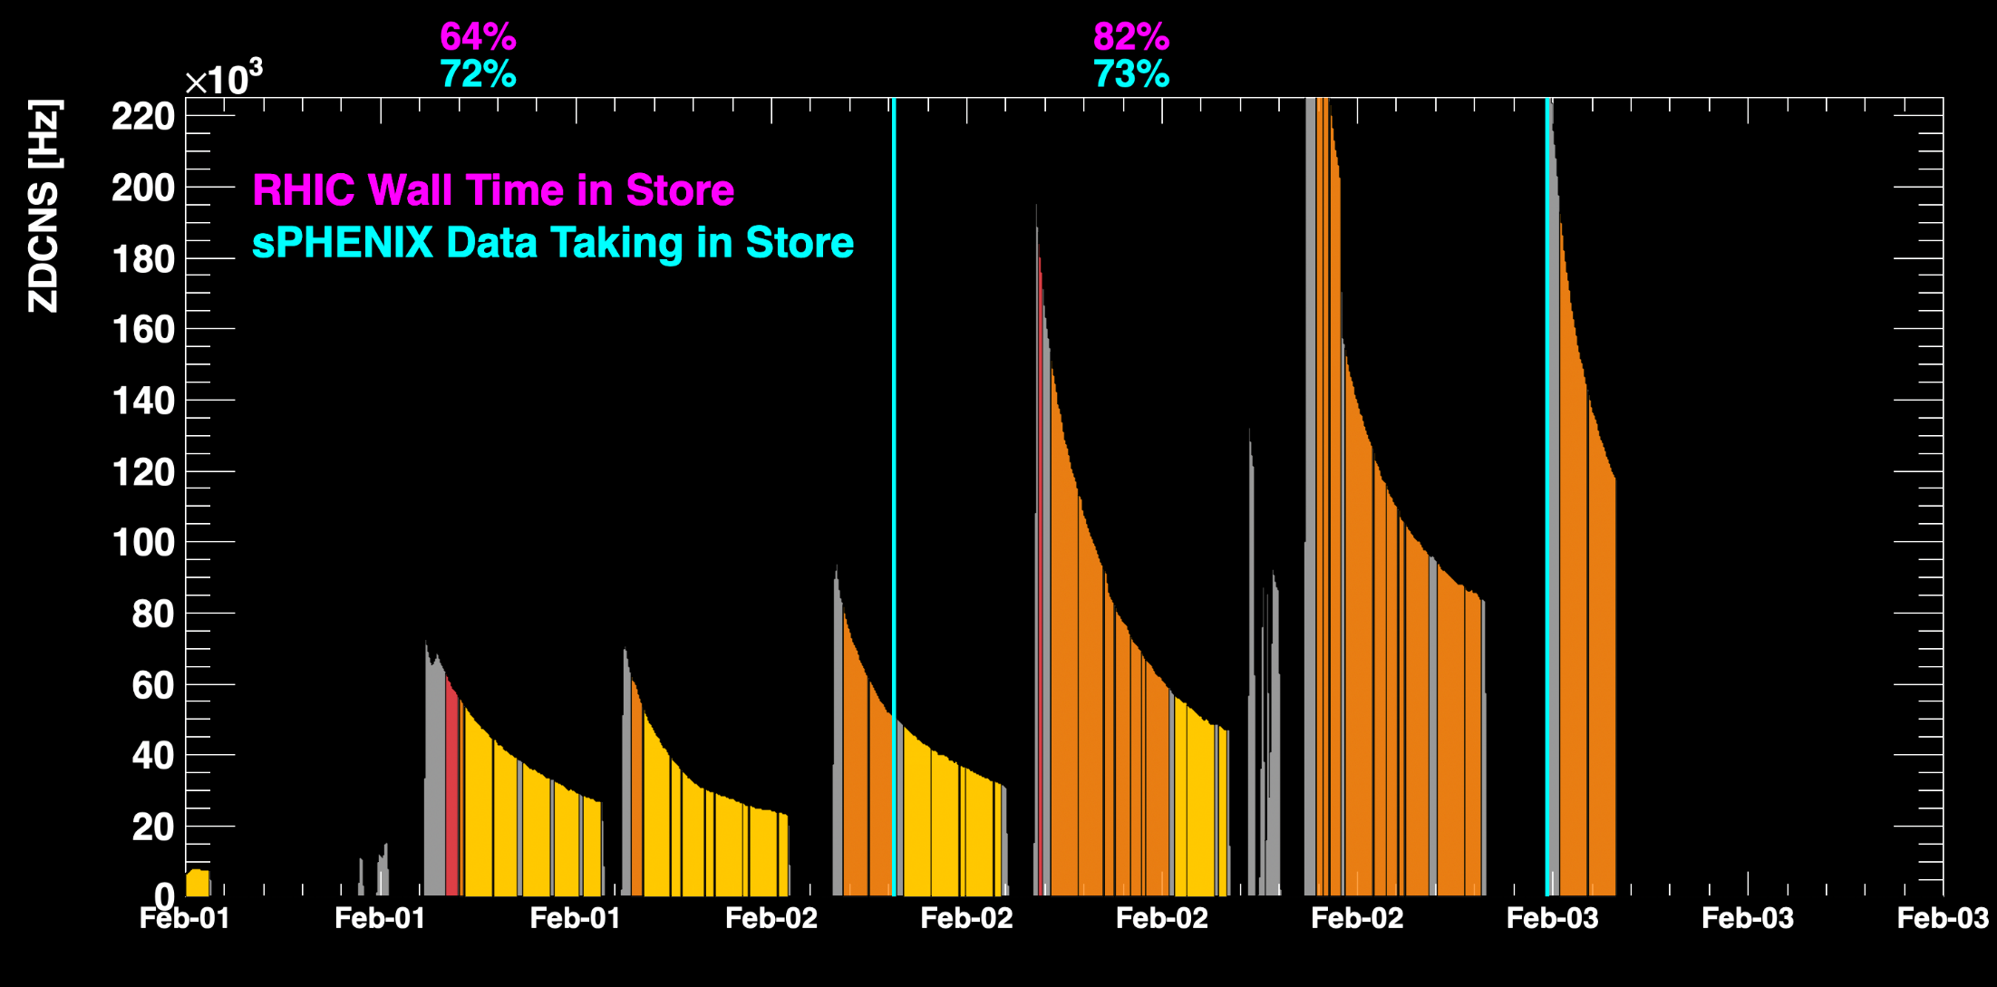
sPHENIX Status (cont.)
TPC Streaming Mode
TPC Triggered mode

Slide 4
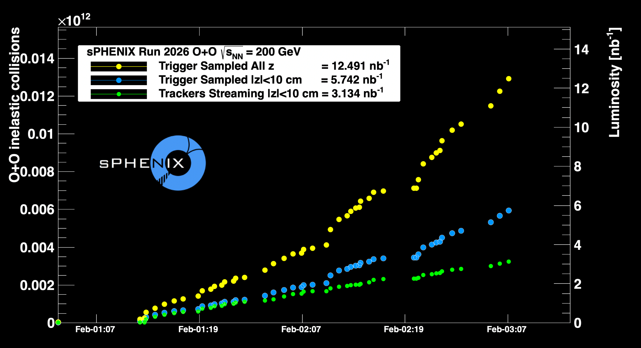
sPHENIX Status (cont.)
full detector, full acceptance

