Slide 1
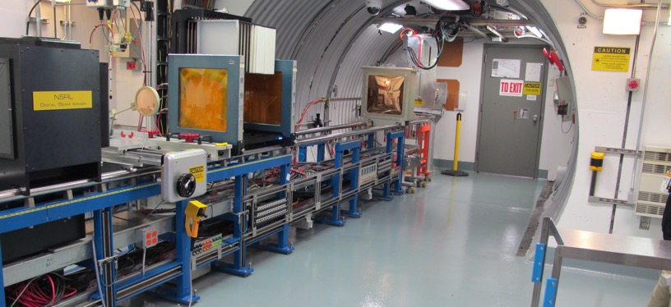
NSRL Time Meeting Report
3 February 2026
Michael Sivertz

Slide 2
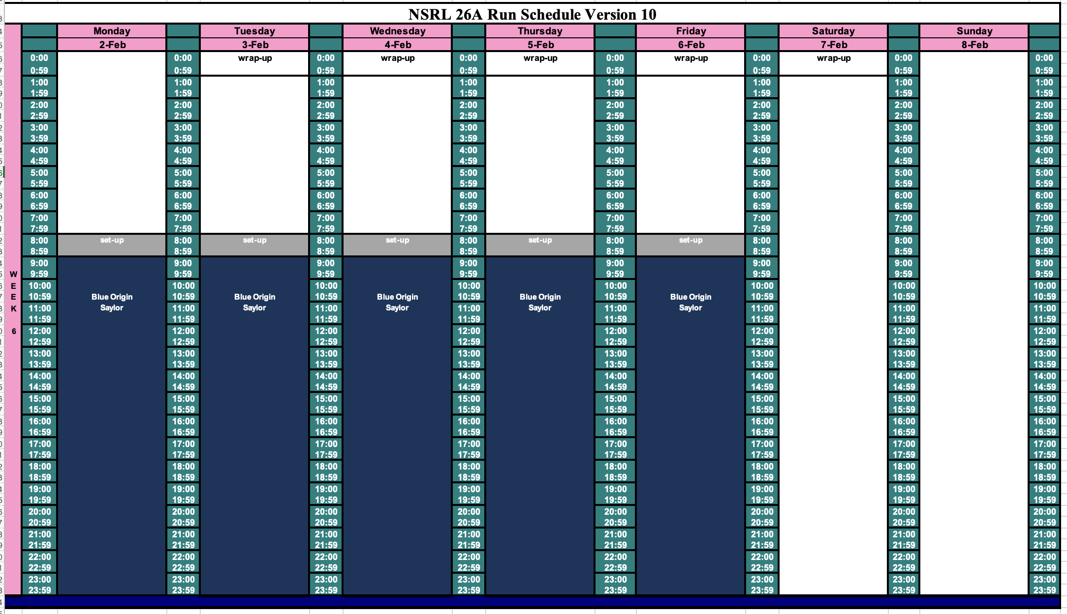
Schedule for this week

Slide 3
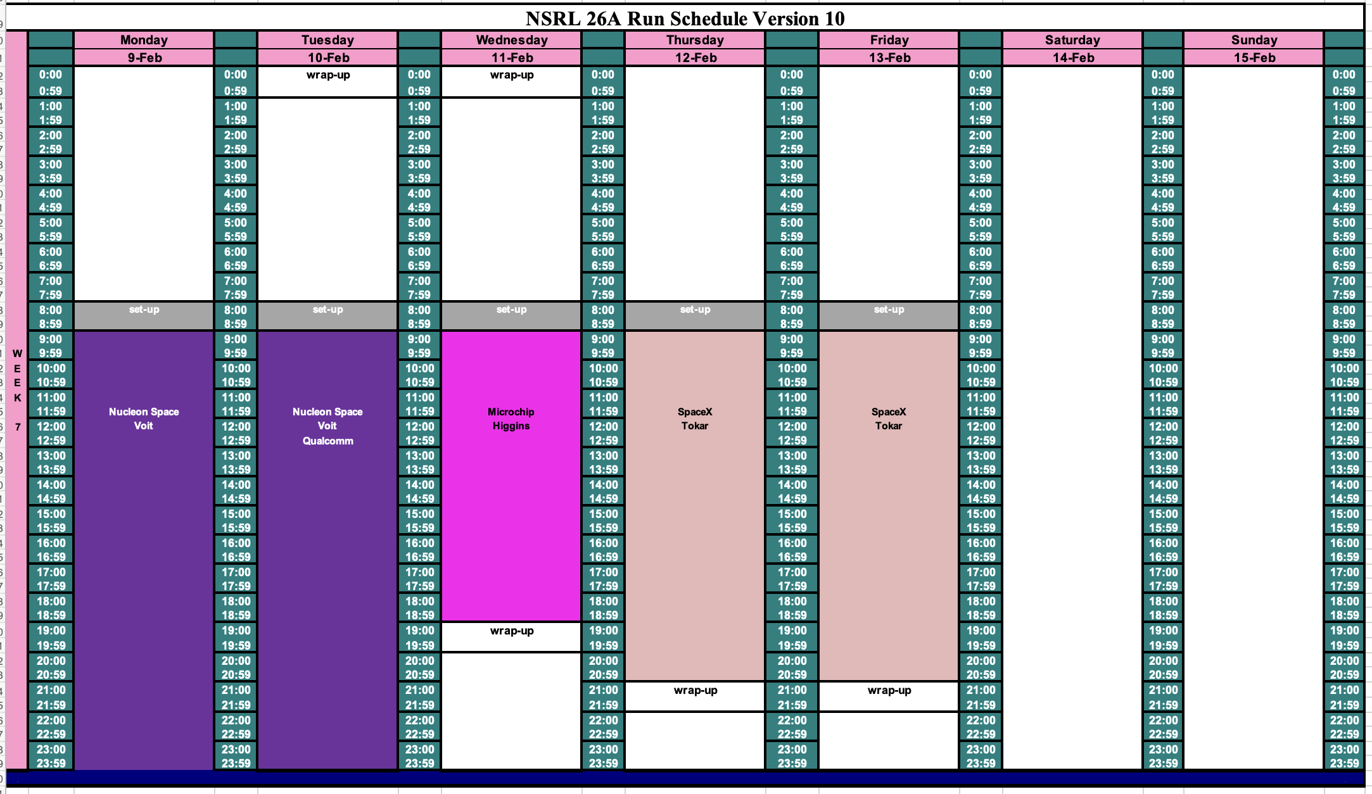
Schedule for next week

Slide 4
Future Schedule
NSRL is doing electronics testing for Blue Origin all this week, 16 hours/day.
Three groups share the following week.
What is the Booster Maintenance schedule for the weeks after RHIC shuts down?

