Slide 1
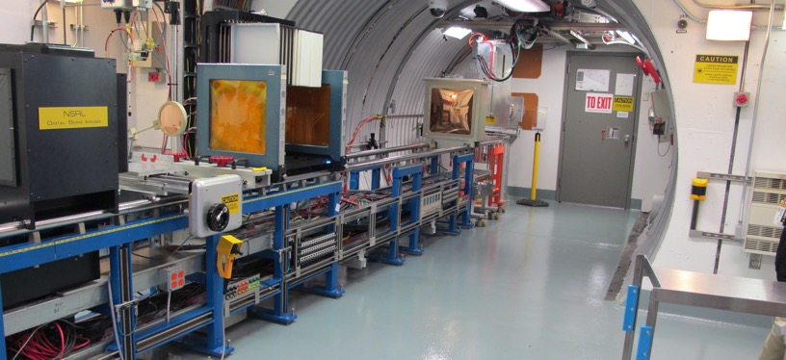
NSRL Time Meeting Report
3 February 2026
Michael Sivertz

Slide 2
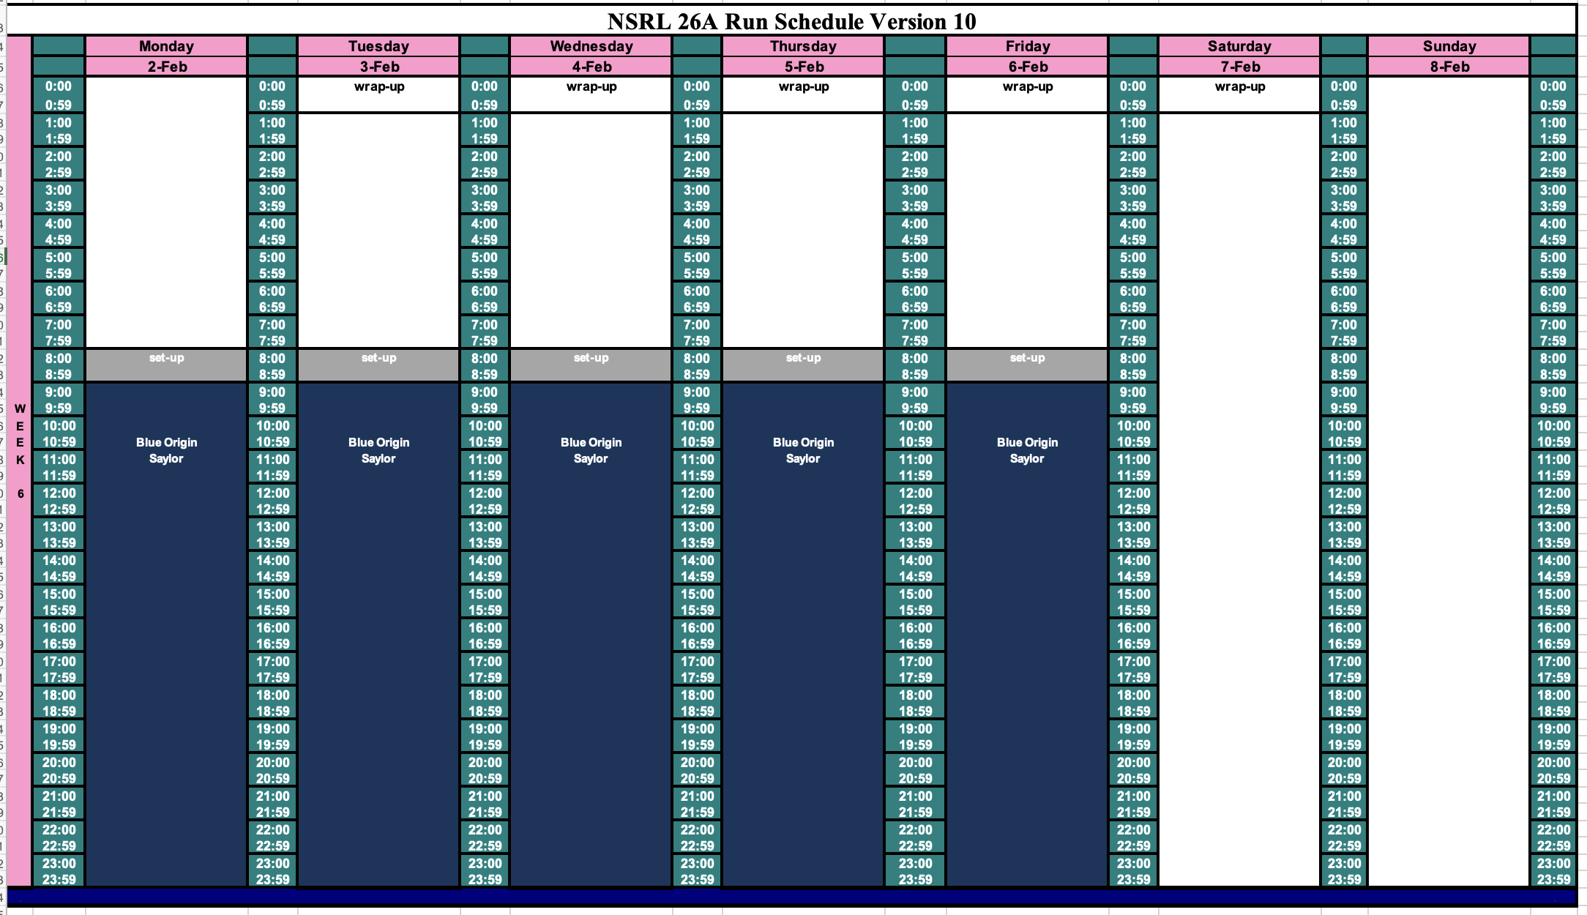
Schedule for this week

Slide 3
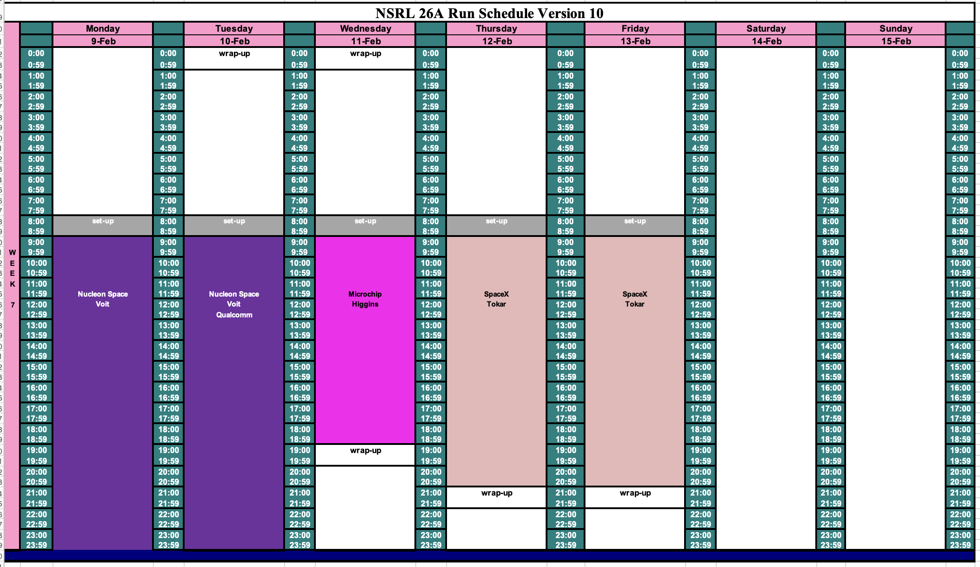
Schedule for next week

Slide 4
Future Schedule
NSRL Dosimetry Control is struggling with an intermittent error that is not yet understood. We can run without it, but would much prefer to solve the problem.
NSRL is doing electronics testing for Blue Origin all this week, 16 hours/day.
Three groups share the following week.
What is the Booster Maintenance schedule for the weeks after RHIC shuts down?

