Slide 1
Data courtesy C. Naylor

Slide 2
Data courtesy C. Naylor

Slide 3
Data courtesy C. Naylor

Slide 4
Data courtesy C. Naylor

Slide 5
Data courtesy C. Naylor

Slide 6
Data courtesy C. Naylor

Slide 7
Data courtesy C. Naylor

Slide 8
Data courtesy C. Naylor

Slide 9
Data courtesy C. Naylor

Slide 10
Data courtesy C. Naylor

Slide 12
Data courtesy C. Naylor

Slide 13
Data courtesy C. Naylor

Slide 14
Data courtesy C. Naylor

Slide 15
Data courtesy C. Naylor

Slide 16
Data courtesy C. Naylor

Slide 17
Data courtesy C. Naylor

Slide 18
Data courtesy C. Naylor

Slide 19
Data courtesy C. Naylor

Slide 20
Data courtesy C. Naylor

Slide 21
Data courtesy C. Naylor

Slide 22
Data courtesy C. Naylor

Slide 23
Operations for BLIP
No BLIP
this past week
BLIP remains in shutdown.
Notes:
BLIP plot from LogView /MCR/PerformanceStats/timeMeetingBLIP.lvdisp
Avail calc on nsrl time Excel sheet

Slide 24
NSRL activity past weeks: 1/27-2/3/2026 (as of 0800)
NSRL running continued with various users and setup. 8 EBIS ions in use (Si, Ti, Fe, Nb, Ag, Tb, Ta, Bi)
Run 26-A continues, schedule posted with users up to 3 April.
Availability: 96.0%
Notes:
Graph and avail calc from nsrl time.xlsx

Slide 25
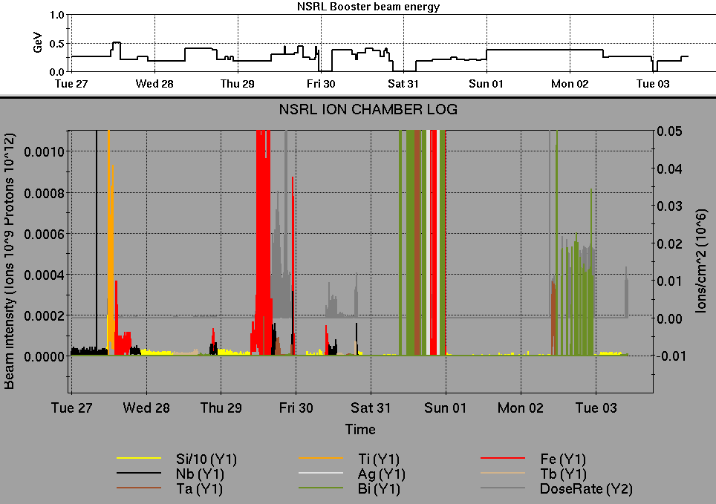
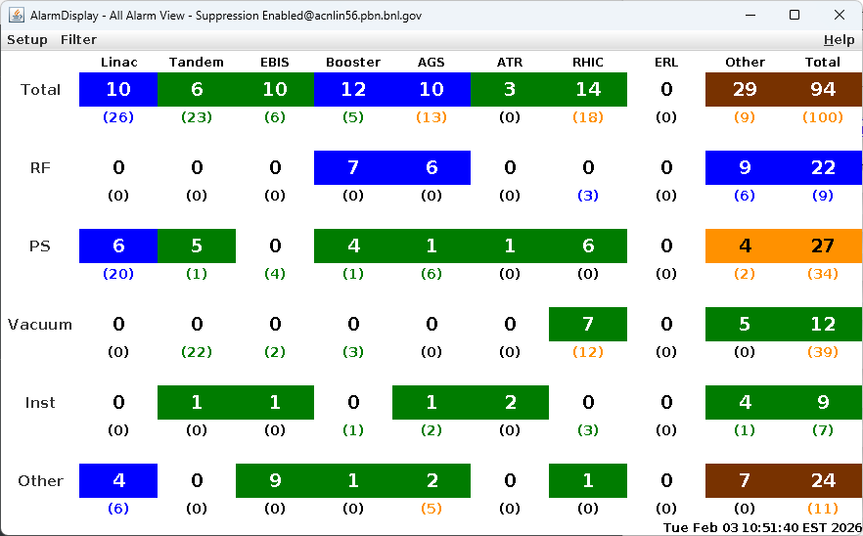
Notes from Operations
Notable failures (>1 hr)
Blue Main Quad PS not ready after maintenance; bad connectors suspected
BtA DH5 PS failure, contactor block replaced
Blue+Yellow QLI, Quench Protection failure in 1002B required hard resets
ODH sensor failure sector 10, F/R response and ACS repair
Booster C1 injection bump PS failure, driver supply reset
Sector 2 permit, loss monitor system failures, resets
Other notes
BPM beam abort (2x); wrong gain during ramp, collimator setup issues
STAR access for detector issues
Various RHIC RF cavity trips, resets
Tandem tuning for Au, O intensity & stability, spark recoveries
Linac Mod 1 voltage issues; A7 chassis replaced
Other various trips, resets, tuning
Polarized beam development, Oxygen setup, H₂ and other CeC setup behind stores this week
Notes:
NSRL plot from LogView /MCR/PerformanceStats/timeMeetingNSRL.lvdisp, select Dose Rate and ion species in use
Screenshot of AlarmSummary

Slide 26
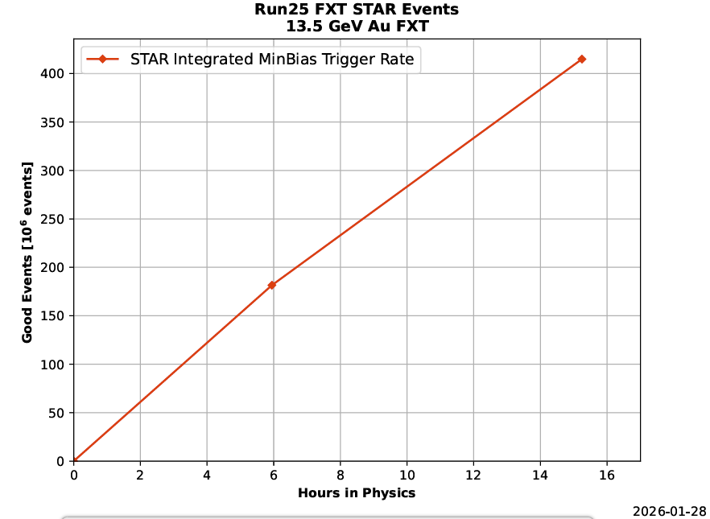
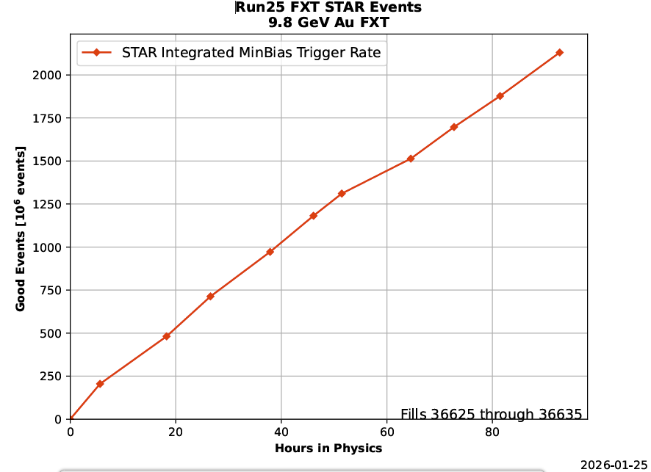
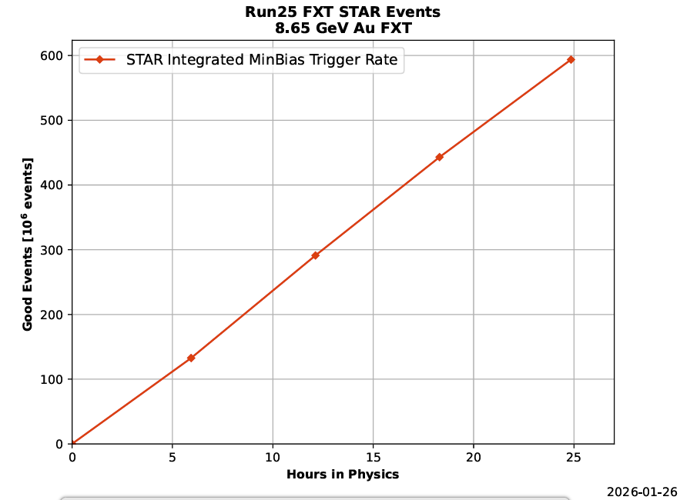
Reminder from Operations
MCR beam operations continue
RHIC Tandem ions (O) for STAR, sPHENIX continue until Friday 0900
Limited access follows until system tests complete.
NSRL shifts scheduled for users & MD, 2 shifts/5 days this week and next.
Protons from Linac; end date 2/8 2359.
Other ions, molecular beams from EBIS.
BLIP target production not scheduled until March.
Beam from high intensity source in BLIP line anticipated after 27 February, pending restart authorization and valid ORC.
AGS tuning (Tandem O, polarized protons, EBIS H₂, D₂), other studies to continue behind stores as time allows.
MCR shift coverage 24/7 until Friday 2359
Day, evening shifts only this weekend and next week.
Data courtesy A. Nicola/C.S. Towle

Slide 27
Keytree notes
Remote keytree systems require a database lookup to validate and authorize distribution of keytokens. The Keytrak system’s database is available for lookup functionality, but can no longer be modified in any way to add or edit qualified personnel.
Personnel affected:
New employees, experimenters arriving after 12/1/2024 could not be enrolled in database
Existing employees & experimenters, not already enrolled, cannot be added or modified in database
Remote keytrees affected:
Iris scan @NSRL
BNLID scan @AGS South gate, North Conjunction Gate
Iris scan @RHIC STAR, sPHENIX, IP12, IP4
Keytrees NOT affected:
BNLID scan @Linac, Booster
BNLID scan @RHIC IP2
MCR keytrees

Slide 28
Keytree notes, continued
Mitigation:
Choose entrants that are currently enrolled to perform the work in the enclosure under Controlled Access (CA).
Obtain CA keys from MCR for remote gate watch
Arrange for local gate watch using other tokens for entrants.
Arrange for Restricted Access, and allow for delays incurred to sweep areas.
CAUTION
Follow procedures. Gate Watch staff will remain vigilant.
No “piggy-backing” – one key/token per entrant.
Access keys are not candy! Authenticated entrant retains possession.
Radiological Controls and the Access Controls System are not to be circumvented. This is (has been) enforced with disciplinary action (dismissal).

Slide 30
Notes:
Reliability comparisons to previous runs

Slide 31
Notes:
Reliability comparisons to previous runs

Slide 32
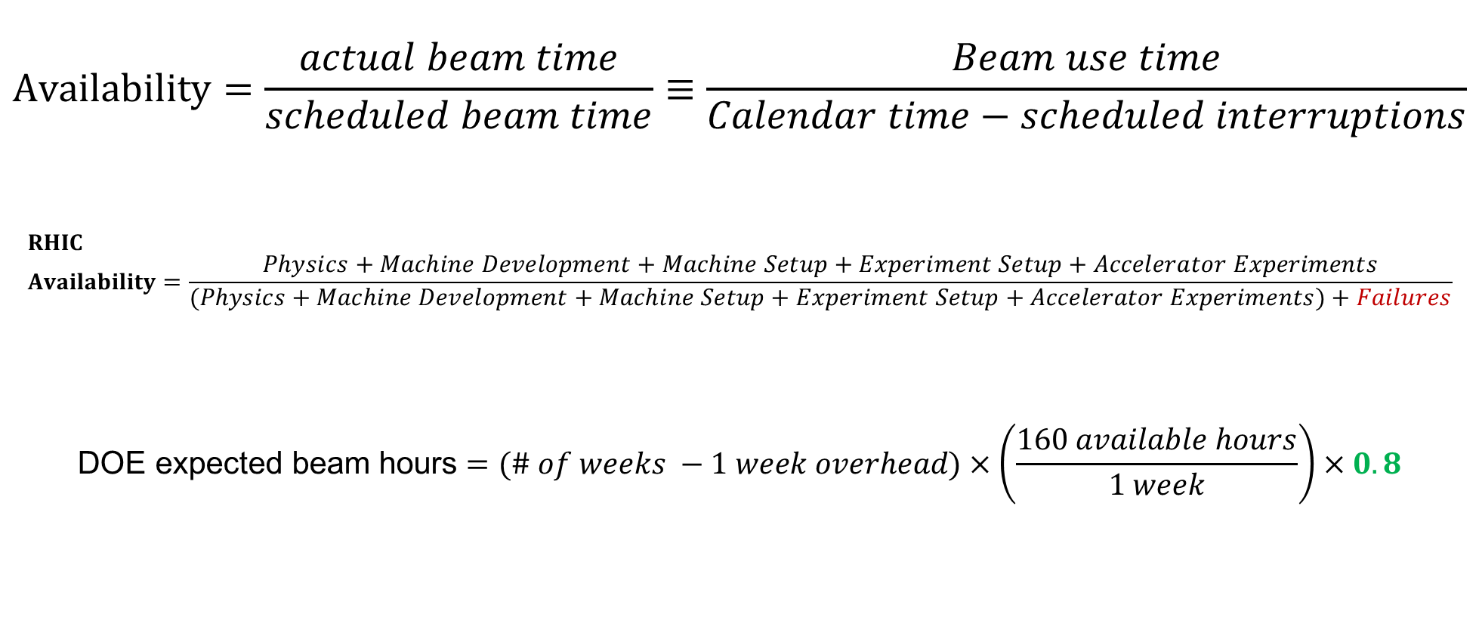
Availability, expected beam hours
$$Availability=\frac{actual beam time}{scheduled beam time}≡\frac{Beam use time}{Calendar time−scheduled interruptions}$$
$$RHIC \\ Availability=\frac{Physics+Machine Development+Machine Setup+Experiment Setup+Accelerator Experiments}{(Physics+Machine Development+Machine Setup+Experiment Setup+Accelerator Experiments)+Failures}$$
$$\text{DOE} \text{expected} \text{beam} \text{hours}=(\# of weeks −1 week overhead)×\left(\frac{160 available hours}{1 week}\right)×0.8$$
Notes:
Normally hidden. Explains how the 85% from DOE comes in to play, & general availability metrics

