Slide 1
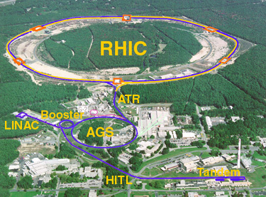
Time Meeting
Accelerator Operations Support

Slide 2

Shutdown kickoff meeting here at 3 tomorrow

Slide 3

Shutdown “Time” Meetings
Here, weekly, then every other… Invite to be sent out

