Slide 1
Astrolinx Mockup (1-31-25)
Weekly Update

Slide 2
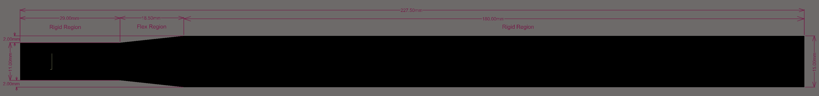
New Board Dimensions
Fixed 15.52mm wide on right side, fixed corner to be 90deg
New serial region is 11mm, zoomed in on next slide

Slide 3
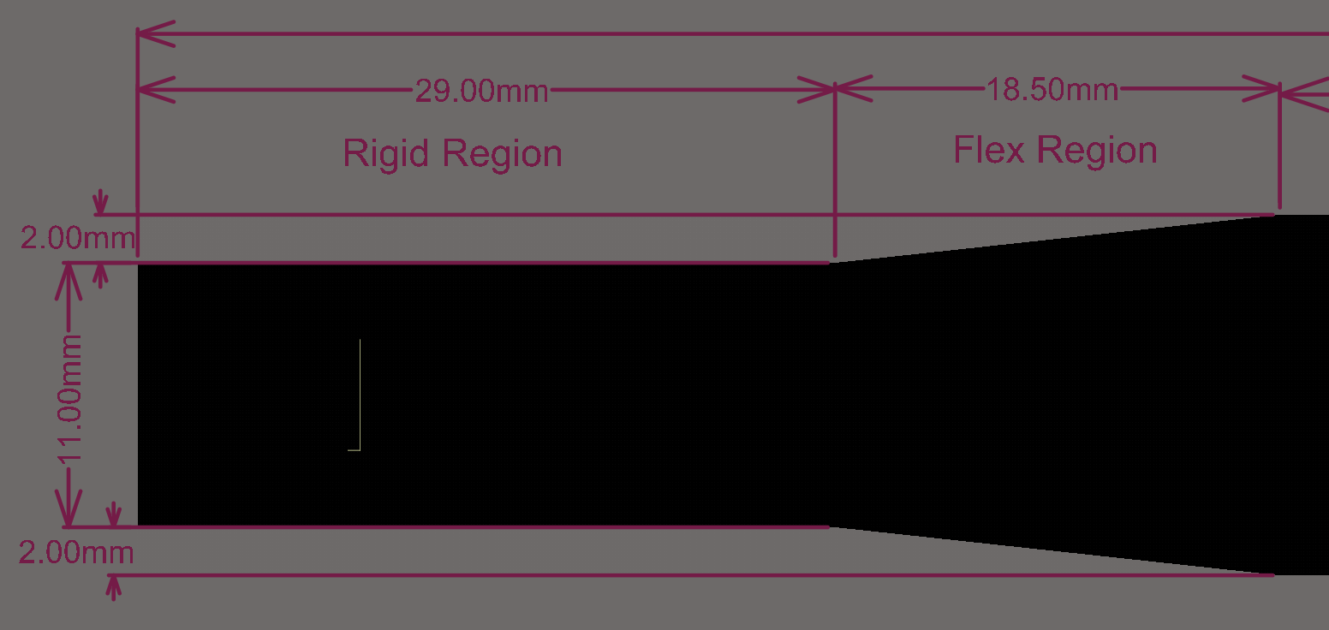
Serial Connection Region

Slide 4
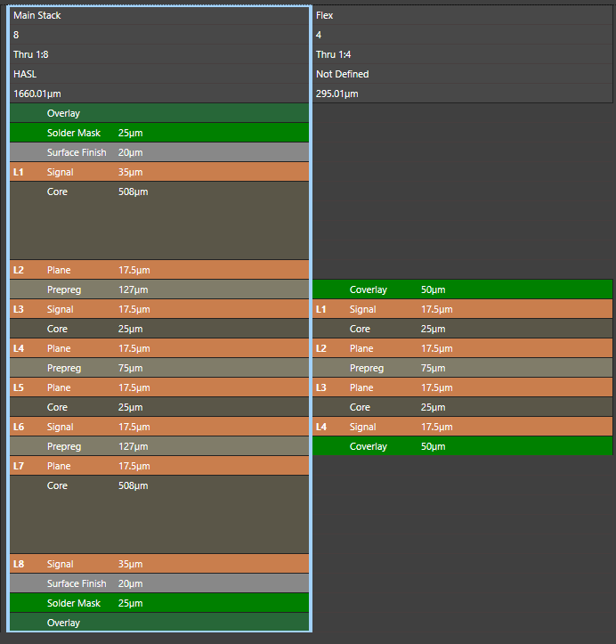
Current Stackup
R04250B rigid cores
R04450T Bondply
Pyralux AP flex cores
Pyralux LF bondply

Slide 5
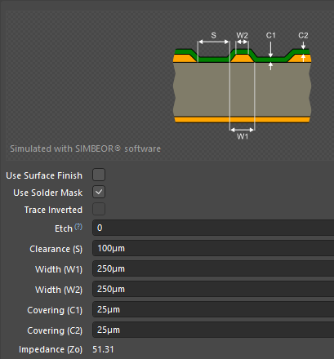
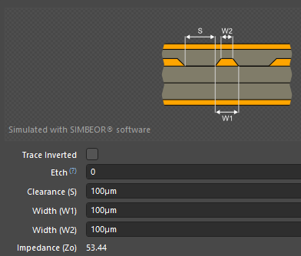
Rigid Impedance Profiles
Above photo is top layer
Impedance ~54.6
Reference: Layer 2
Below phot is layer 3 (top of flex)
Impedance ~53
References: Layer 2/Layer 5

Slide 6
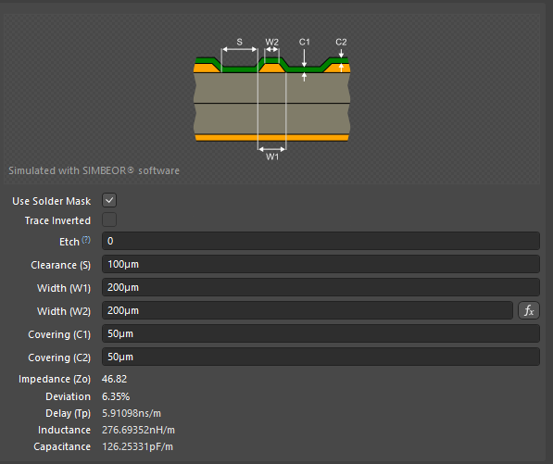
Flex Profile
Layer 3 (top of flex)
Impedance ~49
Reference: Layer 4
Allows routing on layer 5 without disturbing data lines

Slide 7
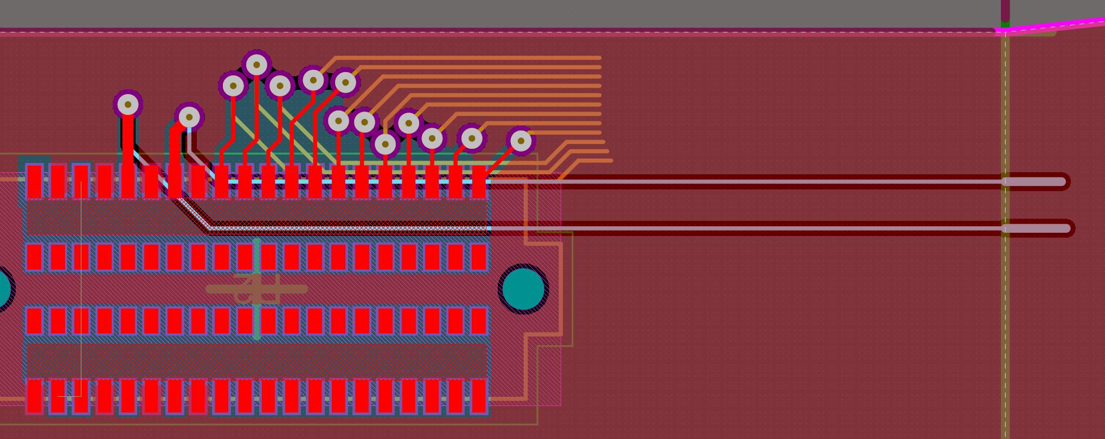
Breakout Mockup

