Slide 1



hpDIRC Present Status and Future Plans
C. Ayerbe Gayoso, J. Datta, K. Dehmelt, A. Deshpande, R. Dzhygadlo, A. Garrett, K. Gnanvo, I. Hossain, C. Hyde, Y. Ilieva, G. Kalicy, A. Lehmann, P. Nadel-Turonski, K. Peters, C. Schwarz, J. Schwiening, N. Shankman

Slide 2
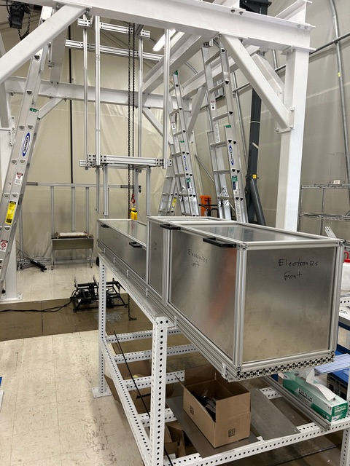
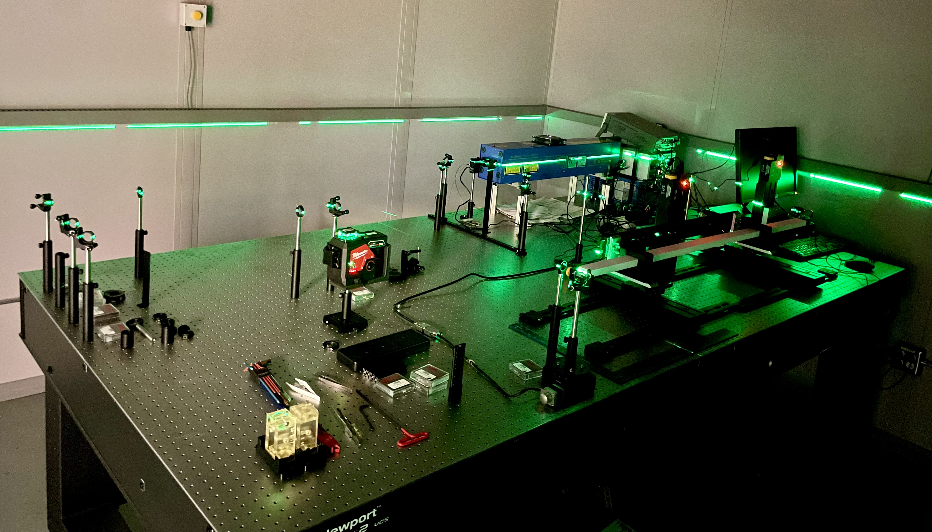
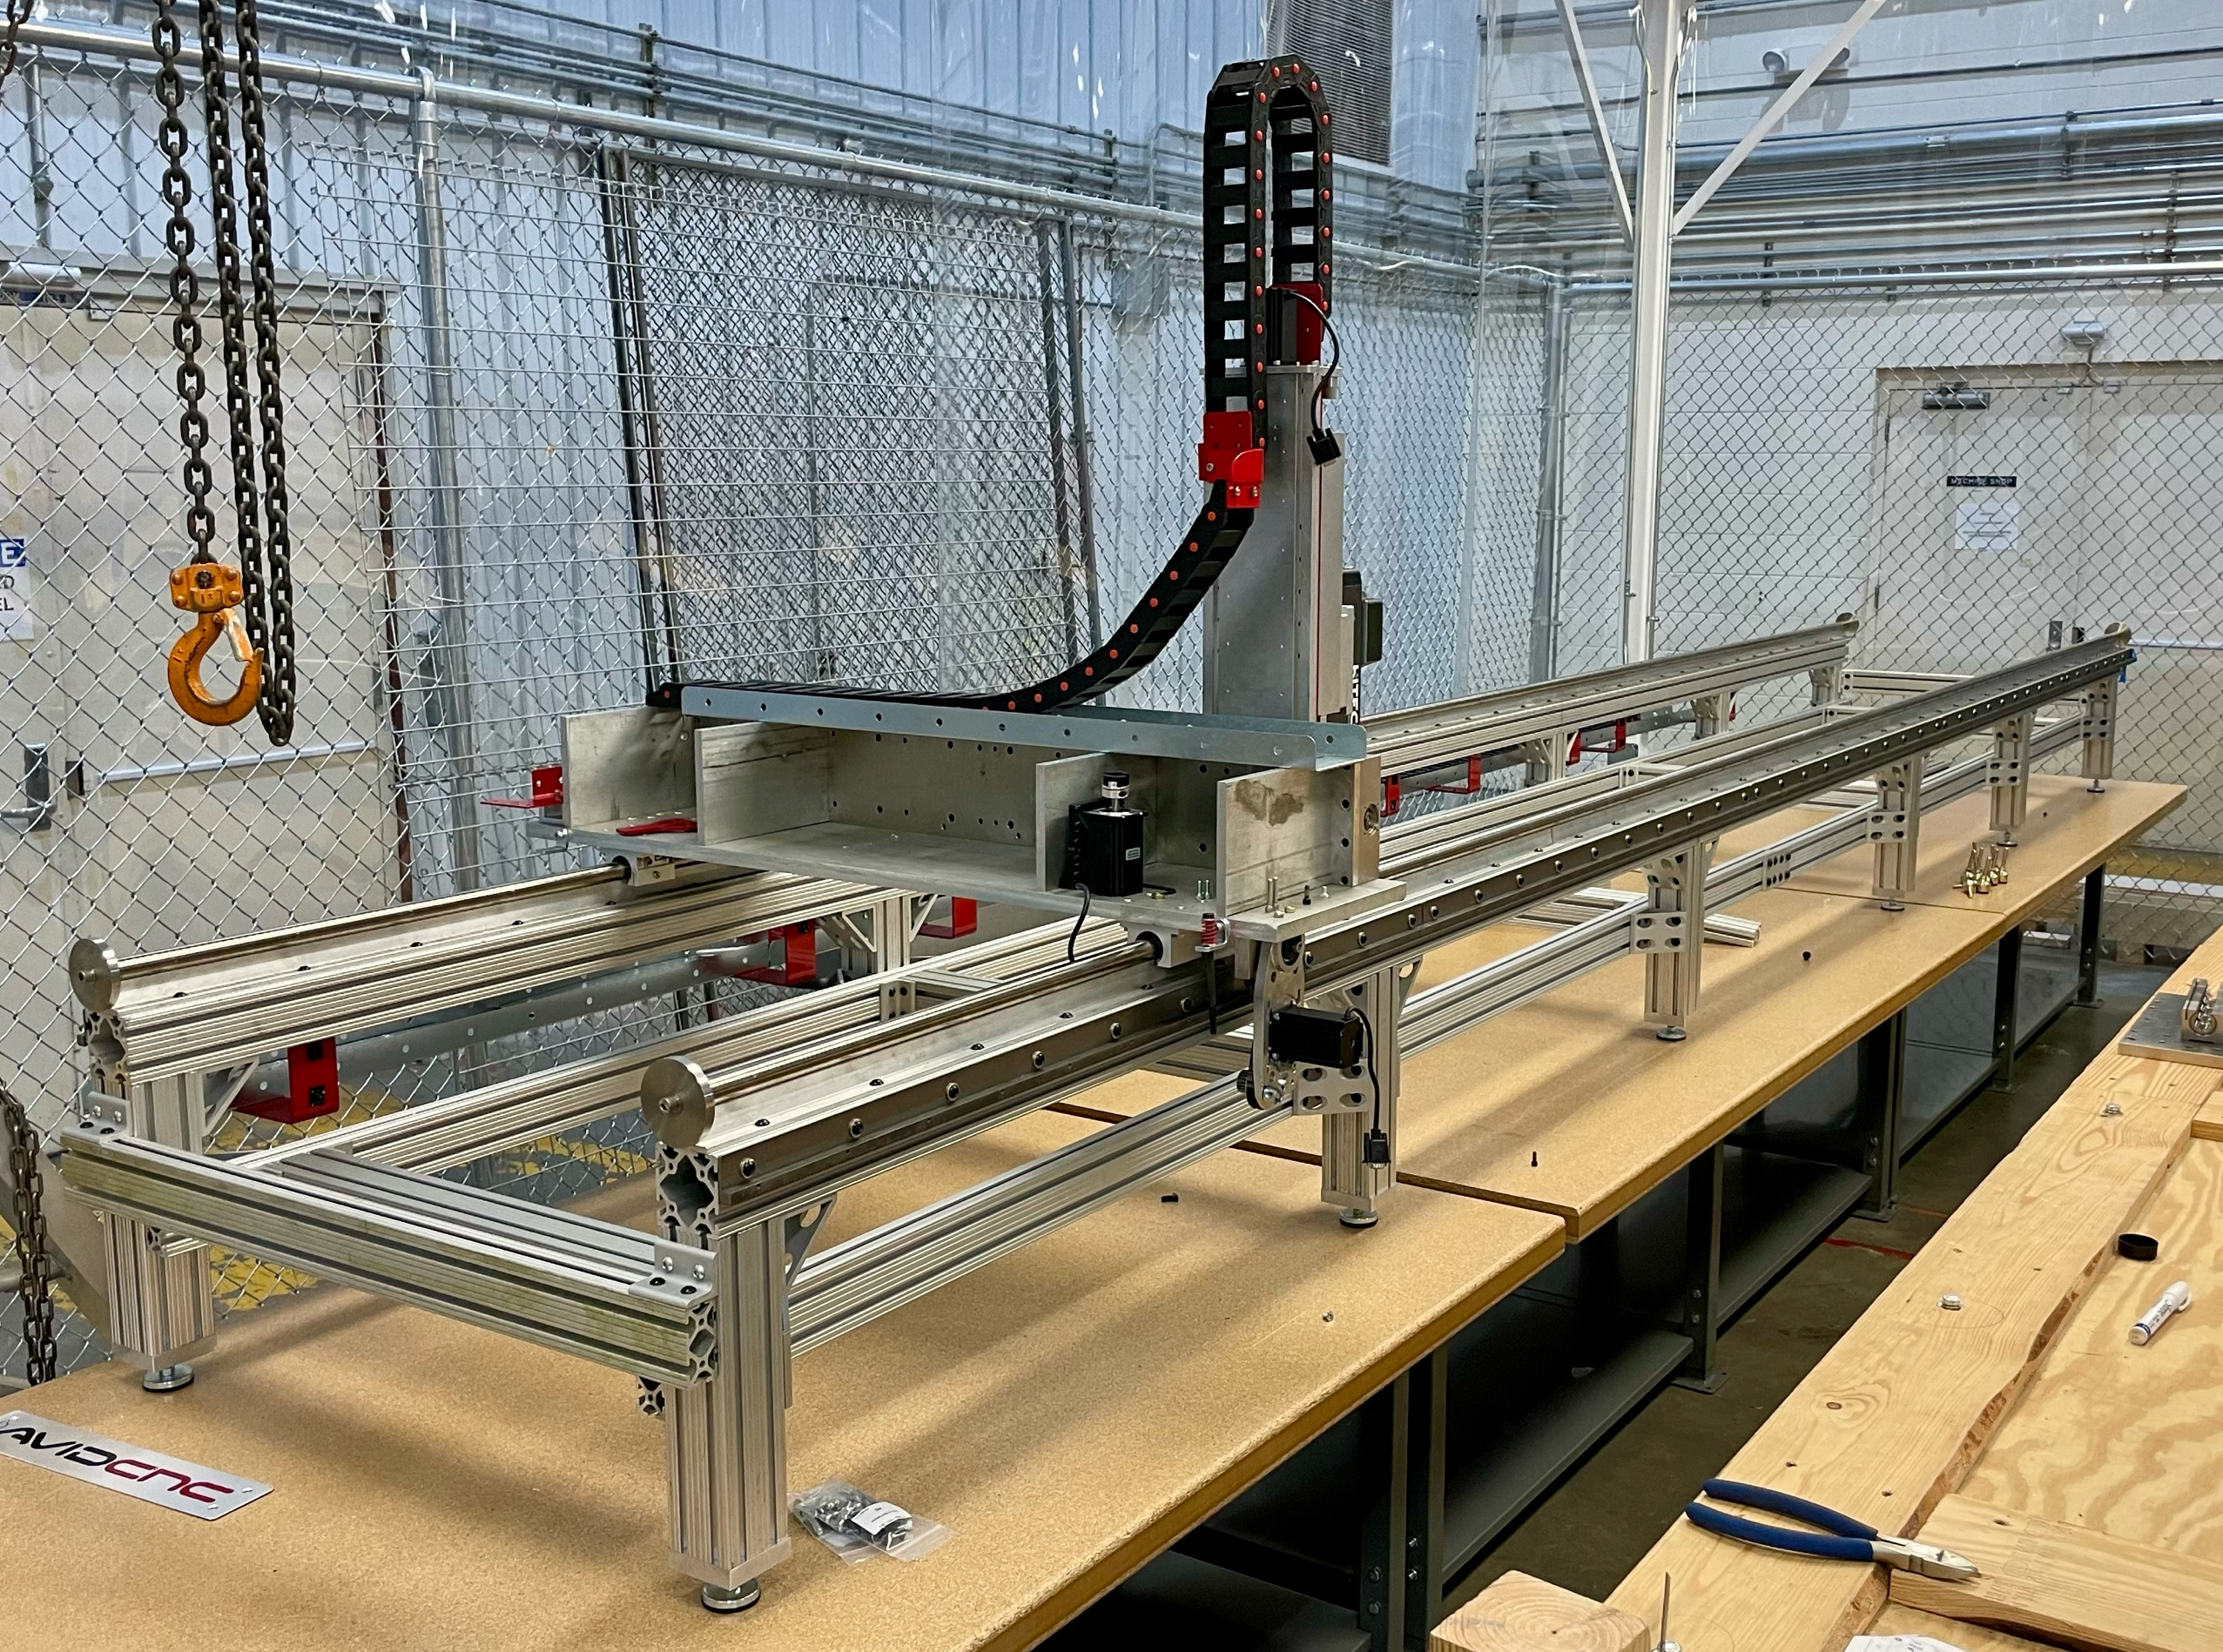
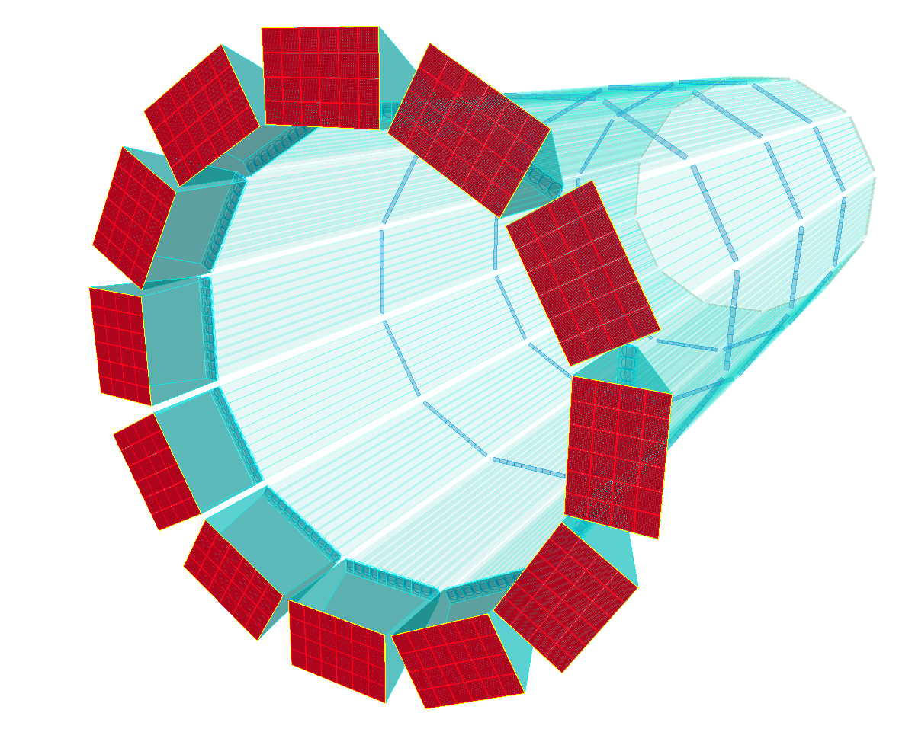
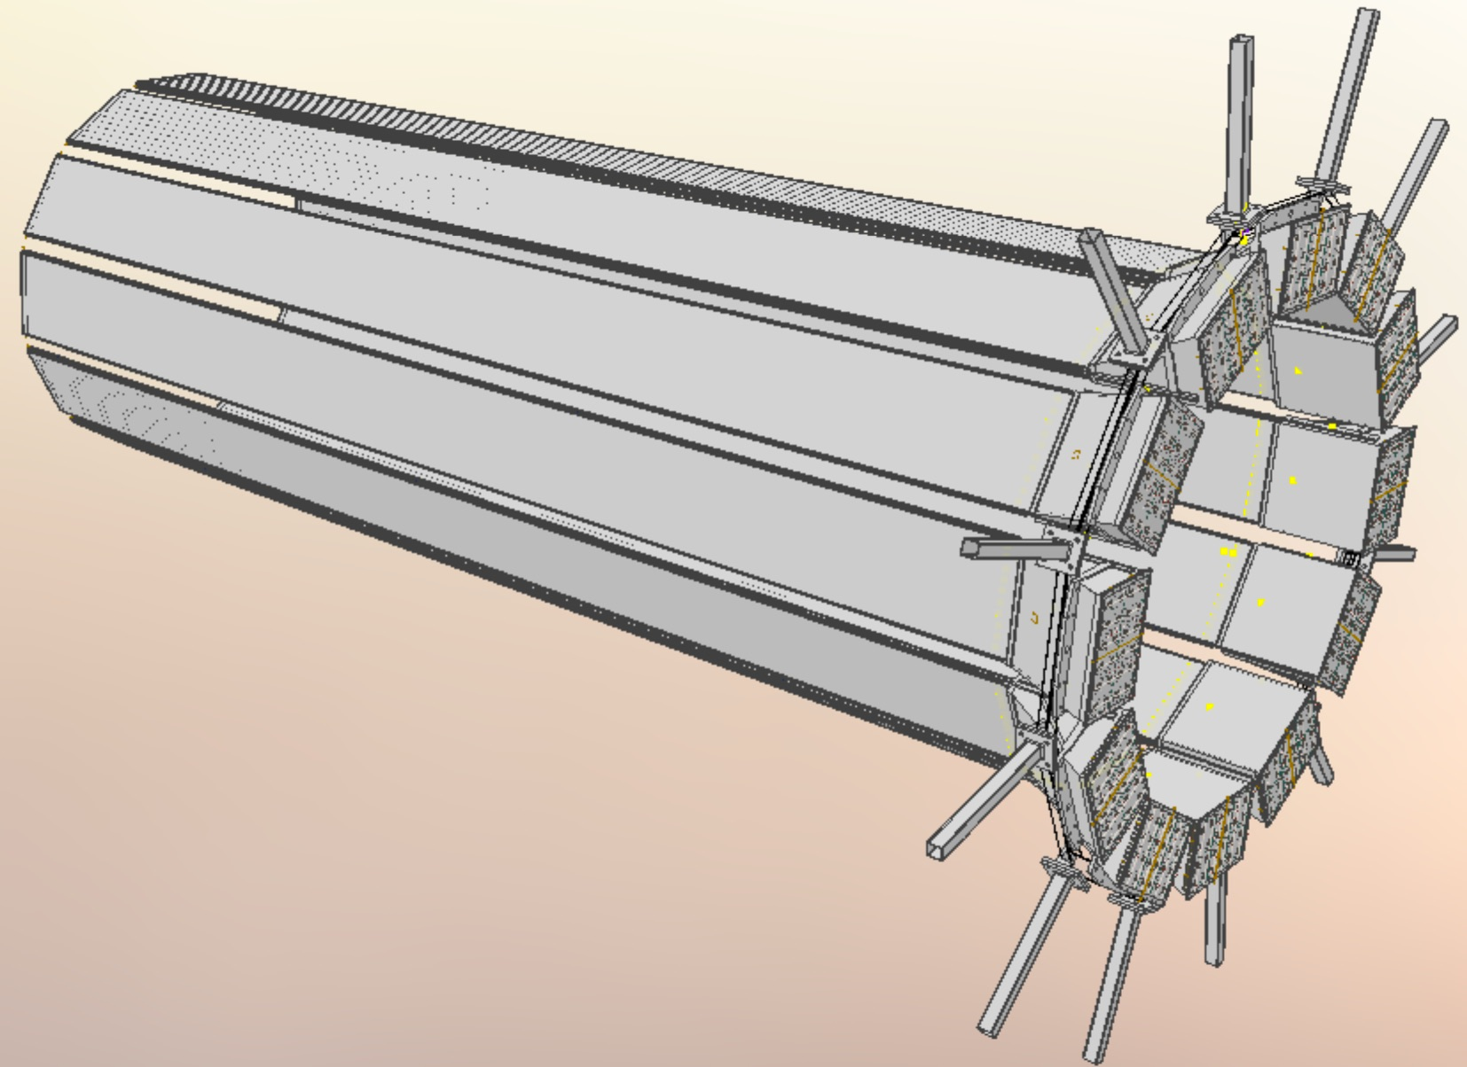
hpDIRC Recent Activities
hpDIRC prototype in Cosmic Ray Telescope (CRT):
CRT construction in final stage at SBU to become test bench for incremental upgrades of new components (bars, sensors, readout electronics, eventually full hpDIRC modules)
Momentum tagger installed and tested
Tracker installation and DAQ synchronization ongoing
Validation of the BaBar DIRC bar reuse:
Bar boxes transferred from SLAC to JLab in April 2024
Disassembly of the boxes have started
Decision on reuse of bars expected by Q1-Q2/2025
Ongoing hpDIRC studies in simulation:
Light-guide, prism, sensor coverage design optimization
Mechanical Design and Integration:
Work with two engineers and synergies with PANDA Barrel DIRC
hpDIRC prototype at SBU
QA lab at JLab
Disassembly setup at JLab
hpDIRC in Geant4
hpDIRC in CAD

Slide 3
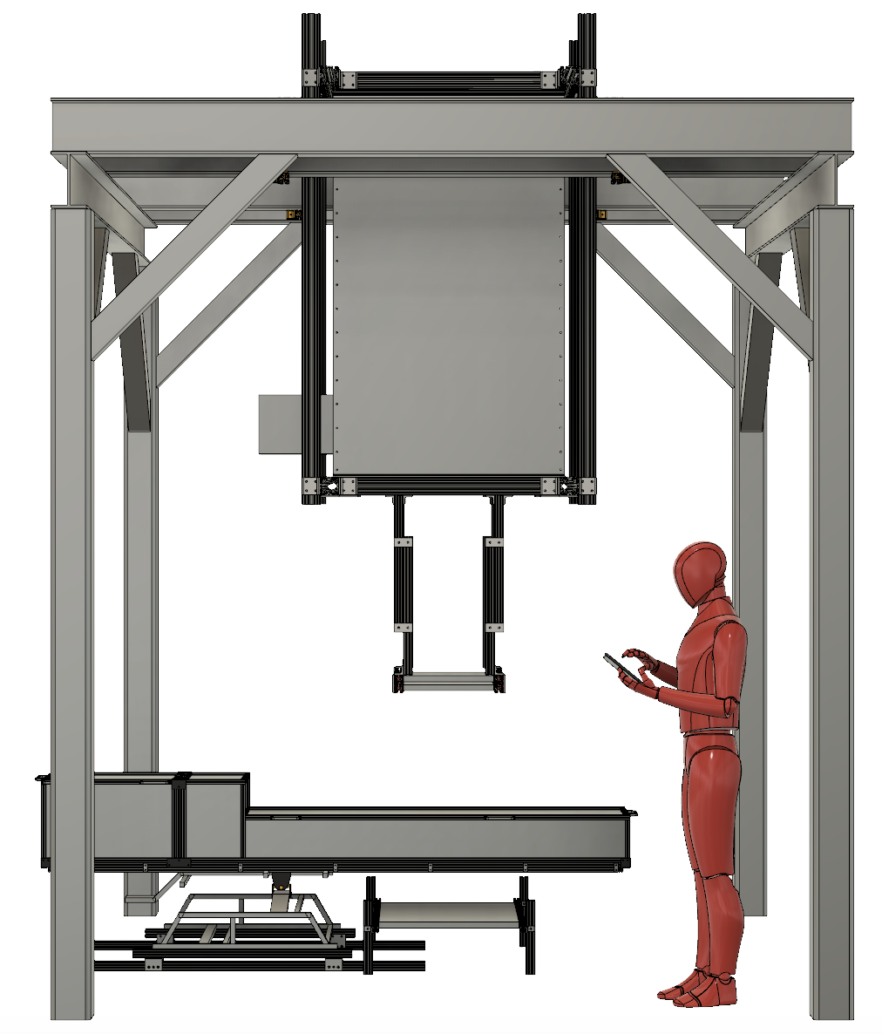
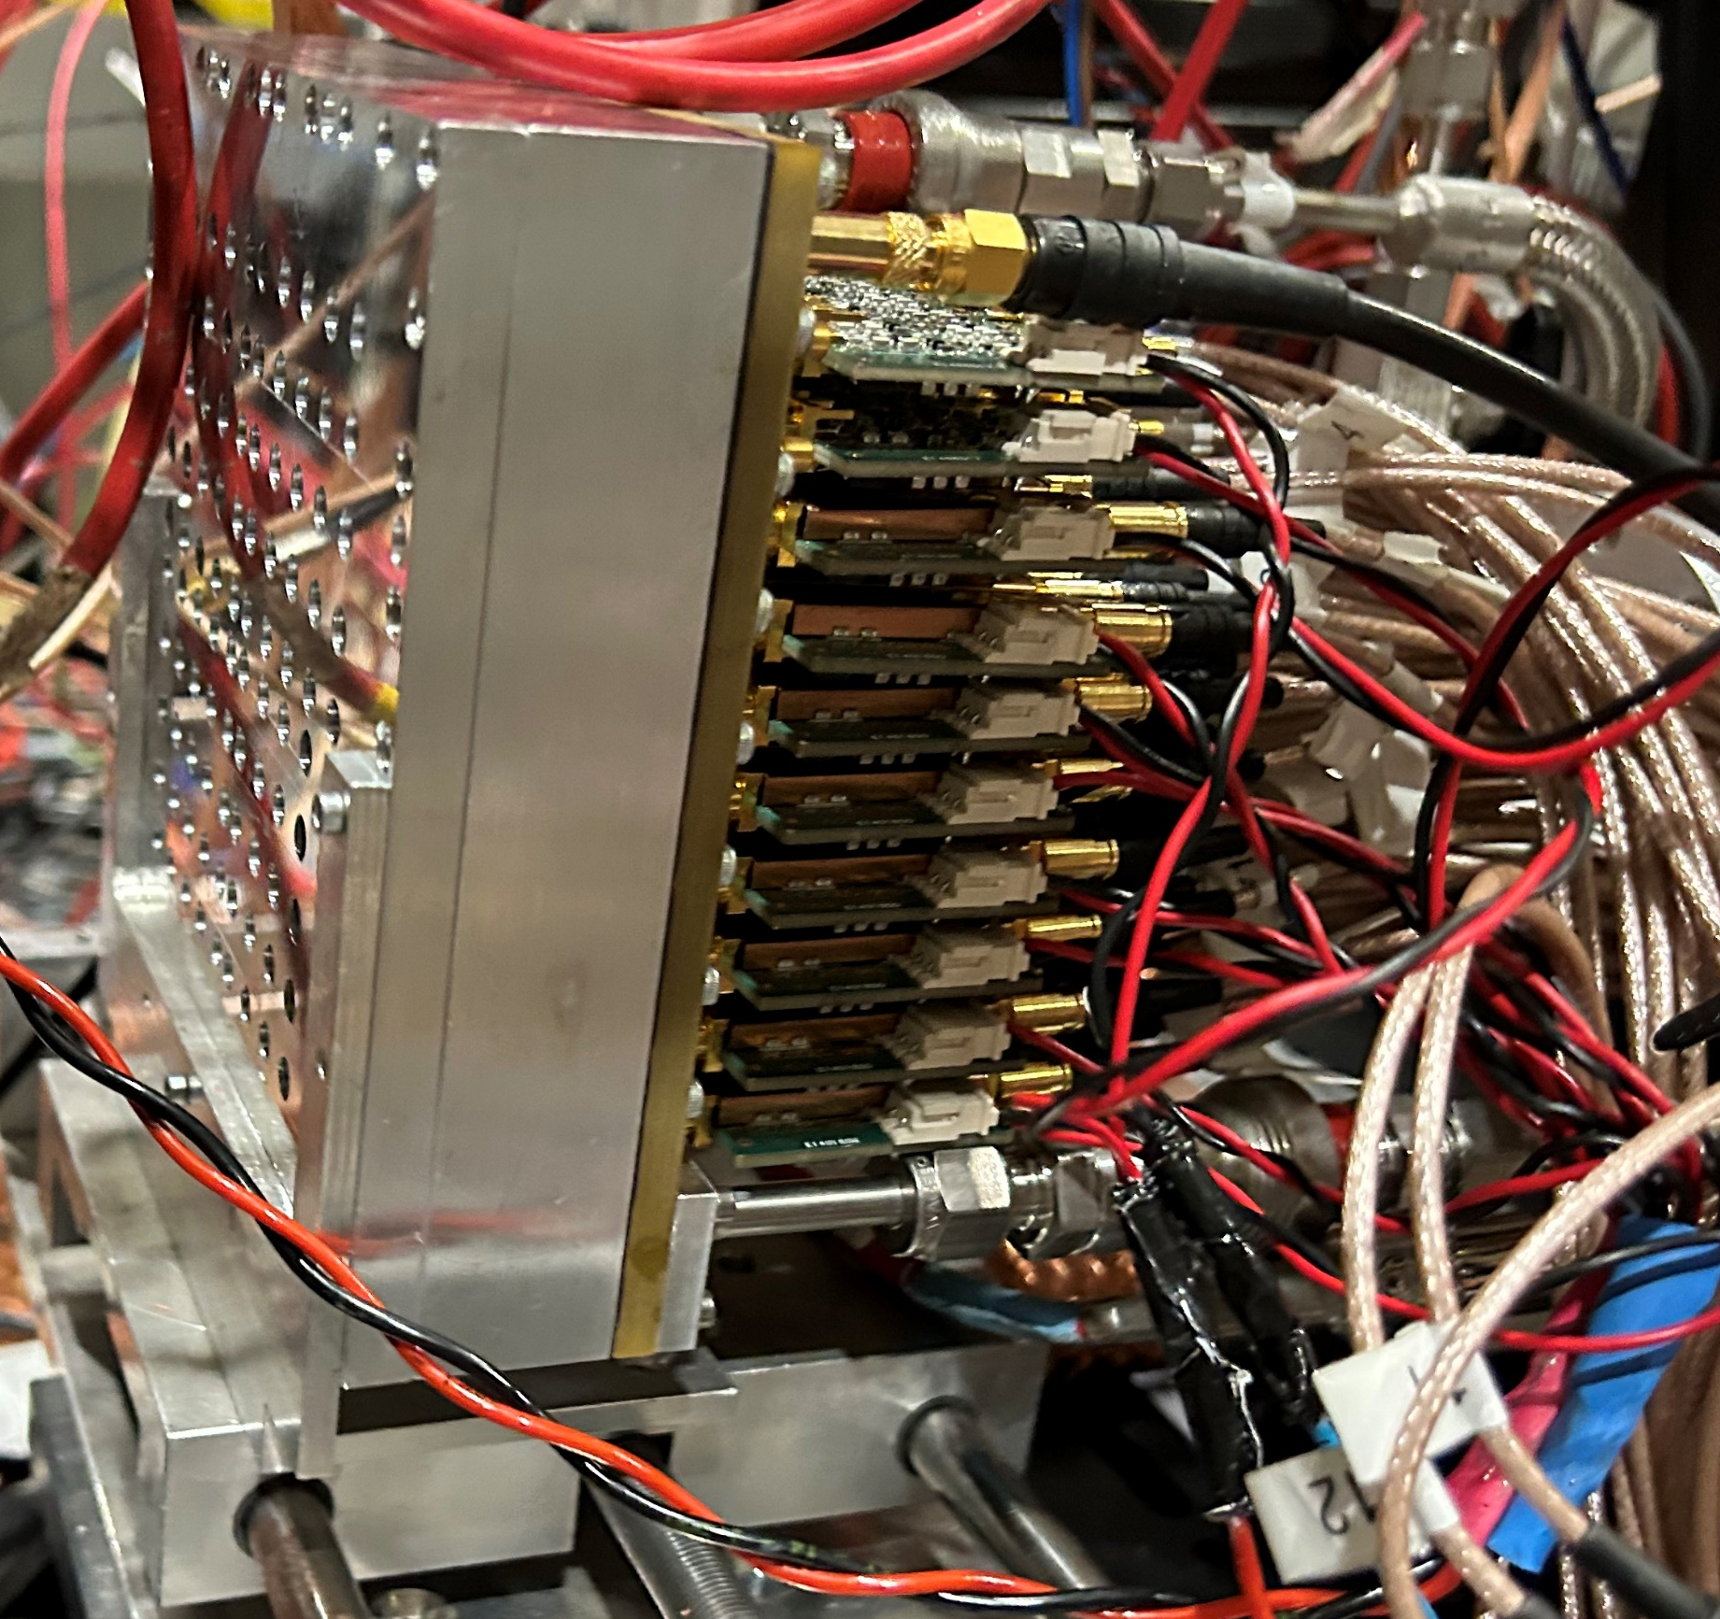
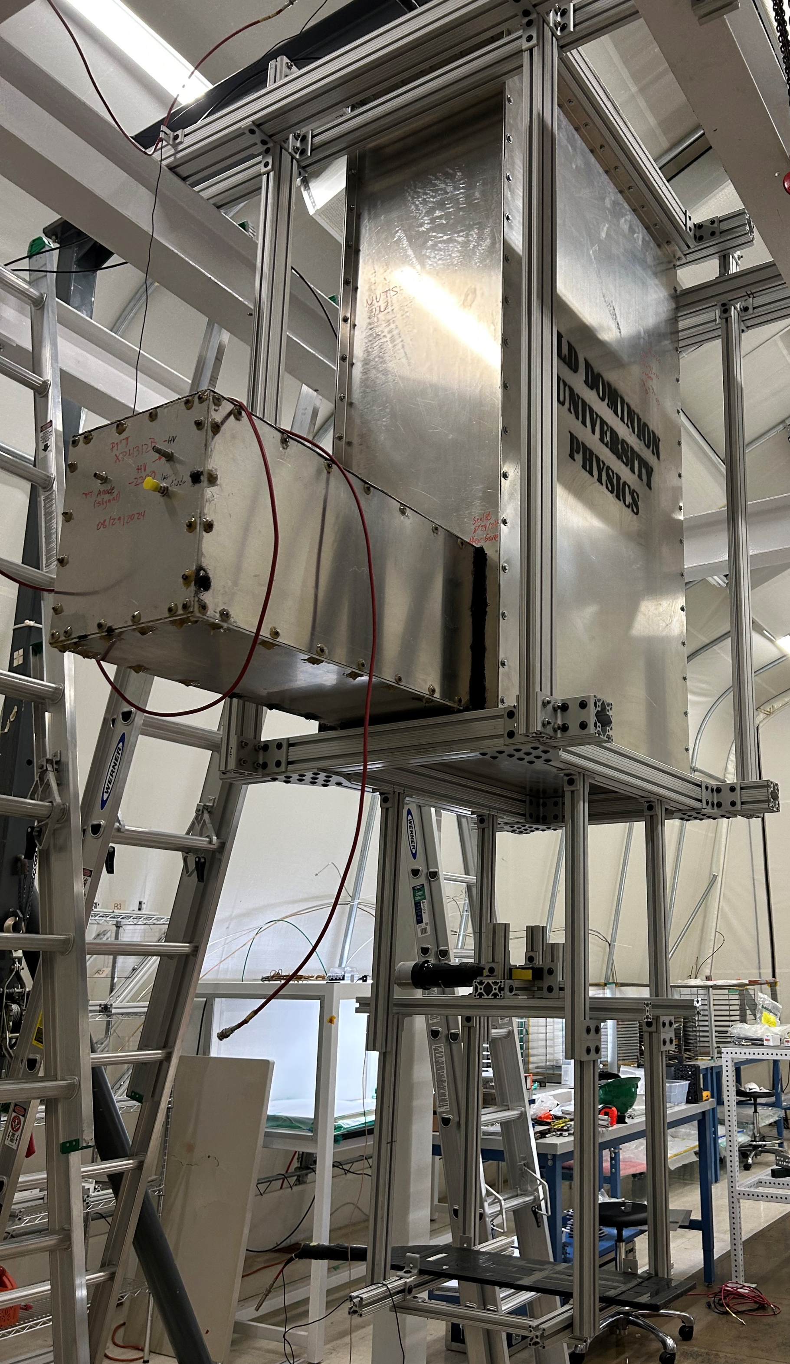
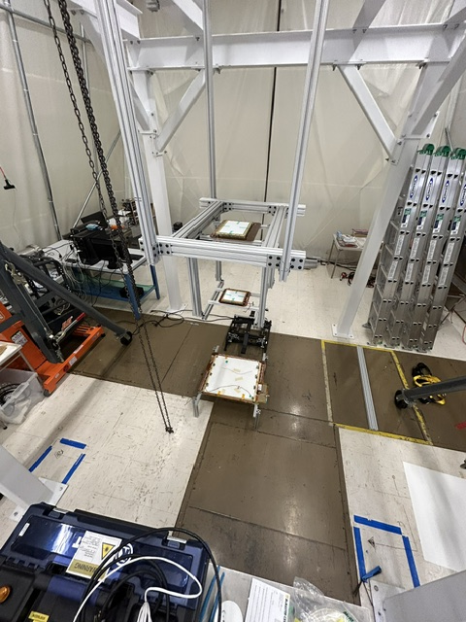
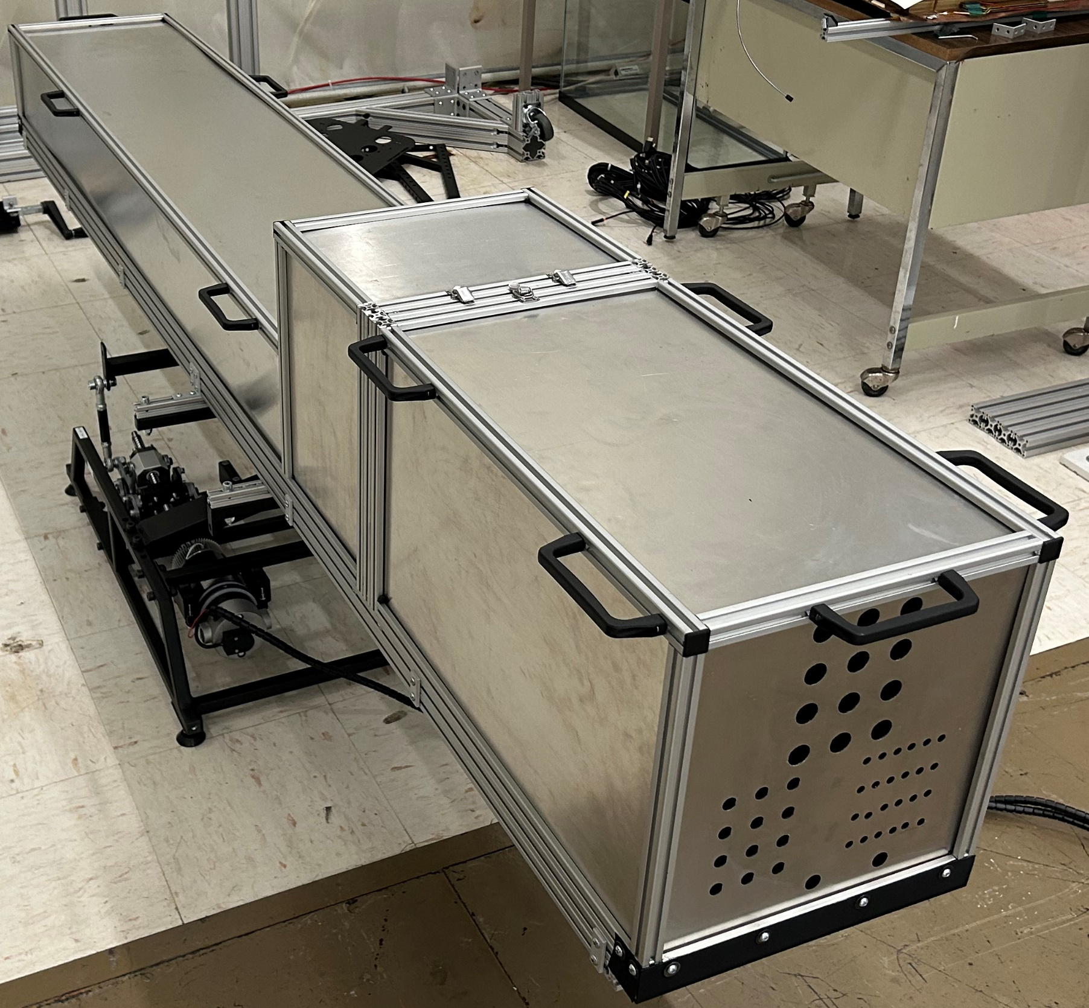
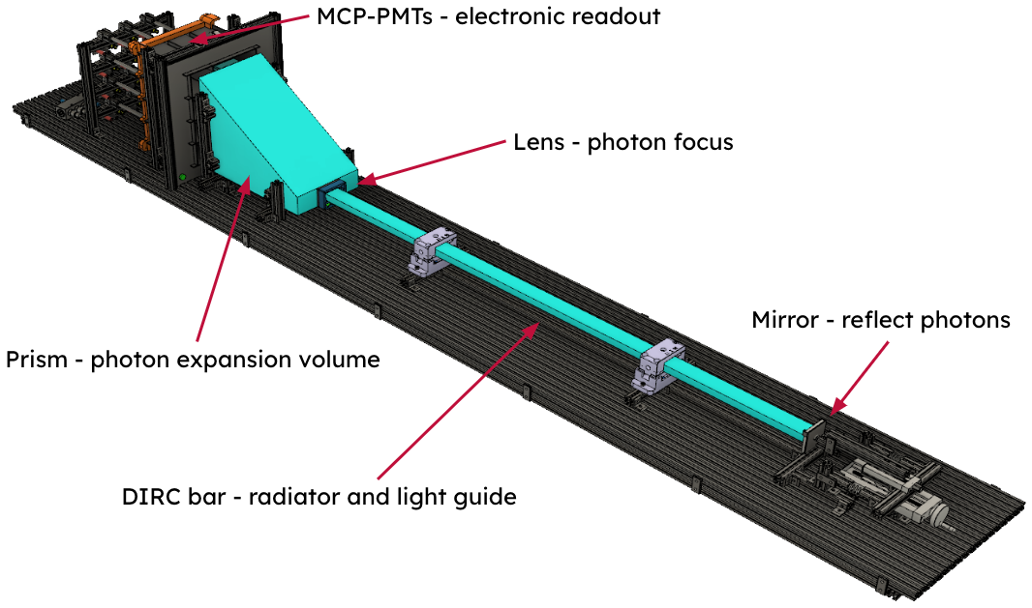
Cosmic Ray Telescope (CRT)
Large area PICOSEC at CERN test beam
Schematic of the DIRC-CRT
Momentum tagger installed and being tested with the scintillators
Trackers in the CRT
Dark box for the DIRC bar
Schematic of the DIRC bar movement system

Slide 4
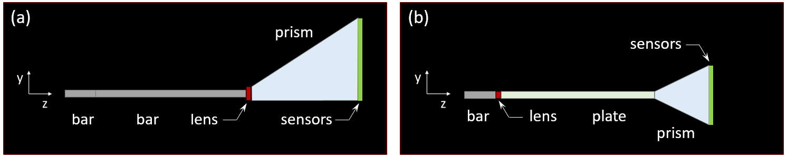


Upcoming Activities
Proposal submitted to DOE for xpDIRC R&D
Regular bi-weekly meetings on Monday to discuss progress
Commissioning of the CRT and start taking data with hpDIRC
For the xpDIRC Hybrid optics study (mitigate focusing errors and reduce cost)
Study of plate configuration with spherical lenses
Optimize lens properties for longer expansion in plate
Study shorter prism, two half-width prisms, possibly with SiPM readout (cost reduction, reduce sensor area of prism by factor 3-4)
Optimize “Thick plate” hybrid design (avoids photon loss in the lens)
Thinner bars (mitigate multiple scattering effects in DIRC bars)
Study potential combination with “Thick plate” hybrid design

