Slide 1
ePIC Calorimetry WG meeting. 02.02.2025
O. Tsai
What our goals for 2025 from the WG Perspective?
Open Discussion.

Slide 2
Looking back, From the Spokesperson’s Perspective
What do we need to accomplish in 2024?
We need to continue to evolve the ePIC Technical Design towards 90% completion and document this in the ePIC contributions to the EIC TDR.
We need to continue to grow the ePIC collaboration
The collaboration needs to grow to realize our goal of building ePIC
Continue to talk about EIC science to the NP community
We need to keep people engaged in ePIC
Continue to work to make ePIC a collaboration where people’s contributions are valued, recognized and encouraged

Slide 3
Looking Forward to 2025+
From the Spokesperson’s Perspective
ePIC faces significant challenges in the coming years:
External Challenges:
New US Administration with new programs and priorities
The EIC project has made design changes for the electron injector complex and is reorganizing the project plan around subprojects – schedule is an issue
Funding and support for groups working in the EIC/ePIC
…
Internal Challenges:
Engagement and workforce continue to be issues
Detector integration and performance
Still an enormous amount of work to do to reach 90% design maturity
…

Slide 4
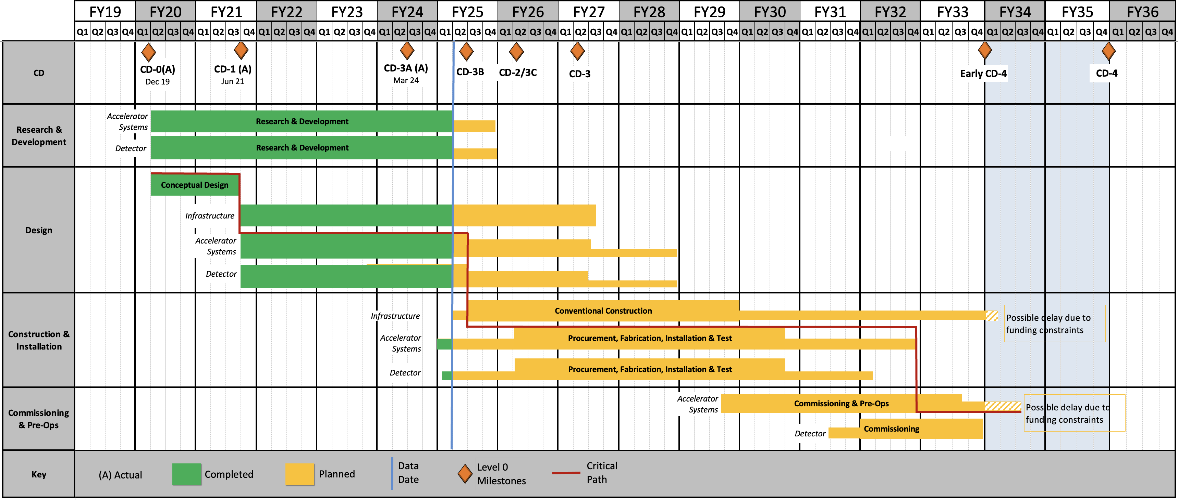
Schedule
From L. Lari CD-3B Plenary Presentation
Notional – project plan to be defined and reviewed in 2025
Under finalization; Mostly Technically Driven after FY2027
CD2/3
SP1
CD2/3
SP2
CD2/3
SP3
The Sub-Projects (SP) delivery strategy is planning to help the start the Early Science program @ Early CD-4 timeframe
RHIC Operations is planned for the end of CY2025
Since CD-1, the critical path is on the Accelerator systems.

Slide 5
Summary
EIC is a unique, high-energy, high-luminosity, polarized beam collider that will be one of the most challenging and exciting accelerator complexes ever built -- only new collider in the next decades.
Priorities for 2025 include:
Execute the CD-3A and CD-3B procurements;
Prepare plans for addressing the “portfolio” of project dependencies; and,
Prepare the performance baseline for the entire project, define appropriate subprojects and prepare the first subproject for approval.
CD-3A procurements are on track with numerous contracts awarded.
Recent DOE Independent Project Review recommended approval of CD-3B procurements
CD-3B Long Lead Procurement items are critical to further reduce project risk.
Anticipate DOE Office of Science authorization of CD-3B this quarter.
For the Detector the goal remains to be fully ready for CD-2/CD-3 in late CY2026

Slide 6
Calorimetry WG modus operandi 2024.
preTDR efforts. (TIC-> WG -> DSL/DSC).
Provide platform for groups with sub-critical mass to discuss sub-system issues.
Discuss topics interesting to all sub-systems (SiPMs rad damages…)
Looking forward:
1 & 2 will be with us for quite some time, but I can’t see how these two topics can keep WG fully engaged in 2025+
Let’s think how to make these meetings useful, interesting for all of us and engaging as a consequence.
Start of discussion.
What our goals for 2025 from the WG Perspective?

