Slide 1
EIC Project Overview
Jim Yeck
EIC Project Director
BNL Associate Laboratory Director
RIKEN & University of Tokyo Collaboration Discussion
February 3, 2025

Slide 2
2024 Highlights
Major Project Milestones
CD-3A LLP approved at ~$90M and initial contracts awarded! Examples:
Accelerator superconducting strand, $163K
Detector EMCal and HCal fibers, $2.3M
Infrastructure electrical substations, $11.2M
CD-3B Final Design Reviews (FDRs) complete, one FDR repeated
Requirements/interfaces for CD-3B items complete
Project is benefiting from lessons learned on CD-3A.
Reviews, Board, and Advisory Committees
More than 20 design reviews
6 Advisory Committee Meetings
5 Advisory Board and two Resource Review Board Meetings
5 Reviews of “Off-Project” Scope
Interaction Region Superconducting Magnet Steering Group established
Annual Director’s Review in October
DOE CD-3B/Status Review in January
Accelerator
New Technical Director in January
Received and assessed Advanced Photon Source magnets at BNL and JLab
Optimized design and scope to mitigate risk
Electron injector modifications eliminate many risks and meet the Mission Need.
International EIC Accelerator Collaboration established
Detector
R&D nearly complete
ePIC Detector technical baseline defined
Preliminary Design Report in preparation
Plans are developing for the EIC Science Program
Infrastructure
$100M New York State Grant for EIC buildings in February
30% Detailed Design submission received in August
60% Detailed Design submission received in December
Significant Progress in 2024, Started Awarding Contracts!

Slide 3
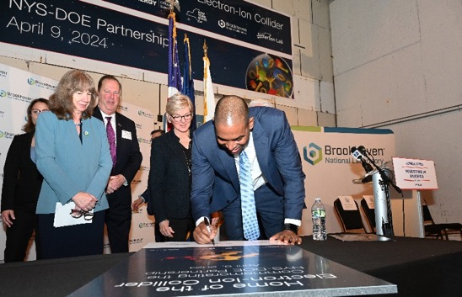
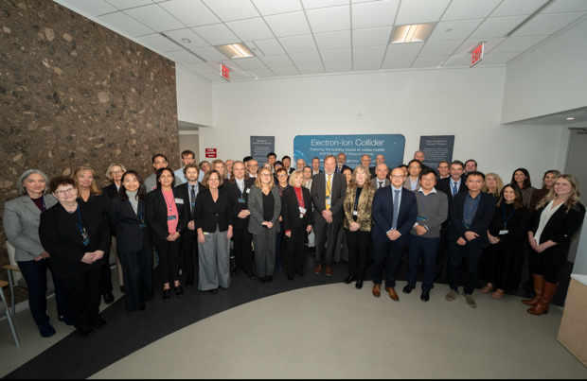

Strong Support from Partners & Collaborators
New York State committed $100M toward construction of EIC buildings and infrastructure.
EIC Accelerator Collaboration kicked off at the International Particle Accelerator Conference with over 150 participants expressing interest in contributing to the global EIC effort.
UK announced £58 million ($75M) for the EIC.
EIC Resource Review Board Meetings in Rome in May 2024 and at BNL in Oct. 2024. Strong participation from Canada, Czech Republic, France, India, Israel, Italy, Japan, Poland, South Korea, United Kingdom, and Taiwan. Next meeting to be held in Prague in June 2025.
In-kind contributions are ~30% of the Detector and ~5% of the Accelerator.

Slide 4
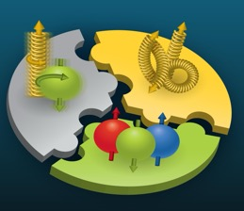

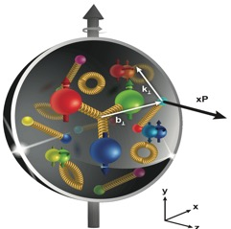
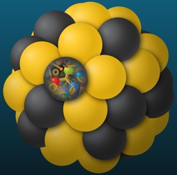
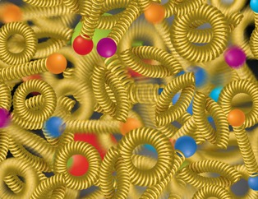
Compelling EIC Science (National Academy Report)
How do quarks, gluons, and orbital angular momentum contribute to proton spin?
Spin: a fundamental property of matter
All elementary particles,
but the Higgs carry spin
Spin cannot be explained by a static picture, rather the interplay between the properties and interactions of quarks and gluons inside
the proton
Does the mass of visible matter emerge from quark-gluon interactions?
Atom: Binding/Mass = 0.00000001
Nucleus: Binding/Mass = 0.01
Proton: Binding/Mass = 100
The EIC will determine an important term contributing to the proton mass, the so-called “QCD trace anomaly.
How can we understand the QCD dynamics and the relation to confinement?
EIC will image quarks and gluons in 3D in space and momentum inside the nucleon & nuclei
Uncover how the nucleon properties emerge from quarks and gluons and their interactions.
How do the quark-gluon interactions create nuclear binding?
Is the structure of a free and bound nucleon the same?
How do quarks and gluons, interact with a nuclear medium?
How do the confined hadronic states emerge from these quarks and gluons?
Does gluon density in nuclei saturate at high energy?
How many gluons can fit in a proton?
How does a dense nuclear environment affect the quarks and gluons, their correlations and interactions?
=
?
gluon
recombination
gluon
splitting
Nobel-Worthy Questions
All Nobel-Worthy Questions!
4

Slide 5
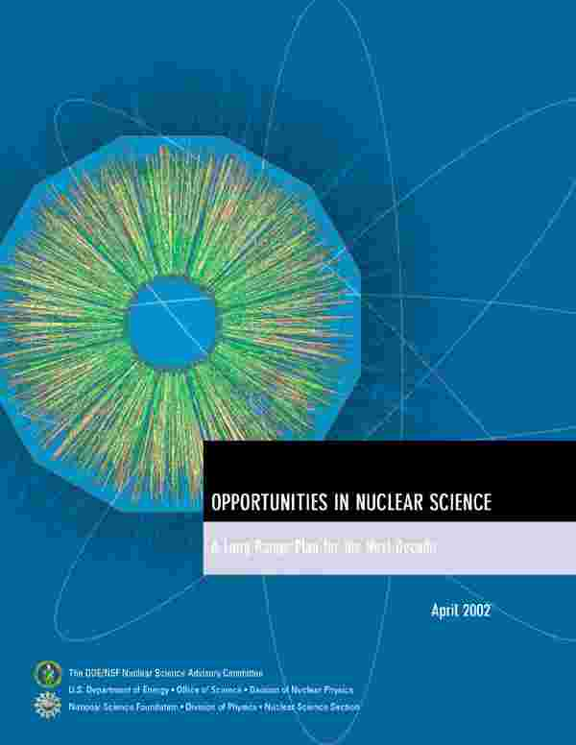
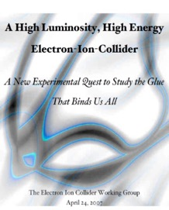
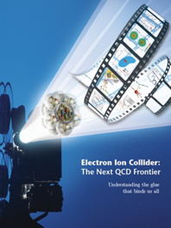

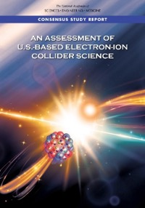

EIC Scientific Case Built Over Decades
2002
2007
2009
“We recommend the expeditious completion of the EIC as the highest priority for facility construction.” (2023)
2010
2012
Gluons and the Quark Sea at High Energies
2013
NSAC
2015
Major Nuclear Physics Facilities for the Next Decade
2018
2021
2023
March 14, 2013
“The science questions that an EIC will answer are central to completing an understanding of atoms as well as being integral to the agenda of nuclear physics today.” (2018)
arXiv:2103.05419
EIC will be the only operating particle collider in the U.S. and the only large collider
to be built in the world in the next 20-30 years.
5

Slide 6
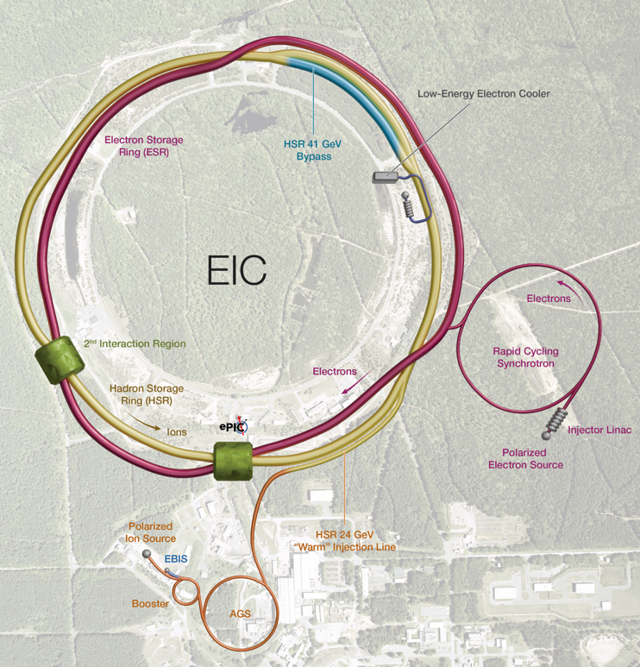
Facility Performance
High Luminosity: L= 10³³ – 10³⁴cm⁻²sec⁻¹
Highly Polarized Beams: 70%
Large Center of Mass Energy Range: E_{cm} = 20 – 140 GeV
Large Ion Species Range: protons – Uranium
Large Detector Acceptance and Good Background Conditions
Possibility to implement a Second Interaction Region (IR)
The EIC design, project scope, and performance parameters address the requirements established by the U.S. Nuclear Science Advisory Committee (NSAC) Long Range Plans (2015 & 2023) and endorsed by the U.S. National Academy of Sciences (2018).

Slide 7
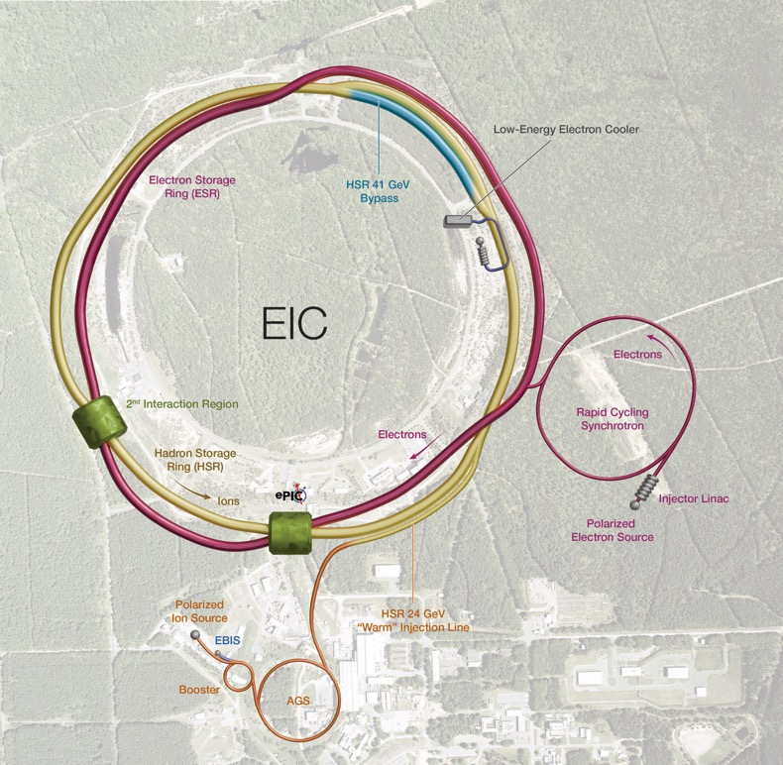


EIC Concept and Machine Parameters
Ultimate EIC Performance Parameters:
High Luminosity: L= 10³³ – 10³⁴cm⁻²sec⁻¹
Highly Polarized Beams: 70%
Large Center of Mass Energy Range: Ecm = 28 – 140 GeV
Large Ion Species Range: protons – Uranium
Large Detector Forward Acceptance and Low-Background Conditions
Possibility to Implement a Second Interaction Region (IR)
Accelerator Status in a glance:
Polarized ion/proton source
Ion injection and initial acceleration systems – Linac (200 MeV), Booster (1.5 GeV), AGS (25 GeV)
Hadron Storage Ring (40-275 GeV) – HSR
Electron Pre-Injector (750 MeV linac) – EPI
Electron Rapid Cycling Synchrotron (0.75 GeV – top energy) – RCS
Electron Storage Ring (5 GeV – 18 GeV) – ESR
Interaction Region(s) – IR
Hadron Injection Cooling System
7

Slide 8

Detector Technical Baseline
Central Detector Baseline Technology choices completed in 2023
Far-Forward/Far-Backward Baseline Technology choices completed (February 2024 IR Integration and Auxiliary Detectors preliminary design review)
Aligned with the international ePIC collaboration interests and built on synergies with the central detector
No significant technology decisions outstanding; emphasis shifted to documenting what-if alternate detector choices to mitigate risk caused by R&D delays and/or dependencies.
Changes to the baseline technology are possible when there are in-kind opportunities and:
Alternative detector technology meets requirements
No adverse impact on schedule, risk, and subsystem interfaces
Positive cost impact due including an agreement for in-kind contributions
pC Hadron
Polarimeter
Rear
SC Magnets
B0 Magnets
& Detectors
Luminosity
Monitor
Photon
Beam
Far Forward
SC Magnets
Dipoles
Hadron Storage Ring
Electron Storage Ring
Low Q²
Taggers
Off Momentum
Detectors
Roman
Pots
Zero Degree
Calorimeter

Slide 9
Japanese Groups in EIC
2015.4: EIC Letter of Interest from Asian countries
20 participants from Japan: RIKEN, Yamagata, Tokyo Tech, Juntendo, KEK, Kyorin, Kyoto, Niigata, Tohoku, Tokyo Science
2019: Science Council of Japan Master Plan 2020 proposal of EIC
Collaboration including nuclear-physics community and high-energy community
Core institutions: Yamagata and RIKEN
Participating institutions: Kobe, Nihon, KEK, etc.
2020: Yellow Report
2020.5: eRD27 “developing a high resolution ZDC for the EIC”
2020.11: Expression of Interest (EOI) from EIC-Japan
2021.3-12: Call for detector proposal from the EIC project
EIC-Japan group participates in the ECCE detector consortium
2022: Science Council of Japan “Medium- and Long-term Research Strategy for Science”
EIC project proposal to be submitted as a part of the High-Energy QCD Frontier Initiative
2023 10 Institutions joined ePIC, Tohoku University asking member ship right now
Japanese Colleagues hold important positions
T. Gunji (Tokyo) as ePIC Executive Board member
Y. Goto (RIKEN) as ePIC Far-Forward (ZDC) Co-Detector Subsystem Technical Coordinator
S. Yano (Hiroshima) as ePIC TOF Deputy Detector Subsystem Leader
R. Seidel (RIKEN) as ePIC Semi-inclusive DIS physics working group convener
2024 RIKEN and University consortium (the University of Tokyo & Osaka University) submitted EIC proposal for funding to MEXT
In Summary:
The EIC project anticipates significant contributions from Japan, drawing on expertise in nuclear physics and experience at RHIC, J-PARC, RIBF, etc. Japanese researchers will bring innovative detector technologies, advanced data analysis techniques, and unique insights into EIC physics from low-energy to high-energy nuclear physics, potentially leading to groundbreaking discoveries in nuclear physics.

Slide 10
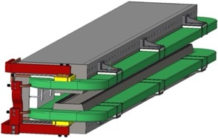
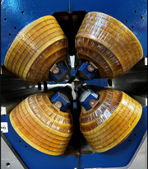
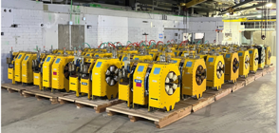
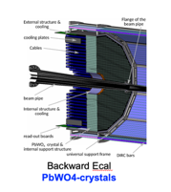
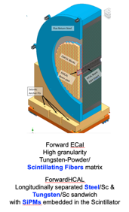
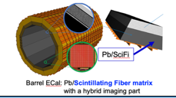
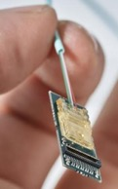
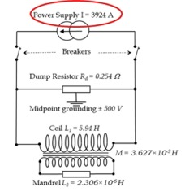
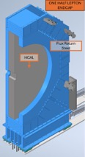
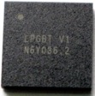
DOE CD-3B Request
The EIC Project requests authority to execute ~ $53M in LLPs, including 35% contingency.
Accelerator
Electron Storage Ring (ESR) Dipole Magnets
Advanced Photon Source (APS) Sextupole Magnet Refurbishment, Testing, and Measurement
ESR Magnetic Measurement Bench
APS Quadrupole Magnet Refurbishment, Testing, and Measurement
ESR APS Quadrupole Magnetic Measurement Stand
* Lead Tungstate Crystals for the Detector Backward Electromagnetic (EM) Calorimeter - Batch 3 and Batch 4
* Scintillating Fibers for the Detector Barrel - Bath 2 and Forward - Batch 2 EM Calorimeters
* Steel for the Detector Forward Hadronic Calorimeter
Detector Solenoid Magnet Power Supply
Detector Electronics Versatile Link Plus Transceiver (VRTX+) and Low Power Giga-bit Transceiver (1pGBT)
Detector Endcap Structures – Flux Return Steel
Detector
* Continuation of CD-3A contracts
10

Slide 11
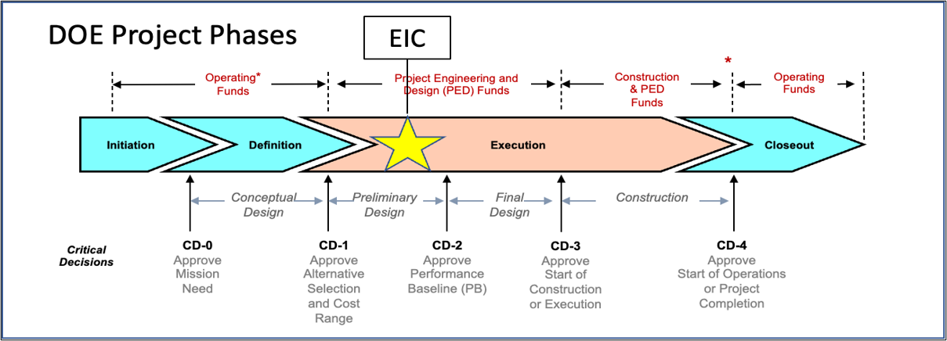
EIC Project-Critical Decisions and Plans
2019
2021
CD-2 and CD-3 in Preparation
CD-4 Early Finish 2034
CD-3A, Long-Lead Procurement, approved March 2024. Excellent use of IRA funding.
CD-3B, Long-Lead Procurement, approval planned for March 2025.

Slide 12
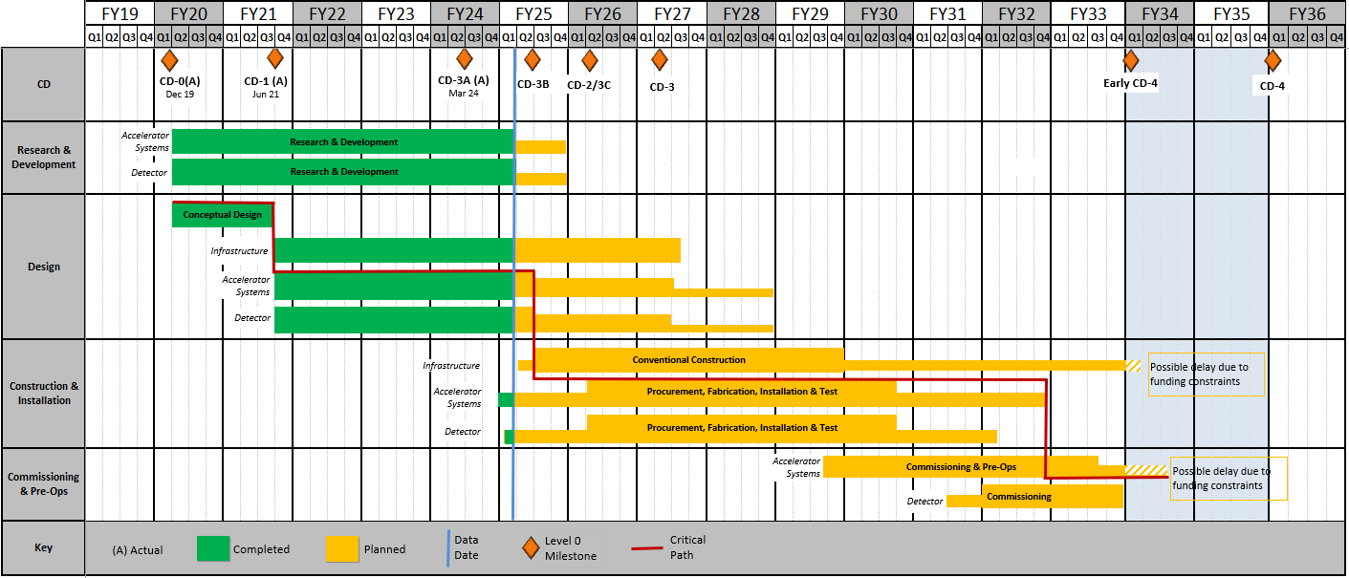
Reference Schedule
EIC project moving from the R&D and design phase into construction phase.
RHIC Operations is planned for the end of CY2025
Since CD-1, the critical path is on the Accelerator systems.
DOE and the project team will update the reference schedule after the FY2025 funding is determined.
12

Slide 13
EIC Project CD-2 and CD-3 Planning
CD-2 Project Planning Objectives and Constraints:
Scope required for the DOE Project Key Performance Parameters (KPPs)
Develop plans for the execution of the portfolio of “off-project” scope
EIC Project total cost less than $3B (working to optimize scope within this objective)
DOE annual project funding not to exceed $300M per year
EIC construction start following the conclusion of RHIC operations
Start Early Science Program when electron-ion collisions begin!
The constraints result in a longer construction schedule and “dark period” than desirable. This can be partially mitigated by constructing EIC in two stages:
Early Science: Electron-ion collisions with the ePIC detector
Mission Need: Additional project scope required to meet the Mission Need
One integrated project delivery plan for the EIC aligned with annual funding constraints.

Slide 14
Preparation for CD-2 and CD-3 w/ Subprojects
Requirements
EIC is a single, integrated line-item project.
Subprojects require well-defined deliverables and interfaces.
Completed subprojects enable the start of the EIC “early science program.”
Annual funding profile for the subprojects must be consistent with DOE guidance.
EIC Scope:
Collider – Infrastructure, HSR, ESR, Install
Electron Injector – Infrastructure, LINAC, RCS, Install
Interaction Region (IR) SC Magnets, Crab Cavities, Integration, Install
Detector, Integration, Install
Start Science Program (Early Science Program)
EIC Full Capabilities

Slide 15
EIC Subproject Plans
Project Office, CD-3A execution underway
NYS Project execution underway
Collider into construction in 2026
IR, ePIC, E-Injector baseline quality in 2026
Project Office Integrated Support, CD-3A, CD-3B, …. (L. Lari)
 | NYS Infrastructure Project (C. Folz)
SP |  | Collider – Infrastructure, HSR, ESR, Installation (C. Folz, SPM)
SP |  |  | Electron Injector – Infras., LINAC, RCS, Install (Q. Wu, POC for April Review)
SP |  |  | IR SC Magnets, Crab Cavities, Integration, Install
 |  |  | Detector, Integration, Install
SP |  |  |  |  |  |  |  | EIC Full Capabilities (K. Wilson, POC)
▲ DOE mini-IPR Jul/Aug 2025 Assesses Tailoring Strategy and Project Execution Plans
▲ DOE IPR in 2026 supports CD approvals
J. Yeck
15

Slide 16
Detector Reviews 2025
Preliminary Design Reviews (60% design maturity, called PDR, PDR2 or PDR3, depending on the subsystem)
PDR2: MPGD Tracking Detectors (6.10.03.02) – Summer 2025 – exact timing linked to progress on first engineering test articles
PDR2: Silicon Tracking Detectors (6.10.03.01) – Fall 2025 – After early results of ITS3 ER2
PDR2: Cherenkov-based Particle Identification Detectors (6.10.04; pfRICH, hpDIRC, dRICH) – early March 2025
PDR2: AC-LGAD-based Particle Identification Detectors (6.10.04; BTOF, FTOF, common systems) – Fall 2025
PDR3: Barrel EM Cal (6.10.05.02) – ~August 2025
PDR2: Backward HCAL (6.10.06.01) – ~September 2025
PDR: Magnet Cryogenics and infrastructure (6.10.07) – September/October 2025
PDR3: Electronics/DAQ-computing (6.10.08. 6.10.09.01) – Late August 2025 – this does not include slow controls
PDR: DAQ-Slow Controls (6.10.09.02) – November/December 2025 – Later to ensure integration DAQ in the collider common platform
PDR: Integration, Infrastructure and Installation (6.10.10) – September/October – everything outside GST, includes cradle, HCAL, etc.
PDR: Integration, Infrastructure and Installation (6.10.10) – November/December 2025 – everything inside GST
PDR3: IR Integration and Auxiliary Detectors (6.10.11) – November/December 2025 – includes 6.10.14 lumi detector
PDR2: Polarimetry (6.10.014) – September/October 2025
Final Design Reviews (FDR):
FDR: Backward & Forward EM Calorimetry, Barrel & Forward HCAL (6.10.05.01; 6.10.05.03; 6.10.06.02; 6.10.06.03) – May 2025
Project Reviews:
OPA CD-3B Review – January 7-9, 2025
OPA Project Status Review – Summer 2025 (~6 months after CD-3B Review)
Other Meetings:
Detector R&D Day hosted by ePIC and EIC Project: ~April 2025
DAC Meeting – Spring 2025 – Comprehensive look to design status and readiness for CD-2. Plan for 3-4 separate days to split topics.
5th RRB Meeting: June 5-6, 2025 – Prague, Czech
ePIC Software & Computing review by host labs: ~April 2025 for status check?

Slide 17
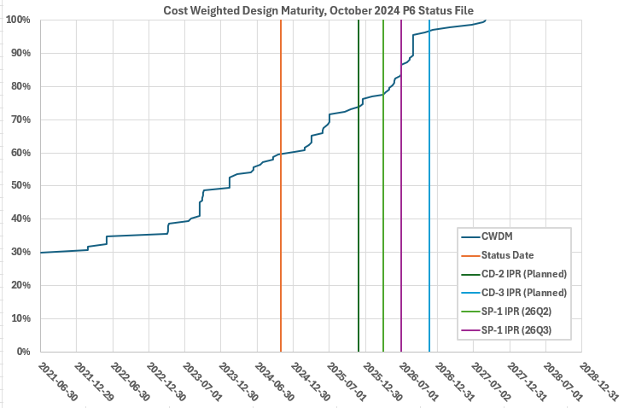
Outlook to CD-2 – Design Maturity
Cost-weighted design maturity:
Present design maturity at 60%
Projected > 80% at end of July 1, 2026
→ Detector itself will be ready for CD-2/CD-3 late CY2026.

Slide 18
EIC Portfolio
Project Scope and Dependencies
DOE EIC Line-Item Project (Subprojects) |  | DOE Order 413.3B, Resource Loaded Schedule (P6), Earned Value Management System (EVMS), Reporting, etc. Contingency included to cover the risks associated with In-Kind Contributions and the NYS ESD Grant.
In-Kind Contributions Accelerator/Detector |  | Deliverables/specifications agreed with Partners and Partners secure funding. Milestones in P6 with schedule tracking and technical integration.
NYS |  | P6, EVMS, NYS ESD Grant Compliance.
Off-Project Scope and Dependencies
Accelerator & Infrastructure |  | BNL accelerators, infrastructure, and lifetime extension needed for EIC. RHIC Removal and Repurposing (D&D) as needed for EIC.
Detector |  | BNL and JLab facilities and resources required for the success of the EIC experimental program.
Host Laboratory |  | BNL support for the EIC project, guests, and users.

Slide 19
Priorities for 2025 and 2026
Priorities for 2025 include:
Execute the CD-3A and CD-3B procurements.
Prepare plans for addressing the “portfolio” of project dependencies including the Removal and Repurposing (R&R) of RHIC facilities (IP6 prepared for ePIC).
Clarify scope of the subprojects and prepare a CD-2 quality performance baseline for the entire project (all subprojects).
Conduct reviews to assess status of CD-2 preparations for each subproject and prepare the collider subproject for DOE approvals in 2026.
R&R work starts upon the completion of the RHIC run in December 2025.
Complete the DOE reviews needed to start EIC construction in 2026 with the approval of the collider subproject. Detector should be baseline ready.

