Slide 1
The Co-Design Center for Quantum Advantage (C²QA): Materials for Quantum Information Science
Jim Misewich
Associate Laboratory Director for Energy and Photon Sciences
Brookhaven National Laboratory
Feb. 3, 2025
The research described herein is Fundamental Research as defined in the ITAR (22 CFR 120.34(a)(8)), EAR (15 CFR 734.8), or Part 810 (10 CFR 810.3), as applicable, and as described in the USD (AT&L) memoranda on Fundamental Research, dated May 24, 2010, and on Contracted Fundamental Research, dated June 26, 2008

Slide 2
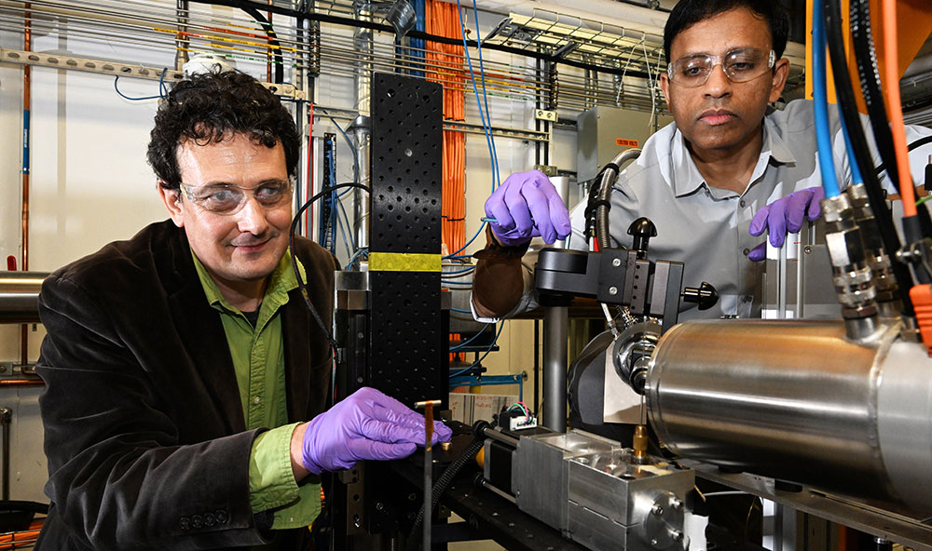
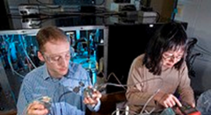

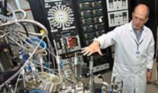
































Laboratory Initiatives:
Light-Enabled Science
Next Generation Information Science
Societal challenges: Energy Security
Integration of BES-Supported Facilities & Programs To Impact DOE Energy Sciences Mission
Chemistry
Biology
Condensed Matter Physics & Materials
BNL CORE PROGRAMS
1. Leading in discovery with light-enabled science (NSLS-II)
2. Developing next-generation information science and technology (QIS, Microelectronics, AI)
3. Addressing environmental and societal challenges (Chemical Conversions, Energy Storage)
C4M
Center for Coupled Chemo-Mechanics of Cementitious Composites for EGS
BNL FACILITIES
RESEARCH CENTERS
PARTNERS
University
National Lab
Industry
New York State

Slide 3
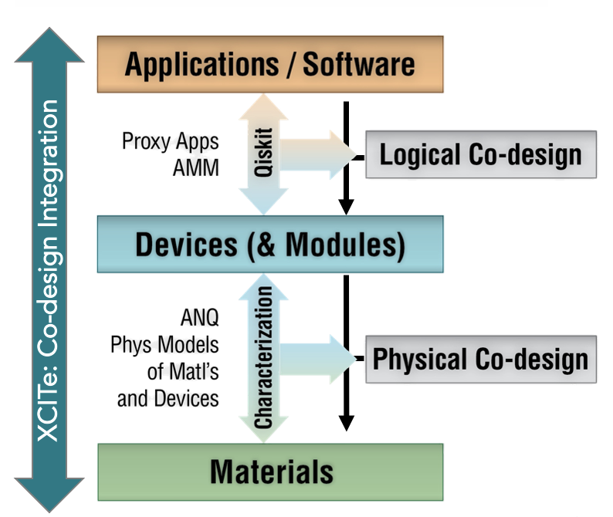
Co-design Center for Quantum Advantage (C²QA)
Challenge: Noise limits scalability and reliability of quantum computers and quantum communication
C²QA Mission: Build the bridge to go beyond the current “noisy intermediate-scale quantum” (NISQ) to the post-NISQ era
Goal: Provide the basic science advances and co-design work to create a clear architecture roadmap and the new technologies required for the US quantum ecosystem to build full-stack systems offering useful quantum advantage for DOE science
Materials focus: Address noise limitations by improving materials performance, investigation of promising new materials.
3

Slide 4


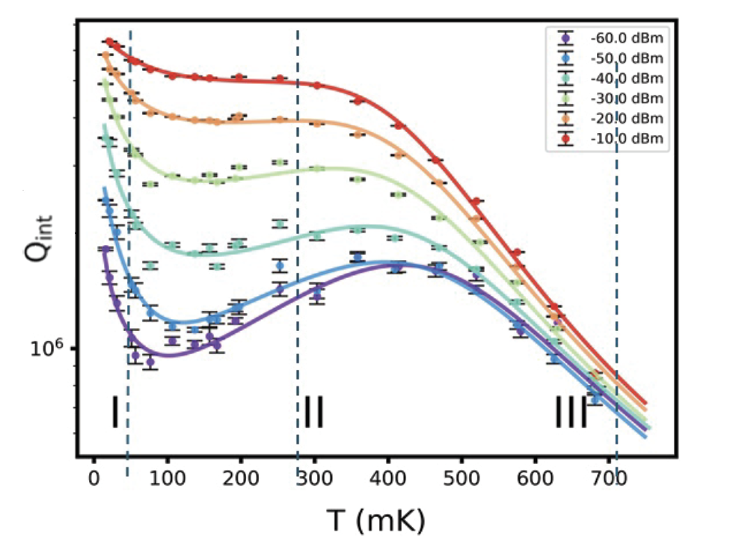
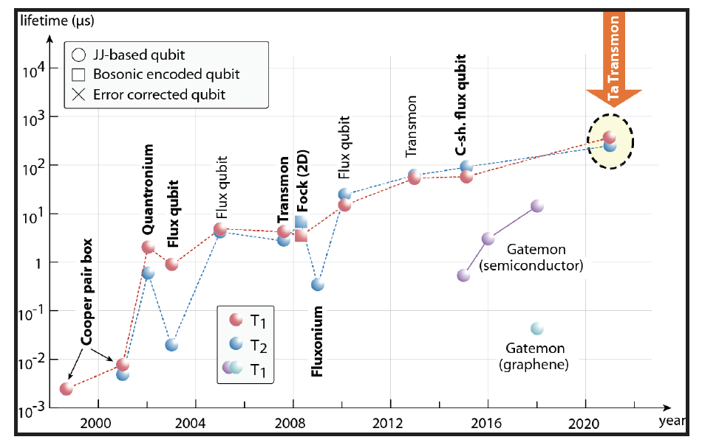
Discover New Quantum Materials to Enhance Quantum Computers
Achievement in Technical Areas of Interest
Detailed understanding of loss mechanisms in superconducting qubits due to two-level defects in materials.
Method
Studied superconducting materials in linear resonators as proxy for qubits.
Significance & Impact
By replacing niobium with tantalum, we achieved:
an order of magnitude improvement in packaging loss
4x improvement in two-level systems loss
Measuring the Q of tantalum resonators as a function of temperature (x-axis) and power (color lines). Data was fit to a model of two-level system defects in nearby dielectrics. Higher Q indicates lower losses, which means longer photon memory or coherence time.
Data adapted from Kjaergaard et al, arXiv:1905.13641 (2020) and Place et. al. Nature Commun. 12, 1779 (2021)
4

Slide 5
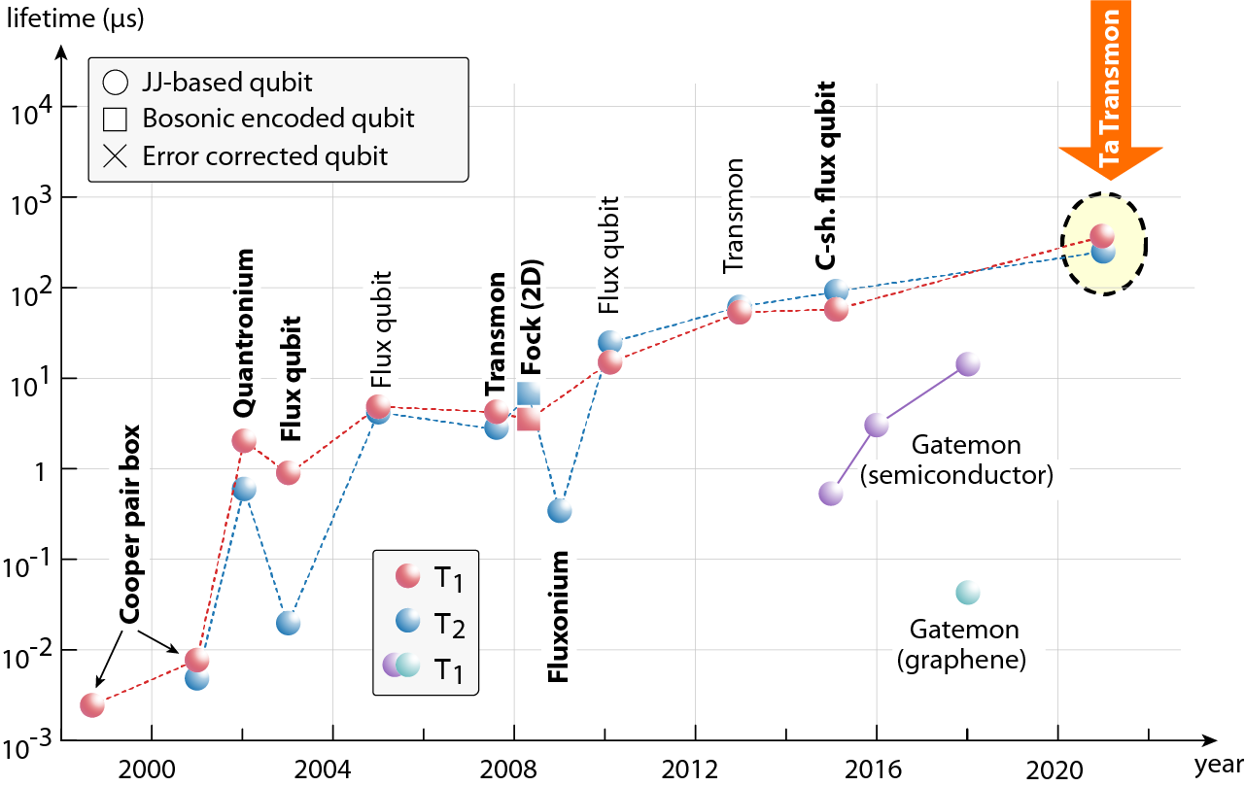
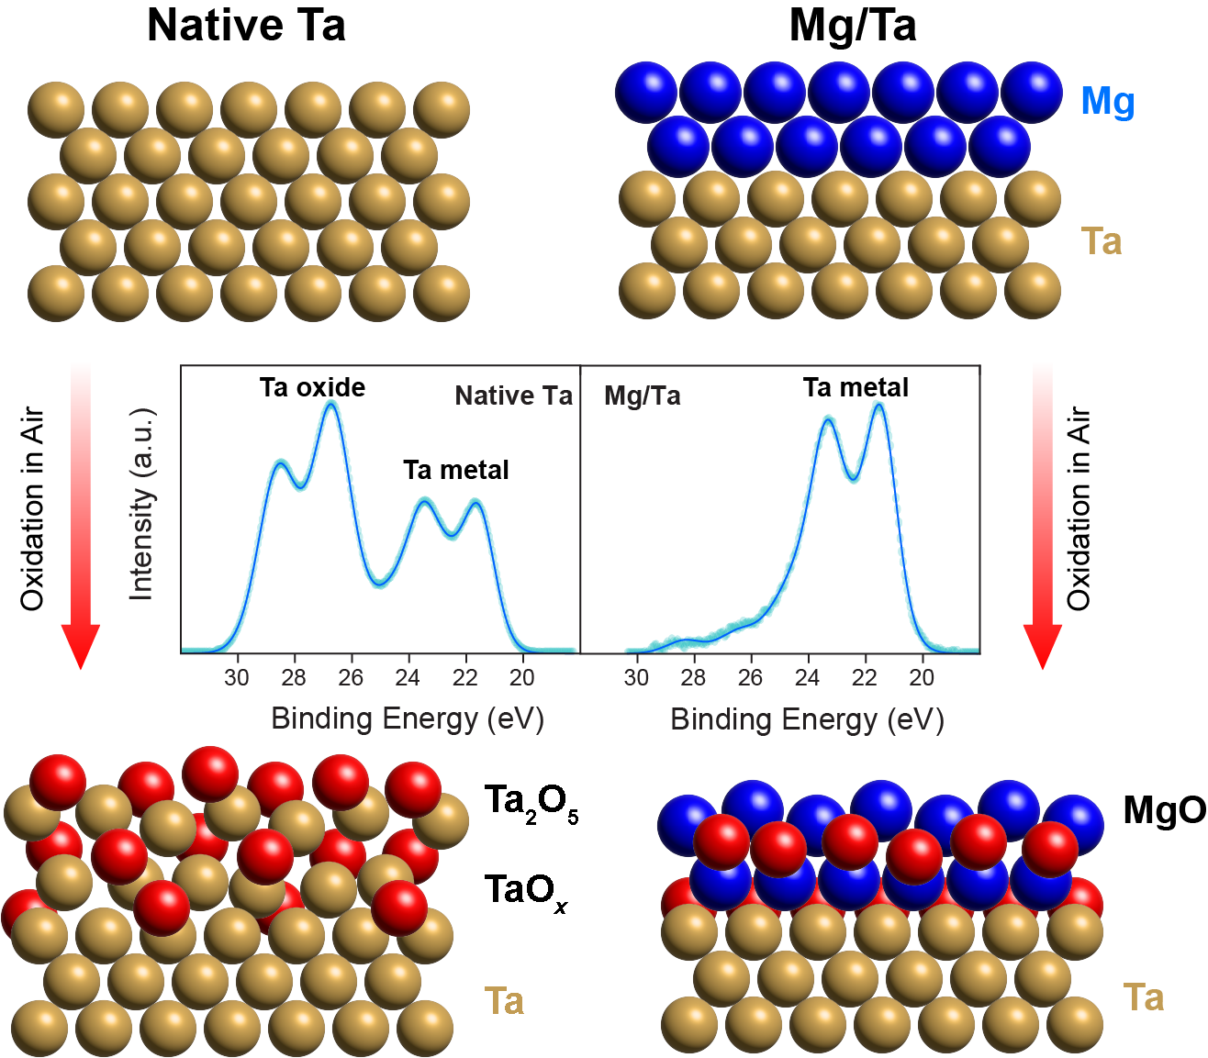
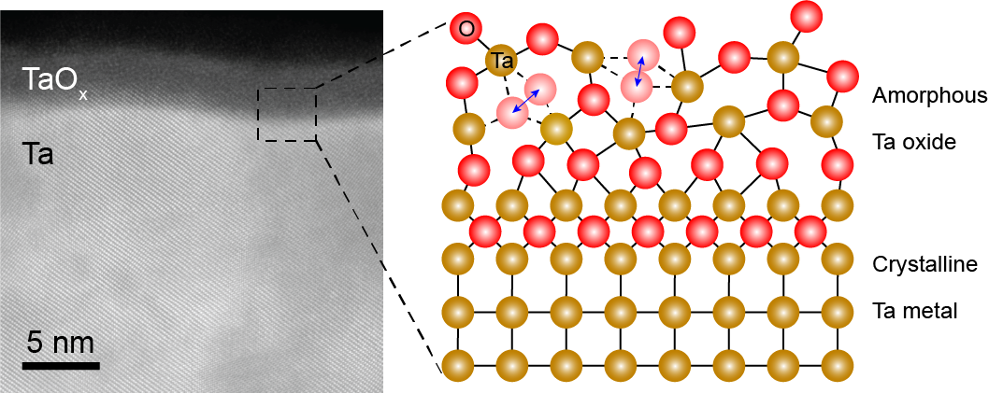



IMPROVED MATERIALS: Removing qubit loss channel from superconductor/air interface
Zhou et al, Adv. Mater. 36, 2310280 (2024)
Tantalum (Ta) extends the superconducting qubit lifetime for its native oxide that is thin (~ 3 nm) and chemically simple
However, Ta oxide remains lossy for being amorphous
Encapsulation by 2-3 nm magnesium (Mg) inhibits Ta oxidation
Mun et al, ACS Nano 18, 1126 (2024)
Notes:
Note:
Graph at the top left: Superconducting qubit lifetime was limited by materials loss. Tantalum qubit makes the latest significant improvement to qubit T1 for its thin, chemically simple native oxide.
Graph at the bottom left: Despite of the advantage, the native oxide of Ta remains an amorphous structure that hosts various structural defects. These defects (shown by the oxygen atoms that can move between two spots) can couple to qubits and leads to quantum decoherence.
Graph at the right side: A promising idea is to encapsulate tantalum surface with oxygen barrier material to inhibit the oxidation of tantalum. It was shown that an ultrathin coating of magnesium can effectively block the oxygen diffusion.

Slide 6
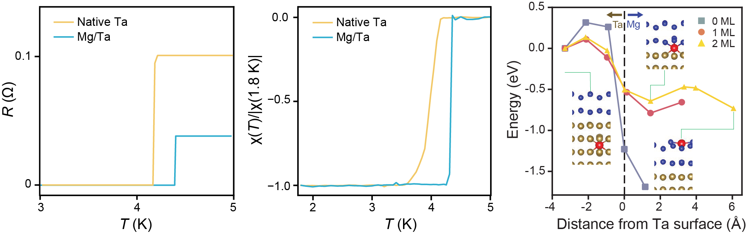
IMPROVED MATERIALS: Mg encapsulation improves Ta as a superconductor
Zhou et al, Adv. Mater. 36, 2310280 (2024)
Mg encapsulation improves the superconducting property of Ta
Higher T_{c} and sharper Meissner transition to superconducting state
First-principles calculation reveals that Mg can purify underlying Ta by gettering impurity elements
Notes:
Note (this slide provides more details on Mg/Ta project):
The two graphs at left and at middle: Mg encapsulation not only blocks Ta oxidation but also improves the superconducting property of Ta. This is shown by the higher T_{c} and sharper Meissner transition to superconducting state
Graph at right side: First-principles calculation reveals that Mg can purify underlying Ta by gettering impurity elements

Slide 7
Ideas for BNL/RIKEN Collaboration
Improving materials and exploring new materials for quantum
Constriction Junctions
Silicides
Ta/MgTa
Computing
Quantum error mitigation/correction
New algorithms
Classical/quantum hybrids

Slide 8
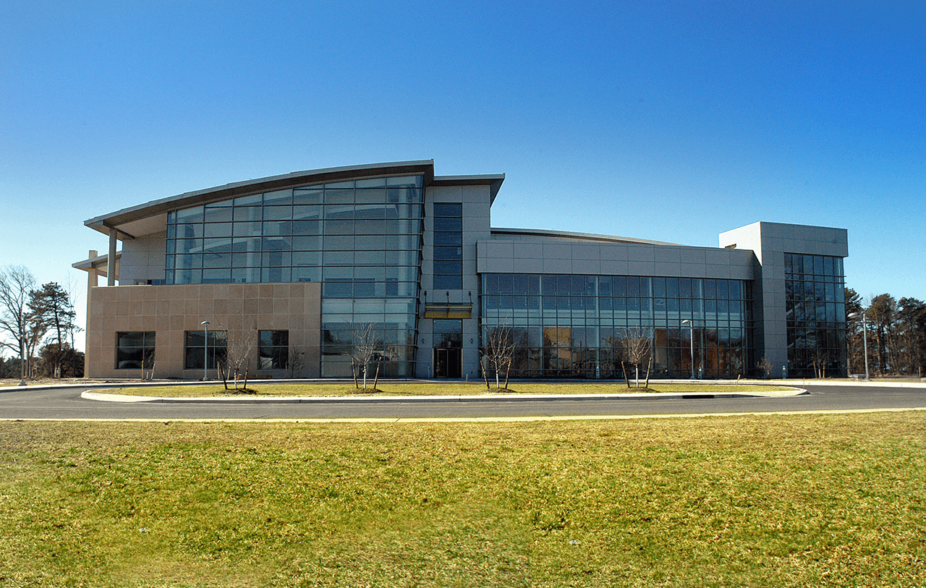
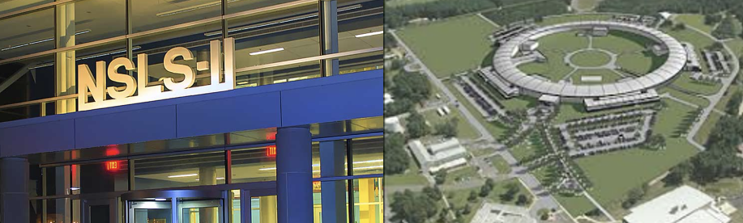
Brookhaven Lab’s QIS Spectrum
QIS Center (C²QA): Transcending the noise barrier in quantum computing
QIS Materials: Fundamental studies of next generation materials
Quantum Internet: Moving qubits over distant devices (Dr. Carini: ALD for Discovery Technology
Quantum-enabled Facilities/Instruments: Overcoming current limitations
Quantum Algorithms and Computation: Answering key scientific questions
Center for Functional Nanomaterials (CFN)
National Synchrotron Light Source II (NSLS-II)
8
Notes:
Linear resonators are measured as a function of power and temperature. One of the main parameters of a linear resonator is the Q-factor. It is extremely important to use materials with low losses in order to achieve a long photon lifetime (high Q-factor). A linear resonator is just a resonant circuit with a linear response -- either an LC resonator or a half-wave transmission line resonator -- as opposed to a qubit, which has a strong non-linearity that means it can only have at most one photon in it at a time. The material is tantalum/tantalum oxide. Packaging loss is the loss associated with the packaging of the device -- parasitic modes, resistive elements, etc.
Device coherence (Q) is non-monotonic with temperature, related to the decoherence and then saturation of parasitic two-level systems in the nearby materials. By changing device parameters – metal and substrate choice, processing conditions, deposition techniques, design and packaging – we can isolate sources of decoherence. We have improved the limit on coherence imposed by packaging by an order of magnitude and can reliably reduce the dominant source of loss – parasitic two-level systems – by a factor of four over the typical achievable results in the field at the start of the program.

Slide 9
Thank You

