Slide 1
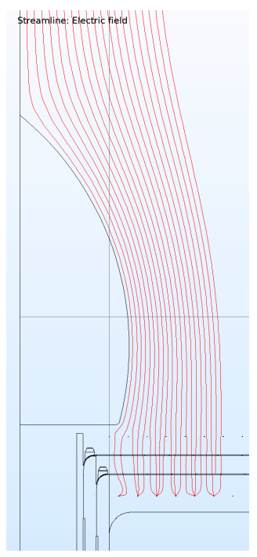
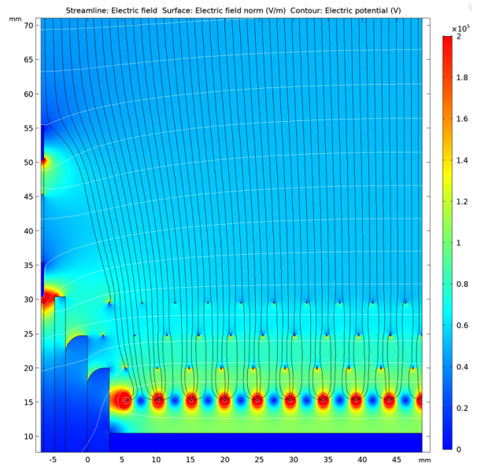
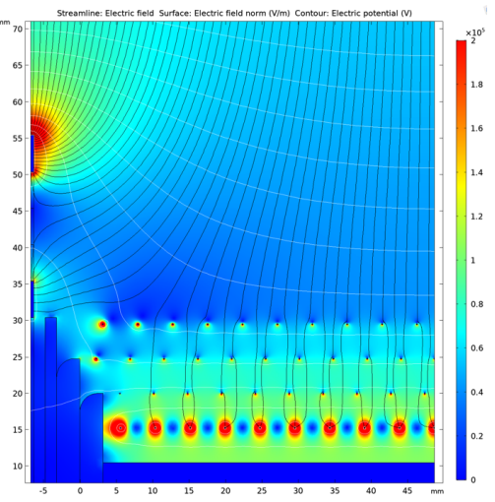
Electron Diverters in ProtoDUNE
Passive Diverters
Used in HD beam side now
Active Diverters
Designed for SP
Bo Yu
Proposed in SP
-1300 V (inner strip)
-2300 V (outer strip)
Actual case in SP
Diverters not biased due to a current drain

Slide 2
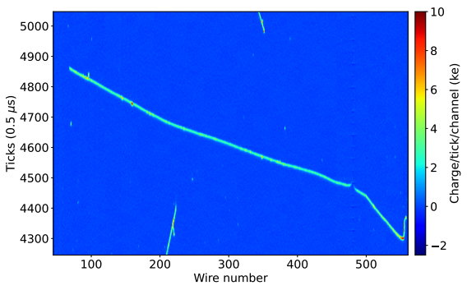
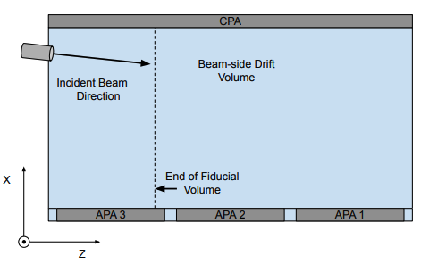
Grounded Active Diverter in ProtoDUNE-SP
Gnd Diverter
Gnd Diverter
Charge loss and spatial distortion; could be more obvious in vertical tracks
Current data analysis cut off at the APA boundary

Slide 3
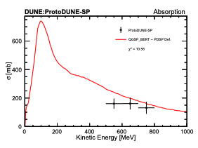
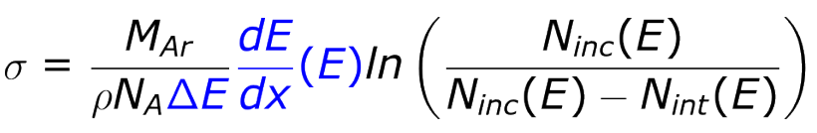
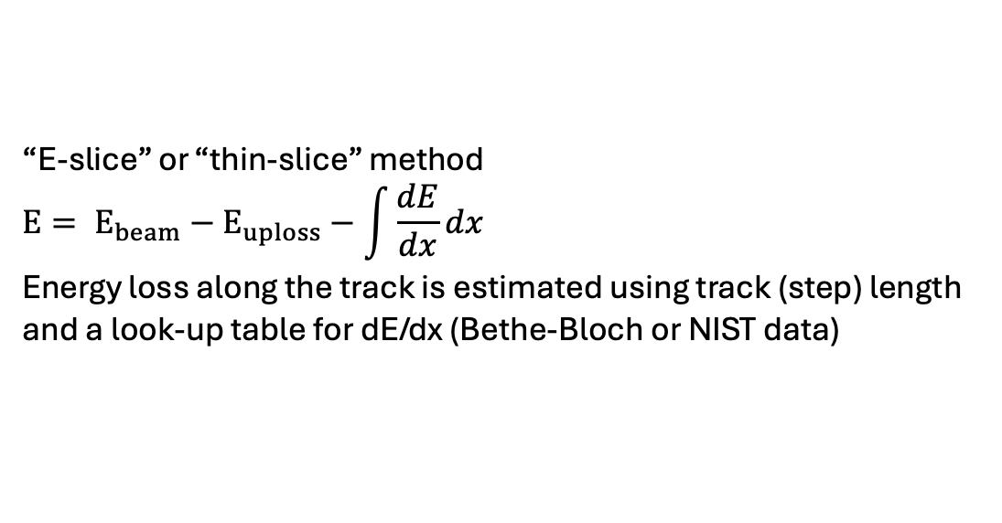
WireCell Imaging
What if WireCell imaging can fix the broken track?
The analysis could take advantage of the stitched track and accumulate more statistics at low energy (mostly near end points)?
Pion inelastic
Jake Calcutt
“E-slice” or “thin-slice” method
$$E= E_{beam}−E_{uploss}−\int{\frac{dE}{dx}dx}$$
Energy loss along the track is estimated using track (step) length and a look-up table for dE/dx (Bethe-Bloch or NIST data)

