Slide 1
ePIC Electronics and DAQ WG - 2/20/2025 – Echelon 0 (Run Control State Model)
News / Announcements
Schedule
Feb 27: GTU & Timing Synchronization Updates
Mar 6: eRD109 Updates
Mar 13: RDO protocols
Mar 20: Echelon 0
~ April 24 -- Combined meeting with SRO WG on monitoring & how its divided between SRO/DAQ
HRPPD / MCPPMT baseline is FCFD → “FCFD/EICROCx” is obsolete and should be removed from documents
Addition Announcements?
Echelon 0
Organize activities for specifying baseline
List of components / data flows
Frameworks
Location / of processing nodes (DAQ room vs SDCC)
Data formats & readers & interface to Echelon 1
Slow Control interface
Run Control state model / organization (Today)
Assumptions
Multiple Simultaneous Runs

Slide 2
Run Control Architecture Assumptions:
Run Control Server
Maintains connections, states of clients
Issues Commands
Configuration File
Which Clients are present and running
Configuration information associated with run
Run Control Clients
Standard Interface (e.g. implements a RC_Client class) for the real time components of the DAQ
Interprets simplistic RC Commands (Configure, Start Run, Stop Run) and implements detailed configuration of subcomponents
Run Control Interfaces(s)
Likely a single controlling interface allowed to run at a time (Could have read only / passing of control between interfaces)
A GUI for shift use, potential specialized versions for experts
Control components of run
Select Configurations to run
Possibly integrated configuration editor (could be separate util)
DB
Must allow for a configuration file that can support schema evolution (STAR uses XML based configuration file, MongoDB, and a java based configuration editor that builds the editor directly from the configuration file specification)
Client
Client
Client
Client
Client
Client
Client
Client
Run Control
Clients
Run Control Server
(Handler)
Client
Run Control
Interface (s)
Ethernet
Client
Client
Client
Client
Web Based
(or)
Local
Client
Run Control
Clients
DB
Run Log
Web Based

Slide 3
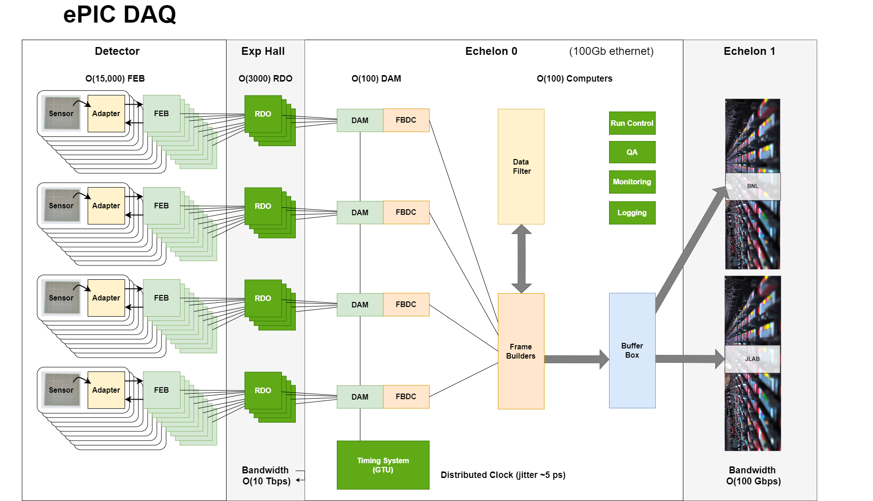
Run Control Assumptions:
Assume Run Control Clients controls relatively significant systems at a lower level
Client List:
~ 100 FBDC’s
Frame Builders
Buffer Box’s
GTU
Monitoring
QA/Echelon 1?
O(<200) clients

Slide 4
Run Control Architecture Assumptions:
Configuration Procedure:
Run Control
Client
Edit Configuration Files (Parameters such as thresholds/routings/modes) (by experts)
Set GUI controlled parameters (Select components, masks)
Select Configuration File
Run Control Server
(Handler)
Logs configuration file to DB
Makes it available to RC Clients
Uses relevant portions of config file
E.g. routing configuration
Frequently changing configuration information (e.g. masks)
Selection of run types
Uses RC selection to load appropriate local configuration files
Loads detailed calibration/static configuration from local files
Client

Slide 5
Run Control Architecture Assumptions:
RC Client State Model:
Example states from STAR RC
State transitions (almost) always take place on send/receipt of command to the RC Server
Lessons learned from STAR
STAR has non-directional transitional states
Error state in STAR takes place on bad status, not separate command
Both lead to ambiguities better avoided…
RC Server State Model:
On server side each client has a “flight” associated with each transition. This allows, for example a special node/nodes to be configured before any other node begins configuration. Or a node to complete stopping/pausing before other nodes begin.
On server side a similar state model exists, defined by aggregating nodes in run as appropriate
State model looks complex, but each client implements small number of functions, and in many cases doesn’t need to override a default.
getReady()
Configure()
Start()
Pause()
Stop()
Autorecover()
REBOOT,
Disconnection
Powerup
Unconnected
Error
Accept Connection
Connected
SET_ERROR
Automatic
Ready
CONFIG
STOP_DONE
CONFIG
configuring
DONE_CONFIG
stopping
Configured
STOP
(usually from Server
Can be from client)
START
starting
DONE_START
DONE_RESTART
Running
PAUSE
restarting
pausing
RESTART
Paused
DONE_PAUSE
DONE_RECOVERY
(from client)
START_RECOVERY
(from client)
Auto-recovering

Slide 6
Requirement for Multiple Simultaneous Runs
Some Detectors Should always be running (scaler’s) and other detectors may be sensitive to beam conditions. We do not want to interrupt basic beam monitoring when starting/stopping physics runs.
Commissioning/Debugging often requires parasitic / or independent running
The main difficulties that will arise are:
Shared resources (GTU, Frame Builders, QA)
Labelling simultaneous runs
Commissioning / Debugging – independent / parasitic running
It should always be possible to run individual FBDC’s and electronics connected via their damn boards independently
Assume clock signal/revtic from GTU is always distributed to all DAM boards in every state. (Requirement for GTU)
All other commands can generated by emulated GTU within the FBDC/DAM board
Data can be written locally by FBDC.
Configuration files can be generated with the configuration file editor, and stored locally
Assuming some run number scheme using an embedded year/date, a scheme can be generated to name data files using a range of years in the distant past.

Slide 7
Simultaneous runs
What is our approach to this?
Do we have a single “stream” of always running detectors, handled as a one-off type of detector?
Do we make a generic system capable of running several simultaneous runs at a time?
How do we organize this?
Possibility 1: Each simultaneous run completely separate (DAM/FBDC/Frame Building Farms/Monitoring/DB copy)
Possibility 2: Each DAM/FBDC has a “mask” of runs it is involved in. Frame builder farms are independent from one another
Possibility 3: Each DAM/FBDC has independent run states, but there is a central run handling system that routes data
It might be a good idea to consider that runs in two components:
Data production running (configuration of electronics up to/through the DAM)
Data routing run configuration (routing of data after the DAM)
This would significantly change the simple state model discussed previously
Possibility 1
Run A
DAM 1
Frame Building Farm 1
DAM 2
DAM 3
Run B
DAM 4
Frame Building Farm
DAM 5
DAM 6
Possibility 2
Run A
DAM 1
Frame Building Farm 1
DAM 2
DAM 3
DAM 4
Run B
DAM 5
Frame Building Farm
DAM 6

Slide 8
Simultaneous runs
What is our approach to this?
Do we have a single “stream” of always running detectors, handled as a one-off type of detector?
Do we make a generic system capable of running several simultaneous runs at a time?
How do we organize this?
Possibility 1: Each simultaneous run completely separate (DAM/FBDC/Frame Building Farms/Monitoring/DB copy)
Possibility 2: Each DAM/FBDC has a “mask” of runs it is involved in. Frame builder farms are independent from one another
Possibility 3: Each DAM/FBDC has independent run states, but there is a central run handling system that routes data
It might be a good idea to consider that runs in two components:
Data production running (configuration of electronics up to/through the DAM)
Data routing run configuration (routing of data after the DAM)
This would significantly change the simple state model discussed previously
Possibility 3
Run A
DAM 1
Frame Building Farm 1
DAM 2
DAM 3
Run Handling
DAM 4
Run B
DAM 5
Frame Building Farm 2
DAM 6
In all cases there are a lot of details to work out
Compatibility of settings for separate runs
Do state transitions for one run affect other runs
What aspects of GTU operation need to be aware of the

Slide 9
Separated Systems
Advantages:
Simple
Adaptable to other systems (e.g. polarimetry)
Disadvantages:
Same detector can’t contribute to multiple simultaneous runs
Need relatively complex merging in reconstruction/SRO to realize benefits from streaming
Need to fully replicate all components
Possibility 1
Run A
DAM 1
Frame Building Farm 1
DAM 2
DAM 3
Run B
DAM 4
Frame Building Farm 2
DAM 5
DAM 6

Slide 10
DAMs configured in multiple runs:
Advantages
All DAMs can contribute to each run
Disadvantages
DAM/FBDC configuration is more complex
DAMs/FBDC need to maintain more than one run state
Possibility 2
Run A
DAM 1
Frame Building Farm 1
DAM 2
DAM 3
DAM 4
Run B
DAM 5
Frame Building Farm
DAM 6

Slide 11
Multiple Runs handled in a frame building component
Advantages
All DAMs can contribute to each run
DAMs do not need any knowledge of the routing of runs
Configuration Consistency issues at the front ends are manifestly non-existent
Disadvantages
“New” component required in the echelon 0
Refactoring of state model needed
Possibility 3
Run A
DAM 1
Frame Building Farm 1
DAM 2
DAM 3
Run Handling
DAM 4
Run B
DAM 5
Frame Building Farm 2
DAM 6

