Slide 1
ePIC Electronics and DAQ WG - 2/13/2025 – ASIC / RDO protocols
News / Announcements
Schedule
Feb 20: Echelon 0 / Run Control State Machine
Feb 27: GTU & Timing Synchronization Updates
Mar 6: eRD109 Updates
Mar 13: RDO protocols
Other Announcements?
ASIC / RDO protocols
Goal is to make progress on protocol document
Readout Chains with emphasis on fast commands downlinks
Summary of Fast Commands
Proposal for protocol document

Slide 2
RDO chains
FEB
On Detector RDO
Off Detector
lpGBT
VTRX+
RDO
FELIX
40 MHz
SFP
SVT, SALSA
lpGBT
SFP/Cu/Firefly
RDO
FELIX
CALOROC
40 MHz
SFP
ASIC
RDO
FELIX
100 MHz
VTRX+
ALCOR
40 MHz
lpGBT
VTRX+
FELIX
EICROC/FCFD
RDO
200 MHz
FLASH ADC
FPP/Cu/Firefly
FELIX
Direct Photon
RDO
Discrete/ASIC
RDO
FELIX
100 MHz
SFP
Discrete ECAL’s, Astropix, Timepix

Slide 3
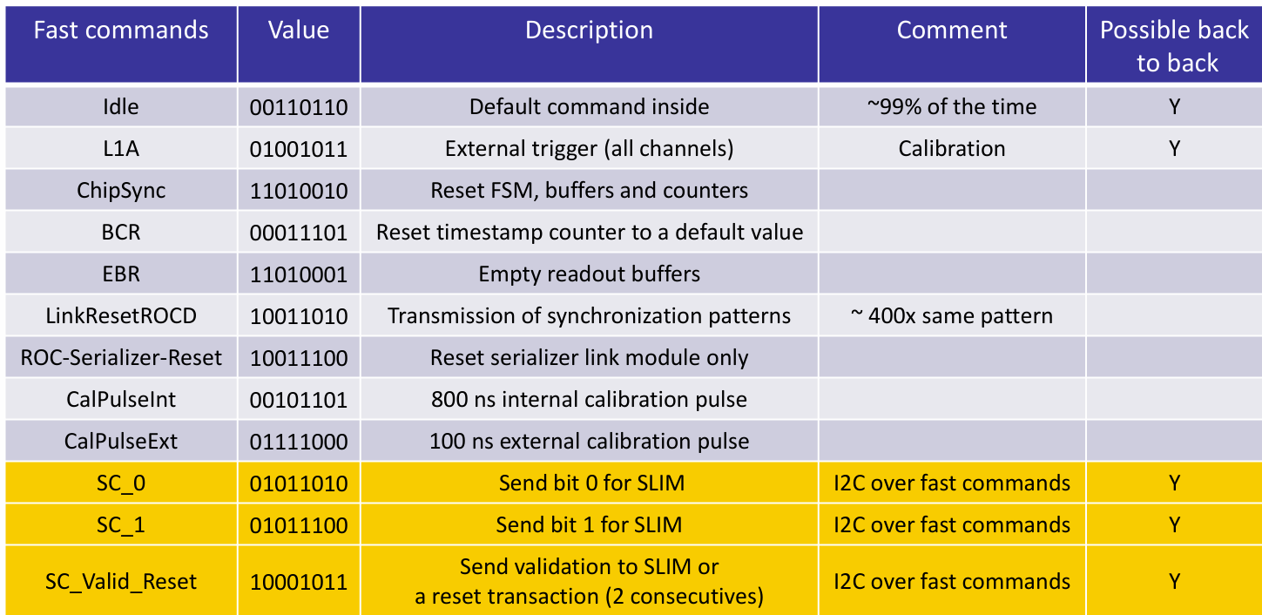
RDO chains
On Detector
Off Detector
FEB
lpGBT
VTRX+
RDO
FELIX
40 MHz
SFP
SVT, SALSA
lpGBT
SFP/Cu/Firefly
RDO
FELIX
CALOROC
40 MHz
SFP
MPGDs / CALOROC:
1 RDO → 4 FEB (1 VTRX+ / 1 lpGBT / 4 ASICs)
320 MB/s downlink per ASIC → 8 bits / 40 MHz clock
1.28 Gb/sec for lpGBT downlink to ASICs
5.12 GB/sec for DAM downlink to RDO (MAX supported by VTRX+ w/no radiation)
Under these assumptions RDO has independent control over fast commands to each ASIC
SVT:
1 RDO → 1 lpGBT in SC path (large number in uplink path avg ~ 9 VTRX+ x 4 TX fiber = 36 uplink fiber/RDO)
Do not know how fast commands map to SVT readout windows, I’m not sure fast command / 40 MHz clock makes sense but there is a mechanism for synchronizing readout windows.
Rate for masking pixels / setting thresholds is certainly an important point given huge number of pixels. (Each lpGBT controls ~ 100 Million pixels)
ASIC
RDO
FELIX
100 MHz
VTRX+
ALCOR
40 MHz
lpGBT
VTRX+
FELIX
EICROC/FCFD
RDO
200 MHz
FLASH ADC
FPP/Cu/Firefly
FELIX
Direct Photon
RDO
Discrete/ASIC
RDO
FELIX
100 MHz
SFP
Discrete ECAL’s, Astropix, Timepix

Slide 4
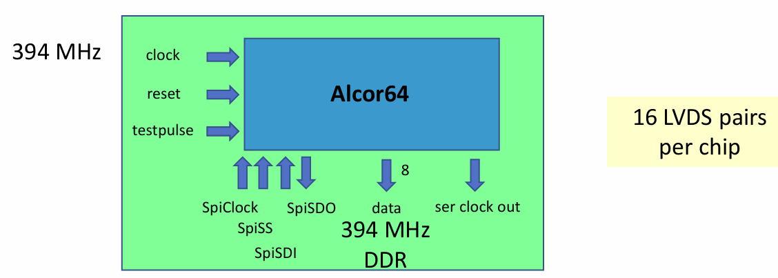
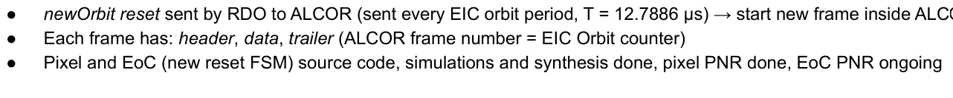
RDO chains
On Detector
Off Detector
FEB
lpGBT
VTRX+
RDO
FELIX
40 MHz
SFP
SVT, SALSA
lpGBT
SFP/Cu/Firefly
RDO
FELIX
CALOROC
40 MHz
SFP
ASIC
RDO
FELIX
100 MHz
VTRX+
ALCOR
ALCOR:
1 RDO downlink uses 1 VTRX+ (max 5.12 GB/sec)
1 RDO → 4
320 MB/s downlink per ASIC → 8 bits / 40 MHz clock
1.28 Gb/sec for lpGBT downlink to ASIC
5.12 GB/sec for DAM downlink to RDO (MAX supported by VTRX+ w/no radiation)
40 MHz
lpGBT
VTRX+
FELIX
EICROC/FCFD
RDO
200 MHz
FLASH ADC
FPP/Cu/Firefly
FELIX
Direct Photon
RDO
Fast Commands: It appears that the run time fast commands may be very simple, but the configuration is more complex as the schematic shows the serial interfaces to the ALCOR
Discrete/ASIC
RDO
FELIX
100 MHz
SFP
Discrete ECAL’s, Astropix, Timepix

Slide 5
RDO chains
EICROC:
RDO is implemented as IP block in FELIX
FEB (1 VTRX+, 1 lpGBT, <= 28 ASICs)
1.28 Gb/sec total downlink bandwidth per FEB but require 8 bit fast command / 40 MHz clock
Fast commands are copied to all ASICs, they can not be independently set by ASIC
EICROC to share (likely) same fast commands as CALOROC / FCFD.
FCFD:
RDO is implemented as IP block in FELIX
FEB (1 VTRX+, 4 lpGBT, <= 82 ASICs)
1.28 Gb/sec total downlink bandwidth per FEB but require 8 bit fast command / 40 MHz clock
Fast commands are copied to all ASICs
FCFD to share (likely) same fast commands as CALOROC / EICROC
On Detector
Off Detector
FEB
lpGBT
VTRX+
RDO
FELIX
40 MHz
SFP
SVT, SALSA
lpGBT
SFP/Cu/Firefly
RDO
FELIX
CALOROC
40 MHz
SFP
ASIC
RDO
FELIX
100 MHz
VTRX+
ALCOR
40 MHz
lpGBT
VTRX+
FELIX
EICROC/FCFD
RDO
200 MHz
FLASH ADC
FPP/Cu/Firefly
FELIX
Direct Photon
RDO
Discrete/ASIC
RDO
FELIX
100 MHz
SFP
Discrete ECAL’s, Astropix, Timepix

Slide 6
RDO chains
On Detector
Off Detector
FEB
Direct Photon:
Straight streaming @ 200 MHz
RDO implemented in IP block of FELIX
Possibly no configuration / fast command handling needed
lpGBT
VTRX+
RDO
FELIX
40 MHz
SFP
SVT, SALSA
lpGBT
SFP/Cu/Firefly
RDO
FELIX
CALOROC
40 MHz
SFP
ASIC
RDO
FELIX
100 MHz
VTRX+
ALCOR
40 MHz
lpGBT
VTRX+
FELIX
EICROC/FCFD
RDO
200 MHz
FLASH ADC
FPP/Cu/Firefly
FELIX
Direct Photon
RDO
Discrete/ASIC
RDO
FELIX
100 MHz
SFP
Discrete ECAL’s, Astropix, Timepix

Slide 7
RDO chains
On Detector
Off Detector
FEB
lpGBT
VTRX+
RDO
FELIX
40 MHz
SFP
SVT, SALSA
Discrete:
Fast commands TBD
Astropix / Timepix:
End of Stave Cards / Spyder readout likely to hide details of sensor communication
lpGBT
SFP/Cu/Firefly
RDO
FELIX
CALOROC
40 MHz
SFP
ASIC
RDO
FELIX
100 MHz
VTRX+
ALCOR
40 MHz
lpGBT
VTRX+
FELIX
EICROC/FCFD
RDO
200 MHz
FLASH ADC
FPP/Cu/Firefly
FELIX
Direct Photon
RDO
Discrete/ASIC
RDO
FELIX
100 MHz
SFP
Discrete ECAL’s, Astropix, Timepix

Slide 8
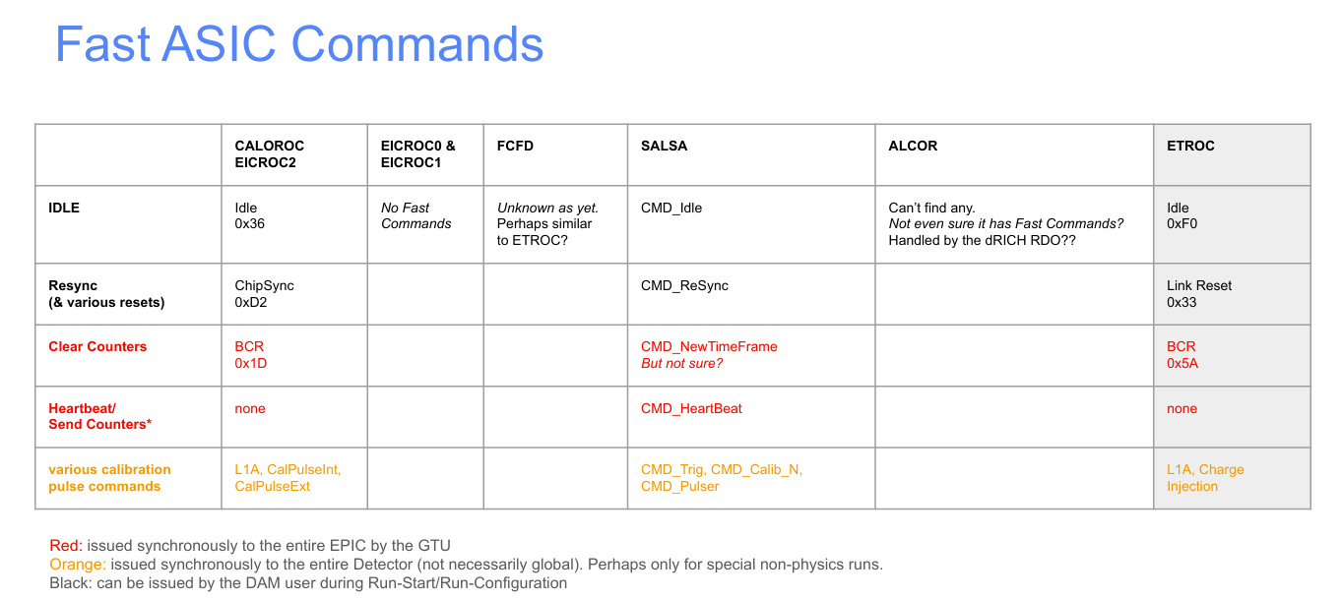
Fast Command Summary:
EICROC/CALOROC/FCFD possible fast commands
Tonko’s summary of fast commands for existing ASICs: https://indico.bnl.gov/event/25839/contributions/100330/attachments/59097/101485/Fast%20ASIC%20Commands%20TL%20Dec2024.pdf

Slide 9
Protocol Document Proposals
Document the rule that synchronous commands are only sent on multiples of 5 EIC Bunch crossings
Decide and document whether RDOs are aware of both 98.5 MHz and 39.4 MHz clocks, or that they are only aware of clock cycles and the clock counter to time conversion is handled in the DAM board. (My preference is the second)
Avoid micromanaging the ASIC commands per detector. Instead assume that there will be a translation stage required for many commands
For the same synchronous commands there may be different bit patterns firing that command for different ASICs
For commands that do not require constant latency, and are not universal define a superset of commands, and allow the translation of a single command into a series of commands issued from the DAM board
Command/Group | Purpose | Require Constant Latency? | Universal
syncSet | Define Clock Reference | Yes | Yes
syncRead | Trigger clock read (full trigger?) | Yes | Yes
pulsers | Synchronized calibration | Yes | No
reset and configure | Initiate configuration/potentially with help from SC interface | No | Yes
slow controls | Fast slow controls routes | No | Yes/No
Not present? Needed?
Run Start | Instruct ASICs to send data
Run Stop | Instruct ASICs to stop sending data
Define a series of states for the ASICs to be in, the triggers for translations to each state, and the behavior of the ASICs in these states:
Irakli has put together a slide deck proposing some ideas: https://indico.bnl.gov/event/26507/contributions/103235/attachments/59952/102982/250106_IM_RunControl.pdf
One of his main requests is that the time frame synchronization be strictly repeating (e.g. Based on a count of rev-ticks)
This seems shared by the ALCOR concept, for example which is defining ASIC frames based on revolutions in the current scheme
Advantage here is that the ASICs can maintain their own understanding of the timing / counters / bunch structure
The other concept is asynchronous definition of the time frame synchronization
Advantage here is that the time frame definition is flexible and defined by the higher level DAQ system, time frame concept doesn’t need to have specific uniform support among different ASICs
Reset scheme has well defined rule (Comes from GTU, not arbitrated with ASIC states)
Eg: On, Configured, Running, etc…
This includes indicating whether inhibiting data sends means that the ASICs don’t produce data, that the RDO doesn’t read any data produced, or whether the DAM board doesn’t read any data produced.
Existing document to be gutted, with obsolete details removed, but existing features listed as requirements. These points to be added. Discuss next month!

