Slide 1
ePIC Global Timing Unit (GTU)
The requirements
The ePIC designs
The GTU design
The current status

Slide 2
1. The requirements
1.1 Synchronized control
Streaming Data
Time Frame 1 …
Time Frame M
Time Frame M+1
Time Frame M+2
Time Frame M+3
Time Frame M+4
Time Frame M+5
START
RE-START
RE-START
STOP
START
RE-START
RE-START
RE-START
RE-START: STOP and START at the same Beam Crossing
Whole detector dead time
1.2 Jitter of the FEB/ASIC received clock: less than 5ps;
  1.3 For TOF detectors, the phase of the clock relative to the beam crossing center point is stable (less than 5ps);
  1.4 For dRICH detector, the phase of the clock relative to the beam crossing center point is stable (< ~100ps) for shutter implementation (zero suppression)

Slide 3
2. The ePIC designs
2.1 The EIC beam crossing
 | Electron Storage Ring (ESR) | Hadron Storage Ring (HSR) (N_{b}=290) | HSR (N_{b}=1160)
Circumference C [m] | 3833.940 | match T_{rev} | match T_{rev}
Revolution period T_{rev}=C/c [µs] | 12.7886
RF harmonic number h [-] | match HSR | 2520 | 7560
RF bucket spacing T_{b}=T_{rev}/h [ns] NOT bunch spacing!!! | match HSR | 5.075 | 1.692
Number of bunches N_{b} | match HSR | 290 | 1160
Bunch spacing T_{bun} [ns] | match HSR | 40.599 | 10.150
Gap length [ns] | match HSR | 1015 | 1015
        Beam crossing: 98.525 MHz or 10.150ns
        Orbit period: 12.7886 µs or 1260 Beam Crossing
 | ESR | HSR
RMS bunch length σ_{z} [mm/ps] | 7-9/23-30 | 75-60/250-200
RMS momentum spread [10⁻⁴] | 5.8-10.9 | 10.3-6.8
RMS horiz beam size σ_{x} [um] | 100-250
σ_{z}/σ_{x} ratio [-] | 28-90 | 240-750
Electron Beam Energy: 5 – 18 GeV
Proton Beam Energy: 41, 100 – 275 GeV
Luminosity: 10³⁴ cm⁻²s⁻¹

Slide 4
2. The ePIC Designs
2.2 The ePIC clocks:
Single clock source, distributed to the whole system
Streaming Data
Time Slice M-1
Time Slice M
Time Slice M+1
Time Slice M+2
Time Slice M+3
Time Slice M+4
Time Slice M+5
Beam crossing ( * electron ion collision )
* * * * * * * *
* * * * * * * *
* * * * * * * *
1 1 1 1
1 1 1 1 1 1 1 1 1 1 1 1
1 1 1 1
2 2 2 2
1 1 1 1 1 1 1 1 1 1 1 1
2 2 2 2
5 5 5 6
5 5 5 5 5 5 5 6 6 6 6 6
5 5 5 6
SRO data header:
Packet number,
Data source ID,
Starting orbit count
Starting BX count
SRO data trailer:
Ending orbit count
Ending BX count
Sync/Error/buffer status
Total word count
7 8 9 0
1 2 3 4 5 6 7 8
3 4 5 6 7 8 9 0 1 2 3 4
7 8 9 0
1 2 3 4
1160 (all or 1/4 with beam)
100 (no-beam /gap)
BX_Clock, 98.5 MHz
GTU→DAM, 9.85 MHz
GTU→DAM, 19.7 MHz
lpGBT_Clock, 39.4 MHz
Any other clocks
All the clocks are phase aligned (fixed)
Nominal Time Slice: 65530 (~2¹⁶) BX, ~0.6 ms, settable in GTU (Synchronization check)

Slide 5
2. The ePIC designs
System Clock: 9.85 MHz (or 19.7 MHz)
2.3 The ePIC Timing/Control distribution
Online computer
Status
GTU: Global Timing Unit
  control encoding, status decoding.
  The interface for machine clock source,
  Data acquisition control and monitor etc.
DAM: Data Aggregation Module:
  The clock/control fanout, and status/busy accumulation.
  local control over the RDO boards connected, though the main function of the DAM is for Data Acquisition.
RDO: optical interface of detector ReaDOut
  control decoding, status encoding.
  The clock/control interface to the front end electronics.
  Data collection from Frontend boards, and data transmission to the DAM
FEB:
  Detector dependent Front End / ASIC carrier boards.
GTU
GTU (O)1
Control
EIC
Common
Platform
Clock
Data Acquisition
DAM
(O)100
DAM
DAM
RDO
(O)1000
RDO
RDO
RDO
RDO
FEB
FEB
FEB
GTU distributes 9.85 (or 19.7) MHz clock, and DAM reconstructs the 98.5 MHz, (and) 39.4 MHz clock

Slide 6
2. The ePIC Designs
2.4: Synchronization
GTU
DAM/RDO to implement time measurement, so that RDOs can compensate the fiber length delay to within one clock period; but, it is easier to use same-length fibers.
GTU/DAM to keep a 11-bit beam crossing counter (terminates at 1260), synchronization check with streaming readout time slice (start/stop) commands; online/offline check with beam orbit structure (collision or no collision);
RDO to keep a 11-bit beam crossing counter (terminates at 1260), or a 9-bit beam crossing counter (terminate at 504 for lpGBT protocol), and a 6-bit (min. ~818 ms), 21-bit (preferred, ~26seconds), or 32-bit (over 15 hours) beam orbit counter;
GTU and DAM should keep a larger beam orbit counter;
RDO to keep a 16-bit (min), or 32-bit (preferred) time slice counter. This counter should not overflow for the maximum DAQ computer buffer.
RDO should assert buffer high_marker no later than one orbit period before it is full and starts to lose data.
RDO starts a new data packet upon receiving time-slice_start, and end the current packet upon receiving time-slice_end or upon receiving a new time-slice_start.
RDO to hold data if the DAM is busy (potential buffer full), and the DAM to hold data if the host computer/Network switch is busy.
The GTU can record dead time by sending TimeSlice_end, and holding TimeSlice_start in responding to RDO busy.
RDO should generate one packet on every readout time slice. The RDO can discard detector data to avoid buffer overflow, or out of synchronization, but this occurrence must be recorded in the data package/trailer.
Data flow
DAQ
Data Buffer ‘FULL’ backpressure
DAM
Status accumulation:
Data Buffer conditions, Out of Sync, Reset_request, etc.
Run_control:
SRO_time_start/stop, RESETs, etc.
RDO

Slide 7
3. The GTU Design
3.1 Clock distribution

Slide 8
3. The GTU Design
3.2 Slow Control

Slide 9
3. The GTU Design
3.3 GTU fast control

Slide 10
3. The GTU Design
3.4 GTU partition (multiple run-control support)
Hardware: Each MGT transceiver corresponds to one DAM. It can be ‘controlled’ independently.
Each MGT is assigned an ID (corresponding to a sub-system);
Each Run_control_user_interface is also assigned an ID (corresponding to a sub-system);
* If we use BIT (instead of INTEGER) for the IDs, multiple sub-systems can be controlled by multiple User Interfaces.
RUN_CONTROL_USER_1
FPGA
command switch
MGT/DAM_1[1:a]
RUN_CONTROL_USER_2
MGT/DAM_2[1:b]
RUN_CONTROL_USER_n
MGT/DAM_m[1:c]
There is (should be) enough FPGA resources to implement a 24x24 (n=24, m=24) switch with broadcast option

Slide 11
3. The GTU Design
3.5 the design
A 4U (high, 19 inch wide) rack mounted box consisting of one GTU base board (16.8 inch wide max), and many Optic transceiver plugin modules (4U high max, to DAM)
Clock
Receiver, control, distribution
16.8 inch wide (max)
FPGA
Run Control
Memory
‘services’
Quad optic TRX
Optic Transceiver plugin module
4 U/7” high (max)
Quad optic TRX
FPGA (SOM)
Quad optic TRX
Power
regulators
Quad optic TRX
Clock fanout
Quad optic TRX
Quad optic TRX
FPGA
Quad optic TRX
Quad optic TRX
Quad optic TRX
Clock fanout
Possible buffers
Power
supplies
Quad optic TRX
Quad optic TRX
GTU base board

Slide 12
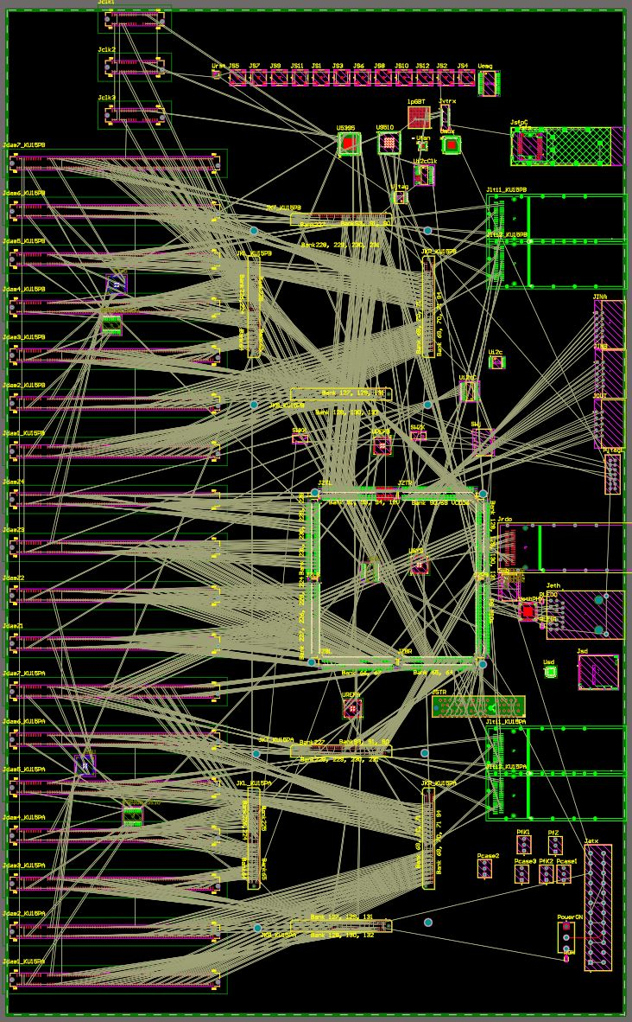
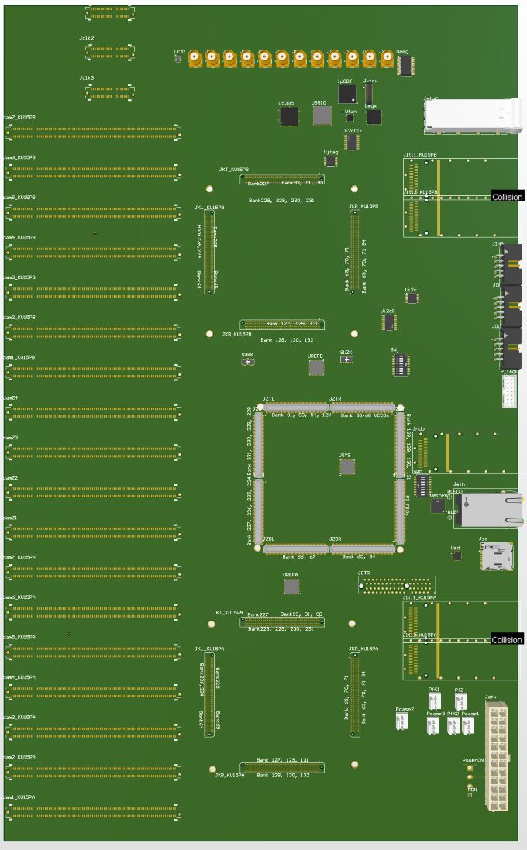
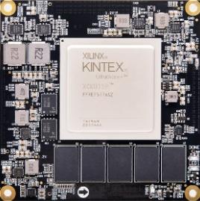
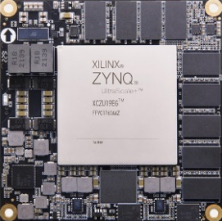
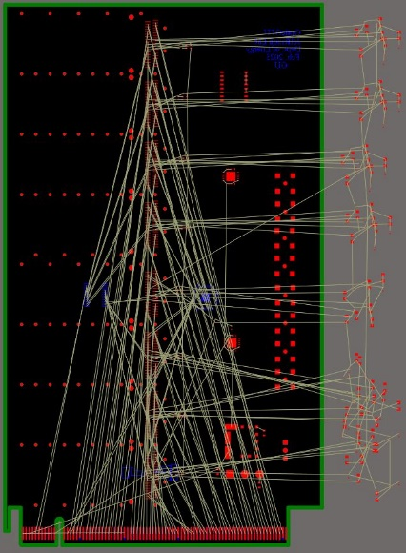
4. The GTU status
262 mm
This summer
Right now:
Schematics: 60%
PCB placement: 80%
PCB routing: 0%
425 mm

Slide 13
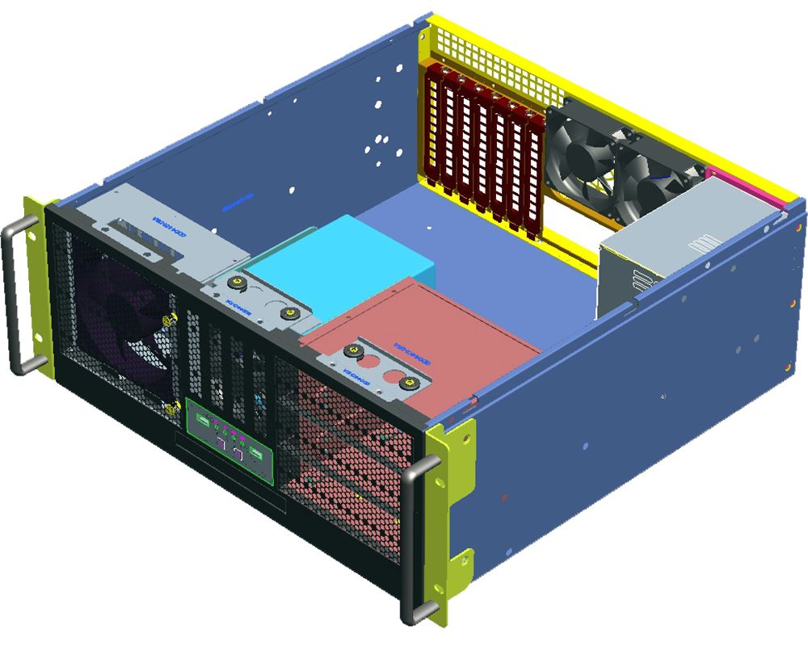

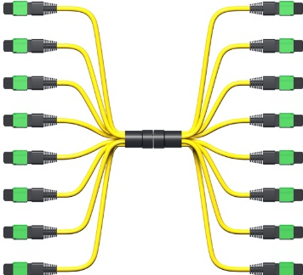
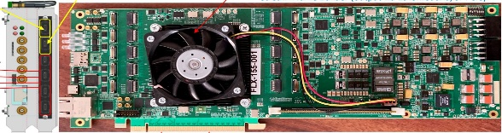
4. The GTU future
GTU
Up to 144
DAM

Slide 14
4. The GTU future
lots of:
Firmware
Software

Slide 15
Thank you

Slide 16
2. The ePIC Designs
2.4 The hardware design
  2.4.1 GTU
GTU required:
EIC common platform interface;
Run Control;
~150 DAM interface
Risk mitigation:
Beam vs clock phase monitoring;
Dedicated clock fanout to TOF
Between GTU and DAM
Same-length Multimode fibers: 4 Tx/4 Rx (inexpensive, standard, commercially available)
Clock @ 9.85 MHz
GTU_CONTROL
GTU
DAM/RDO Status
DAM
Optional/extra

Slide 17
2. The ePIC Designs
2.4 The hardware design
  2.4.2 DAM
DAM clock reconstruct,
98.5 MHz and 39.4 MHz,
Phase aligned with the 9.85 MHz clock,
Additive Jitter ~1ps;
Phase: fixed
Run control
SYNC the run control from GTU and repack in lpGBT format at 39.4 MHz, or non-lpGBT format at 98.5 MHz
ASIC setup, and RDO/FEB monitoring
The DAM will have one MTP fiber port connects to GTU, 48 ports (duplex) connect to 48 RDOs (one port each), and PCIexpress to host PC.

Slide 18
2. The ePIC Designs
2.6 The data format
2.6.1 Between GTU and DAM
PCB Transmitters
Clock @ 9.85 MHz
PCB Receiver
Downlink
GTU_CONTROL, “(min) 8-bits (+ 1 k_bit) @ 98.5 MHz” & “480-bits @9.85 MHz”
FPGA MGT Transceivers
FPGA_MGT Transceiver
Uplink
DAM/RDO Status, “(min) 8-bits (+ 1 k_bit) @ 98.5 MHz” & “480-bits @9.85 MHz”
FPGA IOB Transceivers
To fully use the DAM connection
FPGA_MGT Transceiver
GTU
DAM
The 9.85 MHz clock is also used to align the DAM boards by using the same (length, type) fibers (Synchronization)
2.6.2 Between DAM and RDO/FEB (one-pair of fibers)
Downlink
64-bit at 39.4 MHz for lpGBT, or 64-bit @ 98.5 MHz (for example) for non-lpGBT
lpGBT or FPGA_MGT Transceiver
FPGA MGT Transceivers
Uplink
256-bit at 39.4 MHz for lpGBT, or 64-bit @ 98.5 MHz (for example) for non-lpGBT
DAM
RDO
DAM aligns and repacks the packet (from GTU), and sends the relevant information to the RDO at 39.4 MHz, or 98.5 MHz. The RDO receives the ‘downlink’ after a fixed (same) delay (relative to the GTU generation).

Slide 19
3. The ePIC Designs
2.5 The risk mitigation
2.5.1 Clock phase (RDO/lpGBT recovered clock versus electron beam) monitoring:
2.5.2 Dedicated clock from GTU to TOF_RDO
GTU: Phase Correction
GTU_Optic Transmitter plugin modules
Clock only, to TOF_RDO (optional)
Optic transmitter
Optic Transceiver plugin module
RF-SoC (?)
Optic transmitter
Power
regulators
PhaseOrbit (average)
Optic transmitter
4 U high
Optic transmitter
Optic transmitter
Clock fanout
Phase#1
Phase#2
Phase#1160
Phase#1
Optic transmitter
RDO(area) Clock
Possible choice of Optic Transmitters:
Samtec FireFly, 12 ch TX,
MTP_12 at GTU
LC at RDO
e⁻ Beam pickup

Slide 20
2. The designs
2.4.1 GTU detailed design: clock ‘area’
ZDM
EIC common platform interface
OSC
IN3
OUT9
Si5395
OUT0
To plugin optic transmitters
98.5 MHz
IN1
9.85 MHz
OUT1
AD9510
IN0
OUT0
OUT2
OUT3
AD5330x
To plugin optic transceivers
BXclock
IN0
OUT4
OUT4
AD5330x
OUT5
Clock phase adjustment
Clock_Sync
SPI
Fanout
I2C
Beam Phase monitoring
Orbit
To FPGAs
FPGA (SOM)

Slide 21
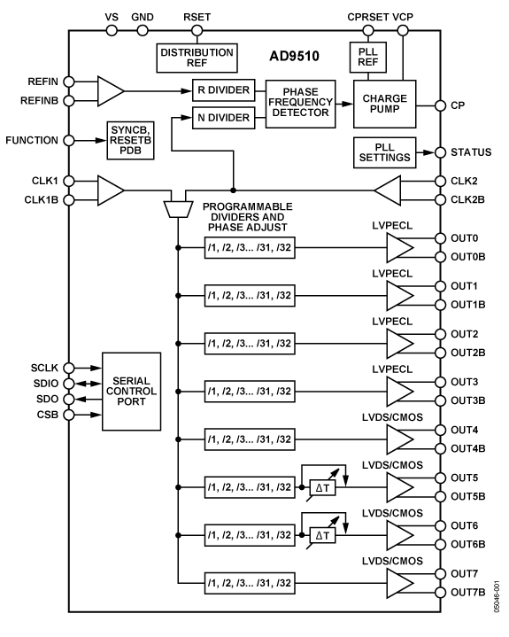
2.4.1 GTU detailed design: AD9510 synchronous clock divider (clk1 input)
Analog Devices AD9510
Additive output jitter (rms)
LVPECL: 225 fs
LVDS/CMOS: 275 fs
Used on the Jlab’s Trigger Interface (TI) modules to generate SYNCHRONIZED /2, /4, /6 and /8 lower frequency clocks.

Slide 22
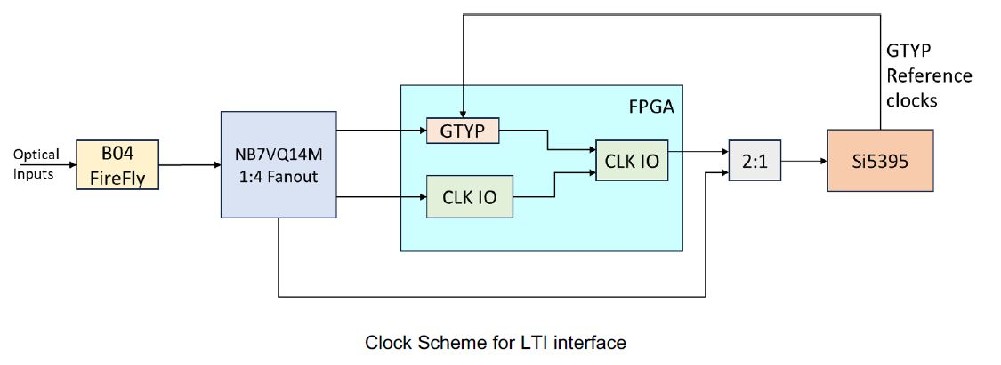
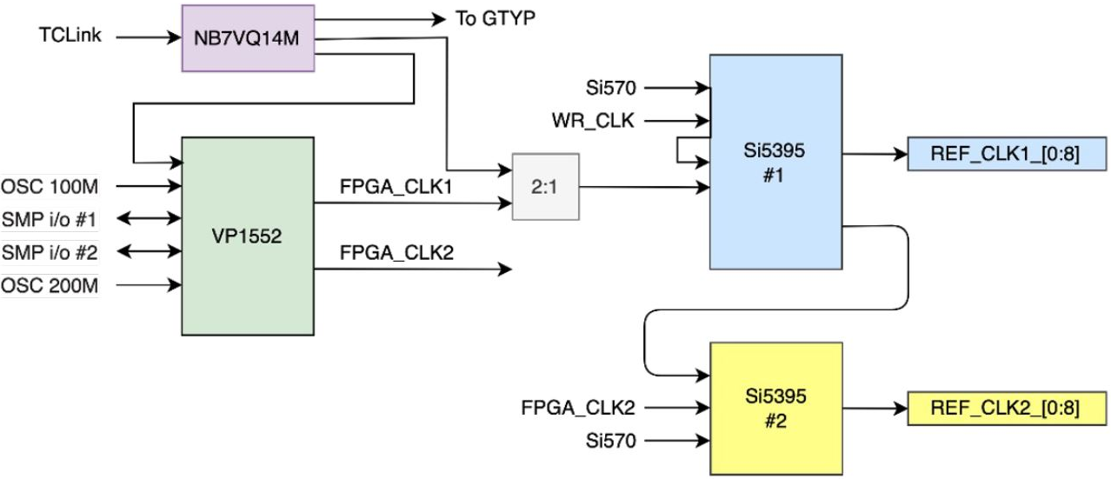
2.4.2 DAM (FLX155) clock interface
Dedicated Clock input,
up to three MGT lanes (Tx/Rx)
MTP multimode 850µm optical
* These two diagrams are from FLX155 presentations

Slide 23
2.6.1 GTU → DAM communication (Downlink, example)
packet | One packet at 9.85 MHz, or 10 ( one word at 98.5 MHz)
word | 1 | 2 | 3 | 4 | 5 | 6 | 7 | 8 | 9 | 10
Bit(9:0) abcdeifghj- | K28.1_3C 0011111001 x0111110xx | K28.2_5C 0011110101 | K28.3_7C 0011110011 | K28.4_9C 0011110010 | K28.5_BC 0011111010 x0111110xx | K28.6_DC 0011110110 | K28.7_FC 0011111000 x0111110xx | K23.7_F7 1110101000 | K27.7_FB 1101101000 | K28.0_1C 0011110100
Bit(19:10) | GTU_RC | GTU_RC | GTU_RC | GTU_RC | GTU_RC | GTU_RC | GTU_RC | GTU_RC | GTU_RC | GTU_RC
Bit(29:20) | BX(7:0) | BX(15:8) | Obx(7:0) | Obx(15:8) | Orbit(47:0), BX(63:16), etc.
Bit(39:30) | DAM | DAM | DAM | DAM | DAM | DAM | DAM | DAM | DAM | DAM
Bit(79:40) | USER | USER | USER | USER | USER | USER | USER | USER | USER | USER
2.6.1 DAM → GTU communication (uplink, for example)
packet | One packet at 9.85 MHz, or ten (single word at 98.5 MHz)
word | 1 | 2 | 3 | 4 | 5 | 6 | 7 | 8 | 9 | 10
Bit(9:0) abcdeifghj- | K28.1/3C 0011111001 x0111110xx | K28.2/5C 0011110101 | K28.3/7C 0011110011 | K28.4/9C 0011110010 | K28.5/BC 0011111010 x0111110xx | K28.6/DC 0011110110 | K28.7/FC 0011111000 x0111110xx | K23.7/F7 1110101000 | K27.7/FB 1101101000 | K28.0/1C 0011110100
Bit(39:10) | Status | Status | Status | Status | Status | Status | Status | Status | Status | Status
Bit(79:40) | RDO/ASIC | RDO/ASIC | RDO/ASIC | RDO/ASIC | RDO/ASIC | RDO/ASIC | RDO/ASIC | RDO/ASIC | RDO/ASIC | RDO/ASIC

Slide 24
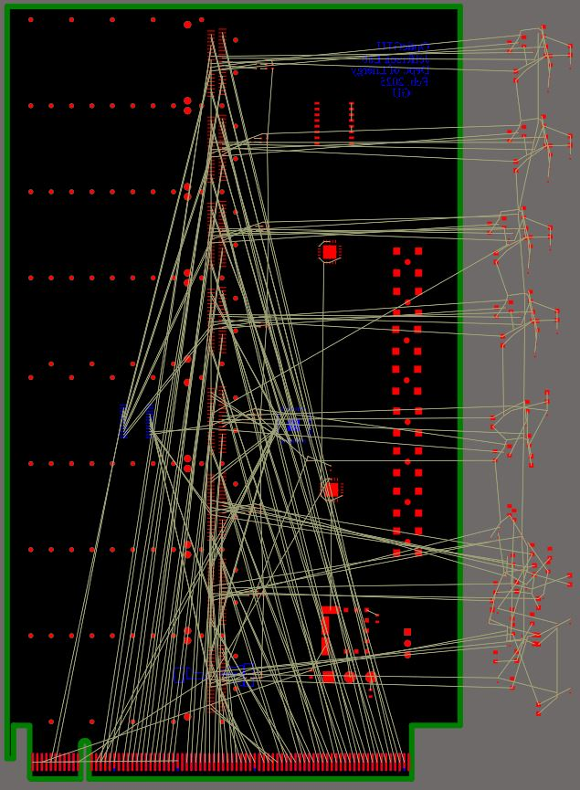
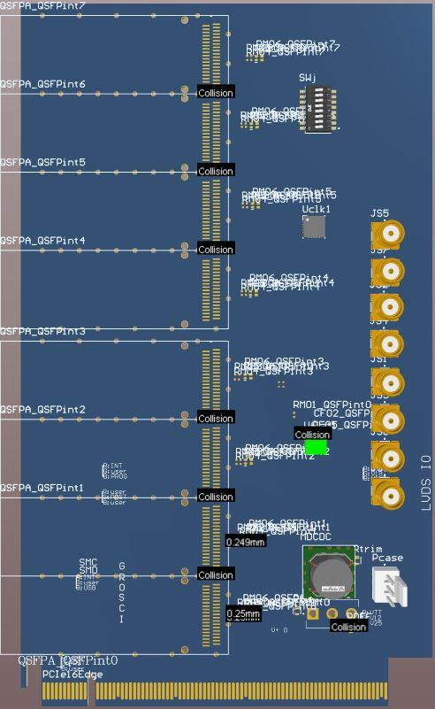
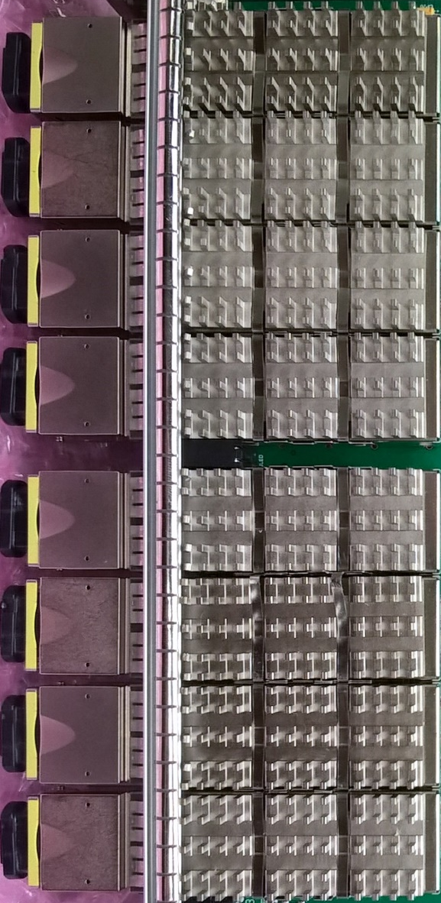
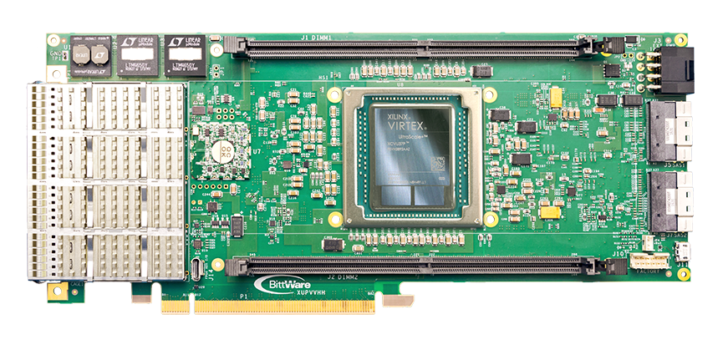
4. GTU optic Adaptor
100mm
170mm

Slide 25
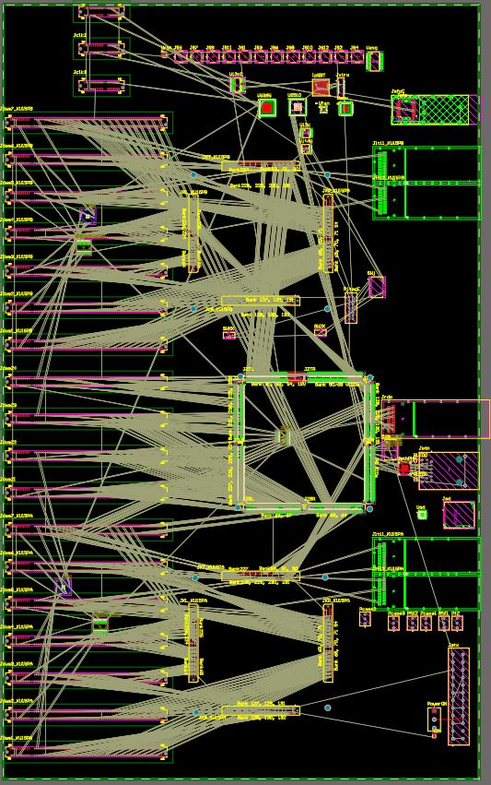
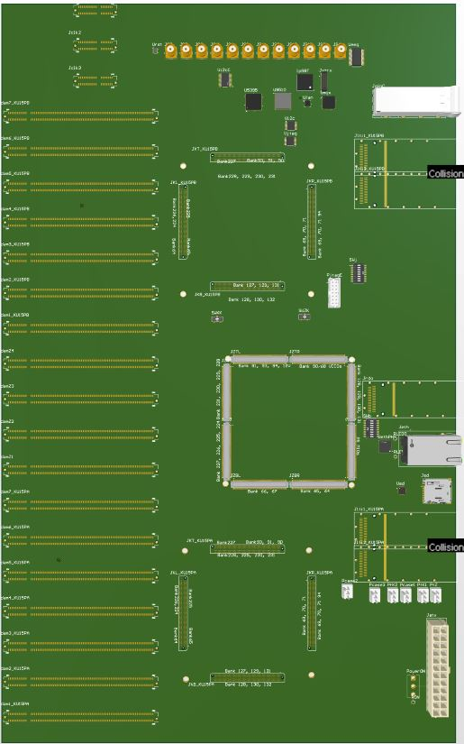
4. GTU base board
262 mm
425 mm

