Slide 1

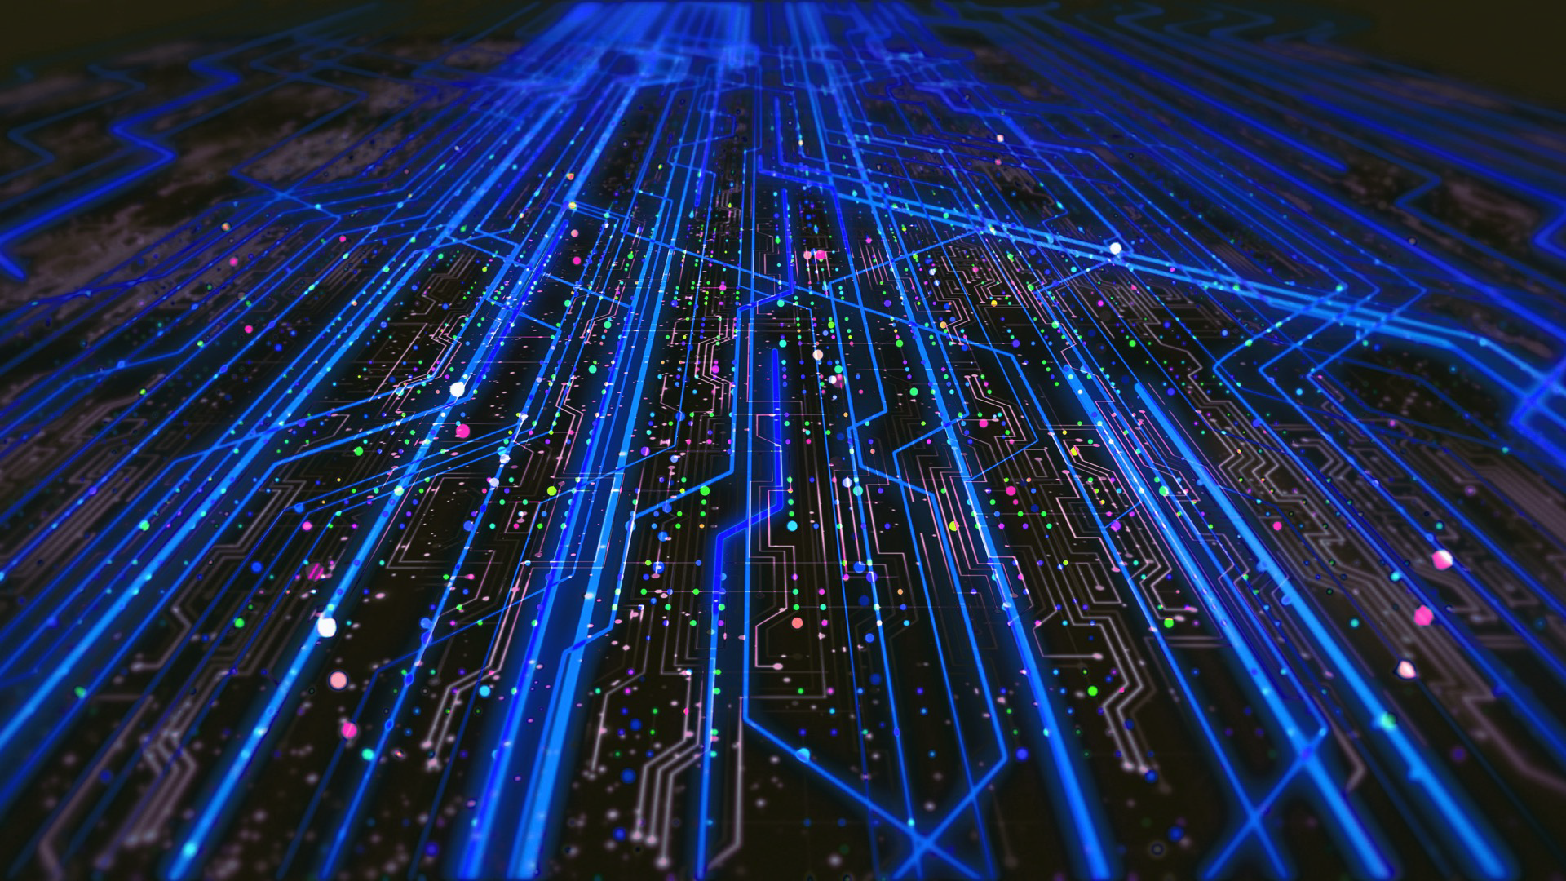

Update on inclusive DDIS in ePIC
Hadi Hashamipour- INFN Cosenza
Apr. 7, 2025
Exclusive+Diffractive Meeting
Centro Nazionale di Ricerca in High-Performance Computing, Big Data and Quantum Computing

Slide 2
Recap since Frascati
We wanted to produce 100k events, but due to shutdown of our local HPC, we have 10k events.
As usual 10x100 generated by RAPGAP.

Slide 3
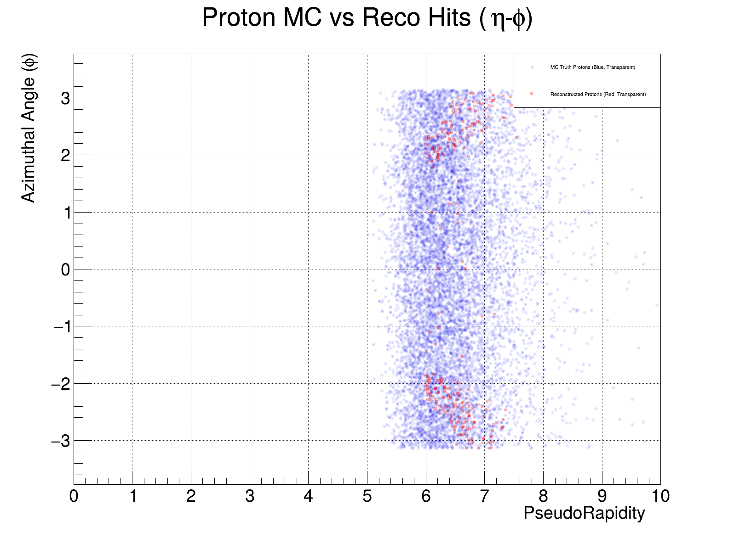
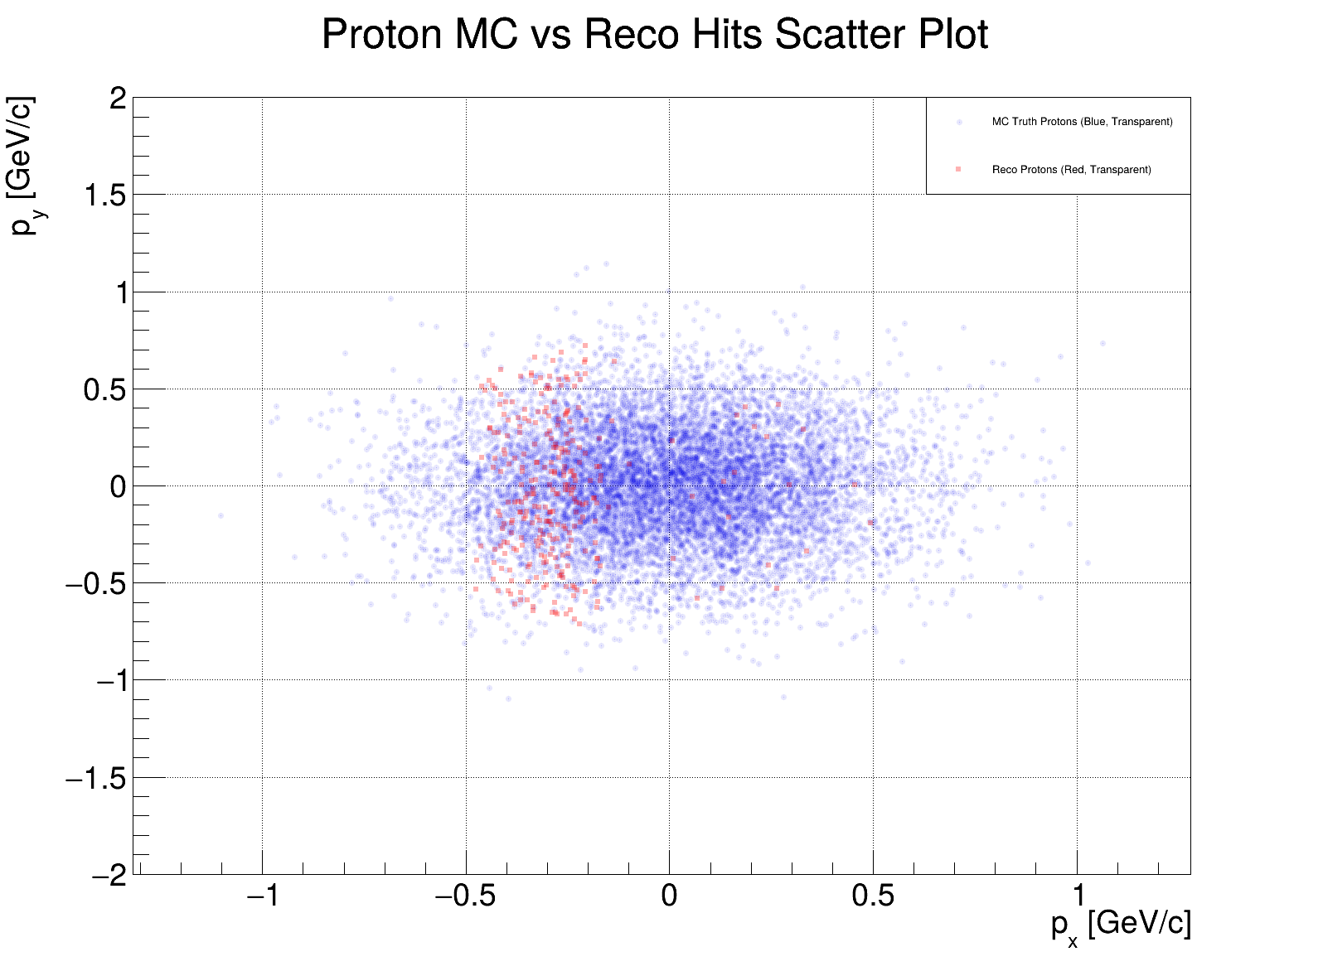
Plots from last week

Slide 4
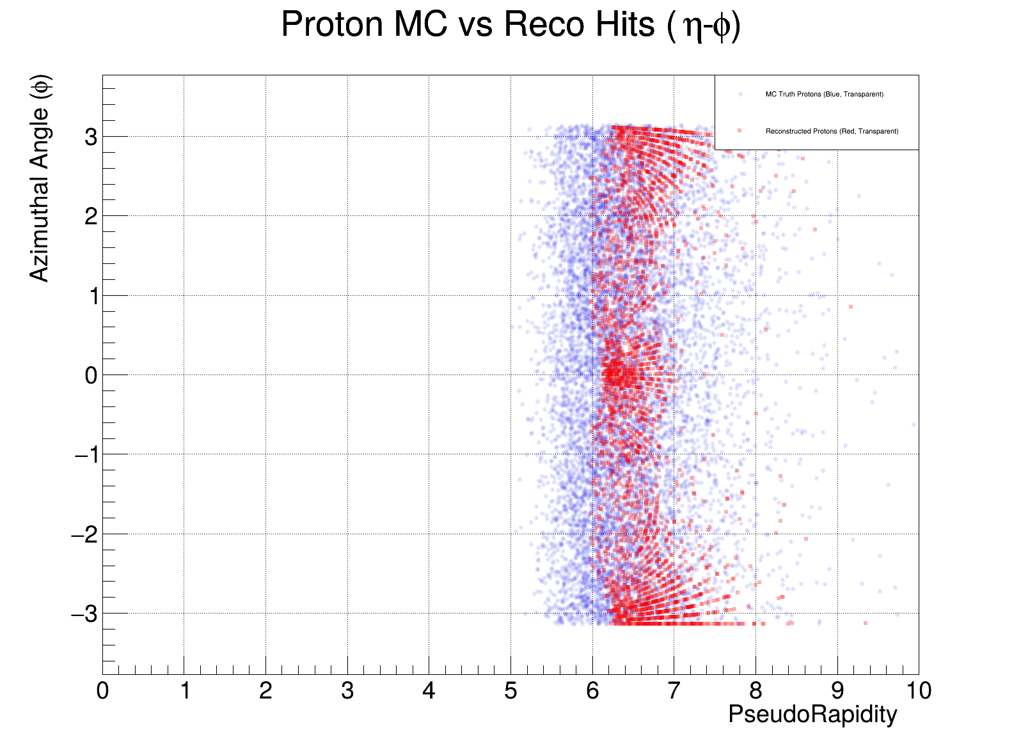
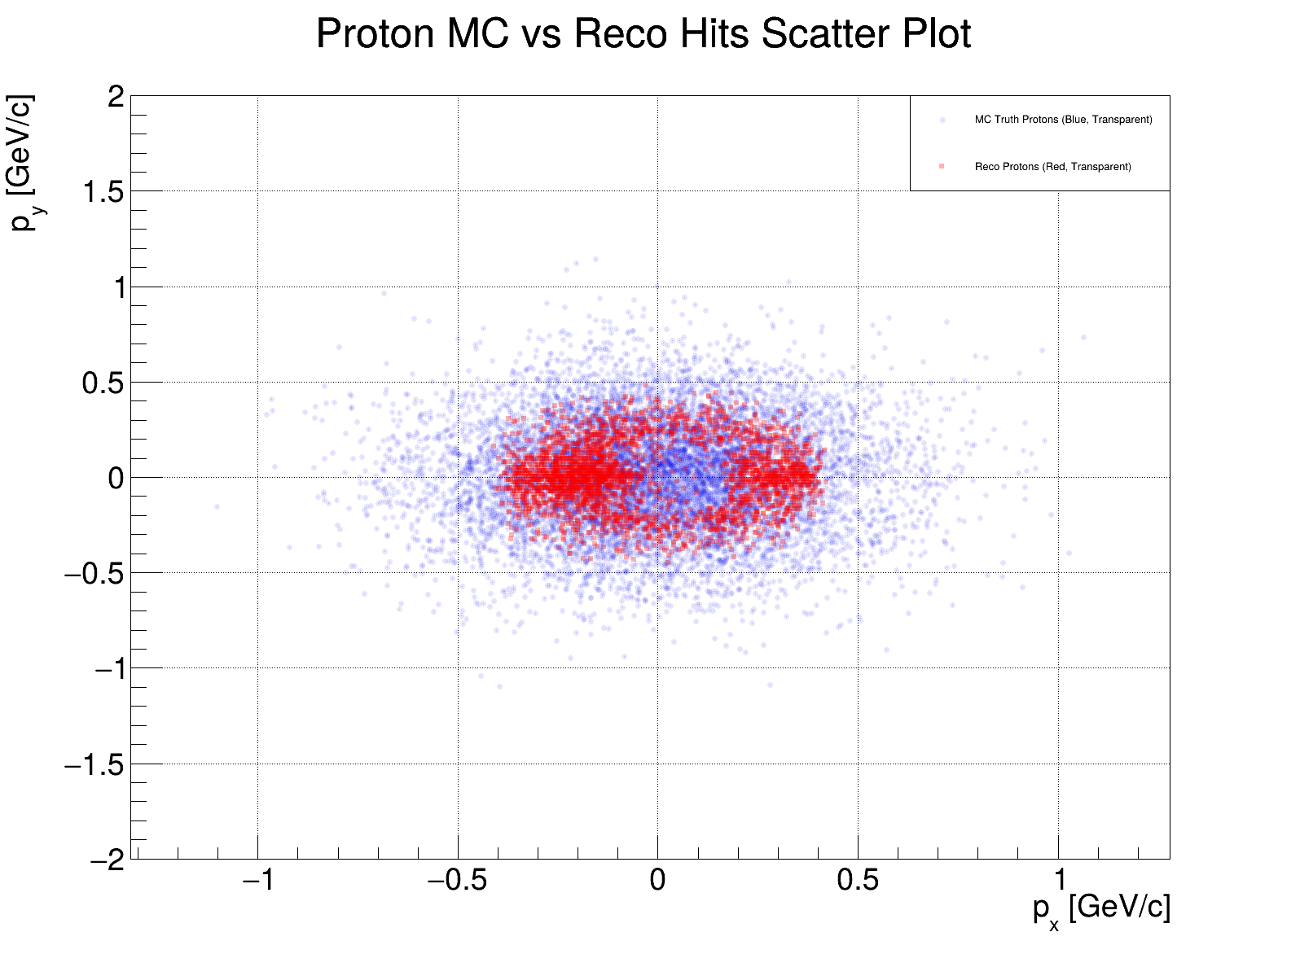
Plots after changing the detector configuration

Slide 5
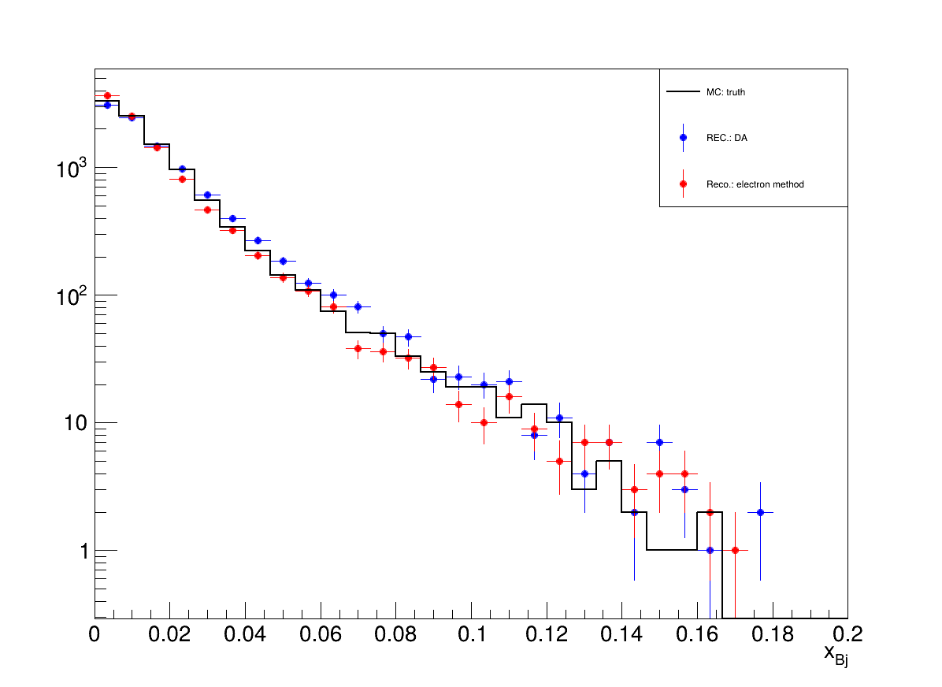
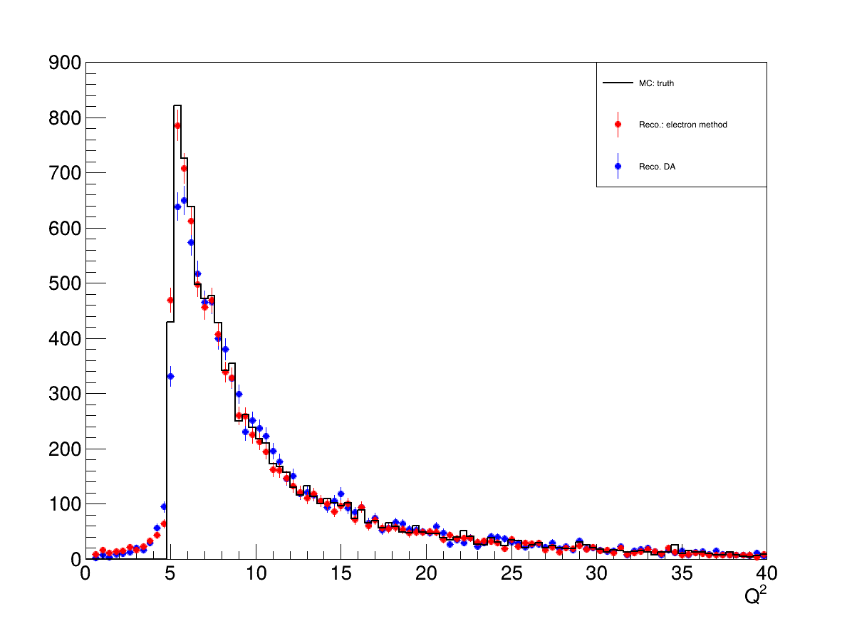
Basic Kinematic Variables

Slide 6
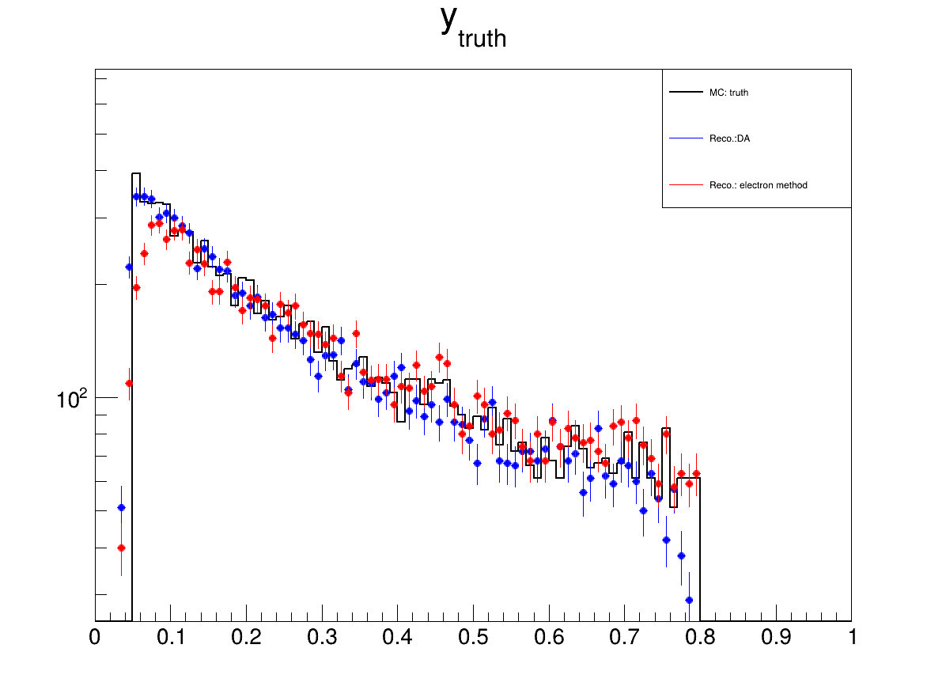
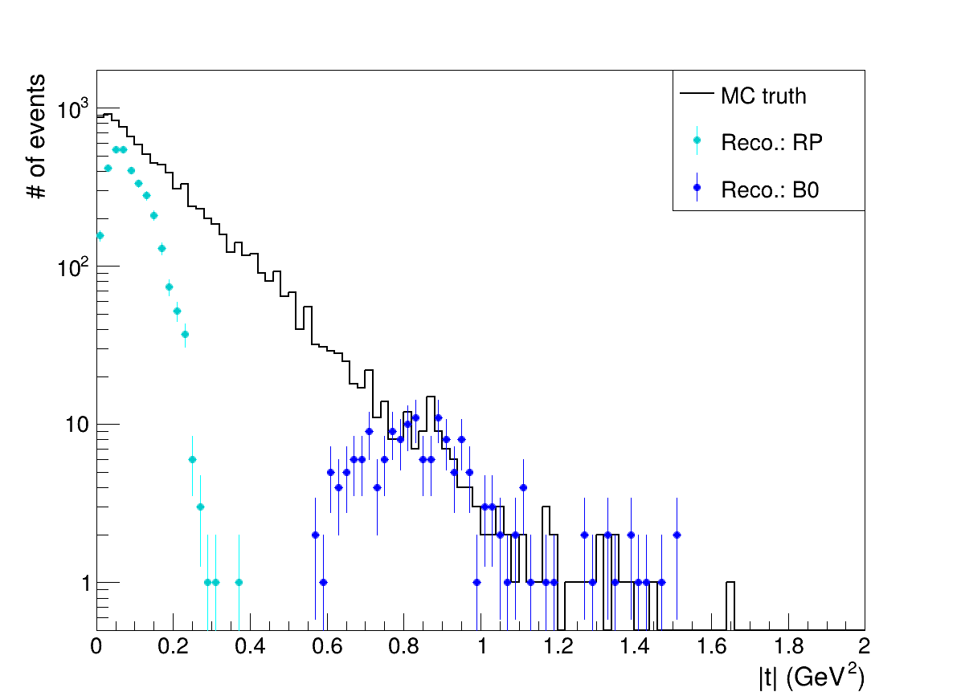
Kinematic variables

Slide 7
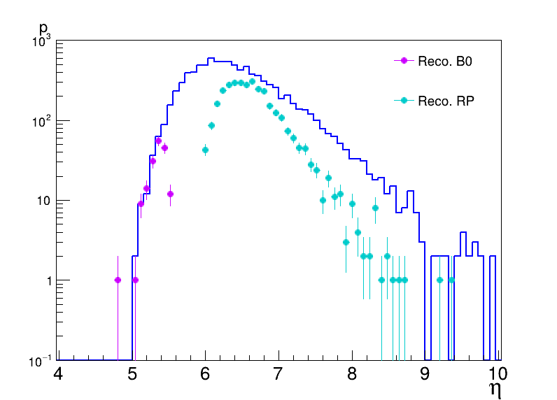
Pseudo-rapidithy distribution of protons

Slide 8
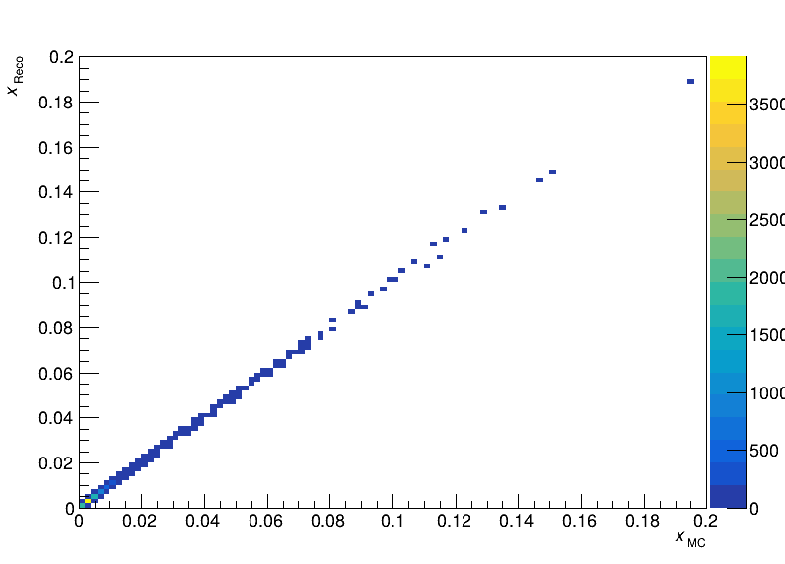
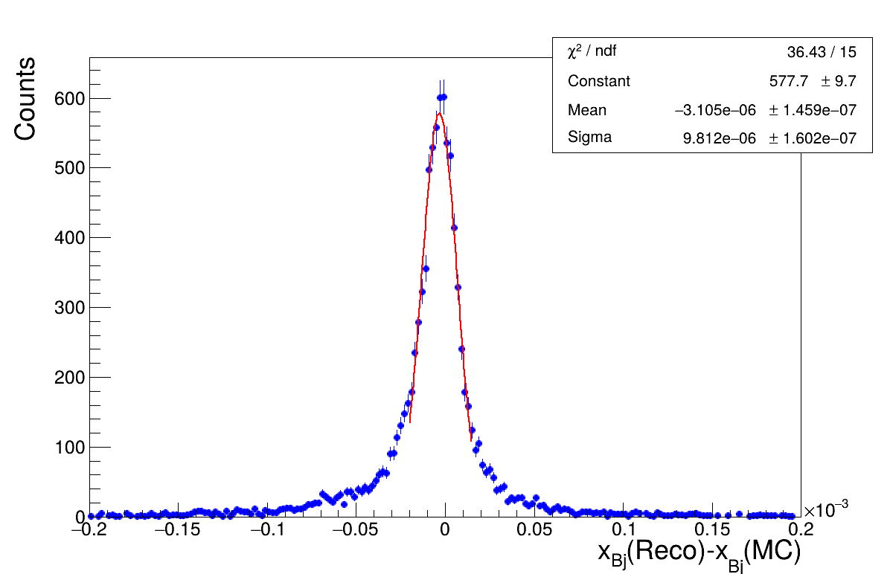
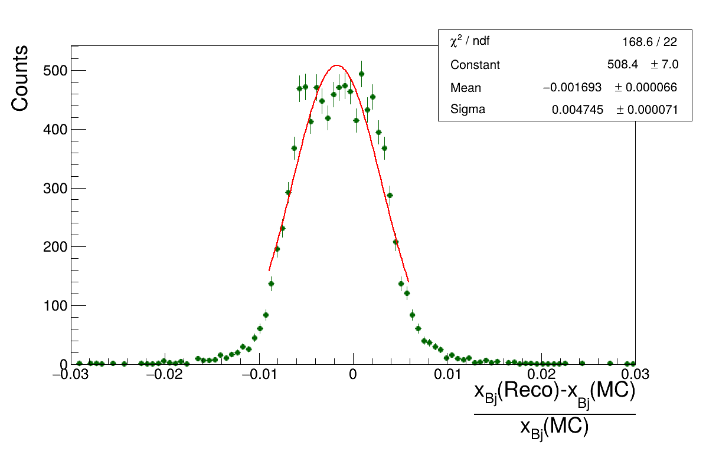
Resolution plots: x_Bj

Slide 9
Resolution plots: x_Bj

Slide 10
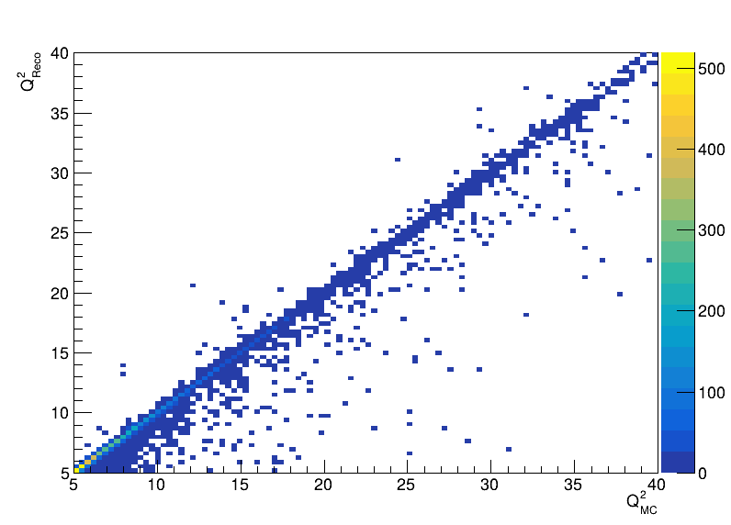
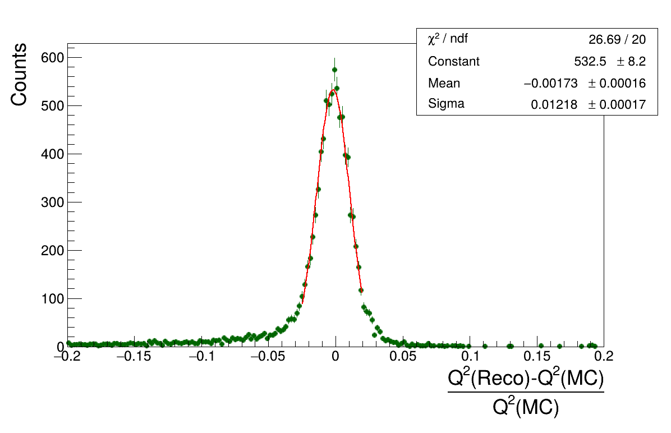
Resolution plots: Q^2

Slide 11
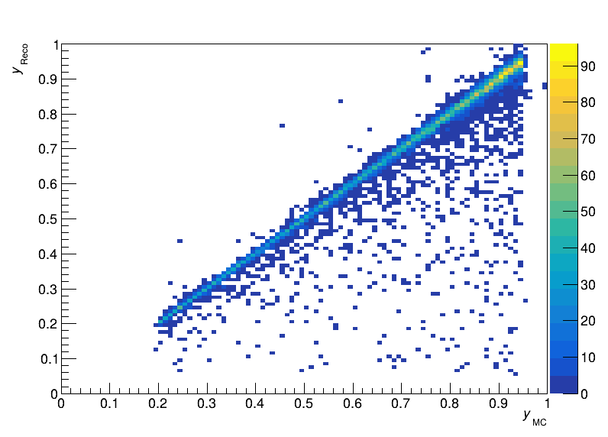
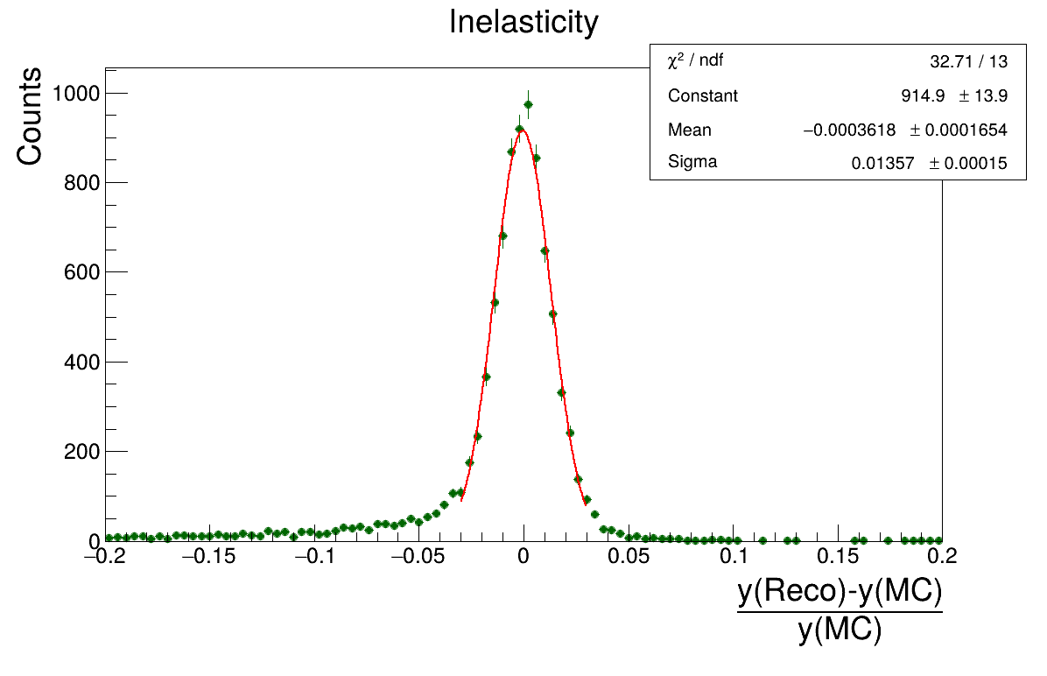
Resolution plots: inelasticity

Slide 12
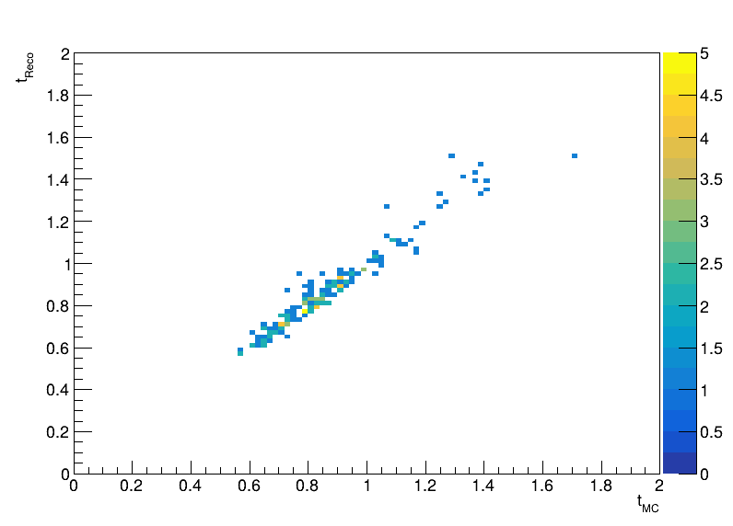
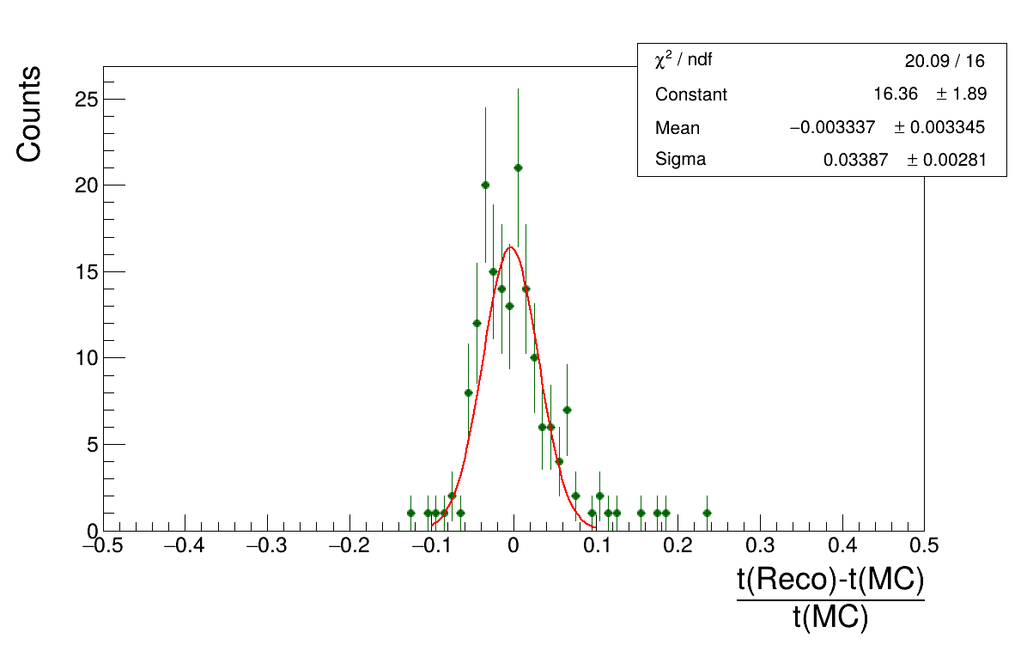
Reconstructed Mandelstam t , tRECO BABE method

Slide 13
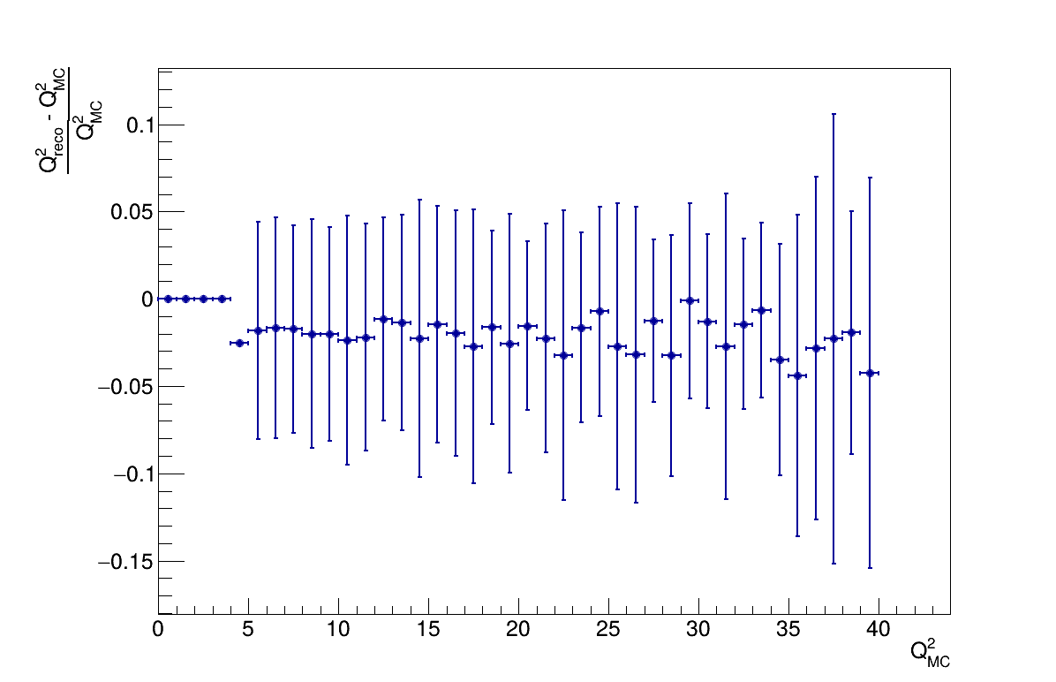
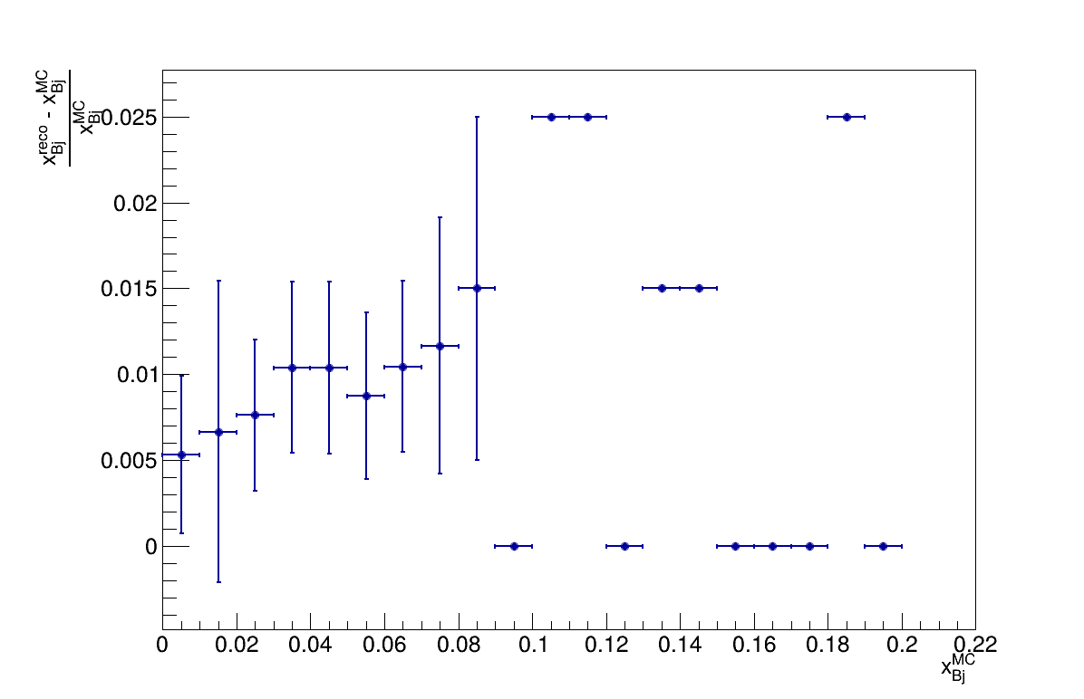
Binned Resolution plots: x_Bj, Q^2

Slide 14
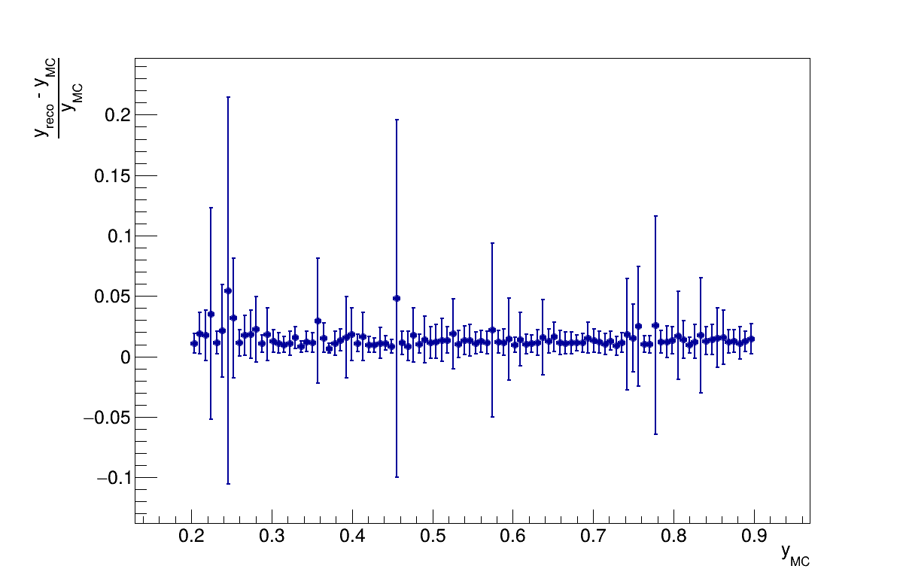
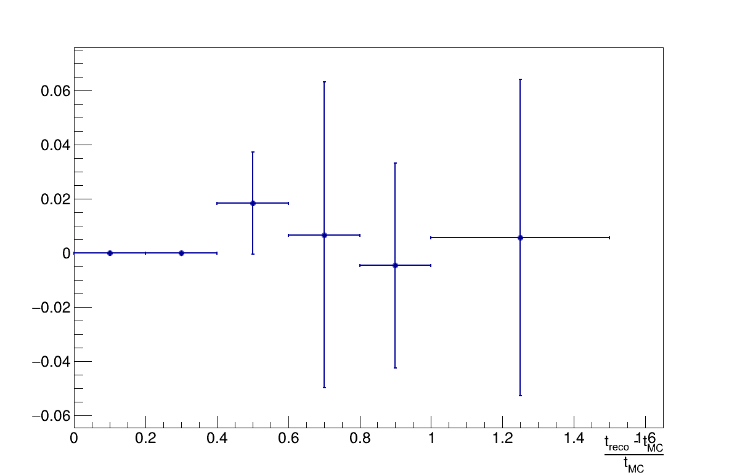
Binned Resolution plots: inelasticity , t

Slide 15
Final remarks & takeaways
Thanks to Alex Jentsch, who found out that I was using the wrong detector configuration.
It was decided that event size of 10K used for these plots is not enough. Because of this point and the last point, I have generated 100K events, the detector simulation and reconstruction is ongoing on ReCaS.
Any rcomments/Questions?

Slide 16
Thank you

