Slide 1
Planning ProtoDUNE

Slide 2
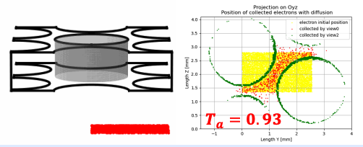
Tasks for ProtoDUNE VD
Prepared for the commissioning, CE noise performance and response calibration (Karla et al.)
Maintain the noise filter module in wire-cell toolkit (Wenqiang/Jay et al.)
Develop the resampling module for TDE (512ns/tick -> 500ns/tick)
Anode transparency study (Xuyang/Jay et al.)
Maintain the GDML with GeGeDe (Nitish/Xin et al.)
Joshua’s CM talk

Slide 3
Tasks for ProtoDUNE HD
Prepared for the upcoming PDHD performance paper after the March workshop
In addition, Wire-Cell team could have a separate paper for summarizing the sigproc, DNN ROI, imaging studies
Add the CE calibration in the official data production (Karla et al.)
Detailly check the noise filter performance (Xuyang/Wenqiang et al.)
Finalize the field response and sigproc study for APA1 (Xuyang et al.)

Slide 4
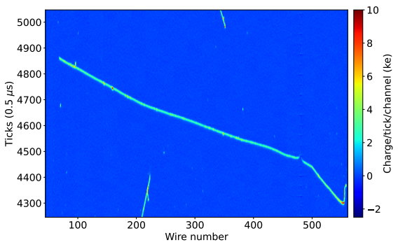
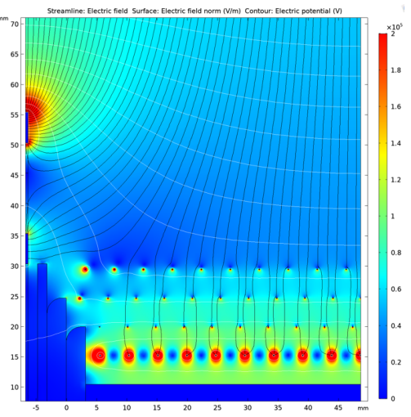
Tasks for ProtoDUNE SP
Bo Yu
Gnd Diverters
Gnd Diverters
Grounded electron diverters introduce a gap at APA boundaries
Pandora-based reconstruction cannot handle the stitching in 2D, losing statistics at low energy
Wire-Cell imaging presumably can stitch this in the 3D and project back to 2D deconvolution result

