Slide 1
K-Nearest Neighbor TMVA Optimization
David Ruth

Slide 2
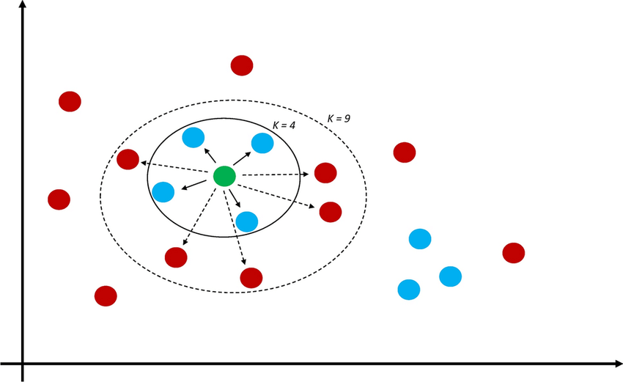
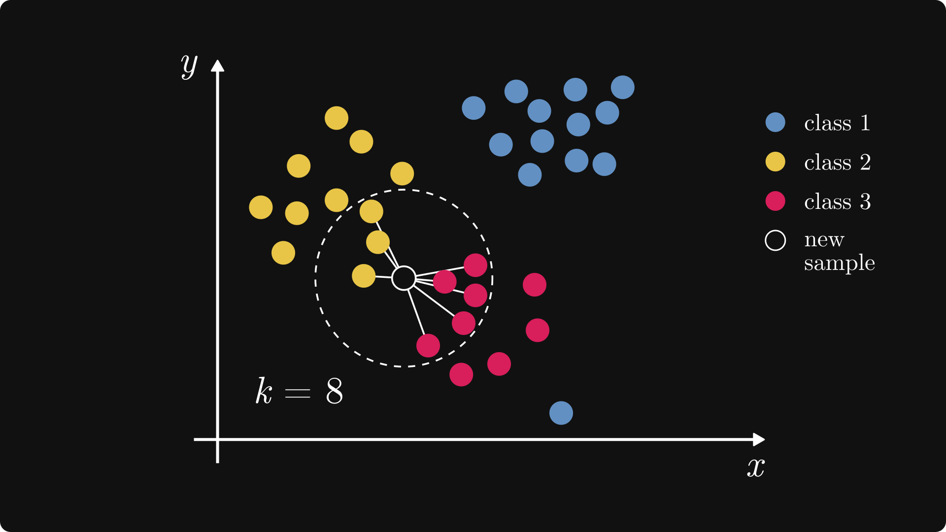
KNN Classifies points by phase-space proximity

Slide 3
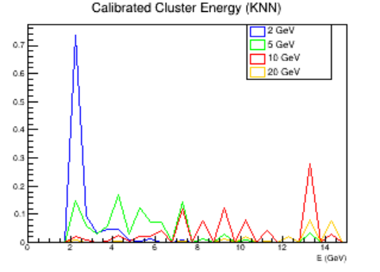
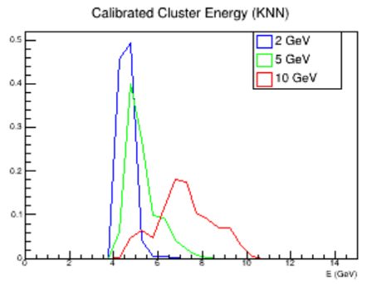
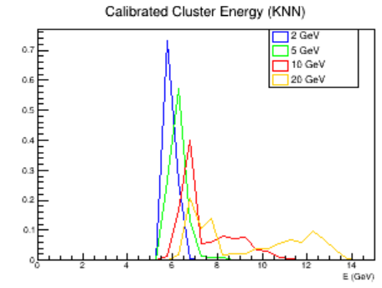
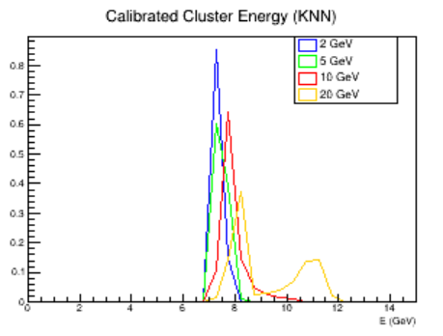
Number of K Nearest Neighbors
5
20
50
75

Slide 4
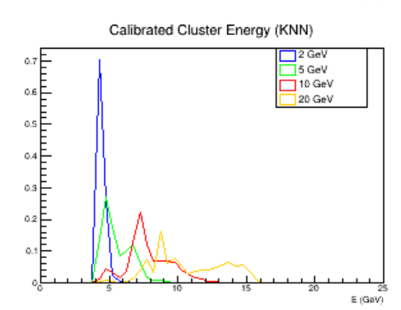
Conclusions
A bit better than it was, but much worse performance than LD and MLP
Not too many hyperparameters we can use to optimize
Practically no difference when using trimming, local linear discriminant, or kernel weighting
No difference between gaussian and polynomial kernel
Small Possibility that performance improves with smaller input vector (Olaiya)
May be better not to spend any more time on it – I don’t believe KNN will be the best network for final calibration in this case
Other question: Do we have a benchmark for how good the TMVA calibration needs to be to be acceptable?

