Slide 1
Photosensors for pfRICH and hpDIRC
Alexander Kiselev (BNL)
ePIC pfRICH Detector Subsystem Collaboration Leader
Incremental Preliminary Design and Safety Review of the pfRICH, dRICH and hpDIRC
April 1st - 2nd, 2025

Slide 2
Outline
Photosensor choice for ePIC pfRICH and hpDIRC
EIC PED contract with Incom
Re-design and a first batch production of DC-coupled EIC HRPPDs
EIC HRPPD evaluation at Incom / JLab / BNL & INFN Trieste
Preparations for Photek MCP-PMT evaluation at the University of Glasgow
Summary & Outlook
2

Slide 3
Charge Questions Addressed
Are the technical performance requirements appropriately defined and complete for this stage of the project?
Are the plans for achieving detector performance and construction sufficiently developed and documented for the present phase of the project?
Are the current designs and plans for detector and electronics readout likely to achieve the performance requirements with a low risk of cost increases, schedule delays, and technical problems?
Are the fabrication and assembly plans for the various particle identification detector systems consistent with the overall project and detector schedule?
Are the plans for detector integration in the EIC detector appropriately developed for the present phase of the project?
Have ES&H and QA considerations been adequately incorporated into the designs at their present stage?
Have the recommendations from previous reviews been adequately addressed?
3

Slide 4
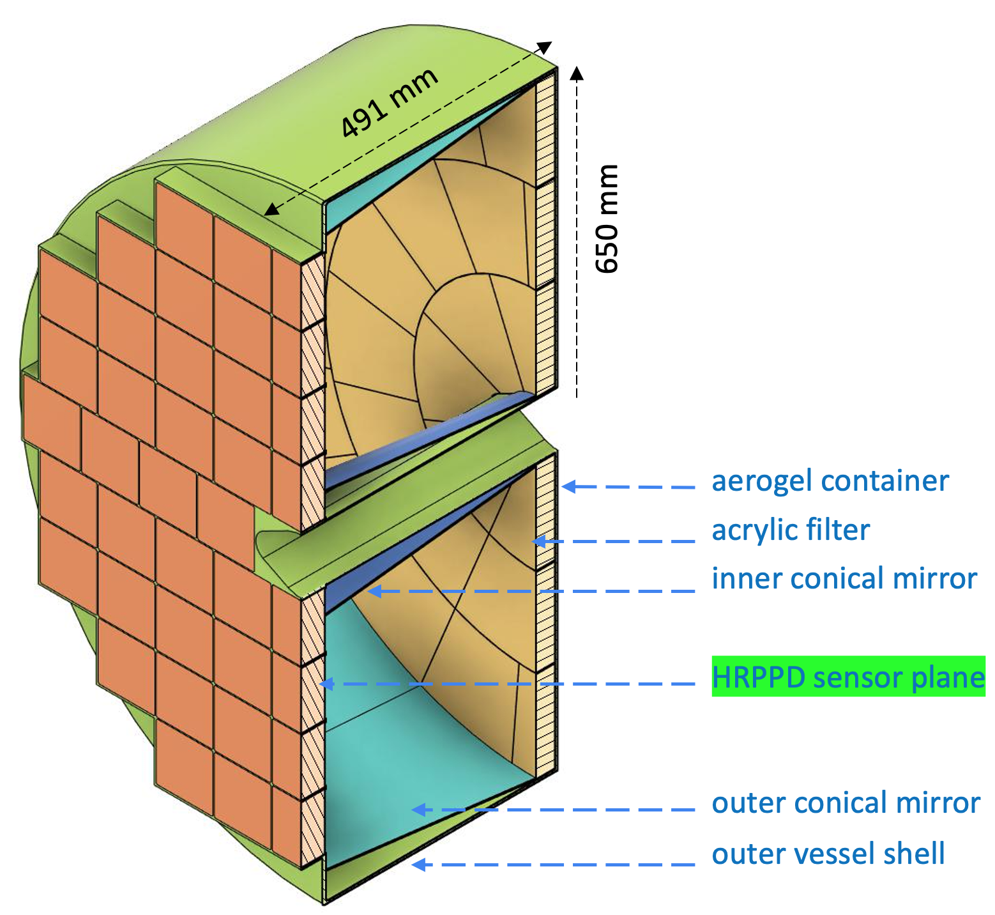
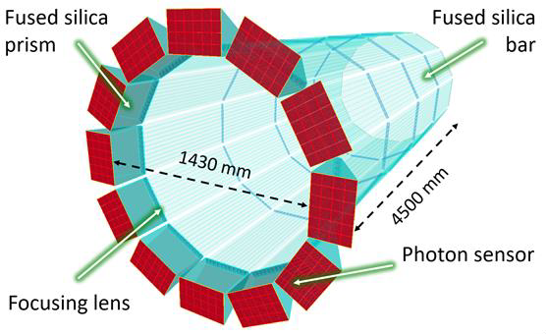
Photosensor Choice for pfRICH and hpDIRC
Charge Question 1
pfRICH: 68 4” HRPPDs total
hpDIRC: 12*6*4 = up to 288 2” MCP-PMTs total
 | pfRICH | DIRC
Baseline solution | DC-coupled HRPPD by Incom Inc. | Auratek MAPMT253 by Photek
Alternative solution | Auratek MAPMT253 by Photek | DC-coupled HRPPD by Incom Inc.
Spatial resolution | Sub-mm | Sub-mm
SPE timing resolution | σ of the core part <50ps | <75ps RMS, including tail
Dark count rate | Few kHz/cm² is acceptable | Few kHz/cm² is acceptable
Occupancy per event | Small: could work with CC-coupled sensors | 200+ p.e. / event: need DC-coupled sensors
We would clearly prefer to have the same photosensor solution for both subsystems
4

Slide 5
HRPPDs by Incom Inc.
5

Slide 6
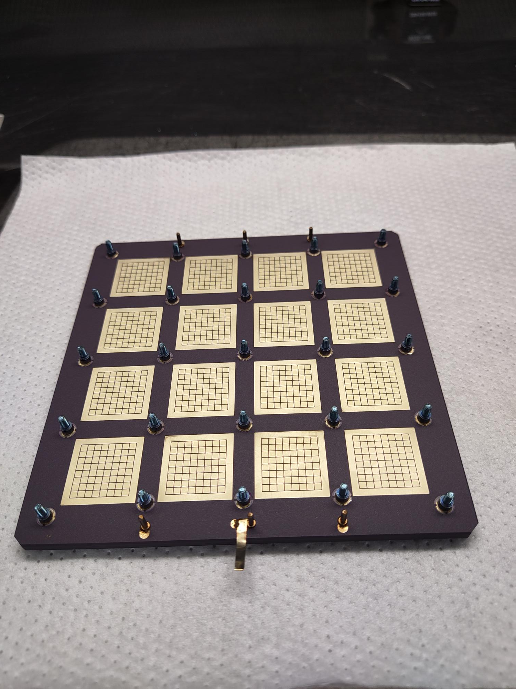
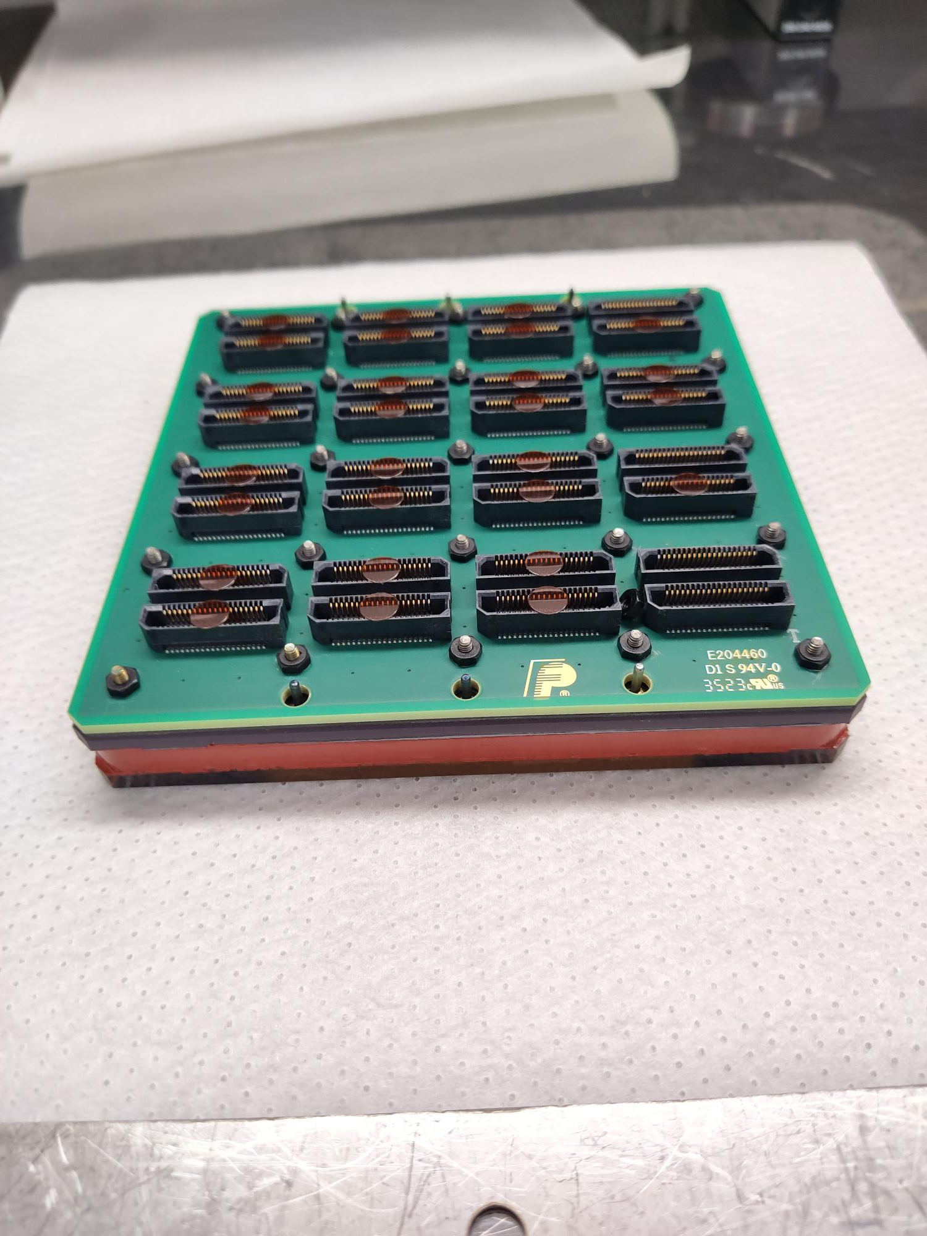
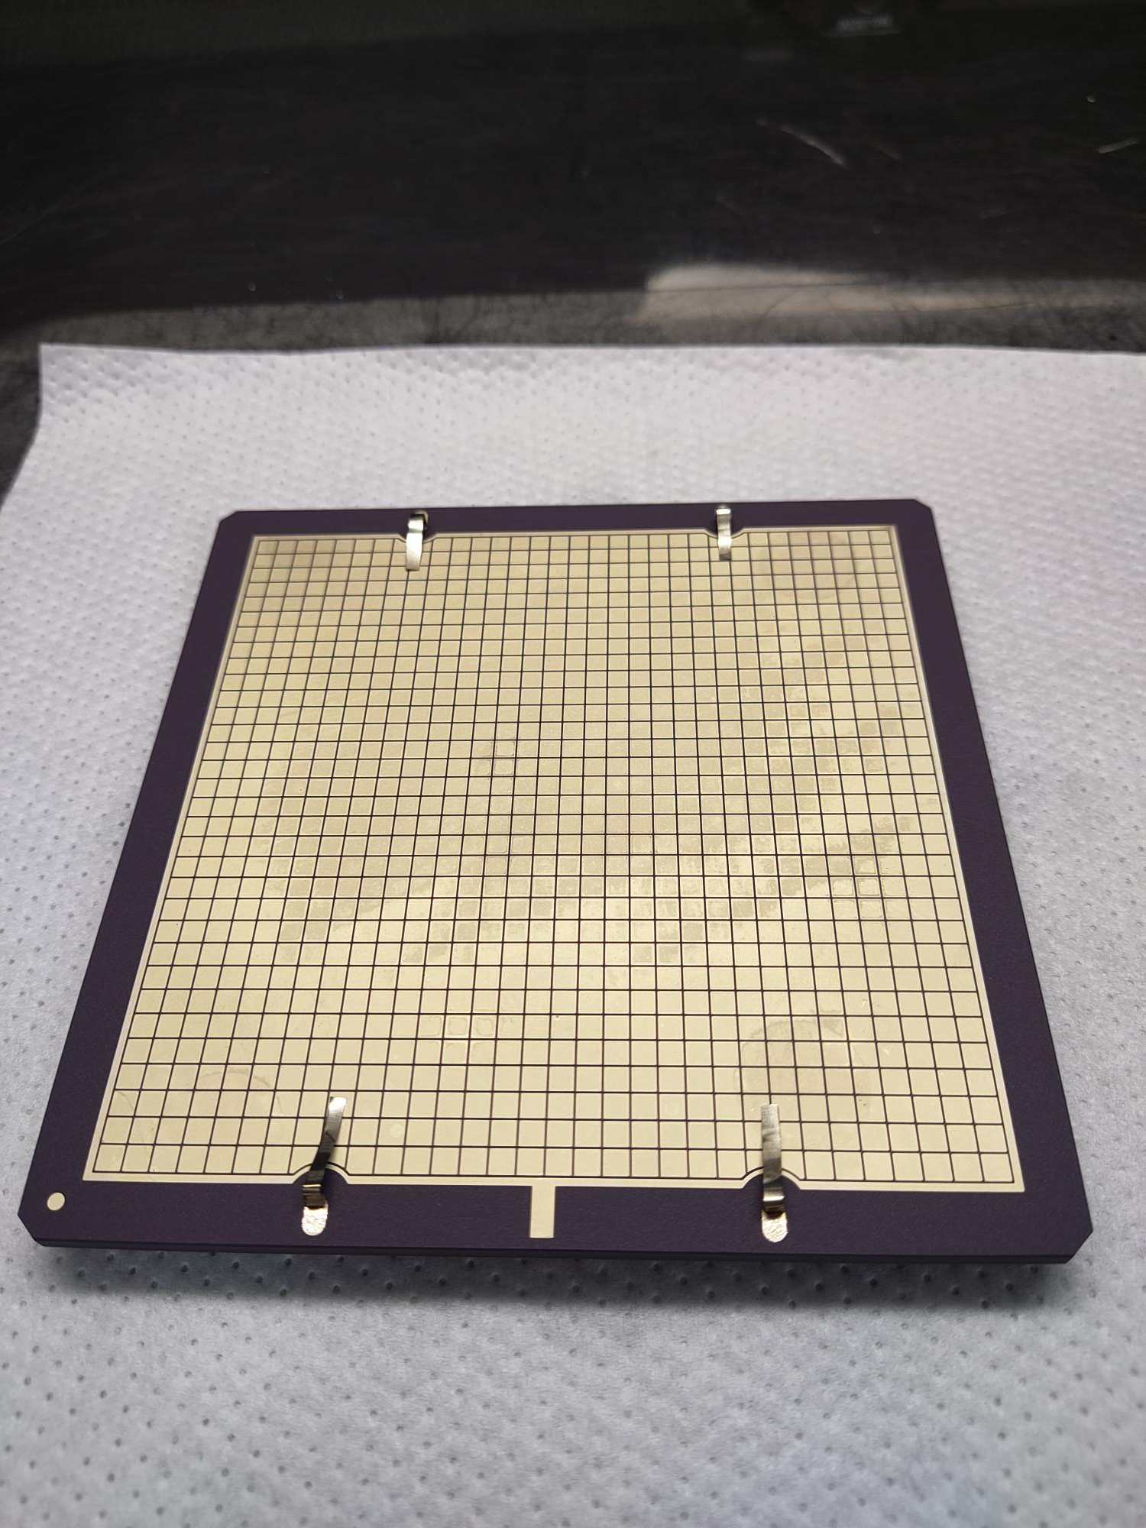
General Information
A uniquely large 120mm x 120mm DC-coupled MCP-PMT
104mm x 104mm active area (~75% geometric efficiency)
5mm thick fused silica (or sapphire) window with a bialkali photocathode
A pair of 10 μm diameter pore MCPs in a chevron configuration
Uniform anode pixellation: 32 x 32 square pads (pitch 3.25mm)
Substantially re-designed for use in EIC
Anode plate vacuum side
Anode plate air side
HRPPD with a passive backplane
6

Slide 7
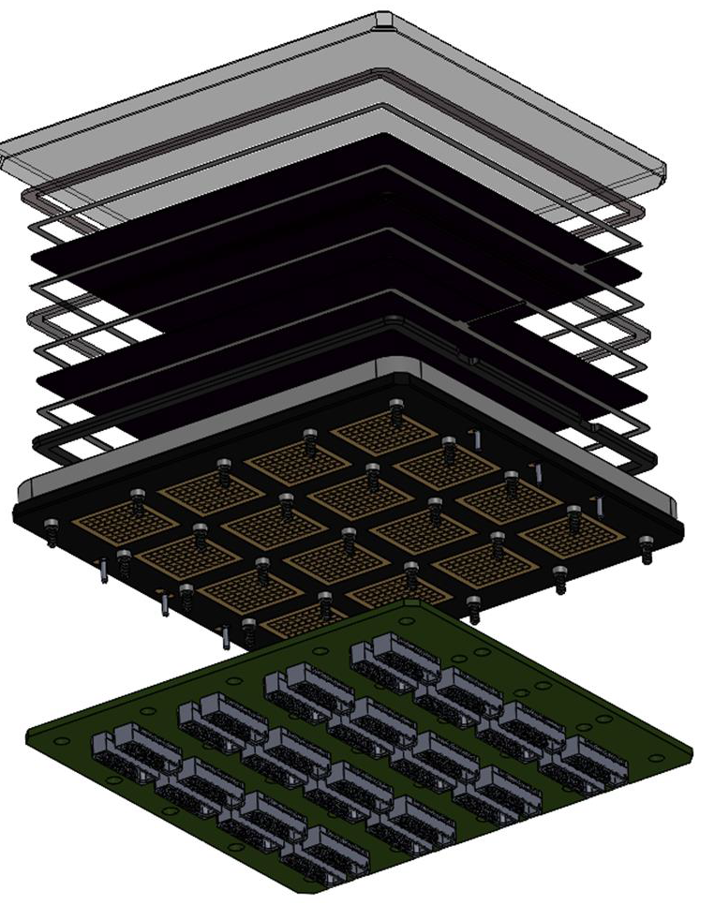
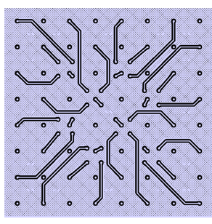
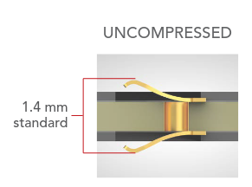
EIC HRPPD Assembly
Fused silica window
MCPs, spacers, etc
8x8 pad pattern
compressed
from 3.25mm (inner side)
to 2.00mm (outer side) pitch
Side wall
Anode plate, a pre-routing
ceramic circuit board
Compression interposers
(not shown)
Interface PCB
4x4 spots, each with 8x8 square pads; 3.25mm pitch
7

Slide 8
2023 EIC Contract with Incom Inc.
Charge Question 1
Link to EIC HRPPD specifications
Perform a first stage of the design adaptation to EIC needs
In general, be as much conservative as possible in this first iteration
Focus on a mechanical and electrical interface, including a complete re-design of the anode plate
Produce five HRPPD tiles of a new design
Demonstrate production capability and reproducibility of key performance parameters
Gain, QE, Photon Detection Efficiency (PDE), Dark Count rates (DCR), timing resolution, …
First generation HRPPDs were “bare sensors” & lacked interfacing completely
First generation yielded only a couple of low QE devices out of a dozen of trials
Contract completed successfully in April 2024 (5+2 HRPPDs purchased)
Comprehensive test program ongoing at BNL / JLab / INFN Trieste
8

Slide 9
Incom’s Internal Testing Summary
Charge Question 3
HRPPD # | Operating Voltage Range (V/MCP) | Dark Rates @ 1X10^6 Gain (Hz/cm^2) | EIC Standard – Dark Rates
15 | 750-850 | 160 | ≤ 2E3Hz/cm^2 at ≥ 10^6 Gain
16 | 625-725 | 0.18
17 | 600-700 | 19
23 | 600-700 | 0.37
24 | 575-700 | 69
25 | 650-750 | <100
26 | 650-700
HRPPD # | Operating Voltage Range (V/MCP) | Gain Range at ≥ 100V Bias on Photocathode (PC)
15 | 750-850 | 6.5E5 – 1.4E7
16 | 625-725 | 9.2E5 – 1.3E7
17 | 600-700 | 1.0E6 – 1.8E7
23 | 600-700 | 2.9E6 – 3.7E7
24 | 575-700 | 6.8E5 – 2.2E7
25 | 650-750 | 1.4E6 – 3.2E7
26 | 650-700 | 8.0E5 – 8.7E6
Link to a May 2024 LAPPD / HRPPD Workshop talk
HRPPD # | Transit Time Spread (lowest recorded, in ps) | EIC Standard – TTS
15 | 59 | ≤60 ps, validated at BNL utilizing a femtosecond laser
16 | 59
17 | 58
23 | 58
24 | 70
25 | 72
26
HRPPD # | QE @ 365nm (Avg./Max.) | Std. Dev.
15 | 32.9% / 34.0% | 1.1%
16 | 34.0% / 35.3% | 0.6%
17 | 35.2% / 36.2% | 0.9%
23 | 26.8% / 28.8% | 1.7%
24 | 36.5% / 37.3% | 0.5%
25 | 26.3% / 28.8% | 1.2%
26 | 32.8% / 34.0% | 0.9%
by Mark Popecki (Incom)
9

Slide 10
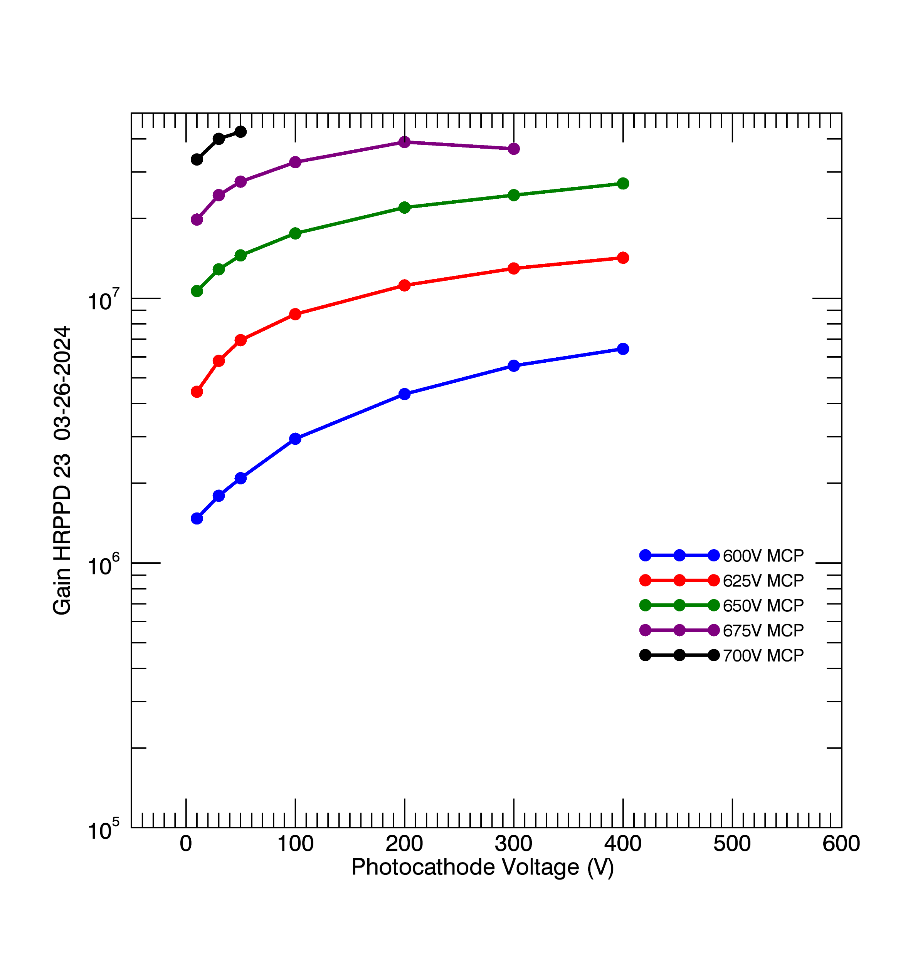
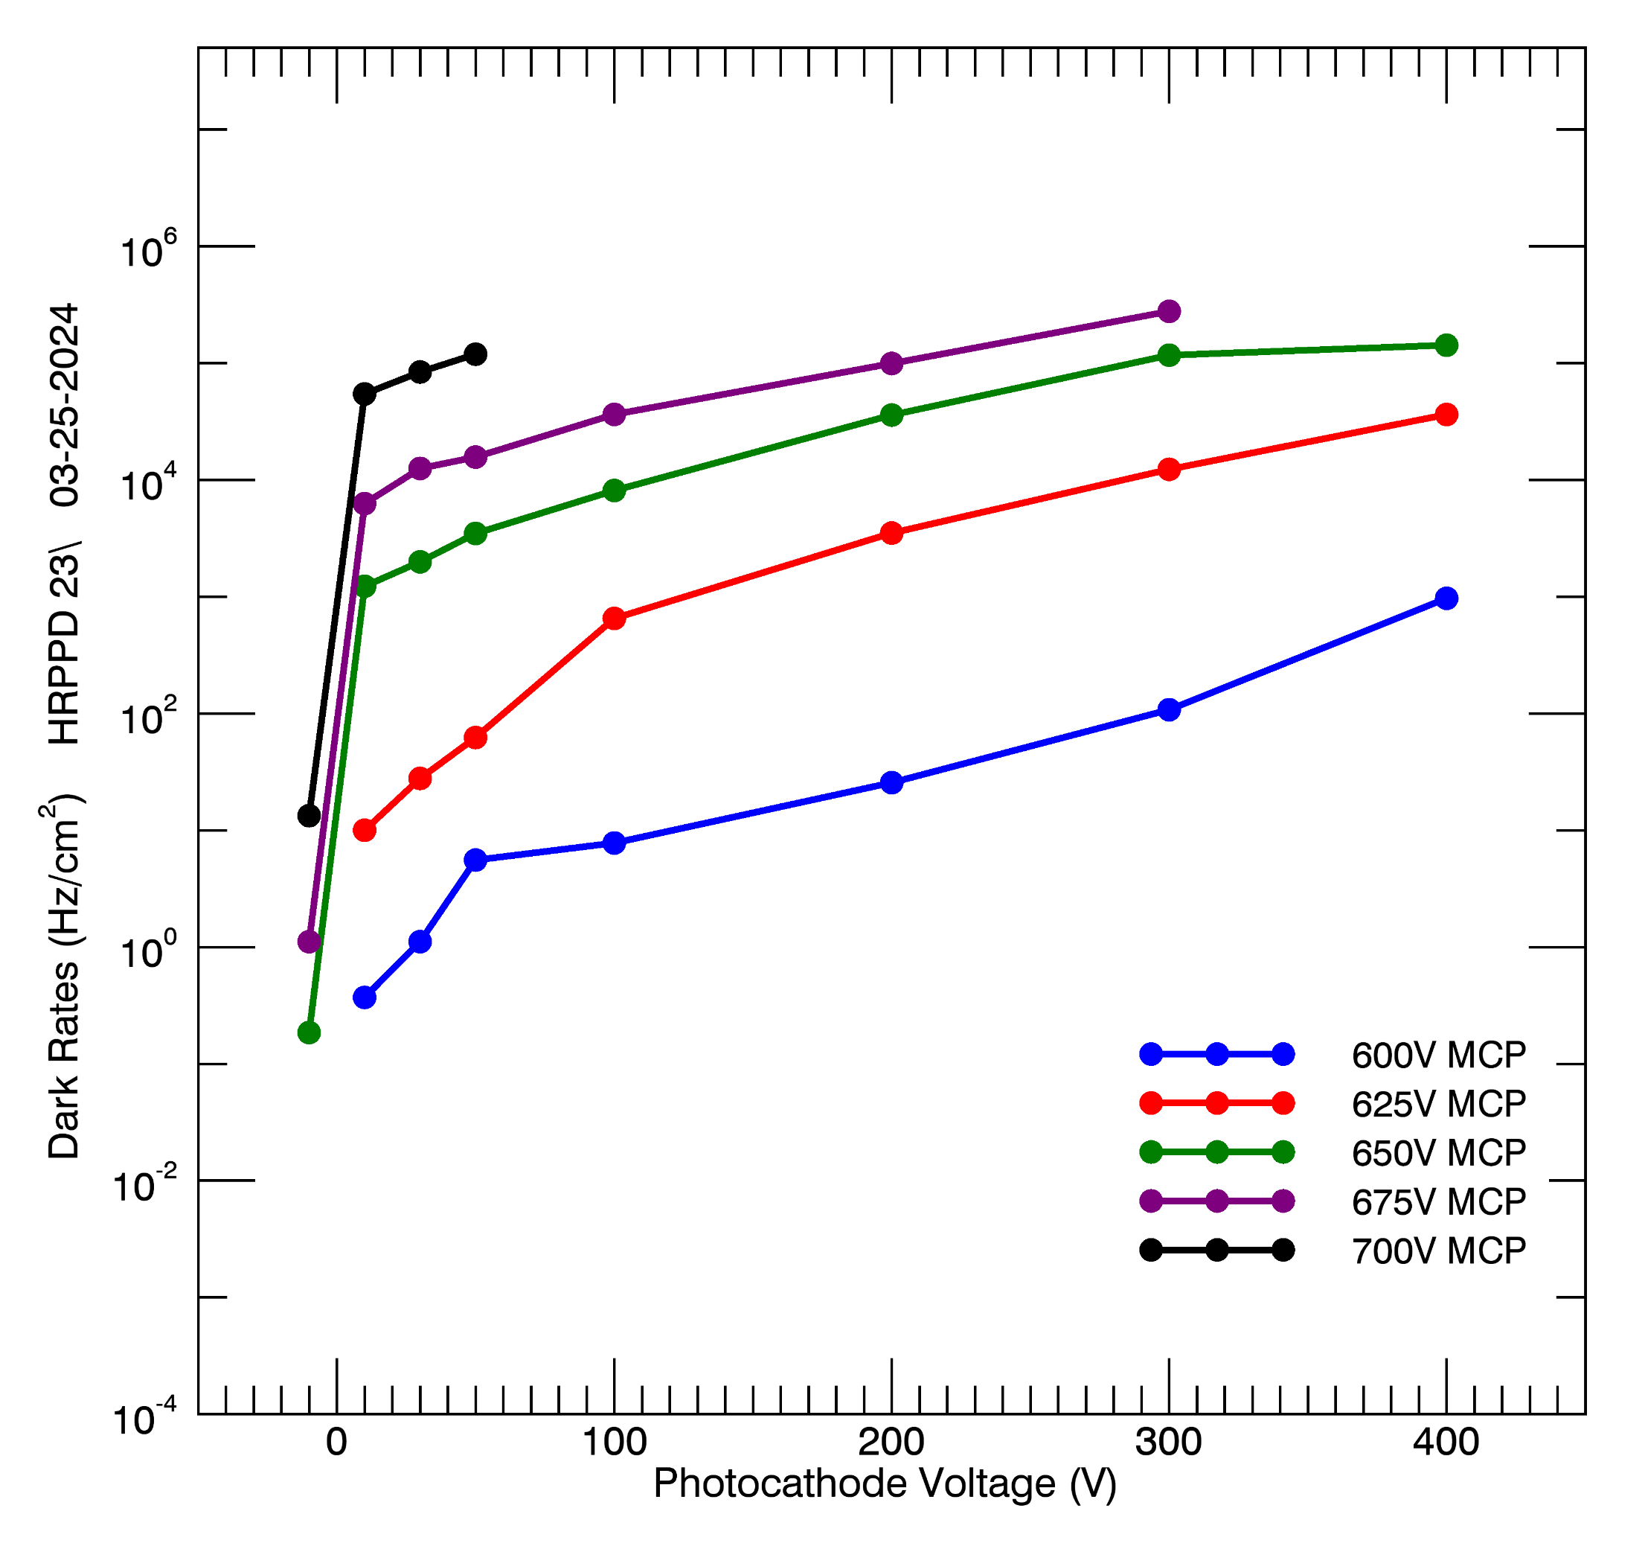
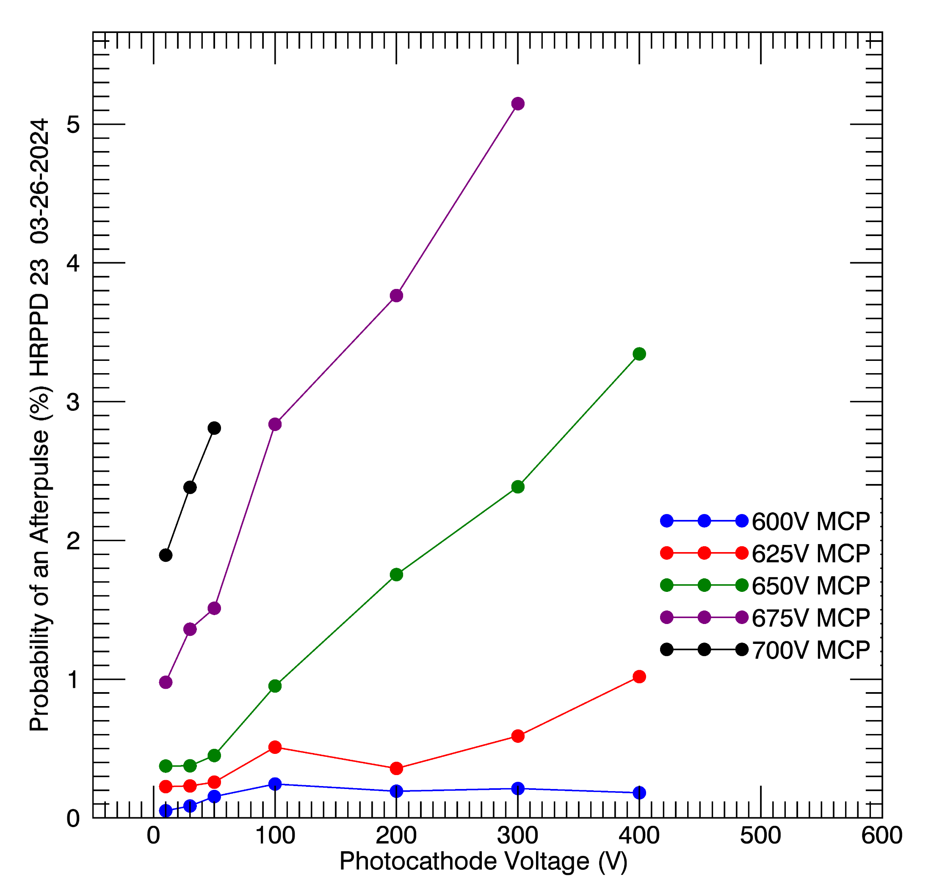
DCR, Gain & Afterpulsing from Incom’s Testing
Charge Question 3
gain
Dark Count Rate
afterpulsing
Newly developed ALD process allows for a high gain at a remarkably low bias voltage
HRPPD #23: dark rates at mid-10⁶ gain are below 1 kHz/cm² with afterpulsing on a ~1% level
10

Slide 11
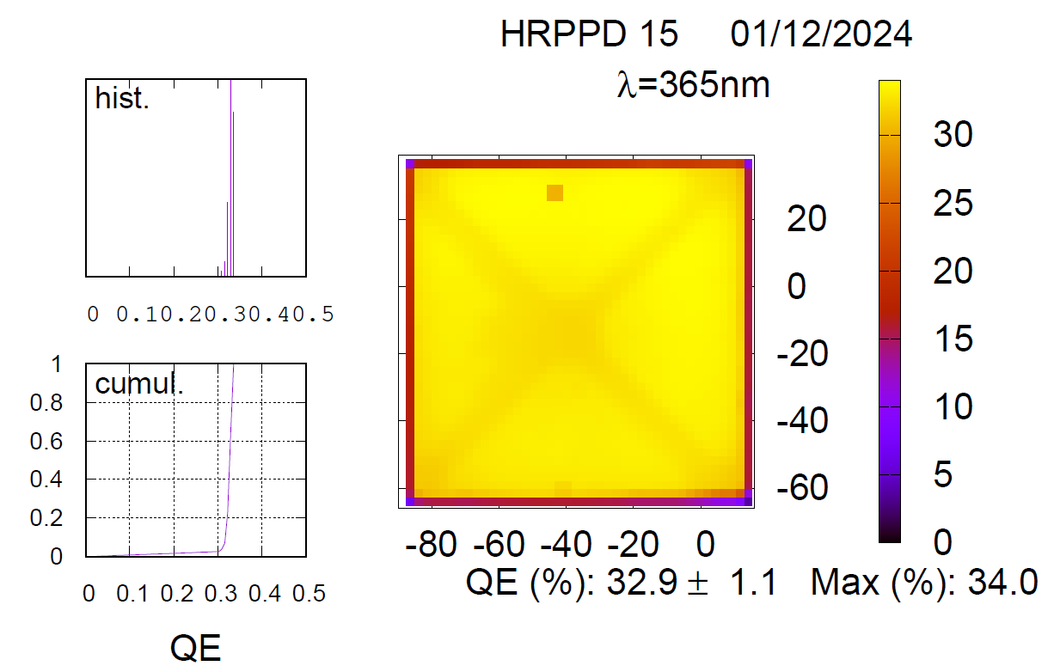
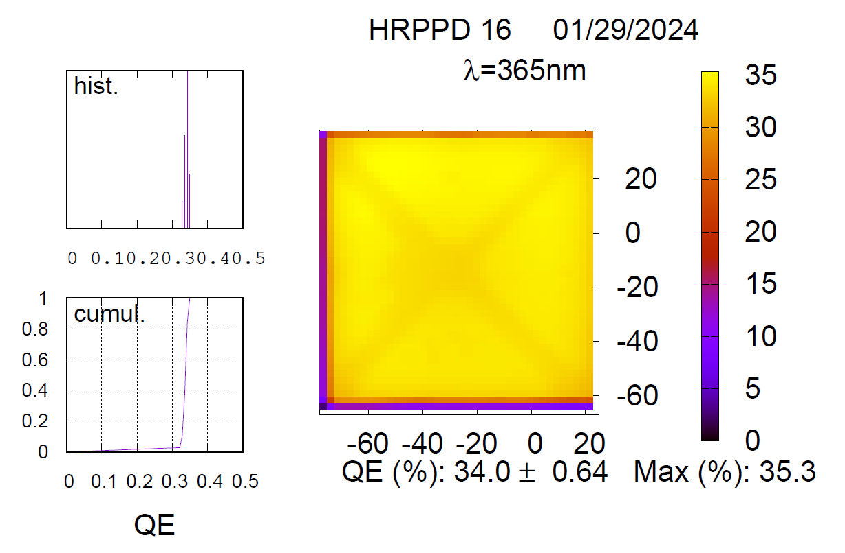
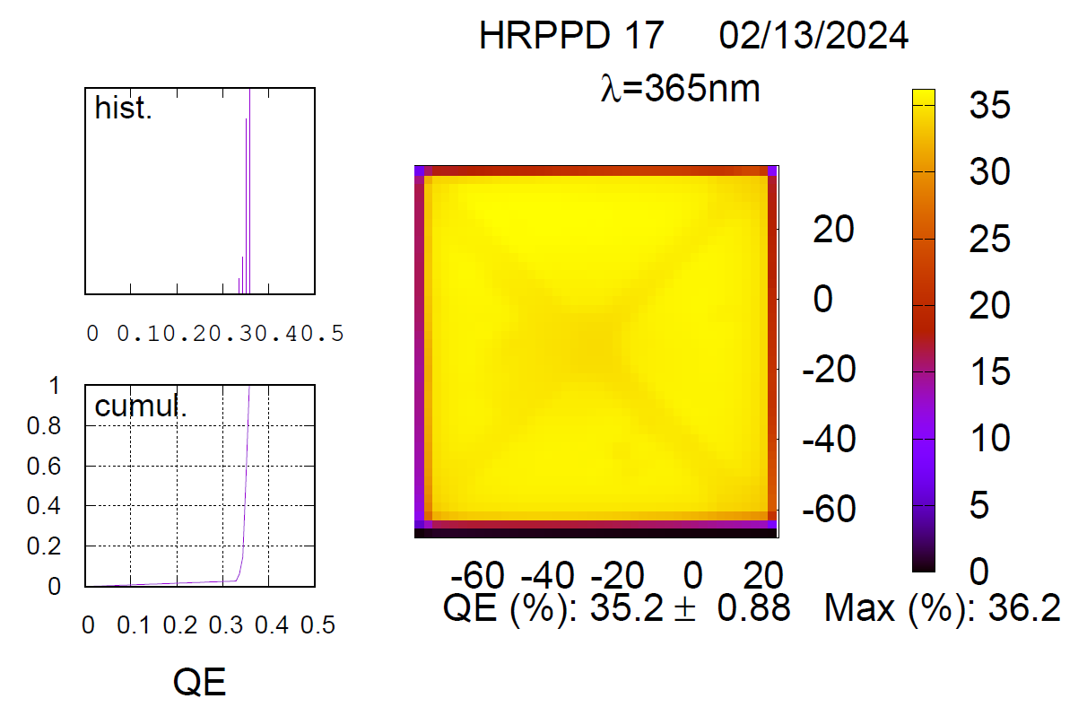
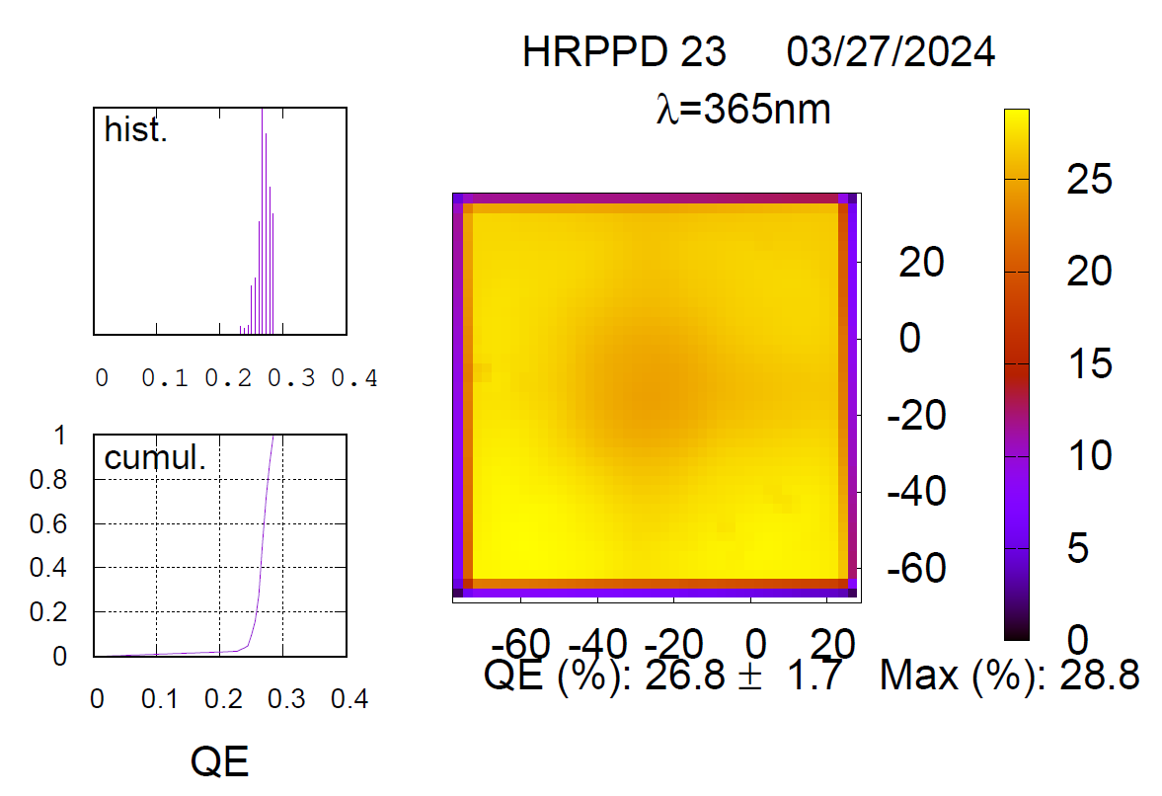
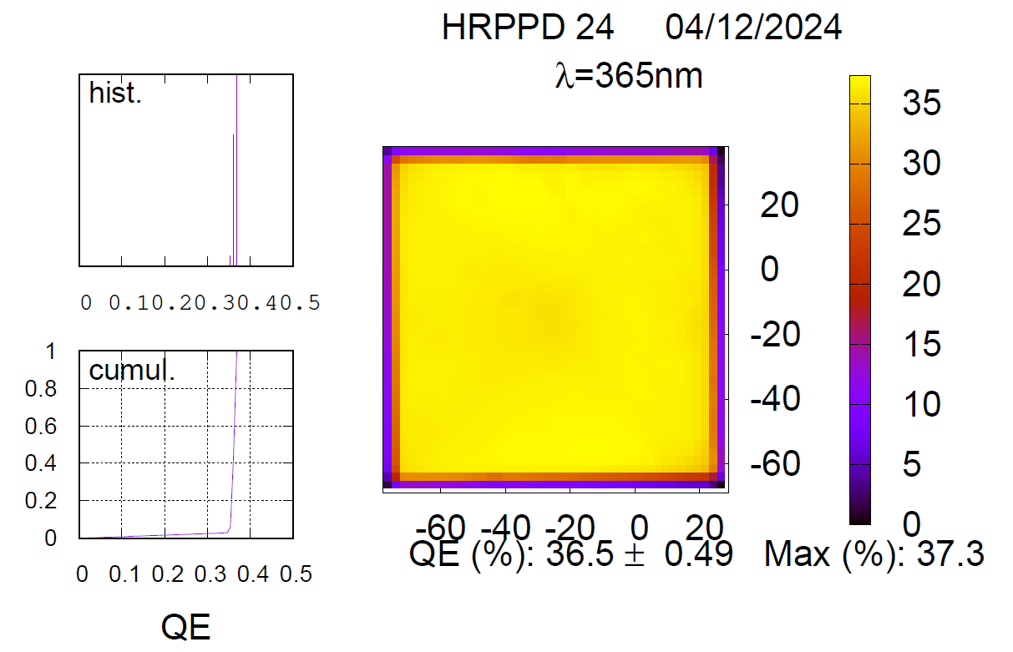
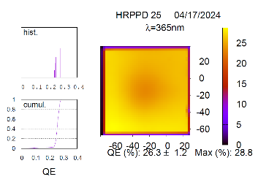
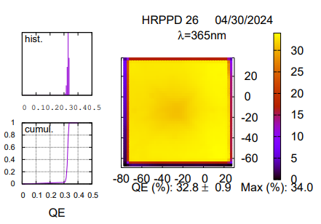
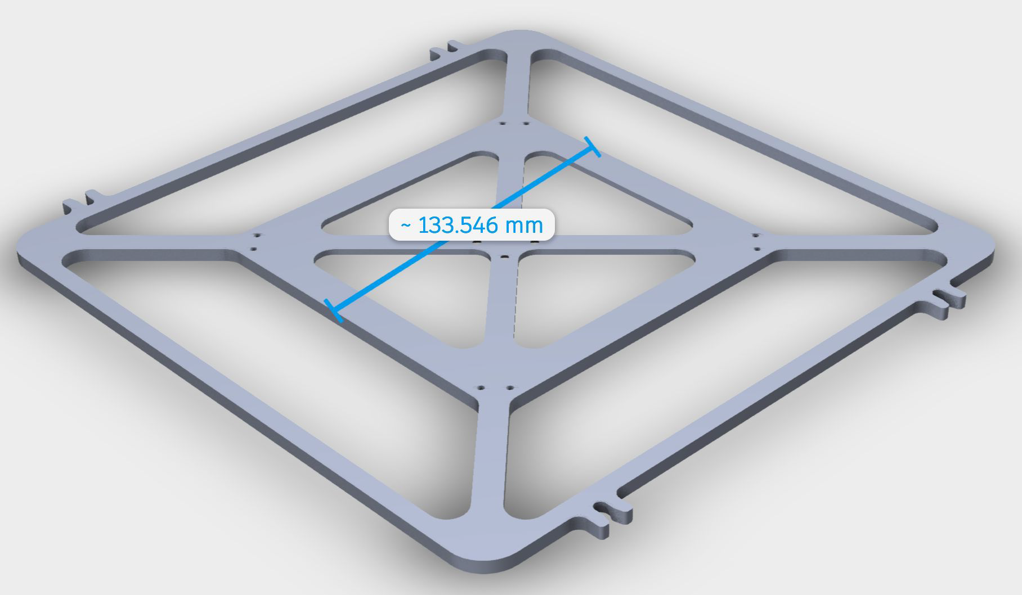
Quantum Efficiency from Incom’s Internal Testing
Charge Question 3
Window support structure
Tiles sealed in vacuum tank #1 are well above 30% (we required 27% min & >30% average)
Uniformity better than expected
Issues with a fraction of tiles produced in tank #2 are understood
11

Slide 12
HRPPD Evaluation by EIC Groups
Charge Question 2
Link to HRPPD evaluation procedure document
Primary QA at JLab
More systematic active area scans (including picosecond timing) at BNL
Magnetic field resilience studies at BNL in April 2025 and possibly later at INFN
Staffed by BNL, Incom, USC, INFN Trieste / Genova
Main objective: gain and timing performance recovery in a “typical” pfRICH and hpDIRC B-field
Aging studies at JLab / BNL / INFN Trieste
Side by side Photek Auratek & Incom HRPPD comparison in Glasgow
12

Slide 13
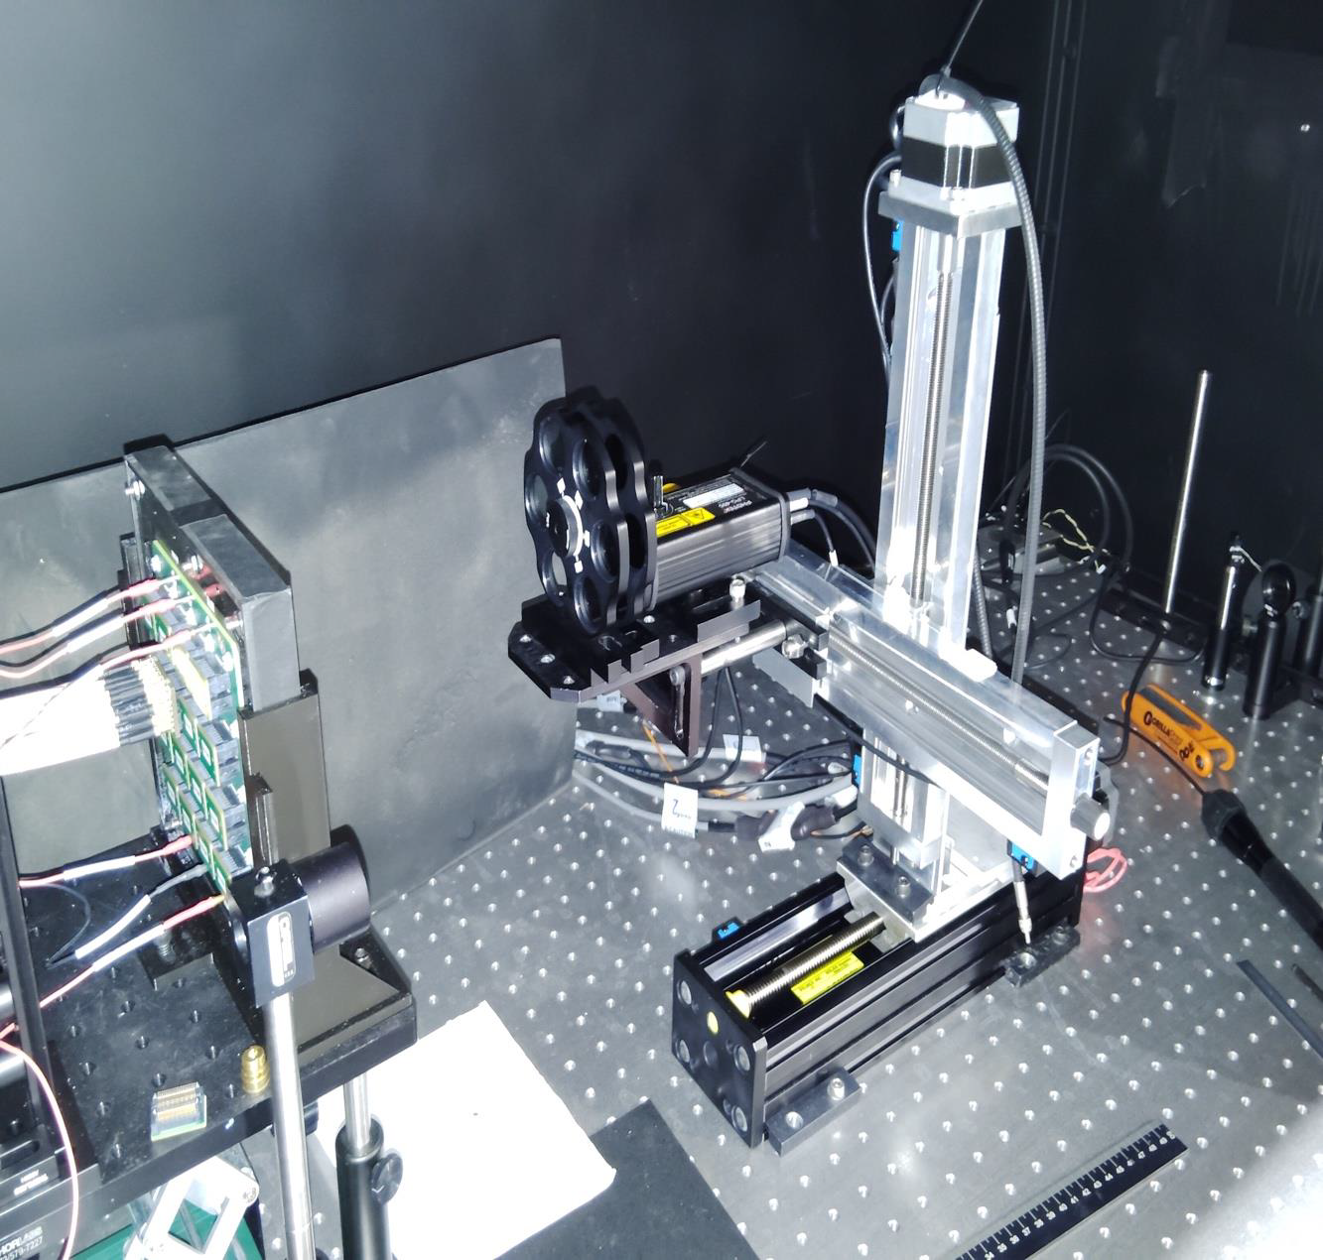
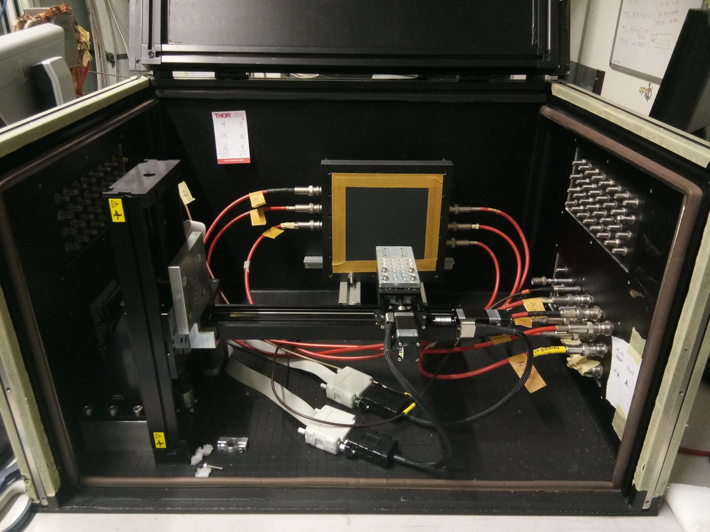
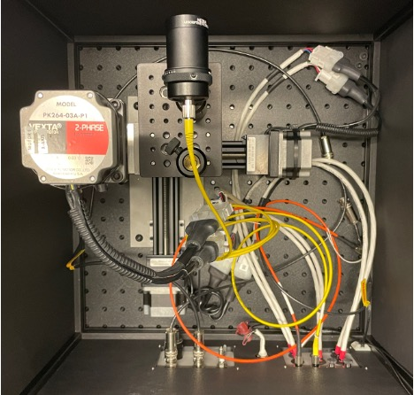
EIC HRPPD Test Stands
Charge Question 2
JLab
INFN Trieste
BNL
Three fully functional QA / test stations available at JLab / BNL & INFN Trieste
See previous slide for a distribution of responsibilities
There is also an MCP-PMT / HRPPD test stand at Glasgow …
... and a clone of BNL old HRPPD setup at Yale
13

Slide 14
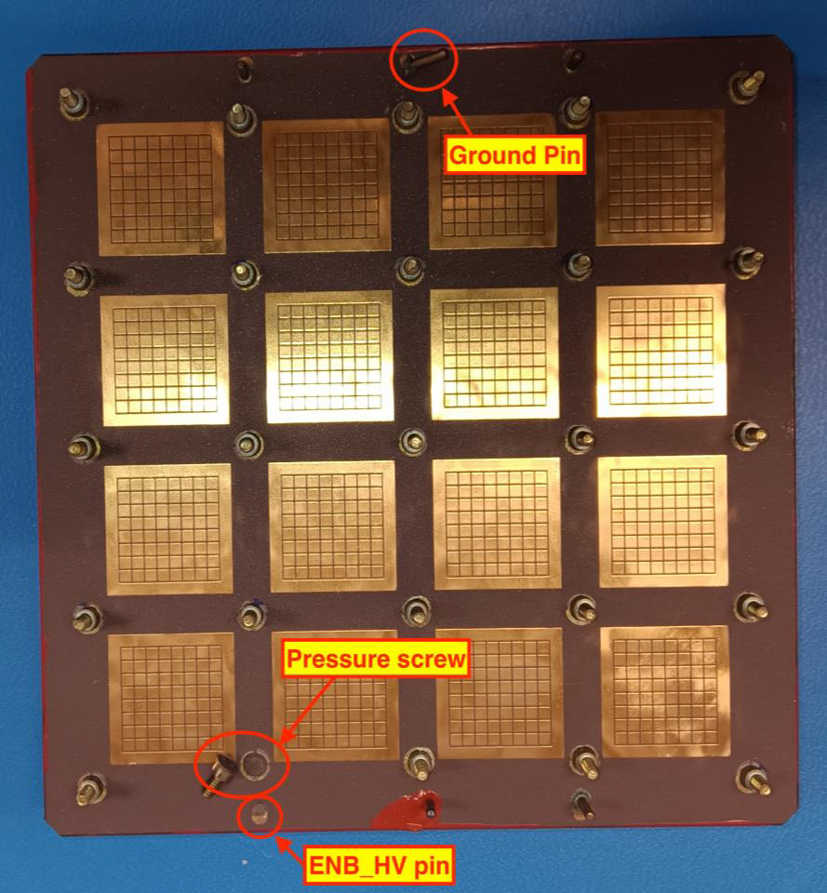
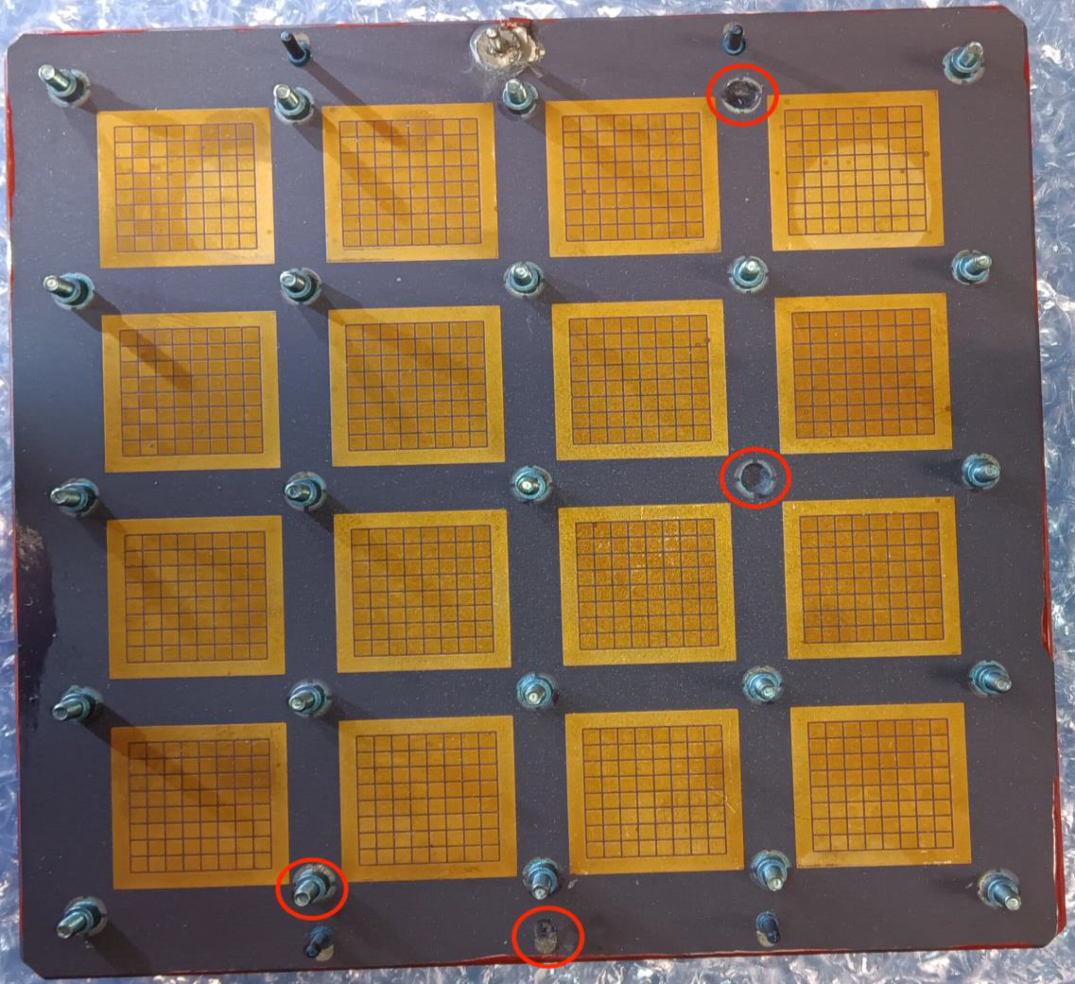
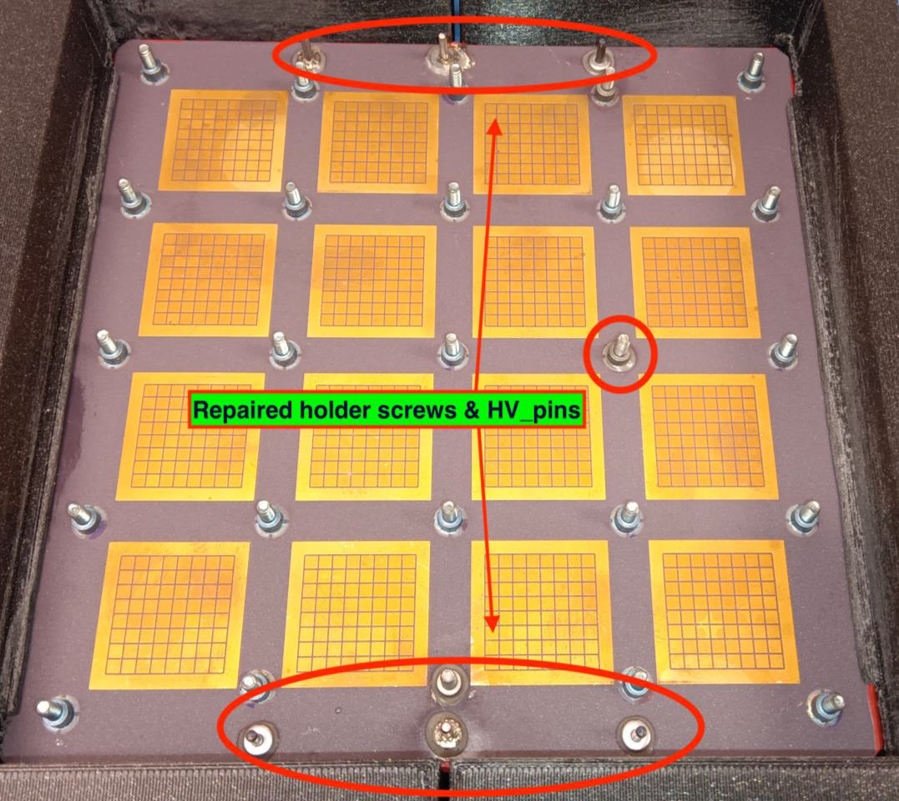
Highlights from Initial QA Process at JLab
Examples of failed HV pins and screws
A present fix by Incom
Several HRPPDs showed issues with falling off HV pins and mechanical screws
Those were promptly fixed by Incom
Solutions for a “final EIC HRPPD design” are being developed
Remove HV pins; embed screws into the ceramic anode body
14

Slide 15
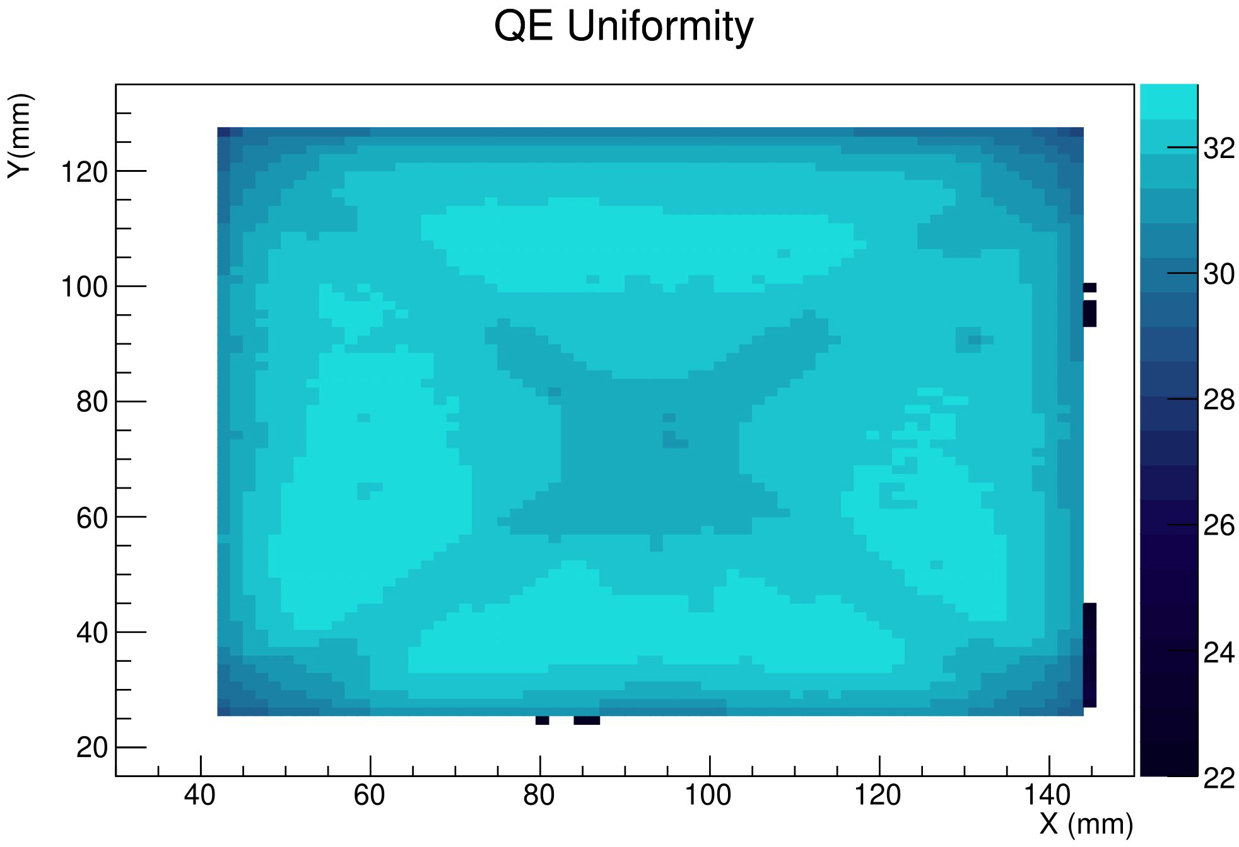
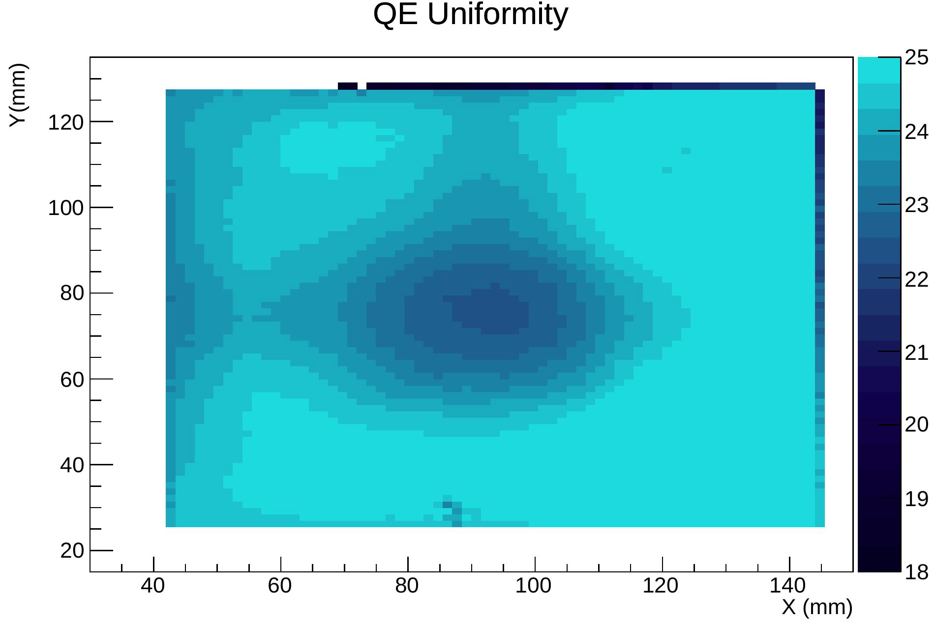
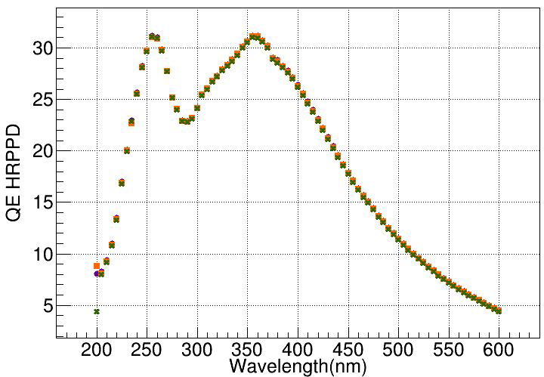
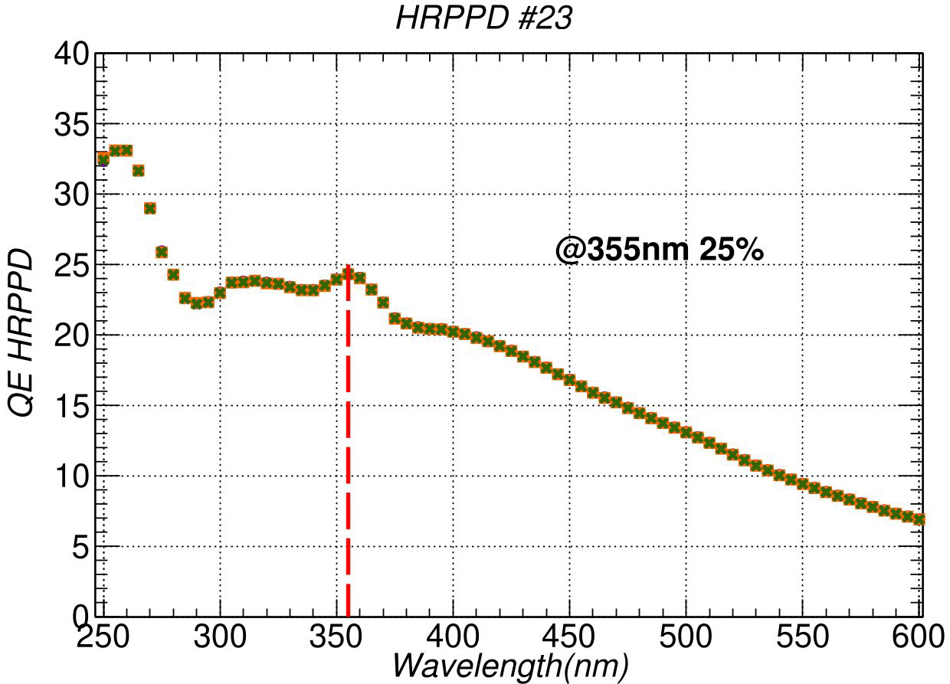
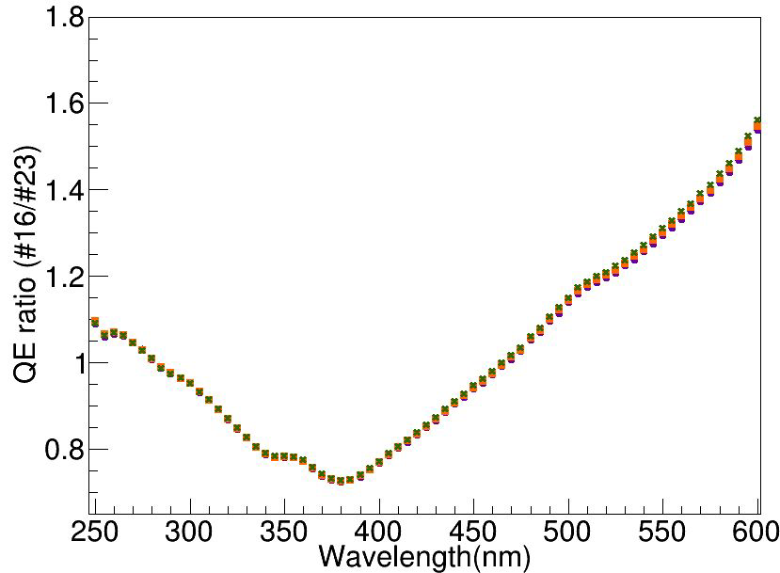
Quantum Efficiency Measurements at BNL
Charge Question 3
2D surface scans @ 365 nm
Pretty uniform across the active area
Origin of non-uniformity is well understood
All HRPPDs sealed in tank #1 have peak QE way above 30%
QE(λ) measurements with a monochromator
HRPPD 16 (sealing tank #1)
HRPPD 23 (sealing tank #2)
HRPPD 23 / HRPPD 16 QE ratio
15

Slide 16
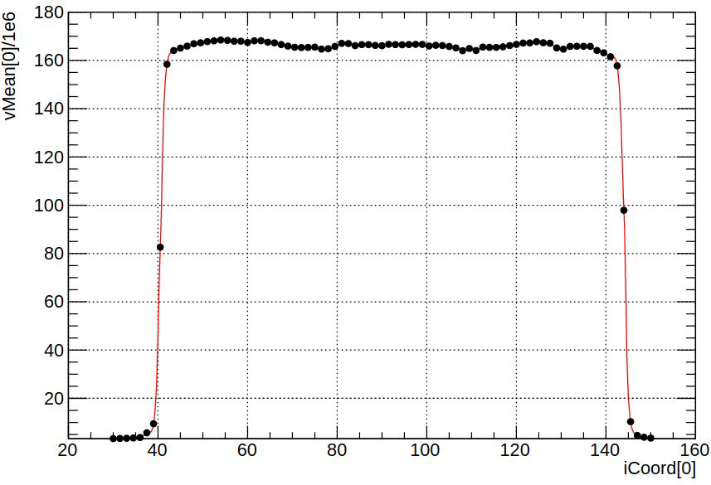
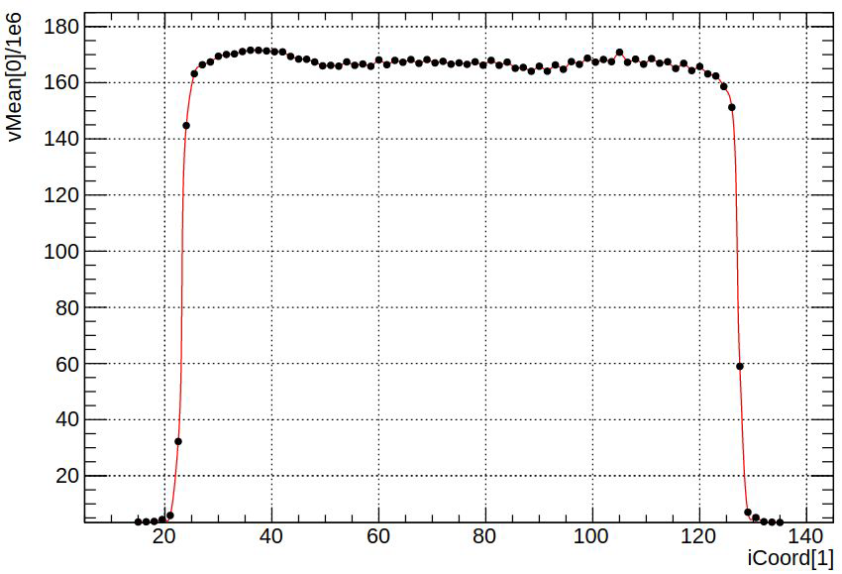
Active Area Evaluation at BNL
X-coordinate
Y-coordinate
Data extracted from QE scans
~104 mm in both projections, as expected [anode pixellation: 32x 3.25mm]
The actual high PDE area with a sufficiently high gain will be somewhat smaller
Overall impression: QE is high enough & Incom’s data confirmed
16

Slide 17
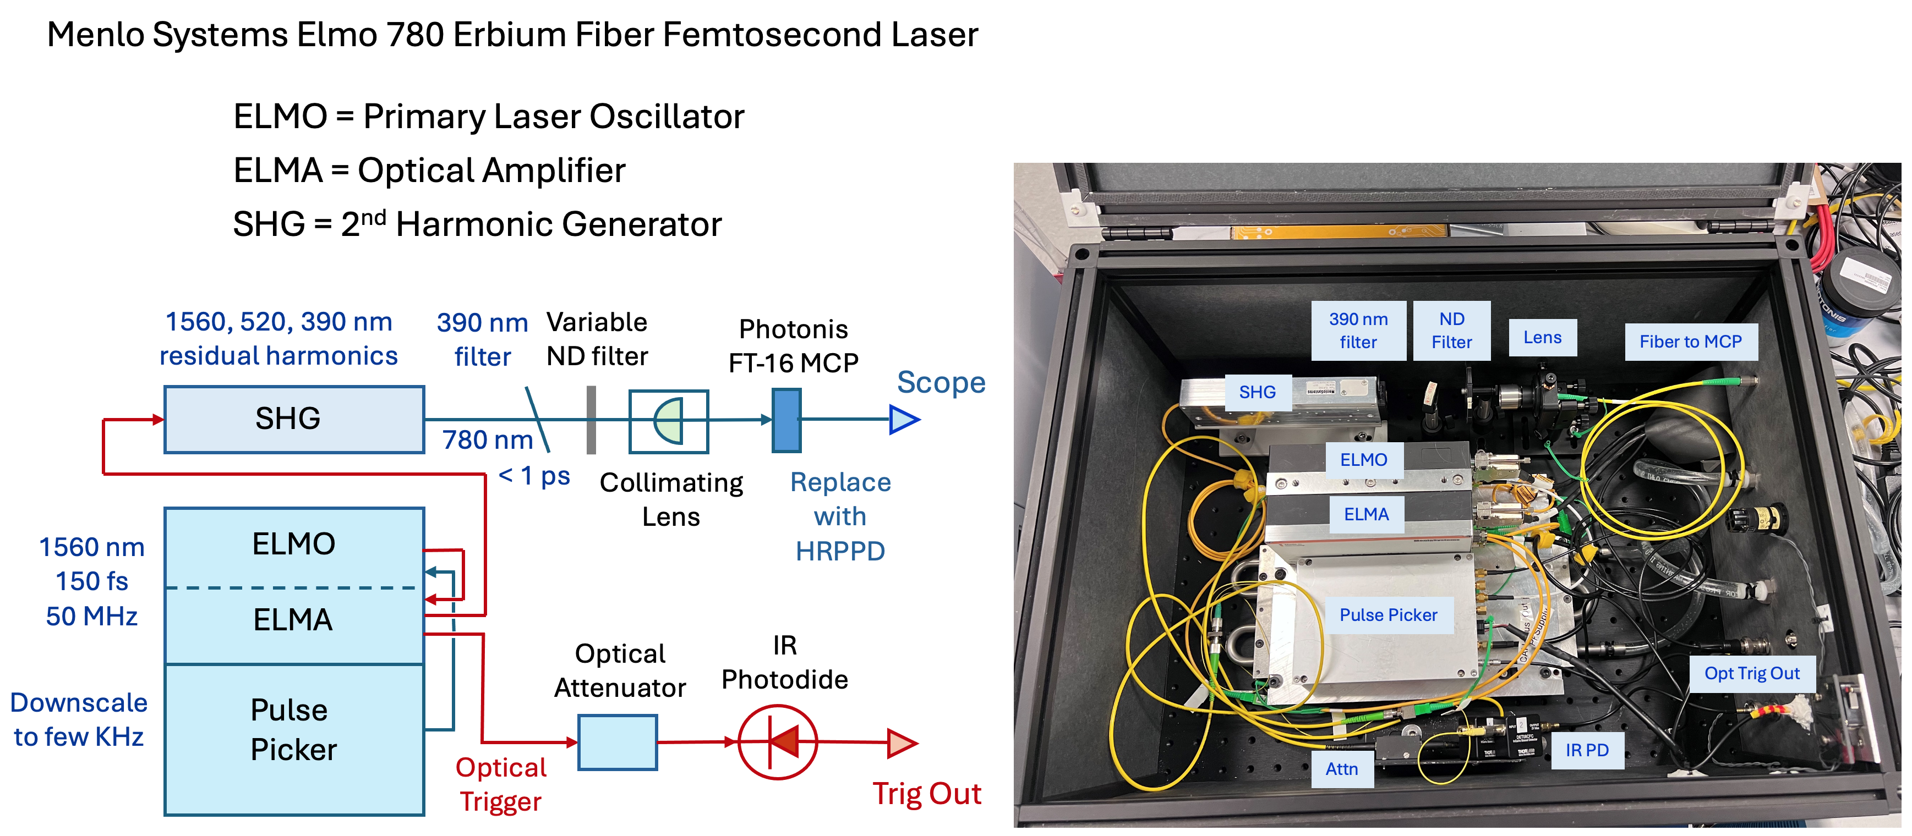
Elmo 780 Femtosecond Laser System at BNL
HRPPD
Scope
We make use of a very low intensity 3rd harmonic @ 390 nm
17

Slide 18
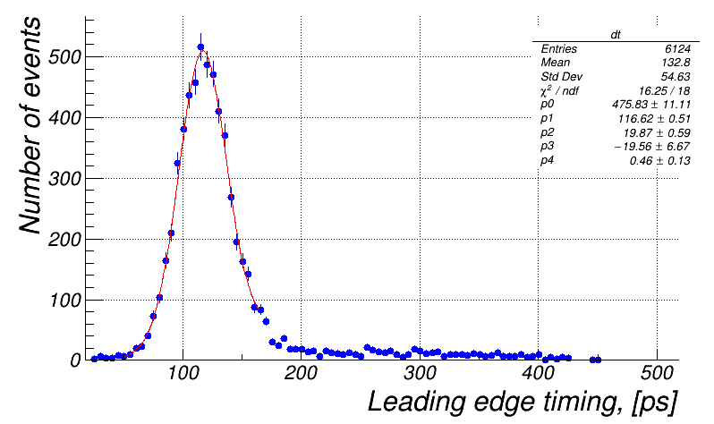
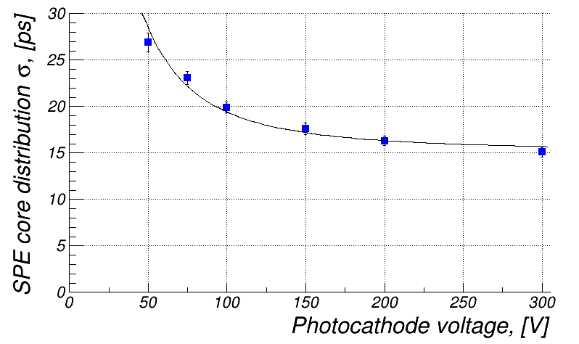
Single Photon Timing Resolution Using Elmo Laser
Charge Question 3
Laser beam focused on a single HRPPD pad center; intensity tuned down to >95% empty events
HRPPD signal used for triggering (5 mV effective threshold)
To increase data taking efficiency
Signal waveform data taken with a Tektronix MSO66B scope (50 GS/s, 8 GHz ABW)
Leading edge fits [10% .. 90%] performed offline; Δt = t_{HRPPD} - t_{FastPD} is a plotted quantity
point shown on the left plot
~15 ps
σ ~ 20 ps core
distribution width;
RMS < 75 ps
18

Slide 19
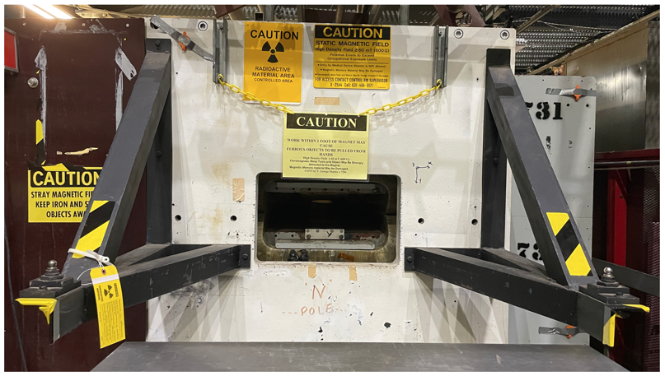
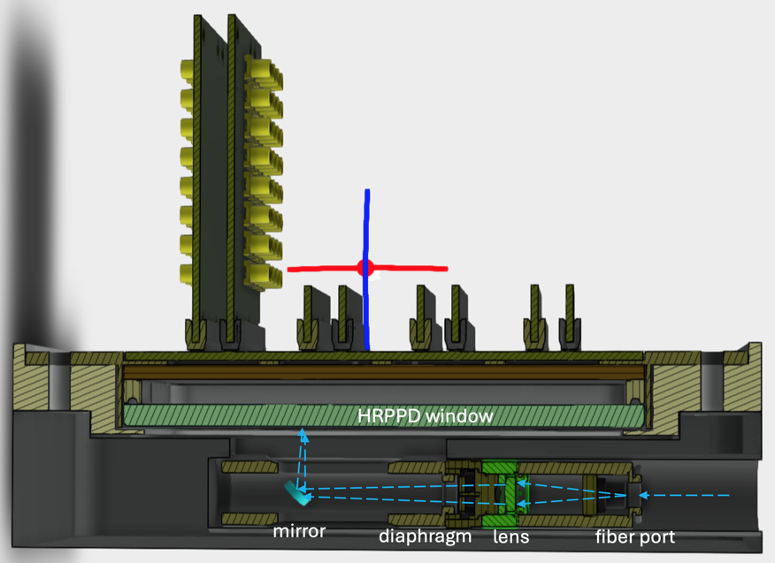
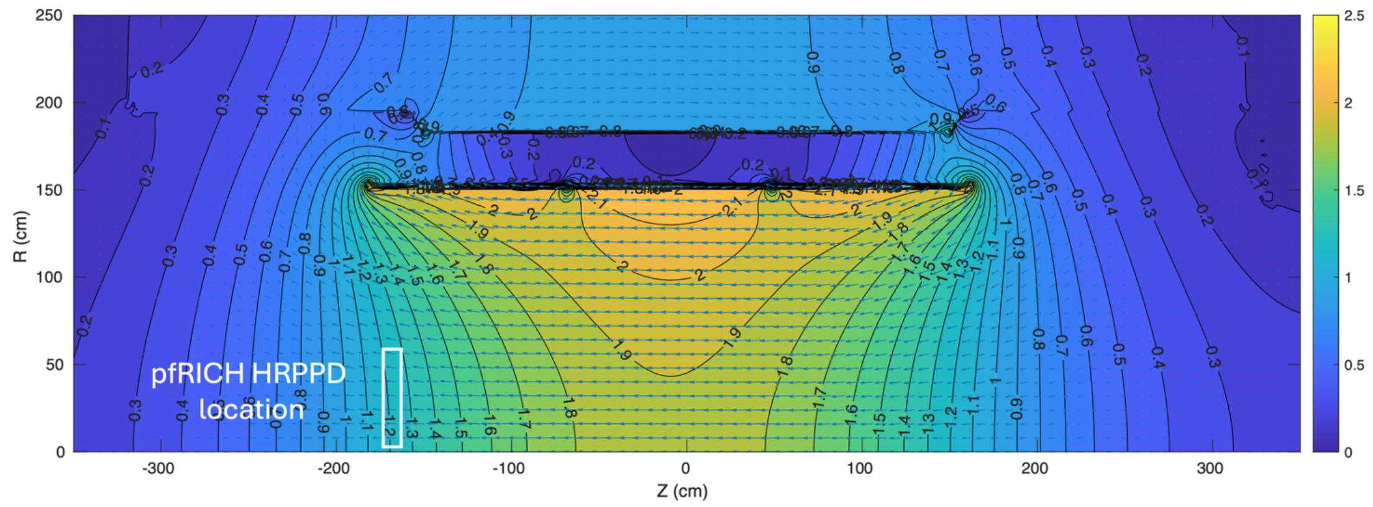
B-field Studies at BNL
Charge Questions 1 & 2
Link to a B-field study proposal
All optical components received
Mechanical setup in being finalized
Planned for the second half of April 2025
A type 18D72 2.2 Tesla dipole with a 6” gap
ePIC MARCO solenoid field map
Dark “box” setup
19

Slide 20
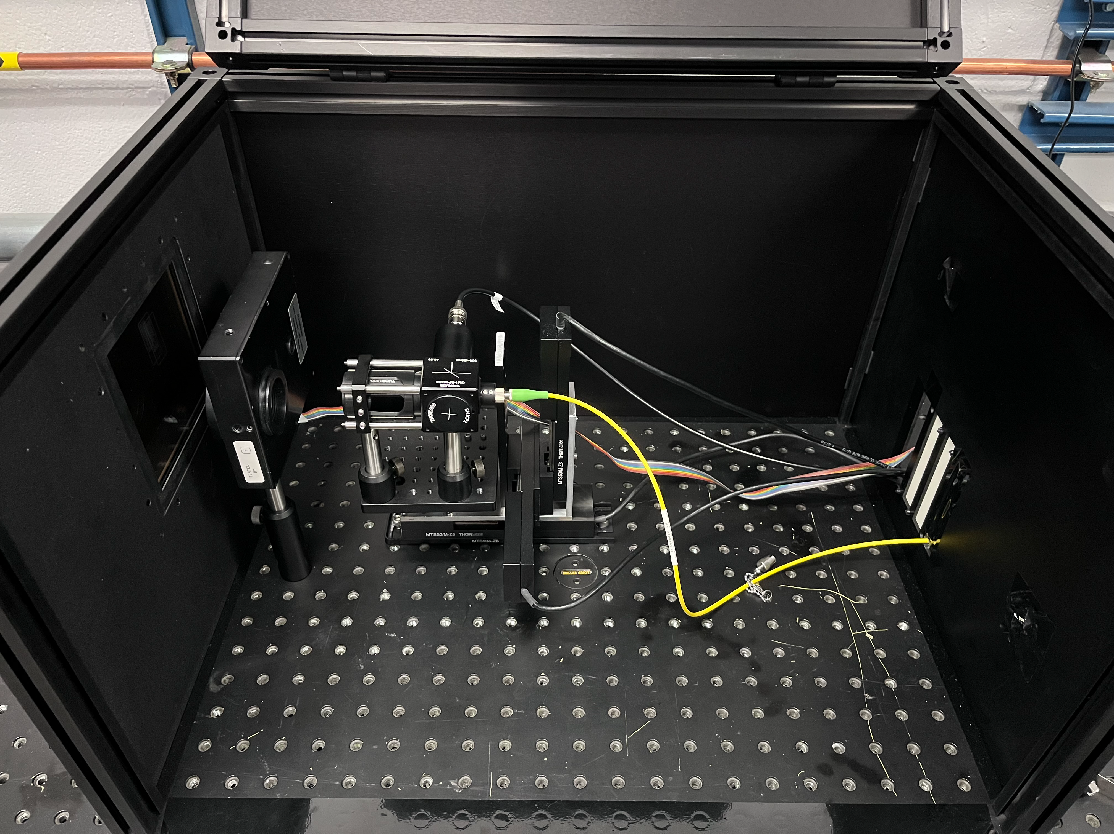
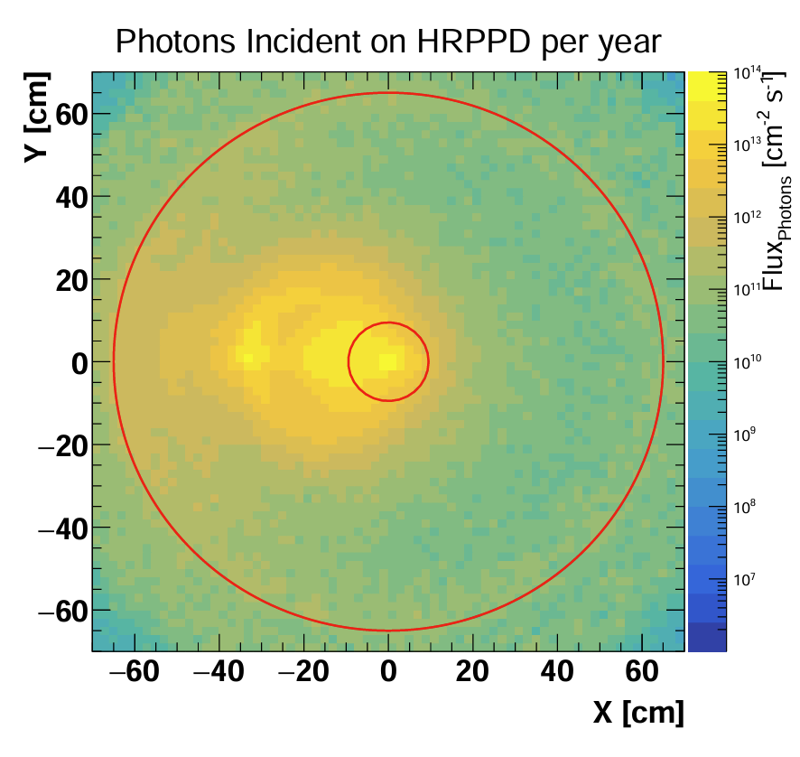
Aging Studies
Charge Questions 1 & 2
Filter
wheel
Reference
photodiode
HRPPD
window
Focusing optics
on XYZ stages
HRPPD aging studies dark box at BNL
Monte-Carlo charged particle fluence estimate
Similar setups at JLab / BNL / INFN Trieste
Experts in LAPPD aging (UT Arlington) participating
https://indico.bnl.gov/category/605/
A coordinated campaign in April - May 2025
20

Slide 21
HRPPD Summary & Our Present Assessment
Yields: all ten Kyocera anodes were functionalized into working HRPPDs at the end
s/n 15 .. 17 (success)
s/n 18 .. 22 (failure, after an attempt to use a second sealing tank)
s/n 23 .. 29 (success, after establishing a way to recycle the lower tile assemblies)
QE: higher than expected and remarkably uniform across the active area
Gain: stable operation at ~10⁷ and beyond
We will not need more than 10⁶ in the experiment
Uniformity is relatively poor, with gain going up by a factor of ~2 towards the active area edge
Timing: looks better than expected
pfRICH should be able to use single photons as a complementary t₀ measurement
Dark rates: very small, even at mid-10⁶ gain
Overall, everything looks very promising & one more iteration is expected
21

Slide 22
Auratek MCP-PMTs by Photek
22

Slide 23
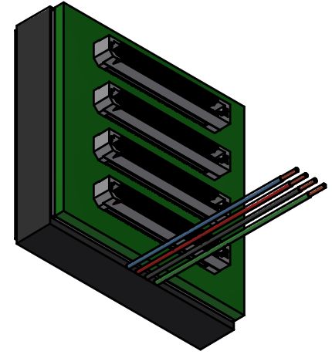
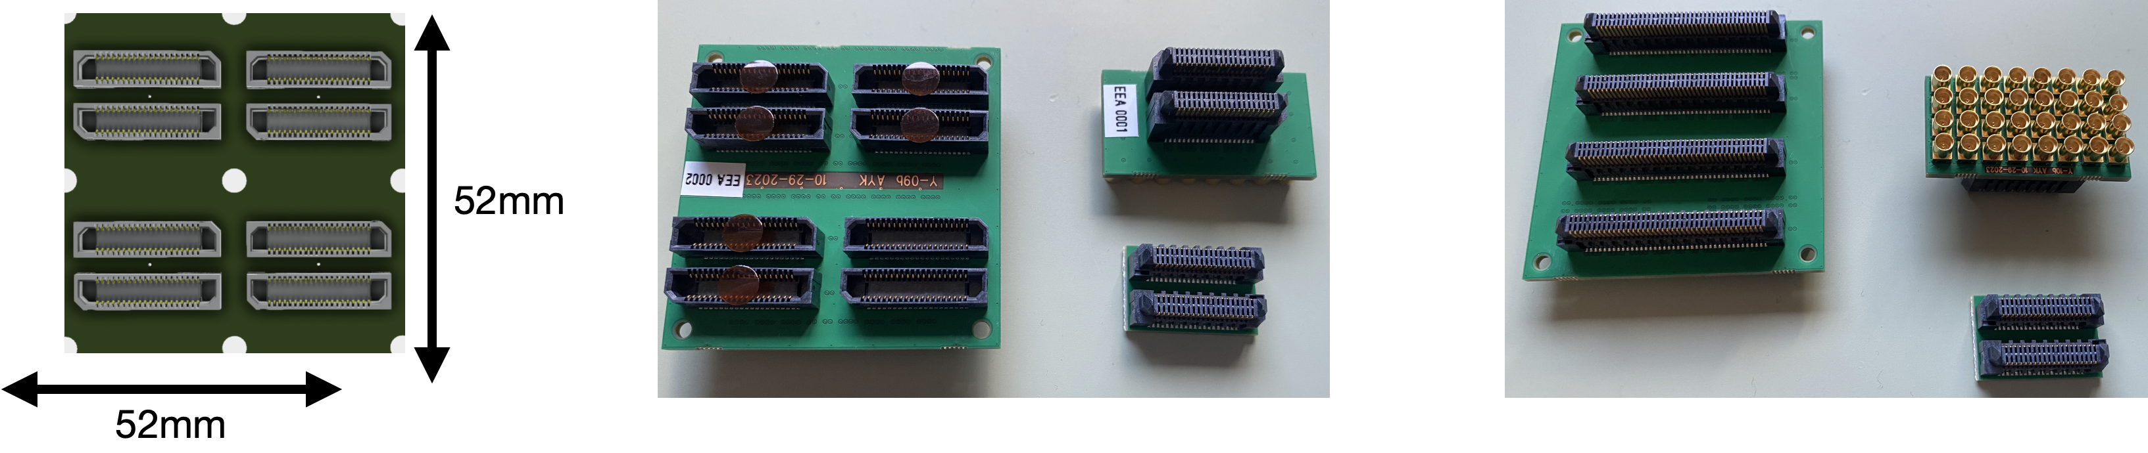
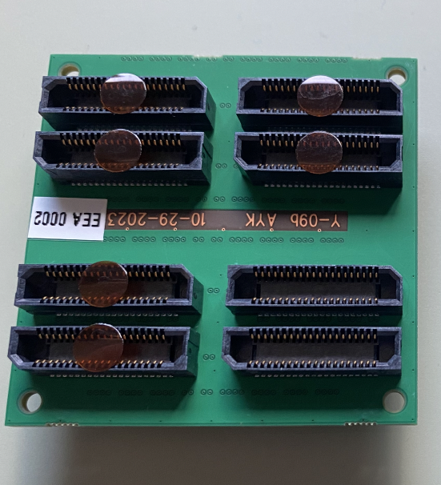
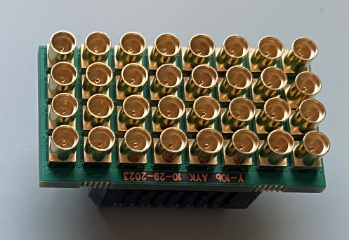
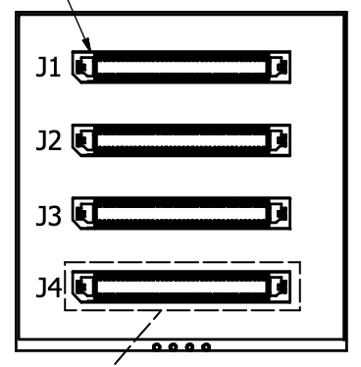
MCP-PMT / HRPPD Evaluation at Glasgow
2” Photek Auratek stock configuration
A set of adapters to “HRPPD world”
Model: MAPMT253 16x16 pixel Multi-anode MCP-PMT
10 μm pores, peak QE up to ~35%, TTS ~40ps RMS
Shipment to Glasgow was expected by mid February 2025
Adapter boards available (see pictures above), as well as DRS4 electronics
23

Slide 24
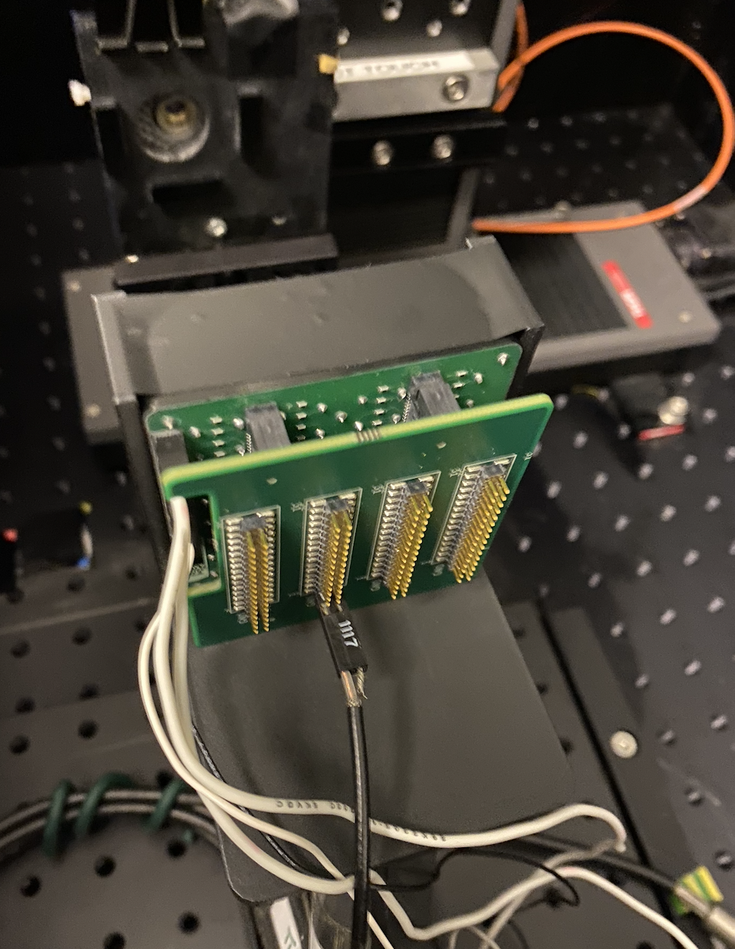
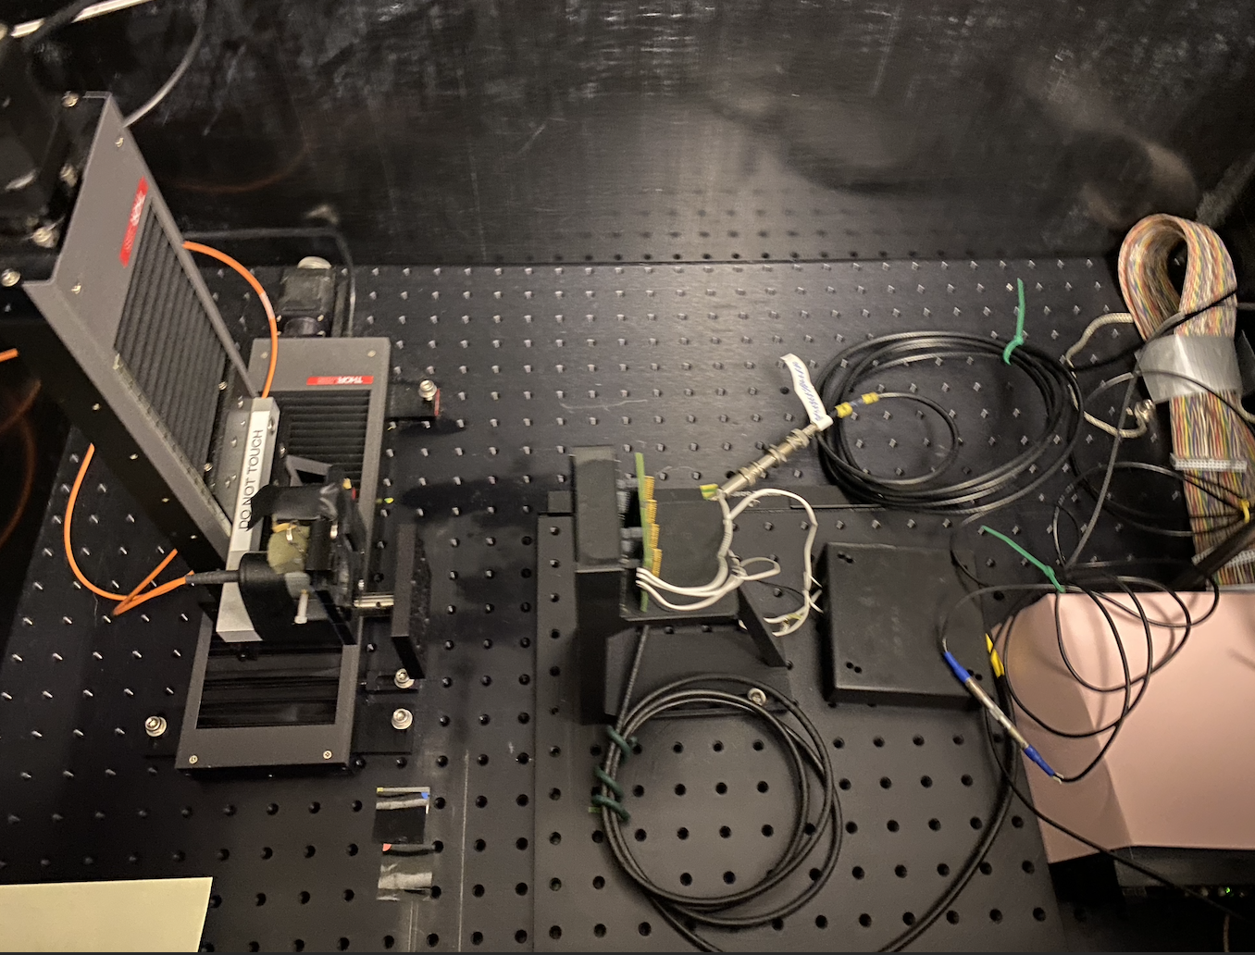
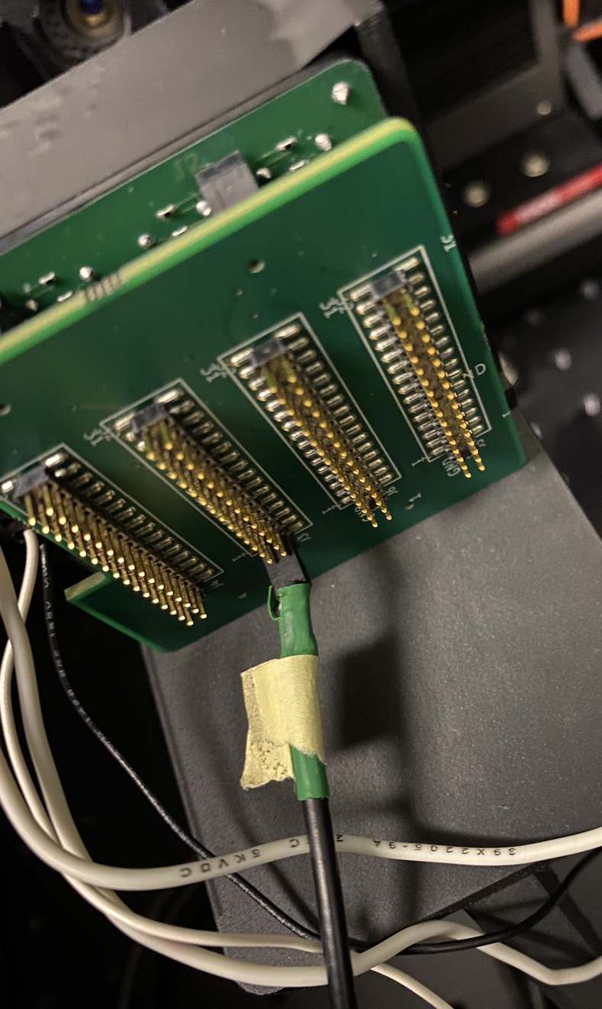
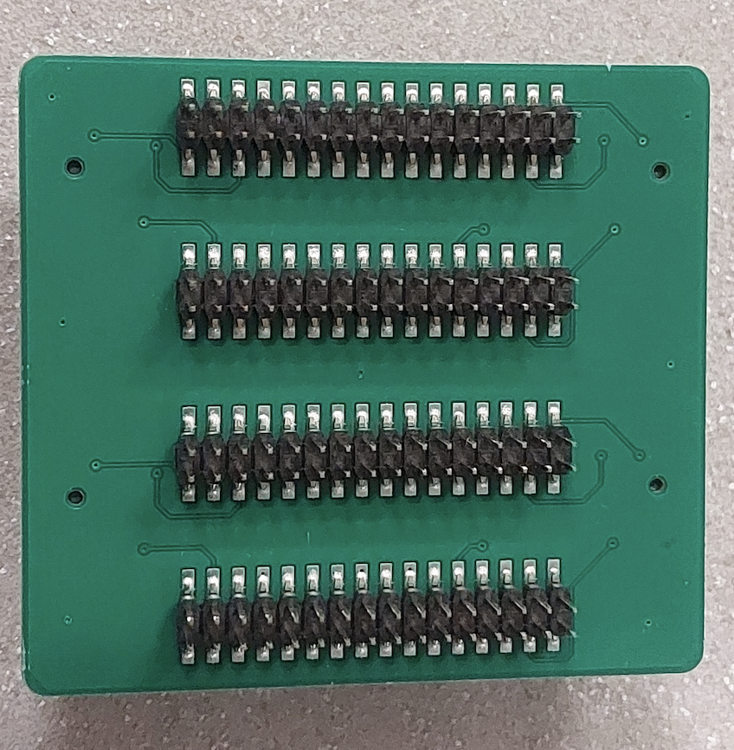
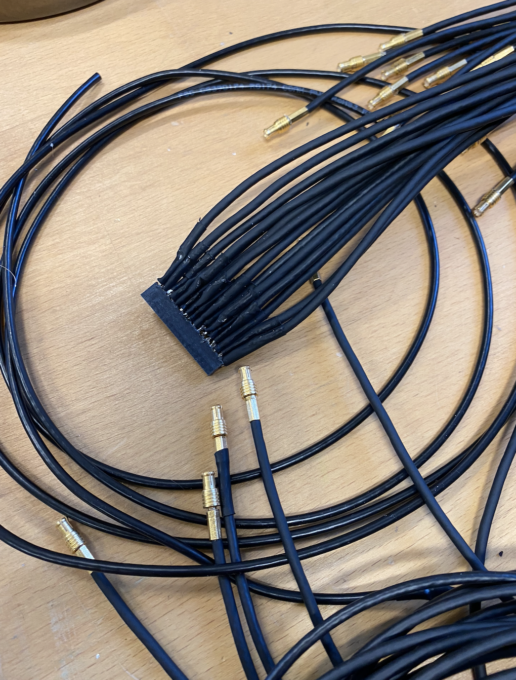
MCP-PMT / HRPPD Evaluation at Glasgow
Charge Question 2
Borrowed Planacon XP85112-S-BA MCP-PMT from GSI
This is the one which was thoroughly tested at Erlangen by A. Lehmann
Will be used as a reference tube
Adapter board for connecting to CAEN V1742 digitizer and MCX cables manufactured
One of the EIC HRPPDs will be shipped to Glasgow for a side-to-side comparison
Adapter Card
Laser on XY-stages
Planacon MCP-PMT
HV divider
DT5742B
24

Slide 25

Comments from July 2023 PID Review
Charge Question 7
-> See slide 20
-> See slides 23-24
-> Such a solution would likely be suboptimal:
In case realized on the HRPPD anode level:
Cost gain is expected to be small; we would not be able to maintain a common pool of pfRICH & hpDIRC spares
In case realized on a front-end board level:
6.50mm pixels would translate into ~4mrad SPE angular resolution (compare to ~5mrad overall with 3.25mm pixels)
One would have to maintain two different FEB designs …
… and deal with fast signal reflections because of non-trivial proximity pad grouping on HRPPD anode air side
25

Slide 26
Summary
26

Slide 27
Summary & Outlook
Incom HRPPDs were adopted as ePIC pfRICH baseline photosensor
An EIC PED contract with Incom Inc. was successfully completed in 2024
Re-design and production of 5+2 EIC HRPPDs
Evaluation effort is ongoing in several institutions working on the EIC Project
The results are very promising so far
A moderate final design update and a test production are anticipated in 2025
Photek Auratek MCP-PMT evaluation as a baseline photosensor for ePIC hpDIRC is awaiting a tube delivery to Glasgow
-> HRPPDs are becoming our preferred solution for both pfRICH and hpDIRC
-> This is our backup solution
27

Slide 28


Slide 29


Slide 30
Mechanical & electrical interface
Topic | Critically important
Add recesses for screws (studs) to the ceramic anode | YES
Use PEEK screws? Decide on epoxying rather than brazing? | YES
Eliminate HV pins & make use of compression interposers | YES
Add more grounding pads to Samtec interposers
Add more HV leads for a bottom MCP (reduce inductance) | YES
Improve photocathode HV lead design | NO

Slide 31
Robustness, longevity
Topic | Critically important
Improve window sealing interface
Switch to sapphire windows | YES
Consider developing >72C temperature sealing alloy | ?
Eliminate / minimize anode tarnish | YES

Slide 32
Performance improvements
Topic | Critically important
Increase geometric efficiency to ~80% | NO
Increase specs for QE to ~28-30% min | NO
Further minimization of transfer gaps | MAY BE
Minor minimization of material budget (window, anode) | NO
Implement sapphire window anti-reflective coating

Slide 33
Minor modifications
Topic | Critically important
Improve inner and outer anode plate pixellation (gaps, etc) | NO
Add more HV ground spots on the rear anode side
Consider a better electrical isolation of the indium seal

Slide 34
Other options
Topic | Critically important
Try a photocathode QE shift towards an optical range
Add a high resistivity ALD coating to side walls (and anode?)
Increase anode segmentation (to 40 x 40 pads or so)
Add window edge reflective coating
Make use of 6 μm MCPs and / or increase bias angle to >13⁰ | MAY BE
Implement anti-reflective coating on a window-PC boundary | MAY BE

Slide 35
Steps towards converging on a single photosensor solution
(1) Complete evaluation of the first batch of EIC HRPPDs
Systematic scans: QE, PDE, gain, DCR, timing, …
Aging, B-field resilience, after-pulsing, high occupancy events
(2) Proceed with a final PED iteration with Incom
Repeat a systematic evaluation
(3) Perform a selective side to side comparison of HRPPD and Photek MCP-PMT
If Photek MCP-PMTs show no substantial performance advantage, take a note
(4) Evaluate functionality of an existing HGCROC3 backplane prototype with an HRPPD
(5) Assuming it provides a reasonable performance, build 5-7 full sets

Slide 36
Steps towards converging on a single photosensor solution
(6) Install a pfRICH prototype with 4-5 HRPPDs on a Cosmic Ray Telescope at SBU
See this talk
(7) At some point move the on-board electronics onto the hpDIRC CRT prototype
And verify the performance on real life multi-hit muon events (cross talk, ringing, etc)
(8) Wait for FCFD evaluation boards
Perform intermediate bench top testing with final EIC HRPPDs (and Photek MCP-PMTs?)
(9) Build a full FCFD backplane
Repeat a fraction of HRPPD performance studies
(10) Perform beam test(s) for both pfRICH and hpDIRC

