Slide 1
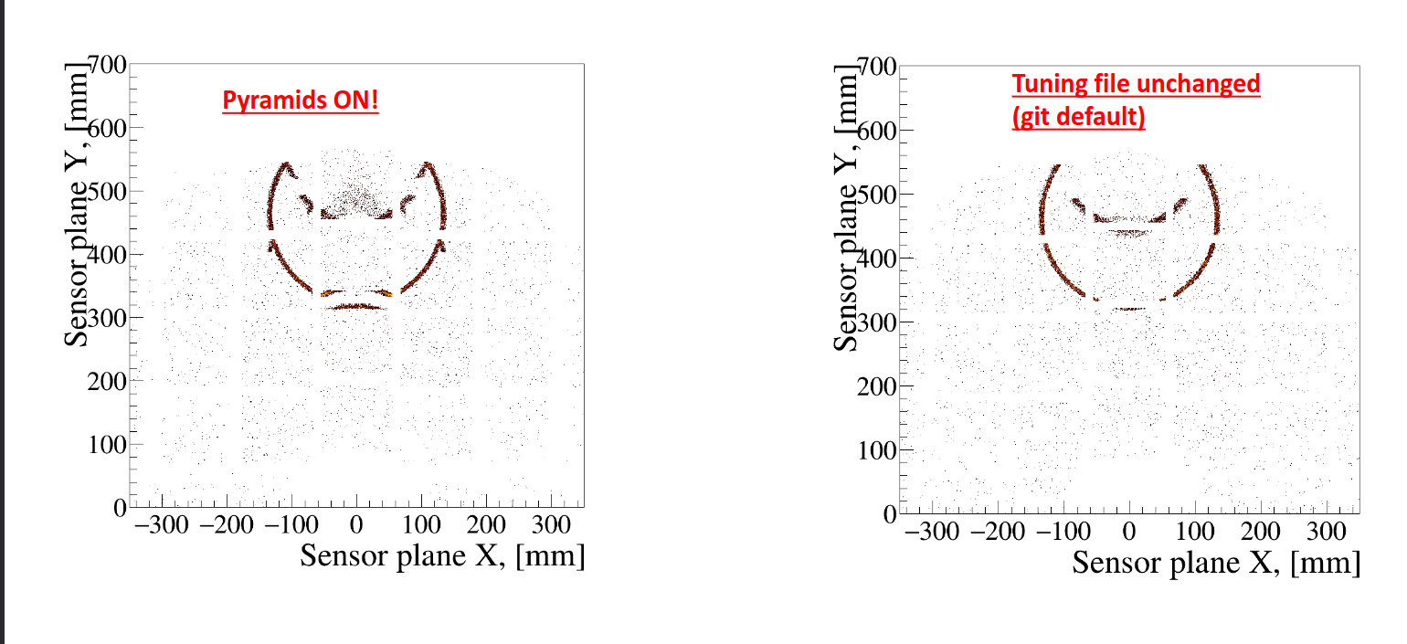
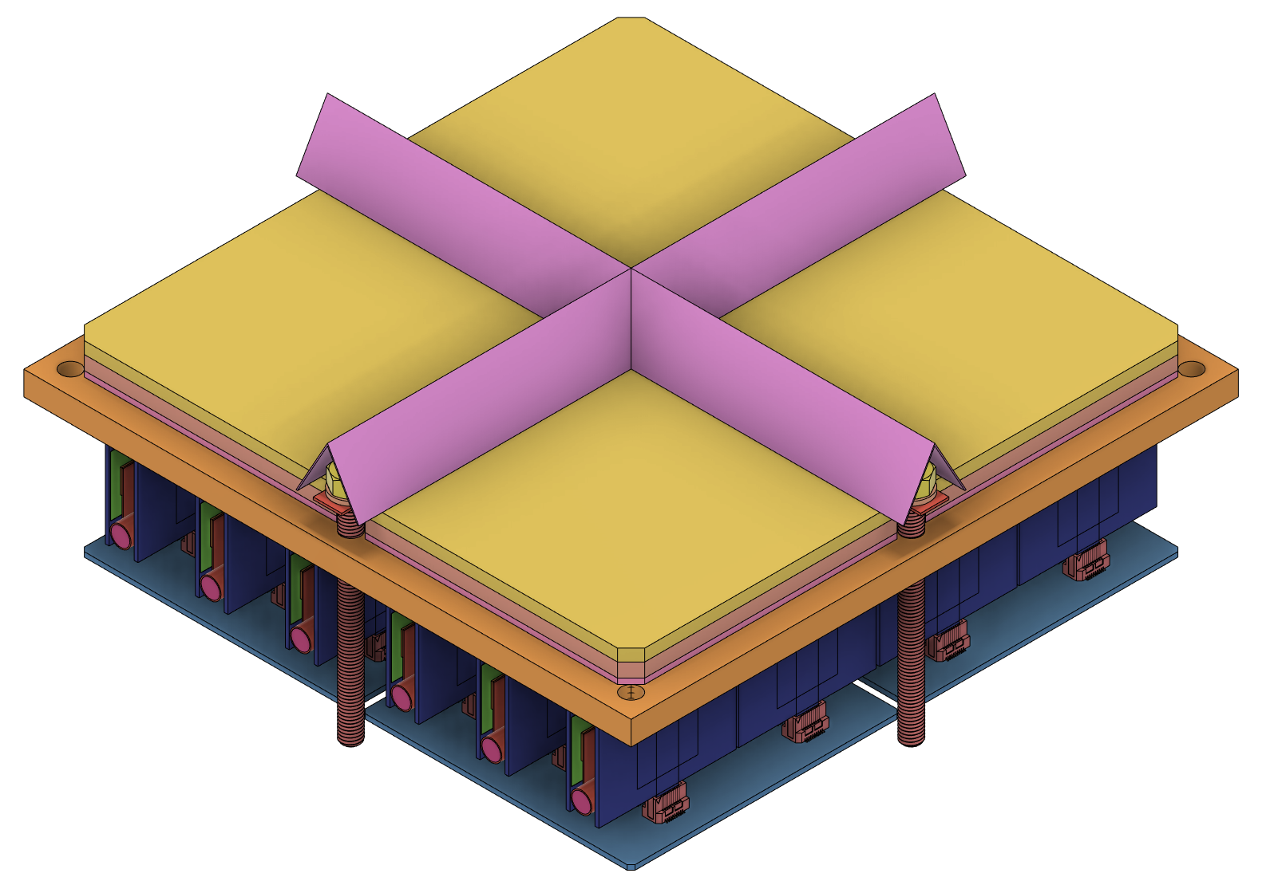
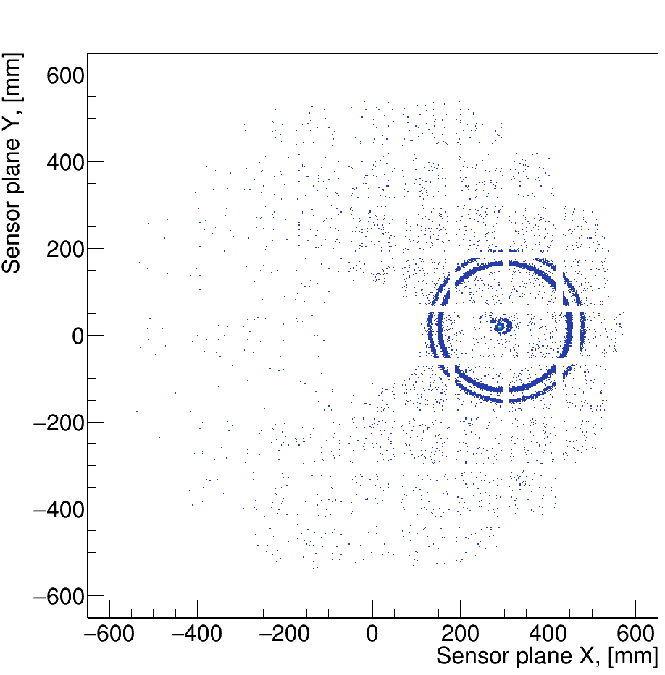
Performance enhancements
Installation of small funneling mirrors around each sensor dead area boundaries
Use of a dual aerogel configuration
Both options implemented in software
Both give a substantial increase in photon yield
Recently added to the baseline configuration as a consequence of a complex ePIC detector tracker optimization (pfRICH expansion volume was shortened by ~5cm)
π⁺ @ 7 GeV/c

