Slide 1




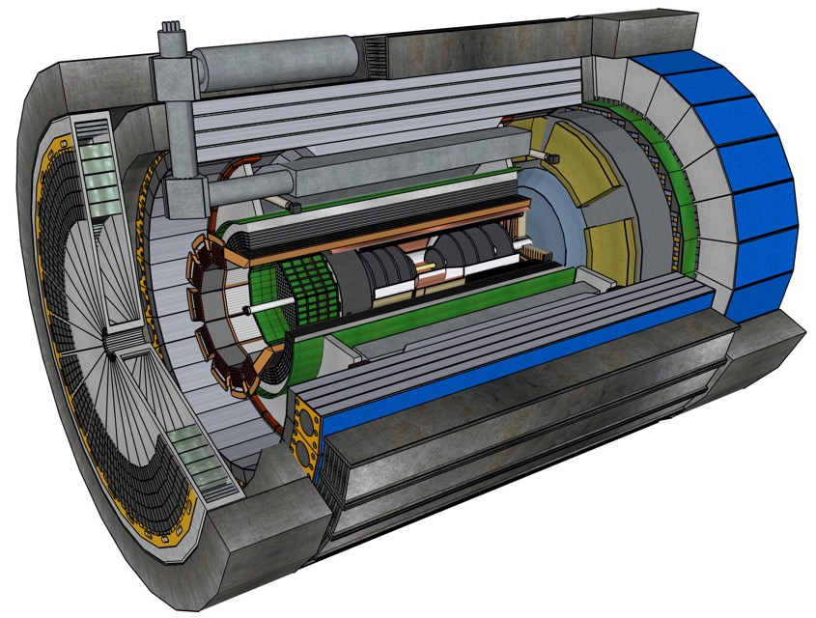













Central Detector Non-DOE Interest & In-Kind
In-kind contribution goal: 30% of the Detector
Barrel
Electromagnetic
Calorimeter
Dual-radiator
RICH
Superconducting
Solenoid
Forward Electromagnetic
Calorimeter
Tracking
Detectors
Backward
Electromagnetic
Calorimeter
DIRC
Time-of-Flight
Backward Hadronic
Calorimeter
Data-Acquisition
Electronics

Slide 2

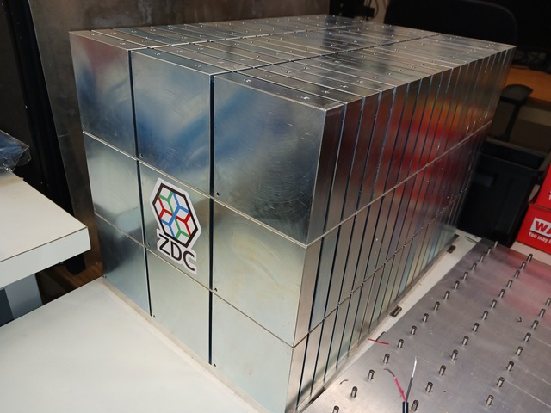
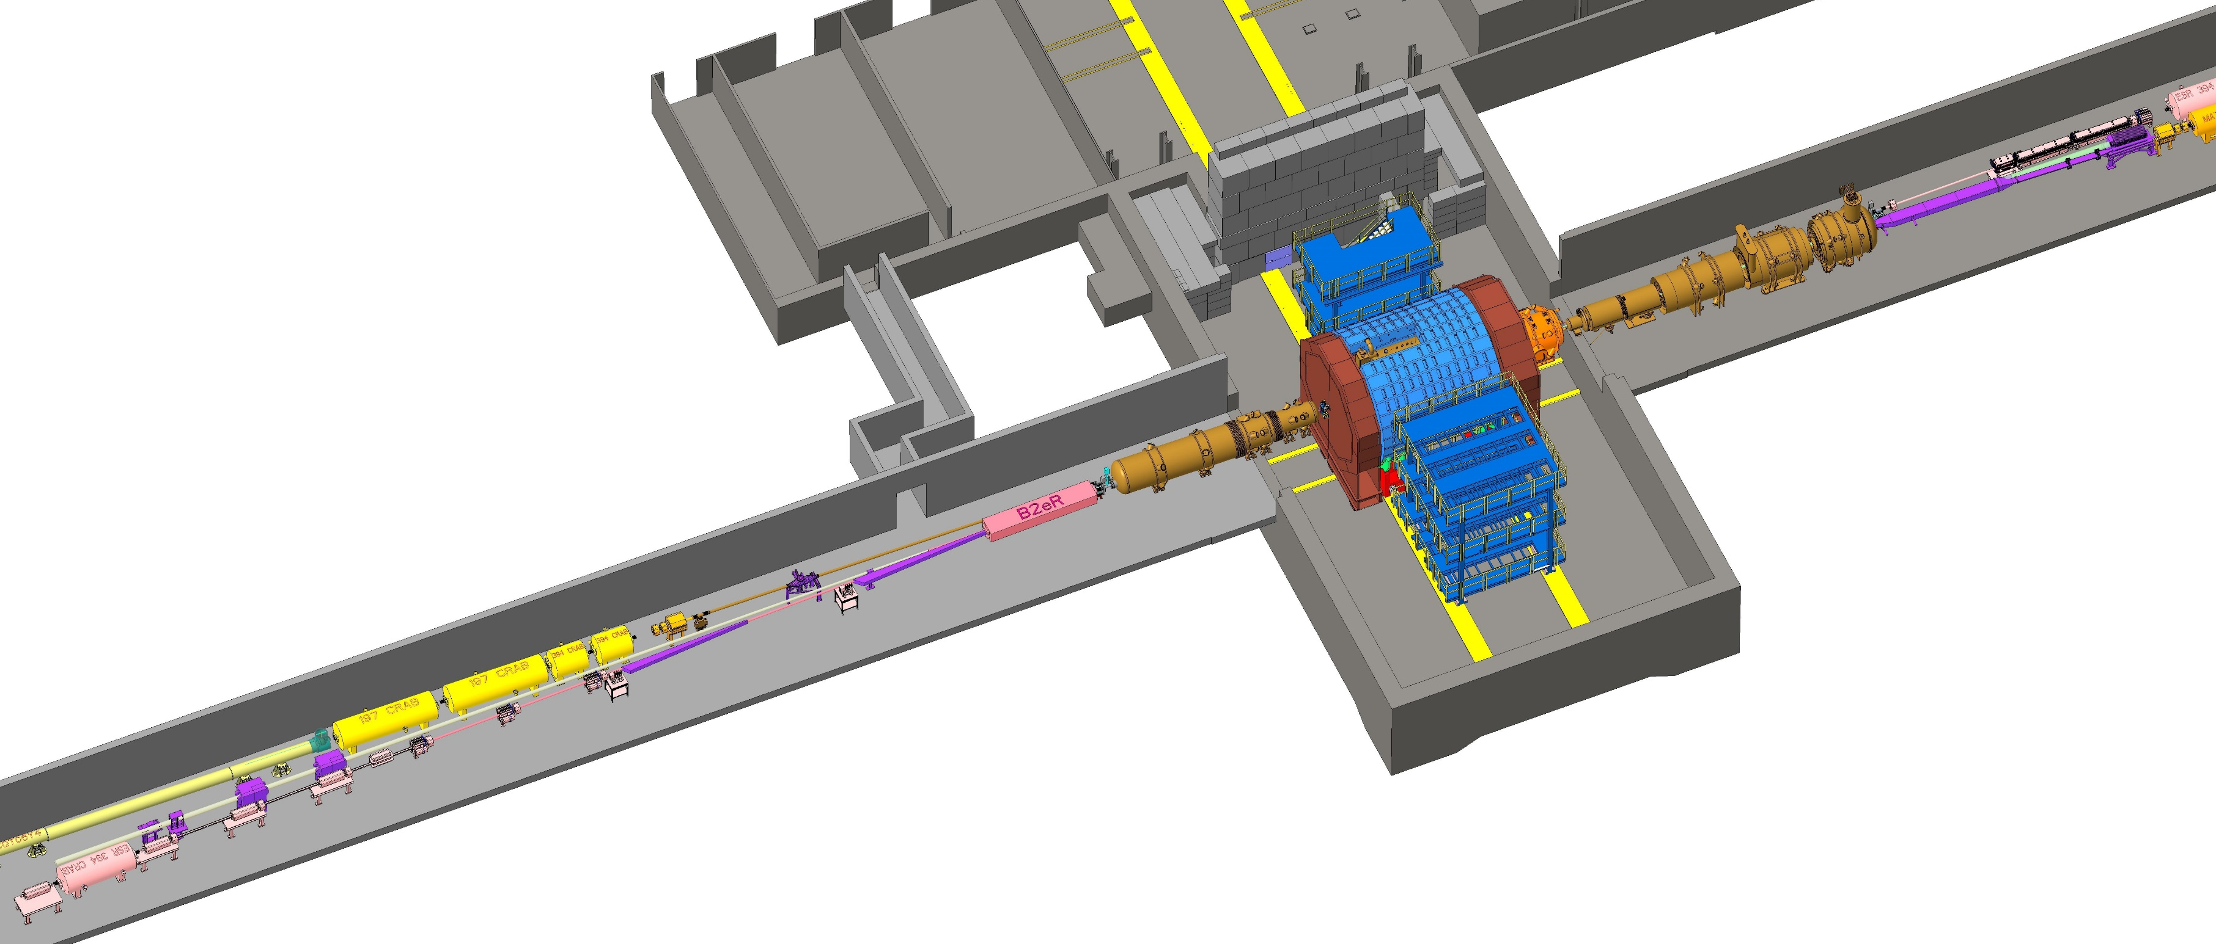

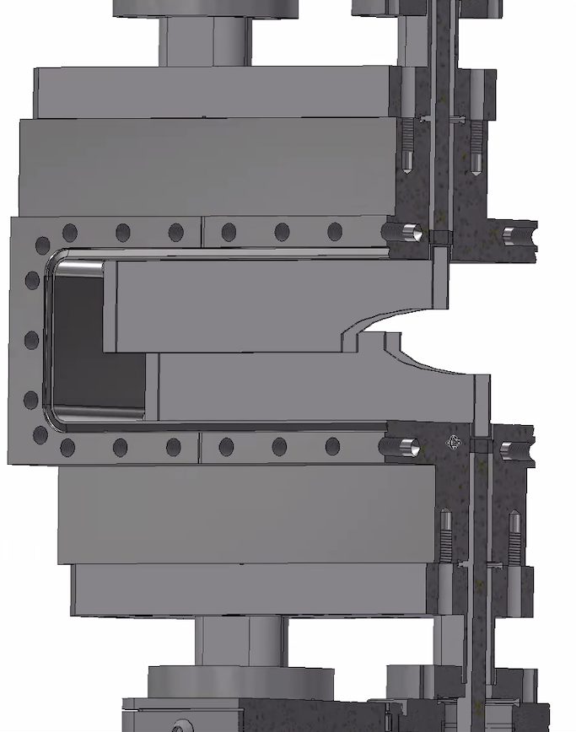


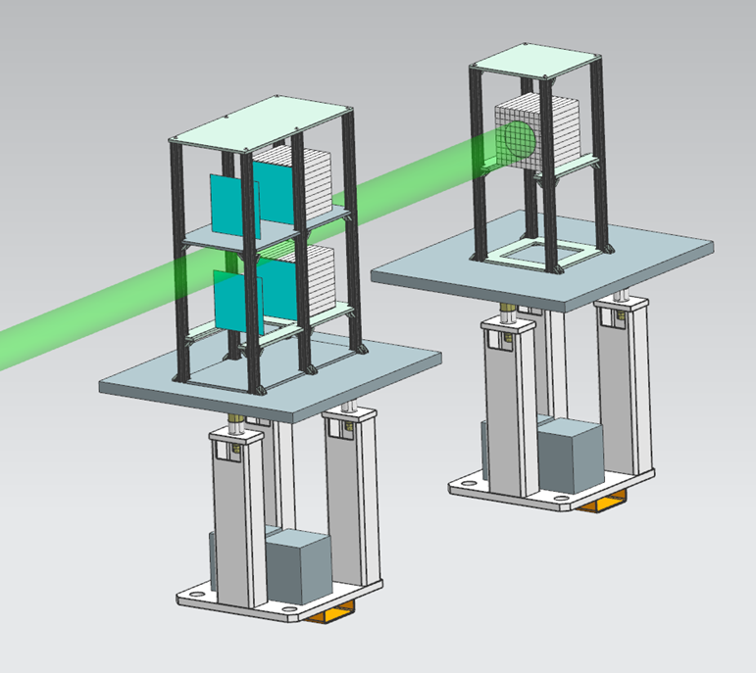

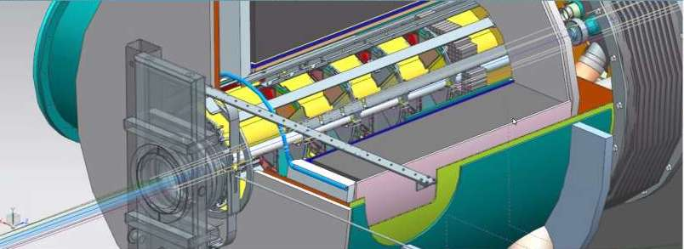
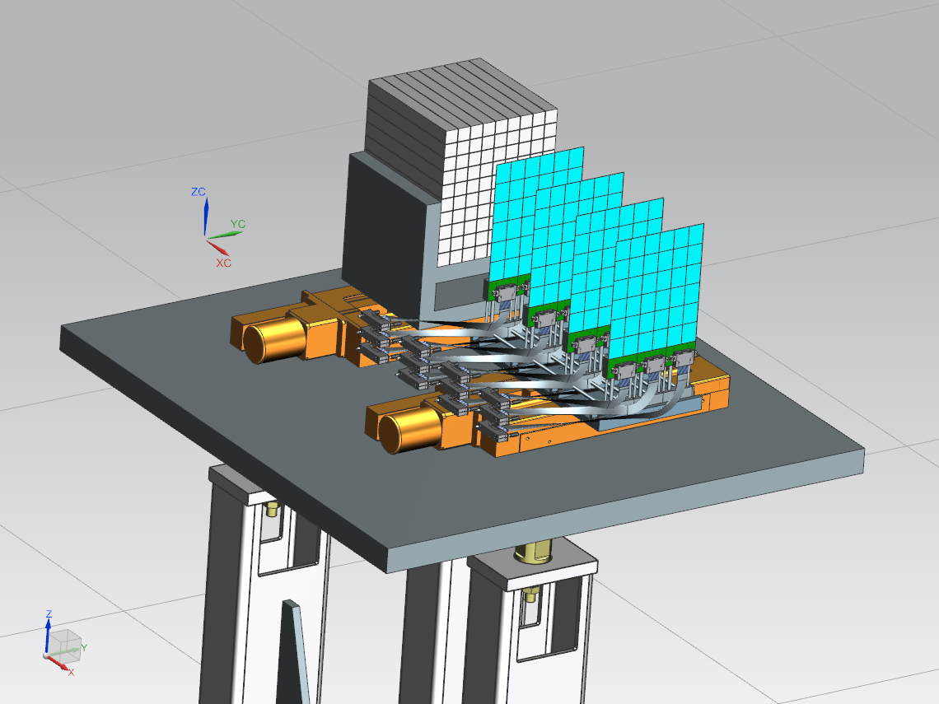


Far-Forward/Far-Backward Detectors Non-DOE Interest & In-kind
Zero Degree Calorimeter
IR vacuum – crucial interface for detectors
e beam
Roman Pots and
Off-Momentum Detectors
p/A beam
B0 Magnet Spectrometer
Luminosity System
Low-Q2 Taggers

Slide 3
Central Detector Non-DOE Interest & In-Kind
In-kind contribution goal: 30% of the Detector
Barrel
Electromagnetic
Calorimeter
Dual-radiator
RICH
INFN Sezione di Bologna
Università di Bologna
INFN Sezione di Ferrara,
Università di Ferrara
INFN Sezione di Trieste
Universita di Trieste
Superconducting
Solenoid
Forward Electromagnetic
Calorimeter
Karlsruhe Institute
of Technology
Tracking
Detectors
University of Birmingham,
Daresbury Laboratory,
INFN Sezione di Bari,
Università di Bari,
Università di Foggia,
INFN Sezione di Padova,
Università di Padova,
INFN Sezione di Pavia,
INFN Sezione di Trieste,
Universita di Trieste,
Czech Technical University
in Prague,
Rutherford Appleton Laboratory
University of Liverpool,
CEA-Saclay,
Seoul National University,
INFN Sezione di Roma Tor Vergata,
Universita di Roma Tor Vergata
Yonsei University,
Gangneung-Wonju National University,
Hanyang University
Jeonbuk National University
Korea University
Kyungpook National University
University of Seoul
Pusan National University
Sungkyunkwan University
Sejong University
Hanyang University
Yonsei University
University of Regina
University of Manitoba
Backward
Electromagnetic
Calorimeter
DIRC
Time-of-Flight
GSI Helmholtzzentrum fuer Schwerionenforschung GmbH
Backward Hadronic
Calorimeter
University of Tokyo, University of Tsukuba, Hiroshima University
Kobe University, Nara Women's University, Nihon University, Shinshu University
National Central University, National Cheng Kung University
National Taiwan University, National Tsing Hua University
IJClab (Orsay)
A. Alikhanian National Laboratory, Armenia,
Charles University (CUNI), Prague
Czech Technical
University in Prague,
NPI The Czech Academy of Sciences
Data-Acquisition
Electronics

Slide 4
Far-Forward/Far-Backward Detectors Non-DOE Interest & In-kind
Zero Degree Calorimeter
IR vacuum – crucial interface for detectors
e beam
Roman Pots and
Off-Momentum Detectors
p/A beam
B0 Magnet Spectrometer
RIKEN Nishina Center
University of Glasgow
AGH University of Krakow
Ben Gurion University of the Negev
Institute of Nuclear Physics Polish Academy of Sciences (IFJ PAN)
Institute of Physics, Academia Sinica
Tel-Aviv University
Warsaw University of Technology, Faculty of Physics
University of York
Luminosity System
Low-Q2 Taggers

