Slide 1
ePIC Electronics
Fernando Barbosa (TJNAF)
L3 CAM WBS 6.10.08
Chief Electrical Engineer
10th EIC DAC Review
June 11th – 13th, 2025

Slide 2
Charge Questions
Is the design of the ePIC detector and its sub-systems appropriate and progressing well?
Are the remaining work and technical, cost and schedule risks adequately understood? Are there opportunities?
Will the detector be technically ready for baselining by late 2025?
Are the detector integration and planning for installation and maintenance progressing well? Are there areas where further ideas should be pursued?
Will the detector be ready for start of construction by late 2026?

Slide 3
Outline
Streaming Readout
    Scale & Technology Summary
    Electronics Development Overview
eRD109 - ASIC & Electronics R&D Initiatives
    Status & Scope
    Progress Reports
    Schedules & Milestones
Summary
In Backup:
Streaming readout chain architecture
FY24/25 eRD109/PED proposal status and milestones

Slide 4
Streaming Readout - Channels – Scale & Technology
Detector System |  | Channels | SensorTechnology | Redout Technology
Si Tracking
 | 3 vertex layers | 7 m^2 | MAPS | lpGBT, VTRX+
 | 2 sagitta layers | 368 pixels | MAPS | lpGBT, VTRX+
 | 5 backward disks | 5,200 MAPS sensors | MAPS | lpGBT, VTRX+
 | 5 forward disks |  | MAPS | lpGBT, VTRX+
MPGD Tracking
 | Barrel, e & H Endcaps | 202 k | uRWELL, MicroMegas | SALSA
Forward Calorimeters
 | LFHCAL | 63,280 | SiPM | CALOROC
 | HCAL Insert | 8 k | SiPM | CALOROC
 | pECAL W/SciFi | 16,000 | SiPM | Discrete
Barrel Calorimeters
 | HCAL | 7,680 | SiPM | CALOROC
 | ECAL SciFi/Pb | 5,760 | SiPM | CALOROC
 | ECAL Imaging Si ASTROPIX | 500 M pixels | Astropix | Astropix
Backward Calorimeters
 | nHCAL | 3,256 | SiPM | CALOROC
 | ECAL (PWO) | 2,852 | SiPM | Discrete
Far Forward
 | B0: 3 Crystal Calorimeter | 135 | SiPM/APD | Discrete
 | B0: 4 AC-LGAD layers | 688,128 | AC-LGAD Pixel | EICROC
 | 2 Roman Pots (RP) | 524,288 | AC-LGAD Pixel | EICROC
 | 2 Off Momentum (OMD) | 294,912 | AC-LGAD Pixel | EICROC
 | ZDC: Crystal Calorimeter | 900 | SiPM/APD | Discrete
 | ZDC: HCAL | 9,216 | SiPM | CALOROC
Far Backward
 | Low Q Tagger 1 | 33,030,144 | Timepix4 | Timepix4
 | Low Q Tagger 2 | 33,030,144 | Timepix4 | Timepix4
 | Low Q Tagger 1+2 Cal | 420 (2x210) | SiPM | CALOROC
 | 2 Lumi PS Calorimeter | 3,360 (2x1680) | SiPM | Discrete
 | 2 Lumi PS Tracker | 128,000 (2x64,000) | AC-LGAD Strip | FCFD
 | Lumi Direct Photon Calorimeter | 100 | SiPM | Flash250
PID-TOF
 | Barrel bTOF | 2,359,296 | AC-LGAD Strip | FCFD
 | Hadron Endcap fTOF | 3,719,168 | AC-LGAD Pixel | EICROC
PID-Cherenkov
 | dRICH | 317,952 | SiPM | ALCOR, VTRX+
 | pfRICH | 69,632 | HRPPD | FCFD Variant
 | hpDIRC | 73,728 | MCP-PMT or HRPPD | FCFD Variant
CERN
eRD109
KIT, NASA (GSFC), ANL
eRD109 Initiatives:
Discrete COTS – SiPM, 14-bit
CALOROC – SiPM, 10-bit
ALCOR – SiPM, 1 pe
EICROC – AC-LGAD, pixel
FCFD – AC-LGAD, strip
SALSA - MPGD
eRD109
U. Glasgow
eRD109
JLab
eRD109
FCFD variant

Slide 5
Electronics Development Overview
Streaming readout electronics:
  ASICs and Discrete versions conform to streaming readout implementation
    ASICs with MM fiber serial links
    Discrete with copper serial links.
Development phases:
  R&D: completed [FY23 –FY24]
  Project Engineering & Design (PED): further developments have transitioned to the current phase (PED) and to include Engineering Articles (in P6) [FY25 – FY26]
  Construction: production & QA/QC of ASICs, FEBs and RDOs to follow readiness reviews (in P6). [FY27 – FY30]
Infrastructure:
  Standards requirements established for environment, cabling, grounding.

Slide 6
eRD109 – ASIC & Electronics R&D Initiatives
eRD109 Addresses EIC ASIC and Electronics R&D needs.
FY23 Proposals - DAC R&D Review August 2022
FY24 Proposals - DAC R&D Review August 2023
FY25 Proposals - DAC R&D Review August 2024
  ASIC & Discrete – Nominal Solutions: (FY23, FY24, FY25)
    Discrete/COTS – Calorimeters, SiPMs, 12-14 bit
    CALOROC (H2GCROC revision for EIC) – Calorimeters, SiPMs, 10 bit *
    EICROC - AC-LGAD pixel *
    FCFD – AC-LGAD strip; FCFD Variant – HRPPD/MCP-PMT **
    ALCOR – dRICH, SiPM, 1 p.e.
    SALSA – MPGD.
  3rd Party Evaluations: (FY23)
      HPSoC, HDSoC – NALU
      ASROC – Anadyne
      FAST – INFN
  Services: Barrel TOF Low-Mass Service Hybrid, (FY23, FY24)
  High Precision Timing, (FY24); TOF Readout Chain (FY25, FY26)
R&D Phase
PED Phase - P6 - onwards
Readiness reviews prior to start of production phase.
* Considerable commitment of resources by OMEGA/IN2P3.
** Considerable synergy with FNAL

Slide 7
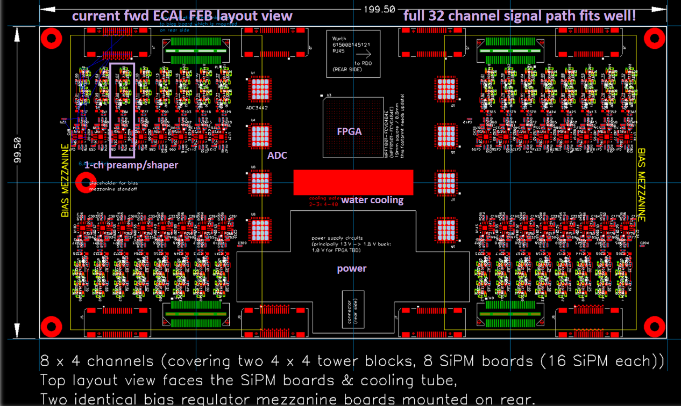
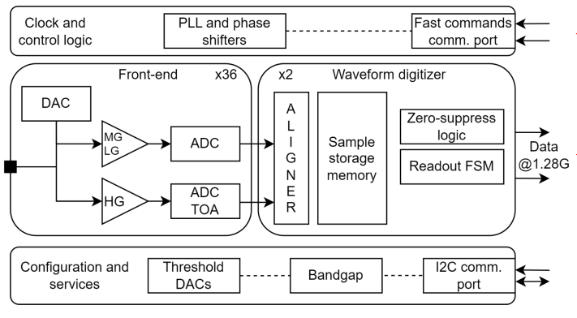
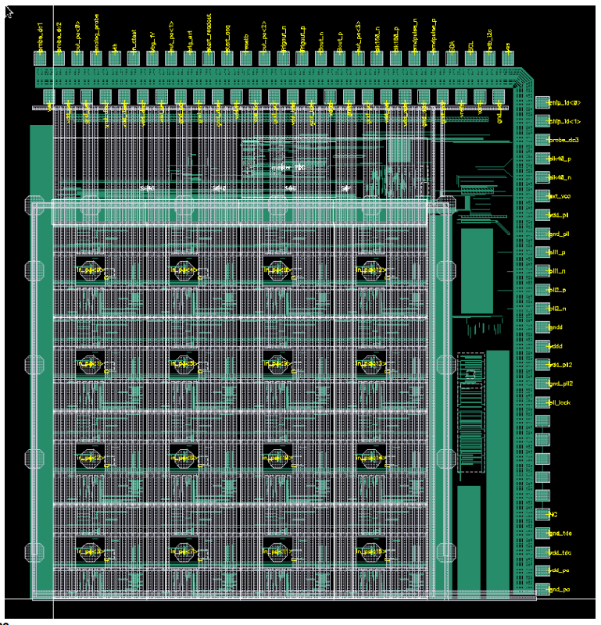
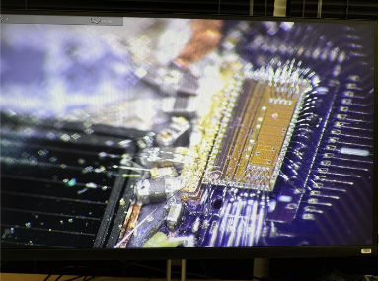
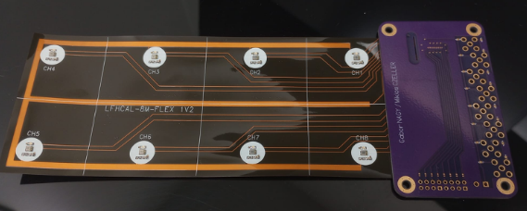
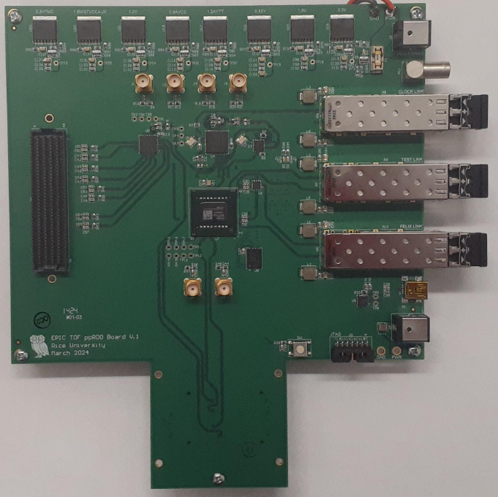
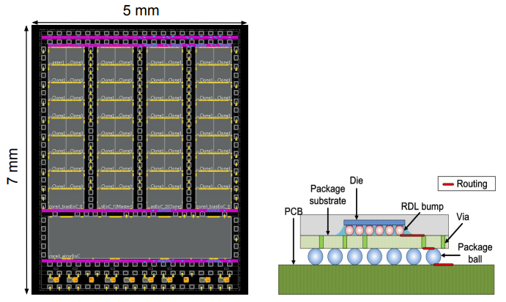
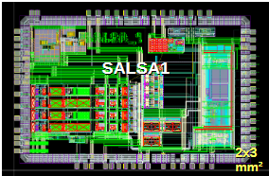
ASICs & Electronics – Component Status
 | Readout Technology | Status & Development Summary | Production | Institution
Discrete/COTS | Calorimeters, SiPM, 14-bit | Devices selected, PCB design practically completed. Beam tests FY24-FY25, Eng. Article FY26 | FY27 | Indiana University
CALOROC | Calorimeters, SiPM, 10-bit | Interface design FY23- FY24, CALOROC1A/B designed FY24-FY25, CALOROC2 (64 ch) FY25-FY26 | FY27 | OMEGA/IN2P3/IJCL, ORNL
EICROC (32x32) | AC-LGAD, pixel | EICROC0A (4x4) designed FY24-FY25, EICROC1 (8x32) (32x32) FY25, EICROC2 (32x32) FY26 | FY27 | OMEGA/IN2P3/IJCL/CEA-Saclay, AGH
FCFD (128) FCFD Variant (64) | AC-LGAD strip HRPPD/MCP-PMT | Front end characterized, FCFDv1 (6 ch) FY23-FY24 characterized, FCFDv1.1 FY25, FCFDv2 FY25-FY26 | FY27 | FNAL
Low-Mass Hybrid | AC-LGAD TOF | Pre-prototypes fabricated and co-cured onto Barrel TOF stave prototypes. Develop low cost hybridization techniques FY25-FY26 | - | ORNL
High Precision Clock Distribution, TOF Readout Chain | AC-LGAD, all | ppRDO PCB (6) complete, Jitter = 3 ps. Finalize development for TOFs, FF, FB detectors with use of EICROC and FCFD ASICs in FY25-FY26 | - | BNL/LBNL/RICE
ALCOR | dRICH, SiPM, 1 p.e. | ALCORv2.1 (32 ch) beam tests FY24, ALCOR v3 (64 ch) FY24-FY26 | FY26 – FY27 | INFN
SALSA | MPGD | SALSA0/1 FY24, SALSA2 (32 ch) designed FY23-FY25, SALSA3 (64 ch) FY25-FY26 | FY27 – FY28 | CEA-Saclay, U Sao Paulo
ASIC production is ~1 Year: Fab, Packaging, Test. Additional information in the following slides. PED is expected to be completed in FY26.
Complete.
Fab submission is imminent.

Slide 8




ASICs & Electronics - Scope of the Effort
Approximate quantities and costs.
Costs include mask sets, fabrication and packaging, wrt quantities needed.
 | #Ch | #Ch/Unit | #ASICs/Wafer | #Wafers | Node (nm) | Packaging | Cost/ch ($) | Institution
Discrete/COTS | 24 k | 32 | NA | 740 Digitizers | COTS | NA | 91 (Includes FE Adapter) | Indiana University
CALOROC | 97 k | 64 | 480 | 5 | 130 | BGA | 3.2 | OMEGA/IN2P3/IJCL, ORNL
EICROC | 5.2 M | 1,024 | 160 | 42 | 130 | Wafer Bump | 0.1 | OMEGA/IN2P3/IJCL/CEA-Saclay, AGH
FCFD strip FCFD Variant | 2.6 M 144 k | 128 64 | 180 | 149 13 | 65 | Wire Bond BGA | 0.5 | FNAL
ALCOR | 318 k | 64 | 800 | 8 | 110 | BGA | 0.9 | INFN
SALSA | 202 k | 64 | 500 | 9 | 65 | BGA | 4.1 | CEA-Saclay, U Sao Paulo
Production
      65 nm: $750 k masks + $3.5 k per wafer
      110 nm: $190 k masks + $4 k per wafer
      130 nm: $250 k masks + $4 k per wafer
Packaging BGA: $3-$7.5 per chip.
ASIC Costs Total: ~$3.3 M
  Masks: ~$2.2 M; Chips: ~$1.1 M

Slide 9
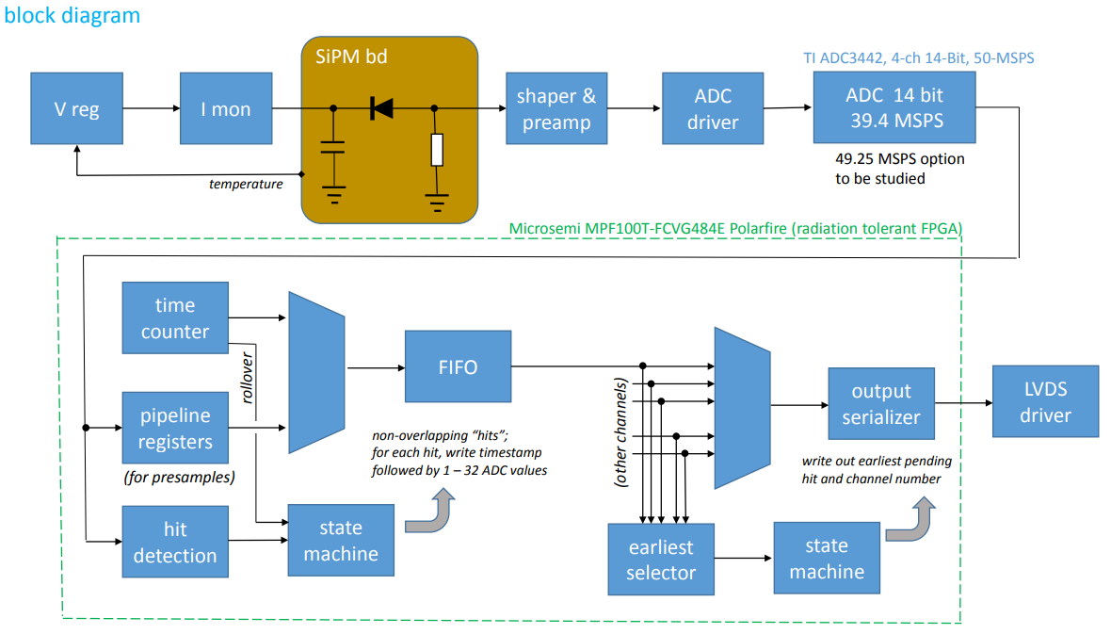
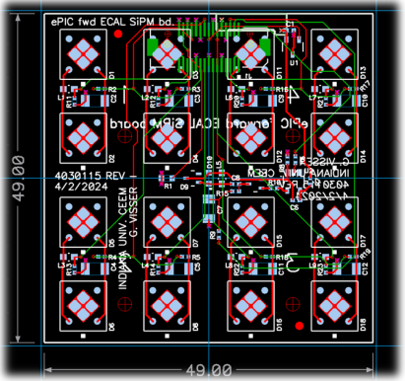
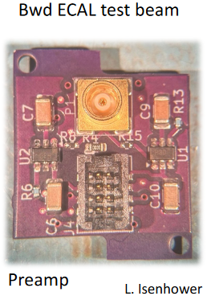
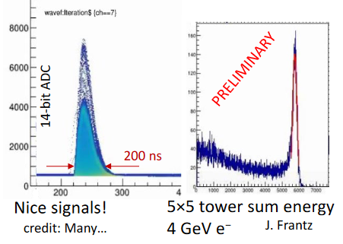
FY25 Status & Progress
Calorimeters, SiPMs – Discrete/COTS/ASIC (IU)
Adapter PCBs
Adapter PCB (Fwd ECAL)
FEB PCBs
FEB PCBs
32 ch Waveform Digitizer
12/14-bit TI ADC3422
Microsemi MPF100T-FCVG484E Polarfire (radiation hard FPGA)
CERN DC/DC converter bPOL12V/bPOL48V or LTC3601
Cabling (CAT6), Power (DC-DC), Cooling (liquid), Packaging (rack).
Progress Summary:
  Developments on fwd, bwd ECALs – DESY tests Feb 2025
  COTS DC/DC converters radiation tested in May 2024.
  Shaping (80 ns peaking time), 12 mW/ch PA
  PCB design practically complete, Adapter PCB prototype under tests.
Design, Fab: FY23 –FY24
Tests + Beam: FY24 – FY25
Engineering Article: FY26
Production: FY27

Slide 10
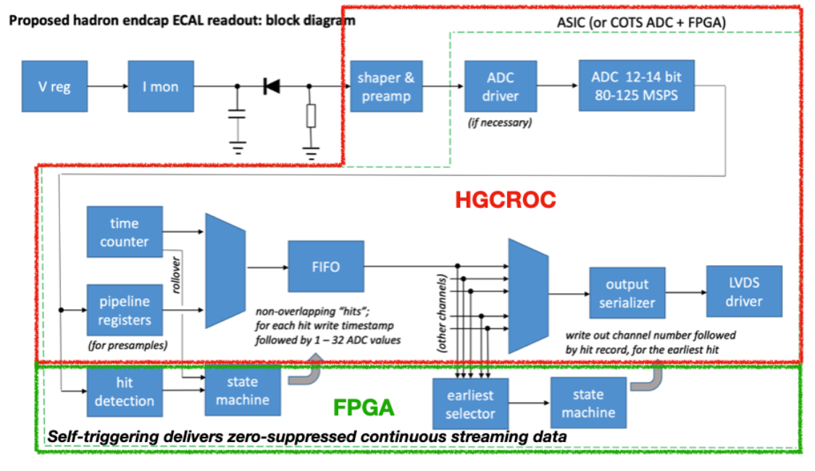
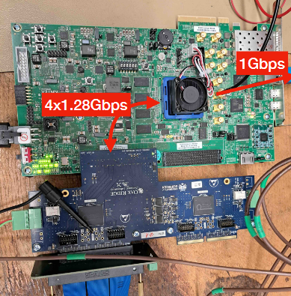
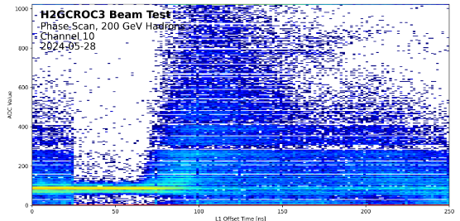
FY25 Status & Progress – cont.
Calorimeters, SiPMs – H2GCROCv3 (ORNL)
Develop a readout solution for the calorimeters with SiPMs by:
  Employing existing H2GCROCv3 ASIC
  Developing PCBs for full readout chain
  Developing cabling infrastructure
  Input to CALOROC design.
Adapter PCBs
FEB PCBs
Beam Tests, Waveforms
RDO PCBs
H2GCROCv3
Progress Summary:
  H2GCROCv3 PCBs (6) from OMEGA with KCU105 FPGA eval kit – Beam tests validating streaming readout operation algorithms.
  I2C and DAQ GUI interfaces done.
  Cabling studies for interconnects from FEBs to RDOs are progressing (SAMTEC connectors).
  LED tests using H2GCROC pulser.
  Testing SiPM summing PCBs for full characterization with multiple sensors under way.

Slide 11
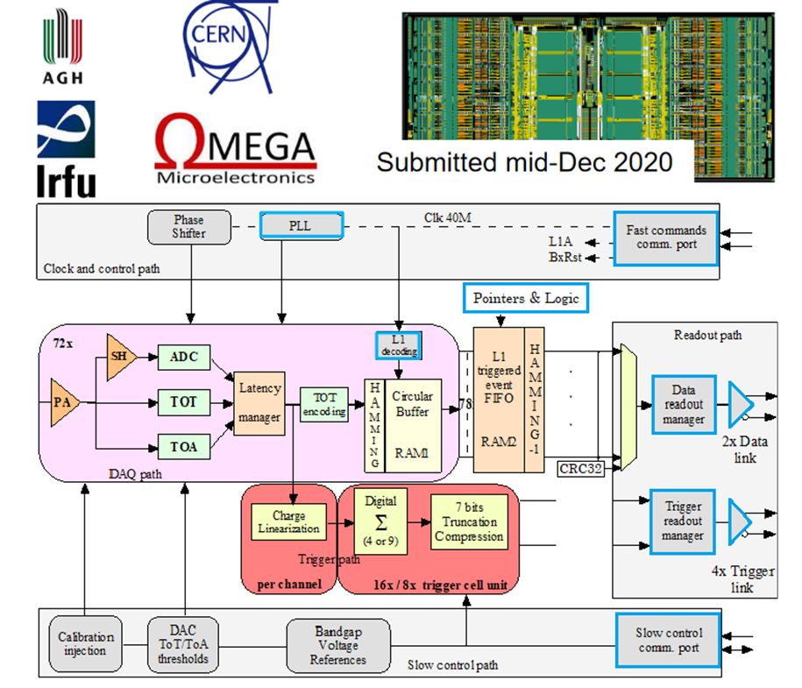
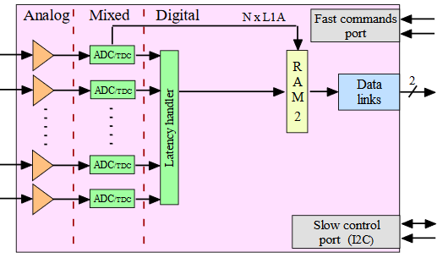
FY25 Status & Progress – cont.
Calorimeters, SiPMs – CALOROC (OMEGA/IN2P3/IJCL)
CALOROV1A
H2GCROCv3
No Change
Modify trig, mem, CLK dist.
1D, 64 ch.
130 nm CMOS
Charge (ADC+TOT) + Time (TOA)
Cdin: 500 pF-10 nF
Dynamic Range: up to 12 nC
Timing: <500 ps (1 MIP)
ADC: 10b; TOT: 15b
39.4 MHz operation from BX 98.5 MHz
Links: 1260.8 Mbps @ 39.4 MHz, multiple
Power: 10 mW/ch
Radiation tolerant.
Progress Summary:
  CALOROC1A and 1B – different FE (TOT or switched gain), same backend.
  Ready for submission – February 2025 – Pending funding.
  Available in June 2025, depending on funding.
  Backend designed and under simulation:
    Streaming Readout logic
    Memory
    Clock pre-scaling & distribution.
Design Backend: FY23 - FY24
CALOROC1A/B: FY24 – FY25
CALOROC2: FY25 – FY26
CALOROC3: FY27 Production

Slide 12
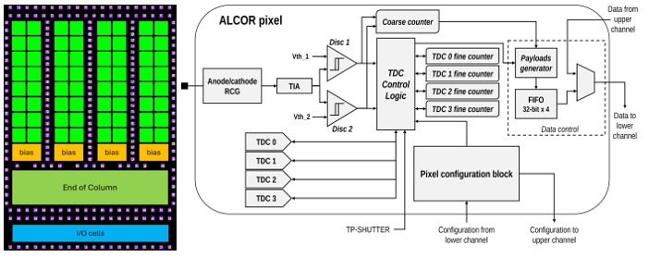
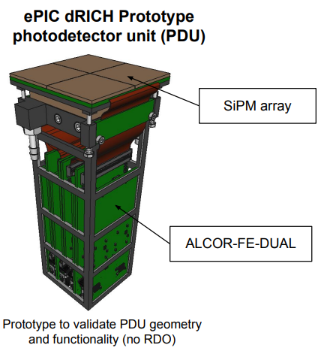
FY25 Status & Progress – cont. dRICH – SiPMs – ALCOR (INFN)
Originally developed by INFN for DARKSIDE.
Progress Summary:
  ALCOR v2: 32-pixel,
  ALCOR v2.1 delivered in Jan 2024 and currently in beam tests.
  Two 32 ch ALCOR on PCB (FE-DUAL) for PDU tests.
  ALCOR 64 ch fabricated.
  ALCOR v3 characterization – September 2025.
  FEB v1 – May 2025.
  RDO v1 – Simulations and layout on-going.
2D 8x8 pixel readout
110 nm CMOS
Dual polarity, RCG Amplification, conditioning, inhibit , digitization.
Modes of operation: single-photon tagging or time and charge.
Triggerless and triggered operation; Digital Shutter; Timing: <150 ps
20-40 ps TDCs, TOA+TOT
5 MHz input
788 Mbps LVDS links.
SPI Configuration.
Power: 12 mW/Ch
Radiation tolerant.
ALCOR v2.1 (32 pixel): FY24
ALCOR v3: FY24 – FY26
ALCOR: FY26 – FY27 Production

Slide 13
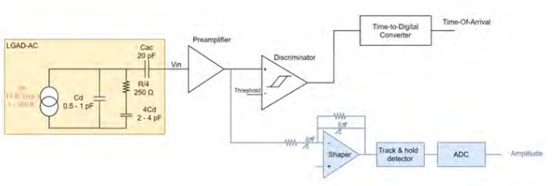
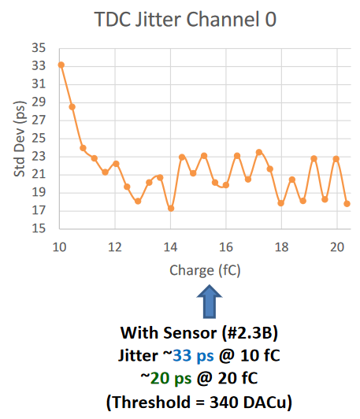
FY25 Status & Progress – Cont.
AC-LGAD pixel – EICROC (OMEGA/IN2P3/IJCLab/CEA-IRFU/AGH)
One pixel – EICROC0
2D, 32x32 pixel readout
130 nm CMOS
Preamp, Discriminator, TOA, ADC, TDC
Cdin: 1-5 pF; Dynamic Range: 1-50 fC
Timing: 30 ps; ADC: 8b; TDC: 10b
39.4 MHz operation from BX 98.5 MHz
Links: 1260.8 Mbps @ 39.4 MHz, multiple
Power: <2 mW/ch
Packaging: Bump+Wire bonds
Radiation tolerant.
Sensor
Plus backend as CALOROC
Progress Summary:
  EICROC0 (4x4) full characterization complete.
  EICROC0,A,B – intermediate iteration for low power complete.
  EICROC1A 8x32, EICROC1 32x32 - complete.
  Ready for submission – February 2025 – Pending funding.
  Available in June 2025, depending on funding.
Wire
EICROC0 (4x4): FY23 – FY24
EICROC0A (4x4): FY24 – FY25
EICROC1A (8x32), EICROC1 (32x32): FY25
EICROC2 (32x32): FY27 – FY28 Production
Wire
Bump
4x4 500 um pixels

Slide 14
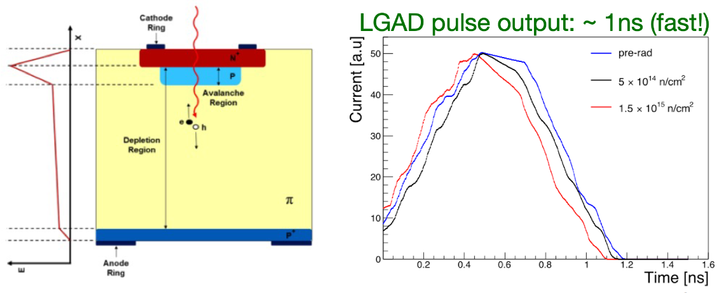
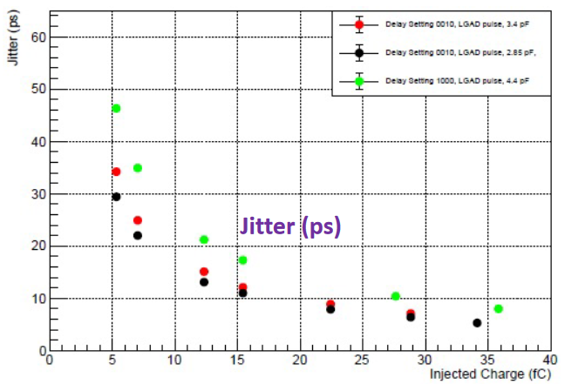
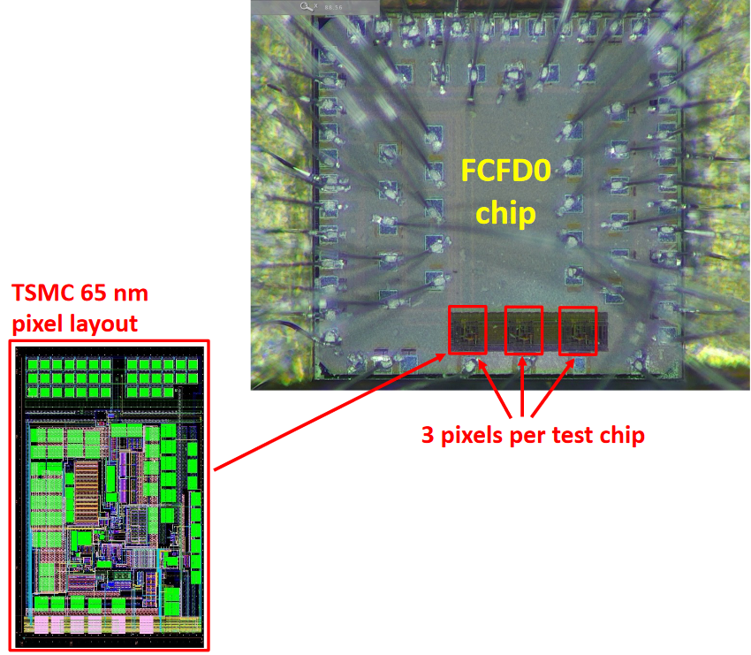
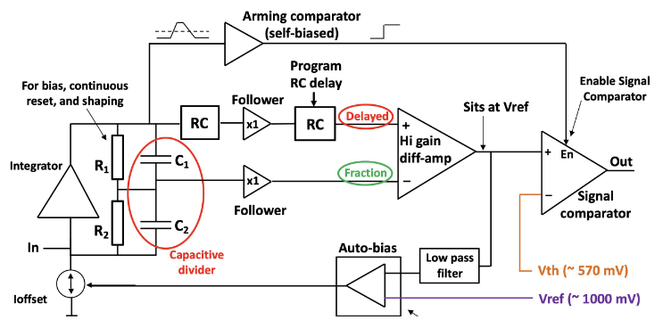
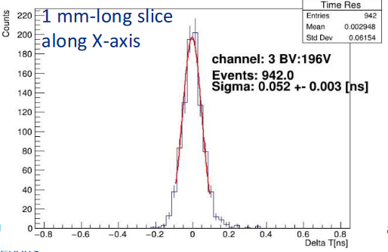
FY25 Status & Progress – Cont.
AC-LGAD strip – FCFD (FNAL)
Progress Summary:
  FCFDv1 – 6 channel received Jan 2024.
  Tested at FNAL in May & June 2024, AC & DC-LGAD (1 mm):
    DC-LGAD @ 50 ps; AC-LGAD @ 52 ps
    AC-LGAD should get ~35 ps with improved comparator.
  FCFDv1.1 – TSMC May 2025; DESY tests in July 2025.
128 ch strip readout
65 nm CMOS
Constant Fraction Discriminator
Plus TDC, ADC, interfaces
Cdin: <15 pF
Dynamic Range: 5-40 fC
Timing: 10-30 ps
Links: ~Gbps, multiple
Radiation tolerant.
FCFDv1 (6 ch): FY23 – FY24
FCFDv1.1 (6ch): May 2025
FCFDv2: FY25 – FY26
FCFDv3: FY27 Production

Slide 15
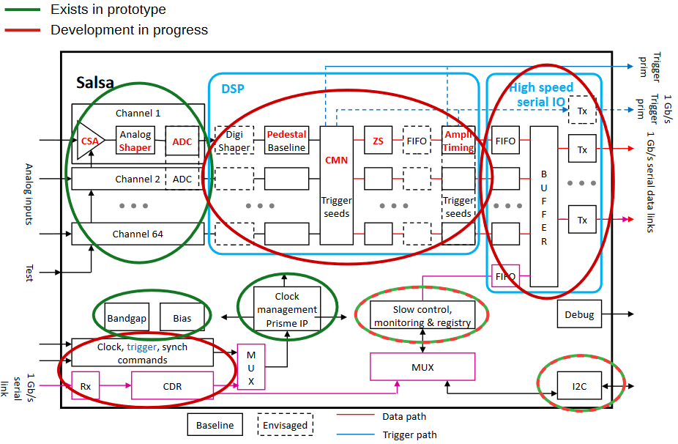
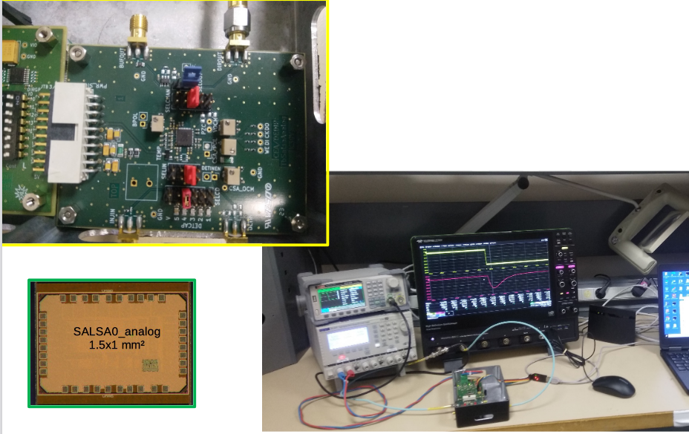
FY25 Status & Progress – Cont.
MPGD – SALSA (CEA-Saclay, U. Sao Paulo)
Progress Summary:
  SALSA0_analog and SALSA0_digital blocks fully characterized.
  PLL block + services prototyped under PRISME. PRISMEv1 – April 2025.
  SALSA1 (full frontend and ADC chain) – under tests.
  SALSA2 (32 ch fully featured with DSP) design in progress for submission in October 2025.
  Tests in 2026, available to users.
64 Ch
65 nm CMOS
Peaking time: 50 – 500 ns;
Inputs: Cdin<200 pF; Dual polarity; Q: 3 – 250 fC
ADC: 12 bits, 5 – 50 MSPS.
Extensive data processing capabilities
I2C configuration.
Triggerless and triggered operation;
Several 1 Gbps links.
Power: 15 mW/Ch
Radiation tolerant.
SALSA0 (IP blocks): FY23
SALSA1: FY23 – FY24
SALSA2: FY23 – FY25
SALSA3: FY25 – FY26
SALSA: FY27 – FY28 Production

Slide 16
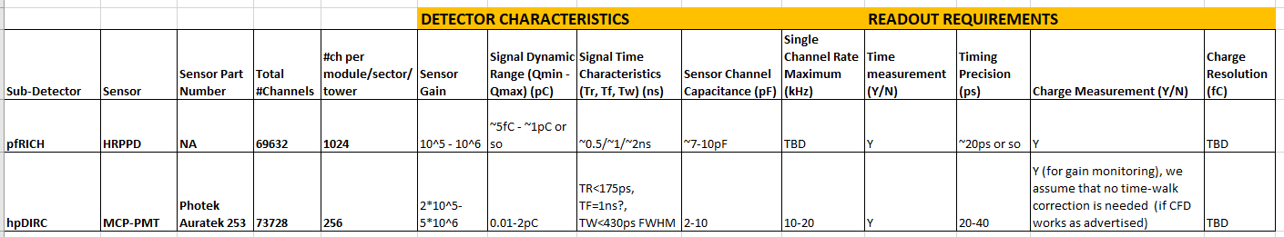
FY25 Status & Progress – Cont.
FCFD Variant for pfRICH, hpDIRC
Specifications & Requirements - Preliminary
FCFD Variant - project schedule being finalized into P6:
  Detectors operational characteristics and requirements
  ASIC preliminary specifications and requirements
  Packaging (64 ch?)
  Additional resources from FNAL.
Dynamic range requirements for pfRICH possibly narrower and agreeable with FCFD design for the bTOF AC-LGADs and wrt timing precision and signal charge envelope
Refining specifications.

Slide 17
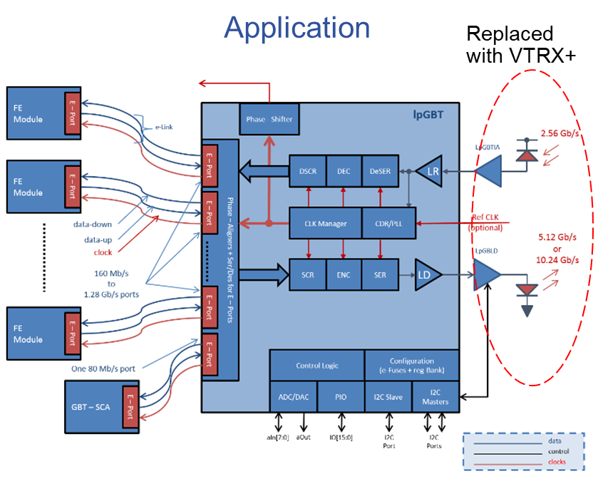
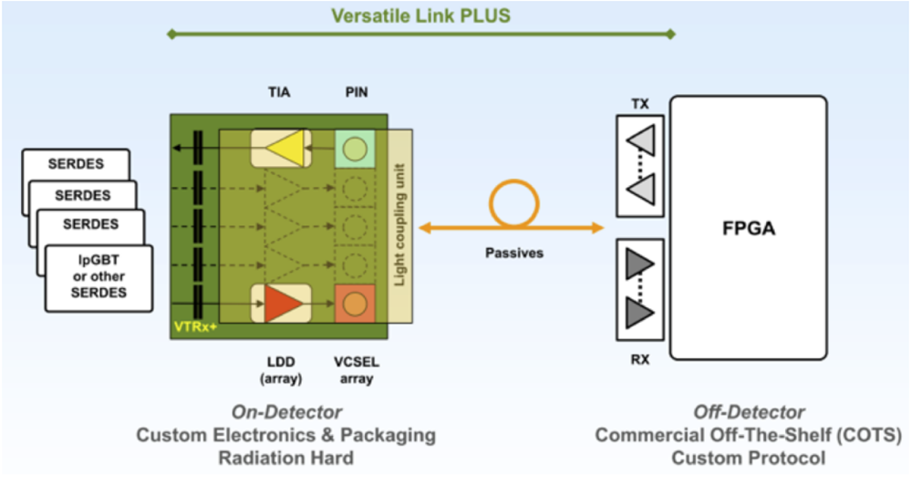
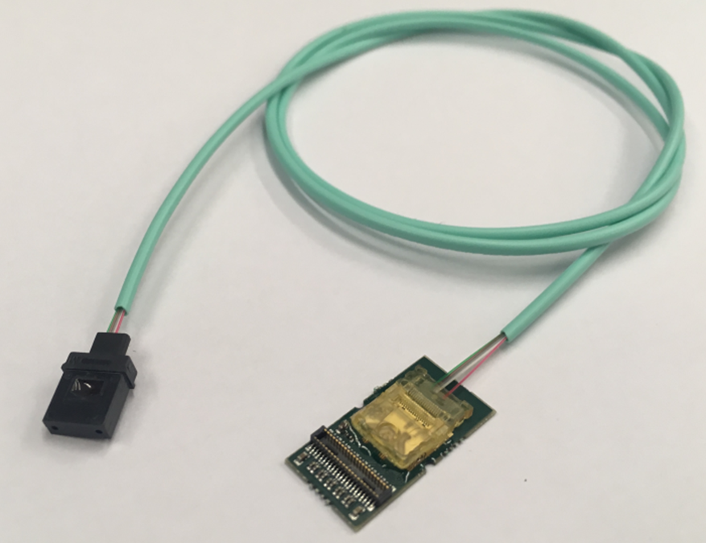
FY25 Status & Progress – Cont.
VTRX+ & lpGBT - Procurements under CD-3B
These electronics readout components are used as optical link modules for data transmission (VTRX+) and as 65nm-CMOS serializer/de-serializer devices (lpGBT) used on the front-end electronics of the EIC detectors, both compact and radiation tolerant.
The lpGBT and VTRX+ devices are essential for the readout of the Silicon Monolithic Active Pixel Sensors MAPS based tracker detectors.
QA/QC performed by CERN prior to delivery.

Slide 18
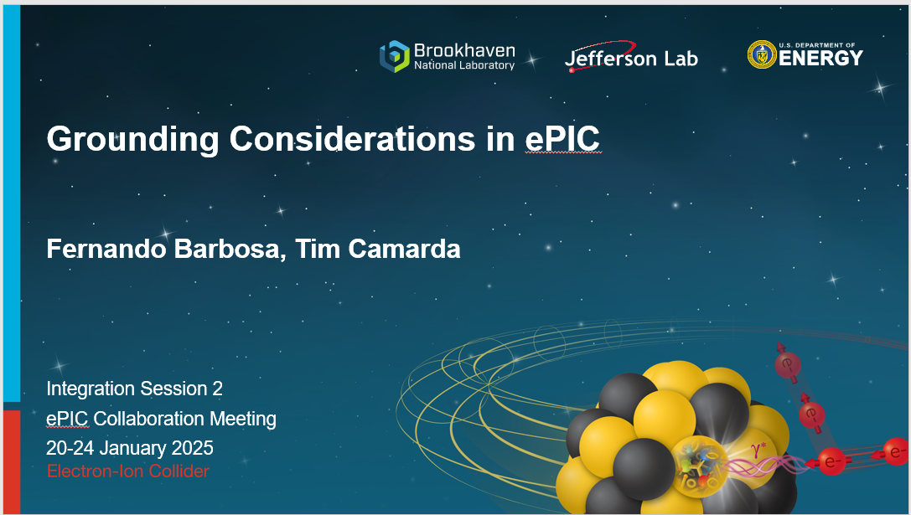
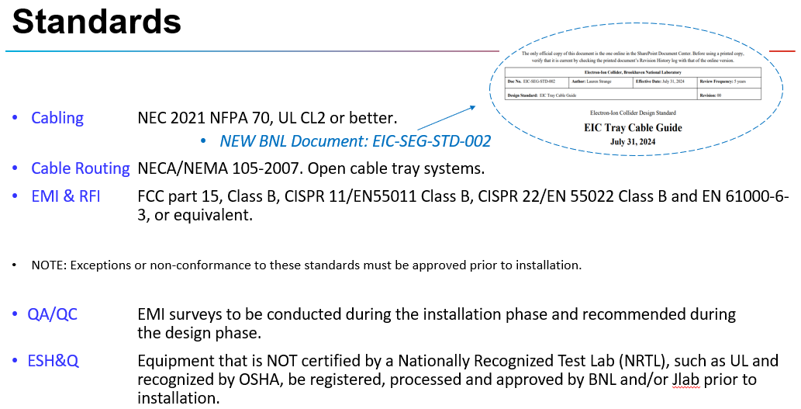
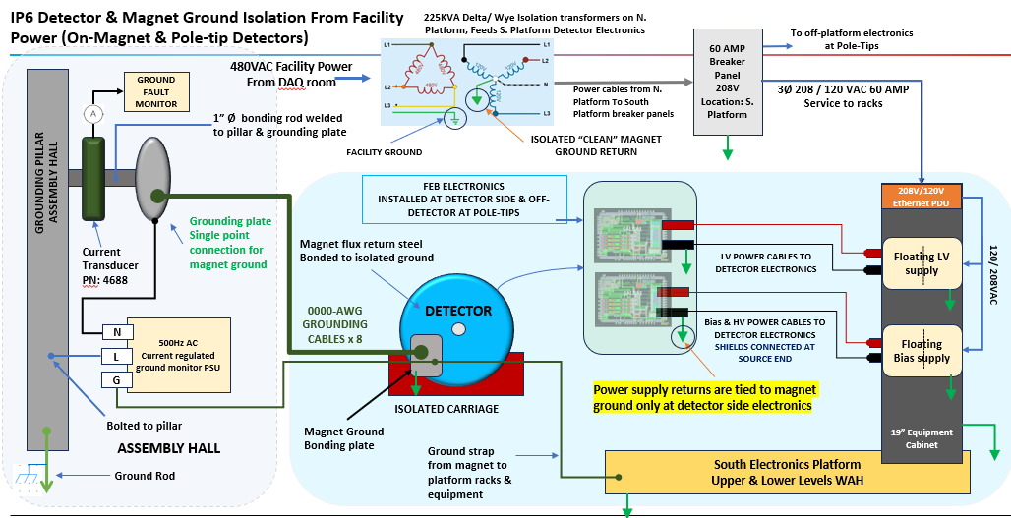
FY25 Status & Progress – Cont.
Infrastructure, Standards, Grounding
Refer to prebrief materials.

Slide 19
Schedule: WBS 6.10.08 – Electronics - Development
Development Process (not to scale)
Construction
FY23 through FY26
ASIC Development
FY26 – FY28 – 1 Year each ASIC
ASIC Fab Production & Testing
NOTE: FEB designs are contingent upon final ASIC pinout/package design.
6 Months
ASIC Testing
FEB Eng. Article Development
Eng. Article Tests
Installation
<1 Year
PCB Production
First Production ASICs
<1 Year
Production Tests
<3 Months
Integration Tests
<3 Months
R&D FY23 - FY24
PED FY25 - FY26
System Tests
ASIC Fab & Eng. Article
FEB Production

Slide 20
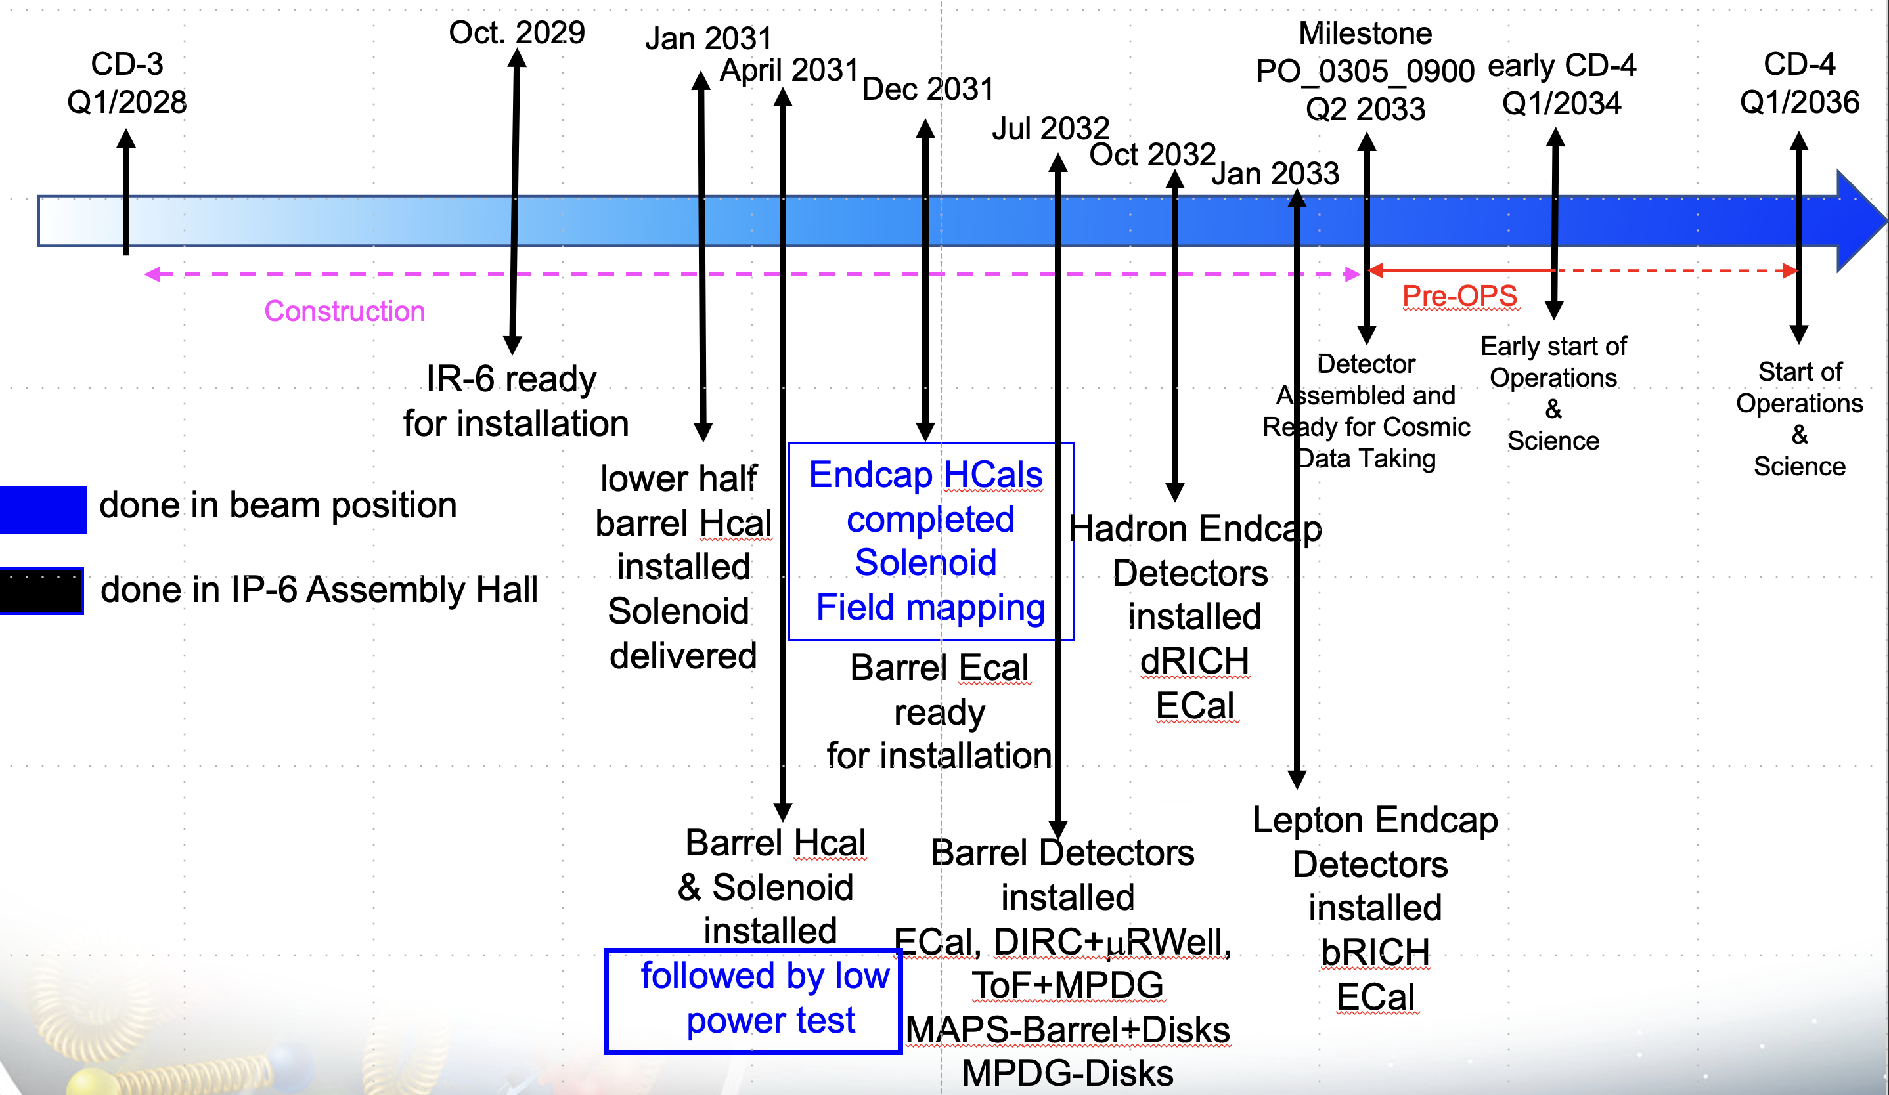
Schedule: WBS 6.10.08 – Electronics - Installation
WBS6.10.02 | eRD109 | Milestones | FEB QC Complete
Calorimeters | Discrete, CALOROC | FY26 & FY27 | Apr 2028 – Jul 2029
AC-LGAD | EICROC, FCFD | FY26 & FY27-28 | Apr 2028 – Jul 2030
dRICH | ALCOR | FY26 & FY26-27 | Apr 2027 – Jul 2029
MPGD | SALSA | FY26 & FY27-28 | Apr 2028 – Jul 2030
HRPPD/MCPMT | FCFD + Variant | FY27 & FY27-28 | Apr 2028 – Jul 2030
Installation
Jan 2031 – Jan 2033
WBS 6.10.02 – Electronics for detectors R&D.
eRD109 – Readout R&D.
Milestones – ASICs readiness reviews & Production.
ASIC Production FY26 – FY28.
FEB QA/QC Complete – Ready for integration.
FY23 – FY26
FY26 – FY28
R&D, PED (eRD109)
ASIC Production
4/2027 – 7/2030
FY26 – FY28
Readout Production & QC
QC Complete

Slide 21
Summary
Considerable progress:
      ASIC interfaces for FEB-RDO – iterative process with designers, on-going
      ASICs meeting with project 2-3 June 2025 @ Saclay – towards production readiness.
      Procured lpGBT and VTRX+ under CD-3B (in production, by CERN).
Resources needed for the next 1-2 years:
  Expect a few prototype MPW runs per design ($)
  Pre-production run per design ($$$) (masks: $250k/130 nm, $750k/65 nm)
  Tests are resource intensive (EE, Tech, prototypes)
  pfRICH, hpDIRC readout – FCFD Variant in progress.
Contracts
  FY23 – Completed
  FY24 – A few requested extensions into FY25
  FY25 – All PED (P6) onward, all submitted, some awaiting award due to funding availability and delays.
Outlook
  Finalize Project Engineering and Design (PED) phase
  Finalize TDR
  Production of ASICs and FEBs, including QA/QC, expected to be ready for installation within FY30 – FY32.

Slide 22
Backup Material

Slide 23
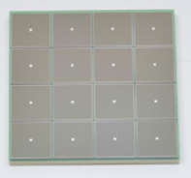
Streaming Readout Chain – P6 Partitions
Global Timing Unit (GTU)
-Interfaces to Collider, Run Control & DAM
-Config & Control
-Clock & Timing
Sub-Detector P6s
Electronics P6
WBS 6.10.08
DAQ P6
WBS 6.10.09
On Detector
SMT BGA
Name
Design
Function
Attributes
Sensor
Detector Specific
-Multi-Channel Sensor
-MAPS
-AC-LGAD
-MPGD
-MCP-PMT
-SiPM
-LAPPD
Adapter
Detector Specific
-HV/Bias Distribution
-HV divider
-Interconnect Routing
-Sensor Specific
-Passive
Front End Board
(FEB)
Detector Specific
-Amplification
-Shaping
-Digitization
-Zero Suppression
-Bias Control & Monitoring
-ASIC/ADC
-Discrete
-Serial Link
Readout Board
(RDO)
Few Variants
-Communication
-Aggregation
-Formatting
-Data Readout
-Config & Control
-Clock & Timing
-FPGA
-Fiber Link
Data Aggregation Module (DAM)
Common
-Computing Interface
-Aggregation
-Software Trigger
-Config & Control
-Clock & Timing
-Large FPGA
-PCIe
-Ethernet
Computing
Common
-Data Buffering and Sinking
-Calibration Support
-QA/Scalers
-Collider Feedback
-Event ID/Building
-Software Trigger
-Monitoring
-COTS
-Ethernet

Slide 24
FY25 eRD109 proposals - Status
 | File | Authors | Sub-Detector | Sensor Type | Readout Solution
A | eRD109_FY24_waveform_readout_prototype_Gerard | G. Visser (IU), et al. | Calorimeter | SiPM | Discrete, COTS
B | eRD109ProposalFY24_Norbert | N. Novitzky (ORNL), F. Dulucq (IN2P3/IJCL), et al. | Calorimeter | SiPM | ASIC (H2GCROCv3, CALOROC)
C | eRD109-application_ALCOR_INFN_TO_BO_Michela | M. Chiosso (INFN), et al. | dRICH | SiPM | ASIC (ALCOR)
D | eRD109-FY24-20230710_Zhenyu | Z. Ye (UIC), et al. | Central, Far-Forward | AC-LGAD, SiPM | ASIC (EICROC, FCFD, CALOROC)
E | eRD109_2024_SALSA_proposal_vfinal2_Damien | D. Neyret (CEA), et al. | Micromegas, GEM, MicroRWell | MPGD | ASIC (SALSA)
Continuation in PED
Continuation in PED
FY25 OPC
Continuation in PED
Continuation in PED
Contract Awards – taking longer than anticipated.
 | Detector/Technology | Discrete/ASIC | Group | Submitted | Awarded
A | Calorimeter/SiPM | Discrete | IUCF | FY26
B | Calorimeter/SiPM | CALOROC/H2GCROCv3 | Omega/IJCL/ORNL | November 2024 | TBA/January 2025
C | dRICH/SiPM | ALCOR | INFN | October 2024 | March 2025
D | AC-LGAD | EICROC | Omega/IN2P3/IJCL | November 2024 | TBA
 |  | FCFD | FNAL | November 2024 | January 2025
 |  | Barrel L-M Serv. Hybrid | ORNL/NWU/RIKEN | BNL | BNL
 |  | TOF Readout Chain | BNL/RICE/LBNL | March 2025 | BNL/FY25/FY26
E | MPGD/µRWell | SALSA | CEA | January 2025 | TBA
 |  |  | USP | January 2025 | February 2025
In consideration of limited OPC funds and aggregation by detector technology application.
TBA – To be awarded

Slide 25
FY24 eRD109 Milestones
Proposal A: Discrete COTS
 | Milestone | Estimated Date | Status
1 | Power, bias, preamp | November 2023 | @ 95%, October 2024
2 | PCB design and fabrication | February 2024 | November 2024
3 | Firmware development | February 2024 | November 2024
4 | Start of bench tests | December 2023 | February 2024
5 | ASIC evaluation | January 2024 | CALOROC, June 2025
6 | Beamtest support and precision measurements | May 2024 | May 2024 - March 2025
7 | Revision of firmware and (potentially) of PCB’s | August 2024 | August 2025
*Power distribution validation: bPOL12V, bPOL48V, LTC3626.
Proposal B: CALOROC/H2GCROCv3
 | Milestone | Estimated Date | Status
1 | Results from beam tests with LFHCAL prototype | October 2023 | August 2024
2 | Start of mid-level tests of the H2GCROC with SiPM | October 2023 | April 2024
3 | Mid-level design of on-detector prototype boards | October 2023 | April 2024
4 | Start of design of off-detector prototype boards | April 2024 | April 2024
5 | FPGA phase 1 firmware completion | December 2023 | May 2024
1 | Start of Interface Design (CALOROC/EICROC) | October 2023 | July 2024
2 | CALOROC1A/1B Submission Ready | May 2025 | June 2025
H2GCROCv3
CALOROC

Slide 26
FY24 eRD109 Milestones – cont.
Proposal C: dRICH ALCOR, RDO
 | Milestone | Estimated Date | Status
1 | Irradiation tests on ALCOR V2 and SEU evaluation | July 2024 | August 2024
2 | ALCOR v3 at 75% completion | September 2024 | August 2024
3 | RDO board for dRICH complete | September 2024 | October 2024
4 | ALCOR v3 Tapeout |  | April 2025
Proposal D: AC-LGAD
 | Milestone | Estimated Date | Status
1 | EICROC0 noise coupling studies | November 2023 | July 2024
2 | Characterization of EICROC0 with 4x4 AC-LGAD | February 2024 | December 2024
3 | EICROC0_v1/EICROC0A design | December 2023 | December 2024
4 | EICROC0_v1/EICROC0A fabrication complete | March 2024 | June 2025
5 | EICROC0_v1 tests complete | September 2024 | December 2025
6 | EICROC1 design and submission to fab | June 2024 | December 2024
7 | EICROC 1 fabrication complete |  | June 2025
1 | FCFDv2 specifications complete | December 2023 | October 2024
2 | FCFDv1 final performance characterization | June 2024 | August 2024
3 | FCFDv1.1 Design of mixed-signal multi-channel | September 2024 | November 2024
4 | FCFDv1.1 fabrication complete | September 2024 | May 2025
EICROC
FCFD

Slide 27
FY24 eRD109 Milestones – cont.
Proposal D: AC-LGAD Cont.
 | Milestone | Estimated Date | Status
1 | Flex PCB design, fabrication and characterization start | April 2024 | April 2024
2 | Flex PCB design, fabrication and characterization completion | July 2024 | September 2024
3 | Low cost sensor-ASIC hybridization | August 2024 | September 2025
1 | Procurement of one ppRDO prototype | May 2024 | May 2024
2 | Firmware Installation on ppRDO | June 2024 | August 2024
3 | Characterization and Measurements of Clocks and Signals | September 2024 | August 2024
4 | Collaboration with Developers to understand the interface between EICROC and the Xilinx dev kit | September 2024 | December 2025
1 | Understand the interfaces between the Artix FPGA evaluation kit and ETROC2, and finalize the plan to use evaluation kit to communicate with ETROC2 | February 2024 | April 2024
2 | Obtain ETROC2 test board, Artix FPGA evaluation kit, extension board and cables needed to connect FPGA Kit and ETROC2 test board | March 2024 | May 2024
3 | Complete 50% of the initial version firmware to communicate with ETROC2 using FPGA evaluation kit | April 2024 | May 2024
4 | Compete the initial version of the firmware to communicate with ETROC2 using FPGA evaluation kit | May 2024 | July 2024
5 | Finalize the firmware to communicate with ETROC2 using FPGA evaluation kit | June 2024 | December 2025
Barrel Low-Mass Service Hybrid
BNL
High Precision Clock Distribution
LBNL

Slide 28
FY24 eRD109 Milestones – cont.
Proposal D: AC-LGAD Cont.
 | Milestone | Estimated Date | Status
1 | Schematics 50% complete; major parts established | March 2024 | April 2024
2 | Order major parts | March 2024 | April 2024
3 | Schematics 100% complete (with internal review) | June 2024 | May 2024
4 | Order all parts | June 2024 | May 2024
5 | PCB layout complete (with internal review) | August 2024 | June 2024
6 | Board assembly complete. 5 pieces delivered | September 2024 | July 2024
7 | Basic electrical & power Q&A. FPGA loads a simple example FW from PROM and blinks LEDs | September 2024 | August 2024
High Precision Clock Distribution - ppRDO
RICE
Proposal E: SALSA
 | Milestone | Estimated Date | Status
1 | SALSA1 design complete and submission | January 2024 | April 2024
2 | SALSA1 evaluation and SALSA2 specifications | July 2024 | December 2024
3 | SALSA2 submission | March 2025 | October 2025
4 | SALSA2 tests | September 2025 | January 2026

Slide 29
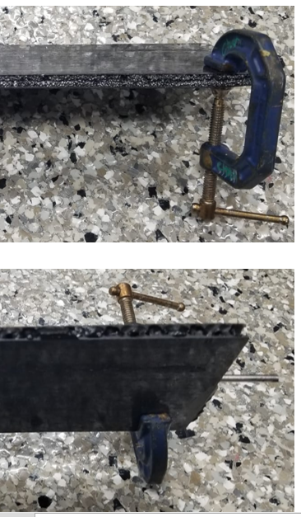
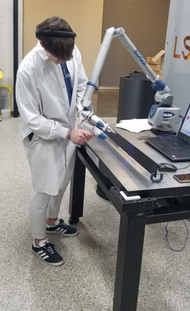
FY25 Status & Progress – Cont.
AC-LGAD – Barrel Low-Mass Hybrid (ORNL)
Flex with LV, HV, Temperature sensors
2-layer and multi-layer Kapton with different stack-ups
With peel-off Kapton to protect ENIG pads
Flex-PCB
Barrel TOF Carbon Fiber Test Structures
Progress Summary:
  Pre-prototypes fabricated and successfully co-cured onto the TOF prototype staves at Purdue.
  Full characterization under way.
  Materials and equipment procured for flip-chip assembly (~$2M from ORNL).
  Started making test assemblies with Flex-PCB pre-prototypes.

Slide 30
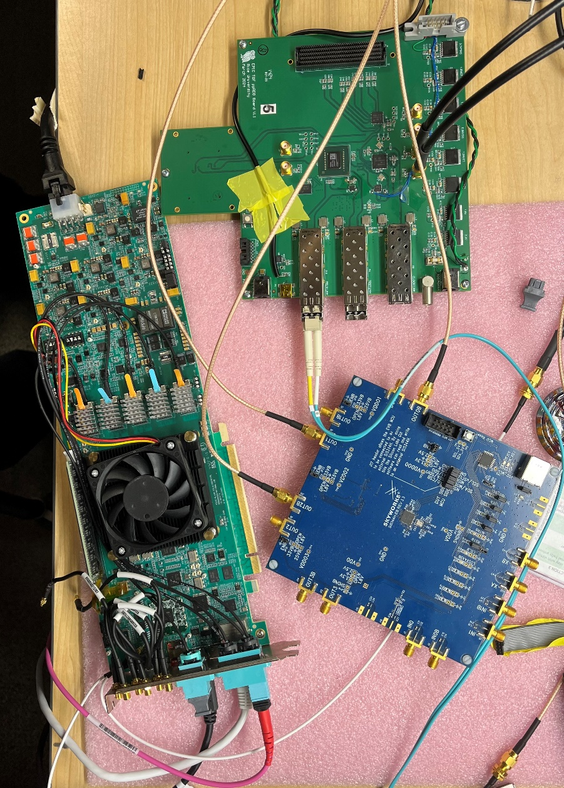
FY25 Status & Progress – Cont.
AC-LGAD – High Precision Clock Distribution (BNL/LBNL/RICE)
ppRDO – pre-prototype Readout Board:
  Generalized to allow readout from various ASICs – FMC connector
  Xilinx Artix+ FPGA (low cost, CERN TCLink compatible
  Clock Jitter cleaner – 5 ps
  Clock recovery on Rx of SFP or direct clock on dedicated fiber
  Establish procedures to readout ePIC’s ASICs prototype PCBs
  Develop common streaming readout scheme with DAQ’s protocols
  Platform for radiation tests (SEU measurement and handling)
ppRDO
(ADCLK944)
Progress Summary:
  Produced and tested 6 PCBs.
  Jitter measured at 3 ps (Ref clock – FLX182 Tx serializer – ppRDO)
  In Progress:
    General firmware
    Readout of CMS ETROC ASIC, as a test
    DAQ readout firmware
    Planning tests with VTRX+ transceiver.
FLX182
Si5344H
(ref Clock)

