Slide 1
DAQ/Computing
David Abbott (JLAB) & Jeff Landgraf (BNL)
L3 Managers WBS 6.03.08 (DAQ)
10th EIC DAC Review
June 11th – 13th, 2025

Slide 2
Charge Questions Addressed
Is the design of the ePIC detector and its sub-systems appropriate and progressing well?
Are the remaining work and technical, cost and schedule risks adequately understood? Are there opportunities?
Will the detector be technically ready for baselining by late 2025?
Are the detector integration and planning for installation and maintenance progressing well? Are there areas where further ideas should be pursued?
Will the detector be ready for start of construction by late 2026?

Slide 3
Scope: WBS 6.03.08 – DAQ/Computing
6.03
EIC Detector
WBS 6.03.08 | DAQ/Computing | D. Abbott/J. Landgraf
Scope Definition: This WBS covers the effort for the data-acquisition (DAQ) and computing necessary to collect all data from the front-end detector electronics as well as from relevant slow control and accelerator systems. The DAQ will support a streaming (triggerless) readout model, collecting all the data from the different subdetectors and suppress detector pedestals and noise.
Deliverables: A DAQ-system compatible with a streaming readout approach of the EIC detector.
6.03.01
Detector Management
6.03.07 Electronics
6.03.02 Tracking
6.03.08 DAQ / Computing
WBS 6.03.08.01 | Data Acquisition | D. Abbott
Scope Definition: This WBS specifically covers the efforts associated with the primary DAQ related infrastructure and requirements including the development of the global timing and synchronization system and the front-end link aggregation hardware (FPGA Based). It also addresses the online computing requirements associated with zero suppression, background and noise filtering as well as event identification.
Deliverables: Custom hardware and firmware, COTS computing and networking as well as software necessary for readout, beam and detector Q/A and intermediate data storage
6.03.03
Particle Identification
6.03.09
Integration, Installation, Infrastructure
6.03.04 EM Calorimetry
6.03.10
IR Integration,
Anc. Detectors
6.03.05
Hadronic Calorimetry
6.03.11
Detector Non-Beam Commissioning
WBS 6.03.08.02 | Slow Controls Integration | D. Abbott
Scope Definition: This WBS addresses efforts necessary for the integration of all detector-related slow controls information. This includes the general network infrastructure in both the experimental hall and the counting house, computing and database resources and manpower to coordinate subdetector slow control software applications and DAQ integration.
Deliverables: A controls system and network infrastructure for the DAQ and all the subdetectors
6.03.06 Detector Magnet
6.03.12
Polarimetry, Luminosity

Slide 4
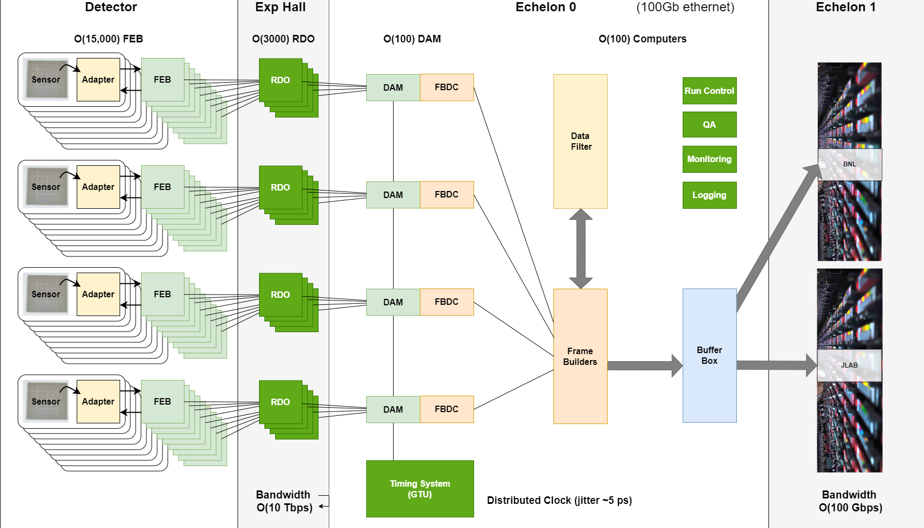
EIC Streaming DAQ/Computing Architecture
Bunch Crossing
~10.2 ns/98.5 MHz
Interaction Rate
~ 2 us/500 kHz
Low occupancy

Slide 5
Streaming in ePIC
DAQ
Definition of streaming is “No L0 trigger”
All data is zero suppressed by the front-end electronics
No system wide deadtime in normal operation
Collaboration should have the full ability to make data selection cuts on the widest possible criteria
Flexible event selection, data selection and background characterization
But subject to an overall throughput budget of ~100Gb/sec
ePIC Streaming will include
Capabilities for hardware and firmware-based triggering / data selection
Capability for flow control
Zero suppression & aggregation within data packets
Greater sensitivity to noise than triggered system
Greater sensitivity to backgrounds than triggered system
Computing
Definition of streaming is “Process data as it arrives”
Fast Reconstruction (~3 weeks not months or years) using automation of calibration and reconstruction.
Requires some overlap between DAQ/computing
Automation of calibrations
Mapping calibration dependencies
Mapping application of calibrations
Mapping evolution of calibrations
QA and monitoring can make use of full offline structure
Consistent schemes and language for data/metadata
Event selection / tagging / and accounting
Global data taking state model, including data types & quantity available, state of calibrations, and reconstruction goals is required for automation

Slide 6
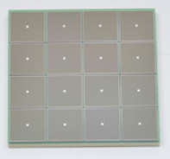
ePIC Readout Chain
WBS 6.03.x
WBS 6.03.07
WBS 6.03.08
Off Project
ECSJI – Joint Institute
Global Timing Unit (GTU)
- Interfaces to Collider
Run Control & DAM
- Config & Control
- Clock & Timing
(BNL)
On Detector
SMT BGA
(JLAB)
Name
Design
Function
Attributes
Sensor
Detector Specific
Multi-Channel Sensor
MAPS, AC-LGAD
MPGD, MCP-PMT
SiPM, LAPPD
Adapter
Detector Specific
-HV/Bias Distribution
-HV divider
-Interconnect Routing
-Sensor Specific
-Passive
Front End Board
(FEB)
Detector Specific
-Amplification
-Shaping
-Digitization
-Zero Suppression
-Bias Control & Monitoring
-ASIC/ADC
-Discrete
-Serial Link
Readout Board
(RDO)
Few Variants
-Communication
-Aggregation
-Formatting
-Data Readout
-Config & Control
-Clock & Timing
-FPGA or lpGBT
-Fiber Link
Data Aggregation Module (DAM)
Common
-Computing Interface
-Aggregation
-Software Trigger
-Config & Control
-Clock & Timing
-Large FPGA
-PCIe
-Ethernet
Echelon 0
Computing
Common
-Data Buffering and Sinking
-Calibration Support
-QA/Scalers
-Collider Feedback
-Event ID/Building
-Software Trigger
-Monitoring
-COTS
-Ethernet
Echelon 1
Computing
Common
- Archive
- Reconstruction
- Analysis

Slide 7
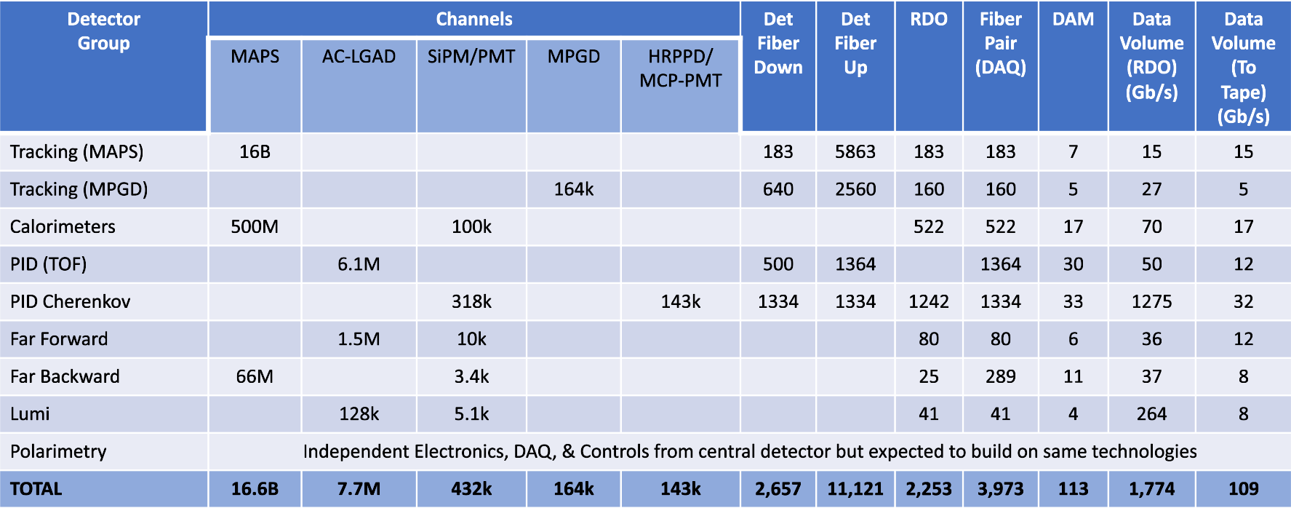
Summary of Channel Counts and Data Flow
Scale of the system:
Electronics
~ 24 detectors
~ 5 Readout Technologies
~ 3000 RDOs (on detector/in racks)
~ 100 DAM boards (DAQ room)
GTU (with interface boards)
Maximum Data Volume
~ 2 Tb/sec digitized
~ 115 Gb/sec recorded
Online Computing
~200 nodes (DAQ Room/SDCC)
Summary of Data Flow
PCI/Eth
Eth
Detector
FEB
Copper
RDO
Fiber
DAM
Readout Computer
Aggregate | 2.0 Tb/sec
Noise | 1.6 Tb /sec
Signal from Physics + Background | 400 Gb / sec
Aggregate | 115 Gb/sec
Collision Signal | 62 Gb/sec
Synchrotron Rad | 6 Gb/sec*
Electron Beam | 4.5 Gb/sec
Hadron Beam | 1.0 Gb/sec
Noise | 41 Gb/sec
Synchrotron radiation caveats:
Rates are based upon hit rate for all ePIC detectors. In fact, data volumes depend upon specific detector hit (64 bits/hit assumed)
Highest Synchrotron radiation / electron beam gas will correspond to lower values for collision signal
Plan to analyze by component soon
*
Aggregate | 2.0 Tb/sec
Per RDO (Avg) | 0.7 Gb/sec

Slide 8
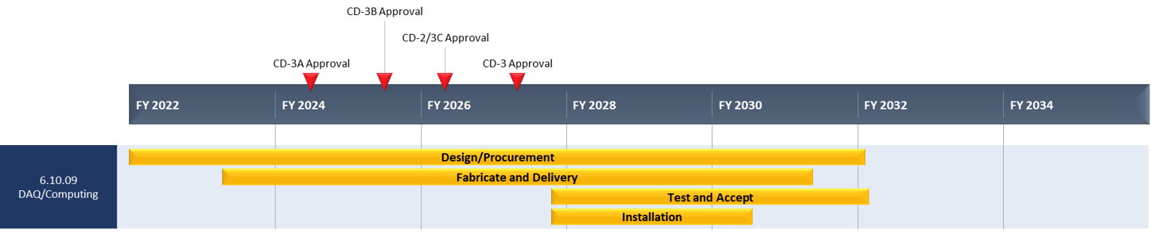
Schedule
A functional DAQ will be necessary for small scale detector testing as well as commissioning and pre-ops.
Computing resources are staged to make purchases when the hardware is needed, taking advantage of price savings and performance improvements in time.
Hardware and software development early in the construction phase will involve a series of releases with increasing functionality.
Detector Install: FY29Q2 - FY31Q2
Cosmics: FY31Q3
Early CD-4: FY32Q4
DAQ Releases:
PicoDAQ FY26Q1
Readout test setups
MicroDAQ: FY26Q4
Readout detector data in test stand using engineering articles
MiniDAQ: FY28Q1
Readout detector data using full hardware and timing chain
Full DAQ-v1: FY29Q2
Full functionality DAQ ready for full system integration & testing
Production DAQ: FY31Q3
Ready for cosmics
PDR1
PicoDAQ
MiniDAQ
Production
DAQ
PDR2
MicroDAQ
Full DAQ-V1
PDR3
Non-LLP pre-baseline schedule is in progress

Slide 9
Schedule
A functional DAQ will be necessary for small scale detector testing as well as commissioning and pre-ops.
Computing resources are staged to make purchases when the hardware is needed, taking advantage of price savings and performance improvements in time.
Hardware and software development early in the construction phase will involve a series of releases with increasing functionality.
Detector Install: FY29Q2 - FY31Q2
Cosmics: FY31Q3
Early CD-4: FY32Q4
DAQ Releases:
PicoDAQ FY26Q1
Readout test setups
MicroDAQ: FY26Q4
Readout detector data in test stand using engineering articles
MiniDAQ: FY28Q1
Readout detector data using full hardware and timing chain
Full DAQ-v1: FY29Q2
Full functionality DAQ ready for full system integration & testing
Production DAQ: FY31Q3
Ready for cosmics
SRO Computing (Off Project)
PicoDAQ
No direct connection to DAQ.
Stand alone testbed development:
Transfer / Data Management (Ruchio)
Orchestration / State Model (e.g. Panda)
Streaming Reconstruction (JANA2)
Calibration workflows
MicroDAQ:
No direct connection to test stands
Data formats defined. Data sharing
MiniDAQ:
Data path in place, integrated data testing starts.
Shared state model in place.
Only Small fraction of final computer resources are in place limits full scale tests.
Full DAQ-v1:
Full functionality DAQ ready for full system integration & testing
Production DAQ:
Running system fully in place
PDR1
PicoDAQ
MiniDAQ
Production
DAQ
PDR2
MicroDAQ
Full DAQ-V1
PDR3
Non-LLP pre-baseline schedule is in progress

Slide 10
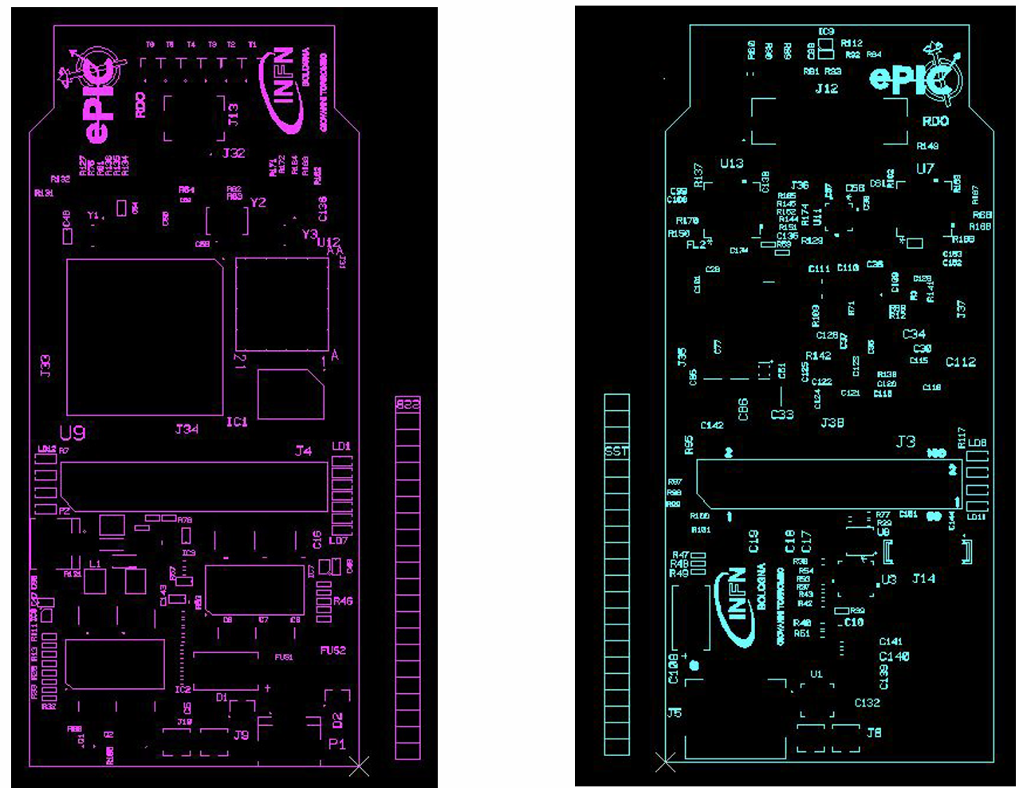
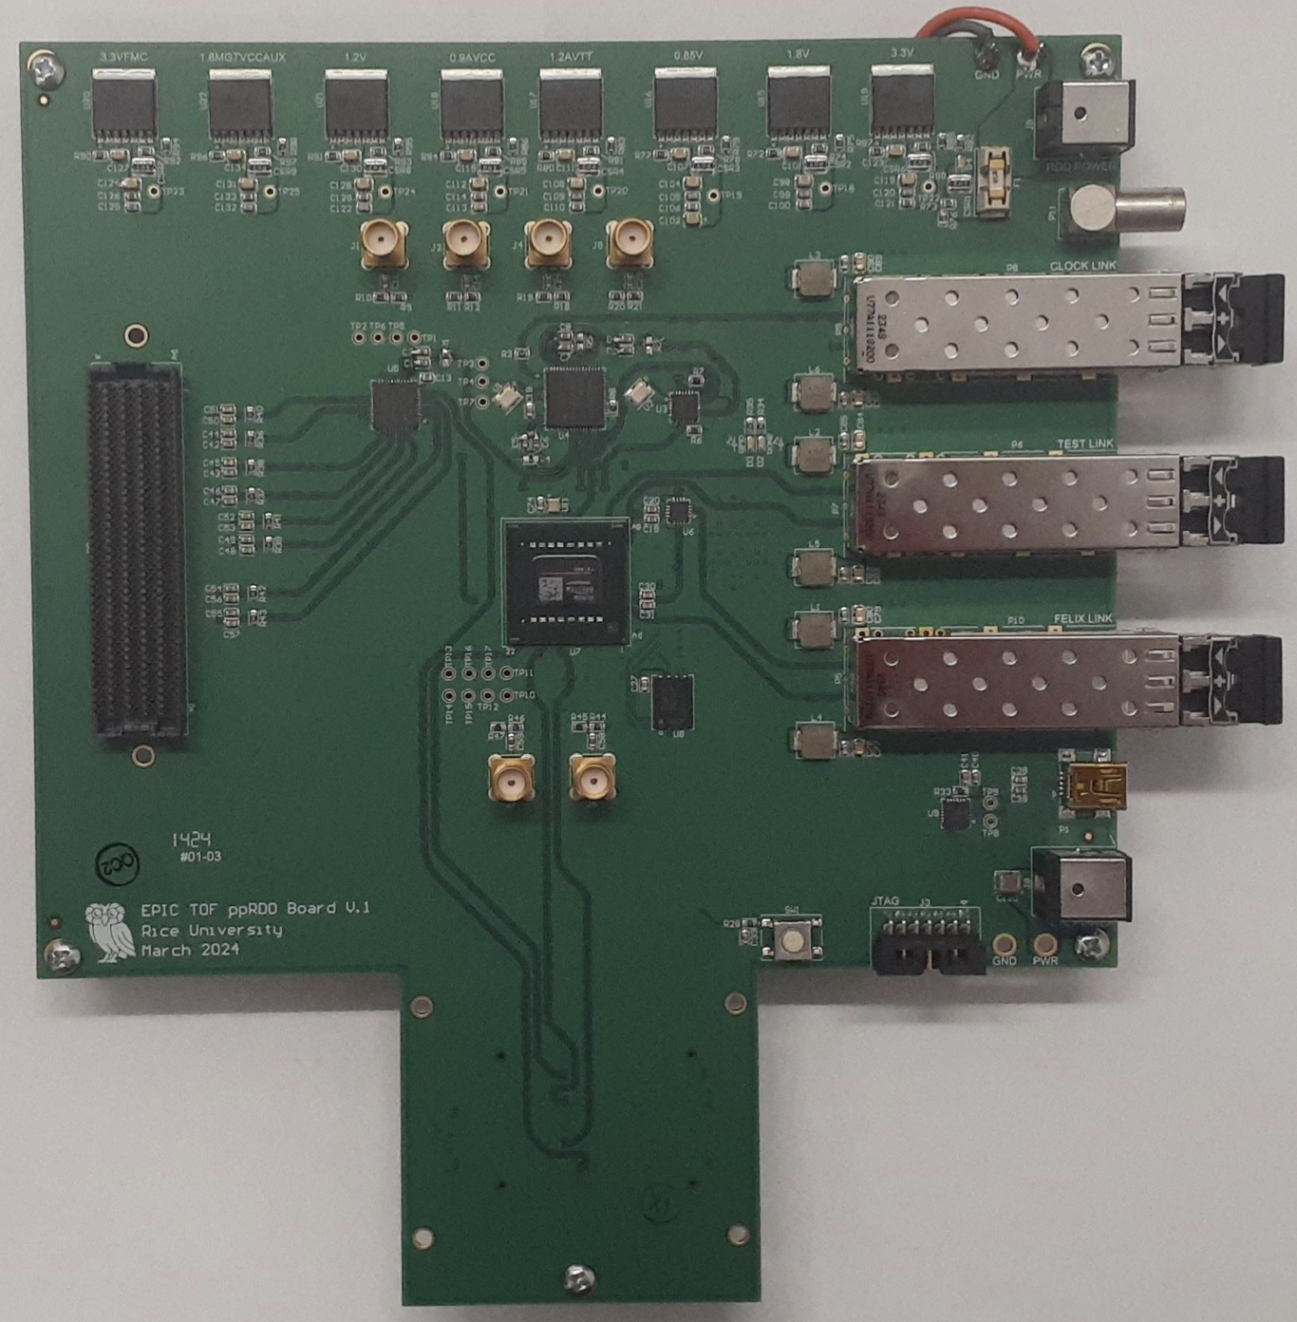
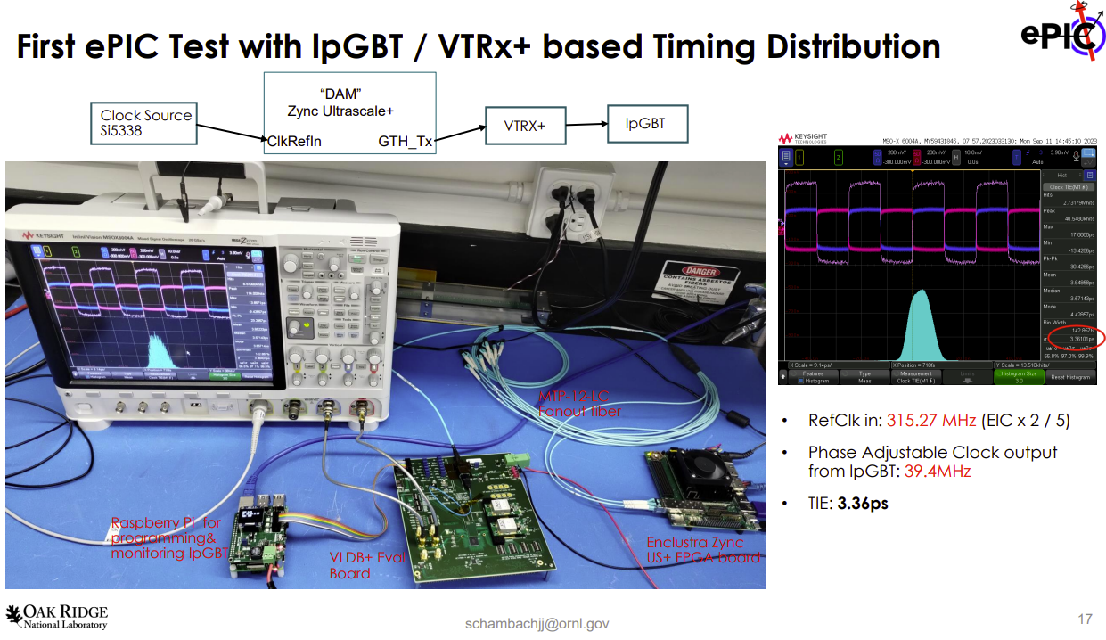
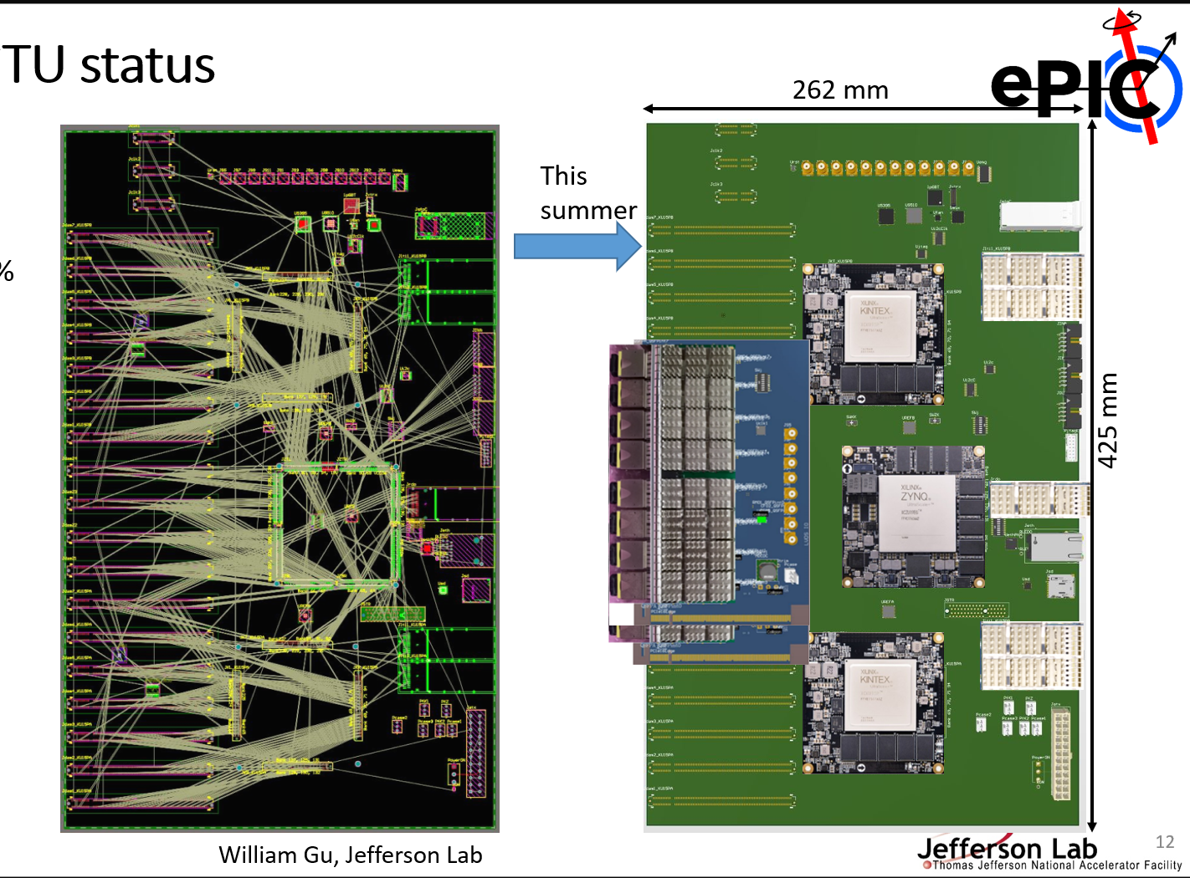
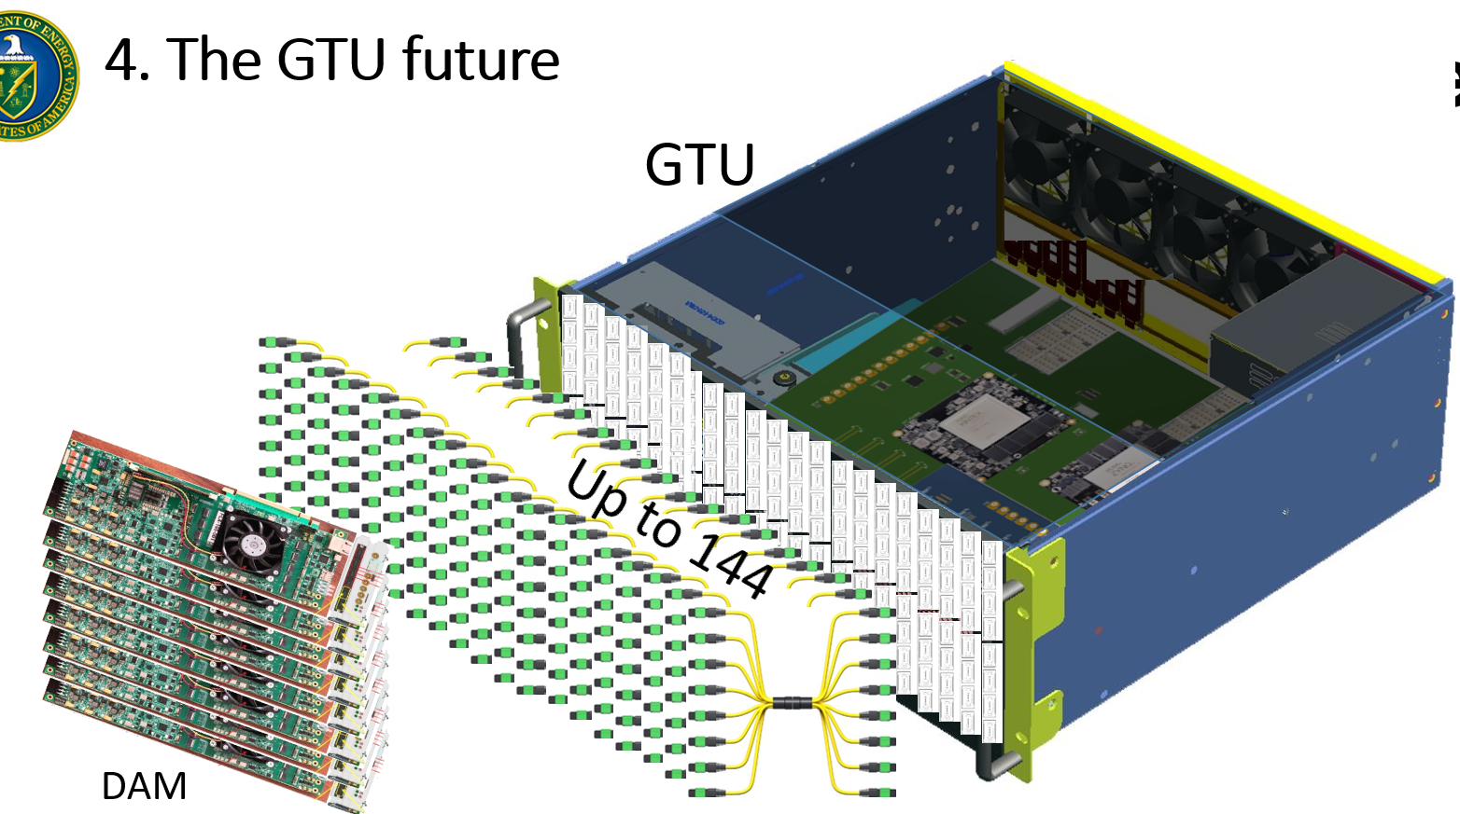
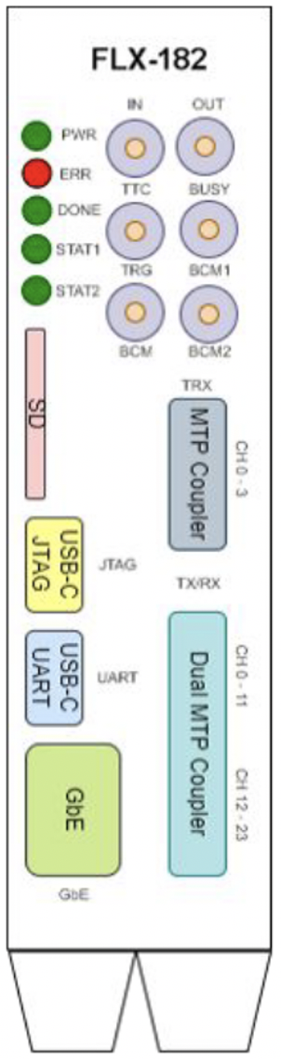
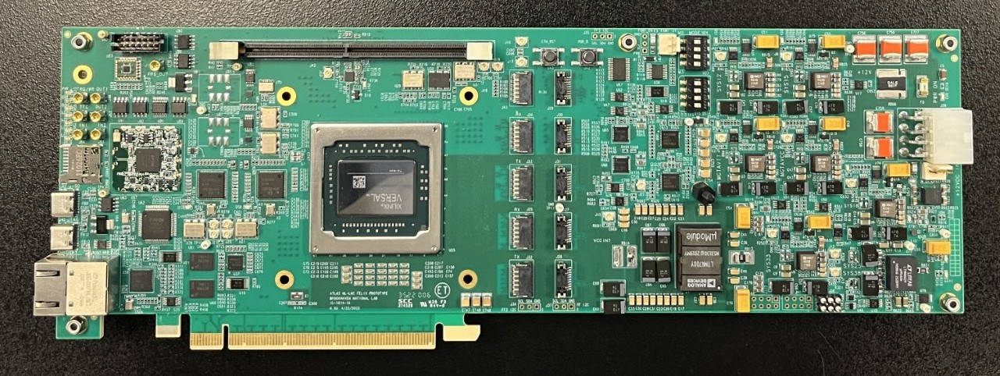
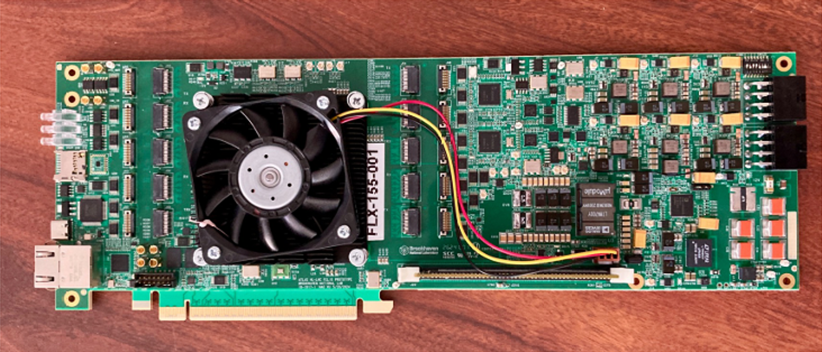
System Component Status (Hardware)
RDO
FPGA/SFP+
TOF Pre-prototype was used for timing studies
TOF moved to lpGBT/VTRX+ (direct)
Continue for Calorimeters
FPGA/VTRX+
INFN Bologna for dRICH
12 Populated PCBs expected June
FPGA: Artix Ultrascale+ Class
Fiber Aggregation (MAPS)
(ITS3/AC-LGAD/others)
lpGBT based FEBs
Component Counts
Pending
GTU
Reconstructed Clock Timing Tests:
Mocked up with dev-kits
< 5ps jitter measured with Ultracale+ FPGA and with lpGBT/VTRX+
Electronics Design:
JLAB Designing
Draft Specification
Schematics 80%
PCB placement 85%
PCB routing 10%
DAM
FLX-182
Developed by ATLAS (Omega Group at BNL)
2 FELIX engineering articles obtained
FLX-155
Targeted for ePIC use
Undergoing testing in Omega Group
Test articles expected 2025

Slide 11
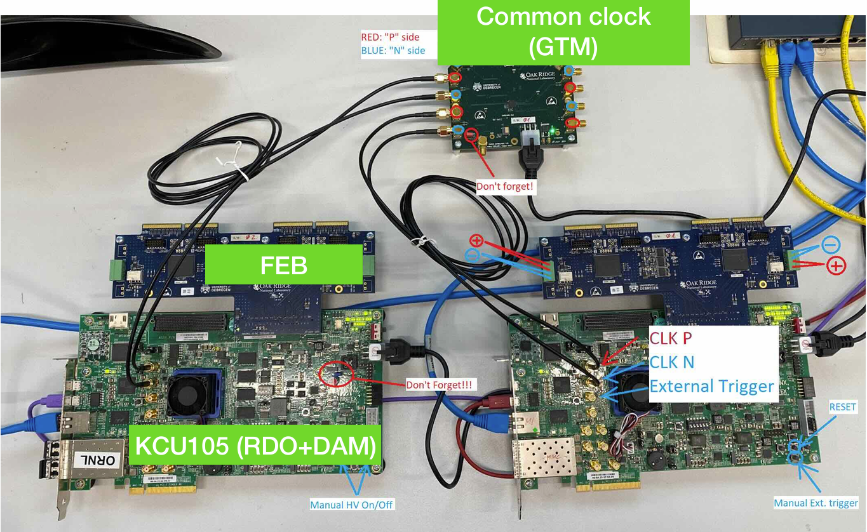
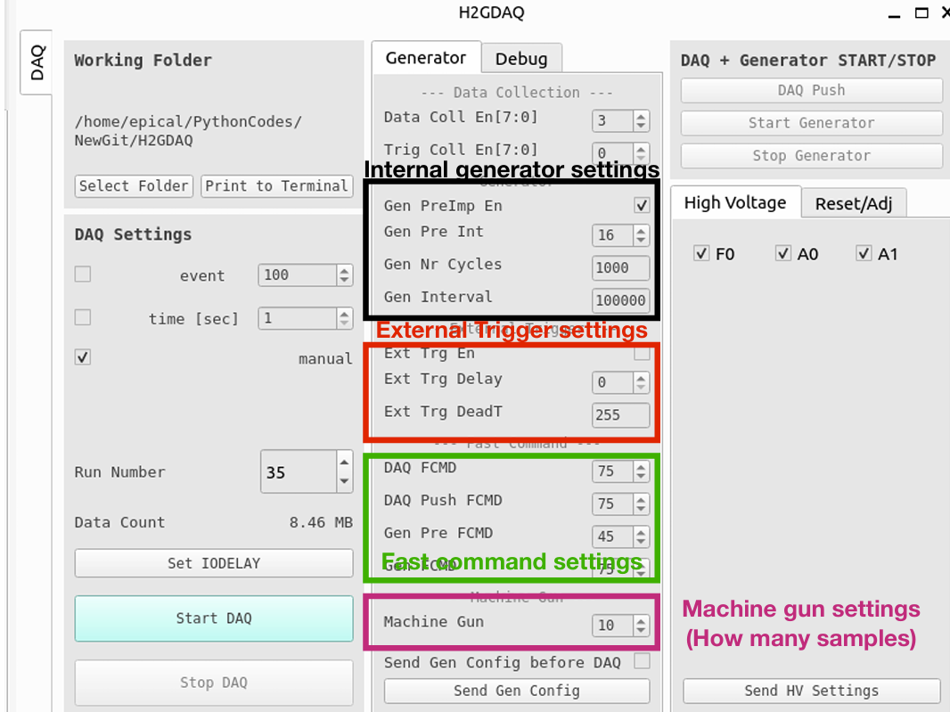
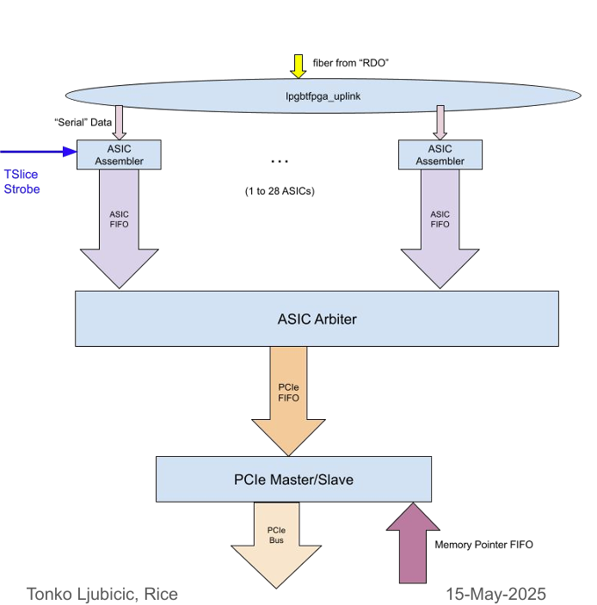
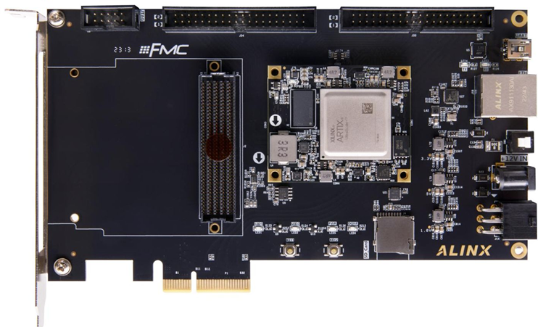
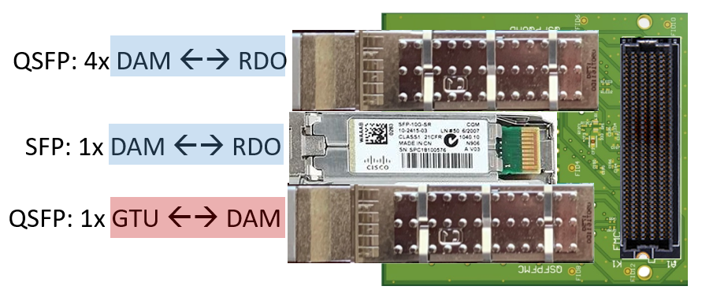
System Component Status (Collab Support)
Test
Setups
BHCAL --- (H2GCROC)
KCU105 (RDO+DAM) (kintex)
Python Config/Control
rcdaq integration
Norbert Novitzky, Miklos Czeller, Gabor Nagy, Shihai Jia, Martin Purschke
TOF DAM-Lite: (ETROC)
Alinx AXAU15 (artix)
Reads from lpGBT
Follows FELIX development scheme
(RICE)
FMC - Q(SFP) Adapter
Stand alone (single board) GTU
Allows use of prototype GTU with dev boards (such as AXAU15)
4-Boards (June)
(JLAB)
PicoDAQ
Jan 2026
First of O(Yearly) DAQ releases
Documented, software & hardware
Each release has increasing functionality
Goals
Readout test stands
Development Base for ePIC DAQ
Currently defining PicoDAQ
Target AXAU15 with FMC adapter as both RDO / DAM
No aggregation needed but intend to provide (RDO, DAM, RDO=DAM in same hardware package)
Ethernet communication to computer
Will document integration tasks to incorporate new FEBs
Control software adapted from BHCAL setup

Slide 12
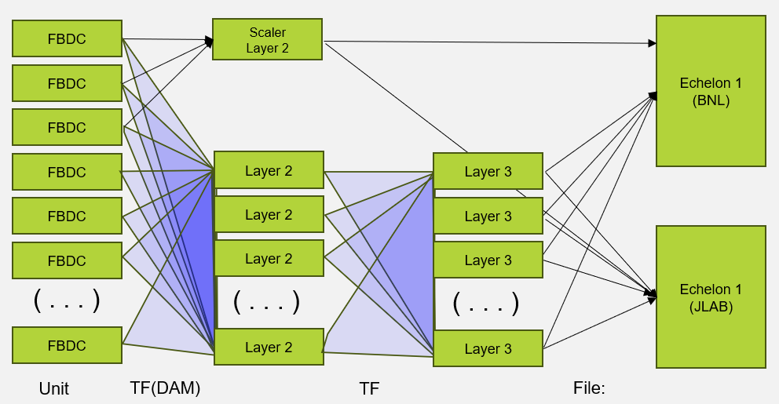
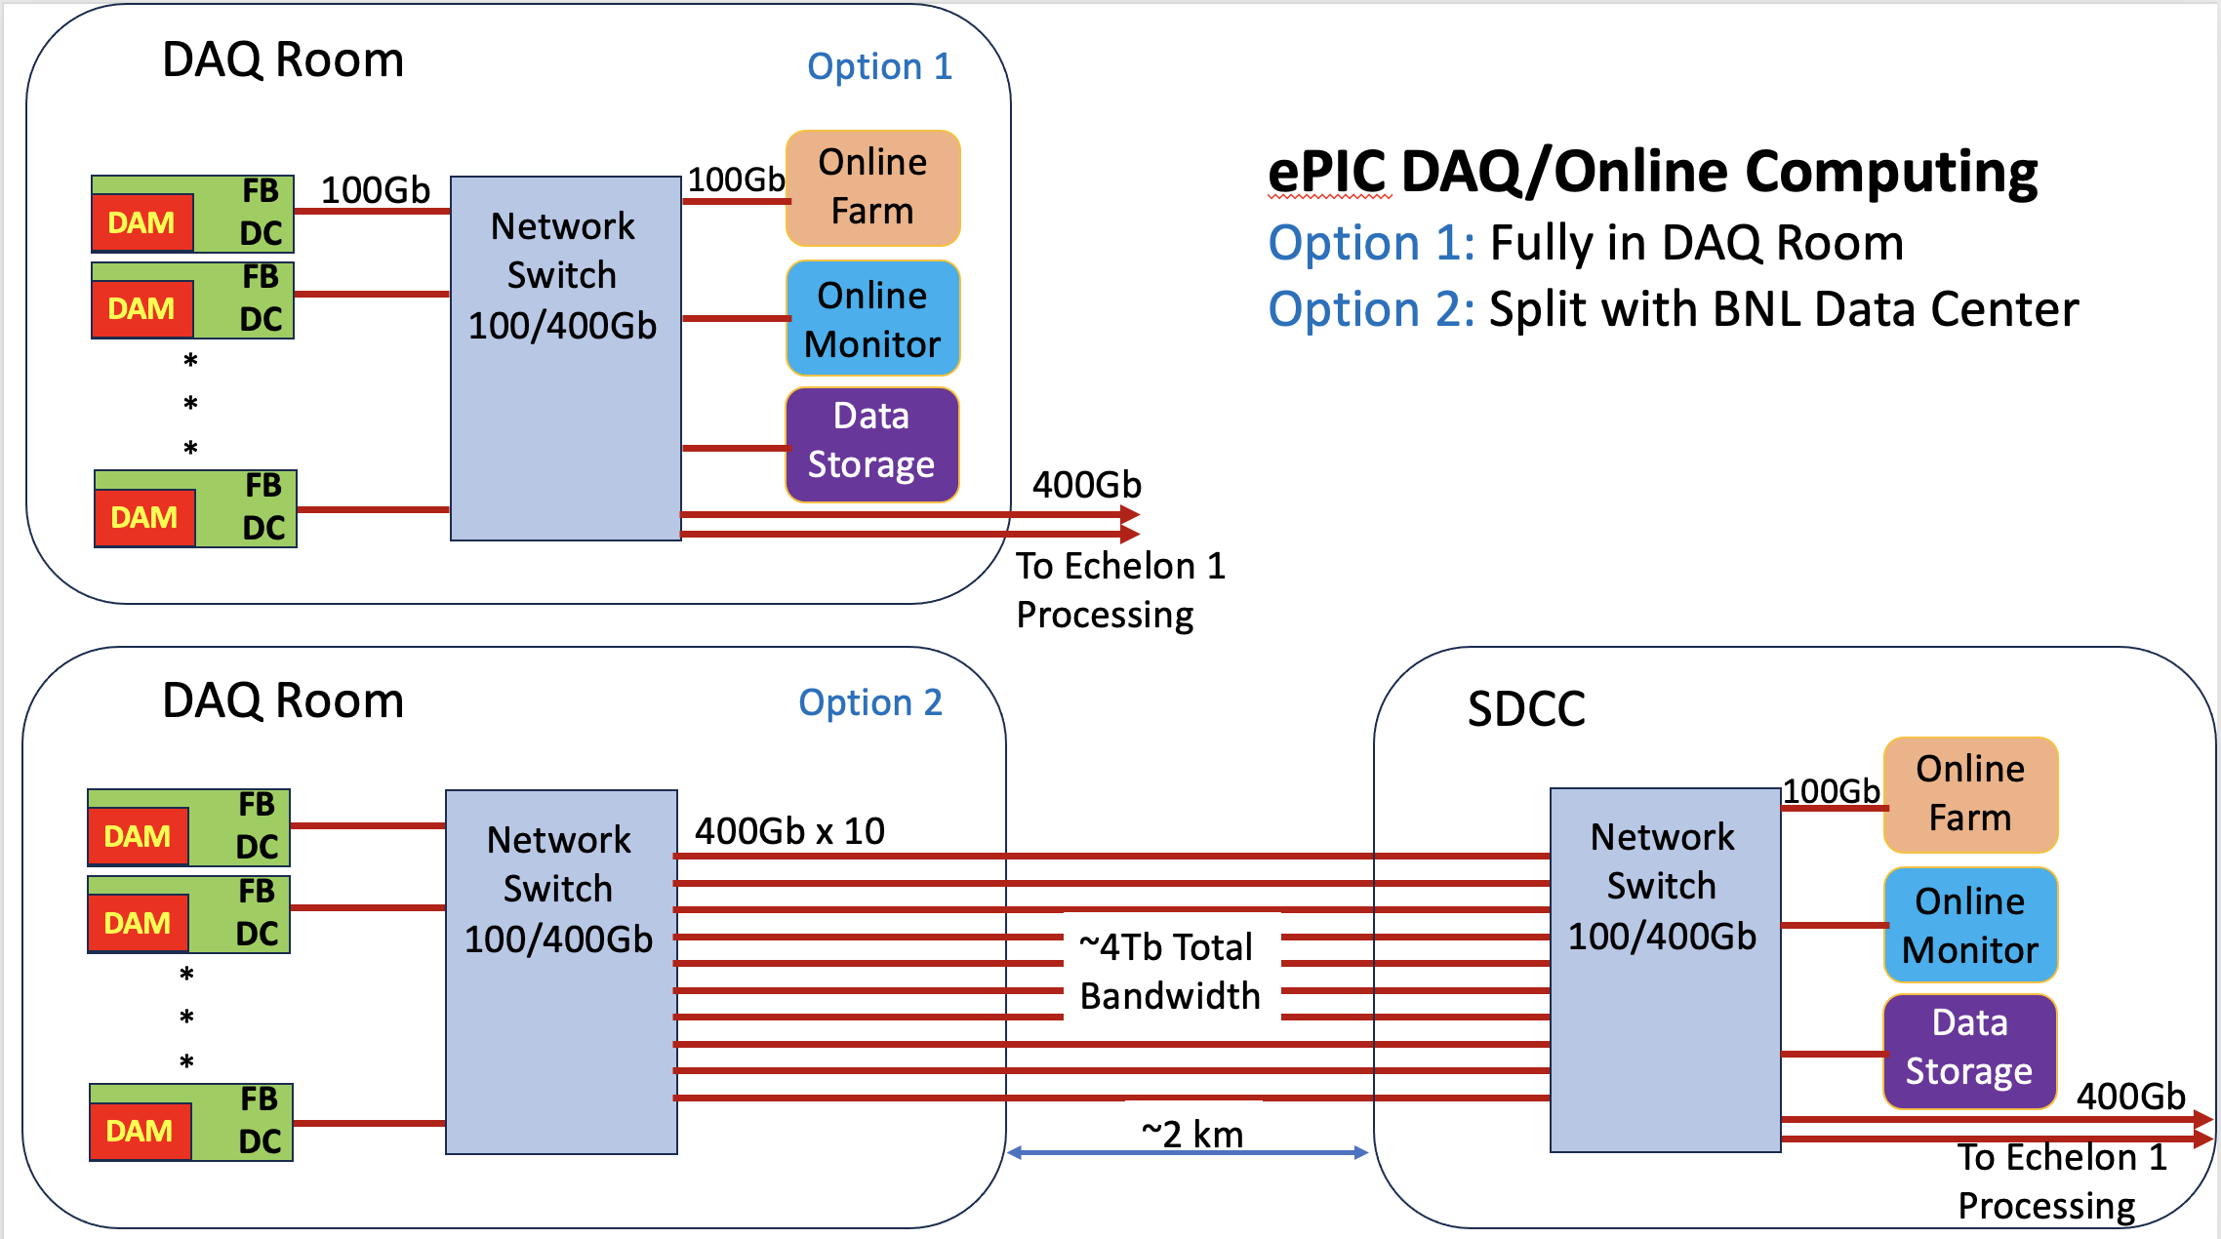
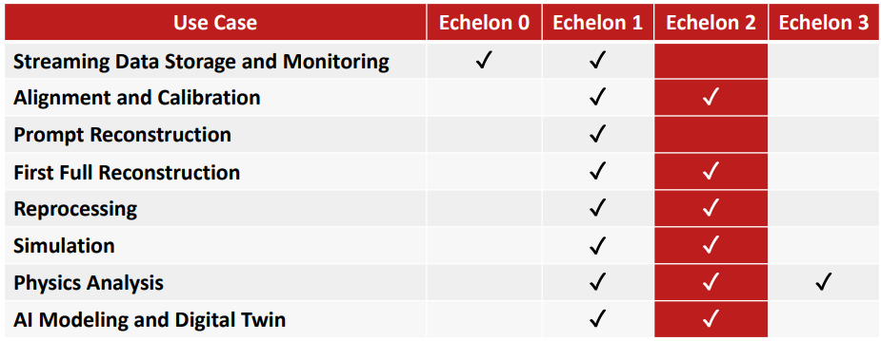

System Component Status (Compute)
Echelon 0
Hardware / Software Components
Run Control
Readout
Frame Building (2 levels)
Data Reduction
Compression
High Level Filtering
Logging
Monitoring
QA
Configuration
Slow Controls interface (IOC)
Buffering and Data Transfer
Echelon 0
Software
Design
Run Control Model:
State model incorporates continuously running components (i.e.. scalers)
“Run” structure to configure / select enabled detectors
Slow Control status part of state model
EIC / LHC clock:
DAM selects 39.4 MHz or 98.5 MHz
GTU distributes 19.7 MHz to avoid phase problems when dividing clock
Fast commands restricted to EIC bunches at multiple of 5 (2 cycles of 39.4 MHz or 5 cycles of 98.5 MHz)
Time Frames:
$2^{16}$ Bunch Crossings ~ .6 ms
Not synchronized to Bunch 0 (Minimize correlation between edge effects and spin states)
Build all detector to each time frame
Group O(1000) TF into Super Time Frames
Data Banks:
RDO / lpGBT produced data formatted but not processed produce raw data banks
Processing (data reduction / or additional information) produces new data banks (no modification)
Fraction of raw banks always retained
Echelon 0 location
DAQ Computing:
~100 Readout computers in DAQ Room
~100 computers located anywhere with sufficient network
Splitting farm between DAQ / SDCC:
reduces DAQ room power/ cooling renovations
Increases (slightly) network requirements
Requires agreements with SDCC for access / control
Details of splitting to be done according to cost benefit analysis
Echelon 1
Compute
Interface
Streaming Readout WG (off project):
Requirements Document Draft In Progress
Test Beds to be developed
- TX / Data management (e.g. Rucio)
- Orchestration / State Model (e.g. Panda)
- Streaming Reconstruction (JANA2)
- Calibration workflows
Interface:
Full Data to be streamed to JLAB/BNL echelon 1
Full Data to be archived at both facilities for redundancy

Slide 13
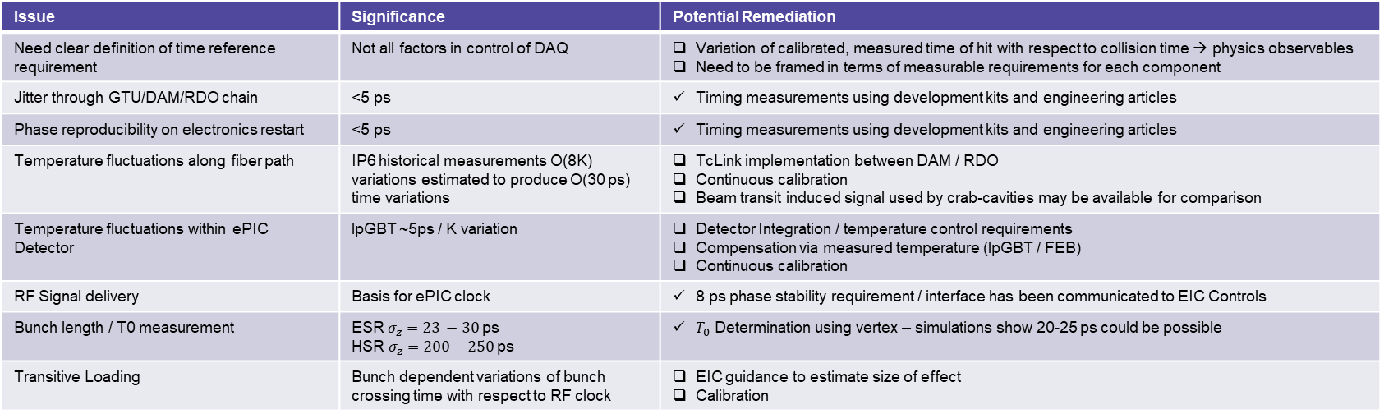
Integration Issues to Resolve
ePIC requires 25-30 ps timing for most sensitive detectors. This is an integration challenge.
ASIC behavior
ASIC zero suppression defines front-end data volumes and affects the resource allocation for fiber/RDO counts/DAM board counts
Have had many discussions with ASIC developers, but do not yet have documentation for digital interfaces to final ASICs
Working meetings June 2-3 expected to make progress on these interfaces
Issue | Significance | Potential Remediation
Need clear definition of time reference requirement | Not all factors in control of DAQ | Variation of calibrated, measured time of hit with respect to collision time → physics observables Need to be framed in terms of measurable requirements for each component
Jitter through GTU/DAM/RDO chain | <5 ps | Timing measurements using development kits and engineering articles
Phase reproducibility on electronics restart | <5 ps | Timing measurements using development kits and engineering articles
Temperature fluctuations along fiber path | IP6 historical measurements O(8K) variations estimated to produce O(30 ps) time variations | TcLink implementation between DAM / RDO Continuous calibration Beam transit induced signal used by crab-cavities may be available for comparison
Temperature fluctuations within ePIC Detector | lpGBT ~5ps / K variation | Detector Integration / temperature control requirements Compensation via measured temperature (lpGBT / FEB) Continuous calibration
RF Signal delivery | Basis for ePIC clock | 8 ps phase stability requirement / interface has been communicated to EIC Controls
Bunch length / T0 measurement | ESR $σ_{z}=23 −30$ps HSR $σ_{z}=200−250$ ps | $T_{0}$ Determination using vertex – simulations show 20-25 ps could be possible
Transitive Loading | Bunch dependent variations of bunch crossing time with respect to RF clock | EIC guidance to estimate size of effect Calibration

Slide 14
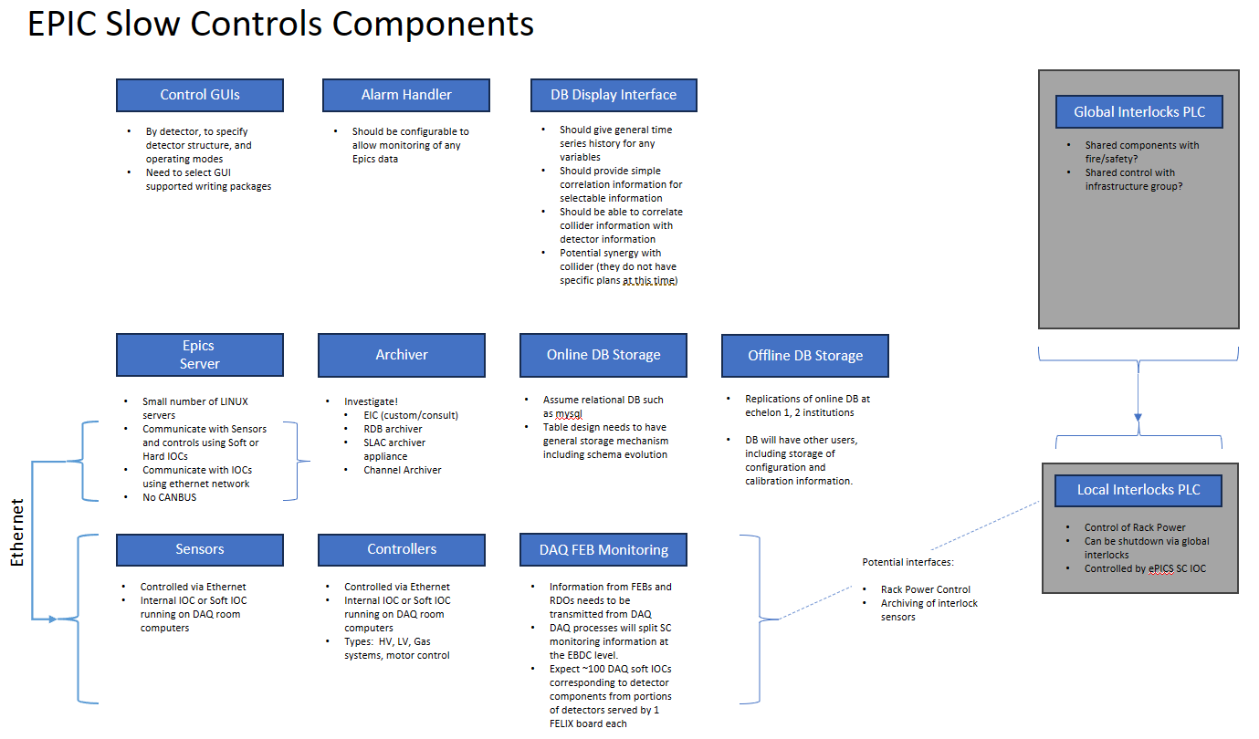
Slow Controls Status
Slow Controls Components and architecture are identified
EPICs Base
Allows use of existing tools
Synergy with EIC Controls
Detector DSCs have been surveyed for detector requirements
Resource Requirements have been Documented
~ 500k variables to be tracked
~ 55 TB/year
~ 73 Mbps network traffic
Preliminary hardware recommendation policies / lists drafted
PLC schemes have been investigated

Slide 15
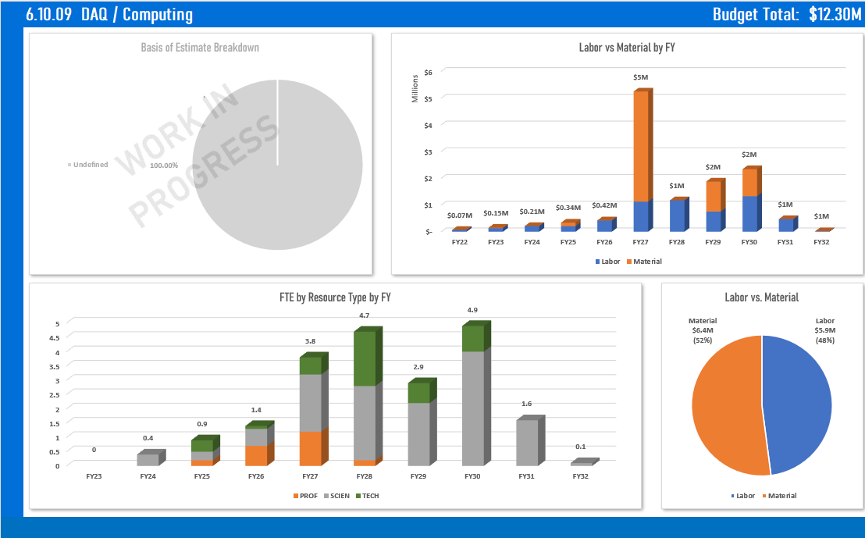
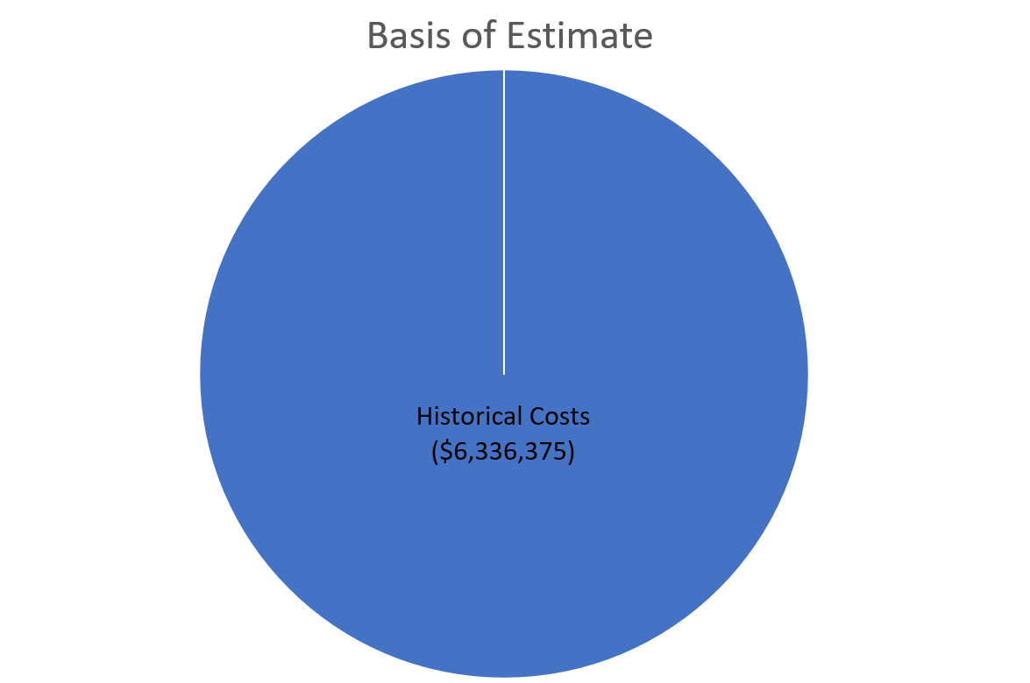
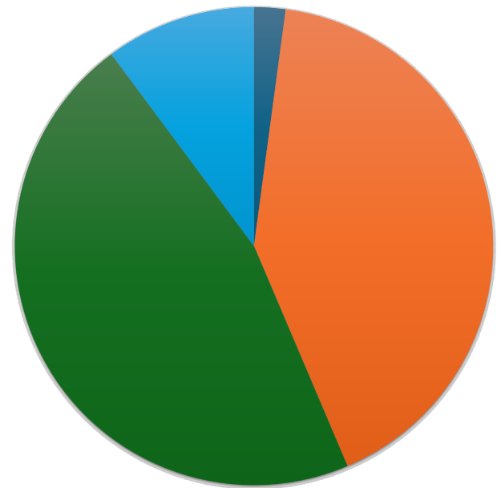
Cost: WBS 6.10.09 - DAQ/Computing
Previous
Experience
($2.6 M)
Engineering
Estimate
($2.9 M)
Catalogue
Price
($0.6 M)
Expert
Opinion
($135 K)

Slide 16
ES&H and QA Considerations
ES&H
Custom Electronics and electronics from outside US
Follow JLab & BNL procedures for equipment not certified by Nationally Recognized Test Labs (NRTL)
Registration and safety reviews
BNL experimental Safety Review Process
Expect readout electronics to be part of each detector review
Installations will be covered by work planning process
Slow Controls
PLC control integrated with Zero Current Detectors for electronics racks
Interface to detector safety interlocks TBD
QA
Installed fiber runs between DAQ room and WAH patch panels
Testing incorporated as part of fiber termination / patch panel installation tasks
Test temperature dependence of phase on fraction of each lot
Electronics requiring QA
lpGBT and VTRX+ testing part of WBS 6.03.07
RDO testing part of WBS 6.03.07 (6.03.08 role in RDO is with respect to the firmware)
DAM acceptance testing (~130 boards)
GTU testing part of development and production
Compute Nodes
Compute nodes will be COTS computers subject to warrantee, and verified during installation

Slide 17
Outlook to CD-2
Resolve details of echelon 0 components in computing enclave
Cost benefit analysis of DAQ room upgrades vs SDCC partitioning in progress
DAM production
Felix model155 will be fully designed and tested during 2025
Plan to produce several engineering articles for DAM testing and development in 2025
Production is roughly aligned with Omega group production schedules but need to refine and finalize schedules / responsibilities
GTU project engineering design in 2025
GTU engineering article to be produced prior to CD2
Firmware and Software development
Finalize protocol definitions
Fully define and schedule the RDO firmware development in light of RDO variations
Document software & firmware components
Define development teams
Slow Controls integration
Fully define scope

Slide 18
Outlook to CD-2
Resolve details of echelon 0 components in computing enclave
Cost benefit analysis of DAQ room upgrades vs SDCC partitioning in progress
DAM production
Felix model155 will be fully designed and tested during 2025
Plan to produce several engineering articles for DAM testing and development in 2025
Production is roughly aligned with Omega group production schedules but need to refine and finalize schedules / responsibilities
GTU project engineering design in 2025
GTU engineering article to be produced prior to CD2
Firmware and Software development
Finalize protocol definitions
Fully define and schedule the RDO firmware development in light of RDO variations
Document software & firmware components
Define development teams
Slow Controls integration
Fully define scope
Tasks for CD-3 in backup slides

Slide 19
Summary
Detailed scope and high-level design of the ePIC DAQ is understood
Component status varies but is progressing
DAM boards are selected. The FELIX board is mature technology and the updated version, FLX-155, is being tested
Reconstructed clock has been tested and meets requirements for both Xilinx Ultrascale+ FPGA and lpGBT implementations
RDO flavors are understood and being refined. Prototypes for two FPGA based RDO flavors are well advanced. Plans for lpGBT and fiber aggregators are being developed. All RDO flavors have significant similarities
GTU electronics design is in progress
Protocol design and documentation has begun and is being iterated
Slow Controls requirements are documented. Planning to hire to increase progress
Planning 60% PDR For Summer 2025 → on track for CD-2

Slide 20
Backup

Slide 21
Tasks for CD-3 Readiness
Full Chain Testing with Engineering Articles
Both 39.4 Mhz and 98.5 MHz systems
Final Design Reviews
GTU
DAM Boards
Procurement Plans
GTU
DAM Boards
Echelon 0 computing test beds
Evaluate scalability of time frame building
Slow Controls Definition and Development

Slide 22
ePIC Detector Scale and Technology Details
Detector System​ | Channels​ | ASIC​ | FEB​ | RDO​ | Gb/s (RDO)​ | Gb/s (Tape)​ | DAM Boards​ | Readout Technology​ | Notes​
Si Tracking: Inner Barrel (IB)​ Outer Barrel (OB)​ Backward Disks (EE)​ Forward Disks (HE)​ | 1.8B Pixels​ 5.0B Pixels​ 4.7B Pixels​ 4.7B Pixels​ | 160​ 495​ 462​ 462​ | 592*​ 1870*​ 1744*​ 1744*​ | 24​ 55​ 52​ 52​ | 2.36​ 3.52​ 4.68​ 4.68​ | 2.36​ 3.52​ 4.68​ 4.68​ | 1​ 2​ 2​ 2​ | ITS-3 sensors &​ ITS-2 staves / w ​ improvements​ | ASIC corresponds to VTRX+ counts​ FEB corresponds to detector fiber​ RDO is off detector Fiber aggregator​ ​
MPGD tracking: Electron Endcap​ Hadron Endcap​ Inner Barrel​ Outer Barrel​ | 16,384​ 16,384​ 32,768​ 98,304​ | 256​ 256​ 512​ 1536​ | 64​ 64​ 128​ 384​ | 16​ 16​ 32​ 96​ | 2.86​ 4.01​ 4.10​ 15.81​ | 0.58​ 0.80​ 0.82​ 3.16​ | 1​ 1​ 1​ 2​ | uRWELL / SALSA​ uRWELL / SALSA​ MicroMegas / SALSA​ uRWELL / SALSA​ | VTRX+ based FEB​
Forward Calorimeters: LFHCAL​ HCAL insert​ ECAL W/SciFi​ Barrel Calorimeters: HCAL​ ECAL SciFi/PB​ ECAL ASTROPIX​ Backward Calorimeters: NHCAL ​ ECAL (PWO)​ | 63,280​ 8k​ 18,320 ​ 1,536​ 5,760​ 500M pixels​ 3,256​ 2,852 ​ | 1130​ 142​ ​ 28​ 102​ ​ 58​ | 1130​ 142​ 574​ 28​ 102​ ​ 58​ 102​ | 74​ 9​ 72​ 2​ 4​ 340​ 4​ 13​ | 18.54​ 17.72​ 14.75​ 0.87​ 11.45​ 1.25​ 3.46​ 2.00​ | 2.47​ 2.36​ 7.36​ 0.12​ 1.52​ 1.25​ 0.47​ 0.99​ | 2​ 1​ 2​ 1​ 1​ 8​ 1​ 1​ | SiPM / CALOROC​ SiPM / CALOROC​ SiPM / Discrete​ SiPM / CALOROC​ SiPM / CALOROC​ Astropix​ SiPM / CALOROC​ SiPM / Discrete​ | CALOROC:​ 56 Ch/CALOROC​ 16 CALOROC / RDO​ ​ Discrete:​ 32 Ch/FEB, ​ 8 FEB/RDO conservative (16 estimate).​ ​
Far Forward: B0: Crystal Calorimeter​ 4 AC-LGAD layer​ 2 Roman Pots​ 2 Off Momentum​ ZDC: Crystal Calorimeter​ HCAL​ | 135​ 688,128​ 524,288​ 294,912​ 900​ 9,216​ | ​ 672​ 512​ 288​ ​ 165​ | 5​ 168​ 128​ 72​ 30​ 165​ | 1​ 42​ 32​ 18​ 4​ 11​ | 2.3​ 12.75​ 14.53​ 3.53​ 2.30​ 0.22​ | 2.3​ 2.1​ 2.1​ 0.7​ 4.5​ .22​ | 1​ 1​ 1​ 1​ 1​ 1​ | SiPM/APD / Discrete​ AC-LGAD / EICROC​ AC-LGAD / EICROC​ AC-LGAD / EICROC​ SiPM/APD / Discrete​ CALOROC ​ | ​ 4 layer x 42 module x 4 EICROC x 1024 ch​ 2 stations x 2 layer x 32 module x 4 EICROC x 1024 ch​ 2 stations x 2 layer x 18 module x 4 EICROC x 1024 ch​ ​ ​
Far Backward: 2 x Low Q Tagger​ 2 x Low Q Tagger Cal​ 2 x Lumi PS Calorimeter​ 2 x Lumi PS tracker​ Direct Photon Lumi Cal​ | 66M pixels​ 3,360​ 5,040​ 128k​ 100​ | 3456​ ​ ​ 1000​ | 288​ ​ ​ 16​ 24​ | 24​ 1​ 1​ 16​ 24*​ | 37​ -​ 19​ 45​ 200​ | .3​ -​ 7​ 2​ 7​ | 10​ 1​ 1​ 2​ 1​ | Timepix4 ​ SiPM / CALOROC​ SiPM / Discrete ​ AC-LGAD: FCFD ​ SiPM / fADC250​ | Firmware Trigger to reduce output rate​ Low Q Calorimeter doesn't run at high luminosity​ ​ ​ Direct Photon: commercial digitizer, no RDO​
PID-TOF: Barrel​ Endcap​ | 2,359,296​ 3,719,168​ | 18,432​ 3,632​ | 288​ 212​ | -​ -​ | 15.95​ 33.92​ | 4.79​ 7.34​ | 24​ 6​ | AC-LGAD: FCFD​ AC-LGAD: EICROC​ | bTOF 128 ch/ASIC, 64 ASIC/RDO​ eTOF 1024 pixel/ASIC, up to 28 ASIC/RDO​
PID-Cherenkov: dRICH​ ​ pfRICH ​ DIRC​ | 317,952​ ​ 69,632​ 73,728​ | 4968​ ​ 544​ 576​ | 4968​ ​ 68​ 24​ | 1242​ ​ -​ -​ | 1240​ ​ 24​ 11​ | 13.5​ ​ 12.5​ 6​ | 30​ ​ 2​ 1​ | SiPM / ALCOR​ ​ HRPPD / FCFD​ HRPPD / FCFD​ | Worse case after radiation. Includes 30% timing window. Requires further data volume reduction Firmware trigger​

Slide 23
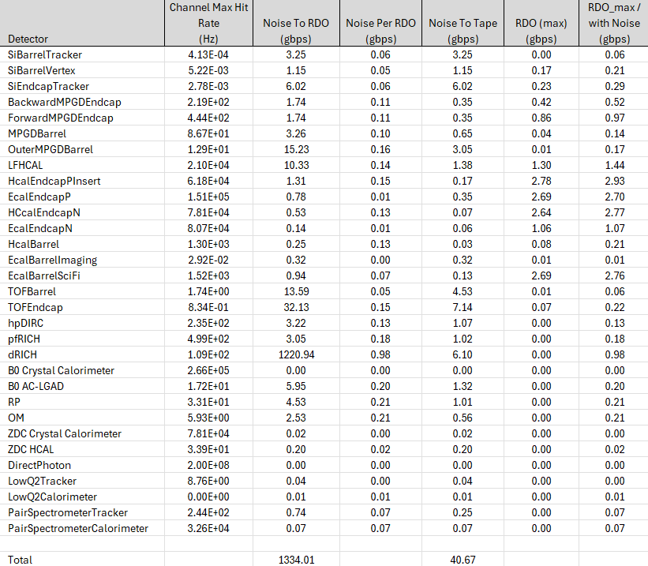
Data Bottlenecks
Evaluated Data Bottlenecks by tiling detector regions with RDO/ASIC combos
RDO data volume spec 8 gbps
Several detectors with max RDO rate ~1/4 bandwidth
Potential data reduction in RDO
Use fewer populated FEB per RDO in strategic locations
dRICH dark currents handled by firmware trigger
Lumi Monitoring:
Direct Photon Calorimeter ~100 channels direct streaming, readout only summary
Track lumi by bunch
Polarimetry
Readout by collider DAQ, not directly by detector
Preliminary Noise Assumptions
Detector | Noise (hz/channel)
ITS3 | 0.01
Astropix | 0.01
Timepix | 0.01
AC-LGAD | 30
HRPPD | 230
dRICH(initial) | 3000
dRICH(Max) | 300,000
All others | 4.5σ = 340

Slide 24
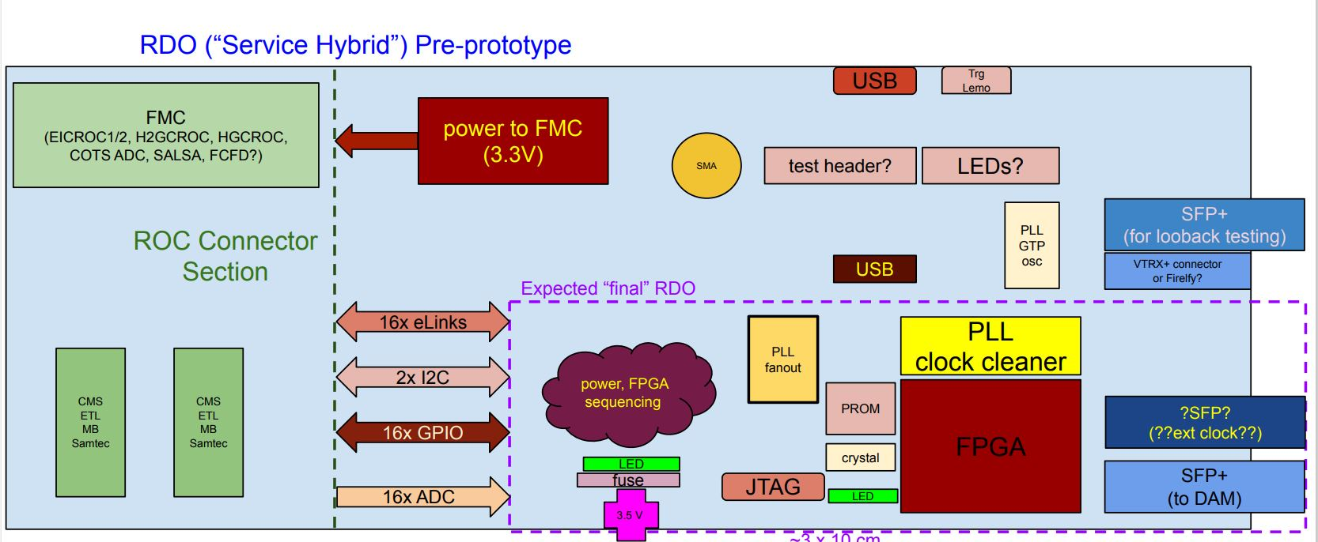
RDO development – General plans
The Readout Board (RDO) is the first processing interface of the DAQ with the front-end electronics/digitizers.
There are currently 6 identified “flavors” of RDO - dependent on the detector subsystems (see Pietro’s for dRICH example)
It must support both a common DAQ communication protocol as well as manage configuration and control with the different front-ends
A pre-prototype board has been produced to support early DAQ and detector development (See Tonko’s talk for more details)
ppRDO
Readout Board Flavors
Detector | Characteristics
TOF | Highest Timing Requirement (Generic)
dRICH | Small Footprint (VTRX+ optics)
ITS-3 | Detector side uses fiber (VTRX+)
Imaging Calorimeter | Integrated with ASTROPIX Sensor
Low Q Tracker | High Rates, 20 TX fibers expected / RDO
Direct Photon Calorimeter | Pure 200MHz Streaming (bypass DAQ protocol)

Slide 25
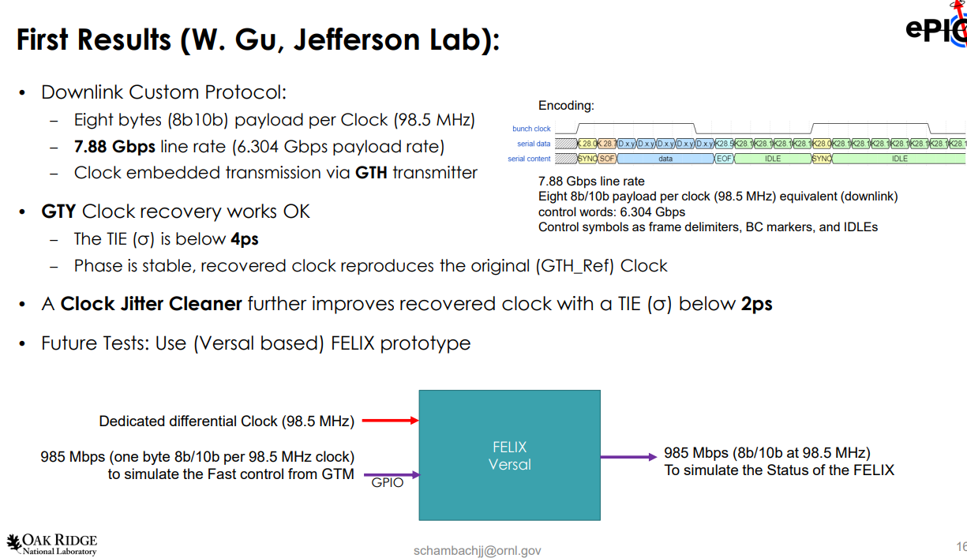
Timing Resolution with Reconstructed Clock

Slide 26
Timing Resolution with Reconstructed Clock

Slide 27
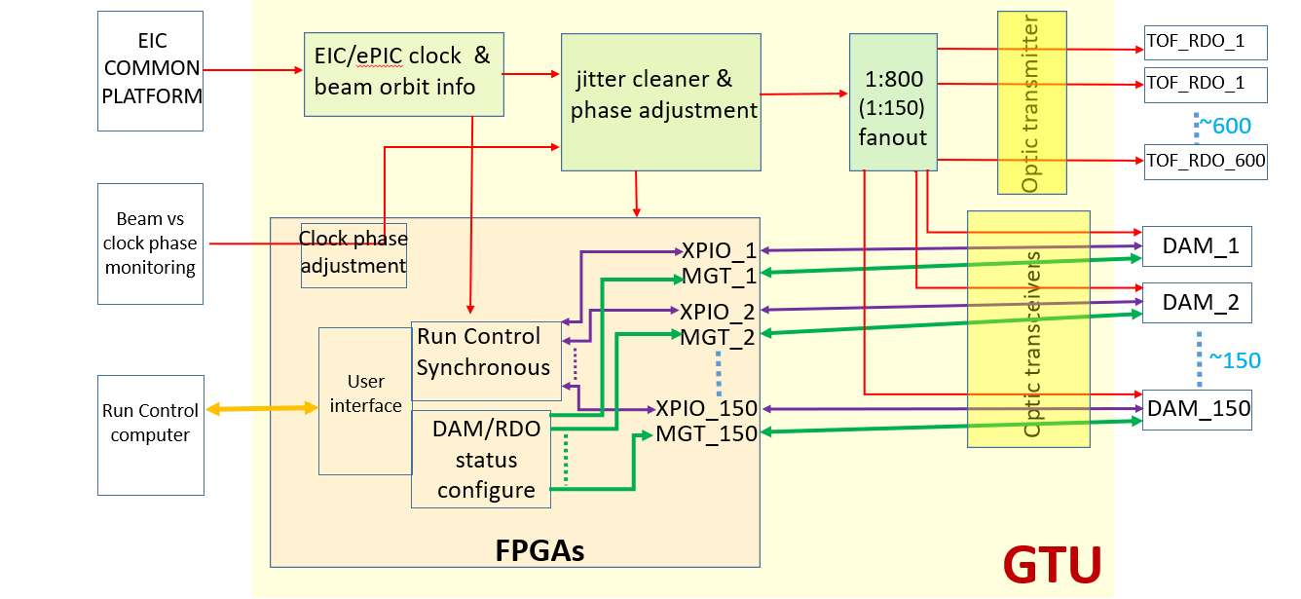
GTU Design: functional diagram

Slide 28
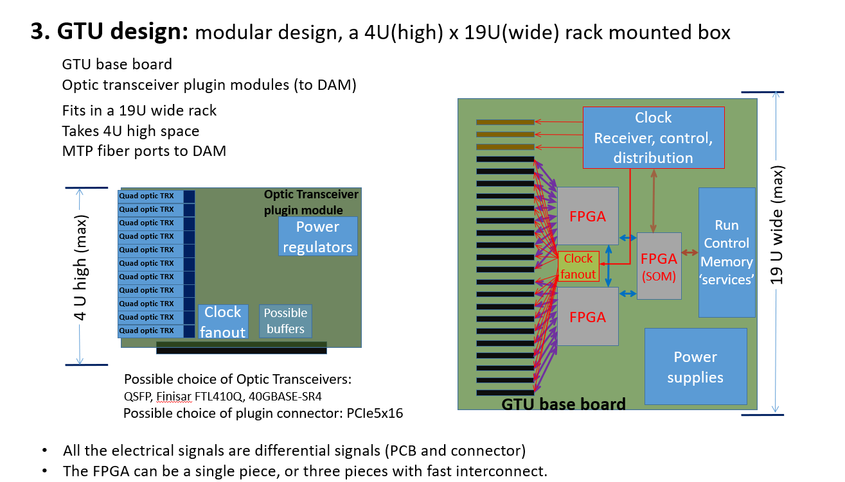
GTU Design

Slide 29
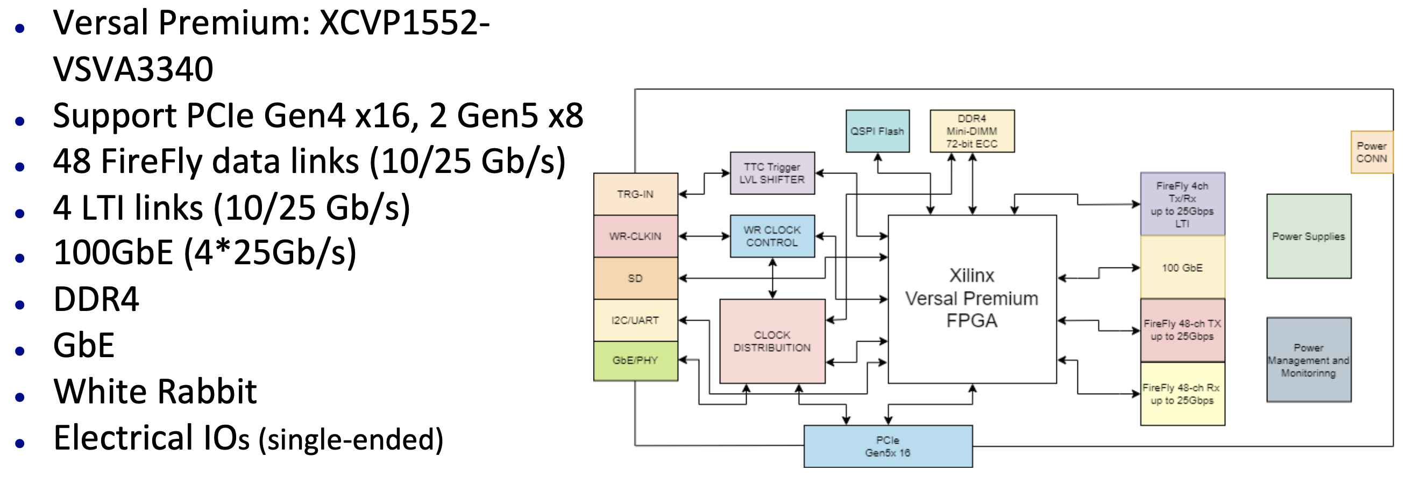
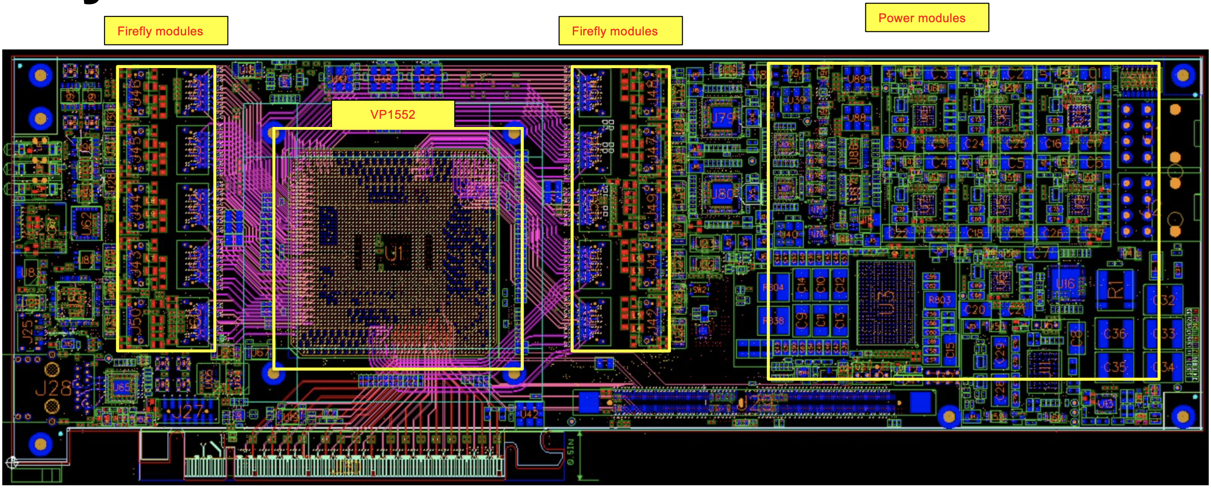
FELIX Updates – FLX-155
FELIX (Front-End Link Exchange) hardware for future ATLAS experiments at HL-LHC is being developed at BNL (Omega Group)
Long term support is insured. Development timelines are compatible with EIC.
ePIC is collaborating with Omega to use this design as our DAM board.
Latest (FLX-155) design review completed by ATLAS and AMD
It has been sent out for fabrication. PCBs available by July.
First 4 populated boards expected by late August/early September
We expect to receive at least one board by the end of this year
Note: 4 fiber LTI Link supports receiving either reconstructed or a direct clock
Versal FPGA is a SoC (Dual Core ARM) and can operate either standalone or in a Server

Slide 30
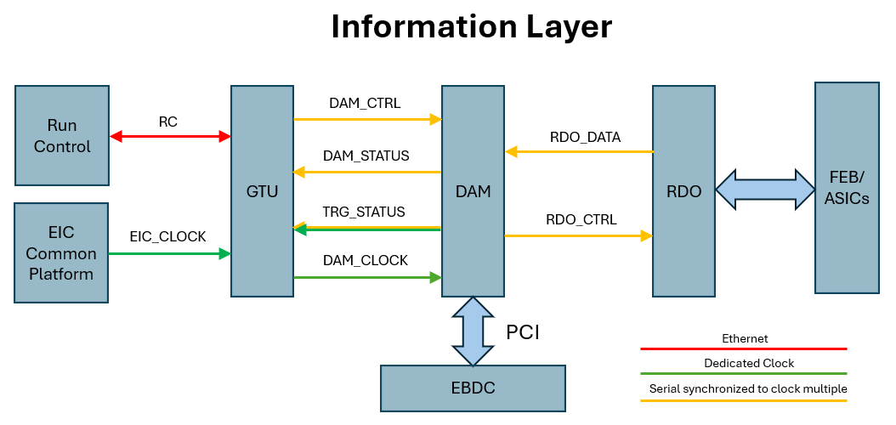
Fiber Protocol / DAQ operation
Synchronous Commands:
64 bits (80 bits 8b/10b encoded) per bunch
Reconstructed clock
Redundant BCO
Distinct synchronous commands (eg)
RC
Time Frame Control & Definition
Flow Control
Trigger
Request special events
Data filter (firmware trigger)
Configuration (ASIC / RDO firmware)
Data Formatting
Data Transfer
Hits
Slow Controls
Time Frame Definition:
16 bits BCO (0.66ms -> 8MB @ 100Gbps)
Flexible formatting
Filtered & Unfiltered data can coexist
Time Frames are built, they contain the full set of detectors for the time period
Tiered Data Format.
High level flexible, named navigation via banks (e.g. star SFS, sPHENIX DAQRC)
Low level supports direct, detector specific (eg ASIC) formats.
Trigger Operation:
Support Max Data Volume to DAM / Readout computer Buffers
Generate Trigger Signals in DAM
Communicate triggered crossings via synchronous cmds through GTU

Slide 31
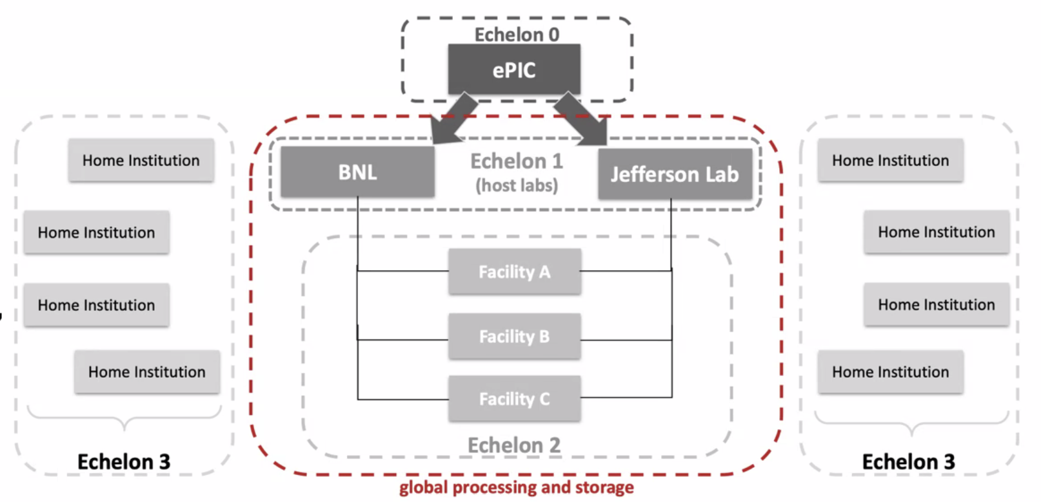
Boundary between Online and Offline
The streaming architecture allows for some blurring of the offline and online processing with respect to calibrations, QA monitoring, and potential seed analysis to improve reconstruction turn around. These aspects are not yet fully specified.
Require an interface to allow sharing of code between offline / online processing
Local buffering (Echelon 0) provides elasticity in the transfer of data to computing facilities
Offline buffering (Echelon 1) will allow several weeks for calibration and reconstruction.
ePIC Scientific Computing
Is a dependency for the project handled in conjunction with host labs.
The Resource Review Board (RRB) looks at the international detector and computing resources.
The ePIC computing groups are actively implementing scientific software as well as working with the DAQ to define the interface with the streaming DAQ system.

Slide 32
Echelon 0 Computing Options
(with Option 2 we need off-project support for enough direct fiber between IP-6 and SDCC)

Slide 33
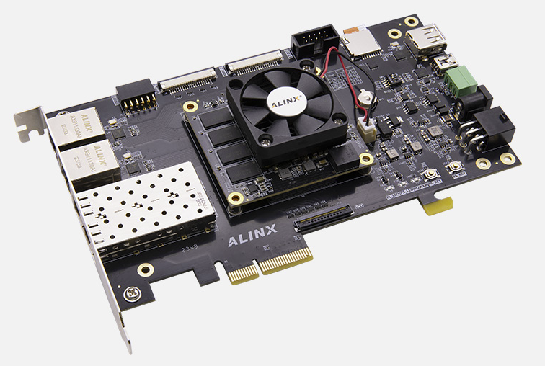
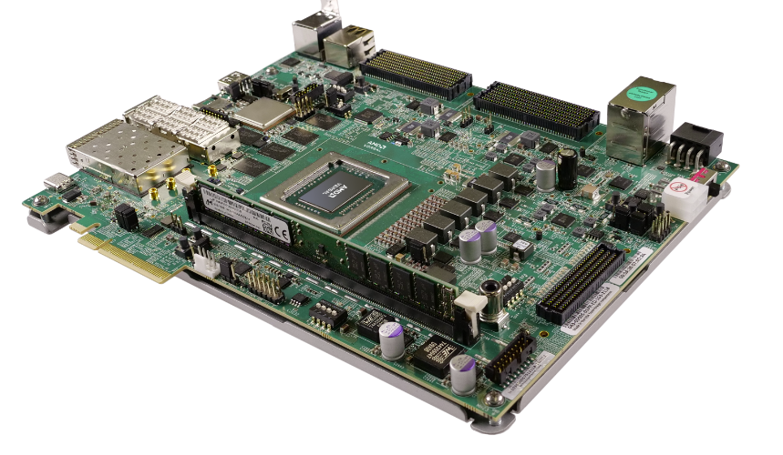
System Components Status
Echelon 0
Compute
Readout Computers
Frame Building Computers
Data Reduction
Filters
Compression
High Level Triggering
DAQ Logging
DAQ Monitoring
DAQ QA
Configuration / Run Control
Slow Controls interface (IOC)
Buffering and Data Transfer
Echelon 1
Compute
Interface
Interface:
Full Data to be streamed to JLAB/BNL echelon 1
Full Data to be archived at both facilities for redundancy
Scientific software and computing is off project dependency:
RRB
ECSJI
Latest Collaboration Review Sept 26-27, 2024
Detector Test Support
Firmware Support for Commercial Development Boards as FELIX substitutes for test stands (to be developed)
2 Port VD100 ($800)
48 port VMK180 ($10k)
Echelon 0 location
DAQ Computing:
~100 Readout computers in DAQ Room
~100 computers located anywhere with sufficient network
Splitting farm reduces DAQ room renovations but increases network requirements, space in SDCC, and complicates access
Cost/benefit analysis to be done

Slide 34
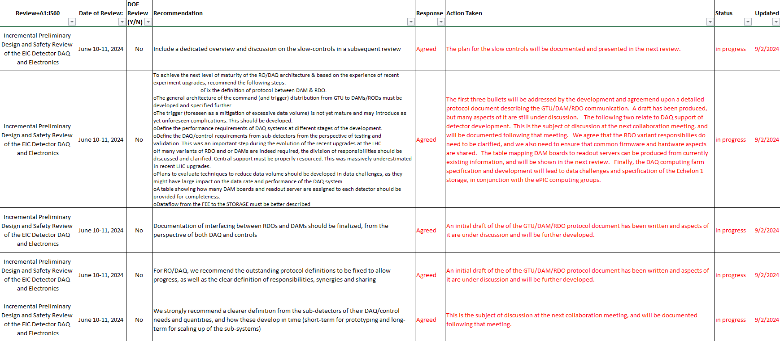
Response to Recommendations (PDR not DOE…)

Slide 35
Response to Recommendations
More Development needed!
Slow controls based on EPICS
Preliminary Counts of components/Variables/Frequencies
Preliminary list of “recommended/supported” equipment
Plan to hire
Summary of recommendations:
Document detailed protocols/algorithms to make the full system work
Electronics (GTU → DAM → RDO → FEB)
Configuration, SC monitoring, Triggering, Flow Control, Special running modes
Computing (Time Frame Building, Logging Monitoring, QA, Data Reduction, Data Formats, Data Sinking)
Response:
This is a significant current effort
Preliminary protocol document drafted but evolving
Initial GTU design effort (conceptual -> detailed)
Risk Mitigations
High Data Volume due to Dark Currents in dRICH
Noise/Background
Response
Efforts to study backgrounds (Synchrotron Radiation Continuing)
Bandwidth for front ends / firmware trigger protocol iteration
Strategy:
Further define “release schedule” of firmware / software
Recommended supported development kits for DAM components
Generic RDO (TOF pre-prototype FPGA based RDO)
DAQ will provide services but detailed development/test plans for 24+ detectors outside of current DAQ scope

