Slide 1
Detector Solenoid Magnet
Renuka Rajput-Ghoshal
Magnet Engineer / L3 CAM
10th EIC DAC Review
June 11th – 13th, 2025

Slide 2
Outline
Charge Questions
Detector Solenoid- Scope and Overview
Detector Solenoid Status
Detector Solenoid Magnet Specifications
Magnet Design and Stray field reduction
Conductor Specifications and Status
Magnet Power Supply
Outlook to CD2 and Beyond
Magnet Cryogenics
Magnet Installation and Mapping
ESH&Q
Summary
10th EIC DAC Meeting

Slide 3
Charge Questions
Is the design of the ePIC detector and its sub-systems appropriate and progressing well?
Are the remaining work and technical, cost and schedule risks adequately understood? Are there opportunities?
Will the detector be technically ready for baselining by late 2025?
Are the detector integration and planning for installation and maintenance progressing well? Are there areas where further ideas should be pursued?
Will the detector be ready for start of construction by late 2026?

Slide 4
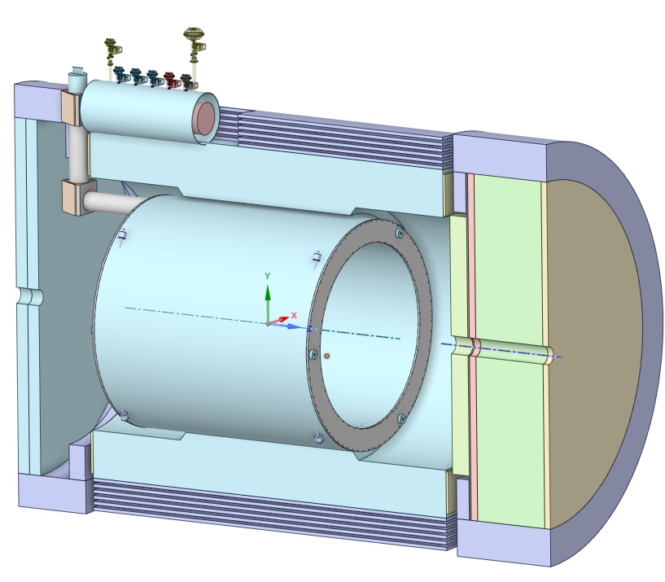
Detector Solenoid- Scope and Overview
WBS | WBS Name | WBS Manager | WBS Description
6.03.06 | Detector Magnets | R. Rajput-Ghoshal | Scope Definition: -Procure and fabricate the central Detector superconducting solenoid Magnet. This will also include the magnet cold test, magnetic field mapping, installation & commissioning of the magnet system. The magnet system includes superconducting coils, support structure, cryostat, control & instrumentation for the magnet, quench protection, magnet power supply, and current leads. This will also include all the vendor visits related to superconducting magnet and associated various sub-systems. Deliverables: -A superconducting magnet system with a 1.7 T central field and 2 T stretch goal, and the subsystems to control and operate it.
Superconducting Detector Solenoid
3.5 m long coil, 2.84 m room temperature bore diameter
2 T on-axis field
Operating Temperature 4.5 K
Conductor: Copper Cladded, Rutherford Cable made with NbTi superconducting strands

Slide 5
Detector Solenoid Magnet-Status
Magnet will be “In-Kind Contribution” from INFN.
  Magnet Design report and other relevant documents were prepared by JLab and shared with CEA and INFN.
  INFN technical team, in collaboration with JLab and CEA, is working on the procurement package.
  The procurement package is expected to be completed in June 2025
  Waiting for the iCRADA documents to get approved from DOE.
Conductor will be procured by JLab and supplied to the magnet vendor as “Government Furnished Material”.
  The expected award date for the conductor is June 30, 2025.
Magnet power supply will be procured by JLab and shipped directly from the power supply vendor to BNL.
  Power supply FDR was done in May 2024.
  The procurement package is ready for approval.
  This can be awarded after the CD-3B ESSAB Approval.

Slide 6
Detector Solenoid Magnet Specifications
Parameter
Detector 1-Solenoid
Comments
Nominal Central Field at IP (T)
2
Safe Operation
Operating Field Range (T)
0.5-2.0
Magnetic Field Polarity
Bipolar
Coil length (mm)
3492
Warm bore diameter (m)
2.84
To keep the same envelope as
Cryostat length (m)
<3.85
the existing BaBAR magnet
Cryostat outer diameter (m)
<3.54
Flat Field area
± 100 cm around center
80 cm radius
Field uniformity in Flat field Area (%)
12.5
RICH area
From z=+180 cm to 280 cm
1. Magnetic field properties
Projectivity in RICH Area
0.1
2. Stray field requirement is
The stray field on the IR magnet was assumed to be <10G. This number will be updated in consultation with IR Magnet Designers.
The stray field requirement does not affect the coil design, it mainly depends on the steel around the magnet.
(mrad@30GeV/c)
10
based on IR magnet location
2
Projectivity in RICH Area (T/Amm
)
Stray field requirement
<10 G @ z=-5.3 m, @z=+7.4 m,
and @R=3.4 m
Charging voltage (V)
10
Fast discharge voltage maximum (V)
500
Quench hot spot temperature (K)
<150
Temperature margin (K)
>1.5
Current margin (%)
<30
Charging time (hr)
2-3
Cooldown time (weeks)
3-4
Cooling scheme
Thermosiphon
Conductor
Cu Stabilized NbTi Rutherford
cable
Operating Temperature
4.5

Slide 7
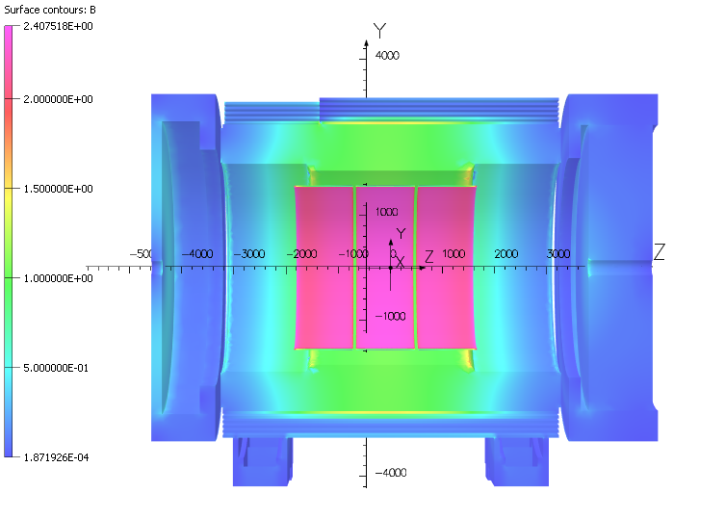
Magnetic Design
Coil is divided in 3 module
Each module has 6 layers
3 modules are chosen, mainly
Feasible single length conductor manufacture
Ease of coil manufacturing
Magnet quench protection
B₀ | 2.0 T | Units
Current | 3924 | A
T_{op} | 4.7 | K
B_{peak} | 2.67 | T
Temp. margin | 2.45 | K
Load line margin | 46.1 | %
I / Ic(T,B_{peak}) | 29.3 | %
Robust and safe operating parameters
Magnet is 10 cm off center
Note: Mitigation of higher stray field on lepton was done using extra steel around the magnet, latest model B5300 <10G
> 1.5 K
<30 %

Slide 8
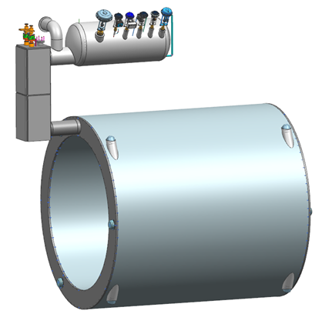
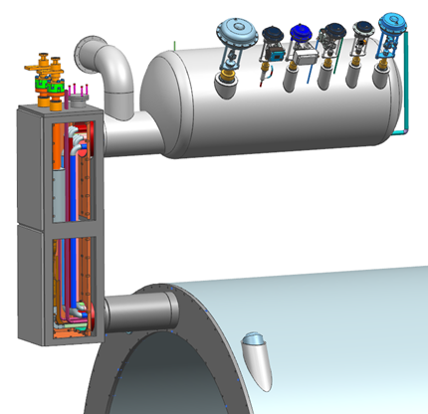
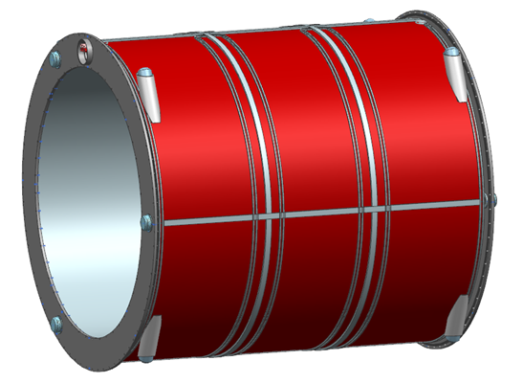
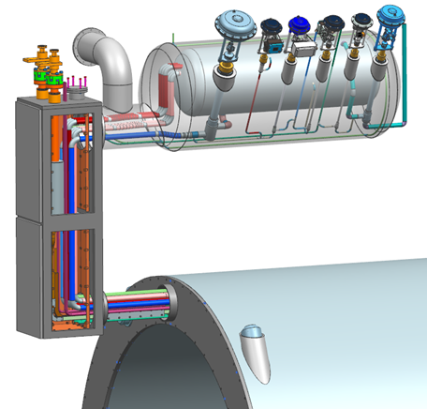
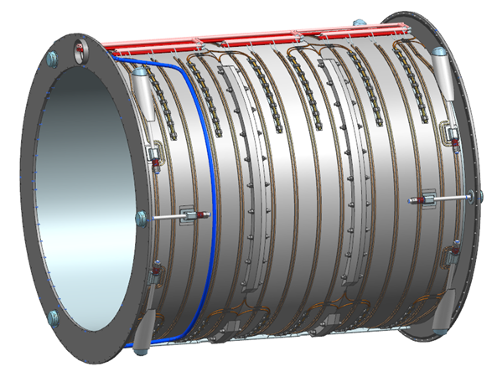
Magnet Assembly
Helium
Phase Separator
Pressure Plate
Thermal Shield
Heat Exchangers
(Primary/Redundant)
Vacuum Pump Out
Thermal Shield
(12 Panels)
Current Leads
Cryostat Assembly
Conductor
And
Current Lead
exit
Chimney
Helium Phase Separator
Helium Return
(Primary)
Current Leads
Conductor Splices
Conductor, Plumbing and Instrumentation exiting magnet and routing to Chimney
Radial Tie-Rod
(4 each end)
Helium Supply
(Primary)
Axial Tie-Rod
(3 each end)
Helium Return
(Redundant)
Helium Tank
Instrumentation
Mandrel Heat Exchangers
(Primary/Redundant)
Helium Supply Line
Mandrel (3 Modules)

Slide 9
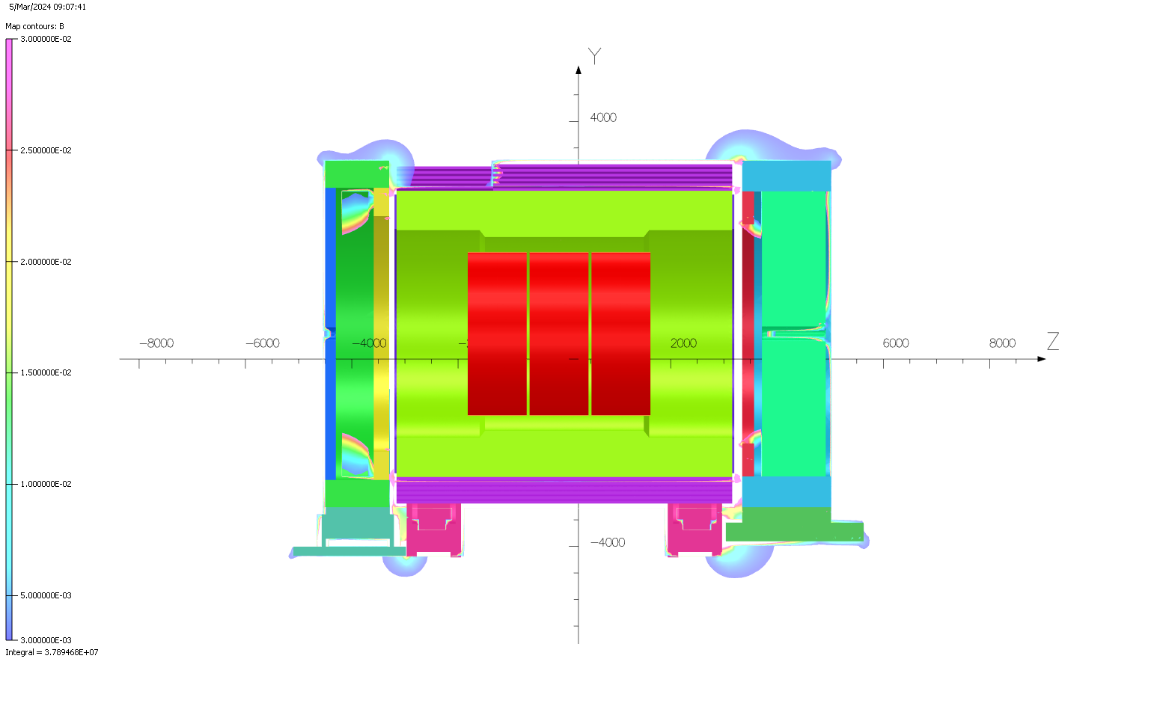
Magnetic Design- Stray Field Reduction
These values were higher than the requirements!
We found a local solution independent of magnet design.
Now the RCS is not in the tunnel, therefore, no requirement of stray field on RCS
Field leakage is primarily near the openings between the barrel and the endcap HCal.
Since RCS has moved out now:
There is no requirement of lower stray field in the radial direction
The extra steel around the HCal barrel is not required any more
The need of extra steel on the lepton side end cap and hadron side end cap is being evaluated

Slide 10
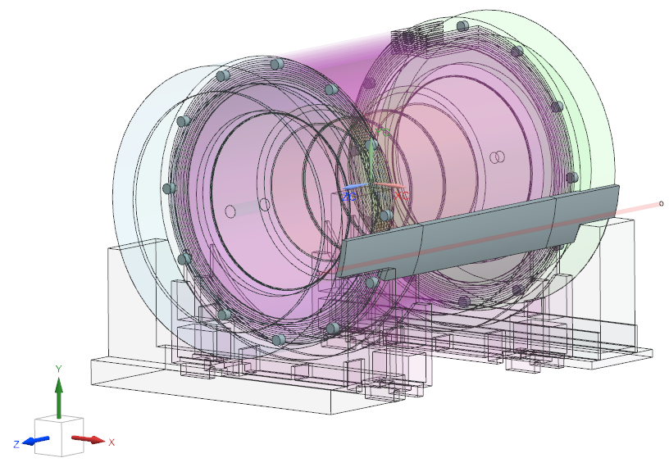
Magnetic Design- Stray Field Reduction
Added links- 1.5 tonnes
12 links on each side
Stray Field Reduction Studies:
Various solutions were tried to minimize the stray field at the IR magnet and on RCS line
The best solution is using small links bridging the service gaps and a block closer to RCS
2b. Added end block – 2 end pieces
2a. Added block
15 tonnes – 3 pieces
Since RCS has moved out of the tunnel, stray field need to be minimized only at the IR magnet.
The use of small links bridging the service gaps meets the stray field specification at IR magnets.

Slide 11
Detector Solenoid Conductor
 | Parameter | Value | Unit
Strand | Strand diameter | 0.847 | mm
 | Cu/NbTi | 1.31
 | I_{c} @ 3T & 4.7K | > 735 | A
 | Filament diameter | < 30 | µm
 | Filament twist pitch | 30 | mm
Cable | NbTi strands | 22
 | Transposition pitch | 50 | mm
 | Width | 8.85 | mm
 | Thickness | 1.49 | mm
Conductor | Copper channel section | 43.7 | mm²
 | Nominal current @2 T | 3924 | A
 | RRR conductor | >= 80
 | Yield strength σ_{0.2%} @ 293 K | >= 165 | MPa
 | Unit length | 1.05 | km
 | Total length | 18.9 | km
Total 18 lengths of 1.05 km are required for the magnet.
We have added 2 lengths to account for production yield.
Current estimated award date for the production conductor is 06/30/2025
Order of conductor samples put in place based on these specifications !
Sample conductor strand tested and shows very good quality strands.
Waiting for cabled and soldered samples.
Production conductor proposal came much higher than expected and higher than P6.
We looked at the alternate plans for the conductor procurement. The alternate plan is more risky and almost same cost as the updated quote from the vendor,

Slide 12
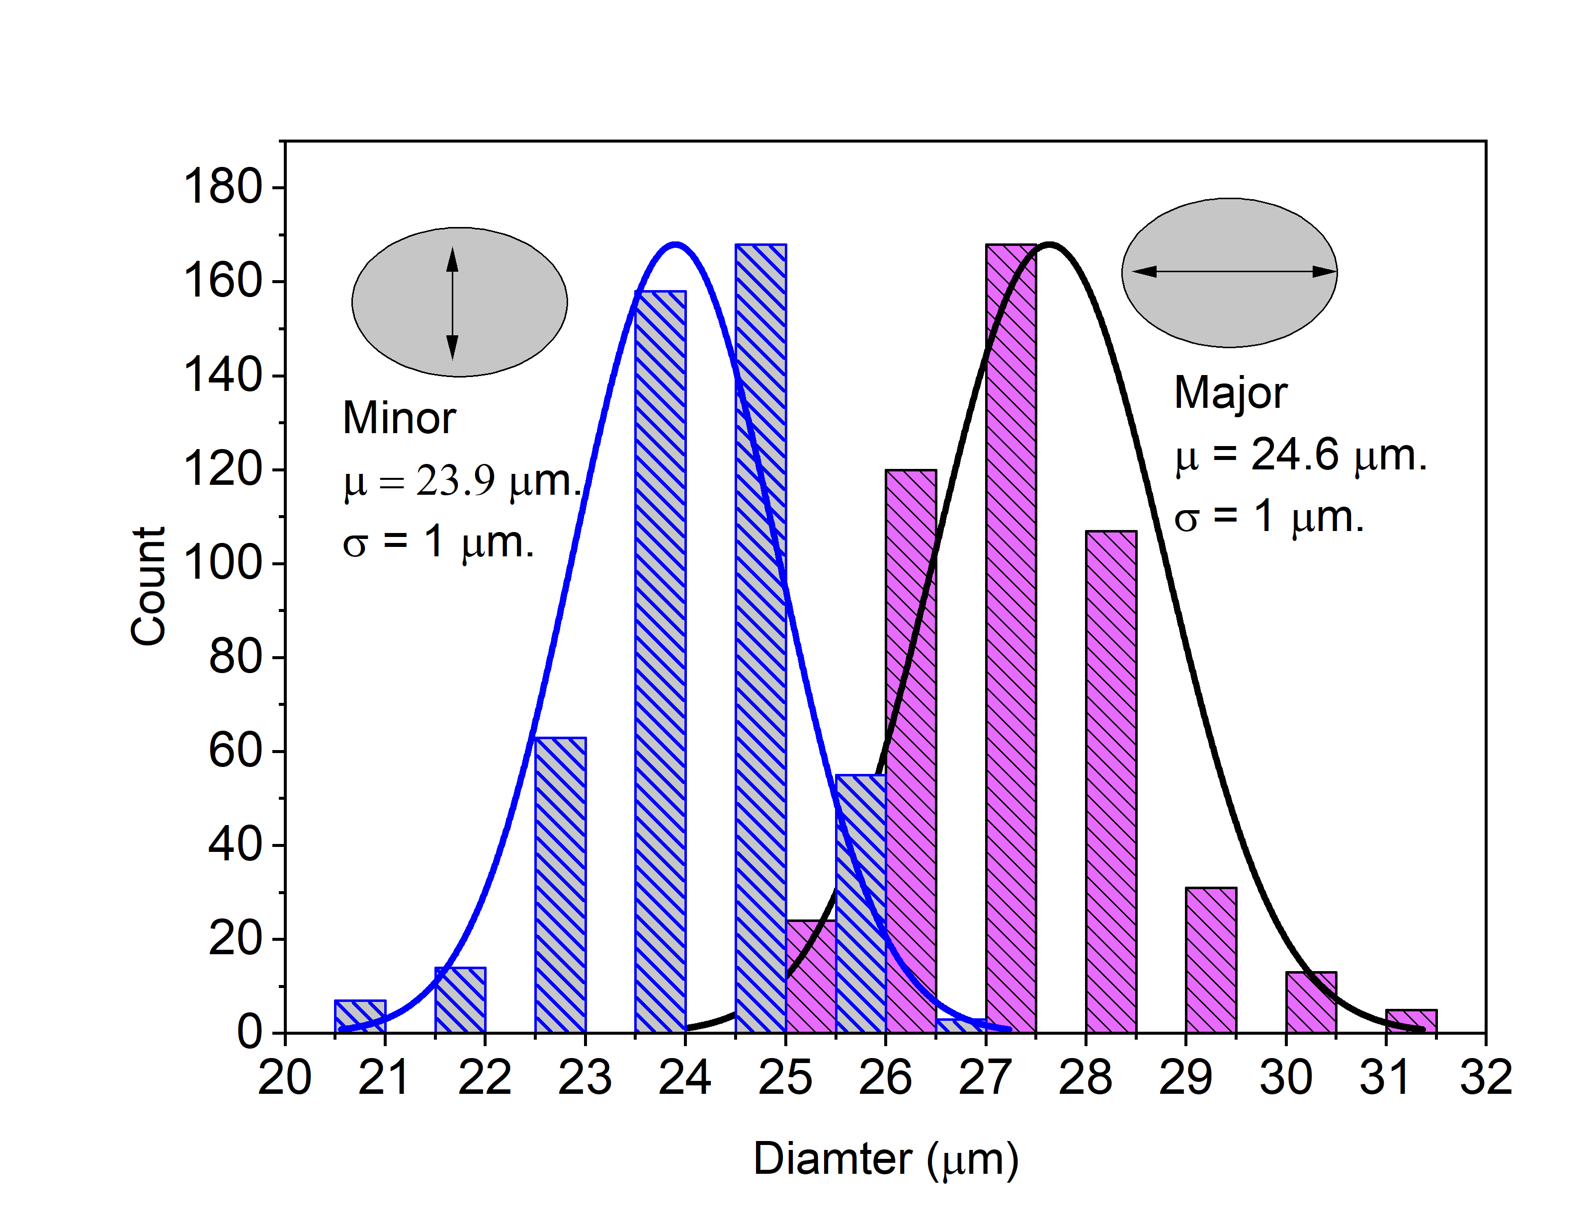
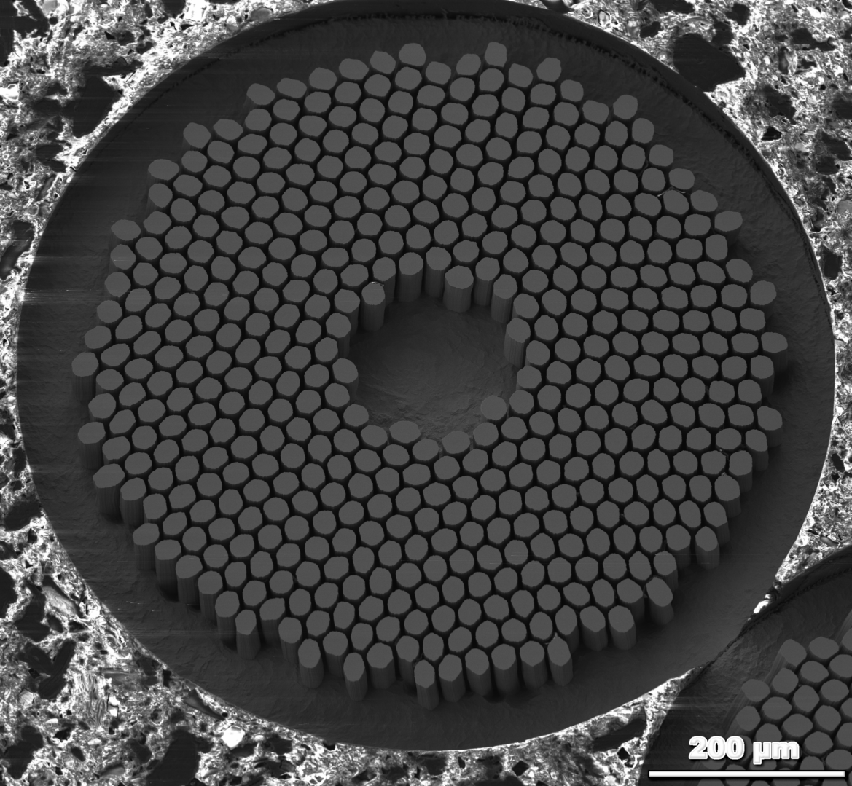
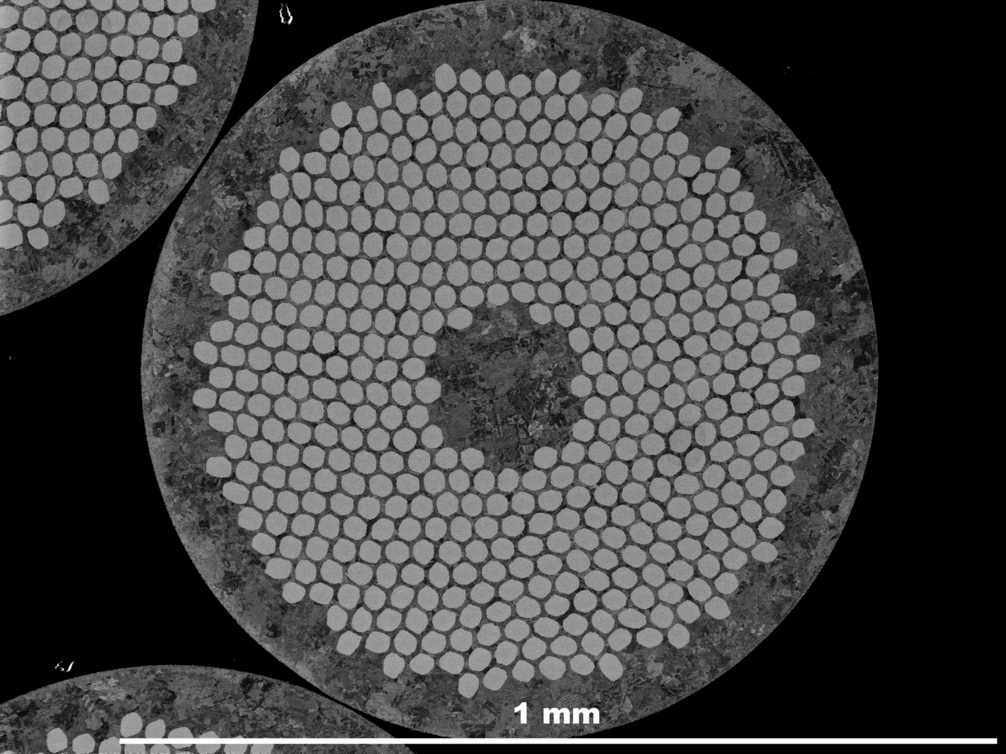
CD3A Status- Sample Conductor
Sample Conductor Status
  Strand received from the vendor,
  Vendor submitted the test results
  Sample strand was sent to University of Twente for further test
  Delay from the vendor for making cable and copper channel,
Strand Sample meets the Specifications
The filaments in the strand are well organized, the distribution of filament size is very uniform
Acknowledgement for SEM:
Shreyas Balachandran, SRF S&T, JLab

Slide 13
Production Conductor- QA/QC
Production units to adhere to same requirements as the sample conductor.
  Critical current:
  Cabling Ic degradation < 5%
  Soldering Ic degradation < 5%
  0.2% Yield strength > 165 MPa
  RRR conductor > 100
External Conductor Tests
  Will be based on strand utilization and test cost per sample
  8-10 billets needed for 21 Unit lengths
  Possibly 10 Sample test, Conductor only
Total 18 lengths are required for the magnet
We plan to add 2 lengths to account for production yield

Slide 14
Magnet Power Supply
The solenoid power supply is a standard superconducting magnet power supply. The power supply will be located about 300 feet far from the magnet.
The power supply is a 5000A, ±20V power supply.
A polarity reversal switch is also included in the power supply. Is part of power supply procurement.
The MPS will be built to BNL/JLAB standard.
An integral tunable magnet quench detection will also be part of the power supply procurement.
test

Slide 15
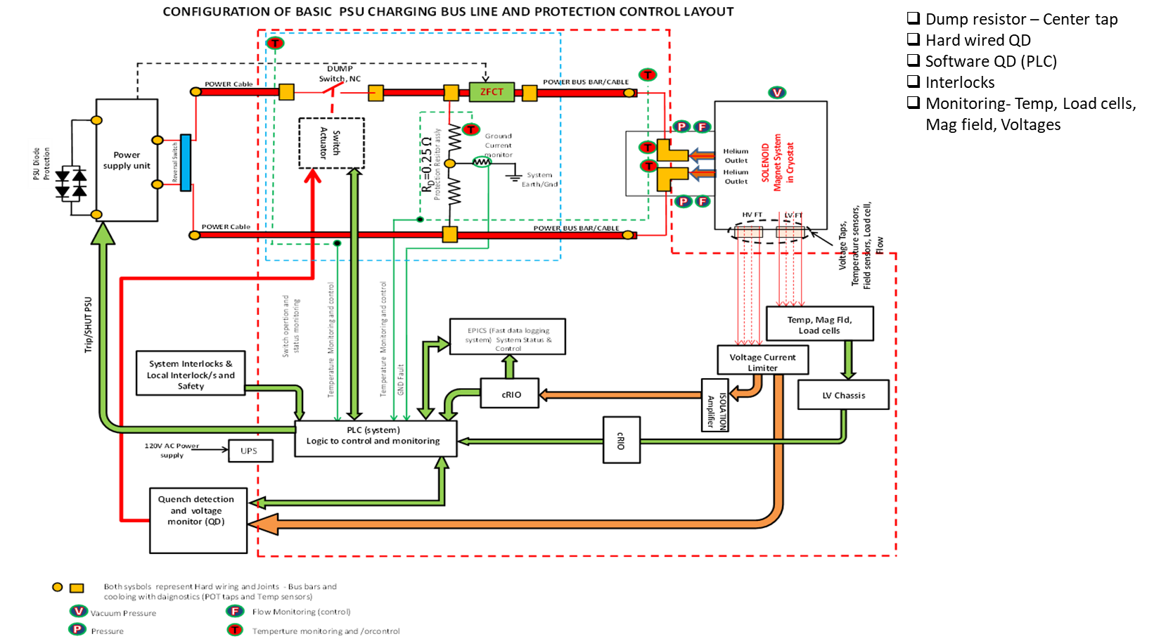
Protection System Layout
Primary security level
Secondary security level

Slide 16
Outlook to CD2 and Beyond
Water cooled leads:
  There are existing leads in the experimental Hall, we need to qualify these for use in this magnet, if not, this will be open procurement after CD3 and the design is based on similar leads bought for 12GeV magnets.
Magnet Cryogenics
  The scope and design of this will be done in consultation with BNL cryogenic group.
  Preliminary design review will be in September/October 2025
Magnet Cold Test
  Magnet will be cold tested after installing the HCal end caps
Magnet Field Mapping
  Magnet Field mapping will be done after installing the Barrel HCal, HCal end caps and extra steel required for minimizing the stray field,
  Field mapping will be done by JLab, CEA engineers and techs from BNL

Slide 17
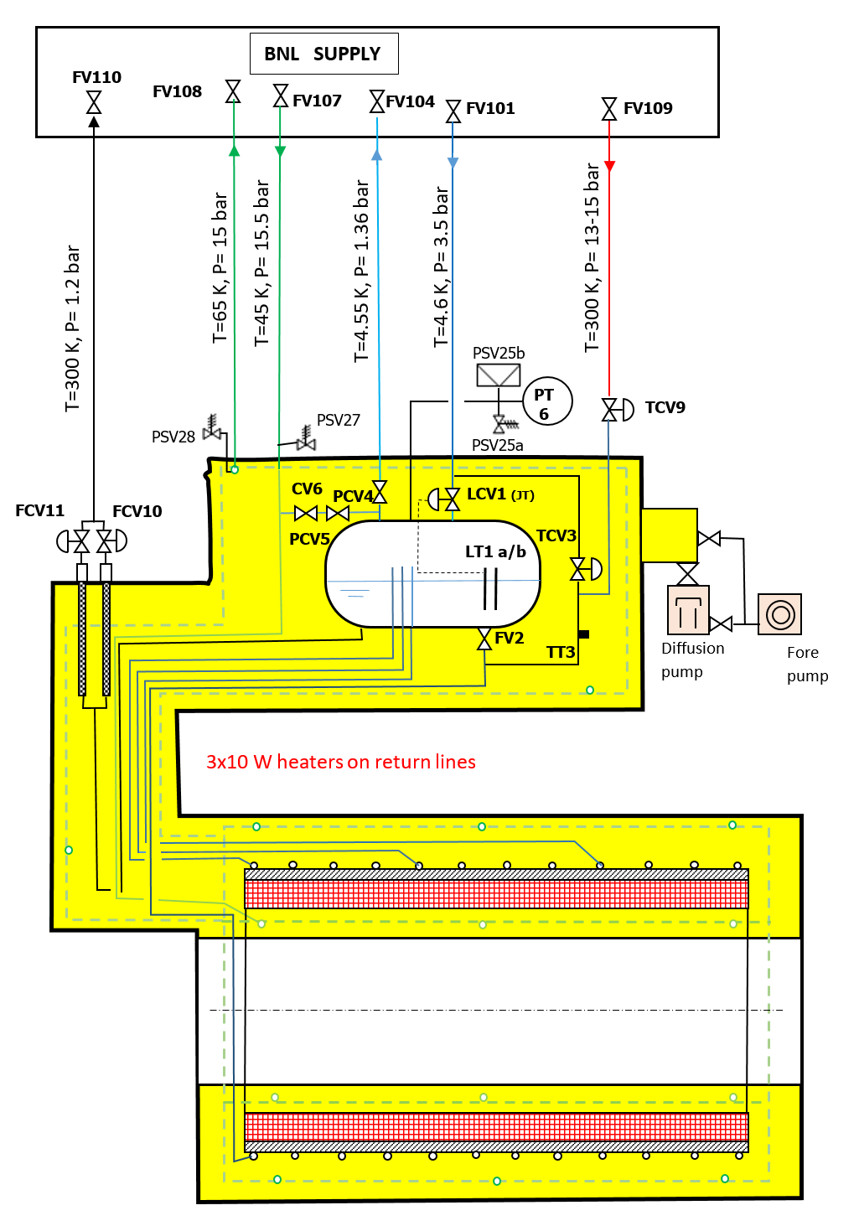
Magnet Cryogenics
The MARCO magnet is a conduction-cooled magnet.
The internal cryogenic system involves a cold mass, thermosiphon system, a phase separator, and one cryogenic chimney.
The MARCO magnet is cooled using cold and warm helium during operation.
Phase
SeparatorTank
110 L
Current
Leads
Cryogenic chimney
Cold mass
20 tonnes
Thermal
Shield

Slide 18
Magnet Cryogenics-Contd.
Magnet Thermal Parameters
The magnet cooldown time is approximately 7 days
The maximum temperature of the magnet during long term shut-down is 100 K
During transfer of magnet between halls, the coil temperature drifts from 4.5 K to 80 K in approximately 1.5-2 days.
Magnet transfer during Halls
The different scenarios in which the magnet will be moved :
From assembly hall to experimental hall (during installation)
From experimental hall to assembly hall -during shut down or maintenance
From assembly hall to experimental hall -after shutdown or maintenance
Helium Requirement during Magnet transfer
There is no active cryogenic cooling during transfers.
During magnet transfer the temperature of the magnet to increases to ~80 K.
On the completion of the transfer, the cryogenic connections are to be made to limit the temperature of the magnet to 100 K
Either Two distribution boxes or one distribution box with a penetration through the wall is required to meet the cryogenic requirements of the magnet.

Slide 19
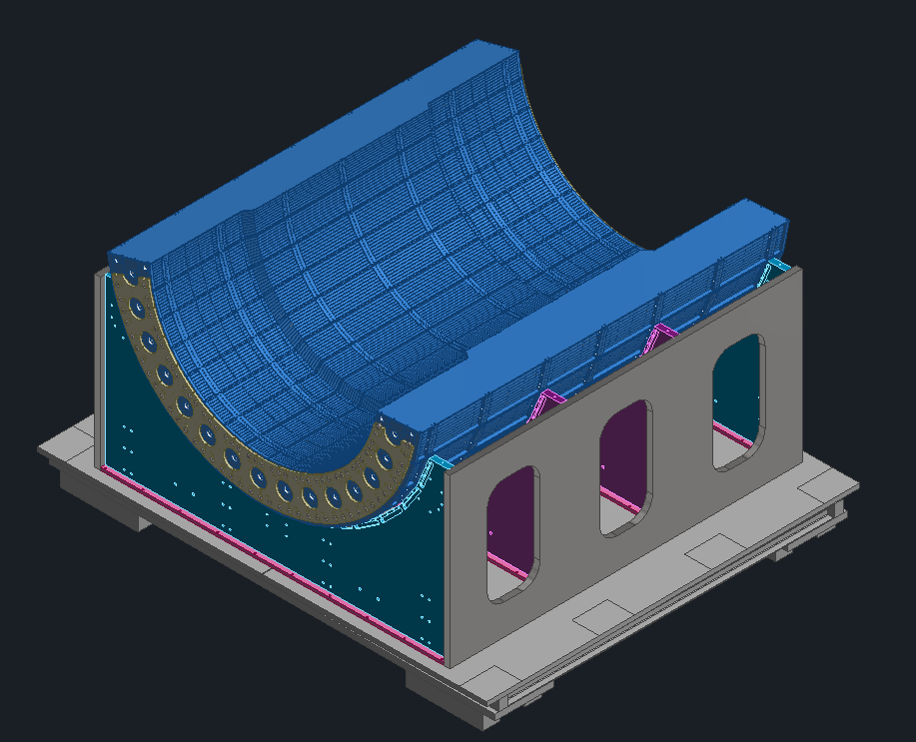
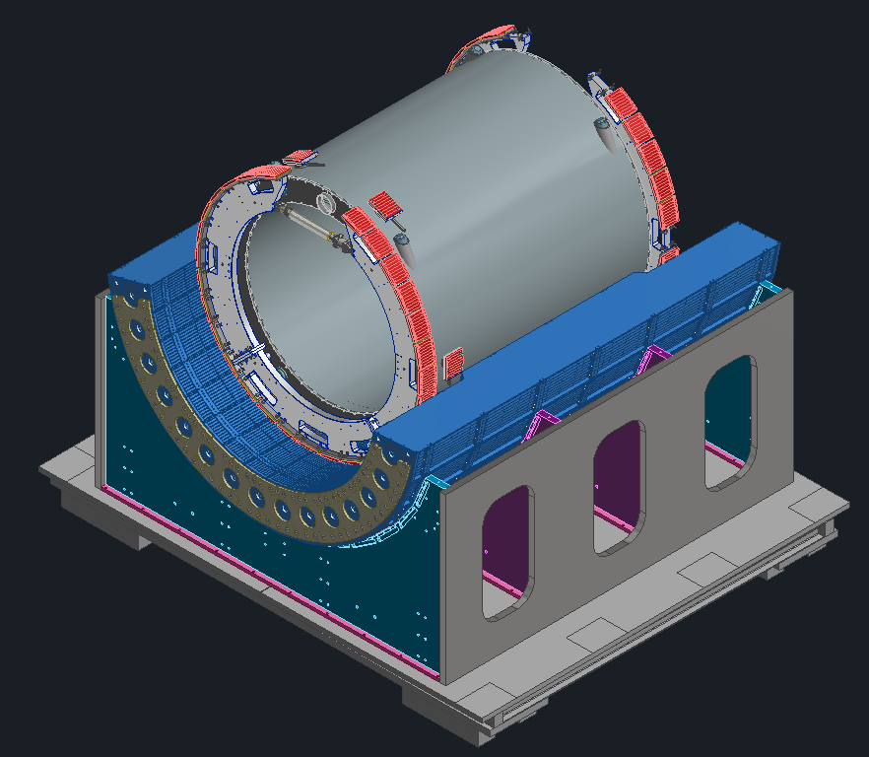
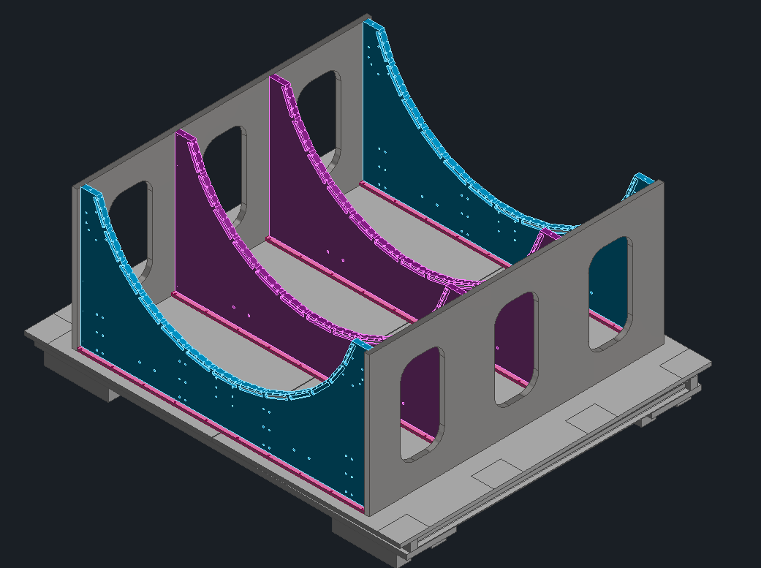
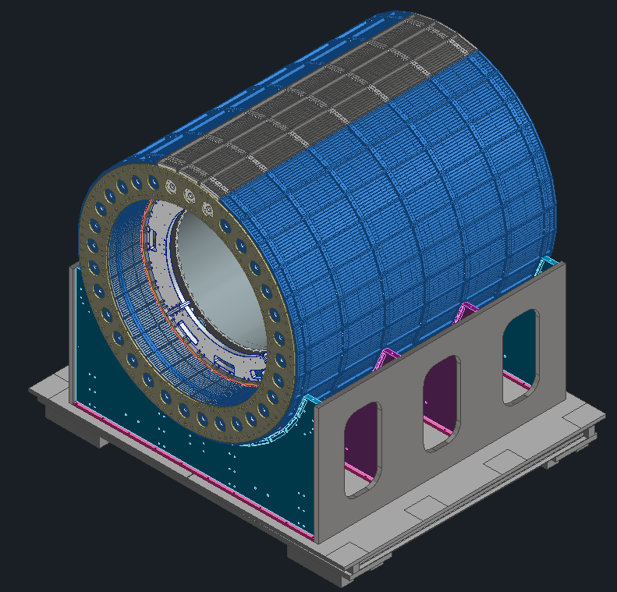
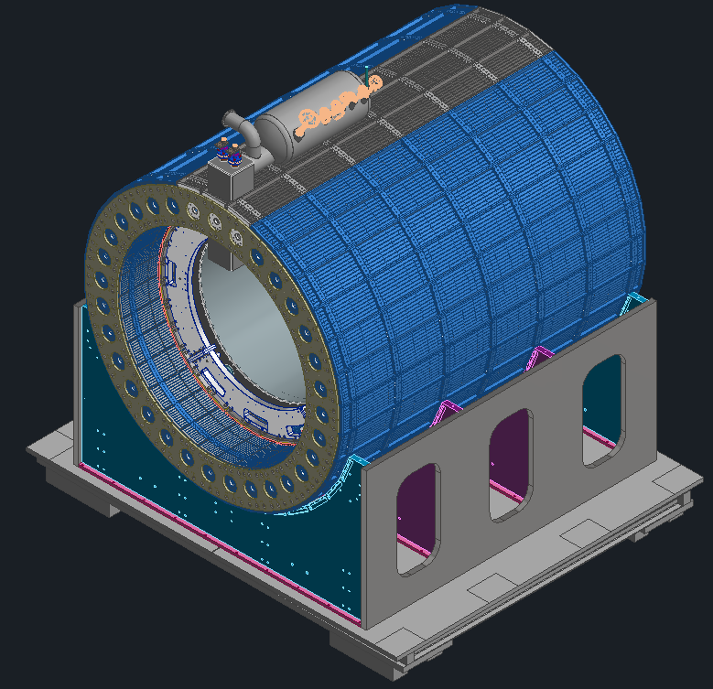
Magnet Installation
Bottom HCal Installed
Magnet with support rings installed
Cradle Installed
Magnet Arrival Checks
Instrumentation cables and cryo connections
Vacuum check
Low current Test
Move the magnet to the Hall
Cool Down magnet
Install the end-caps
Energize to the full current
Map the magnet
Magnet Chimney Installed
Top Half HCal Installed

Slide 20
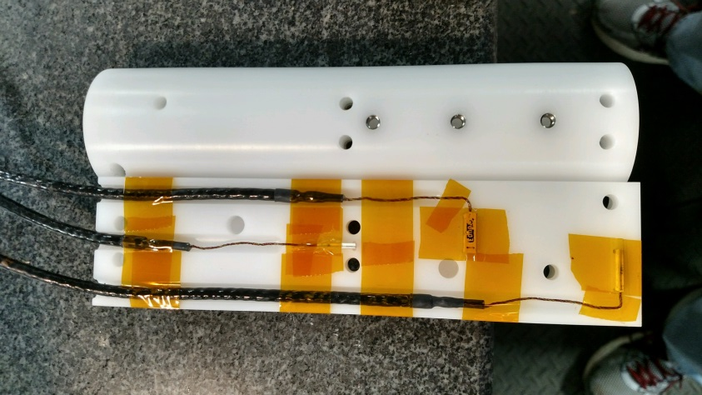
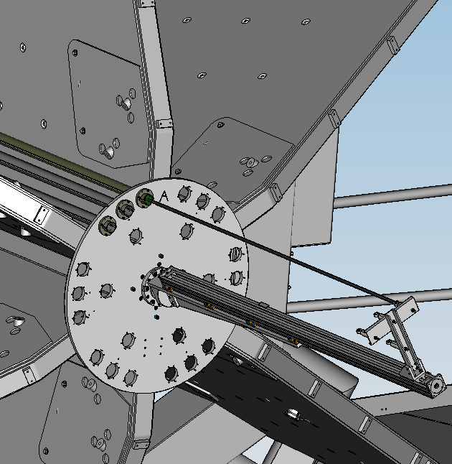
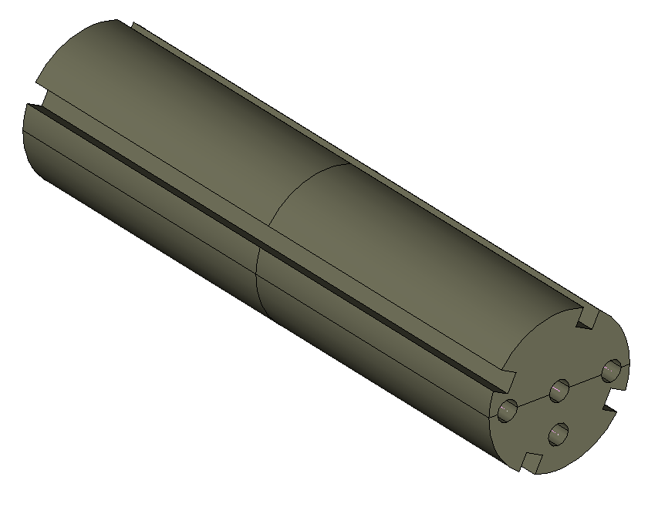
Magnet Mapping
Slots control rotation
Tube Assembly
Push Rod
Rod Attachment
Three transverse Hall probes positioned in the probe holder to measure Bx, By, and Bz
Holder made from Delrin
Precisely machined upstream and downstream plates
The plates will be surveyed prior to install to know hole locations
Precise pins locate and orient the carbon fiber tubes
Pins assure locating/repeatability of carbon fiber tubes to 0.05mm [0.002”]
Carbon fiber tubes will be moved from one sector to another
Linear slide/motor/controller accurate to 0.010mm [0.0004”]
Downstream End Plate
Linear Slide

Slide 21
ESH&Q- Electrical & Pressure Vessel
Magnet Power supply, electrical and Instrumentation feedthroughs will comply as per 6210 Electrical Safety Manual
    NFPA 70E, 2015 - Standards for Electrical Safety in the Workplace
    National Electric Code (NEC) Handbook
    DOE–HDBK-1092, 2013 – Department of Energy Electrical Safety Handbook
    ES&H Manual 6230 Electrical Safety Manual
    JLAB-6220 AC Electrical Equipment Safe Work Program
All the vessel are designed according to the requirements of ASME codes
Pressure piping is governed by ASMEB31.3
Reciprocal arrangements are in place between JLab and BNL
Experimental Hall will be updated for the required ODH.

Slide 22
Summary
Magnet Design is complete and magnet procurement documents are being prepared with international collaborators.
The expected award date for conductor is end of June 2025.
  Sample conductor testing is going well, the strand received from the vendor is of very good quality and meets the specification.
Magnet power supply procurement documents are ready for approval and the procurement will start after CD3-B ESAAB approval.
Cryo review will be in September/October 2025.
Magnet mapping is planned, and details will be worked out after CD2/3.

Slide 23
Back up

Slide 24
How We Work
Collaboration of Jefferson Lab, CEA Saclay and Brookhaven National Lab
  All the design work is done as in-kind/contract with CEA Saclay augmented with Jefferson Lab work
CEA Saclay is involved in reviewing all the procurement documents and sample conductor testing.
Expectation is that vendor contract may follow similar pattern for vendor oversight.
Further discussions are ongoing on with INFN for in-kind contribution
Magnet team members:
  JLab: Renuka Rajput-Ghoshal, Probir Ghoshal, Sandesh Gopinath, Eric Sun, and Dan Young
  BNL: Rahul Sharma, Roland Wimmer and Roberto Than
  CEA, Saclay: Valerio Calvelli, Christophe Berriaud, Jean-Pierre Lottin, Hugo Reymond, and Francesco Stacchi

