Slide 1
Integration, Installation and Infrastructure
Rahul Sharma (BNL)
Chief Mechanical Engineer/L3 CAM
6.03.09 Triple I group
10th EIC DAC Review
June 11th – 13th, 2025

Slide 2
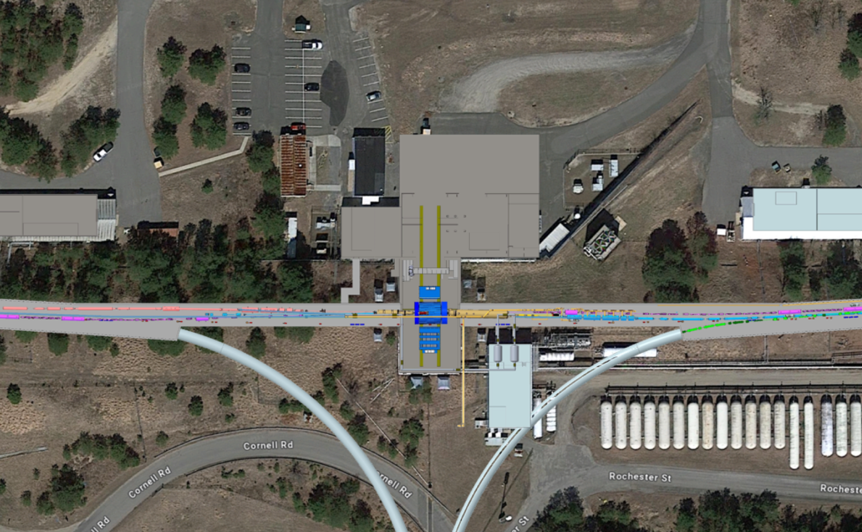
Outline
Charge Questions
Scope Description
Triple I Team
EPIC Detector 1006 Halls
In Kind/Reused Items
Infrastructure and Utilities
EPIC Full Model Overview
8mrad Rotation
Services Layout & Management
Installation Sequence (Barrel)
Magnetic Forces Analysis
Power
Summary/Next Steps
Parking Lot
DAQ and Control Room
Assembly Hall
1006
Elec and Pump Room
ePIC
WAH

Slide 3
Charge Questions
Is the design of the ePIC detector and its sub-systems appropriate and progressing well?
Are the remaining work and technical, cost and schedule risks adequately understood? Are there opportunities?
Will the detector be technically ready for baselining by late 2025?
Are the detector integration and planning for installation and maintenance progressing well? Are there areas where further ideas should be pursued?
Will the detector be ready for start of construction by late 2026?

Slide 4
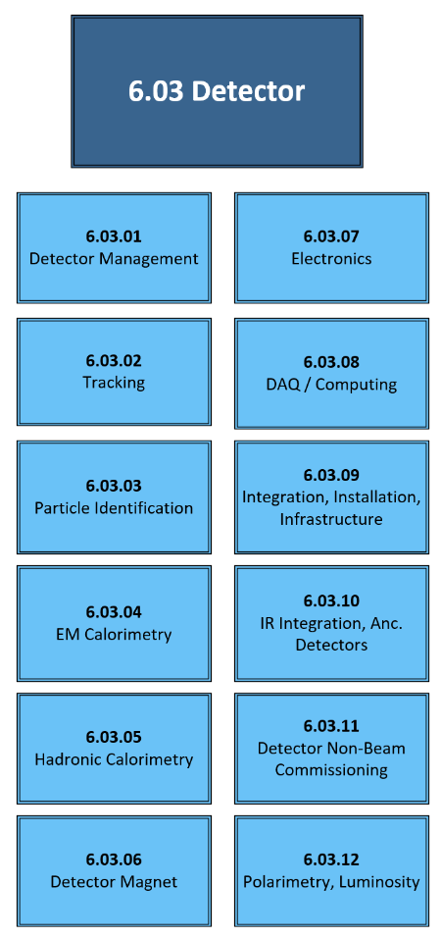
Scope Description:
WBS | WBS Name | WBS Manager | LLP Scope Description
06.03.09 | Integration, Installation and Infrastructure | R. Sharma | Scope Definition: This WBS item covers the following: Effort needed to design and build new infrastructure, modify/repurpose existing infrastructure and Integration of various subdetectors for construction of ePIC detector in Bldg 1006 Assembly Hall and Experimental Hall. Deliverables: Designing, Manufacturing, Assembly and Installation of Support Structures for various sub detectors. Includes the support to complete the installation scope prior to commissioning. Integration of various sub detectors and other detector components in ePIC detector. Defining and Managing interfaces between experimental equipment, magnet, various sub detectors, other detector components and collider and provide guidance to various detector subgroups regarding design of their respective detectors. Providing and Managing utilities (Power, Water, Cooling, HVAC) for Detector and the building.
Effort needed to design and build new infrastructure, modify/repurpose existing infrastructure and Integration of various subdetectors for construction of ePIC detector in Bldg 1006 Assembly Hall and Experimental Hall.

Slide 5
EPIC Triple I Team:
Rahul Sharma (BNL) – Chief Mechanical Engineer
Walt Akers (JLAB) – Systems Integration
Roland Wimmer (BNL)– Mechanical Engineer
Dan Cacace (BNL) – Mechanical Engineer
Alex Eslinger (JLAB) – Mechanical Engineer – pfRICH and dRICH Design
Ron Lassiter (JLAB)– Forward Detectors - Mechanical Engineer
Johnathan Smith (JLAB)- Mechanical Engineer
Andreas Jung (Purdue University) – AC LGAD and Carbon Fiber Support Structure
Karim Hamdi (BNL)– Mechanical Designer
John Tuozzolo (BNL) – Mechanical Designer
Nathaniel Speece-Moyer (BNL) – Mechanical Engineer
Seung Joon Lee (JLAB) – Detector Scientist
Avishay Mizrahi (Tel Aviv) – Mechanical Engineer - DIRC
Julien Bettane ( IJC Lab-Orsay)
Joshua Crafts (CUA) – Postdoc - EEEMCAL
Tom O’Connor and Kevin Bailey (ANL) – Barrel EMCAL Design
Girish Gowda (BNL) – CFD and Thermal Analysis Engineer

Slide 6
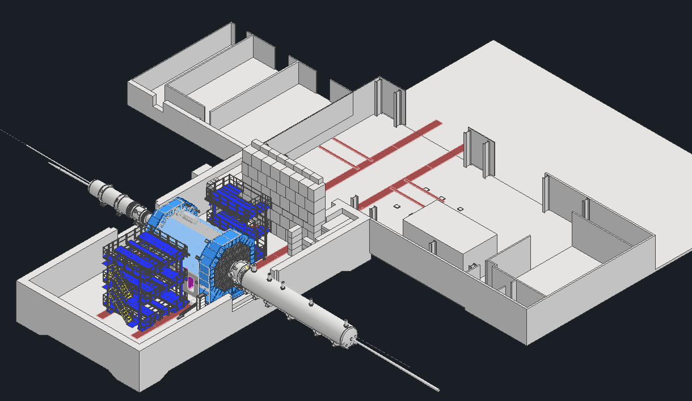
EPIC Detector, Assembly Hall and Experimental Hall
Control Room
DAQ Room
Parking Lot
Ring inside
WEST
NORTH
HADRONS
Exp. hall
Assembly hall
Clean Room
Pump & Elec Rooms
EAST
Ring outside
SOUTH
ELECTRONS
EPIC Detector Barrel will be assembled in the Assembly Hall and End Caps will be assembled in the Experimental Hall
During maintenance shutdowns, detector barrel (central detector) can be rolled out from Experimental Hall to the Assembly Hall

Slide 7
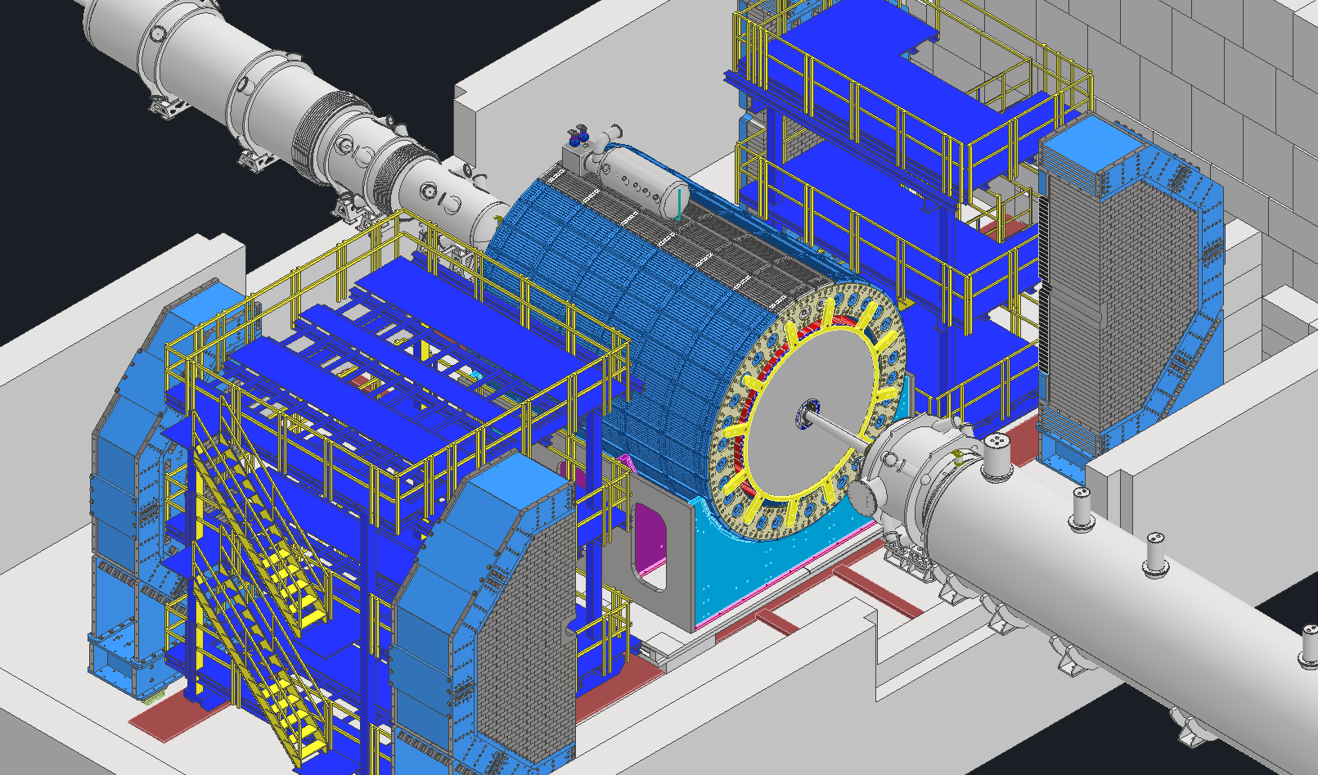
In Kind/Reused Items
From STAR (Existing detector in Bldg. 1006)
  North and South Platform for STAR will be modified and used for ePIC. Modifications needed to clear the path for opening of End Caps.
  Plan on using same pistons and moving mechanism from STAR. Pistons will be refurbished and new control unit will be used.
sPHENIX (Existing detector in Bldg.1008)
  Barrel HCAL Detector
  Detector Cradle from existing detector (sPHENIX) will also be reused.

Slide 8
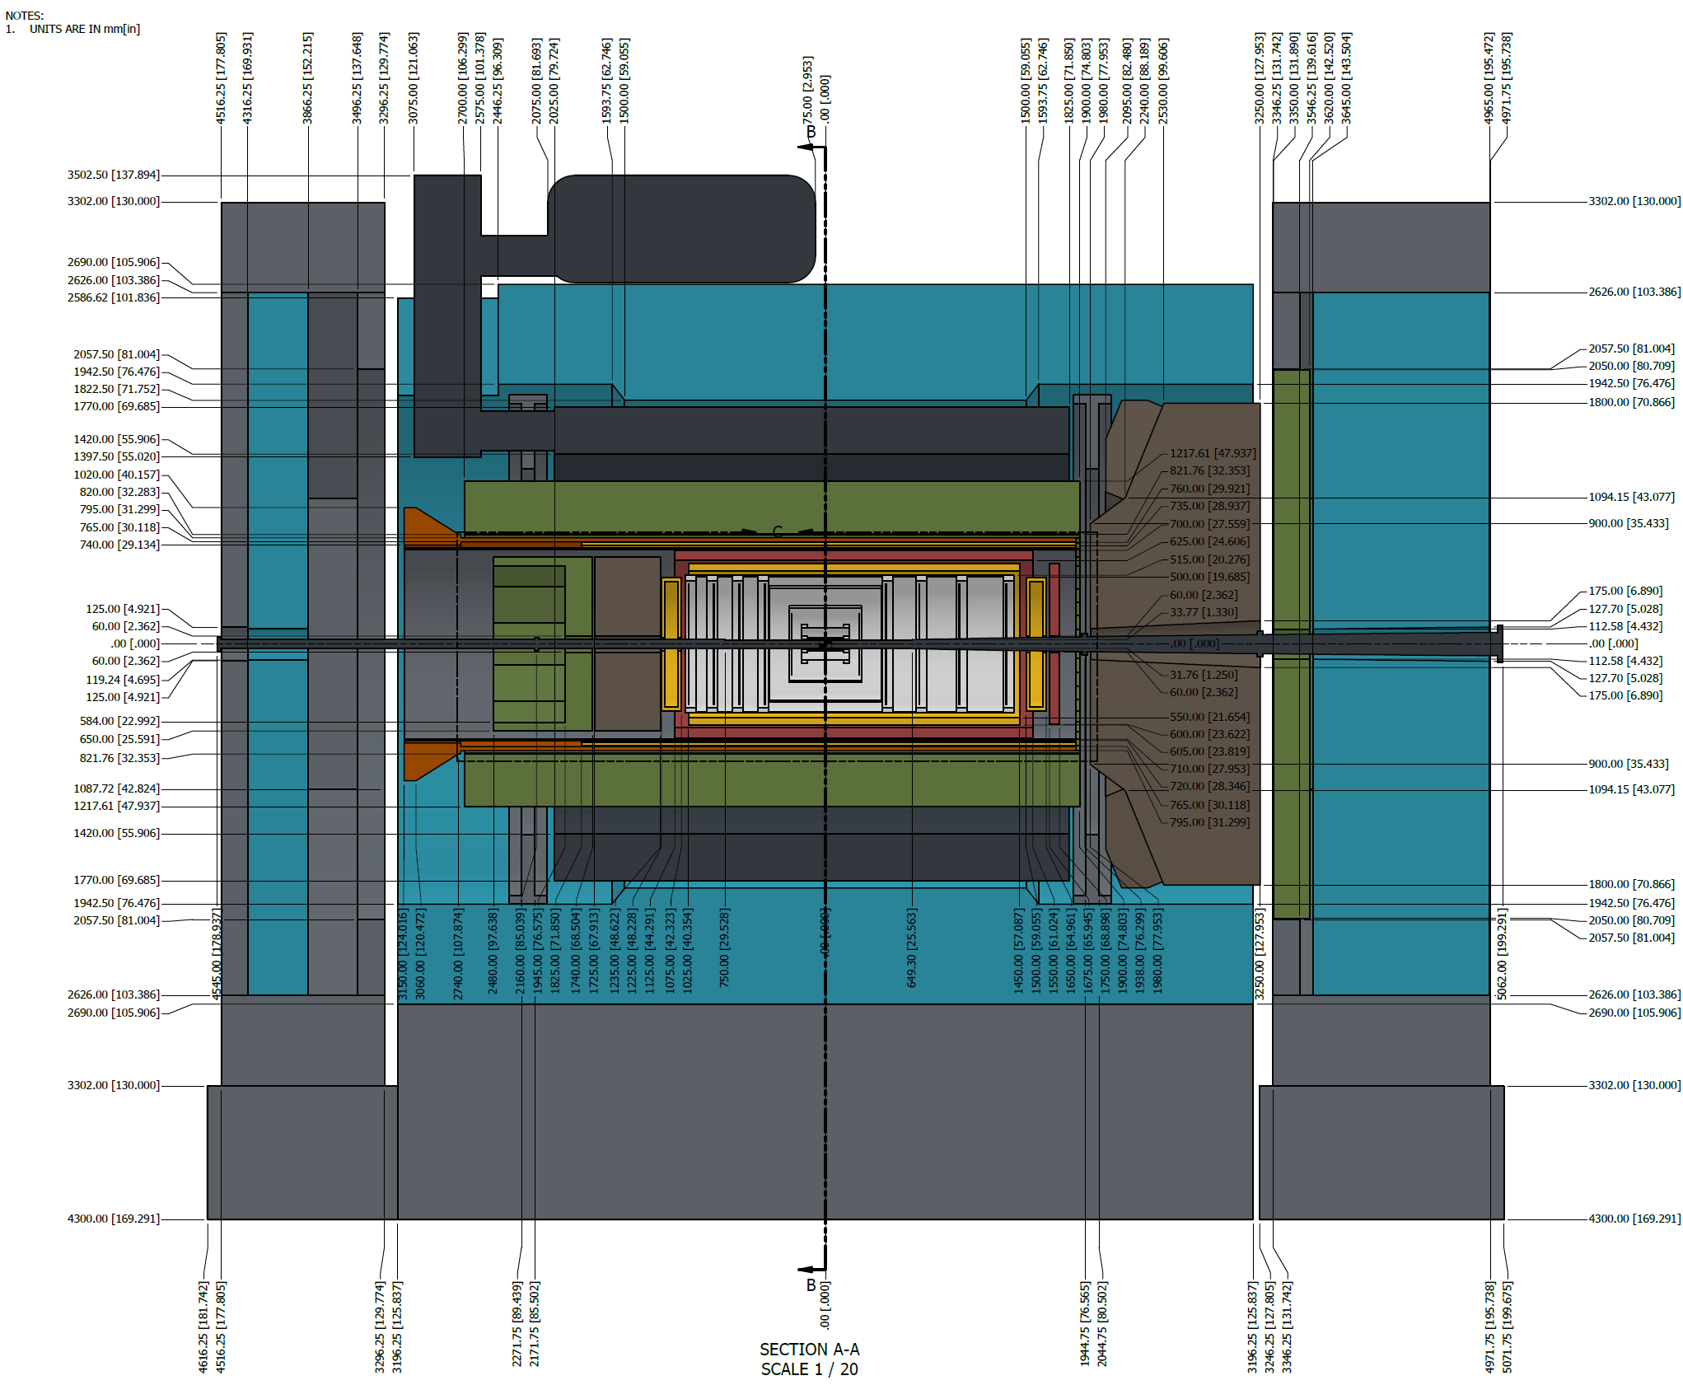
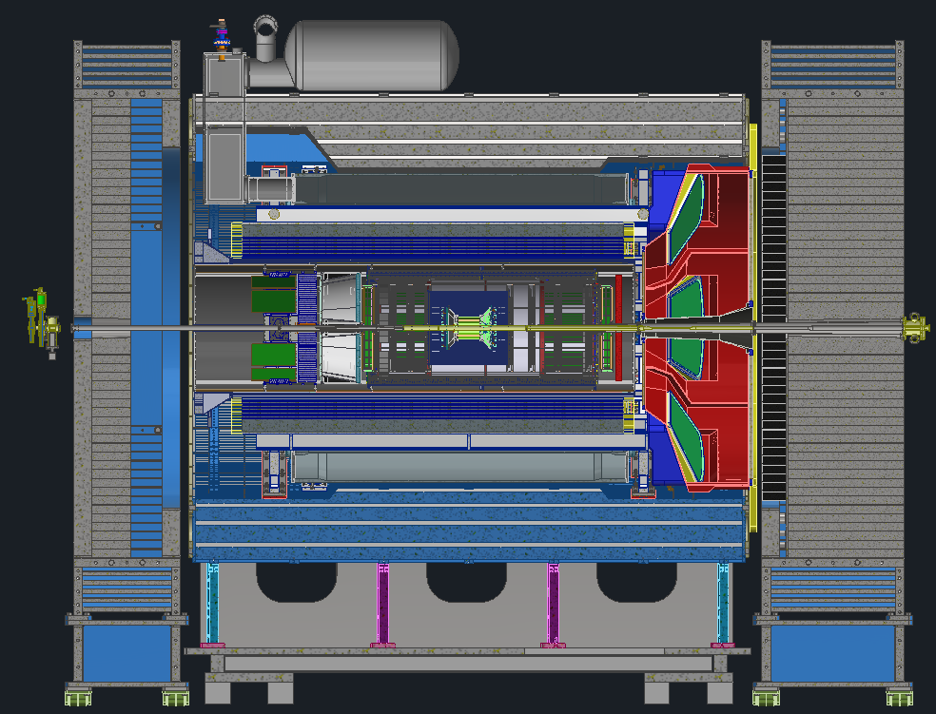
ePIC Full Model Overview
ePIC Sub-detectors Envelopes Model
ePIC Integrated Model

Slide 9
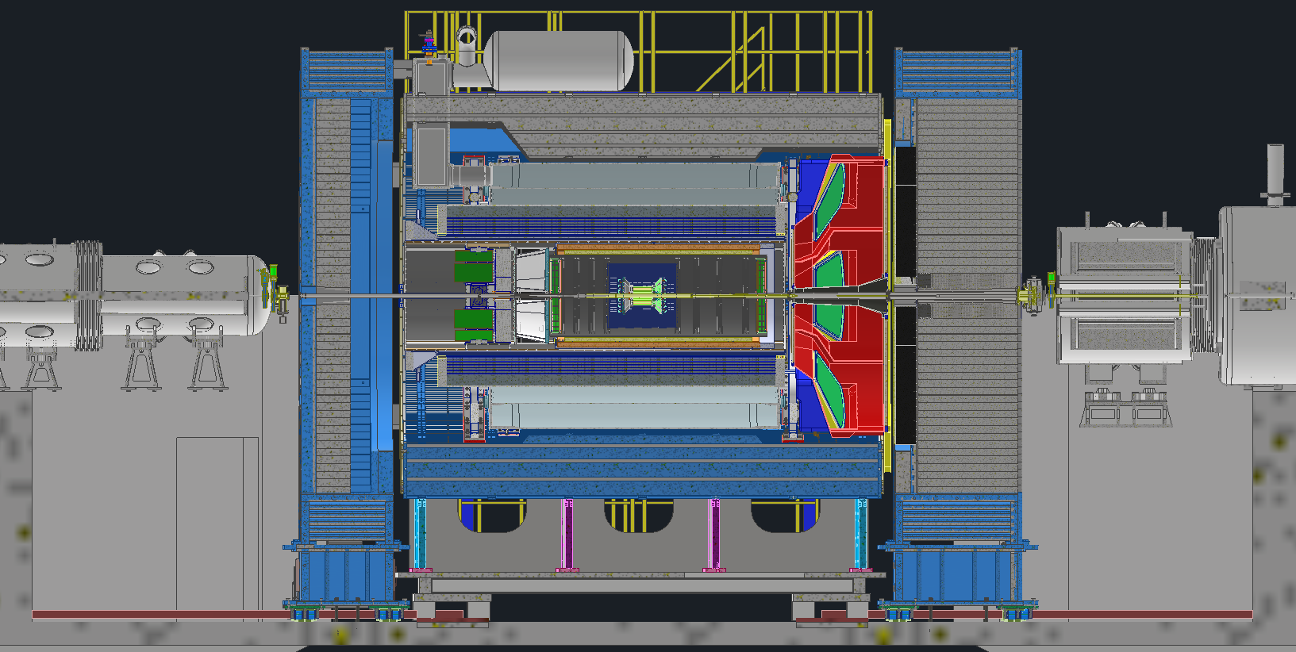
Overall Integration
Central Barrel
Forward End Cap
Backward End Cap
B0 Magnet
Gate valve
Gate valve
Rear Magnets
Services Gap
Services Gap
End caps fit between the central barrel and the magnets/valves

Slide 10
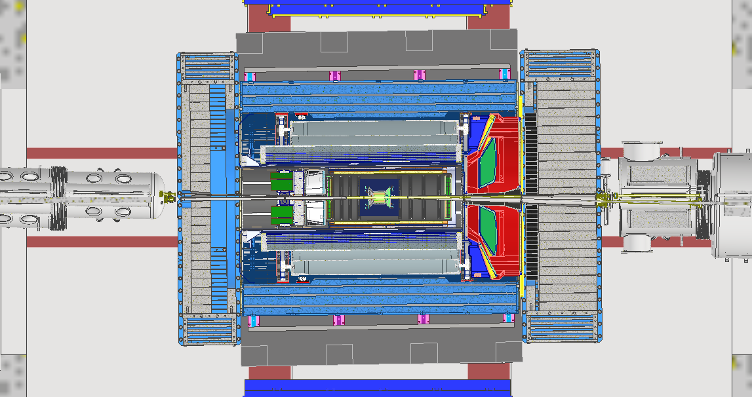
8mrad Rotation
TOP VIEW
9.518m
5.018m
Lepton Endcap 260 Tons
Hadron Endcap 400 Tons
Central Barrel 900 Tons
IP 6
0.39m
0.45m
8mrad
1.671m
1.204m
ePIC Detector is aligned with the Electron beam which is at 8 mrad angle through the Hall. It creates some design complications for various detector components.

Slide 11
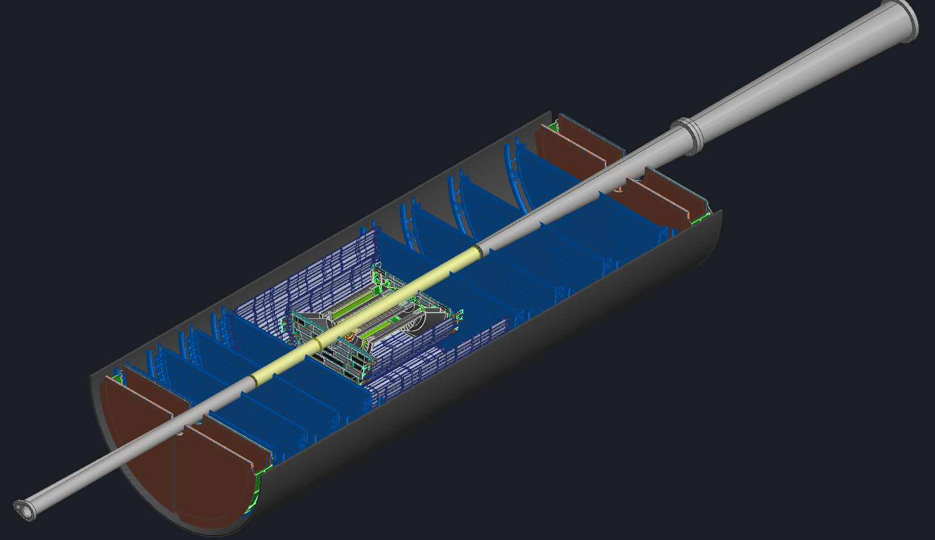
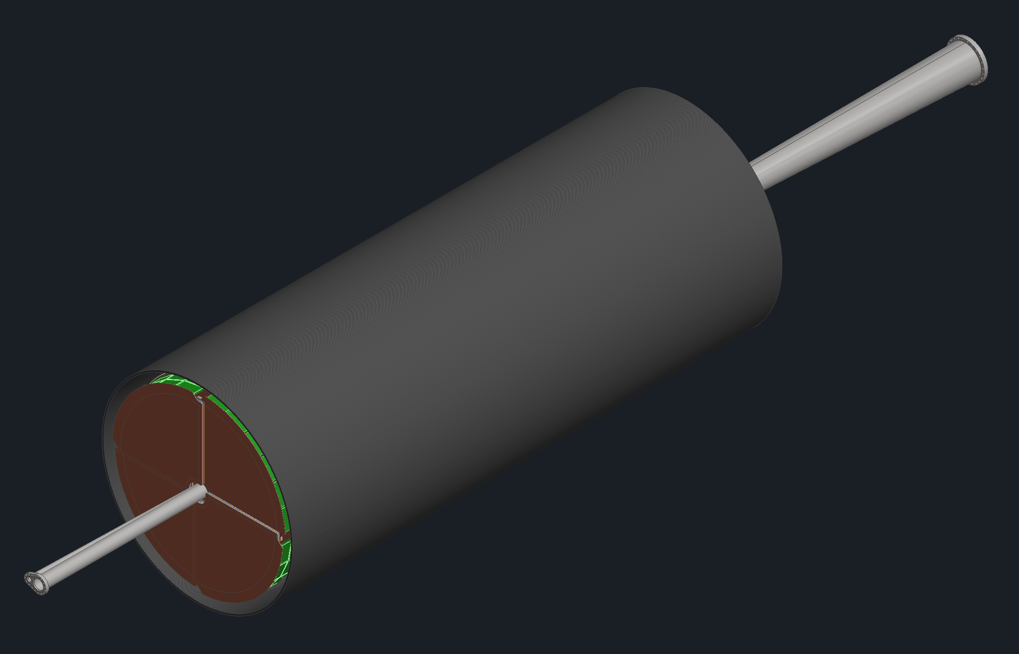
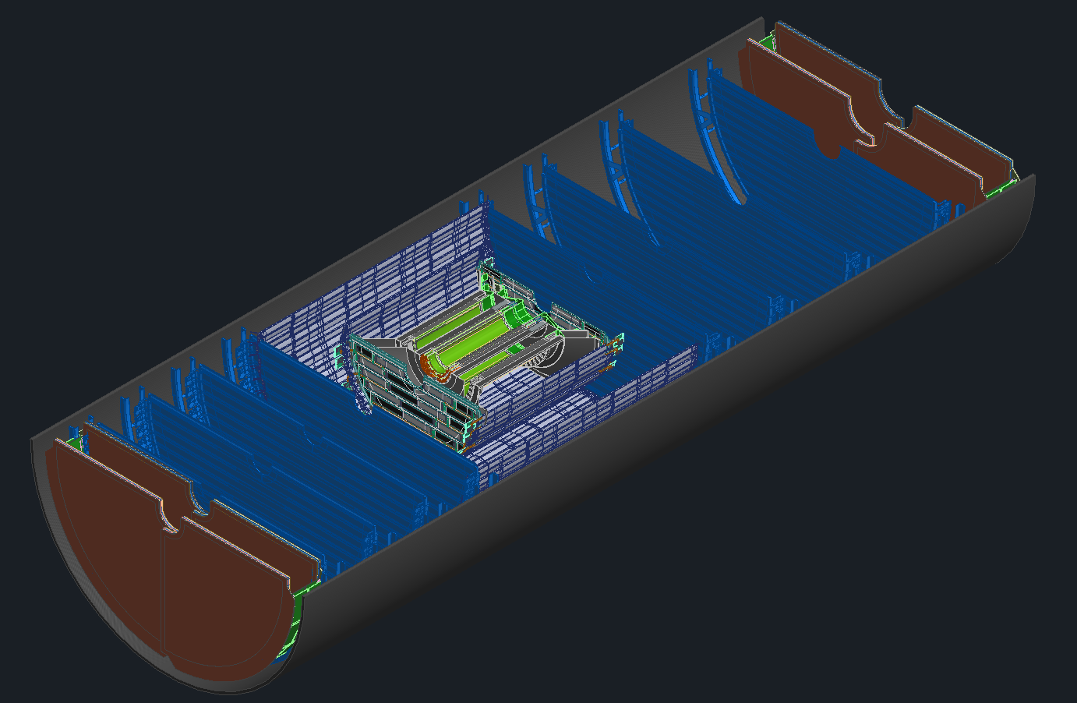
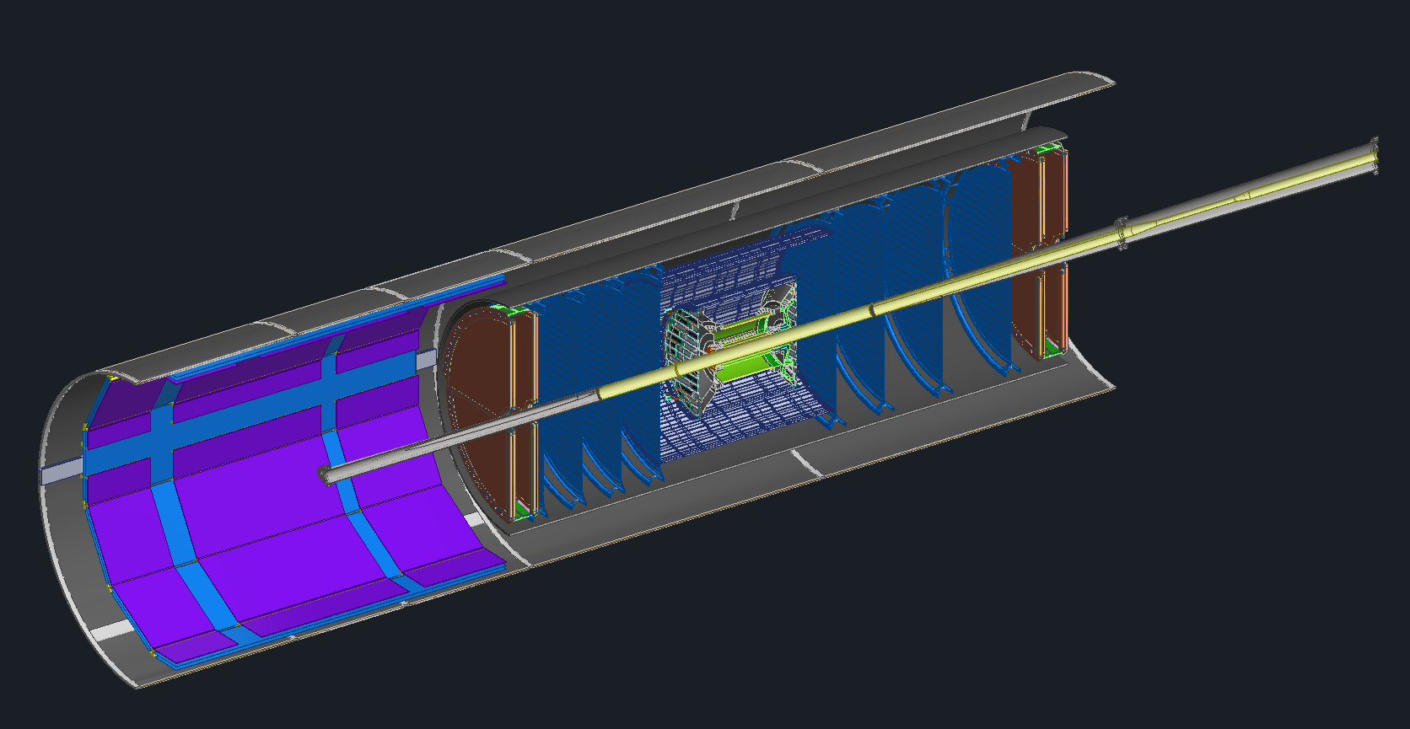
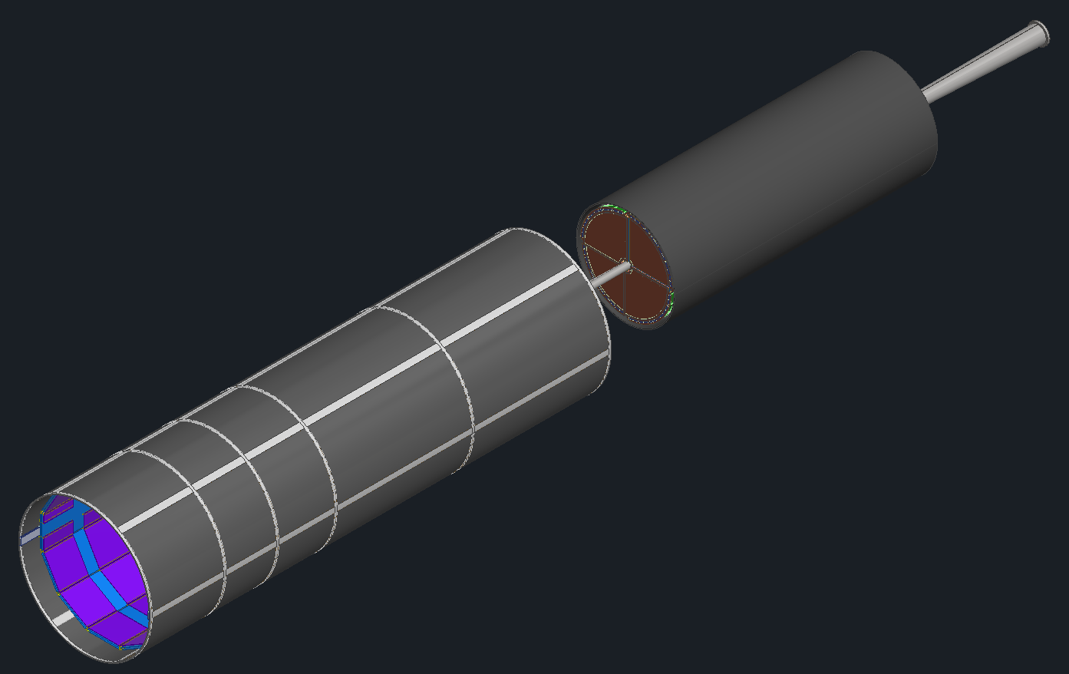
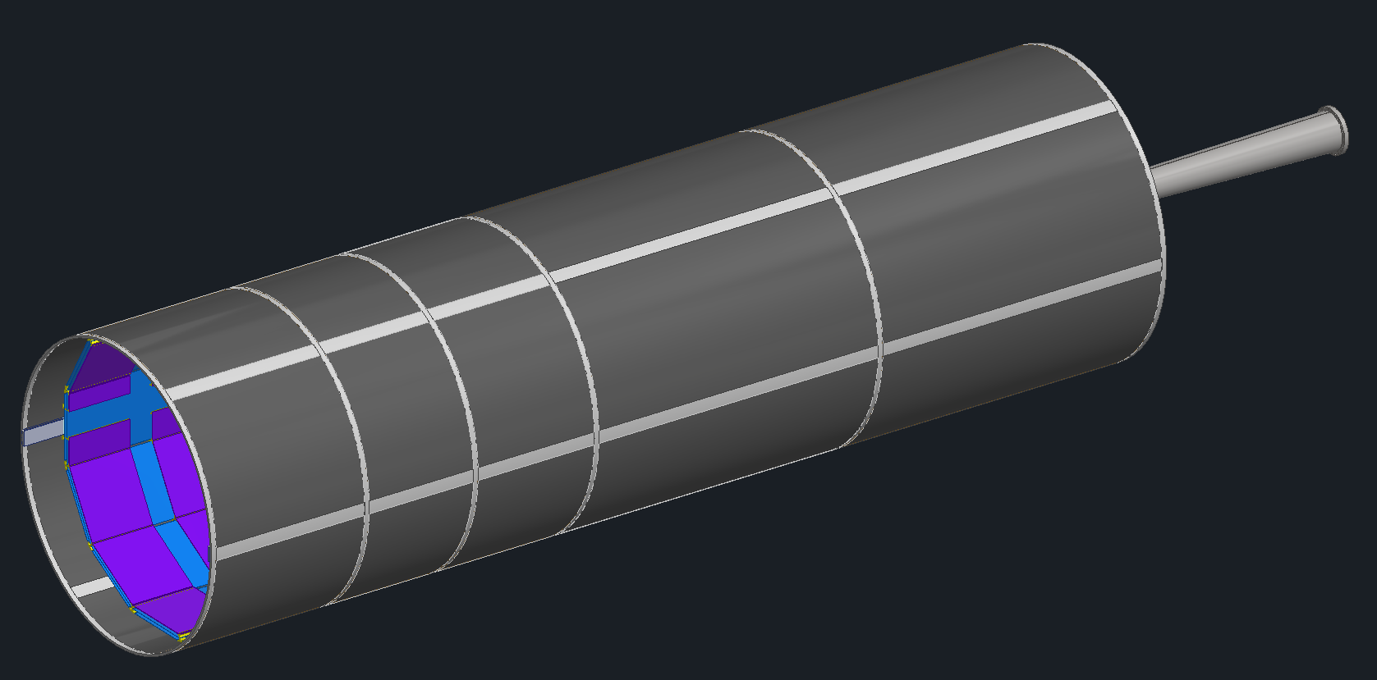
Global Support Tube (GST) Assembly
Step 1: PST Bottom half assembly
Step 2: Beampipe Installation
Step 3: PST Top half Installation
SVT Disks
SVT Tracker
MPGD Disks
Step 4: PST Installation into GST
Step 5: GST ready for installation into Central Barrel
Global Support Tube (GST) is the Carbon fiber support structure for inner detectors. GST assembly will take place in the Assembly hall on a set of carts
Cymbal (Inner MPGD) and Barrel TOF detector trays will be installed after GST is installed in Barrel during initial installation.
Cymbal and Barrel TOF detectors can be removed for maintenance in the experimental hall without removing GST assembly from Barrel.

Slide 12
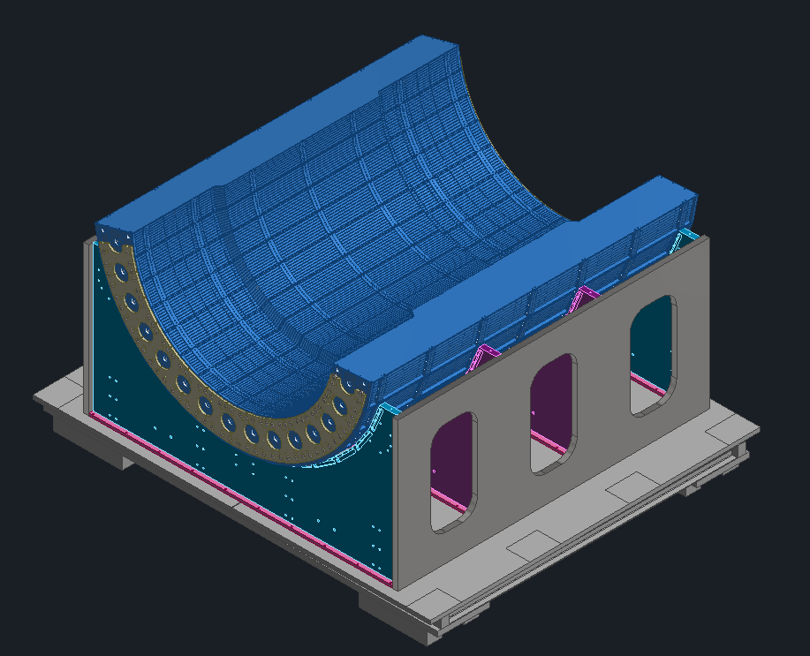
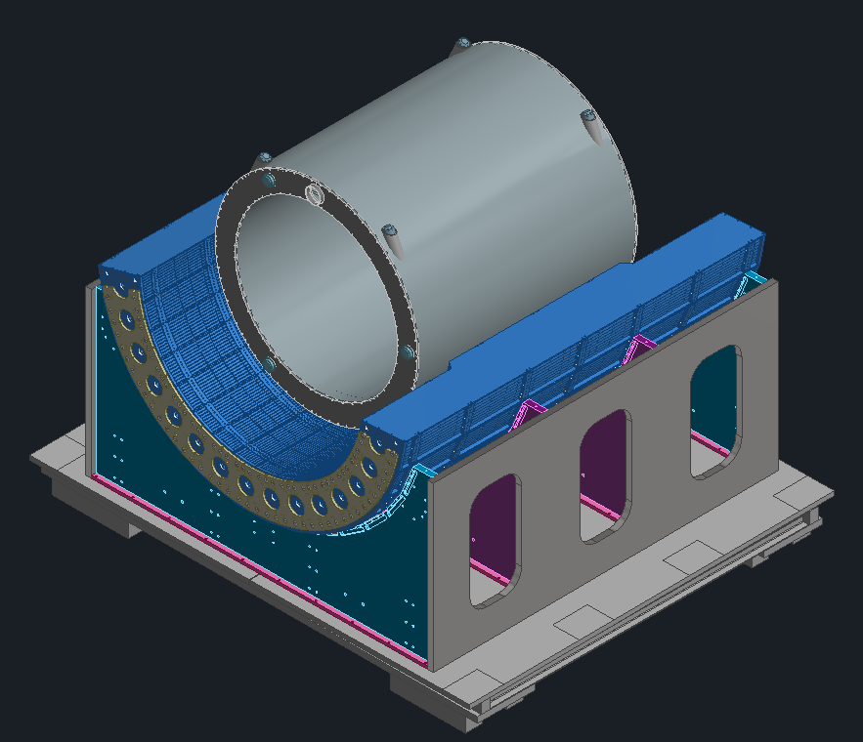
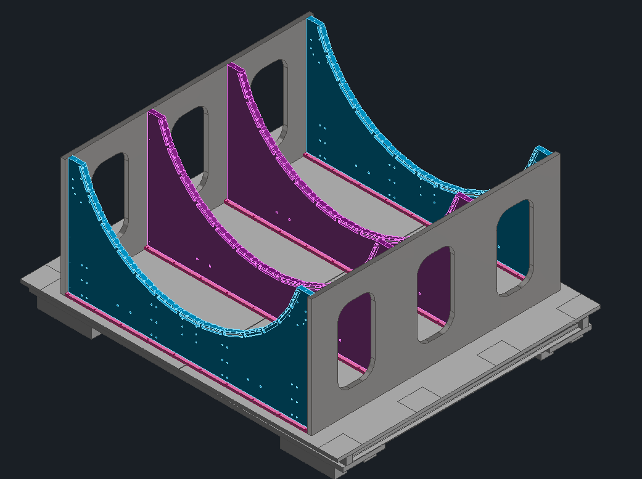
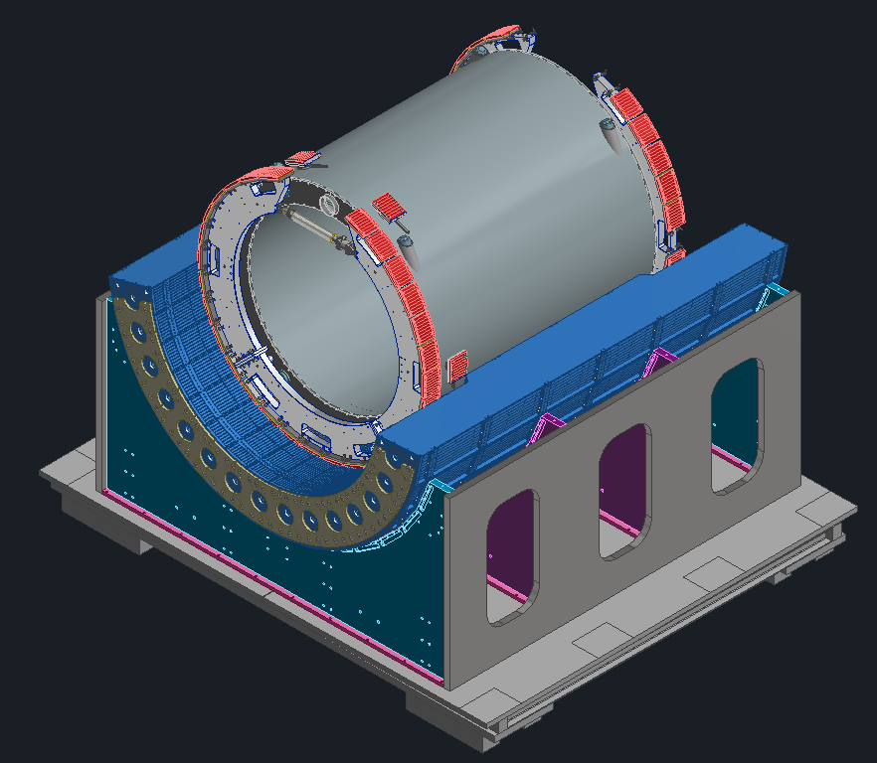
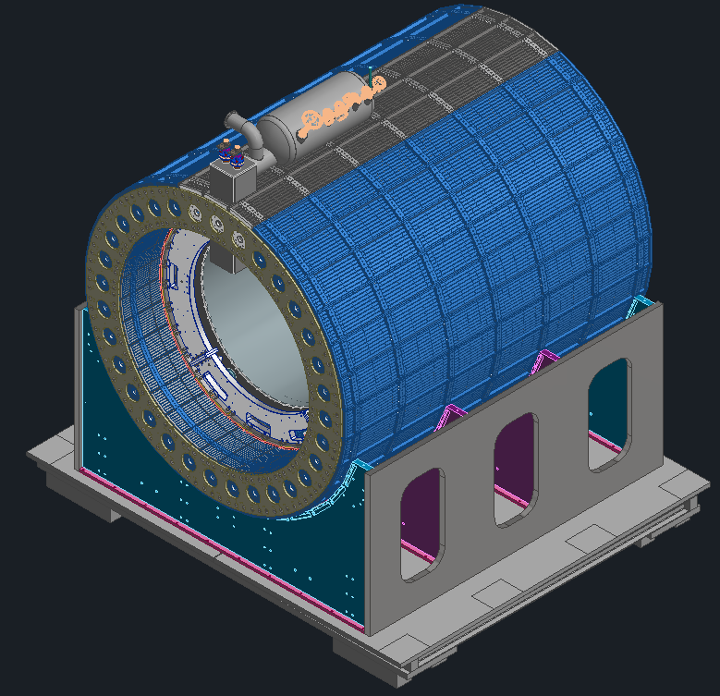
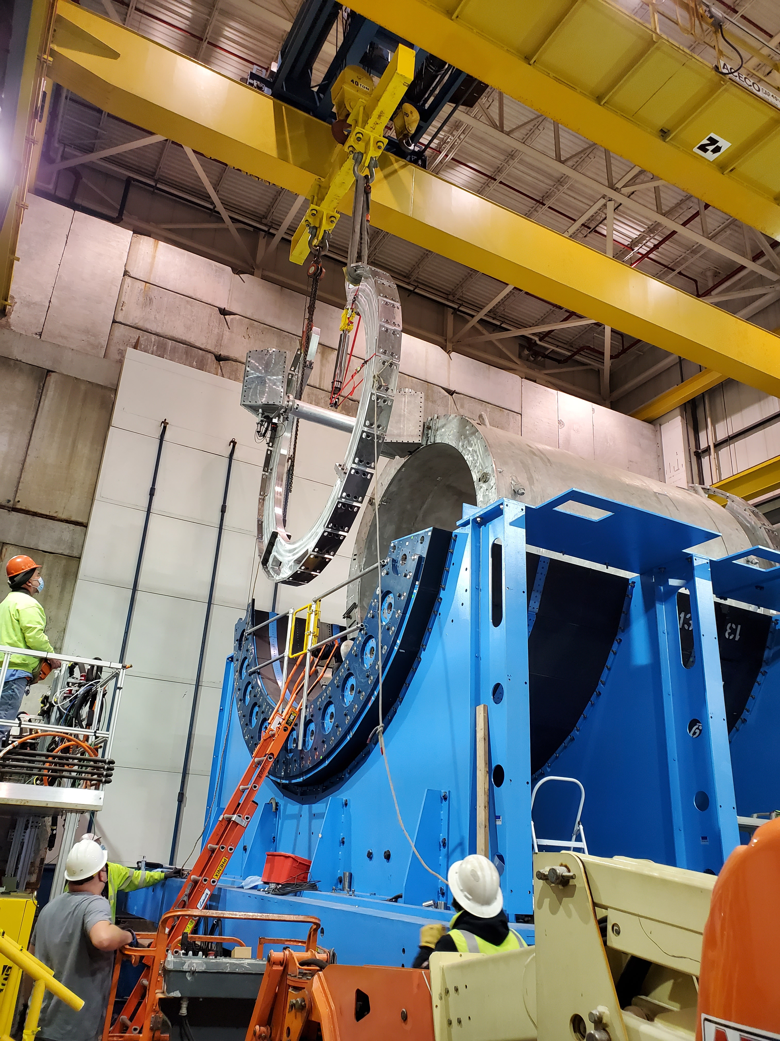
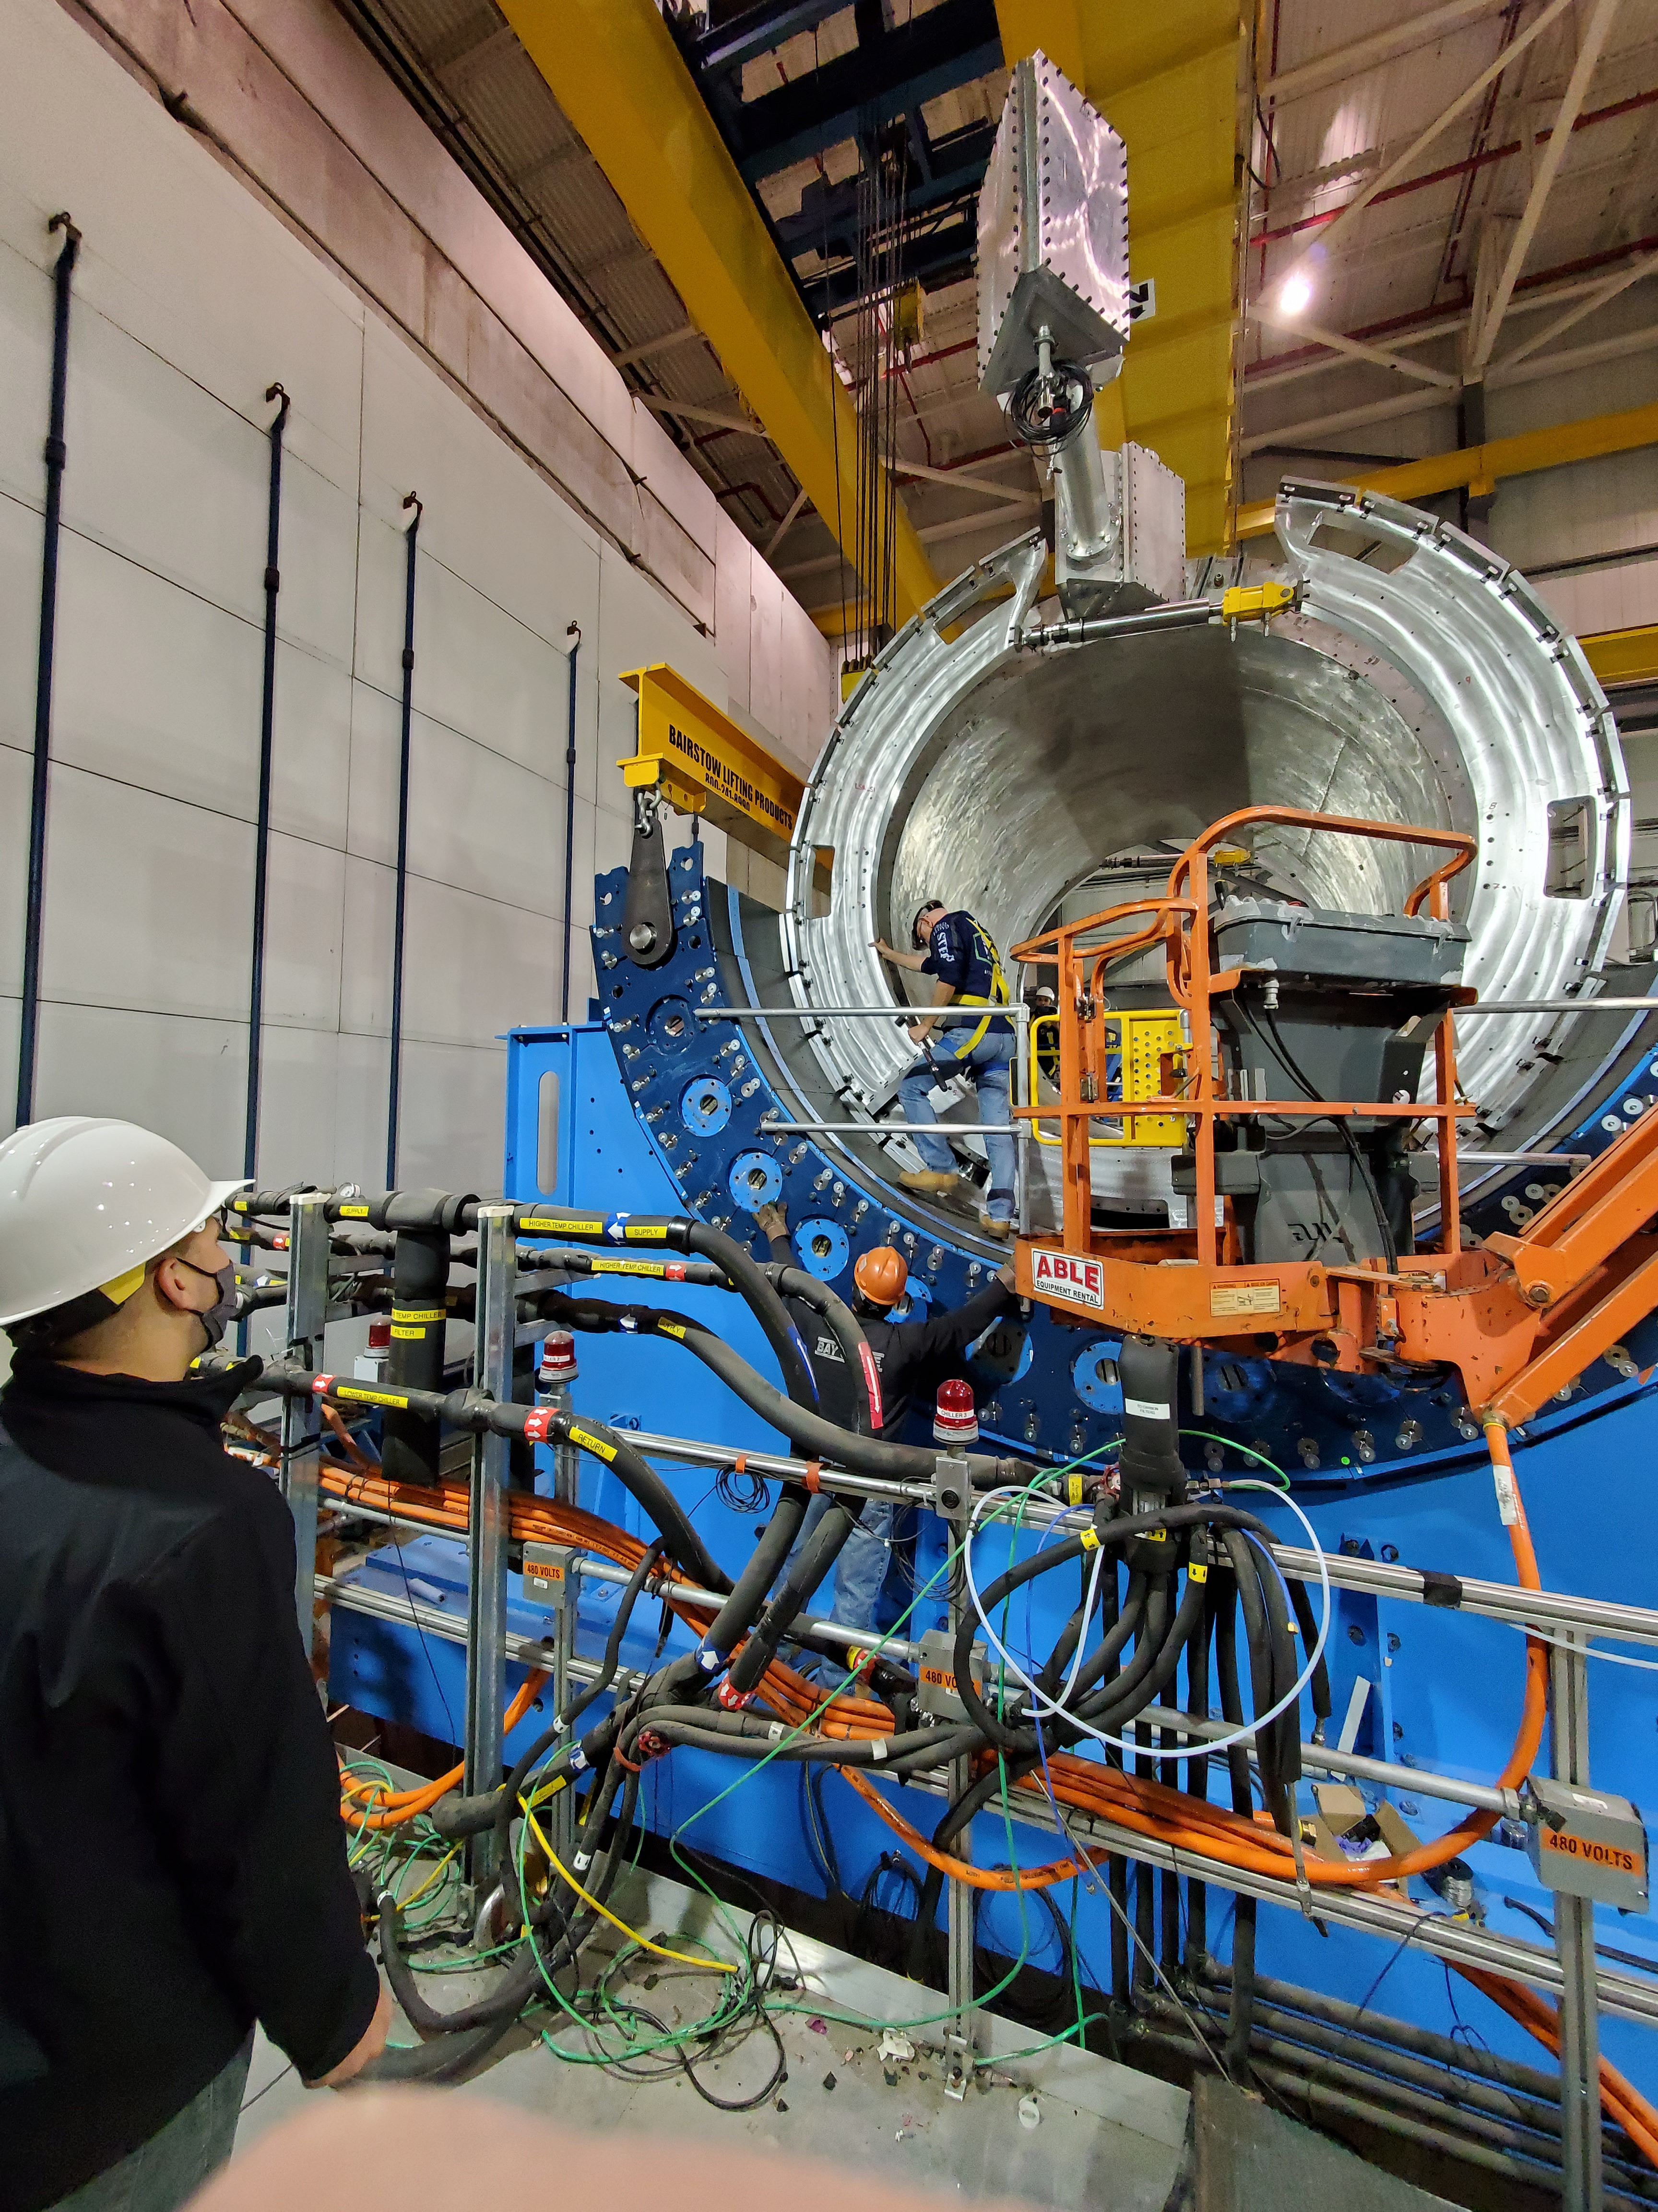
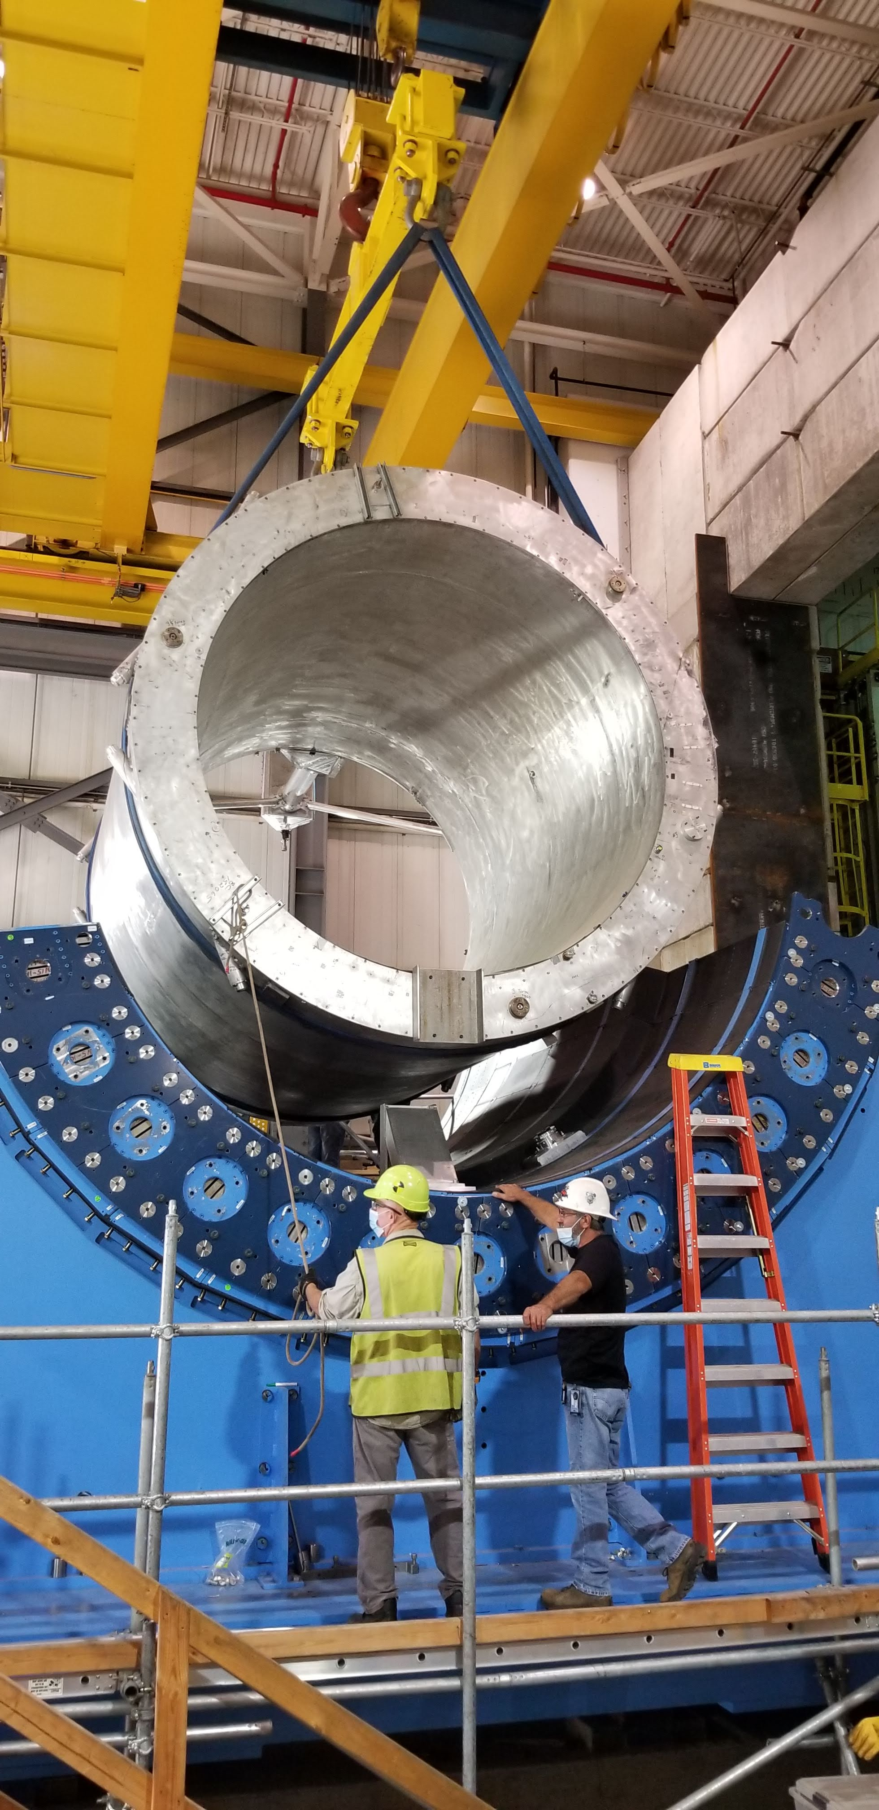
ePIC Barrel Assembly
Step 1:
Detector Cradle
Step 2:
HCAL Bottom Half Installation
Step 3:
Superconducting Magnet (MARCO)
Step 4:
Magnet Support Rings Installation
Step 5:
HCAL Top Half and Magnet Chimney Installation
Photos of Magnet Installation from sPHENIX Experiment

Slide 13
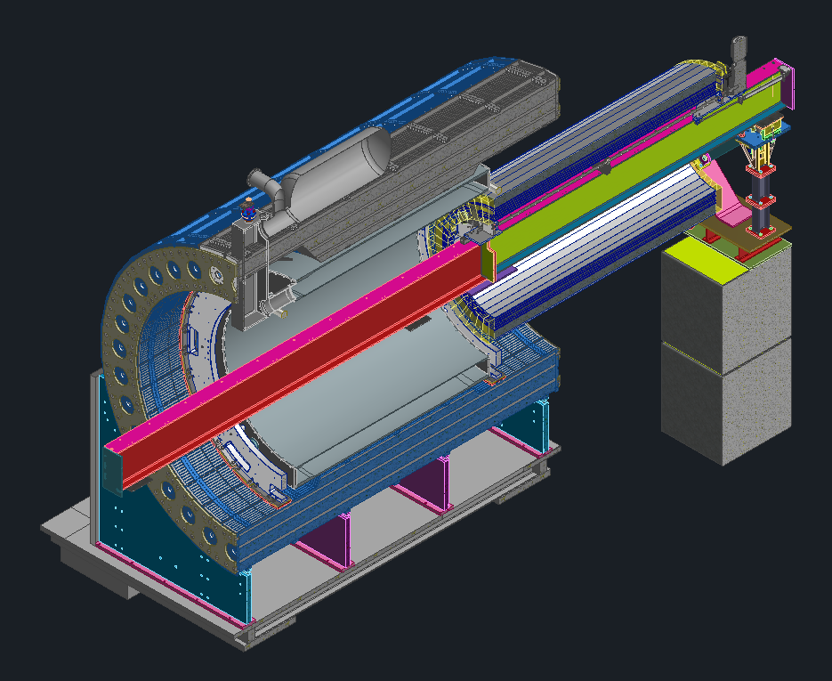
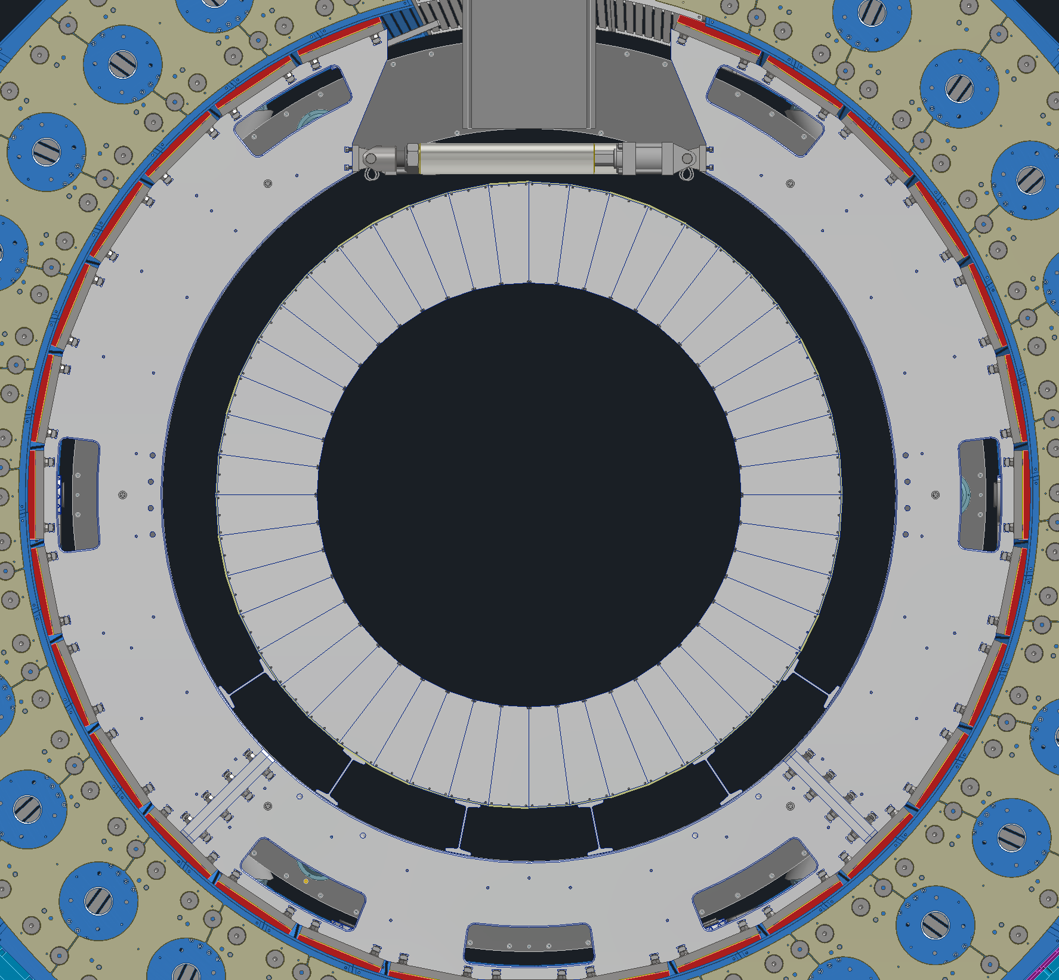
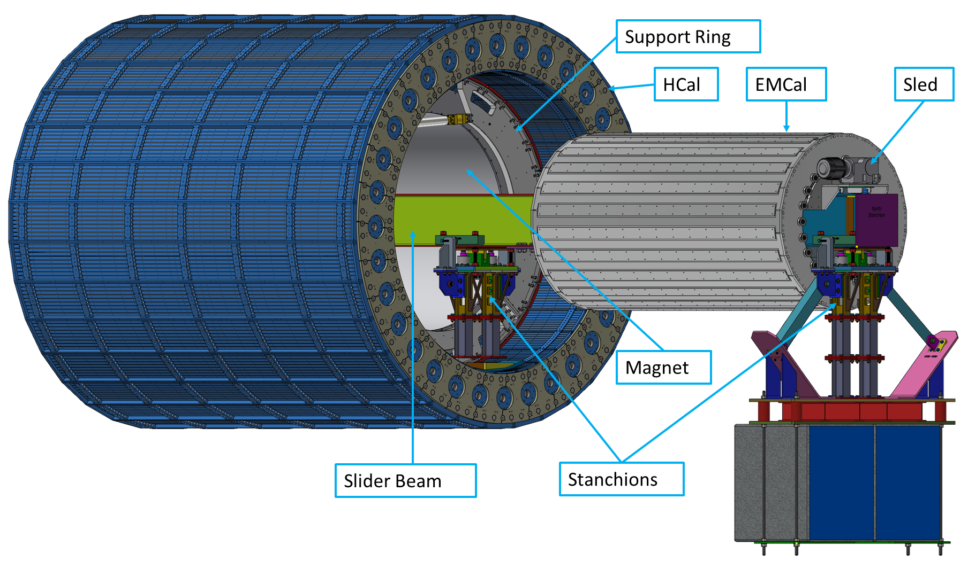
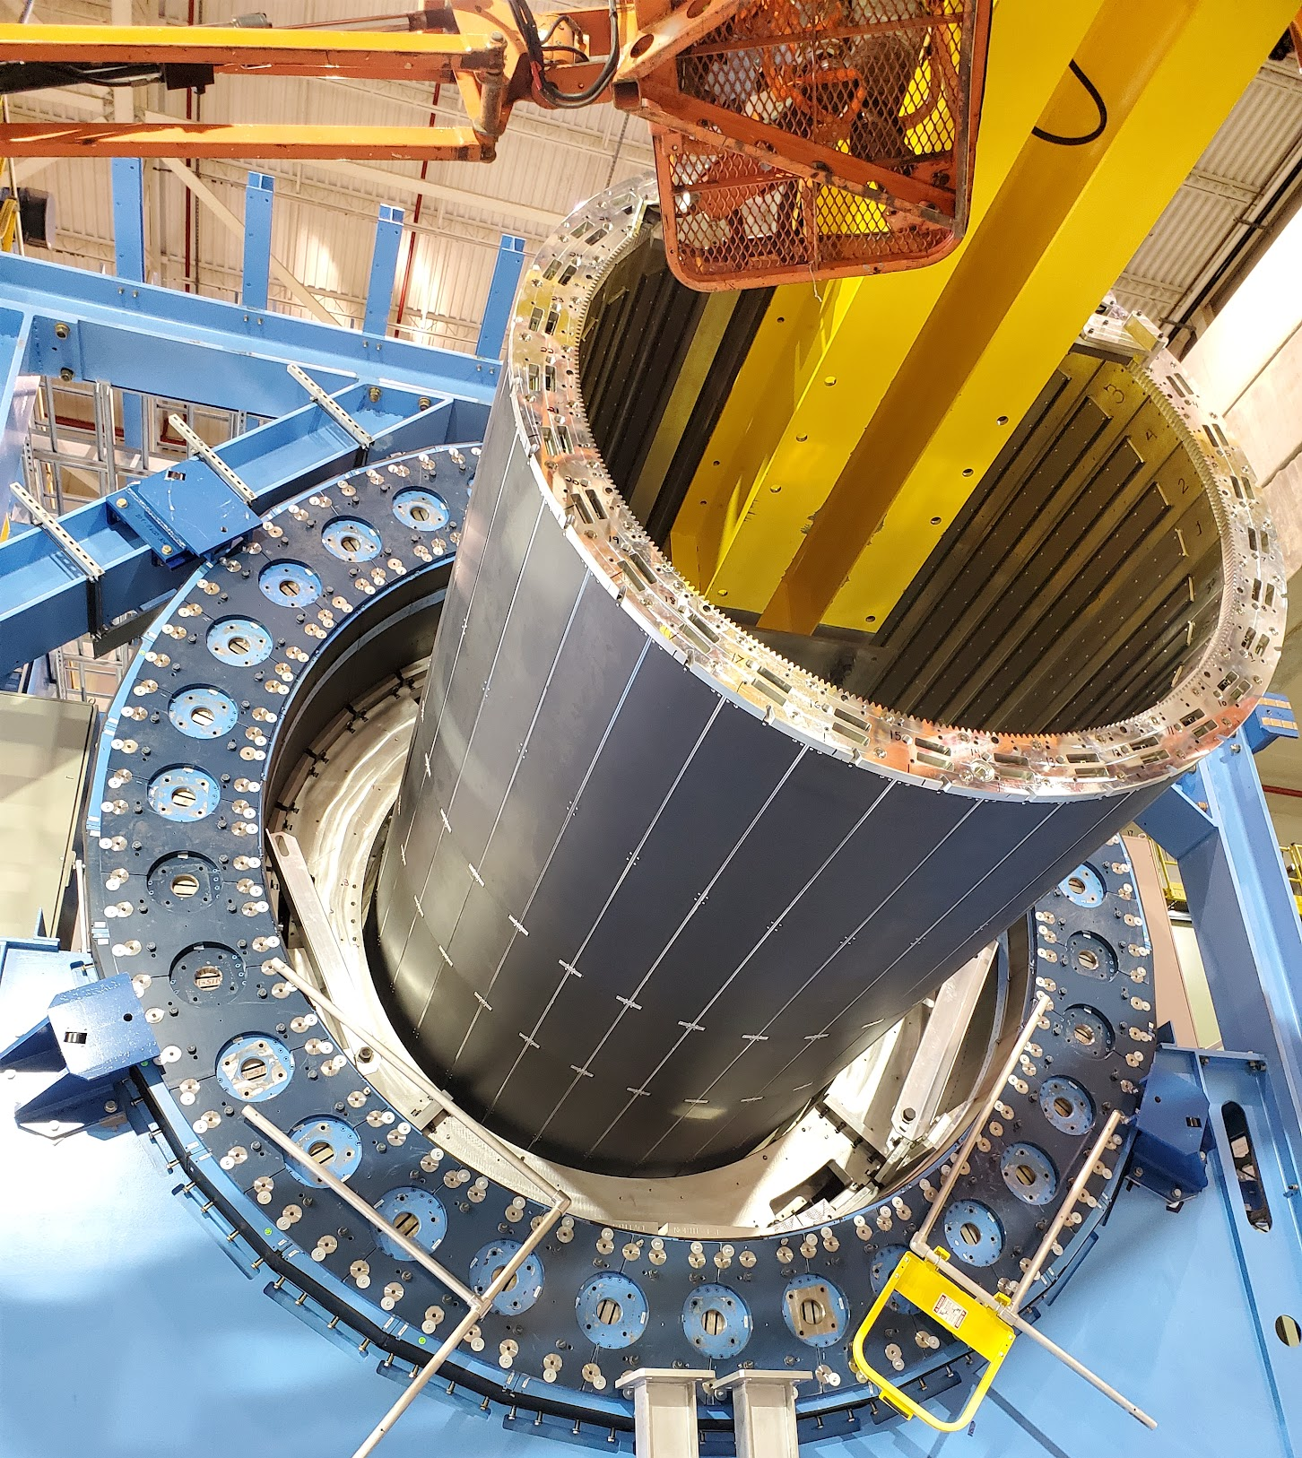
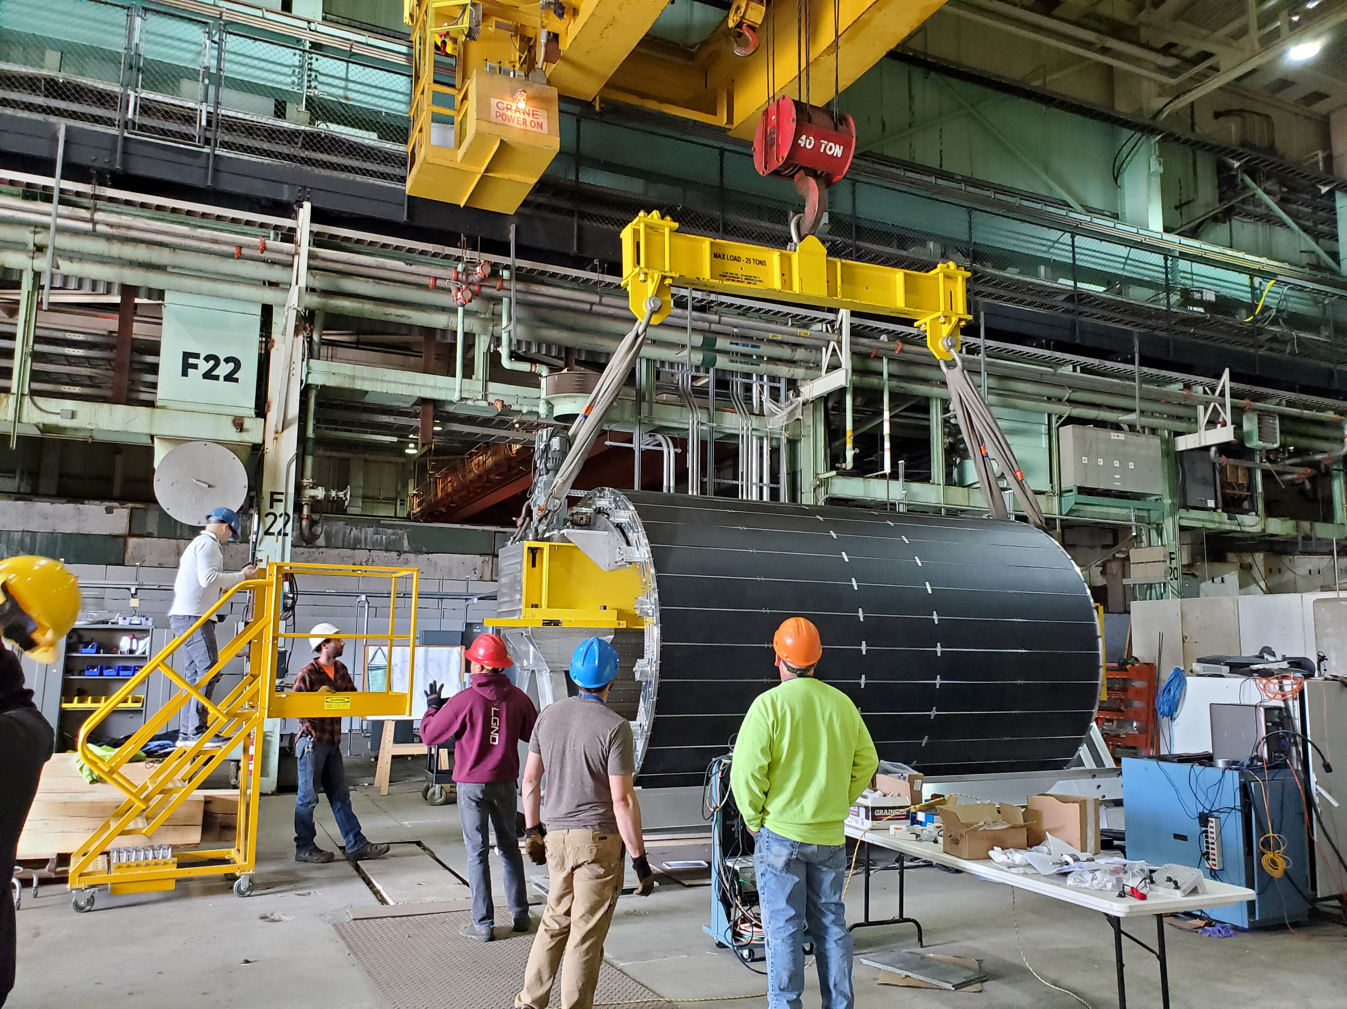
ePIC Barrel Assembly
Barrel EMCAL
Support Ring
Support I Beams
Barrel EMCAL Assembly
ePIC
sPHENIX
Step 6: Barrel EMCAL Installation:
We plan to use existing installation tooling from sPHENIX that was used to install Inner HCAL as shown in photos
The I-beam is inserted into the HCal and supported on stanchions.
Barrel EMCal will be assembled in front of ePIC Barrel
The Barrel EMCal is rolled in via the sled on the I-beam.
The Barrel EMCal is attached to the support rings.
The I-beam and stanchions are removed.
Barrel EMCal will be supported via the sPHENIX inner support rings
At both inner support rings there will be aluminum I-Beams for support
Support Hierarchy:
  Cradle → HCal → Inner Support Rings → EMCal Support → Barrel EMCal → Carbon Fiber Support Tube → Inner Detectors

Slide 14
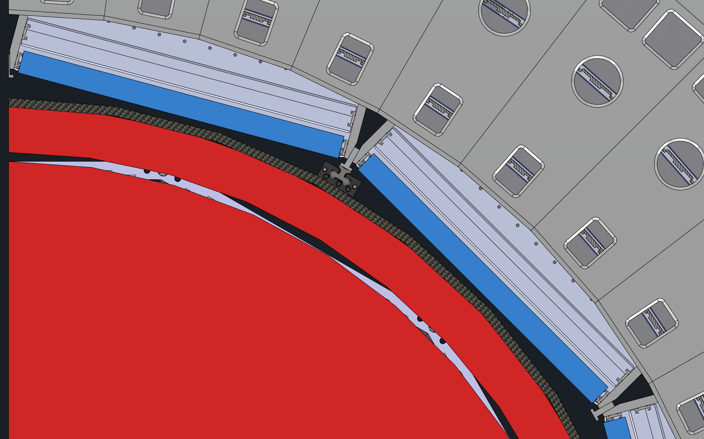
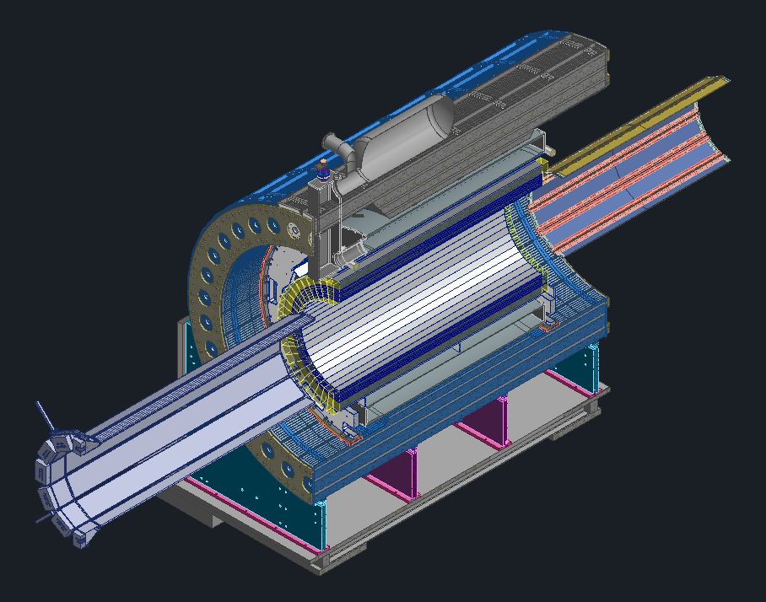
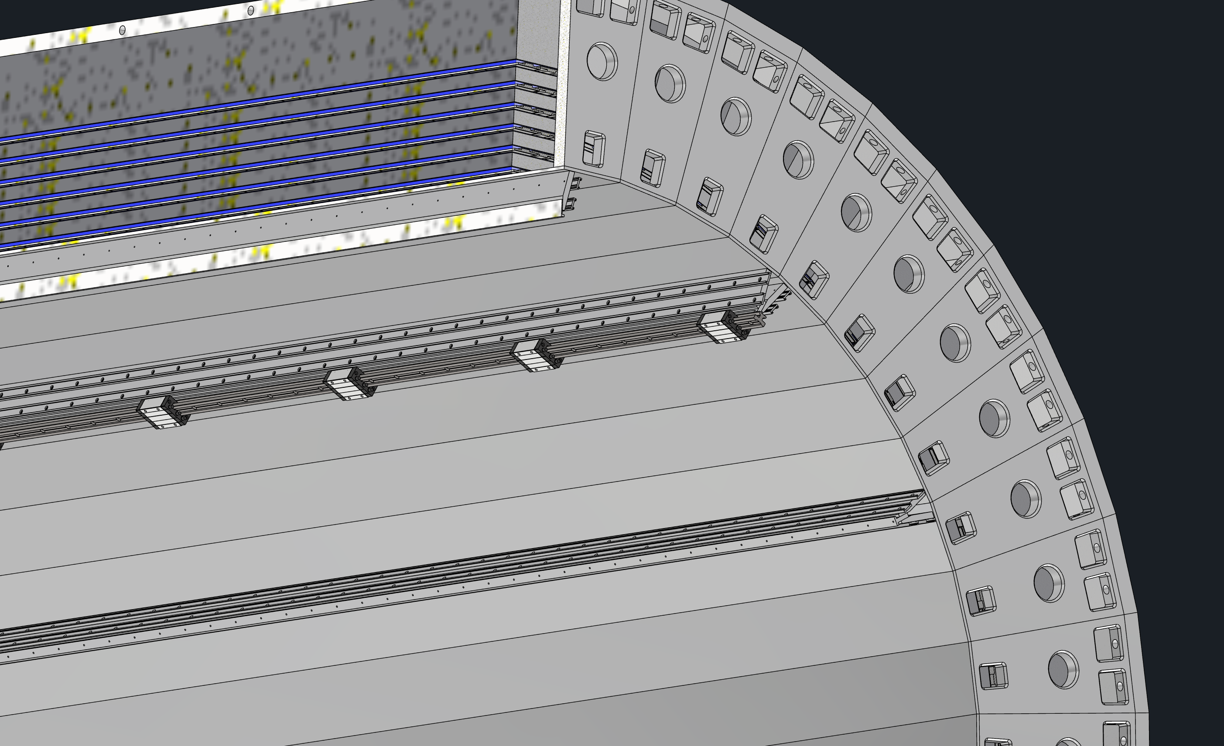
ePIC Barrel Assembly
Step 7: DIRC Bars and Outer MPGDs Installation
DIRC Bar Boxes
Carbon Fiber Tube
Outer MPGDs
Outer MPGDs
Support Rails
DIRC Bar Boxes

Slide 15
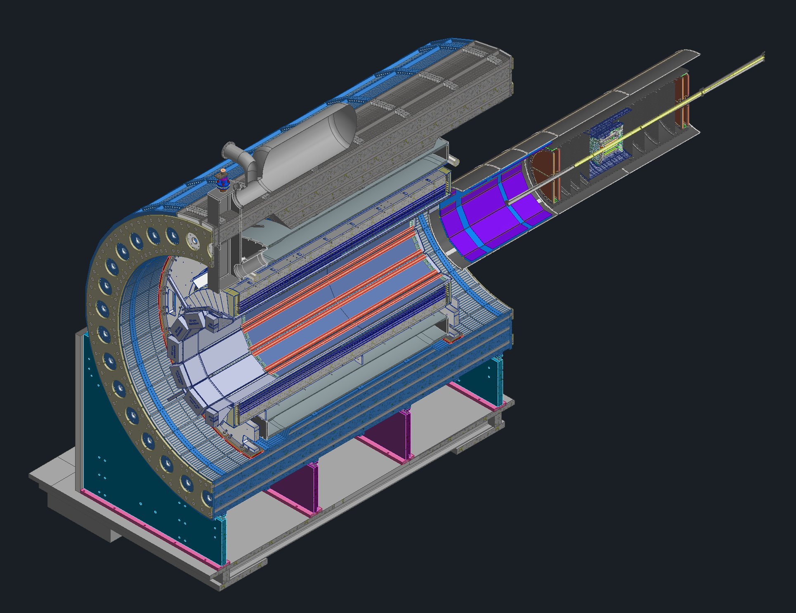
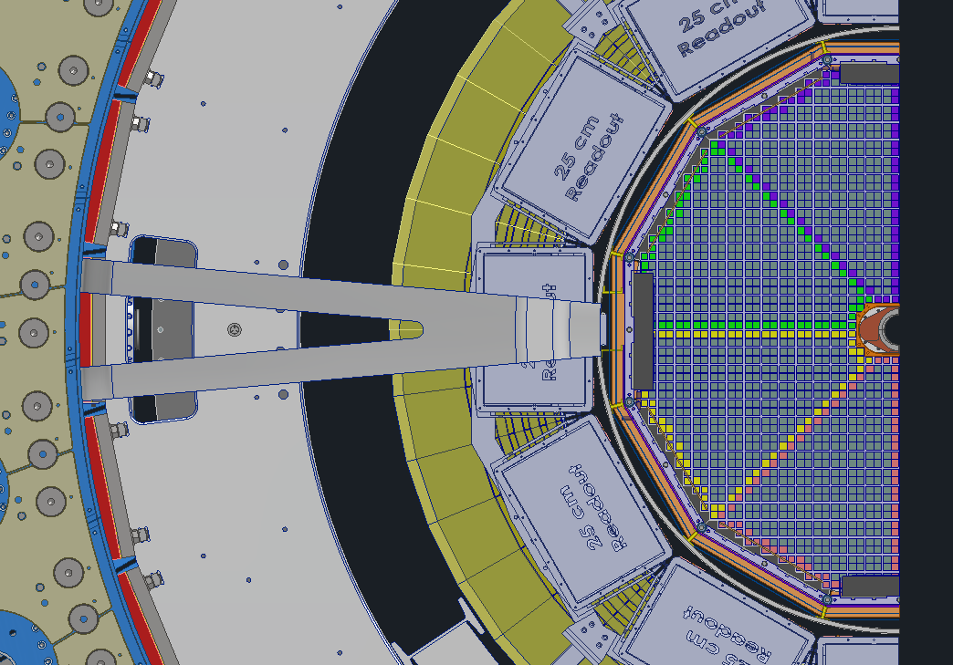
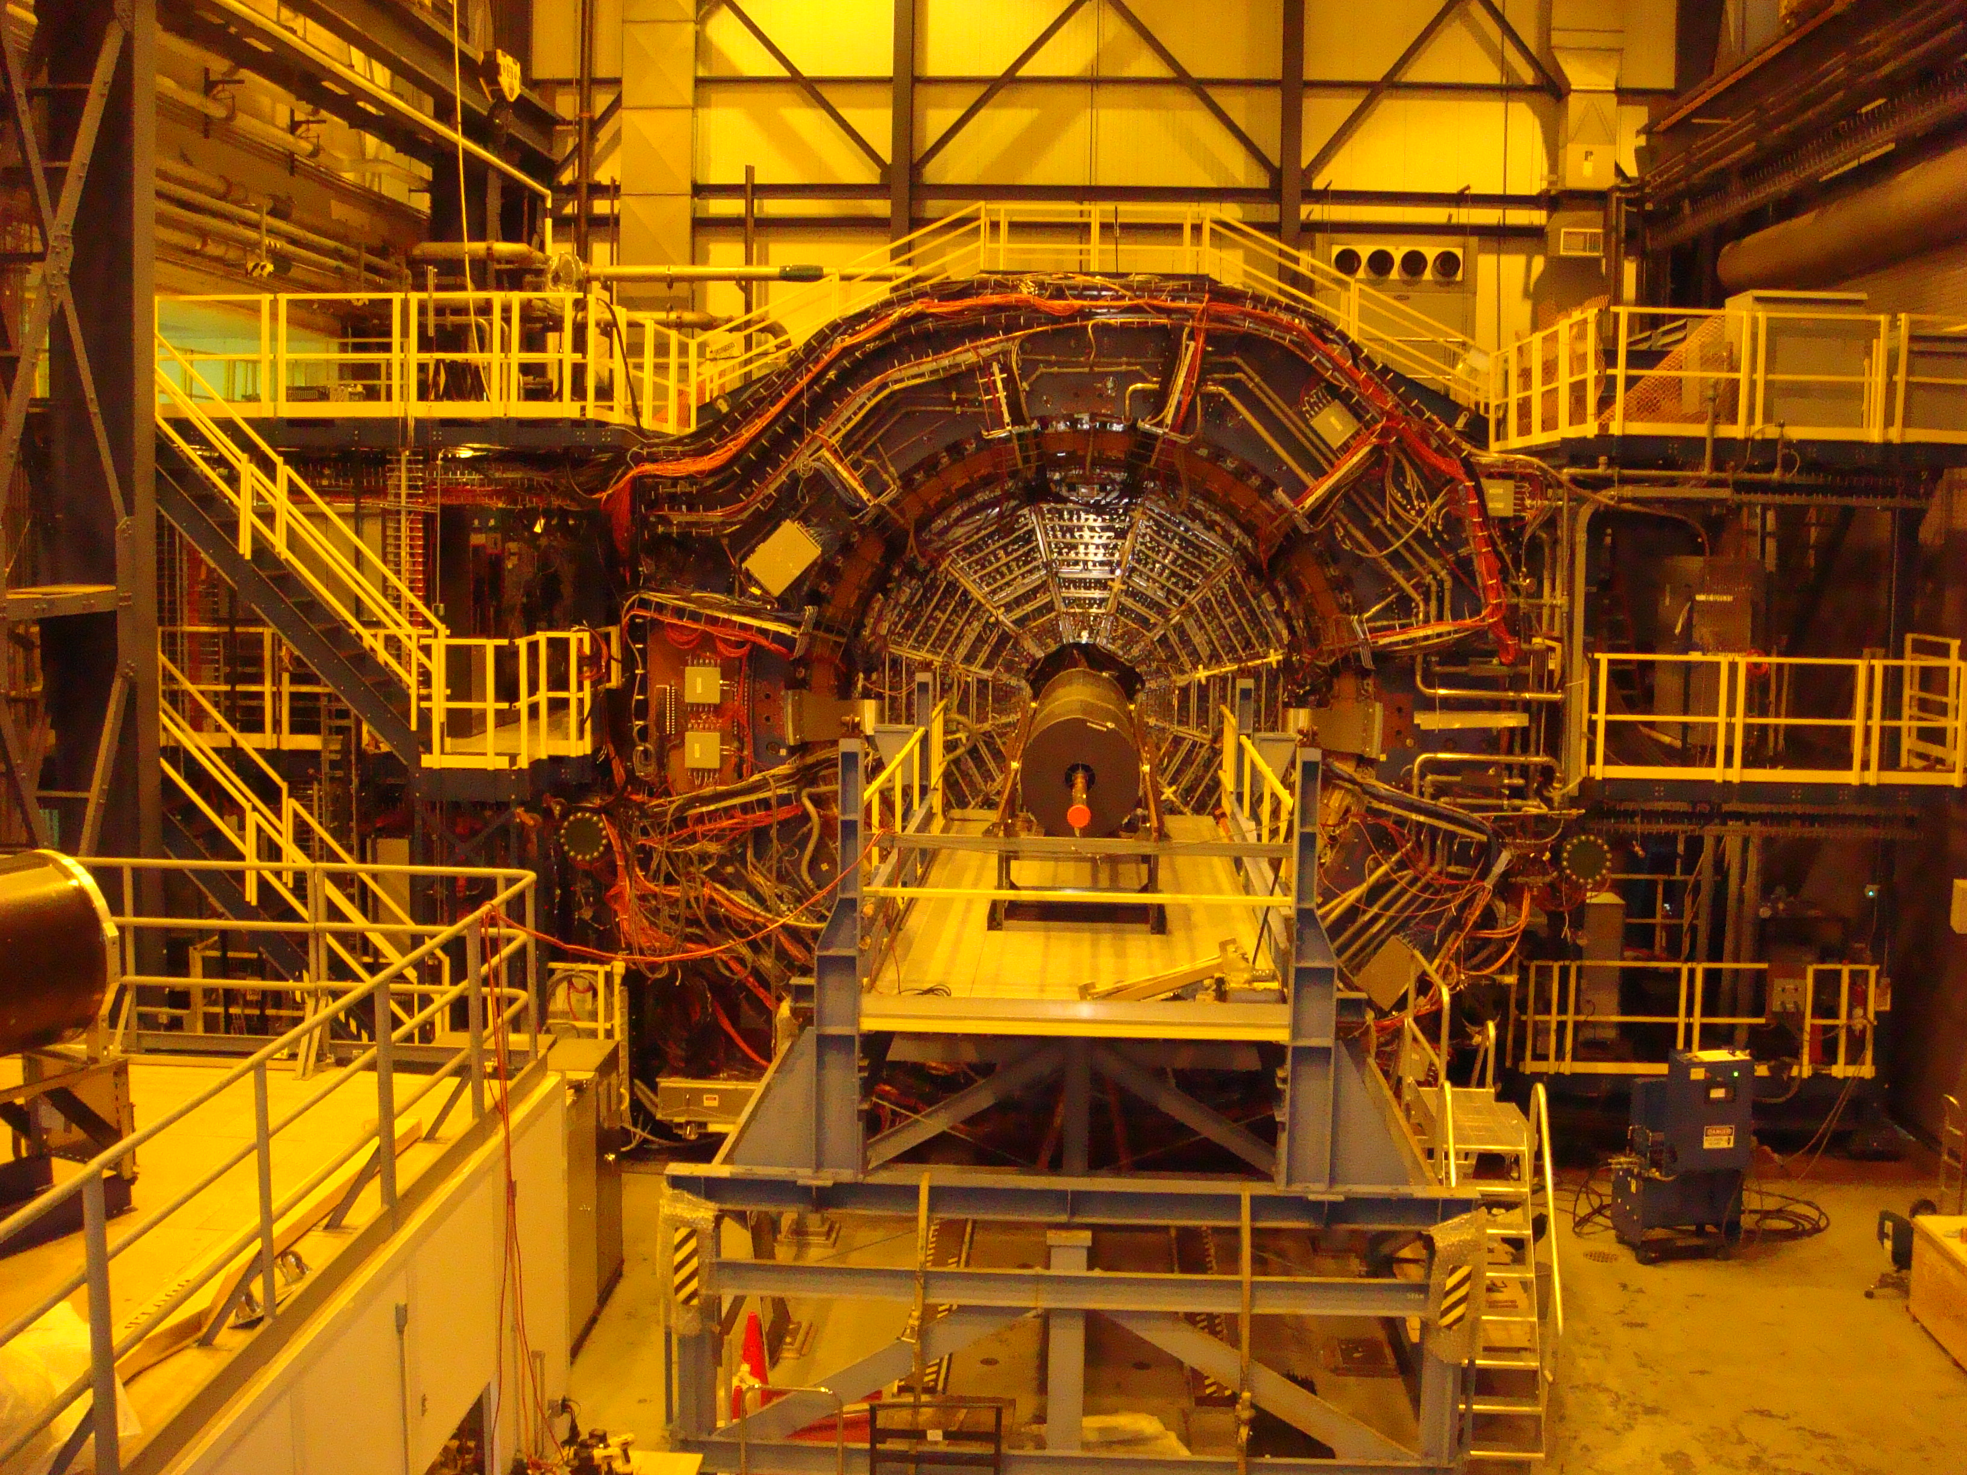
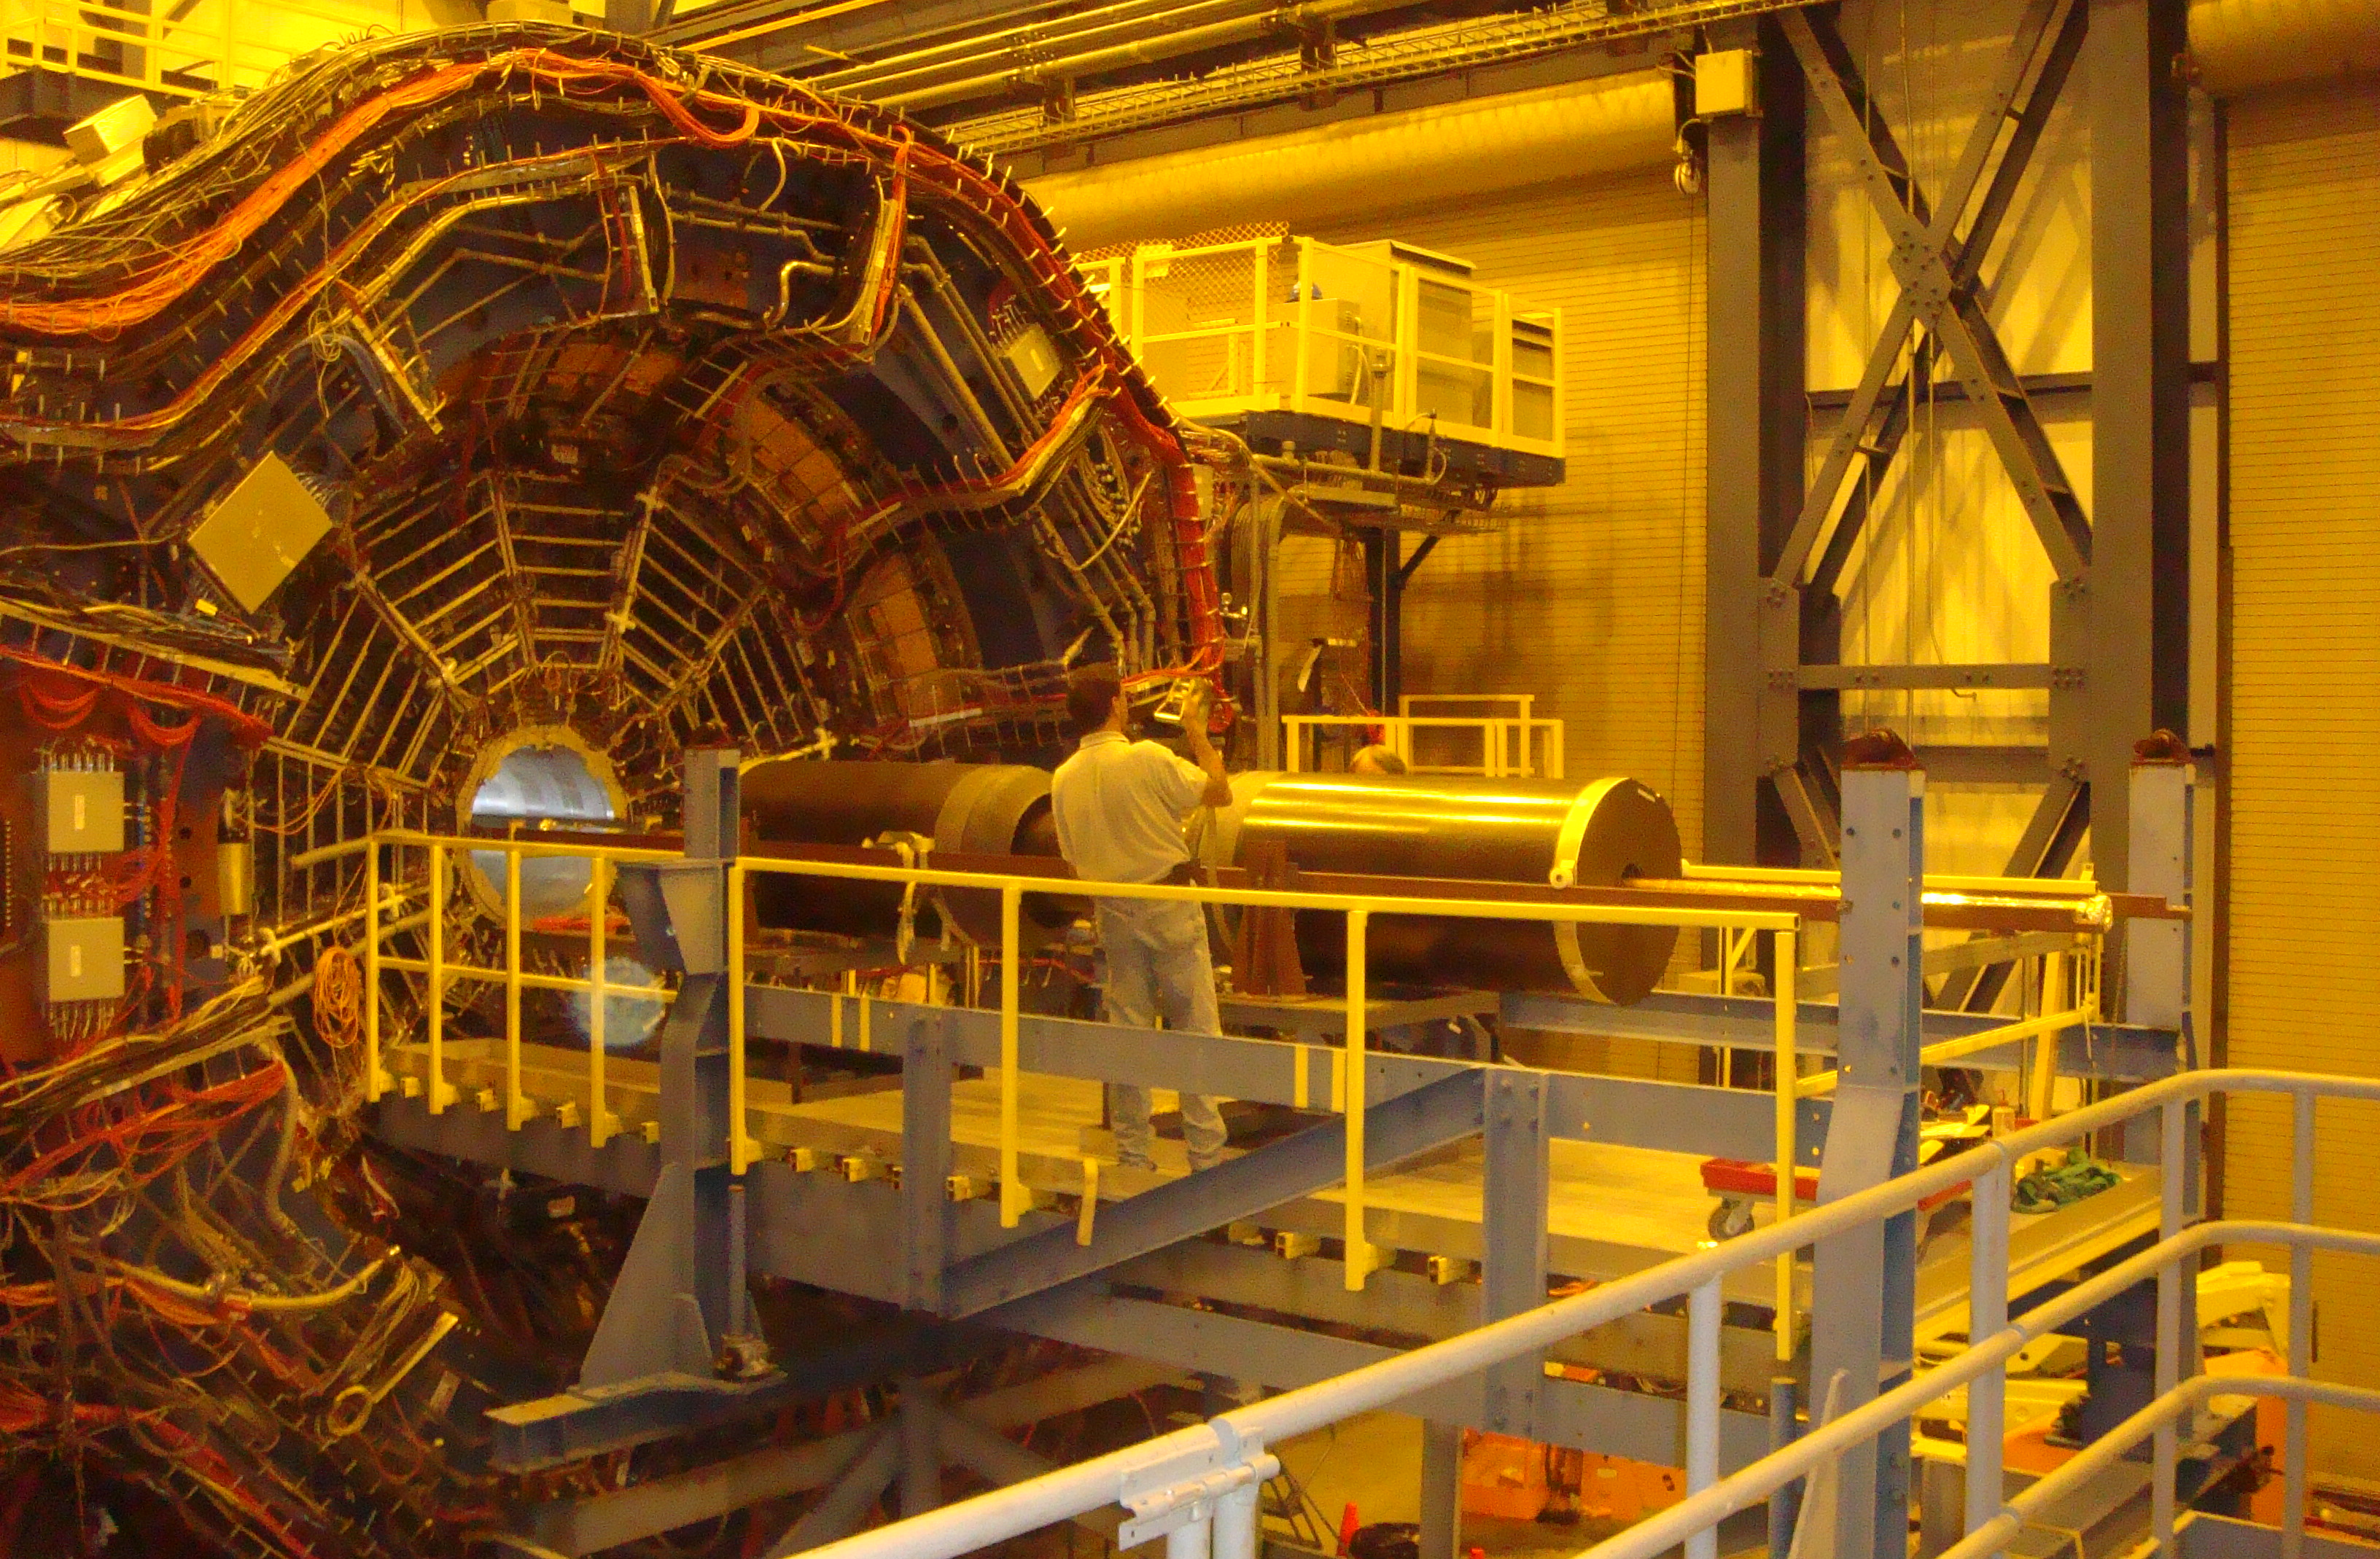
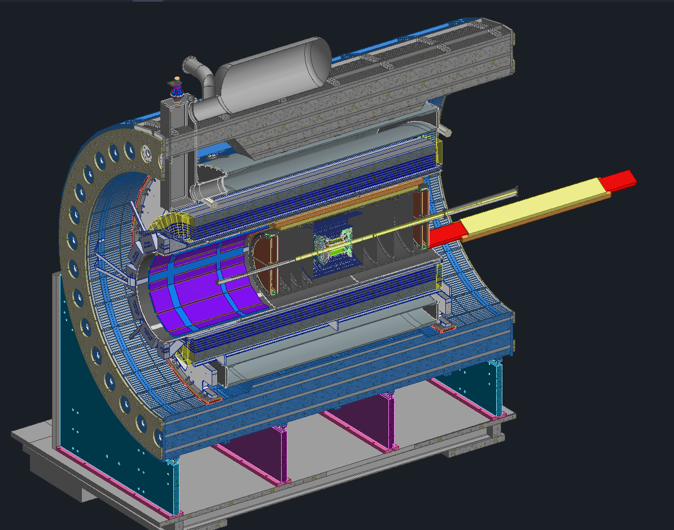
ePIC Barrel Assembly
Step 8: GST Installation into Central Barrel
GST Support Bracket
Planning on reusing STAR IDS Platform for GST Installation
Step 9: ToF & CYMBAL Installation into GST
STAR Carbon Fiber detector Support Structure Installation

Slide 16
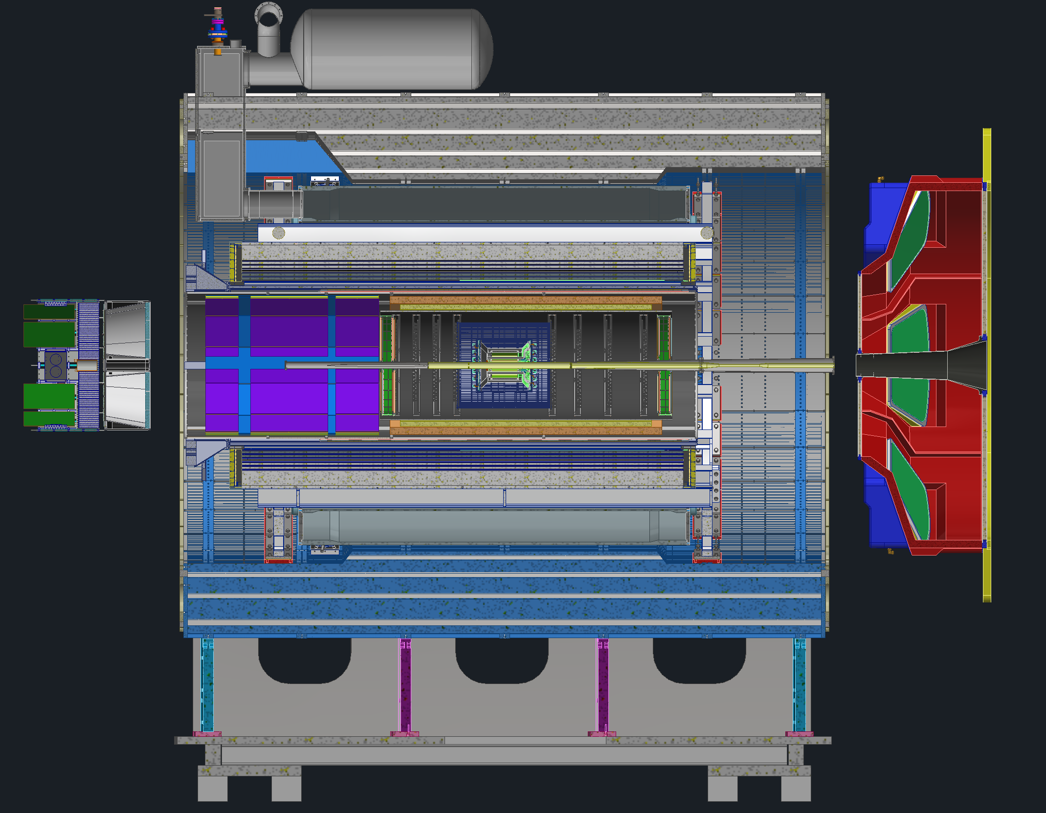
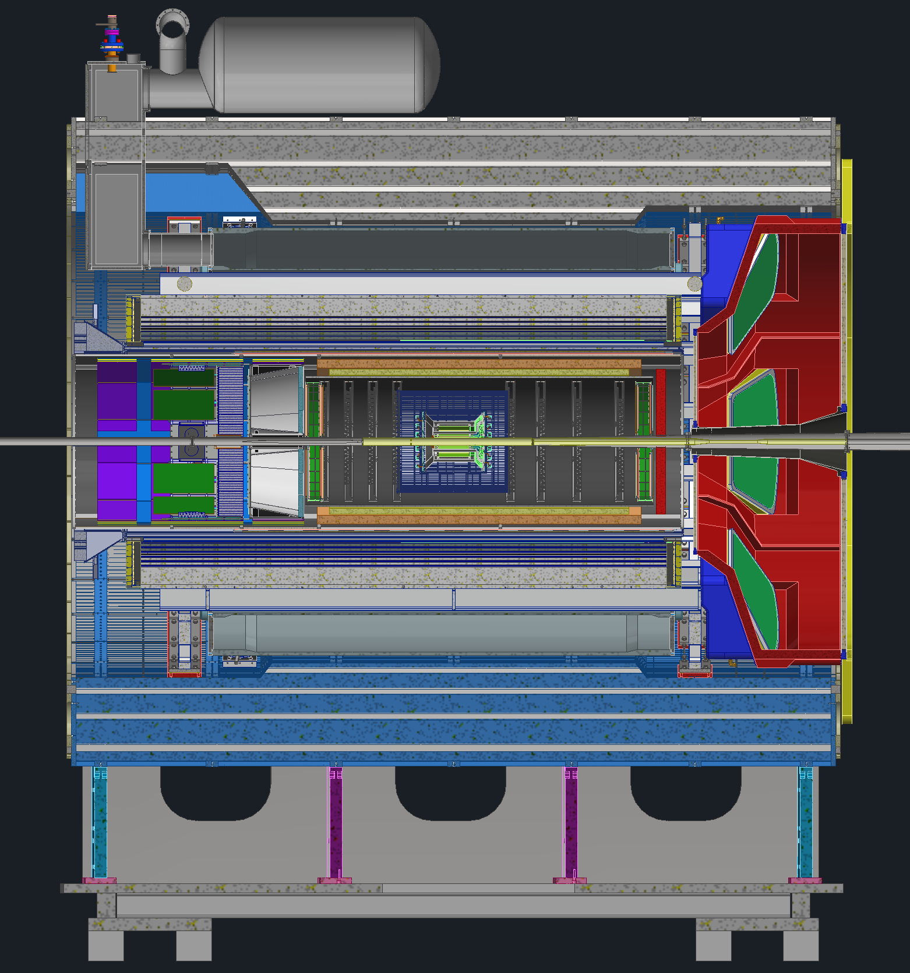
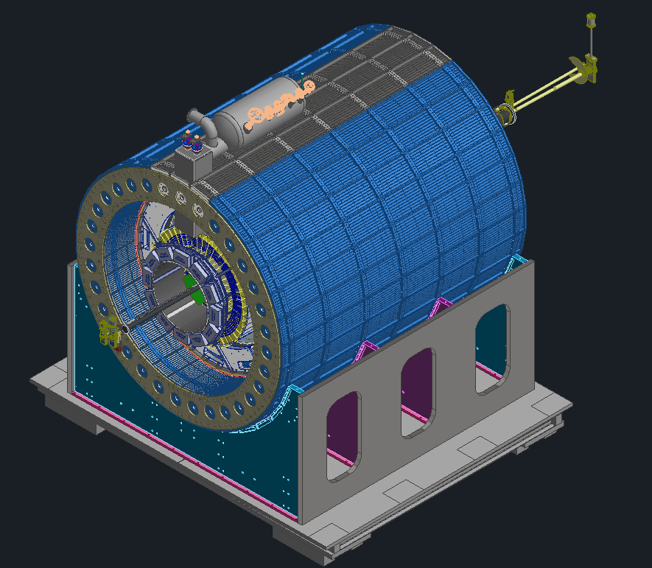
ePIC Barrel Assembly
Step 10: EEEMCAL, pfRICH, & dRICH Installation
Step 11: Assembly Complete
pfRICH and dRICH detectors are installed from backward side and dRICH detector is installed from Forward side.
After Final Assembly, detector is ready to be rolled in to the experimental hall.

Slide 17
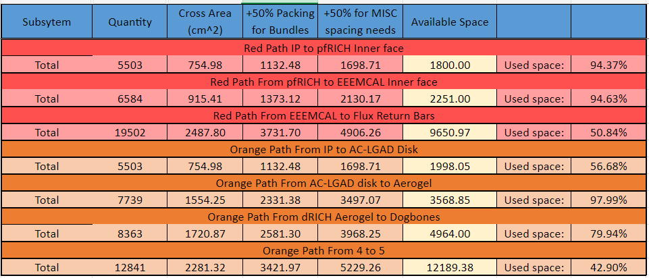
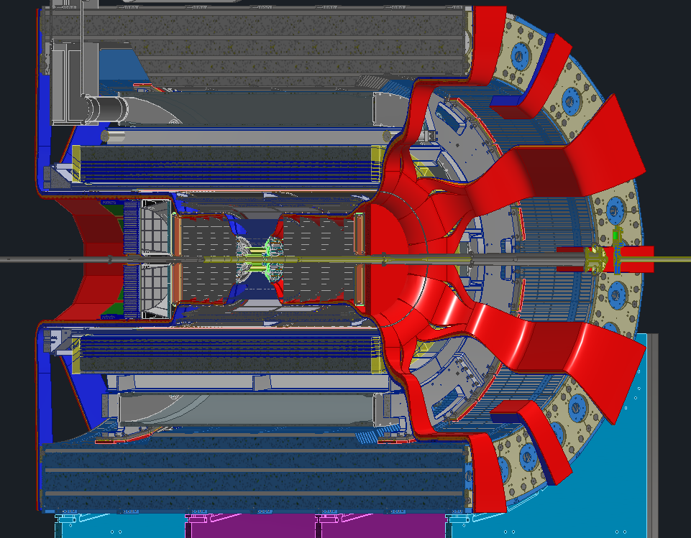
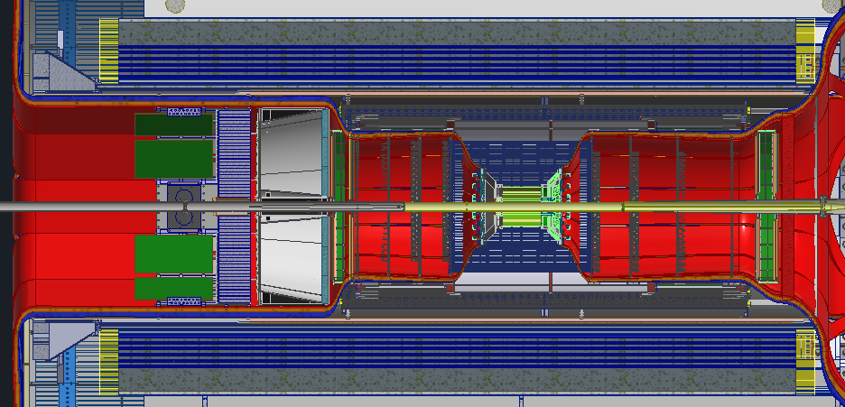
Services Layout
Services (Cables and Cooling Lines etc.) must pass through the gap between Endcaps and detector barrel
Services Estimates were collected from various subgroups.
Layout is shown in snapshots below.

Slide 18
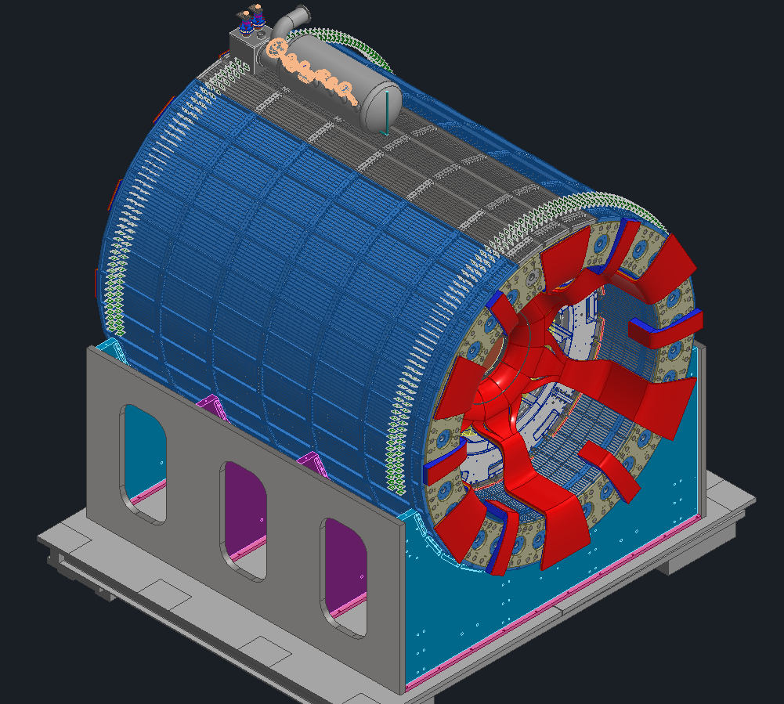
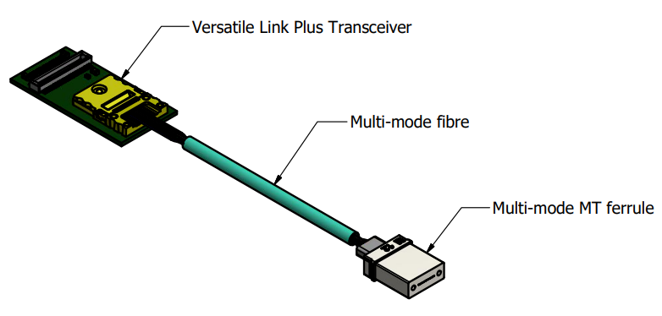
RDO Placement
Summer 2024 added VTRX+ modules
The RDOs can now be placed much farther away, outside the detector
RDOs will be mounted to the outside diameter of the sPHENIX HCAL where space is available
VTRX+ Modules will be placed on each detector adjacent to their FEBs
RDOs
VTRX+ Modules
Fibers
Fiber Patch Panel

Slide 19
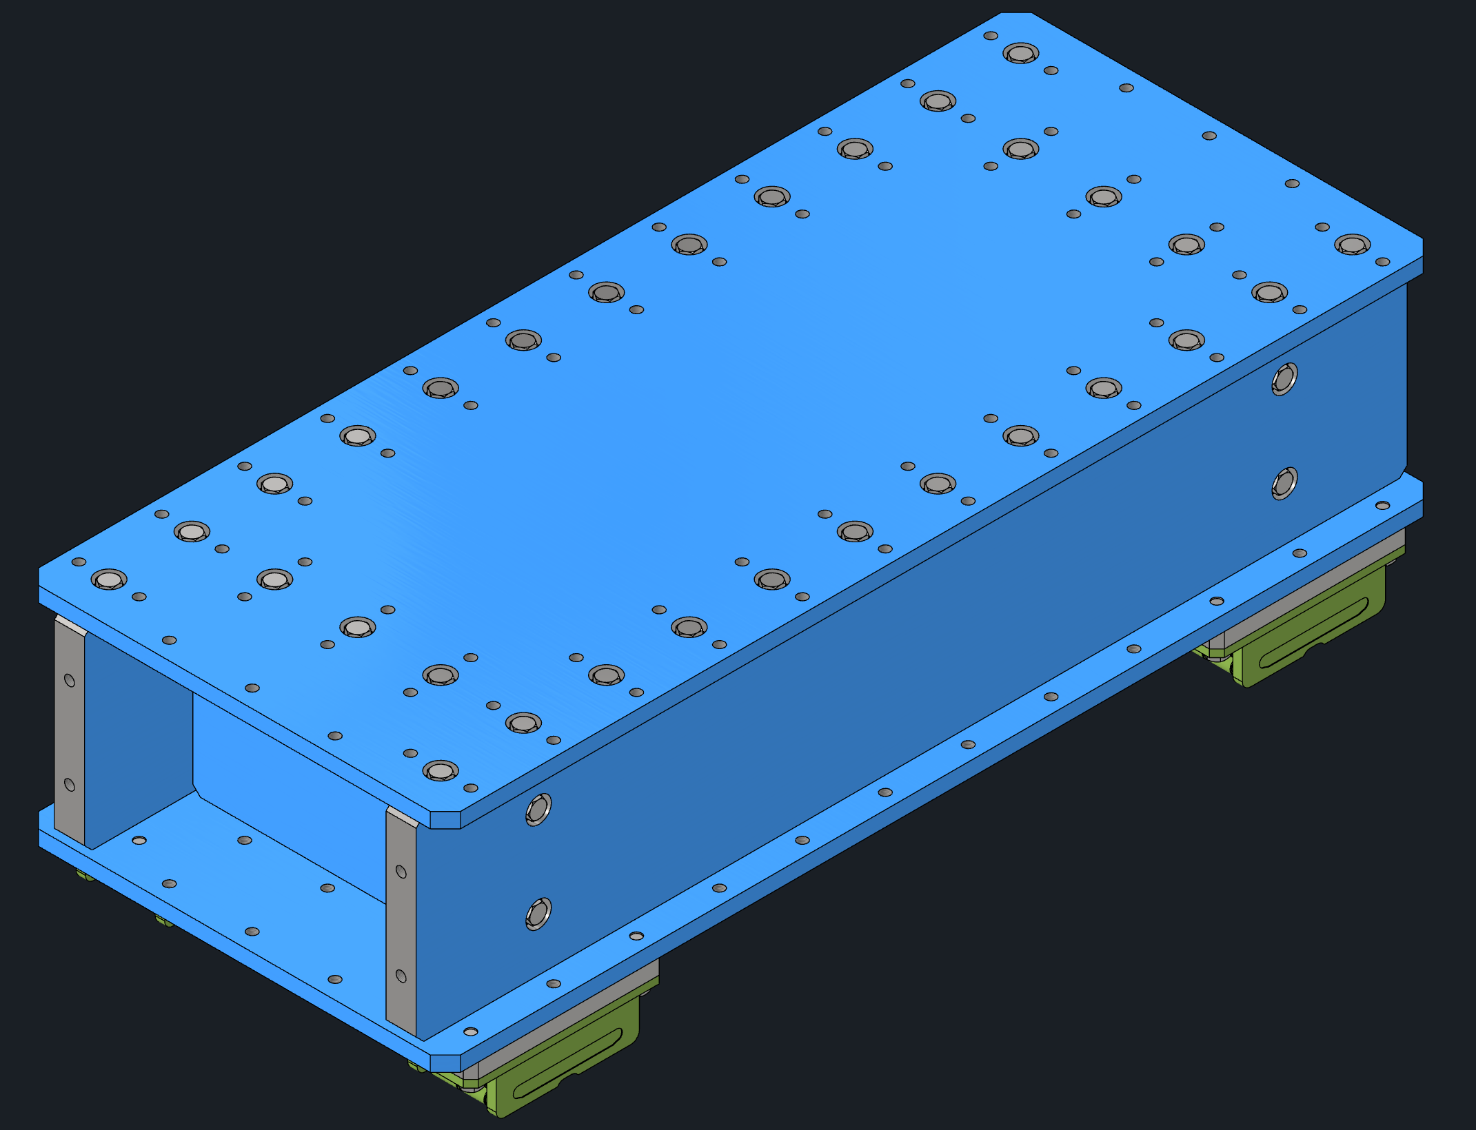
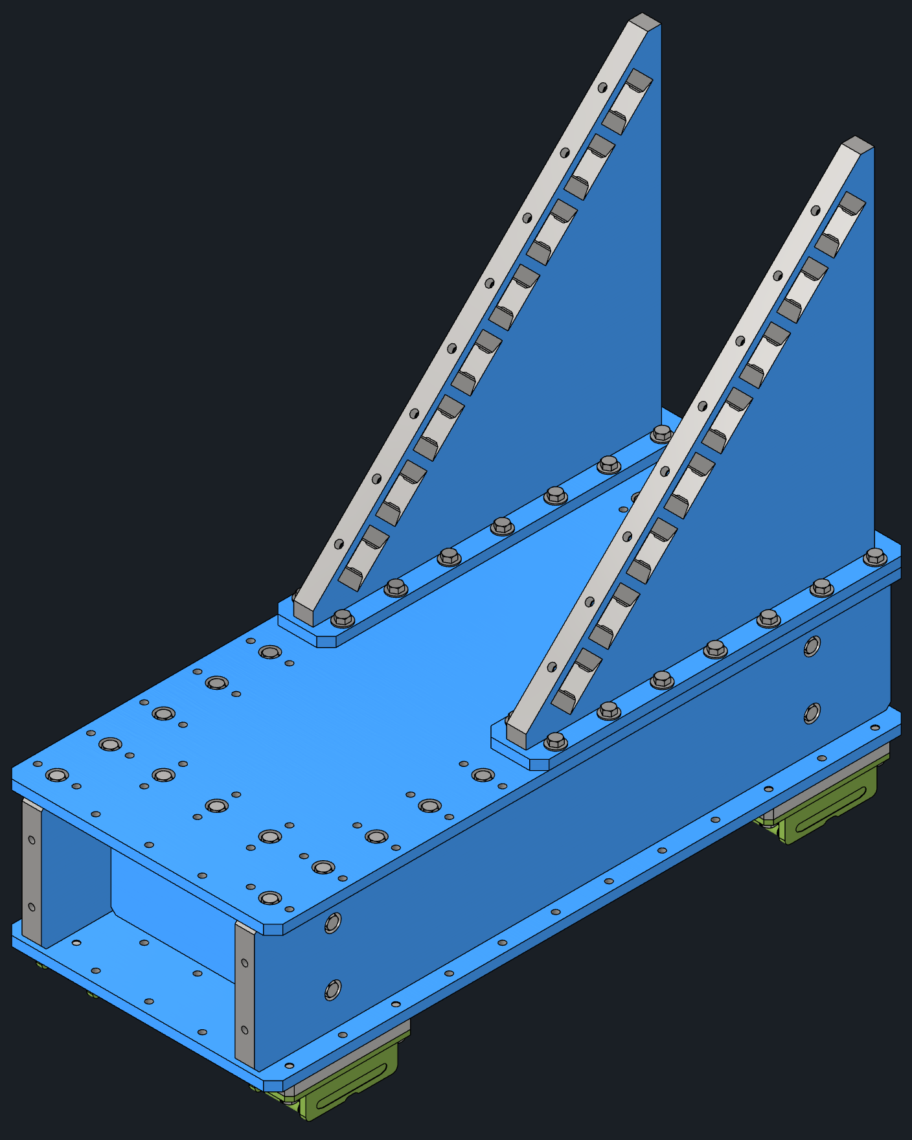
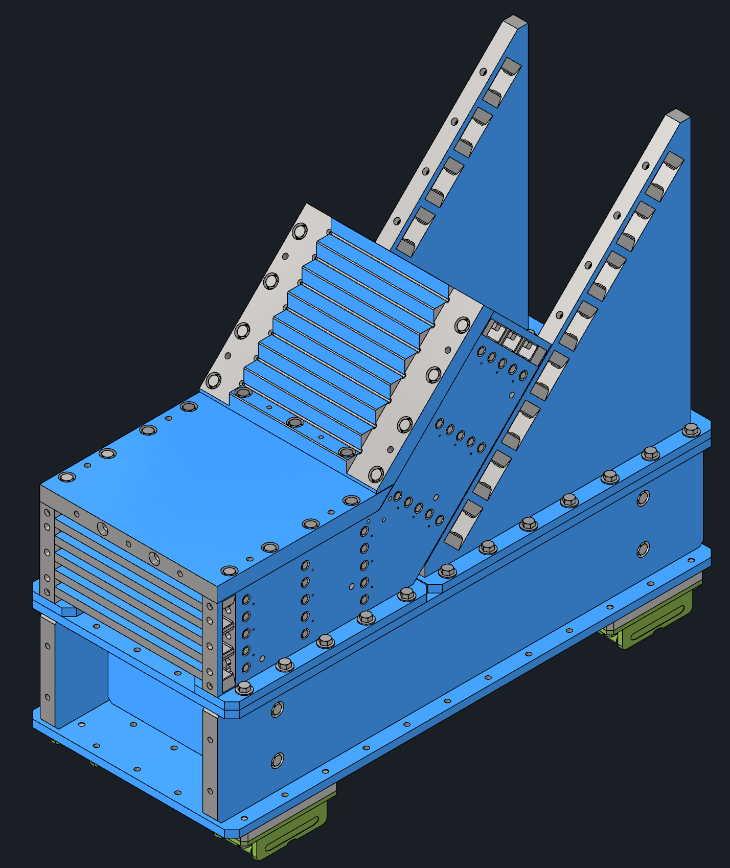
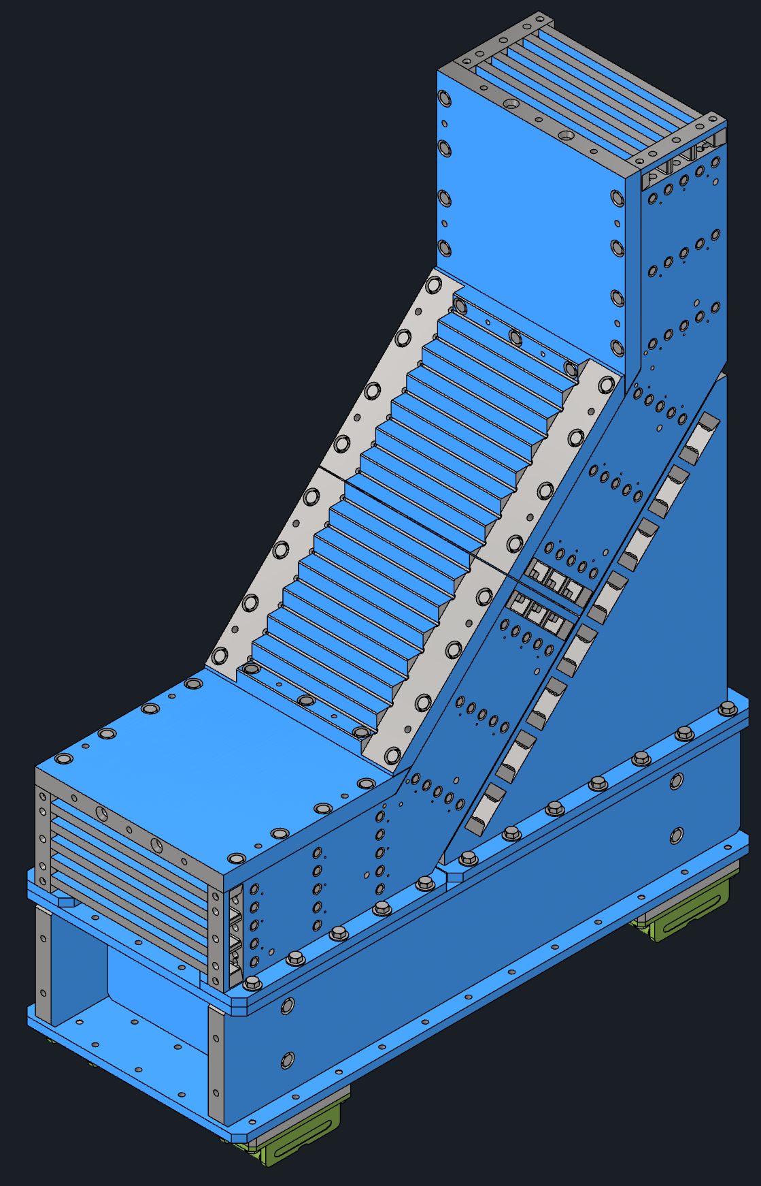
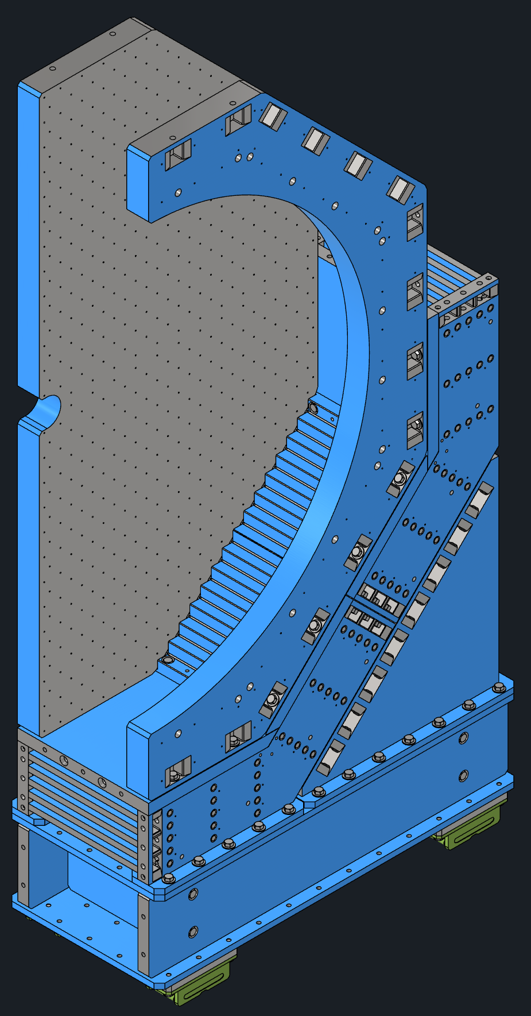
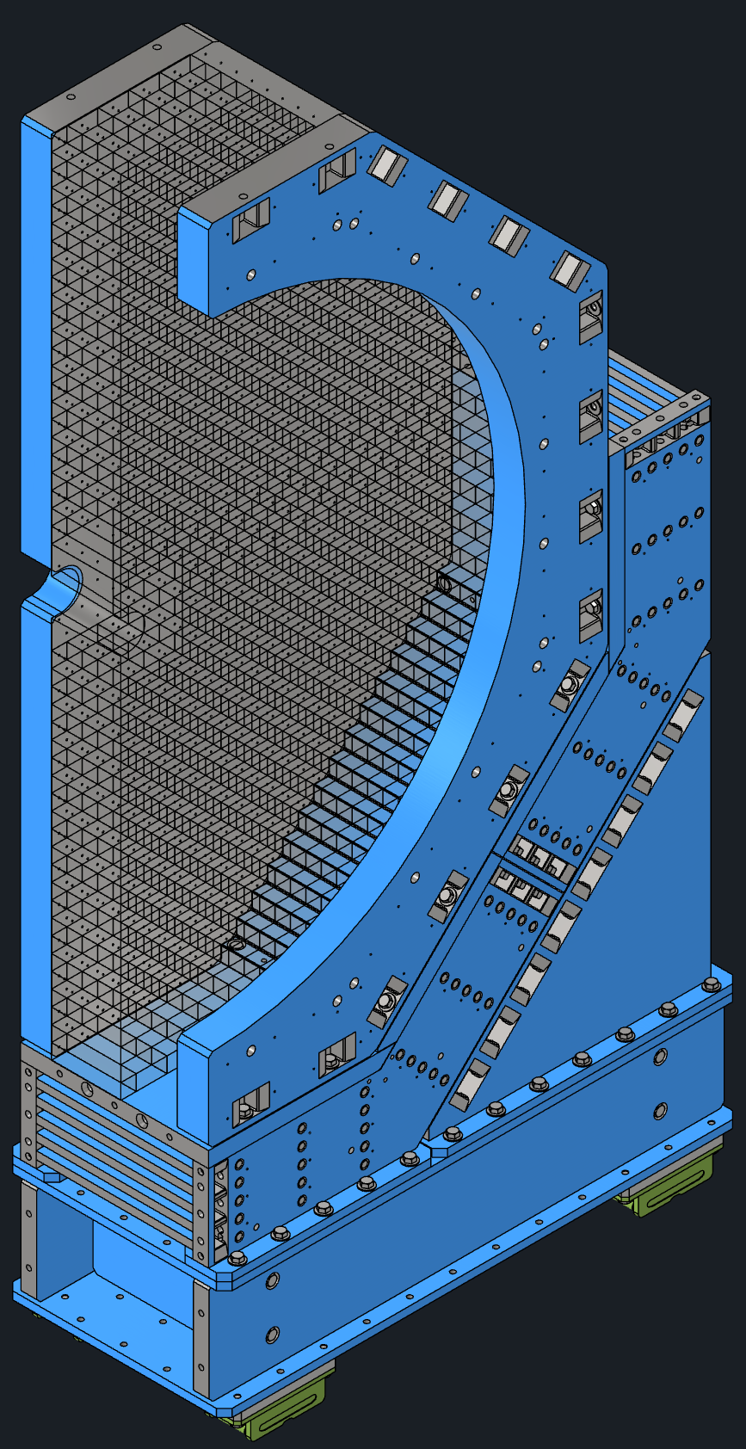
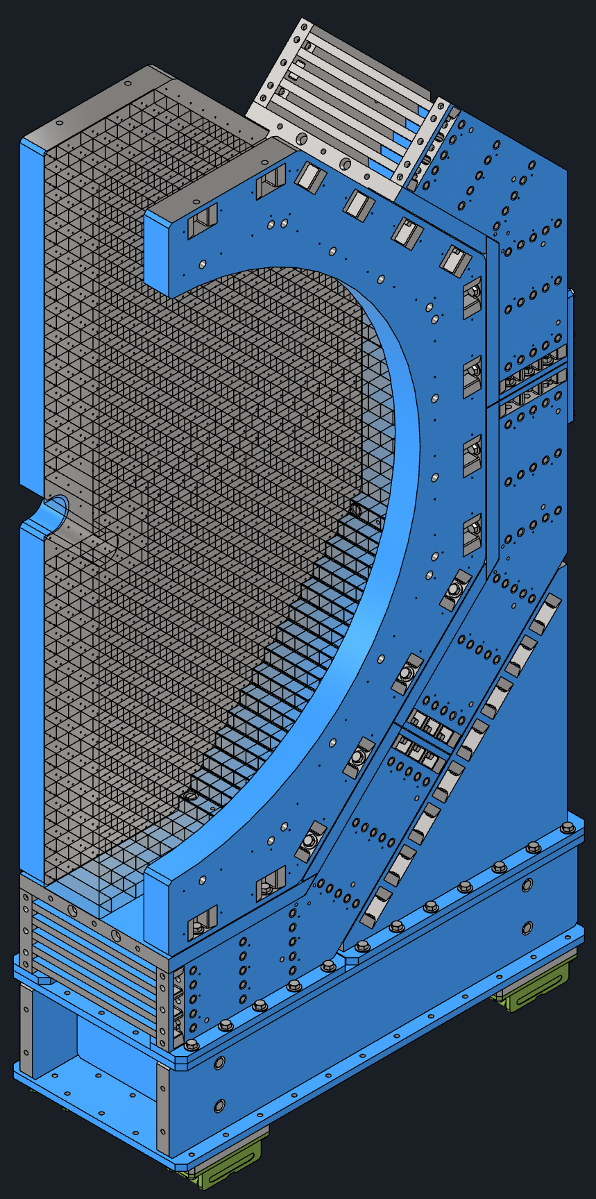

Endcap Assembly Steps
1. Base shimmed to height and anchored
FE: 11.25ton BE: 9.5ton
2. Flux return support attached
FE: 15ton BE: 13.25ton
3. First flux return module attached
FE: 28.25ton BE: 23.5ton
4. Second flux return module attached
FE: 41.5ton BE: 33.75ton
5. Pole tip and half annulus attached
FE: 51.5ton BE: 60.5ton
6. Detector installed
FE: 51.5ton (+100ton) BE: 60.5ton (+30ton)
7. Third flux return module attached
FE: 65.5ton (+100ton) BE: 71.25ton (+30ton)
8. Forth flux return module attached
FE: 79.5ton (+100ton) BE: 82ton (+30ton)

Slide 20



EndCaps
1&4
Status:
FDR completed
Design and analysis completed
Drawings completed and being reviewed
Vendor Quotes available
Possibility of reduction of flux return steel if magnet simulations can show it works. Potential for some cost savings.
PRRs planned for Summer 2025
Forward Endcap (FE)
11’x6’x25’, 200ton
Backward Endcap (BE)
11’x4’x25’, 130ton
HCal
EMCal
Pole Tip
HCal
Seismic Restraints
Seismic Restraints
Flux Return
Flux Return
Hydraulic Rams
Hydraulic Jacks
Hydraulic Jacks
Hilman Rollers
Anchor Bolts
Hilman Rollers

Slide 21




Barrel EMCAL Cooling
University of Manitoba – Thermal Analysis of BIC single sector
Computational design of BIC with 48 sectors,
showing one of the sectors in detail
Gathered all the cooling requirements from various sub detector groups.
Cooling Requirements Spreadsheet is posted with prebrief material.
Design being worked on to be ready for PDR.

Slide 22







Forward EMCAL Cooling
Sector Geometry
FEB Heat Sink Temperature
Copper tube (inch)
0.25
Water flow rate (litre/min) | Flow velocity (m/s) | Tube Length (m) | Pressure drop (psi) | Temperature rise (C) | FEB Heat load (W) | SiPM Heat load (W)
0.83 | 0.76 | 6 | 2.1 | 2 | 4.5 | 0.17
Sectional View
Relative Humidity (%) | Dew Point Temperature (C) | Water Inlet Temperature (C) | FEB Temperature (C) | SiPM Temperature (C)
100 | 20 | 22 | 25.9 | 23.8
Temperature Requirements
Maintain FEB temperature 3 C above dew point
Cooling the SiPMs to be determined
Materials
Copper thickness (10 %) in FEB
Copper thickness (5%) in SiPM Board
FEB and SiPM Board thickness : 2 mm
Way Forward:
Design being worked on to be ready by PDR.
FEB Temperature
SiPM Temperature

Slide 23

Gas Systems for ePIC
pfRICH & hpDIRC
  Uses dry Nitrogen
  Design requirements are understood and easy to implement.
MPGD
  Uses a mixture of Argon, CO₂, and isobutane
  Gas mixture ratios still need to be finalized
  A dedicated safety system is required due to the flammability of isobutane
  Design is relatively straightforward and can be implemented with standard practices
dRICH
  Uses Hexafluoroethane (C₂F₆) as the radiator gas
  Due to C₂F₆ being a greenhouse gas, a recirculation/recovery system is necessary
  System is more complex than the others
  Leveraging designs from existing experiments will help accelerate development
  Combination of gas filtering and phase separators will be used for the recovery system.
  STAR TPC gas system plumbing from gas pad to experimental hall is a potential candidate for reuse
PLC Control System with UPS
Storage Tank
Filters
Separation System
Compressors
COMPASS RICH Gas system seves as a baseline to dRICH Gas System

Slide 24

ePIC Detector Electronics Power & Services
Detector | Type | Front End LV Power | HV Bias | LV Power Supply Type | HV Power Supply Type | Power Supply Location | LV Power Feed | LV Feed Cables | Cooling
EE HCAL | SiPM | 200W | 50W@ 50V | MPV 4016I | Wiener MPV 8120I | S. Platform, 19” rackmount | 10V @ 20A | 4x 14 AWG | Liquid
E-EE EMCAL | SiPM | 500W | 500W@50V | MPV 4016I | Wiener MPV 8120I | W. Platform, 19” rackmount | 10V @ 50A | 4x 12AWG | Convection
pfRICH | HRPPD | 260W | 70W@3kV | MPV 4018I | CAEN A1515BV | S. Platform, 19” rackmount | 1.2V@ 220A | 14x 12AWG | Liquid/ Neg. pressure
EE MPDG Disk | uRWELL | 350W | 1.5W@1.5kV | MDH-07/16 | CAEN A1515BV | S. Platform, 19” rackmount | 10V @ 315A | 2x 10AWG | Liquid
Outer Barrel MPGD | uRWELL | 1.6kW | 1.5W@1.5kV | MDH-07/16 | CAEN A1515BV | S. Platform, 19” rackmount | 10V @160A | 12x 12AWG | Liquid
Inner Barrel MPGD | uRWELL | 700W | 1.5W@1.5kV | MDH-07/16 | CAEN A1515BV | S. Platform, 19” rackmount | 10V@120A | 15x 12AWG | Liquid
MAPS Disk | EIC-LAS | 3kW | Derived from LV system | MPV 4018I | N/A | S. Platform, 19” rackmount | 3.6V@ 960A | 48x 10AWG | Liquid
MAPS Sagita Layer3 | EIC-LAS | 680W | Derived from LV system | MPV 4018I | N/A | S. Platform, 19” rackmount | 2.4V@ 194A | 16x 12AWG | Liquid
MAPS Sagita Layer4 | EIC-LAS | 1.4kW | Derived from LV system | MPV 4018I | N/A | S. Platform, 19” rackmount | 4.8V @ 235A | 18x 12AWG | Liquid
Barrel HCAL | SiPM | 220W | 1.6W @50V | MPV 8016I | MPV 8120I | S. Platform, 19” rackmount | 10V @ 22A | 8x 16AWG | Liquid
Barrel ECAL | SiPM + AstroPix | 1.6kW | 1W @50V & 100W @ 400V | MDH-07/16 | MPV 8120I & EHS F005p | S. Platform, 19” rackmount | 10V @ 160A | 16x 12AWG | Liquid
DIRC | HRPPD | 300W | 70W@3kV | MPV 4018I | CAEN A1515BV | S. Platform, 19” rackmount | 1.2V@ 250A | 16x 12AWG | Liquid
Barrel TOF | AG-LGAD | 2400W | 4W@400V | PL506 | CAEN A1625 | S. Platform, 19” rackmount | 10V @ 240A | 12x 10AWG | Liquid
HE TOF | AG-LGAD | 10.6kW | 4W@400V | PL506 | CAEN A1625 | S. Platform, 19” rackmount | 10V @ 1,060A | 48x 10AWG | Liquid
dRICH | SiPM | 300W | 23W@70V | MPV 4016I | MPV 8120I | S. Platform, 19” rackmount | 10V @ 30A | 4x14AWG | Liquid
FWD ECAL | SiPM | 2.8kW | 750W@ 50V | PL506 | MPV 8120I | W. Platform, 19” rackmount | 10V @ 280A | 20x 12AWG | Liquid
HE HCAL | SiPM | 1.7kW | 3kW@ 50V | PL506 | MPV 8120I | E. Platform, 19” rackmount | 10V @ 170A | 12x 12 AWG | Convection
MARCO (SC Magnet) Power:
  New Power Supplies will be used. Existing Water cooled leads for STAR (Length 300 feet) with current capacity >4000 Amps were evaluated by ePIC Magnet Group can be used. New Magnet DAQ Rack will be placed on Third Level of South Platform and Dump Resistors on the Third Level of North Platform.
Looking at the STAR Detector Power One Line Diagram and comparing it with the EPIC Detector power requirements for various subdetectors, it seems like we have adequate power for EPIC needs. The EPIC detector Electronics power was estimated using table above which is available on sharepoint. Refer to ePIC Services on-line Spreadsheet for details of power distribution.

Slide 25
Maintenance Plan for ePIC
Detailed ePIC Installation Schedule and Maintenance Schedules were created and are posted as prebrief materials. Following maintenance plan will be followed for detectors:
HCAL: HCAL Sectors are not removable. All the electronics will be on the exterior and is accessible for maintenance.
Magnet: Cryostat is not removable. Chimney and Phase separator are on top of HCAL and are accessible for maintenance.
Barrel EMCAL: Is removable only in case of full upgrade of the detector. All electronics are accessible on both ends.
DIRC : Bar Boxes can be removed but not needed. Electronics are accessible from the backward end.
Outer MPGD: Modules can be removed inside the experimental hall for full maintenance.
Cymbal & Barrel TOF: Modules can be removed inside the experimental hall for full maintenance.
EEEMCAL and pfRICH: Detectors can be removed inside the experimental hall for full maintenance.
dRICH: Detector can be removed inside the experimental hall for full maintenance.
Inner Detectors (Si Disks, Si Tracker, MPGD Disks): GST can be removed in the assembly hall for full maintenance.
TOF Disk: Detector can be removed inside the experimental hall for full maintenance.
Forward HCAL: Towers/Modules not removable. Electronics accessible from the back end.
Forward EMCAL: Modules removable. Electronics accessible from the back end.
Backward HCAL: Towers/Modules not removable. Electronics accessible from the front end.
Electronics racks/chillers/cooling systems/gas systems are accessible from north and south platforms.

Slide 26
ES&H
Harnesses, safety glasses, work gloves and other PPE will be identified for work required.
Follow all OSHA guidelines and BNL SBMS for designing scaffolds and other access provisions for assembly and installation of all components.
All components are designed and analyzed to a reasonable factor of safety to mitigate any risk of structural failure.
Cranes and other access equipment such as scissor lifts and bucket lifts are periodically inspected as per guidelines in SBMS.
We identified that ePIC detector and all its components weigh more than STAR detector. Requisition for floor load analysis is pinned.
Safety systems (Fire Suppression and Smoke Detection):
  Are part of existing bldg. 1006 and need to be updated during refurbishment of facility.
Sniffers will be installed next to MPGD detectors on both Forward and Backward Ends to detect leakage of any flammable gas.
ODH Safety standards will need to be evaluated.

Slide 27
Outlook to CD-2 and Summary
PDRs for Support Structures, Integration and Installation to be done from Oct to Dec 2025.
We will further refine the designs of various sub detectors, their support structures.
Identification of conflicts and resolution.
Cabling plan and RDO placements needs to be further refined with cable trays etc.
Seismic and Magnetic Forces are taken into consideration for design of support structures.
Cooling and Power requirements for various detectors and electronics are continuously being refined.
Gas Systems preliminary design to be finished and reviewed by end of calendar year.
Safety Engineers are integrated in the Engineering Meetings to help with design development.

Slide 28


Slide 29


Infrastructure and Utilities
2
ePIC detector weight including Endcaps is more than existing STAR detector.
Analysis required to find out if any modifications are needed to the current concrete floor.
New rails will be needed for the Endcaps
Detailed explanation of following details were put together in the document “EPIC Floor Loads and Placement” and have been provided to EIC Infrastructure Group.
  Hillman Rollers and their placement,
  Location of new rails,
  Weights of EPIC Barrel, Hadron & Lepton Endcaps
  Other relevant details with detailed drawings and model snapshots.
SOW with Requisition in BNL Procurement System.
External consulting firm to analyze loads on concrete floor.
Detailed explanation of utilities and upgrades needed were also put together in the document “EPIC Utilities” and have been provided to EIC Infrastructure Group.

Slide 30

GST Model with Detectors
EEEMCAL
pfRICH
B MPGD Disk
B Si Disks
Cymbal
SVT
Barrel TOF
F Si Disks
F MPGD Disk
TOF Disk
Current Inner Detector Models inside GST.
Working on design modifications to make Barrel TOF and Cymbal detectors serviceable in the experimental hall.

Slide 31



pfRICH
Major Components:
  Vessel
  Sensor Plane
  Mirrors
  Aerogel Wall

Slide 32




dRICH
Estimated Weight: 2000kg
Due to the anticipated need for maintenance in the hall, options to remove the dRICH were investigated.
dRICH is kept whole and slid as far back as possible.
Services Representation
Sensor
Boxes
Spherical
Mirrors
Gas
Volume
Aerogel
Inner Beampipe
Housing
Spherical
Sensor Plane

Slide 33




EEEmCAL
SiPM and crystals configuration
Mechanical design & Clearances
Cooling
Stability required : +/- 0,1 °C
Power: 50 W (by box)
Copper plate in front < 5 mm
Water cooling plate (internal & external)
Air cooling for the electronic boxes

