Slide 1
Electron and Hadron Polarimetry
WBS 6.10.14
Frank Rathmann
Dave Gaskell
Hadron Polarimetry Electron Polarimetry
BNL
JLab
10th EIC DAC Meeting
June 11-13, 2025

Slide 2
Charge Questions Addressed
Is the design of the ePIC detector and its sub-systems appropriate and progressing well?
Are the remaining work and technical, cost and schedule risks adequately understood? Are there opportunities?
Will the detector be technically ready for baselining by late 2025?
Are the detector integration and planning for installation and maintenance progressing well? Are there areas where further ideas should be pursued?
Will the detector be ready for start of construction by late 2026?

Slide 3
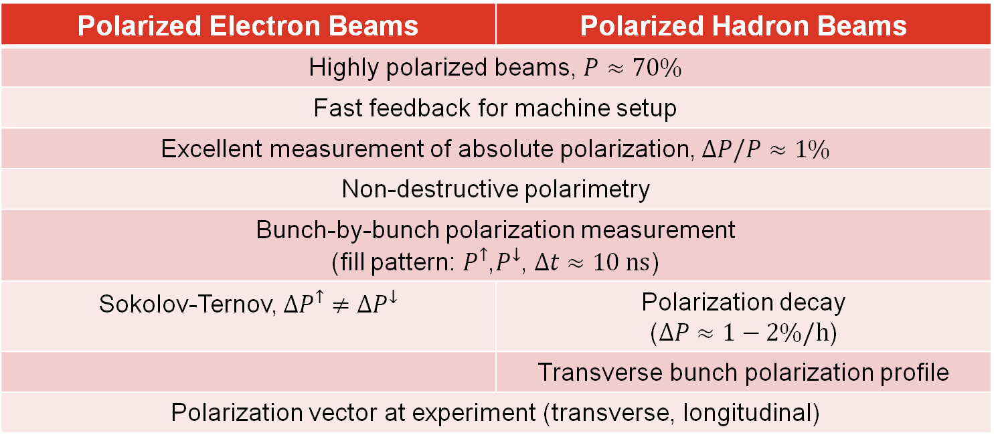
Requirements
Polarized Electron Beams | Polarized Hadron Beams
Highly polarized beams, $P≈70\%$
Fast feedback for machine setup
Excellent measurement of absolute polarization, $ΔP/P≈1\%$
Non-destructive polarimetry
Bunch-by-bunch polarization measurement (fill pattern: $P^{↑}$,$P^{↓}$, $Δt≈10 ns$)
Sokolov-Ternov, $∆P^{↑}≠∆P^{↓}$ | Polarization decay ($∆P≈1−2\%/h$)
 | Transverse bunch polarization profile
Polarization vector at experiment (transverse, longitudinal)

Slide 4
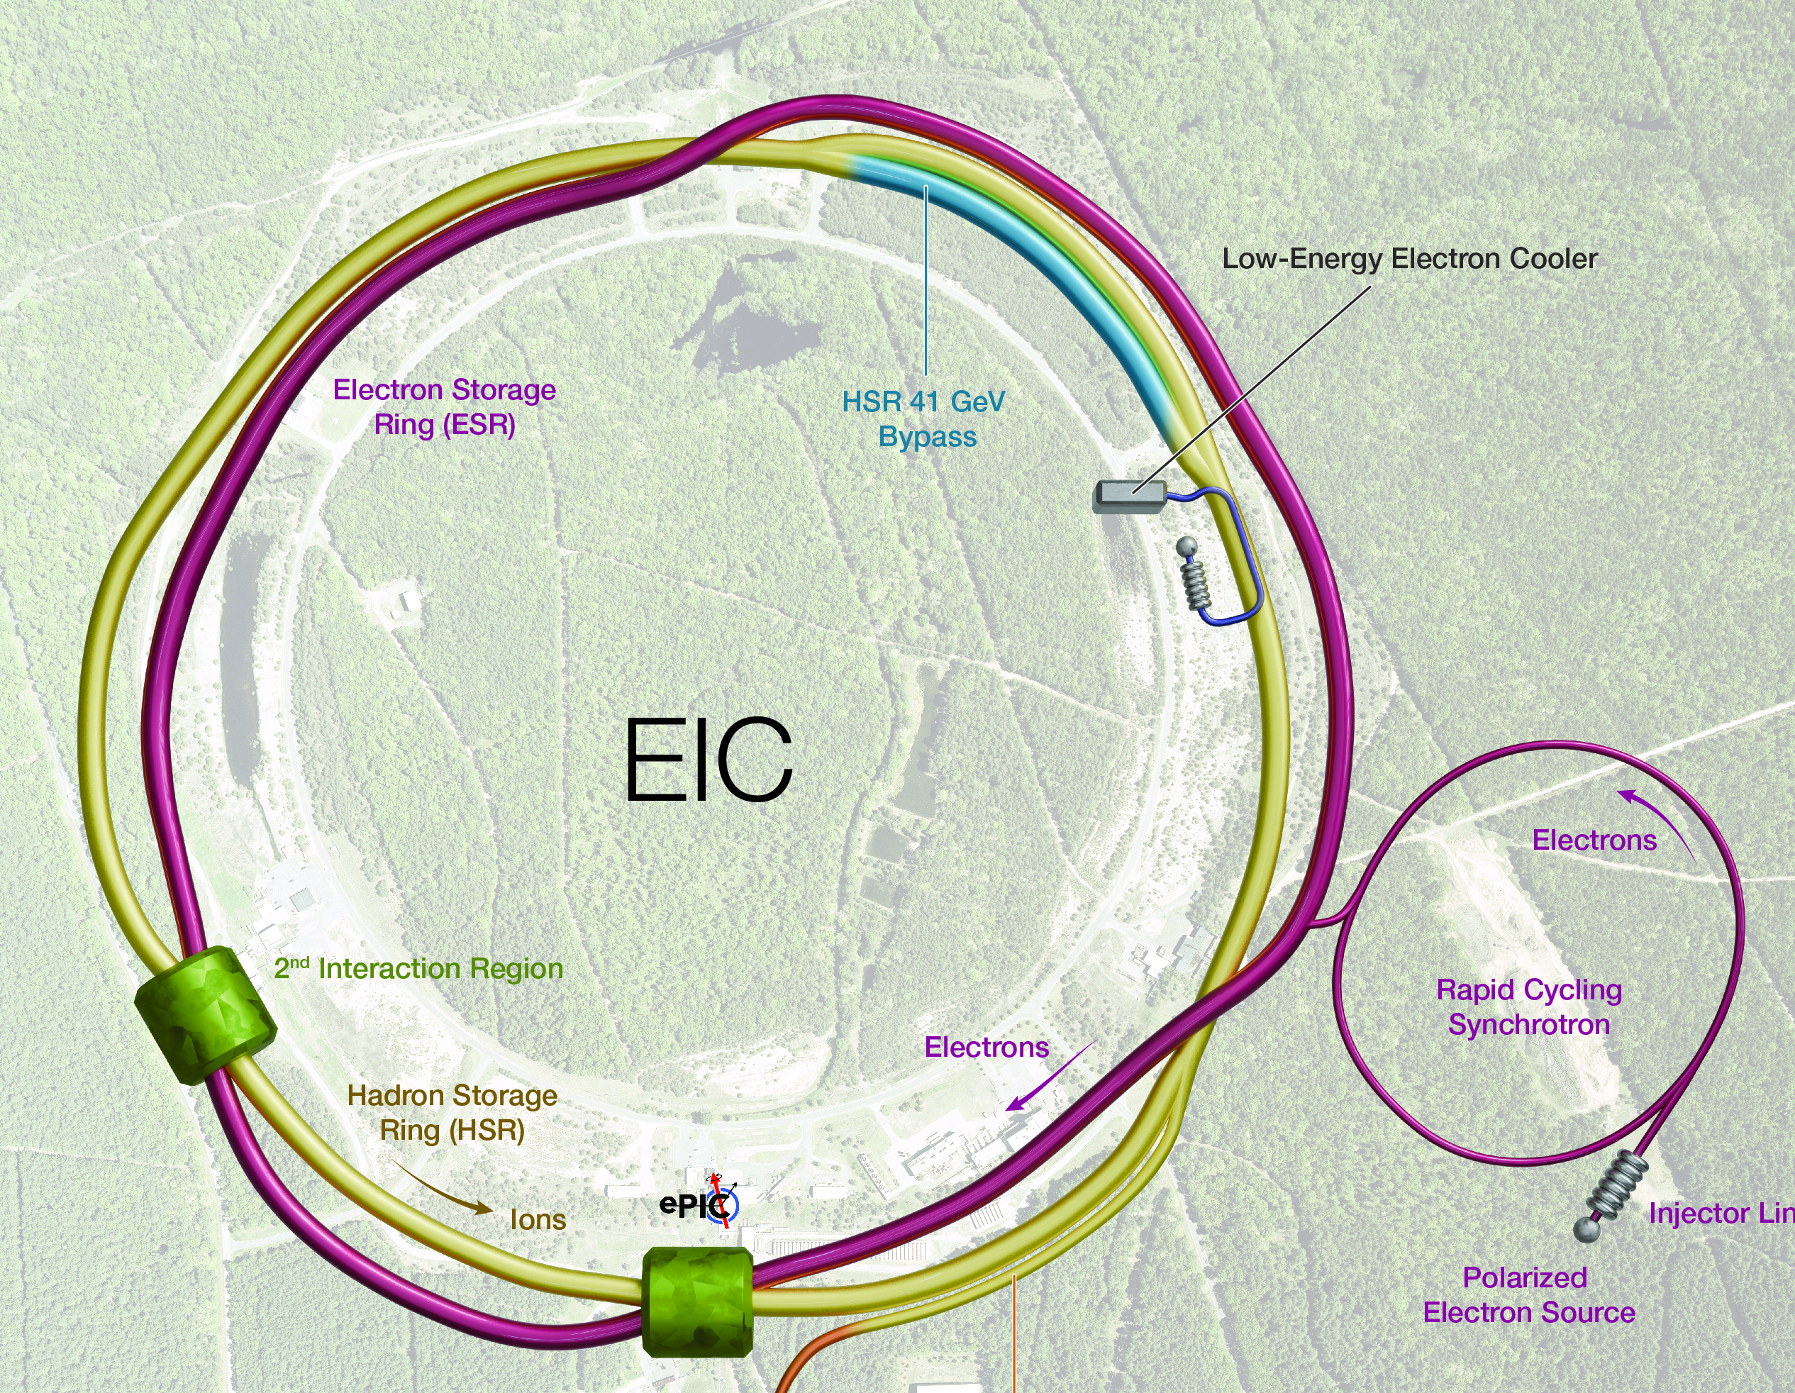
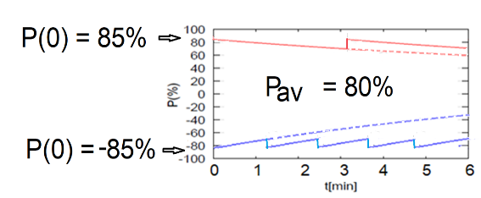
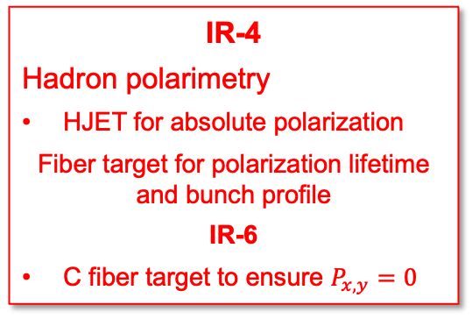

Scope
IR-6
Local polarimetry
Inside spin rotators
Fiber target for hadron polarization orientation
Compton backscattering for electron polarization (ESR)
RCS
Compton backscattering for electron polarization
IR-4
Hadron polarimetry
HJET for absolute polarization
Fiber target for polarization lifetime and bunch profile
IR-6
C fiber target to ensure $P_{x,y}=0$
$$10 \text{ns}$$
transverse
longitudinal
Electron and hadron bunches stored for several hours.

Slide 5
Electron Polarimeters

Slide 6
Compton Polarimetry
Analyzing powers
Generic Compton Polarimeter
Longitudinal analyzing power depends only on backscattered photon energy
Key systems:
Laser
Photon and electron detectors
Dipole
Transverse analyzing power depends on backscattered photon energy and azimuthal angle relative to polarization direction
ESR Compton will measure both P_{L} and P_{T}
RCS Compton will measure primarily P_{T}

Slide 7
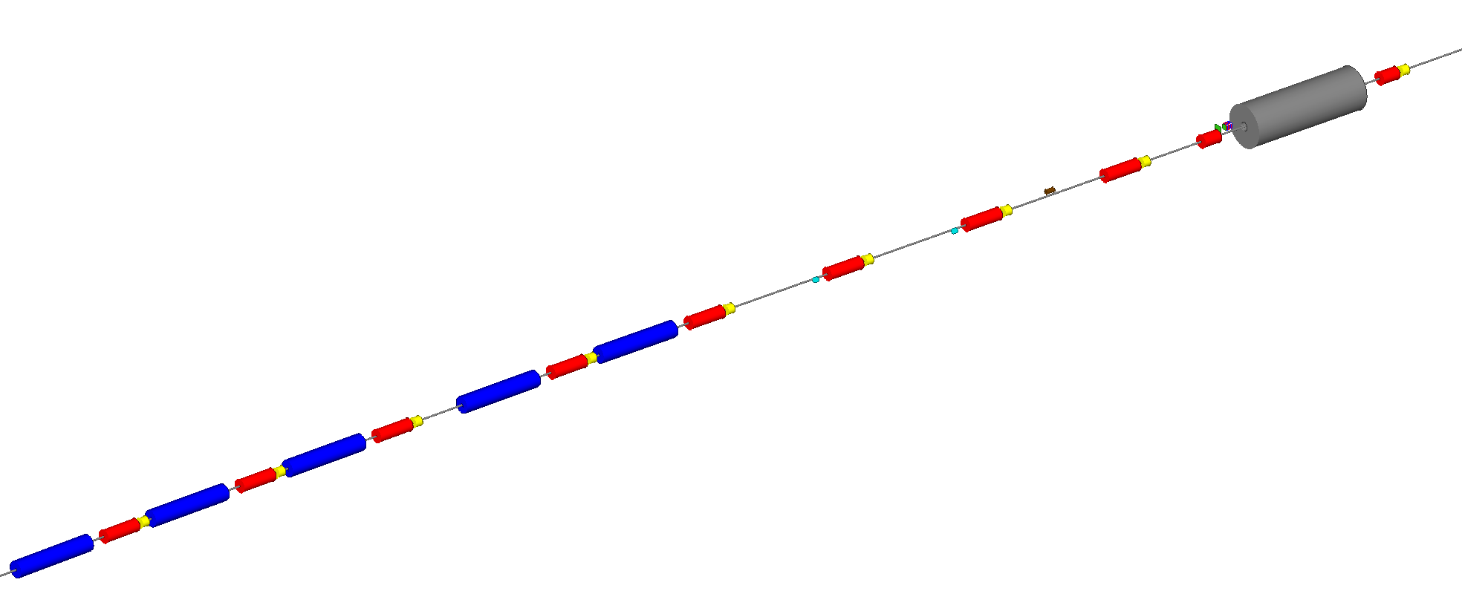
Electron Storage Ring Polarimeter
Polarization components at Laser IP
Photon Detector
(30 m from Laser IP)
Crab cavity
Beam energy | P_{L} | P_{T}
5 GeV | 99.1% | 13.2%
10 GeV | 96.5% | 26.2%
18 GeV | 89.0% | 45.6%
Electron Detector
D2EF
Q3EF
Q4EF
D3EF
θ_{B}=13 mr
Q5EF
D4EF
θ_{B}=1.5 mr
Q6EF
D5EF
θ_{B}=1.5 mr
Q7EF
*
Q8EF
D6EF
θ_{B}=12 mr
Q9EF
Polarimeter Components:
RF-pulsed laser system (under development)
Position sensitive detectors (diamond strips) for scattered electrons and backscattered photons
Calorimeter for backscattered photons
Will operate in single-photon mode
Q10EF
Laser IP​
74 m upstream of IP-6

Slide 8
ESR Compton Laser System Requirements
Configuration | Beam energy | Time (minutes)
P_{L} | 18 | 0.1
P_{T} |  | 0.8
P_{L} | 10 | 0.2
P_{T} |  | 1.4
P_{L} | 5 | 0.5
P_{T} |  | 1.8
Time estimates from Ciprian Gal
Time needed for 1% (statistics) measurement
Estimates assume ”differential” measurement, 100% efficiency
Laser power constraint: sufficient power to provide ~ 1 backscattered photon/bunch-laser crossing
Want to make “single photon” measurements – not integrating
532 nm laser with ~5 W average power at same frequency as EIC electron bunches sufficient
Resulting measurement times as noted above – easily meets beam lifetime constraints → less than 2 minutes

Slide 9
ESR Compton: Laser System
Laser system based on similar system used in JLab injector and LERF
Gain-switched diode seed laser 10 ps pulses @ 1064 nm
Variable frequency allows optimal use at different bunch frequencies (100 MHz vs 25 MHz)
Fiber amplifier → average power 10-20 W
Optional: Frequency doubling system (LBO or PPLN)
Partially reflective exit window to monitor reflected laser polarization
Gain-switched seed laser components procured under earlier generic EIC R&D
Shukui Zhang (JLab) assisting with seed laser configuration and system testing
Fiber amplifier obtained - work underway in Compton polarimetry laser lab at JLab

Slide 10
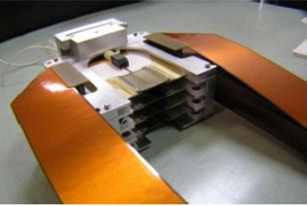
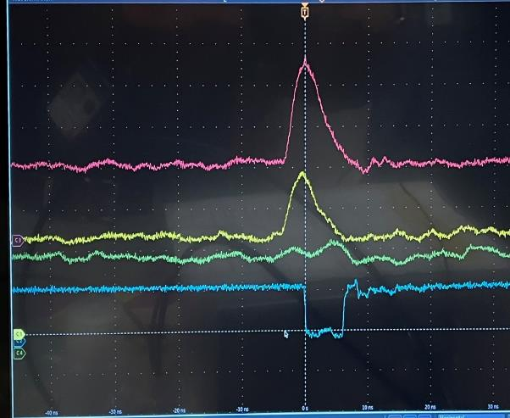
ESR Compton: Position Detectors
Position sensitive detectors are needed to measure:
Scattered electrons → P_{L}
Backscattered photons → P_{T}
Technology choice: diamond strips
Radiation hard, good time response
No performance degradation after 10 MRad of exposure (Q-weak @ JLAB)
Detector size: 6 cm (electrons) / 5 cm (photons)
Required segmentation: 250 μm (electrons) / 100-200 μm (photons)
Custom ASIC readout required
New “FLAT32” chip based on “CALYPSO” (used at LHC) under development for JLab/MOLLER (just completed)
Meets timing requirements of EIC (10 ns)
Can also be used for pulse height, pulse integration readout
Some minor modifications needed
JLab Hall C diamond detector
10 ns

Slide 11
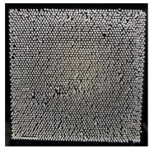
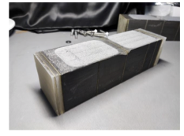
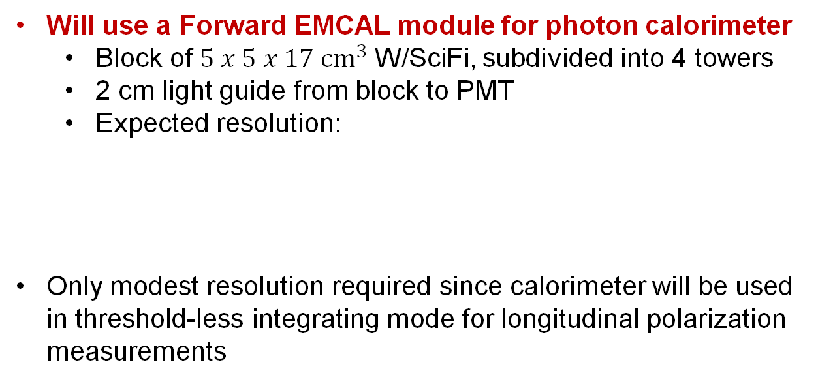
ESR Compton Photon Calorimeter
Will use a Forward EMCAL module for photon calorimeter
Block of $5 x 5 x 17 {cm}^{3}$W/SciFi, subdivided into 4 towers
2 cm light guide from block to PMT
Expected resolution:
Only modest resolution required since calorimeter will be used in threshold-less integrating mode for longitudinal polarization measurements

Slide 12
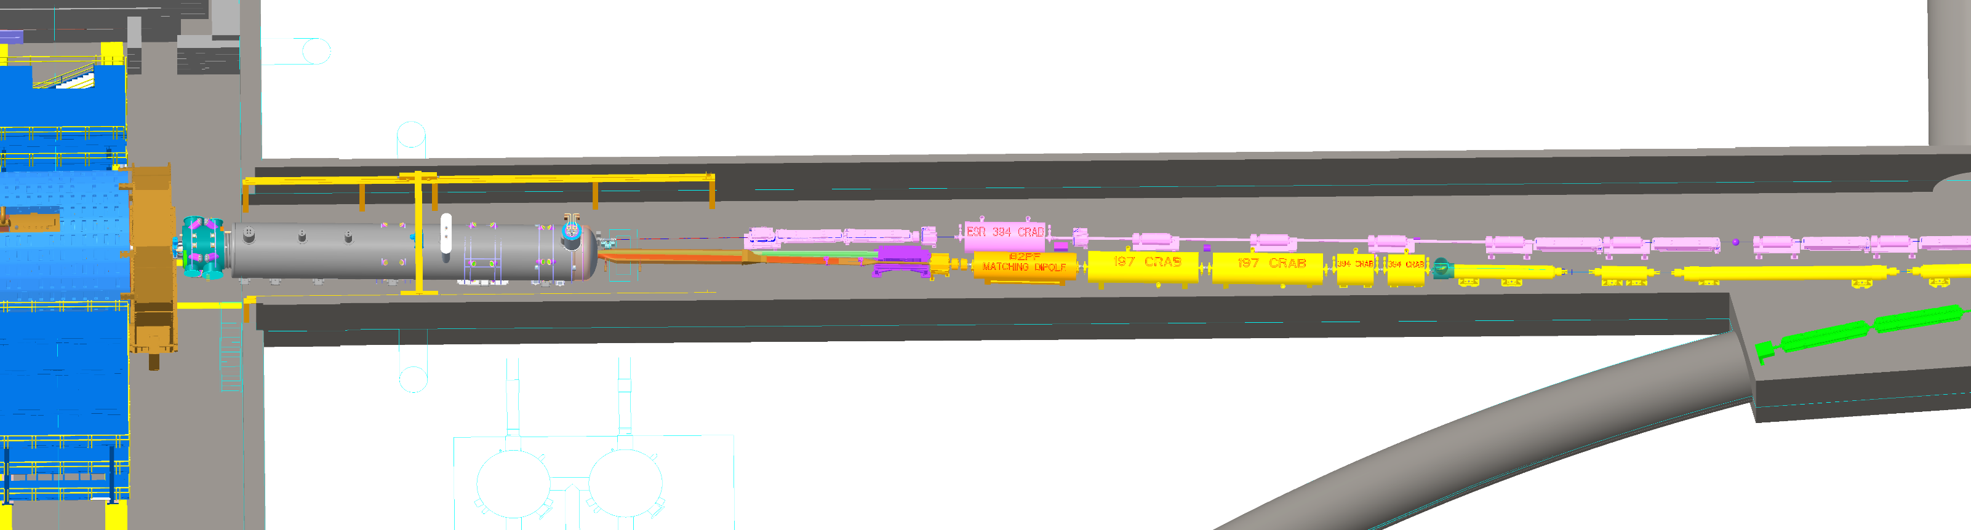
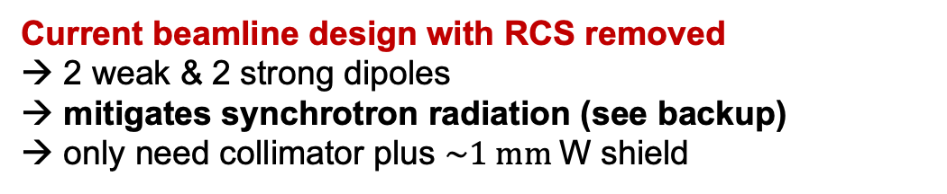
ESR Beamline Design
Crab Cavity
Photon
detector
Electron
detector
Weak dipoles
θ_{B}=1.5 mr
IP6
Bijan Bhandari 09.12.2024
Laser IP
Current beamline design with RCS removed
→ 2 weak & 2 strong dipoles → mitigates synchrotron radiation (see backup) → only need collimator plus $\sim 1 mm$W shield
Electron detector outside vacuum pipe → RF shield used to mitigate beam impedance issues

Slide 13
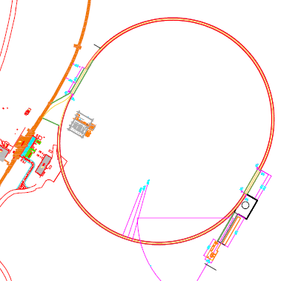
Rapid Cycling Synchrotron Polarimeter
RCS properties
RCS accelerates electron bunches from 3 GeV to full beam energy (5-18 GeV)
Bunch repetition rate: 1-2 Hz
Bunch charge: up to 28 nA
Ramping time: 100 ms
Polarimetry challenges
Analyzing power depends on beam energy
Low average current
Bunch lifetime is short
Proposed polarimeter location
Compton polarimeter will also be used in the RCS
Average over several bunches – can tag accelerating bunches to get information on bunches at fixed energy
Requires measurement in multiphoton mode (many backscattered photons/electron bunch)
Will use same detector technologies as ESR Compton
RCS

Slide 14
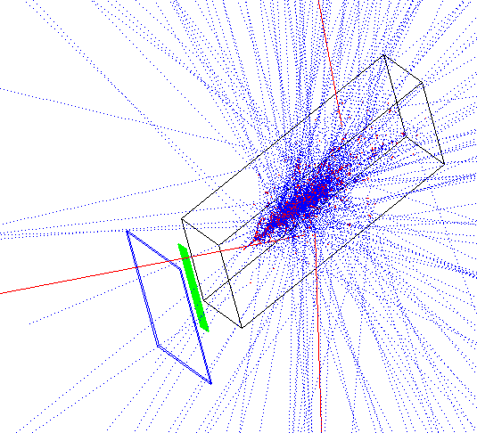
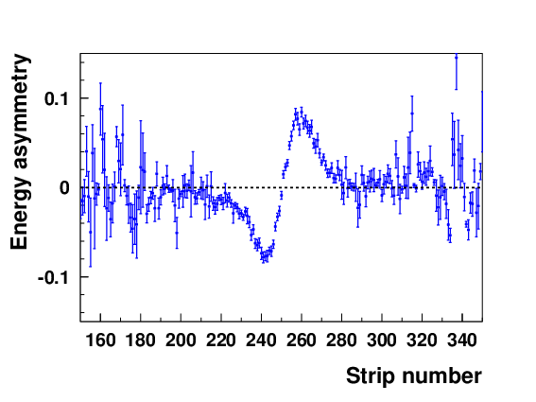
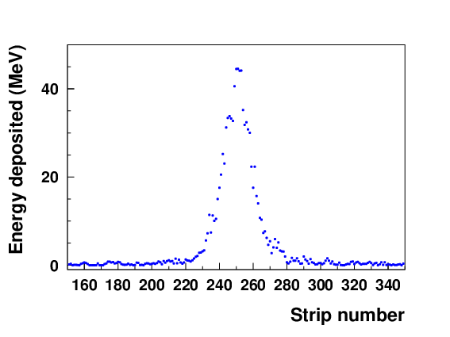
RCS Compton Detector Simulations
RCS Compton polarimeter will operate in multi-photon mode
Each laser-electron bunch collision will result in thousands of backscattered photons
Polarization will be extracted by measuring the energy-asymmetry → total energy deposited in the detector for each laser helicity state
Calorimeter (5 cm x 5 cm)
18 GeV
Tungsten converter
Diamond strips (0.1 mm pitch)
Energy deposited in each strip of diamond detector
Energy asymmetry
Simulated 10 laser pulses → 10,000 backscattered photons per pules

Slide 15
Tasks for CD-2 readiness: Electron polarimeters
Details for polarimeter and beamline integration
Both laser system and photon/electron detector exit ports need careful integration
Impedance issues must be included in design
Integrate polarimeter layout details in machine model
Complete DAQ design
Specify modules
Determine readout mode (streaming vs. triggered)
Will have 2nd Preliminary Design Review at the end of 2025

Slide 16
Hadron Polarimeters

Slide 17
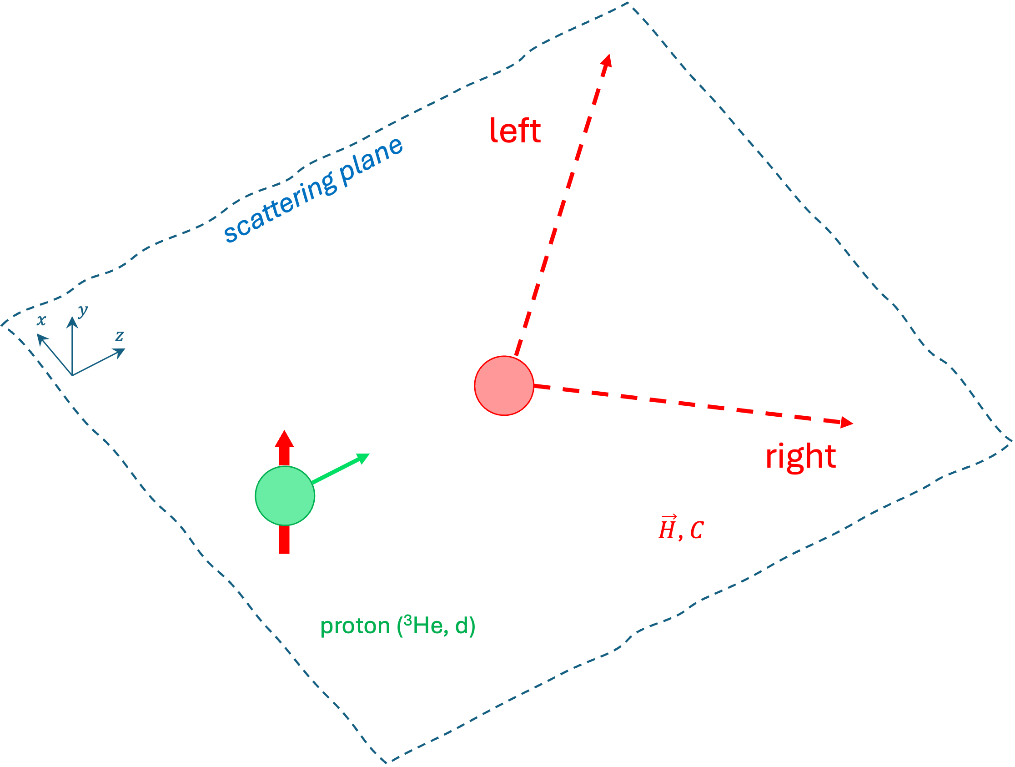
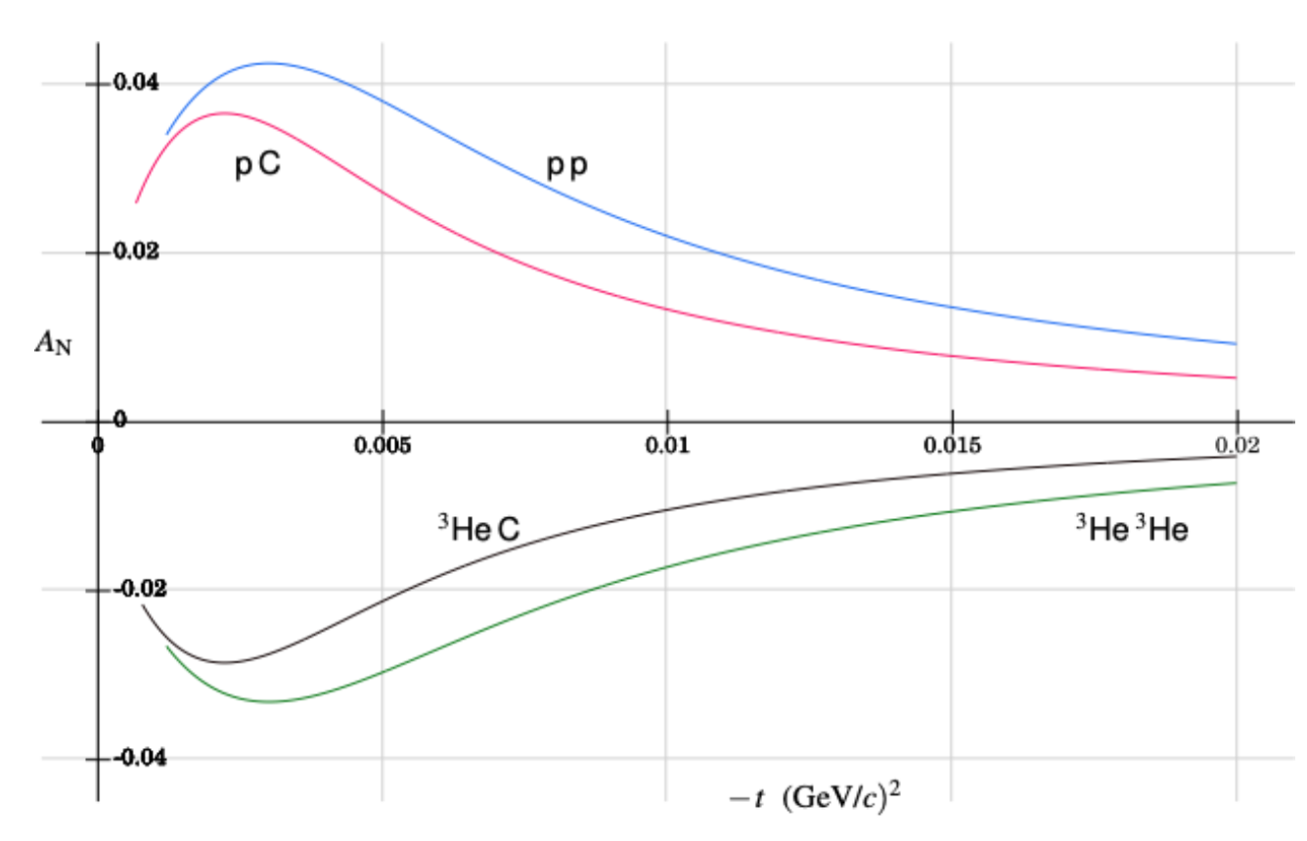
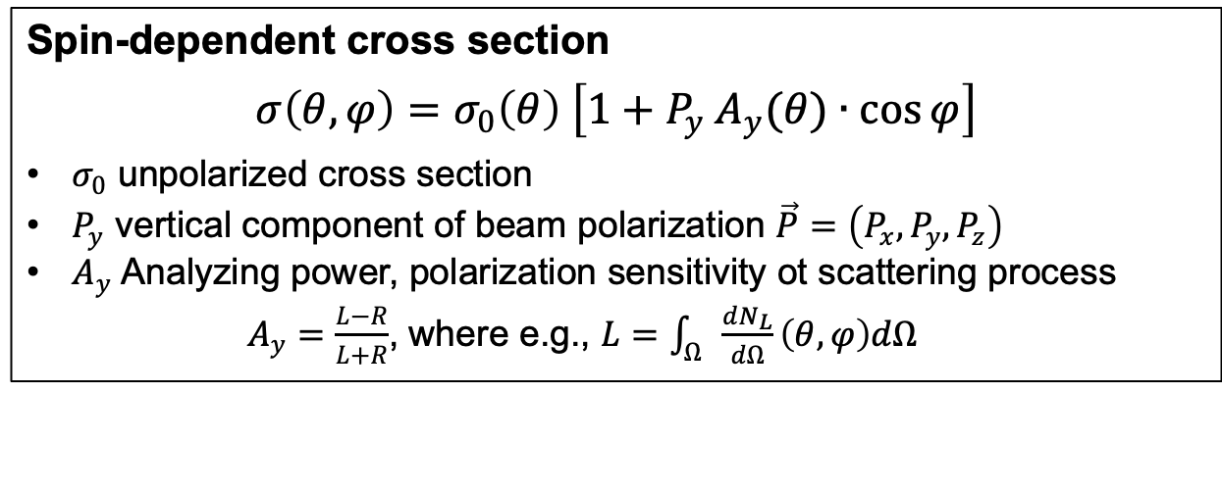

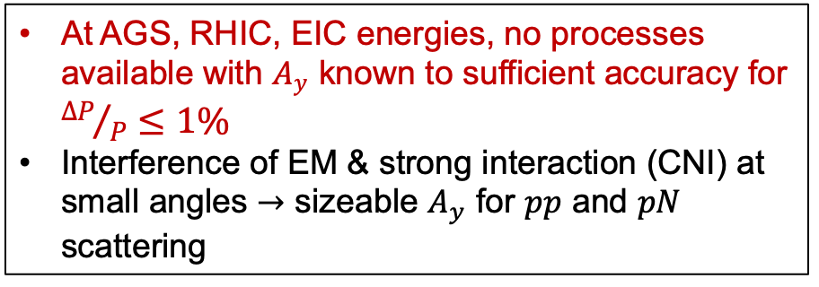
Hadron Polarimetry: CNI region
Spin-dependent cross section
$$σ\left(θ,φ\right)=σ_{0}\left(θ\right) \left[1+P_{y} A_{y}(θ)∙\cos{φ}\right]$$
$σ_{0}$ unpolarized cross section
$P_{y}$ vertical component of beam polarization $\vec{P}=\left(P_{x},P_{y},P_{z}\right)$
$A_{y}$ Analyzing power, polarization sensitivity ot scattering process
$A_{y}=\frac{L−R}{L+R}$, where e.g., $L=\int_{Ω}{\frac{dN_{L}}{dΩ}\left(θ,φ\right)dΩ}$
$A_{y}$ in CNI region N. Buttimore, PoS PSTP2013, 057 (2013)
At AGS, RHIC, EIC energies, no processes available with $A_{y}$ known to sufficient accuracy for ${∆P}/P≤1\%$
Interference of EM & strong interaction (CNI) at small angles $→$ sizeable $A_{y}$ for $pp$ and $pN$ scattering

Slide 18
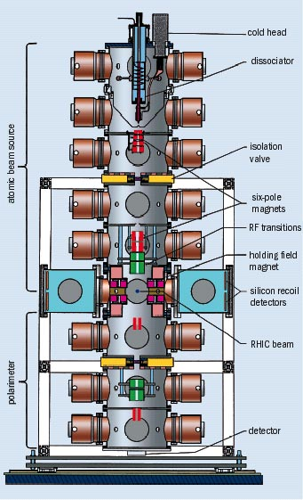
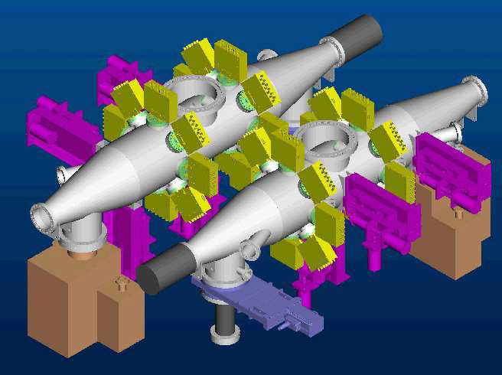
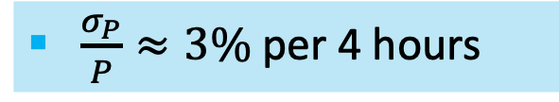
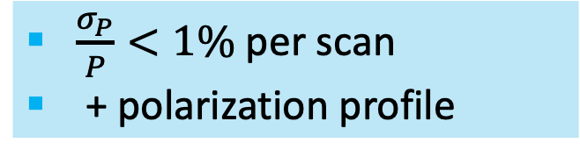
Hadron Polarimetry at EIC
HJET polarimeter (absolute, slow)
pC polarimeters (fast, relative)
ABS
BRP
$\frac{σ_{P}}{P}<1\%$per scan
+ polarization profile
$\frac{σ_{P}}{P}≈3\%$per 4 hours

Slide 19
Polarimetry at EIC: Timing
 |  | EIC
ring | RHIC | HSR | HSR | ESR
species | proton | proton | proton | electron
mode | flattop | injection | flattop | flattop
Energy [GeV)] | 250 | 23.5 | 275 | 10
Number of bunches | 120 | 290 | 1160 | 1160
Bunch length [cm] | 55 | 24 | 6 | 0.7
Bunch frequency [MHz] | 9.38 | 22.65 | 90.68 | 90.68
Bunch spacing [ns] | 106.6 | 44.14 | 11.02 | 11.02
Hadron polarization measurements foreseen at:
Injector chain Beam polarizations measured at 200 MeV linac and AGS
HSR absolute polarization measurements at:
injection (½ h electron cooling period)
Flattop through store
Routine operation of pC and HJET

Slide 20
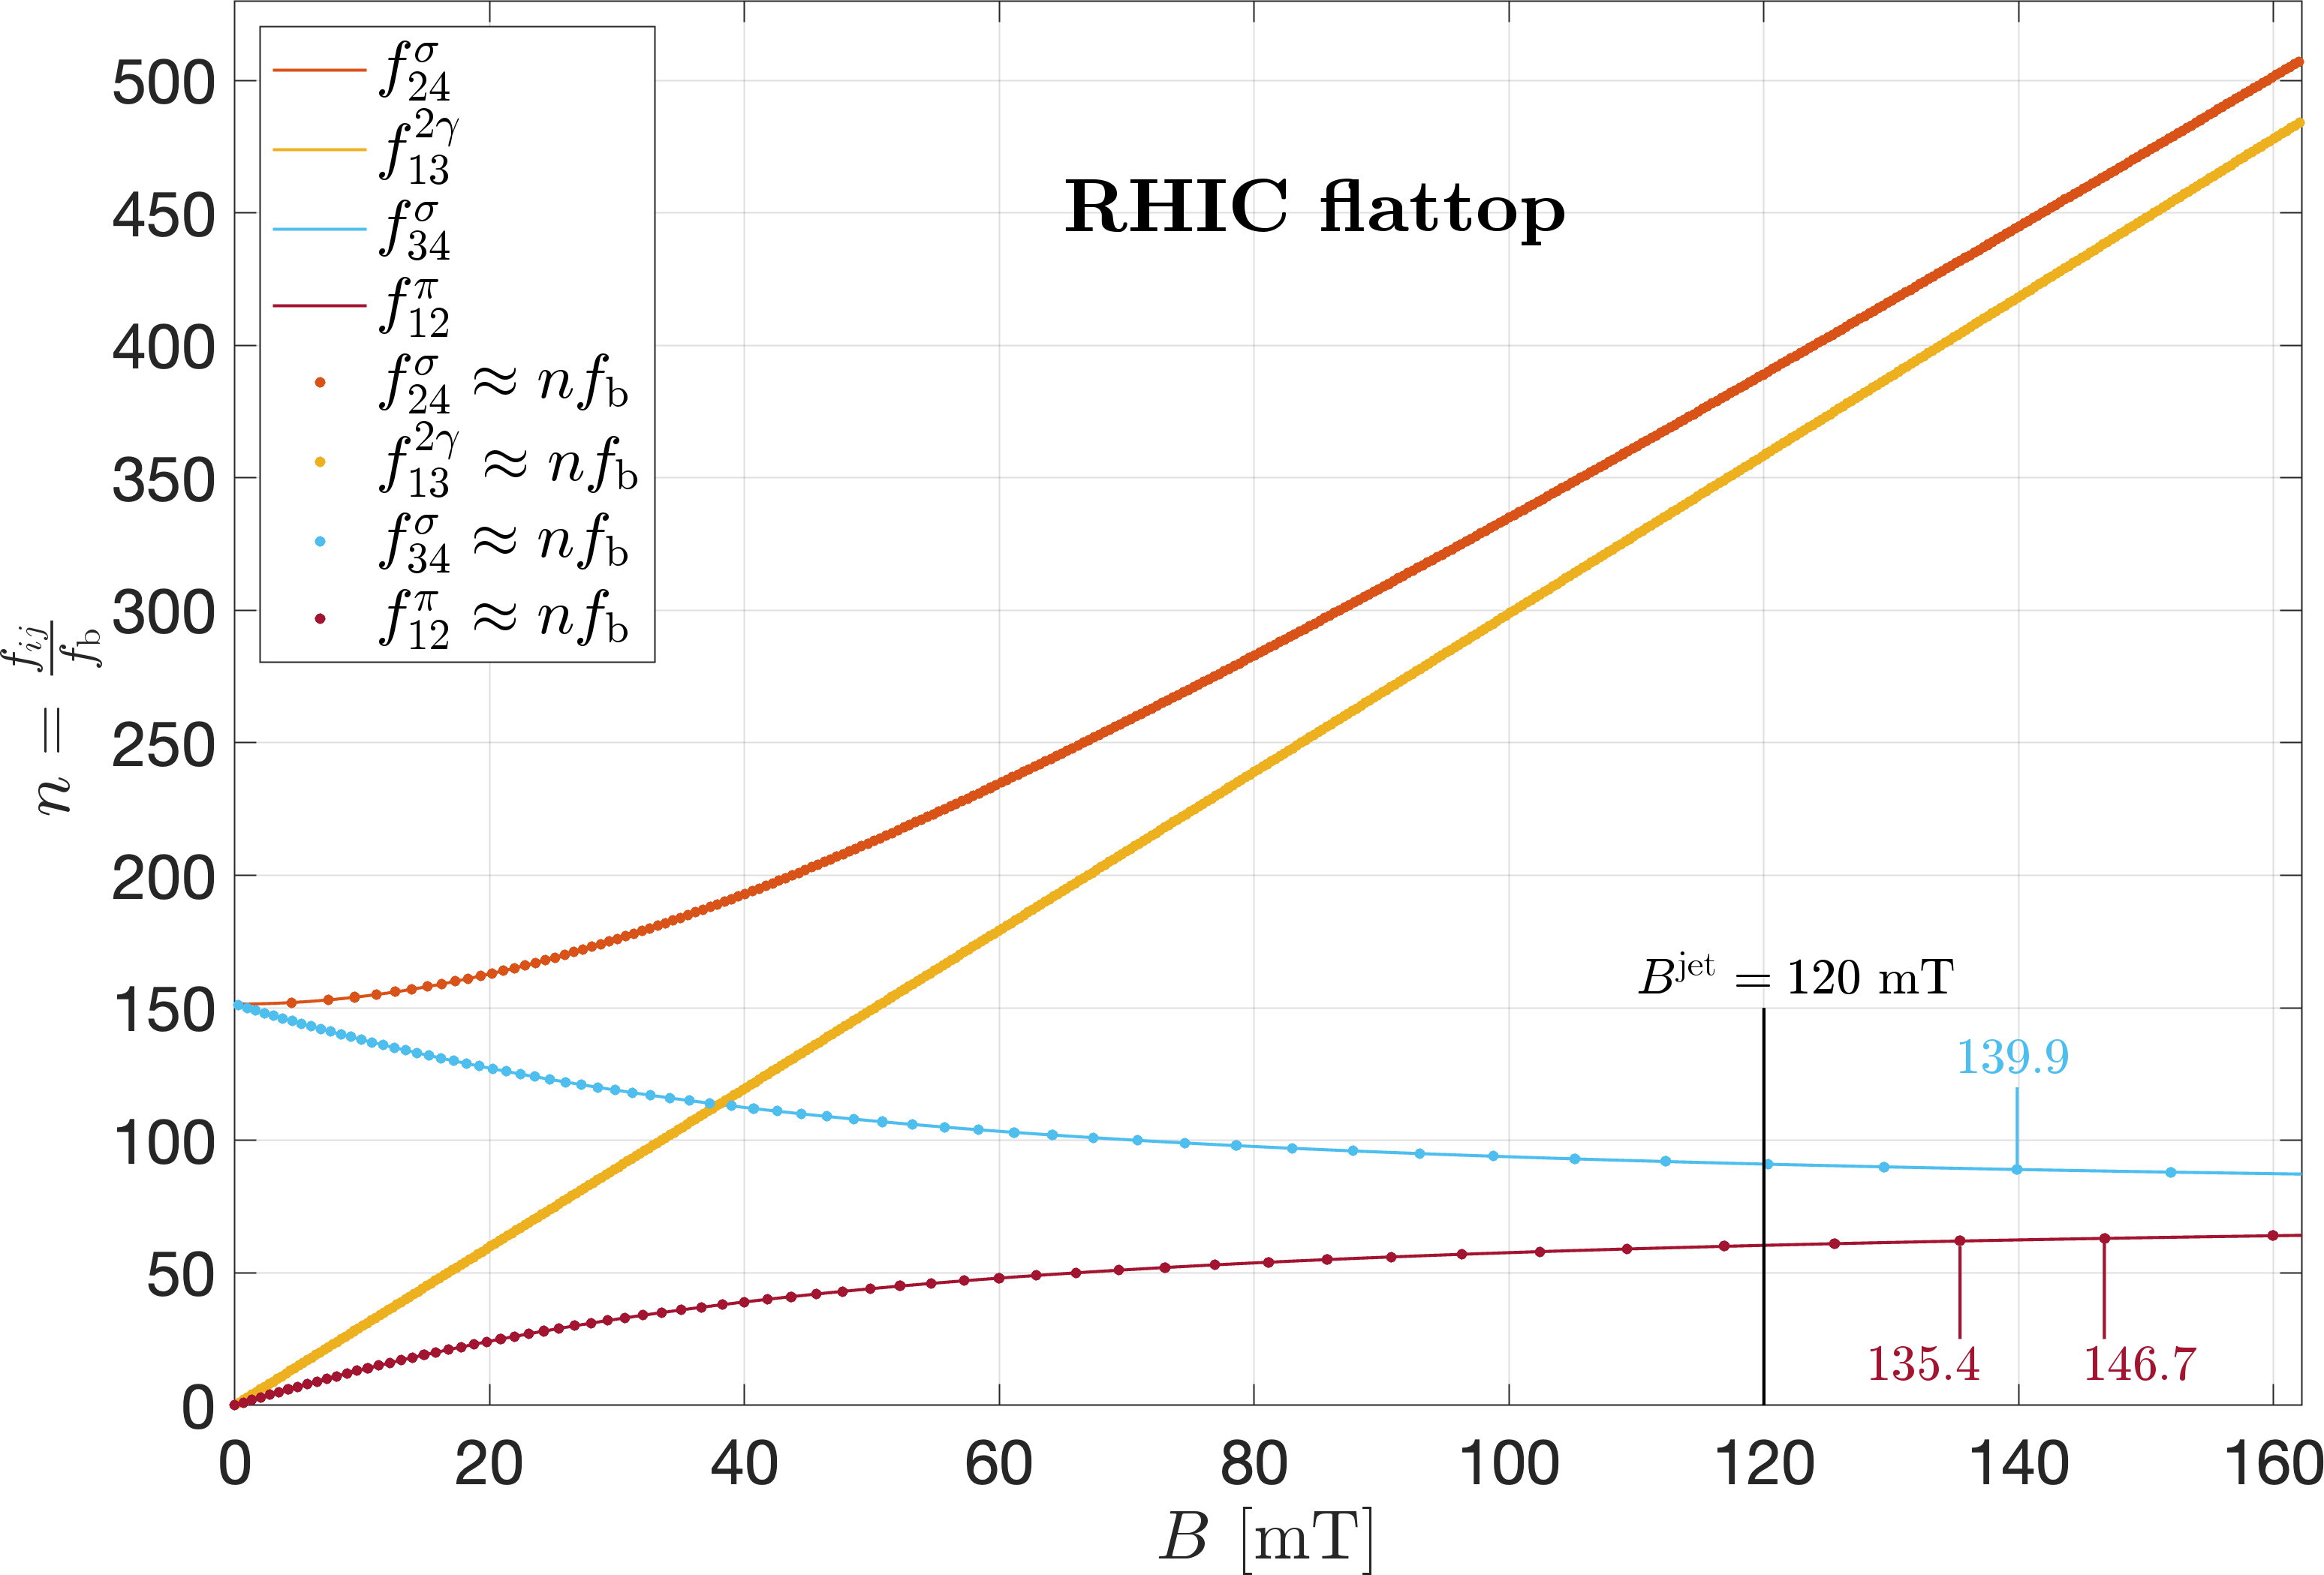
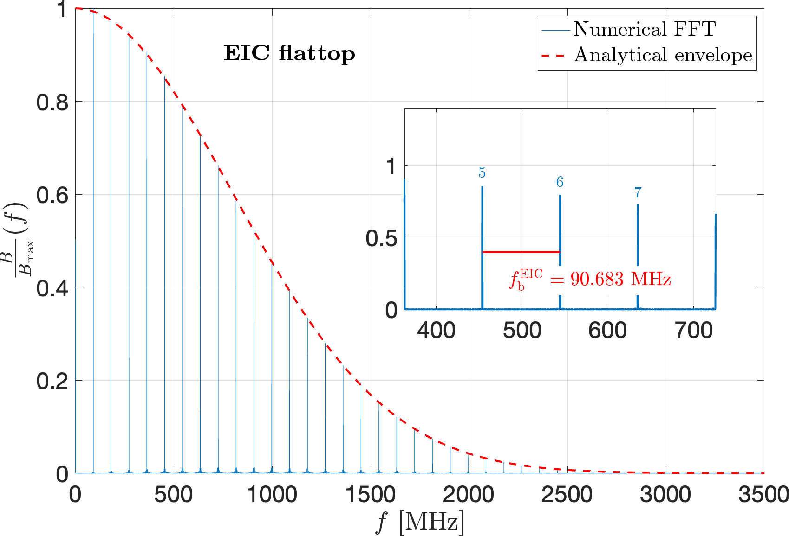
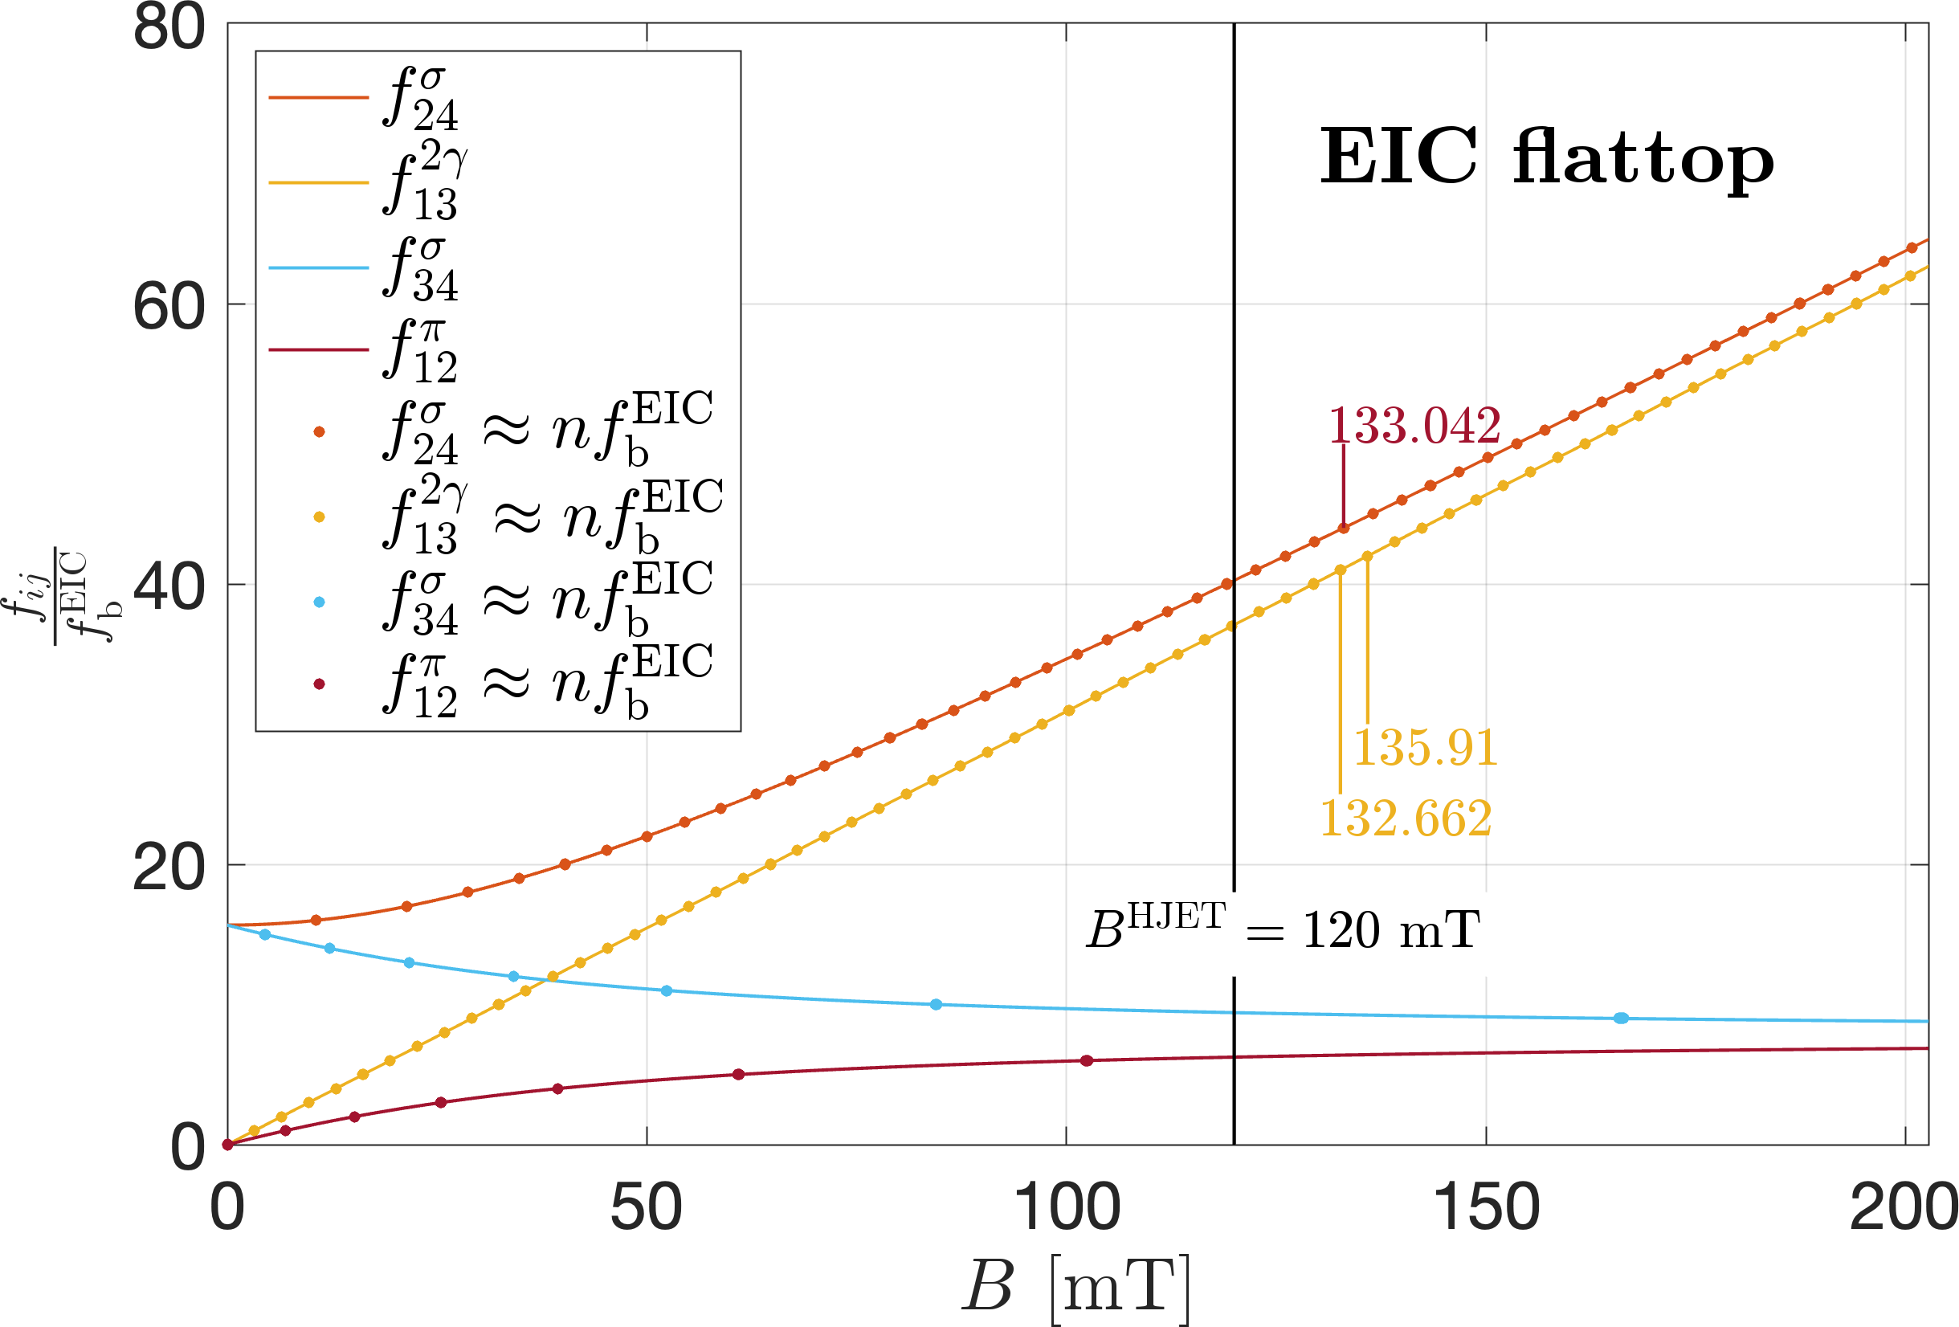
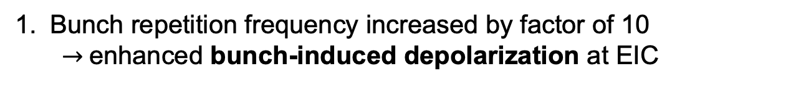
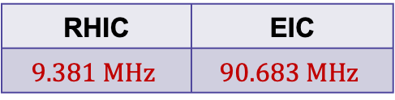
HJET at EIC: bunch field depolarization
Bunch repetition frequency increased by factor of 10
$→$enhanced bunch-induced depolarization at EIC
RHIC | EIC
$$9.381 MHz$$ | $$90.683 MHz$$
No operation like that at EIC
ok
Depolarization analysis for HJET show that we need to to avoid low harmonic numbers

Slide 21
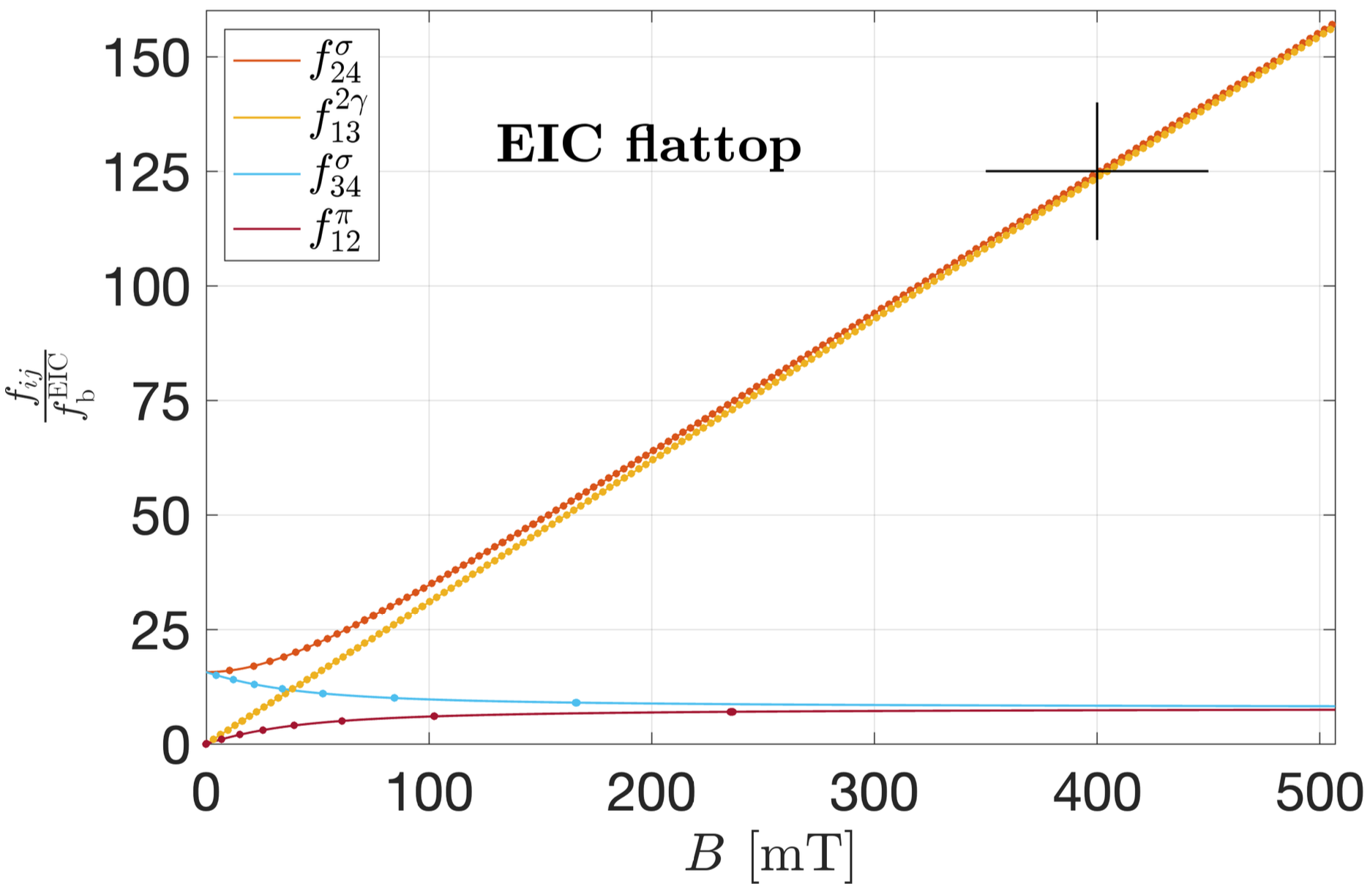
HJET at EIC: mitigation
Avoid bunch-induced depolarization by HJET operation at $B≈400 mT$
Operate
HJET here

Slide 22
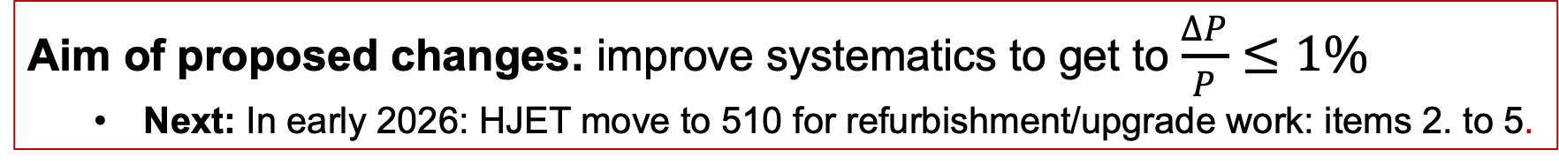
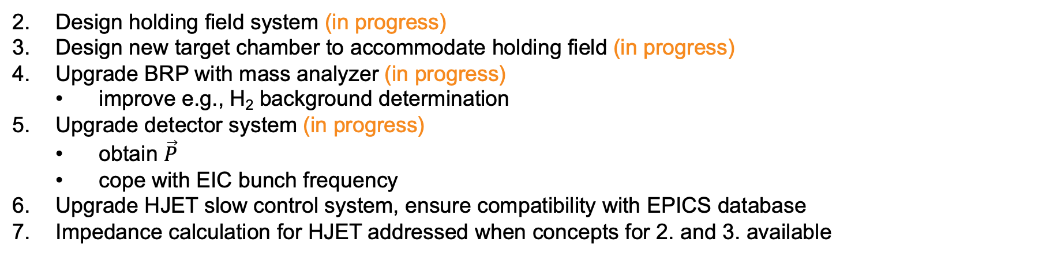
HJET at EIC: planned modifications
Design holding field system (in progress)
Design new target chamber to accommodate holding field (in progress)
Upgrade BRP with mass analyzer (in progress)
improve e.g., H₂ background determination
Upgrade detector system (in progress)
obtain $\vec{P}$
cope with EIC bunch frequency
Upgrade HJET slow control system, ensure compatibility with EPICS database
Impedance calculation for HJET addressed when concepts for 2. and 3. available
Aim of proposed changes: improve systematics to get to $\frac{∆P}{P}≤1\%$
Next: In early 2026: HJET move to 510 for refurbishment/upgrade work: items 2. to 5.

Slide 23
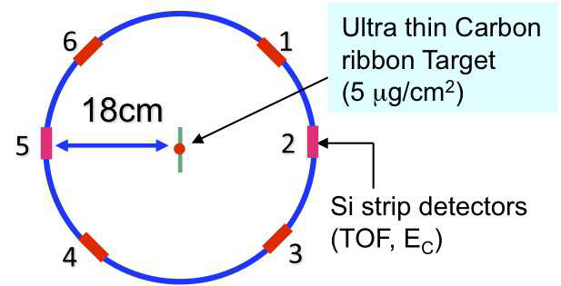
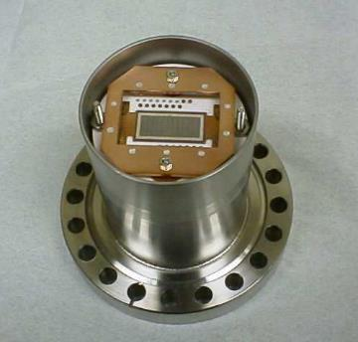
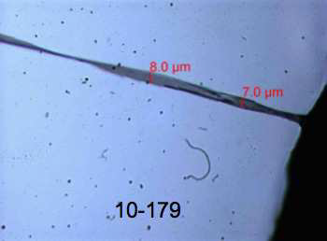
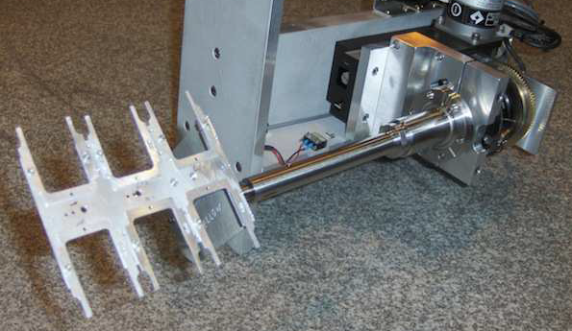
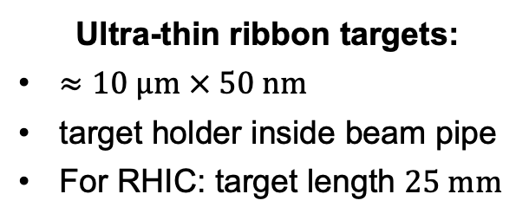
C fiber target polarimeter: present system
Ultra-thin ribbon targets:
$≈10 μm × 50 nm$
target holder inside beam pipe
For RHIC: target length $25 mm$

Slide 24
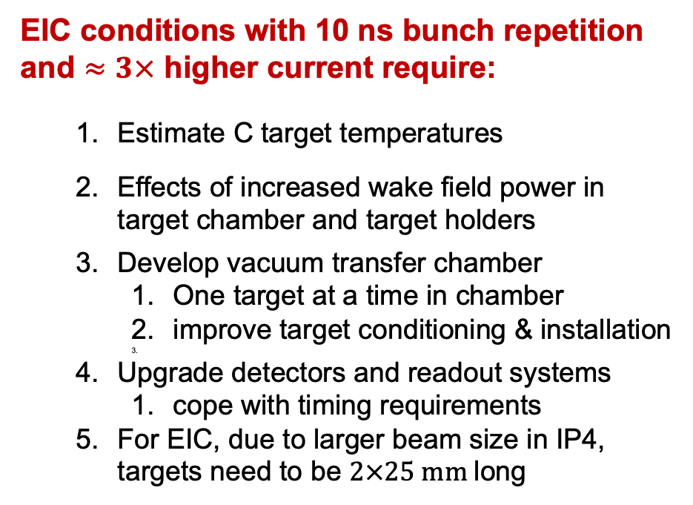
C fiber target polarimeter: upgrades for EIC
EIC conditions with 10 ns bunch repetition and $≈3×$ higher current require:
Estimate C target temperatures
Effects of increased wake field power in target chamber and target holders
Develop vacuum transfer chamber
One target at a time in chamber
improve target conditioning & installation
Upgrade detectors and readout systems
cope with timing requirements
For EIC, due to larger beam size in IP4, targets need to be $2×25 mm$long
pC target chambers will be moved to 510 for refurbishment and upgrades in early 2026

Slide 25
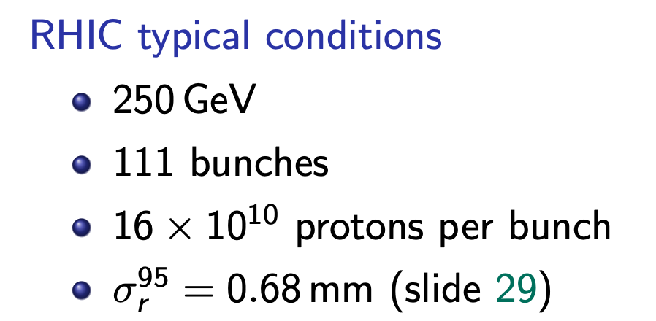
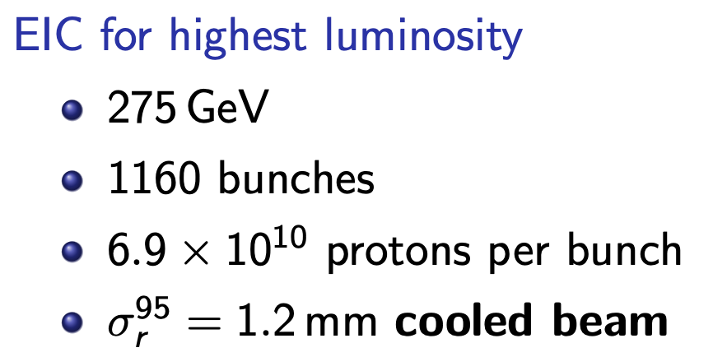
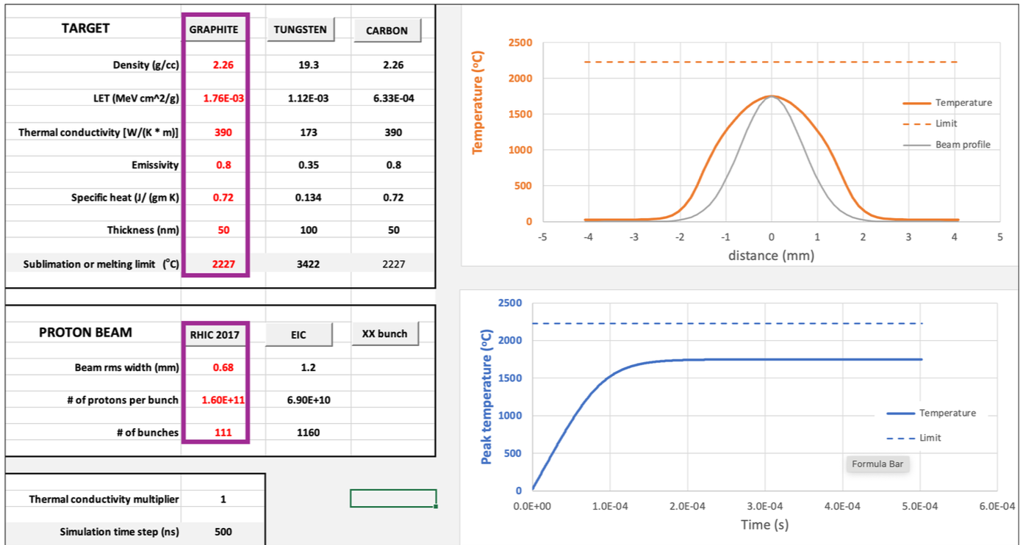
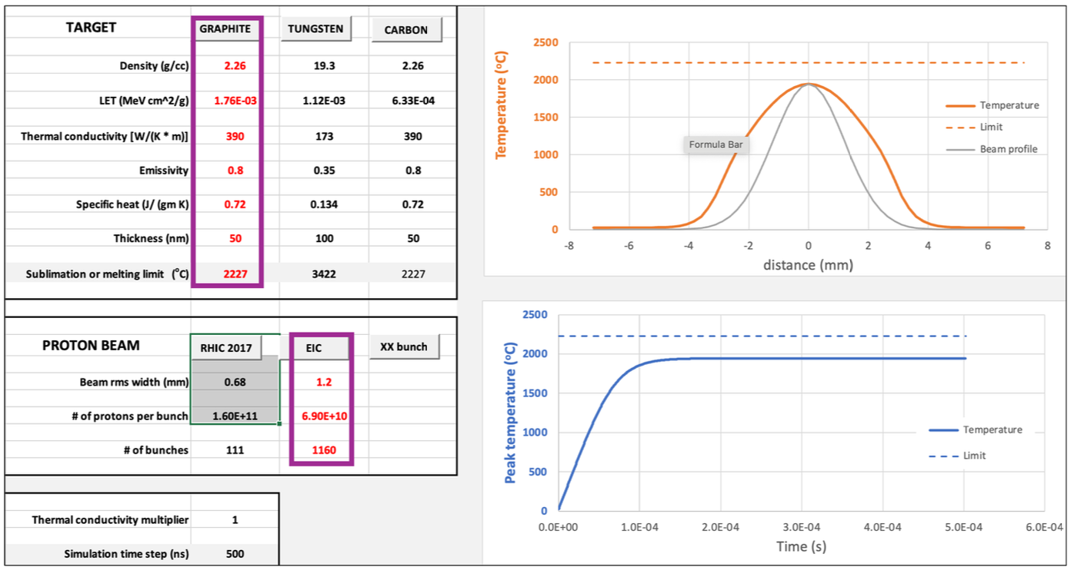

C fiber target polarimeter: target heating
Target heating (code by Peter Thieberger)
With realistic beam sizes, target heating about same at RHIC and EIC
$→$ changed ID #128 in Risk Registry to low
Independent modeling approach of C target heating by proton beams (in progress)

Slide 26
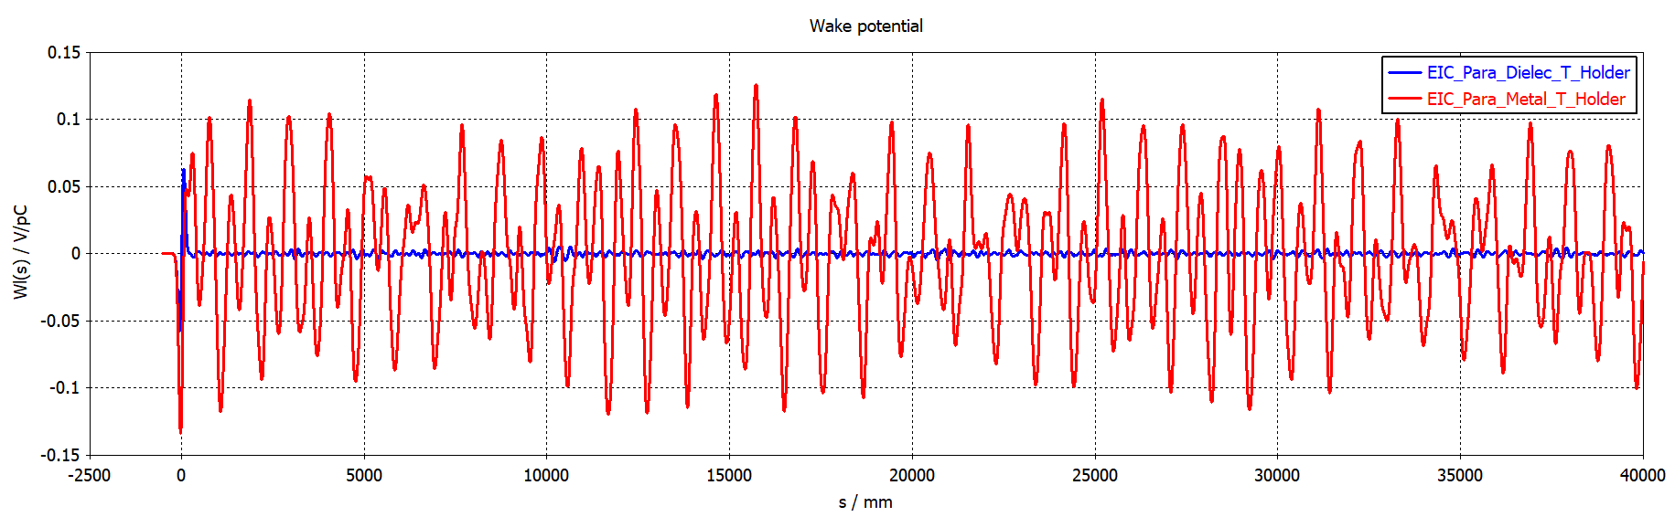
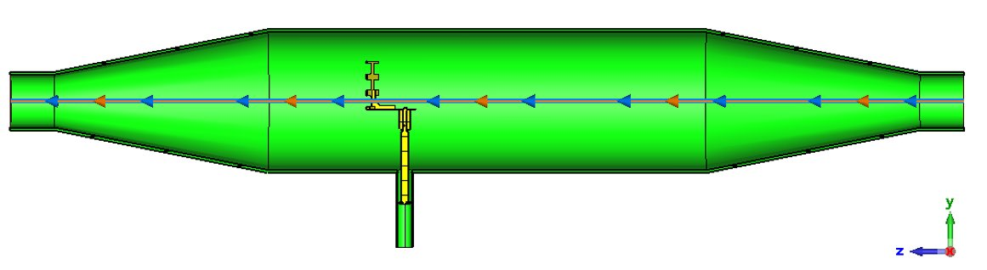
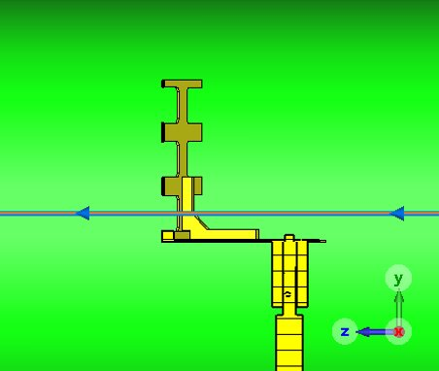
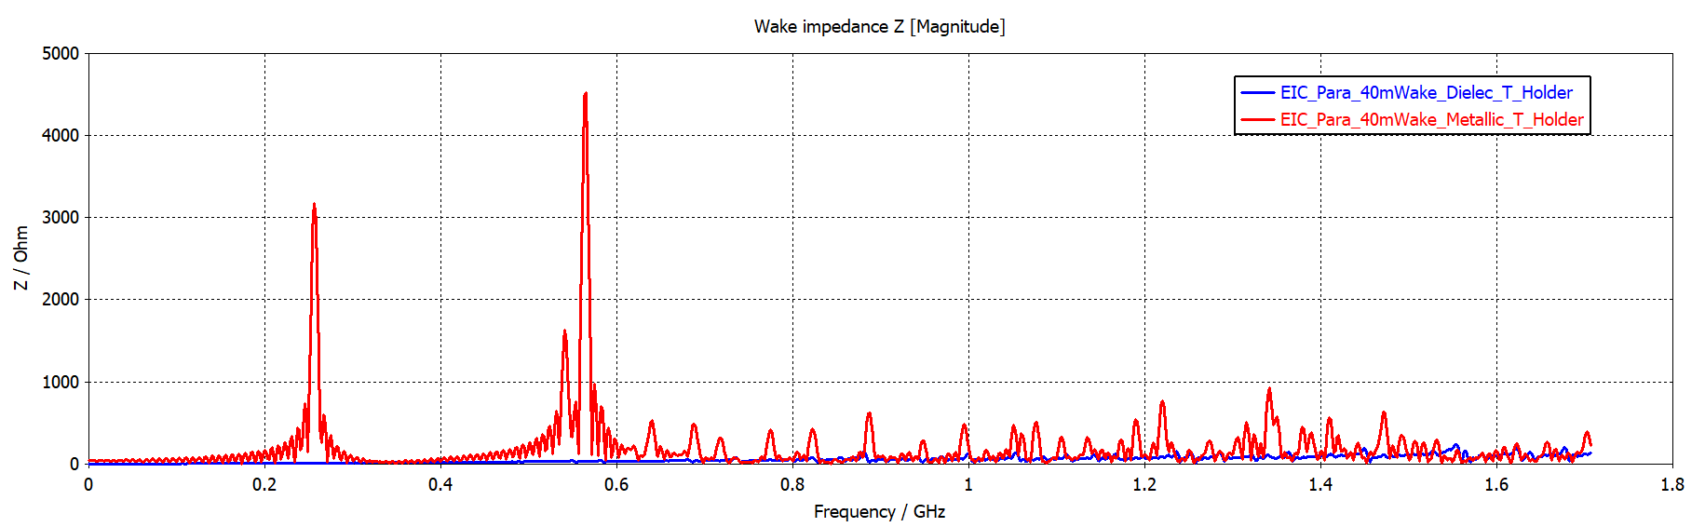
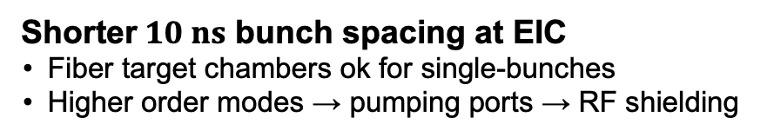
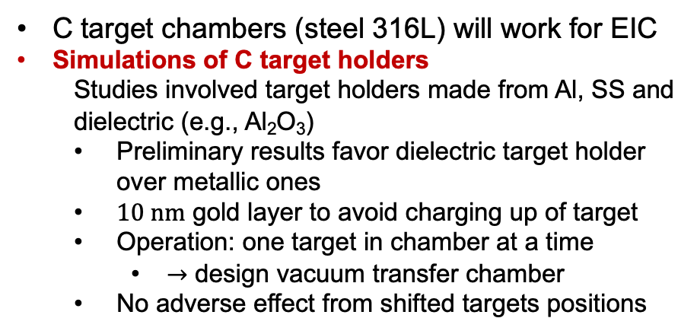
C fiber target polarimeter: impedance calculations I
Shorter$10 ns$ bunch spacing at EIC
Fiber target chambers ok for single-bunches
Higher order modes → pumping ports → RF shielding
Fresh results from Medani Sangroula (CAD)
Wake field potential
C target chambers (steel 316L) will work for EIC
Simulations of C target holders
Studies involved target holders made from Al, SS and dielectric (e.g., Al₂O₃)
Preliminary results favor dielectric target holder over metallic ones
$10 nm$ gold layer to avoid charging up of target
Operation: one target in chamber at a time
$→$ design vacuum transfer chamber
No adverse effect from shifted targets positions
Wake impedance
Improved performance of machine when dielectric target holder will be used

Slide 27
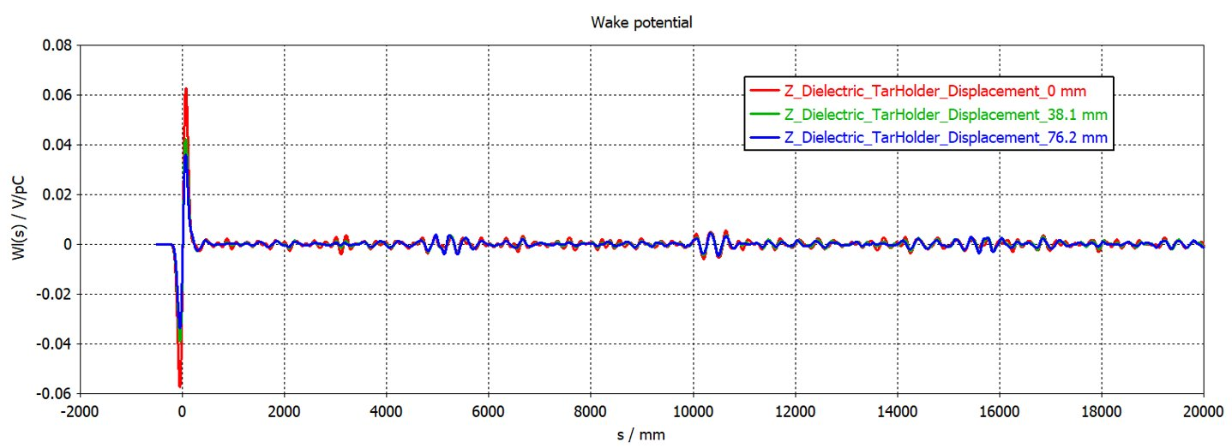
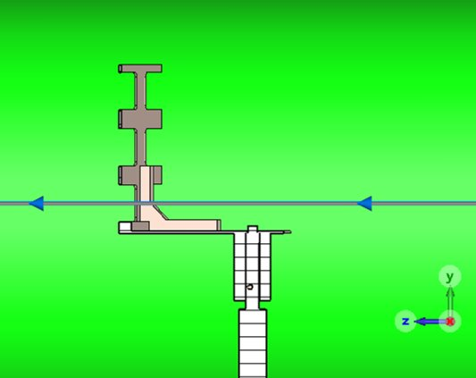


C fiber target polarimeter: impedance calculations II
Shifted dielectric target positions:
Like RHIC, EIC will use multiple targets on same target holders
Wake field potential
Wakefield amplitude decrease with target holder shifted down
Similar behavior when different C targets are inserted into beam from same target holder

Slide 28



New development: ³He atomic beam
Provide absolute polarization measurement for ${3\vec{\text{He}}}^{++}$ beams
MIT development for nEDM exp’t at Oakridge (discontinued) (P. T MohanMurthy, J. Kelsey, J. Dodge, R. Redwine, R. Milner, P. Binns, B. O’Rourke)
High flux device with beam at 1 K
$≥{10}^{14}\frac{atoms}{s}→d_{t}≥{10}^{13} \frac{atoms}{{cm}^{2}}$
ideal for absolute ³He⁺⁺ polarimetry at EIC
³He beam polarimetry will be needed a few years after initial EIC commissioning

Slide 29

Hadron polarimetry overview: Layout at IP4
Choice of location driven by required drift space
Carbon and polarized H and ³He targets all located in one place
minimize spin rotations between polarimeters
Enables efficient use of common infrastructure
Triplet (Q3)
CNI
3He Jet
HJet
2X Warm D0
Longit SC Pickup
4X Horiz SC Kicker
4X Vert SC Kicker
HJet Tagger Drift /
Tagging System
Q4
Ion Pump
HSR
7.5 m
E. Link
5/16/2025

Slide 30

Polarimeter Schedule
Final Design Review
Final commissioning
Polarimeters ready for beam development (L2_0600 Construction of Components Complete)
2nd PDR
Construction
Installation
Final RHIC operations

Slide 31



Polarimeter systematics: previous experiments
Electron polarimetry: systematic uncertainties from previous Compton polarimeters
Longitudinal:
LPOL @ HERA (collider): $\left({σ_{P}}/P\right)<1.2 \%$ $→$ Photon detector in multi-photon mode
Q-Weak in Hall C @ JLab (fixed target): $\left({σ_{P}}/P\right)<0.59 \%$ $→$ Electron detector, counting mode
CREX in Hall A @ JLab (fixed target): $\left({σ_{P}}/P\right)<0.36 \%$ $→$ Photon detector, integrating mode
Transverse:
TPOL @ HERA (collider): $\left({σ_{P}}/P\right)<1.87 \%$ $→$ Photon detector in counting mode
EIC Compton polarimeter designs make use of lessons learned from these devices
Hadron polarimeters
Transverse:
Systematic error for RHIC proton beam polarization ($P_{y}$) in run 17
SSA:$\left({σ_{P}}/P\right)≅1.3 \%$, DSA:$\left({σ_{P}}/P\right)≅2.4 \%$
Longitudinal
$P_{z}$ is at present not directly accessible at RHIC
Goal of $\left({σ_{P}}/P\right)≈1\%$ not needed on day 1
Systematics of absolute polarimetry during first years of operation will benefit from upgrades (slides 22 & 24)

Slide 32

Tasks for CD-2 readiness: hadron polarimeters
Hadron polarimeters
Accelerator integration of hadron polarimetry available
HJET modifications
to be integrated: target chamber with holding field, QMA for BRP, detector system
Present RHIC pC polarimeter system applicable at EIC
Temperature estimates of C ribbon targets with updated EIC beam sizes $→$ at IP4, targets will hold
corresponding estimates for targets at IP6 to be done
Wakefield calculations indicate use of dielectric target holders
Redesign of existing chamber to accommodate vacuum loading system for targets
New ³He atomic beam target development is in progress and aligned with EIC ramp up & commissioning
Readout/detector choice for C, HJET, and 3He polarimeter required
Will have 2nd Preliminary Design Review at the end of 2025

Slide 33
Summary
Basic polarimetry methods and detector technologies established
Design progressing towards CD-2 in FY26 and CD-3 in FY27
Demands at EIC significantly higher than at previous facilities
designs in place to meet demands
Future modifications beyond EIC baseline not precluded with current designs
All polarimeters shall be ready for operation at start of polarized beam commissioning
Primary purpose of RCS polarimeter is beam development
All other polarimeters will be used for beam development in addition to later monitoring

Slide 34
Backup

Slide 35

Scope Definition

Slide 36
ESH and QA
Electron polarimeters:
ESH: Compton polarimeter laser safety systems will use common approach with other EIC laser systems (i.e., detector gain monitoring , etc.)
Requirements:
Interlocked laser room outside accelerator tunnel
Interlocked laser enclosures where laser interacts with electron beam
Needs have been identified in dependency review
QA: Compton laser and detector components will be tested at JLab before installation at EIC
Laser → seed laser, amplifiers, fiber, reflective window
Diamond detectors → tests of detectors and FLAT32 with cosmics and radioactive sources
Photon calorimeters → tests with cosmics and sources. Tests in JLab polarimeters possible depending on beam schedule
Hadron polarimeters:
After 20 years of operating experience with pC and HJET polarimeters at RHIC, ESH and QA related issues have been ironed out.

Slide 37

Polarimetry design: status review
Committee:
Dipangkar Dutta (Mississippi State University)
Jenny List (DESY)
Paolo Lenisa (Ferrara University)
Frank Rathmann (FZ Jülich)
Review: January 17-18, 2023
Summary of Recommendations
Electron Polarimetry
Develop alternative detector concept based on silicon
Detailed simulations including all backgrounds and shielding
Explore transverse polarization measurements using synchrotron radiation
More detailed detector requirements for RCS polarimeter
Hadron Polarimetry
Target gas analyzer should be used to determine molecular fraction in the HJet
Explore using thinner Si detectors in both HJet and pC polarimeters to veto punch through events
In addition to exploring new target materials for pC polarimeter, explore larger beam size
Obtain beam time with AGS pC polarimeter to test detectors
Theoretical assessment of $A_{y}$ in ³He-³He elastic
Further ³He studies during remaining RHIC runs
Closed
On-going/scheduled

Slide 38
additional material
Electron polarimeter

Slide 39
Synchrotron Backgrounds in ESR Compton
18 GeV
Simulations by Zhengqiao Zhang (Synrad+ and Geant4)
Weak dipoles
Strong dipoles
Synchrotron radiation from strong dipoles (D6EF, D3EF) too large – thick shield needed for photon detector
→ Weak dipoles with small bend will re-direct synchrotron flux from strong dipoles to be outside photon detector acceptance

Slide 40

ESR Beamline Design
New beamline design with 2 weak and 2 strong dipoles mitigates synchrotron radiation → only need collimator plus $\sim 1 mm$W shield
Crab cavity
Photon detector
Electron detector
Weak dipoles
*
θ_{B}=1.5 mr
θ_{B}=1.5 mr
Laser IP​
Electron detector outside vacuum pipe → RF shield used to mitigate beam impedance issues

Slide 41
Electron Detector Size and Segmentation
Electron detector (horizontal) size determined by spectrum at 18 GeV (spectrum has largest horizontal spread)
Need to capture zero-crossing to endpoint → detector should cover at least 60 mm
Segmentation dictated by spectrum at 5 GeV (smallest spread)
Scales ~ energy → 17 mm
Need at least 30 bins, so a strip pitch of about 550 μm would be sufficient
At 18 GeV, zero-crossing about 3 cm from beam
5 GeV → 8-10 mm – this might be challenging
Ciprian Gal
Beam position
Asymmetry at electron detector @18 GeV

Slide 42
RCS Compton Rates Rate and measurement time estimates
Average analyzing power:
→ Average value of asymmetry over acceptance
Energy-weighted:
→ Energy deposited in detector for each helicity state
Differential:
→ Measurement of asymmetry bin-by-bin vs. energy, etc.
Assuming 80% polarization, <P_{laser}>= 6mW, 300 μm beam spot size…, → time for 1% measurement
E_{beam} | A_{avg} | T_{avg} | A_{energy} | T_{energy} | A_{diff} | T_{diff}
5 | 4.51% | 243 s | 5.78% | 148 s | 5.48% | 164 s
10 | 7.79% | 92 s | 10.15% | 54 s | 9.56% | 61 s
18 | 11.29% | 51 s | 14.91% | 29 s | 13.96% | 33 s

Slide 43
additional material
Hadron polarimeters

Slide 44




Polarized Atomic Hydrogen Jet Target
Dissociator
Set of eight $Si$ strip detectors
12 vertical strips
$3.75 \text{mm}$ pitch
$500 \text{μ}\text{m}$ thick
Holding field
Detectors
beam

Slide 45

Coulomb-Nuclear interference I

Slide 46

Coulomb-Nuclear interference II

Slide 47










Hadron Polarimetry R&D
(Part of WBS 6.02.03 Accelerator R&D)
$3He→pd$break-up
Tagging with hadron calorimeters
ZDC’s installed downstream of HJET (behind DX)
Operational in RHIC Run 23 (𝐴𝑢+𝐴𝑢)
Neutron peak calibration needed
Deflection angle $Z/A$
$$p:e/m=1$$
$$\int{B\text{d}l}$$
$$h:e/m=2/3$$
$$d:e/m=1/2$$
$$h$$
target
$$n:e/m=0$$
During RHIC Run 24
${3He}^{++}$ beam from EBIS source ready
Successful APEX 100 GeV in July/August 2024
Installation at IP12
3 modules between beam pipes
nA, nB, nC
1 module outside beam pipes
pC
All modules operational
DX

Slide 48



Simulation of ³He-³He tagger in IP4
Two warm dipoles behind polarimeter targets
Drift region includes stochastic kicker tanks
Simulations by Zhengqiao Zhang
40 m
DMP jet model to simulate $hh$ fixed target collisions
Four types of events:
All ³He break up
Breakup of ³He target
Breakup of ³He beam
All ³He stay intact
Tag events where ³He beam breaks up, as detectors identify 3He recoil
1
2
3
4

Slide 49





Hadron Polarimeter R&D
(Part of WBS 6.02.03 Accelerator R&D)
Second detector layer installed in pC polarimeter
Included in DAQ since start of Run22 operations
Data from RHIC Run 22
Hybrid simulation
PYTHIA & GEANT
Repeated with 10 ns bunch spacing
Veto punch through particles
TOF vs. $E_{kin}$ in layer 1 (F)
with a match in second layer (R)
Proton time-of-flight

