Slide 1
Accelerator and Detector Commissioning Plan
E.C. Aschenauer (BNL)
Co-Associate Director for the Experimental Program
L3 Control Account Manager for Detector Commissioning and Pre-Ops
10th EIC DAC Review
June 11th – 13th, 2025

Slide 2
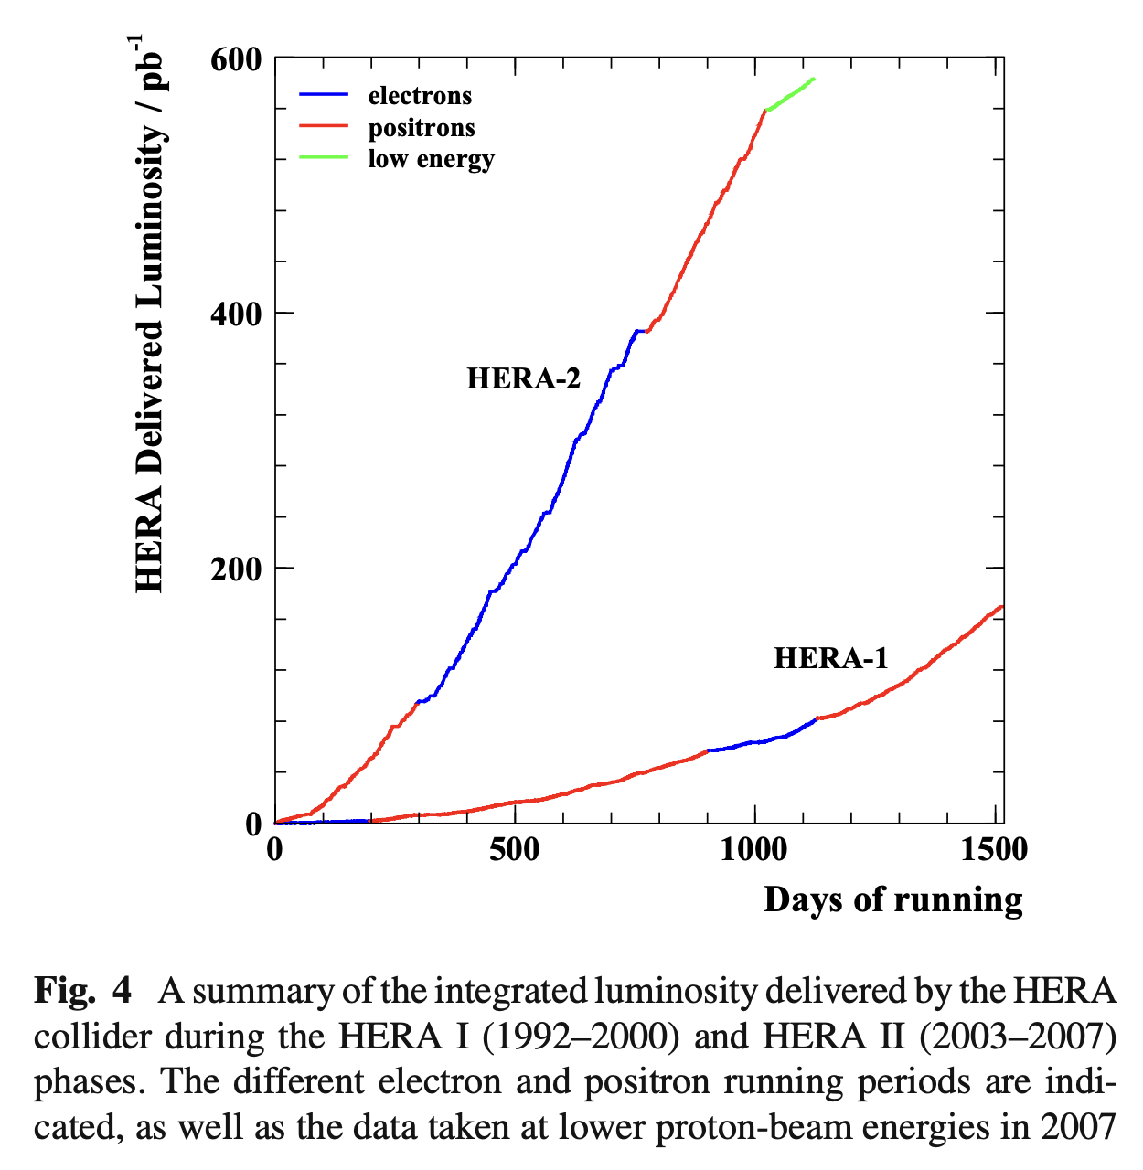
Lessons from HERA @ DESY
Commissioning is the process of bringing an accelerator and its components from installation to full operational readiness, including verifying functionality, optimizing performance, and ensuring stable, high-quality beam delivery for experiments.
HERA-1 (1992–2000): Achieved first ep collisions in 1992; commissioning focused on stable beam operations, synchronization of electron and proton rings, and optimizing the interaction region for initial physics runs.
HERA-2 (2003–2007): Major upgrade to boost luminosity and add electron polarization; commissioning faced significant challenges from increased detector backgrounds, synchrotron radiation, and beam-gas interactions, limiting performance gains.
Took several months post-installation to re-establish stable operations.
Electron beam polarization never reached HERA-1 levels
Key Lessons: Importance of early background simulations, careful polarization control, and vacuum quality in high-luminosity, high-precision colliders.
https://link.springer.com/article/10.1140/epjc/s10052-016-4152-3

Slide 3
Ramping up EIC performance

Slide 4
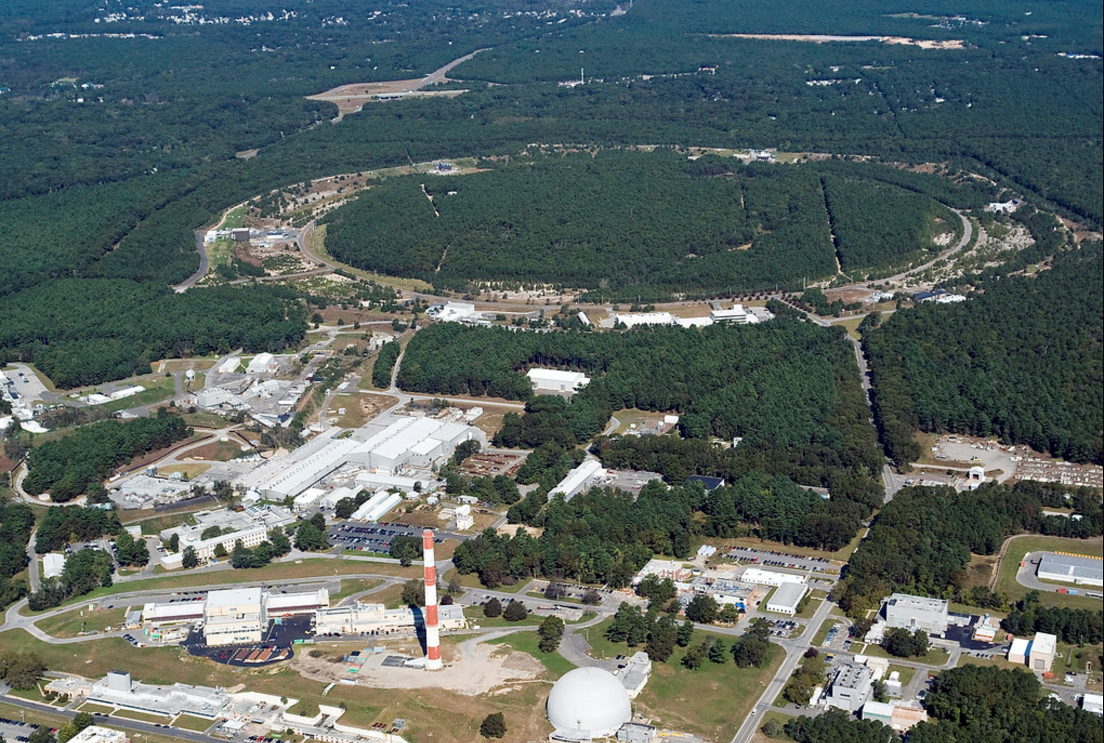

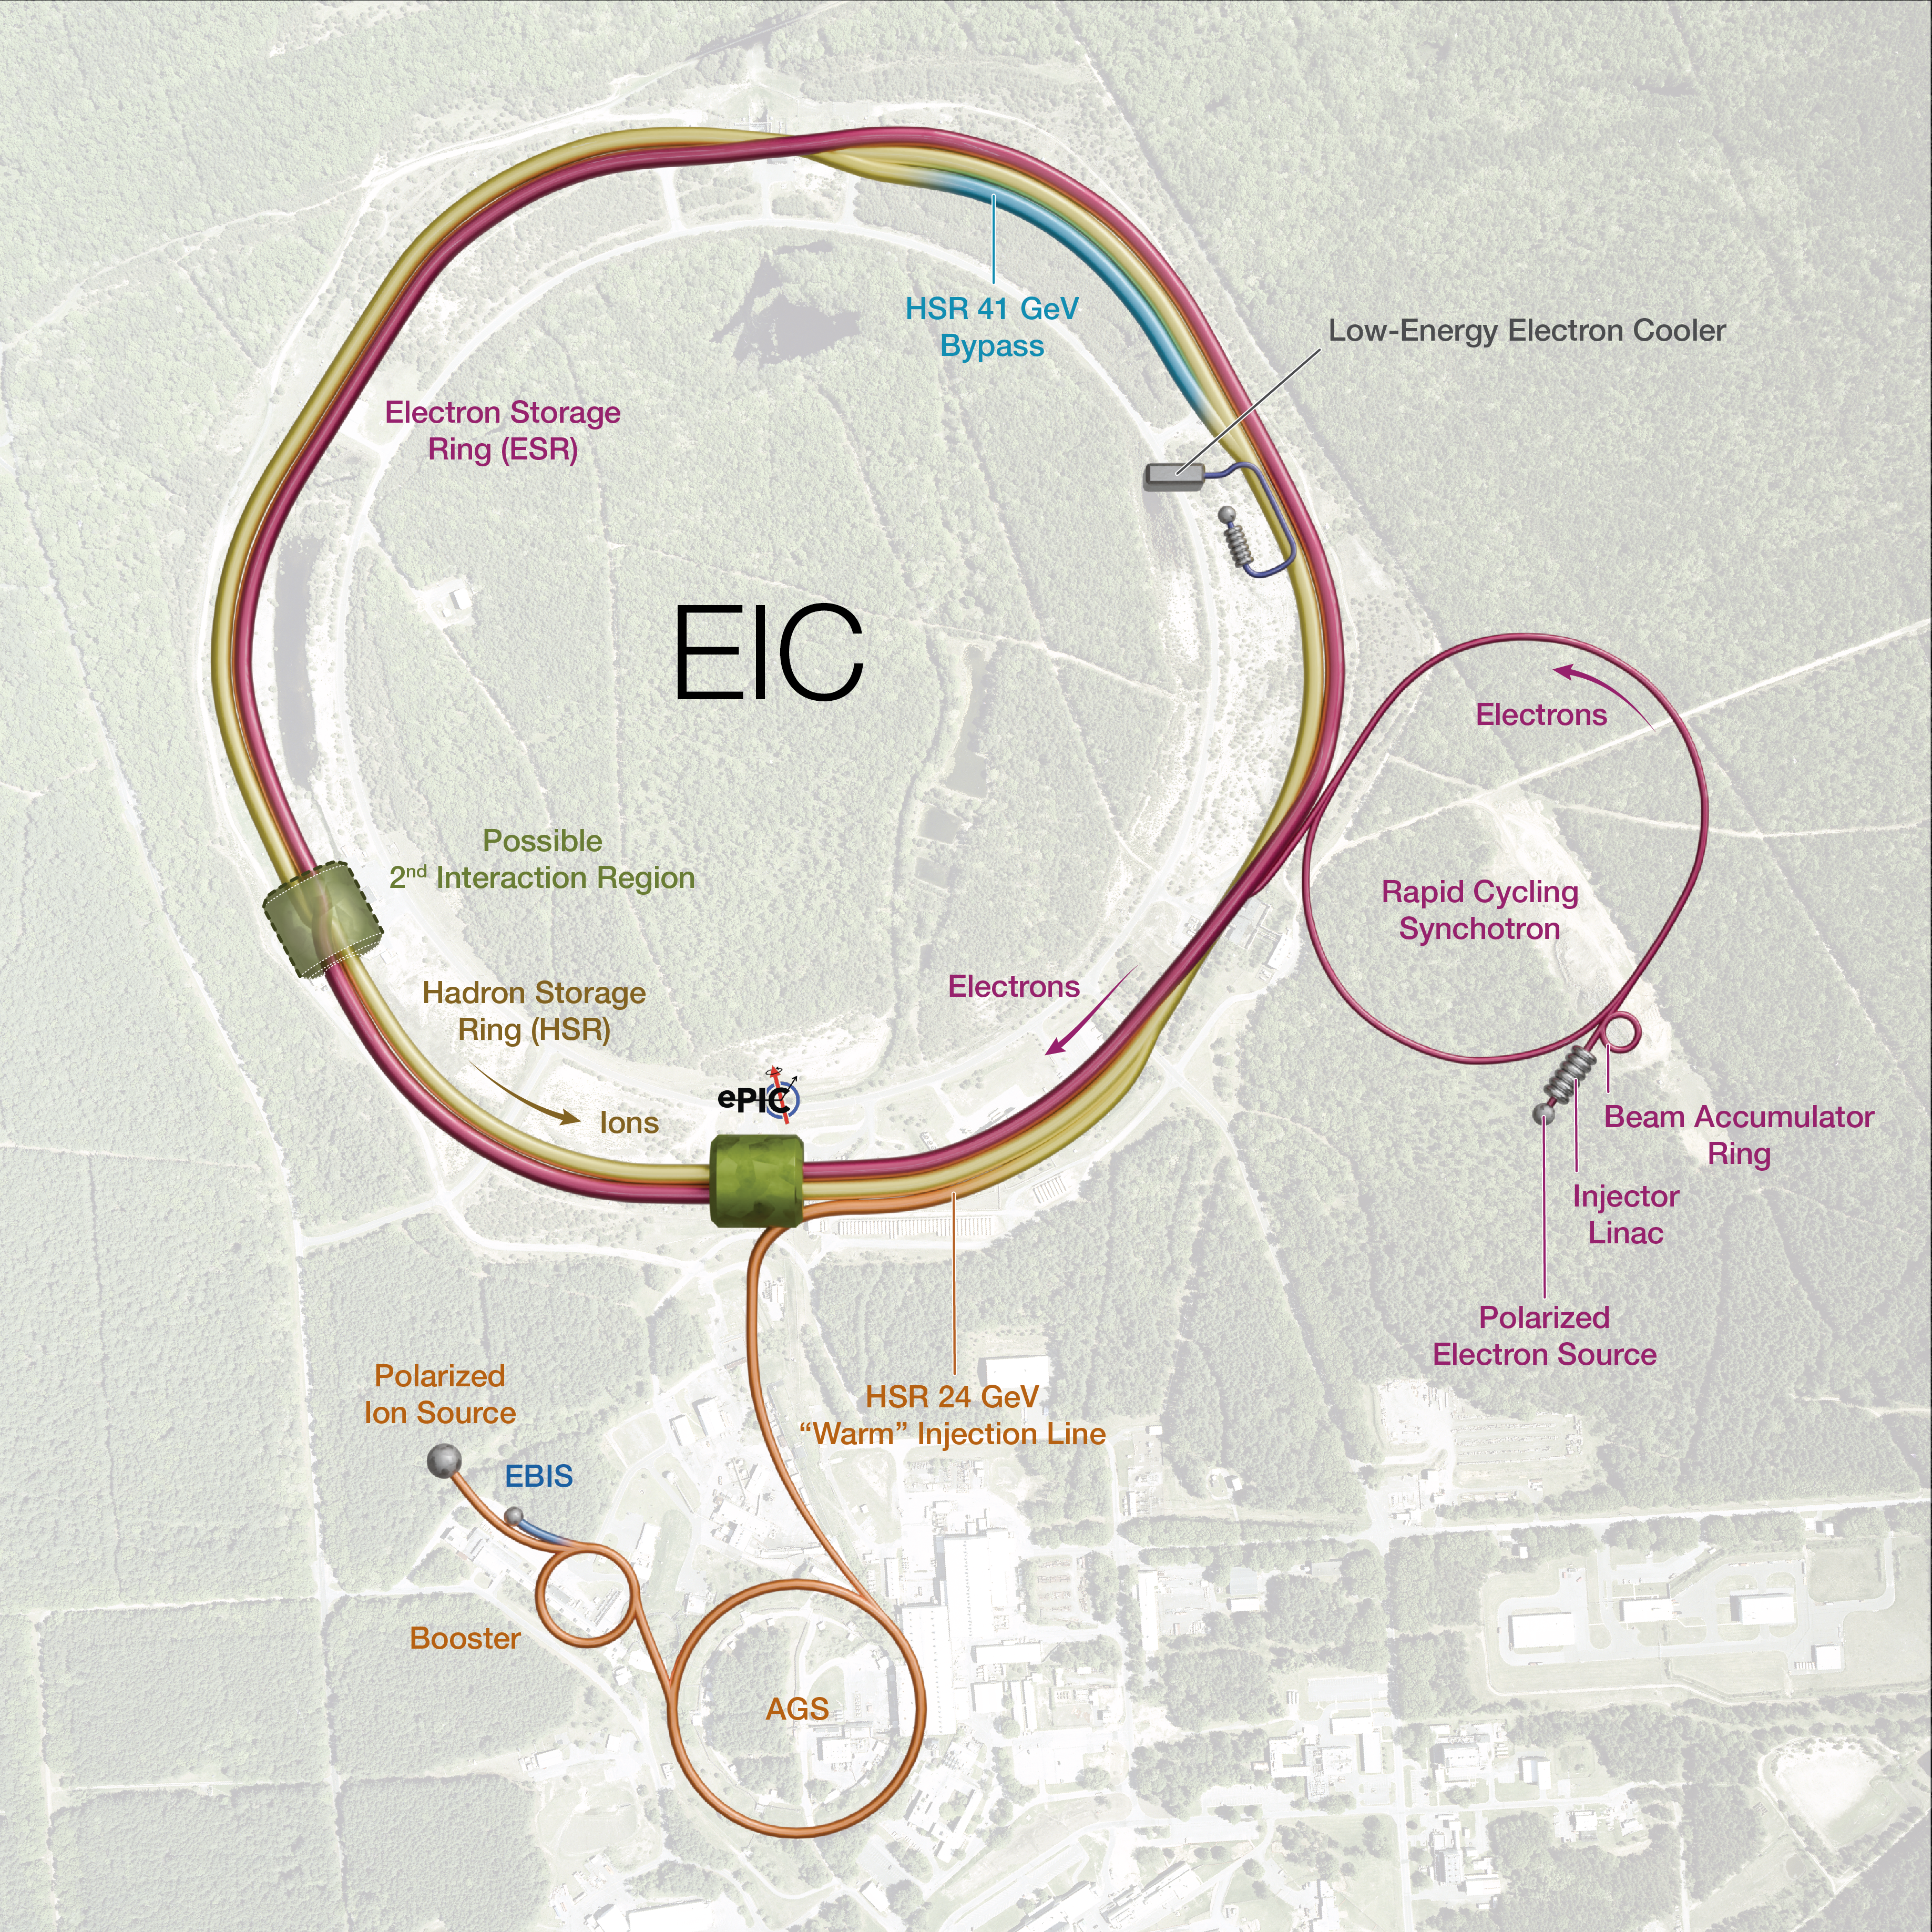

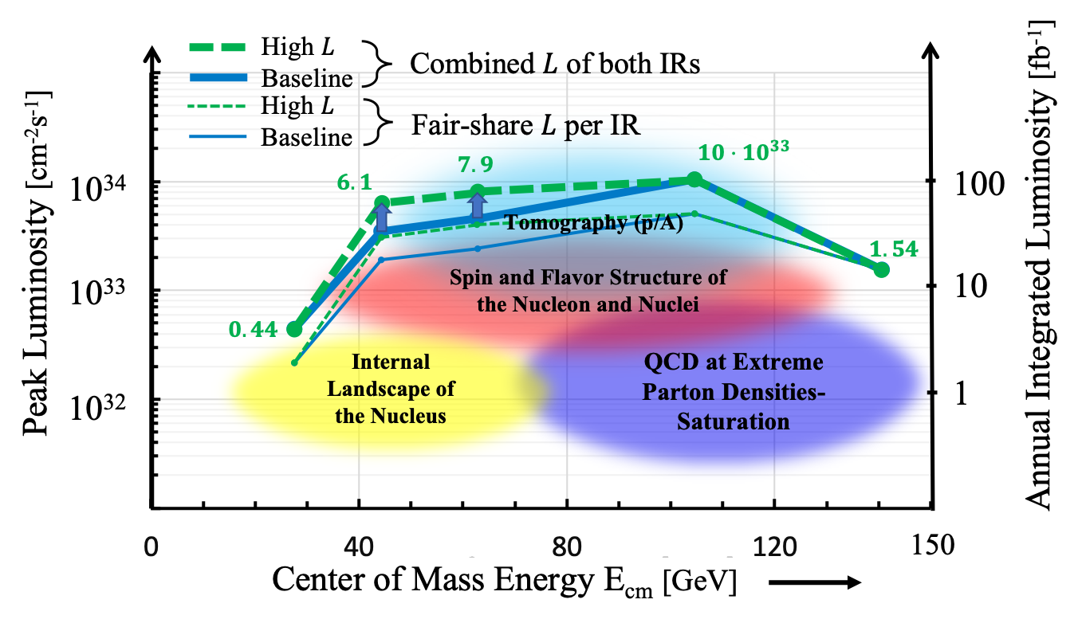
EIC Design Overview
Hadron Storage Ring (RHIC Rings) 40, 100-275 GeV
Based on existing, well maintained, well performing RHIC
Superconducting magnets (existing)
1160 bunches, 1A beam current (3x RHIC)
Bright vertical beam emittance 1.5 nm (“flat beams”)
Cooling at injection and later upgrade → high energy cooler
Electron Storage Ring 5–18 GeV
Large beam current, 2.5 A, 9 MW S.R. power, S.C. RF
Need to inject polarized bunches
Swap-out injection for electron bunches (at 1 Hz) to maintain high polarization
High current, highly polarized (88%) electron source
Electron Pre-Injector (750 MeV linac)
Electron Rapid Cycling Synchrotron, 1Hz, 0.75 -> 18 GeV
Spin transparent due to high quasi-periodicity
High luminosity Interaction Region(s)
Large bore superconducting final focusing magnets
25 mrad crossing angle with crab cavities
Spin Rotators (longitudinal spin)
Forward hadron instrumentation
Bunch Crossing ~ 10.2 ns/98.5 MHz
RHIC
RHIC

Slide 5
Project Delivery Strategy
Project Delivery Strategy: Deliver the full EIC facility scope as part of the line-item construction project using subprojects and the phased completion of the EIC project scope. The strategy enables the start of the EIC science program during collider commissioning and for the concurrent completion of the full capability required to meet the DOE Mission Need.
Global Project Integrated Support, CD-3A, CD-3B, Commissioning …. (L. Lari)
 | NYS Infrastructure Project (C. Folz)
First SP |  | Accelerator Storage Rings – Infras., HSR, ESR, Installation (C. Folz, SPM)
 |  |  | Detector, Integration, Install (R. Ent and E. Aschenauer, POCs)
 |  |  | IR SC Magnets, Crab Cavities, Integration, Install (S. Nagaitsev, POC)
 |  |  | Electron Injector – Infras., LINAC, RCS, Install (Q. Wu, POC)
 |  |  | Start of Science Program
Last SP |  |  |  |  |  |  |  | Project Full Capability (K. Wilson, POC)

Slide 6
Accelerator at Day One and at full Capability
EIC commissioning and Ramp Up​
Full EIC Capabilities
RCS:
7nC / bunch Add an accumulation ring to reach 28 nC / bunch
5 – 10 GeV polarized e- and add RF to accelerate to 18 GeV electrons
ESR:
7nC / bunch Add more RF cavities to operate at 18 GeV electrons
5 – 10 GeV polarized e- and with 28 nC / bunch
Add 394 MHz crab cavities for full luminosity capabilities
HSR:
100 – 250 GeV polarized p Update PS to reach 275 GeV protons and 110 GeV/u
100 GeV/u nuclear beams nuclei
cooling at injection energy Add 41 GeV bypass to get full beam energy capabilities
Add 394 MHz crab cavities for full luminosity capabilities
Proposal for initial years of science during EIC commissioning and ramp up, is driven by​
Start of the promised NSAC/NAS science program
Alignment with expected order in commissioning the collider and ramp up of performance that comes with gain of operational experience
Having access to new physics results early to get high impact publications, i.e. PRLs, ……

Slide 7
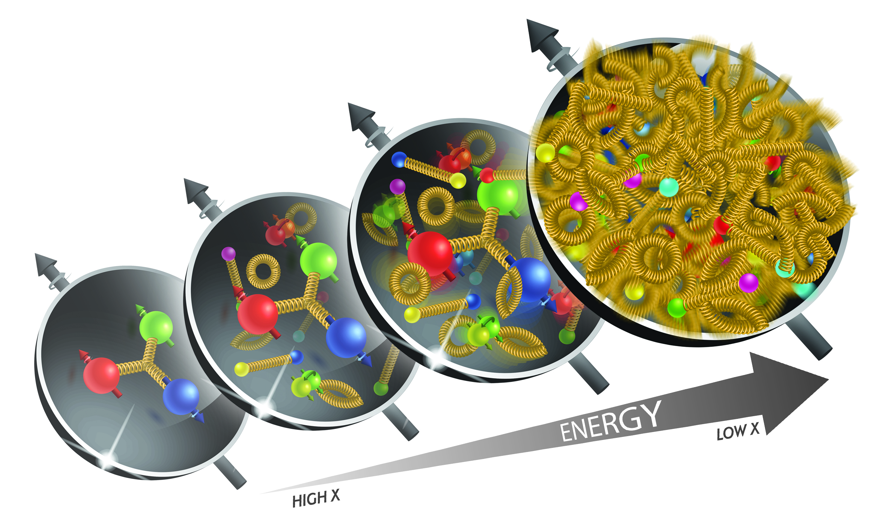
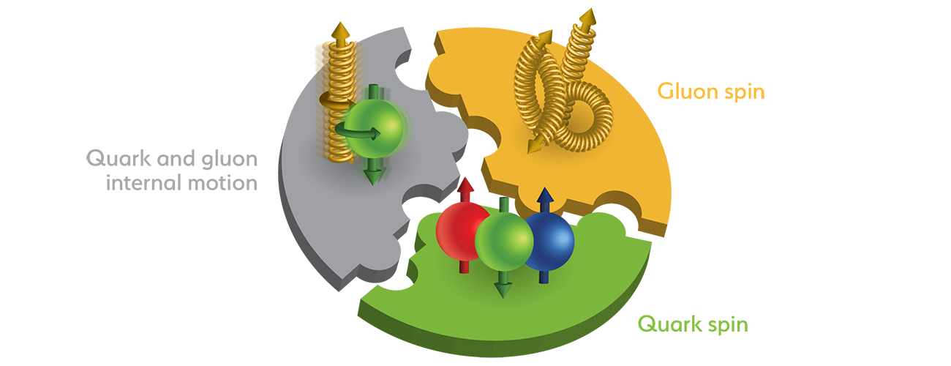
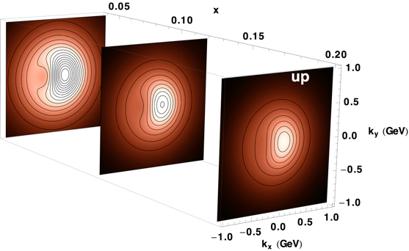
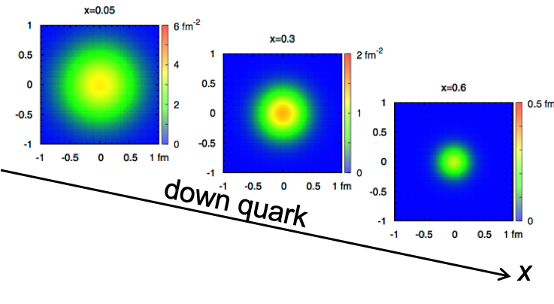
Accelerator Performance for NAS Science
science program during
EIC commissioning
and ramp up​
Full EIC capabilities
map the out nucleon and nuclei structure from high to low x
span center-of-mass energy √s: 45 – 100 GeV
wide center-of-mass energy: √s: 30 – 140 GeV
access to spin structure of nucleons and nuclei
Spin vehicle to access the spatial and momentum structure of the nucleon in 3d
quark – gluon structure of light nuclei
polarized electron and hadron (p, He-3) beams
accessing the highest gluon densities → saturation
How quarks and gluons interact with a nuclear medium
nuclear beams: d to Pb at √s: 45 – 63 GeV
nuclear beams: d to Pb at √s: 30 – 90 GeV → access to highest & lowest x
mapping the spatial and momentum structure of nucleons and nuclei in 3d
high luminosity ≤10³³ cm⁻²s⁻¹
large acceptance in p_{T} (0.2 – 1.3 GeV) through forward focusing IR magnets
access to rare probes, i.e. Ws and BSM Physics
precision mapping the spatial and momentum structure of nucleons and nuclei in 3d
high luminosity: > 10³³ cm⁻²s⁻¹
gluon emission
gluon recombination
?
=

Slide 8
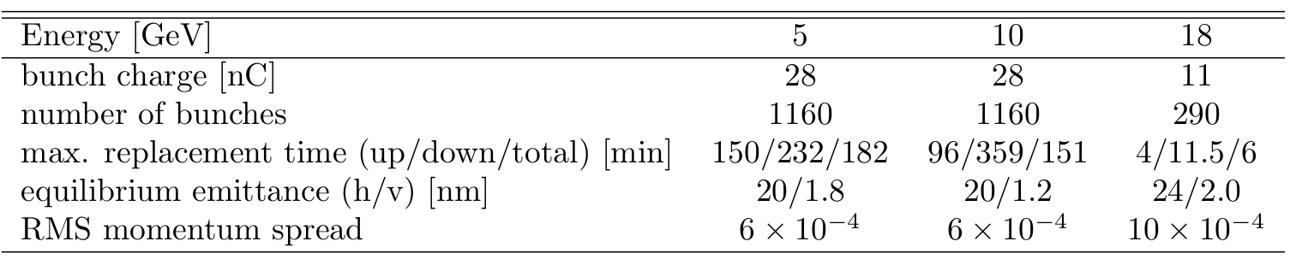
What do we need to commission
RCS (Rapid Cycling Synchrotron – aka the electron injector):
operate the RCS
get polarization in the RCS
swap out of electron bunches in the ESR
ESR (Electron Storage Ring):
operating with spin rotator to get longitudinal polarization
swap out of electron bunches to preserve polarization, needed because Sokolov Ternov depolarizes ”up” spin direction
HSR (Hadron Storage Ring):
operating beams off center
transverse and longitudinal beam polarization (needs spin rotator) for protons and He-3
pre-cooling of hadron beams
operating with crab cavities
Maximum replacement times (= max. allowable storage times in ESR) are based
on 85% injected polarization and 70% time averaged polarization

Slide 9

ePIC Setup at EIC Start Up
→ Initial commissioning of collider rings is with instrumented beam pipe only.
→ Subsequently, the ePIC detector rolls in for pre-ops with detector. Goal:
Central ePIC has all subsystems installed
Ancillary detectors all supports are installed, but some of the detector packages are not installed for safety reason for year 1.
ZDC and Lumi-detector are fully installed
Off-Momentum detectors should be in save position, so they can be used if beam is stable
Roman Pots will not be installed
low Q2 Tagger should be discussed
hadron and electron polarimetry will be installed from day-1 operating EIC
Hadrons
Ring Inside
Electrons
Photon
Beam
pC Hadron
Polarimeter
Rear
SC Magnets
B0 Magnets
& Detectors
Far Forward
SC Magnets
Luminosity
Monitor
Dipoles
Hadron Storage Ring
Electron Storage Ring
Low Q²
Taggers
Off Momentum
Detectors
Roman
Pots
Zero Degree
Calorimeter
Ring Outside

Slide 10
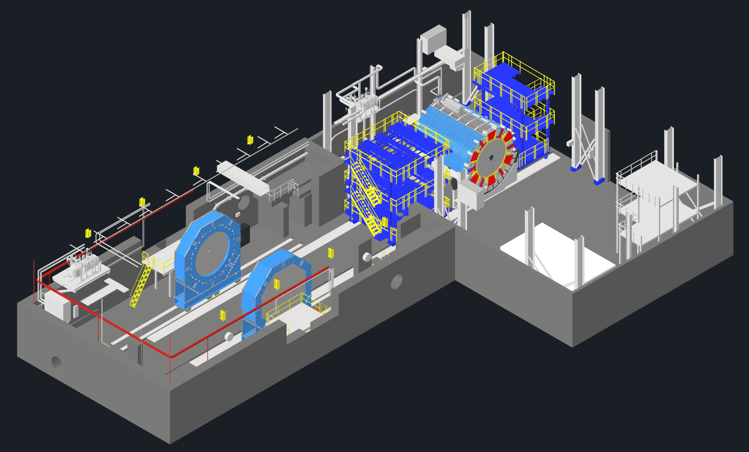
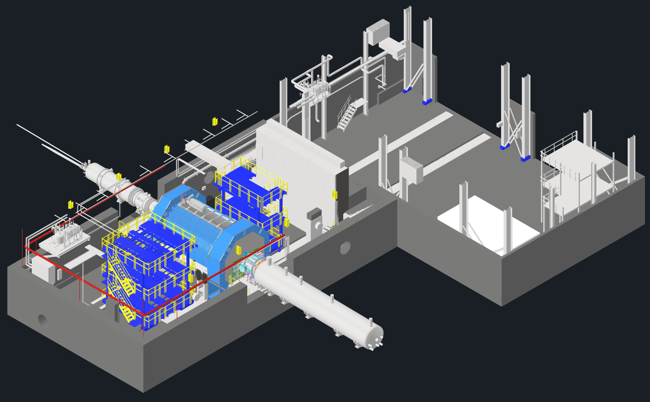
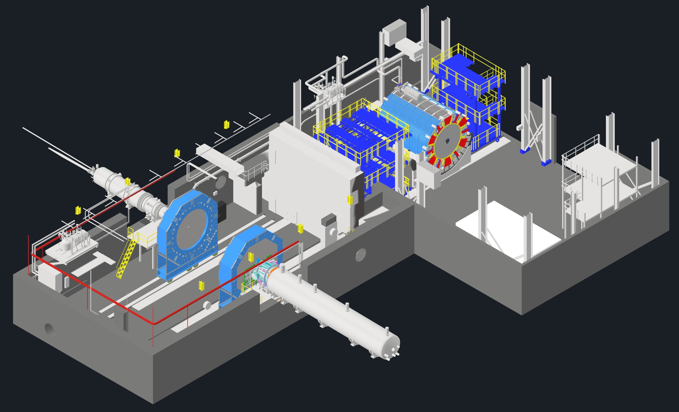
EIC - ePIC Commissioning
Q2/2033
~ CY 2034
exact dates under development
ePIC no-beam commissioning
ePIC commissioning with beam
ePIC fully assembled and Ready for Cosmic Data Taking
EIC first beam commissioning
central ePIC in assembly hall
endcap calorimeters
and beam pipe with instrumentation to have a first look on backgrounds
Luminosity detector and hadron & electron polarimeters fully installed
move central
ePIC into wide-angle hall
commission
ePIC with beam
All auxiliary detectors, but RPs and OMDs are installed
Start of Science
program
RPs and OMDs will be installed in year-2

Slide 11
Beam Energy and Average Orbit Radius in the HSR
3He
p
20 mm
130 GeV
100 GeV
store
275 GeV
70 mm $∅$ beam pipe
Since the electron revolution frequency is fixed, the hadron orbit must be adjusted with energy to keep the collisions in sync.
Zr
Ag,
Nb,
Ru,
Cu
d
Au,
p
U
Prefer ~130 GeV/u, which corresponds to a ‘centered’ hadron beam (path length difference ΔR ~ 0, this is achieved for a beam where Z ~ 0.5A) → Ru (44/104), Cu (29/63.5), Ag (47/107) Nb (41/93), …..
Do not want to exceed the present RHIC maximum dipole fields (corresponds to 250 GeV protons or 833 T-m)

Slide 12
Proposal for the Science Program in the First Years of EIC
Year - 1
Year - 2
Year - 3
Year - 4
Year - 5
Start with Phase 1 EIC
New Capability:
Commission electron polarization in parallel
Run:
10 GeV electrons on 115 GeV/u heavy ion beams (Ag or Nb or Cu or Ru)
Physics:
Add your preferred science topic
Phase 1 EIC
+ long. electron polarization
New Capability:
Commission proton polarization in parallel
Run:
10 GeV long. polarized electrons on 130 GeV/u Deuterium
Physics:
Add your preferred science topic
Run:
Last weeks 10 GeV long. polarized electrons and 130 GeV polarized protons
Physics:
Add your preferred science topic
Phase 1 EIC
+ long. electron polarization
+ proton polarization
New Capability:
Commission running with hadron spin rotators
Run:
10 GeV long. polarized electrons on 130 GeV transverse polarized protons
Physics:
Add your preferred science topic
Run:
Last weeks switch to longitudinal proton polarization
Physics:
Add your preferred science topic
Phase 1 EIC
+ long. electron polarization
+ proton polarization
+ operation of hadron spin rotators
New Capability:
Commission hadron accelerator to operate with not centered orbits
Run:
10 GeV long. polarized electrons on 100 GeV Au
Physics:
Add your preferred science topic
Run:
10 GeV long. polarized electrons on 250 GeV transverse and longitudinal polarized protons
Physics:
Add your preferred science topic
Phase 1 EIC
+ long. electron polarization
+ proton polarization
+ operation of hadron spin rotators
+ operation of hadron beams with not centered orbits
Run:
10 GeV long. polarized electrons on 100 GeV Au
Physics:
Add your preferred science topic
Run:
10 GeV long. polarized electrons on 166 GeV transverse and longitudinal polarized He-3
Physics:
Add your preferred science topic
Time to install additional ESR RF and HSR PS to
reach design Current and max. Energies

Slide 13
Proposal for the Science Program in the First Years of EIC
Year - 5
Year - 6
Year - 7
Phase 1 EIC
+ long. electron polarization
+ proton polarization
+ operation of hadron spin rotators
+ operation of hadron beams with not centered orbits
Run:
10 GeV polarized electrons on 100 GeV Au
Physics:
Add your preferred science topic
Run:
10 GeV long. electrons on 166 GeV transverse and longitudinal polarized He-3
Physics:
Add your preferred science topic
Phase 1 EIC
+ long. electron polarization
+ proton polarization
+ operation of hadron spin rotators
+ operation of hadron beams with not centered orbits
New Capability:
Commission ESR & HSR at max. energy and beam currents
Run:
18 GeV long. polarized electrons on 275 GeV/u polarized (longitudinal & transverse) proton beams
Physics:
Add your preferred science topic
Phase 1 EIC
+ long. electron polarization
+ proton polarization
+ operation of hadron spin rotators
+ operation of hadron beams with not centered orbits
+ operation of ESR & HSR at max. energy and beam currents
New Capability:
Operate HSR with 41 GeV bypass
Run:
5 GeV long. polarized electrons on 41 GeV transverse polarized proton beams
Physics:
Add your preferred science topic
Full EIC Capabilities

Slide 14
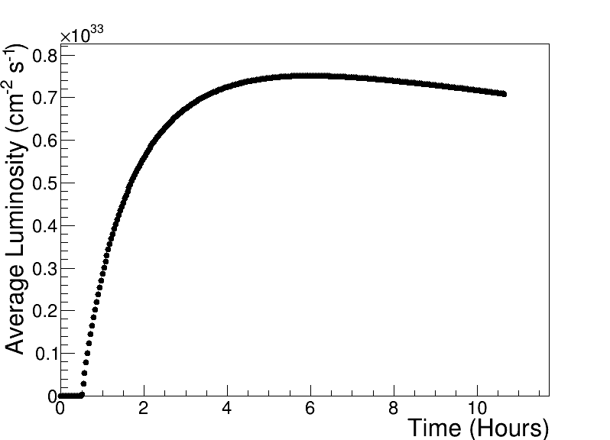
Assumptions and Luminosity Calculation
7 nC electron bunch charge compared to 28 nC (CDR)
Constant proton beam IP divergencies are maintained throughout the store by gradual increase of proton IP beta-functions as the beam emittance increases.
The electron IP beta-functions are adjusted accordingly to match electron and proton transverse beam size.
Ion beam is cooled at low energy (24 GeV/u) but no stochastic cooling is used in the store
1 Run is 30 weeks of operation at 80% uptime
2 h store turnaround time
30 min at the beginning of the store is taken by the ESR fill and detector turn-on
Not yet included a ramp of of luminosity through the Run (see Table)
Note: Luminosity numbers have changed due to a better model for taking uptime and store cycles into account
250 GeV x 10 GeV
RHIC | EIC Early Years (assumption)
1st week 25% of projected lumi / week 2nd week 50% of projected lumi / week 3rd week 75% of projected lumi / week 4th week 100% of projected lumi / week | 1st week 10% of projected lumi / week Then increase by 10% every week → 10 weeks to reach projected lumi / week

Slide 15
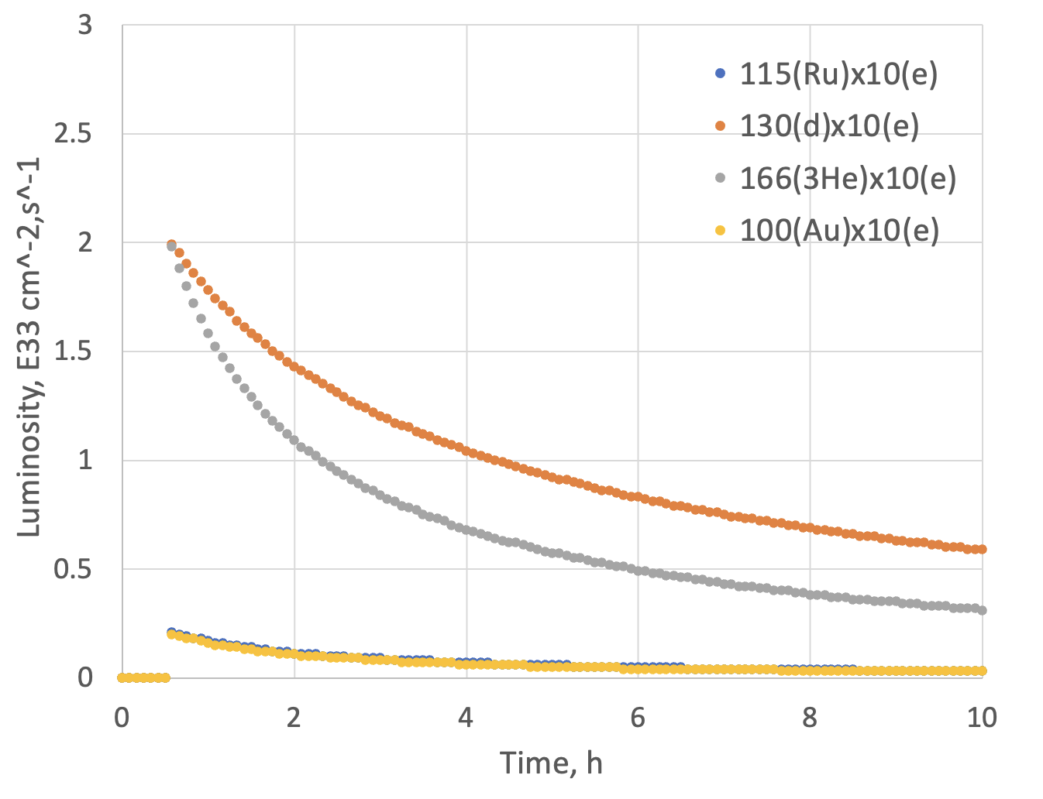
Assumptions and Luminosity
Possible Beam energies:
electron: 5 GeV, 10 GeV and ultimately 18 GeV
proton: 41 GeV, 100 GeV to 255 GeV ultimately 275 GeV
Au: 41 GeV, 100 GeV to 110 GeV ultimately
A: 41 GeV, 100 GeV to Max ~255 / (A/Z) ultimately ~275 / (A/Z)
eA luminosities for Phase-I
 | Lumi per Fill (5 h) | Lumi per Year
10 GeV e x 115 GeV Ru | 1.3 pb⁻¹ | 0.74 fb⁻¹
10 GeV e x 100 GeV Au | 1.2 pb⁻¹ | 0.69 fb⁻¹
10 GeV e x 130 GeV d | 16 pb⁻¹ | 9.3 fb⁻¹
10 GeV e x 166 GeV ³He | 12 pb⁻¹ | 7.1 fb⁻¹
Note:
eA luminosity is per nucleon

Slide 16
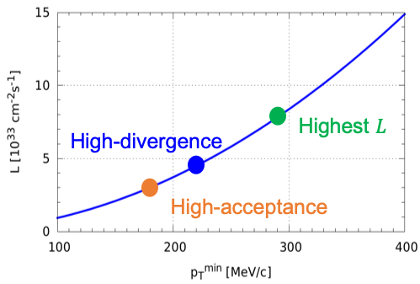
ep Luminosity for Early Years
High Divergence | Lumi per Day | Lumi per Year
5 GeV e x 250 GeV p | 44.7 pb⁻¹ | 7.5 fb⁻¹
10 GeV e x 250 GeV p | 62.9 pb⁻¹ | 10.6 fb⁻¹
5 GeV e x 130 GeV p | 29.8 pb⁻¹ | 5.0 fb-1
10 GeV e x 130 GeV p | 36.2 pb⁻¹ | 6.09 fb⁻¹
Low Divergence | Lumi per Day | Lumi per Year
5 GeV e x 250 GeV p | 32.7 pb⁻¹ | 5.5 fb⁻¹
10 GeV e x 250 GeV p | 42.1 pb⁻¹ | 7.07 fb⁻¹
5 GeV e x 130 GeV p | 27.9 pb⁻¹ | 4.7 fb⁻¹
10 GeV e x 130 GeV p | 33.6 pb⁻¹ | 5.6 fb⁻¹
Compare to HERA integrated luminosity 1992 – 2007: 0.6 fb⁻¹
Remember:
high divergence: higher lumi, but reduced acceptance
for low forward particle p_{T}^{min}
low divergence: lower lumi, but increased acceptance
for low forward particle p_{T}^{min}
→ important for exclusive processes
Illustration
Low-divergence

Slide 17
EIC Commissioning: Summary
Commissioning Scope: Transition from installation to full operational readiness, ensuring stable, high-quality, polarized beam delivery.
Lessons from Other Colliders:
Early background simulation is critical.
Electron polarization and beam-gas interactions require proactive mitigation.
Vacuum quality and synchrotron radiation must be tightly controlled.
EIC Machine Highlights:
Reuses RHIC tunnel and infrastructure.
Polarized e⁻ (5–18 GeV) and ion beams (up to 275 GeV).
Unique capabilities: high polarization, flexible ion species, high luminosity.
Commissioning Strategy:
Year-by-year phased approach (electron, proton, He-3 polarization; spin rotators; non-centered orbits).
Initial runs target early science with heavy ions, followed by increasing complexity.
Detector Readiness:
ePIC central detector + key auxiliary systems installed on Day One.
Gradual inclusion of Roman Pots, Low-Q² taggers, and forward detectors.
Goal: Deliver impactful early physics (e.g., PRLs), fulfill NAS/NSAC science objectives, and enable precision 3D mapping of nucleons and nuclei.

Slide 18


Slide 19


Slide 20
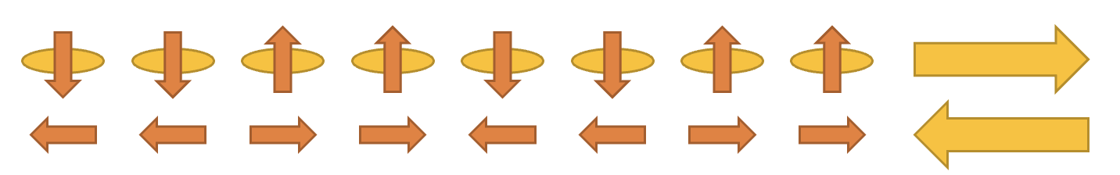
Initial thoughts on the EIC Commissioning Strategy
Science Requirement for Polarisation:
need high polarization (~70%) → experimental uncertainties proportional to 1/(P_{e}²P_{A}²L) or 1/(P_{e/A}²L) depending on measurements (single or double spin dependent observables)
if electron polarization is required, it needs to be always longitudinal → requires ESR spin rotators
to limit systematics → optimum would be to have arbitrary spin patters for both HSR and ESR
HSR: have trains of 4 bunches with the same spin direction​
ESR: using RCS allows for arbitrary spin patters in the ESR through replacements
Running at 5 and 10 GeV electrons:
we want polarization as early as possible,
depolarization is small → max allowable replacement time for 10 GeV 360 mins (85% → 70%) for the preferred polarization state and 96 mins for opposite direction
→ proposal run only the preferred spin state per fill → backup to swap out option in case backgrounds at detector
would be high
Consequence: need to flip the ESR spin rotators between fills to keep systematics small → possible; optics does not depend on spin rotator polarity and in the shadow of filling the HSR we change spin rotator polarity in ESR
Maximum replacement times (= max. allowable storage times in ESR) are based
on 85% injected polarization and 70% time averaged polarization

Slide 21
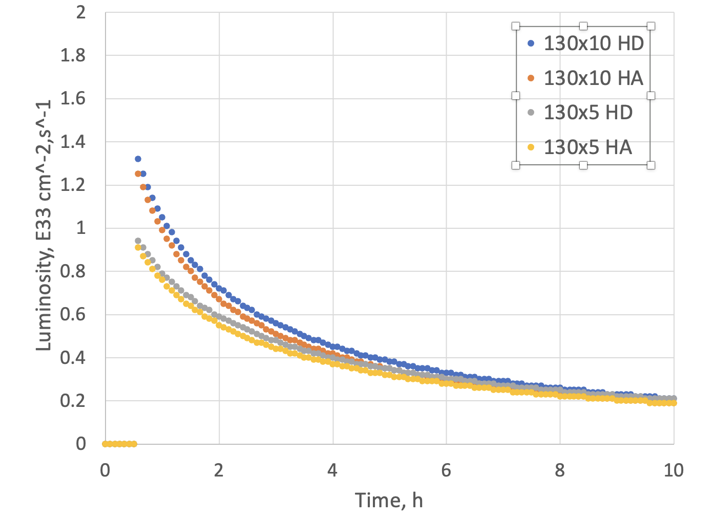
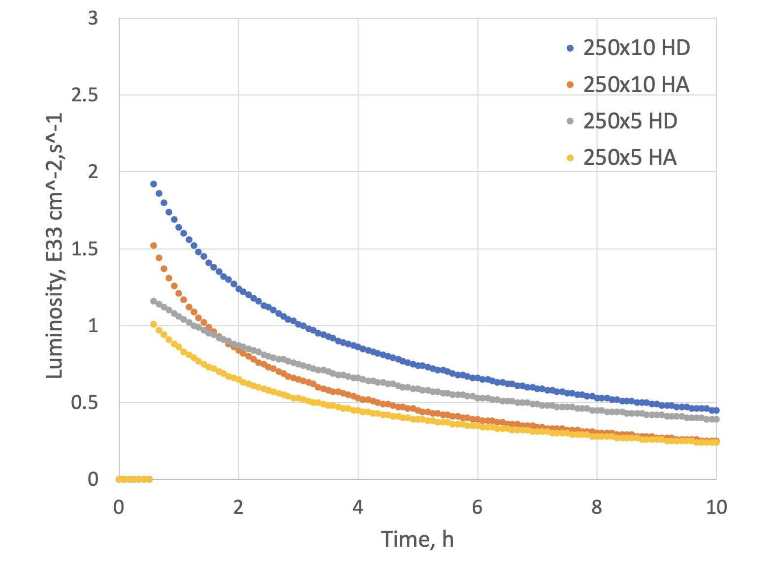
Luminosity ep for Phase-1
Compare to HERA peak luminosity
of 5x10³¹cm⁻²sec⁻¹
Max average luminosity without SHC: 0.8 x 10³³ cm⁻² s⁻¹ with 5.9 hr store
250 GeV x 10 GeV

Slide 22
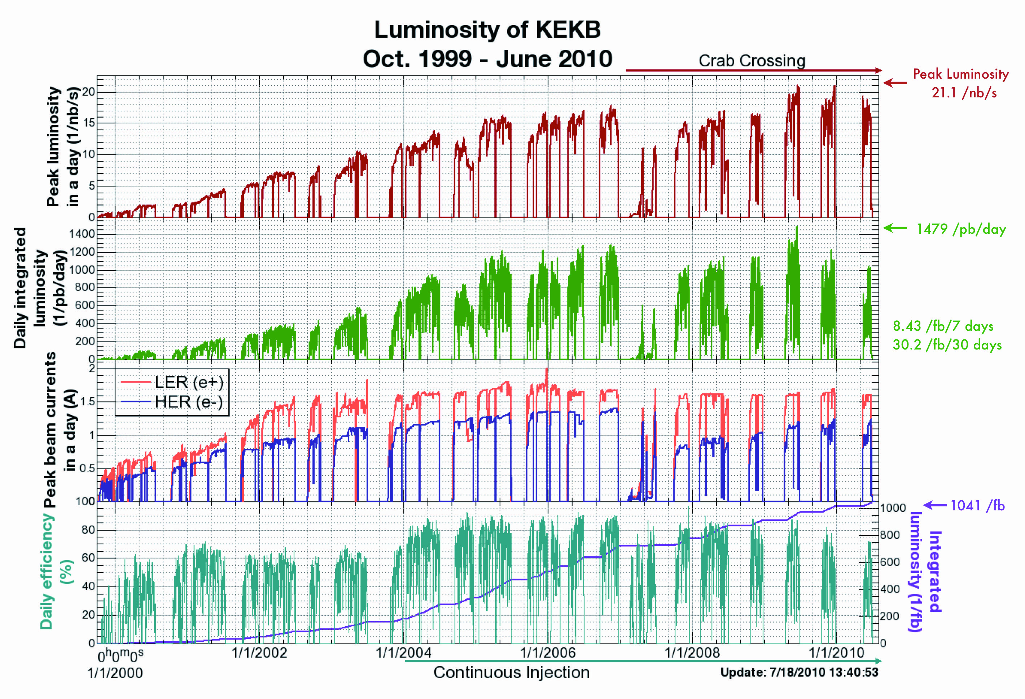
Experience ramping up KEKB and SuperKEKB
KEKB took ~5 years to reach design luminosity
SuperKEKB has not yet reached design luminosity
> 20 below goal
operating since 2019
Several reasons, beam instabilities and beam backgrounds

Slide 23
Lessons from HERA II upgrade
HERA performed an upgrade to increase luminosity by a factor of 5
Mainly by squeezing the beam more at the IP by redesign of the IR
The upgrade increased backgrounds dramatically → Several month shutdown to implement improvements
Electron beam polarization never reached HERA-I levels, H1 and Zeus solenoids (~1T) not well compensated
Main culprits:
no careful simulations prior to the upgrade
Proton beam-gas interactions most severe background
Needed an extremely good vacuum to mitigate this
Synchrotron radiation background
Background to detectors
Excess heating of beam pipe
Can damage flanges, etc.
Can heat beam pipe, decreasing vacuum
Electron beam-gas

Slide 24
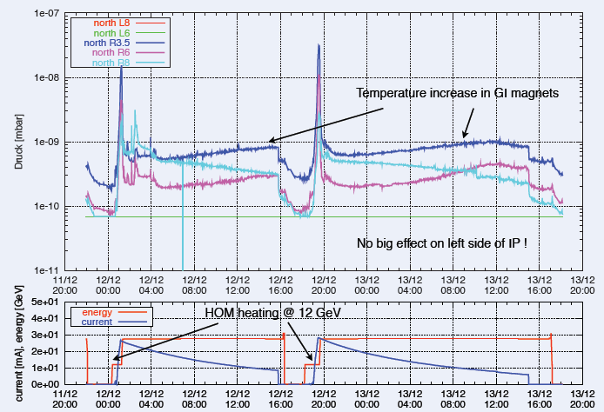
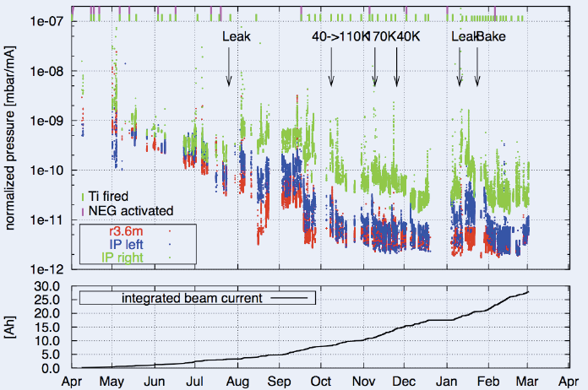
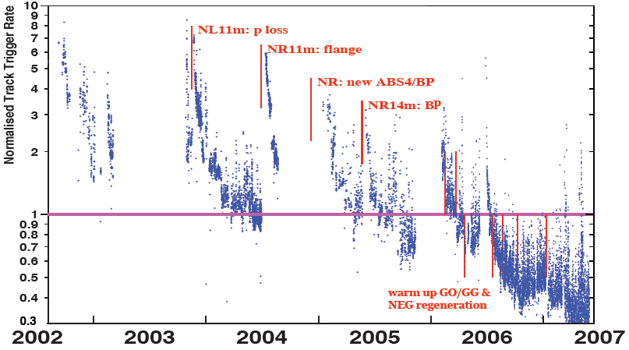
Lessons from HERA II upgrade
Dynamic pressure increase due
to thermal and photo desorption
Pressure vs. integrated electron
current 2002 - 03
Proton Beam Gas Background
Two time constants for vacuum
conditioning
Short term after leaks 20 – 30 days
Long term 600 days

Slide 25
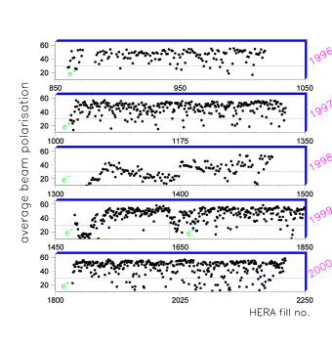
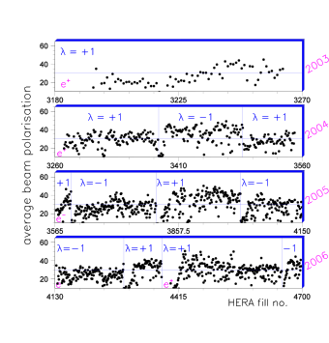
Lessons from HERA II upgrade
Electron polarization through Sokolov Ternov
Luminosity and Polarization have been strongly anti-corelated

Slide 26
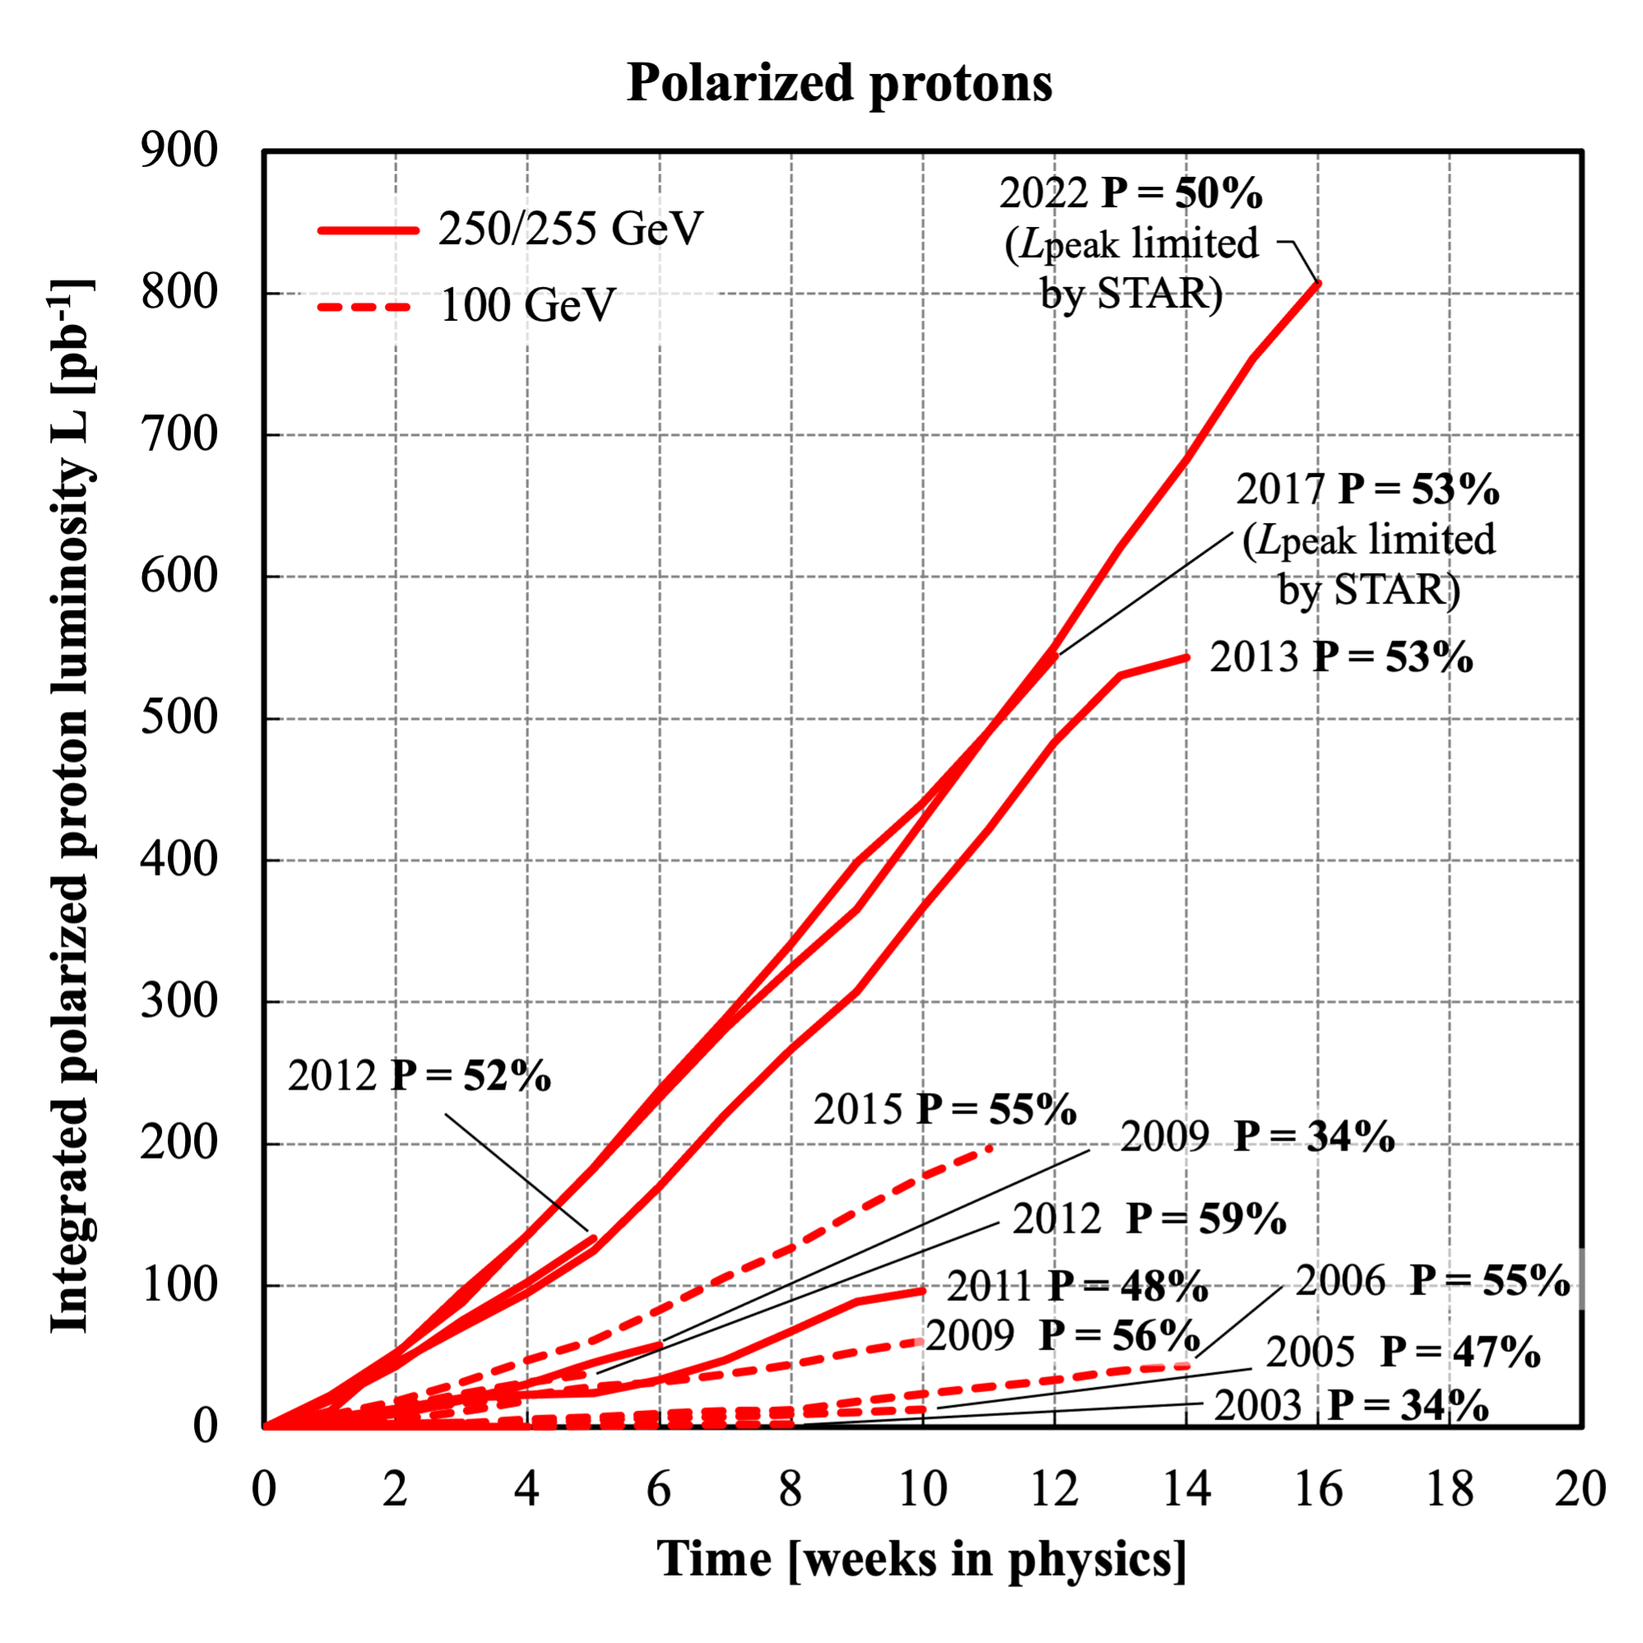
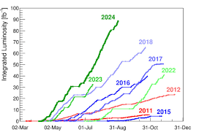
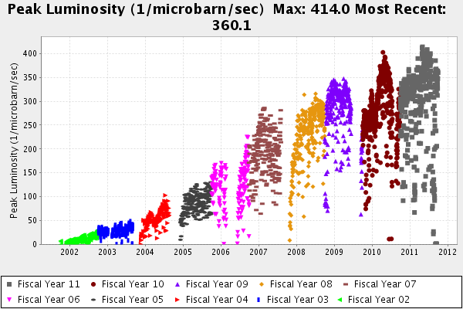
Lessons learnt from pp Colliders
Tevatron
LHC
RHIC
The pbar electron cooler was added in July of 2005. The initial luminosity increased by ~50% at first and then it took many years to take advantage of the cooler by optimizing the store length, beam-beam interactions, etc.
First beam September 10th, 2008, malfunction 9 days later no beam for experiments till 2010, March 19th, 2010 collisions at 7 TeV
Design Lumi was reached June 2016
13.6 TeV reached April 2022
First Beam in 2000
Polarization and Luminosity often anti-corelated.
Took in 2015 in one year the integrated luminosity from all the years before at √s=100 GeV and for √s=250 GeV in 2017

Slide 27
EIC Science Program in the early Years of EIC
Proposal to bring EIC online got feedback from
ePIC Leadership June 2024
Detector Advisory Committee Meeting June 2024
Users during EIC-UG/ePIC Summer Meeting July 2024
EIC Project Strategy Workshop August 2024
EIC@JLab Friday meeting September 2024
ePIC dedicated meeting on early science September 2024
Machine Advisory Committee Meeting September 2024
EIC CD-3B and Status Directors review October 2024
EIC RRB Meeting November 2024
EIC DOE OPA CD-3B LLP Review January 2025

