Slide 1
EIC Tracking and Particle Identification Requirements
Sourav Tarafdar (JLAB) EIC Project Detector Scientist
Rolf Ent (JLAB) Co-Associate Director for the Experimental Program
Benedikt Zihlmann (JLAB) L3 CAM WBS 6.10.04 PID
10th EIC DAC Review
June 11th – 13th, 2025

Slide 2
Outline
Overview of Subsystem Requirements.
Tracking detectors in ePIC
Requirements for Tracking Detectors
Overview of Interfaces
Interfaces for Tracking Detectors
Particle Identification Detectors in ePIC
Requirements for Particle Identification Detectors
Interfaces for Particle Identification Detectors
Conclusion
10th EIC DAC Meeting
S.Tarafdar / R.Ent / B.Zihlmann

Slide 3
Subsystem Requirement Overview
Requirement flow
General Requirement
Functional Requirement
Performance Requirement
Identifies fundamental capabilities that the system must have in order to accomplish its purpose
e.g. Need to identify low momentum particles to satisfy Physics requirement of EIC
Identifies the functions that the system must perform in order to satisfy it’s general requirements
e.g. To identify low momentum particles there has to be x*sigma separation
Describes quantitatively how well the functions must perform in order for the system to be successful in it’s operating environment.
e.g. ToF sensors need to have xxx ps timing resolution
(All info is online at https://eic.jlab.org/Detector)
10th EIC DAC Meeting
S.Tarafdar / R.Ent / B.Zihlmann

Slide 4
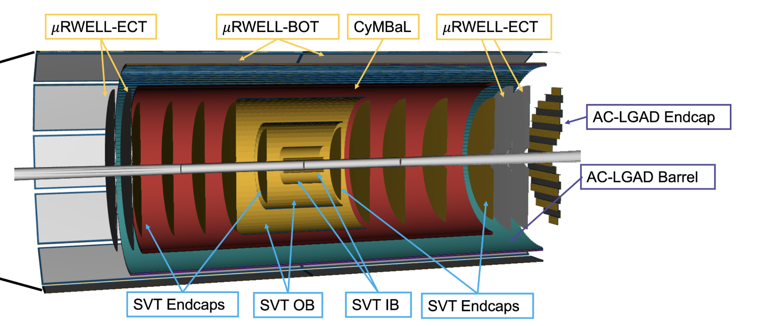
ePIC Tracking subsystems
Two different technologies for charged particle tracking
  Silicon
  Gaseous
Silicon based trackers
  SVT (Silicon Vertex Tracker) Endcaps
  SVT (Silicon Vertex Tracker) OB
  SVT (Silicon Vertex Tracker) IB
  AC-LGAD Barrel & Endcap
Gas based trackers
  CyMBaL (Cylindrical MicroMegas Barrel Layer)
  µRWELL-BOT (µRWELL Barrel Outer Tracker)
  µRWELL-ECT (µRWELL End Cap Tracker)
10th EIC DAC Meeting
S.Tarafdar / R.Ent / B.Zihlmann

Slide 5
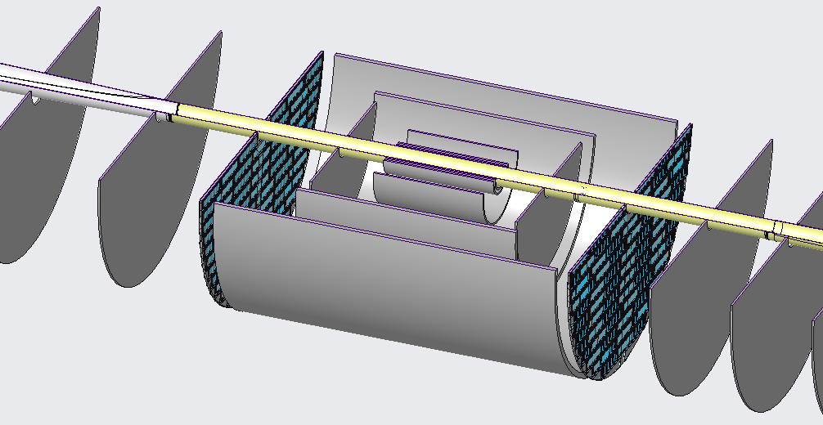
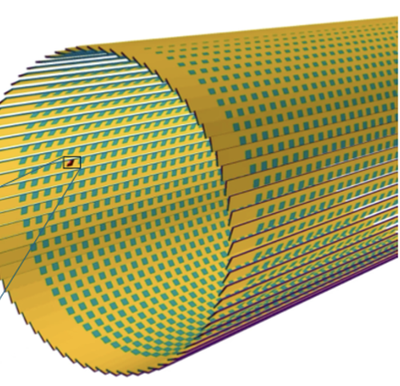
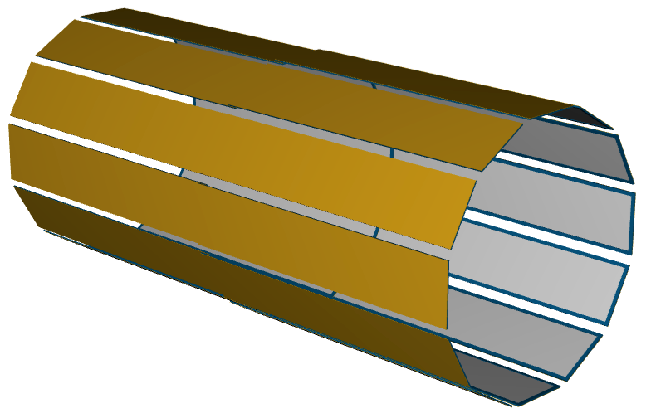
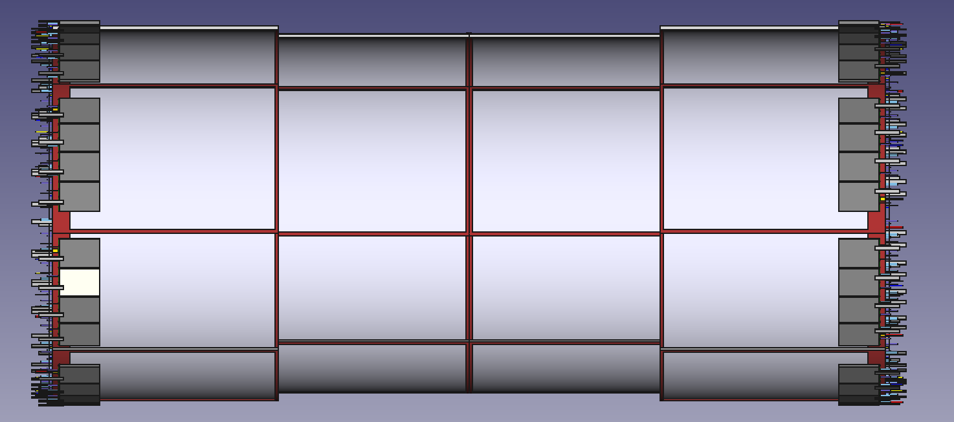
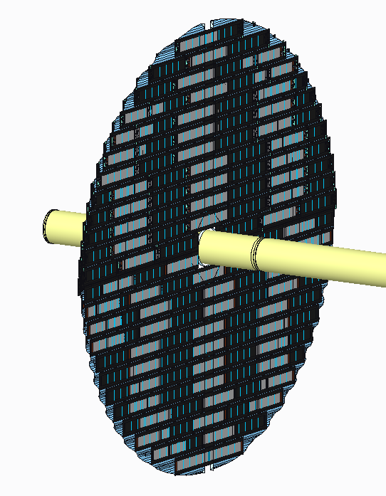
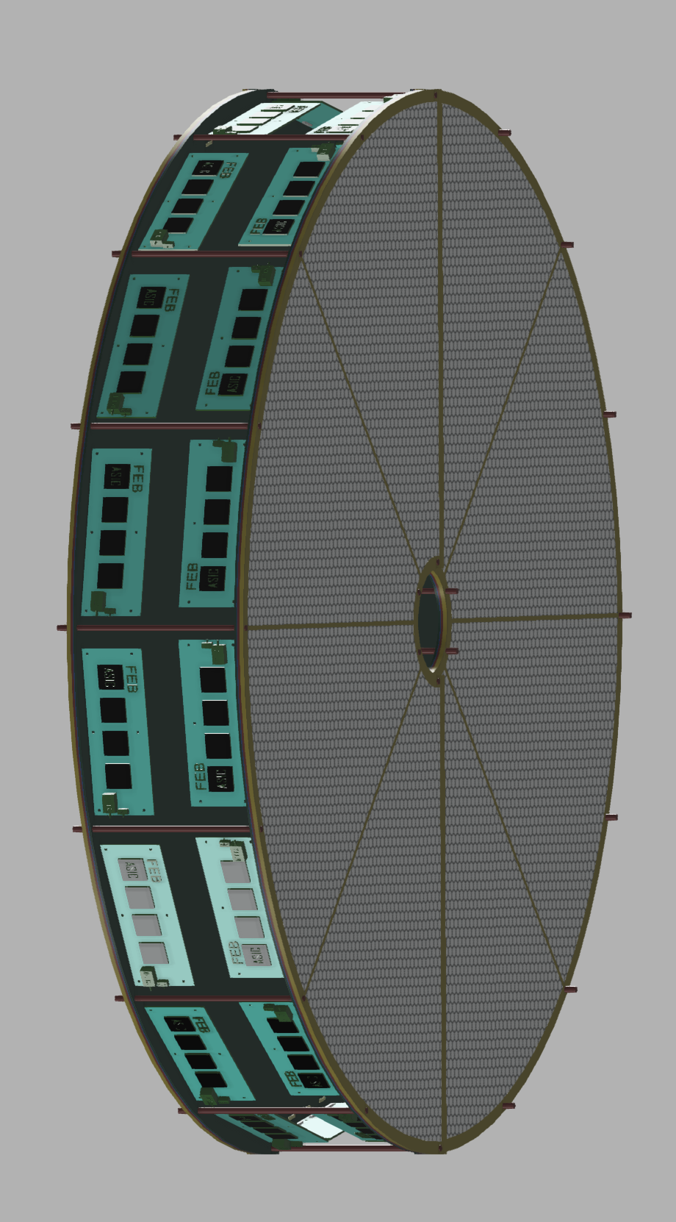
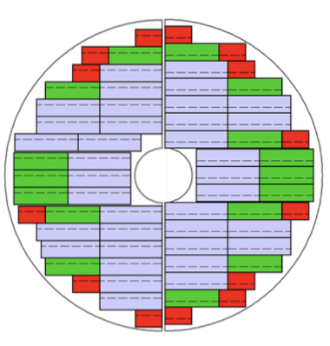
ePIC Tracking subsystems
BARREL TRACKERS
µRWELL-BOT based on
µRWELL technology
Placed close to hpDIRC to improve angular and space point resolution to aid in PID.
Provide redundancy and pattern recognition for tracking
Silicon vertex tracker
based on ALICE ITS3
Displaced vertex reconstruction
Momentum resolution of 0.05%pT⊕0.5% and spatial resolution 20μm/pT⊕ 5μm
CyMBaL based on
µMegas technology
Provide redundancy and pattern recognition for tracking
Barrel AC-LGAD
Provide additional space point with spatial resolution of ~ 30 μm
Backward (e⁻ end cap) trackers
Forward (hadron end cap) trackers
MAPS disks
Momentum resolution of (0.1)%pT⊕1.0 (2.0)% and spatial resolution 30μm/pT⊕ (20-40 )μm
µRWELL disks
Provide redundancy and pattern recognition for tracking.
Aid in background rejection
AC-LGAD disk
µRWELL disks
Provide redundancy and pattern recognition for tracking.
Aid in background rejection
MAPS disks
Momentum resolution of (0.1)%pT⊕1.0 (2.0)% and spatial resolution 30μm/pT⊕ (20-40 )μm
With 30 um spatial resolution aid in providing additional space point
* More details in the upcoming presentations
10th EIC DAC Meeting
S.Tarafdar / R.Ent / B.Zihlmann

Slide 6
Subsystem Requirements (Tracking detectors)
FUNCTIONAL REQUIREMENTS
Name | Description | Parent
Tracking Systems
F-DET-TRAK.1 | The tracking system must provide a low detection threshold for pions and kaons. | G-DET.1 G-DET-TRAK.1
F-DET-TRAK.2 | The tracking system must provide high hermicity in exclusive and diffractive channels. | G-DET.1 G-DET-TRAK.2
F-DET-TRAK.3 | The tracking system must provide good impact parameter resolution for heavy flavor measurements. | G-DET-TRAK.3
F-DET-TRAK.4 | The tracking system will require adequate infrastructure resources (i.e. power, cooling, cryogens, etc.) to ensure it can function reliably during continuous operations. | G-DET-TRAK.4
F-DET-TRAK.5 | The configuration of the tracking system within the detector will be coordinated to ensure efficient operation and to minimize adverse interactions between sub-systems. | G-DET-TRAK.4 G-DET-TRAK.5
F-DET-TRAK.6 | The tracking system and its support systems must fit in the available space AND provide adequate plenums and pathways for the delivery of services, resources and communications, and for the removal of heat and waste during operations. | G-DET-TRAK.4 G-DET-TRAK.5
F-DET-TRAK.7 | A structural support infrastructure must be provided that supports the weight of the tracking system and peripheral equipment, and safely distributes that load to the ground. | G-DET-TRAK.4 G-DET-TRAK.5
PERFORMANCE REQUIREMENTS
Name | Description | Parent
Tracking Systems
P-DET-TRAK.1 | The tracking system must provide a minimum pT of 100 MeV π, 130 MeV K. | F-DET-TRAK.1
P-DET-TRAK.2 | The tracking system shall provide cooling (air/liquid) for silicon sensors. | F-DET-TRAK.4 F-DET-TRAK.6
P-DET-TRAK.3 | The tracking system shall provide power supplies for bias and low voltages. | F-DET-TRAK.4 F-DET-TRAK.6
P-DET-TRAK.4 | The tracking system shall provide a gas mixing system for gaseous detectors. | F-DET-TRAK.4 F-DET-TRAK.6
P-DET-TRAK.5 | The tracking system will require cooling infrastructure that is sufficient to ensure the operating temperature remains within an acceptable range. | F-DET-TRAK.4 F-DET-TRAK.6
P-DET-TRAK.6 | The tracking system will require electrical power to support the operation of the detector sub-components and electronics. | F-DET-TRAK.4 F-DET-TRAK.6
P-DET-TRAK.7 | The tracking system will require communications infrastructure to support data collection, monitoring and control. | F-DET-TRAK.4 F-DET-TRAK.6
P-DET-TRAK.8 | The tracking system will require a structural support system to carry the cumulative weight of the detectors and peripheral services, and to distribute that load to other supporting infrastructure or to the floor. | F-DET-TRAK.7
P-DET-TRAK.9 | The tracking system must fit within the constraints of the surrounding detector sub-systems and have adequate space for the delivery of services and the removal of waste. | F-DET-TRAK.5 F-DET-TRAK.6
GENERAL REQUIREMENTS
Name | Description
Tracking Systems
G-DET-TRAK.1 | The tracking systems shall provide coordinate measurements of charged particles traversing a magnetic field, and provide a sufficient lever arm to provide measurements of the momenta and angles of the particles.
G-DET-TRAK.2 | Tracking functionality shall cover the backward, the barrel and the forward region.
G-DET-TRAK.3 | The tracking system shall provide a measurement of the vertex coordinates in the barrel region.
G-DET-TRAK.4 | The tracking system will be functionally integrated with the other detectors, with the interaction region components, and with the facility infrastructure.
G-DET-TRAK.5 | The tracking system must fit within the available space in the experimental hall, and be consistent with the available infrastructure and resources.
10th EIC DAC Meeting
S.Tarafdar / R.Ent / B.Zihlmann

Slide 7
Backward Tracking System Requirement
Backward Tracking Systems
P-DET-TRAK-BCK.1 | The backward tracking system shall provide coverage in rapidity region between -3.5 to -1.0. | F-DET-TRAK.2
P-DET-TRAK-BCK.2 | The backward tracking system shall provide a momentum resolution of σp/p ~ 0.05%⨯p+1.0% in the rapidity region between -2.5 to -1.0. | F-DET-TRAK.2
P-DET-TRAK-BCK.3 | The backward tracking system shall provide a momentum resolution of σp/p ~ 0.10%⨯p+2.0% in the rapidity region between -3.5 to -2.5. | F-DET-TRAK.2
P-DET-TRAK-BCK.4 | The backward tracking system shall provide a spatial resolution of σxy ∼ 30/pT ⊕ 20 μm in the rapidity region between -2.5 to -1.0. | F-DET-TRAK.2
P-DET-TRAK-BCK.5 | The backward tracking system shall provide a spatial resolution of σxy ∼ 30/pT ⊕ 40 μm in the rapidity region between -3.5 to -2.5. | F-DET-TRAK.2
Tracking Systems
F-DET-TRAK-1 | The tracking system must provide a low detection threshold for pions and kaons. | G-DET.1 G-DET-TRAK-1
Tracking Systems
G-DET-TRAK-1 | The tracking systems shall provide coordinate measurements of charged particles traversing a magnetic field, and provide a sufficient lever arm to provide measurements of the momenta and angles of the particles.
10th EIC DAC Meeting
S.Tarafdar / R.Ent / B.Zihlmann

Slide 8
Barrel Tracking System Requirement
Barrel Tracking Systems
P-DET-TRAK-BAR.1 | The barrel tracking system shall provide a momentum resolution < 5%. | F-DET-TRAK.2
P-DET-TRAK-BAR.2 | The barrel tracking system shall provide a low material budget: < 5% X0. | F-DET-TRAK.1
P-DET-TRAK-BAR.3 | The barrel tracking system shall provide a momentum resolution of σp/p ~ 0.05%⨯p+0.5% in the rapidity region between -1 to 1. | F-DET-TRAK.2
P-DET-TRAK-BAR.4 | The barrel tracking system shall provide a spatial resolution of σxy ∼ 20/pT ⊕ 5 μm in the rapidity region between -1 to 1. | F-DET-TRAK.3
Tracking Systems
F-DET-TRAK-1 | The tracking system must provide a low detection threshold for pions and kaons. | G-DET.1 G-DET-TRAK-1
F-DET-TRAK.2 | The tracking system must provide high hermicity in exclusive and diffractive channels. | G-DET.1 G-DET-TRAK.2
F-DET-TRAK.3 | The tracking system must provide good impact parameter resolution for heavy flavor measurements. | G-DET-TRAK.3
Tracking Systems
G-DET-TRAK-1 | The tracking systems shall provide coordinate measurements of charged particles traversing a magnetic field, and provide a sufficient lever arm to provide measurements of the momenta and angles of the particles.
10th EIC DAC Meeting
S.Tarafdar / R.Ent / B.Zihlmann

Slide 9
Forward Tracking System Requirement
Forward Tracking Systems
Tracking Systems
F-DET-TRAK-1 | The tracking system must provide a low detection threshold for pions and kaons. | G-DET.1 G-DET-TRAK-1
P-DET-TRAK-FWD.1 | The forward tracking system shall provide coverage in rapidity region between -1.0 to 3.5. | F-DET-TRAK.2
Tracking Systems
G-DET-TRAK-1 | The tracking systems shall provide coordinate measurements of charged particles traversing a magnetic field, and provide a sufficient lever arm to provide measurements of the momenta and angles of the particles.
P-DET-TRAK-FWD.2 | The forward tracking system shall provide a momentum resolution of σp/p ~ 0.05%⨯p+1.0% in the rapidity region between 1.0 to 2.5. | F-DET-TRAK.2
P-DET-TRAK-FWD.3 | The forward tracking system shall provide a momentum resolution of σp/p ~ 0.10%⨯p+2.0% in the rapidity region between 2.5 to 3.5. | F-DET-TRAK.2
P-DET-TRAK-FWD.4 | The forward tracking system shall provide a spatial resolution of σxy ∼ 30/pT ⊕ 20 μm in the rapidity region between 1.0 to 2.5. | F-DET-TRAK.2
P-DET-TRAK-FWD.5 | The forward tracking system shall provide a spatial resolution of σxy ∼ 30/pT ⊕ 40 μm in the rapidity region between 2.5 to 3.5. | F-DET-TRAK.2
F-DET-TRAK.2 | The tracking system must provide high hermicity in exclusive and diffractive channels. | G-DET.1 G-DET-TRAK.2
F-DET-TRAK.3 | The tracking system must provide good impact parameter resolution for heavy flavor measurements. | G-DET-TRAK.3
10th EIC DAC Meeting
S.Tarafdar / R.Ent / B.Zihlmann

Slide 10
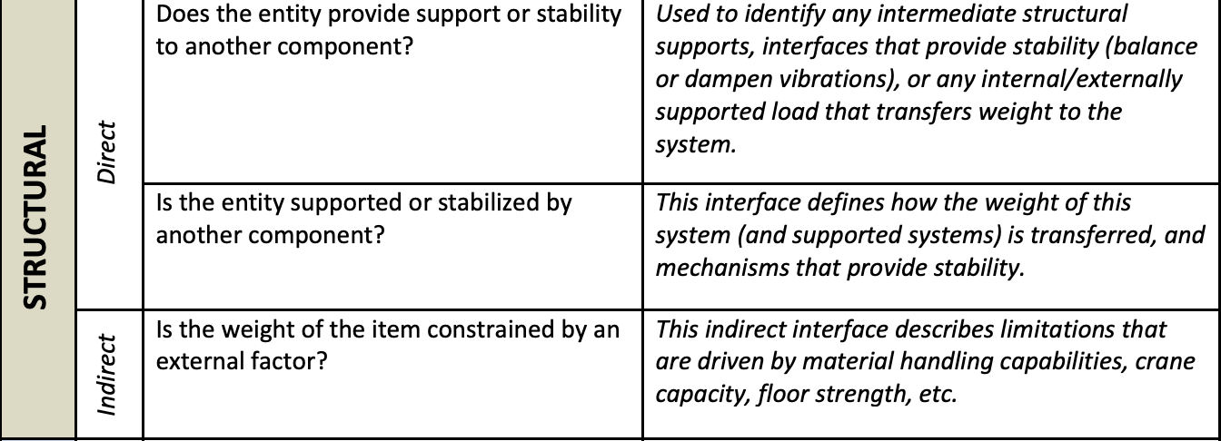
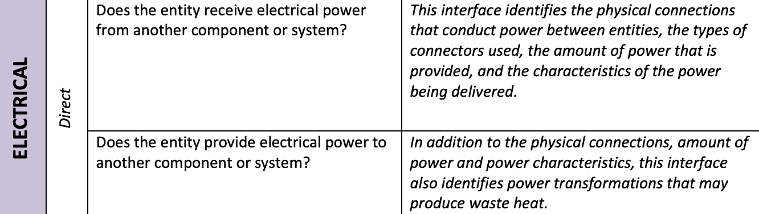
Detector Systems Interface General Idea
Defined relationship between two or more distinct entities to satisfy a dependency or requirement .
Identifying interfaces : Interrogate set of parameters
            Requirements
            Known interfaces
            Related systems
Examples of questions for interrogating requirements :
Other examples of interrogations can be based on data, cryogenics, controls, gas/fluid flows etc.
10th EIC DAC Meeting
S.Tarafdar / R.Ent / B.Zihlmann

Slide 11
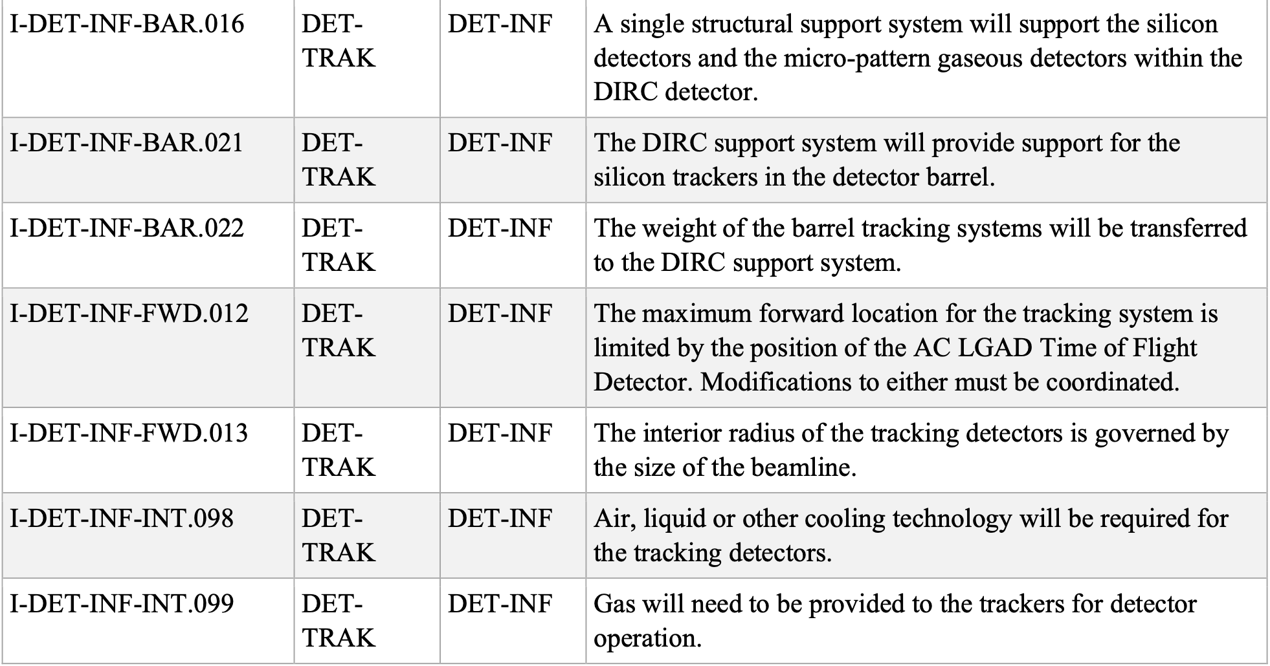
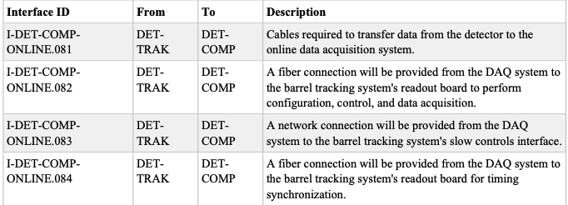
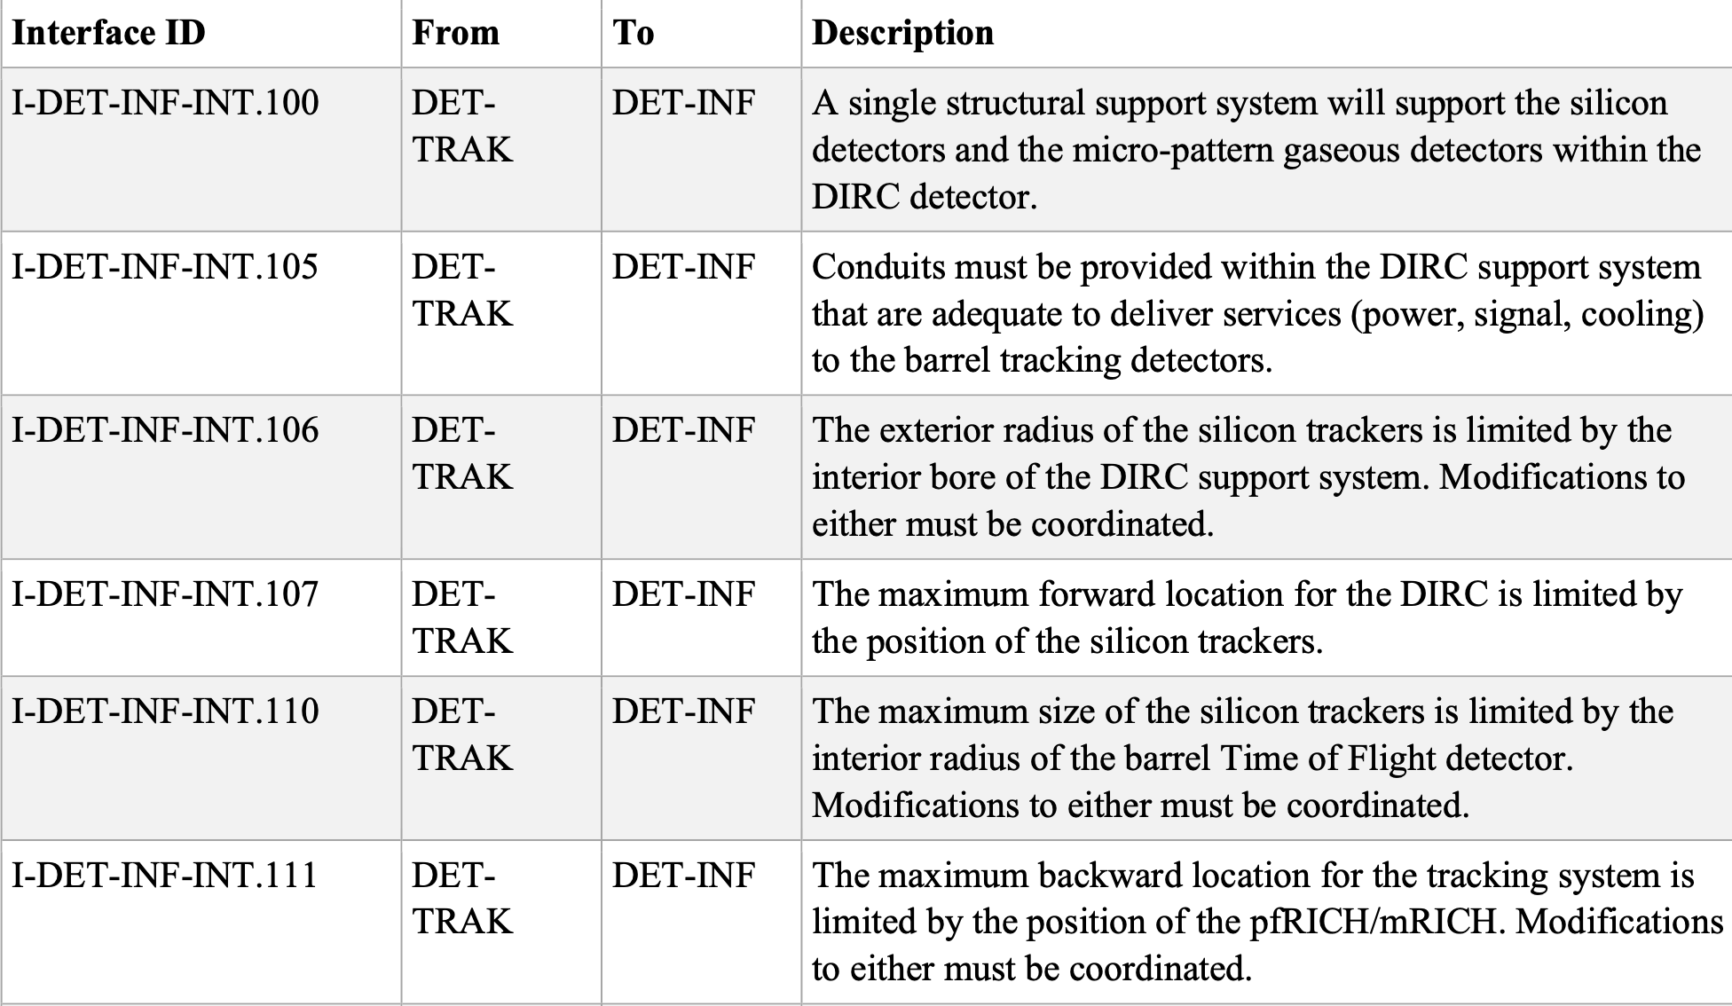
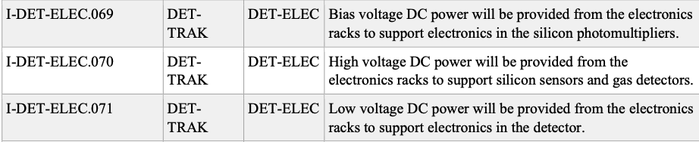
Tracking subsystem Interfaces
Detectors – Infrastructure interface (Structural interrogation)
Detectors – DAQ/Computing interface (Data interrogation)
Detectors- Electronics interface (Electrical interrogation)
Interface between tracking and PID detectors also exist https://eic.jlab.org/Interfaces/InterfaceMatrix.html
10th EIC DAC Meeting
S.Tarafdar / R.Ent / B.Zihlmann

Slide 12
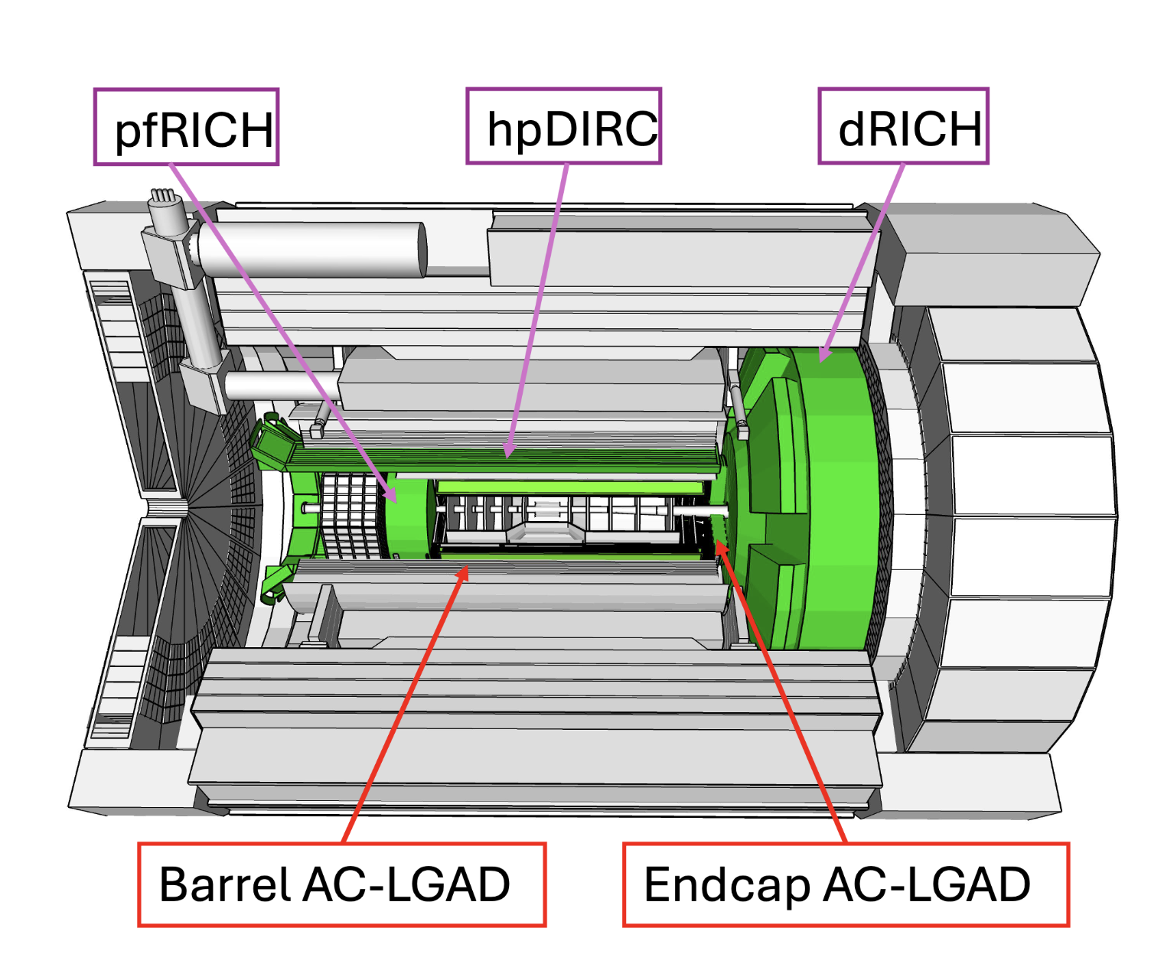
ePIC PID subsystem
Two different techniques for particle identification
  Cherenkov imaging
  Time of Flight
Cherenkov imaging detectors in ePIC
  Proximity Focussing RICH (pfRICH)
  High Performance DIRC (hpDIRC)
  Dual-radiator RICH (dRICH)
Time of Flight detectors in ePIC
  Barrel AC-LGAD Time of Flight
  Endcap AC-LGAD Time of Flight
10th EIC DAC Meeting
S.Tarafdar / R.Ent / B.Zihlmann

Slide 13
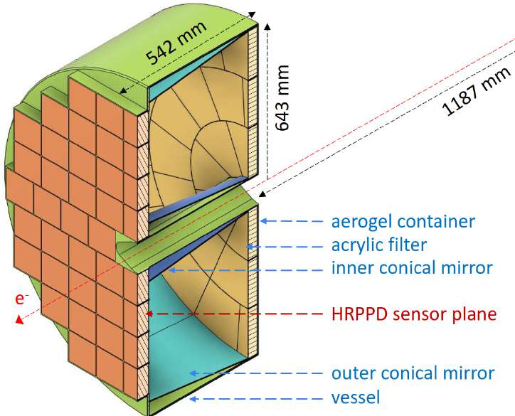
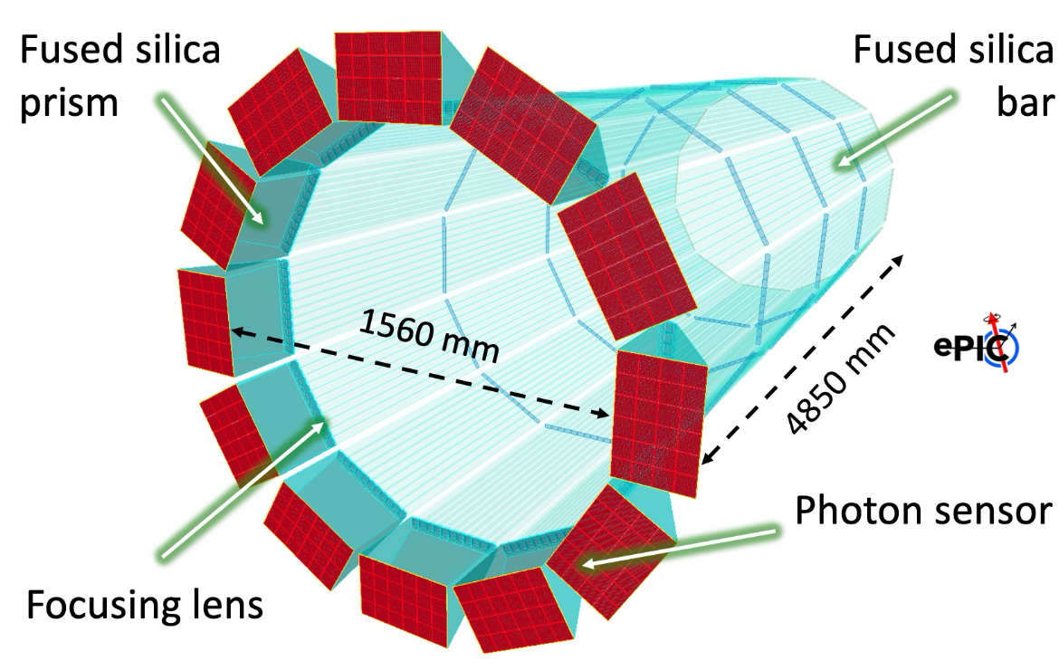
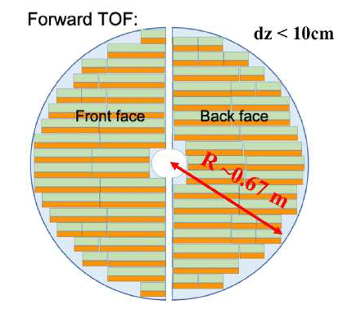
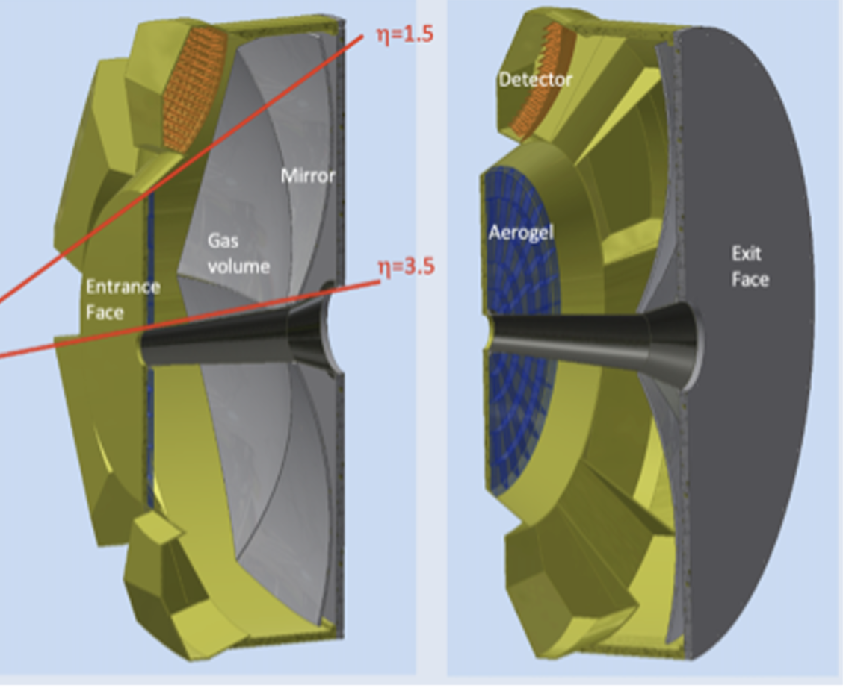
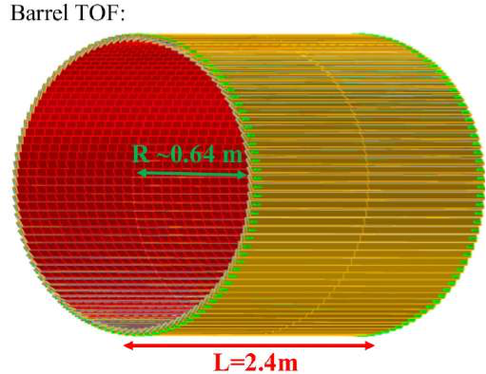
ePIC PID subsystem
Backward RICH (pfRICH)
Barrel DIRC (hpDIRC)
Barrel TOF
Forward TOF
Forward RICH
π/K of 3σ separation between 0.2-1.2 GeV/c
AC-LGAD strip sensors with
timing resolution of ~ 35 ps.
π/K of 3σ separation between 0.2 to 2.3 GeV
AC-LGAD pixel sensors with timing resolution of ~ 20 ps
π/K of 3σ separation
between 3 and 50 GeV/c.
Aerogel (n = 1.026) and C₂F₆ gas as two different radiators.
Focusing mirror
SiPM as Photosensors
π/K/p of 3σ separation up to 7 GeV/c
Utilizes long proximity gap (~30 cm) with 1.04 refractive index aerogel
High-Rate Picosecond Photon Detectors (HRPPD) as photosensor with single photon timing resolution of ~30-40 ps
π/K/p of 3σ separation up to 6 GeV/c
Quartz bars as radiators
Saphire lens as focusing optics
Compact Solid fused silica prism as expansion volume
MCP-PMT as photosensors.
* More details in the upcoming presentations
10th EIC DAC Meeting
S.Tarafdar / R.Ent / B.Zihlmann

Slide 14
Subsystem Requirements (PID detectors)
GENERAL REQUIREMENTS
Name | Description
Particle Identification Systems
G-DET-PID.1 | The PID detector systems shall provide a means to separately identify pions, kaons and protons following the electron-ion collision.
G-DET-PID.2 | The particle identification systems shall consist of backward, barrel, and forward sub-systems.
G-DET-PID.3 | The PID detector system will be functionally integrated with the other detectors, with the interaction region components, and with the facility infrastructure.
G-DET-PID.4 | The PID detector system must fit within the available space in the experimental hall, and be consistent with the available infrastructure and resources.
FUNCTIONAL REQUIREMENTS
Name | Description | Parent
Particle Identification Systems
F-DET-PID.1 | The PID detector system will require adequate infrastructure resources (i.e. power, cooling, cryogens, etc.) to ensure it can function reliably during continuous operations. | G-DET-PID.3
F-DET-PID.2 | The configuration of the PID detector system within the detector will be coordinated to ensure efficient operation and to minimize adverse interactions between sub-systems. | G-DET-PID.3 G-DET-PID.4
F-DET-PID.3 | The PID detector system and its support systems must fit in the available space AND provide adequate plenums and pathways for the delivery of services, resources and communications, and for the removal of heat and waste during operations. | G-DET-PID.3 G-DET-PID.4
F-DET-PID.4 | A structural support infrastructure must be provided that supports the weight of the PID detector system and peripheral equipment, and safely distributes that load to the ground. | G-DET-PID.3 G-DET-PID.4
PERFORMANCE REQUIREMENTS
Name | Description | Parent
Particle Identification Systems
P-DET-PID.1 | The PID detectors will require cooling infrastructure that is sufficient to ensure the operating temperature remains within an acceptable range. | F-DET-PID.1 F-DET-PID.3
P-DET-PID.2 | The PID detectors will require electrical power to support the operation of the detector sub-components and electronics. | F-DET-PID.1 F-DET-PID.3
P-DET-PID.3 | The PID detectors will require communications infrastructure to support data collection, monitoring and control. | F-DET-PID.1 F-DET-PID.3
P-DET-PID.4 | The PID detectors will require a structural support system to carry the cumulative weight of the detectors and peripheral services, and to distribute that load to other supporting infrastructure or to the floor. | F-DET-PID.4
P-DET-PID.5 | The PID detectors and support system must fit within the constraints of the surrounding detector sub-systems and have adequate space for the delivery of services and the removal of waste. | F-DET-PID.3 F-DET-PID.4
10th EIC DAC Meeting
S.Tarafdar / R.Ent / B.Zihlmann

Slide 15
Backward RICH (pfRICH) Requirements
Backward PID Systems
Backward RICH Detectors
P-DET-PID-BCK-RICH.1 | The PID Detector in the backward region will require appropriate support structure to hold the detector in place. | F-DET-PID-BCK-RICH.1
P-DET-PID-BCK-RICH.2 | The PID Detector in the backward region will require appropriate support DC voltage and power for operating detector sensors and associated electronics. HV up to 2000V negative for 68x5 channels and LV for 68x4 channels. | F-DET-PID-BCK-RICH.1
P-DET-PID-BCK-RICH.3 | The PID Detector in the backward region will require cooling and removal of heat generated by detector electronics and digitizers. | F-DET-PID-BCK-RICH.1
P-DET-PID-BCK-RICH.4 | The PID Detector in the backward region will require detector signal transmission electronics and lines defined by the DAQ system. | F-DET-PID-BCK-RICH.1
P-DET-PID-BCK-RICH.5 | The PID Detector in the backward region will require survey marks or hooks for survey tools to determine its physical location in the barrel as a whole and its sub-components. | F-DET-PID-BCK-RICH.1
P-DET-PID-BCK-RICH.6 | The PID detector in the backward region will require a continuous flow of dry nitrogen to protect the aerogel radiator. | F-DET-PID.1 F-DET-PID.3
P-DET-PID-BCK-RICH.7 | The particle identification system will provide 3 sigma pi/K separation from 1 up to 7 GeV/c. | F-DET-PID-BCK-RICH.1
Backward PID Systems
Backward RICH Detectors
F-DET-PID-BCK-RICH.1 | The PID detector in the backward region shall differentiate between pions, kaons and protons. | G-DET-PID-BCK-RICH.1
Backward PID Systems
Backward RICH Detectors
G-DET-PID-BCK-RICH.1 | The PID detector in the backward region is responsible for particle identification of charged hadrons.
10th EIC DAC Meeting
S.Tarafdar / R.Ent / B.Zihlmann

Slide 16
Barrel DIRC (hpDIRC) Requirements
Barrel PID Detectors
Barrel DIRC Detectors
P-DET-PID-BAR-DIRC.1 | The PID Detector in the barrel region will require appropriate support structure to hold the detector in place as well as all sub-detector systems that reside within its bore. | F-DET-PID.4
P-DET-PID-BAR-DIRC.2 | The PID Detector in the barrel region will require appropriate support DC voltage and power for operating detector sensors and associated electronics. HV up to 2000V negative is for 5x72 channels and LV for 4x72 channels. | F-DET-PID.1 F-DET-PID.3
P-DET-PID-BAR-DIRC.3 | The PID Detector in the barrel region will require cooling and removal of heat generated by detector electronics and digitizers. | F-DET-PID.1 F-DET-PID.3
P-DET-PID-BAR-DIRC.4 | The PID Detector in the barrel region will require detector signal transmission electronics and lines defined by the DAQ system. | F-DET-PID.1 F-DET-PID.3
P-DET-PID-BAR-DIRC.5 | The PID Detector in the barrel region will require survey marks or hooks for survey tools to determine its physical location in the barrel as a whole and its sub-components. | F-DET-PID.3
P-DET-PID-BAR-DIRC.6 | The PID detector requires a 0.5mrad tracking resolution as input to reach its peak performance. | F-DET-PID.3
P-DET-PID-BAR-DIRC.7 | The DIRC system will provide 3 sigma pi/K separation above 1 GeV/c. | F-DET-PID-BAR-DIRC.1
Barrel PID Detectors
Barrel DIRC Detectors
F-DET-PID-BAR-DIRC.1 | The PID detector in the barrel region shall differentiate between pions, kaons and protons. | G-DET-PID-BAR-DIRC.1
Barrel PID Systems
Barrel DIRC Systems
G-DET-PID-BAR-DIRC.1 | The barrel PID detector is responsible for high momenta particle identification.
10th EIC DAC Meeting
S.Tarafdar / R.Ent / B.Zihlmann

Slide 17
Barrel Time of Flight Requirements
Barrel time-of-flight Systems
P-DET-PID-BAR-TOF.1 | Will require DC voltage supply of approximately 11V. There will be 2 lines for each of the 144 connections. | F-DET-PID.1 F-DET-PID.3
P-DET-PID-BAR-TOF.2 | Will require sensor voltage supply of approximately 200V. There will be 2 lines for each of the 144 connections. | F-DET-PID.1 F-DET-PID.3
P-DET-PID-BAR-TOF.3 | Will require DAQ fiber optics. Two lines for each of the 144 connections. | F-DET-PID.1 F-DET-PID.3
P-DET-PID-BAR-TOF.4 | Will require cooling to remove 4kW of heat | F-DET-PID.1 F-DET-PID.3
P-DET-PID-BAR-TOF.5 | TOF will weigh approximately 70 KG, and will require structural support to maintain its position and stability. | F-DET-PID.4
P-DET-PID-BAR-TOF.6 | The time-of-flight system will provide 3 sigma pi/K separation from 0.2 up to 1.2 GeV/c. | F-DET-PID-BAR-TOF.1
Barrel time-of-flight Systems
F-DET-PID-BAR-TOF.1 | The time-of-flight system will provide separation of pions from kaons to match the high-performance DIRC detector in particle momentum range. | G-DET-PID-BAR-TOF.1
Barrel time-of-flight Systems
G-DET-PID-BAR-TOF.1 | The barrel PID detector is responsible for low momenta particle identification.
10th EIC DAC Meeting
S.Tarafdar / R.Ent / B.Zihlmann

Slide 18
Forward Time of Flight Requirements
Forward TOF Detectors
P-DET-PID-FWD-TOF.1 | The PID Detector in the forward region will require appropriate support structure to hold the detector in place. | F-DET-PID.4
P-DET-PID-FWD-TOF.2 | Will require DC voltage supply of approximately 11V. There will be 2 lines for each of the 212 connections. | F-DET-PID.1 F-DET-PID.3
P-DET-PID-FWD-TOF.3 | Will require sensor voltage supply of approximately 200V. There will be 2 lines for each of the 212 connections. | F-DET-PID.1 F-DET-PID.3
P-DET-PID-FWD-TOF.4 | Will require DAQ fiber optics. Two lines for each of the 212 connections. | F-DET-PID.1 F-DET-PID.3
P-DET-PID-FWD-TOF.5 | Will require cooling to remove 13kW of heat | F-DET-PID.1 F-DET-PID.3
P-DET-PID-FWD-TOF.6 | The time-of-flight system will provide 3 sigma pi/K separation from 0.2 up to 2.3 GeV/c. | F-DET-PID-FWD-TOF.1
Forward TOF Detectors
F-DET-PID-FWD-TOF.1 | The forward time-of-flight system will provide separation of pions from kaons to match the forward RICH detector in particle momentum range. | G-DET-PID-FWD-TOF.1
Forward TOF Detectors
G-DET-PID-FWD-TOF.1 | The forward PID detector is responsible for low momenta particle identification.
10th EIC DAC Meeting
S.Tarafdar / R.Ent / B.Zihlmann

Slide 19
Forward RICH (dRICH)
Forward PID Systems
Forward RICH Detectors
P-DET-PID-FWD-RICH.1 | The PID Detector in the forward region will require appropriate support structure to hold the detector in place. | F-DET-PID.4
P-DET-PID-FWD-RICH.2 | The PID Detector in the forward region will require appropriate support DC voltage and power for operating detector sensors and associated electronics. The expected LV are 70V/1mA 312 channels, 4V/5A 312 channels, 3V/5A 312 channels 4V/2A 312 channels. | F-DET-PID.1 F-DET-PID.3
P-DET-PID-FWD-RICH.3 | The PID Detector in the forward region will require cooling and removal of heat generated by detector electronics and digitizers. Expect coolant at “room” temperature to remove 2.75kW heat for each of the 6 sectors. | F-DET-PID.1 F-DET-PID.3
P-DET-PID-FWD-RICH.4 | The PID Detector in the forward region will require detector signal transmission electronics and lines defined by the DAQ system. | F-DET-PID.1 F-DET-PID.3
P-DET-PID-FWD-RICH.5 | The PID Detector in the forward region will require survey marks or hooks for survey tools to determine its physical location in the barrel as a whole and its sub-components. | F-DET-PID.1 F-DET-PID.3
P-DET-PID-FWD-RICH.6 | The RICH detector will require a continuous recirculating flow of radiator gas. This will require a gas recovery system operating at high pressure outside the detector on the platform. (Design authority required) | F-DET-PID.1 F-DET-PID.3
P-DET-PID-FWD-RICH.7 | The RICH detector will require a continuous flow of dry nitrogen to protect the aerogel radiator. | F-DET-PID.1 F-DET-PID.3
P-DET-PID-FWD-RICH.8 | The RICH detector will require subzero cooling for its photo-sensors at -30deg C. Cooling lines with insulation required. | F-DET-PID.1 F-DET-PID.3
P-DET-PID-FWD-RICH.9 | Input from tracking with an angular resolution of about 0.X mrad is required to reach full performance of the dRICH. | F-DET-PID.1 F-DET-PID.3
P-DET-PID-FWD-RICH.10 | The dRICH system will provide 3 sigma pi/K separation between 3 and 50 GeV/c. | F-DET-PID-FWD-RICH.1
Forward PID Systems
Forward RICH Detectors
F-DET-PID-FWD-RICH.1 | The PID detector in the forward region shall differentiate between pions, kaons and protons. | G-DET-PID-FWD-RICH.1
Forward PID Systems
Forward RICH Detectors
G-DET-PID-FWD-RICH.1 | The forward PID detector is responsible for high momenta particle identification.
10th EIC DAC Meeting
S.Tarafdar / R.Ent / B.Zihlmann

Slide 20
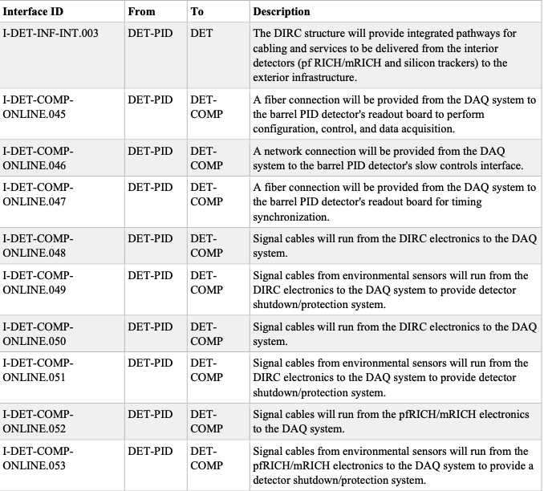
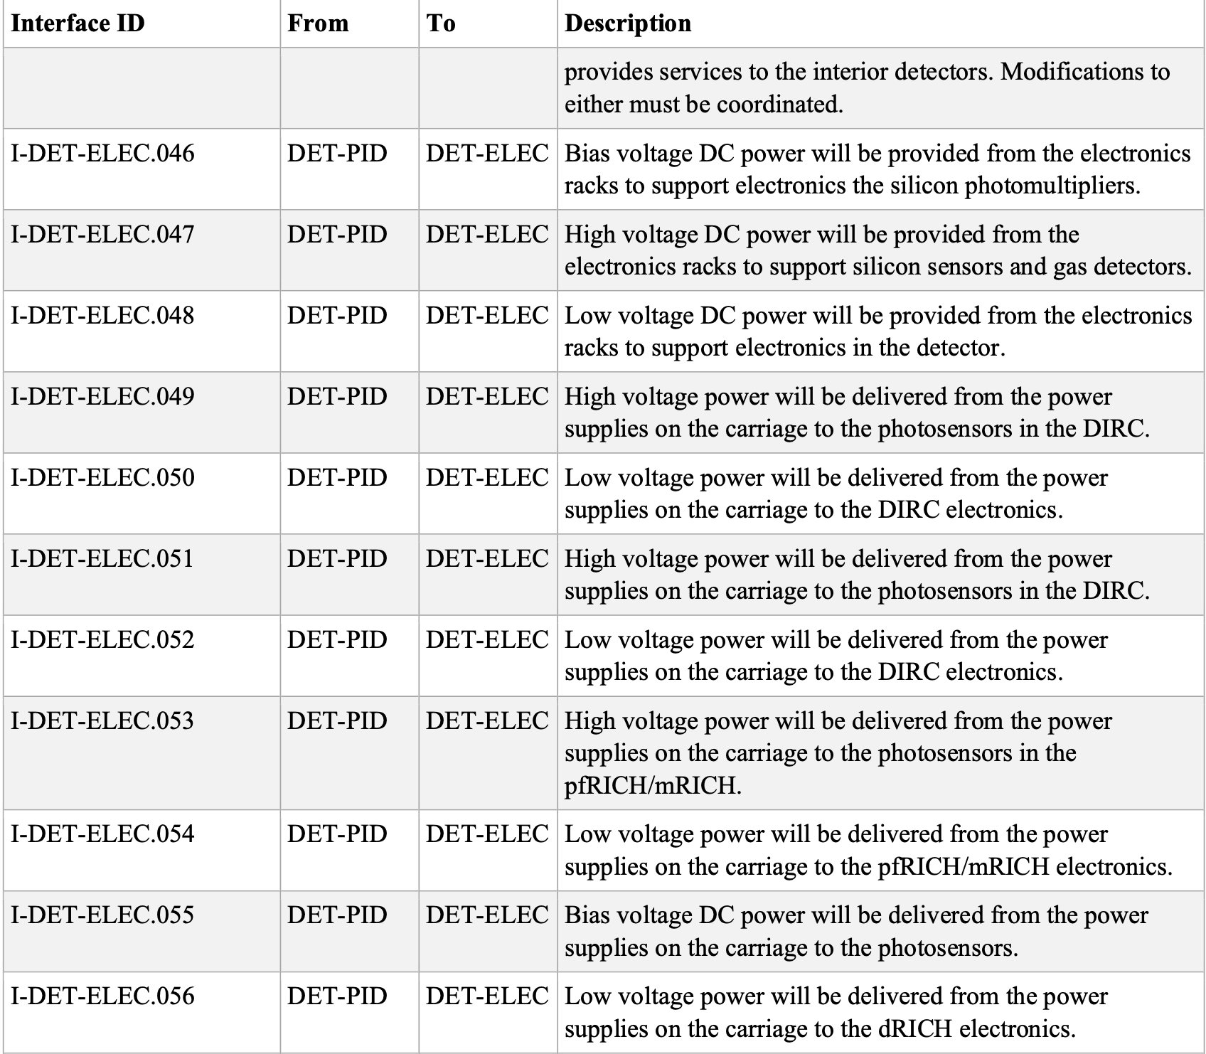
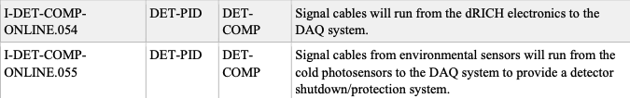
PID subsystem Interfaces
PID subsystem – DAQ/Computation interface
PID subsystem – Electronics interface
10th EIC DAC Meeting
S.Tarafdar / R.Ent / B.Zihlmann

Slide 21
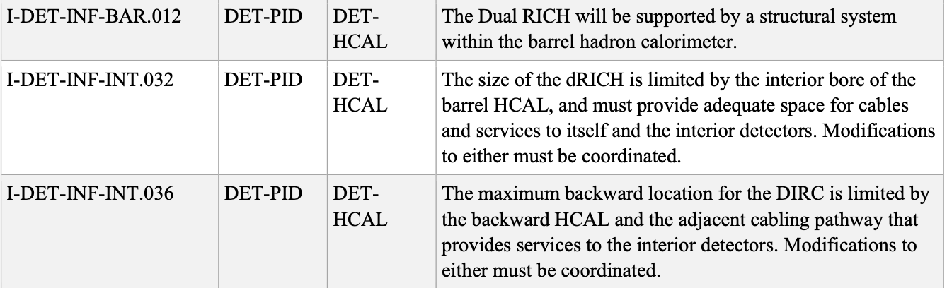
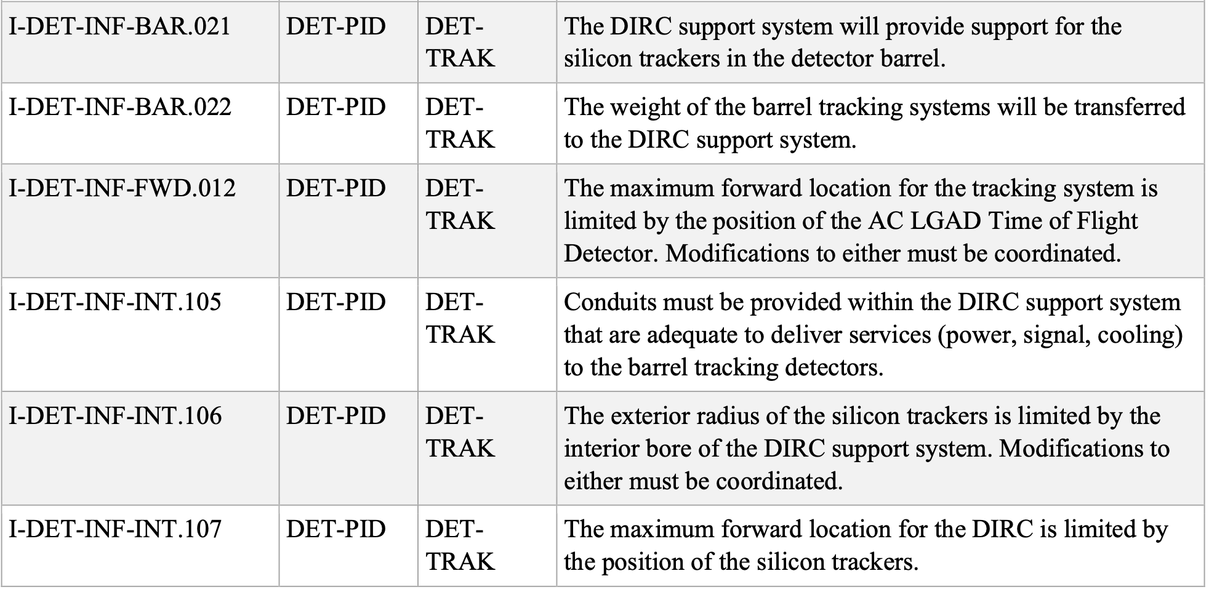
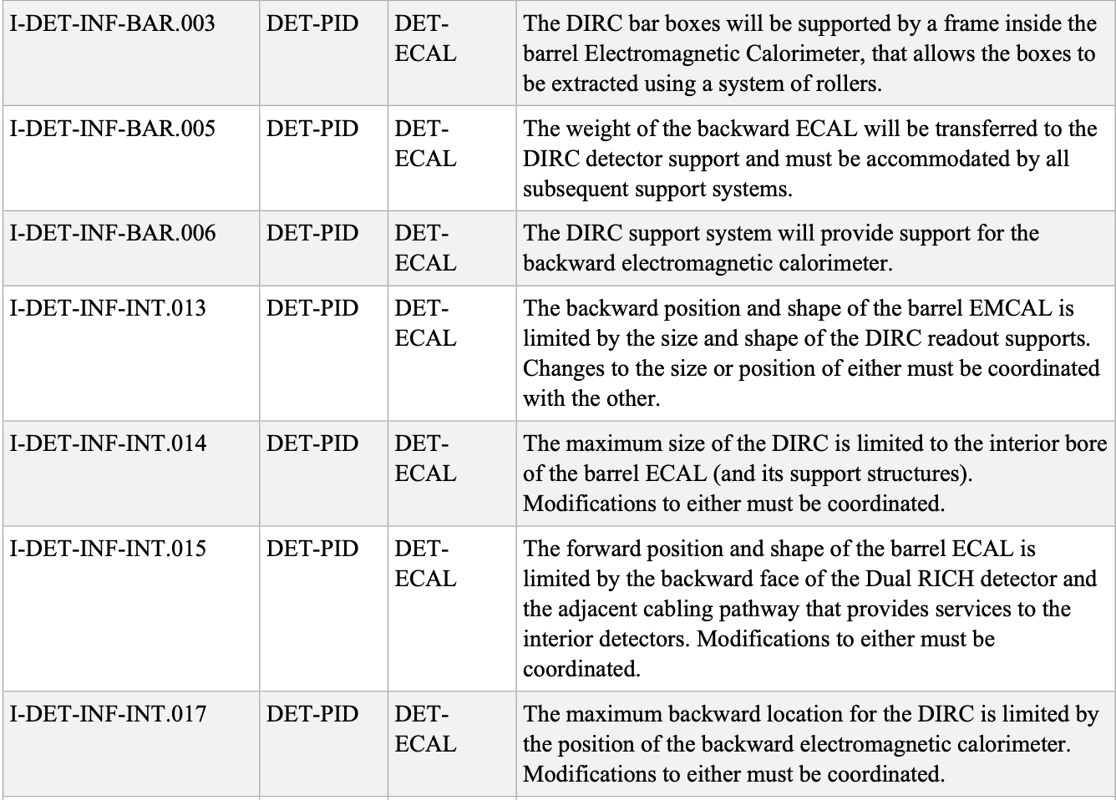
PID subsystem Interfaces (subsys – subsys)
PID subsystem – Calorimeter interface
PID subsystem – Tracking subsystem
Not complete list of interfaces shown on slides.
Interfaces between PID subsystem , magnet, detector infrastructure also exist
More details can be found in https://eic.jlab.org/Interfaces/InterfaceMatrix.html
10th EIC DAC Meeting
S.Tarafdar / R.Ent / B.Zihlmann

Slide 22
Summary
Requirements for both tracking and PID subsystem are well defined
(all are accessible online at https://eic.jlab.org/Detector)
Final version of General, Functional & Performance Requirements for EIC Detector Systems document has been approved.
(ref: https://indico.bnl.gov/event/28081/attachments/62045/106458/General_Functional_Performance.Requirements.pdf)
Interfaces are well defined.
(ref: https://eic.jlab.org/Documents/DET/Interfaces/DET-Interfaces-20241212.pdf)
Interface controls are being worked on. Some Interface Control Documents exist (CD-3A scope).
(the process to automatically generate templates from interfaces is ready)
10th EIC DAC Meeting
S.Tarafdar / R.Ent / B.Zihlmann

Slide 23

QUESTIONS
10th EIC DAC Meeting
S.Tarafdar / R.Ent / B.Zihlmann

Slide 24
Backup
10th EIC DAC Meeting
S.Tarafdar / R.Ent / B.Zihlmann

Slide 25
Tracking subsystem upcoming presentations
Ongoing Engineering Design activities
  SVT Endcaps :
    Ongoing effort in finalizing design and layout along with development of test article.
  SVT IB :
    Completion of preliminary design and ongoing effort to finalize assembly procedure along with building test articles.
  SVT OB :
    Prototyping of curved surface is ongoing
  Gas based trackers
    All gaseous trackers are in the process of assembling first test article.
  More details on future tasks on Si-trackers and MPGD trackers later today
10th EIC DAC Meeting
Sourav Tarafdar

Slide 26
PID subsystem upcoming presentations
pfRICH Engineering Design activities
  First article pfRICH vessel outer shell production
  Fine tuning of the aerogel refractive index and bulk uniformity measurement procedure
  HRPPD performance confirmation in the ~1.7 T magnetic field
  Engineering aspects of cooling, light monitoring, HV and LV.
  More details on future tasks by Brian Page for pfRICH.
TOF Engineering Design activities
  Characterization of both strip and pixel sensors with encouraging results
  Testing of first ever large AC-LGAD (3.2 X 4 cm)
  Production status of full size pixel sensors by HPK
  More details in talk by Simone Mazza & Mathieu Benoit for ToF.
dRICH Engineering Design activities
  Real scale 1-sector prototype validation
  ALCOR readout with RDO validation.
  Ongoing optimization of Optics parameters.
  Composite material usage to minimize material budget
  More details about future activities by Marco Contalbrigo on dRICH.
hpDIRC future activities
  Disassembly of bar boxes
  QA of disassembled bars
  Validity of photosensors (MCP-PMTs and HRPPD)
  More details on future activities by Greg Kalicy on hpDIRC.
10th EIC DAC Meeting
S.Tarafdar / R.Ent / B.Zihlmann

