Slide 1
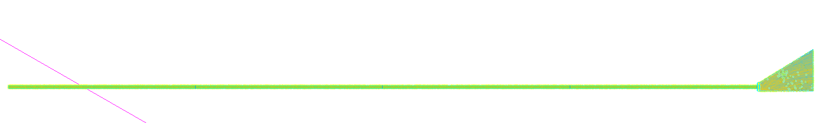
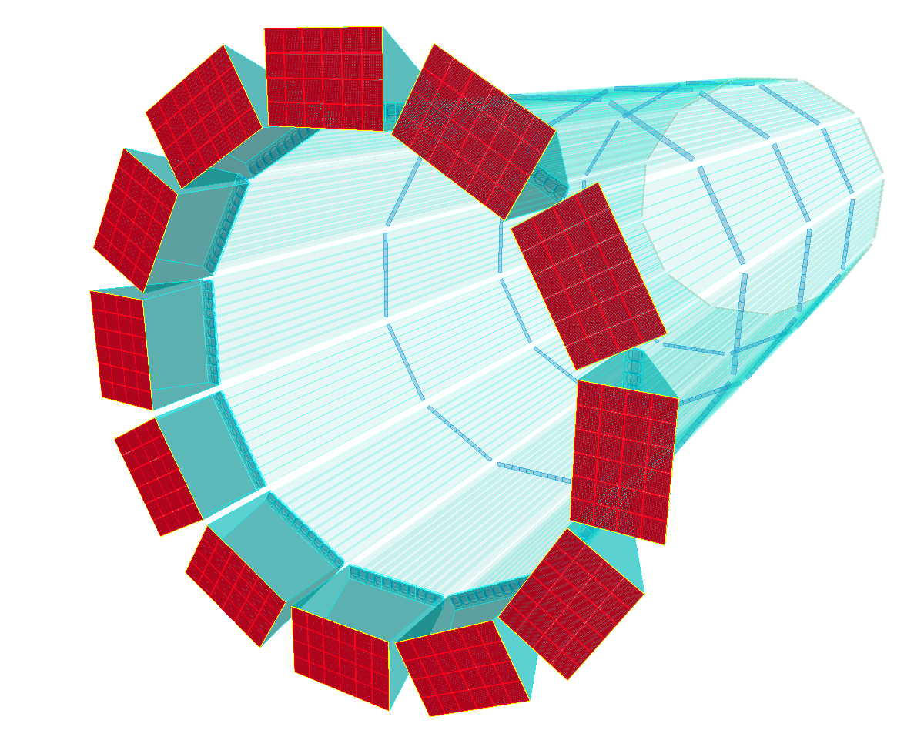






The hpDIRC Detector for the ePIC Experiment
Greg Kalicy
EIC DAC Meeting
June 12th, 2025

Slide 2
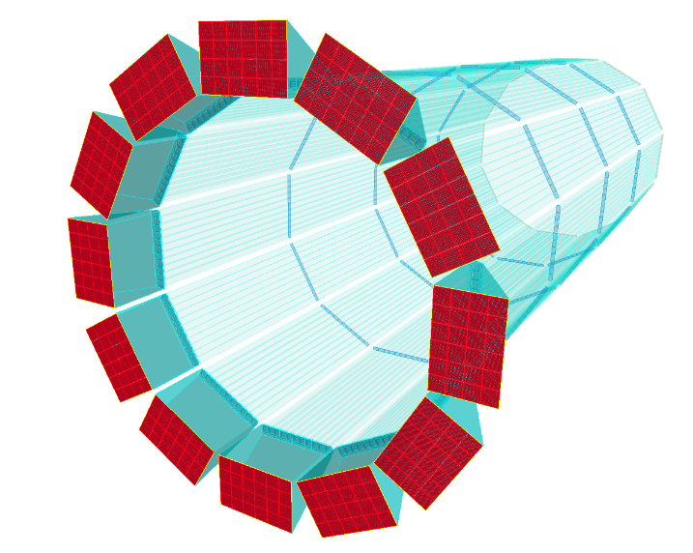
Executive Summary
The hpDIRC has been selected for the barrel PID of the EIC ePIC Detector
Expected PID performance meets ePIC requirements (Yellow Report),
separation: ≥ 3 s.d. π/K up to 6 GeV/c, ≥ 3 s.d. e/π up to ~1.1 GeV/c
Key elements, simulation and focusing lenses, validated in particle beams in 2018
Main remaining steps towards production readiness and TDR in 2026:
  Validation of reusing BaBar DIRC radiator bars
  Evaluation of sensors and readout ASIC (synergy with pfRICH and electronics/DAQ)
  Completion of mechanical design and integration
No challenges expected for ES&H and QA
hpDIRC DSC includes nine institutions with well-established expertise and interest in work packages
Plans for remaining studies, QA preparations, and construction match project schedule
Passed 60% Design review in April 2025

Slide 3
Incremental Preliminary Design and Safety Review
April 1-2, 2025: 60% Design Review of ePIC PID systems: pfRICH, dRICH, and hpDIRC
Review Committee:
    Peter Krizan (U Ljubljana), Chair
    Floris Keizer (CERN)
    Ana Amelia Machado (UniCamp)
    Koji Nakamura (KEK)
    Justin Stevens (W&M)
Slides from Review are available as pre-brief material
Feedback:
  "The PID detectors are fully on track for the CD2/3 review on the current project timeline."
  Significant progress acknowledged and final experimental validation tests encouraged
  Clear directions to prepare comprehensive documentation of remaining studies

Slide 4
EIC DAC Review Charge
Is the design of the ePIC detector and its sub-systems appropriate and progressing well?
Are the remaining work and technical, cost and schedule risks adequately understood?
Are there opportunities?
Will the detector be technically ready for baselining by late 2025?
Are the detector integration and planning for installation and maintenance progressing well?
Are there areas where further ideas should be pursued?
Will the detector be ready for start of construction by late 2026?

Slide 5
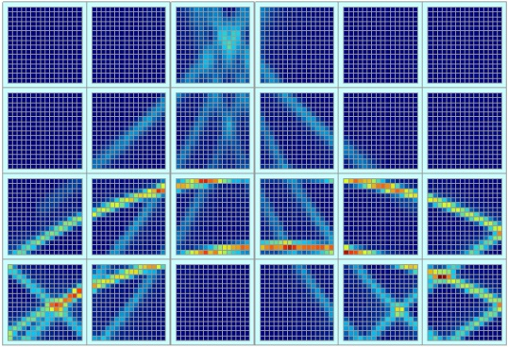
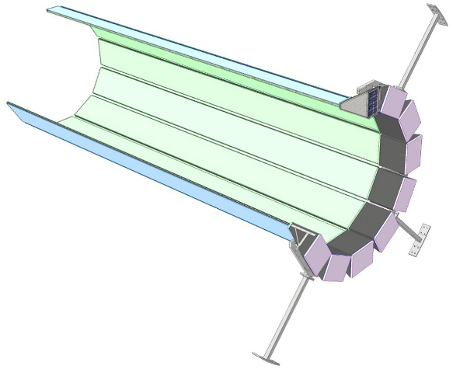
Outline
Introduction
  ePIC requirements for hadronic barrel PID
  DIRC principle
High-performance DIRC for ePIC
  R&D
  Preliminary design
  Simulation and expected performance
  Validation with prototype in particle beams and CRT
Main components
  Specifications, validation plans
Mechanical design and detector integration
Quality control and assurance
hpDIRC collaboration and responsibilities
Schedule

Slide 6
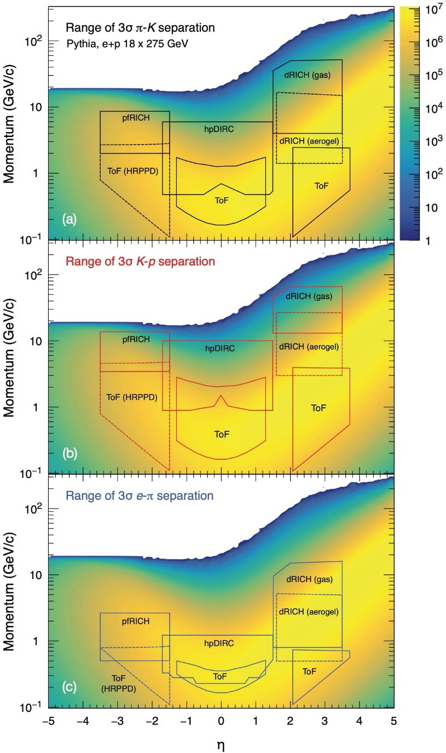
Charged PID Requirements in ePIC
Performance requirement definition
Summary of PID requirements in ePIC
EIC physics requires clean and efficient PID over a wide angular range
Hadronic PID required to separate:
  Electrons from charged hadrons -> electron ID mostly provided by
  calorimeters, supplemented for lower momenta by DIRC/RICH detectors
  Charged pions, kaons, and protons from each other
Requirements for barrel PID (-1 ≤ η ≤ +1):
  Main separation power requirement: ≥ 3 s.d. π/K up to 6 GeV/c
  System needs to be radially compact (impact on cost of outer systems)
  Minor changes to detector position and dimensions do not impact
  hpDIRC performance (sensor in B-field and detector integration)
  Low demand on detector services (simplified integration and operation)
hpDIRC capable of reaching required performance at 6 GeV/c for 0.5 mrad tracking angular precision

Slide 7
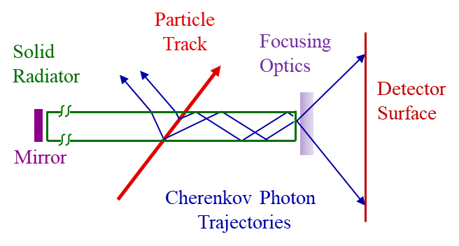
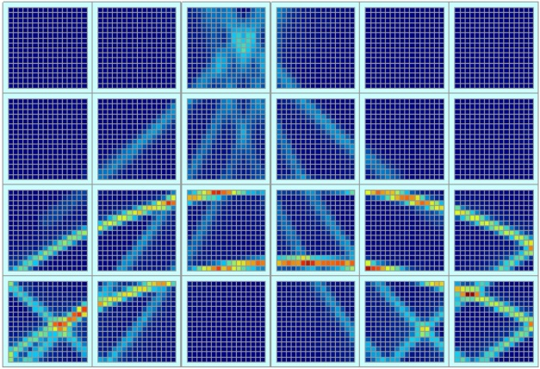
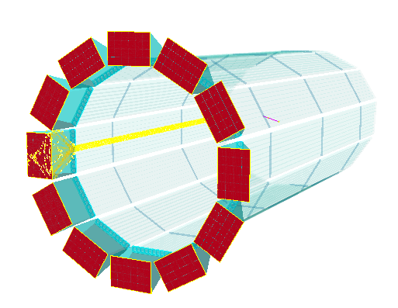

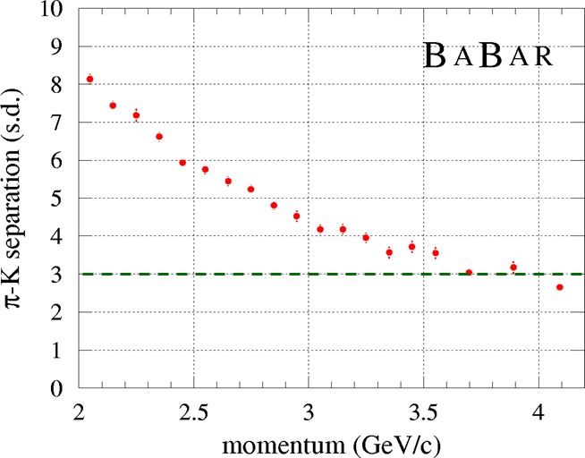
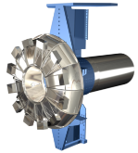

DIRC Concept
Detection of Internally Reflected Cherenkov Light
Accumulated ePIC hpDIRC hit pattern (Geant4)
Pioneered by the BaBar experiment
at the SLAC National Accelerator Laboratory
Fused silica bars or plates used as radiator and light guide
Detector surface is outside active volume
Cherenkov angle is conserved during internal reflections
and reconstructed from detected photons
Ultimate deliverable: PID likelihoods
BaBar DIRC achievement:
3 s.d. π/K separation up to 3.5 GeV/c

Slide 8
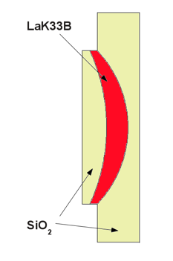
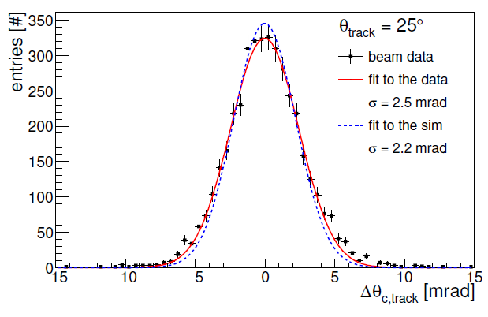
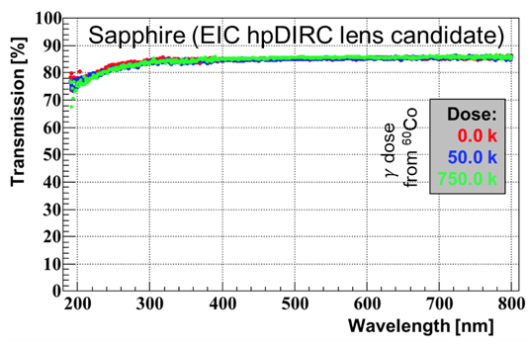
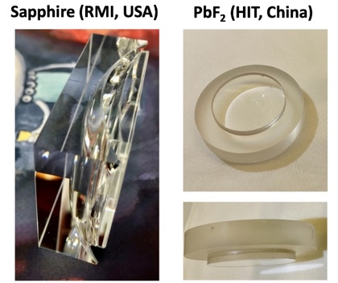
High-Performance DIRC R&D
Detector and readout design
10+ years ago: DIRC good candidate for hadronic particle in EIC detector barrel –
if π/K momentum coverage achieved by BaBar DIRC is increased by 50%
R&D for a high-performance EIC DIRC started in 2011 (synergetic with PANDA DIRC)
(Funded by DOE/BNL/JLab as RD2011-3, eRD4, eRD14, eRD103)
EIC DIRC R&D Milestones:
  2012: First multi-layer high-refractive index lens concept to avoid photon loss at air gaps
  2012: First 2-layer and 3-layer prototype lenses produced by industry
  2014: Simulation showed that lens-based design is expected to reach 1 mrad
  Cherenkov angle resolution, equivalent to 3 s.d. π/K separation at 6 GeV/c
  2015: First successful CERN beam test with muti-layer spherical lens
  2017: Identified sapphire and PbF₂ as radiation-hard material candidates for lenses
  2018: Validated 3-layer spherical lens performance and Geant4 simulation
  with PANDA DIRC prototype with particle beam at CERN
  2019: First radiation-hard lens prototypes fabricated by industry
  2022: hpDIRC selected as barrel PID solution for EIC detector
  2024: Transportation and start of BaBar bar box assembly, separation of first bar
Initial 3-layer lens concept
Cherenkov angle per particle, CERN 2015
radiation hardness of sapphire
radiation hard lens prototypes

Slide 9
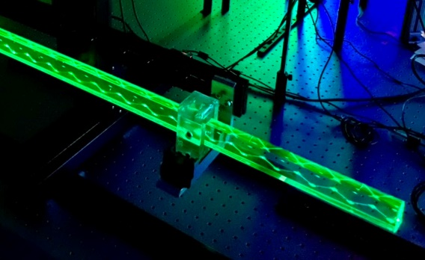
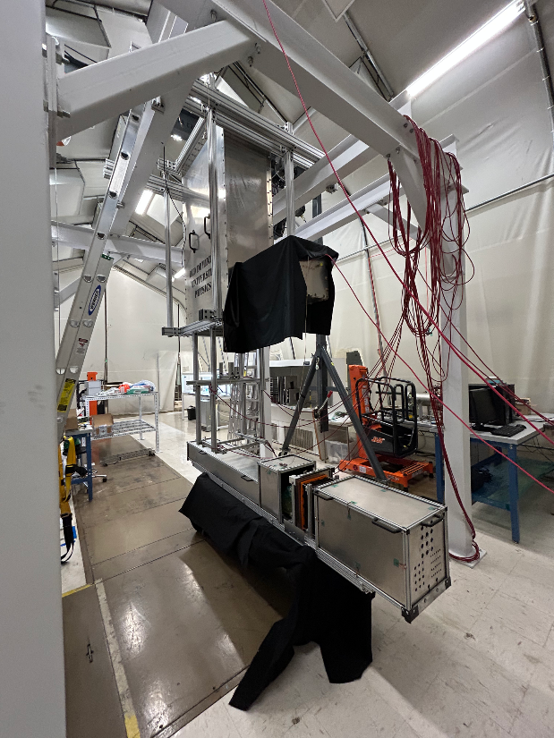
High-Performance DIRC R&D
Detector and readout design
Milestone reached: hpDIRC R&D concluded
Preparation for production readiness of hpDIRC: key components tested on dedicated optical benches, integrated vertical-slice prototype ready for tests within the Cosmic Ray Telescope (CRT) facility.
  All major design questions have been resolved, confirming the maturity of the hpDIRC baseline.
  Lens design and performance validated through systematic test bench measurements.
  First legacy DIRC radiator bars successfully separated and undergoing detailed characterization.
  Sensor and readout electronics development is actively progressing, led by collaborative efforts within eRD109 and eRD110.
  Full chain system validation of the complete hpDIRC setup will be performed in the CRT before entering the construction phase.

Slide 10
High-Performance DIRC Overview
Detector and readout design
Extending DIRC π/K separation coverage to 6 GeV/c
  Concept: fast focusing DIRC, utilizing high-resolution 3D (x,y,t) reconstruction.
  Radiation-hard 3-layer spherical lens to reduce bar image size and shape imaging plane;
  Lifetime-enhanced MCP-PMTs with fine anode segmentation to reduce pixel size;
  Fast photon timing for chromatic dispersion mitigation and background rejection;
  Narrow bars for robust performance in high-multiplicity jet events;
  Compact expansion volume to simplify integration into central detector.
  Benefit from additional ePIC detector improvements:
    High-precision tracking, expect 0.5 mrad polar angle resolution;
    Post-DIRC tracking layer (EMCal AstroPix) for multiple scattering mitigation.
  Predicted performance for central rapidity range -1.5 ≤ η ≤ +1.5:
  3σ π/K separation up to at least 6 GeV/c (Cherenkov angle resolution per particle ≤ 1 mrad),
  supplemental e/π separation up to 1.1 GeV/c.
Schematic view of the EIC hpDIRC

Slide 11
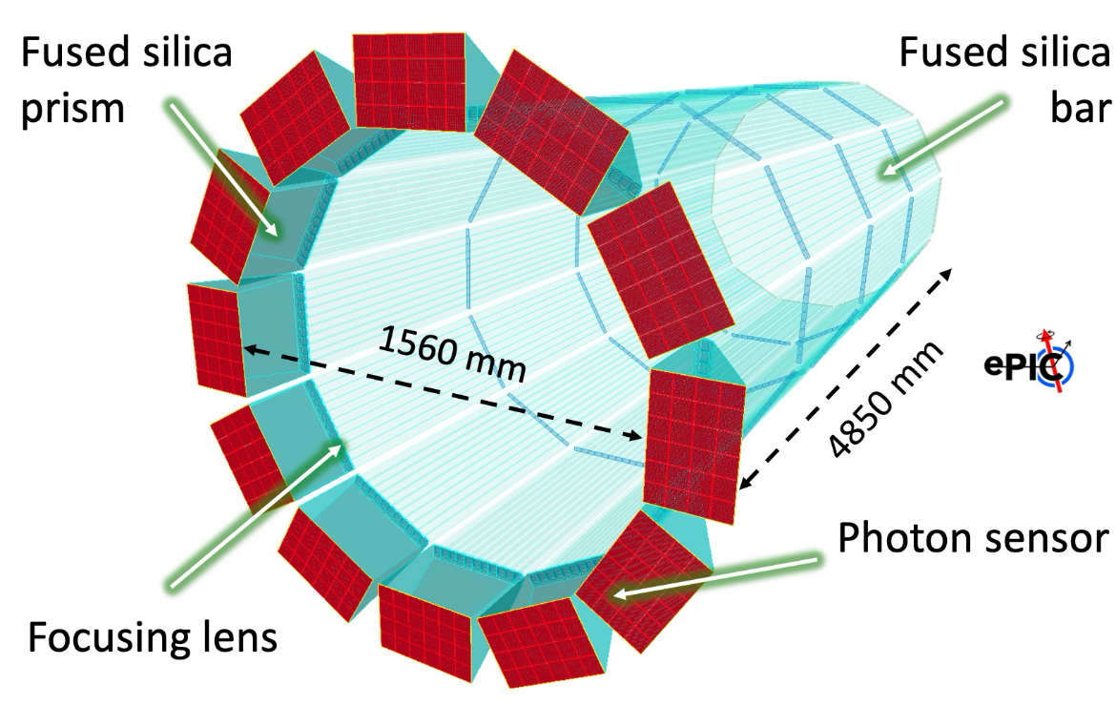

hpDIRC Design
Detector and readout design
Radiator bars:
  Barrel radius: 780 mm, 12 sectors
  10 long bars per sector, 4500 mm x 35 mm x 17 mm (L x W x T)
  Long bar: 4 bars, glued end-to-end
  Short bars made from highly polished synthetic fused silica
  Flat mirror on far end
Focusing optics:
  Radiation-hard 3-layer spherical lens (sapphire)
Expansion volume:
  Solid fused silica prism: 25 x 35 x 30 cm³ (H x W x L)
Readout system:
  MCP-PMT Sensors (Photek/Incom)
  ASIC-based Electronics (FCFD)
hpDIRC Components:
(CFRP bar box and readout box, flat mirror are not shown)
Sensors
Expansion Volume
Readout Electronics
Focusing
Lens
Radiator bar

Slide 12
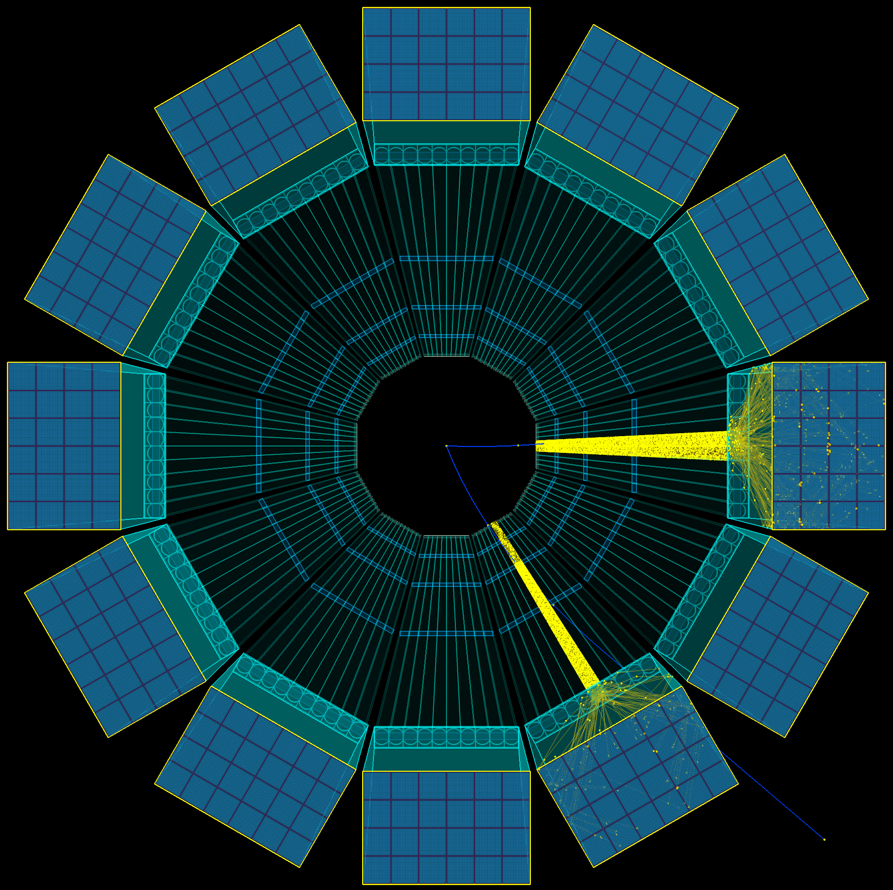
hpDIRC Simulation
Performance evaluation
Stand-alone Geant4 Simulation
  Realistic optics, geometry, and material properties – based on prototypes and experimental data, wavelength-dependent material properties and processes
  Validated with test beam data
  Used for design optimization studies and to test novel design options
Full ePIC Simulation:
  Functionality of Stand-alone simulation imported and integrated
  Repeat physics background and detector impact study in the full software stack
Reconstruction and PID methods:
  Geometrical (BABAR-like), robust and fast method based on Look-Up Tables,
  delivers Cherenkov angle per particle and Single Photon Resolution (useful for
  calibration and in prototype tests), does not depend on precise time measurement
  Time Imaging (Belle II TOP-like), uses Probability Density Functions (analytical or
  simulation-based), makes optimum use of precision of position and time information
Pythia events in hpDIRC simulation

Slide 13
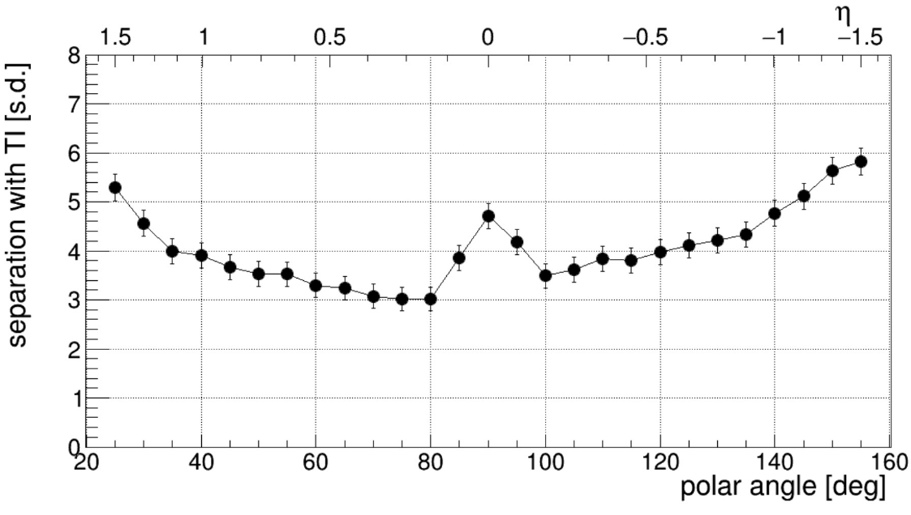
hpDIRC Simulation
Performance evaluation
Recent hpDIRC related studies:
  Confirmed robust performance in magnetic field, using physics
  events (Pythia) to include backgrounds, multiple tracks per bar (WSU)
  Performance with latest ePIC angular track resolution maps (GSI)
  → High-precision angular resolution crucial for reaching required hpDIRC performance.
  Verifying optimal sensor coverage (CUA, GSI)
  Study of the impact of bar imperfections on the hpDIRC performance
  relevant for the BaBar bar refurbishment (GSI)
  Impact of bar/lens misalignments on performance (Jazan)
  Machine Learning approach to reconstruction (W&M)
  Preparation for hpDIRC full chain test setup operation at CRT
  (SBU, GSI, ODU)
π/K separation power at 6 GeV/c
Geant4
time imaging reconstruction
0.5 mrad tracking, 100 ps photon timing
Simulation studies performed with
Stand-alone Geant4 simulation
Single particles from particle gun
No magnetic field, no other ePIC subsystems
0.5 mrad tracking resolution
→ Performance requirements reached: ≥ 3 s.d. π/K separation at 6 GeV/c for all angles

Slide 14

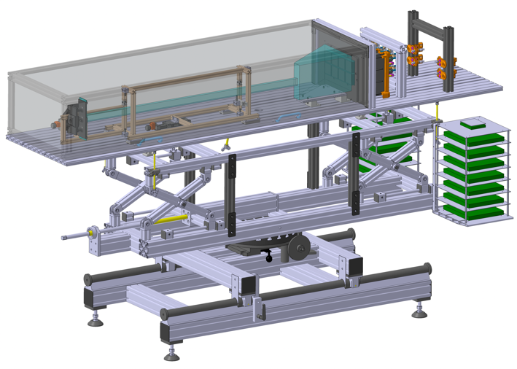
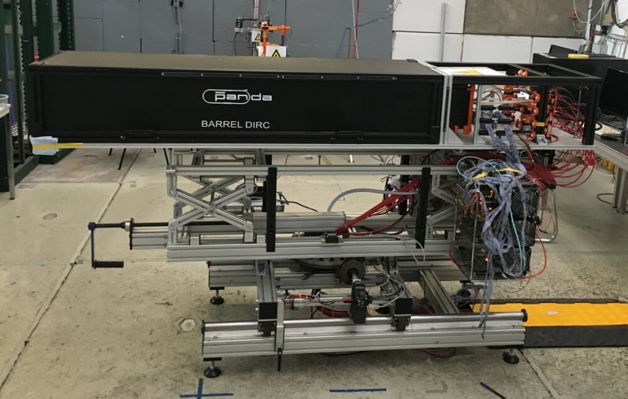
Validation of Simulation and Components
Performance and construction plans
Performance validation: synergetic beam test with PANDA prototype at CERN PS in 2018
Narrow fused silica bar, hpDIRC 3-layer spherical lens
30 cm-deep fused silica prism
2x4 PHOTONIS Planacon MCP-PMT array
(larger pixels, slower readout electronics than EIC)
PiLas picosecond laser calibration system
7 GeV/c π/p beam equivalent to 3.5 GeV/c π/K
MCP-TOF system to cleanly tag π and p events
View from inside the Barrel DIRC dark box
Schematic view of 2018 prototype
MCP-PMT array
Dark box for optics
(bar, lens, prism)
Frontend electronics (PADIWA)
(air-cooled)
Rotation stage
(remote controlled)
DAQ boards (TRB)

Slide 15
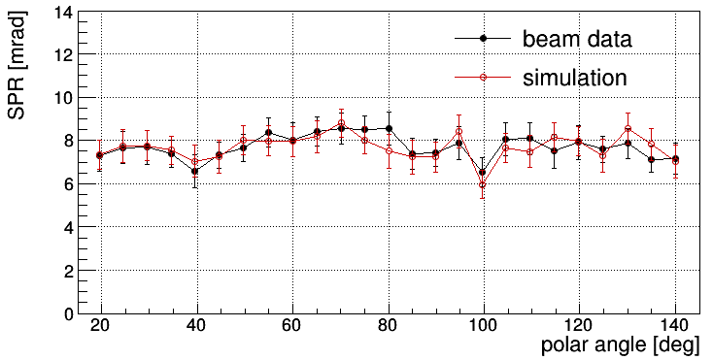
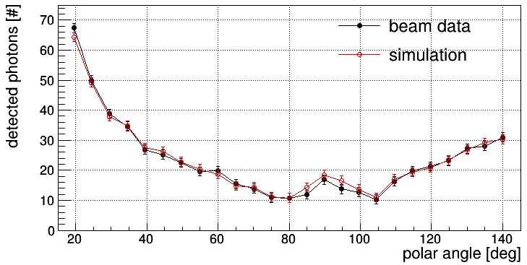
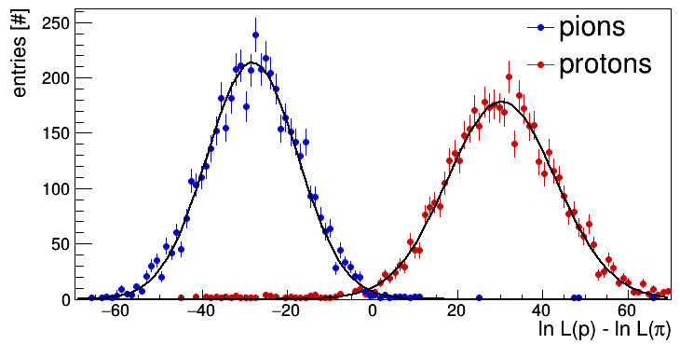
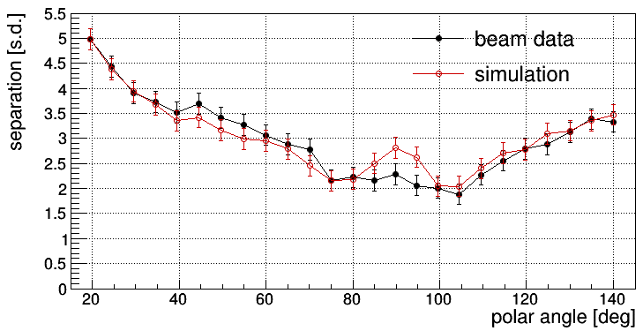
Validation of Simulation and Components
Performance and construction plans
Performance validation: 2018 prototype at CERN PS
observed hit pattern at polar angle 20°
SPR
Photon yield
π/p separation power @ 7 GeV/c
Measured Cherenkov angle resolution per photon (SPR), photon yield, and
π/K separation in excellent agreement with expectation and Geant4 simulation
Achieved π/K separation power of N_{sep}=5.2 s.d. with time imaging reconstruction
for PANDA configuration, will improve with smaller pixels, better PDE and timing
Same simulation/reconstruction code used for EIC high-performance DIRC
-> Confidence in Geant prediction for hpDIRC performance
π/p separation

Slide 16
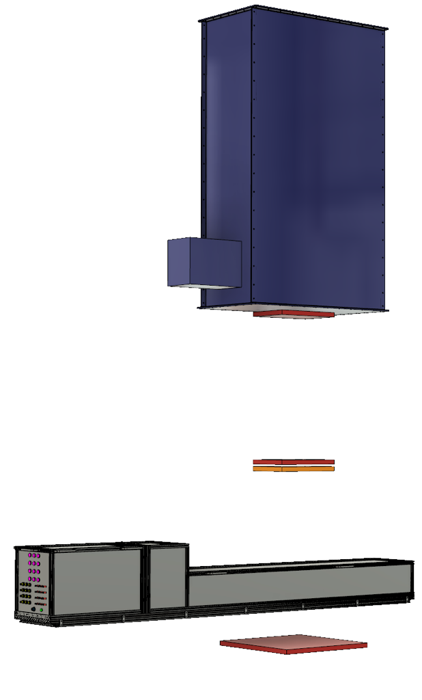
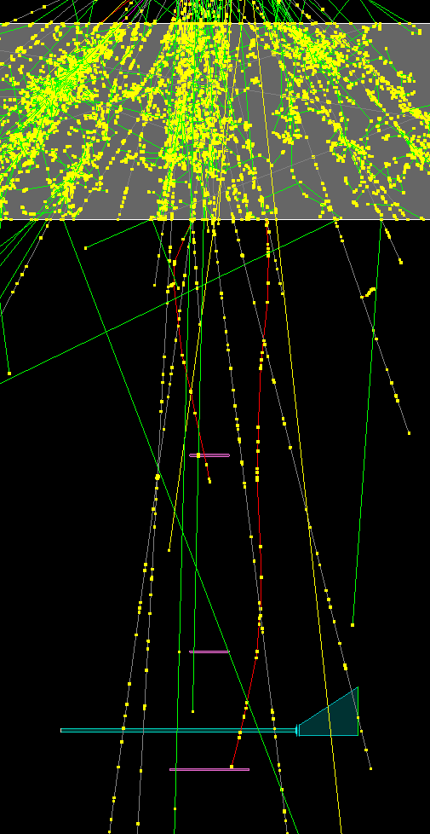
Validation of Simulation and Components
Performance and construction plans
CRT setup CAD schematic
Cosmic Ray Telescope (CRT) at SBU
Facility to test incremental upgrades of setup with hpDIRC components, performance evaluation
Initial PANDA Barrel DIRC-based setup for commissioning
Modular design will allow to add new ePIC hpDIRC components once they become available
Cherenkov Tagger to select muons above 3.5 GeV/c
Three tracking stations for high-precision 3D-track reconstruction (location optimized with simulations)
PicoSec detector for event timing (JLab group committed prototype and personnel to project)
Geant4 simulation used to optimize setup arrangement
Geant4 simulation of CRT setup
Cherenkov Tagger
4 m
Tracking Station 1
Tracking Station 2
PicoSec
hpDIRC Prototype
Tracking Station 3
1.5 m

Slide 17
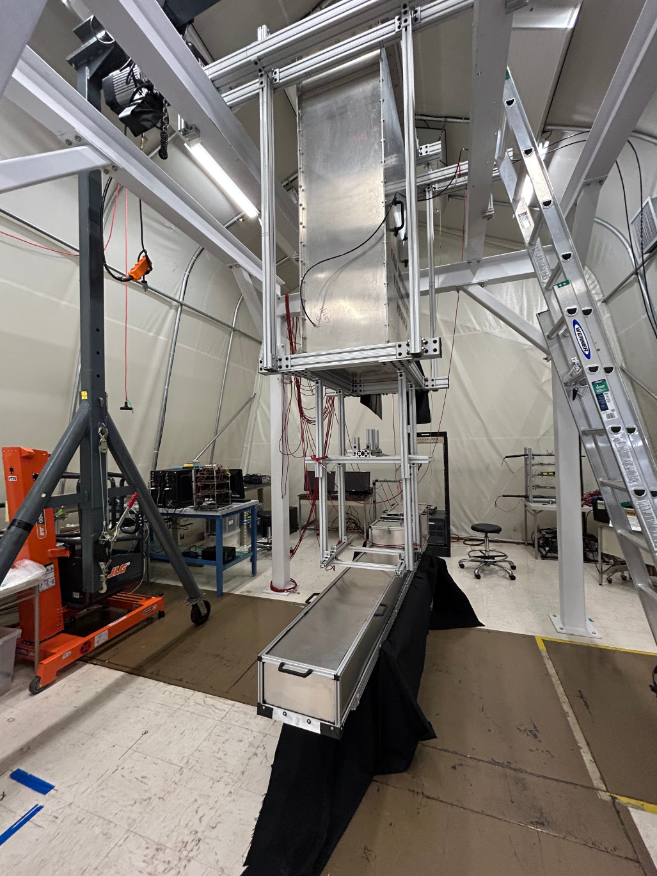

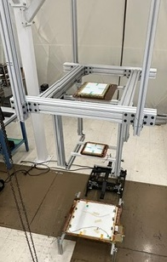
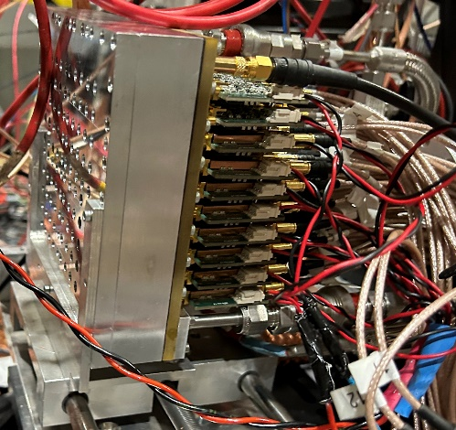
Validation of Simulation and Components
Performance and construction plans
Trackers in the CRT
Cherenkov
Tagger
Cherenkov
Tagger
DAQs
Large area PICOSEC
hpDIRC
Prototype
hpDIRC
Prototype

Slide 18
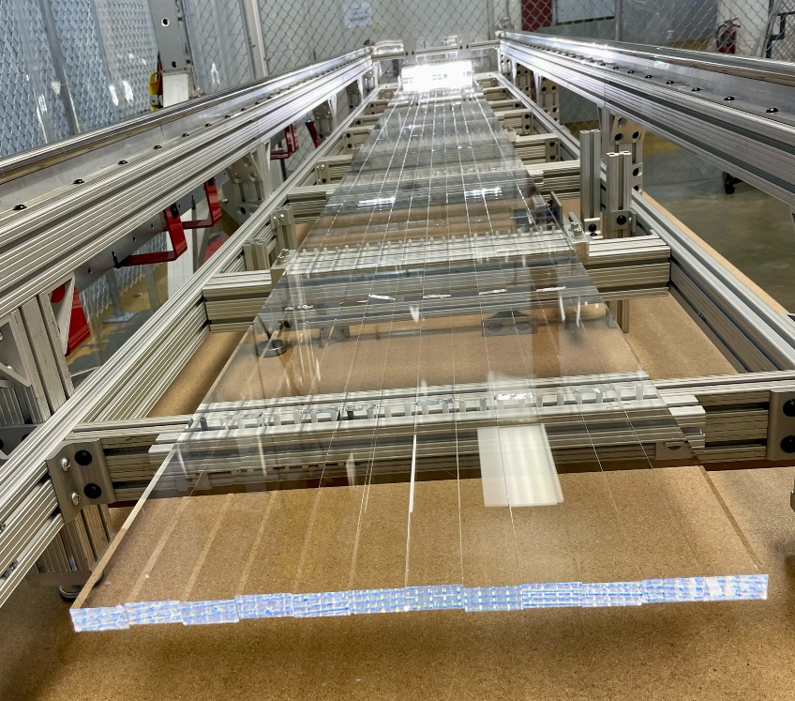
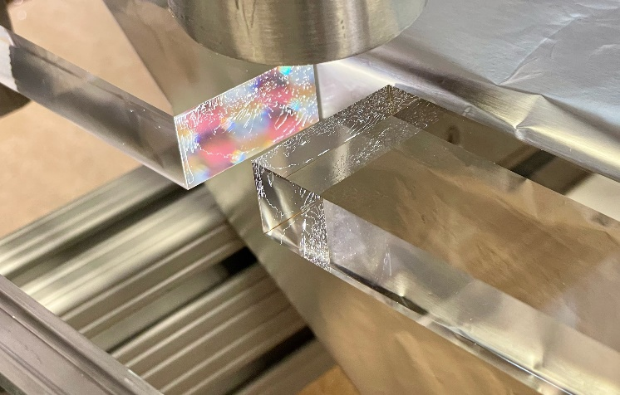
Reuse of BaBar DIRC Bars
Fabrication and assembly plans
  BaBar DIRC decommissioned in 2010, SLAC/DOE made DIRC bars available for
  reuse, 4 bar boxes awarded to JLab and installed as GlueX DIRC in 2018,
  remaining 8 boxes awarded to JLab for potential use in EIC DIRC
    Bar boxes transported to JLab in April 2024
  BABAR bar boxes are too long for the ePIC barrel, existing wedges at readout end
  are incompatible with lens focusing: need to disassemble bar boxes for reuse
    Facility, setups, and tools developed, disassembly of first bar box in progress
  hpDIRC barrel requires total of 360 short bars (1.225 m length)
  Eight bar boxes currently located at JLab could yield up to 384 short bars,
  sufficient to cover rapidity range -1.65 ≤ η ≤ +1.65
  Additional 120 bars required for the light guide section, η ≤ -1.65, to couple to lenses
  Quality of bar surfaces, 25 years after initial production and disassembly, to be verified
    QA of first disassembled bars in progress

Slide 19
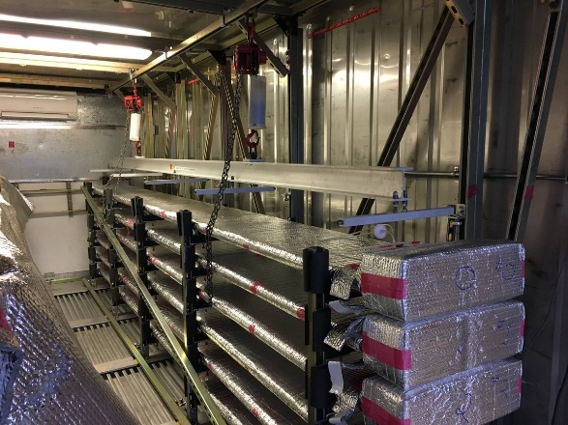
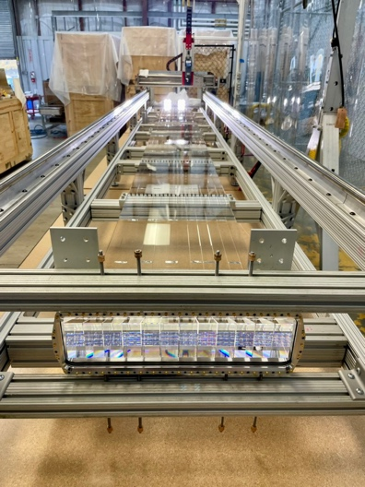
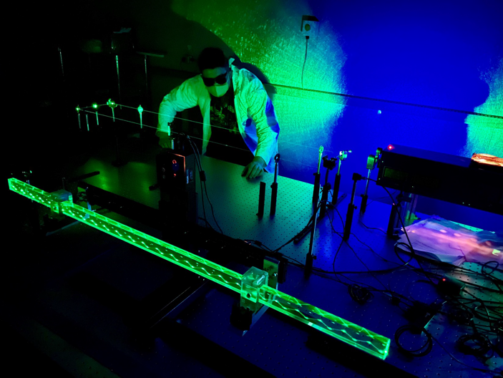



BABAR DIRC bar boxes at SLAC
Opened BABAR DIRC bar box at JLab
BABAR DIRC bar in JLab QA setup
PYTHIA events in ePIC hpDIRC
ePIC hpDIRC
DIRC Bar Specifications and BABAR DIRC Bar
Refurbishment for ePIC
PID Review – April 2nd
JLab EIC Meeting – April 4th
Final Design Review of the BABAR DIRC Bar Refurbishment for the High-Performance DIRC Particle Identification Detector
Jochen SCHWIENING
GSI Helmholtzzentrum für Schwerionenforschung GmbH

Slide 20
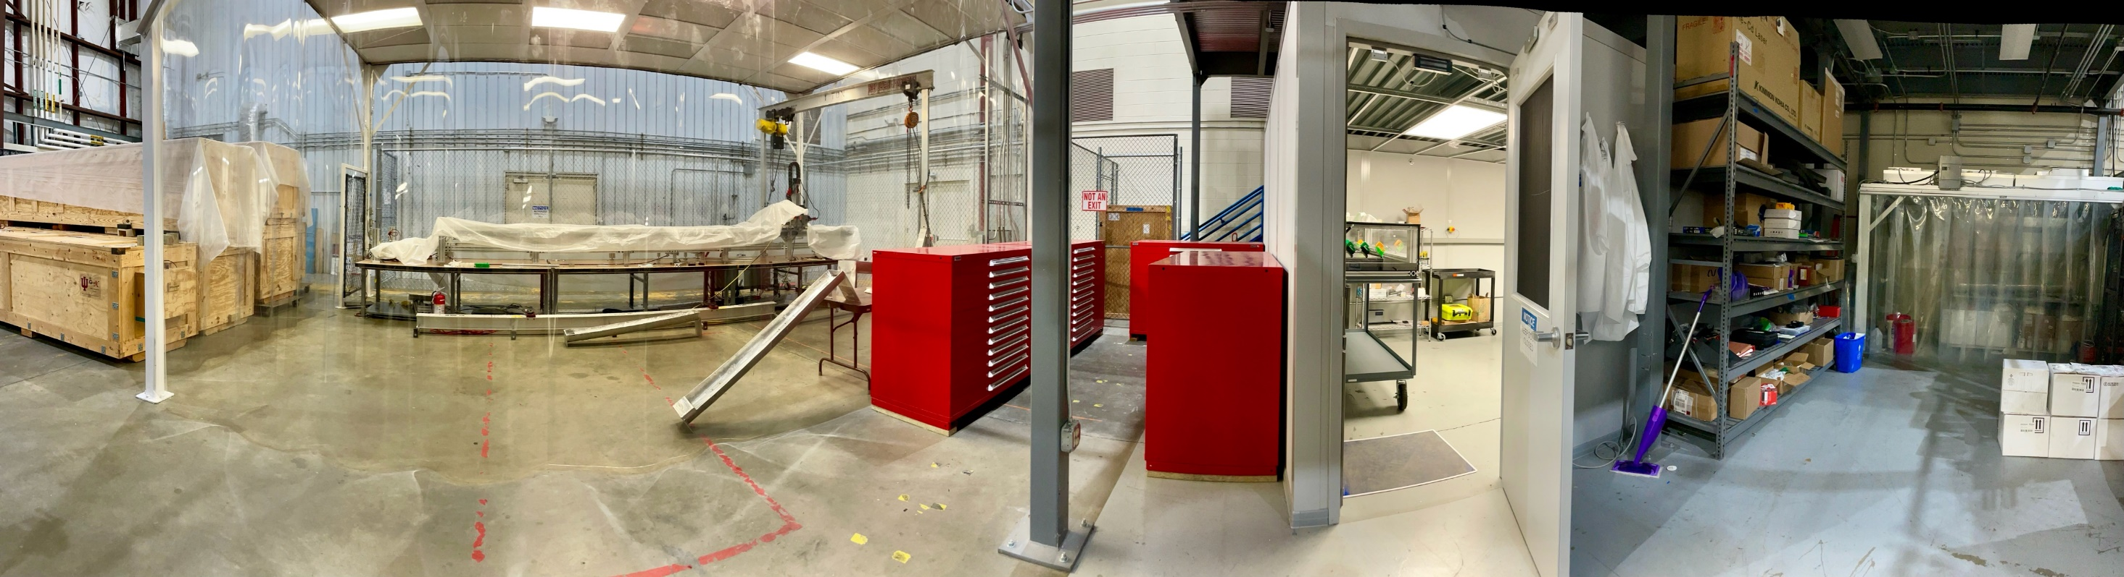
Reuse of BaBar DIRC Bars
Fabrication and assembly plans
Bar boxes in
transportation
crates
Clean disassembly tent
Storage
cabinets
QA laser lab
Cleaning station
Disassembly process in JLab:
Bar boxes are disassembled and bars are separated in clean tent
Cleaning station to remove residue glue, visually inspect bars
QA laser lab to inspect quality of the bars after disassembly
Measured bars are wrapped, tagged and stored in cabinets
Team working on disassembly:
3 JLab Technicians: Andrew Lumanog, Caleb Graham, David Edwards
2 Scientists: Greg Kalicy (CUA), Sourav Tarafdar (JLab)
JLab DSG Group: Tyler Lemon, George Jacobs, Mindy Leffel
Graduate Students: Shelby Arrigo (W&M)

Slide 21
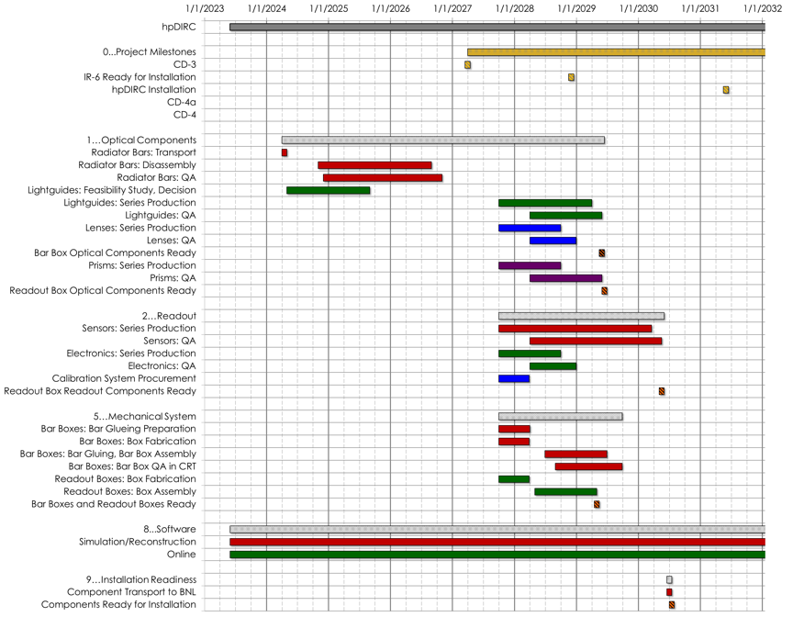
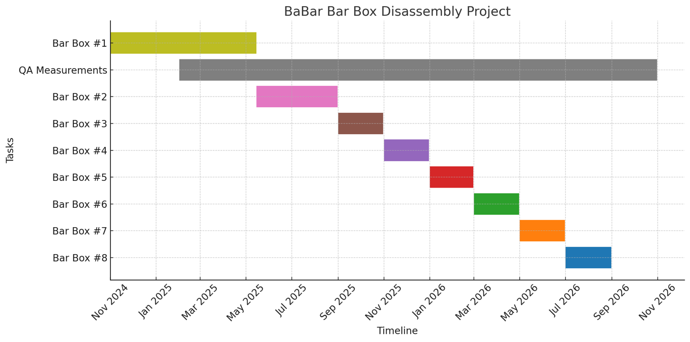
Reuse of BaBar DIRC Bars
Fabrication and assembly plans
Resource-loaded schedule for refurbishment
  Expect work on each bar box to take about 2 months
    Disassemble and remove one bar box shell: 2 weeks
    Decouple 3 bar-bar joints, clean bar ends: 2 days
    Clean and visually inspect one bar, tag ID, place bar in holder: ½ day
    Laser QA measurement, wrap, move to storage: 1 day
  Spreadsheet keeps track of bar tag ID, properties, location
  Some of the task executed in parallel
  Task completion expected by Nov 2026
Refurbishment schedule fits overall ePIC hpDIRC schedule

Slide 22
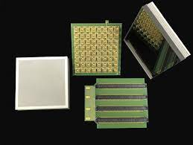
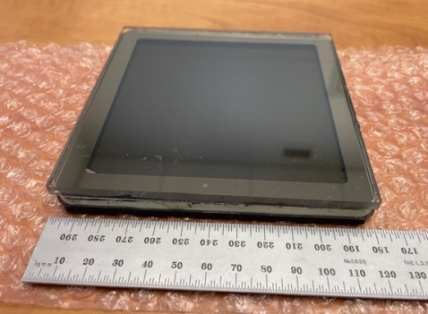
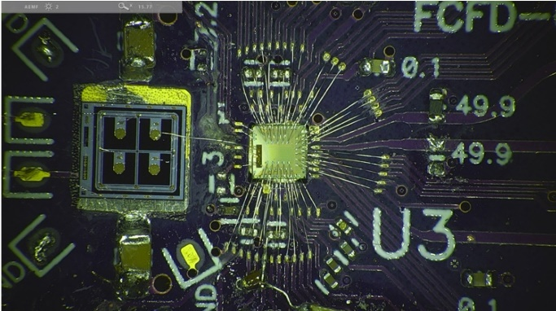
Readout
Detector and readout design
hpDIRC readout: Microchannel-Plate PMTs + ASIC-based electronics
MCP-PMTs capable of meeting all hpDIRC requirements (A. Lehmann review talk at RICH2022)
Baseline sensor for hpDIRC: 2’’ Photek MAPMT 253 MCP-PMT
Potential solution: DC-coupled Incom HRPPD
Making use of synergy with pfRICH, optimizing cost and workforce
  See pfRICH presentation from Brian for more HRPPD details
  and Alexander’s slides on sensors from recent PID Review
Setups are ready for side-by-side comparison and evaluation of key performance
parameters with clear plan to have initial results and decision on sensor before TDR
Baseline front-end board: FCFD
Synergetic development with ePIC AC-LGAD and pfRICH systems
Low-power ASIC, 128 channels per board
Will deliver hit time, time over threshold
  See readout presentation from Fernando and DAQ presentation from David
Photek MAPMT 253
INCOM Gen III HRPPD prototype (front/back view)
A. Kiselev
FCFDv0

Slide 23
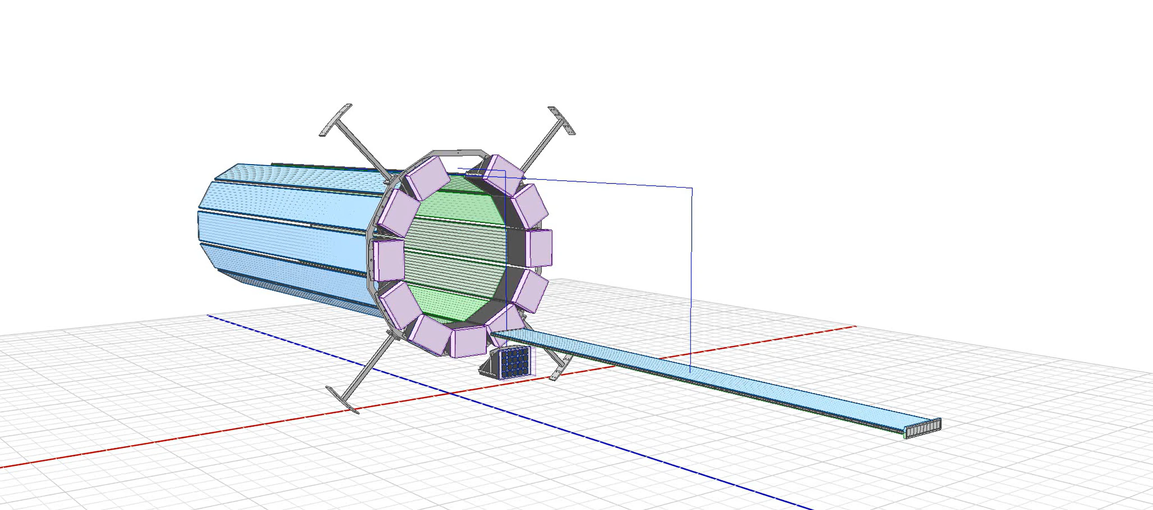
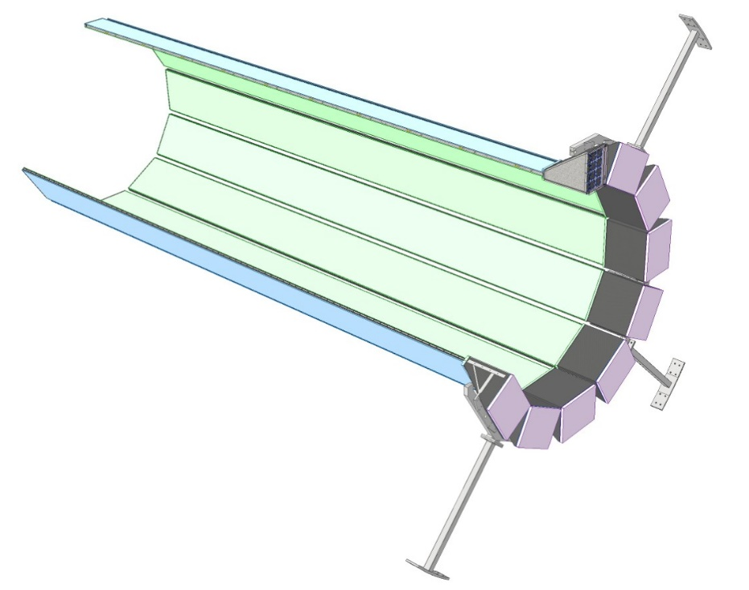
Mechanical Support and Integration
Detector integration plans
Engineering/integration support for hpDIRC from EIC project:
Avishay Mizrahi (MIT)
Kris Cleveland (JLab)
Support Ring
Bar Box
Prism Box
Forward
Backward
Connection to ePIC Barrel

Slide 24
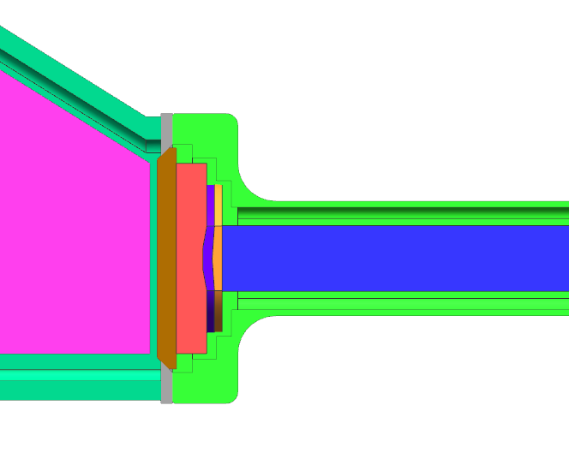
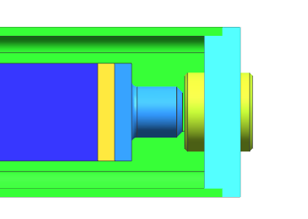
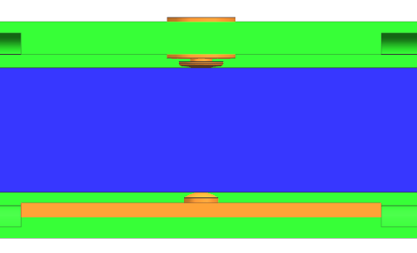
Mechanical Support and Integration
Detector integration plans
Bar Boxes:
CFRP Shell
  Approximately 4.6m Long
  Thickness: 1.5 mm – 3 mm
    (thicker in key locations)
Contains Quartz Radiator Bars, Mirrors, and Lenses
  10 long bars each formed by 3 short bars and a light guide section
  Radiator bars supported on rounded nylon buttons to minimize losses
Capped on each end
  Spring End Plate at Forward End
  Adjustable spring assemblies for each bar
  Maintain compression in glue joints
  Optically transparent window at backward end
  Counters force from springs at forward end
  Provides gas-tight boundary
F = ~900N
Window
Mirror Plunger
Mirror
End Plate
Lens
Prism
Bar
Light Guide
Spring Shell
Spring
Spring Button
Bar
Fixed Button

Slide 25
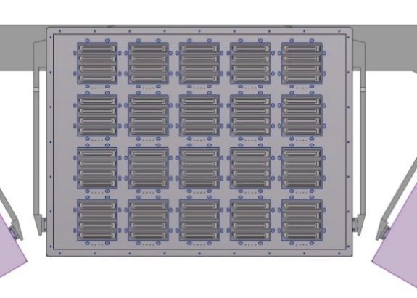
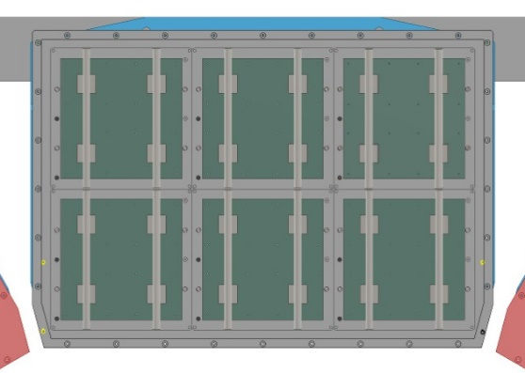
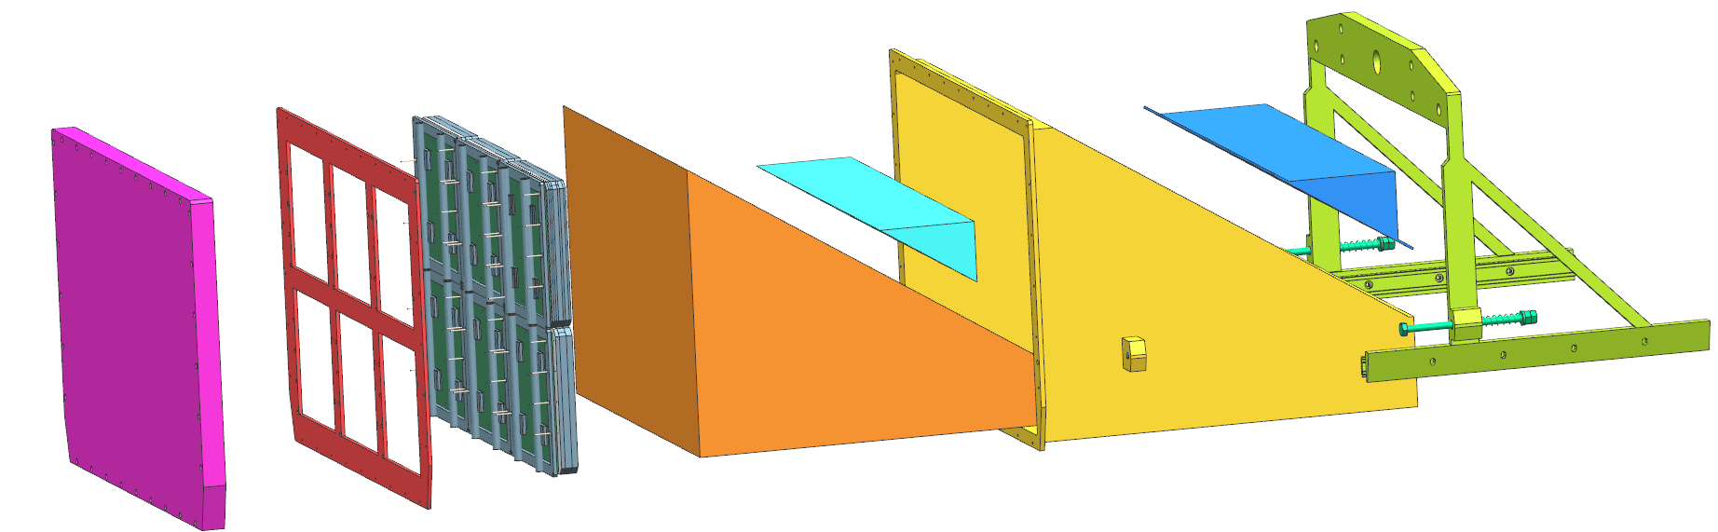
Mechanical Support and Integration
Detector integration plans
Readout Box
Box shell
    Current material: CFRP
    Current thickness: 5 mm
Contains expansion prism, calibration laser system
Supports sensors, readout electronics, and associated services
Mechanical design solutions for two sensor options:
    MCP-PMT (baseline)
    HRPPD
Optical cookie connection between prism and bar box window
MCP-PMT
HRPPD
Sensors, Readout Electronics, Service connections
Calibration Prism
Calibration Prism Cover
Light-Tight Cover
Carrier
Prism Box Shell
Expansion Prism
Alignment Grid
Adjustable Spring Prism-Bar Box Connector

Slide 26





QA Plan
Quality Assurance
Quality assurance plans (100% components will be verified/tested)
Combination of process control/QA at vendor site and lab measurements
Radiator bars and light guides: vendor QA for mechanical properties,
laser scanning system at JLab to monitor internal photon transport efficiency
of disassembled BaBar DIRC bars and/or new DIRC bars
Sensors and electronics: laser pulser systems at CUA/JLab/USC (TBD)
to measure gain, quantum and collection efficiency, dark count rate, etc
Lenses: laser lab at ODU to evaluate shape of focal plane
Prisms: vendor QA, checks at WSU
Bar boxes, prism boxes: vendor QA, checks at CRT (SBU or JLab)
Assembled DIRC module (bar box coupled to readout box, vertical slice):
Cosmic Ray Telescope at SBU or JLab
Installed DIRC module in ePIC: picosecond laser pulser calibration system,
cameras to monitor optical coupling between sensors, prisms, lenses
Lens evaluation setup at ODU
DIRC laser lab at JLab
DIRC lab and Cosmic Ray setup at SBU (photos, Geant4)

Slide 27

Schedule
Fabrication and assembly plans
hpDIRC technical schedule consistent
with project schedule
hpDIRC scheduled for installation into
ePIC in June 2031, expect hpDIRC readiness for installation well before that date

Slide 28


hpDIRC DSC
Fabrication and assembly plans
ePIC hpDIRC group (DSC)
  Core formed by groups that have been involved in the BaBar, GlueX, and PANDA
  DIRC counters, and in the EIC DIRC R&D program, for many years, some since 2011
  Current number of people across all institutions actively involved is 25
Responsibility examples:
  Radiators: transport and disassembly of BaBar DIRC bar boxes,
  validation quality of disassembled bars, optional QA
  of new bars/plates for light guide section – JLab, CUA, W&M
  Bar boxes: gluing of bars and lenses, assembly of
  bar boxes, QA in Cosmic Ray Telescope – SBU, JLab
  Lenses: evaluation of focal plane, QA – ODU, CUA
  Sensors: QA, readout chain tests – USC, Glasgow
  Readout boxes: assembly, QA – WSU
  Simulation, reconstruction – CUA, GSI, W&M, WSU, Jazan

Slide 29

Summary
ePIC hpDIRC: Fast focusing DIRC concept, developed over 10+ years of EIC R&D
Expected PID performance meets ePIC requirements (Yellow Report),
separation: 3 ≥ s.d. π/K up to 6 GeV/c, ≥ 3 s.d. e/π up to ~1.1 GeV/c
Key elements, simulation and focusing lenses, validated in particle beam in 2018
Main remaining steps towards production readiness and TDR:
  Validation of reusing BaBar DIRC radiator bars
  Evaluation of sensors and readout ASIC (synergy with pfRICH)
  Completion of mechanical design and integration
ePIC hpDIRC group includes nine institutions, 23 active participants
with well-established expertise
Plans for remaining studies, QA, and construction match project schedule
Passed 60% Design review in April 2025
Passed Final Design Review of BaBar DIRC bar refurbishment in April 2025

