Slide 1

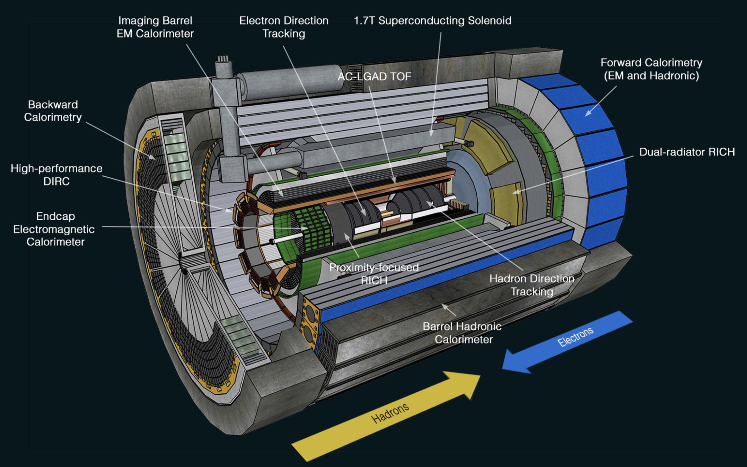
ePIC dRICH Status
ePIC Detector
M. Contalbrigo – INFN Ferrara - DSCL
10th EIC DAC Meeting – June 11th - 13th, 2025
M. Contalbrigo
10th EIC DAC Meeting - June 11th – 13th, 2025
1

Slide 2
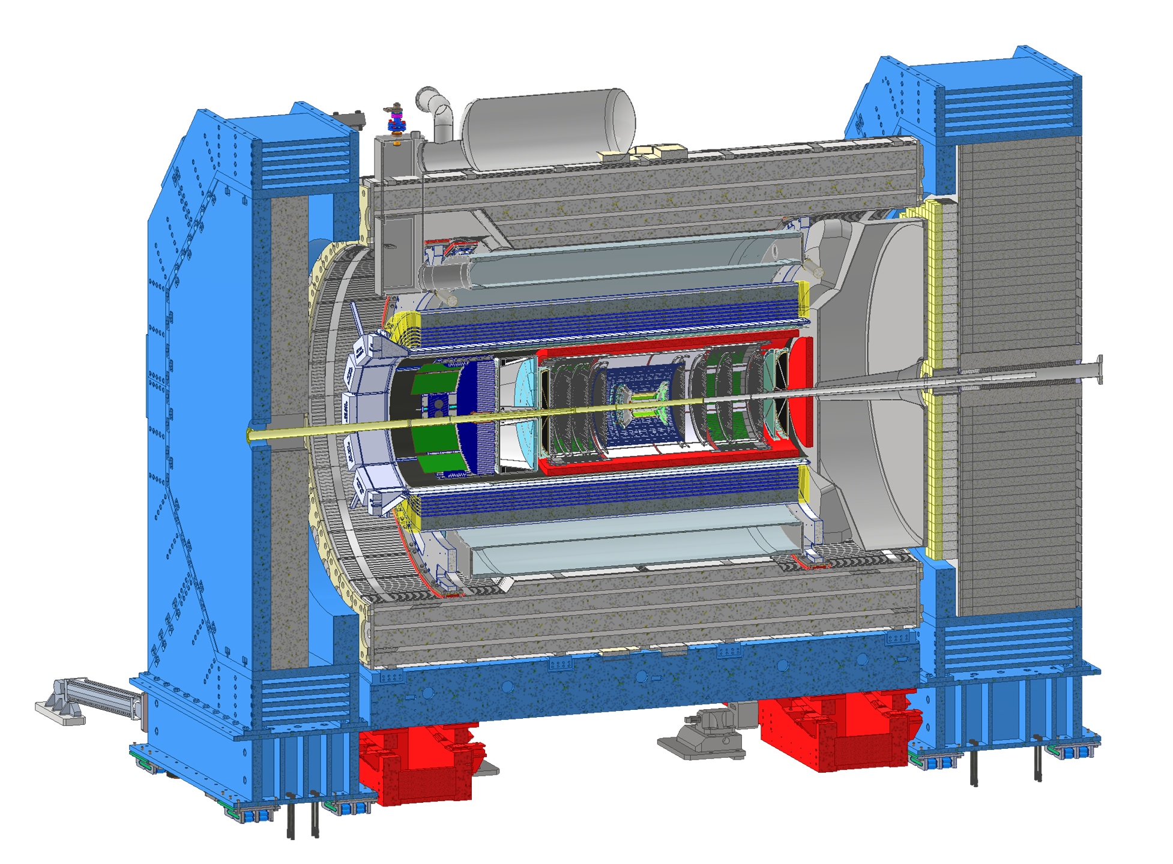
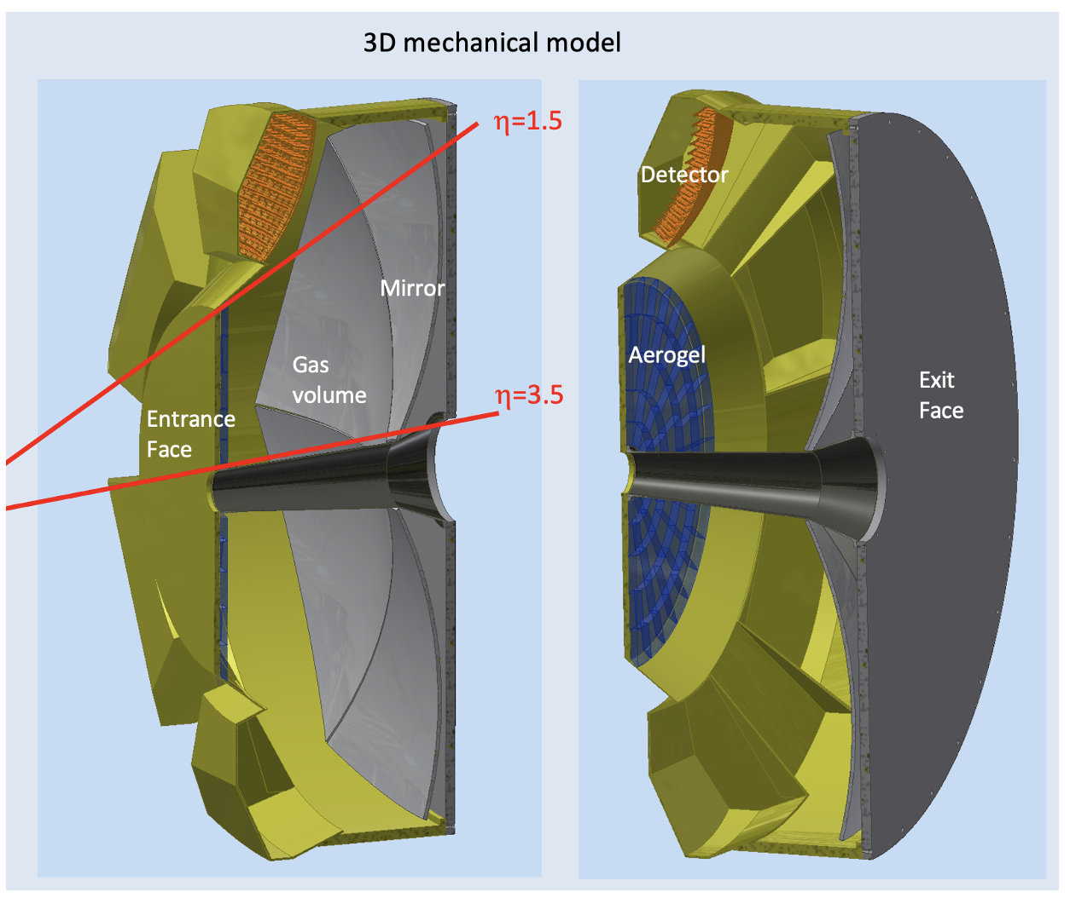
ePIC dRICH
Dual-radiator Ring-imaging Cherenkov Detector (dRICH)
Essential to access flavor information
Goals:
Hadron 3σ−separation between 3 - 50 GeV/c
Complement electron ID below 15 GeV/c
Cover forward pseudorapidity 1.5 (barrel) - 3.5 (b. pipe)
dRICH Features:
Extended 3-50 GeV/c momentum range --> Dual radiator
Single-photon detection in high Bfield --> SiPM
Limited space --> Compact optics with curved detector
4m
M. Contalbrigo
10th EIC DAC Meeting - June 11th – 13th, 2025
2

Slide 3
Review Charges
Charge 1: Is the design of the ePIC detector and its sub-systems appropriate and progressing well ?
Slides 4 - 5 - 6 - 7 - 9 - 10 - 11 - 15 - 18
Charge 2: Are the remaining work and technical, cost and schedule risks adequately understood ?
Are there opportunities?
Slides 5 - 8 - 13 - 14 - 16 - 17 - 20 and pre-TDR (pre-brief material)
Charge 3: Will the detector be technically ready for baselining by late 2025 ?
Slides 12 - 21 - 24
Charge 4: Are the detector integration and planning for installation and maintenance progressing well ?
Are there areas where further ideas should be pursued ?
Slides 19
Charge 5: Will the detector be ready for start of construction by late 2026 ?
Slides 12 - 21 - 24
Past Review: Action taken following recommendations
Slide 14 - 19 - 22 - 23 - 24
M. Contalbrigo
10th EIC DAC Meeting - June 11th – 13th, 2025
3

Slide 4
Design Status
Technical requirements
Validated technical solutions
Before CD-2
Momentum reach above 15 GeV/c to overlap with gas
More than 10 detected photons from 4 cm thickness
Single photon resolution approaching 2 mrad
n = 1.026
dn/dλ = 6 10⁻⁶ nm⁻¹
scattering length > 50 mm
Aerogel:
Dimensions
Momentum reach above 50 GeV/c at pseudorapidity > 2.5
More than 20 detected photons from 1 m depth
Single photon resolution approaching 1 mrad
with n = 1.00086
dn/dλ = 0.2 10⁻⁶ nm⁻¹
absorption length > 100 m
Gas:
C₂F₆
Purging
Focalization of Cherenkov light onto the detector surface
Preservation of the Cherenkov information
Material budget limited to O(2 %) of radiation length
Carbon fiber material
Roughness of few nm
Angular precision < 0.3 mrad
Mirror:
Coating
Single photon detection capability in highly non-uniform magnetic field
Excellent PDE in the visible range to cope with aerogel
Marginal contribution to the angular resolution
Preserve prompt Cherenkov information
Tolerance to few 10¹⁰ 1-MeV neutron equivalent fluence
Spatial resolution of 3 x 3 mm²
Time resolution O(100 ps)
Operation at < -30 degrees
Annealing curing cycles
Sensors:
SiPM
Layout
Annealing
Below 1 p.e. signal threshold capability
Preserve sensor time resolution to cope with dark counts and accidentals
More than 300 kHz/ch rate capability
Streaming readout with suppression of no-interaction frames
ALCOR chip (ToT architecture)
Time resolution < 200 ps
Rate > 300 kHz/ch
Readout:
ALCOR
ALCOR 64ch
RDO
Mechanics:
Acceptance maximized in 1.5 – 3.5 pseudorapidity range
Material budget minimized in acceptance
Compatibility with barrel maintenance at IP6
Composite materials
Single open volume
Detector in the barrel shadow
Real-scale
prototype
Cooling
M. Contalbrigo
10th EIC DAC Meeting - June 11th – 13th, 2025
4
Notes:
Vedere soglia in terms of fC.

Slide 5
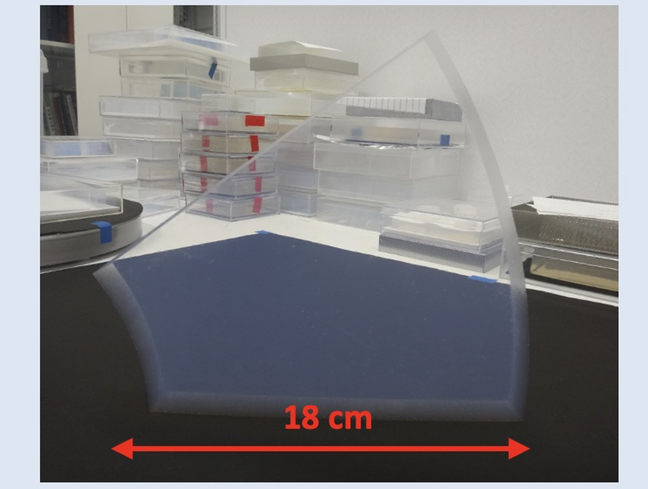
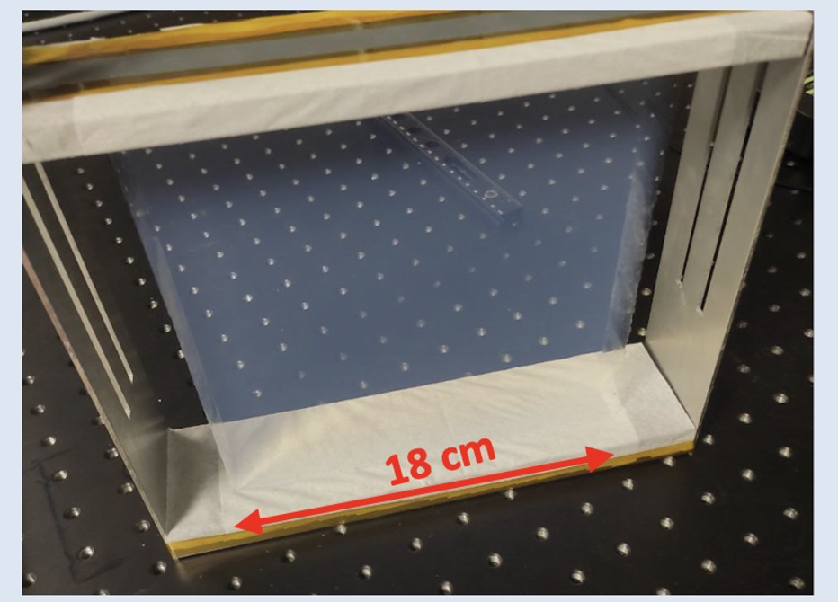
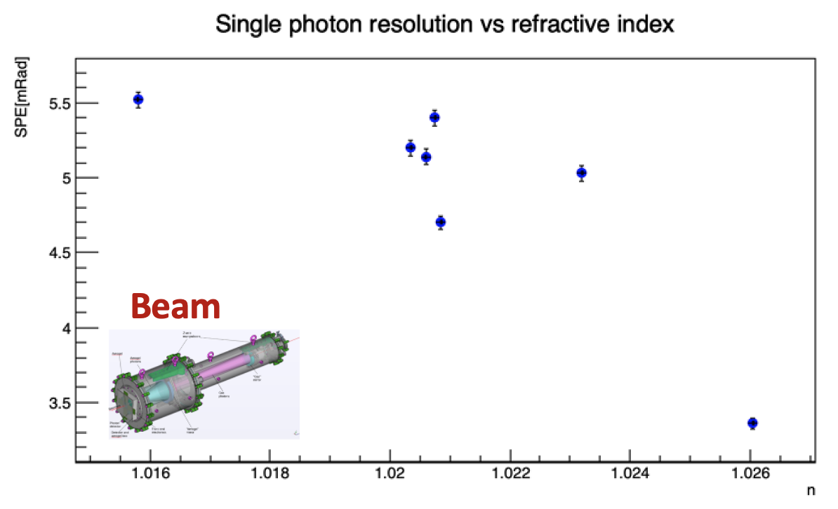
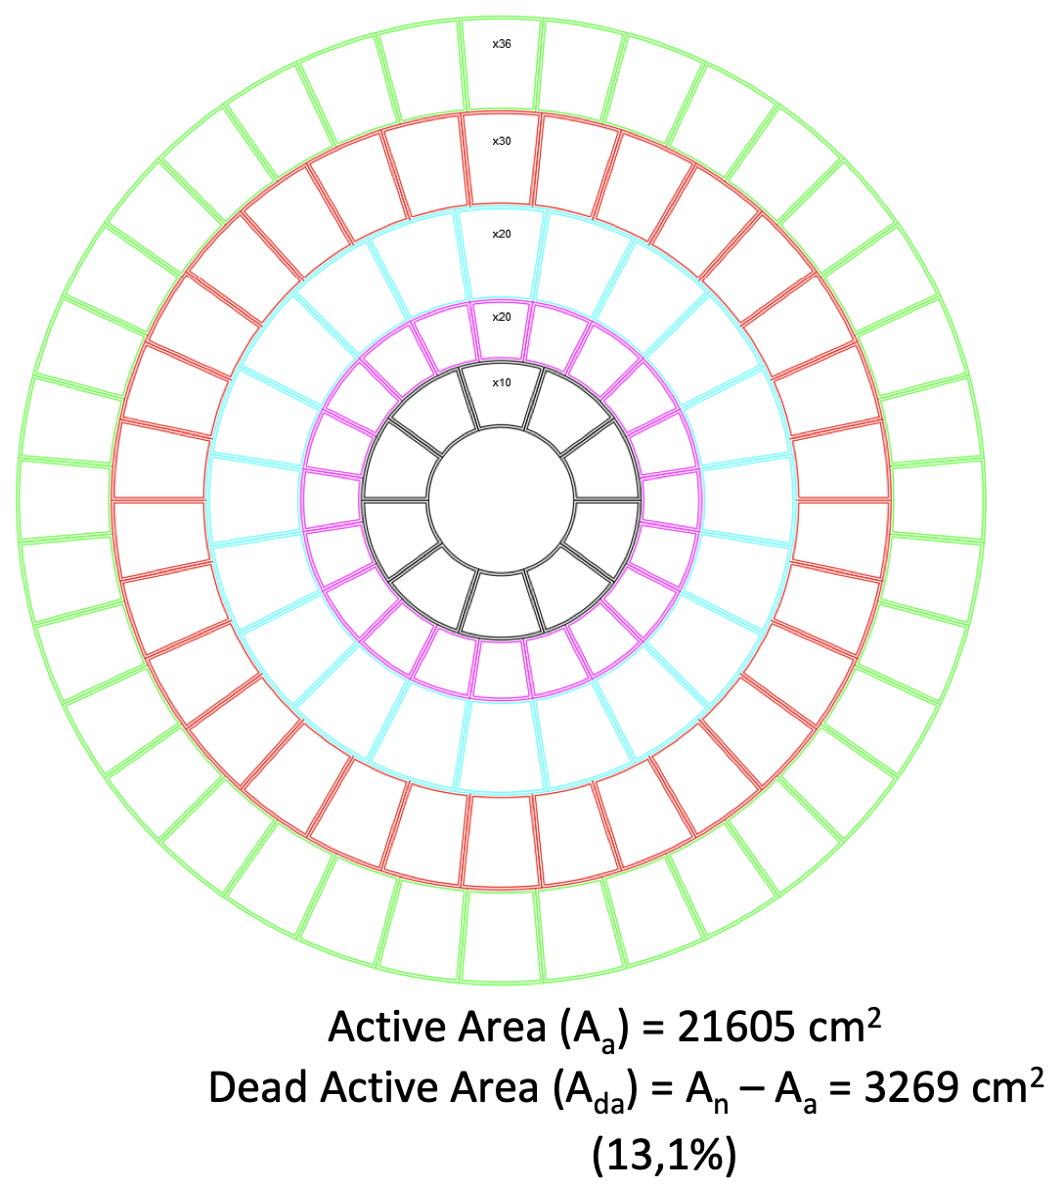
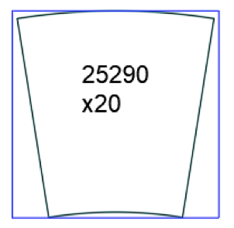
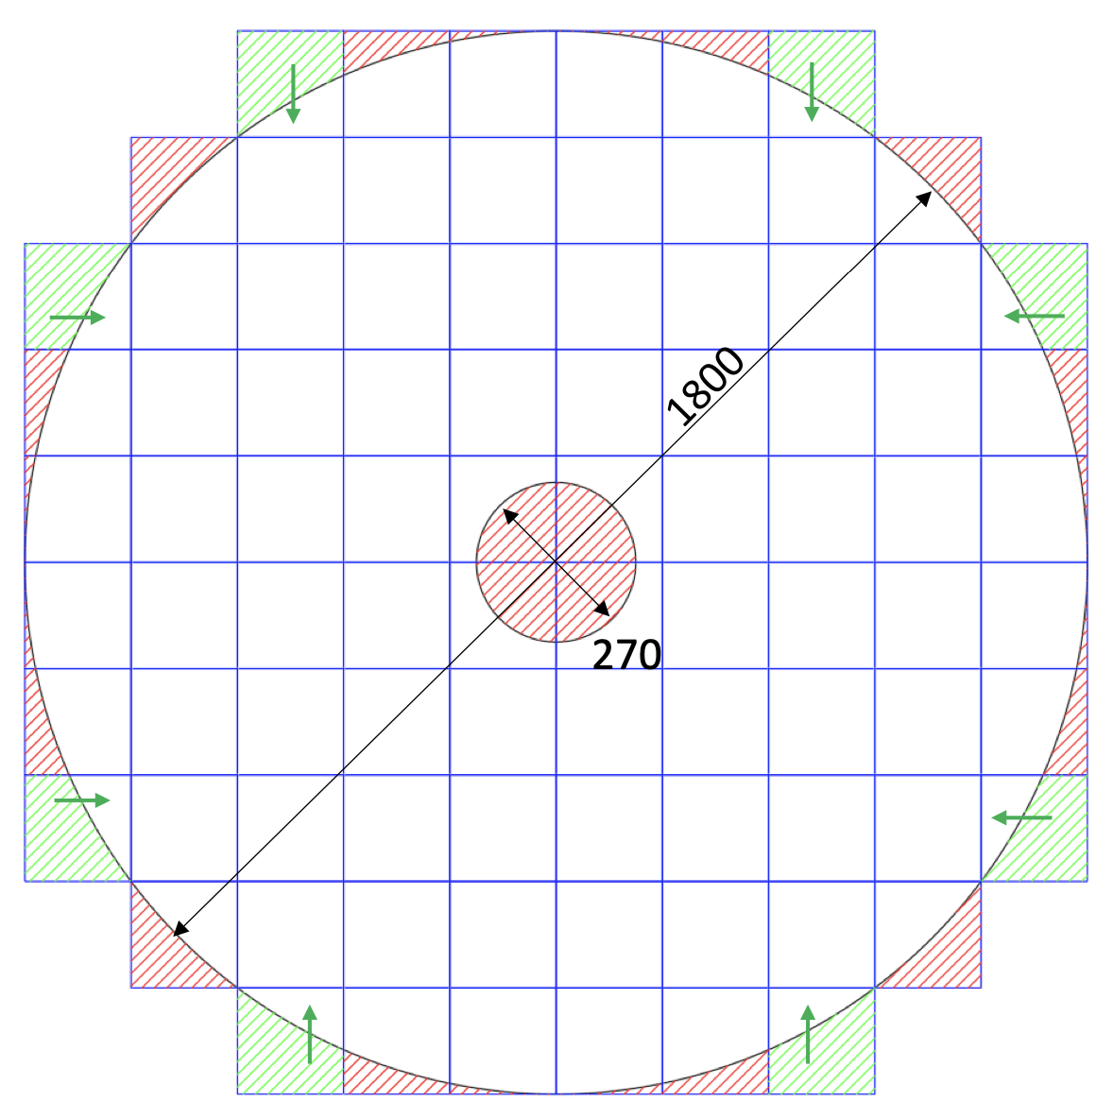
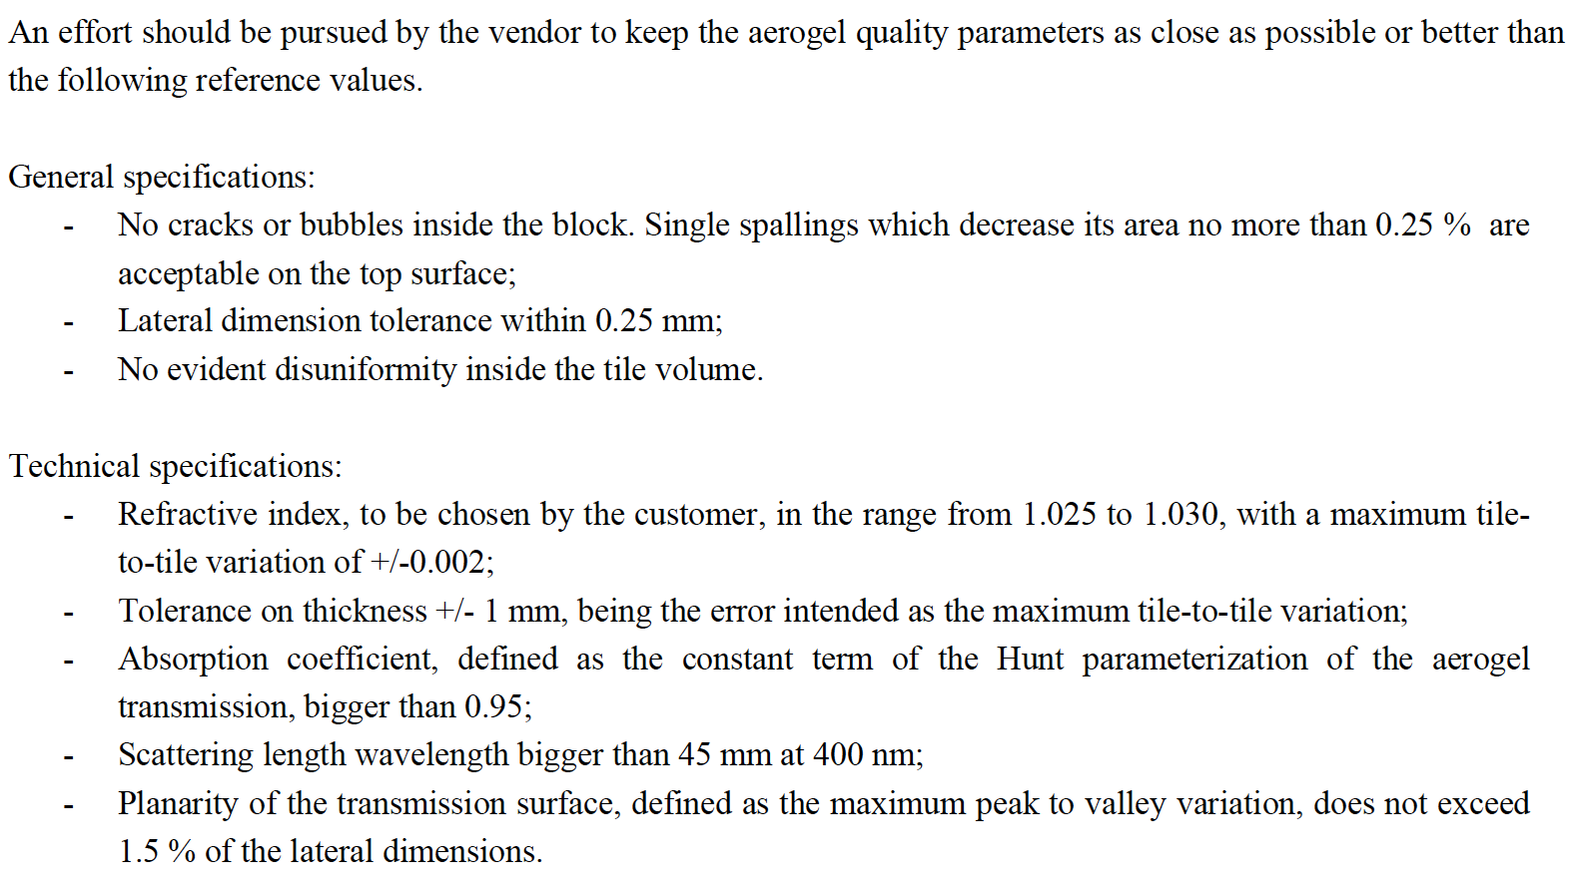
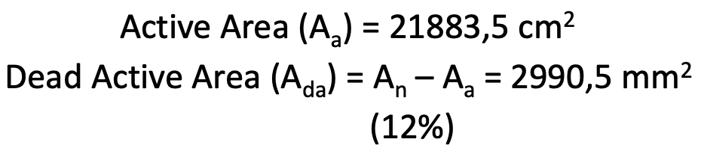
Aerogel Pre-Production
Aerogel with n=1.026 validated with lab and prototype tests
Details on
Backup 26
Lab + Beam
Engineering of the aerogel wall expected by 2026
First large aerogel tile demonstrators delivered
dRICH baseline specifications
Goal
Active Area = 21605 cm²
Dead Area = 3269 cm² (13%)
Wasted Area = 9112 cm² (27 %)
Active Area = 21368 cm²
Dead Area = 3506 cm² (14%)
Wasted Area = 1868 cm² (7 %)
M. Contalbrigo
10th EIC DAC Meeting - June 11th – 13th, 2025
5
Notes:
Come si arriva ai 1.8 Tbps ? 3 KHz / 3(shutter) * 3e5 (canali) *64

Slide 6
Design Status
Technical requirements
Validated technical solutions
Before CD-2
Momentum reach above 15 GeV/c to overlap with gas
More than 10 detected photons from 4 cm thickness
Single photon resolution approaching 2 mrad
n = 1.026
dn/dλ = 6 10⁻⁶ nm⁻¹
scattering length > 50 mm
Aerogel:
Dimensions
Momentum reach above 50 GeV/c at pseudorapidity > 2.5
More than 20 detected photons from 1 m depth
Single photon resolution approaching 1 mrad
with n = 1.00086
dn/dλ = 0.2 10⁻⁶ nm⁻¹
absorption length > 100 m
Gas:
C₂F₆
Purging
Focalization of Cherenkov light onto the detector surface
Preservation of the Cherenkov information
Material budget limited to O(2 %) of radiation length
Carbon fiber material
Roughness of few nm
Angular precision < 0.3 mrad
Mirror:
Coating
Single photon detection capability in highly non-uniform magnetic field
Excellent PDE in the visible range to cope with aerogel
Marginal contribution to the angular resolution
Preserve prompt Cherenkov information
Tolerance to few 10¹⁰ 1-MeV neutron equivalent fluence
Spatial resolution of 3 x 3 mm²
Time resolution O(100 ps)
Operation at < -30 degrees
Annealing curing cycles
Sensors:
SiPM
Layout
Annealing
Below 1 p.e. signal threshold capability
Preserve sensor time resolution to cope with dark counts and accidentals
More than 300 kHz/ch rate capability
Streaming readout with suppression of no-interaction frames
ALCOR chip (ToT architecture)
Time resolution < 200 ps
Rate > 300 kHz/ch
Readout:
ALCOR
ALCOR 64ch
RDO
Mechanics:
Acceptance maximized in 1.5 – 3.5 pseudorapidity range
Material budget minimized in acceptance
Compatibility with barrel maintenance at IP6
Composite materials
Single open volume
Detector in the barrel shadow
Real-scale
prototype
Cooling
M. Contalbrigo
10th EIC DAC Meeting - June 11th – 13th, 2025
6
Notes:
Vedere soglia in terms of fC.

Slide 7
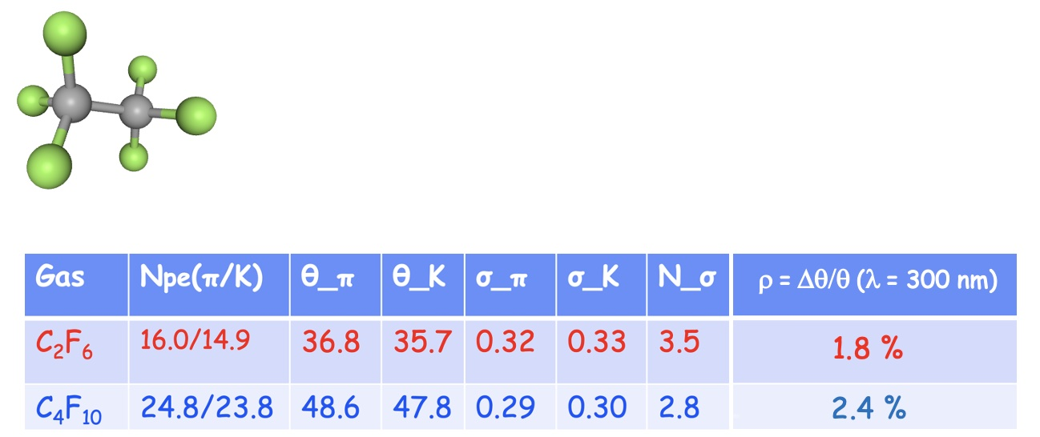
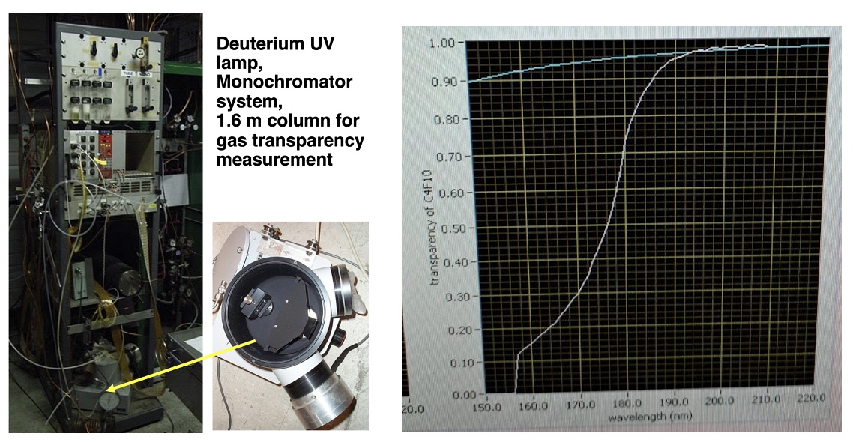
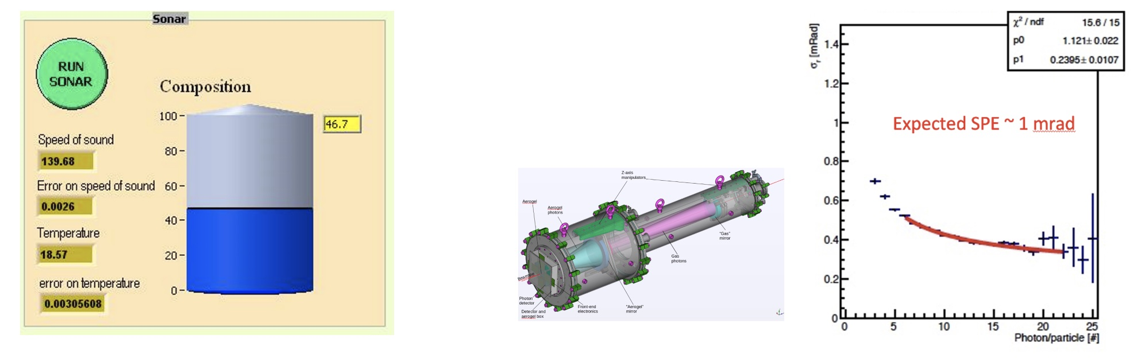
Gas Radiator Technical Performance
Baseline Hexsafluoroethane validated with lab and beam tests
Transmission in UV range > 98 %
C₂F₆ molecular weight: 138.01 g/mol
boiling point: -78.1 °C
melting point: -100.6 °C
density: 5.734 kg/m³ at 24 °C
density: 16.08 kg/m³ at -78 °C
1 covalent + 6 hydrogen bonds
Expected performance
obtained with
dRICH prototype
σ₀
σ₁
Measured 139.7 m/s
speed of sound confirms
negligible contaminants
after few year in bottle
σ₀
M. Contalbrigo
10th EIC DAC Meeting - June 11th – 13th, 2025
7

Slide 8
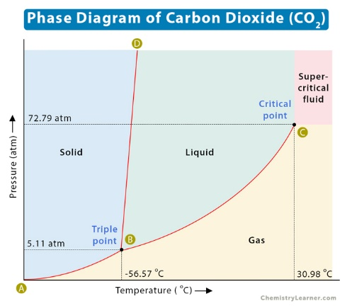
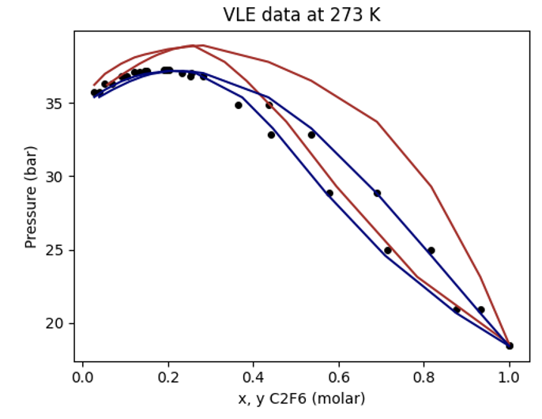
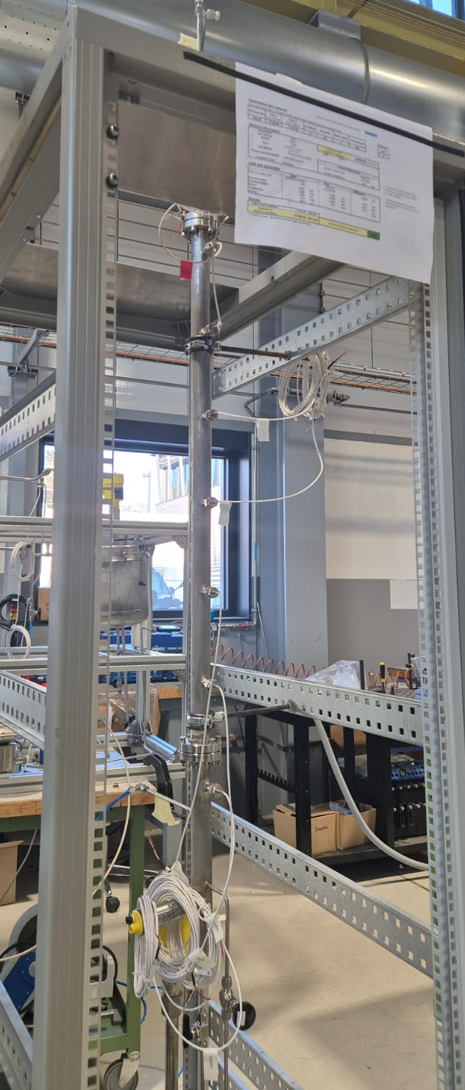
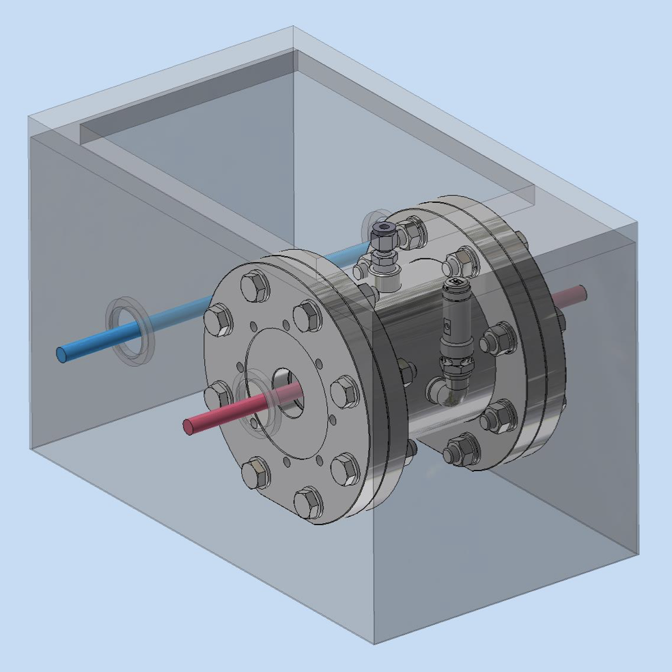
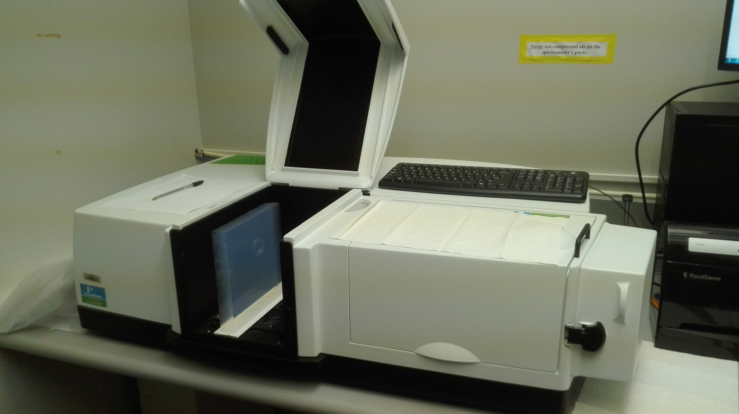
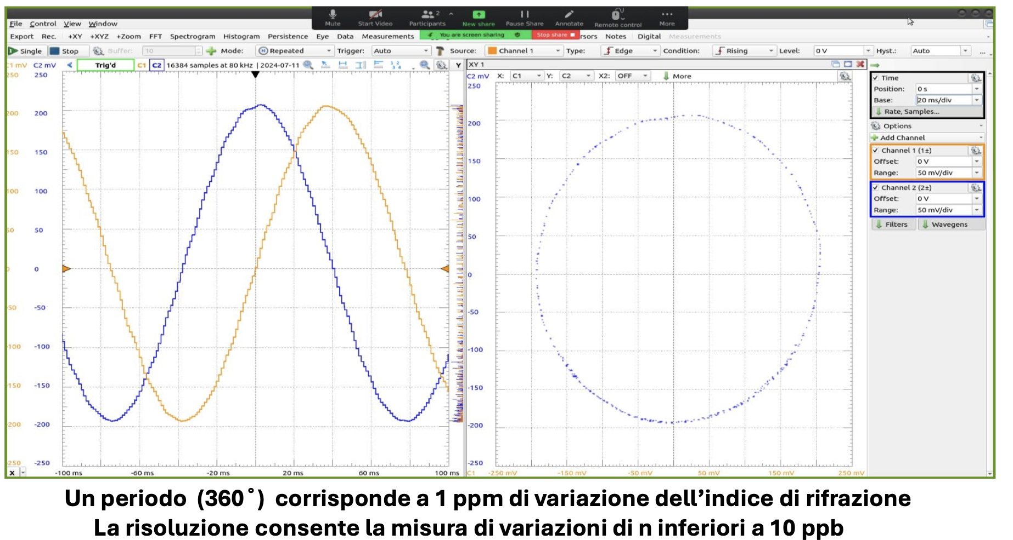
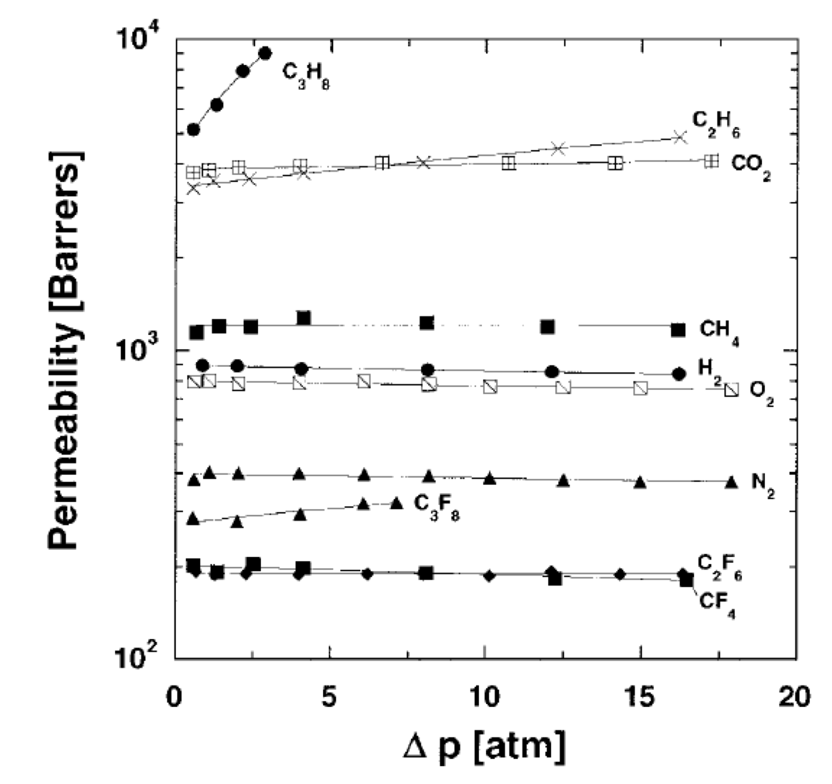
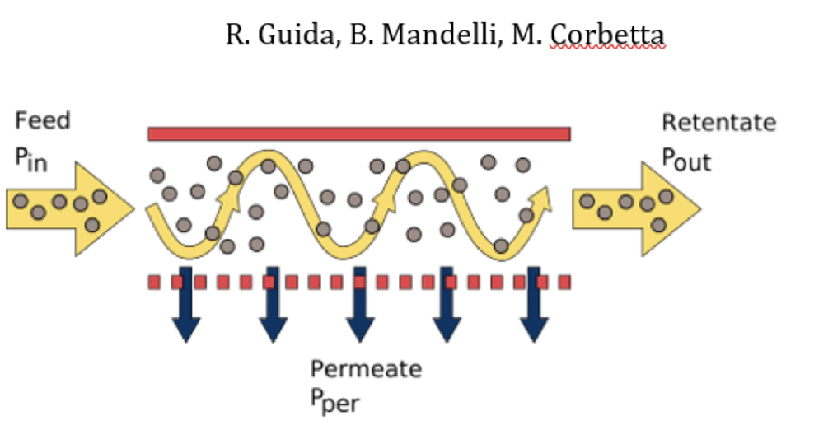
Gas Separation and Purging
Development of gas separation protocols expected by 2026
Design of online purity monitors expected by 2026
Purging via liquefaction of stand-by gas
Updated vapor-liquid equilibrium C₂F₆-CO₂ model, test in preparation at CERN
Sonar to measure speed of sound
10 bar chamber + specrophotometer to measure
light transmission in the visible range
Purging via membranes
Jamin interferometer for precise n determination
Effective separation of CF₄ and CO₂ demostrated in LHCb
hpps://edms.cern.ch/document/2816490/1
C₂F₆
CO₂
Nominal sensitivity down to 10 ppm of refractive index
M. Contalbrigo
10th EIC DAC Meeting - June 11th – 13th, 2025
8

Slide 9
Design Status
Technical requirements
Validated technical solutions
Before CD-2
Momentum reach above 15 GeV/c to overlap with gas
More than 10 detected photons from 4 cm thickness
Single photon resolution approaching 2 mrad
n = 1.026
dn/dλ = 6 10⁻⁶ nm⁻¹
scattering length > 50 mm
Aerogel:
Dimensions
Momentum reach above 50 GeV/c at pseudorapidity > 2.5
More than 20 detected photons from 1 m depth
Single photon resolution approaching 1 mrad
with n = 1.00086
dn/dλ = 0.2 10⁻⁶ nm⁻¹
absorption length > 100 m
Gas:
C₂F₆
Purging
Focalization of Cherenkov light onto the detector surface
Preservation of the Cherenkov information
Material budget limited to O(2 %) of radiation length
Carbon fiber material
Roughness of few nm
Angular precision < 0.3 mrad
Mirror:
Coating
Single photon detection capability in highly non-uniform magnetic field
Excellent PDE in the visible range to cope with aerogel
Marginal contribution to the angular resolution
Preserve prompt Cherenkov information
Tolerance to few 10¹⁰ 1-MeV neutron equivalent fluence
Spatial resolution of 3 x 3 mm²
Time resolution O(100 ps)
Operation at < -30 degrees
Annealing curing cycles
Sensors:
SiPM
Layout
Annealing
Below 1 p.e. signal threshold capability
Preserve sensor time resolution to cope with dark counts and accidentals
More than 300 kHz/ch rate capability
Streaming readout with suppression of no-interaction frames
ALCOR chip (ToT architecture)
Time resolution < 200 ps
Rate > 300 kHz/ch
Readout:
ALCOR
ALCOR 64ch
RDO
Mechanics:
Acceptance maximized in 1.5 – 3.5 pseudorapidity range
Material budget minimized in acceptance
Compatibility with barrel maintenance at IP6
Composite materials
Single open volume
Detector in the barrel shadow
Real-scale
prototype
Cooling
M. Contalbrigo
10th EIC DAC Meeting - June 11th – 13th, 2025
9
Notes:
Vedere soglia in terms of fC.

Slide 10
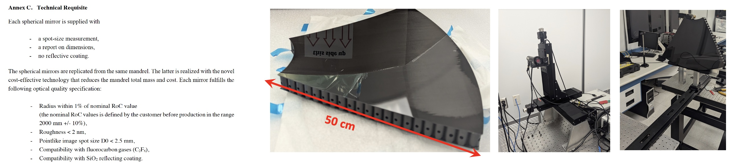
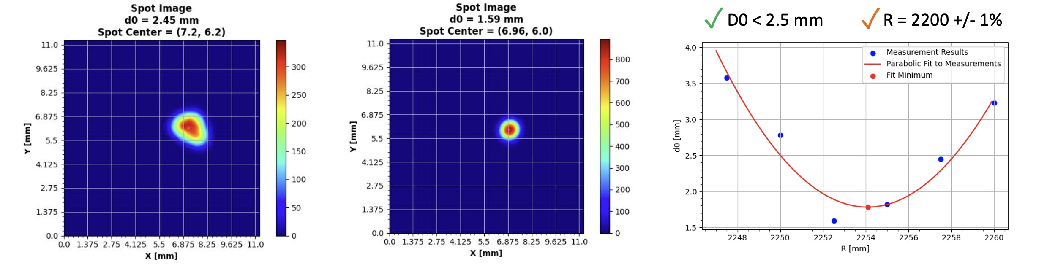
Mirror Technical Performance
CFRP substrate mid-size (~50 cm side) demonstrator validated with lab tests before coating
Details on
Backup 27
M. Contalbrigo
10th EIC DAC Meeting - June 11th – 13th, 2025
10

Slide 11
Design Status
Technical requirements
Validated technical solutions
Before CD-2
Momentum reach above 15 GeV/c to overlap with gas
More than 10 detected photons from 4 cm thickness
Single photon resolution approaching 2 mrad
n = 1.026
dn/dλ = 6 10⁻⁶ nm⁻¹
scattering length > 50 mm
Aerogel:
Dimensions
Momentum reach above 50 GeV/c at pseudorapidity > 2.5
More than 20 detected photons from 1 m depth
Single photon resolution approaching 1 mrad
with n = 1.00086
dn/dλ = 0.2 10⁻⁶ nm⁻¹
absorption length > 100 m
Gas:
C₂F₆
Purging
Focalization of Cherenkov light onto the detector surface
Preservation of the Cherenkov information
Material budget limited to O(2 %) of radiation length
Carbon fiber material
Roughness of few nm
Angular precision < 0.3 mrad
Mirror:
Coating
Single photon detection capability in highly non-uniform magnetic field
Excellent PDE in the visible range to cope with aerogel
Marginal contribution to the angular resolution
Preserve prompt Cherenkov information
Tolerance to few 10¹⁰ 1-MeV neutron equivalent fluence
Spatial resolution of 3 x 3 mm²
Time resolution O(100 ps)
Operation at < -30 degrees
Annealing curing cycles
Sensors:
SiPM
Layout
Annealing
Below 1 p.e. signal threshold capability
Preserve sensor time resolution to cope with dark counts and accidentals
More than 300 kHz/ch rate capability
Streaming readout with suppression of no-interaction frames
ALCOR chip (ToT architecture)
Time resolution < 200 ps
Rate > 300 kHz/ch
Readout:
ALCOR
ALCOR 64ch
RDO
Mechanics:
Acceptance maximized in 1.5 – 3.5 pseudorapidity range
Material budget minimized in acceptance
Compatibility with barrel maintenance at IP6
Composite materials
Single open volume
Detector in the barrel shadow
Real-scale
prototype
Cooling
M. Contalbrigo
10th EIC DAC Meeting - June 11th – 13th, 2025
11
Notes:
Vedere soglia in terms of fC.

Slide 12
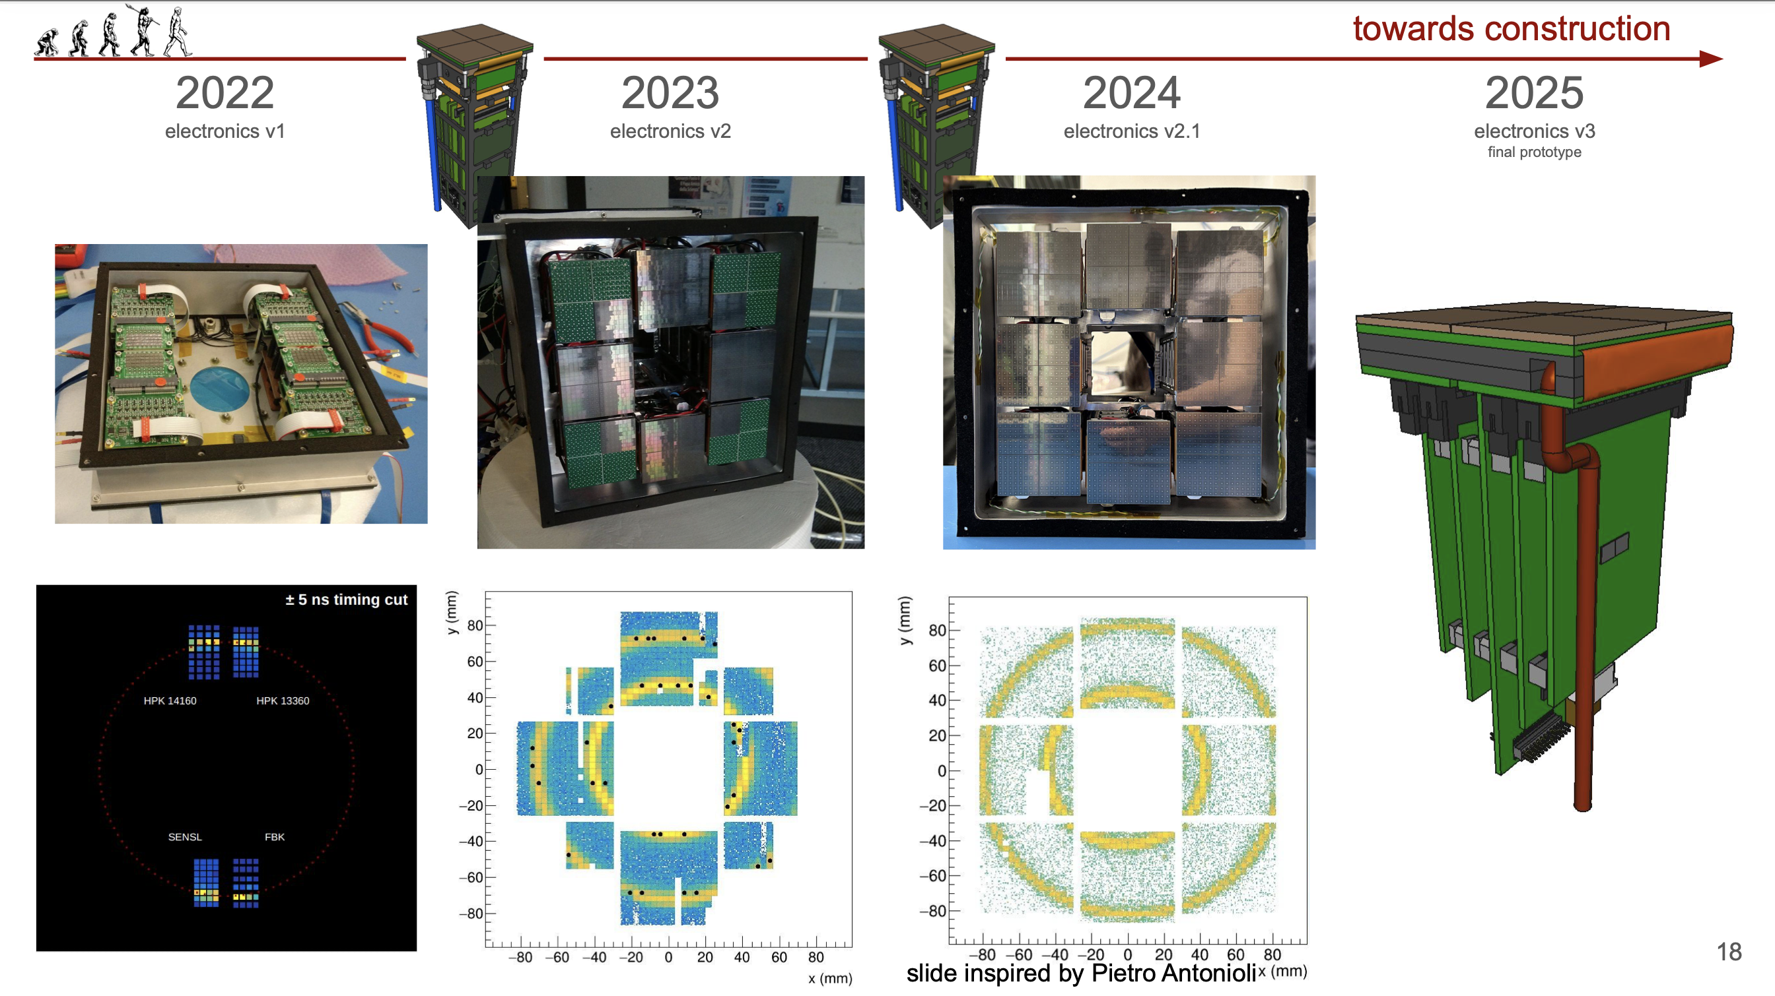
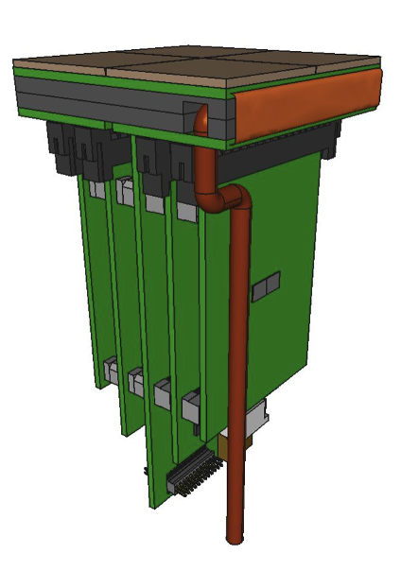
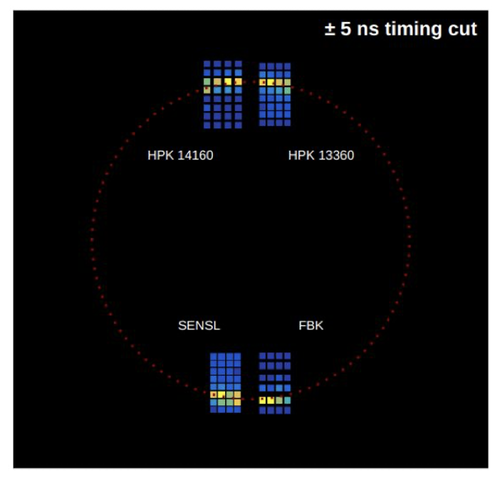
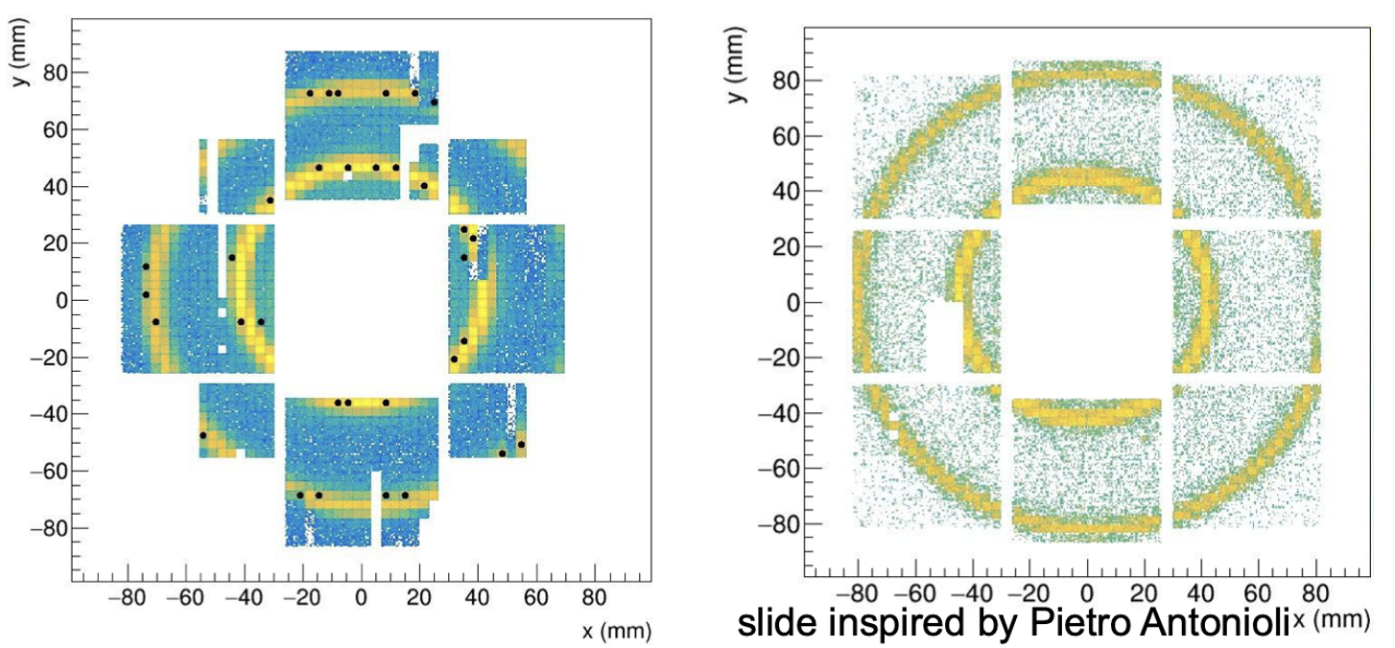
Photon Detector
Steadly progress of photodetector towards integrated design completion in 2026
/26
50 μm
75 μm
ALCOR 32 ch
Full size engineering
test article
2025
+ SiPM carrierv3
+ RDO
2026
+ ALCOR 64ch
+ FEB 64
M. Contalbrigo
10th EIC DAC Meeting - June 11th – 13th, 2025
12
Notes:
Come si arriva ai 1.8 Tbps ? 3 KHz / 3(shutter) * 3e5 (canali) *64

Slide 13
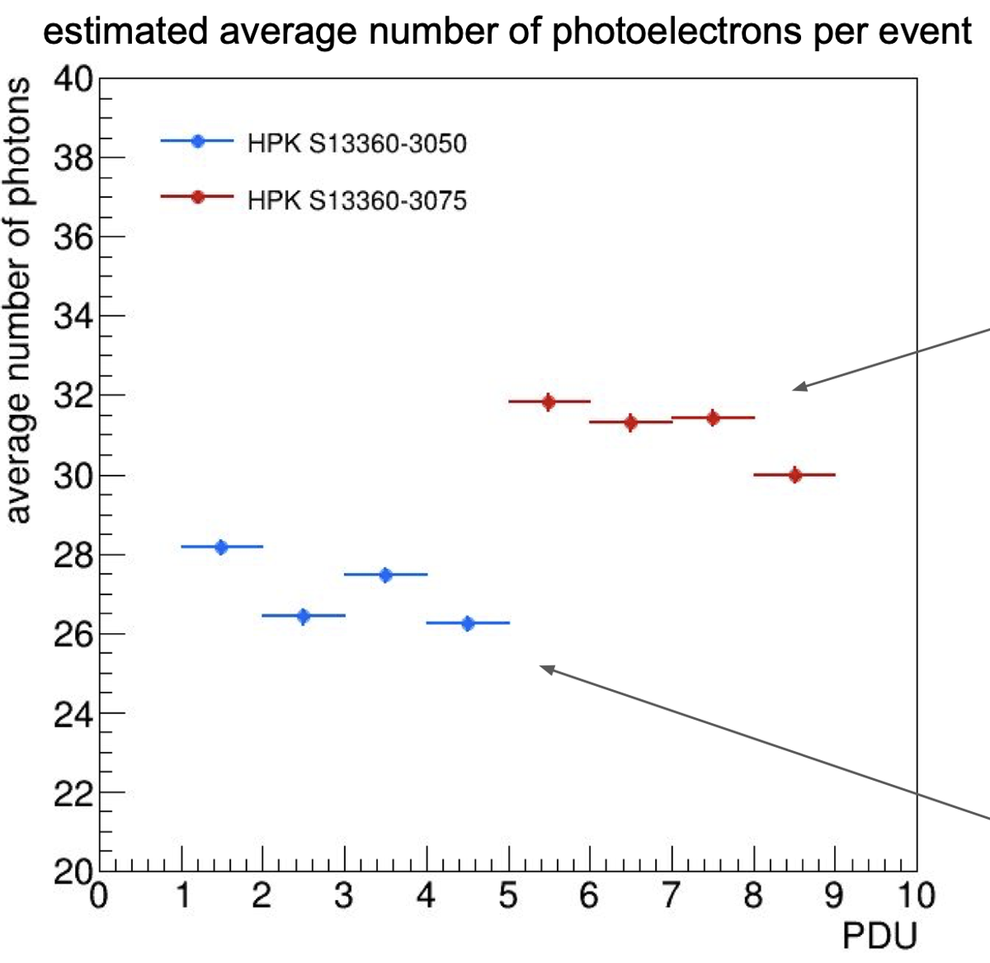
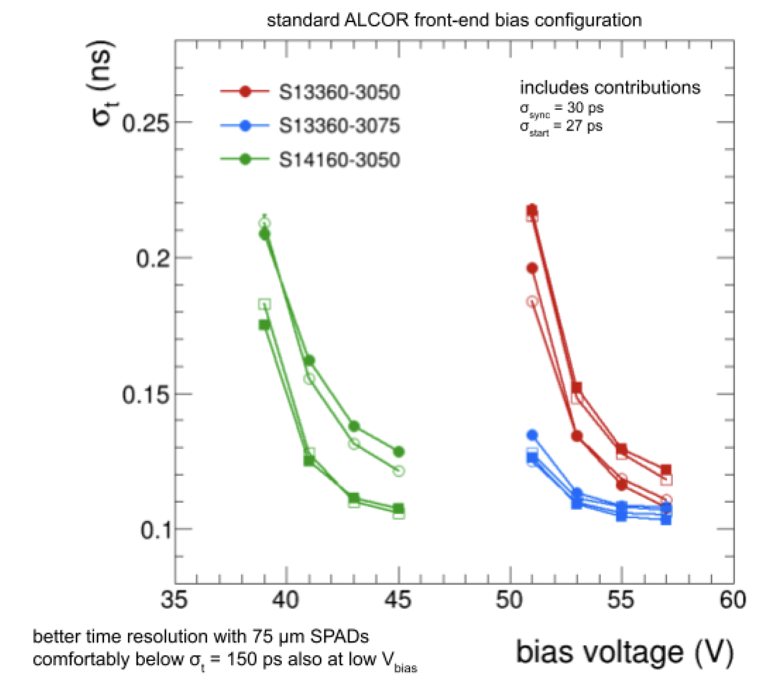
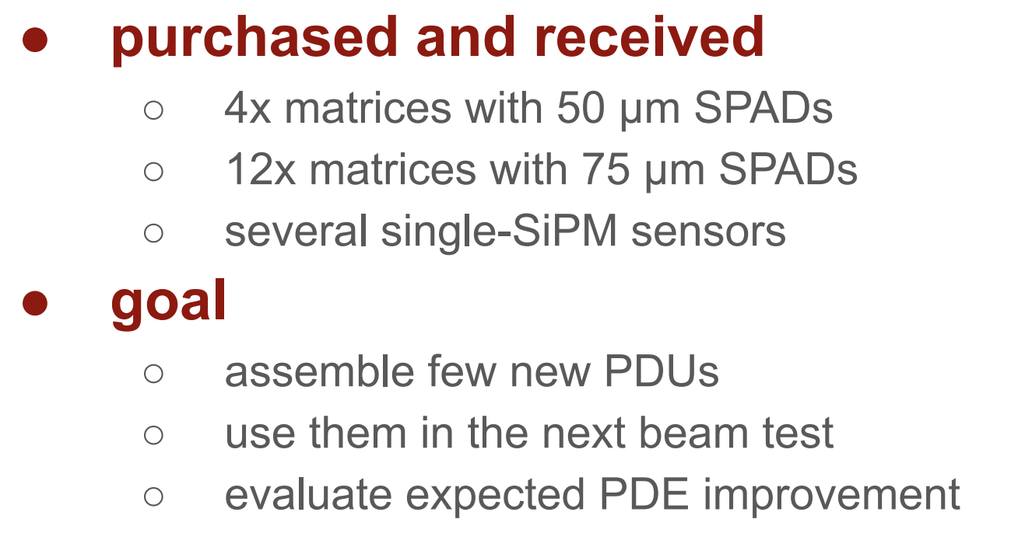
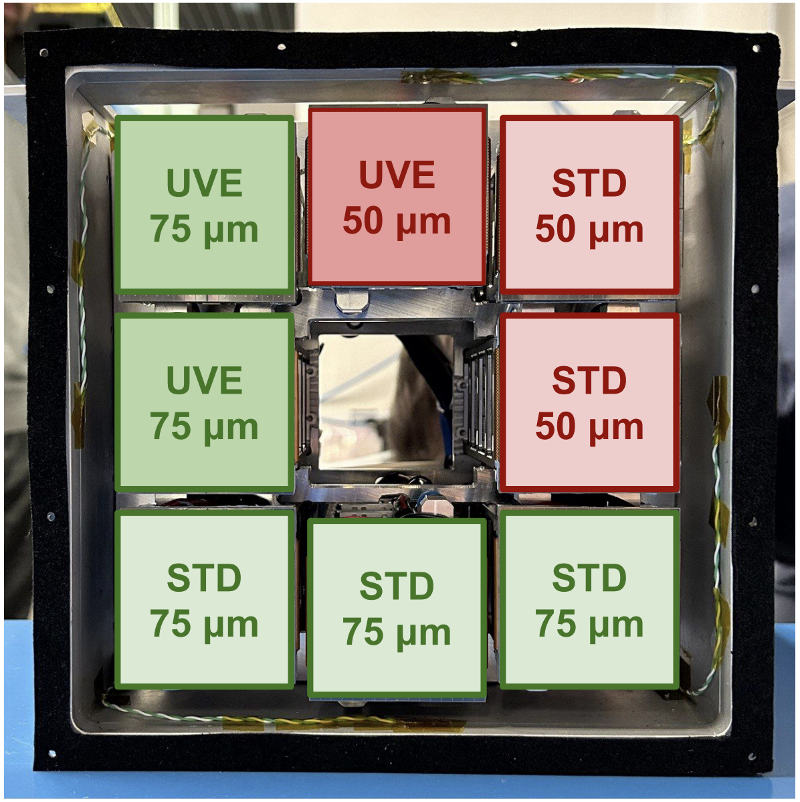
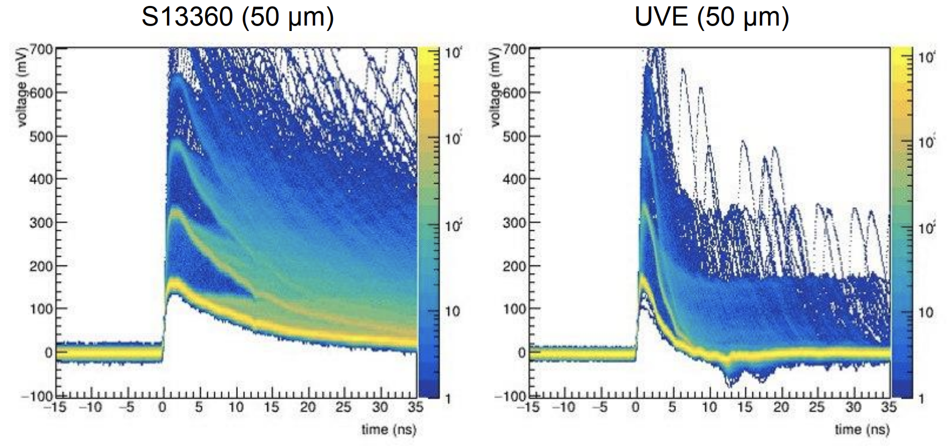
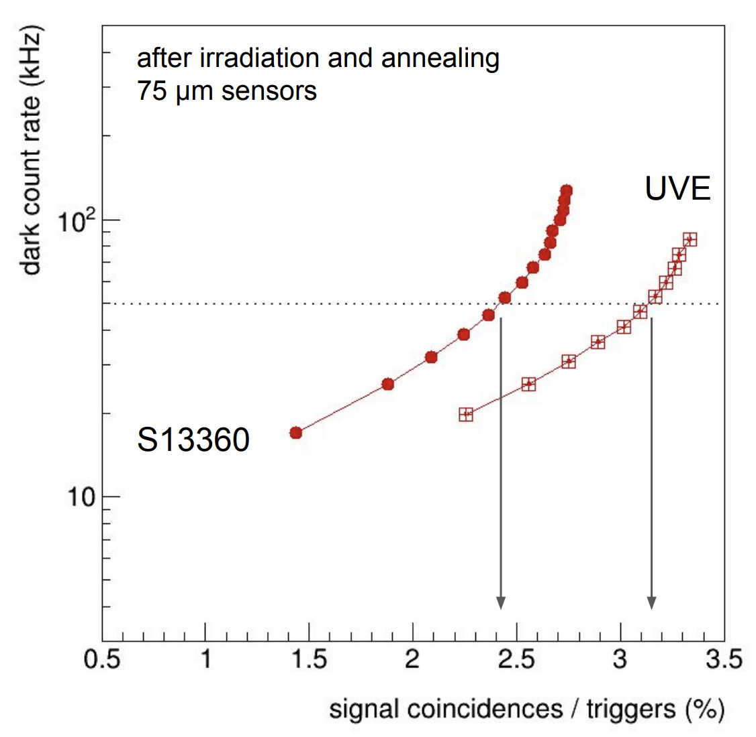
Sensor Layout Engineering
Baseline specs defined at the SiPM LLP Rewiew in fall 2023 after several tests on a variety of sensors
Details on
Backup 28
Photon yield
Time resolution with ALCOR redout
SPAD size
75 μm
eRD102-FY25
50 μm
Novel HPK UVE fast SiPM
M. Contalbrigo
10th EIC DAC Meeting - June 11th – 13th, 2025
13
Notes:
Come si arriva ai 1.8 Tbps ? 3 KHz / 3(shutter) * 3e5 (canali) *64

Slide 14
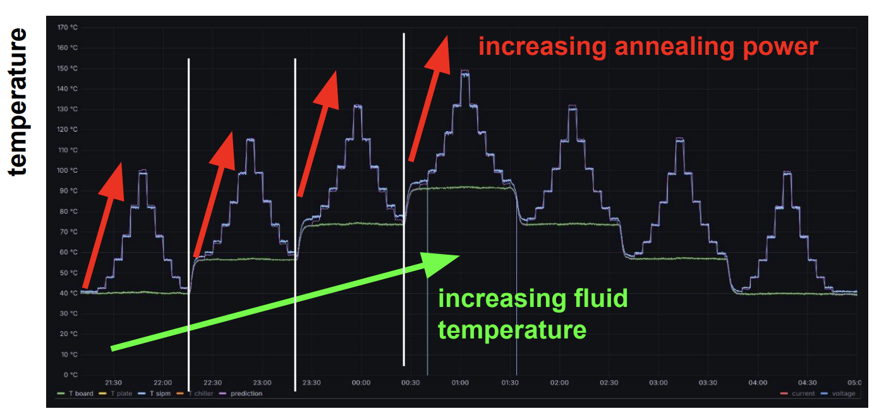
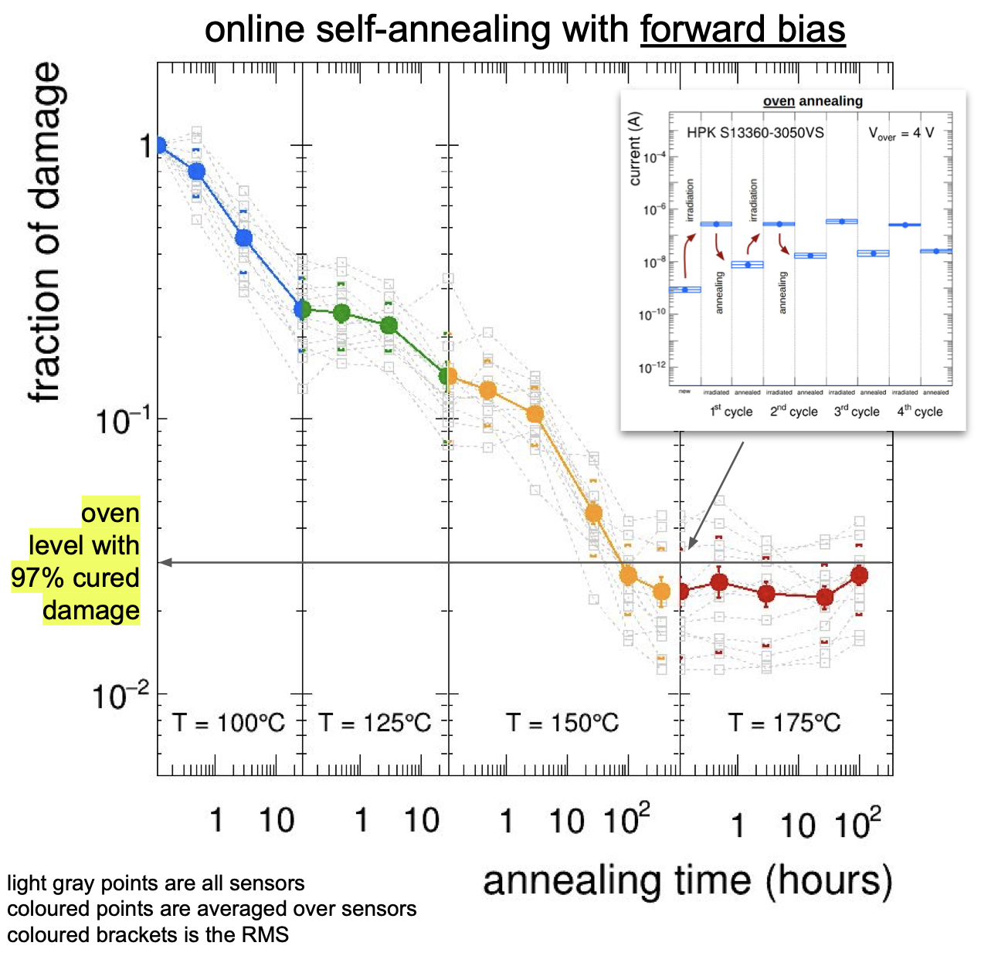
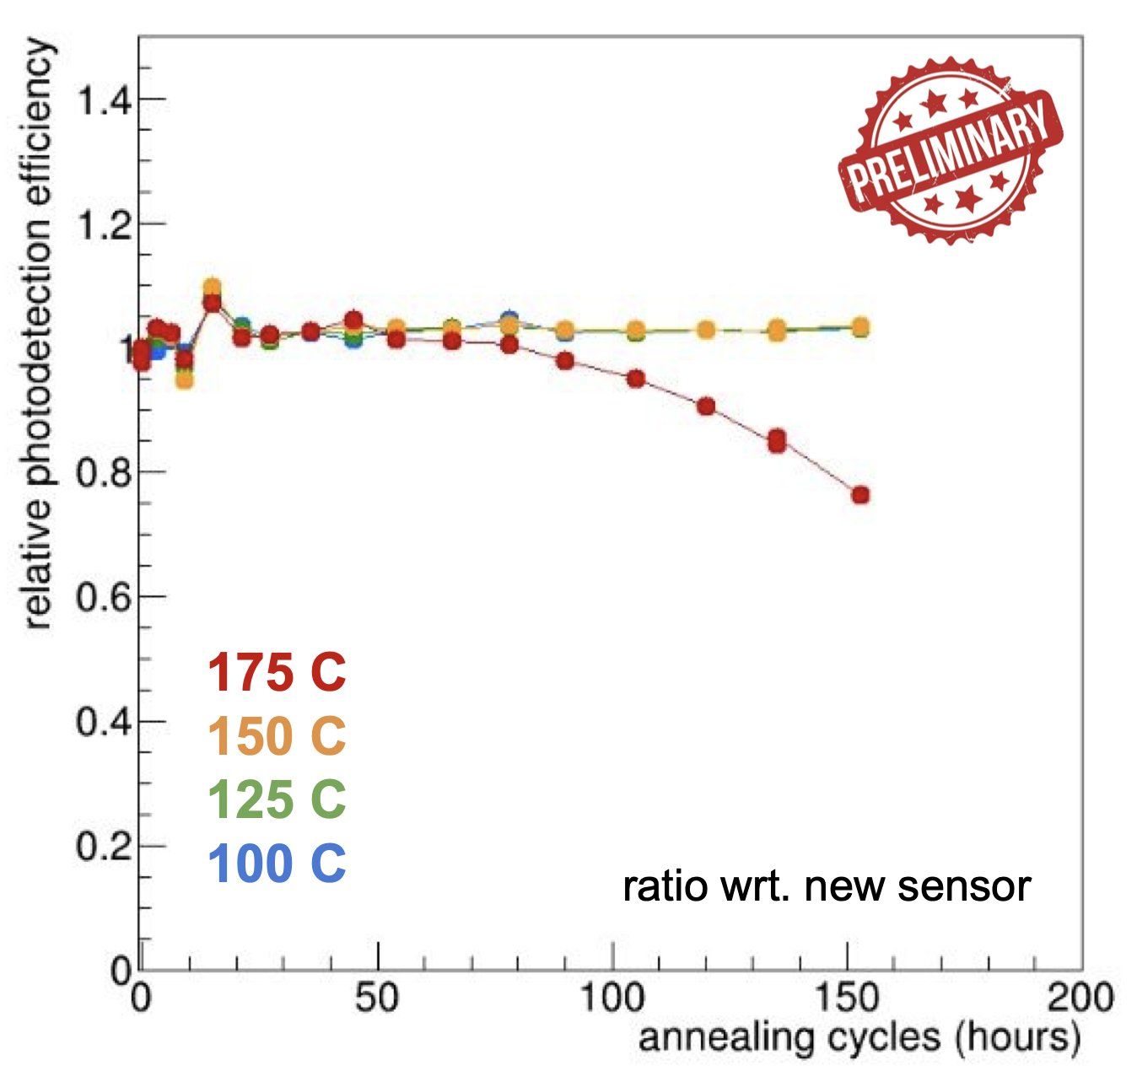
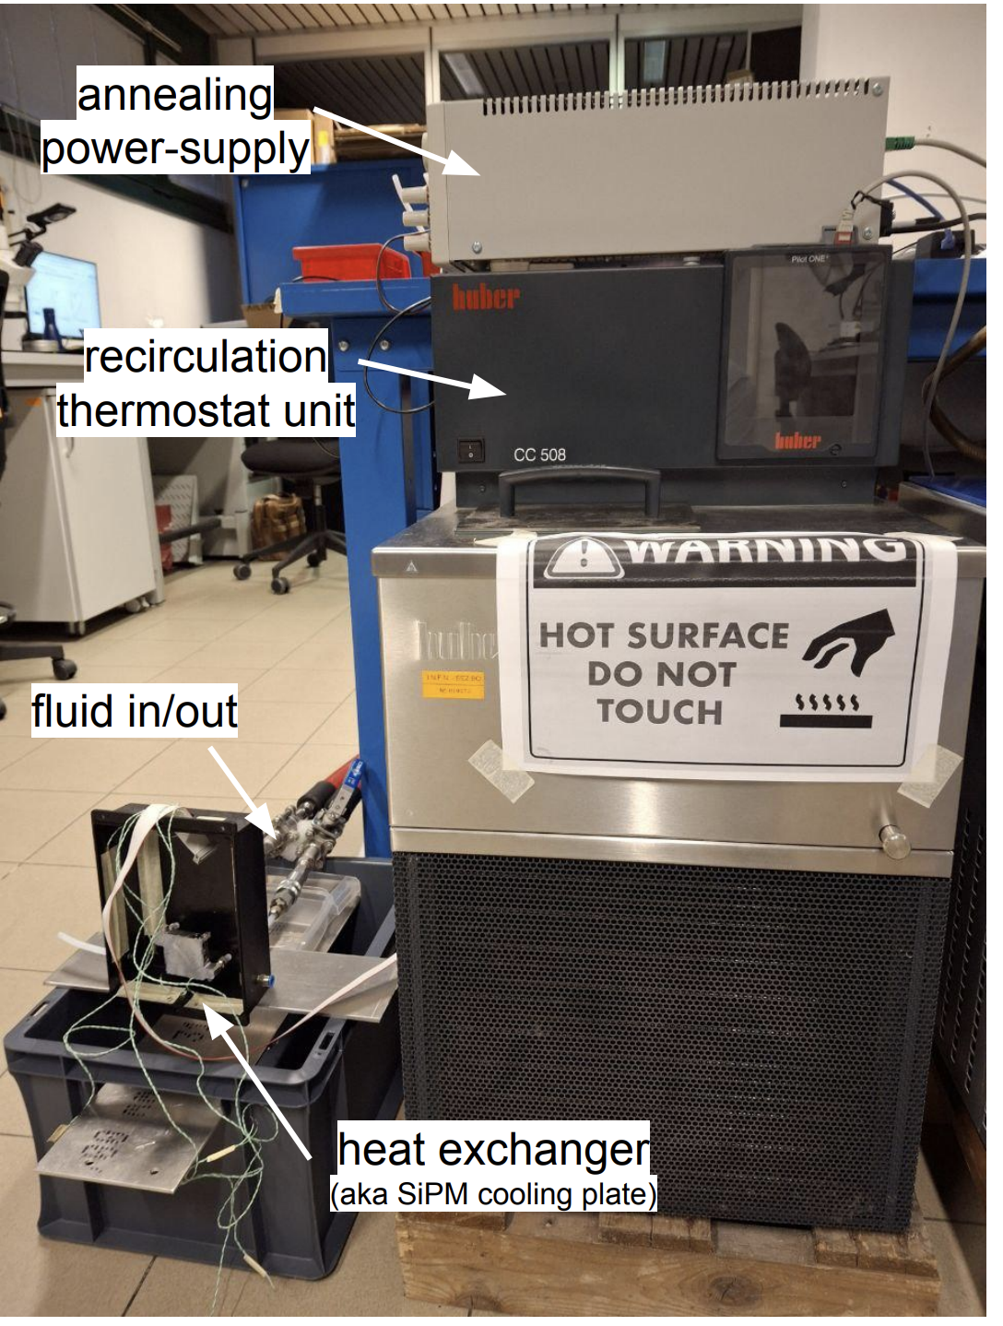
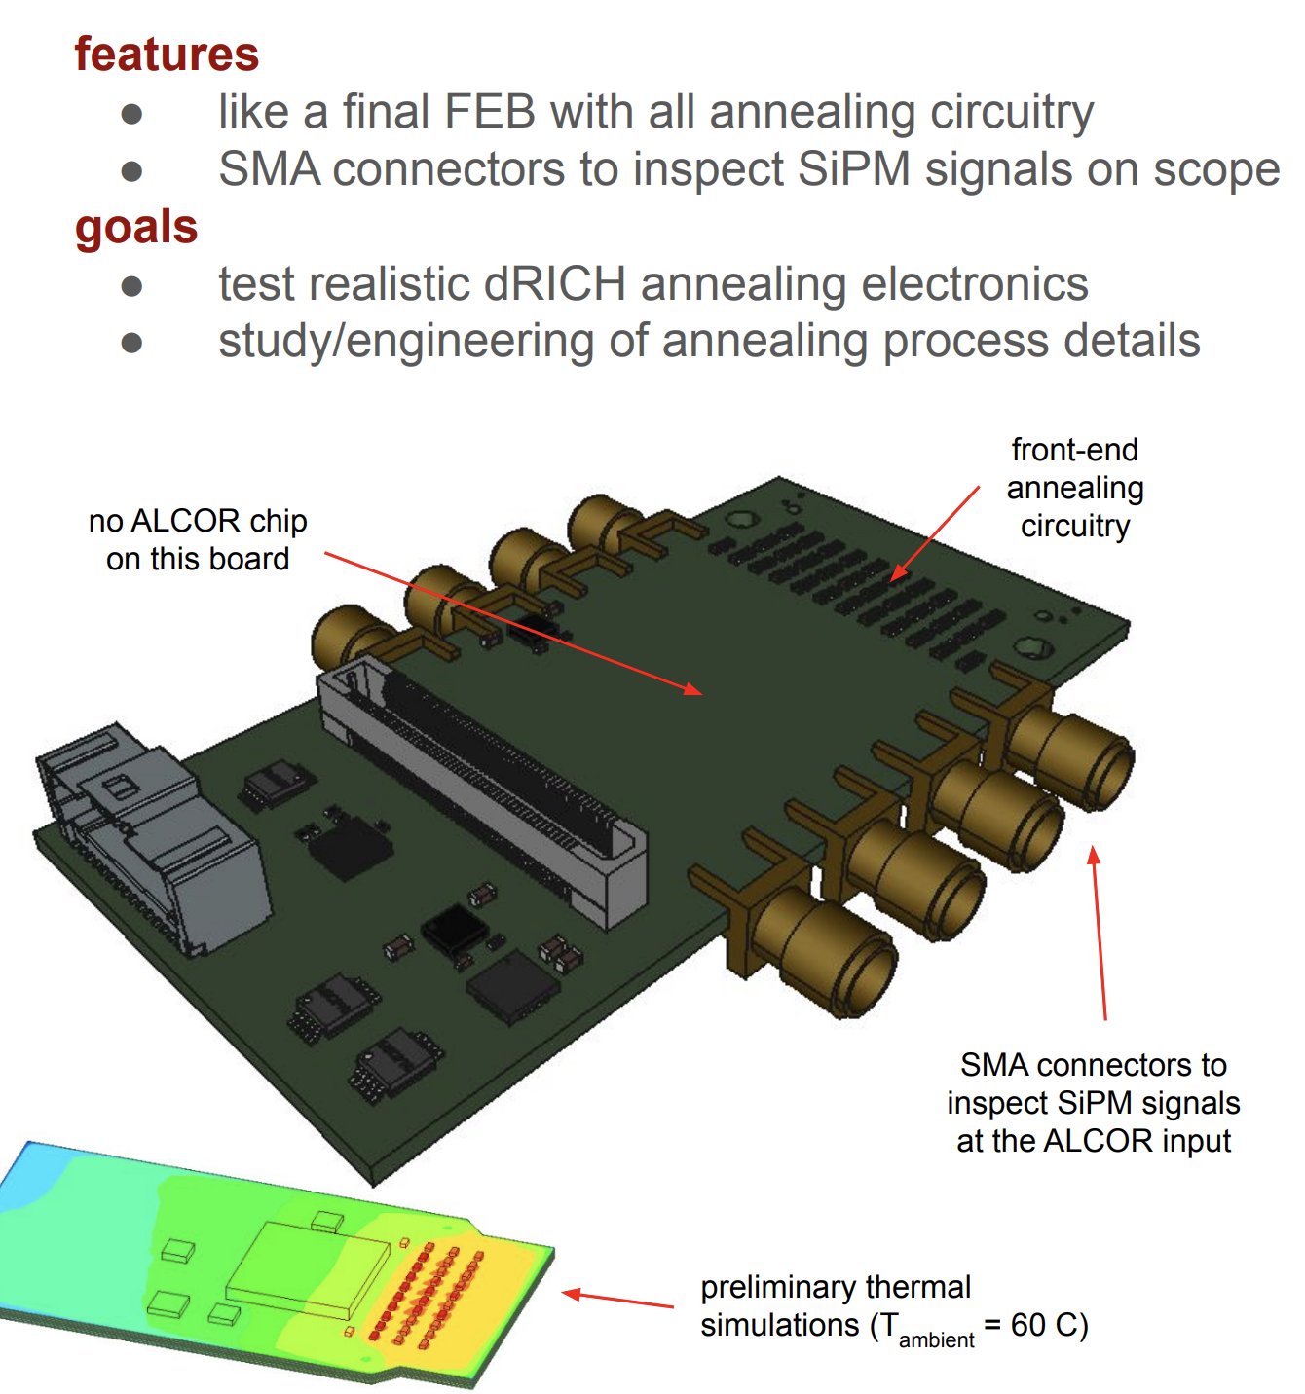
Annealing Engineering
PED funds
Completion of engineering of the SiPM optimized layout and temperature treatments expected by 2026
Recomm. (DAC): Annealing procedures should be investigated, and defined; this will
have implications for the design of the read-out board (heating).
Details of in-situ annealing protocol based on Joule-effect
M. Contalbrigo
10th EIC DAC Meeting - June 11th – 13th, 2025
14
Notes:
Come si arriva ai 1.8 Tbps ? 3 KHz / 3(shutter) * 3e5 (canali) *64

Slide 15
Design Status
Technical requirements
Validated technical solutions
Before CD-2
Momentum reach above 15 GeV/c to overlap with gas
More than 10 detected photons from 4 cm thickness
Single photon resolution approaching 2 mrad
n = 1.026
dn/dλ = 6 10⁻⁶ nm⁻¹
scattering length > 50 mm
Aerogel:
Dimensions
Momentum reach above 50 GeV/c at pseudorapidity > 2.5
More than 20 detected photons from 1 m depth
Single photon resolution approaching 1 mrad
with n = 1.00086
dn/dλ = 0.2 10⁻⁶ nm⁻¹
absorption length > 100 m
Gas:
C₂F₆
Purging
Focalization of Cherenkov light onto the detector surface
Preservation of the Cherenkov information
Material budget limited to O(2 %) of radiation length
Carbon fiber material
Roughness of few nm
Angular precision < 0.3 mrad
Mirror:
Coating
Single photon detection capability in highly non-uniform magnetic field
Excellent PDE in the visible range to cope with aerogel
Marginal contribution to the angular resolution
Preserve prompt Cherenkov information
Tolerance to few 10¹⁰ 1-MeV neutron equivalent fluence
Spatial resolution of 3 x 3 mm²
Time resolution O(100 ps)
Operation at < -30 degrees
Annealing curing cycles
Sensors:
SiPM
Layout
Annealing
Below 1 p.e. signal threshold capability
Preserve sensor time resolution to cope with dark counts and accidentals
More than 300 kHz/ch rate capability
Streaming readout with suppression of no-interaction frames
ALCOR chip (ToT architecture)
Time resolution < 200 ps
Rate > 300 kHz/ch
Readout:
ALCOR
ALCOR 64ch
RDO
Mechanics:
Acceptance maximized in 1.5 – 3.5 pseudorapidity range
Material budget minimized in acceptance
Compatibility with barrel maintenance at IP6
Composite materials
Single open volume
Detector in the barrel shadow
Real-scale
prototype
Cooling
M. Contalbrigo
10th EIC DAC Meeting - June 11th – 13th, 2025
15
Notes:
Vedere soglia in terms of fC.

Slide 16
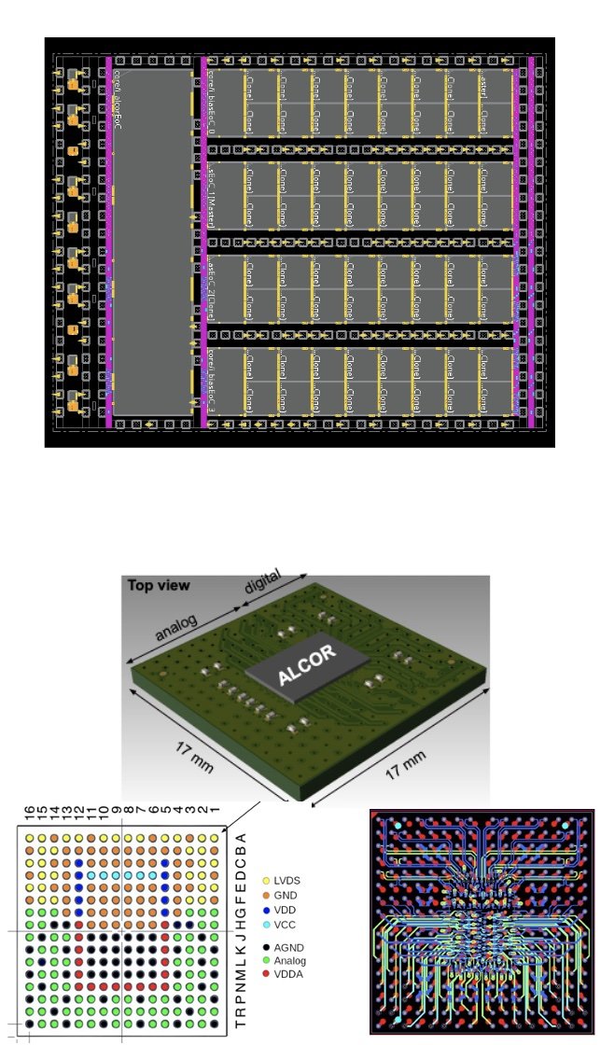
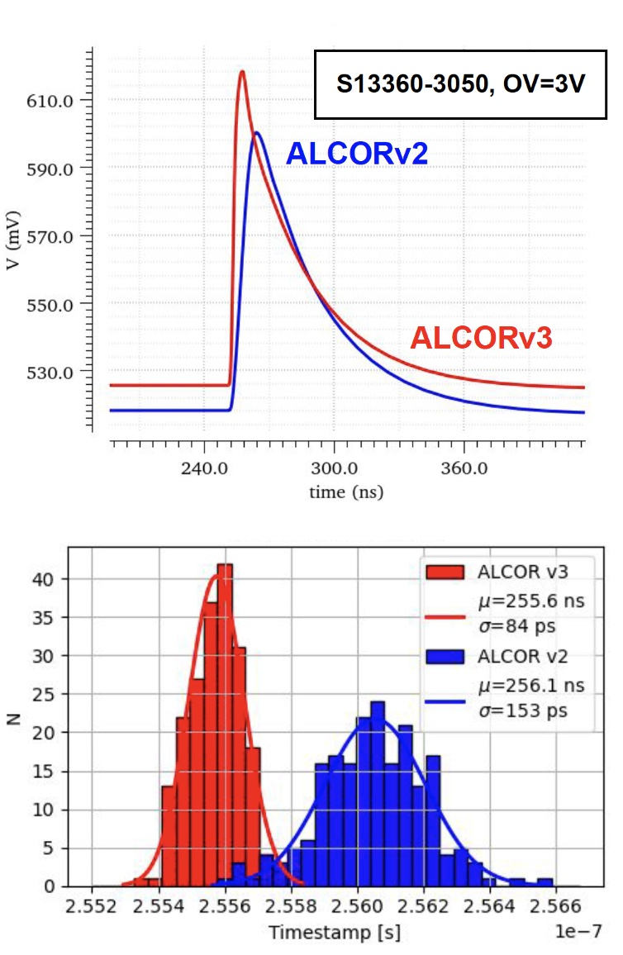
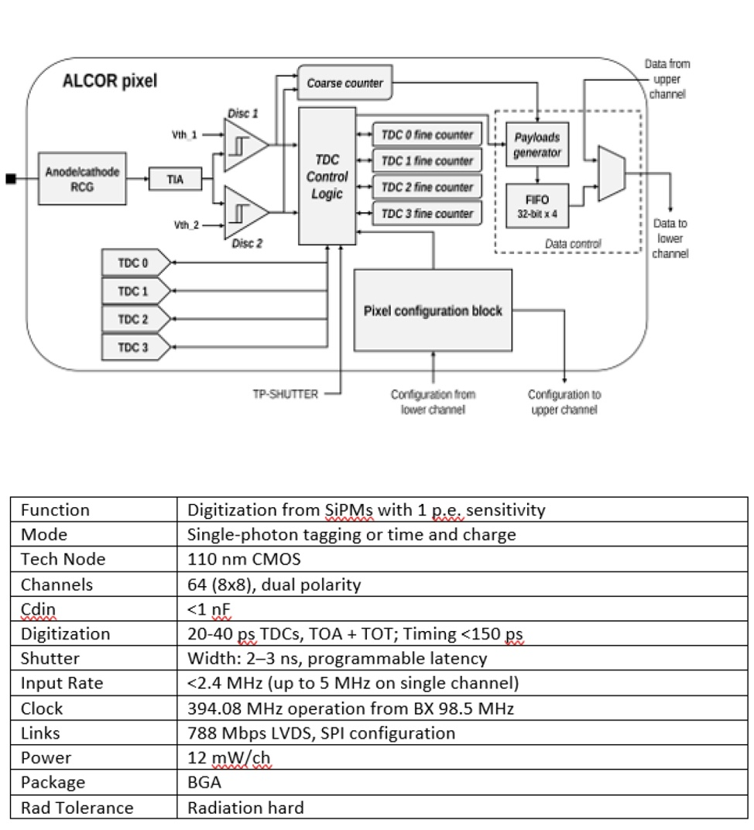
ALCOR Readout Chip & FEB
eRD109
ALCOR spces defined with years of lab + beam tests with the 32 channel version - ALCORv64 ready for pilot production
MPW run in March ‘25
Silicon die layout
Improved timing and digital shutter
ALCOR block diagram
Compact ball-grid array (BGA)
package with interposer
ALCOR key specifications
M. Contalbrigo
10th EIC DAC Meeting - June 11th – 13th, 2025
16
Notes:
Vedere stage in ingresso, c’e’ gain programmabile ?

Slide 17
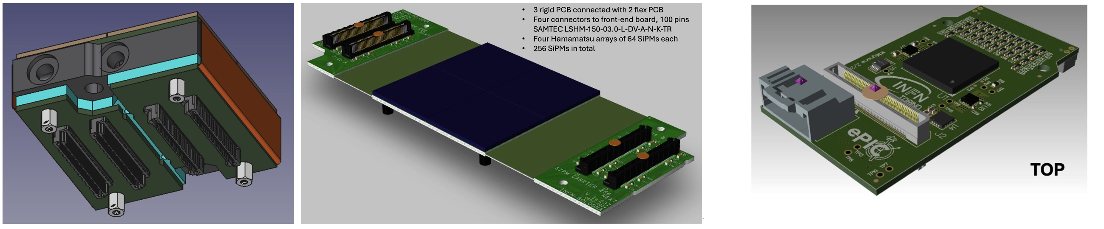
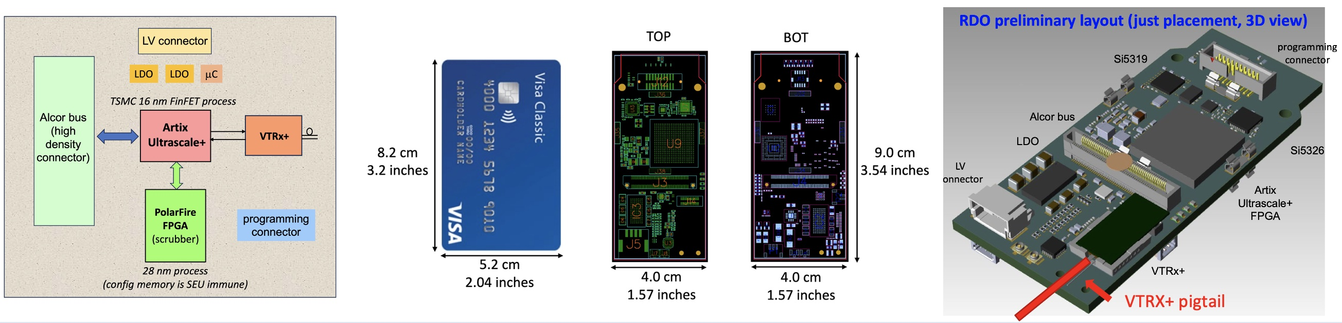
Readout Electronic
Design of the readout electronics in the “final” ePIC layout version is ready for test production.
Details on
Backup 29
Backup 30
Proton irradiation campaigns for ALCOR-32 and key RDO components showed SEU rate is within the expected manageable levels
A working DAQ scheme has been identified to support ML online data filtering at sub-detector level against pure dark-count event
Carrier v3
Test-production started ‘Jan 25
Front-End Board (FEB)
Readout Board (RDO)
Delivery imminent
M. Contalbrigo
10th EIC DAC Meeting - June 11th – 13th, 2025
17
Notes:
N ties smaller than ePIC!

Slide 18
Design Status
Technical requirements
Validated technical solutions
Before CD-2
Momentum reach above 15 GeV/c to overlap with gas
More than 10 detected photons from 4 cm thickness
Single photon resolution approaching 2 mrad
n = 1.026
dn/dλ = 6 10⁻⁶ nm⁻¹
scattering length > 50 mm
Aerogel:
Dimensions
Momentum reach above 50 GeV/c at pseudorapidity > 2.5
More than 20 detected photons from 1 m depth
Single photon resolution approaching 1 mrad
with n = 1.00086
dn/dλ = 0.2 10⁻⁶ nm⁻¹
absorption length > 100 m
Gas:
C₂F₆
Purging
Focalization of Cherenkov light onto the detector surface
Preservation of the Cherenkov information
Material budget limited to O(2 %) of radiation length
Carbon fiber material
Roughness of few nm
Angular precision < 0.3 mrad
Mirror:
Coating
Single photon detection capability in highly non-uniform magnetic field
Excellent PDE in the visible range to cope with aerogel
Marginal contribution to the angular resolution
Preserve prompt Cherenkov information
Tolerance to few 10¹⁰ 1-MeV neutron equivalent fluence
Spatial resolution of 3 x 3 mm²
Time resolution O(100 ps)
Operation at < -30 degrees
Annealing curing cycles
Sensors:
SiPM
Layout
Annealing
Below 1 p.e. signal threshold capability
Preserve sensor time resolution to cope with dark counts and accidentals
More than 300 kHz/ch rate capability
Streaming readout with suppression of no-interaction frames
ALCOR chip (ToT architecture)
Time resolution < 200 ps
Rate > 300 kHz/ch
Readout:
ALCOR
ALCOR 64ch
RDO
Mechanics:
Acceptance maximized in 1.5 – 3.5 pseudorapidity range
Material budget minimized in acceptance
Compatibility with barrel maintenance at IP6
Composite materials
Single open volume
Detector in the barrel shadow
Real-scale
prototype
Cooling
M. Contalbrigo
10th EIC DAC Meeting - June 11th – 13th, 2025
18
Notes:
Vedere soglia in terms of fC.

Slide 19

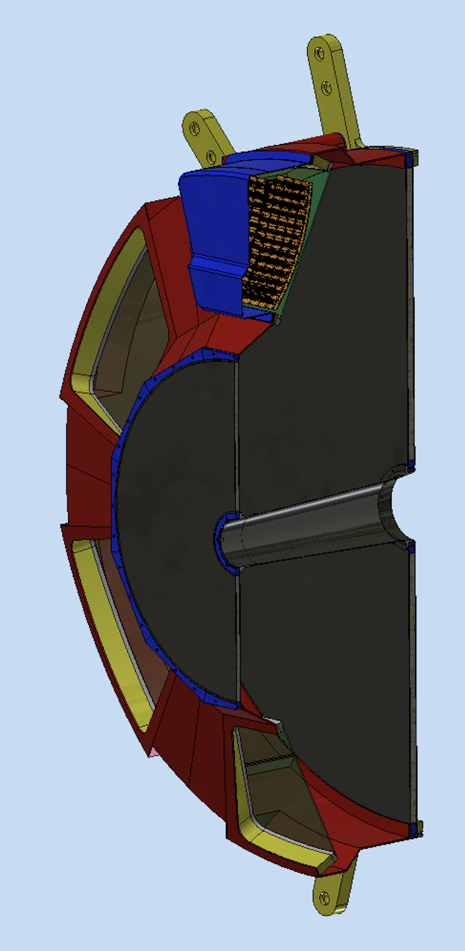
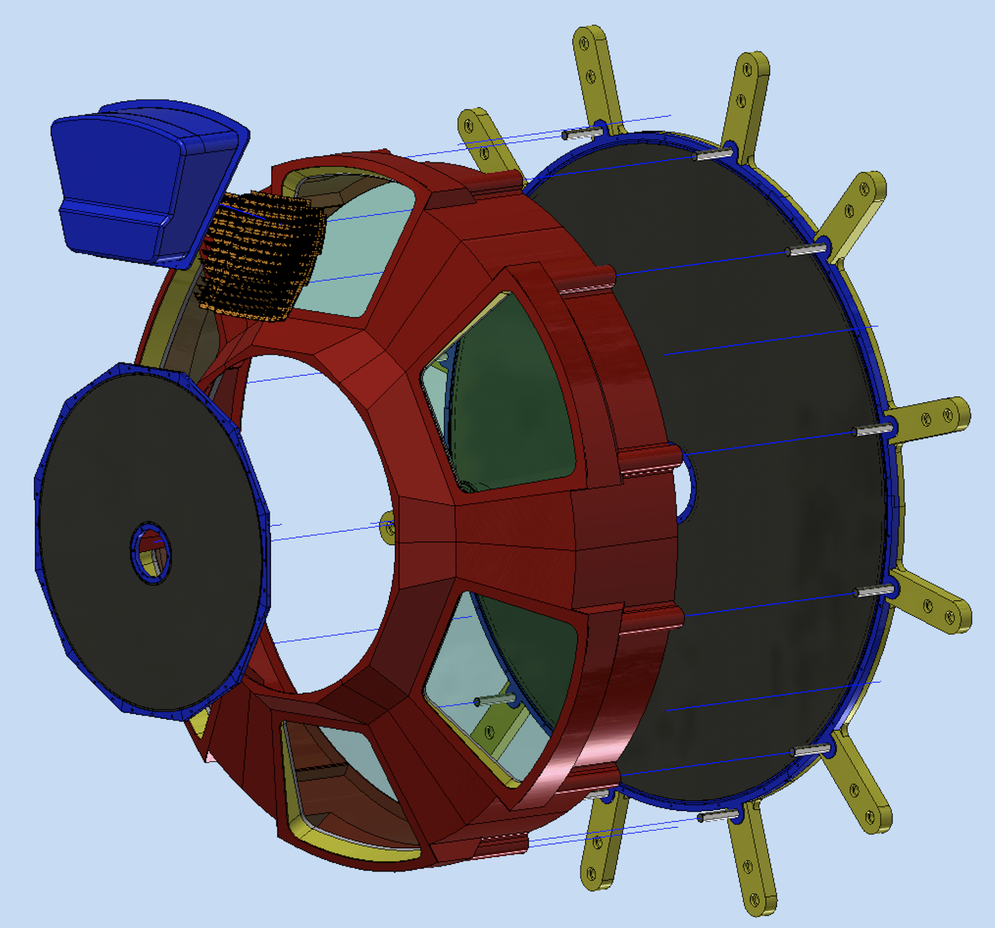
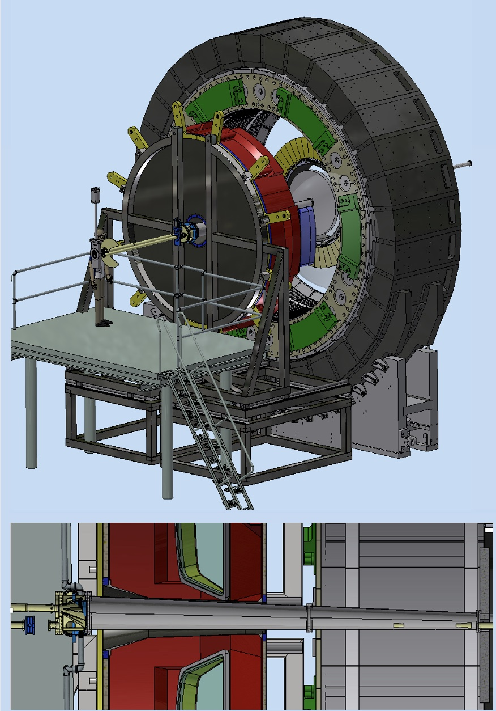
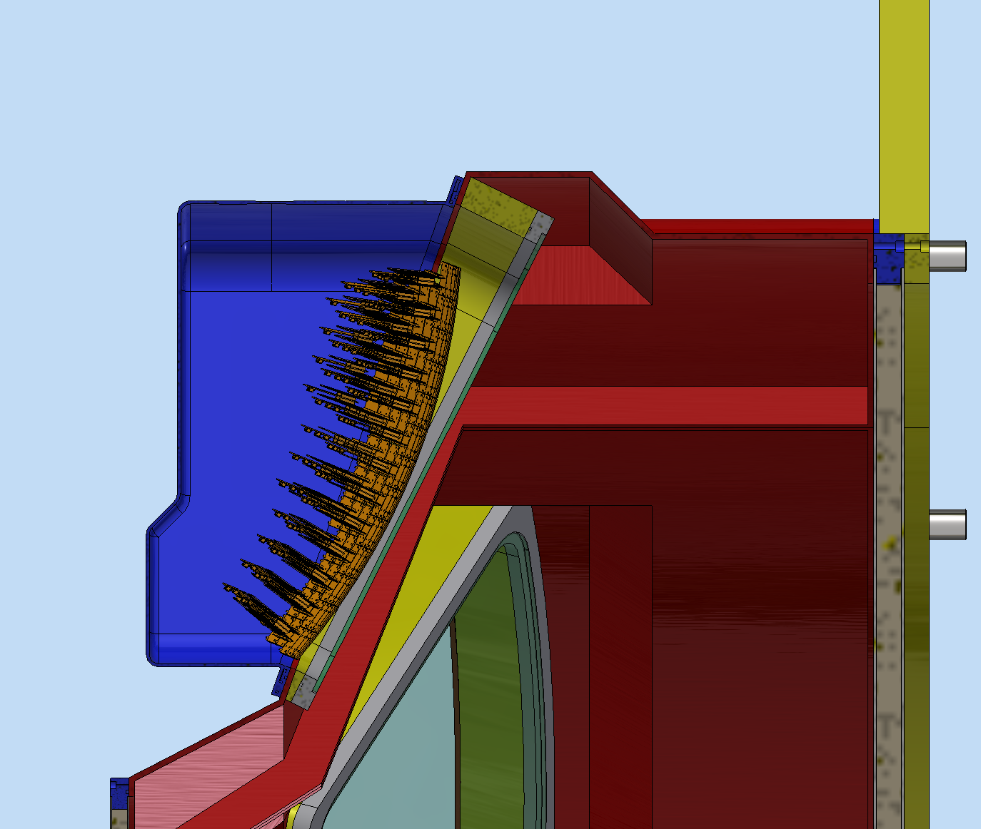
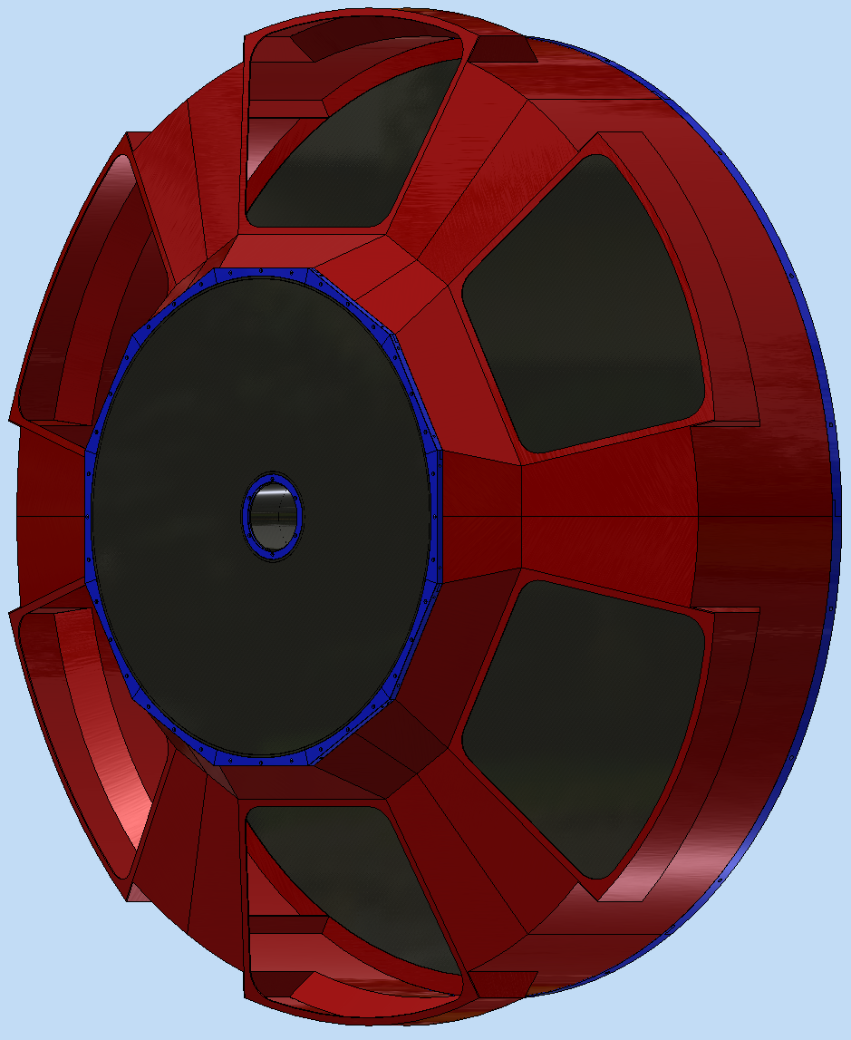
General Layout
A detailed mechanical model of the single-vessel detector is outlined with composite materials
Shell
(CFRP bulk)
Recomm. (DAC): Provide material for the pending decision
on the single vs two vessel version of the detector.
Detector box
(aluminum)
Exit window
(CFRP sandwich)
Pipe
(bulk)
Entrance window
(CFRP sandwich)
PDU detector
Quartz window
Composite materials
Total wieght: ~ 2 ton
Detector box
Off-axis bore
M. Contalbrigo
10th EIC DAC Meeting - June 11th – 13th, 2025
19

Slide 20
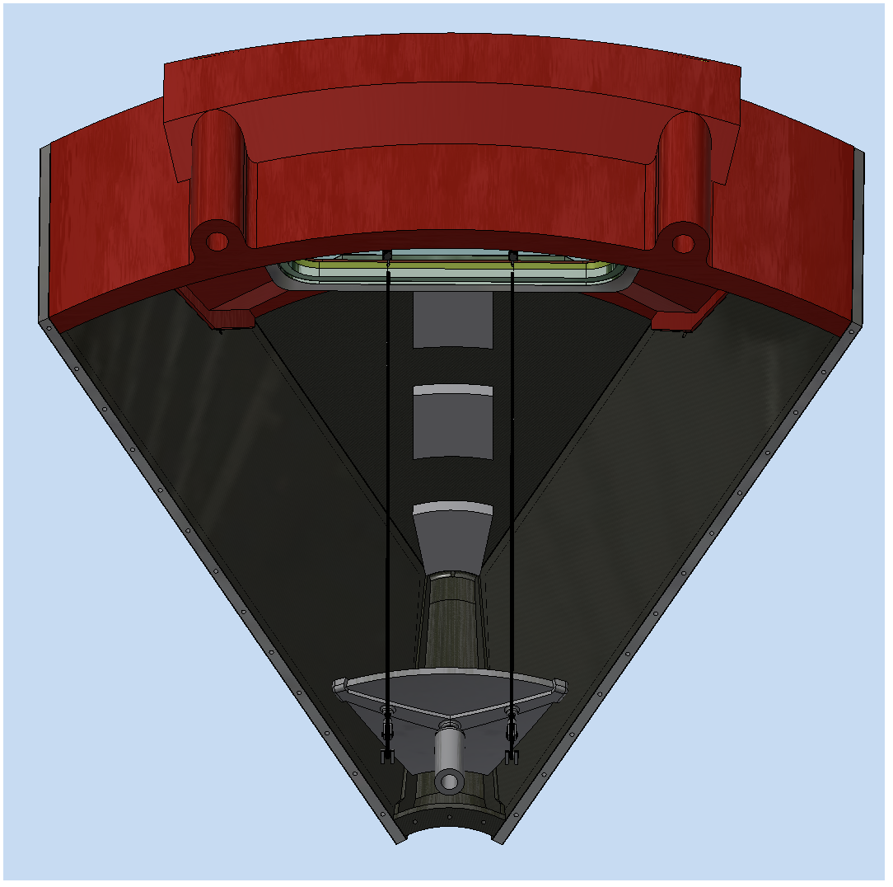







Realistic Components
eRD102-FY25
Engineering of all the mechanical details pursued with the real-scale prototype being realized in 2025
Aerogel support
Mirror mounting and alignment (aka NA62)
Vessel
PO issued
CFRP Layer
composition
M. Contalbrigo
10th EIC DAC Meeting - June 11th – 13th, 2025
20

Slide 21



Test Beams
Previous validations:
Dual-radiator concept
C₂F₆ radiator gas performance
Aerogel rafractive index
SiPM-ALCOR readout chain
EIC-drive readout plane
Temperature gradients
2025
2025 main goals:
Real scale 1-sector prototype
with demo components
ALCOR readout with RDO
Slot at SPS H8 in November
M. Contalbrigo
10th EIC DAC Meeting - June 11th – 13th, 2025
21

Slide 22


Quartz Window
Ongoing comparative simulation vs prototype thermal study expected to be completed by mid 2026
Details on
Backup 33
SiPM plane, cycled from 22º to -30º
3 mm lucite window
Recomm. (DAC): Investigate whether windows are necessary to separate regions at
different temperatures (gas radiator and the photon detector), and if needed, whether
they impact performance significantly.
Ongoing study with ANSYS workbench simulations
Benchmarked by dRICH prototype
Gradients are largely mitigated by
- double lucite window (with air gap) x 0.5
- 8 mm thick quartz window
- inner gas recirculation x 0.1
Gas volume with thermocouples
Temperature profile
5 x 5 cm step
Temperature profile
M. Contalbrigo
10th EIC DAC Meeting - June 11th – 13th, 2025
22
Notes:
Dove metto NISER ?

Slide 23





dRICH Performance Study
Simulation within ePIC dd4hep framework accounts for tracking, material budget and magnetic bending.
Details on Backup 34
Model bases on lab characterization and test-beam data of components
p
Photons impinging angles and transmission probability
k
π
π
e
M. Contalbrigo
10th EIC DAC Meeting - June 11th – 13th, 2025
23
Notes:
A quale pseudorapidity ?

Slide 24


Construction Plan
60% Preliminary Design Review passed. A construction and QA plan is outlined accounting for lead, assembling and commissioning time
Recomm. (DAC): Present at least a vague timeline for the project at the next DAC review.
Details on Backup 31-32
2027
2028
2029
2030
2031
2032
v
v
v
v
v
v
TDR
CD-2: Validate ALCOR-64 & RDO design
Validate real-scale prototype mechanics
Study detector box engineering
Define baseline integration and maintenance plan
Work out a baseline cooling & gas sytem
CD-3: Optimize component performance
Complete component integration
Finalize cooling & gas system
Detail detector integration and maintenance
Stage 1: Procurement for the PDU components (asics, SiPM, carrier, FEB, RDO…)
Anticipate mirror and gas procurement to reduce risk
Stage 2 : Central 2-3 year for the detector box assembling before delivery to BNL
Aerogel production after engineering optimization
Gas system realization after BNL authority approval
Stage 3: Mechanical structures
Assembling and completion of services
6 months of contingency and functionality tests
M. Contalbrigo
10th EIC DAC Meeting - June 11th – 13th, 2025
24

Slide 25
Conclusions
dRICH Design Status is documented in the pre-TDR:
dRICH passed 60% Preliminary Design Review on April 1-2, 2025
Essential technical performance has been validated for each dRICH component
Engineering is ongoing with pre-productions for performance vs cost optimization
Workforce is increasing, with focus in simulations and engineering
Ultimate R&D achievements expected in 2025 (real-scale prototype, RDO, ALCOR64)
On track for CD-2 in 2026 and Final Design completion in January 2027 as for P6
Previous DAC Recommendations:
✓ Annealing procedures should be investigated and defined; this will have implications for the design of the read-out board (heating).
✓ Provide material for the pending decision on the single vs two vessel version of the detector.
✓ Present at least a vague timeline for the project at the next DAC review.
✓ Investigate whether windows are necessary to separate regions at different temperatures (gas radiator and the photon detector),
and if needed, whether they impact performance significantly.
M. Contalbrigo
10th EIC DAC Meeting - June 11th – 13th, 2025
25

Slide 26




Aerogel Technical Performance
Aerogel with n=1.026 validated with lab and prototype tests
* meet SPE resolution expectations
* scattering length > 50 mm
* match with TOF end point (2.5 GeV/c)
* overlap with gas (> 12 GeV/c)
* photon yield > 10 per particle with MAPMTs
Lab
Various samples from Aerogel Factory
Goal
Goal
40% ring coverage by MAPMTs
M. Contalbrigo
10th EIC DAC Meeting - June 11th – 13th, 2025
26
Notes:
Come si arriva ai 1.8 Tbps ? 3 KHz / 3(shutter) * 3e5 (canali) *64

Slide 27





Mirror Substrate & Coating
Ongoing activities with possible synergies with pfRICH to be completed by 2026
Studying special material (ultra-low degassing)
Developing portable reflectivity test bench
Testing coating (SBU) on dRICH samples
X-ray reflectivity off CMA mirror
(rho ~ 2.1 g/cm³, roughness ~ 1 nm)
M. Contalbrigo
10th EIC DAC Meeting - June 11th – 13th, 2025
27

Slide 28



Sensor Technical Performance
Baseline specs defined at the SiPM LLP Rewiew in fall 2023 after several tests on a variety of sensors
Based on PDE vs DCR studies
over a variety of SiPM
new
annealed
post 10⁻⁹ neq
M. Contalbrigo
10th EIC DAC Meeting - June 11th – 13th, 2025
28
Notes:
Aggiungere distribuzioni in numero fotoni ?

Slide 29



Readout Irradiation Tests
Singe-event upset (SEU) rate of dRICH electronics is manageable with standard firmware redundancy and resets features
Regular irradiation campaign ongoing:
Neutron irradiation campaign at LNL-CN (9-11 October 24)
Gamma irradiation campaign at CERN-GIF (14-16 October 24)
Proton irradiation campaign at TIFPA (12-14 December 24)
ALCOR radiation tolerance
RDO radiation tolerance
Measured
Mean SEU time @ ePIC
Si5326 (clock)
4 h
Attiny (power)
3.8 h
AU15P (FPGA)
2 min
M. Contalbrigo
10th EIC DAC Meeting - June 11th – 13th, 2025
29
Notes:
TMR triple modular redundancy
CRC cyclic redundancy check
SEU single event upset

Slide 30







dRICH Online Filtering
A working DAQ scheme has been identified to support ML online data filtering at sub-detector level against pure dark-count event
Scheme based on ePIC DAM (Felix) &
APEIRON communication network (INFN)
sub-sector integrated analysis
detector integrated analysis
Preliminary tests
Classifier
M. Contalbrigo
10th EIC DAC Meeting - June 11th – 13th, 2025
30
Notes:
Farsi spieare la latenza. Bisogna sapere ul data rate a cui sono arrivati (factor 2?)

Slide 31

dRICH Overview
Preliminary commitments for the construction phase are defined
24 staff
18 postdocs/
students
18 technicians/
engineers
8 staff
2 postdocs/
students
2 technicians/
engineers
8 staff
2 postdocs/
students
Many groups have committed to the construction phase of the above items
QA stations are of common interest: best performance with co-funded equipment & shared workforce
open to collaborators: opportunity for secondments and students traning
M. Contalbrigo
10th EIC DAC Meeting - June 11th – 13th, 2025
31

Slide 32






Quality Assurance
QA is organized to allow essential acceptance tests on 100% of components plus in-depth sample characterization
QA stations organized in order to
Be close to the assembling site
Ensure adequate personnel training
Provide redundancy & investment synergy
Support specific in-deep characterization studies
Aerogel: Integrity, defects, transmittance, refractive index, dimensions, planarity
Mirror: Dimensions, shape accuracy, radius, reflectivity
Sensors: Electrical connections, quench resistor, I-V characteristics, DCR, relative PDE
Readout: Electrical connections, bias levels, threshold and gain scans, time jitter, DAQ rate
Gas: Refractive index, transparency, sound speed, leakage rate
M. Contalbrigo
10th EIC DAC Meeting - June 11th – 13th, 2025
32

Slide 33






Preliminary Cooling Study
Duct O(10”)
(cool air)
Pipe O(1”)
Preliminary CFD
(Computational Fluid
Dynamics) Simulation
M. Contalbrigo
10th EIC DAC Meeting - June 11th – 13th, 2025
33

Slide 34



dRICH Performance Study
dRICH technological choices are supported by a structured performance and simulations activity
Essential to guide technological choices
Effective entry-point for new collaborators
Significant reinforcement of the simulation group
New performance study group being initiated
Focussed on SIDIS physics
Experience in Spin Physics and Nucelon Structure gained at
HERMES (DESY), CLAS12 (JLab) and COMPASS (CERN)
INFN FE-BO-PV-TO-SA-LNS-TS (7 staff, 5 student/postdoc)
INFN TS-CS
U. of Salerno
Duke U.
Central U. of Karnataka
Central U. of Haryana
Ramaiah U. of Applied Science
Close collaboration with Theory groups already
active in inpact studies on (un-)polarized TMDs
INFN PV-TO (4 staff, 1 student/postdoc)
(5 staff, 11 student/postdoc)
M. Contalbrigo
10th EIC DAC Meeting - June 11th – 13th, 2025
34

