Slide 1

Overview AC-LGAD Time-of-Flight
Satoshi YANO
(Hiroshima University)
The 10th Detector Advisory Committee Review
June 11th – 13th, 2025

Slide 2
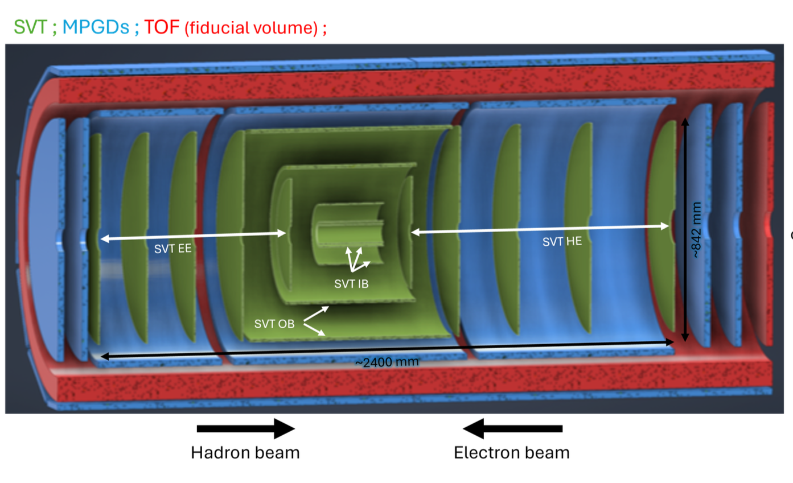
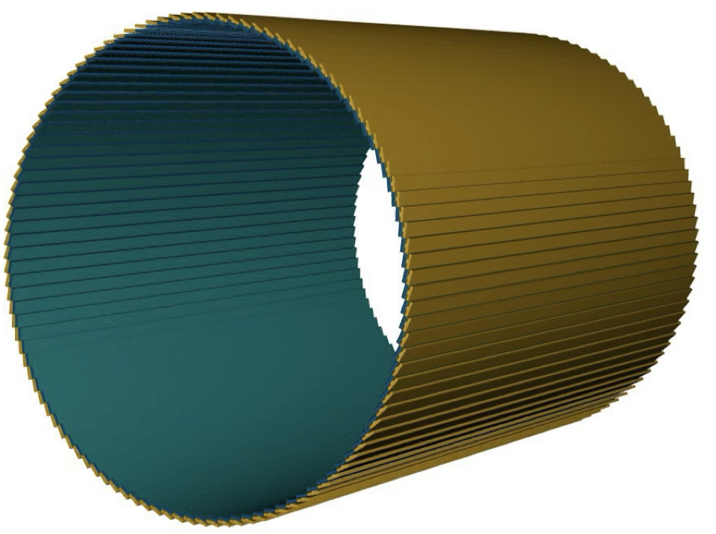
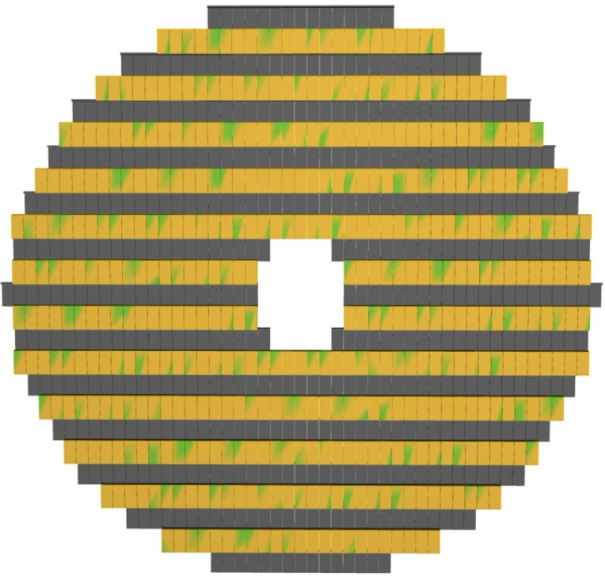
Recap of AC-LGAD TOF
Barrel-TOF (BTOF)
Forward-TOF (FTOF)
-1.33<η<1.74
1.84<η<3.61
0.64 m
10.5 cm
60 cm
~2.8 m
The ePIC AC-LGAD TOF system is used for particle identification (PID), tracking, and background rejection in both mid-rapidity (BTOF) and forward-rapidity (FTOF) regions.
A position resolution of O(10s ps) and a timing resolution of O(10s um) for PID and tracking within a space of less than 10 cm in thickness are required

Slide 3
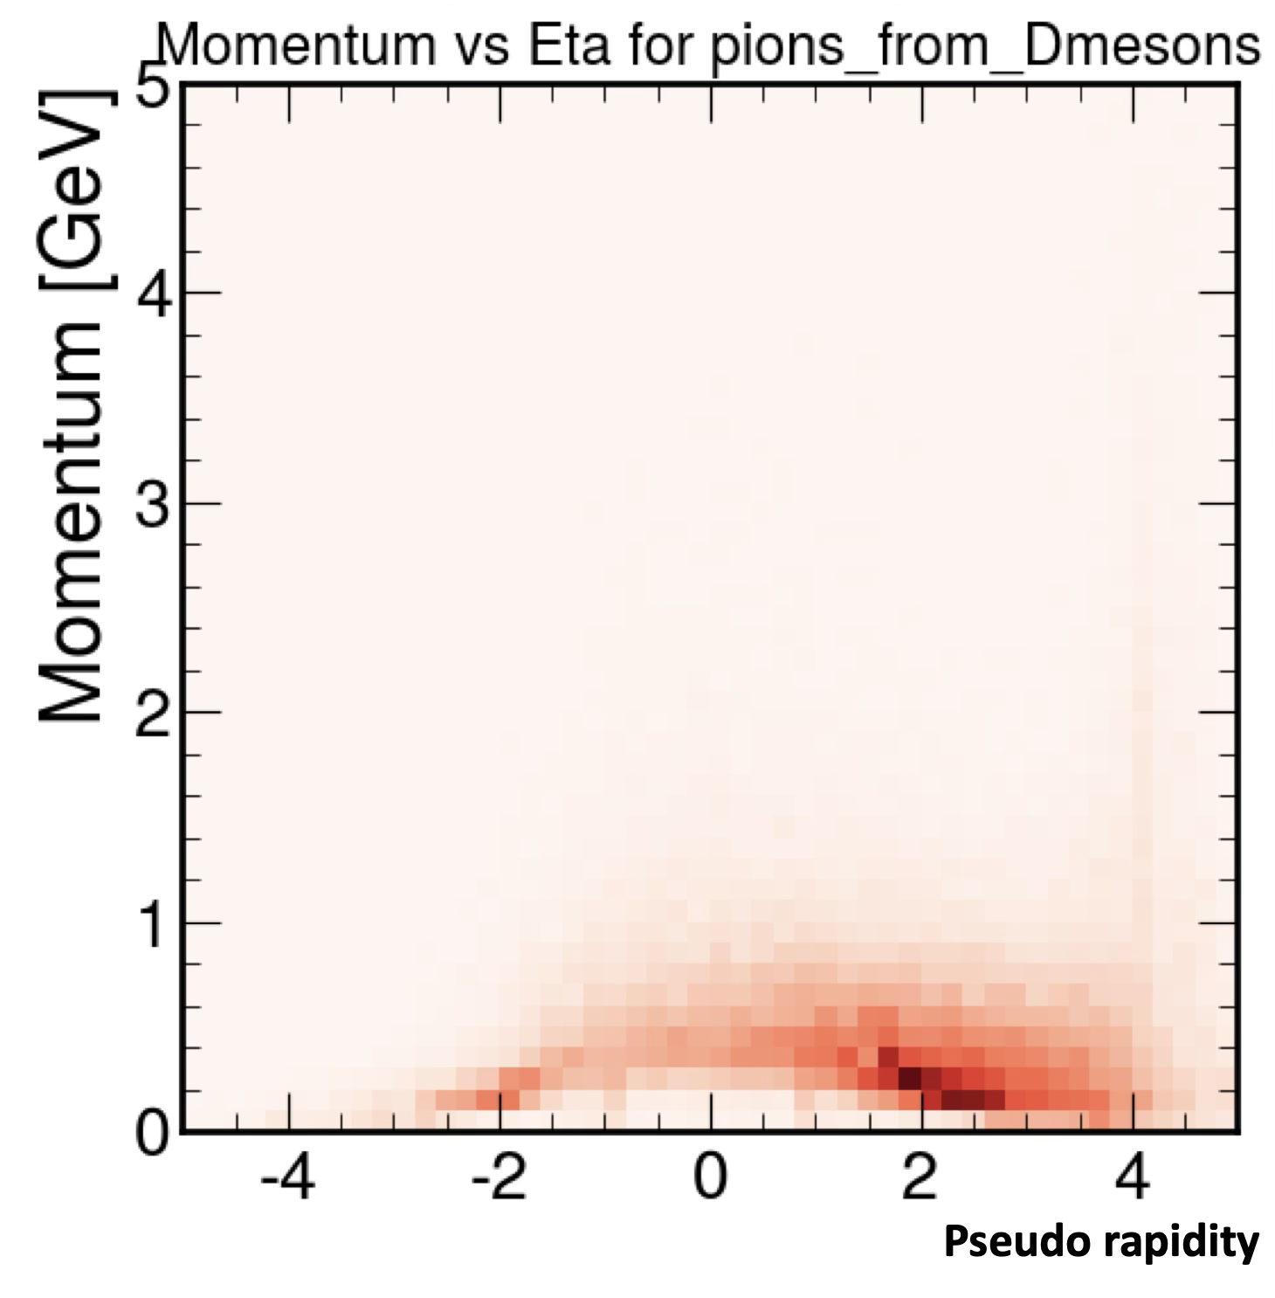
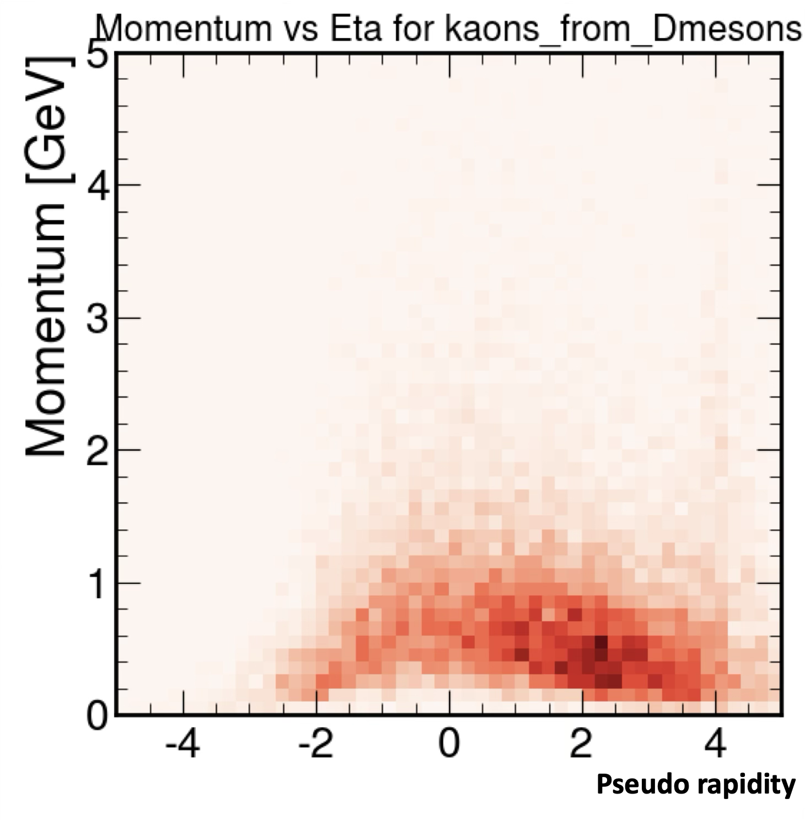
Impact on the ePIC PID performance
Focus of TOF is below p = 1 GeV/c
Particle-Identification at low momentum region is the primary task
Used in conjunction with Cherenkov light detectors to eliminate PID gaps and to cross-calibrate each other in overlapping regions
hpDIRC
dRICH
hpDIRC
dRICH
K/p 3σ
π/K 3σ
BTOF
FTOF
BTOF
Assuming
BTOF σ_{tot} = 35 ps
FTOF σ_{tot} = 25 ps
FTOF
Decay products from D-meson in ep DIS @ √s = 141 GeV

Slide 4
Technology Choice: AC-LGAD
Low Gain Avalanche Detector (LGAD) is a silicon detector with a thin gain layer making high electric field
High field increases the signal rise time and improves time resolution
Individual layer is implemented under each electrode, so inactive is not negligible and granularity limitation is there
AC-LGAD uses AC-coupled readout with one large gain layer
Inactive area is eliminated by one large gain layer
Position resolution is improved by using the charge sharing
K. Nakamura et al., JPS Conf. Proc. 34, 010016 (2021)

Slide 5
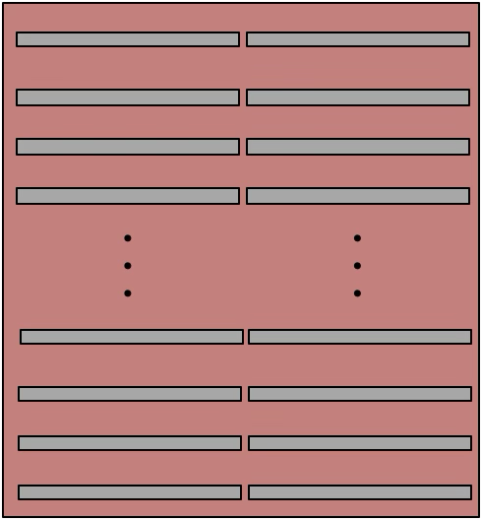
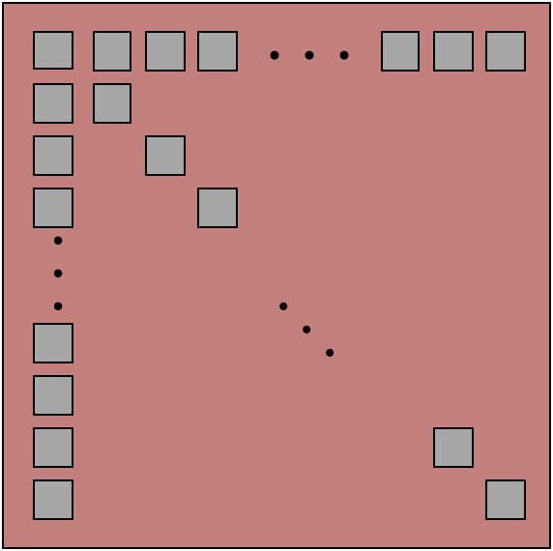
AC-LGAD Sensor Design for TOF
Strip-type sensor for BTOF
32x20 mm² (full-size) and 32x10 mm² (half) size with 0.05x10 mm² pad
The readout geometry is 64x2=128 ch for full-size, 64x1=64 ch for half-size
Prototype best score: σ_{time} ~ 35 ps and σ_{pos} < 20 μm
Pixel-type sensor for FTOF
16x16 mm² size with 0.05x0.05 mm² pad
The readout geometry is 32x32=1024 ch
Prototype best score: σ_{time} ~ 20 ps and σ_{pos} ~ 20 μm
2 rows
32 rows
Strip-type for BTOF
# Full-size: ~13.8k
# Half-size: ~4.6k
~12 m²
~2.4 M channels
Pixel-type for FTOF
# Sensor: ~3.6k
~1.1 m²
~3.6 M channels
64 cols
32 cols

Slide 6
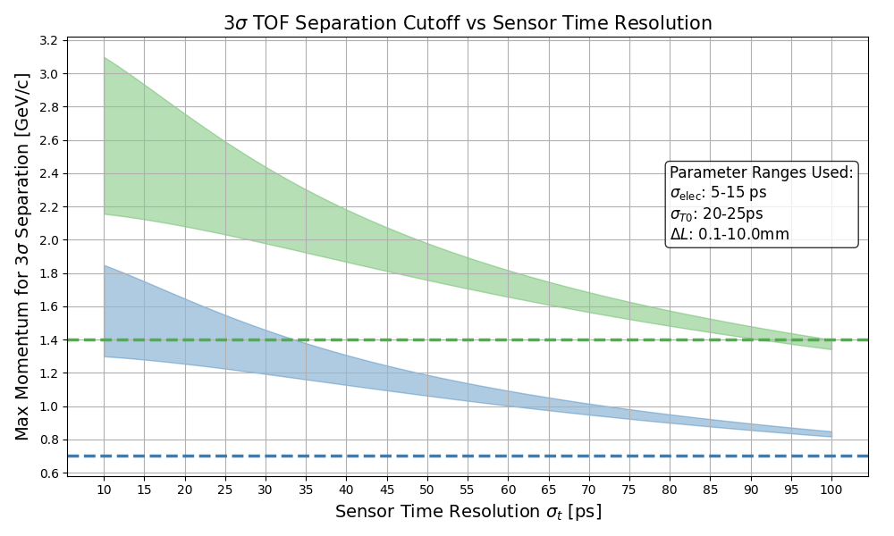
Sensor Timing Resolution on the entire PID performance
Current best performance
σ_{sensor} ~ 35 ps
PID overlapping with hpDIRC for cross calibration
→ More robust PID
Δp ~ 0.5 GeV/c
Lost overlap
hpDIRC limit for K/p sep.
Δp ~ 0.45 GeV/c
hpDIRC limit for π/K sep.
Even in the worst case scenario, with current sensor performance (σ_{sensor}~35 ps), there is an overlap area with hpDIRC → Already no PID hole
σ_{sensor}< 90 ps meets the requirement of having overlap region with hpDIRC in the worst case

Slide 7
Important Points in Development
Performance of Large AC-LGAD Sensors
First application using AC-LGAD for HEP
Identify the elements necessary for stable operation by thoroughly understand the characteristics
Mechanical and electrical design on a low material budget
Over 2.7 m length but within a few percent of material budget (for BTOF)
Accurate transmission of signal strength and timing information on a low material budget in a long distance
Thermal control due to AC-LGAD's high sensitivity to temperature gradients
Detail will be introduced by
BTOF → Simone Mazza (UCSC)
FTOF → Mathieu Benoit (ORNL)

