Slide 1
ePIC Backward EM calorimeter (EEEMCAL) status
Tanja Horn (CUA/JLab), DSL
Carlos Munoz-Camacho (IJCLab-Orsay), DSTC
for the EEEMCAL Consortium
10th EIC DAC Review
June 11th – 13th, 2025

Slide 2
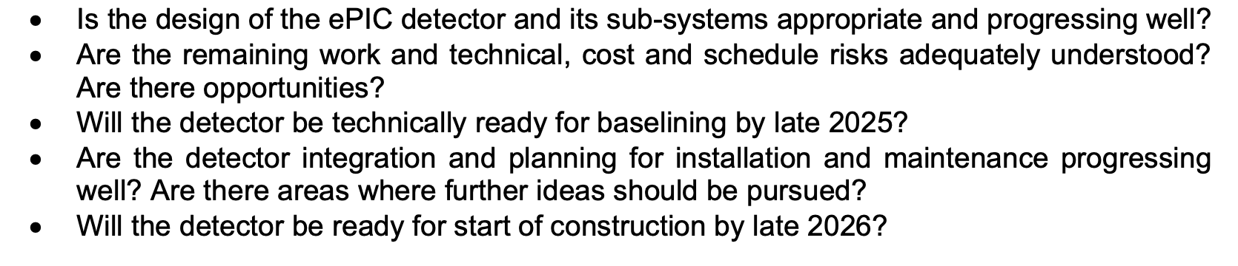
Charge Questions
10th EIC DAC Meeting
Tanja Horn

Slide 3
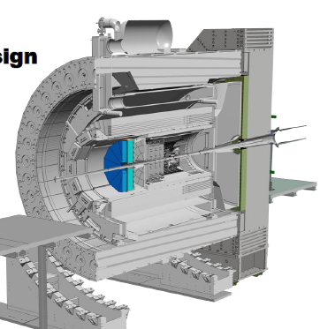
EEEMCAL Major Components
Radiator consisting of scintillating lead tungstate (PWO) crystals and a thin reflector wrapping. The physics requirements for electron identification and detection dictate the main requirements for the radiator.
Photosensors consisting of multi-pixel photon counters (MPPC) grouped into an array to maximize the surface coverage of the PWO blocks.
Mechanical structure, including installation fixtures and a cooling system providing thermal stabilization, which is important for crystal performance.
Signal Processing/DAQ providing the front-end electronics to transmit the signals to the data analysis modules.
Simulations/Software providing the software libraries and infrastructure foundation for extracting the physics from the detector.
10th EIC DAC Meeting, June 11th – 13th 2025
Tanja Horn

Slide 4
EEEMCAL Status Summary
Status
FDR PWO crystals – completed
FDR MPPC – completed
Detailed mechanical design – approaching 80%
Front End Readout – at different stages
Engineering article test runs – multiple prototype beam tests completed, engineering articles complete and last phase of beam tests ongoing
CD3A QA on PWO crystals – first (140) articles passed QA
Assembly and Installation planning - ongoing
Items for 2025
EEEMCAL FDR – plan for this Fall after completion of further scheduled DESY and JLab beam tests
Finalize mechanical design
Finalize front-end electronics (FEE) and associated cooling design
Final cooling implementation depends on final beam tests for FEE readout choice
Continue CD3A (and in 2026+ also CD3B) QA on PWO crystals
10th EIC DAC Meeting, June 11th – 13th 2025
Tanja Horn

Slide 5
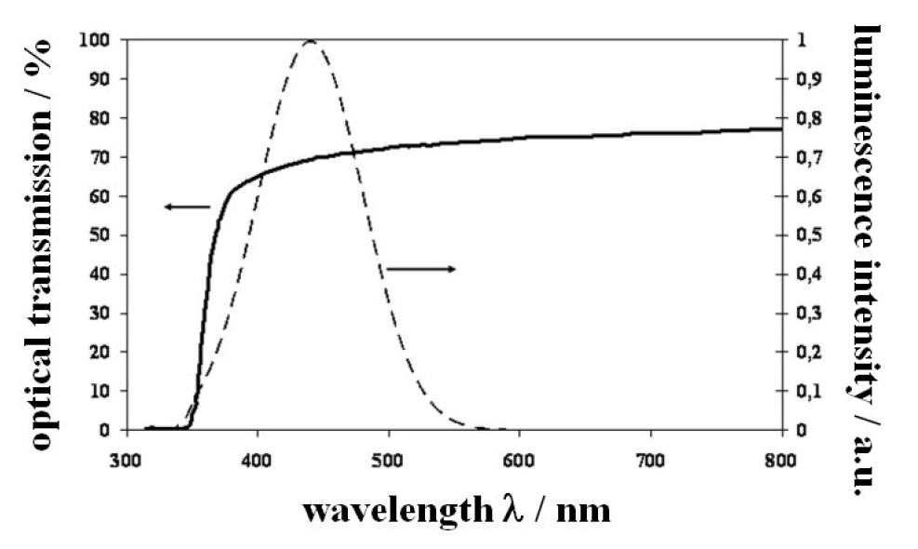
PWO Specifications
Parameter | Unit | EEEMCAL Required | Q&A Inform. Source
Light Yield (LY) at RT (for all sides polished crystals) | pe/MeV | ≥15 | Test with γ-source
LY(100ns)/LY(1μs) | % | >90 | Test with γ-source
Longitudinal Transmission at λ=360 nm at λ=420 nm at λ=620 nm | % % % | ≥35 ≥60 ≥70 | Optical Measurement
Transverse Transmission and LY uniformity along crystal | % | 10 | Optical Measurement
Inhomogeneity of Transverse Transmission Δλ at T=50% | nm | ≤5 | Optic. Measure.
Induced radiation absorption coefficient Δk at λ=420 nm and RT, for integral dose >100 Gy | m⁻¹ | <1.5 | Irradiate with different sources
Mean value of dk | m⁻¹ | ≤1.0 | Test
Tolerance in Length Tolerance in sides | μm μm | ≤±0,-100 ≤±50 | Measure.
Surface polished, roughness Ra | μm | ≤0.02 | Vendor
Tolerance in Rectangularity (90°) | degree | ≤0.1 | Measure.
Purity specific. (raw material) |  |  | Vendor
Mo contamination | ppm | <10 | Vendor
La, Y, Nb, Lu contamination | ppm | ? | Vendor
Smaller decay time – fast timing
LY (100ns)/LY(1us) specification
Optimizing the light yield relies on crystal transmittance in the near UV region
longitudinal transmittance specification
Transmittance spectrum in agreement with photosensor curve
Require homogeneous collection of scintillation light along the crystal
specification on transverse transmittance
Mechanical specifications important for assembly, e.g., to minimize gaps
Raw materials used impact crystal performance – QA with vendor
PbWO₄ specifications are similar to those achieved for JLab Projects (NPS, FCAL)

Slide 6

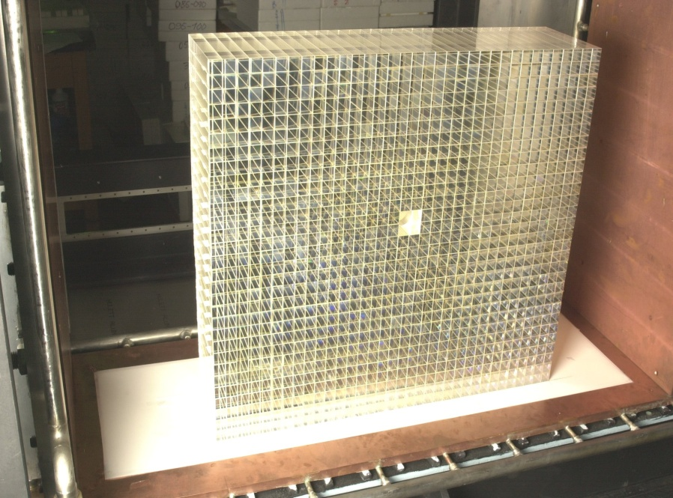
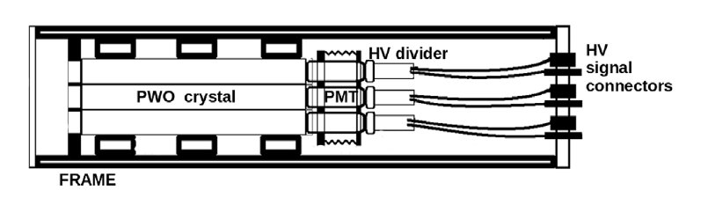
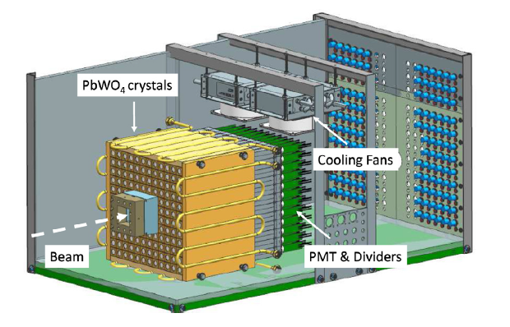
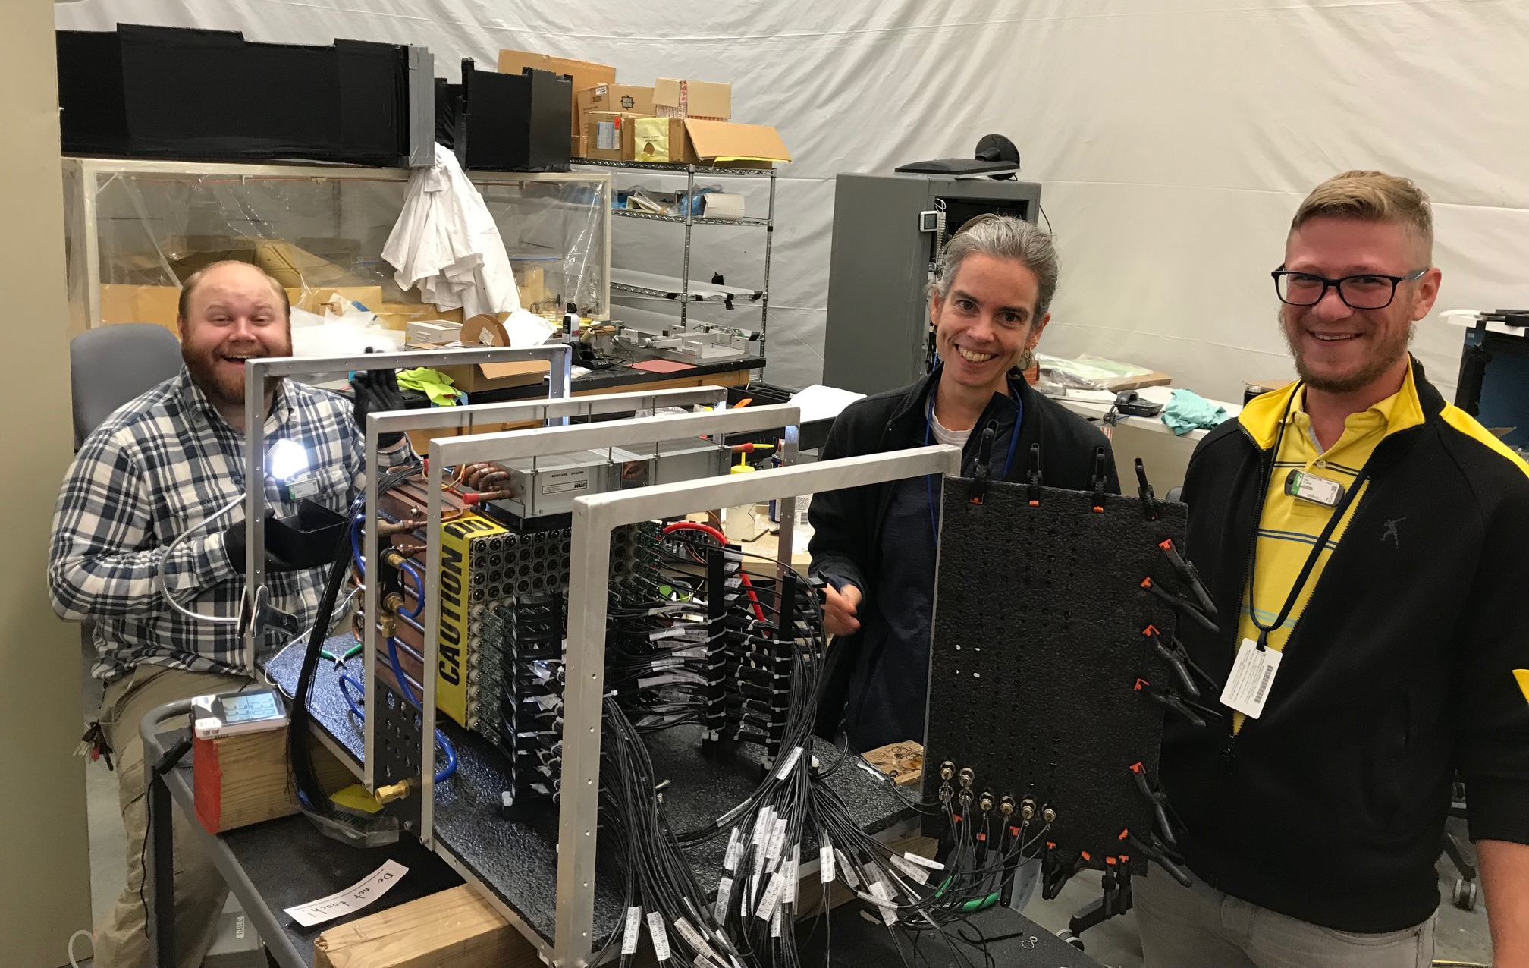
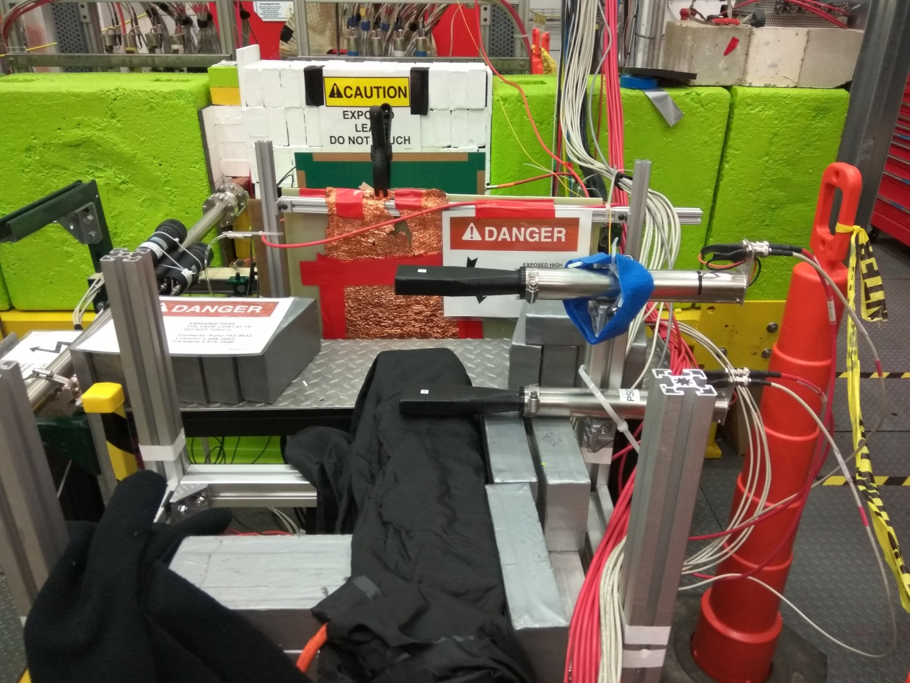
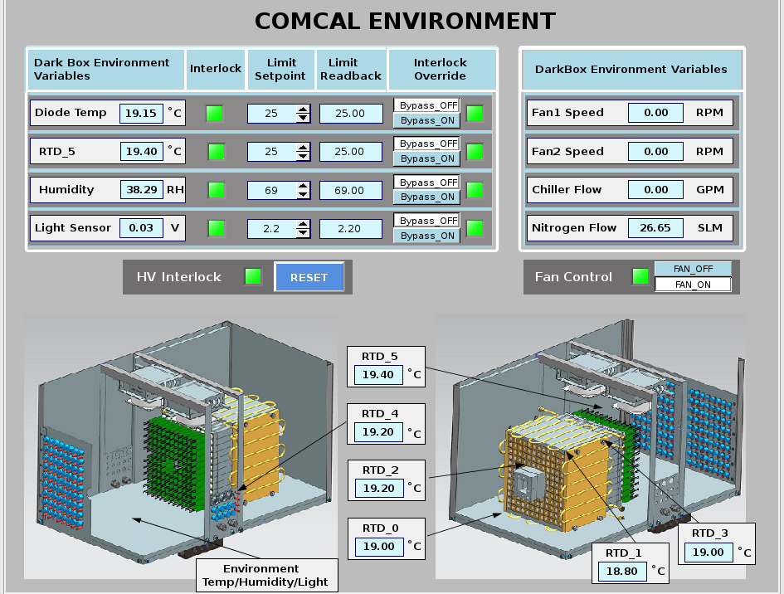
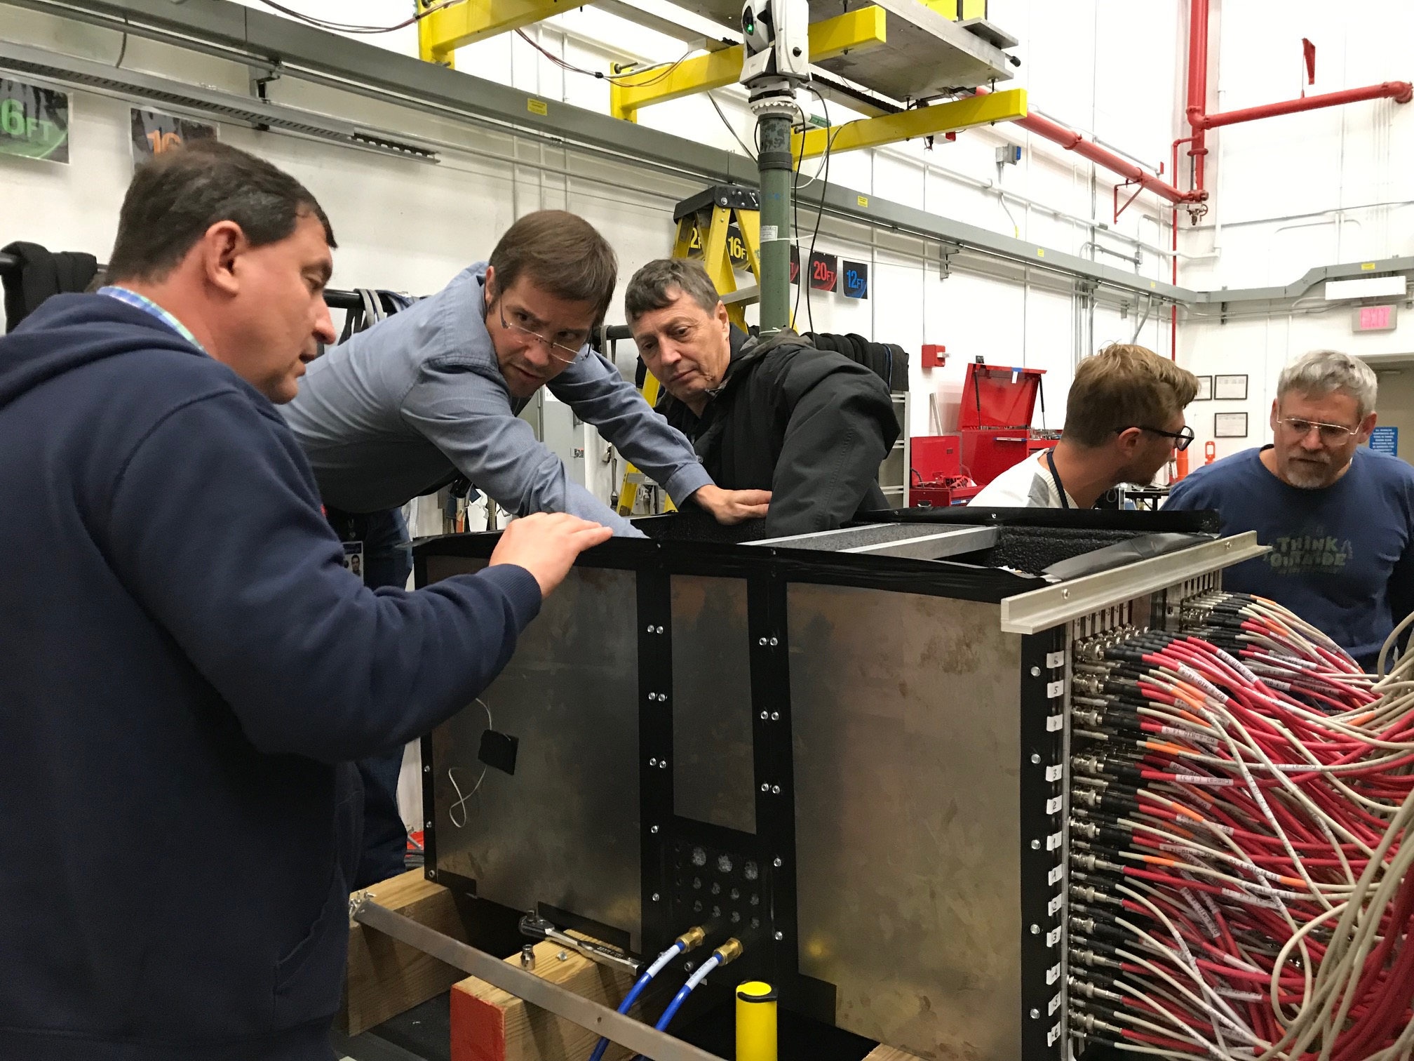
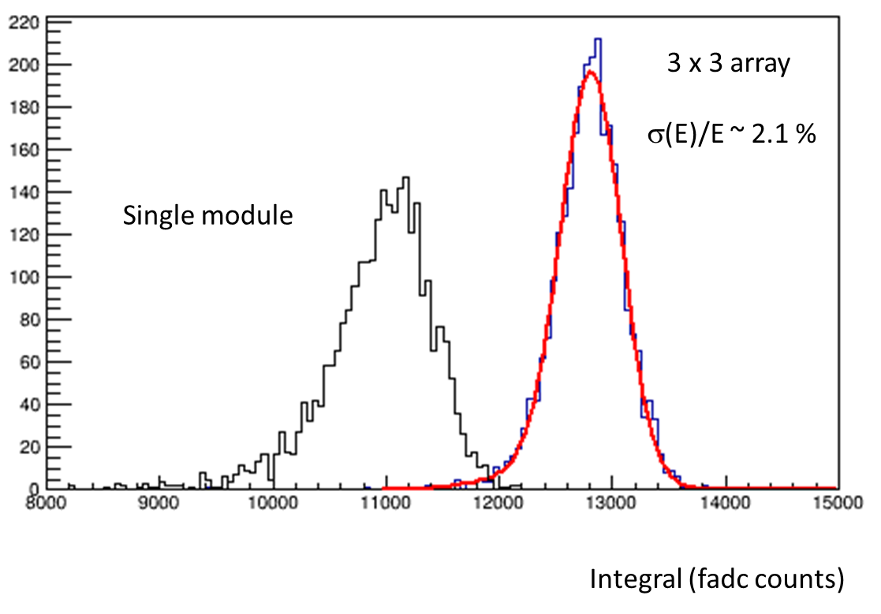
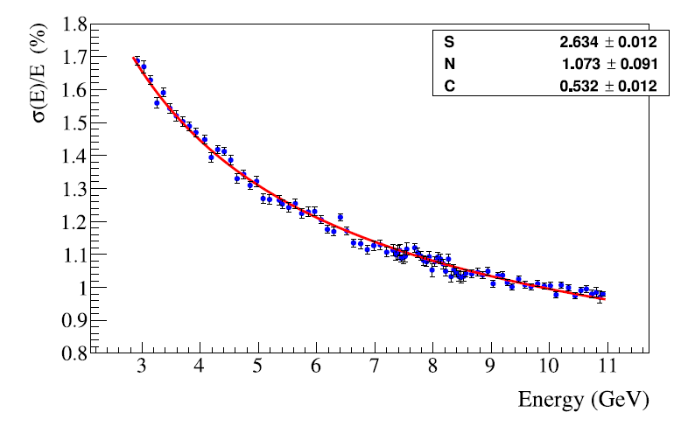
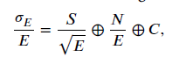
Crystal Beam Test Campaigns at JLab
12x12 prototypes (2019)
144 PbWO₄ (PWO-II) crystals
CRYTUR/Czech Rep/
HyCal (pre-2014)
1152 PbWO₄ crystals (PWO-I)
SICCAS/China
3x3 prototypes (2018/19)
9 PbWO₄ (PWO-II) crystals
CRYTUR/Czech Rep.
ComCal/FCAL
6

Slide 7
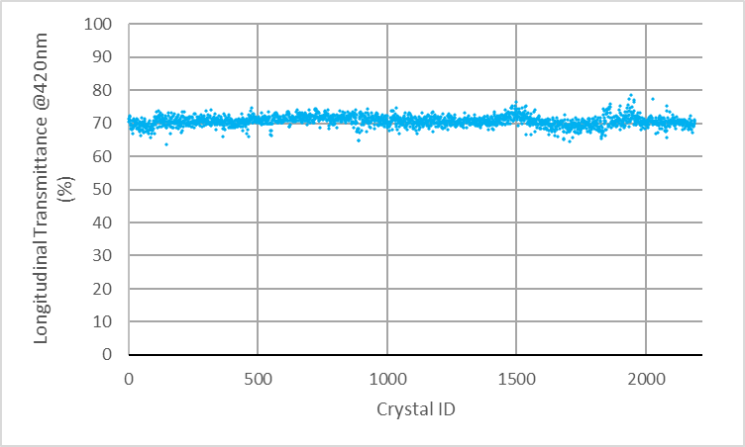
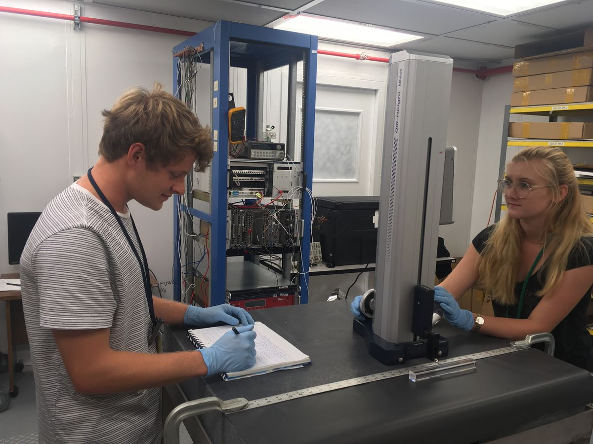
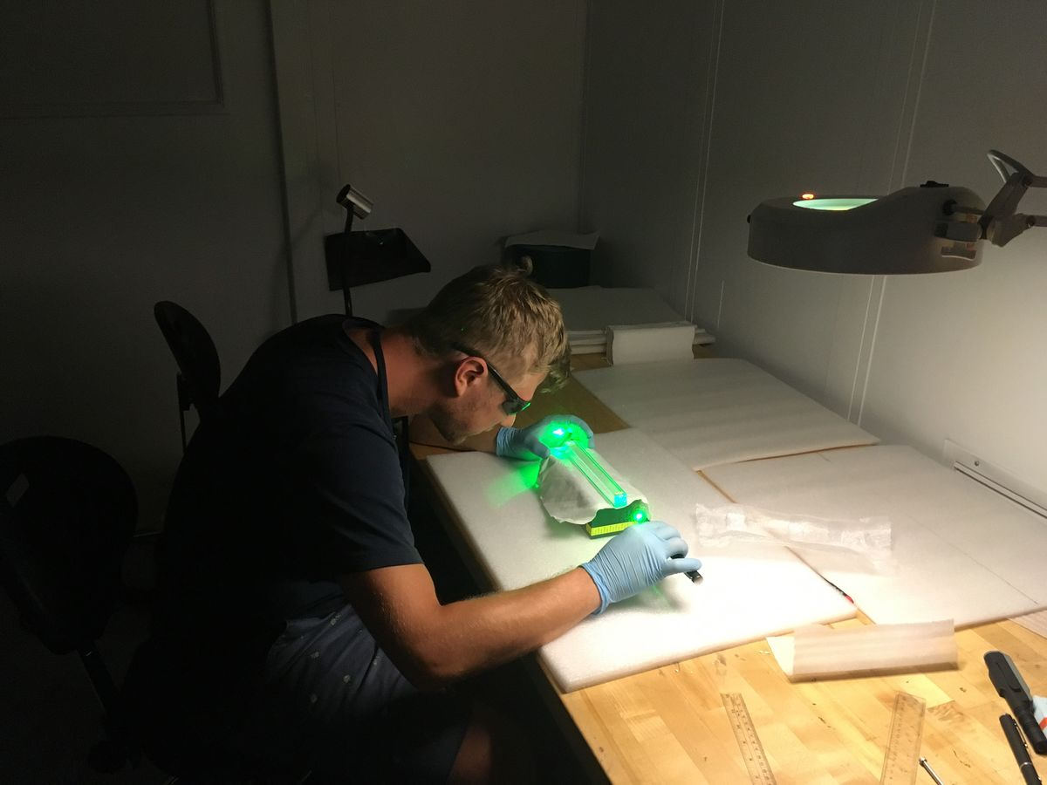
PWO Quality Assurance Protocol
Characterization results of CRYTUR produced crystals (2017 – present)
PWO crystals are CD3A item
First articles (140 crystals) passed QA
Additional 110 crystals arrived at JLab end of May 2025 awaiting QA
The QA builds on the process developed for NPS and consists of:
2 step visual inspection
mechanical dimension measurement
light yield measurement
Kinetics
transmittance measurement
induced radiation absorption coefficient.
Light Yield (LY)
Longitudinal Transmittance
Period with focus on highest LY (PANDA, NPS)
Period with focus on new specifications (EIC, FCAL)
EEEMCAL requirement
EEEMCAL requirement
Kinetics
EEEMCAL requirement
>90% of light in fast component
10th EIC DAC Meeting, June 11th – 13th 2025
Tanja Horn

Slide 8
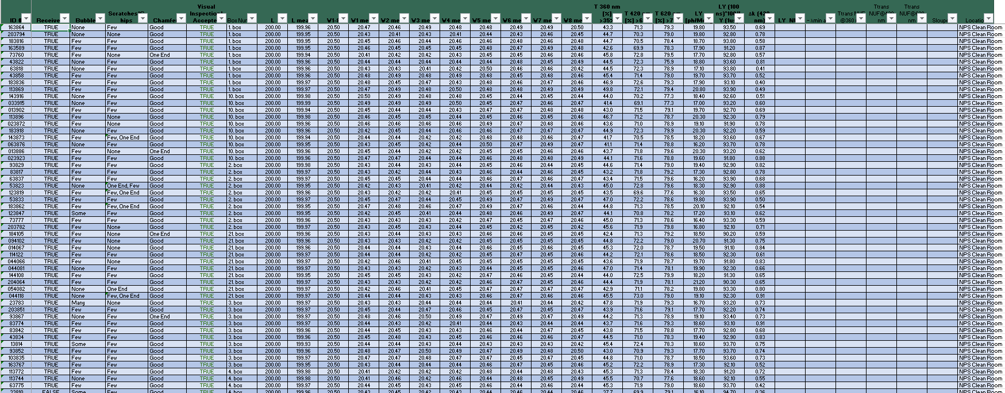
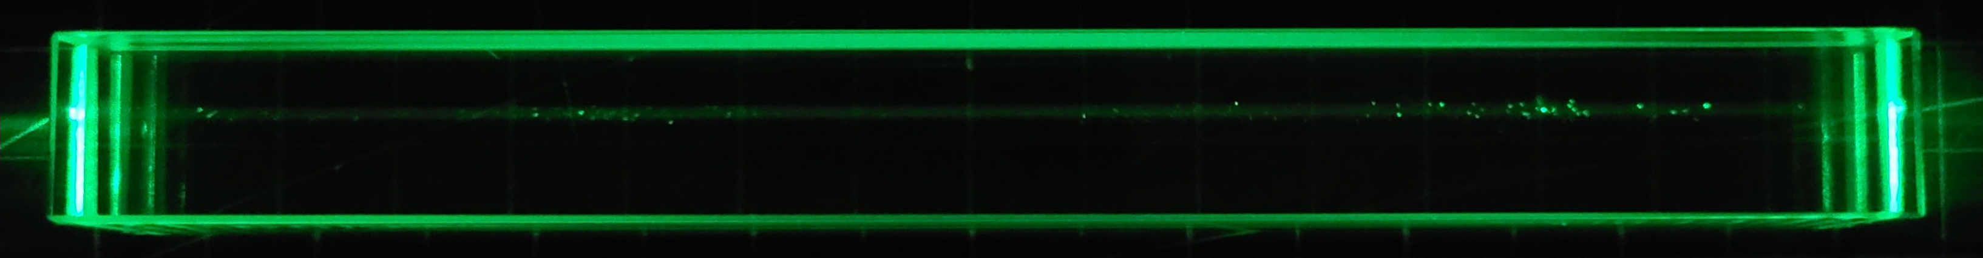
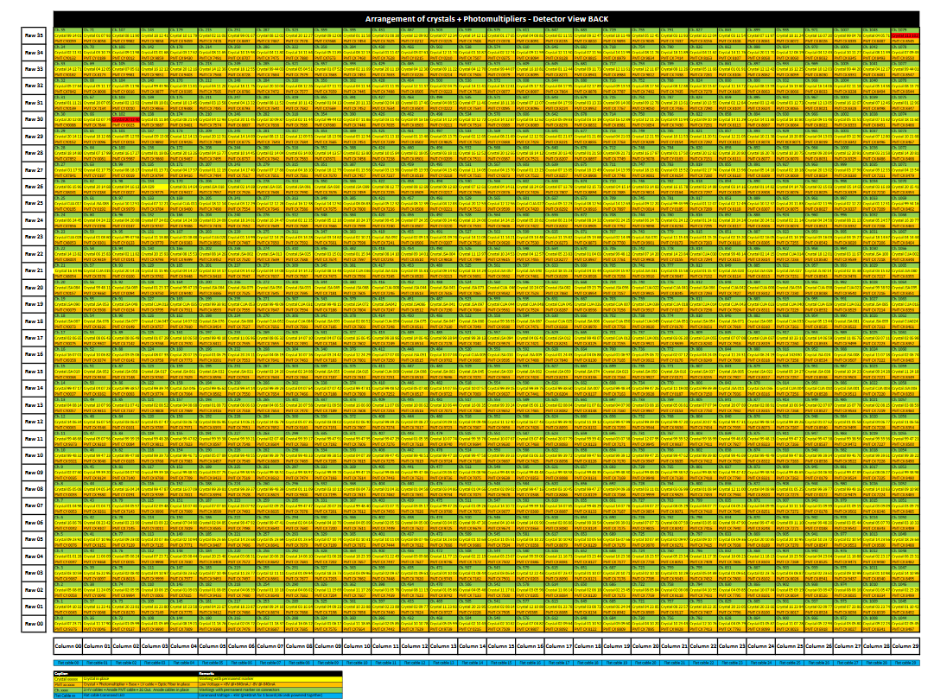
PWO Quality Assurance Documentation
Crystal quality assurance results are documented in a central location with a master spreadsheet
Crystal characterization results
Crystal images are documented along with the numerical characteristic
NPS Crystal+PMT+Cable module map
10th EIC DAC Meeting, June 11th – 13th 2025
Tanja Horn

Slide 9
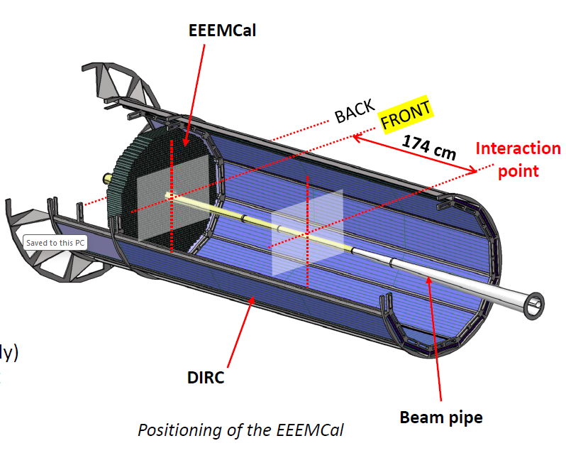
Mechanical Design Overview
Physics Considerations
Distance interaction point/EEEMCal = 174 cm
Minimize the material & space between crystals
Be as close as possible to the beampipe
Optimize radiation lengths in front of the detector as possible, e.g., material budget is a consideration for the pfRICH (not shown)
Thermal Considerations
Good stability of the room temperature around 23°C
Temperature stability for crystals to within 0.1°C
About 1500 W to dissipate
Installation Considerations
Removing the detector in one block
Respect clearance between beam pipe and the DIRC
10th EIC DAC Meeting, June 11th – 13th 2025
Tanja Horn

Slide 10
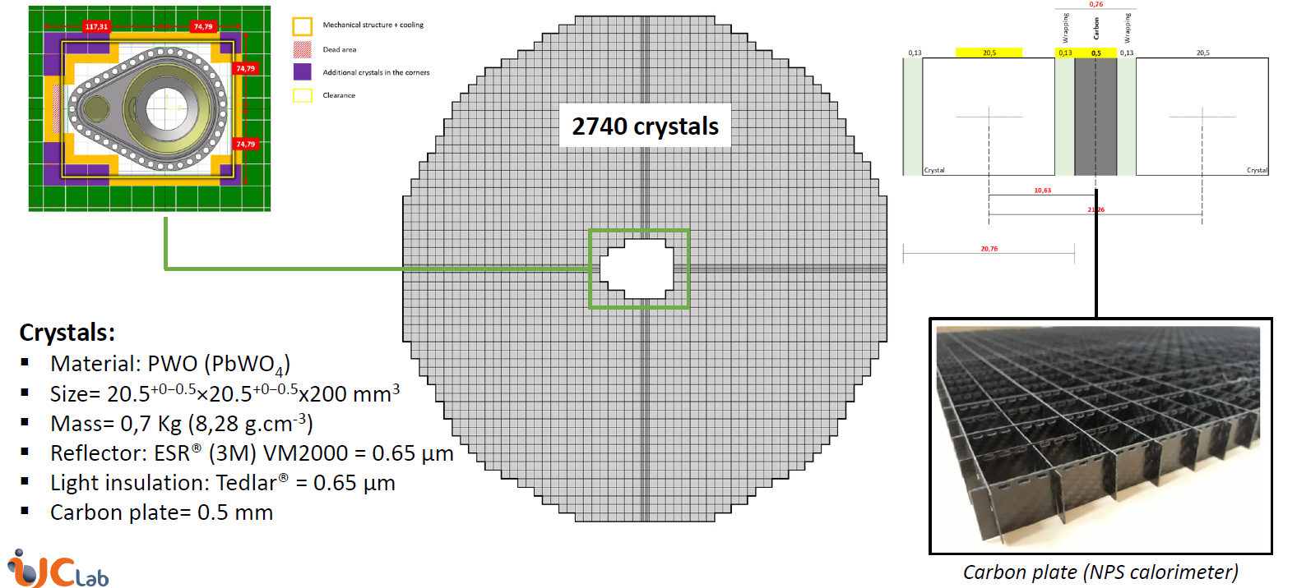
Crystal Configuration
Crystal configuration is defined
Main clearances are defined
10th EIC DAC Meeting, June 11th – 13th 2025
Tanja Horn

Slide 11
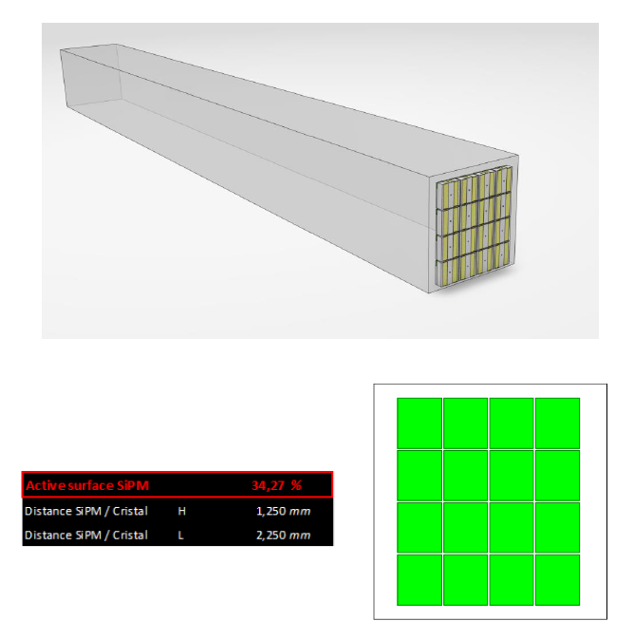
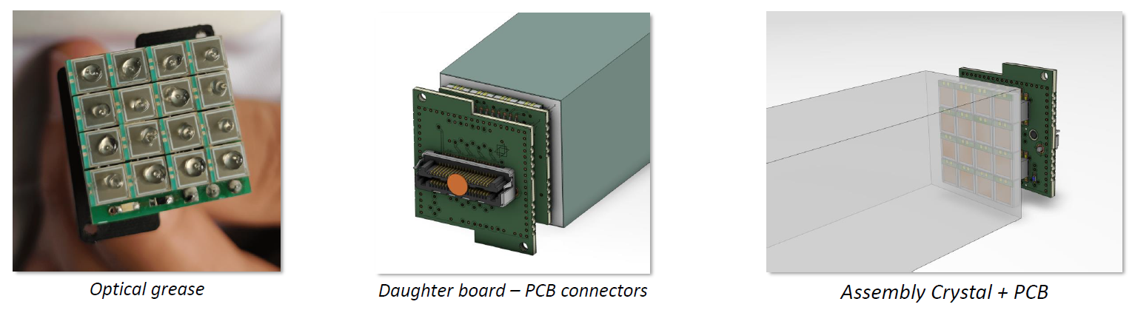
MPPC Configuration and Coupling to Crystal
MPPC
Active surface 3mm x 3mm
External size: 4.35mm x 3.85mm
Reference: S14160-3015PS
16 MPPC per crystal → 43840 MPPC
Space between MPPC: 0.2mm
Surface covered by MPPC: ~34%
Coupling to Crystal (Very Front End)
4x4 MPPC coupled with optical grease
1 PCB with the MPPC welded
1 PCB with the output connecter plugged on the PCB MPPC
Choice of MPPC done
10th EIC DAC Meeting, June 11th – 13th 2025
Tanja Horn

Slide 12
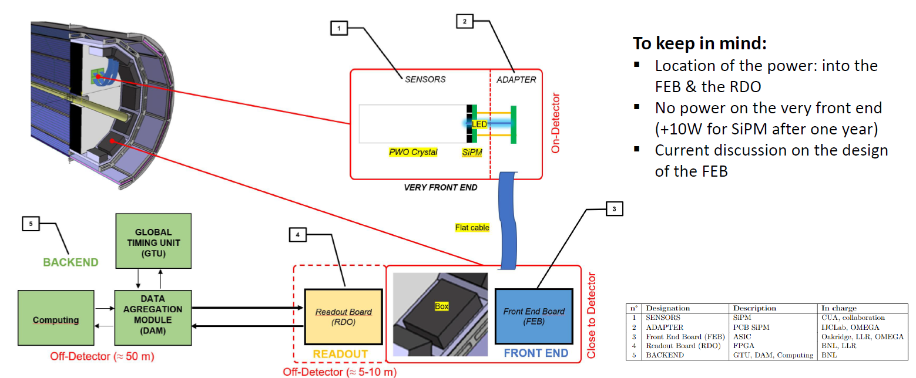
Readout/DAQ Overview
Work on FEE ongoing
Location of power depends on FEE
10th EIC DAC Meeting, June 11th – 13th 2025
Tanja Horn

Slide 13
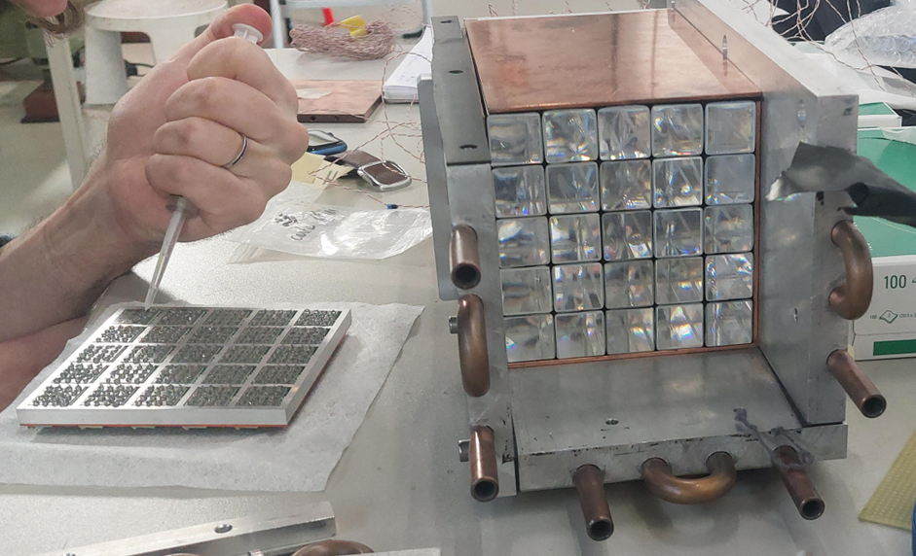
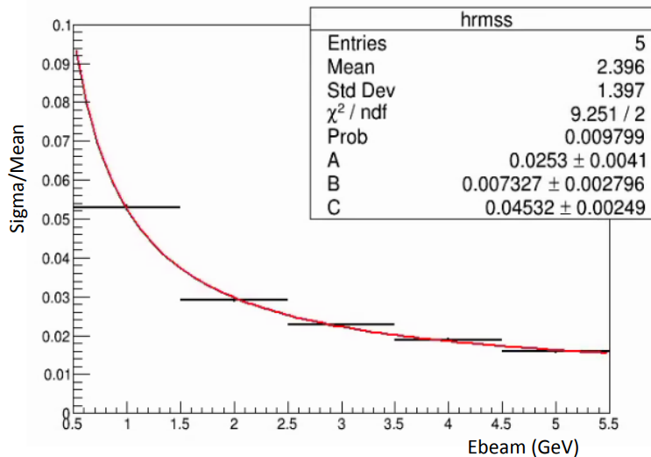
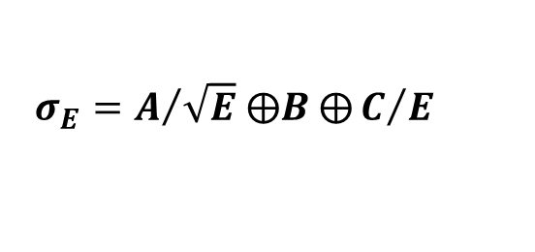
DESY beam test (spring 2025)
25 PWO crystals from CRYTUR
SiPM readout
Cooling and temp control
Two readout option tested:
Readout with H2GCROC3b chip
Preamp board & CAEN V1725S 14-bit 250MS/s digitizers
1 – 5 GeV electron beam through a 2x2 mm² collimator
Triggered by 2 scintillators
Typical DAQ rates: ~50-100 Hz
Discrete
electronics
Successful readout of all 400 channels with both set of electronics
Significant noise (1/E) term in the energy resolution not yet understood:
Likely PS instability due to large capacitance of sensors
H2GCROC3b electronics suffered some additional issues (eg. poor grounding in some adaptor boards)
Potential light leaks or beam energy spread (under investigation)
$${σ_{E}=A}/{\sqrt{E} ⨁B ⨁C/E}$$
Upcoming 2nd campaign at DESY this Fall with improved setup
10th EIC DAC Meeting, June 11th – 13th 2025
Tanja Horn

Slide 14
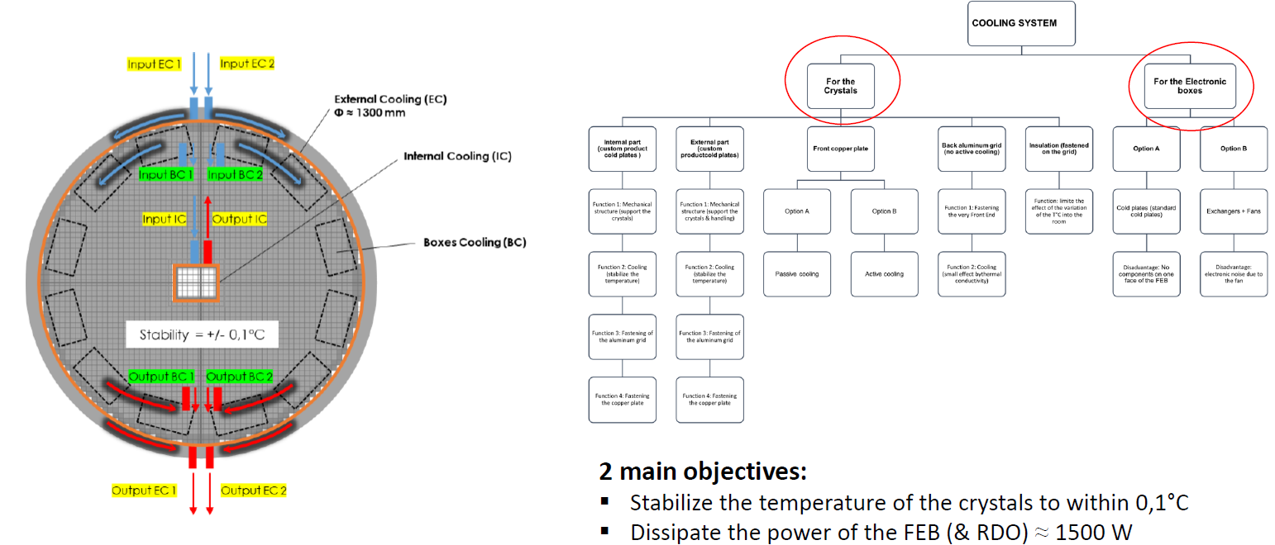
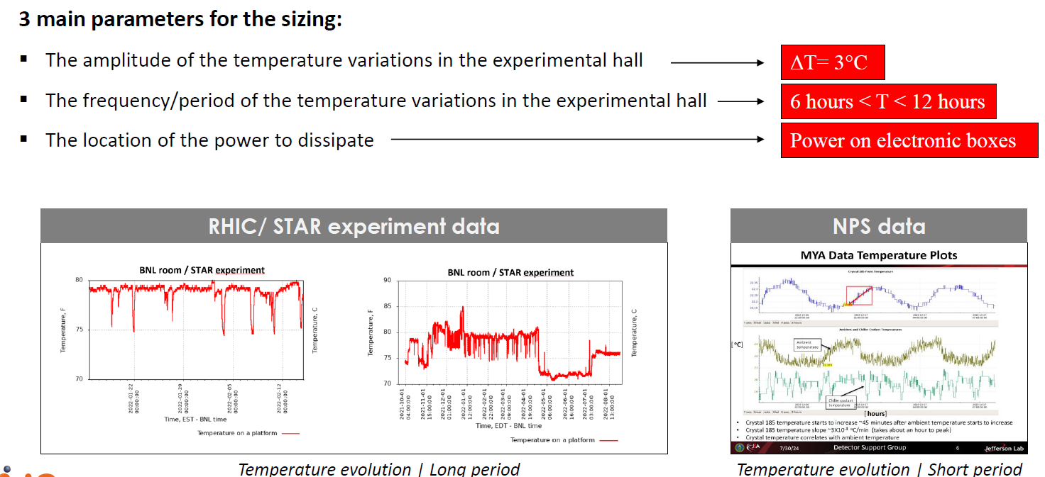
Cooling Overview and Requirements
Cooling environment is known
Crystal cooling
Electronics cooling
10th EIC DAC Meeting, June 11th – 13th 2025
Tanja Horn

Slide 15
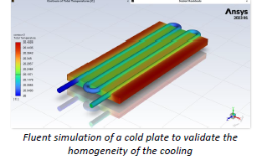
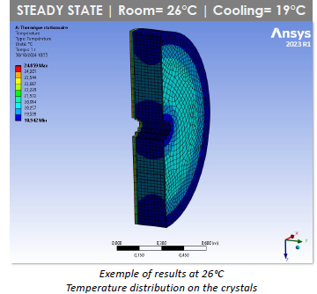
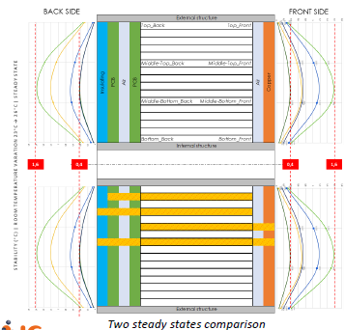
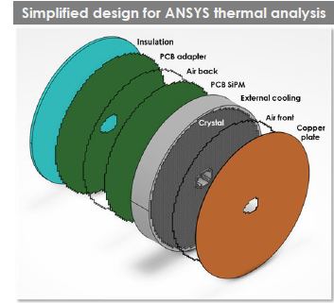
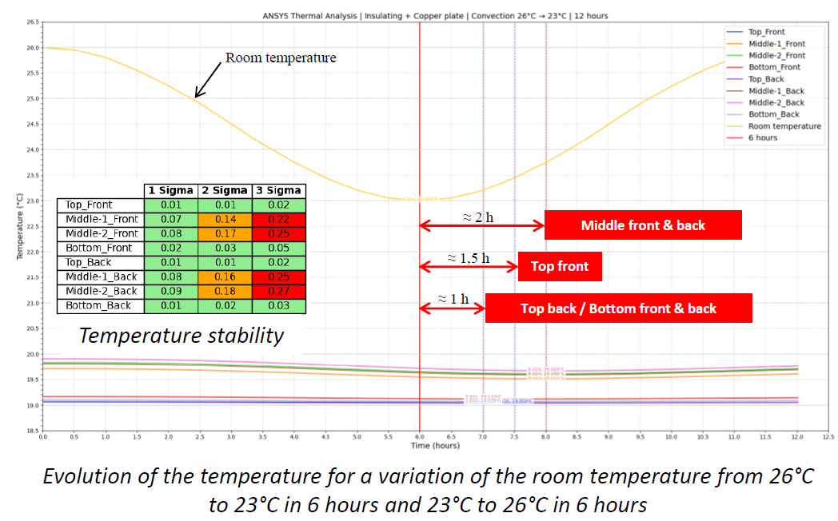
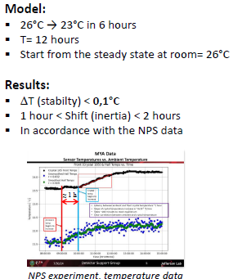
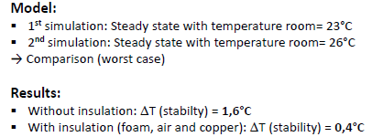
Thermal Simulations
Thermal simulations with advanced design available
Simple Model
Steady State
Compare two Steady States
Check impact of room temperature variation and insulation
External and internal cooling at the same temperature
Transient State
10th EIC DAC Meeting, June 11th – 13th 2025
Tanja Horn

Slide 16
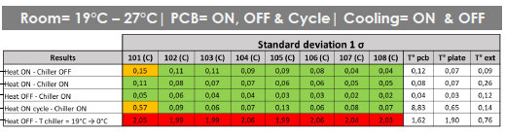
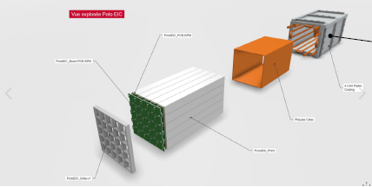
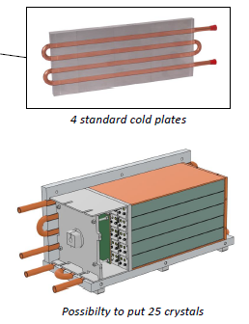
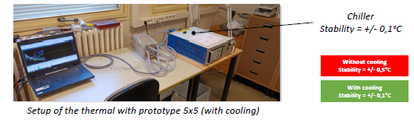
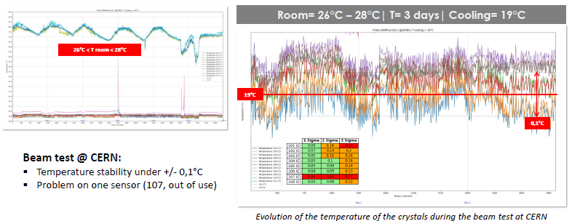
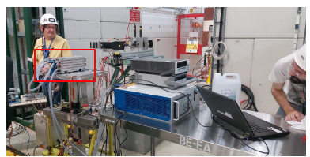
Thermal Tests
Room Temperature Tests
Tests with beam
10th EIC DAC Meeting, June 11th – 13th 2025
Tanja Horn

Slide 17
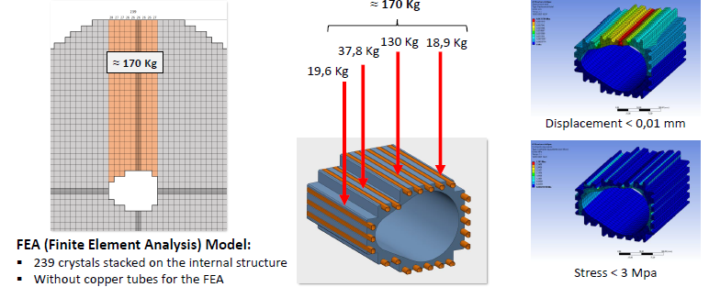
Mechanical Design – Internal Structure
10th EIC DAC Meeting, June 11th – 13th 2025
Tanja Horn

Slide 18
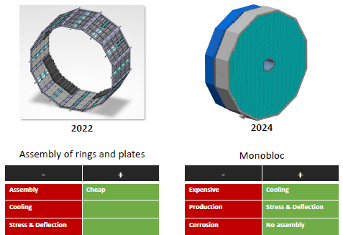
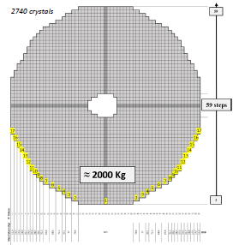
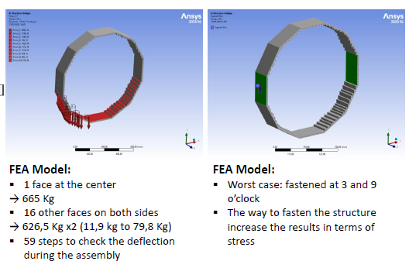
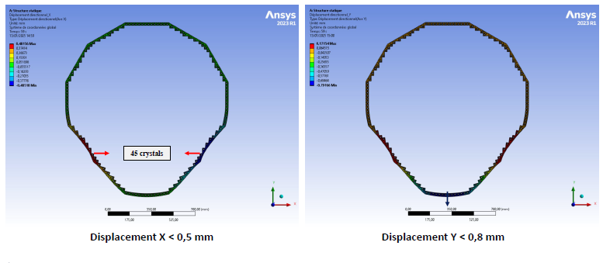
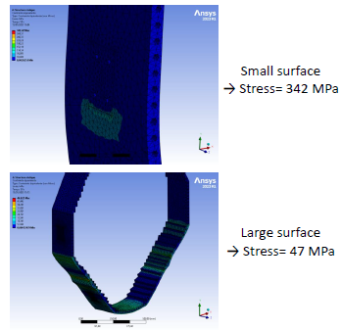
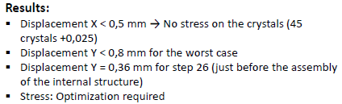
Mechanical Design – External Structure
Results of FEA are encouraging
Perform FEA simulation with advanced design
Choose means of production for structures (machining or foundry)
10th EIC DAC Meeting, June 11th – 13th 2025
Tanja Horn

Slide 19
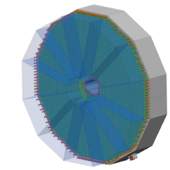


Mechanical Design – Assembly
Procedure ongoing
Depends on very front-end and FEB
Assembly test at IJCLab
Still deciding on the final assembly at JLab or BNL
10th EIC DAC Meeting, June 11th – 13th 2025
Tanja Horn

Slide 20


Mechanical Design – Installation
Backward ECAL fixed with rails to the GST (global support tube) in carbon fiber and showing the external cooling structure planned with FSW technology
Define positioning of the rails for insertion of detector
Study handling of the detector
Services depend on FEB and cooling
10th EIC DAC Meeting, June 11th – 13th 2025
Tanja Horn

Slide 21






Software/Simulation Development
Software builds on experience from JLab projects (e.g., HYCAL, FCAL, NPS, etc.)
Anticipated to follow a similar workflow
Slow controls: HV monitoring
EEEMCAL in ePIC simulation framework
Sample pulse amplitude
EEEMCAL performance
Online diagnostic plots
10th EIC DAC Meeting, June 11th – 13th 2025
Tanja Horn

Slide 22


Organization and Development Overview
Item | Institutions
Crystals | CUA, UKY, JMU, MIT
MPPC | ACU, OU, Lehigh, FIU
Mechanical | IJCLab-Orsay
Signal Processing | IJCLab-Orsay, OU, ACU
Simulations and Software | AANL, UKY, AU, W&M
10th EIC DAC Meeting, June 11th – 13th 2025
Tanja Horn

Slide 23
Summary
Design of EEEMCAL is nearing 90% completion.
Crystal first (140) articles have passed QA
Remaining technical work in FEE is progressing well and expected to reach 90% mark soon
Thermal simulations complete
Multiple prototype beam tests completed, engineering articles complete and last phase of beam tests ongoing
Last aspects of integration (FEE and associated cooling) need to be finalized after test beam completed
Still deciding on final assembly at JLab or BNL
EEEMCAL is on track to be technically ready for baselining at the end of the year
10th EIC DAC Meeting, June 11th – 13th 2025
Tanja Horn

Slide 24
10th EIC DAC Meeting, June 11th – 13th 2025

Slide 25

Context for PbWO₄ Specifications
In general, for high-precision electromagnetic calorimetry, the following are of relevance:
Smaller radiation length for smaller longitudinal size
Smaller Moliere radius allowing higher granularity
Smaller decay time
Better energy resolution. Larger number of photoelectrons per MeV to reach higher resolution
Smaller constant term contribution to energy resolution, mainly due to non-uniformity and gaps, to readout and noise. → for sensitivity checks need tests with detector prototypes in beam
Reasonable temperature dependence to light yield
Higher radiation hardness (EM and/or hadron fluences)
PbWO₄ meets the requirements of an extremely fast, compact, and radiation hard scintillator material providing sufficient luminescence yield to achieve good energy resolution.

Slide 26



















QA facilities at Universities
Optical Transmittance (L/T)
Crystal light yield and timing
Radiation Hardness and recovery
Cs-137 source and calibrated 2-inch PMT (Hamamatsu R2059-01) with QE(420nm)=24%.
Co-60 sources
Modified Varian Cary 5000 spectrometer
PbF₂
x-ray irradiation system (Faxitron CP-160)
Perkin-Elmer Lambda 950 spectrometer
Na-22 source and 2-inch PMT (XP2262)
Cs-137 source and 2-inch PMT
Co-60 source, 222 TBq, simultaneous irradiation of nine crystals/water; different dose rates possible
Varian Cary 5000 spectrometer
Electrons 5.5 MeV < E_{e} < 16.6 MeV; adjust beam intensity to illumination with g rays (Co-60, 30 Gy)
26

Slide 27





JLab crystal test facility for PbWO₄ QA and prototype
Dedicated cleanroom facility for crystal characterization
Mitutoyo QM - for mechanical dimensions measurements. Precise to 1 micron.
Crystal Light Yield measurements
Optical transmittance with integrating sphere
Radiation hardness in beam
Beam test facility with tagged photon beam up to 4-5 GeV
Technique demonstrated successfully for NPS can be adapted for EIC prototype tests
27

Slide 28




PbWO₄ crystal production for JLab Projects
EIC crystals are rectangular like NPS crystals with similar tolerances
Length uniformity of CRYTUR crystals (2017 – present)
Average: 199.95 mm +0/-0.02 mm
~2190 PWO crystals delivered continuously for projects at JLab since 2017
Crystals used for both NPS and FCAL-2
All 1100 NPS crystals for NPS passed the NPS quality assurance tests (similar for FCAL-2)
Consistent with EEEMCAL tolerance
CRYTUR is a well established and tested vendor that can deliver crystals of the quality needed for EIC

