Slide 1
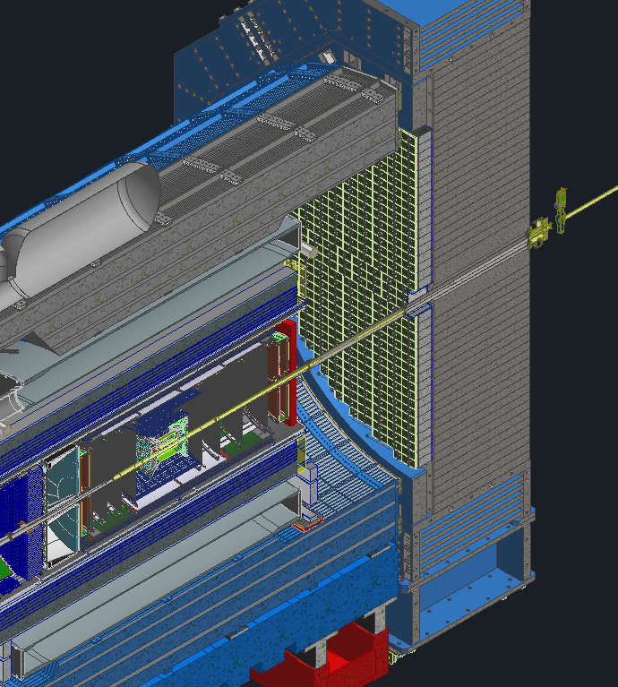
Forward EM Calorimeter
Status Report
O. Tsai (UCLA/BNL)
for FEMC Consortium
BNL, Chinese EIC ECal Consortium (Fudan, Shandong, Tsinghua and South China Normal Universities), Indiana University, UC EIC Consortium (University of California at Los Angeles, University of California Riverside), Indian ePIC Consortium.
10th EIC DAC Meeting, June 11th-13th, 2025

Slide 2
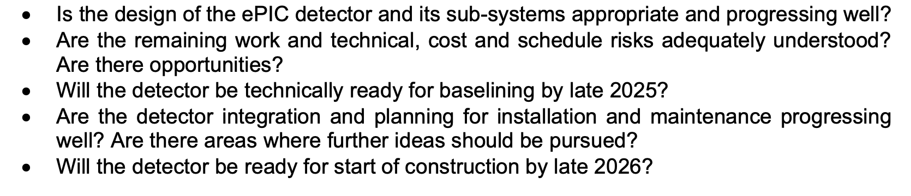
Charge Questions Addressed
10th EIC DAC Meeting, June 11th-13th, 2025

Slide 3
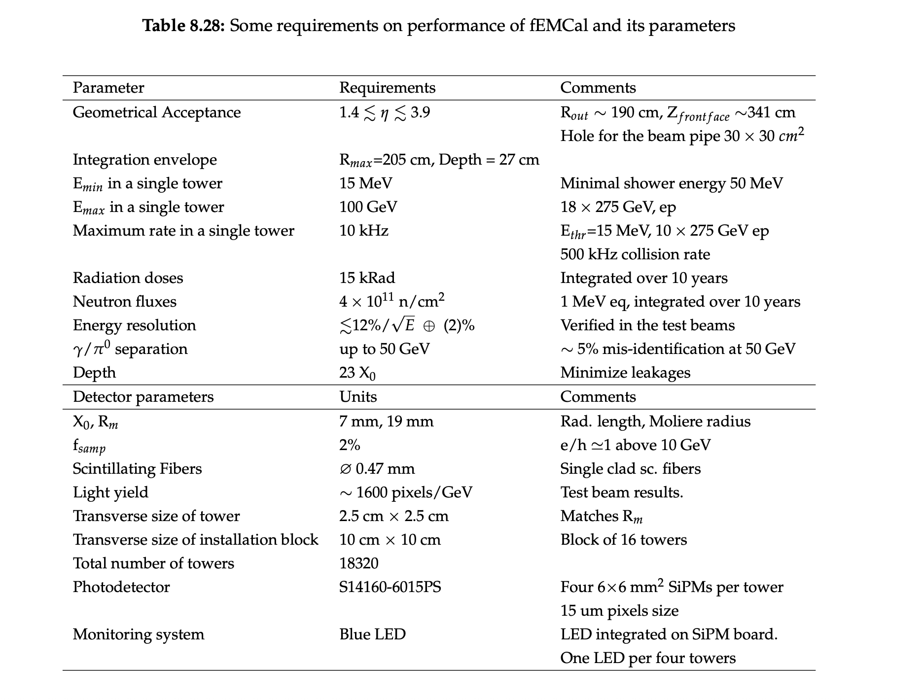
FEMC Detector Parameters Table. Pre-TDR Version 1.
10th EIC DAC Meeting, June 11th-13th, 2025

Slide 4
FEMC Status Summary:
FDR SiPMs - completed
FDR Sc. Fibers - completed
eRD106 Test Run to validate LY collection/uniformity - completed
eRD106 Validation of module production – completed
eRD106 Structural tests - completed
Detailed Mechanical Design – approaching to ~90%
Front End Readout – at different stages - (~50%-95%)
CD3A QA on sc. fibers - ongoing
Production planning – in progress
In the pipeline for 2025:
1. FEMC FDR
2. TDR Version 2
3. Complete FEB tests in the lab
4. Continue development of mechanical models and finalizing production drawings.
10th EIC DAC Meeting, June 11th-13th, 2025

Slide 5
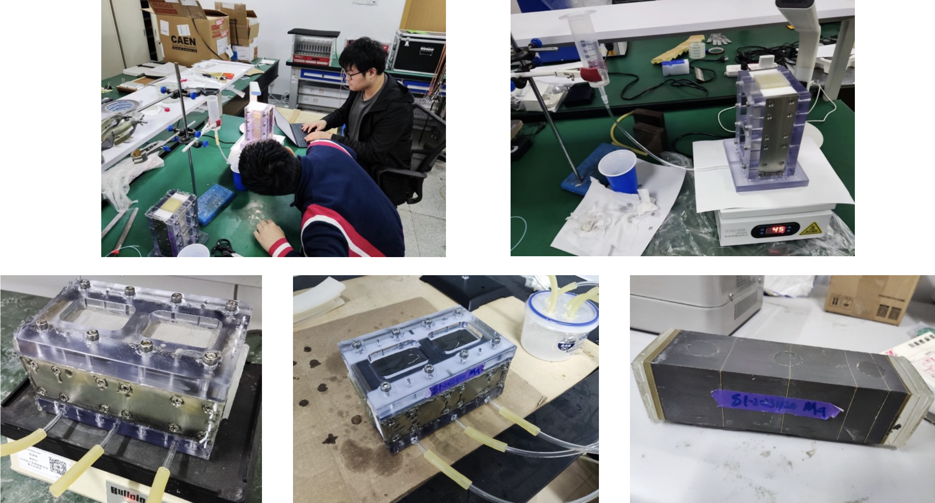
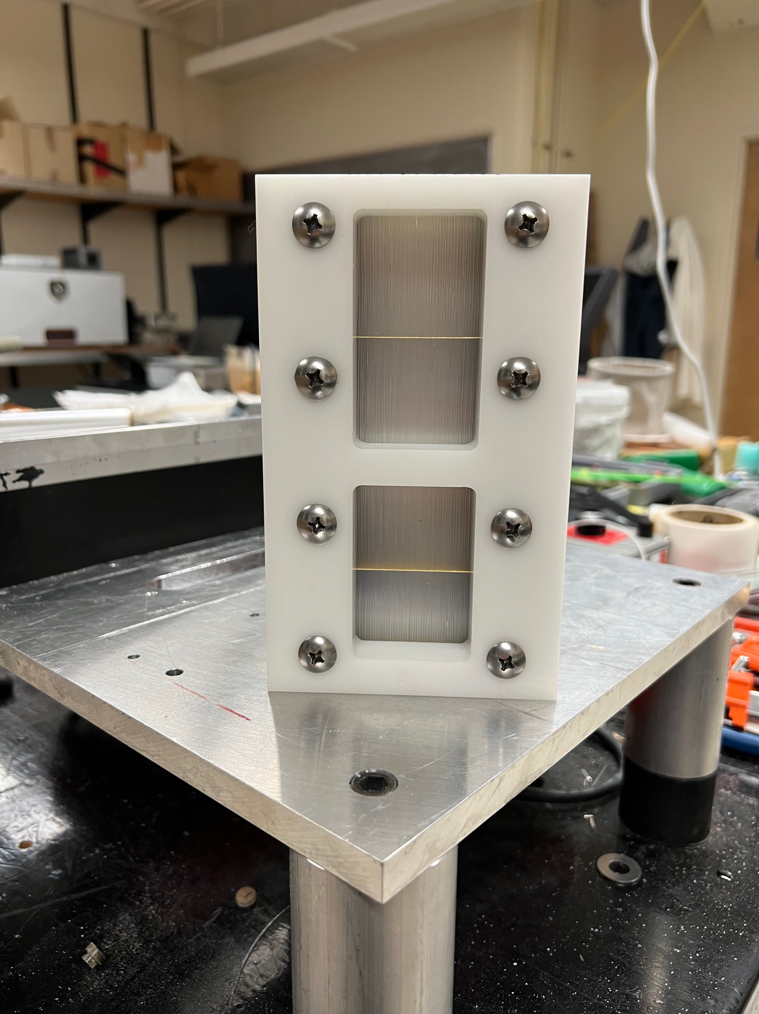
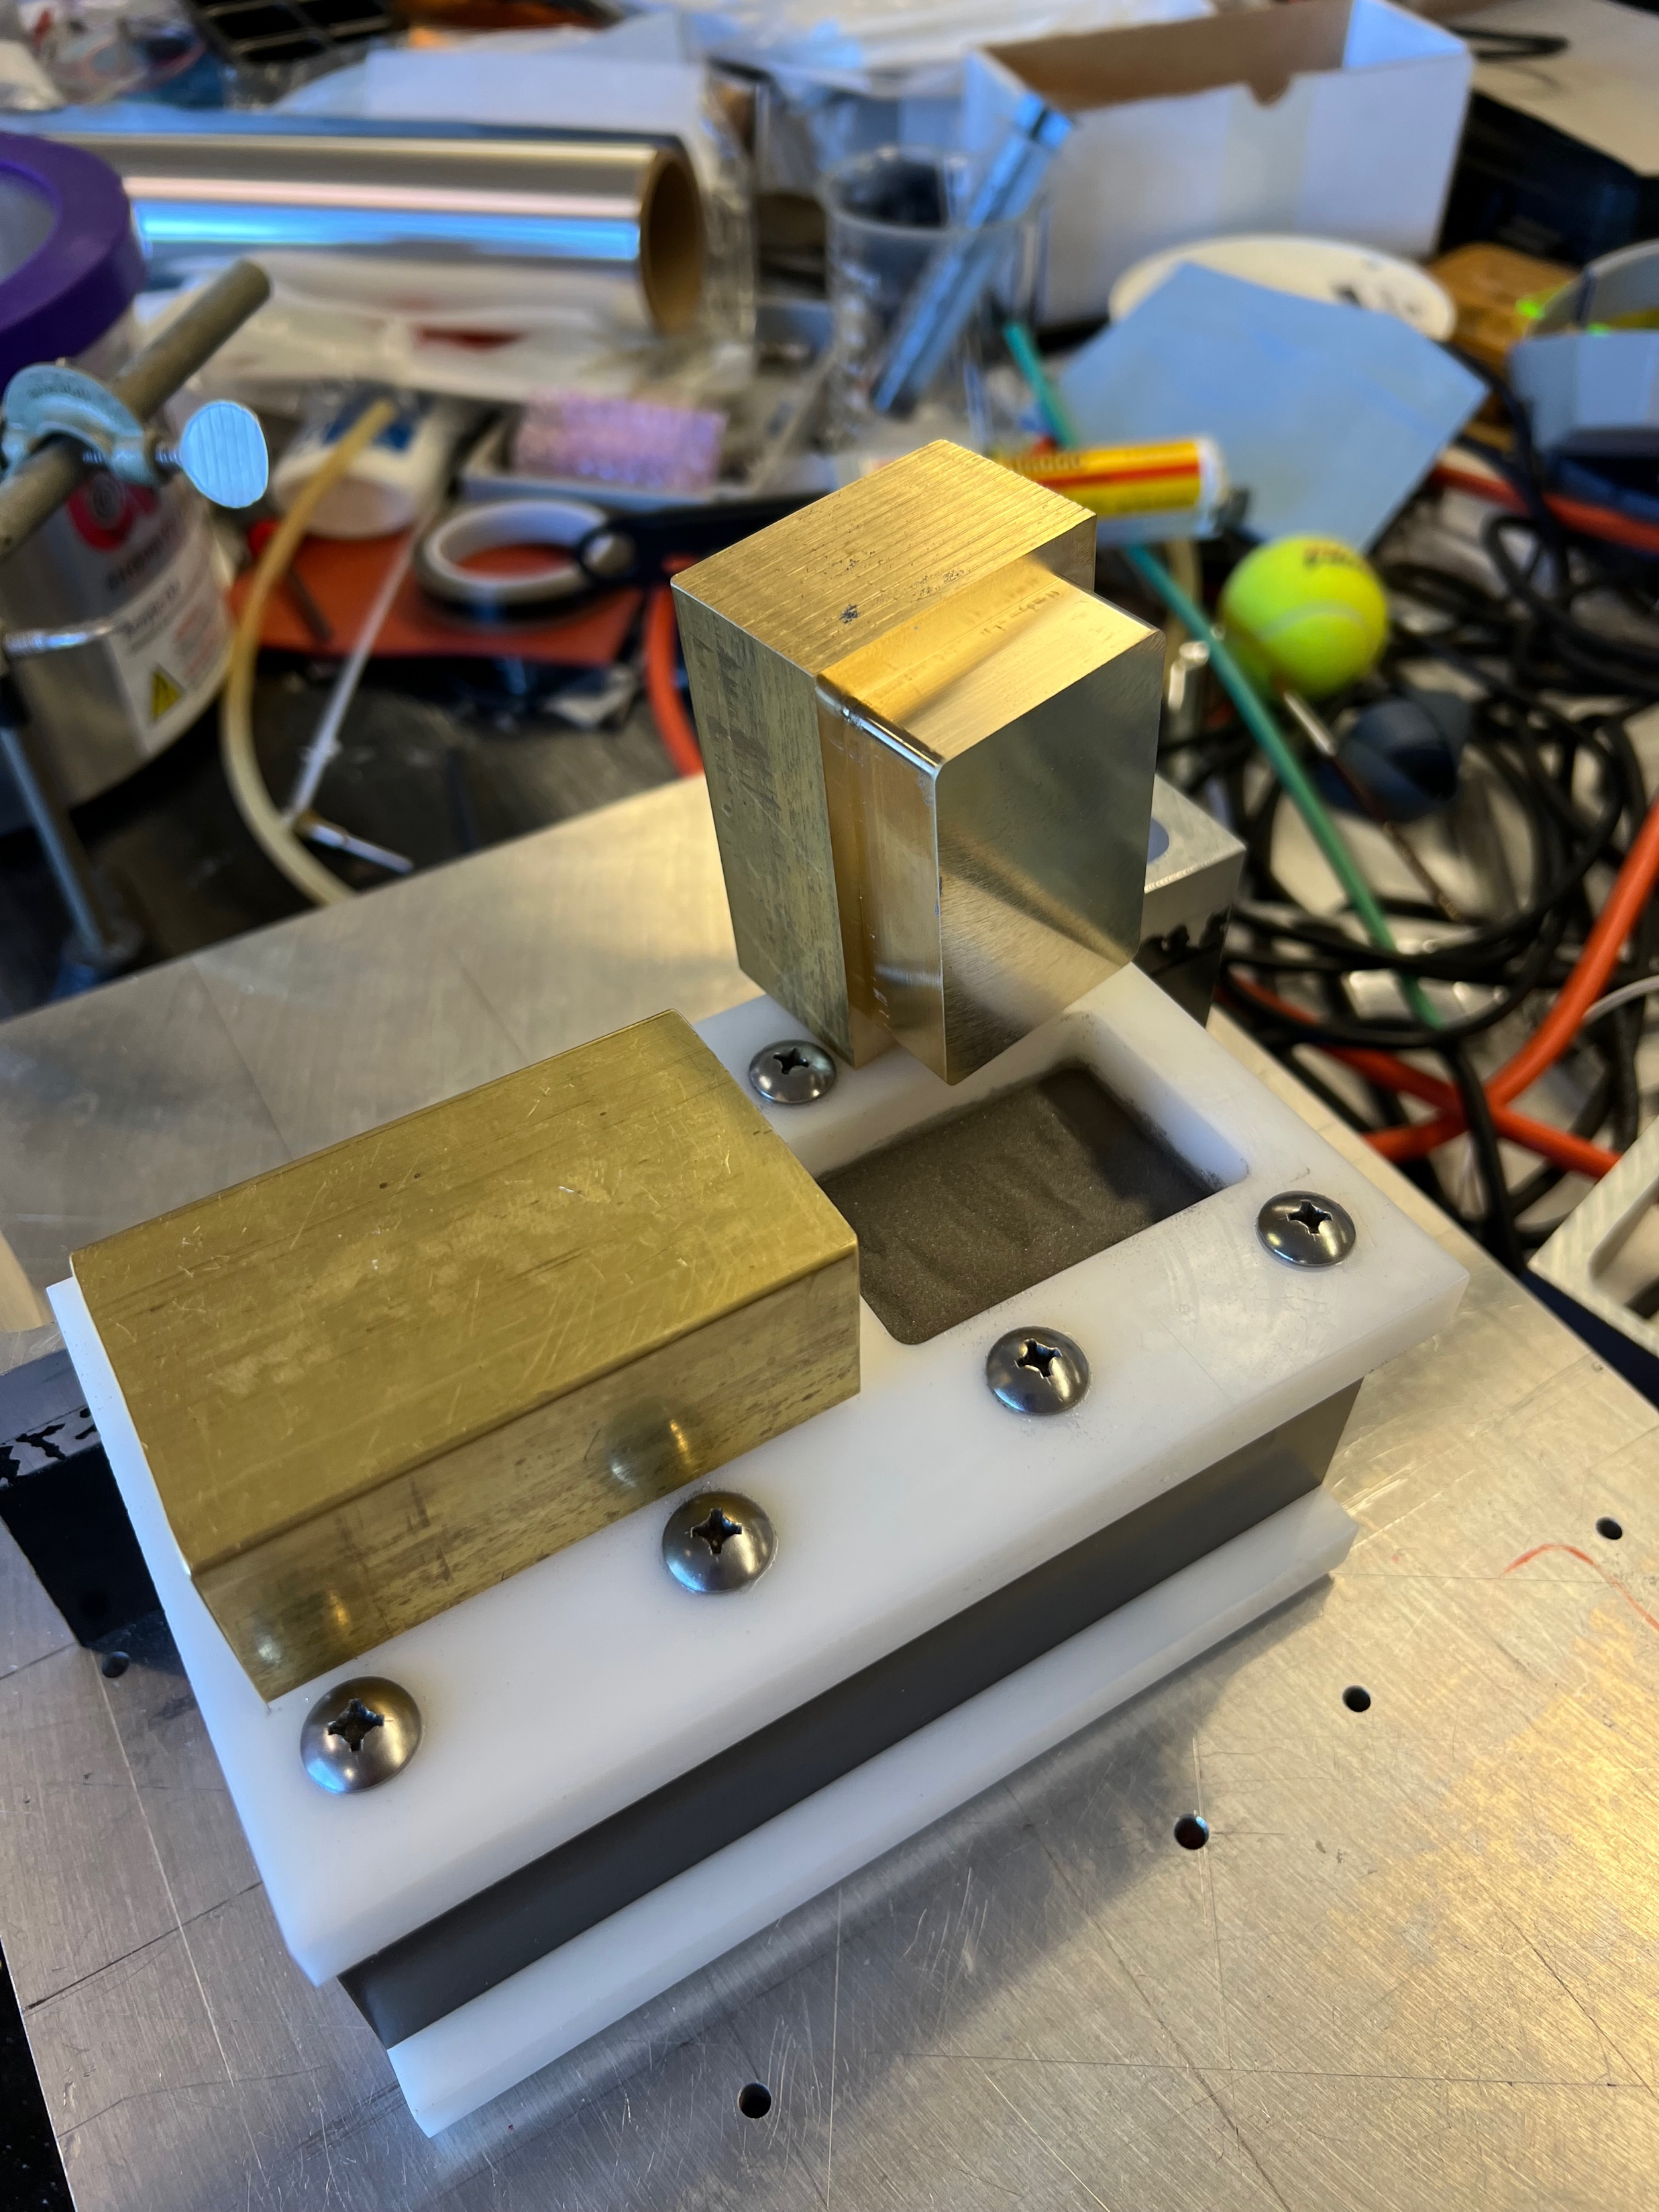
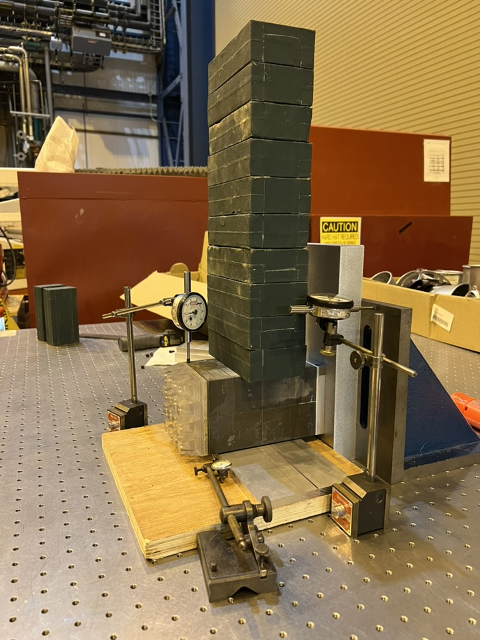
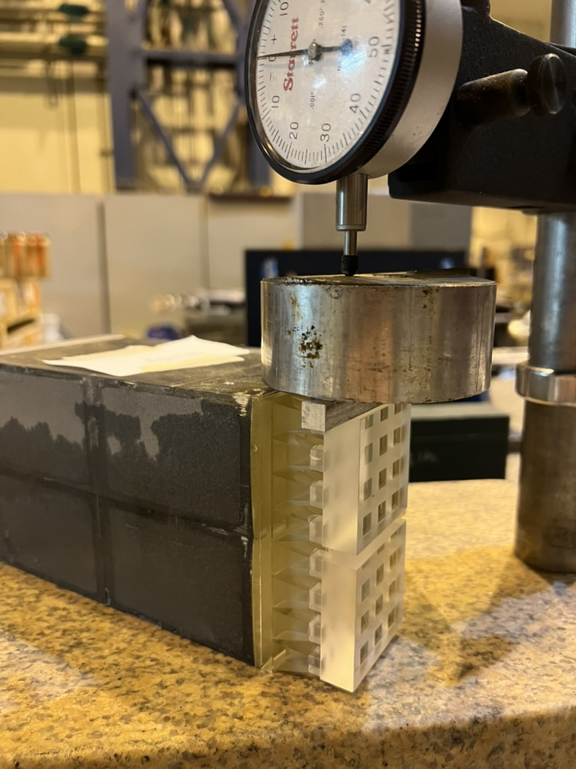
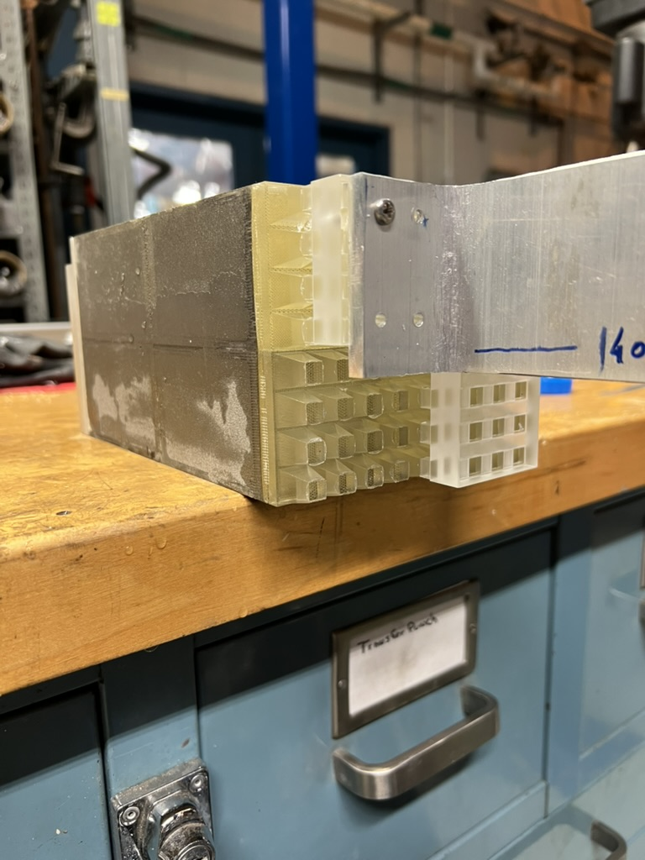
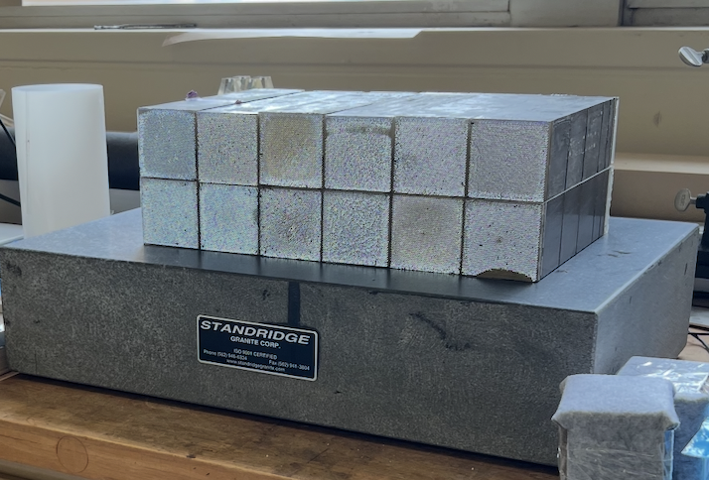
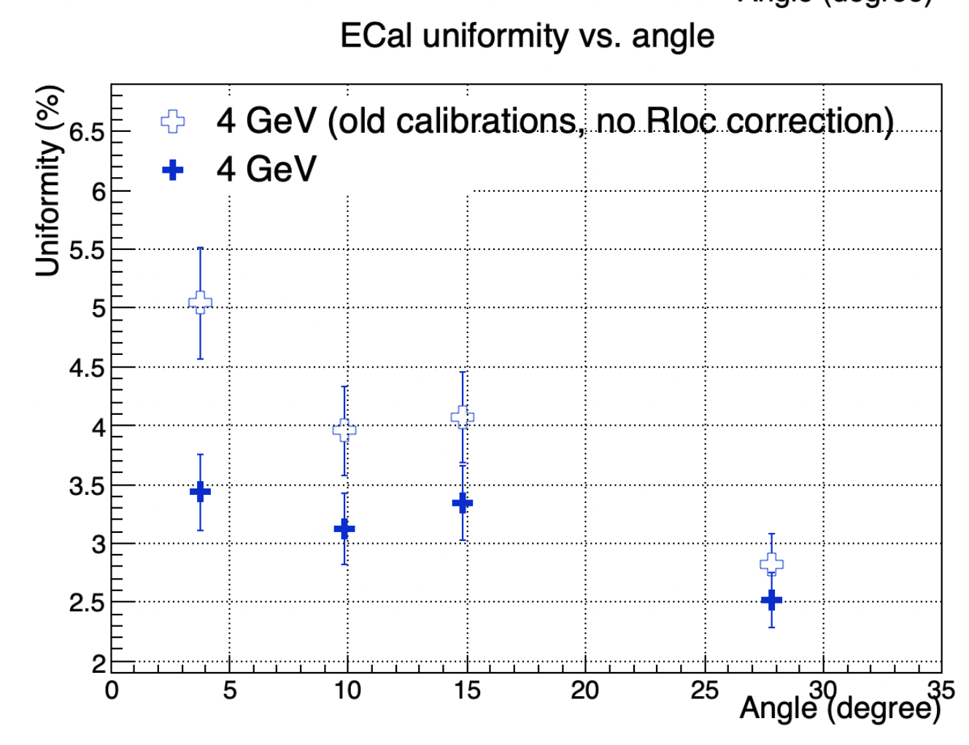
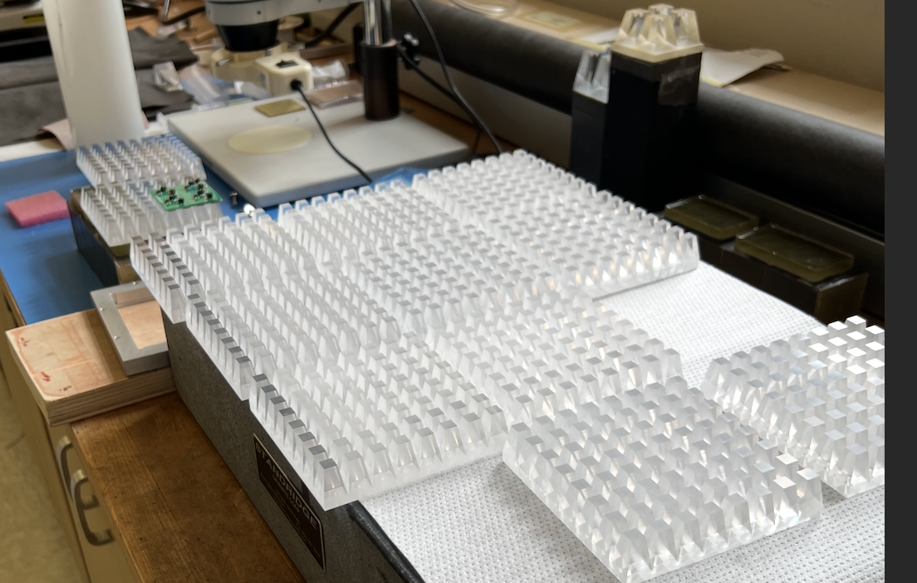
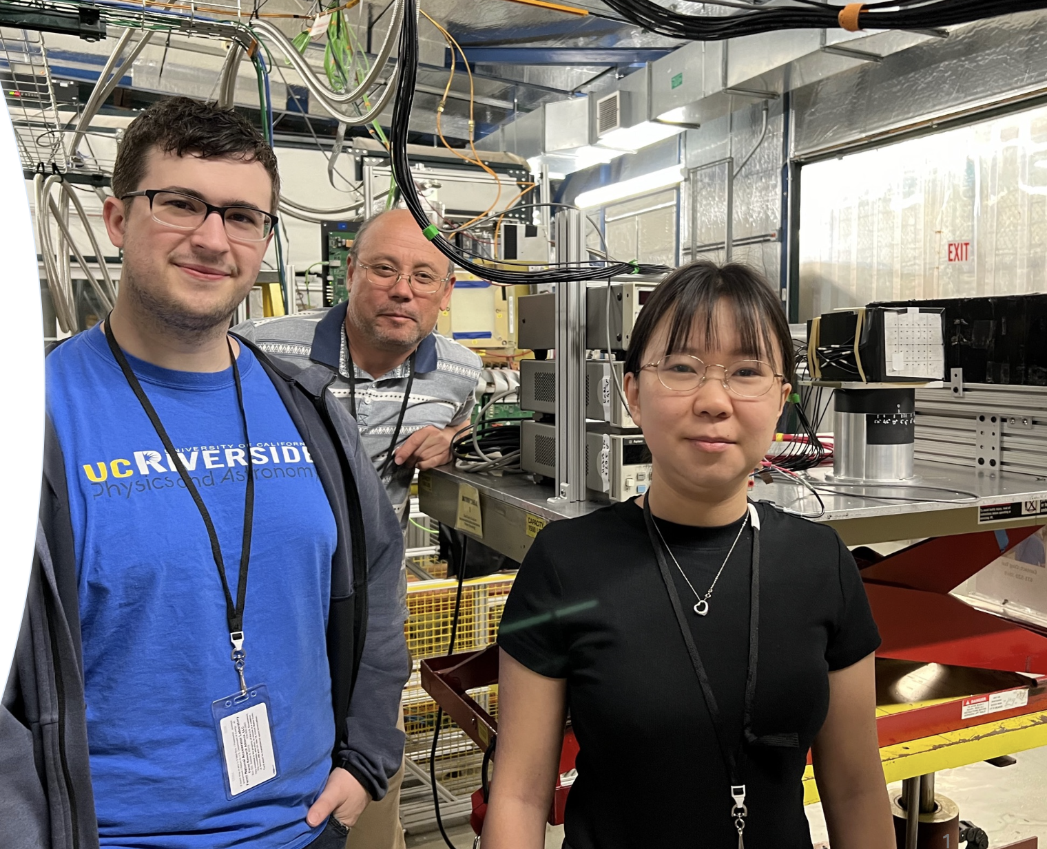
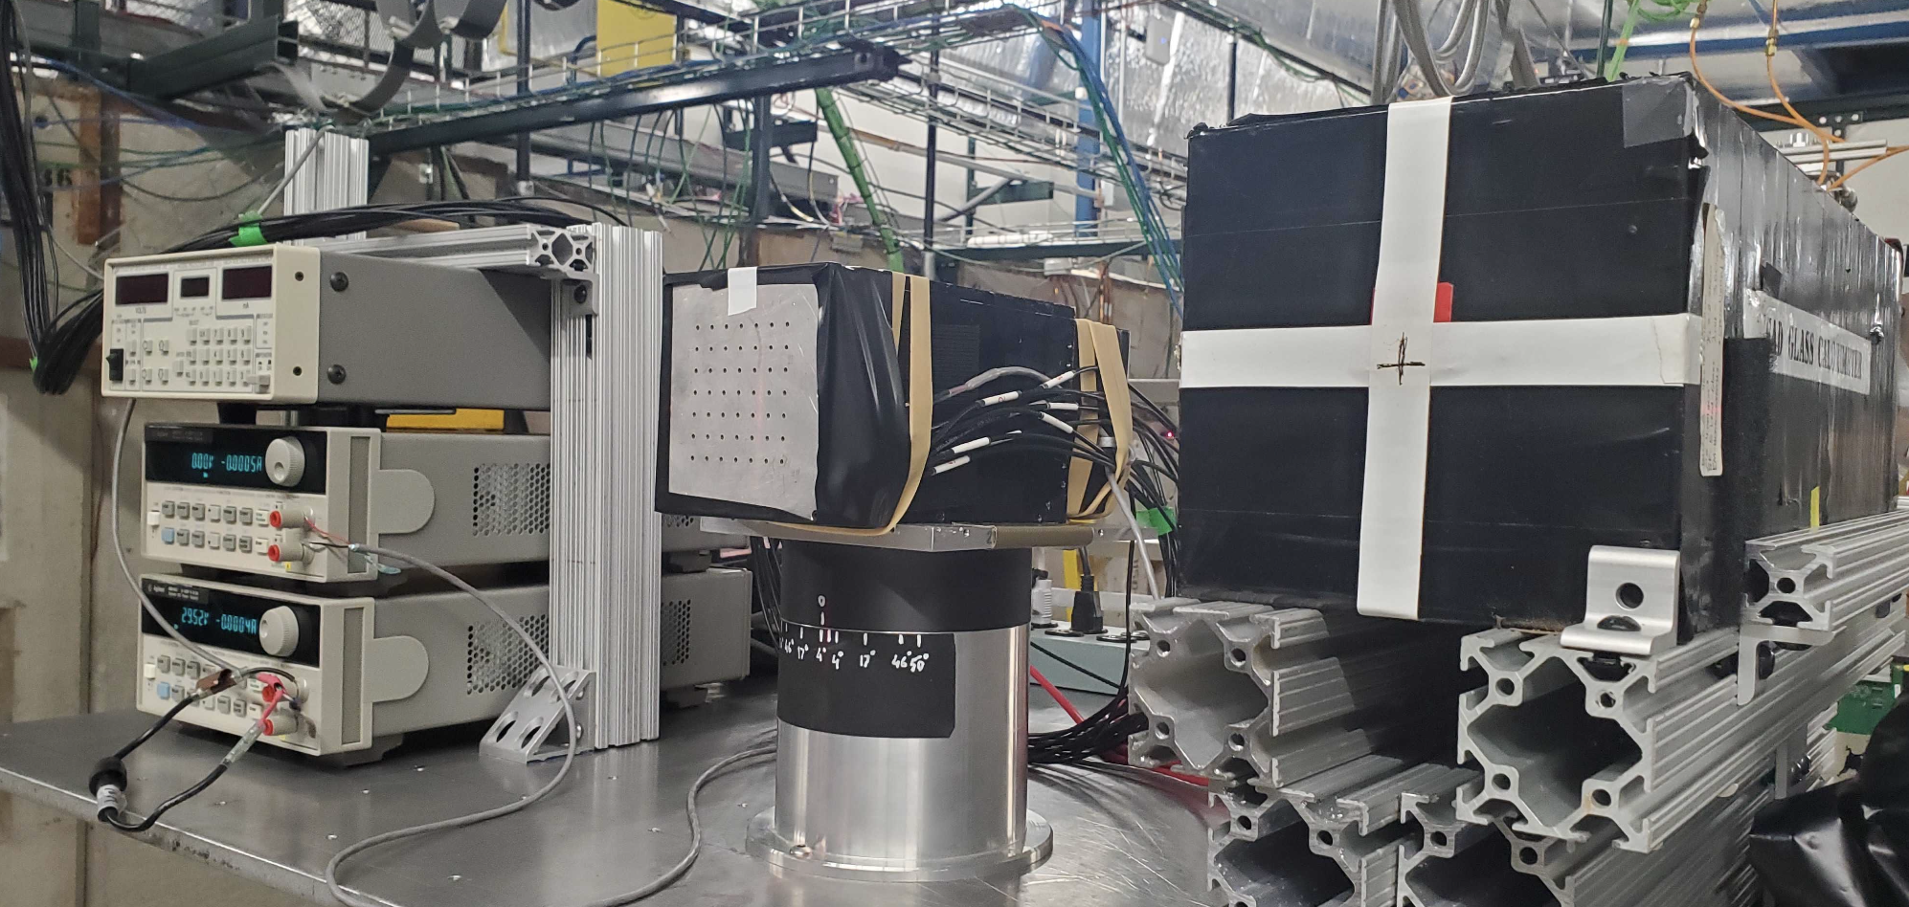
Some Completed Tasks
Structural tests at BNL
De-paneling SiPM boards
Block productions at Fudan and UCLA
Design Goal
Test Run at FNAL by UC EIC consortium members.
Light Guides Produced at Indiana University
10th EIC DAC Meeting, June 11th-13th, 2025

Slide 6
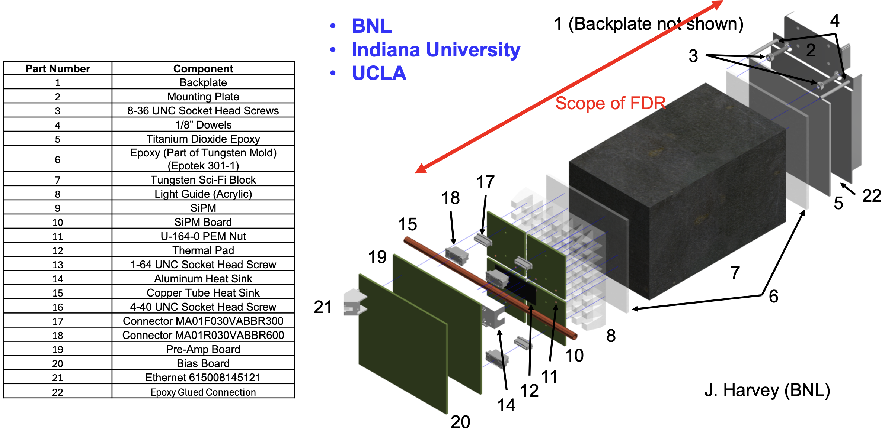
FEMC FDR Scope
WScFi Blocks
LG
SiPM Boards
Mounting to HCal
Mounting to HCAL was iterated to simplify installation procedures. Driven by BNL 3I group.
New parts were ordered. Tests projected to be completed by the end of summer.
This change does not affect FDR or previous structural tests.
10th EIC DAC Meeting, June 11th-13th, 2025

Slide 7
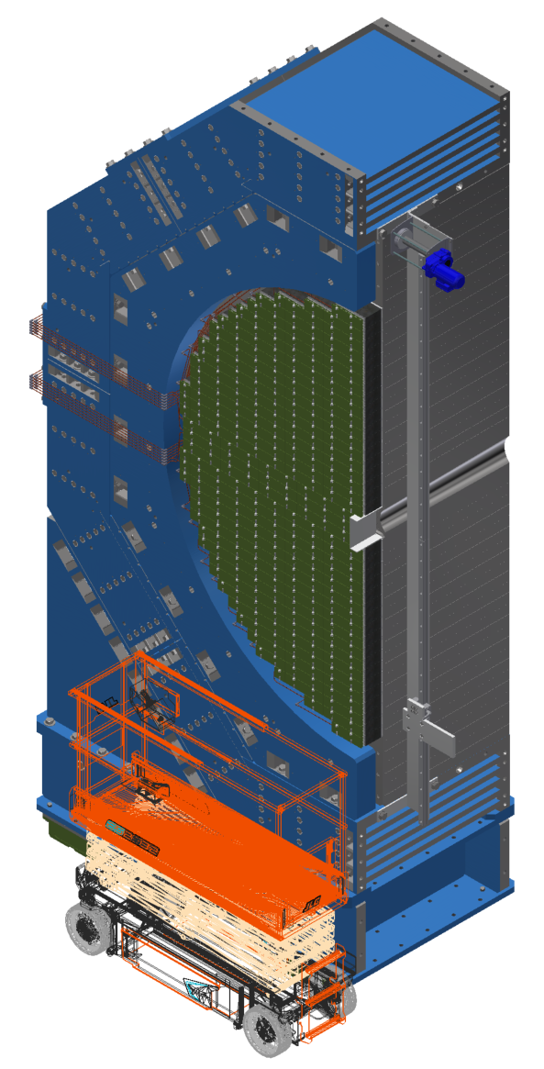
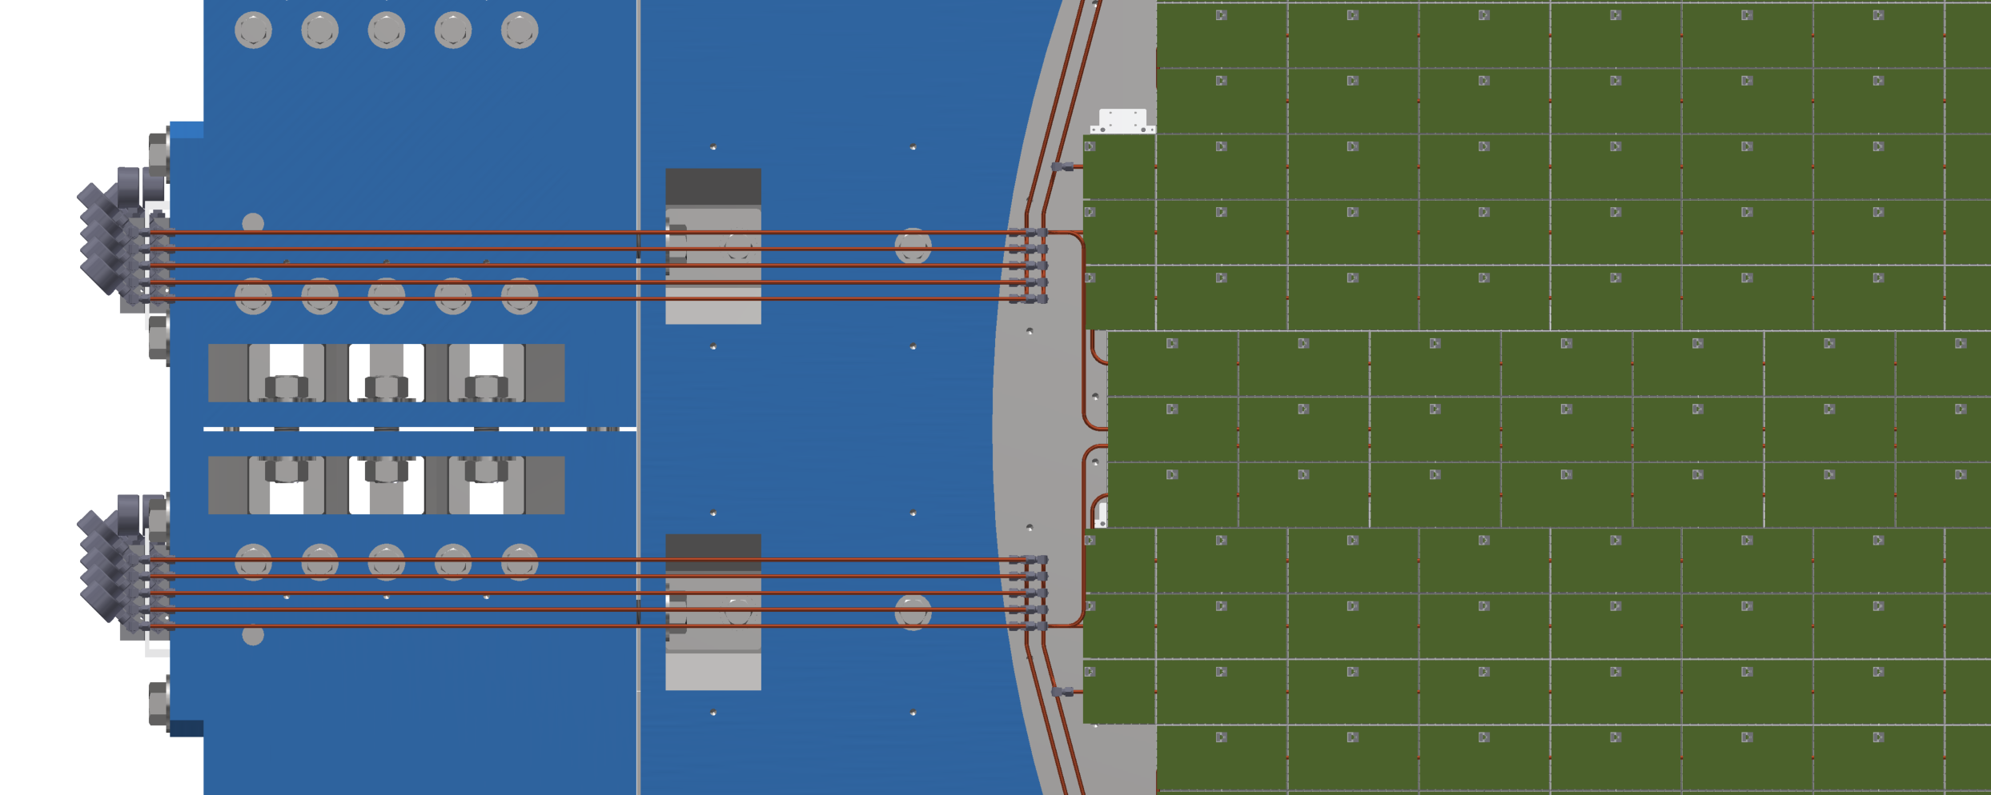
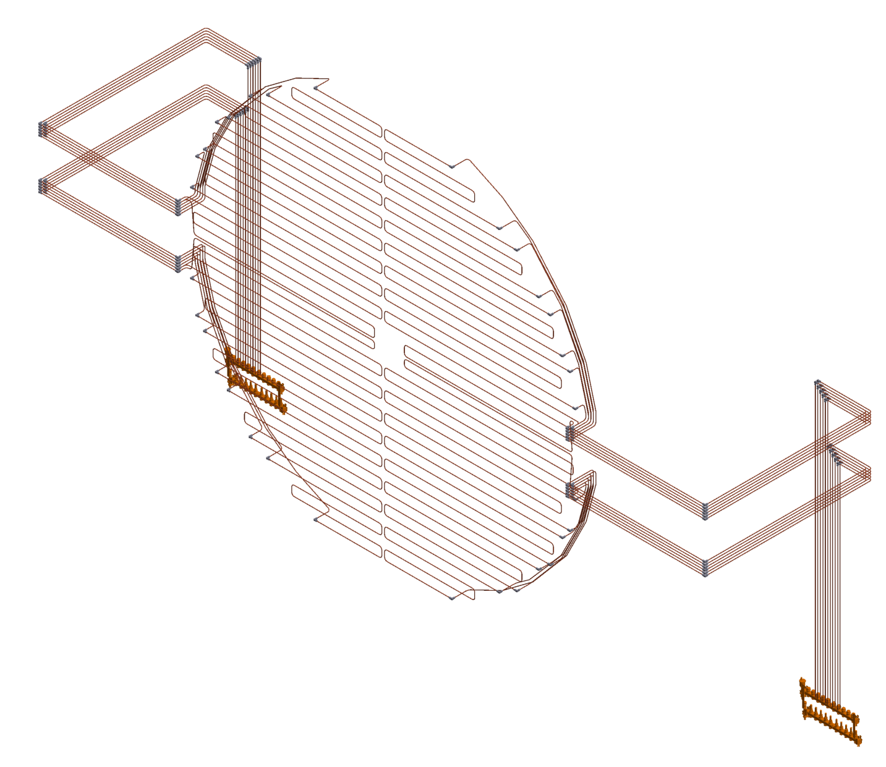
Detail Mechanical Model Status
Integration
Installation
Maintenance
Cooling
Cabling Pass
Cooling
Loops
Installation
fixture for
~ 20 kg FEMC installation blocks
with SiPM boards glued.
10th EIC DAC Meeting, June 11th-13th, 2025

Slide 8
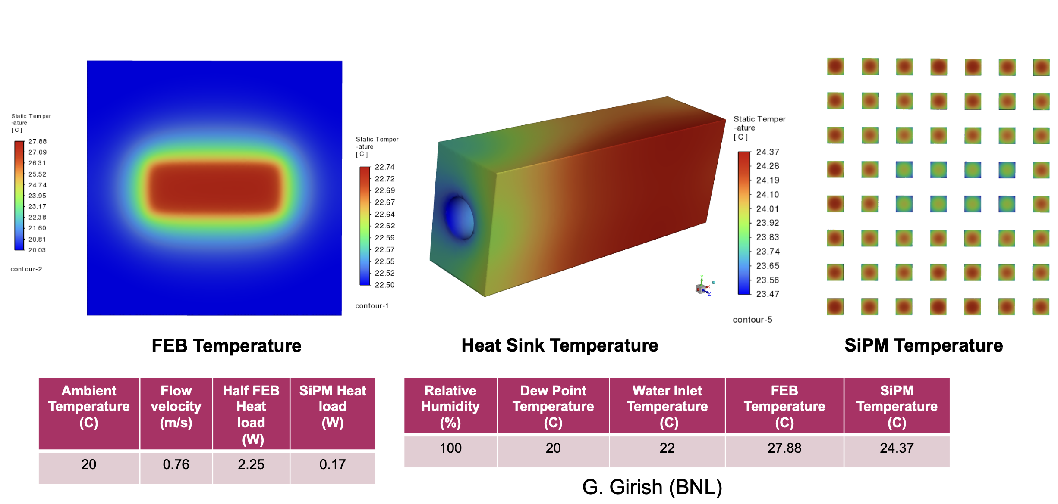
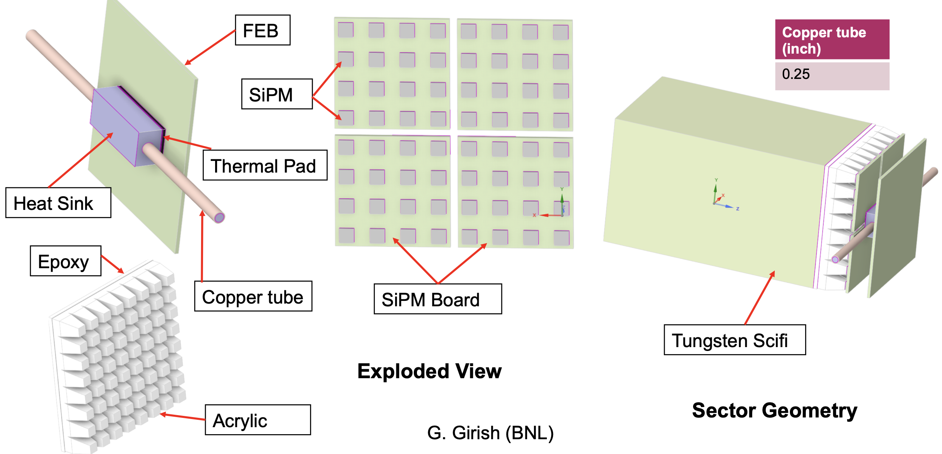
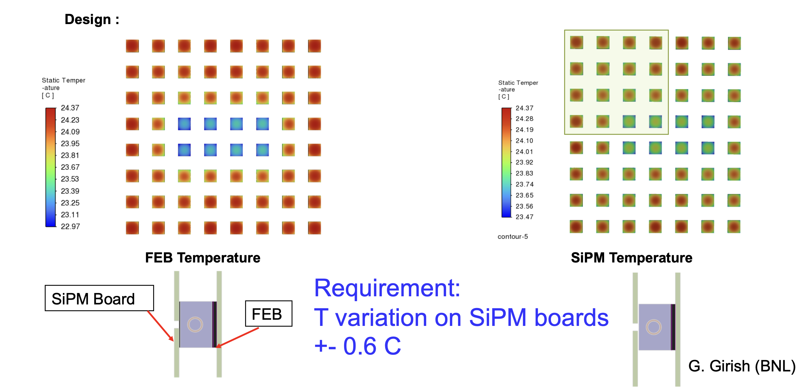
Mechanical Model, Cooling simulations. Examples.
Simulations will be augmented with
bench test measurements at Indiana University.
SiPM FDR
10th EIC DAC Meeting, June 11th-13th, 2025

Slide 9
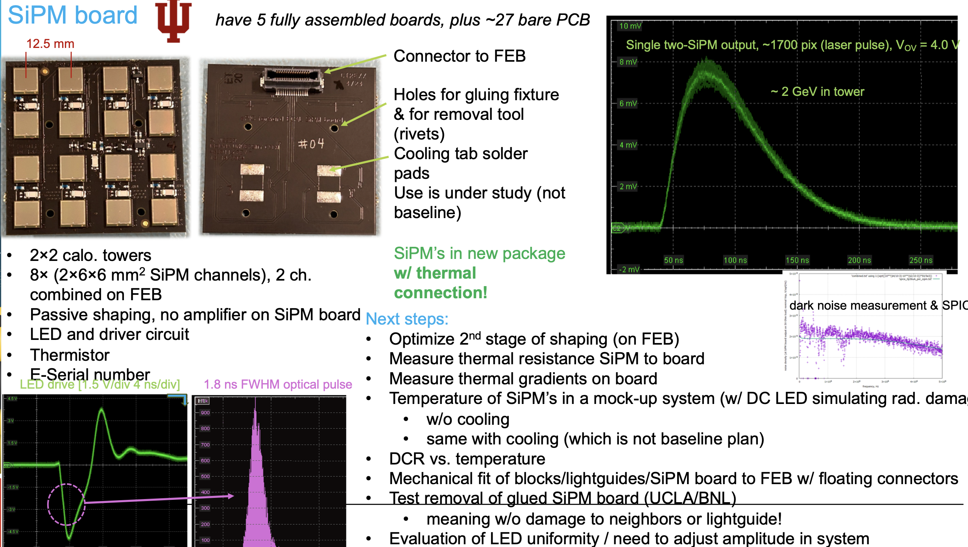
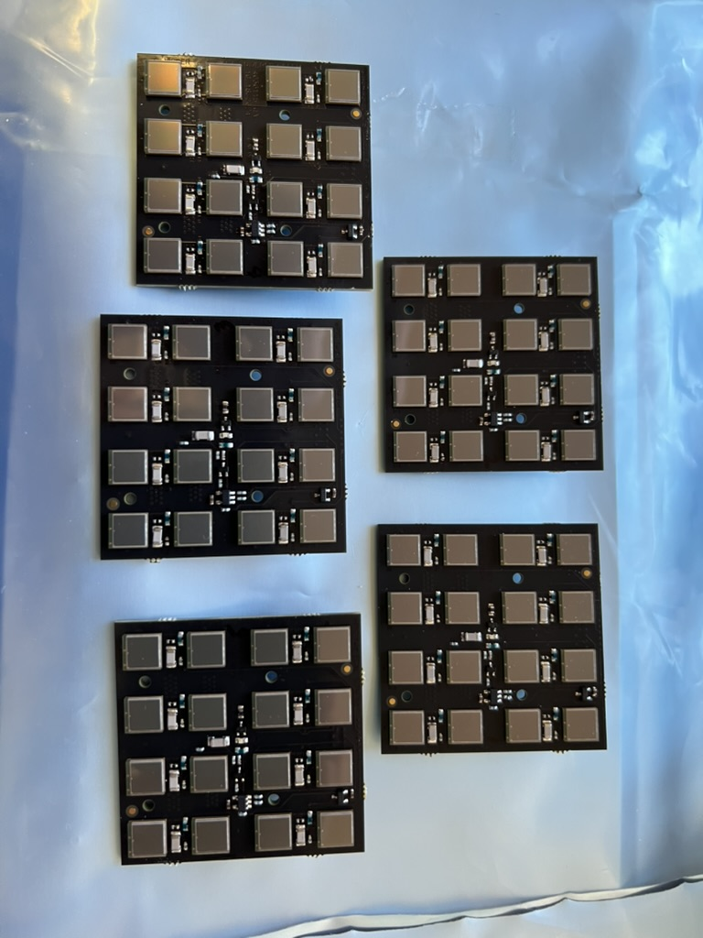
SiPM Boards FDR Status
5 SiPM Board final design.
S14160-6015PS
Boards assembled at UCLA electronics shop
10th EIC DAC Meeting, June 11th-13th, 2025

Slide 10
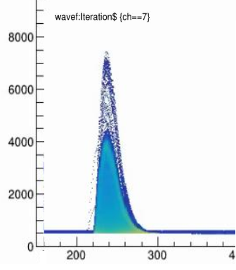
Front End Electronics Developments Status
Completed SiPM board design & prototype production (Cirexx Inc.); five boards assembled at UCLA Electronics Shop. 97% final completion.
FEB cooling and cable integration designed, and FEB PCB design modified for the change to final block spacing 101.0 mm and cooling interface. 85% complete on FEB interface (IU), ~60% complete water sys. (BNL).
First stage of readout (shaping and preamplifier) validated in ePIC backward ECAL application (February test beam @ DESY), w/ CAEN ADC
4 GeV e⁻
14-bit ADC
Two-channel prototype full signal chain including ADC and streaming readout: Design to finish in June, tests starting late July. 75% design complete.
Full FEB: Main board 50% design complete, SiPM bias daughterboard 70% design complete. Finalize after 2-ch prototype tests, September. Full readout tests complete November 2025
Key components for prototype & FEB are in hand
1st stage signals into ADC
(bwd ECAL @ DESY)
10th EIC DAC Meeting, June 11th-13th, 2025

Slide 11
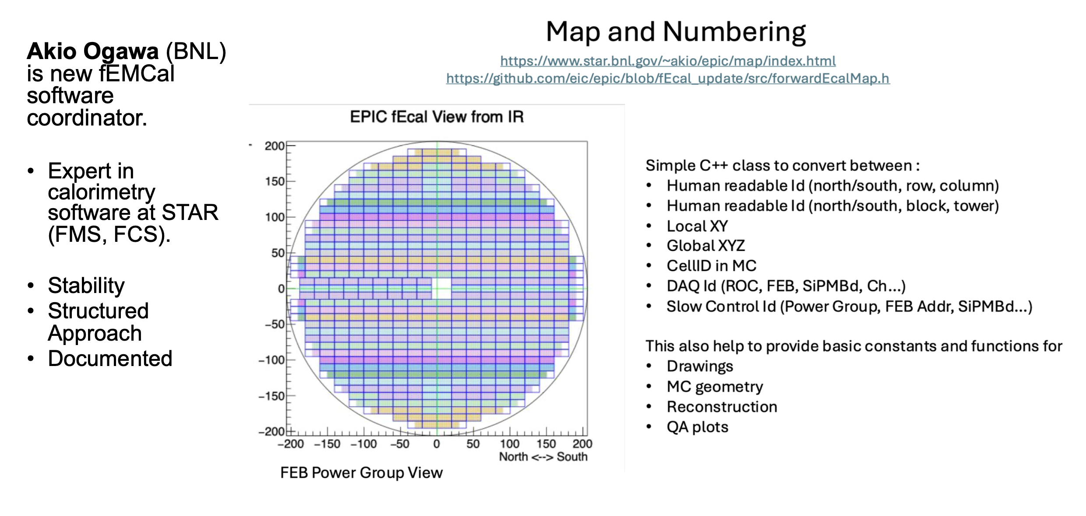
Software Developments Status
10th EIC DAC Meeting, June 11th-13th, 2025

Slide 12
Sc. Fibers, First Article QA
Sc. Fibers CD3A item.
First Article Fibers at UCLA at mid April 2025. Did not passed QA, LY is 40% lower than expected. That was an unexpected surprise to us and Luxium.
Status Update: Collaboration with Luxium
Holding weekly meetings with Luxium to address and resolve production issues
UCLA QA procedures successfully duplicated at Luxium
Sample exchanges between Luxium and UCLA confirm consistent measurement results at both sites
Recent Luxium samples passed UCLA QA tests
Agreed to use common reference samples at both locations moving forward
Luxium to perform full QA testing on first two shipments following UCLA protocols
First shipment approved by BNL, expected arrival: late June
Open issue: Root cause of poor quality in the initial 100 fibers remains unclear
10th EIC DAC Meeting, June 11th-13th, 2025

Slide 13
Production Planning Status
Forward ECal WBS, Workforce
Forward Ecal
WBS 6.10.05.03
Block Production
In China
Block Production
USA
Installation
block Assembly
Readout
Electronics
Photosensors
Integration
Fudan
Shandong
Tsinghua
UCLA
UCR
BNL
UCLA
Indiana University
UCLA
BNL
UCR
UCLA
BNL
WScFi Blocks
Production
WScFi Blocks
Production
Installation Blocks
Production
Structural tests
Readout Electronics
Production
Calibrations
SiPM boards
Assembly
Calibrations
Integration with
Hadron EndCap
ePIC central detector
eRD106
eRD106
eRD106
eRD106/109
eRD106
Original plan benefited from experienced Chinese production site. This is not possible now.
Indian Consortium expressed interest about a year ago to participate in FEMC project.
10th EIC DAC Meeting, June 11th-13th, 2025

Slide 14

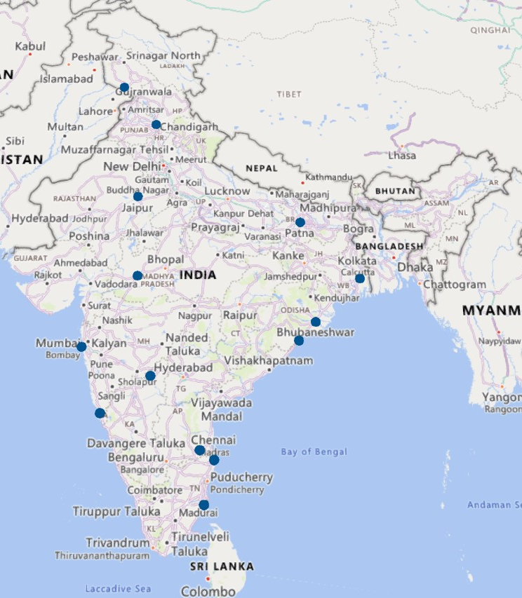

Indian Institutes interested in ePIC at EIC
Production Planning Status
20 Institutes from all around India have shown interest. More are willing to join.
Interests in the following hardware and software activities.
PID – dRICH
Forward ECAL
ToF – AC LGAD
Simulation studies
A single production site at NISER
Participating Universities sends personnel to NISER
Two scenarios:
Block production site in India + assembly site in the US.
Full production in the US
10th EIC DAC Meeting, June 11th-13th, 2025

Slide 15
Summary
The design of the FEMC is nearing 90% completion.
The remaining technical work, particularly in areas such as front-end electronics, is progressing well and expected to reach the 90% mark soon.
The FEMC is on track to be technically ready for baselining by the end of the year.
All aspects of integration, installation, and maintenance have been thoroughly discussed and iterated with the 3I group, and these considerations have been incorporated into the design.
Two production scenarios are currently under consideration.
Thanks!
10th EIC DAC Meeting, June 11th-13th, 2025

