Slide 1
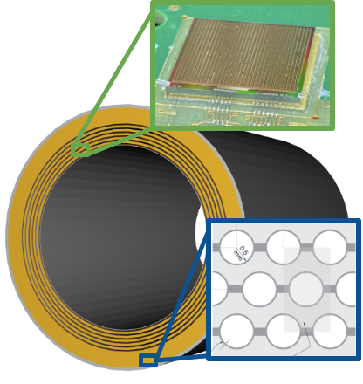
Barrel Imaging Calorimeter
The ePIC Barrel Imaging Calorimeter
Jessica Metcalfe
EIC DAC Review
Argonne National Laboratory
on behalf of the BIC DSC
June 13, 2025

Slide 2
Outline
BIC Overview
Recent Progress & Plans
Charge:
Is the design of the ePIC detector and its sub-systems appropriate and progressing well?
Are the remaining work and technical, cost and schedule risks adequately understood? Are there opportunities?
Will the detector be technically ready for baselining by late 2025?
Are the detector integration and planning for installation and maintenance progressing well? Are there areas where further ideas should be pursued?
Will the detector be ready for start of construction by late 2026?

Slide 3
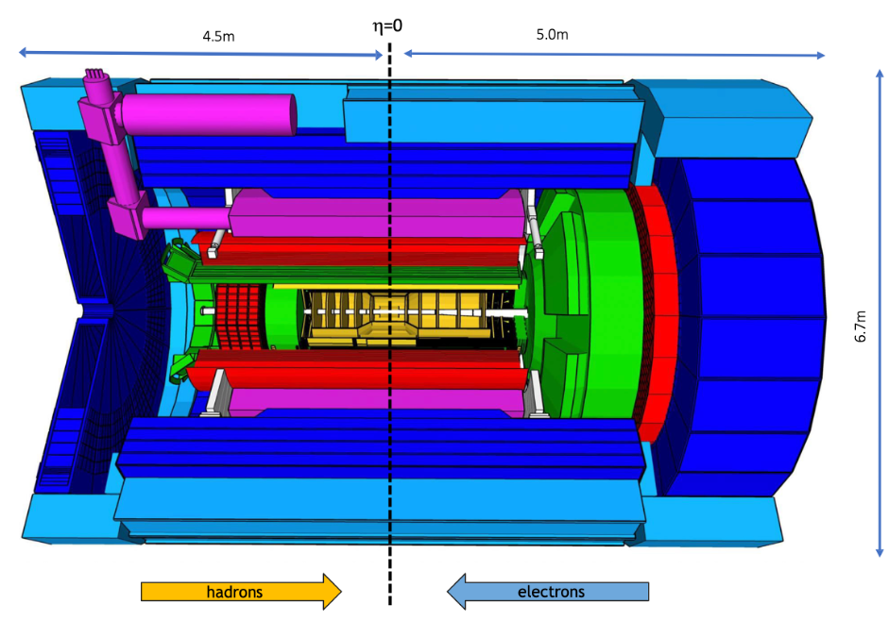
Barrel Imaging Calorimeter (BIC)
–Barrel Electromagnetic Calorimeter for ePIC
BIC Detector Geometry:
Active Length: 435 cm
Inner Radius: 82 cm
Structure: 48 trapezoidal sectors
Weight: 42.5 US Tons
η Range: -1.71 < η < 1.31
Sector thickness: ~40cm
Total thickness > 17.1 X₀ (depending on η)
Barrel HCAL
Magnet
BIC
hpDIRC
Backward HCAL
SVT, Gaseous Trackers, and TOF
dRICH
FEMC
LFHCAL
EEEMC
pfRICH

Slide 4
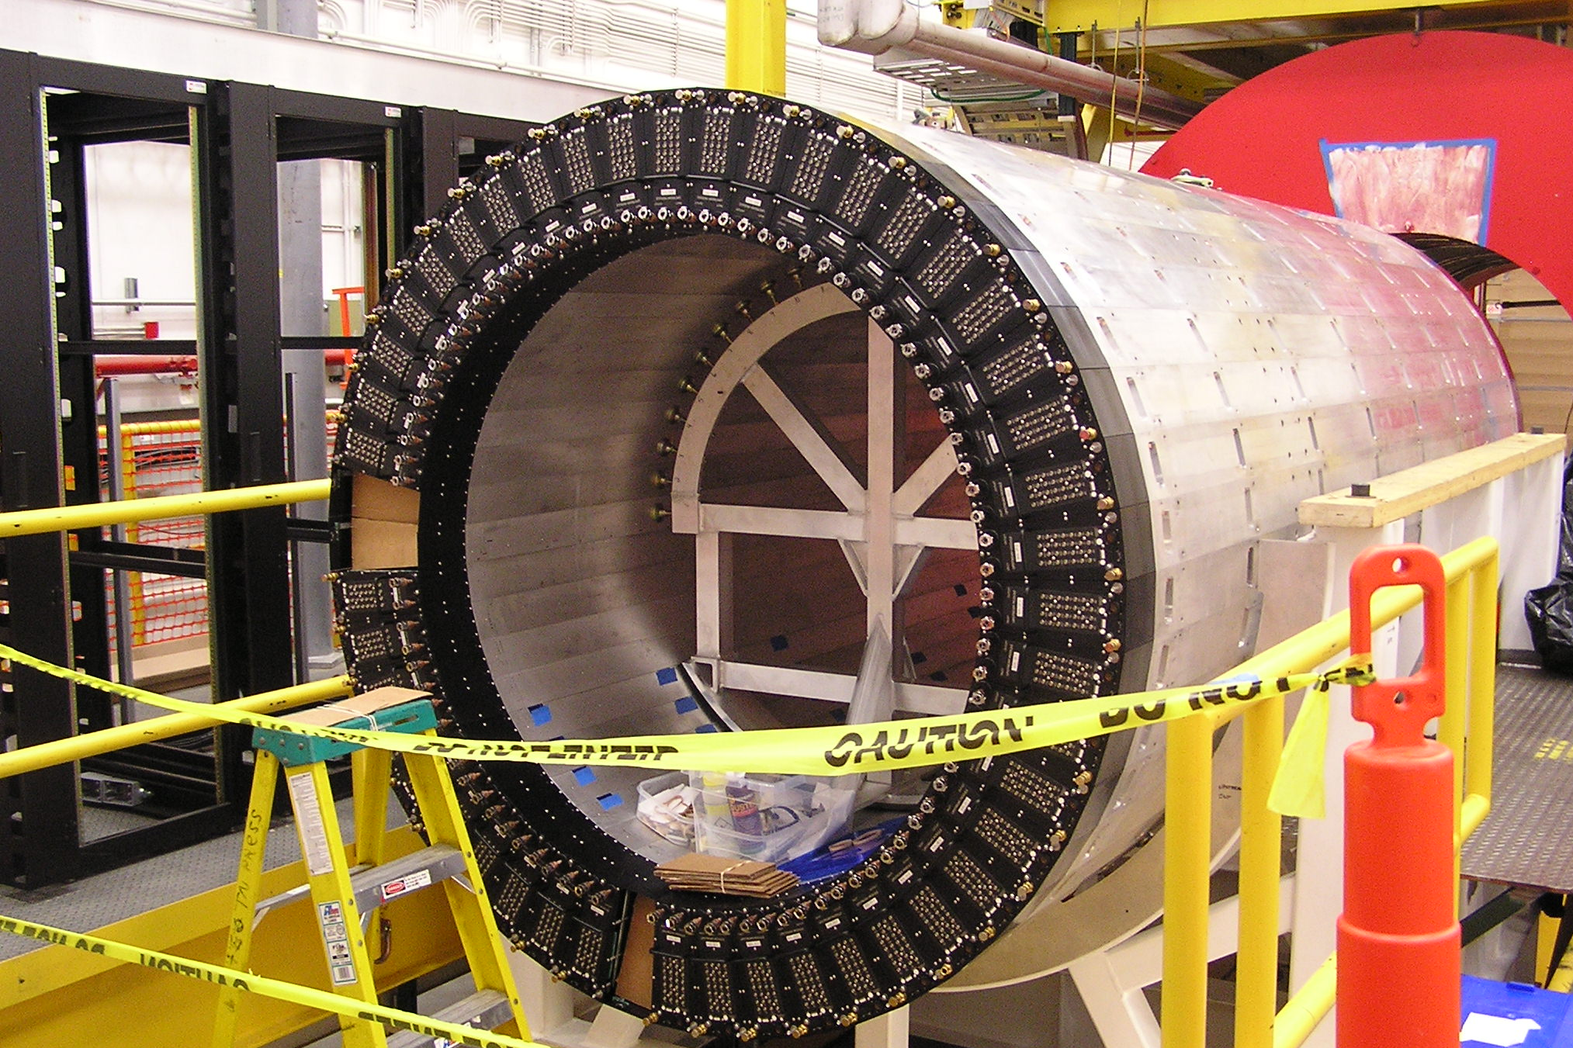
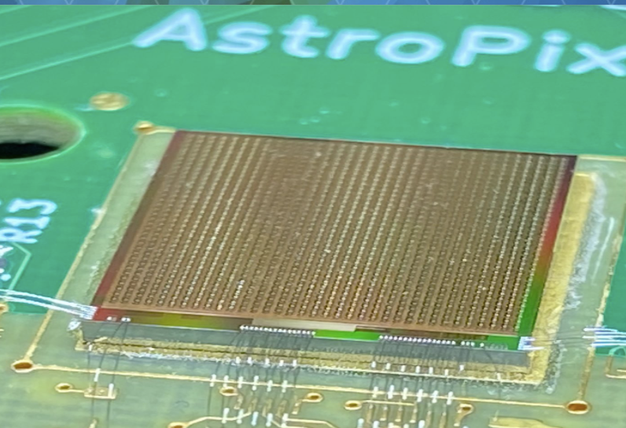
Concept: A Hybrid Imaging Calorimeter
Combination of a high-performance sampling calorimeter with inexpensive silicon sensors for shower profiling
NIM, A 896 (2018) 24-42
NIM, A 1019 (2021) 165795
Start from mature layered Pb/ScFi technology with side-readout (same as the GlueX calorimeter) for state-of-the-art sampling calorimeter performance
Insert layers of monolithic AstroPix sensors (inexpensive ultra-low-power silicon sensor developed for NASA) in the first half of the calorimeter to capture a 3D image of the developing shower
4

Slide 5
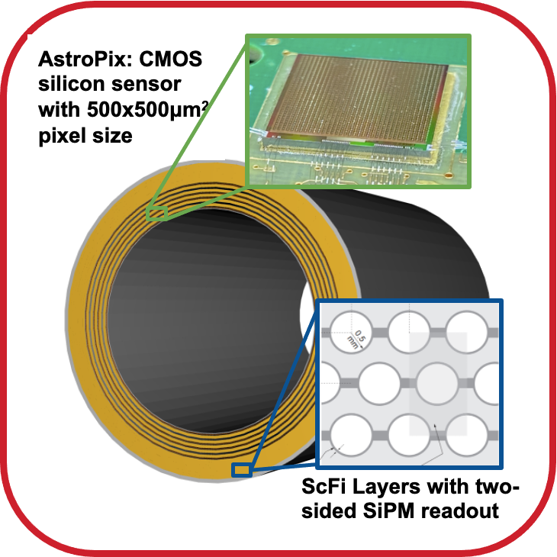
Concept: A Hybrid Imaging Calorimeter
Combination of a high-performance sampling calorimeter with inexpensive silicon sensors for shower profiling
NIM, A 896 (2018) 24-42
NIM, A 1019 (2021) 165795
Start from mature layered Pb/ScFi technology with side-readout (same as the GlueX calorimeter) for state-of-the-art sampling calorimeter performance
Insert layers of monolithic AstroPix sensors (inexpensive ultra-low-power silicon sensor developed for NASA) in the first half of the calorimeter to capture a 3D image of the developing shower
5

Slide 6
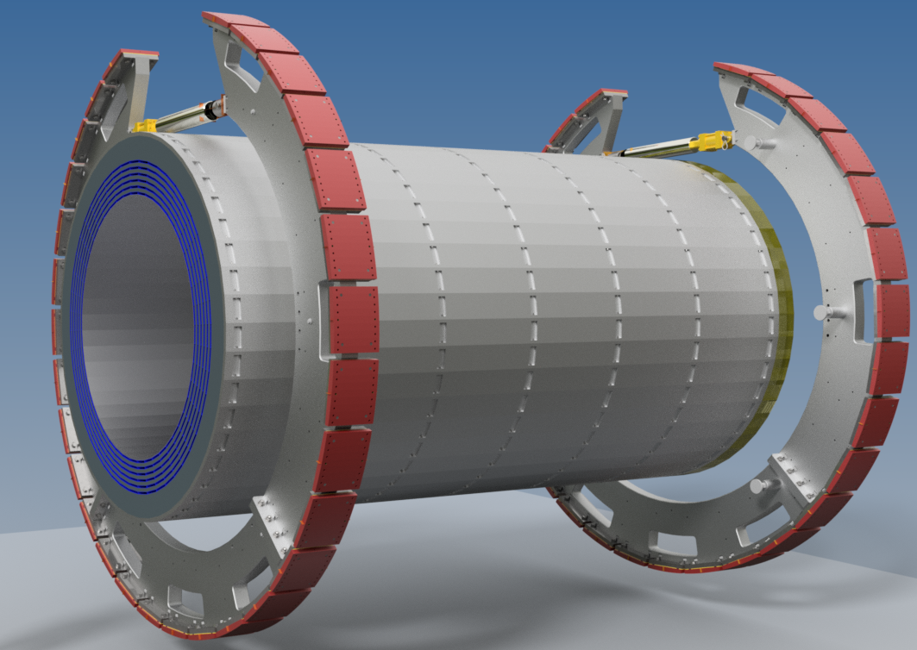
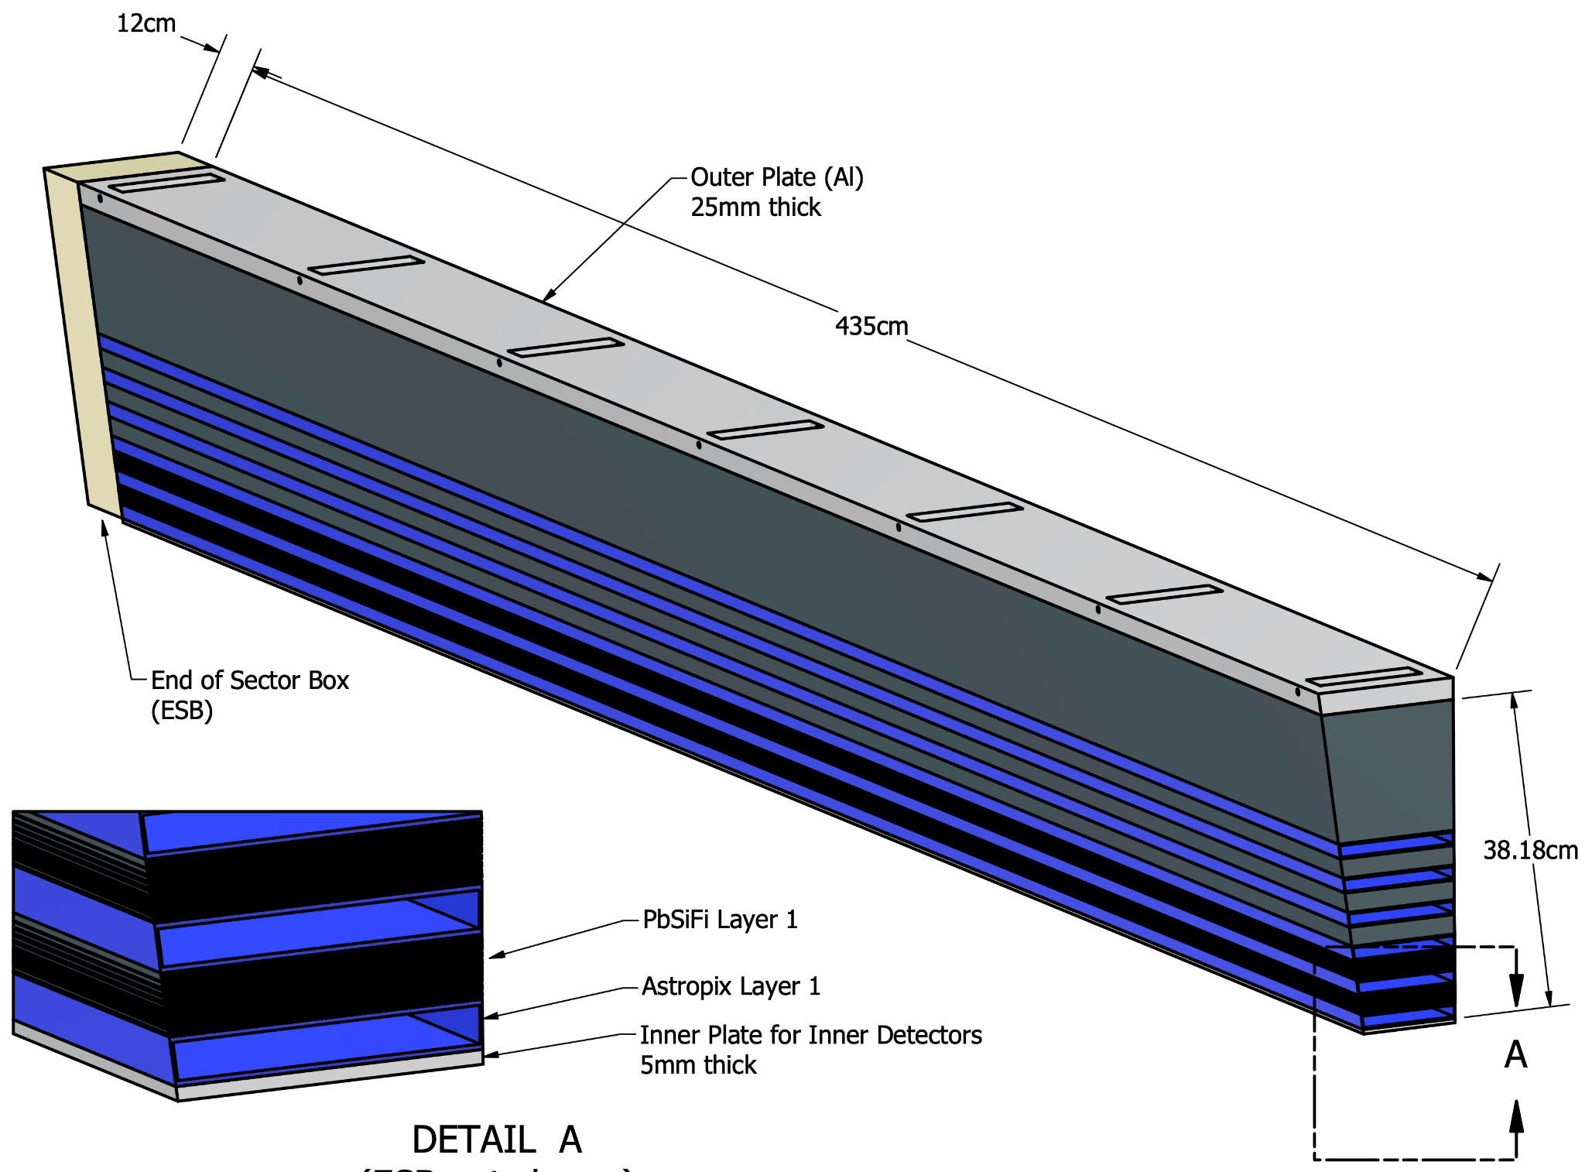
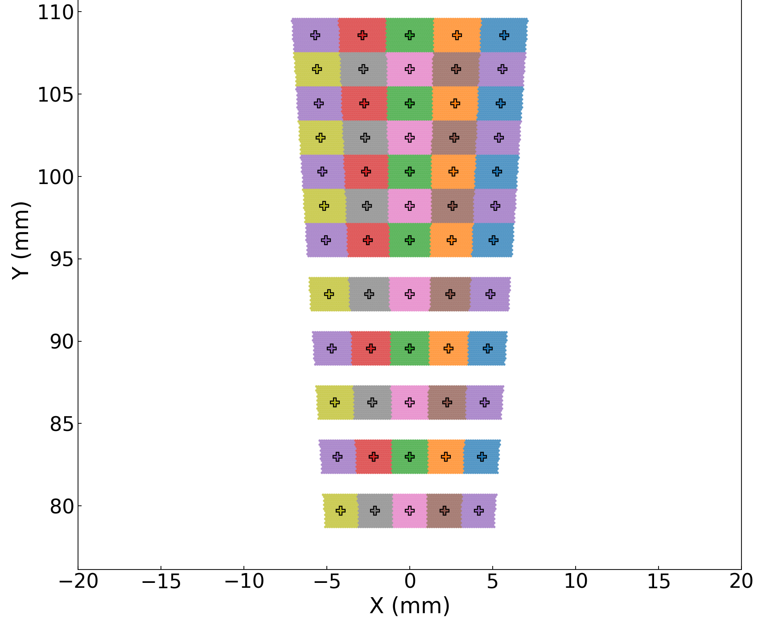
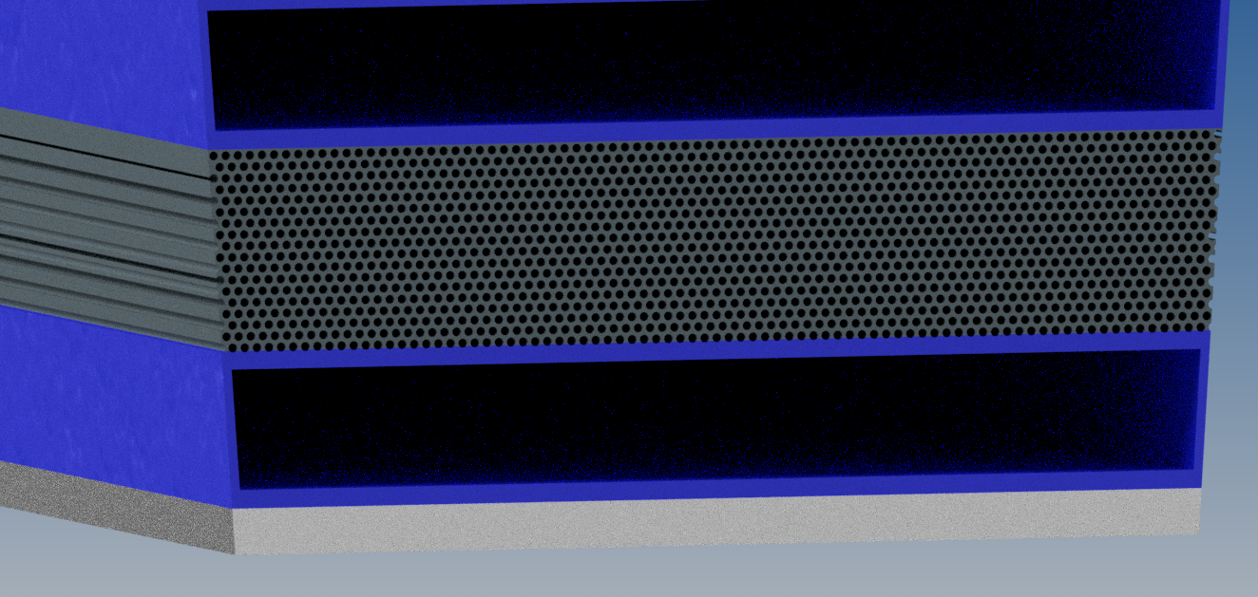
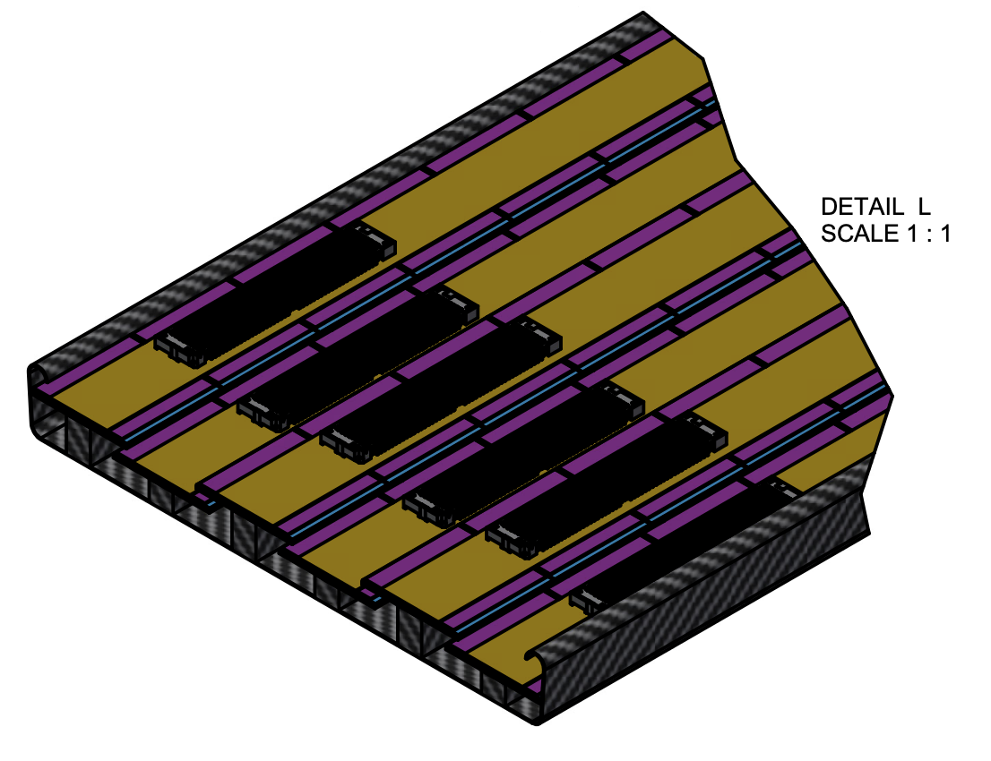
Barrel Imaging Calorimeter
Pb/SciFi Layers - 17 rows of fiber between corrugated lead.
Each sector has 12 Pb/ScFi layers.
Individual light guides divide each layer in 5 readout cells.
Sector Mechanics
Single sector
82.0 cm
Single BIC Sector
SiPMs - 5 per layer x 12 layers = 60
(Hamamatsu S14161-3050)
Sector side view
AstroPix Layer 2 (empty)
Pb/ScFi Layer 1
AstroPix Layer 1
Tray - Structure holding the AstroPix staves for a single layer (217.5 cm long).
AstroPix Module - Nine AstroPix sensors daisy-chained together on Flex PCB.
A stave consists of 12 modules.
A tray contains of 6-8 staves.

Slide 7
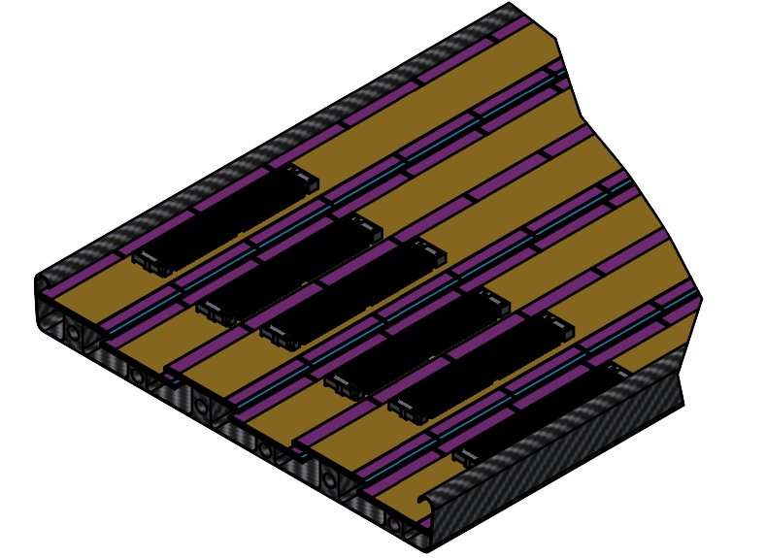
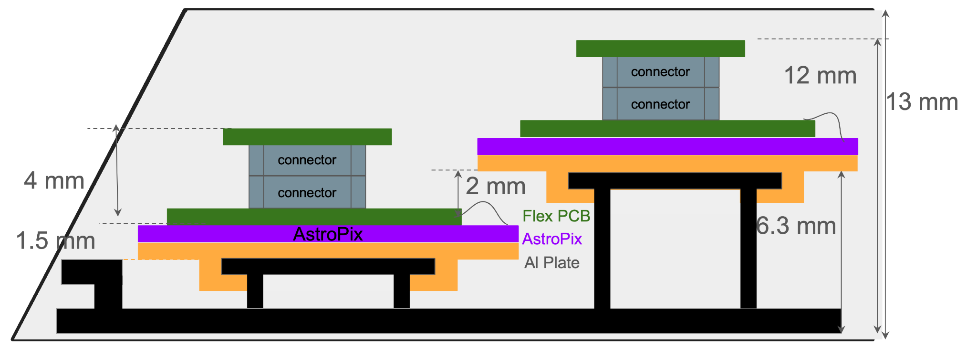
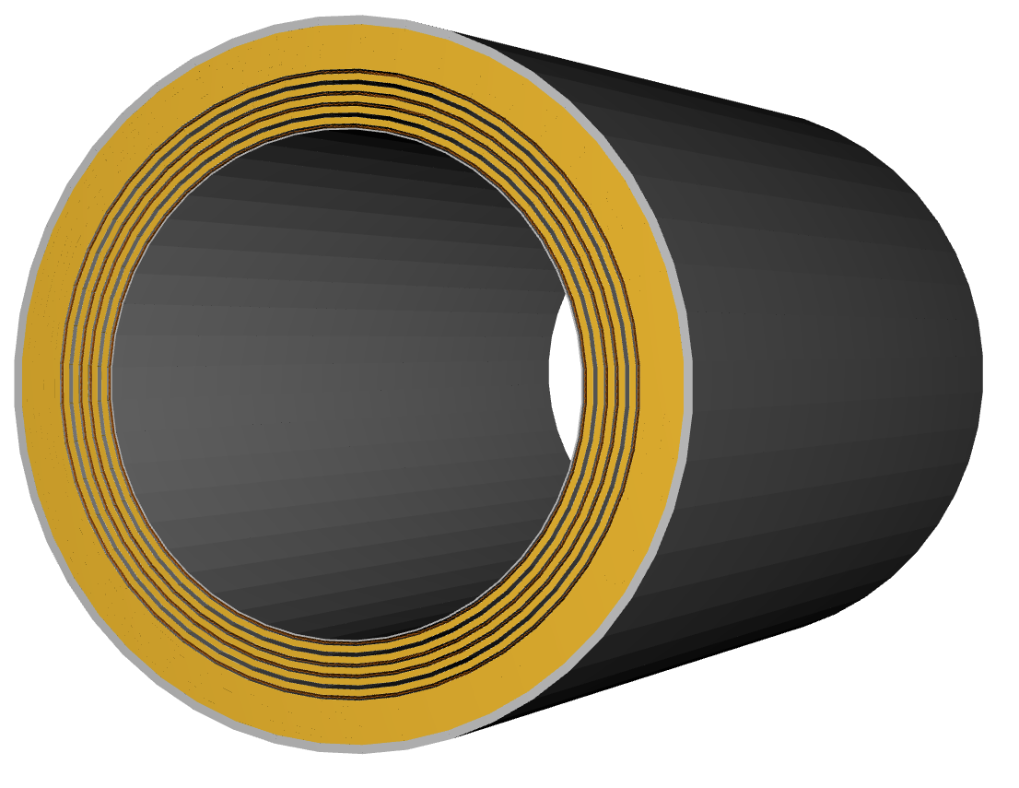
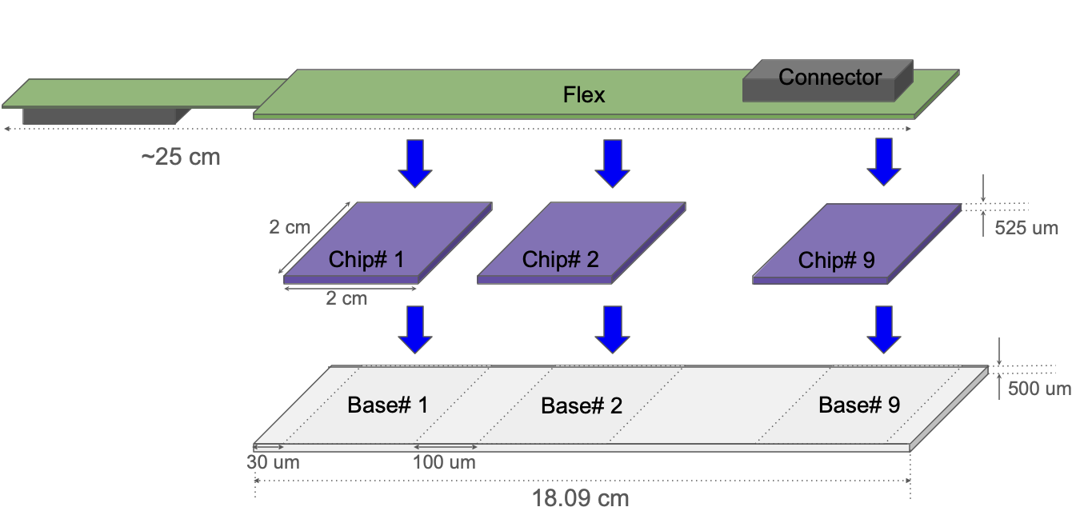
Barrel Imaging Calorimeter
AstroPix Wafers & Modules
Stave (12 modules)
AstroPix: silicon sensor with 500x500μm² pixel size
Tray
Module:
AstroLinx

Slide 8
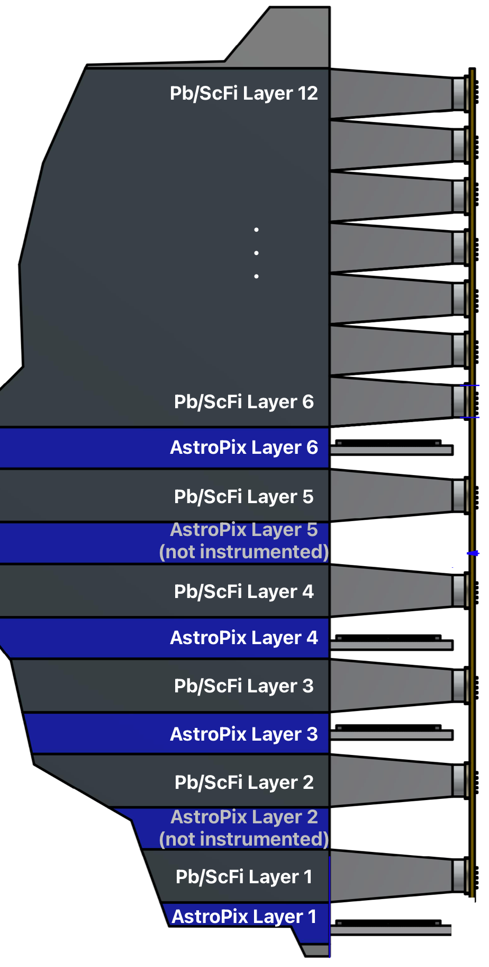
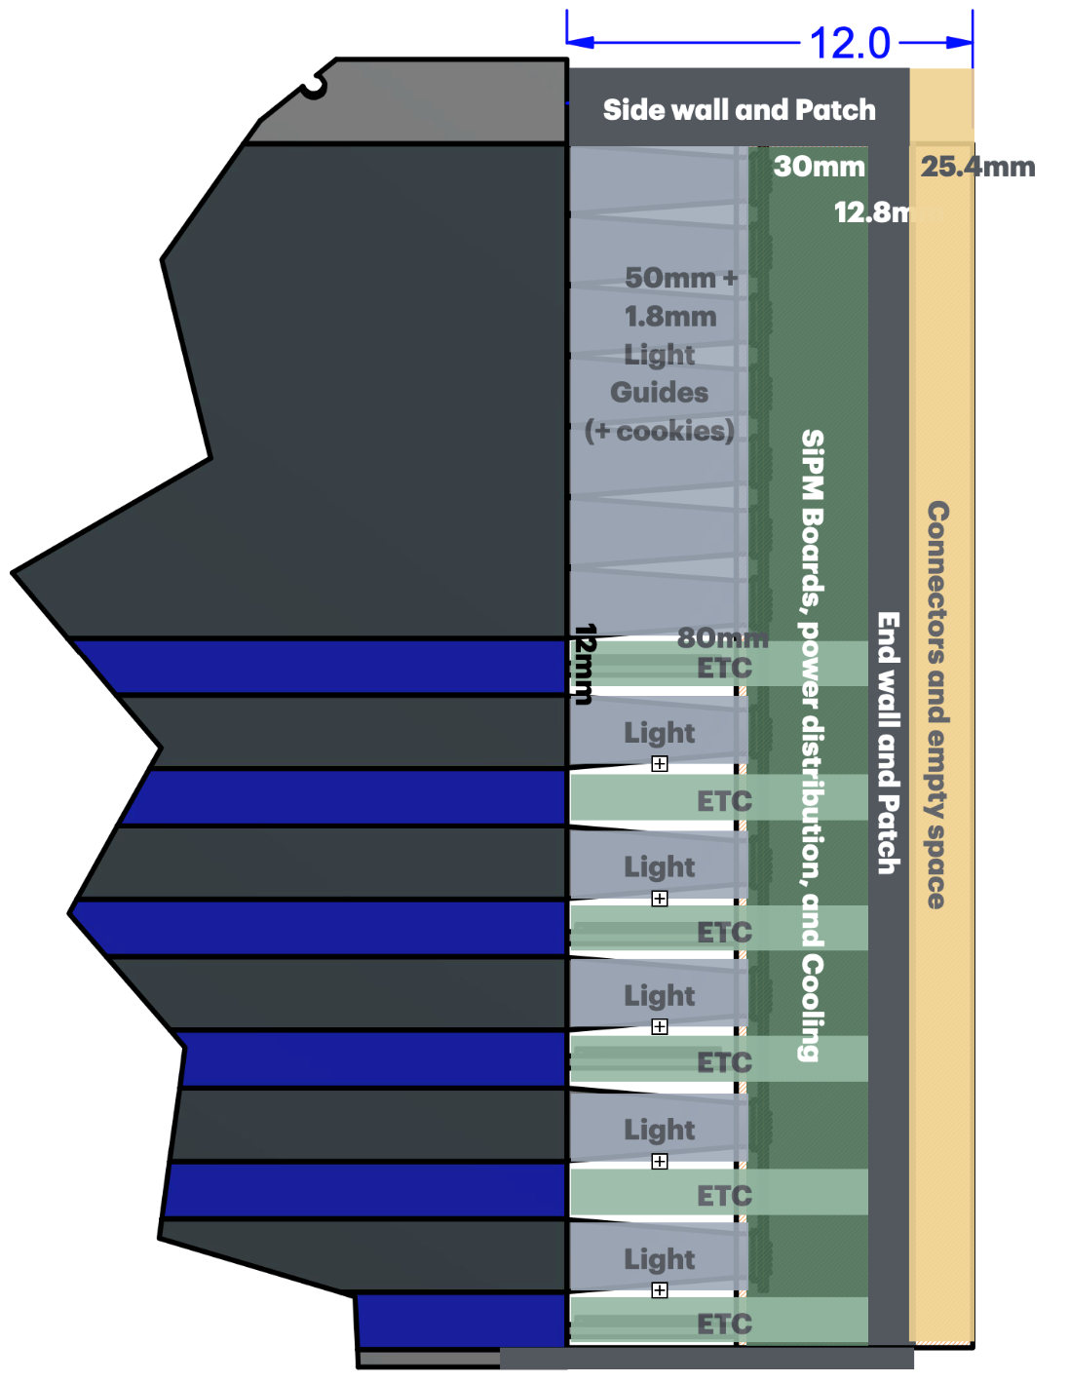
Barrel Imaging Calorimeter
End-of-Sector Boxes (ESB) & DAQ
Outer radius
Bulk back section of Pb/ScFi
Pb/SciFi:
light guides
cookies
SiPMs
CALOROC
cooling
Tracker:
ETC: End of Tray Card for AstroPix readout
6 slots for AstroPix sensors, 4 instrumented interleaved with 5 Pb/ScFi layers
Inner radius

Slide 9
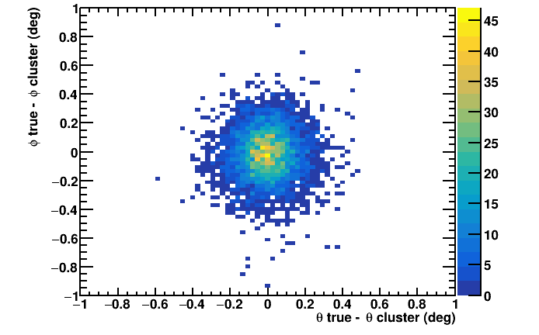
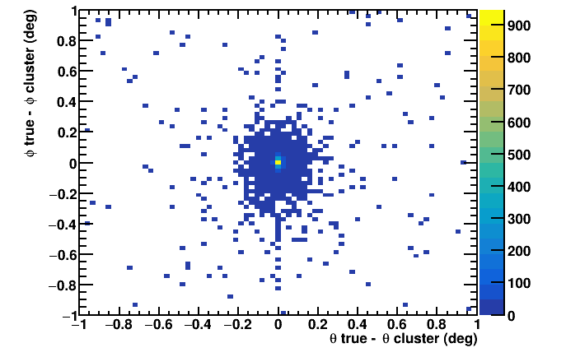
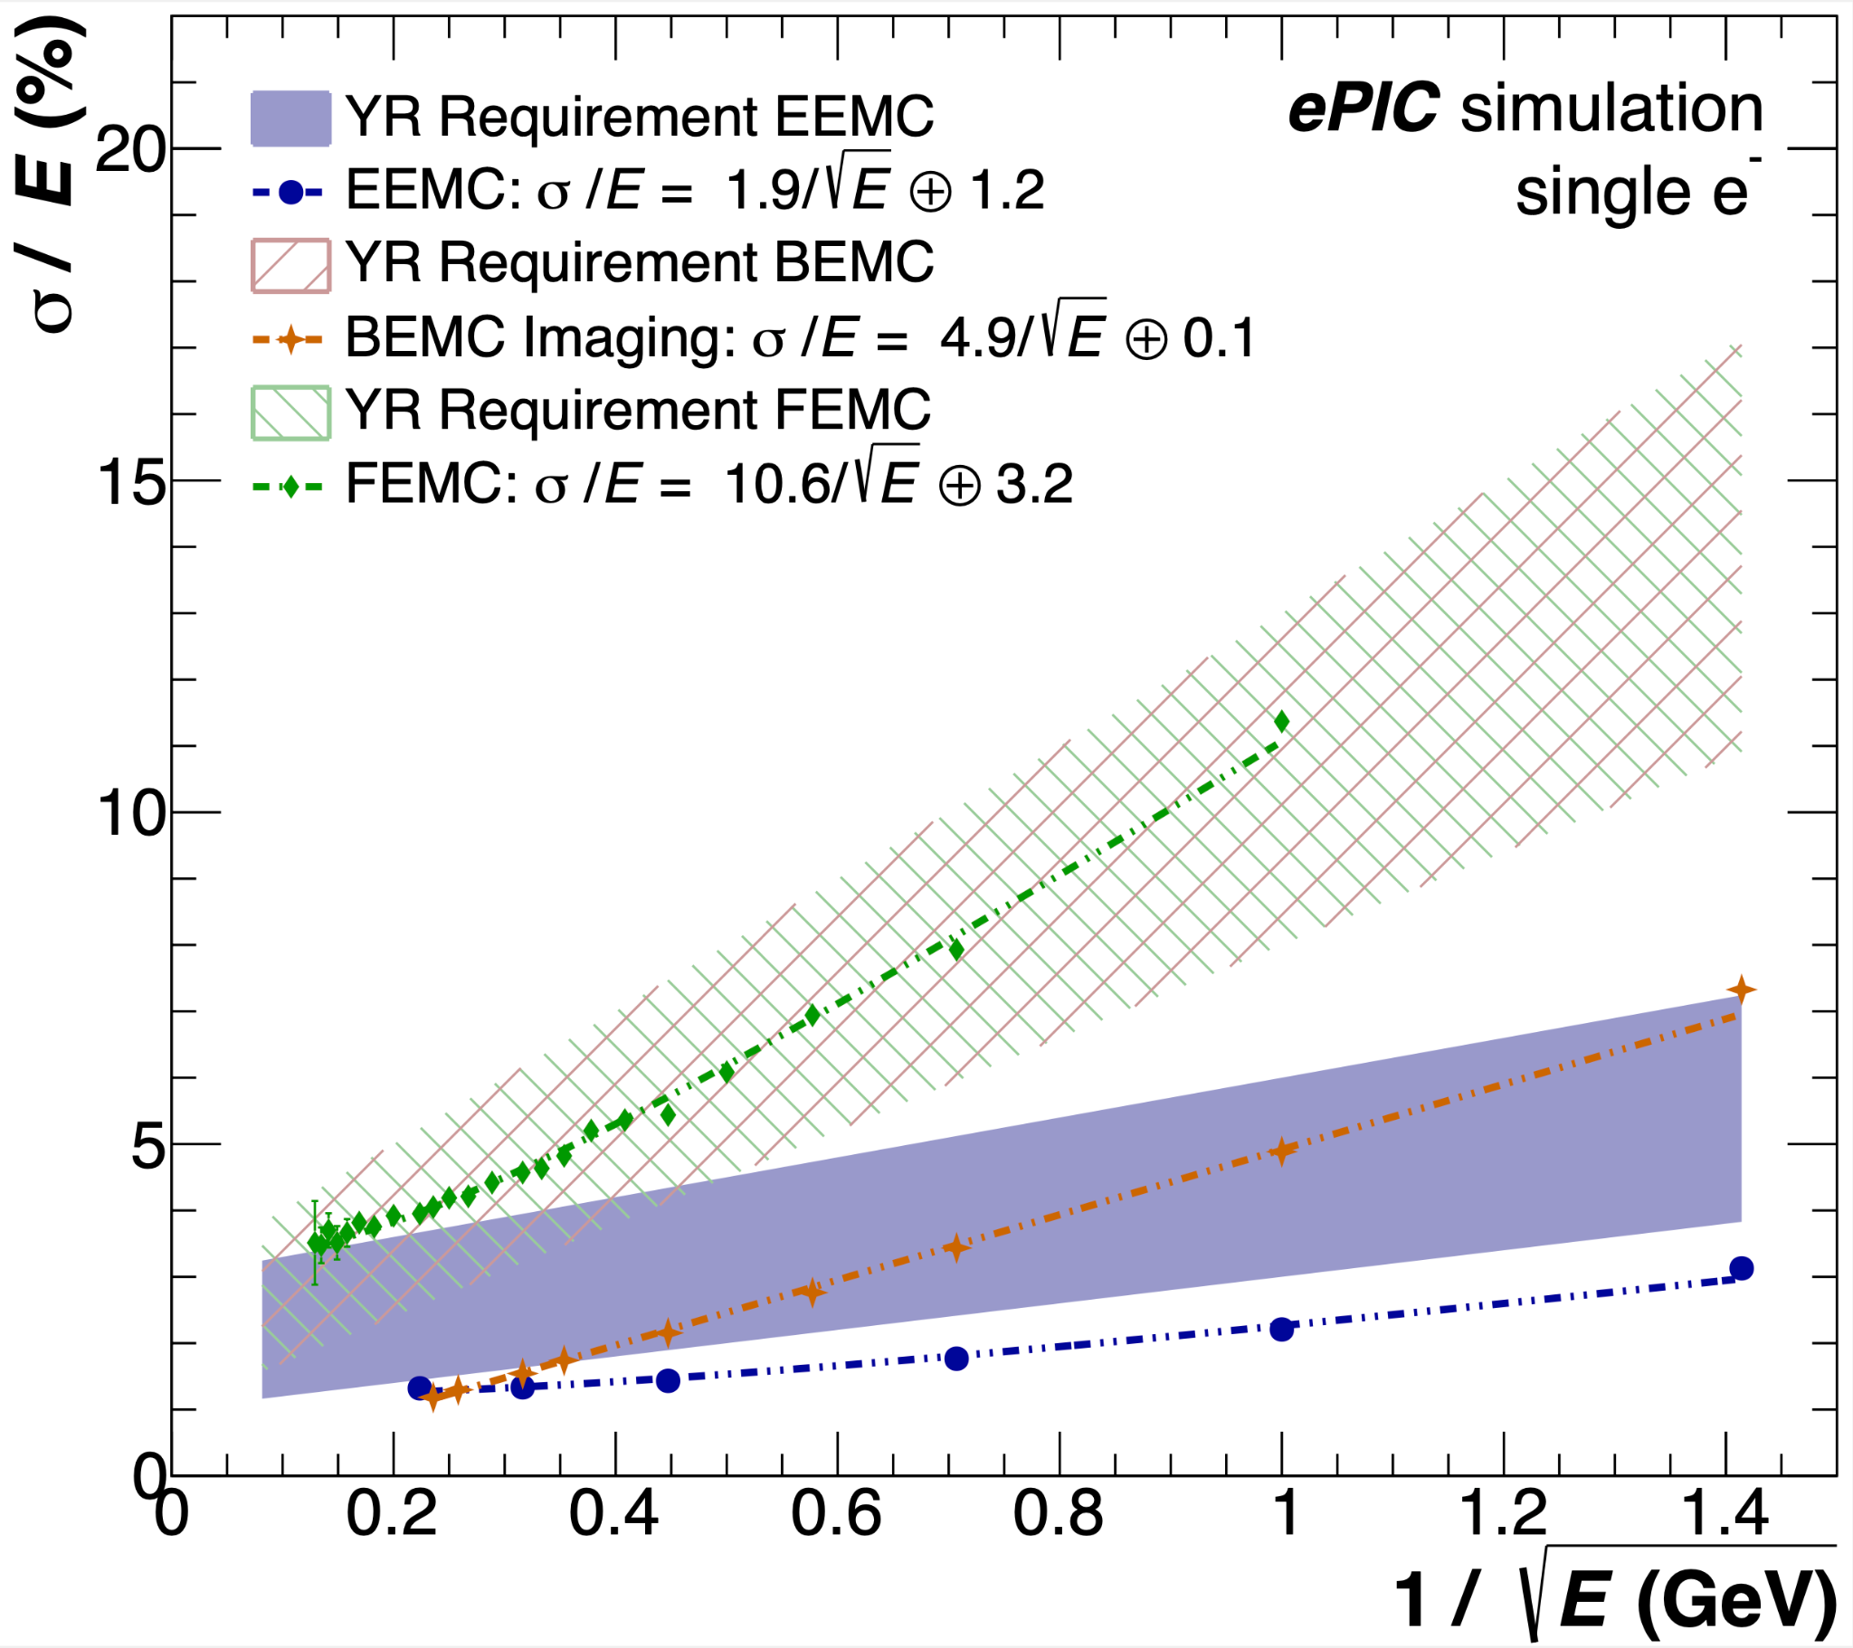
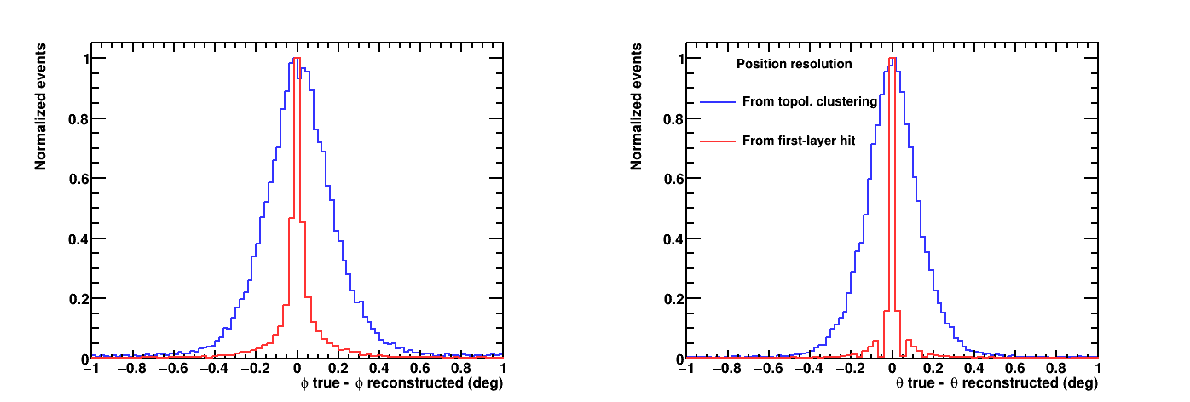
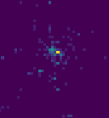
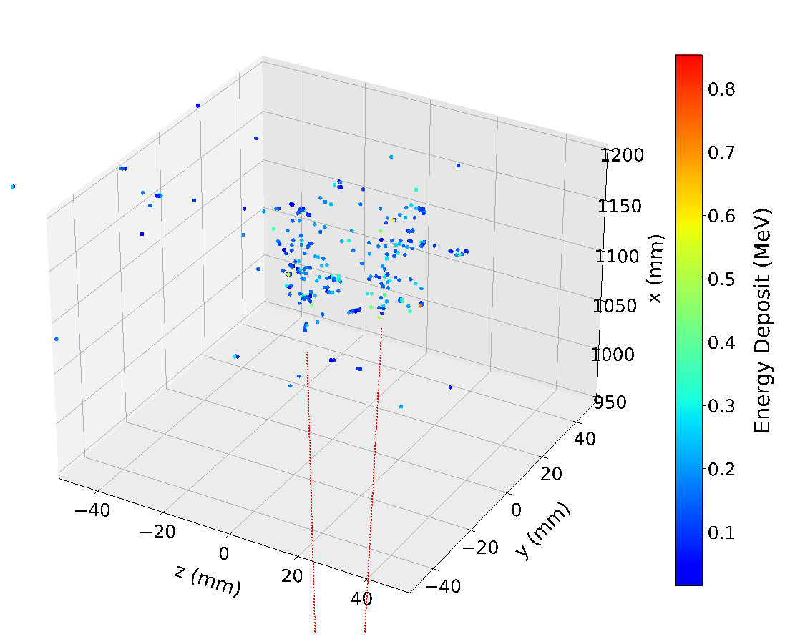
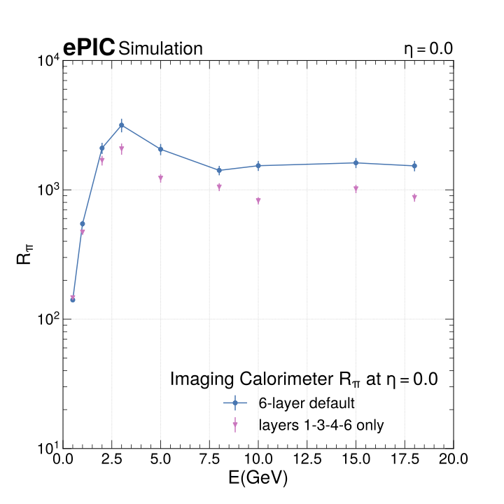
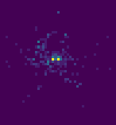
BIC Performance
Simulations
Deep calorimeter (η = 0 ~17.1 X₀) while compact at ~ 40 cm
Excellent energy resolution (5.2% /√𝑬 ⨁ 1.0%)
Unrivaled low-energy electron-pion separation by combining the energy measurement with shower imaging
Unrivaled position resolution due to the silicon layers
Deep enough to serve as inner HCal
Very good low-energy performance
Wealth of information enables new measurements, ideally suited for particle-flow
May serve as tracking layer behind the DIRC
single photon
π⁰ → ɣɣ
See prebrief materials for more detail

Slide 10
BIC Recent Progress & Plans

Slide 11
Summary of Design and Test Articles Status
BIC Design Completion |  | Concept | Preliminary Design (60%) | First Test Article | Final Design (90%)
Sector Mechanics | Scintillating Fibers (CD3a/b) | ✓ | ✓ | ✓ | ✓
 | Pb/SciFi Matrix Construction | ✓ | ✓ | ✓ Short matrix | Oct 2025
 | Carbon Fiber Frames | ✓ | ✓ | Short Frame Jul 2025 | Nov 2025
 | Sector Construction | ✓ | ✓ | Short Multi-layer Aug 2025 | Nov 2025
 | Tracker Tray | ✓ | Aug 2025 | Sep 2025 | Oct 2025
 | Tracker Module Base | ✓ | ✓ | Jun 2025
Tracker: AstroPix Modules | AstroPix | ✓ | ✓ | ✓ (v3) | ✓ (v5)
 | Wafer/chip probing | ✓ | ✓ | Aug 2025 | Nov 2025
 | AstroLinx | ✓ | ✓ | Jul 2025 | Apr 2026
 | AstroPix Module | ✓ | ✓ | Sep 2025 | May 2026
 | Stave/SuperStave | ✓ | ✓ | Nov 2025 | May 2026
End-of-Sector Box (ESB) & DAQ | Lightguides | ✓ | ✓ | Jun 2025 | Jun 2025
 | SiPM's | ✓ | ✓ | ✓ | ✓
 | CALOROC readout | ✓ | ✓ | ✓ (H2GCROC) | ✓ (H2GCROC)
 | End-of-Tray Card | ✓ | Contract delay
 | Electrical Services | ✓ | 75% | July 2025 | Sep 2025
 | Cooling | ✓ | 40% | July 2025 | Sep 2025
 | ESB Test Article | ✓ | ✓ | July 2025 | Sep 2025
System Test | Integrated System Tests | ✓ | ✓ | ✓ (BabyBCal + SFILs + Chip/Module) | Aug 2026

Slide 12

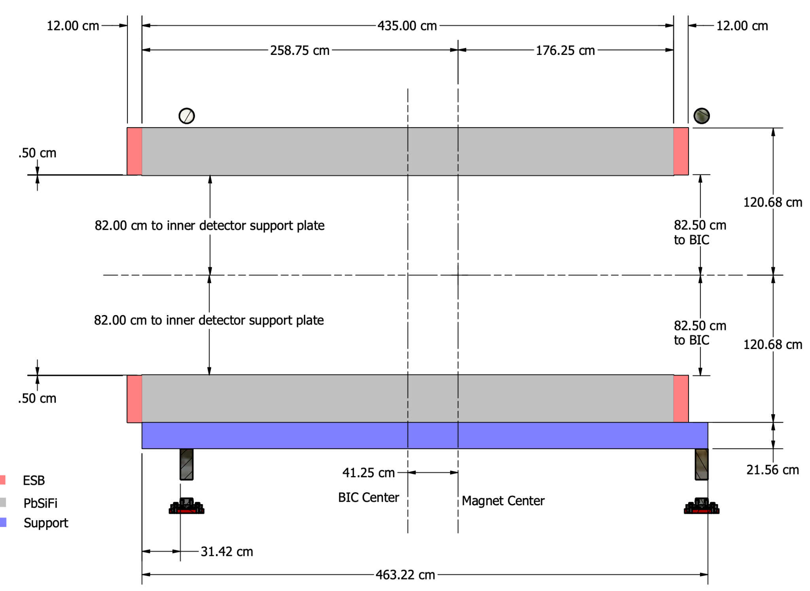
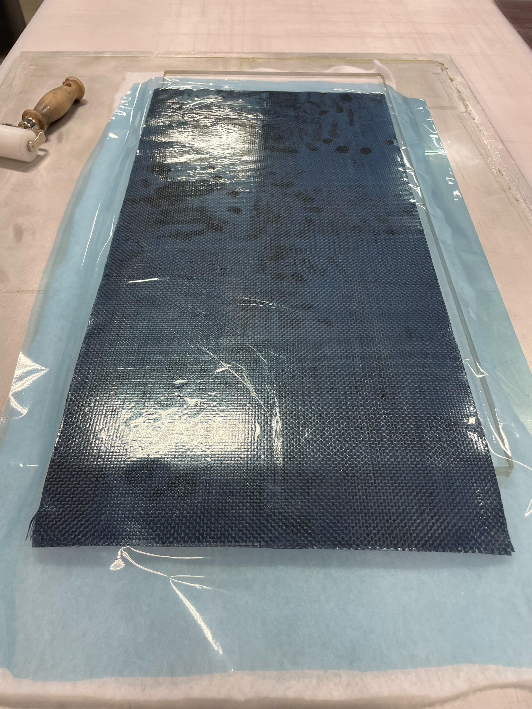
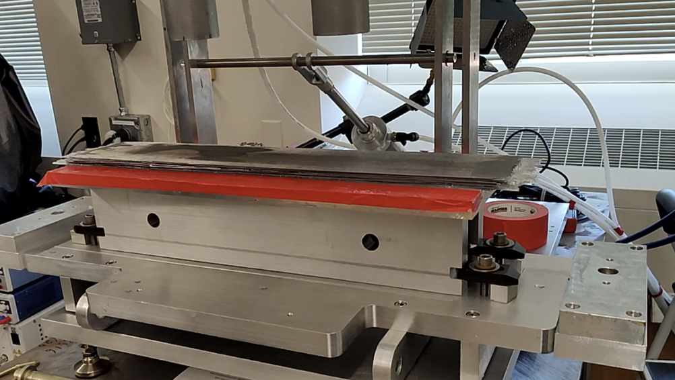
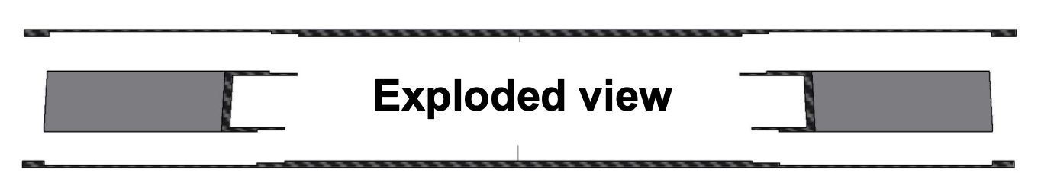
Sector Mechanics
Design Progress
Interfaces to the rest of ePIC well-defined and mostly frozen
BIC engineers in close contact with the Project engineers
Geometries & envelopes documented and versioned
Technical challenges:
Demonstrate self-supporting design and integration with ePIC
Detailed FEA needs delamination measurements for CF-Pb interface, and for the Pb/SciFi matrix itself.
We are building test articles for Mode I & II Interlaminar Fracture Toughness measurements (ongoing, due late June 2025)
CF frame integration and matrix construction tolerances
Subcontract with Purdue Composites to design/build CF components and for FEA
CF Frame Side Wall
First CF layup for delamination test articles (May 28, 2025)
Short Pb/ScFi test article on the press bed, in preparation for the delamination test articles (May 23, 2025)
Exploded view of the CF fiber frame components, with filler material on the sides (to be machined away after pressing)

Slide 13
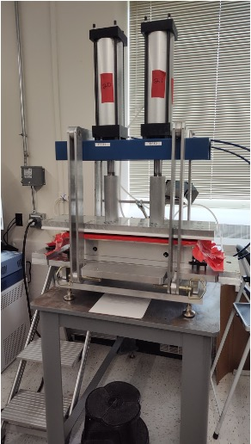
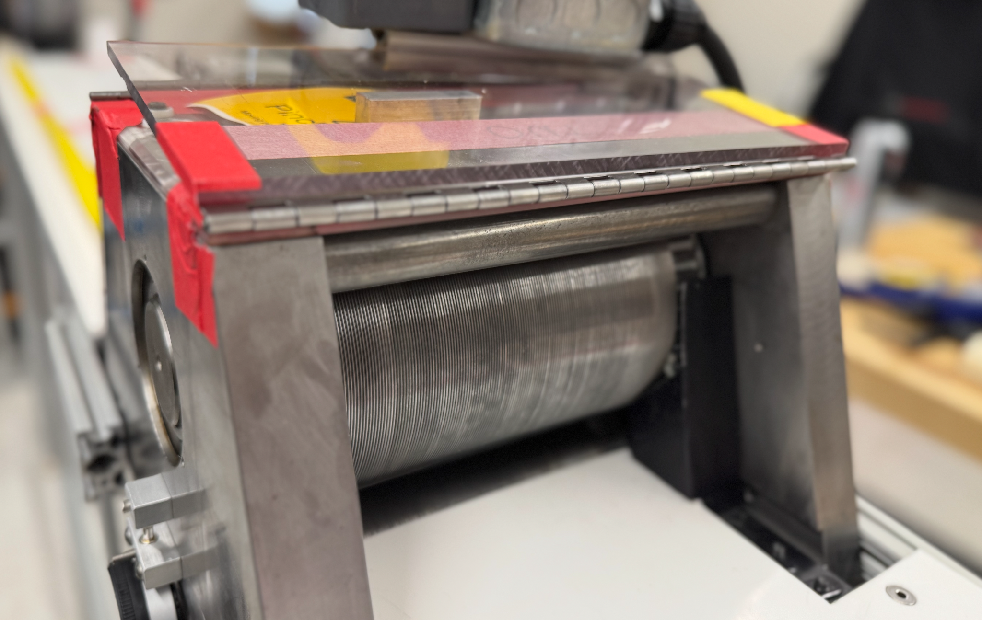
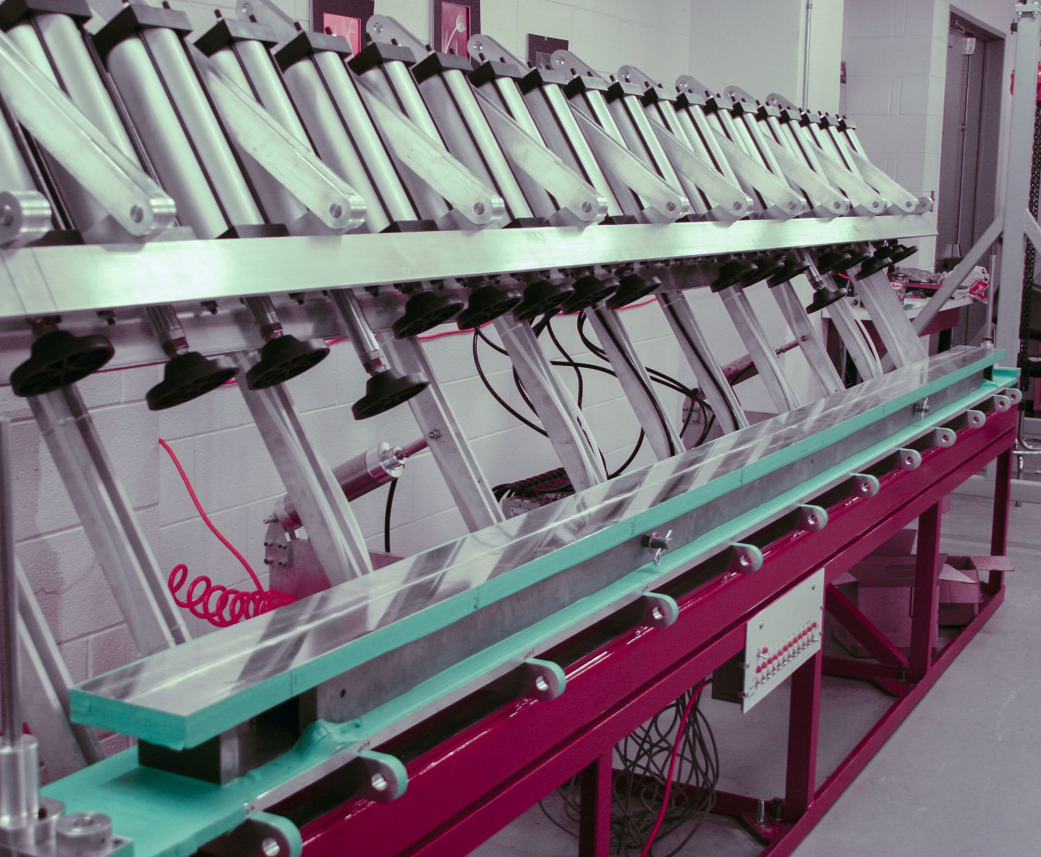
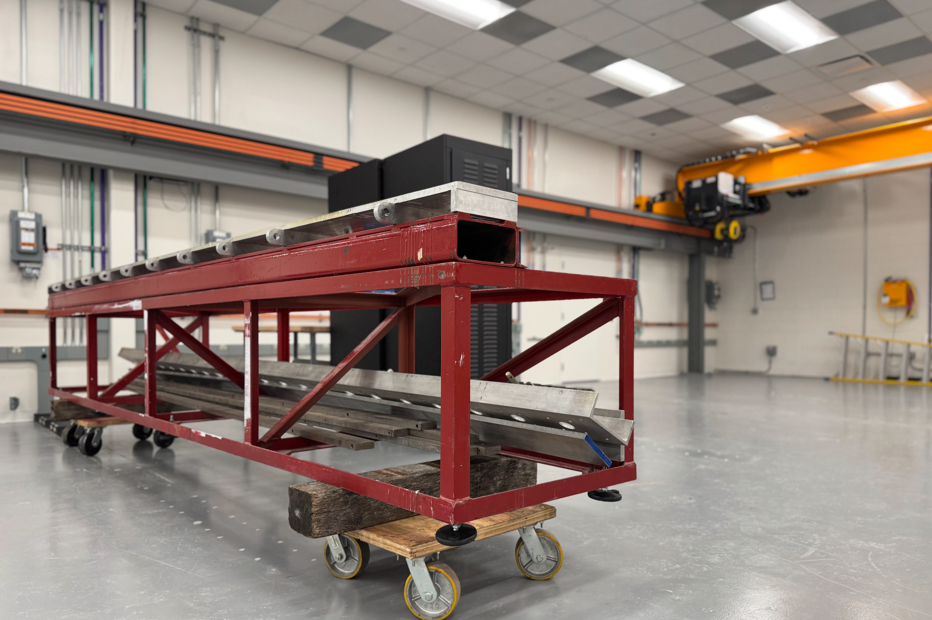
Sector Mechanics
Equipment Status
Newly built press for short test articles, and for evaluating press piston quality (pistons inherited from U. Regina)
Planned Test Articles
Goals and Test Articles:
Demonstrate we can reproduce the GlueX matrix production for short sizes (0.5m) - almost done
short test article with inert optical fibers, short SFIL with GlueX fibers, short Bulk sector with GlueX fibers
Demonstrate we can integrate CF frames with the required tolerances - Summer 2025
Short multilayer test articles with integrated CF frames (inert fibers)
Demonstrate we can reproduce the GlueX matrix quality for longer sizes (3m) - Fall 2025
Long SFIL with GlueX fibers
Demonstrate we can integrate CF frames at these longer sizes - Winter 2025
Long multilayer test article with GlueX fibers
Demonstrate we can build a full-scale 4.35m long BIC sector - 2026
Preproduction test article using the BIC fibers
Swager inherited from U. Regina, upgraded with new table and guarding and fully operational
Preliminary Design
Full-size press inherited from U. Regina, being modified for BIC to accommodate longer sectors and taller stack height
Final Design
Preproduction
All critical equipment commissioned and operational to produce test articles on schedule!
Assembled press @ University of Regina
for GlueX BCAL fabrication
Press frame @ Argonne in our new sector production space (5500 sq ft)

Slide 14
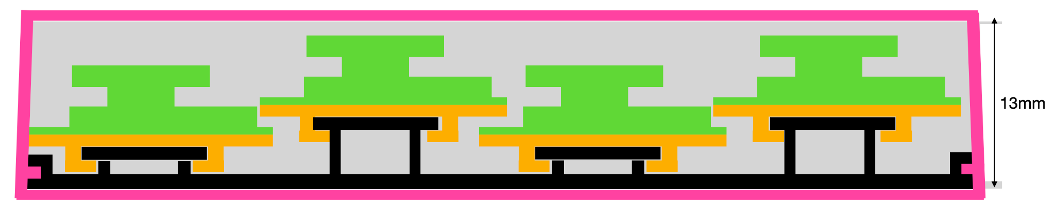
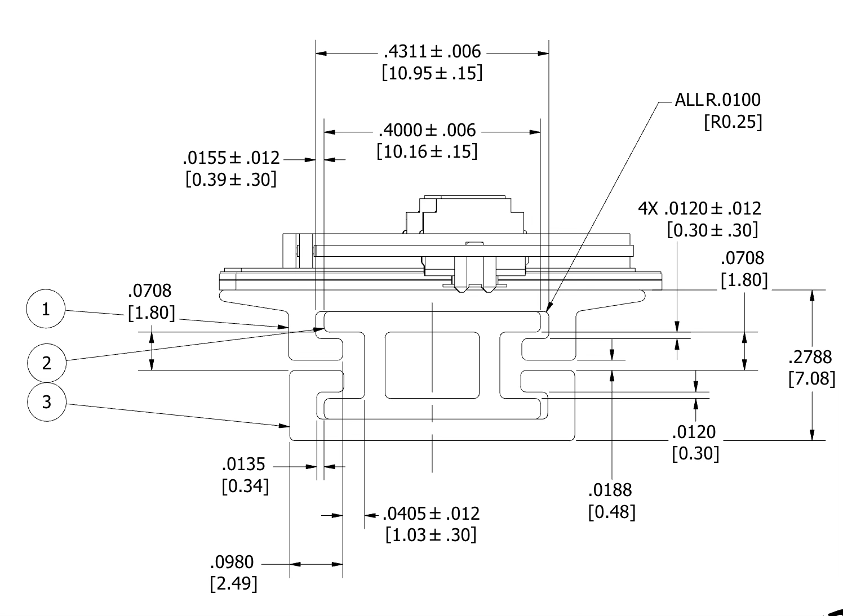
Tray, Stave, & Module Mechanics
Design & Test Article Progress
Module
Carbon Fiber Shelf
Design: staves integrated into tray
slide modules directly onto tray
tray slides into sector drawer/slot
minimize height and simplify installation
reduce number of components to produce
Trays positioned at outer radius has sensors pointing inwards
locked in place: leverages trapezoidal design
First fabrication of mechanical test article based on earlier design concept
Components made out of extruded aluminum to minimize cost
Validate fabrication tolerances with extruded aluminum
Validate mechanical stability
Delivery expected in June
Module Base
Extruded Al Tray (slides into shelf)
Initial stave concept being produced:

Slide 15
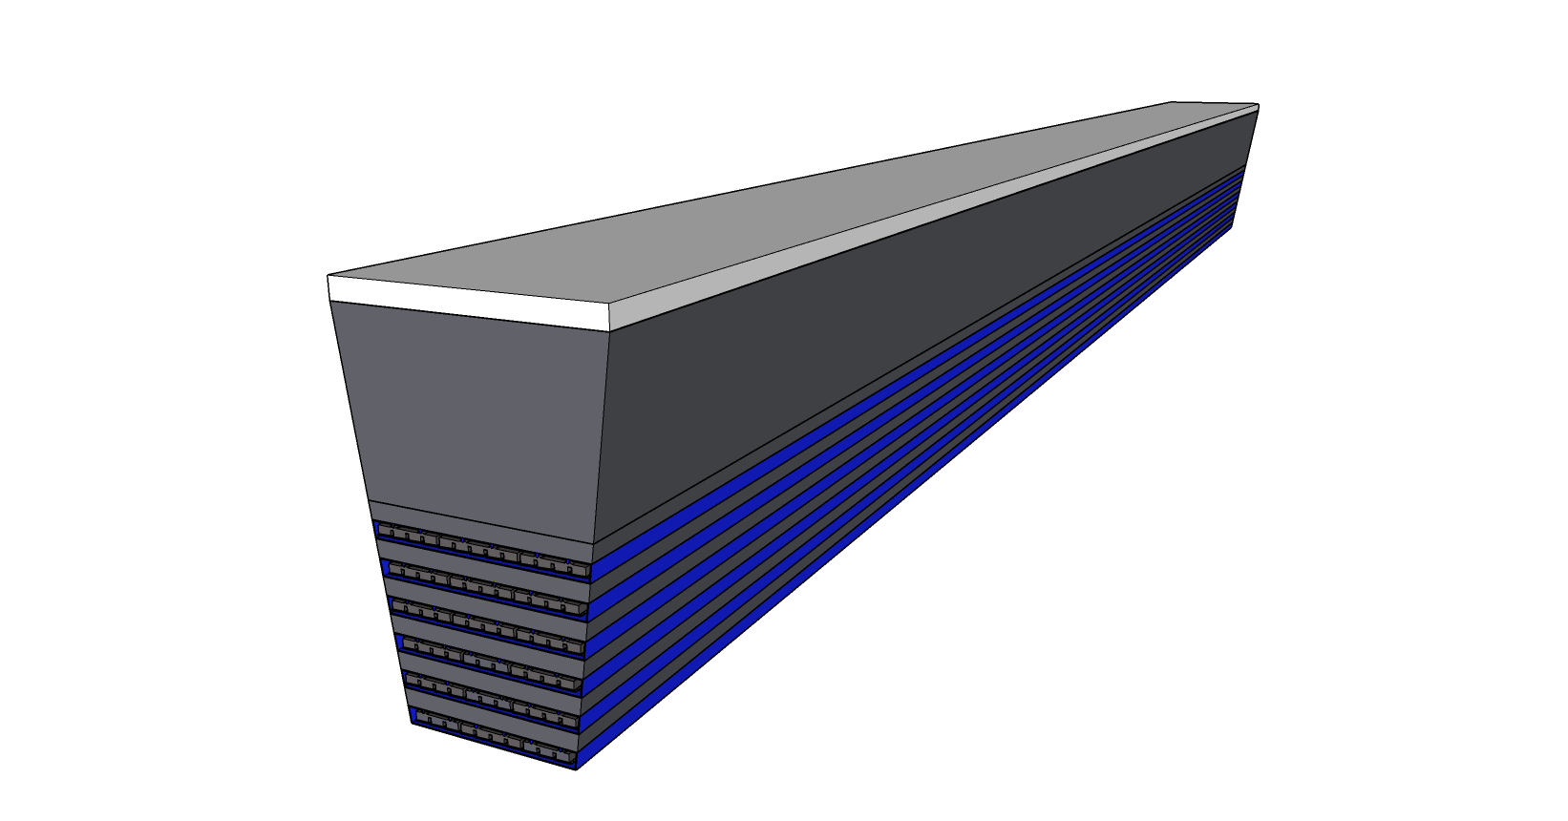
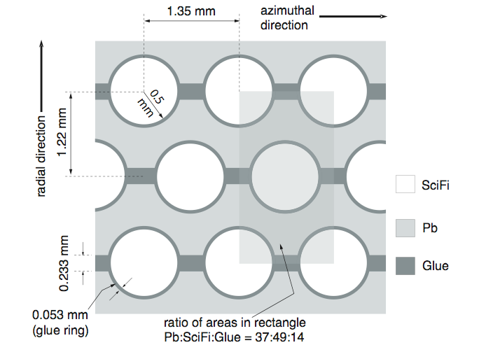
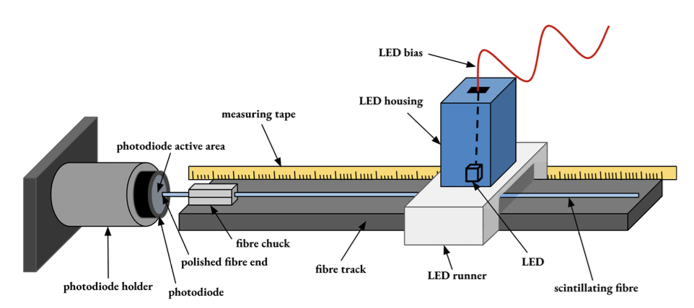
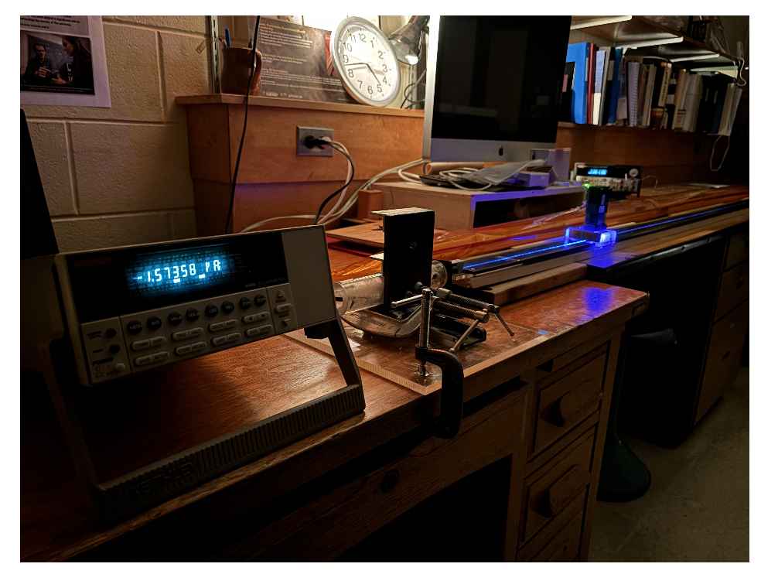
Fibers
CD3a
Attenuated signal from showers reaches both sides of the calorimeter
Read out from two sides with light-guides and SiPMs enclosed in end-of-sector box (ESB)
Pb/SciFi layers probe shower radially
Shower position extracted from both ends’ TOA (in addition to AstroPix position information)
Production test stands completed
Bidding process for production fibers is wrapping up
Testing of two vendor options completed
Contract being awarded, expect in mid-June
Fiber Direction
Fiber test stand with photodiode + LED

Slide 16
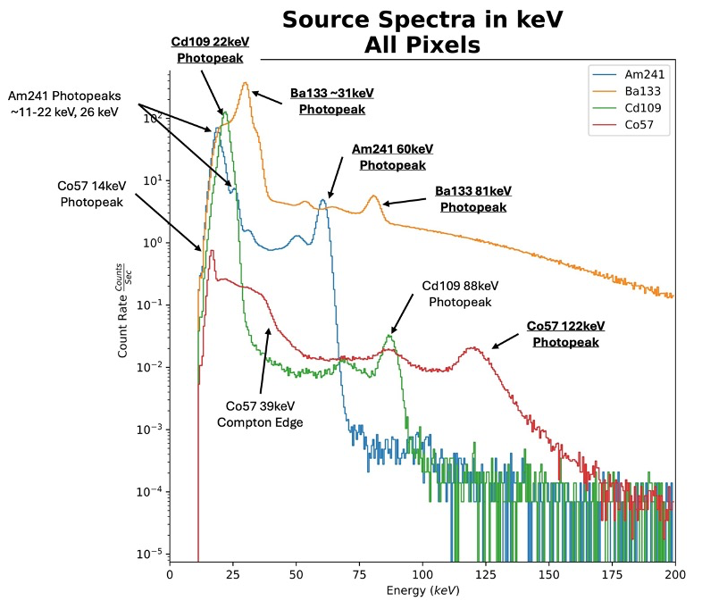
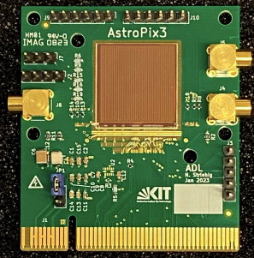
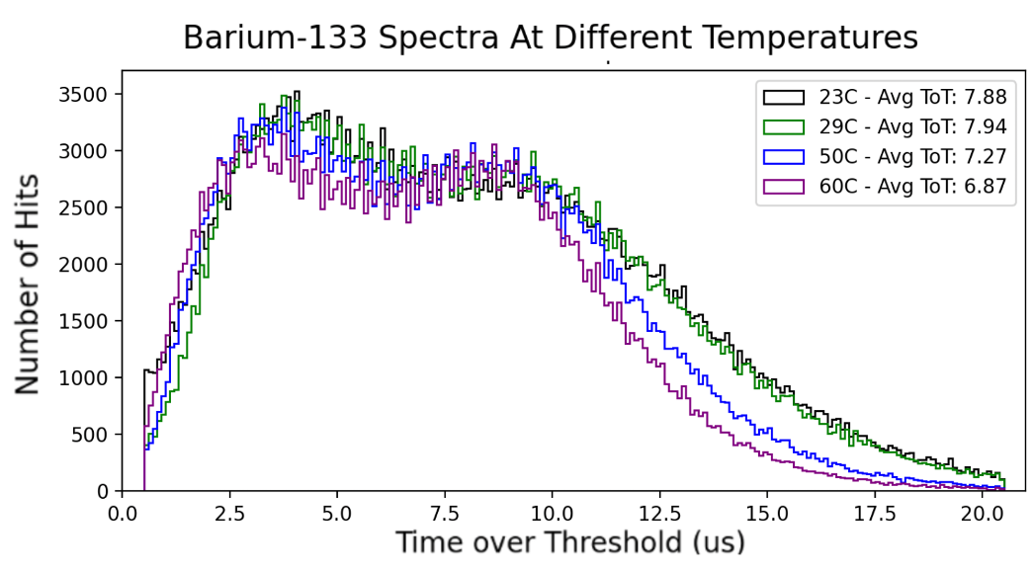
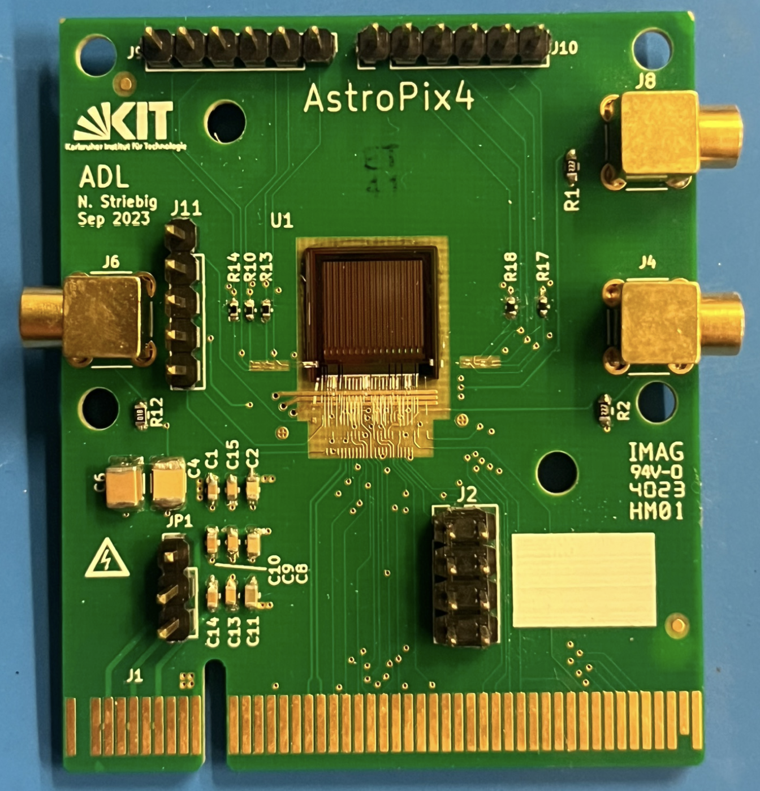
AstroPix
PED: Preliminary/Final Designs
AstroPix v3
First full size design: 1.87 cm ⨉ 1.96 cm
Row/Column readout
Pixel pitch: 500 μm
Pixel matrix: 35 ⨉ 35
0.88 mW/cm² analog, 12 mW digital
2.5 MHz timestamp, 200 MHz ToT
→ Large size chip for mechanical testing, early performance criteria, daisy chaining
AstroPix v4
MPW run, small size: 1 cm ⨉ 1 cm
Individual pixel readout
TuneDAC for pixel-by-pixel thresholds
0.96 mW/cm² analog, 3 mW digital
3 timestamps, 3.25ns time resolution
bug: flash TDC reset
Pixel pitch: 500 μm
Pixel matrix: 13 ⨉ 16
→Excellent tuning, energy resolution
AstroPix v3

Slide 17
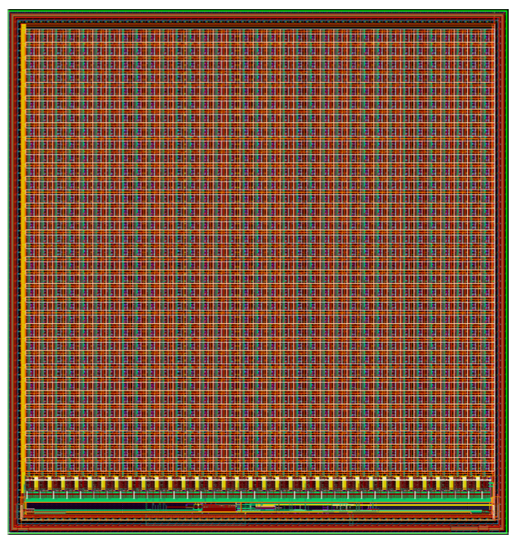
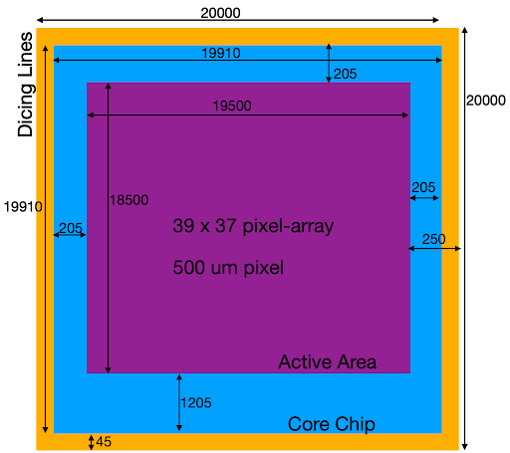
AstroPix
BIC PRE-Production:
AstroPix v5
Large size: 1.87 cm ⨉ 1.96 cm
Pixel pitch: 500 μm
Pixel matrix: 36 ⨉ 34
0.96 mW/cm² analog, 3 mW digital
3 timestamps, 3.25ns time resolution (bug-fix)
Change of design to new vendor (AMS)
Switch to deep p-well (from n-well)
No in-pixel CMOS comparators → implemented some columns with different NMOS comparators in order to optimize power/performance
Two columns with full dynamic range
→Being submitted for fabrication now (experienced delays with contract)
BIC Final Chip Design:
AstroPix v6
Final Full Size: 2 cm ⨉ 2 cm
Pixel pitch: ~500 μm
Pixel matrix: 39 ⨉ 37
2 mW/cm²
Expected
Minor updates to size
Select comparator design (from v5 columns)
Bug fixes (if any)
→Expect to submit the Final production design in an engineering run in 2026
paid for by EIC Project
timescale does not match NASA funding, would have to wait until December 2028 for the next full size run (as decided in NASA AstroPix proposal in January 2025)
verify the design before production fabrication can start

Slide 18
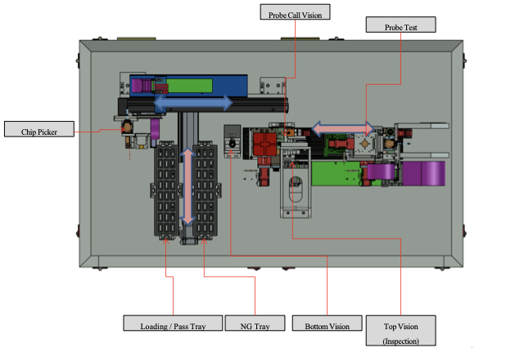
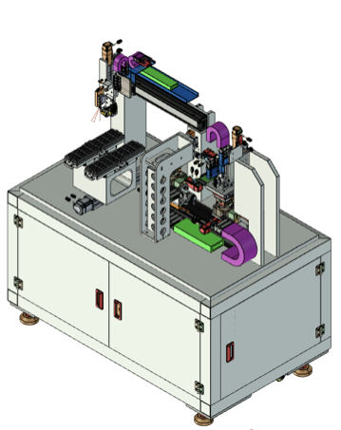
Wafer/Chip Probing
Wafer/chip level testing prior to module assembly
Quality Control Testing
Sensor bias with HV, analog and digital performance check, threshold tuning calibration checks
Chip probe card design for v3 is complete and expected delivery in June
Allow us to validate the chip QC testing on ~80 v3 chips this summer
Opportunity to switch from wafer to chip probing
leverage experience and equipment from Koreans on ALICE
dicing happens before chip probing–next step is module assembly
need to confirm testing rates fit in schedule
V5 design update will be ready in the fall

Slide 19
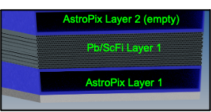
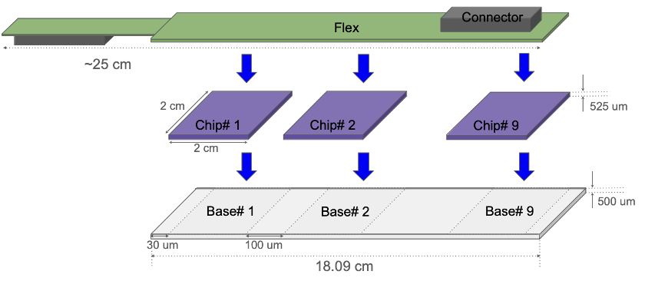


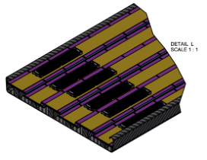
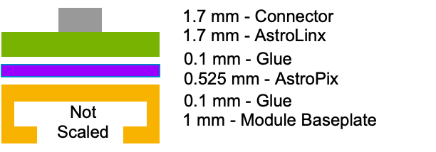

Modules
9-chips, 1 flavor
AstroLinx: Module PCB
Module Stackup:
Module Base Plate (from mechanics)
Iterated stackup with AstroLinx design and mechanics module baseplate/stave/tray design to fit within envelope
9 AstroPix chips on Al sheet (first mechanical prototype)
•Assembly/handling procedures and tools started development

Slide 20


Modules
9-chip PCB prototype
Mockup the AstroLinx electronics
Power distribution stability
Daisy chain read-out
Testing DAQ development
AstroLinx
Optimized for module performance
Meets all required operation specifications
Bulkier design than expected in order to keep a single flavor for all modules
First design completed and under review
First fabricated parts are expected this summer
Another iteration is anticipated for final design
First Module Prototypes
Plan to build ~6 modules with extruded Al module base, AstroPix v3, and AstroLinx this summer/fall
AstroPix v3 9-chip board
Daisy chain readout through 9 chips

Slide 21



End-of-Sector Boxes
Lightguides, cookies, SiPMs, CALOROC, ETC
Manages all powering and data collection on-detector
Interfaces for envelope, services and cooling with ePIC
envelope & integration procedure nearly final
provide electrical cabling service requirements, cooling, and other DAQ needs to ePIC
CALOROC for SiPM readout, then common RDO to FELIX
Lightguide options under test, comparing to SFILs
CALOROC design being submitted now, evolution of H2GCROC used by CMS, ALICE
End of Tray Card (ETC) to readout AstroPix to FELIX
ETC to be designed by NASA Goddard Space Flight Center (GSFC), but work has not started due to extensive delays in processing the contract. GSFC has designed similar FPGA boards for AstroPix, so they will be able to start from existing designs

Slide 22



System Testing
Project R&D Phase Completed: See 2025 R&D Day Presentation
GlueX Baby BCal tested at FTBF in FY24 with mixed e/π beams & MIPs, despite limited beam time.
Data analyzed for e and π response and separation in SciFi/Pb section. Simulations benchmarked. https://arxiv.org/abs/2504.03079
AstroPix v3 performance validated against design requirements.
Proof-of-principle AstroPix integration demonstrated in beam and on bench.
Thin ScFi/Pb layers with new SiPMs and optical cookies commissioned on bench.
Large-scale readout integration now pursued under PED program.
FBTF Telescope with BIC Prototype
Comparison of reconstructed e⁻ energy in Baby BCAL for data and simulation
measured at FBTF.
Thin ScFi/Pb layer
BIC-Korea: Beam test campaigns (CERN, KEK) focused on building capabilities and team expertise in testing readout and system integration.

Slide 23

BIC Project Phases
PED: Preliminary Design
PED: Final Design
Preproduction
Production
Preliminary Design Review
Summer 2025
Final Design Review
Spring/Summer 2026
Need CD3 approval to start production articles
~early 2027
Production Readiness Review
Deliver BIC to BNL
~Dec 2031
Preliminary Design Review, 60% design completion
AstroPix v3 (and v4)
BabyBCal & Lanky BCal
Individual components
First (second) test articles
AstroPix v5
One full sector
Final designs (90%)
Production style procedures
AstroPix v6 validation tests
AstroPix v6
48 sectors

Slide 24
Summary
Technical progress is rapidly progressing
60% design complete at PDR, summer 2025
Interfaces to ePIC and between BIC sub-systems are complete and documented
geometry/envelope, integration into ePIC, electrical services, cooling
expect there could still be some minor adjustments
Fiber type selected
AstroPix v6 final design will be ready for submission in 2026
First designs of almost all components complete now
End-of-Tray Card delayed, but intermediate DAQ available
Expect demonstration of individual test articles ready by the end of 2025
Pb/SciFi sections, Lightguide/SiPm’s, Wafer probing, Module (v3), Carbon Fiber sections, Short Sector

Slide 25
Backup

Slide 26

BIC Organization Chart

Slide 27





Modules toolings
•Toolings for assembly during PED phase
•Align the chips on Al base plate with chip-to-chip gap of 100 um
•aligns AstroLinx with chips
• allow glue amount control and fixes glue height during cure time
•multiple modules can be assembled parallelly

Slide 28

System Testing - FTBF Beam Test
June 2024 beam test
Extremely challenging conditions: only 30% of the 1-week test beam
Prototypes and test articles:
Setup 1: Baby BCal (ScFi/Pb prototype) shipped from JLab to Argonne/FBTF integrated with single AstroPix v3 chip
Setup 2: AstroPix multi-channel board and quad chip with successful daisy chain readout of v3
FBTF Telescope with BIC Prototype
Beam Test goals:
Commission both setups in the beam including the first test of the integration between AstroPix and Pb/SciFi
Benchmark response to electrons and pions
SciFi/Pb results from June 2024 summarized in https://arxiv.org/abs/2504.03079
Multichannel AstroPix v3 board

Slide 29



FTBF Beam Test - Overview
Despite extremely challenging FTBF conditions (30% of the 1 week beam test):
Successfully commissioned the DAQ system for the Baby BCAL
Tuned and included Cherenkov counter information for electron/pion particle identification in our data stream
Performed a proof-of-concept integration between the AstroPix layer and Baby BCAL using the AstroPix analog signal
Collected sets of electron/pion data at 4, 6, 8, and 10 GeV, as well as sets of muon/pion and proton data for calibration purposes
Calibrated energy response with two different calibration methods
e/π beam
Example electron event energy deposit in Baby BCAL

Slide 30


FTBF Beam Test - Electron Energy Response
Benchmark simulations and beam energy spread using electron response
Baby Bcal implemented in dd4hep: Response simulated including realistic beam momentum and position spread, realistic model for attenuation and photoelectron response based on measured phe/GeV and fiber attenuation and digitization
Energy resolution extracted (measurement limitation: 2-3% dp/p at FTBF)
Good constrain power over the constant term ~1.5 ± 0.4%
Simulations describe the electron data well
Electron energy resolution
Comparison between e⁻ data and simulation

Slide 31

FTBF Beam Test - Data Analysis
Baby BCal data calibrated with muons and electron-based calibration
Electrons selected by events where upstream Cherenkov & downstream Cherenkov outer PMT fired
Refinement cuts to remove spurious signals and to improve containment of showers
Total energy from geometric sum of North & South (2 sides of Baby BCAL) reconstructed energies
Beam profile from AstroPix (wide, especially for 4 GeV π/e)
Non-negligible and not precisely known beam Δp/p (~3%) affecting constant term
Linearity of the calorimeter response

Slide 32



FTBF Beam Test - Pion Response
Data: Response to e⁻/π⁻
Data: Separation e⁻/π⁻
Pions selected with no hits in the Cherenkovs exhibit a MIP peak and a shower peak
Electrons and pions well separated, but both have tails: Electron tail – showers upstream, horizontal leakage, Pion tail – electron misID, pileup.
Data/simulation agreement reasonable, agrees well in 6 GeV, slightly overshoots at 4 GeV, and undershoots at 8 GeV (A possible contributor: mean beam momentum and its spread)
e/pion separation extracted for the Baby BCAL in the test beam environment (also affected by the beam spread): shows the impact of longitudinal segmentation
Data and Simulation:
Response to e⁻/π⁻
Presented methods in various degree incorporate artifacts of the test beam setup: beam momentum smearing, effects of upstream material, possible pileup, and beam profile variations

Slide 33
FTBF Beam Test Summary
SciFi/Pb results from June 2024 summarized in
https://arxiv.org/abs/2504.03079
Electron and pion response measured
Energy resolution extracted (measurement limitation: 2-3% dp/p at FTBF)
Good constrain power over the constant term ~1.5 ± 0.4%
Simulations describe the electron and pion data well
e/pion separation extracted within the full system in the test beam environment
affected by FTBF beam conditions including Δp spread
Presented methods in various degree incorporate artifacts of the test beam setup: beam momentum smearing, effects of upstream material, possible pileup, and beam profile variations

Slide 34



System Testing - AstroPix/SFILs Integrations
Synchronization (AstroPix-SFILs): LVDS MISO0/1 signals that generated from Astropix used as trigger IN for Baby BCAL
SFILs: new S14 SiPM arrays, optical cookies, 8 cm machined light-guides
Test station for optical coupling and improvements
Setup successfully commissioned at bench with cosmics
SFIL A
cosmic
AstroPix single chip signal
AstroPix v3
SFIL A
SFIL B
SFIL B

Slide 35



System Testing - AstroPix/BCAL Integrations
AstroPix v3 integration tests: first proof-of-concept demonstration of the integration of two daisy-chained AstroPix layers and Baby BCal and AstroPix in a beam-like environment.
120 GeV Proton
chip 1
chip 0
Preliminary
Col
Preliminary
Col
The multilayer AstroPix v3 setup which we tested at FTBF, and an example of the recorded 120 GeV proton beam events from the first two layers, read in coincidence
Baby BCal event triggered on AstroPix signal from 120 GeV proton. Event A shows MIP-like behavior, event B shows hadronic shower behavior.

Slide 36



R&D Phase III - AstroPix Beam Data Analysis
Preliminary
AstroPix v3
120 GeV proton
Example AstroPix data collected with a 120 GeV proton beam. The hit map reveals the proton beam profile. The collected ToT values for the marked pixels are presented in the matrix of plots on the right
Calibrated response to 120 GeV
protons and Am-241 and Ba-133
calibration response

Slide 37


Particle Identification
electron-pion: method
Optimized cut on E/p from different depth of Pb/ScFi layers at very high electron efficiency
Finding optimal number of SciFi/Pb layers to optimize calorimeter depth
Convolutional neural network utilizing energy and spatial information for shower (details: backup)
Example for 2 GeV e/π
Scan through different number of SciFi/Pb layers to find the optimal maximal depth
Peak ~ layer 10-11
Highlighted ScFi layers shown

Slide 38


Particle Identification
electron-pion: nominal performance - 4 AstroPix layers
4-layer configuration: layers 1-3-4-6
4-layer configuration: Exceeds 10³ pion rejection performance loss at the low to mid energies where rejection is most needed
6-layer configuration Exceeds 10³ pion rejection almost everywhere, including mid to high energies: future upgrade for future high-luminosity runs where more high-energy particles available

Slide 39


Particle Identification
Pion contamination in DIS 10 x 100 GeV - 4 AstroPix layers
Challenging goal: Achieve 90% electron purity from the combined detector performance (ECAL + DIRC)
To keep π contamination systematic uncertainty to required 1% level
BIC fulfills the requirement in all η ranges
6 layers

Slide 40

Fiber Specs

Slide 41

Sector Mechanics
Pb/SciFi Matrix:
Fabrication and Test Articles
Swager was commissioned in test lab
Fabricating short sections for first test articles
First articles are almost within final specifications
Expect to have demonstrated fabrication process this summer
Production fabrication area is ready to move in
Production fabrication steps:
Fiber reception + QC
Baseline: fibers come in canes (pre-cut, in contract!)
Mitigation: fibers in spools: cutting + additional QC + relaxation
Lead reception (rolls to size) + swaging
CF frame component reception, produced as subcontract
Manufacture matrix (lead-epoxy-fiber), mayan pyramid
~ 0.5-1 layer / press / day, continuous QC
Integrate CF frames in production process (monolith)
Machine sectors at external machine shop; QC
Polish ScFi + final QC
Ship to BNL

