Slide 1

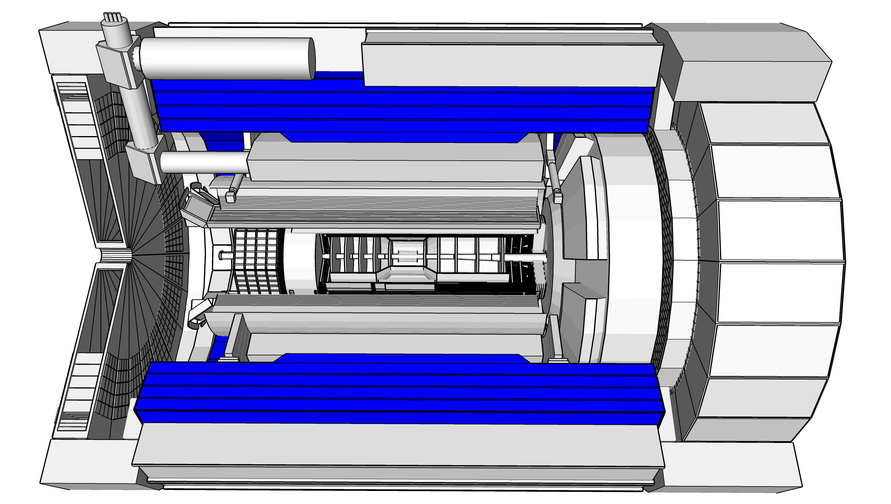
The Barrel Hadronic Calorimeter - BHCal
DSLs: S. Bathe (Baruch) & M. Sarsour (GSU)
Team: ANNL, Baruch, BNL, GSU, ISU, ORNL , UNH

Slide 2
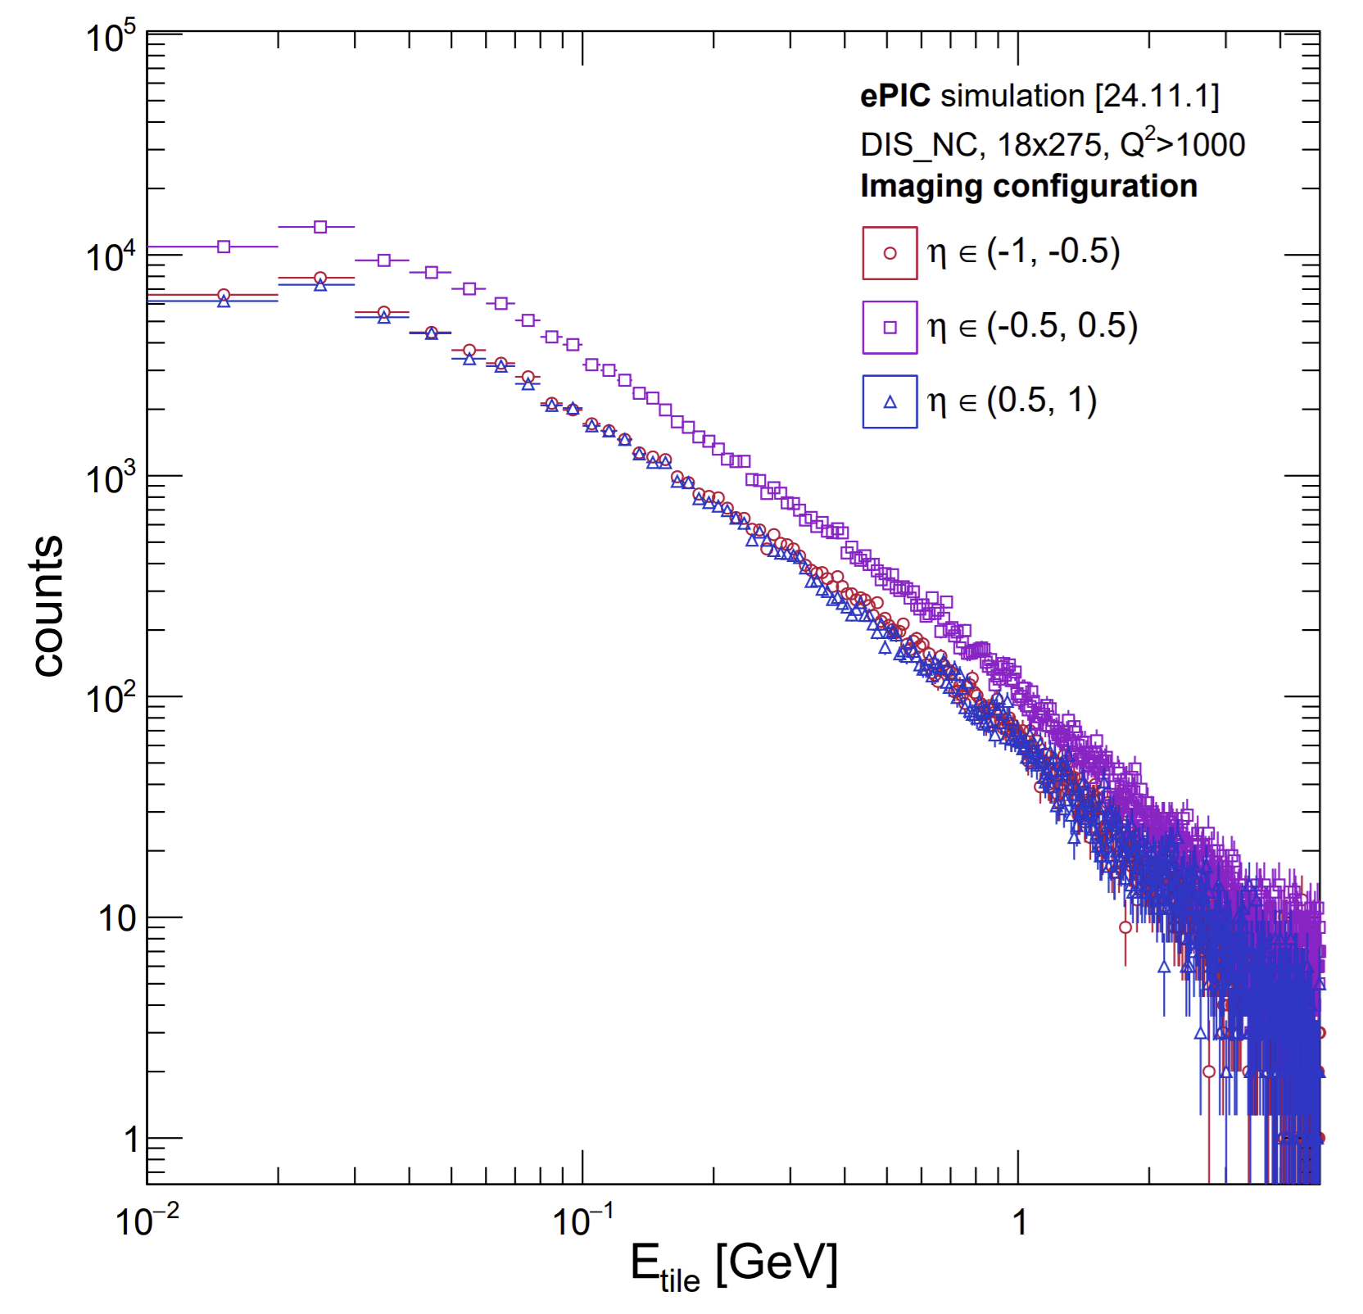
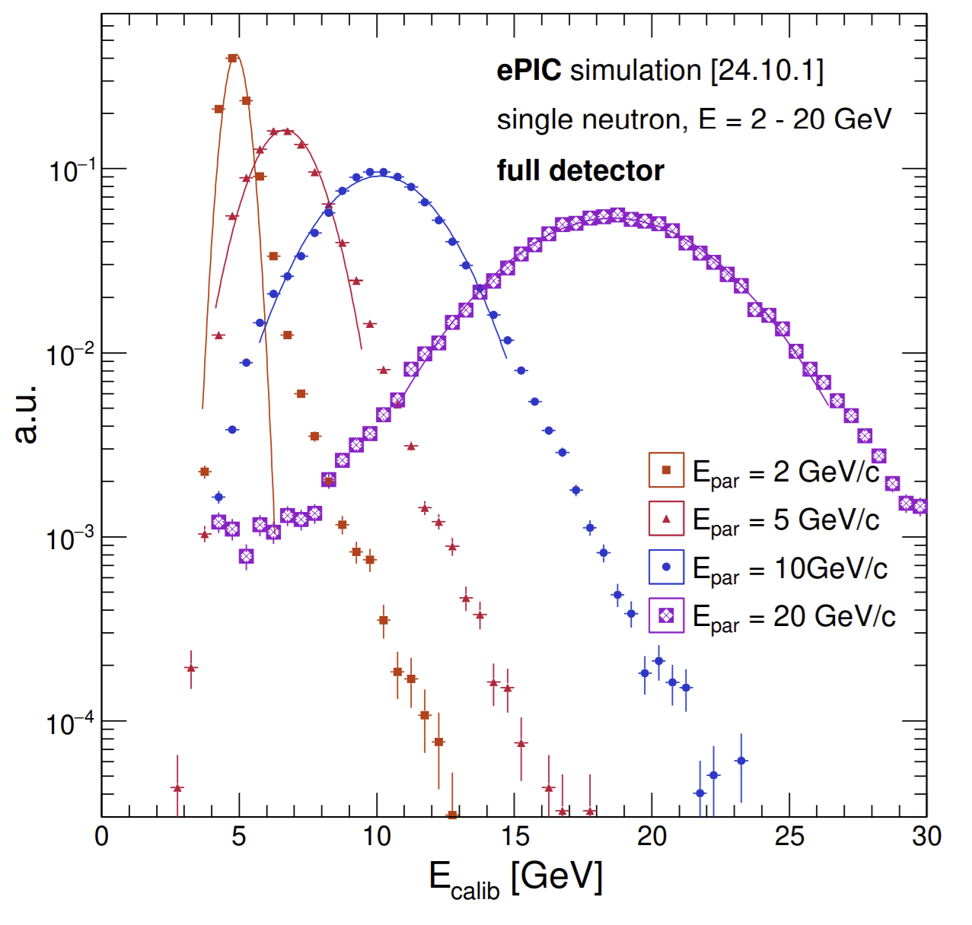
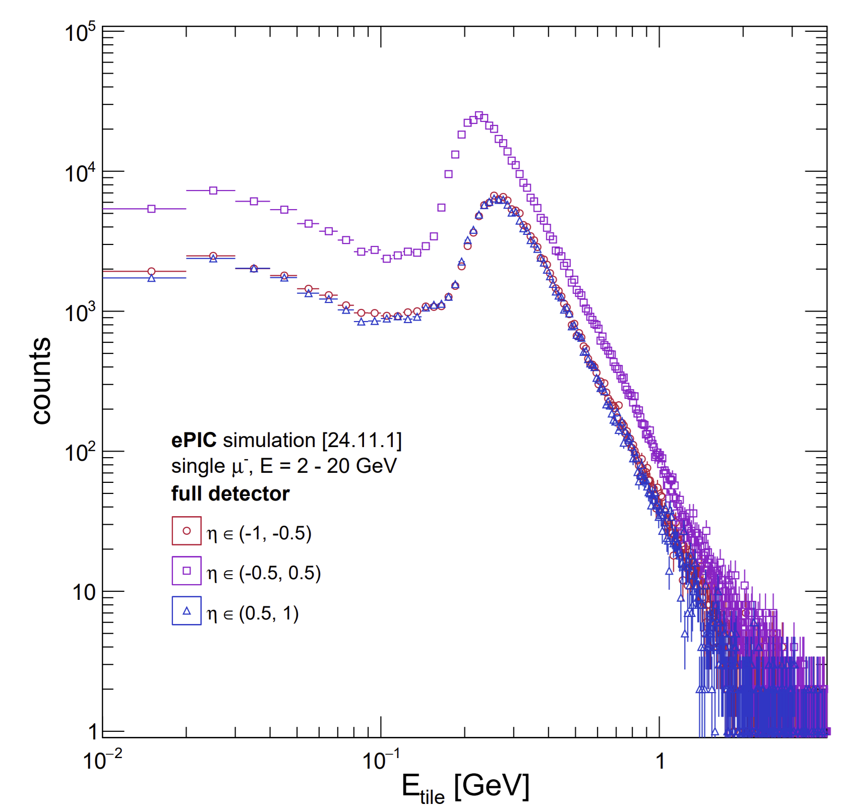
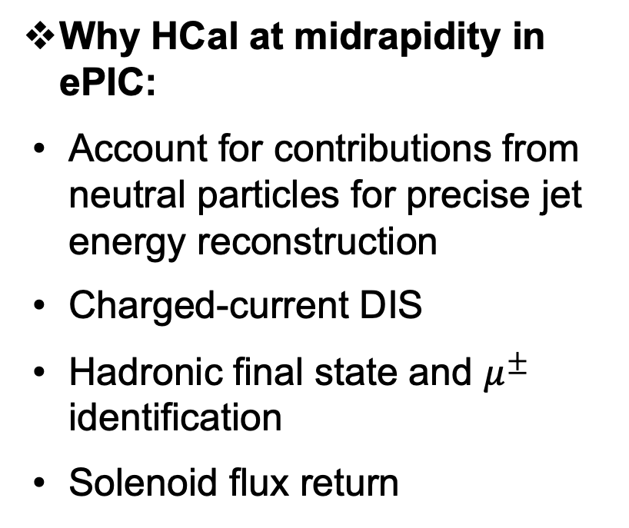
The Barrel Hadronic Calorimeter - BHCal
Why HCal at midrapidity in ePIC:
Account for contributions from neutral particles for precise jet energy reconstruction
Charged-current DIS
Hadronic final state and $μ^{±}$ identification
Solenoid flux return

Slide 3
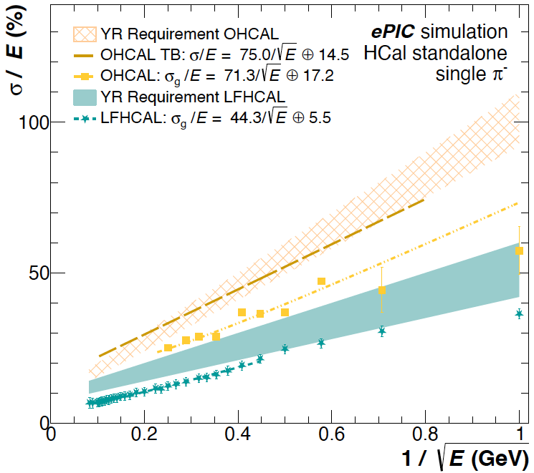
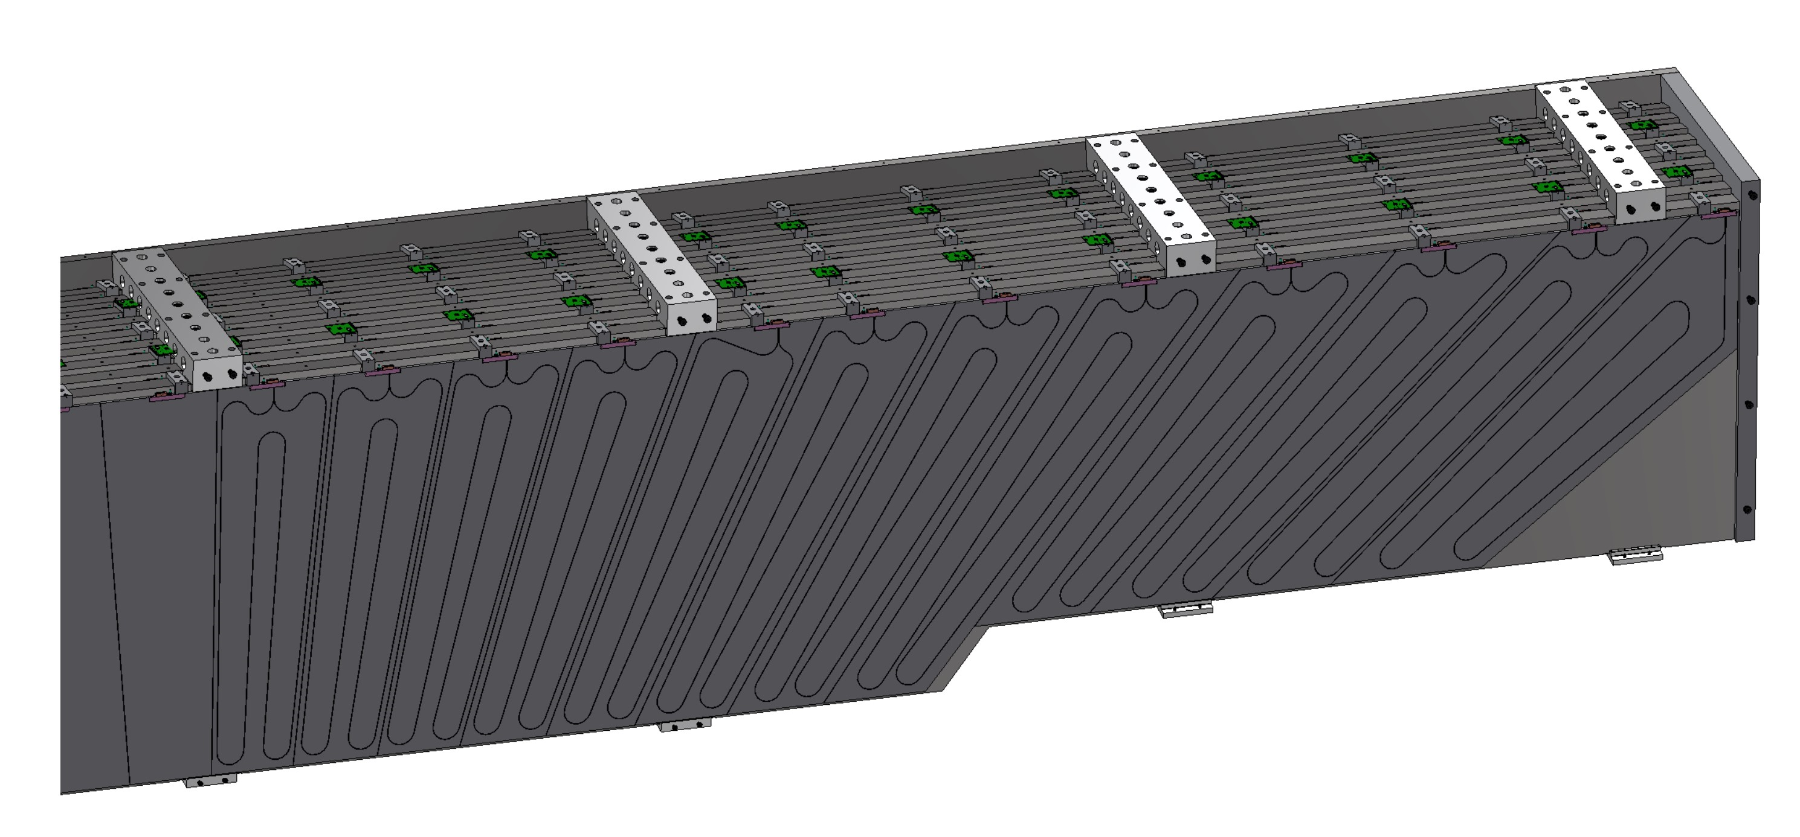
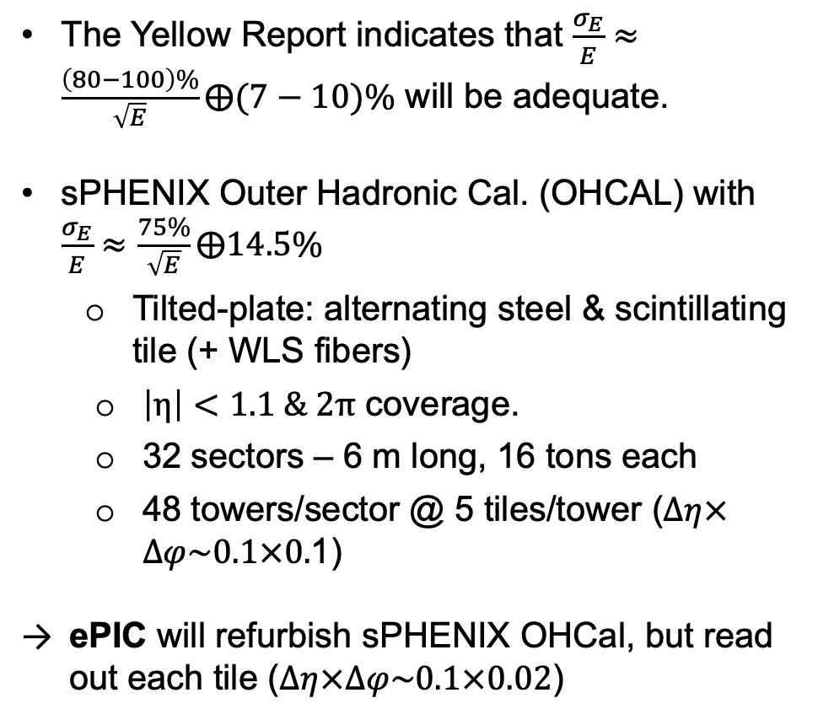
BHCal Requirements
The Yellow Report indicates that $\frac{σ_{E}}{E}≈\frac{\left(80−100\right)\%}{\sqrt{E}}⨁(7−10)\%$ will be adequate.
sPHENIX Outer Hadronic Cal. (OHCAL) with $\frac{σ_{E}}{E}≈\frac{75\%}{\sqrt{E}}⨁14.5\%$
Tilted-plate: alternating steel & scintillating tile (+ WLS fibers)
$\left|η\right|<1.1 \& 2π$ coverage.
32 sectors – 6 m long, 16 tons each
48 towers/sector @ 5 tiles/tower ($Δη×Δφ\sim 0.1×0.$1)
ePIC will refurbish sPHENIX OHCal, but read out each tile ($Δη×Δφ\sim 0.1×0.02$)
Half-sector

Slide 4
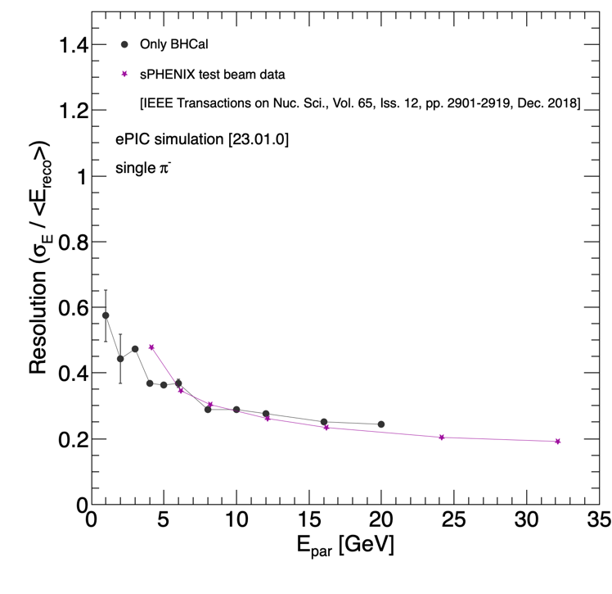
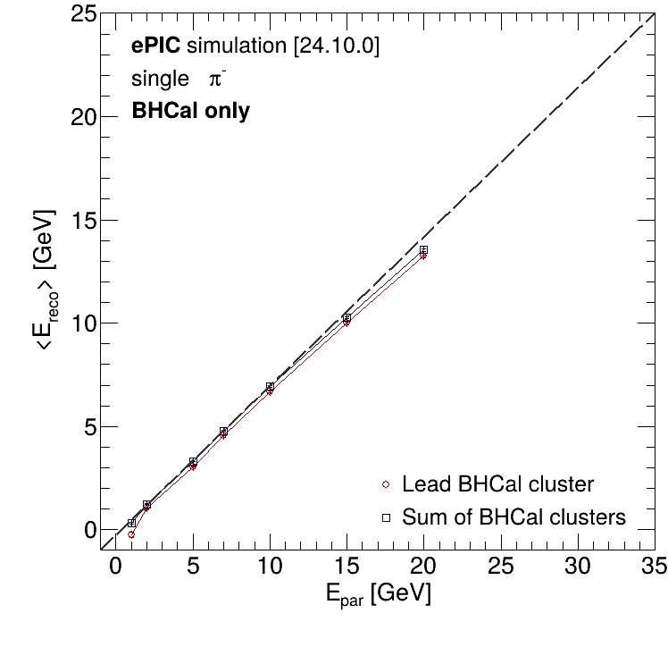
BHCal in ePIC Simulation Framework
BHCal implemented in DD4hep simulation of ePIC
Resolution&Linearity from ePIC simulation vs. sPHENIX test beam data (IEEE Transactions on Nuc. Sci., Vol. 65, 2901 – 2919 (2018))
By Derek Anderson (ISU)
The simulation results are done with towers.
Ongoing: include CAD geom. through GDML files + per-tile simulations (clustering, ... etc).

Slide 5
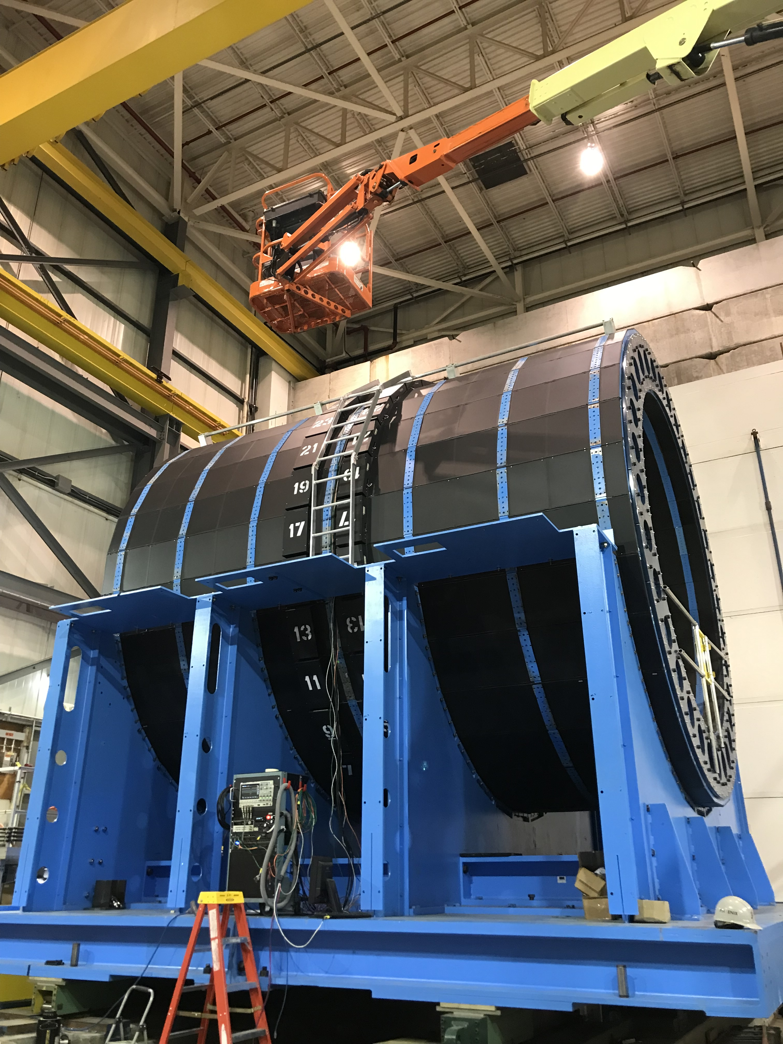
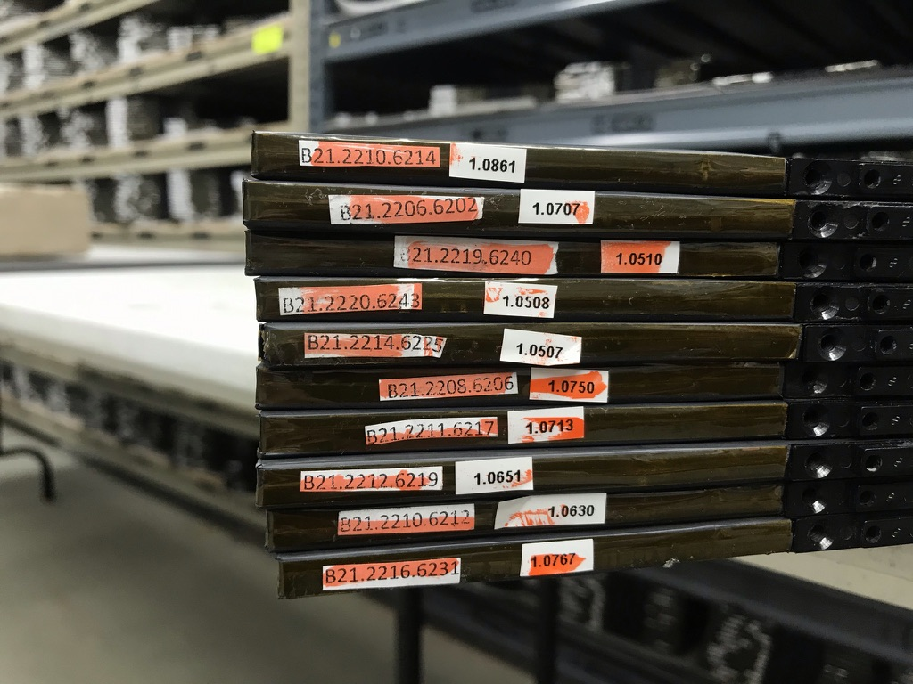
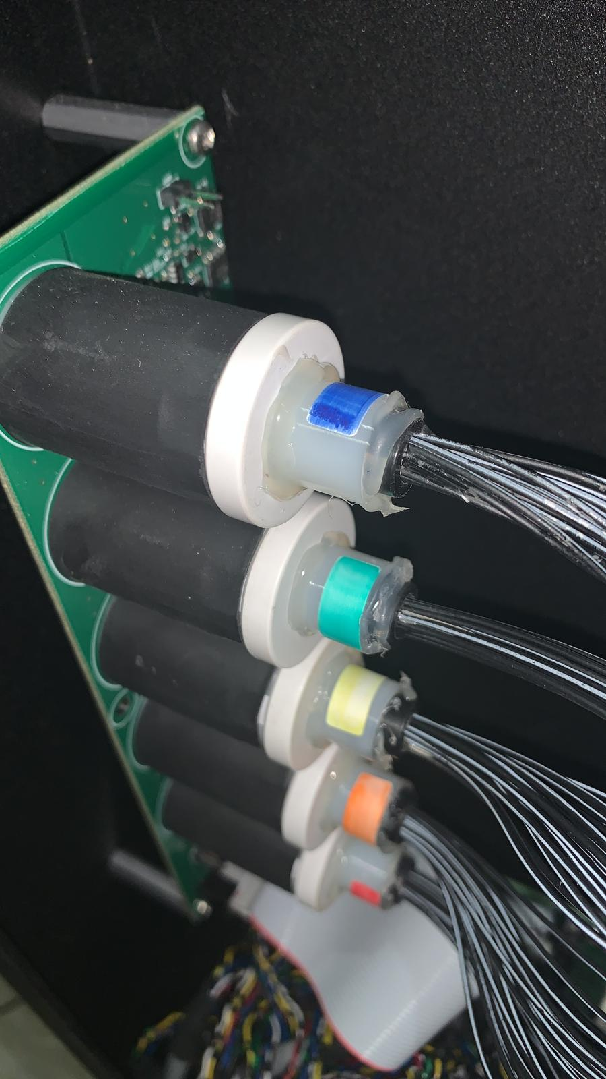
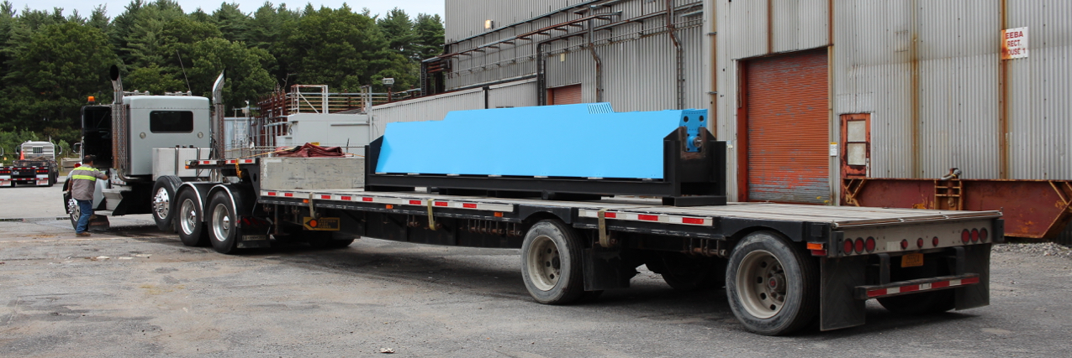
Refurbishing sPHENIX Barrel HCal
Parts to be reused
Steel sectors
Scintillating tiles
Have few spares (of order 8 per shape)
fiber system to distribute LED light
intended to be reused
LED system is being developed

Slide 6
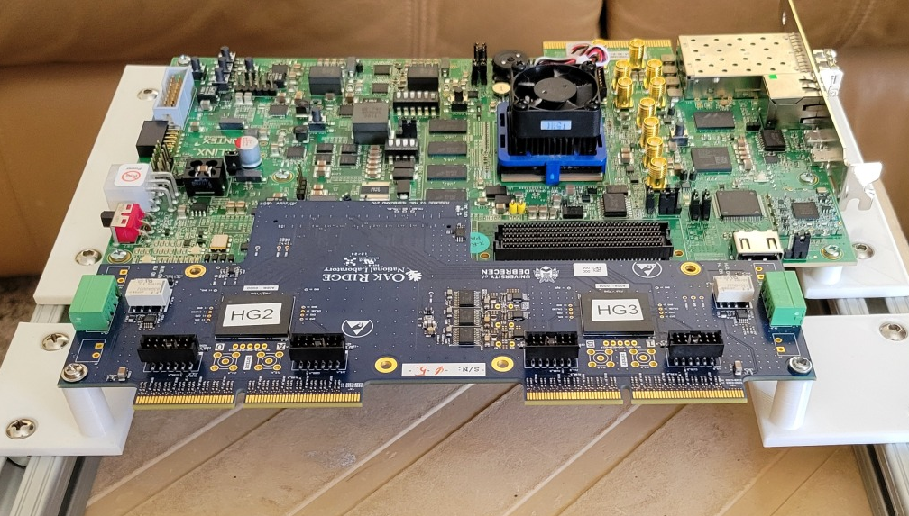
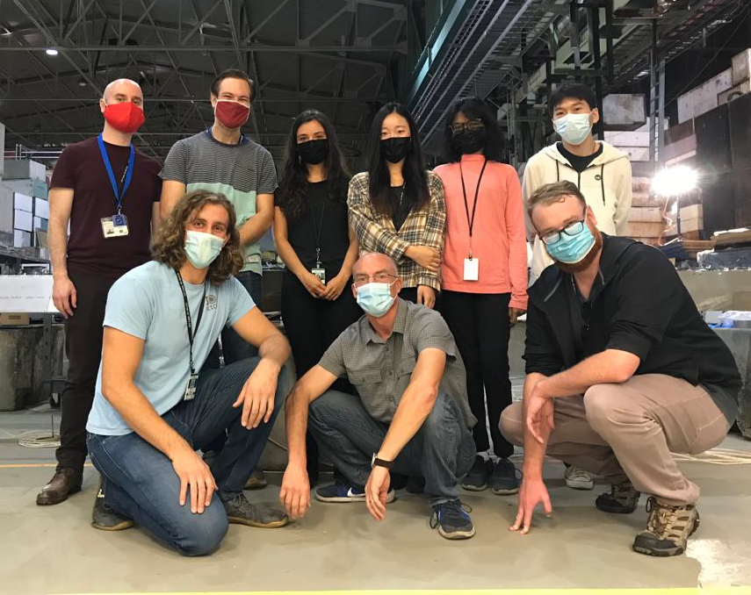
Refurbishing sPHENIX Barrel HCal
New parts
SiPMs
Read-out boards
Coax cables to read-out board
Bias & LV supplies
LED monitoring system
Labor
sPHENIX outer HCal assembly was 5-person-year effort, e.g. if done in a year, it needs 5 people working each day
Setting up the factory takes time:
Space lay-out
Set up of test racks
Establishing testing procedures
In sPHENIX, started this two years early

Slide 7
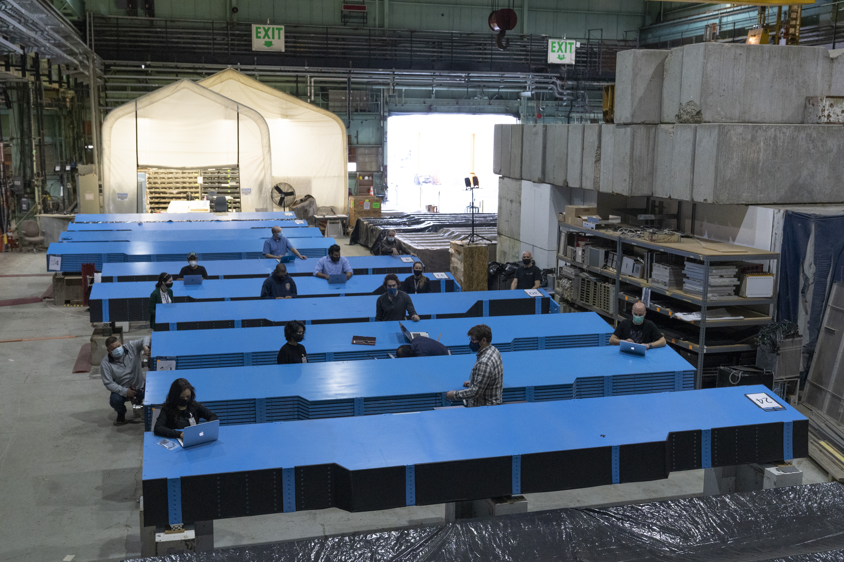
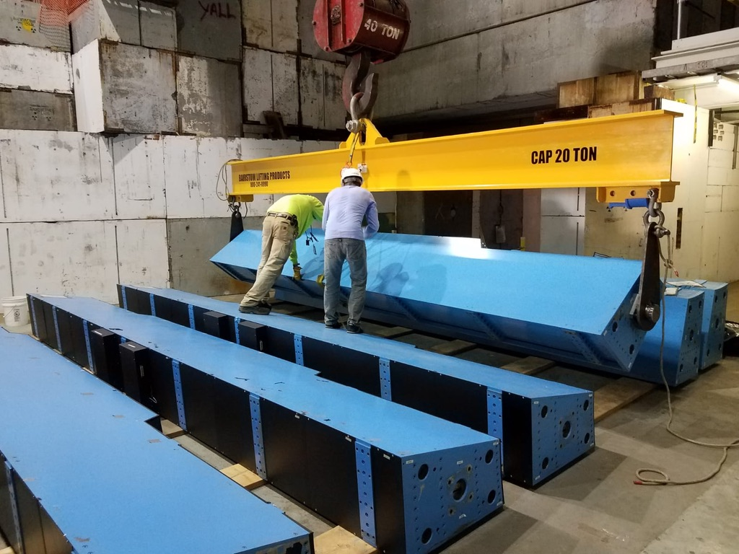
Lessons Learned
Have as many sectors set up for assembly simultaneously as possible
doubling the space used for sPHENIX in 912
Do most of the labor with students and postdocs
Some 50 people worked in the sPHENIX HCal factory
Dedicated technician support essential (electrical/mechanical work)
Heavy need for rigging

Slide 8
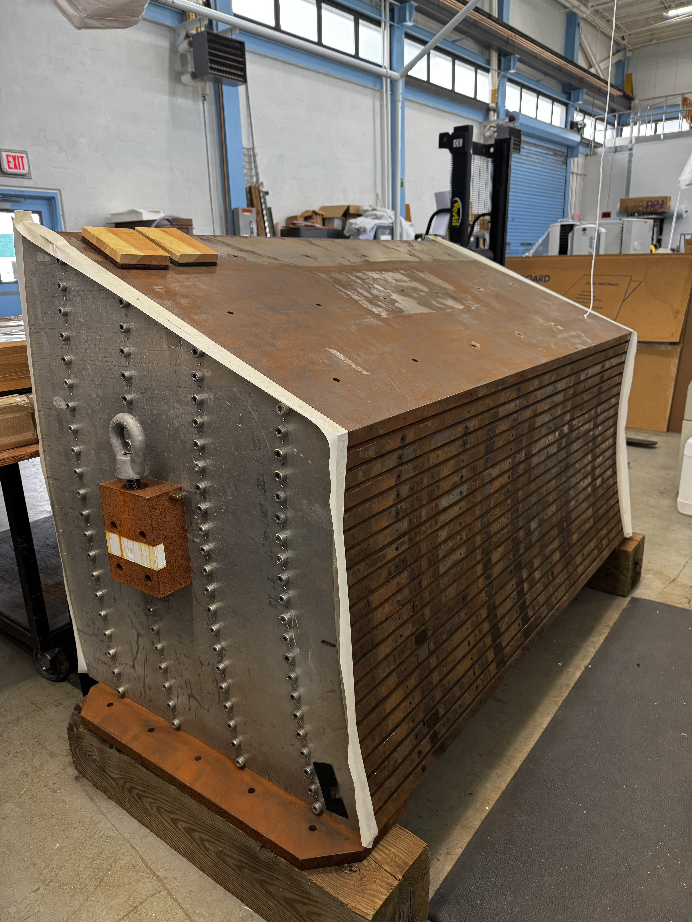
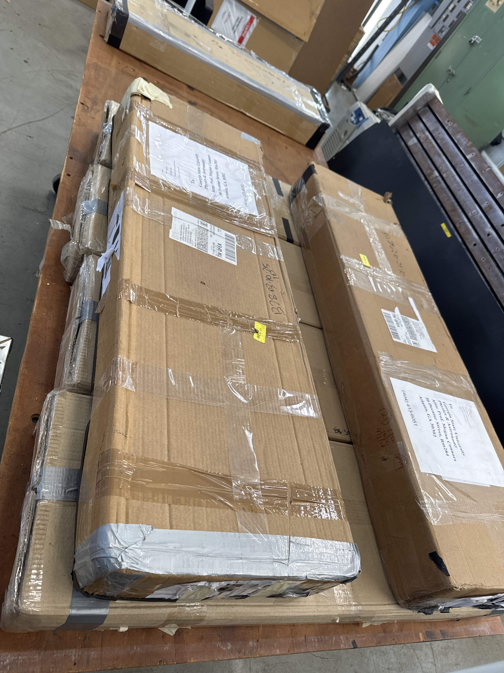
Beam Test
Desired to characterize all components and calibrate simulations
Plan
Refurbish sPHENIX old prototype steel
80 spare tiles
120 new ePIC SiPMs
H2GCROCv3 board from Norbert Novitzky (ORNL)

Slide 9
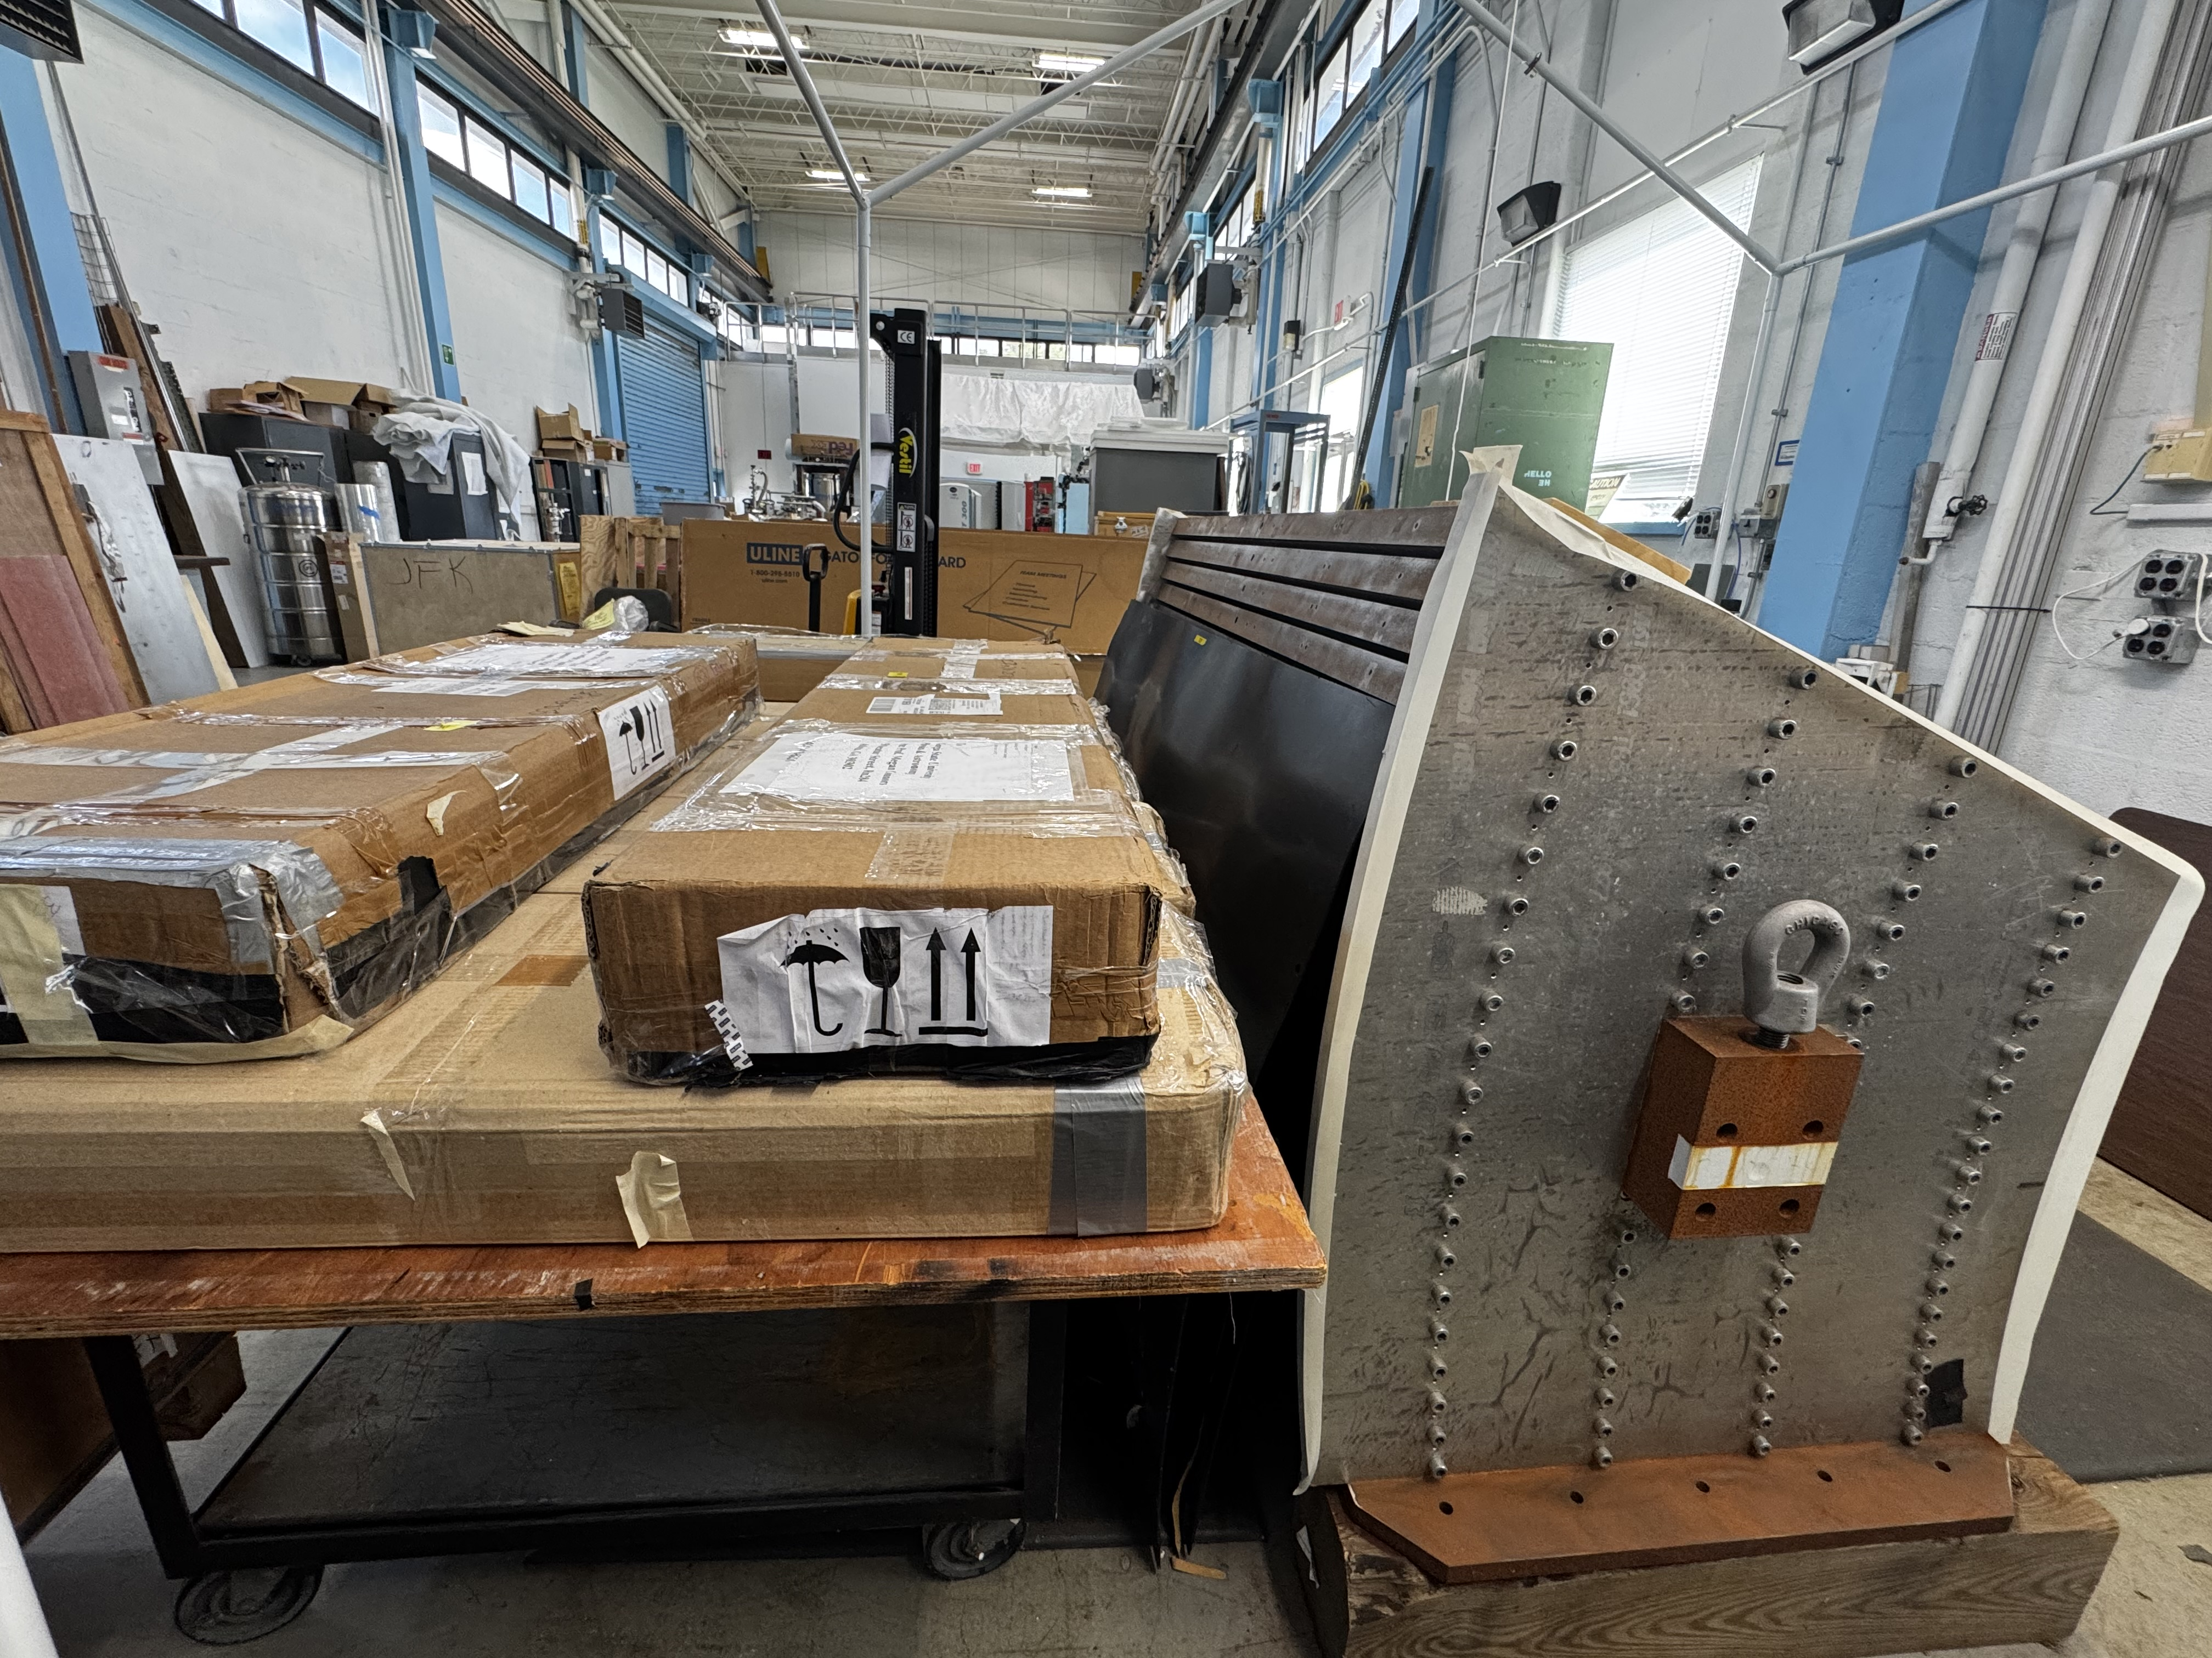
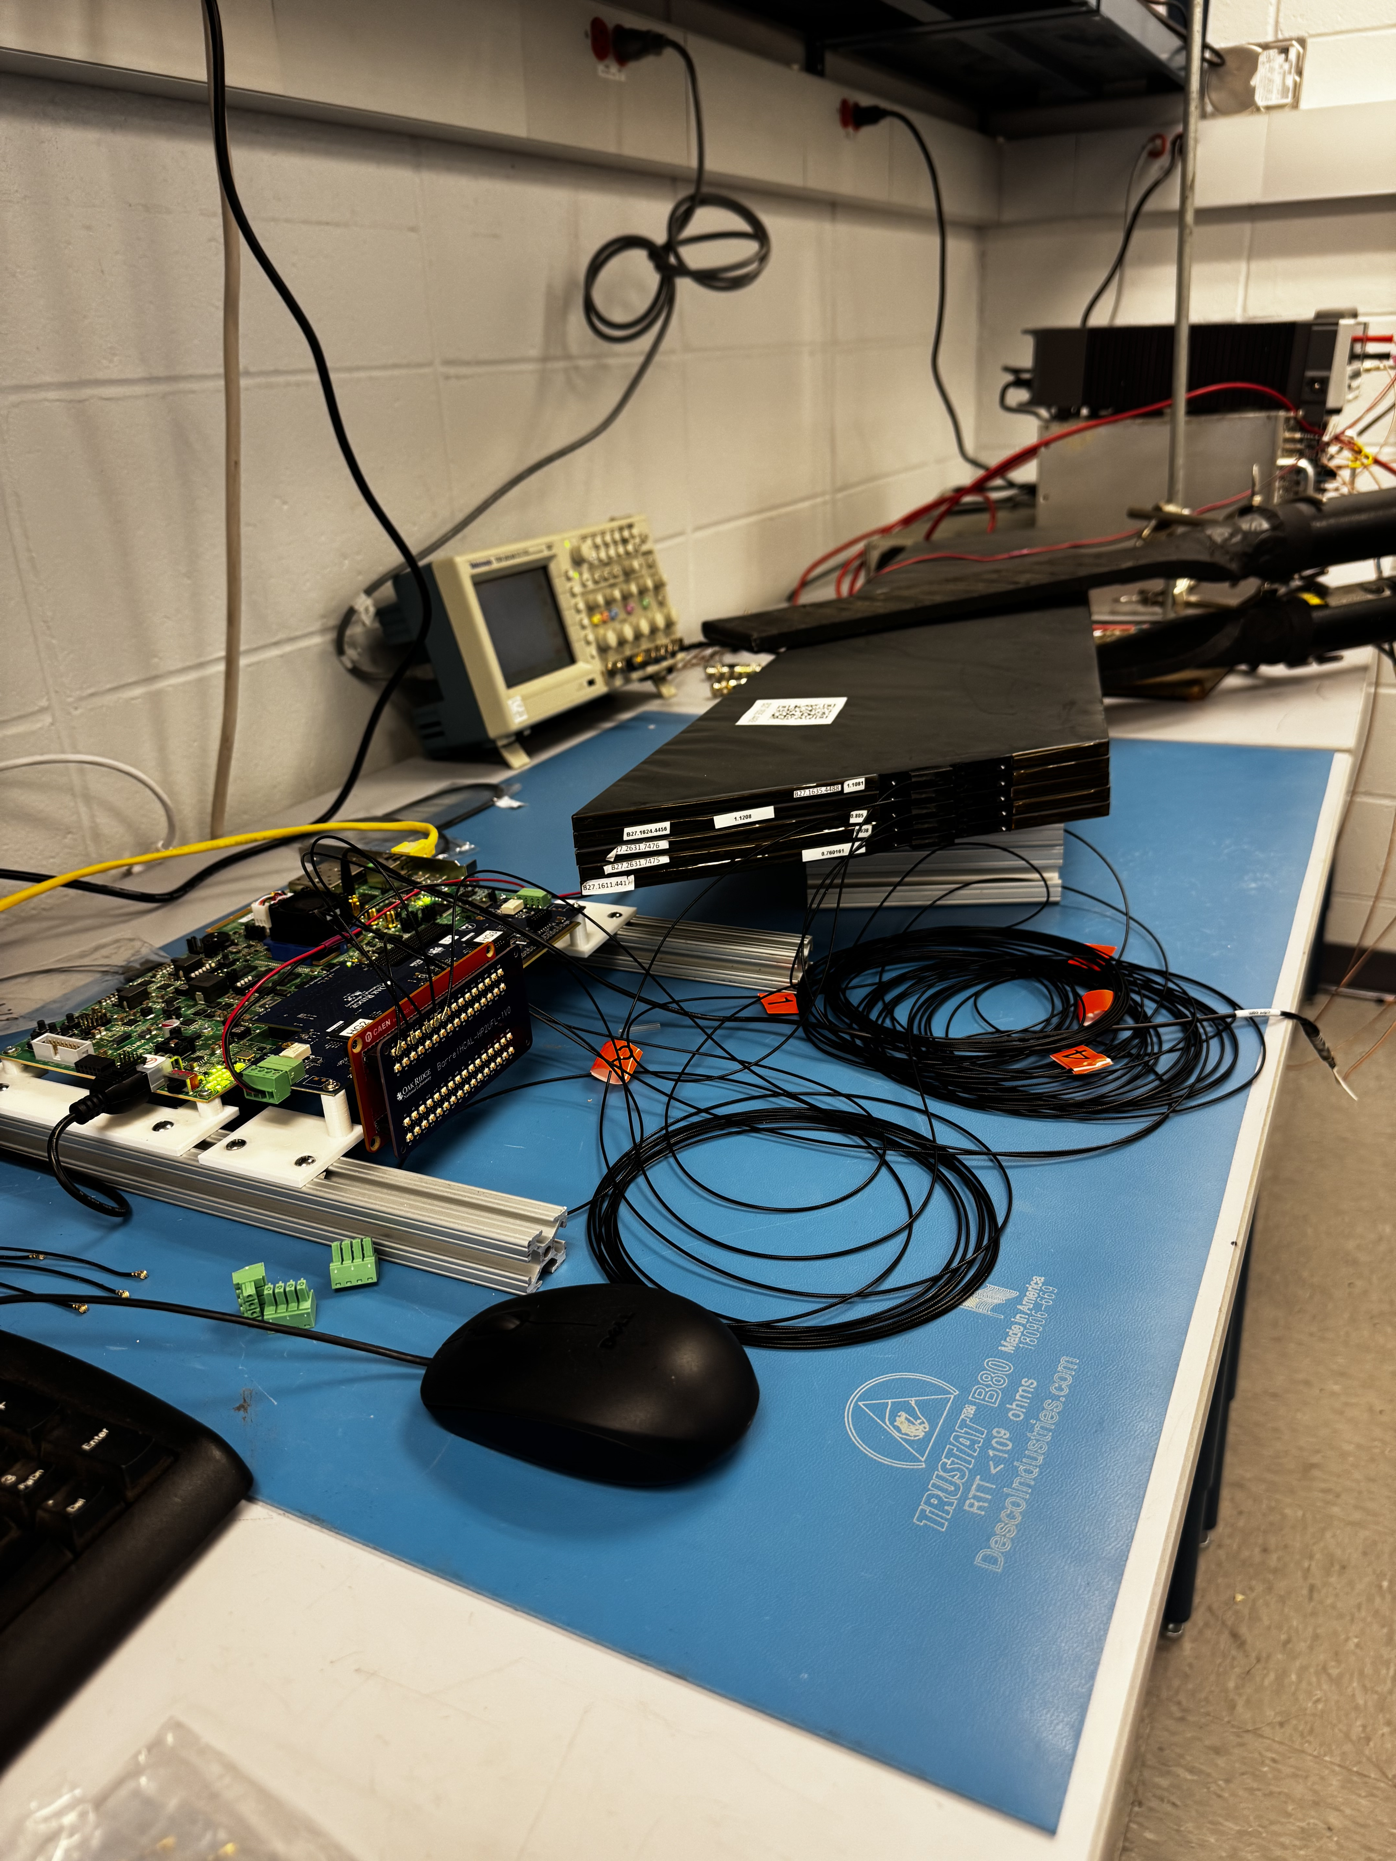
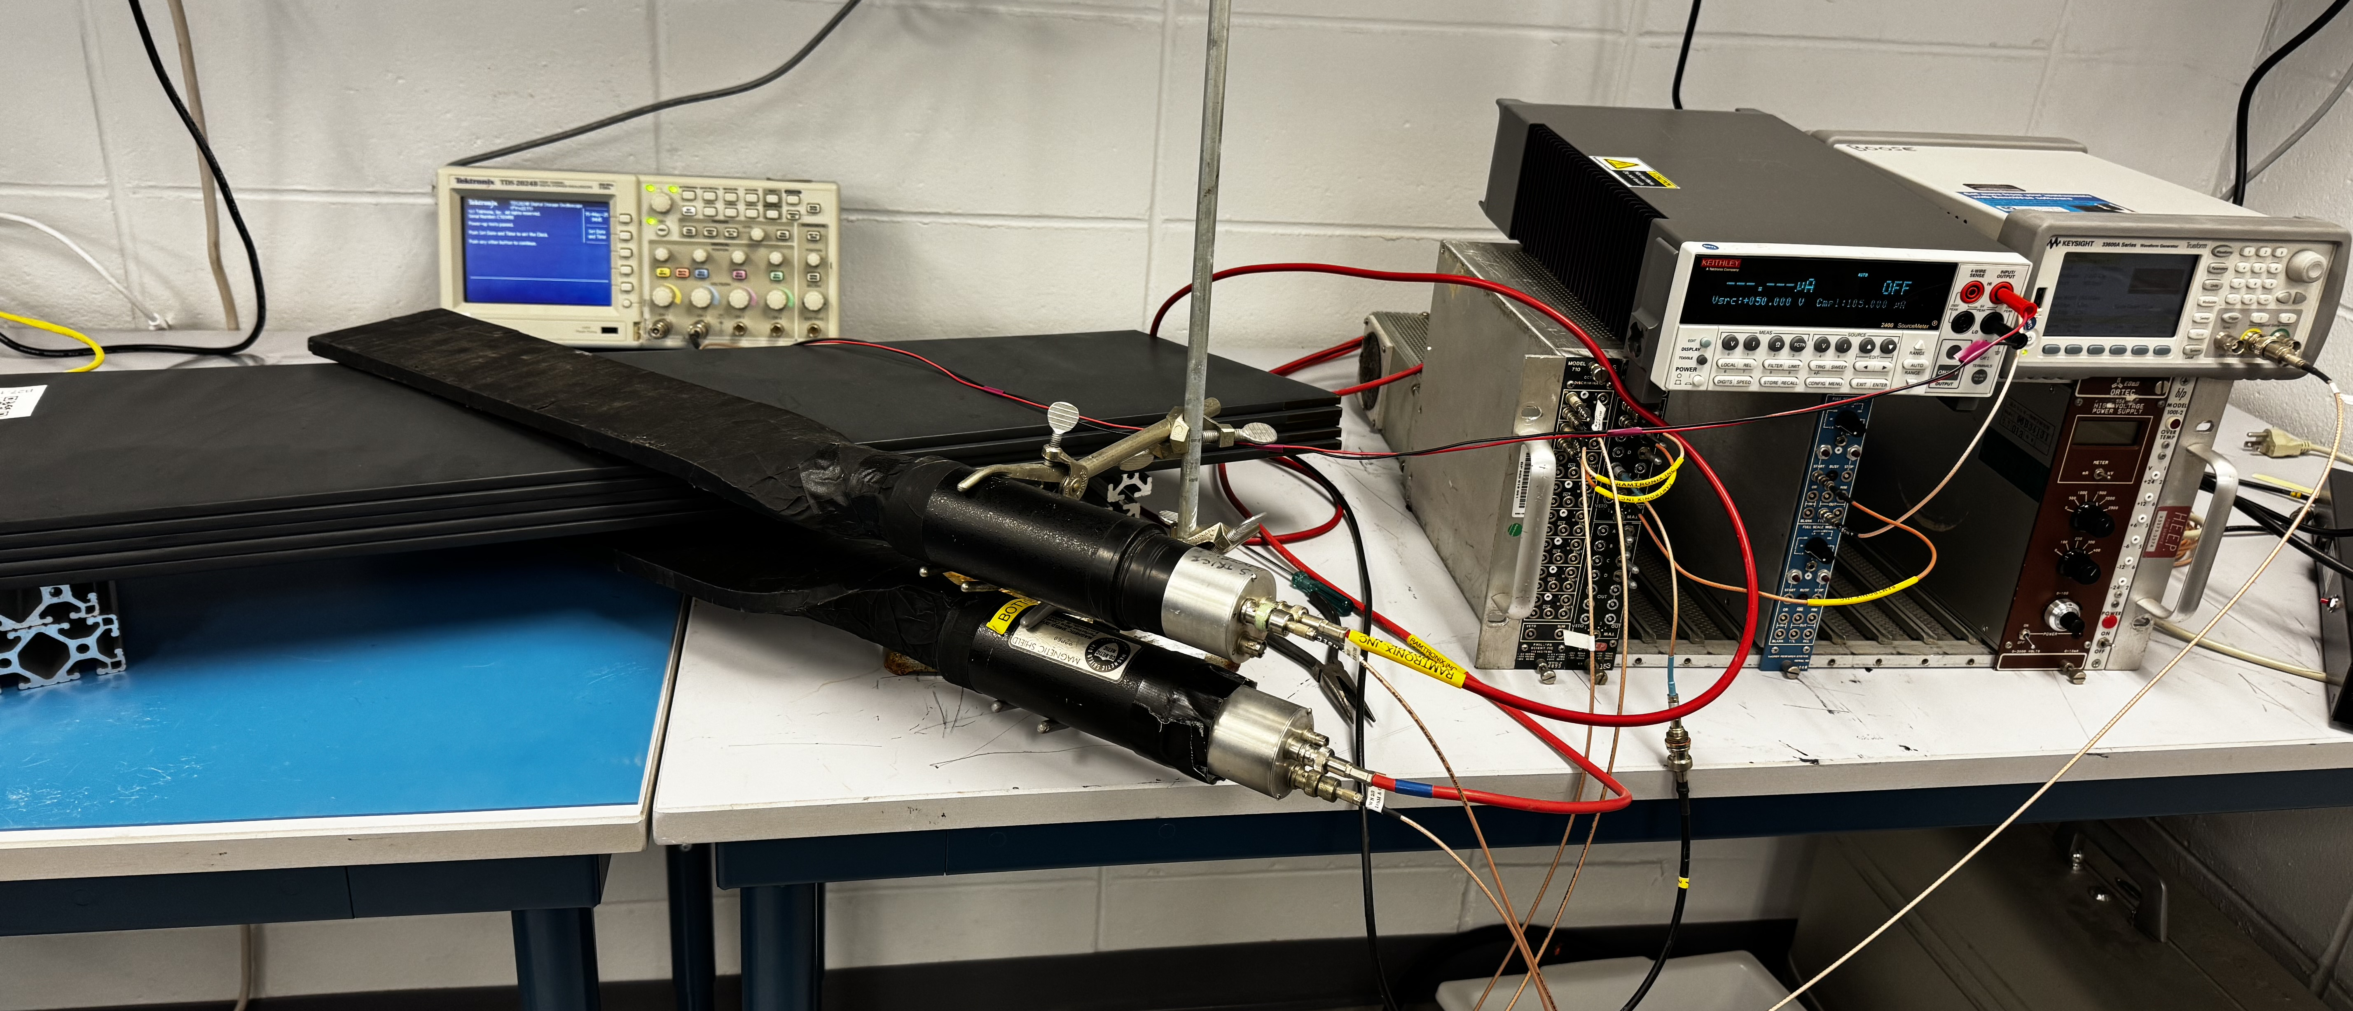
Beam Test
What do we have?
Test-stand in the HCal Lab at BNL (5 OHCal tiles read individually with H2GCROCv3 board with RCDAQ.)
Similar test stands are planned at UNH and GSU to gain hands-on experience with the readout system and DAQ.
Where?
FermiLab (pending schedule)
CERN

Slide 10
Summary
Reuse sPHENIX BHCAL
Generally satisfies Yellow-Report energy resolution requirements and plan to read single tiles to improve constat term
Performance already measured in a test beam as well as in sPHENIX
Plan for BHCal test beam
Reading single tiles with the new H2GCROC based electronics chain
Have all components and plan to put it together over the summer
It is critical to have time to refurbish the Barrel HCal for the reuse at ePIC. The refurbishment is estimated to take 1.5 years with one team redoing the work done constructing the HCal.

Slide 11
Backup Slides

Slide 12
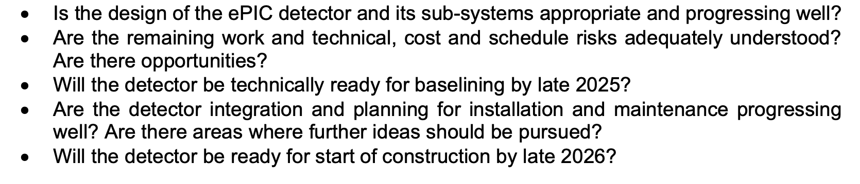
Charge Questions Addressed

Slide 13
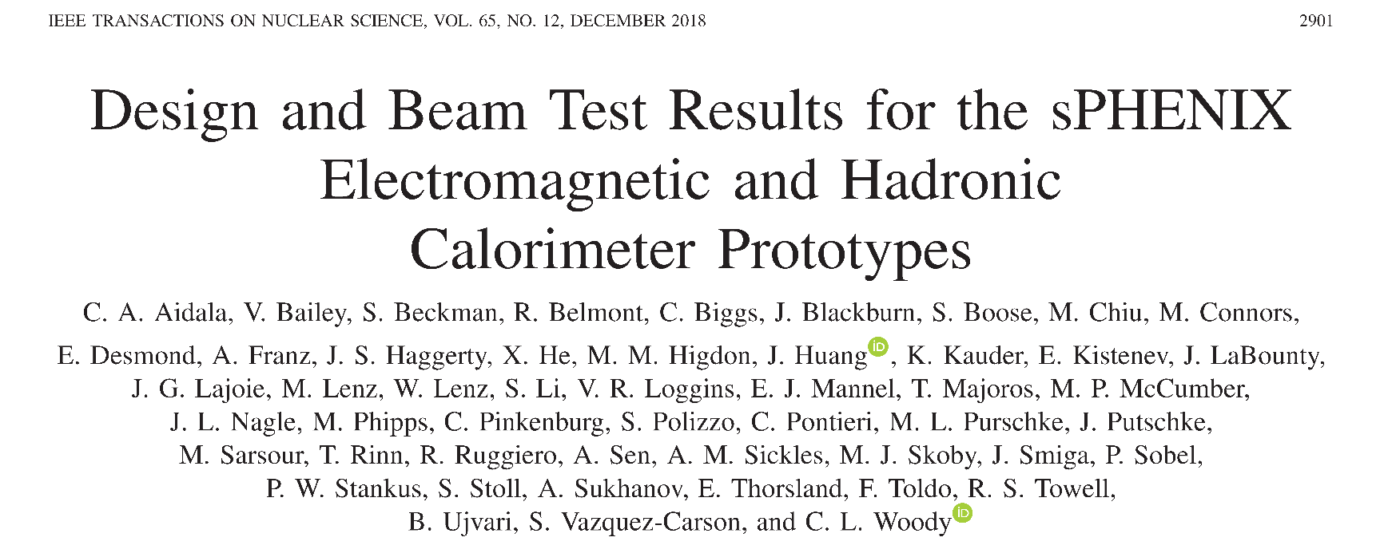
Prior Test Beam Results
Detailed studies of performance and comparison with simulations done in test beam (T-1044).
Performance of full device will be measured in sPHENIX. We should achieve a reduced constant term due to tighter control on the scintillator variation in a tower for production sectors.
Data vs. Monte-Carlo comparison

Slide 14
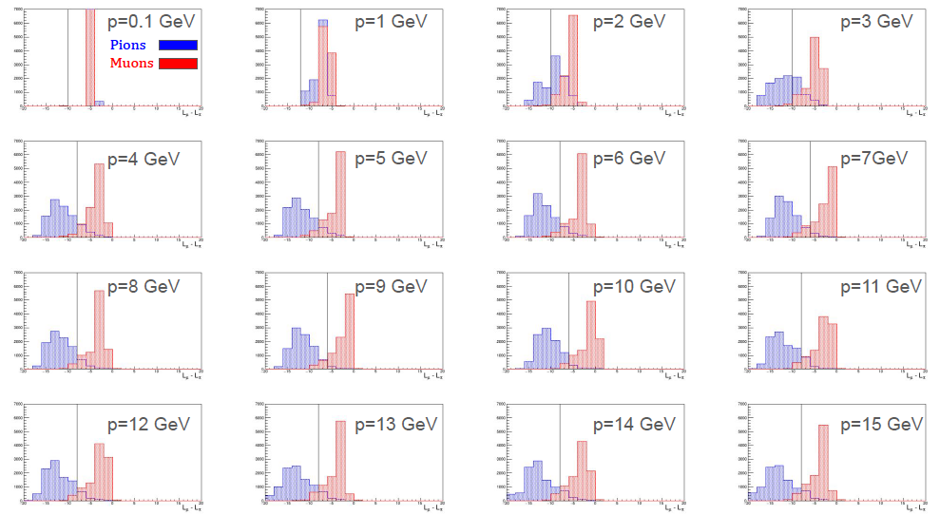
Initial studies: Log Likelihood Difference Using Barrel HCal E/p and Shower Radius

