Slide 1

nHCal (backward hadronic calorimeter)
C. Riedl (UIUC), DSTC
L. Kosarzewski (OSU), DSL
D. Brandenburg (OSU)
10th EIC DAC Review
June 11th – 13th, 2025

Slide 2
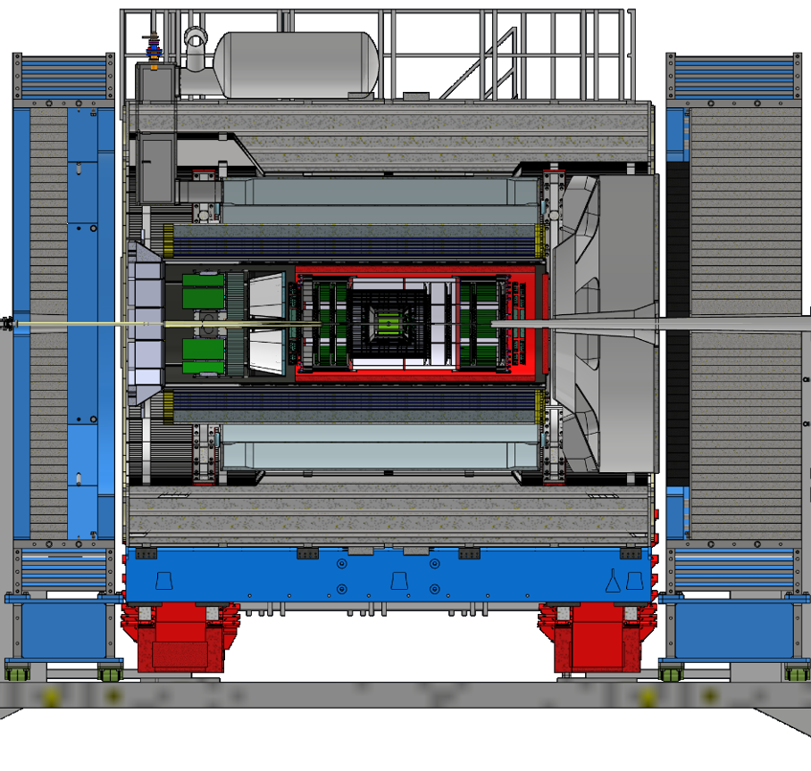
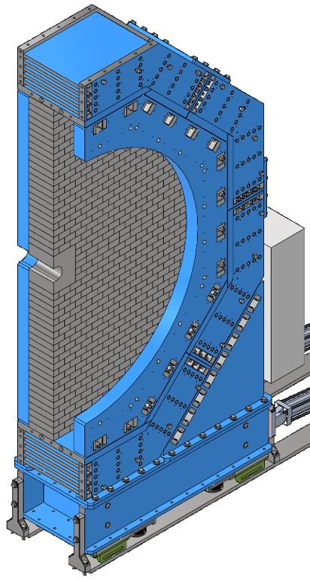

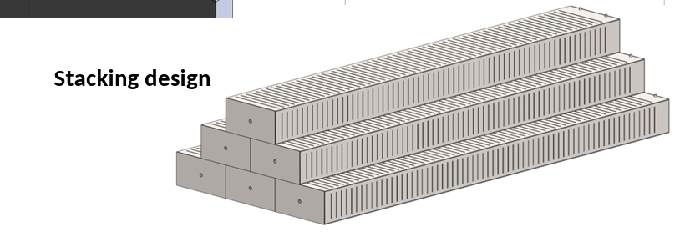
Backward (electron-going) hadronic calorimeter - nHCal
Tail catcher calorimeter with sampling approach, alternating Fe / SciTiles layers
p/A
e
nHCal
LFHCal
-387cm
  Synergies with LFHCal (choice of technology)
  Interaction lengths: 2.4 (LFHCal: 6)
  Default length = 45cm,
  up to ~70cm available
  Default design:
45cm
8M
4M
10 layers of each
4 cm steel +
4 mm scintillator
45cm
10cm
10cm
1
tile
−4.14 < η < −1.18
  Similar to LFHCal design
The nHCal is surrounded by an outer collar, backed by a flux return plate and has an oculus ring placed in front.
Use non-magnetic steel as absorber since the nHCal is decoupled from the flux return
transverse tile size,
number of layers, scintillator & absorber thickness

Slide 3
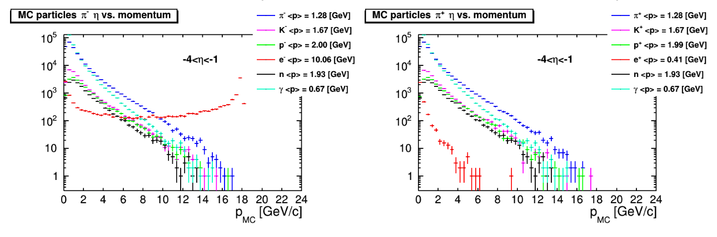
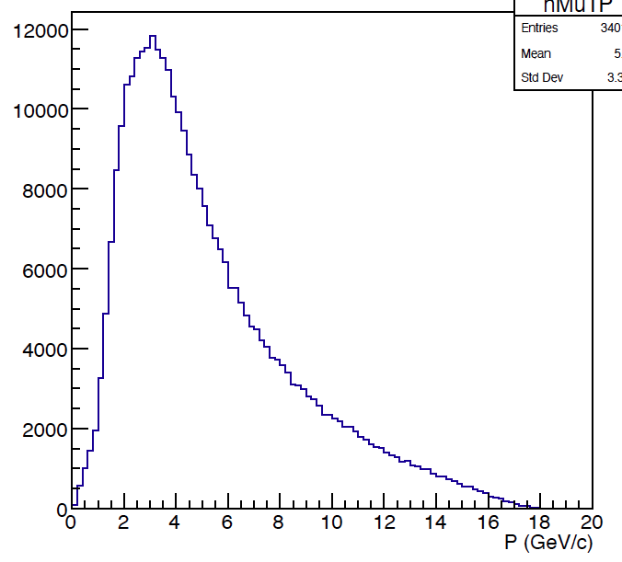
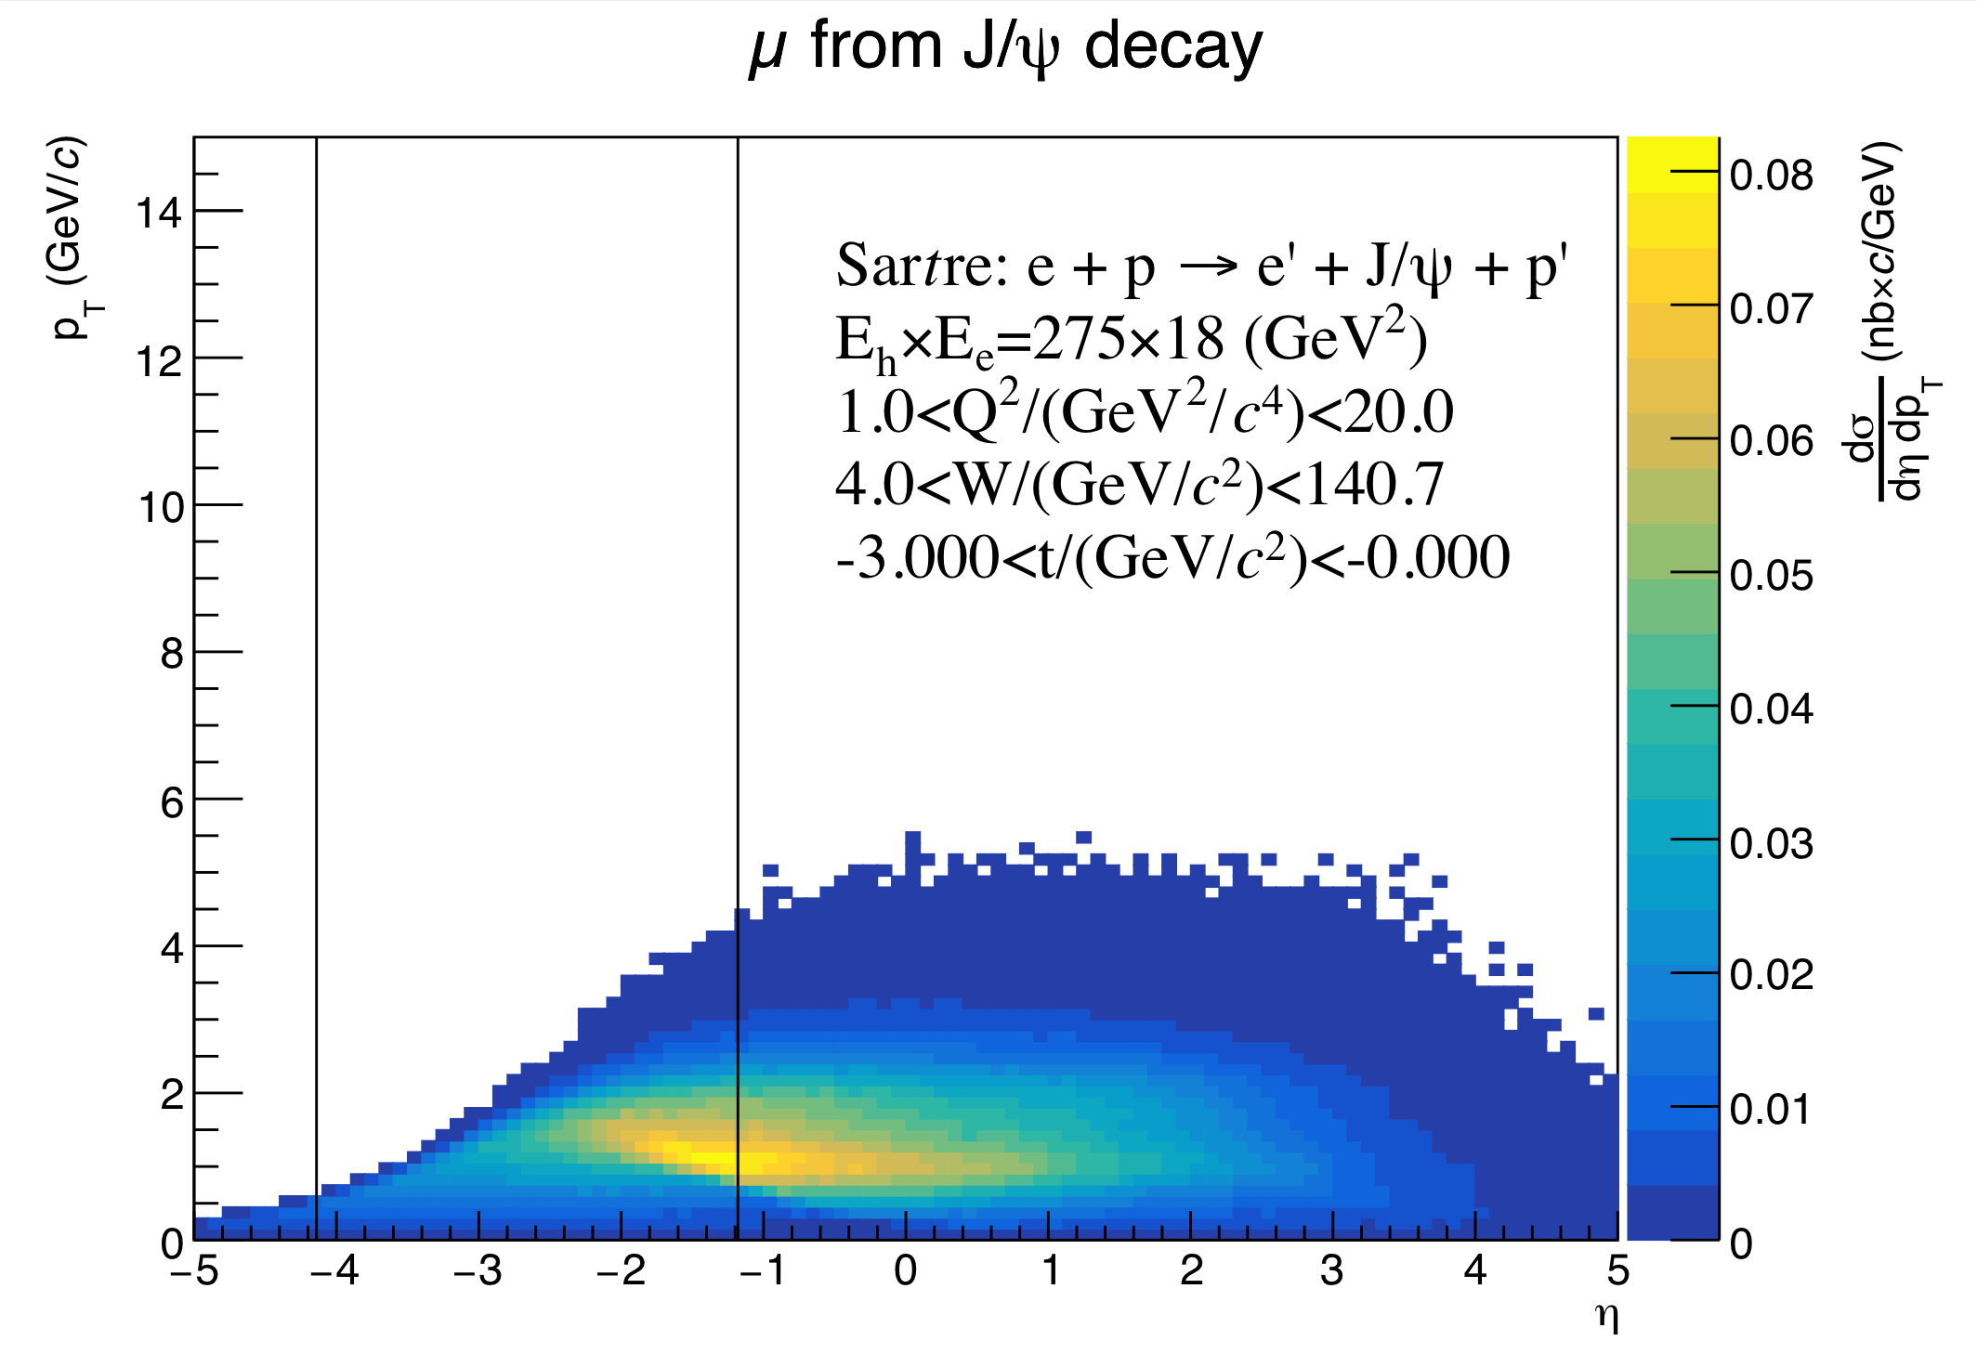
Main purpose of nHCal
Tail catcher calorimeter in the backward (electron-going) direction
Important for low-x and -Q2, high-y (high gluon densities) - core aspects of EIC physics mission
  Diffraction, neutral and charged jets
  Neutron detection and muon ID
Lessons from HERA / H1 backward SPACAL
neutrons and negatively charged particles
-4<η<-1
neutrons in the nHCal:
<p>=1.9 GeV/c <E>=2.2 GeV
DIS ep 18x275
pythia
Q² > 1 GeV²
muons from diffractive J/𝜓 decay
muons in the nHCal:
<p>=5.3 GeV/c <E>=5.3 GeV
-4<η<-1
NIMA 386 (1997), 397-408
PLB 665 (2008), 139-146
<p>=XXX GeV/c <E>=XXX GeV
neutrons and positively charged particles

Slide 4

nHCal design optimization via simulations - overview
Physics impact ➡︎ Design parameter⬇︎ | σE/E | Eff | μ/π sep. | λint
Gross length | x | x
Tile configuration | x | x
Z-layer readout | x |  | x
Sampling fraction, absorber/scintillator ratio |  |  |  | x
Absorber material | x |  |  | x
Is the design of the ePIC detector and its sub-systems appropriate and progressing well?
Design optimization
Variations from default: transverse tile size,
number of layers, scintillator & absorber thickness
Dedicated simulations
  “Single particle” - in progress
  Then full simulations with background
5x5 or 10x10 | scintillator thickness | 0.4 |  |  |  | 0.6 | 0.8
[cm] | absorber thickness | 4 | 3 | 2 | 1.52 | 2 | 4
10 layers |  | 45
12 layers |  | 54
13 layers |  |  | 46
15 layers |  | 68
20 layers |  |  |  | 50 |  | 54 | 58
28 layers |  |  |  |  | 57
gross length
nHCal default design (10x10)
LFHCal configuration (5x5)
OSU, CTU, UIUC

Slide 5
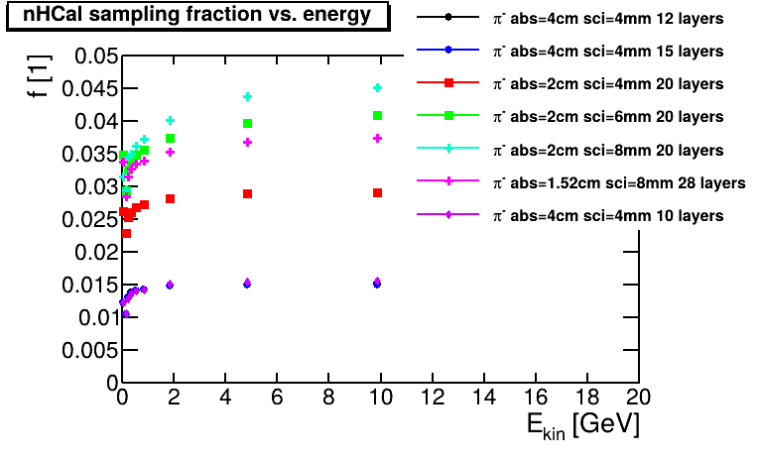
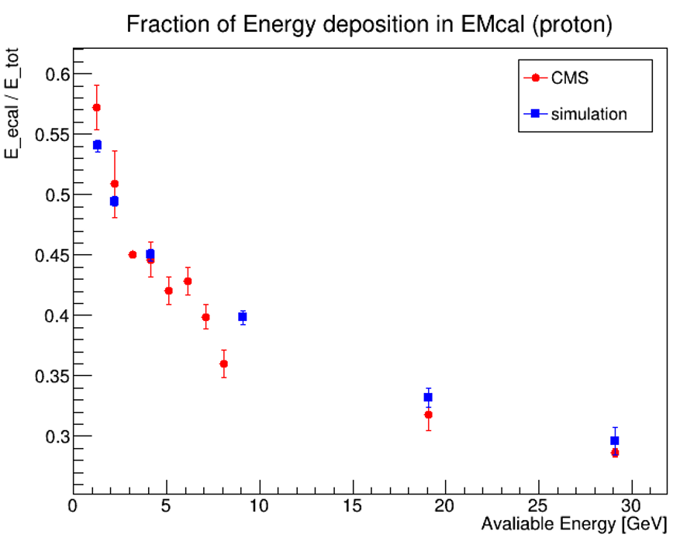
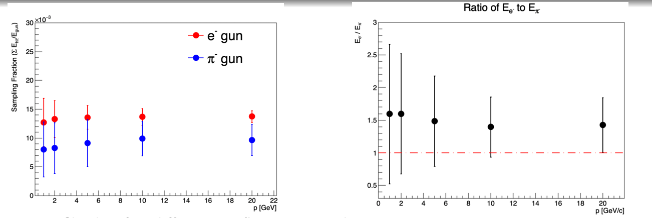
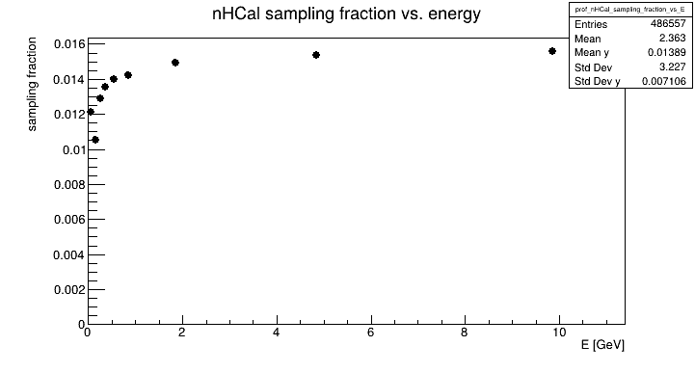
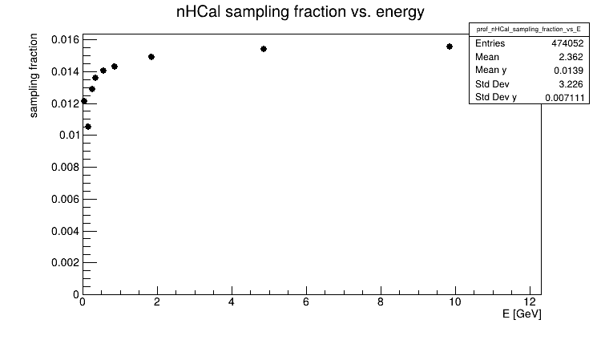
Sampling fractions
Sampling fraction = energy deposit in
absorber / incident energy
  ~ 1-1.5% for default design
  (10x10, 10 layers, 4cm absorber, 4mm scintillator)
  ~ 3-4.5% for more layers and/or thicker scintillator
  Not dependent on particle species (n or π⁻)
  - reflects how much of a particle shower can be sampled
  Not dependent on tile size (10x10 or 5x5)
  Design optimization driven by other parameters,
  in particular efficiency
  Reminder - nHCal is a tail catcher
Also validated understanding and simulation uncertainty of the material budget upstream of nHCal
Leszek Kosarzewski (OSU)
Tianhao Jin (OSU)
CMS EMCal + HCal beamtest https://cds.cern.ch/record/1046333
  Study this in conjunction with energy resolution / scale (Elke mentioned DeltaE not important for this calo)

Slide 6
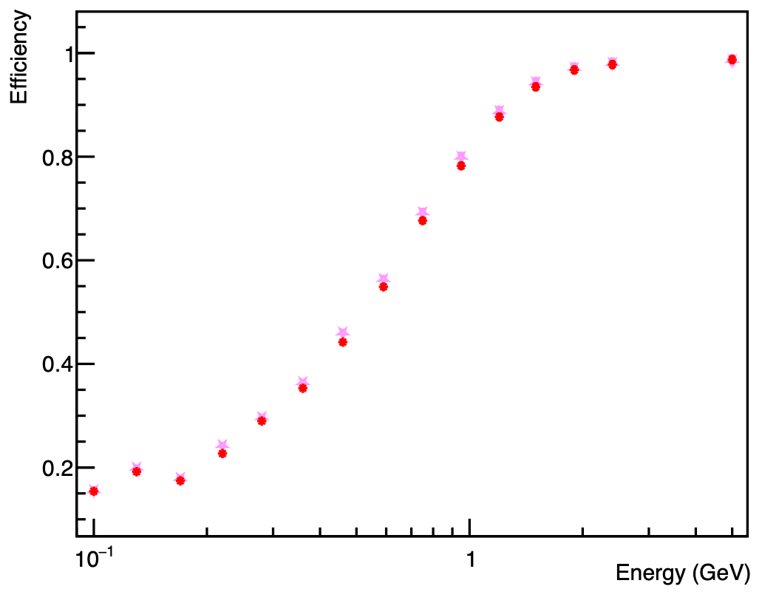
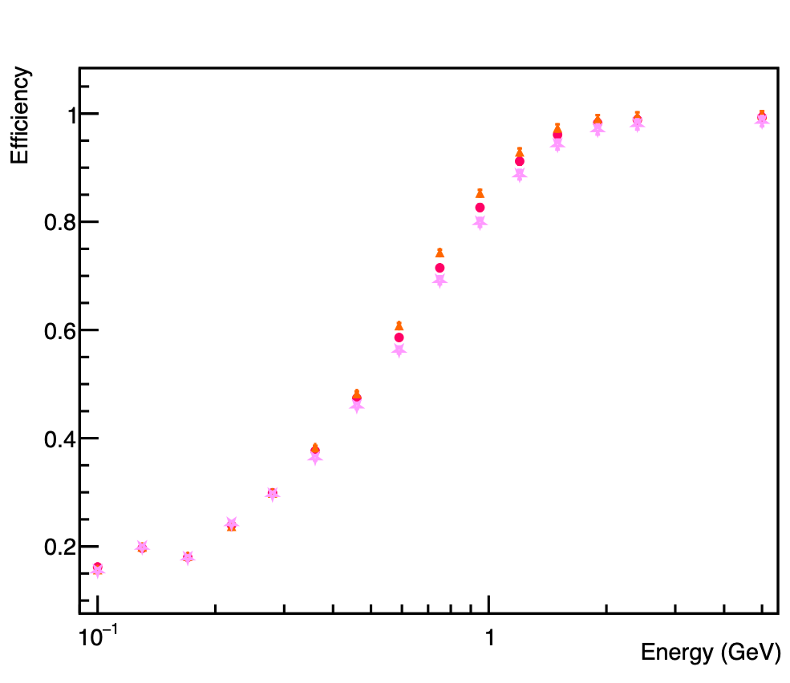
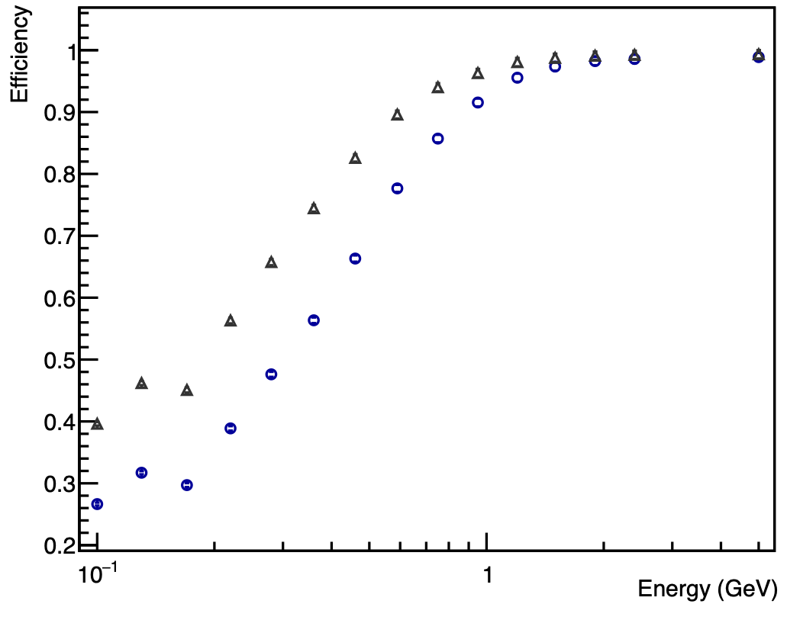
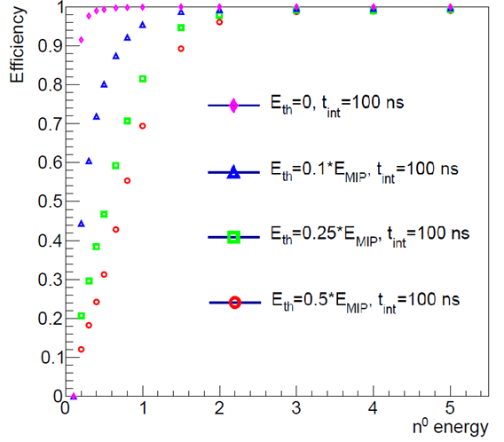
Efficiency for neutrons
Neutron efficiency for different nHCal geometries
  Tile size has small impact
  All scenarios fit into the available depth
Efficiency increases with
  Number of layers (⇒ length of calorimeter):
  10 → 15 layers increases efficiency by about 5% for 1 GeV neutrons
  Scintillator / absorber ratio:
  scintillator 4mm → 8mm increases efficiency by nearly 20% for 0.5 GeV neutrons
  10cm x 10cm (45cm)
  5cm x 5cm (45cm)
  10 layers (45cm)
  Default design with different tile sizes
  10 layers, 4cm absorber, 4mm scintillator
  12 layers (54cm)
  15 layers (68cm)
  Default design with different number of layers
  10cm x 10cm, 4cm absorber, 4mm scintillator
  Vary scintillator thickness 10cm x 10cm, 2cm absorber, 20 layers
Sam Corey (OSU)
  △ 8mm scintillator (58cm)
  ❍ 4mm scintillator (50cm)
XXX change 1 at a time
highest = lfhcal - 57
middle: 2cm, 4mm - 50
XXX Sam is working on similar plots - instead of different thresholds (part of pre-TDR work), will have different geometries
XXX How were the individual data points acquired? —> on hit level

Slide 7
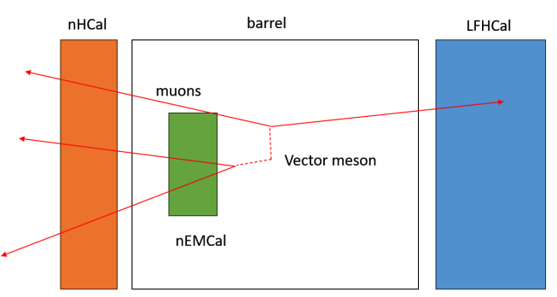
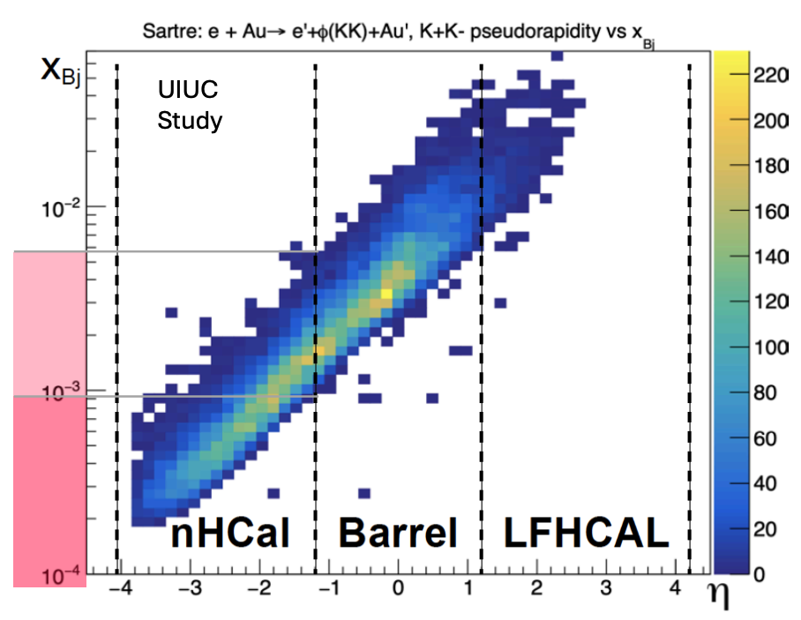
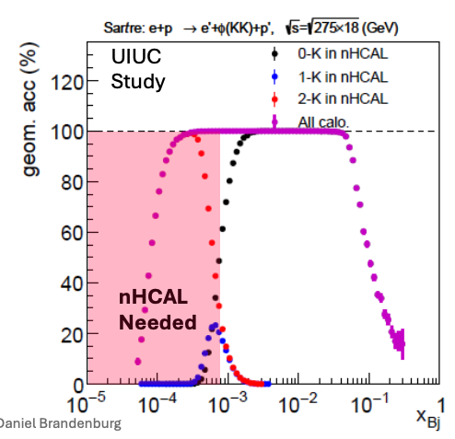
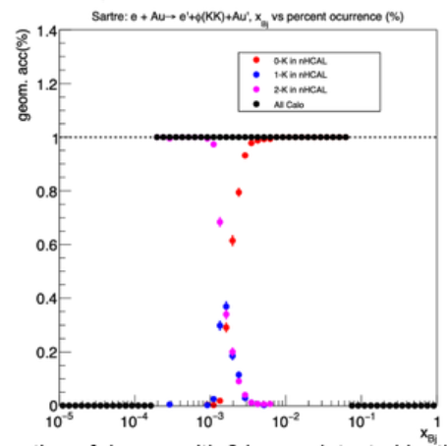
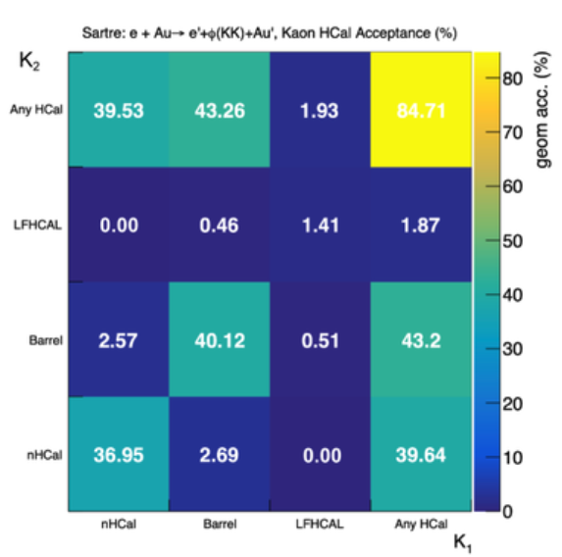
VM decay & efficiency for muon ID
Additional backward acceptance provides access to a more complete set of vector-meson decay topologies
  nHCal crucial for low-x
Muon ID efficiency studies ongoing
  + enhances clean separation of scattered electron from di-muon final states
J/𝜓→μμ
xBj
𝜙→K⁺K⁻
𝜙→K⁺K⁻
pT
[GeV]
42%: >=1 kaon in nHCal acceptance
nHCal
η
η
xBj
Vincent Andrieux (UIUC)
Dhruv Sharma (UIUC)

Slide 8
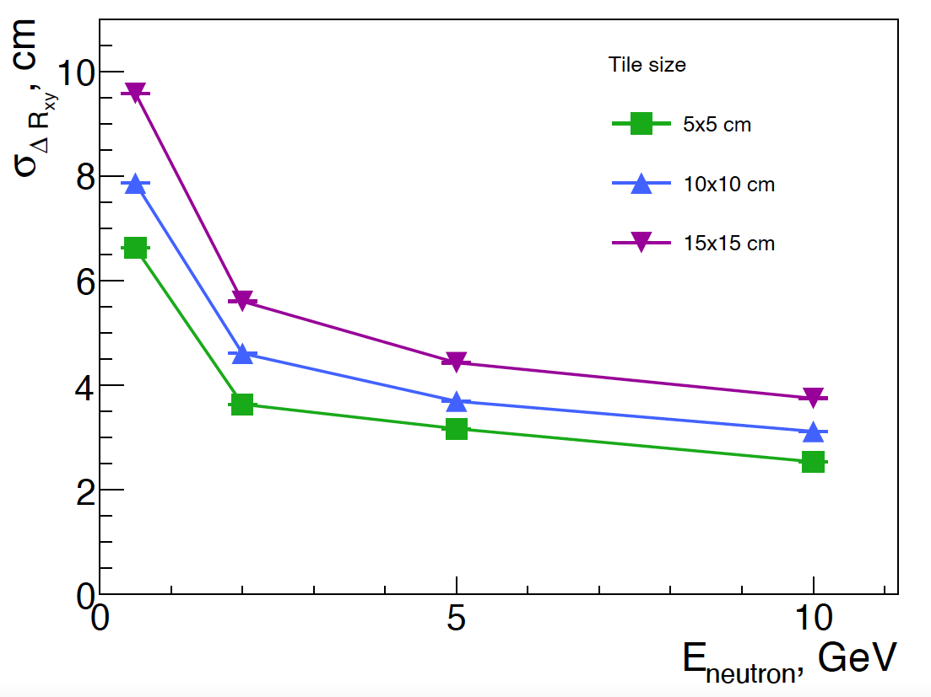
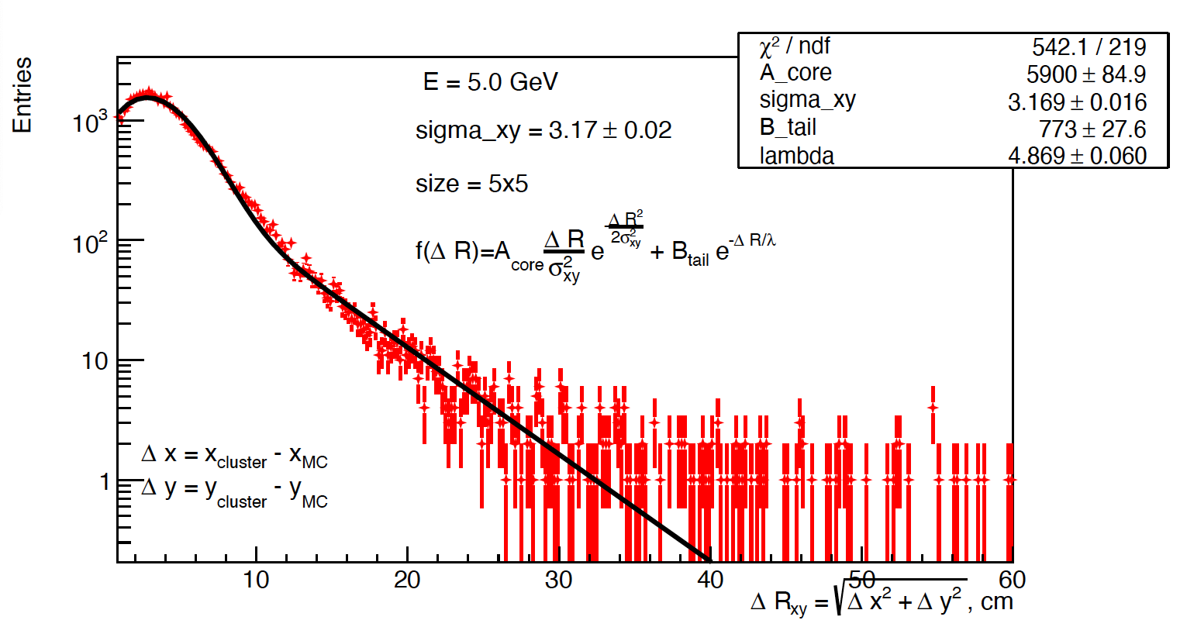

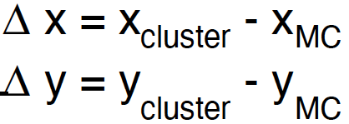
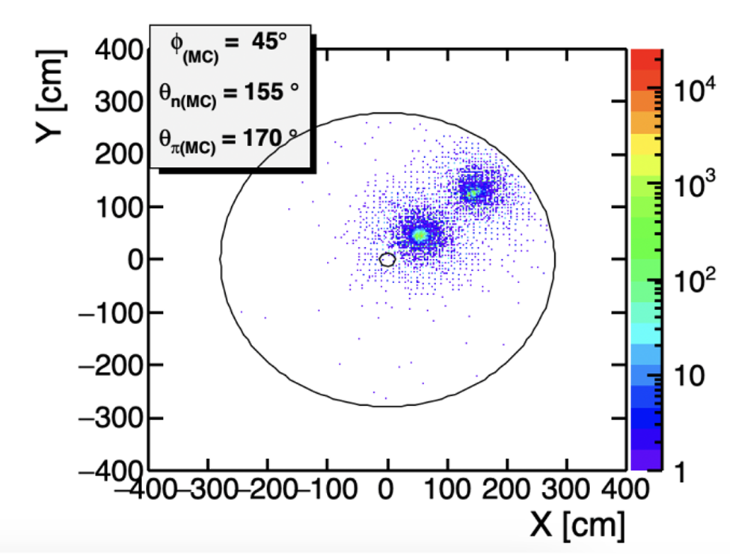
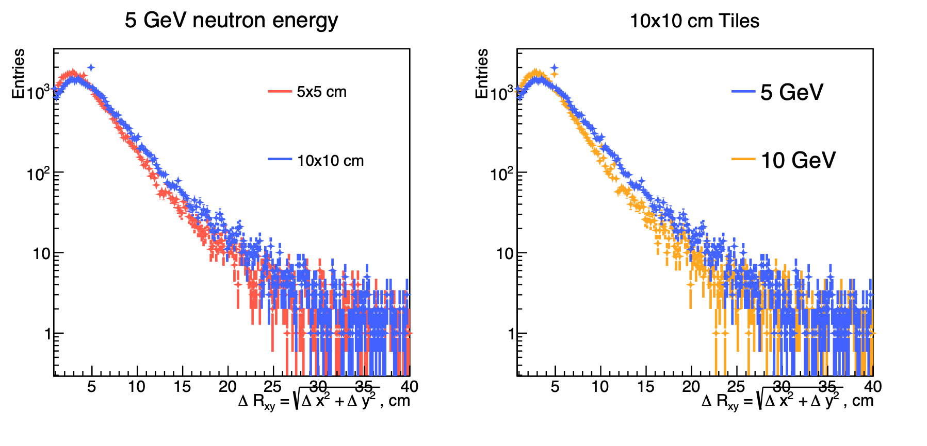
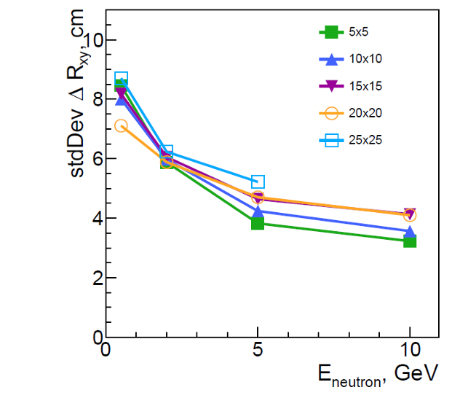
Position resolution for neutrons
Transverse position resolution
  Default design with varying tile size
Neutron position resolution insensitive to tile size
  Not unexpected due to size of clusters
Neutron and pion
clusters can be
distinguished
when separated
by ~30cm
Alexandr Prozorov (CTU)
π−
neutrons
change neutron energy
change tile size
Subhadip Pal (CTU)
  Optimization of position resolution will be mainly driven by muon ID!
  plot hasn’t been updated but it is important

Slide 9
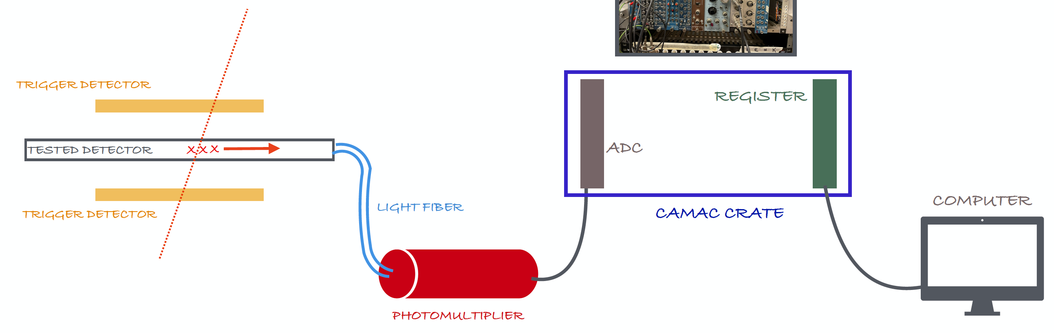
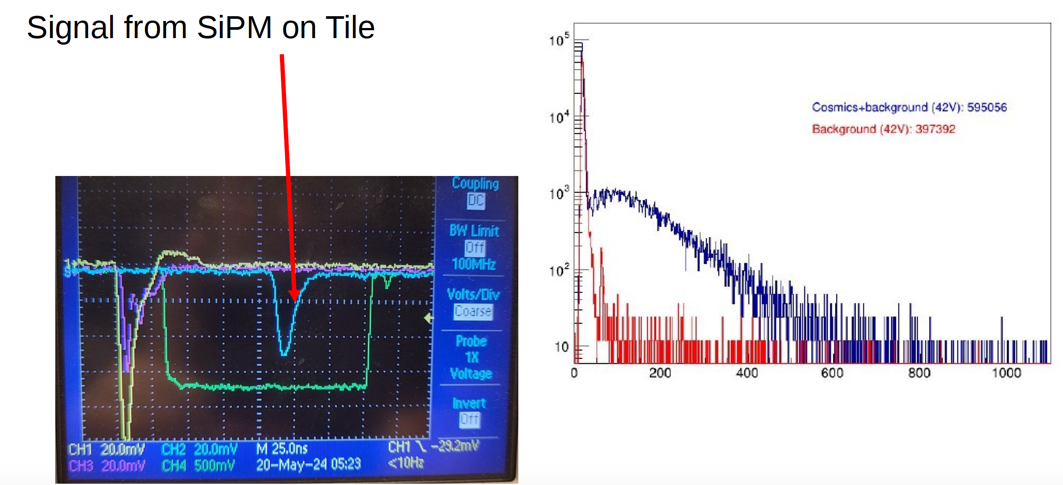
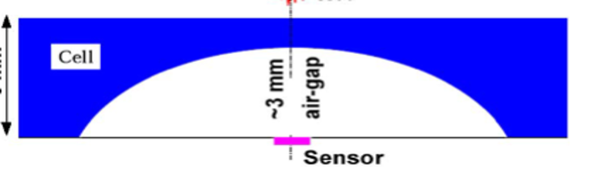
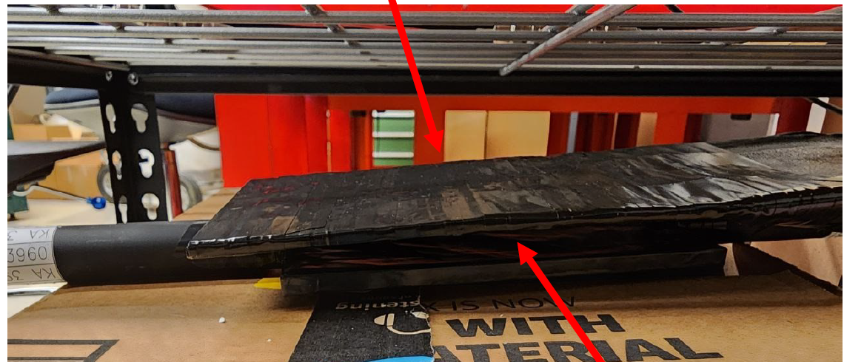
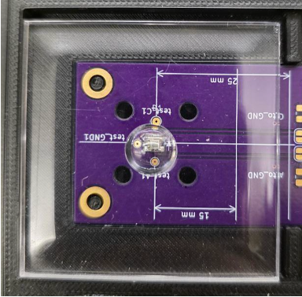
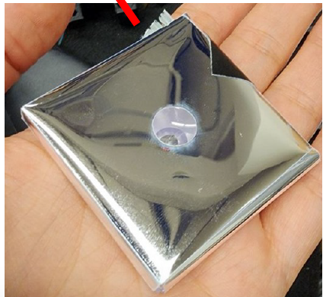
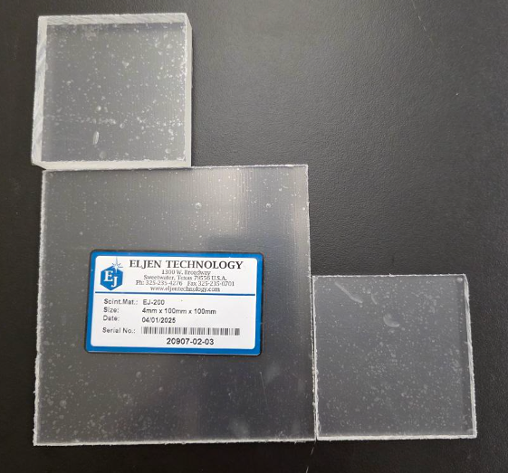
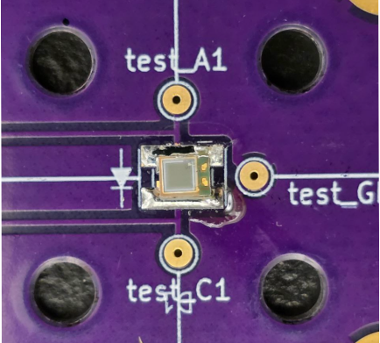
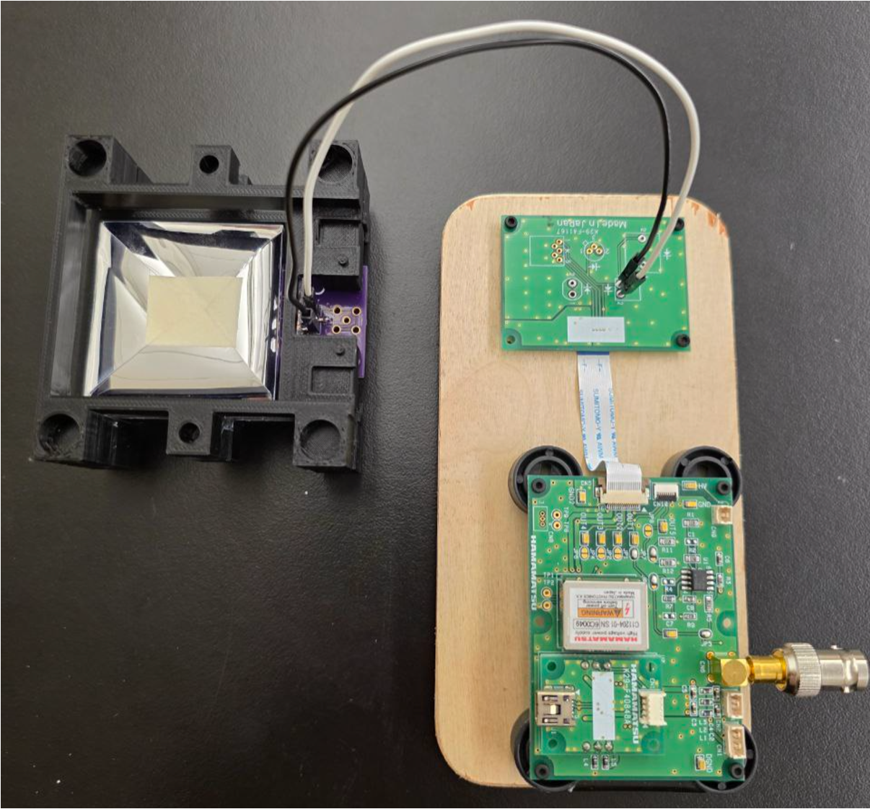
nHCal performance evaluation
muon telescope for cosmics testing
trigger detector
Tile testing at OSU
  Cosmics and Sr source
    Vary tile size (5x5, 10x10)
    Vary tile thickness (4, 6, 8 mm)
    Vary SiPM placement (center, corner, edge)
  Performance evaluation
    Light yield per MIP, uniformity, cross-talk
  Completion: July
register
SiPM-on-tile + controlling board
ADC
trigger detector
CAMAC crate
signal from SiPM-on-tile
scintillating tiles of different thickness and size
Maria Stefaniak, Yevheniia Khyzhniak (OSU)
SiPM: S14160-1315PS
mention synergy with LFHCal - SiPM-on-tile

Slide 10
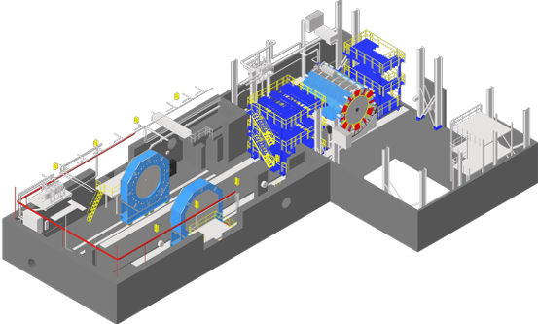
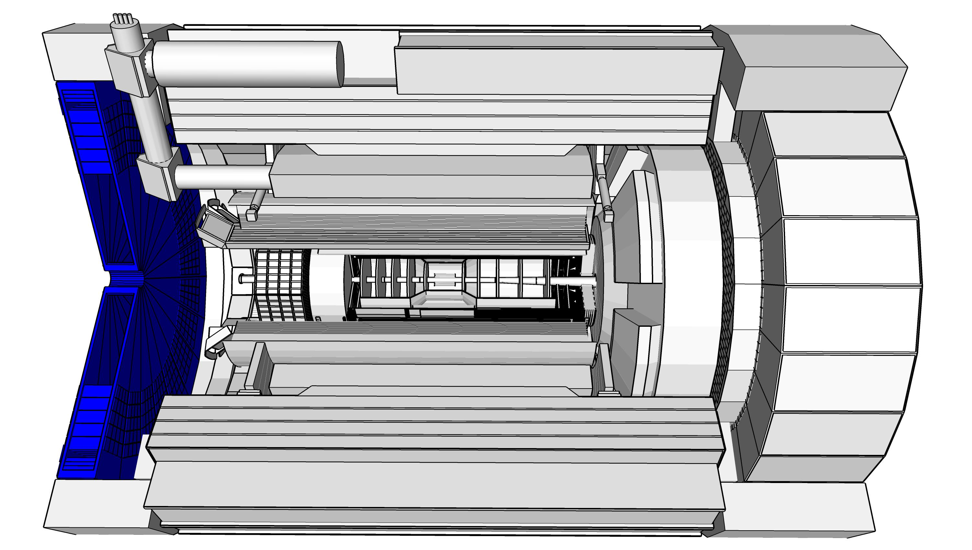
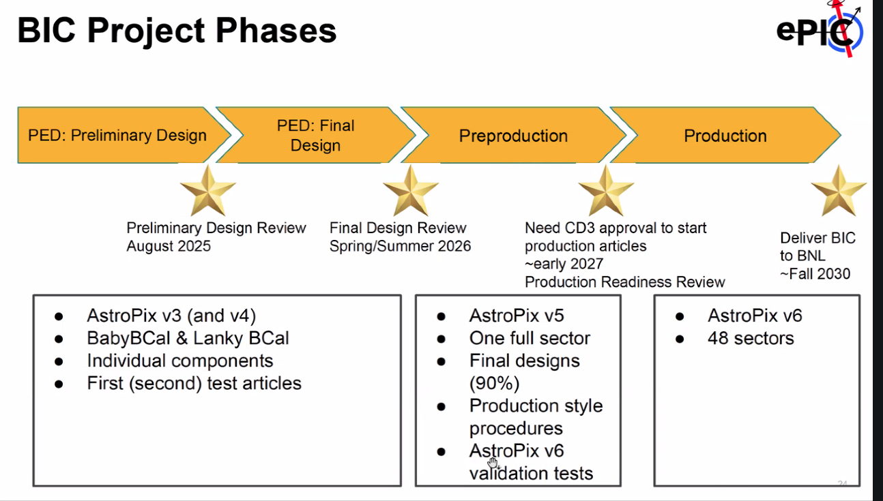
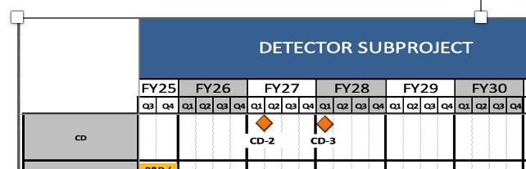
nHCal baselining and start of construction
calendar year | 2025 |  |  |  | 2026 |  |  |  | 2027 |  |  |  | 2028 |  |  |  | 2029 |  |  |  | 2030 |  |  |  | 2031 |  |  |  | 2032
 |  |  |  |  |  |  |  |  |  |  |  |  |  | Procurement
 |  |  |  |  |  |  |  |  |  |  |  |  |  | Production
 |  |  |  |  |  |  |  |  |  |  |  |  |  |  |  |  |  |  | Module assembly and testing at BNL
 | PDR |  | 60%
 |  |  |  |  |  | FDR |  | 90%
 |  |  |  |  |  |  |  |  |  |  |  |  |  |  |  |  |  |  |  |  |  | magnet test
 |  |  |  |  |  |  |  |  |  |  |  |  |  |  |  |  |  |  |  |  |  |  |  |  |  | Installation
Will the detector be technically ready for baselining by late 2025?
  60% design maturity (PDR) in fall 2025
Will the detector be ready for start of construction by late 2026?
  Aim for 90% design maturity (FDR) in 2026. Procurement after CD-3 (SiPMs, scintillator tiles, electronics, steel modules) & start of production (loading of SiPM boards and tile wrapping)
  The nHCal can be delivered later than most other detectors because it is decoupled
  from the flux return and does not need to be in place for the solenoid field mapping
  Ample time after FDR from synergies with the LFHCal
fall 2025
end 2026
baselineing = 60%!
March 2031
spring 2031
April 2032
Procurement: SiPMs, scintillator tiles, electronics, and steel modules.
Production may then include the loading of the SiPM boards (probably through a vendor) and the scintillator wrapping (ideally with an automated setup from the LFHCAL setup).
But ideally, everything gets delivered directly to BNL for final assembly (and storage) until installation.
We have requested some lab/assembly space similar to the BHCAL for this. (This is an off-project dependence and you don't have to worry about it.)
So, I would just keep "procurement" (without delivery) and "module assembly and testing".
Core production times will be short, but procurement will probably have to be sequenced with the LFHCAL items.
For the FDR, we typically use 90% design maturity. There can be small changes or things to tie up afterwards.
You could add "final design" leading into the FDR, because this will require some mechanical and electrical engineers (for drawings and modifications of the readout board).
I think the main message is, that the NHCAL has plenty of time after the FDR from synergies with the LFHCAL.
solenoid field mapping with flux return completed
start nHCal installation in wide angle hall
complete nHCal installation
PDR2
CD2
nHCal 60% design maturity
nHCal final design
nHCal procurement, production, shipping and assembly

Slide 11
nHCal integration and planning for installation & maintenance
Are the detector integration and planning for installation and maintenance progressing well? Are there areas where further ideas should be pursued?
Integration: services (LV, signal, slow control cables) and possibly cooling
  Total dissipated heat: 0.5-2.4 kW (10cmx10cm tiles)
  FEEs towards the IP ⇒ nHCal has to be serviced and maintained from the front (unlike LFHCal)
FEEs
open lepton end cap to maintain detector
have to break vacuum to roll out endcap! Not advantageous for polarization….

Slide 12
nHCal summary
Status:
  Simulation studies with single particles in progress
  Actively testing scintillating tiles at OSU
  Preparing PDR2 in ~September 2025
What is missing until CD-2:
  Completion of lab tests (July) and simulation campaigns including full simulations (end of year)
  Optimizing design - tile size, tile and absorber thicknesses, number of layers, gross length -
  up to CD-2 and beyond
Desire of beam tests with neutron and muon beams to verify simulations and characterize performance
Synergy with LFHCal - choice of technology
Involved institutions: OSU, UIUC, CTU, BNL

Slide 13
backup slides

Slide 14
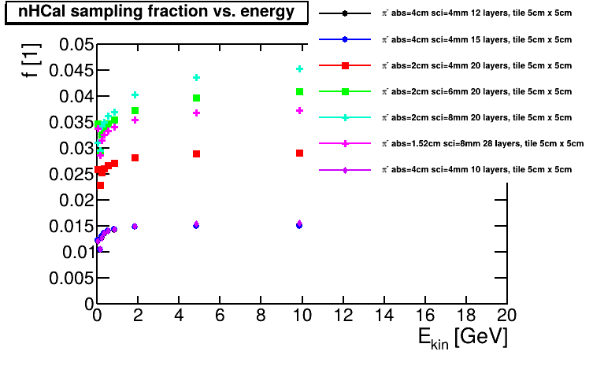
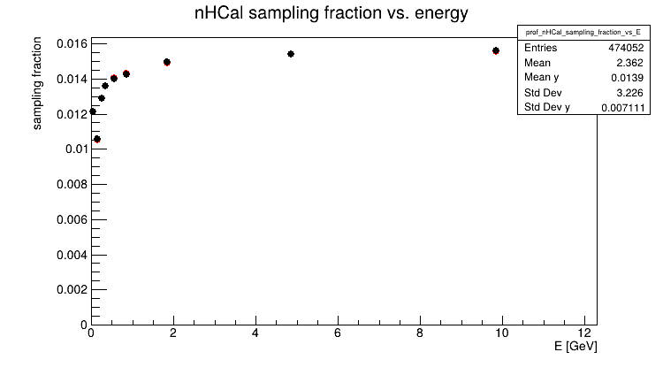
Sampling fractions
10cm x 10cm tiles
5cm x 5cm tiles
Top row: vary geometry
Right: vary particle species
✸ neutrons
✸ π−
  10cm x10 cm, 10 layers,
  4cm absorber, 4mm scintillator

Slide 15
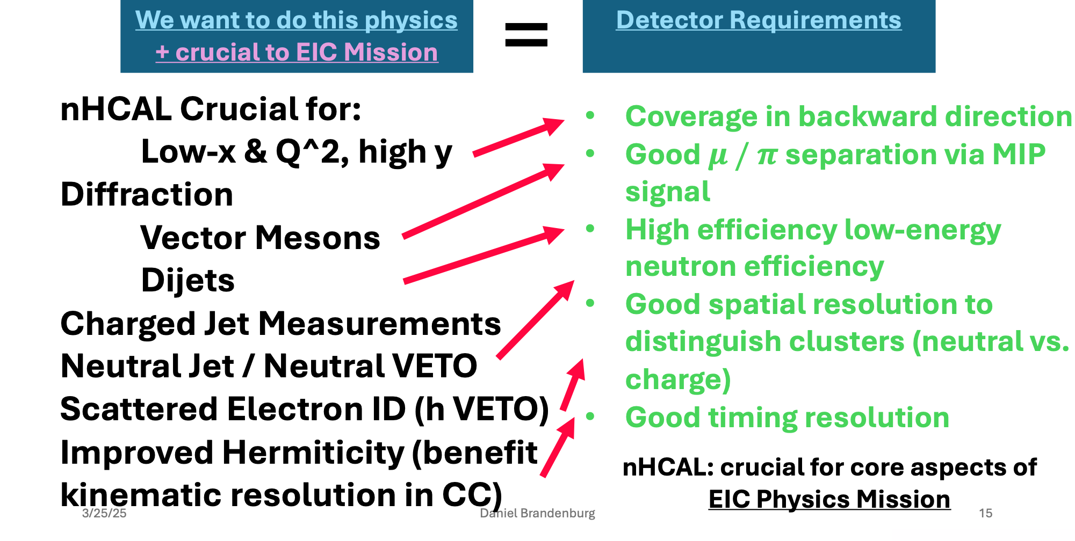
nHCal project design - purposes and requirements
Purpose |  | Requirements
Low x and Q², high y high gluon densities |  | Coverage in backwards direction
diffraction | vector mesons | Good μ/π separation via MIP signal
 | dijets | High efficiency for low-energy neutron detection
Neutral jets / neutral veto
Charged jets |  | Good spatial resolution to distinguish clusters (neutral vs. charged)
Scattered electron ID (h veto)
Improved hermiticity (➚ kinematic resolution in CC) |  | Good timing resolution
nHCal crucial for core aspects of EIC physics mission
Lessons from HERA / H1 backward SPACAL
NIMA 386 (1997), 397-408
PLB 665 (2008), 139-146
High efficiency for low-energy neutron detection (>90% detection efficiency for 2 GeV neutrons; track-cluster matching)
Hadron-beam background veto for dRICH (together with LFHCAL)
Low x (10⁻³ − 10⁻²) and Q², high y

Slide 16

nHCal default design - parameters
 | nHCal | LFHCal
material | same | Fe / SciTiles
interaction length | 2.4 | 6.0
depth along beam axis | 45cm | 132cm
number of physical layers | 10 | 60
thickness of layers | 40mm / 4mm | 16mm / 4mm
tile size | 10cm x 10cm | 5cm x 5cm
module size | 10cm x 20cm x 45cm (8M), 10cm x 10cm x 45cm (4M) | 10cm x 20cm x 140cm (8M), 10cm x 10cm x 140cm (4M)
number of modules | same | 1058 (8M), 72 (4M)
tiles per layer | 2x (1058+72) | 8x (1058+72)
number of ROC | 10x 2x (1058+72)=22,600 | 6x 8x (1058+72)=54,240
nHCal similar but not identical to LFHCal design. Both are based on the sampling calorimeter technology with alternating layers of absorber and scintillator
(+ insert modules)
nHCal geometry [cm]
forward EMCal has 1 interaction length - backward EMCal? (couldn’t find number, checked pre TDR and google)
2x14
45
2x276

