Slide 1
Beamline Design and Integration
Charles Hetzel
EIC Vacuum Group Leader
10th EIC DAC Review
June 11th – 13th, 2025

Slide 2
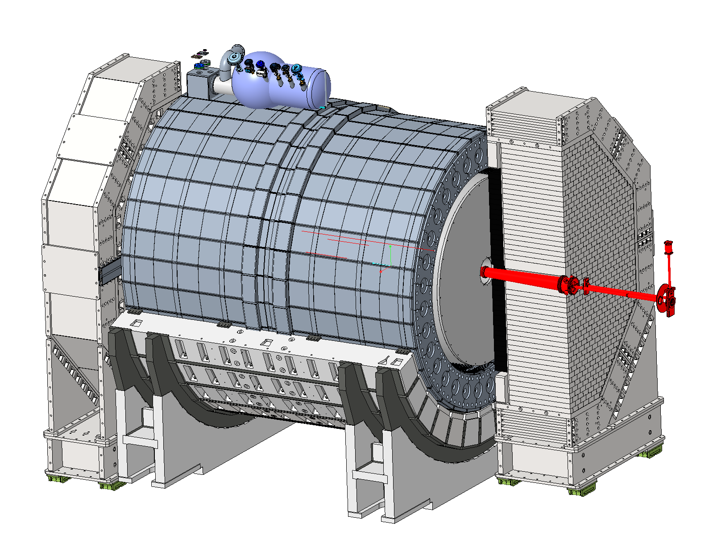
Outline
Interaction Region Vacuum Overview
Design Status and Progress
Central Detector Chamber
Forward Side
Rear Side
Next Steps
Summary

Slide 3
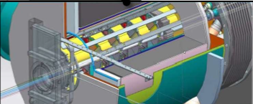
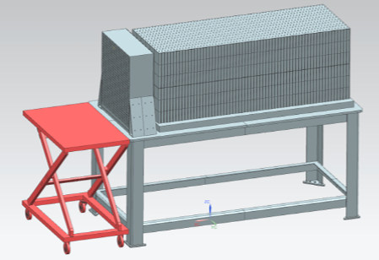
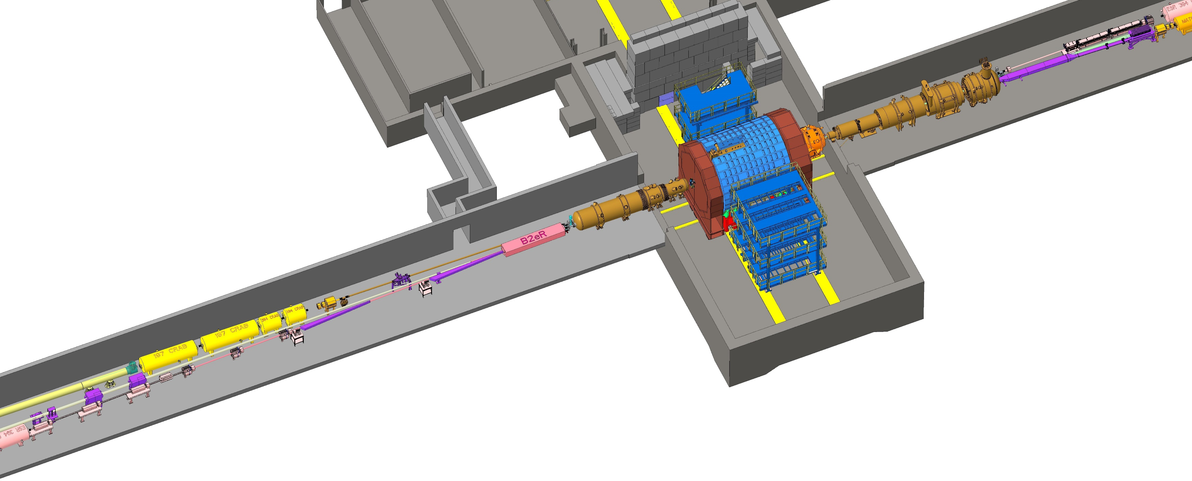
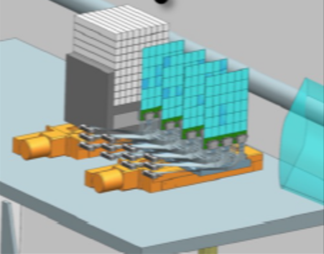
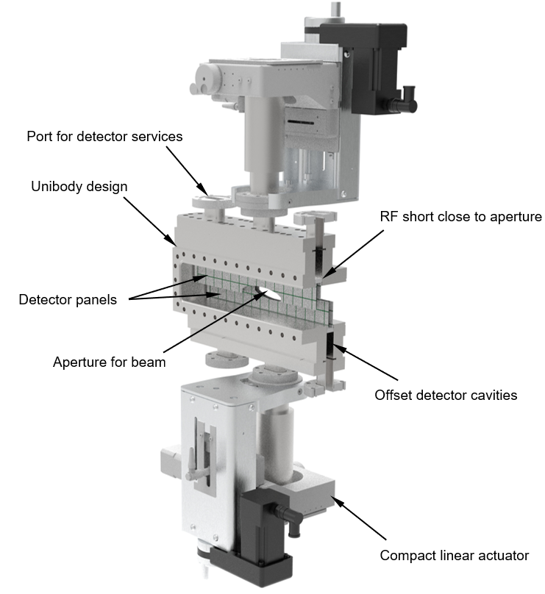
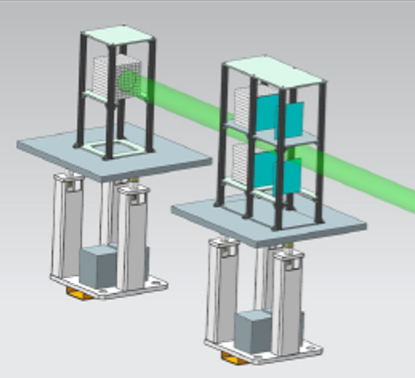
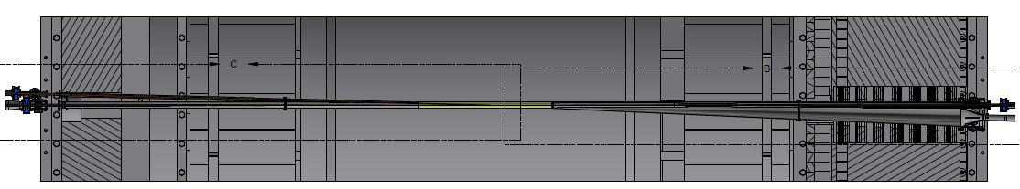
IR Vacuum overview
Complicated integrations between detectors and magnets
Very different requirements between rings
Electron cloud in HSR
Synchrotron radiation in ESR
B0 magnet spectrometer
Zero-degree calorimeter
Low Q² taggers
Luminosity system
FORWARD SIDE
REAR SIDE
CENTRAL DETECTOR
Roman pot and off momentum detectors
Central detector

Slide 4
Requirements and Challenges
Cryostats will be assembled in the tunnel
Low dynamic pressure required to minimize beam-gas interactions (< 1 x10⁻⁹ mbar)
Electron forward side
Large beam sizes due to strong focusing (β_{x} > 900m)
Synchrotron radiation from upstream dipoles (26mrad bend 30m away -> 38 kW)
Electron rear side
Synchrotron radiation
Hadron forward side
Large aperture required to transport off-momentum and neutral particles
Chamber integration, alignment and support system
Hadron rear side
Injection and ramping optics
4

Slide 5
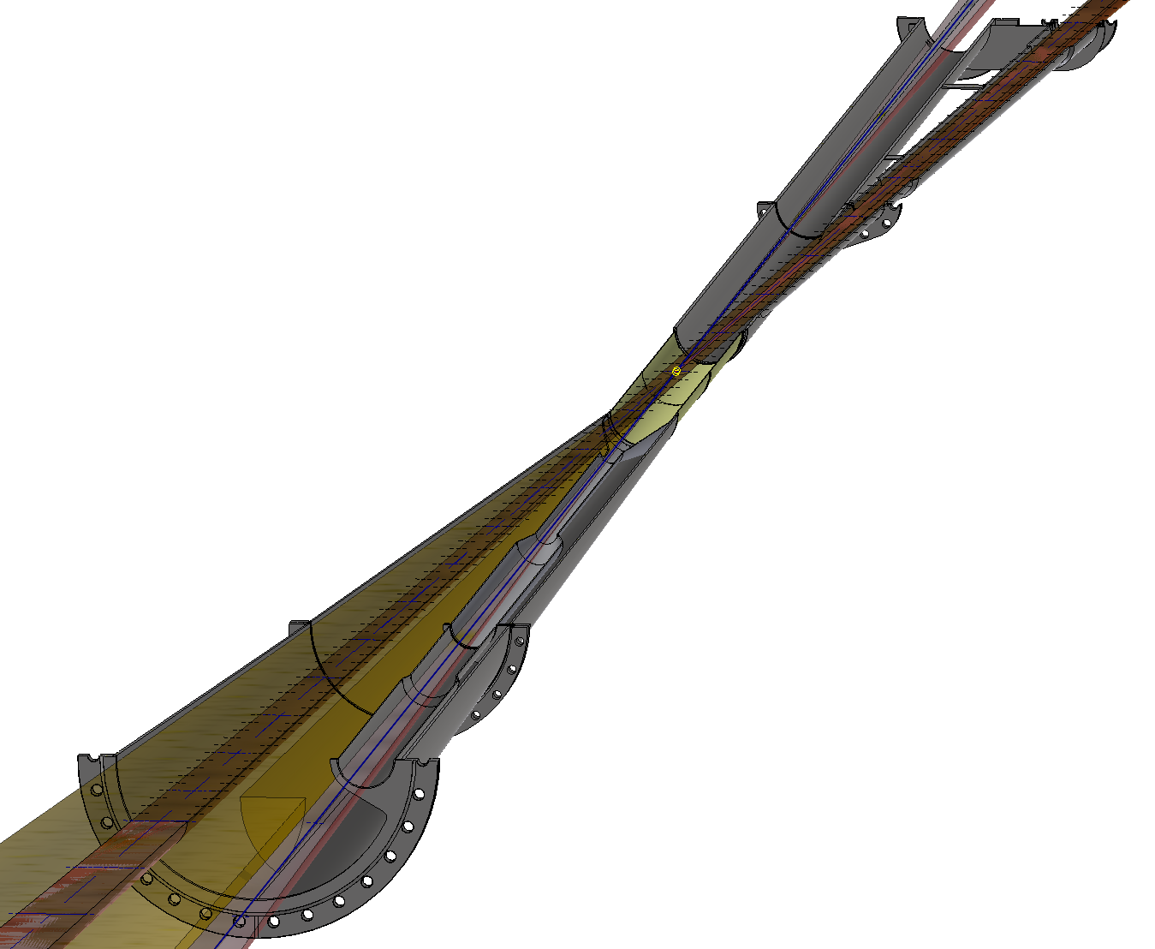
Central Detector Chamber Updates
Luminosity cone
Improved electron beam pipe
Diameter steps down with stay clear envelope
Collimates scattered photons from upstream
Better integration with detector
Optimized flange locations
Removed flange before DRICH
Integration of BPMs
Gate valve solution for both sides of detector
Electron stay clear
(13.5σ_{x} 22.5 σ_{y})
Hadron stay clear
(Collision optics)
Hadron stay clear
(Injection optics)
Beryllium section
B0 cone
Electron beam pipe
Electron stay clear
(13.5σ_{x} 22.5 σ_{y})
Hadron stay clear
(Includes injection, neutral and +/-1.3 GeV )

Slide 6
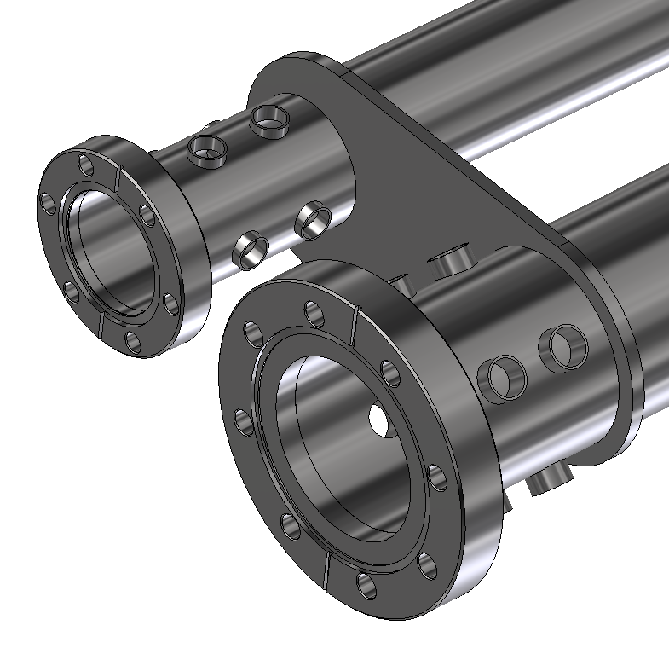
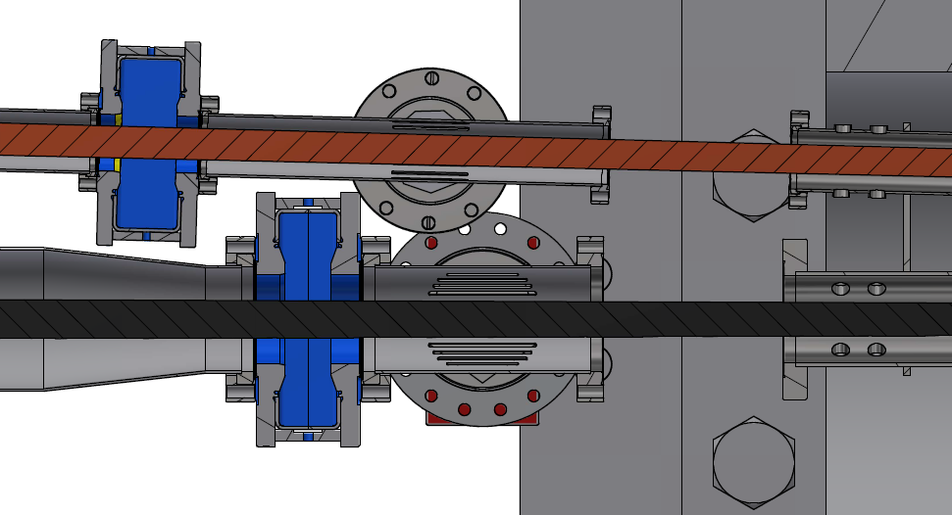
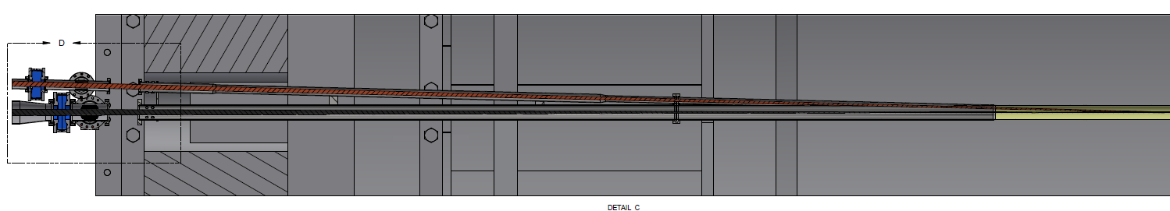
Central Detector Chamber - Rear Side
Beam pipes rigidly connected
RF shielded bellows
(not shown)
BPMs
(2 sets)
Gate valves
Rear cryostat
Hadrons
Electrons
Hadrons
Electrons

Slide 7
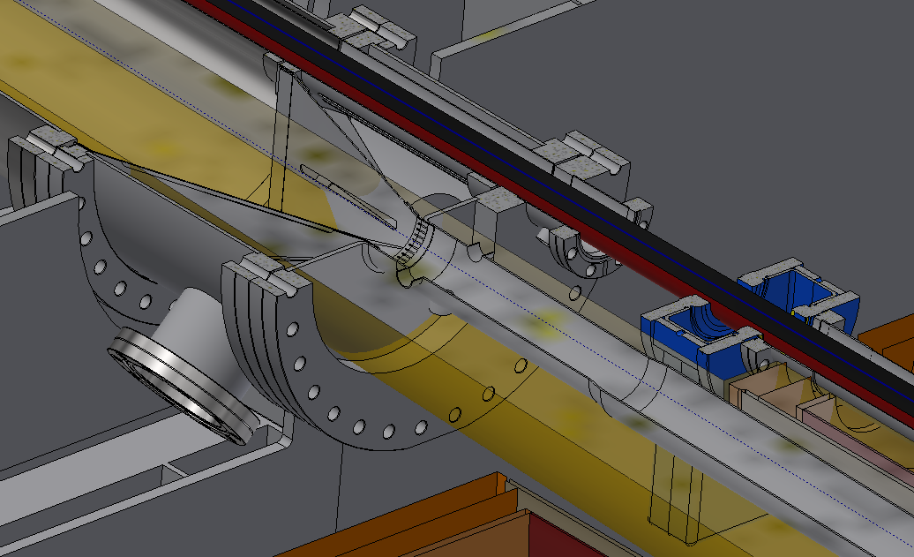
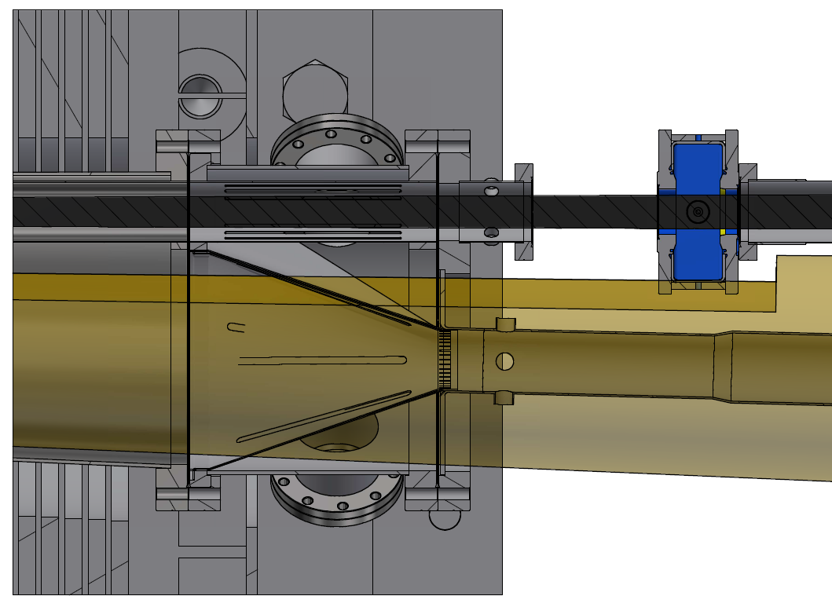
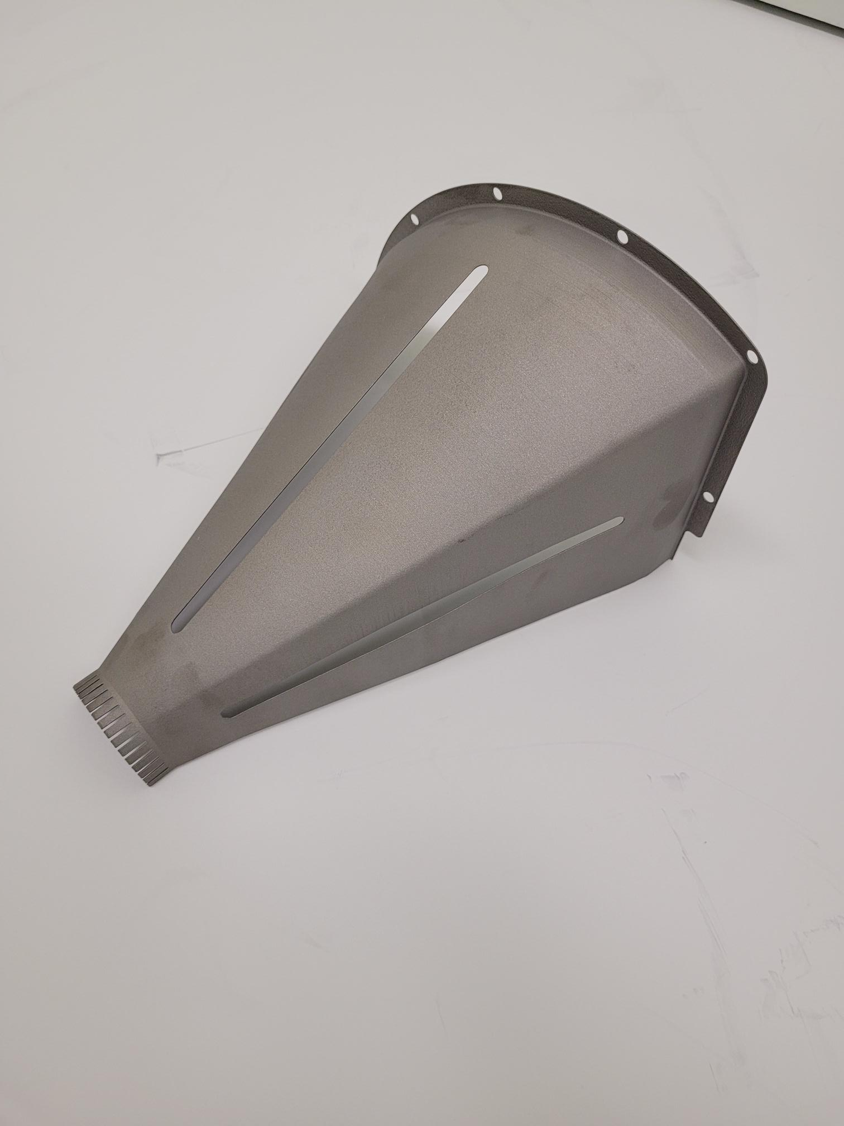
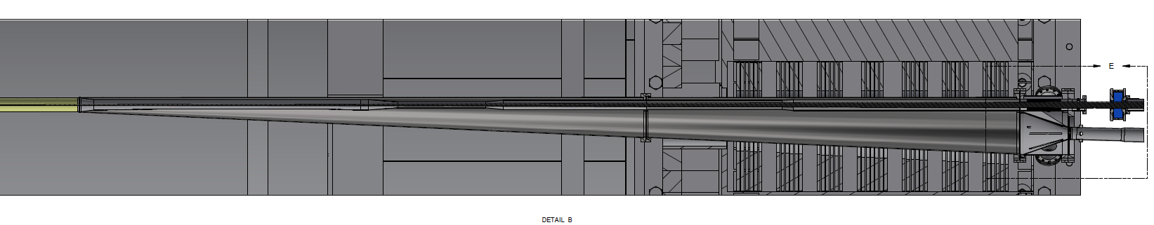
Central Detector Chamber – Forward Side
Anchor to B0
RF bellows (not shown)
Vacuum window
GV (electrons)
RF taper
Pump port
BPMs
Hadrons
Electrons

Slide 8
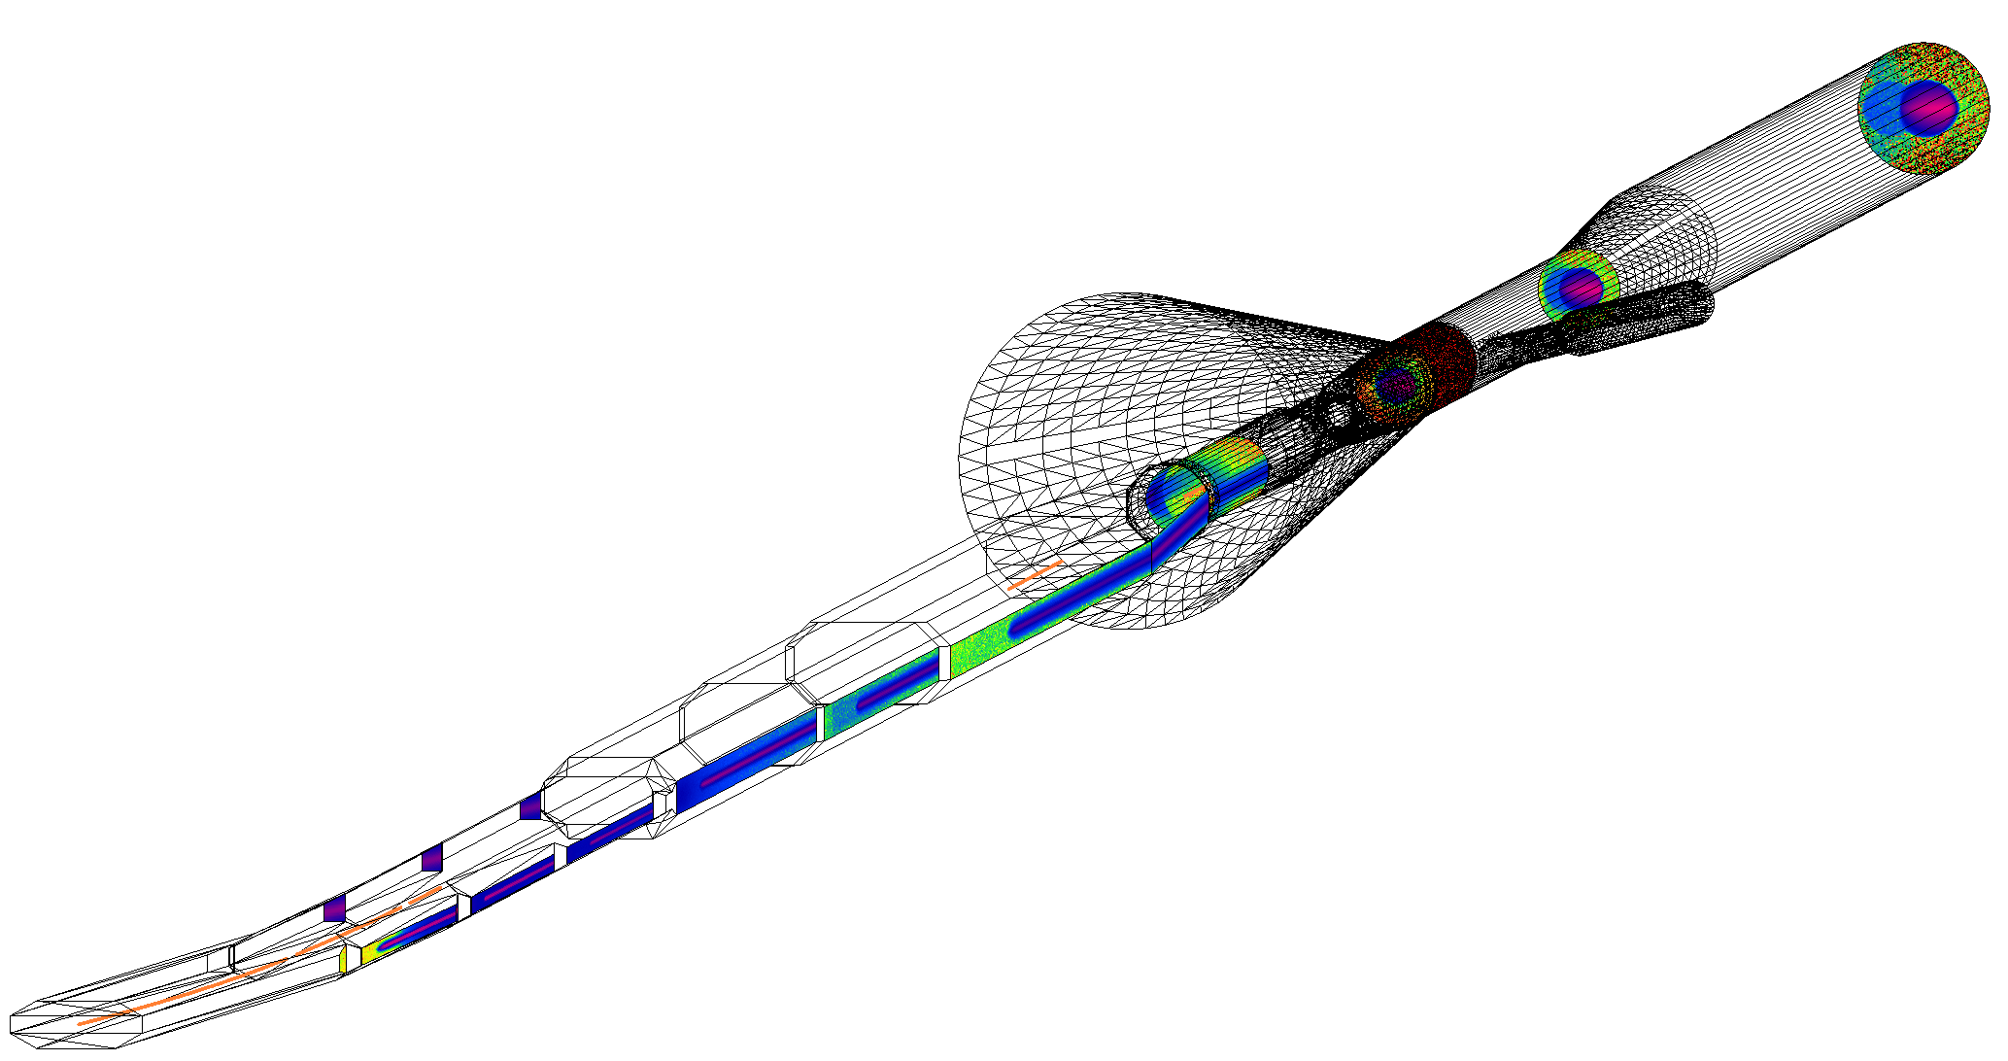
Modified Lattice Improvements
Major reduction of heat load inside cryostat (2.9kW vs 7.2kW)
1mm tungsten shielding required instead of 3mm
High heat load beam screen required
Constant aperture through rear side
Simulation assumes 10% of charge in tails
Exit rear central detector chamber: 274 W
Entrance of Be section: 274 W
Exit rear cryostat: 274 W
Drift 3 + Q1eF: 418 W
(~1% of total power)
Q0eF: 58 W
Start of cryostat
D1eF
(.891 m, 1.5 mrad)
D2eF
(2.726 m, 5.14 mrad)
Taper Q1eF->Q0eF: 874 W
(~3% of total power)
D3eF
(3.8 m, 19.56 mrad)
Drift 4: 413 W
(~1% of total power)
Drift 5: 1141 W
(~3% of total power)
Before cryostat: 34.41 kW
(~91% of total power)

Slide 9
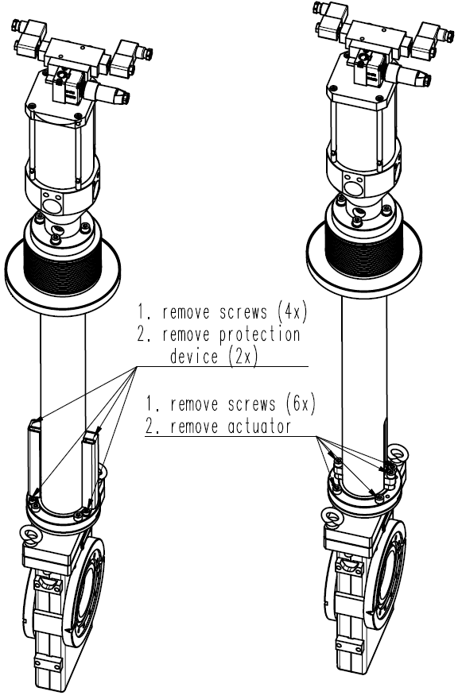
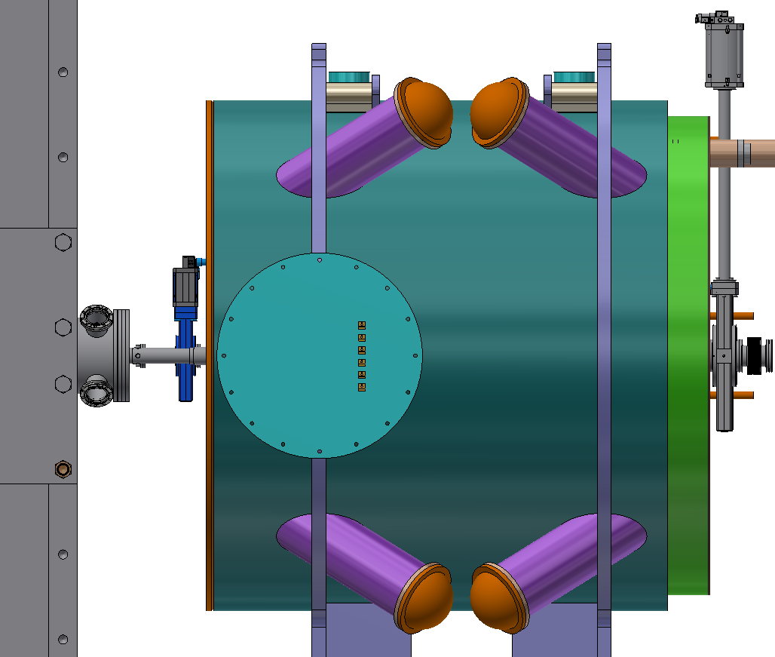
B0 Vacuum Chambers
Electron ring GV
Valve body: DN40
Aperture: 52mm (DN50 CF flange)
Extra ports on valve body
Actuator outside cryostat
(Port for hot N2 injection)
Hadron ring GV
Valve body: DN100
Aperture: 72.78mm
Extended actuator
Extra ports on valve body
Anchor to B0

Slide 10
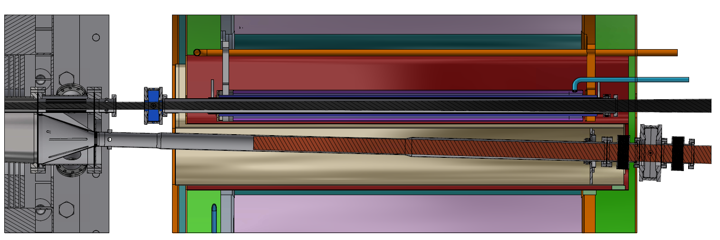
B0 Vacuum Chambers
RF shielded bellows
(not shown)
Warm/Cold border Electrons
Actively cooled electron beam pipe
Electron stay clear
Room temperature hadron beam pipe
Off momentum stay clear
Warm/Cold border Hadrons

Slide 11
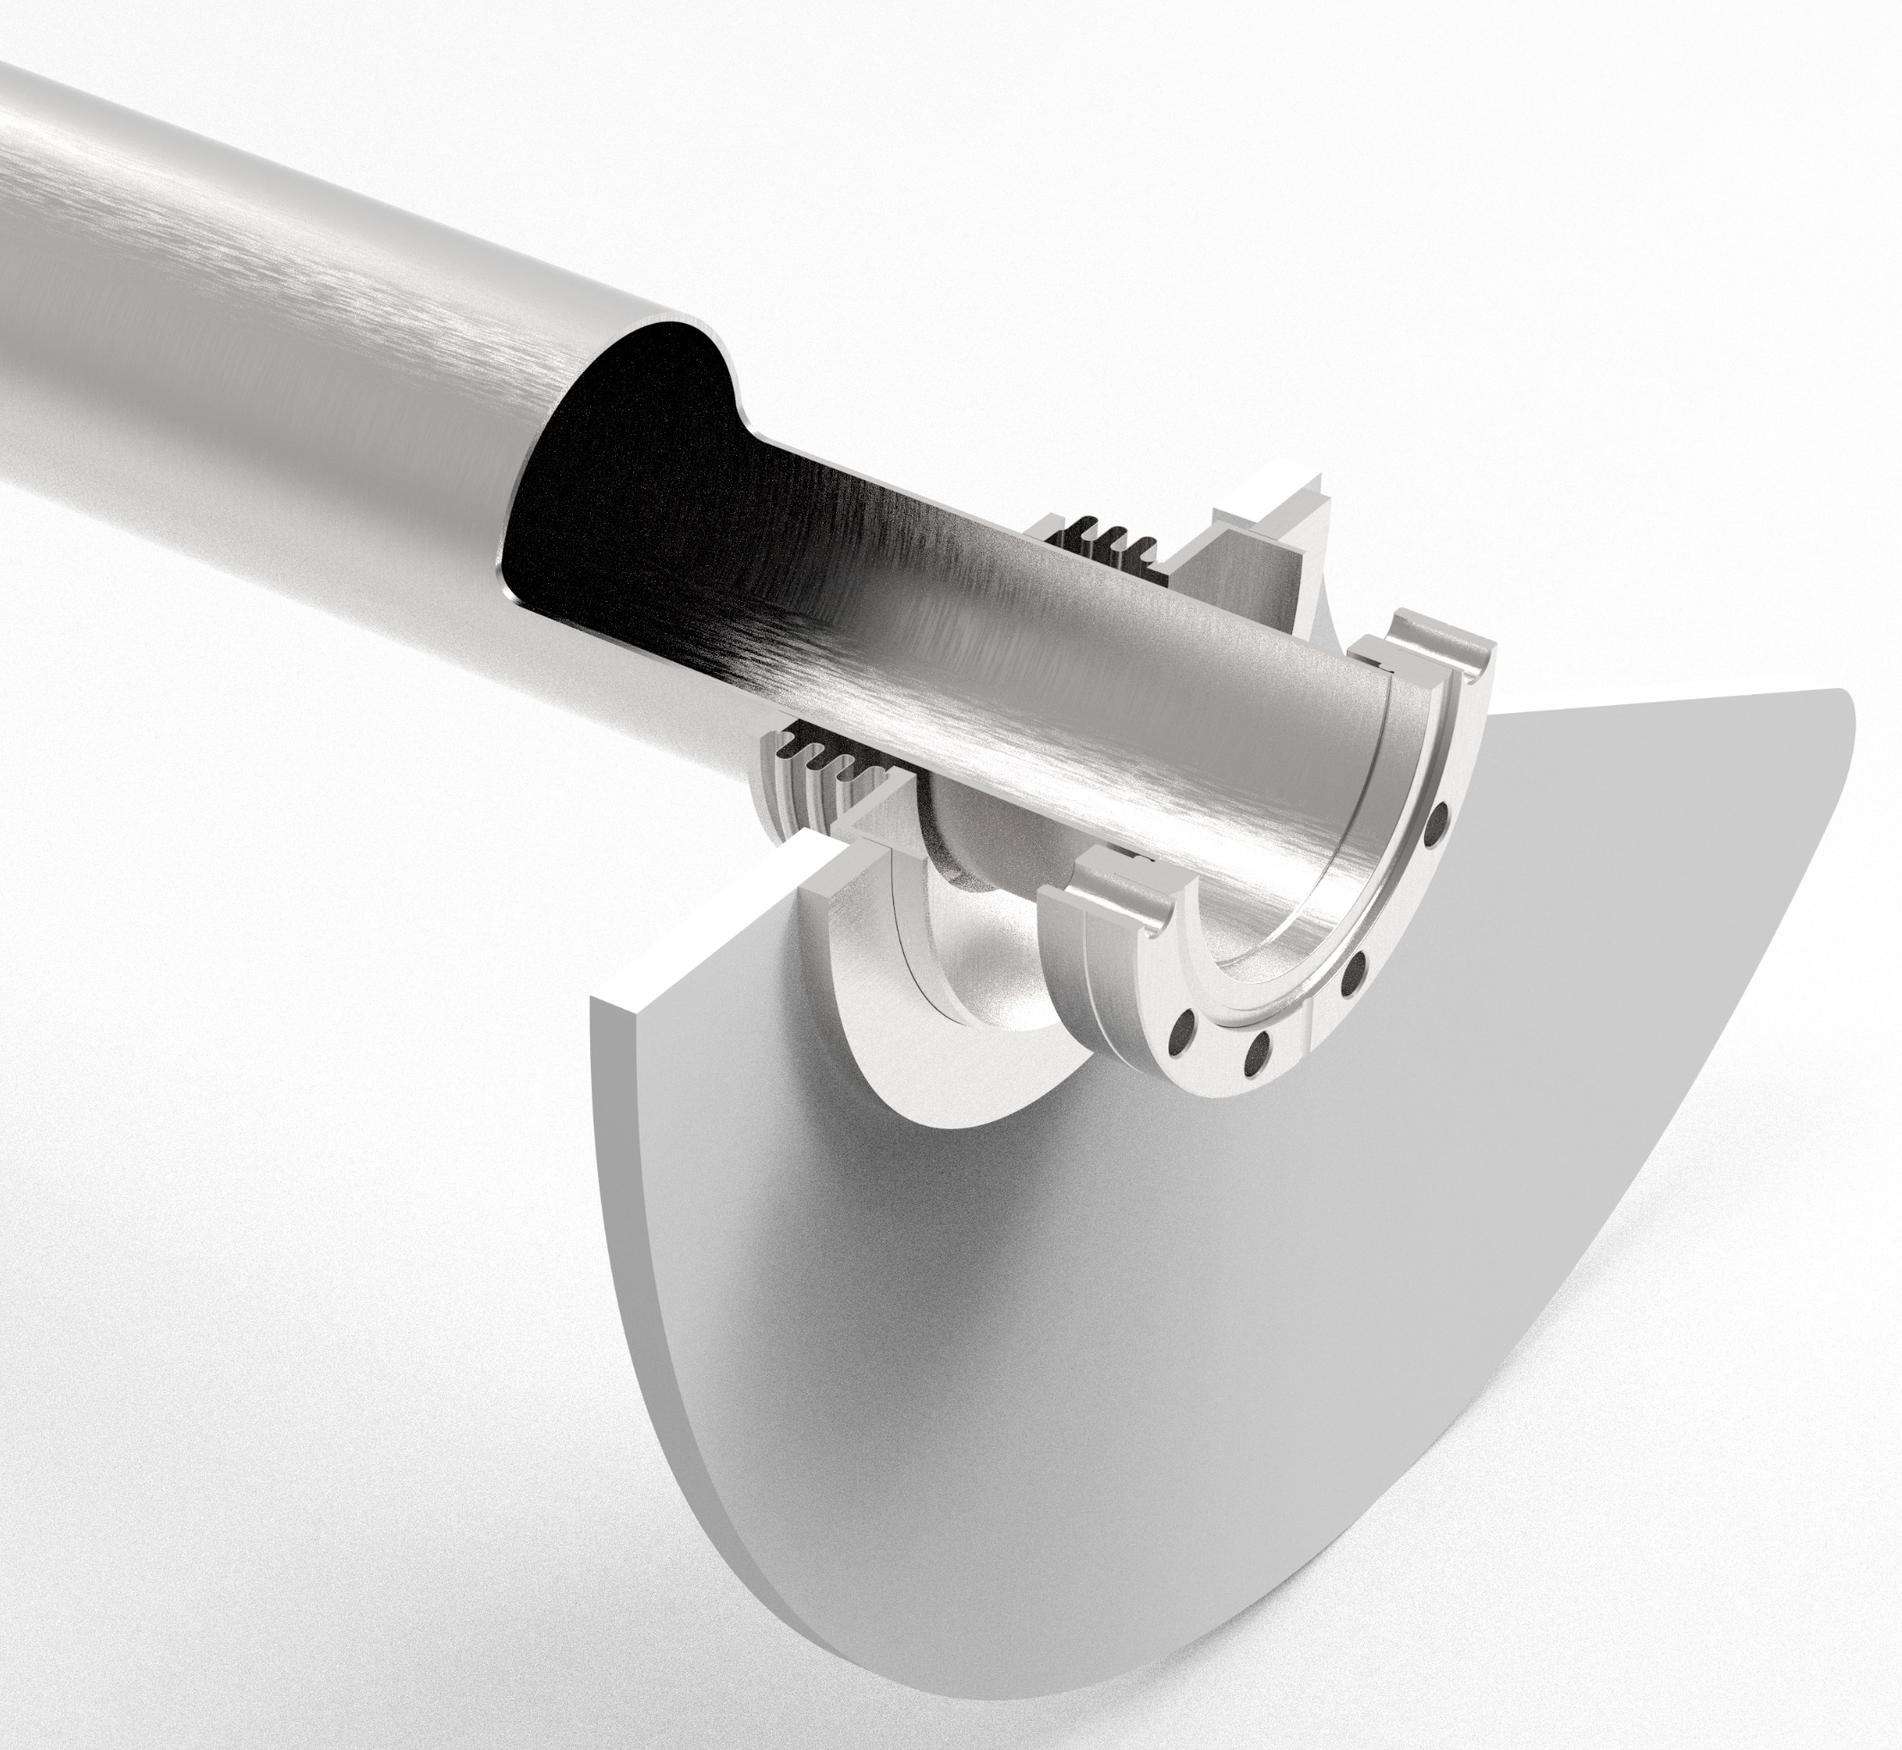
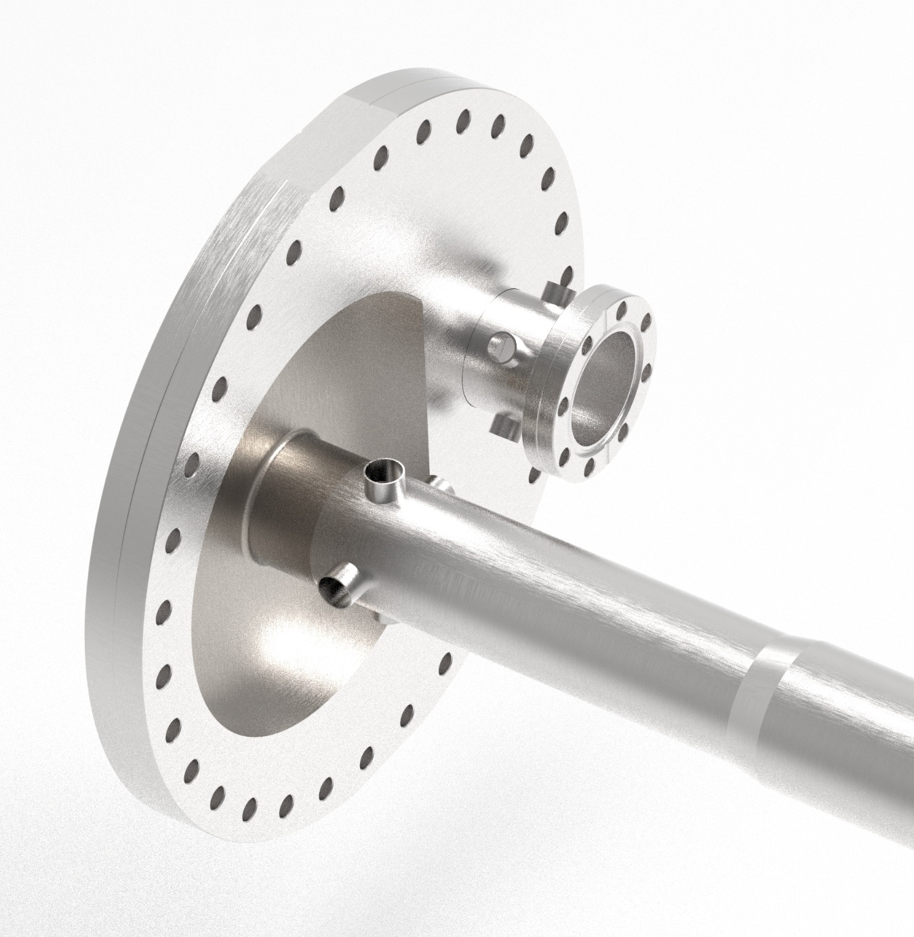
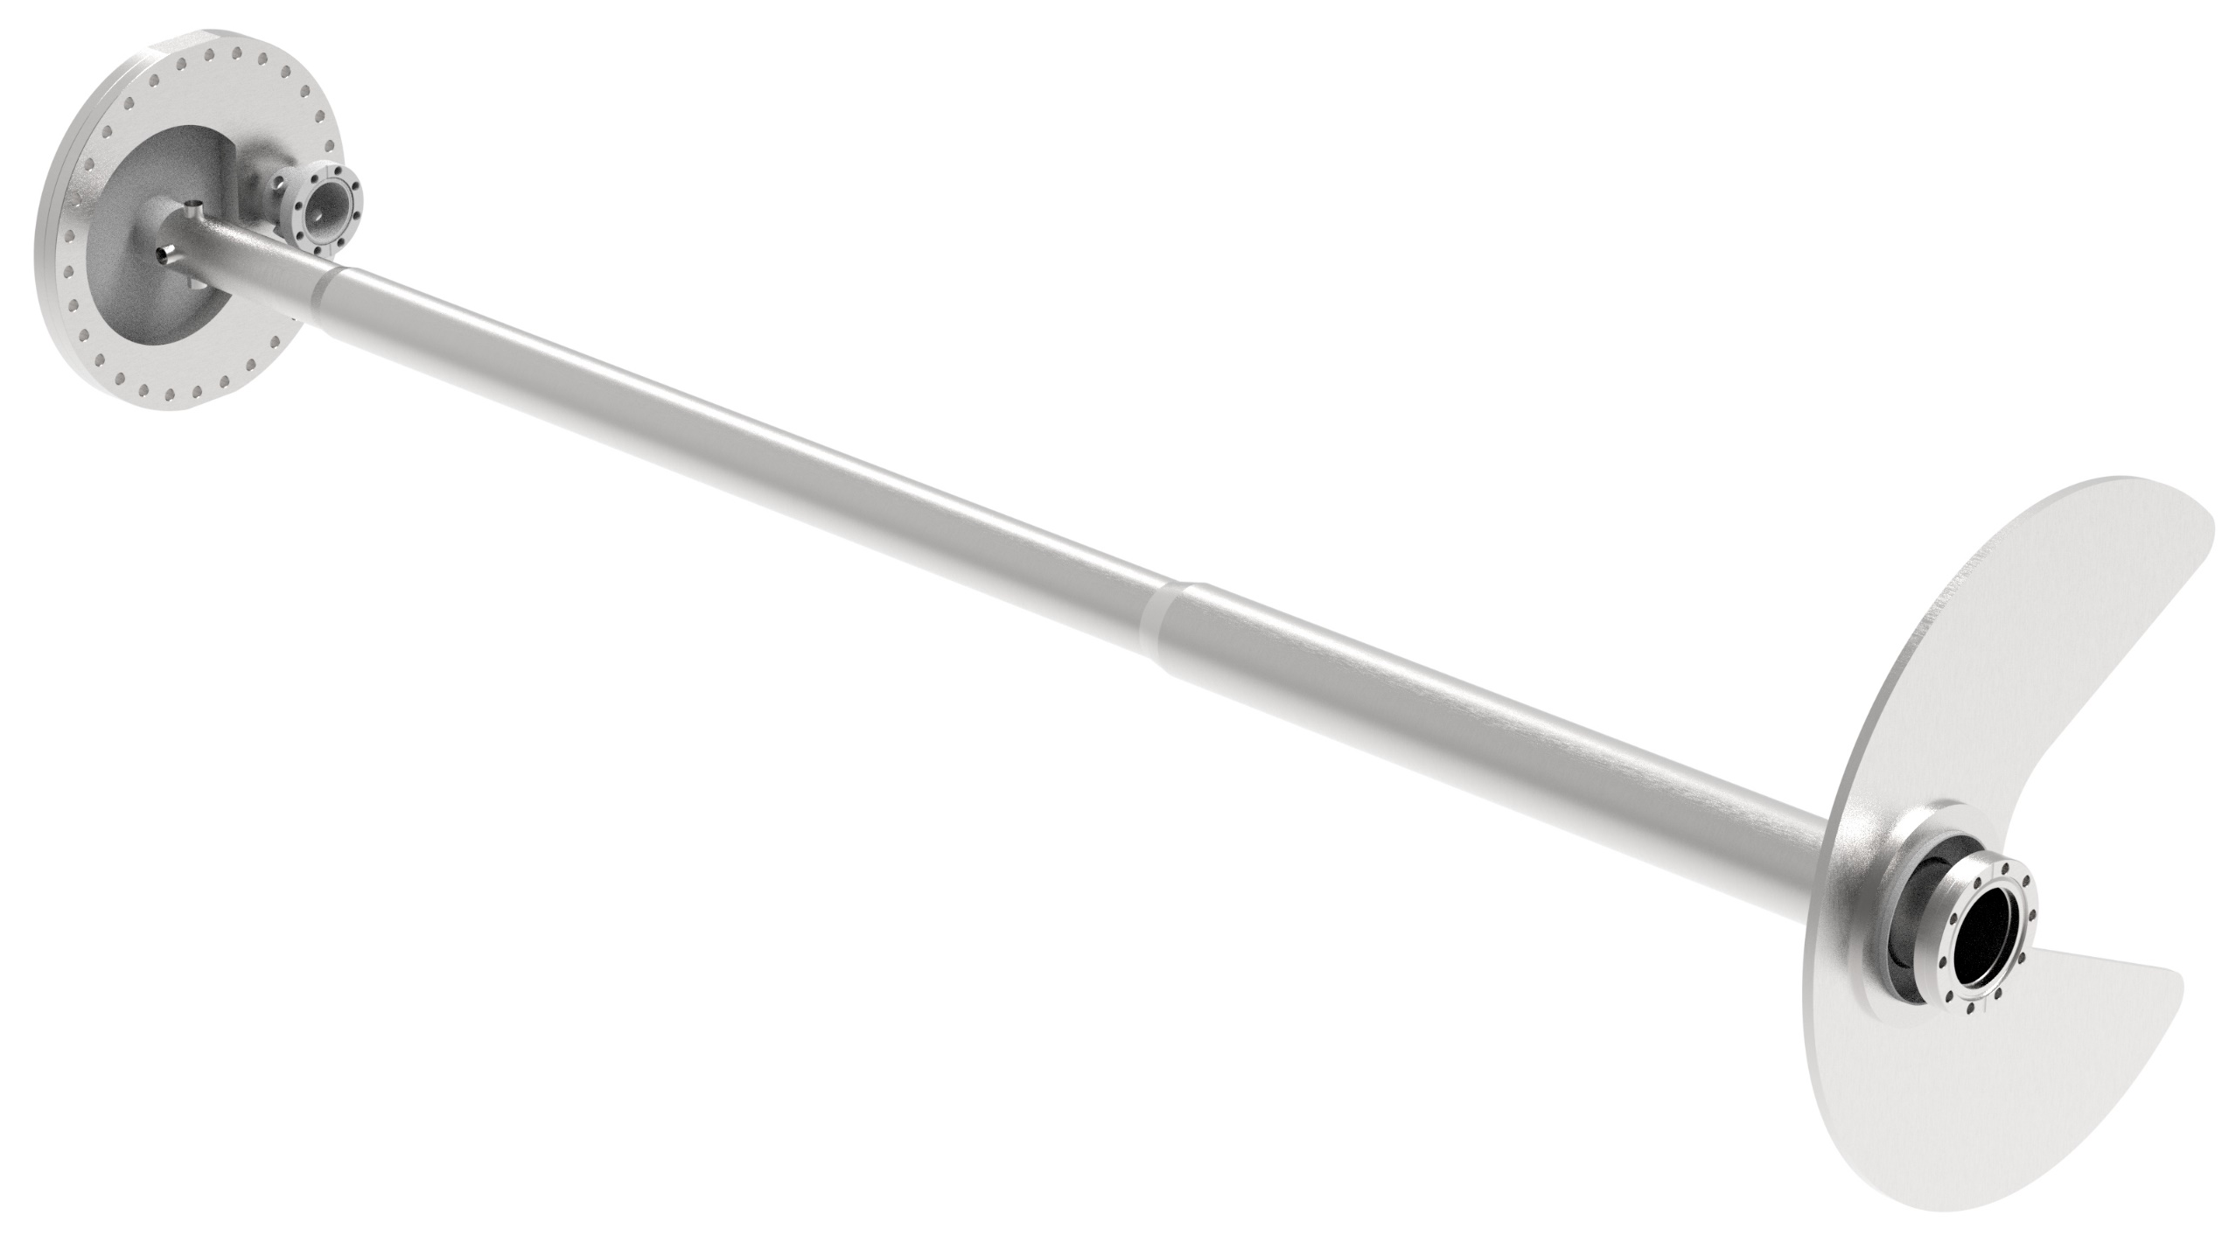
B0 Hadron Vacuum Chamber
Compliance between cryostat
Requires copper platting and aC coating
Integral part of B0 magnet
BPMs for both beam lines on single part
Weld-in to minimize footprint
Hole in cryostat wall
Weld after installation
Electrons
Stepped beam pipe due to stay clear envelope
Exit window
Insulating vacuum wall of B0 cryostat

Slide 12
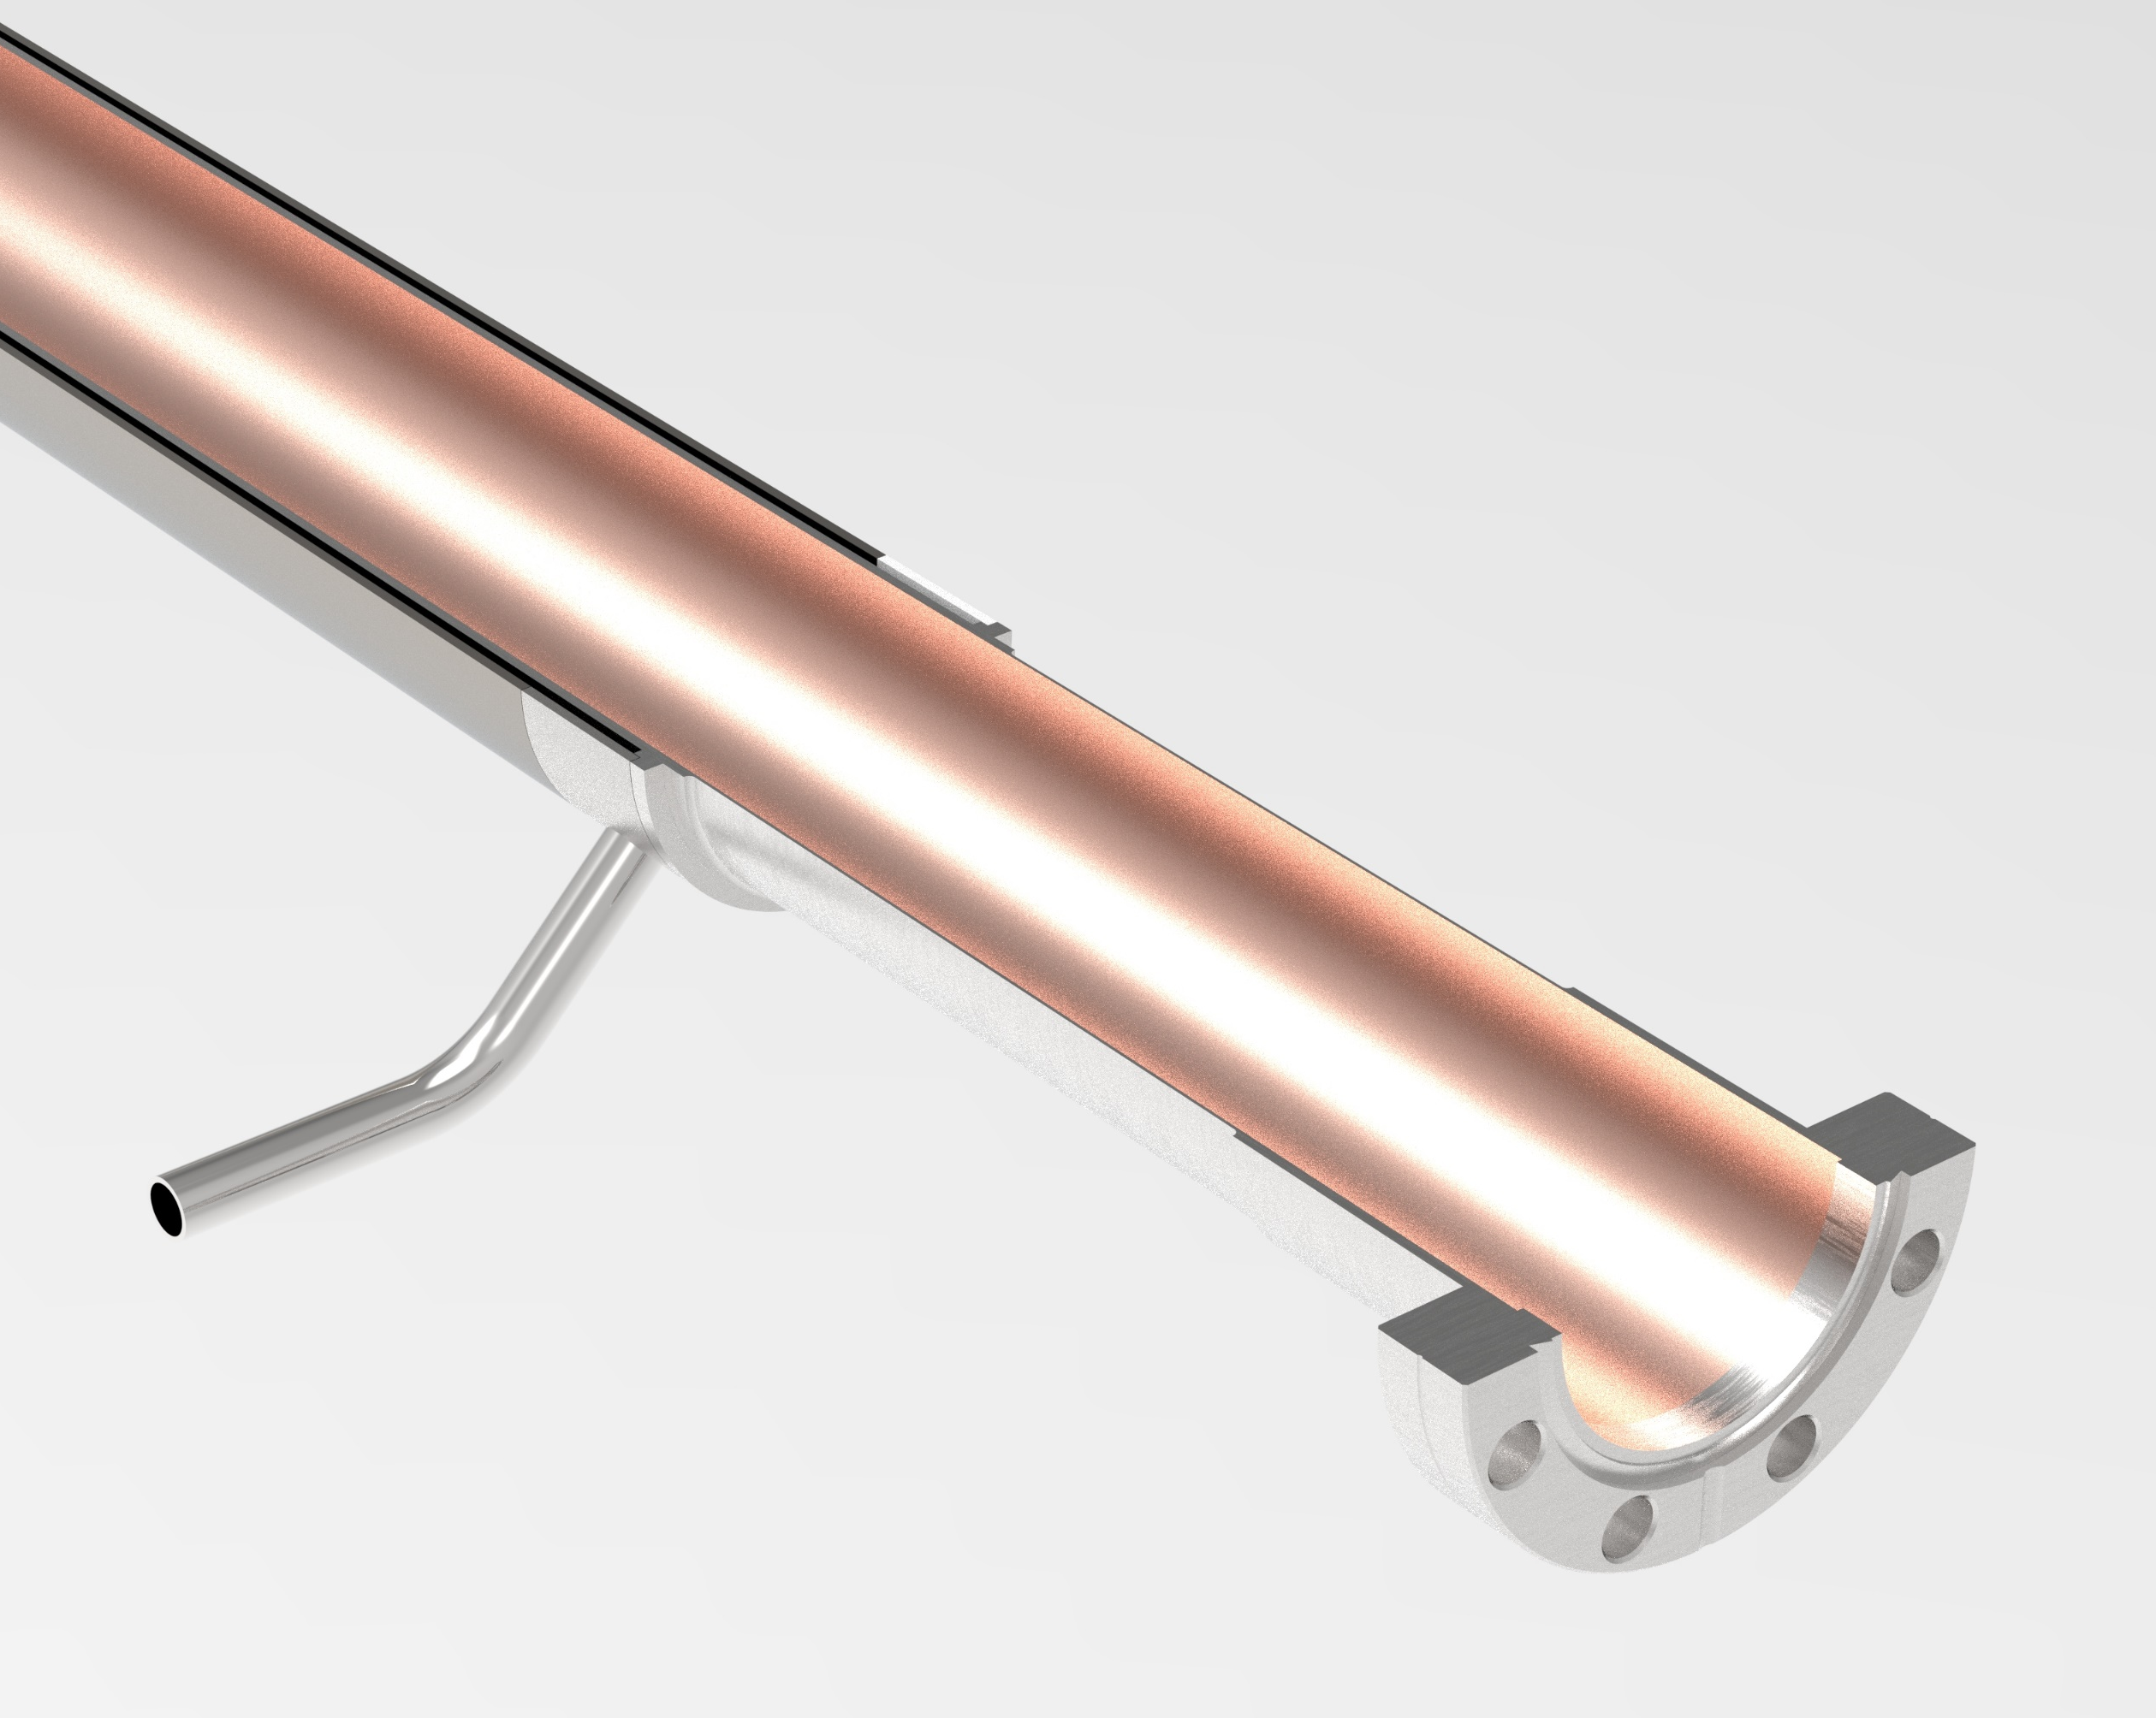
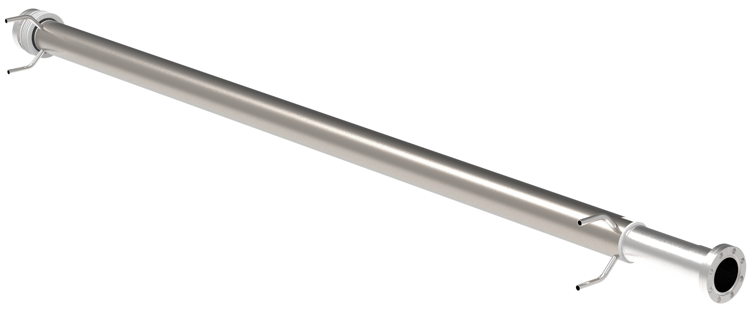
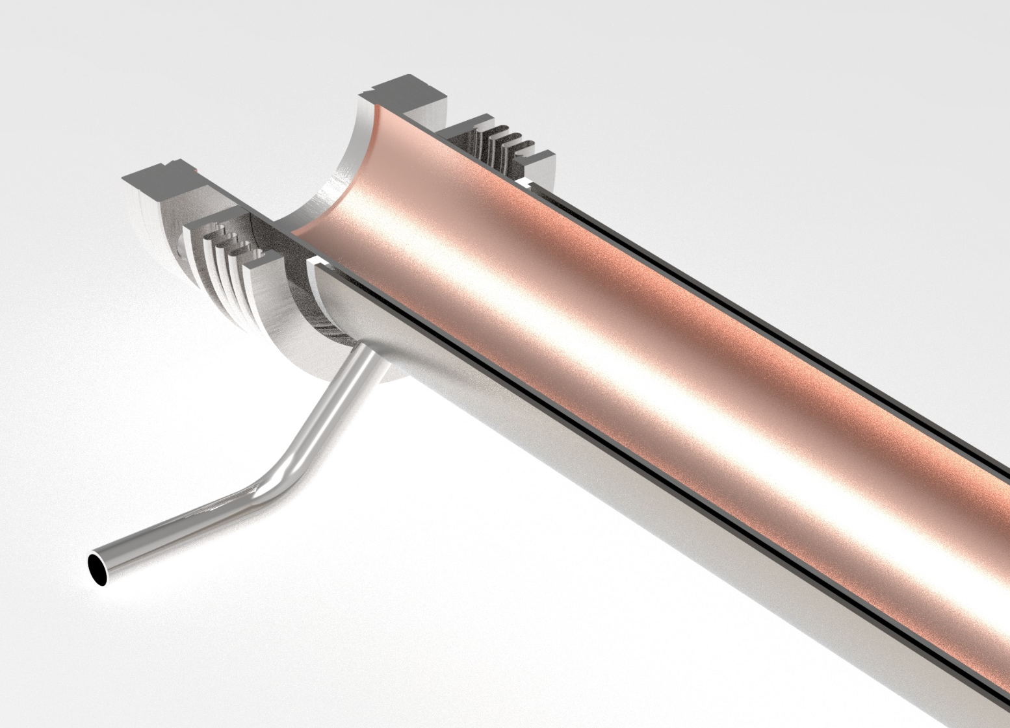
B0 Electron Vacuum Chamber
Coolant passage
Requires copper platting
Integral part of B0 magnet
Final welding after installed in cold mass
Welded on after chamber inserted
Thinned wall section
Liquid helium inlet
Welded on after chamber inserted
Compliance bellows
Welded to magnet structure
Outer cooling jacket
Liquid helium exit
Coolant passage

Slide 13
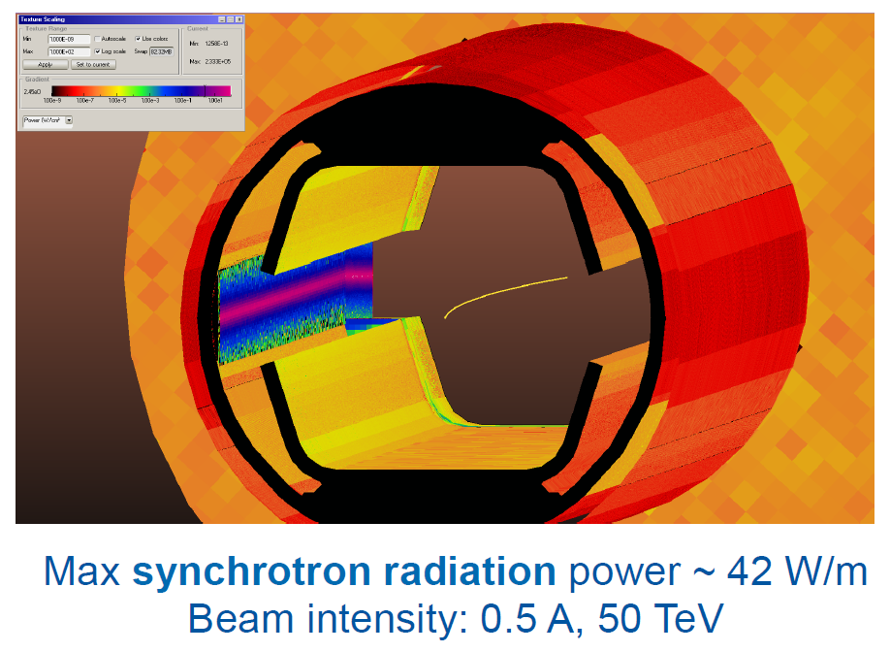
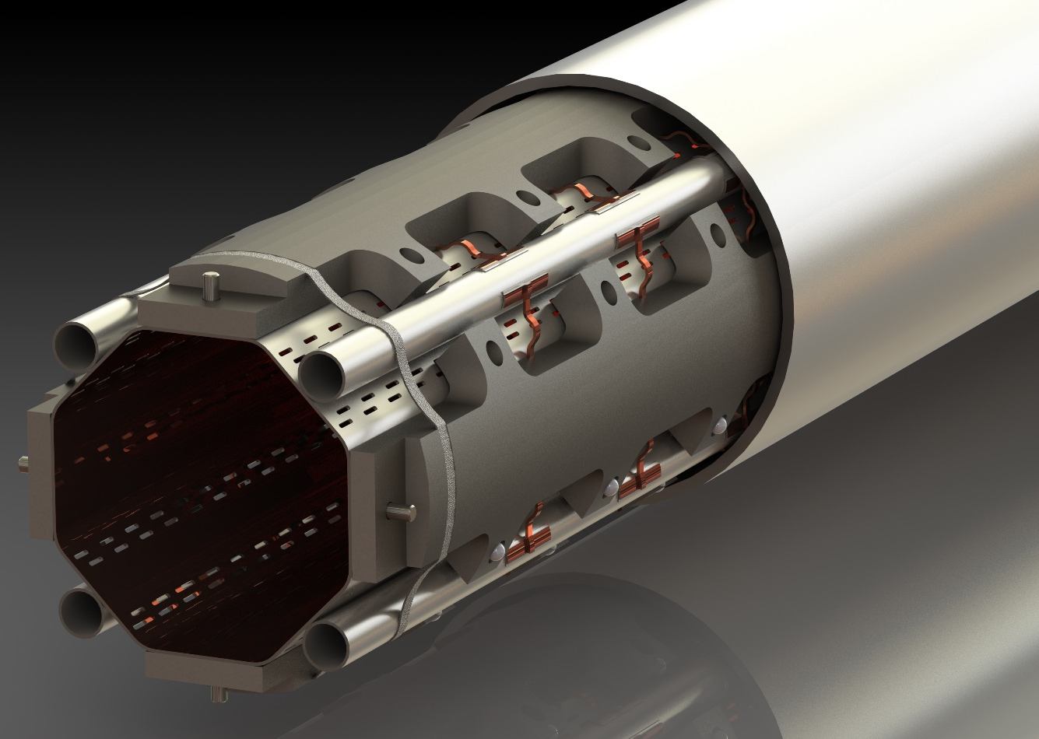
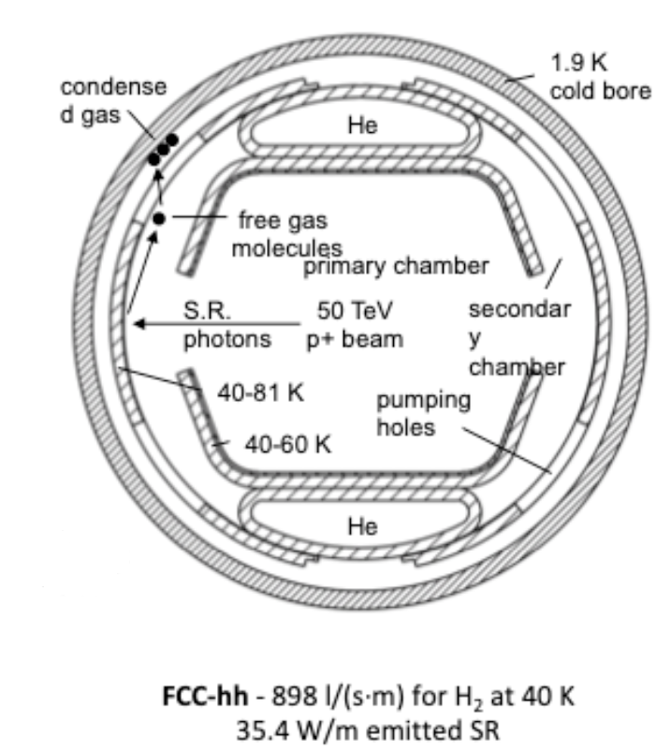
Electron Beam Screen
M. Morrone
CERN (FCC-hh)
Very high heat load in first section and taper (375 W/m)
Added complication due to shielding
May be easier to increase beam screen wall thickness
Need to take advantage of 2K cryopumping from cold bore
Beam screen <80K
C. Garion
CERN (HiLumi)

Slide 14
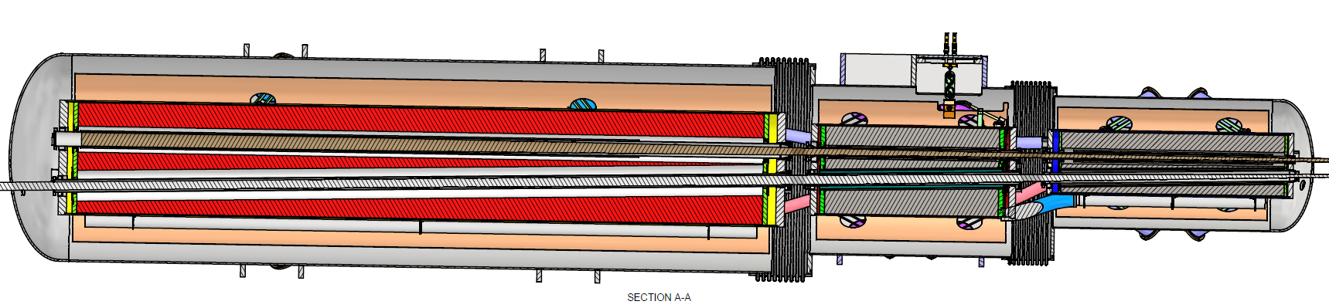
Rear Cryostat Assembly
Hadrons
Q2pR
Q1BpR
Q1ApR
Q2eR
Q1eR
Drift
Electrons
Hadron stay clear based on points provided
10 σ_{x} and 10 σ_{y} high divergence (no orbit offsets)
Gold injection at 2.5 micron normalized, 8/7 sigma (x/y), 10m horizontal 0.9m vertical betas
Points provide at beginning, middle and end of each lattice magnet element plus every 10cm through the detector
Electron stay clear based on 18 GeV collision optics
Envelope for other energies are smaller (V6.3.1)
Stay clear includes 13.5 σ_{x} and 22.5 σ_{y} only (no orbit offsets)
RF bellows required between each cold mass (both beam lines)
BPM required in each interconnect

Slide 15
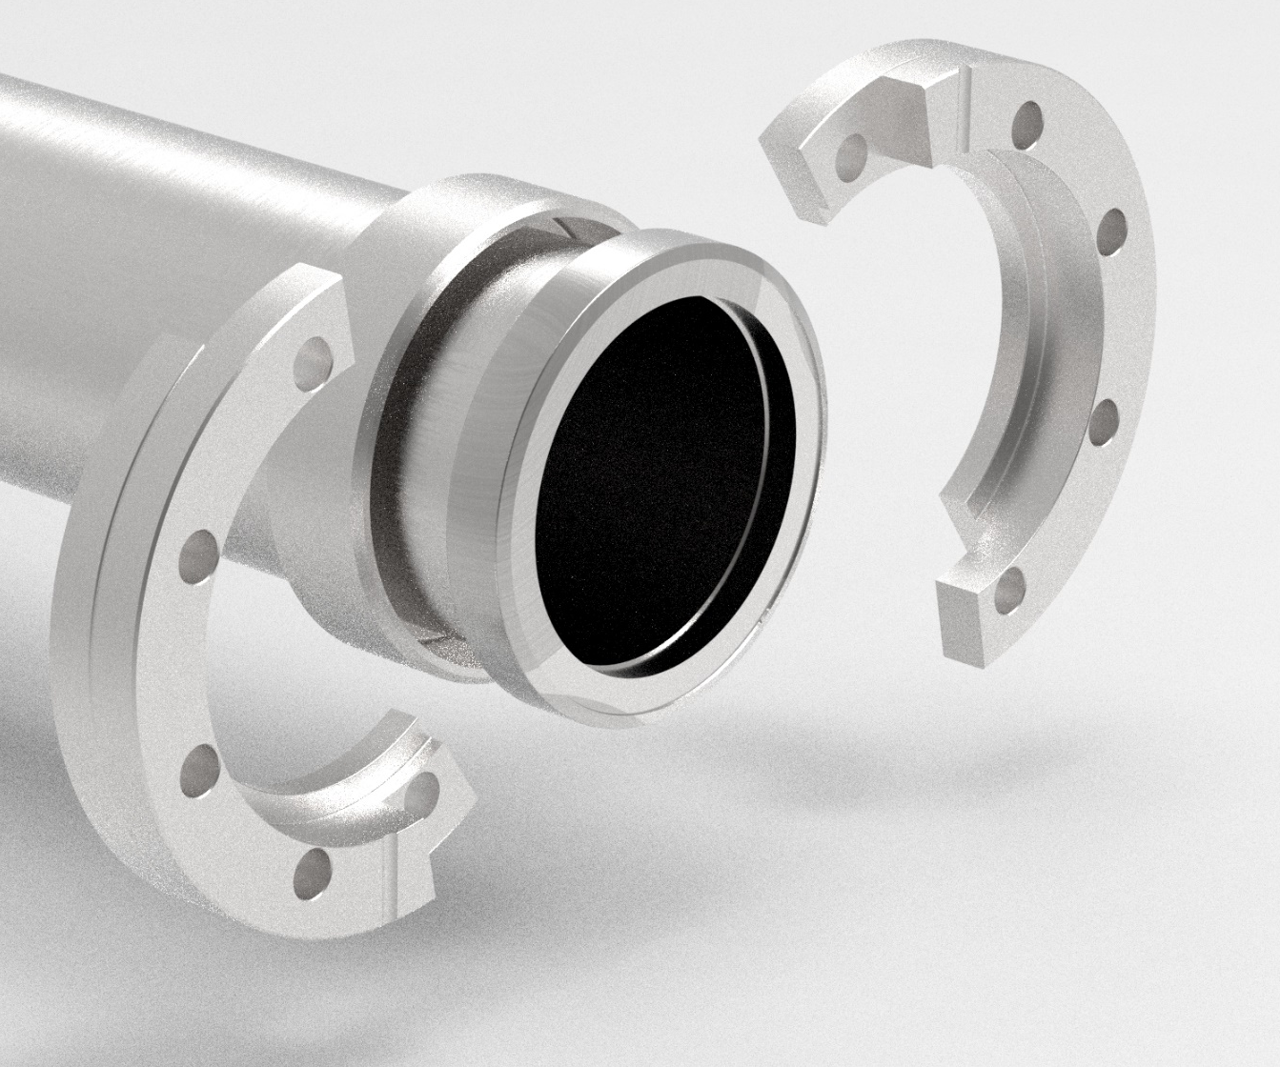
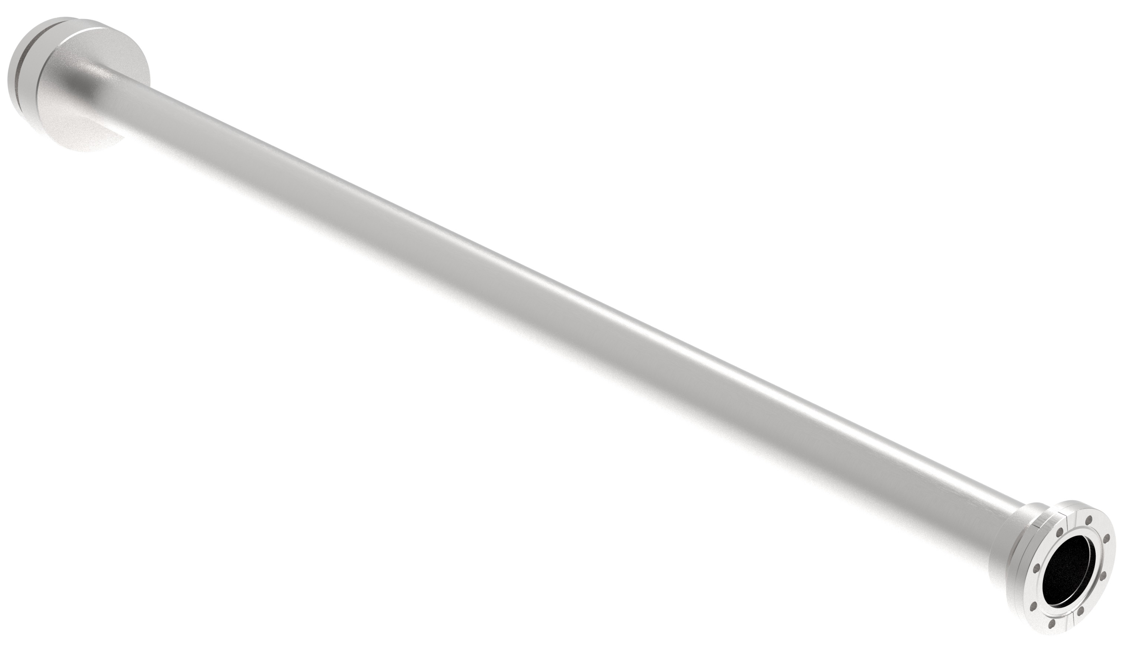
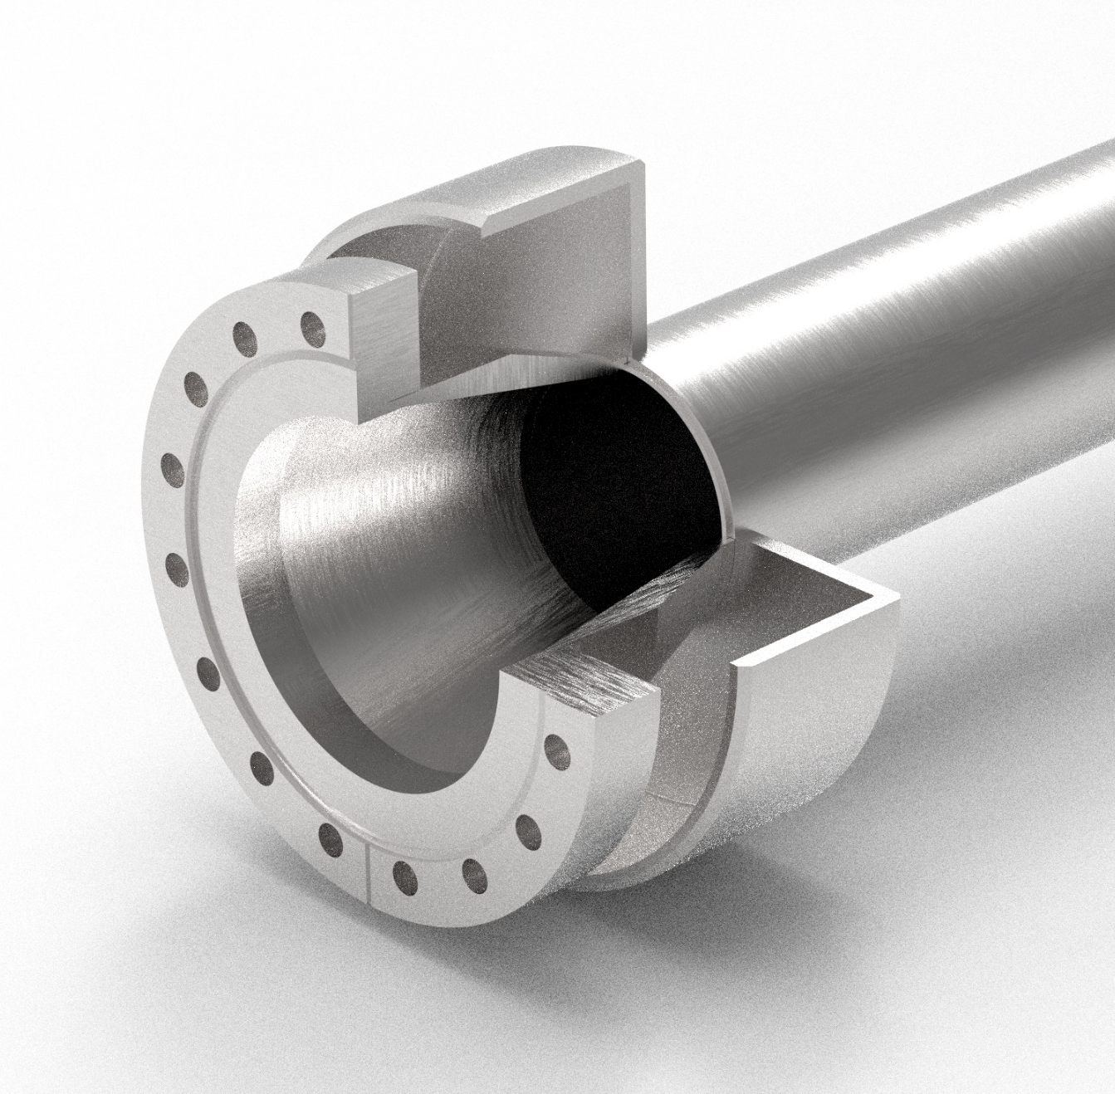
Chamber Concept
Split flange ring
Liquid He interface
(no UHV – He interface)
Intermediate spacers not shown
Part of chamber
Large diameter weld cuff
IP SIDE
Split ring installed after magnet installation
Standard tubing
Weld seam
Taper
Small diameter weld cuff
(slightly larger than flange insert)
NON-IP SIDE

Slide 16
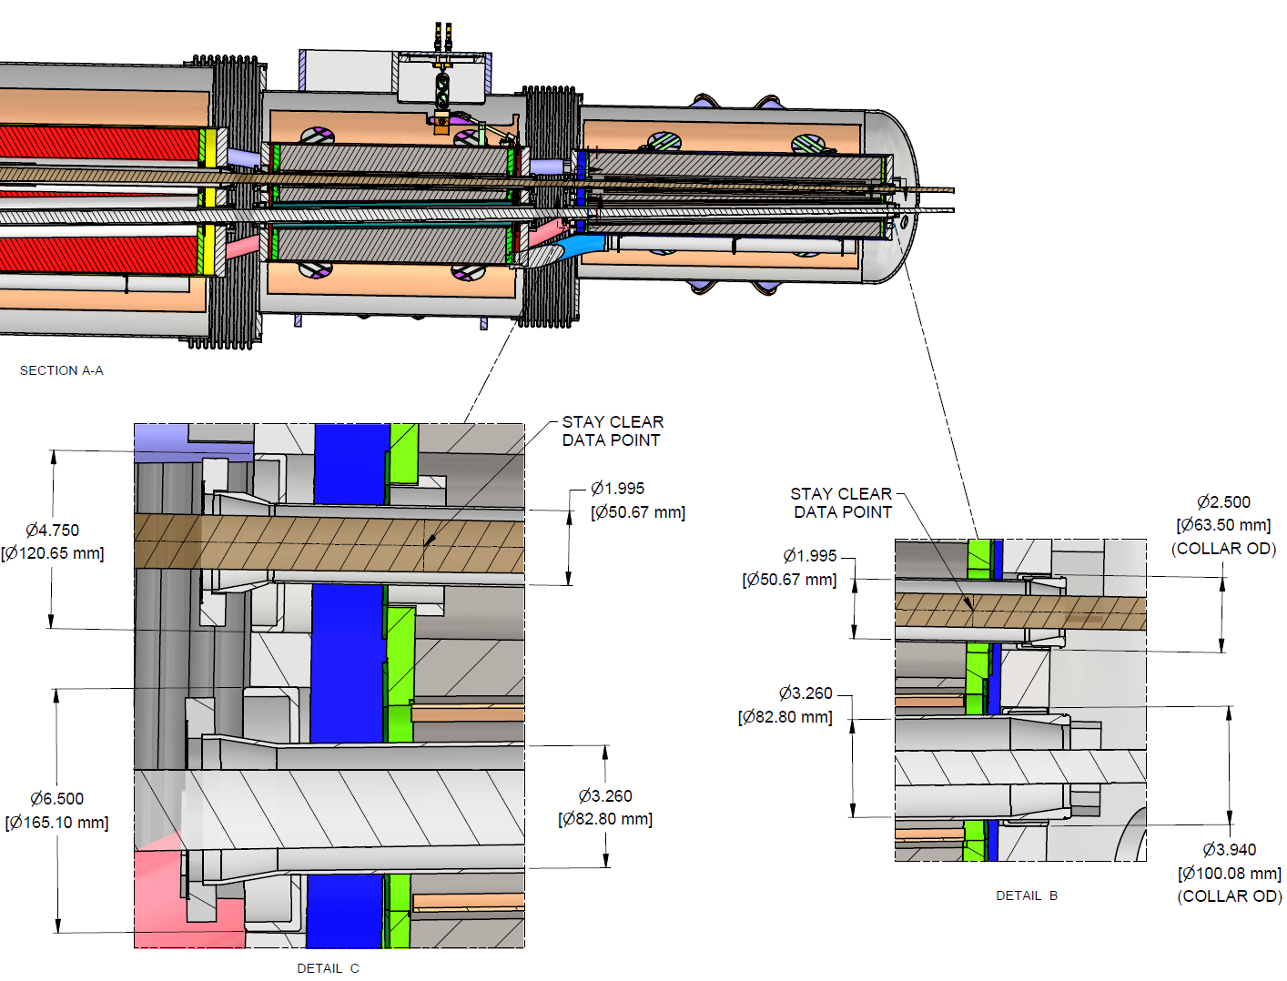
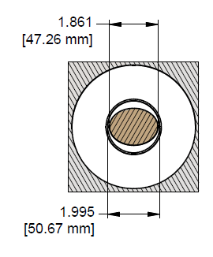
Rear Interconnects
Standard tubing sizes
Hadrons : 2” x .065” wall
Electrons: 3.5” x .12” wall
Chambers complete before installation
Slid in from non-IP side
Welding cuffs to protect plating/coatings
Intermediate spacers to keep tube centered
Taper transitions at ends
Sperate weld on piece
Weld joint protected by cuffs
Bellows welded to IP side
IP side of RC-1
Non-IP Side of RC-1

Slide 17
Next Steps
Finalize and document apertures through final focusing magnets
Beam stay clear envelopes defined
Record of decision in draft
Central detector chamber
Water cooling to mitigate synchrotron radiation
Chamber integration, alignment and support system
Finalize in situ bake out system
Beam screen design for forward electron side
High heat load, radiation shielding required
Optimize to maximize cryo-pumping from cold bore (decrease beam-gas events)
Update pressure profile through IR area
Geometry for rear side electron vacuum chambers
Luminosity exit window, low Q² taggers
Advance mechanical design of far forward side vacuum system

Slide 18
Summary
Integration of detector systems with the accelerator components progressing
Geometry shared as it is being developed
Experimental requirements are key drivers in designs
Compromises are negotiated when needed
Active discussions between stake holders to resolve remaining challenges
Experimental program, magnet division, accelerator physics, technical systems, etc.

