Slide 1




Barrel TOF technical status
Dr. Simone M. Mazza
TOF Technical Coordibator
(SCIPP, UC Santa Cruz)
June 11th - 13th, 2025, 10th EIC DAC Review

Slide 2
Charge questions
Q1: Is the design of the ePIC detector and its sub-systems appropriate and progressing well?
Q2: Are the remaining work and technical, cost and schedule risks adequately understood? Are there opportunities?
Q3: Will the detector be technically ready for baselining by late 2025?
Q4: Are the detector integration and planning for installation and maintenance progressing well? Are there areas where further ideas should be pursued?
Q5: Will the detector be ready for start of construction by late 2026?

Slide 3
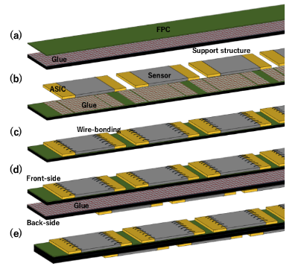
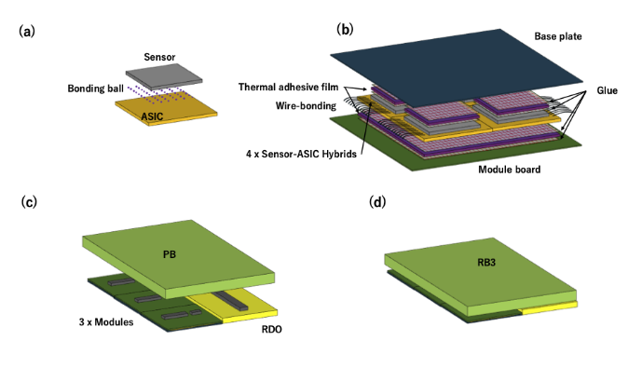
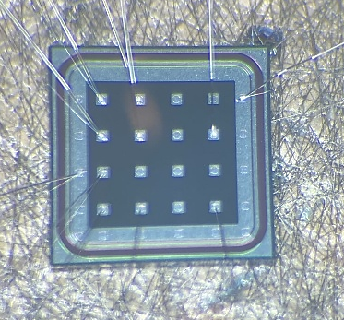
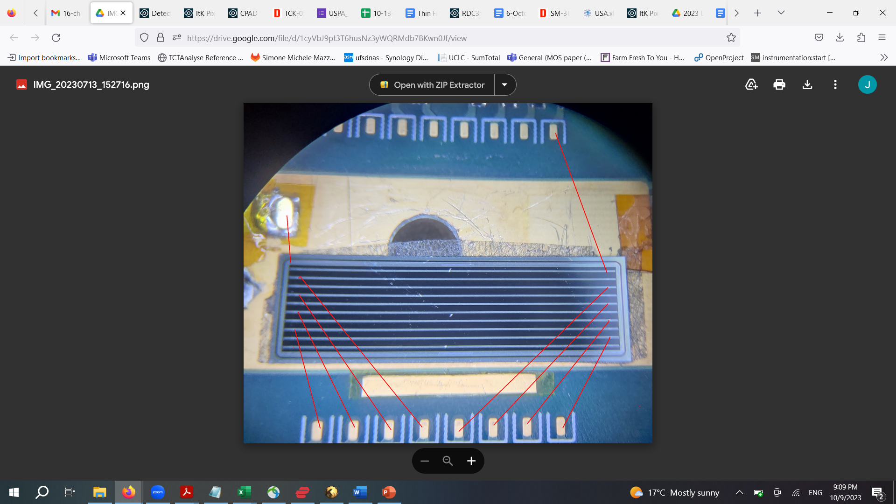
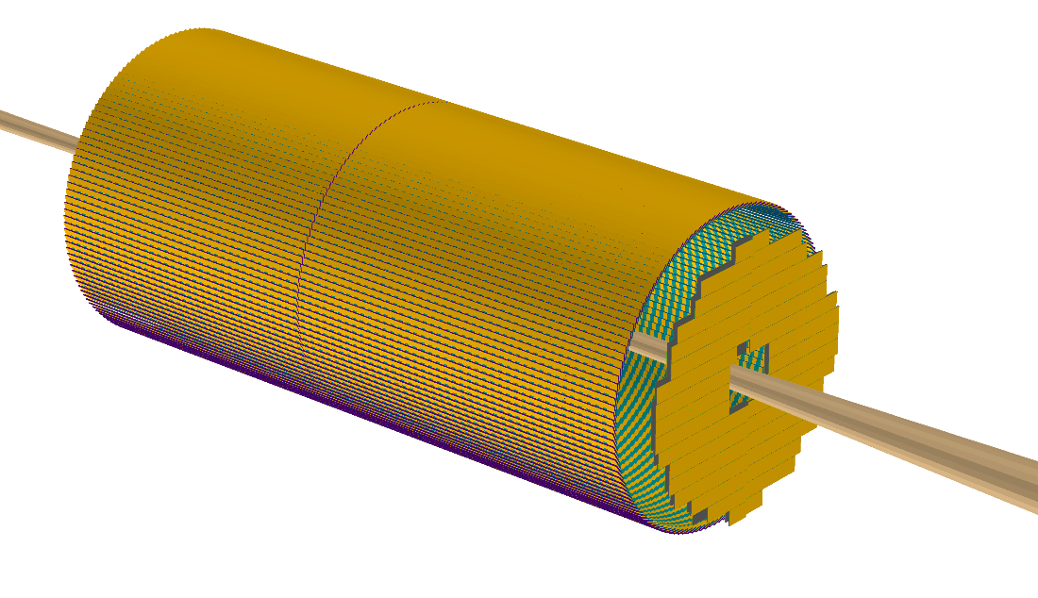
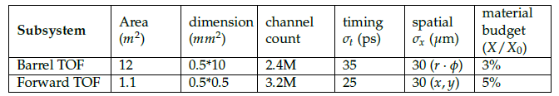
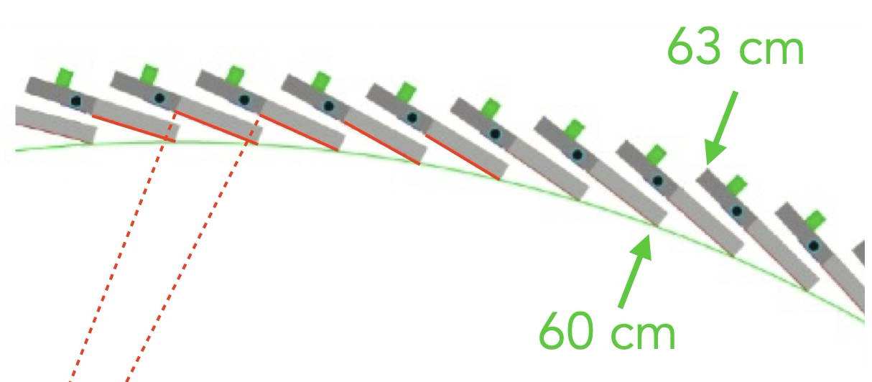
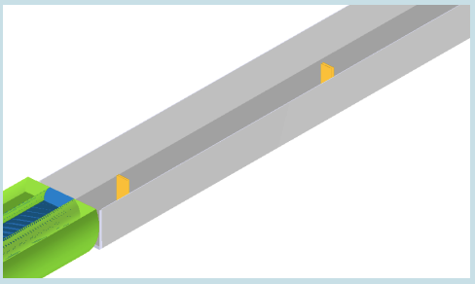
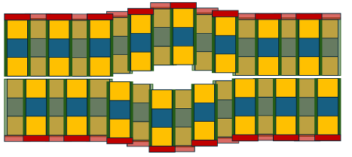
TOF layout in ePIC
Q1, Q2
This talk
Sensors: pixels
Readout: EICROC
Sensors: strips
Readout: FCFD
Next talk
Sensor R&D is mostly in common and shared between subsystems
Make cylindrical shape
by tilted staves
Off-Momentum Detectors (OMD)
Sensors: pixels
Readout: EICROC

Slide 4
Sensors for the ePIC BTOF

Slide 5
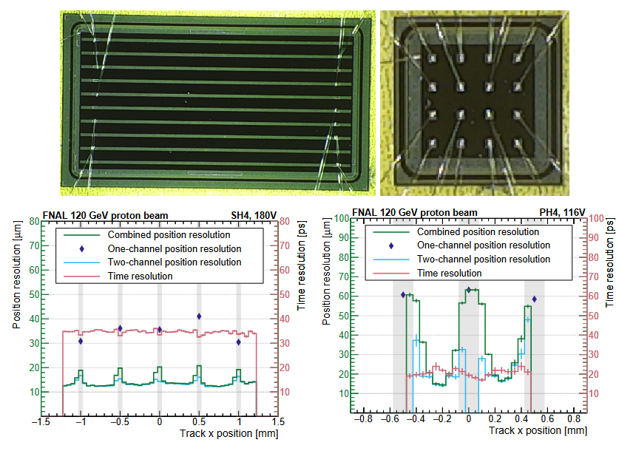
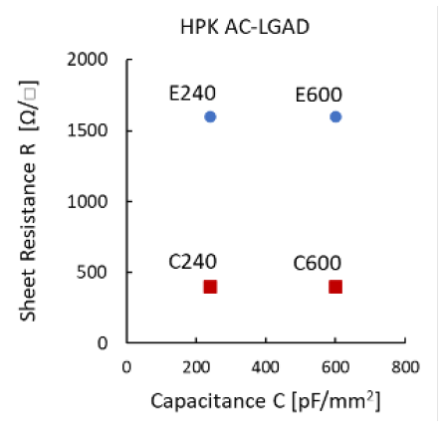
2023 HPK production
Q1, Q2
Test beam and laboratory campaign to characterize HPK sample
  Matrix of different pitch/size metal, different N+ resistivity and oxide thicknesses
FNAL test beam results from HPK 2023 production, most ePIC requirements are met
  Time resolution ~35ps, and positioning resolution ~15um for 1cm x 500um strips
Laboratory studies done with TCT laser
  Type E strips (more resistive) have better performance
  1cm strip length is the best compromise
References: https://arxiv.org/abs/2407.09928 https://doi.org/10.1016/j.nima.2024.169478

Slide 6
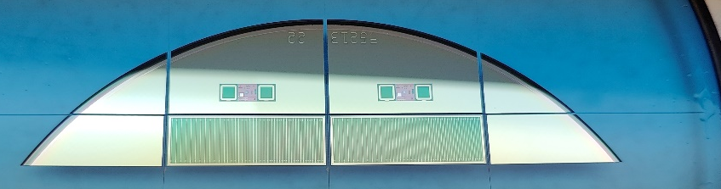
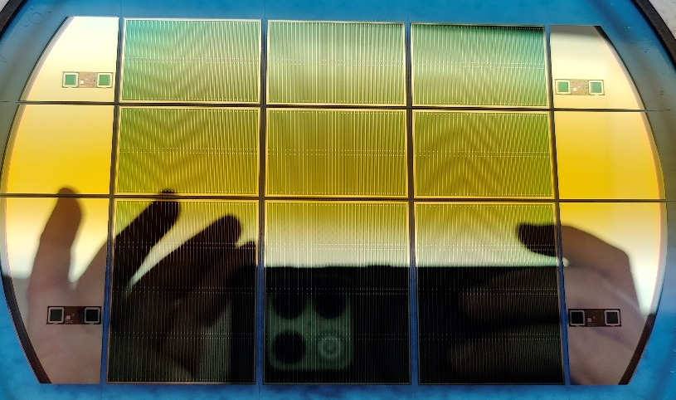
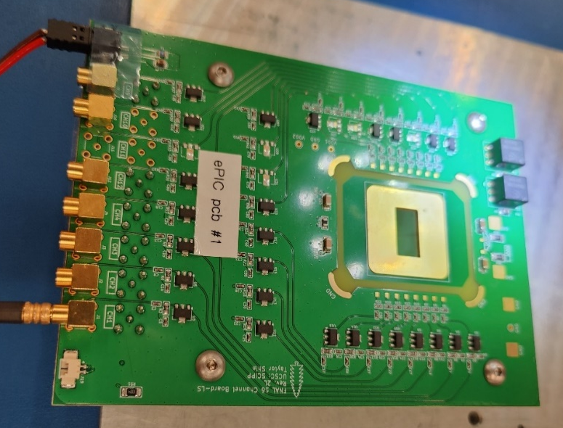
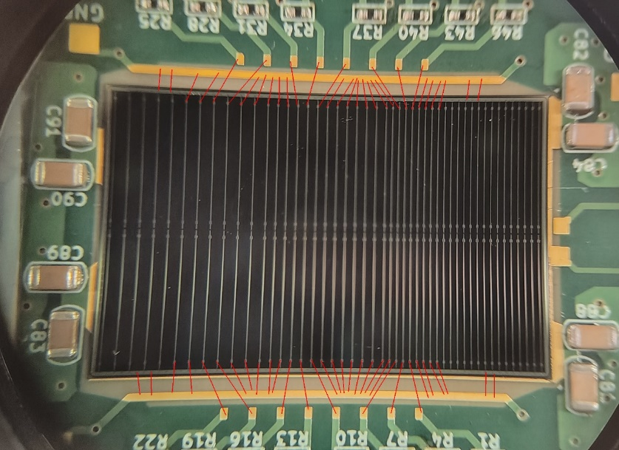
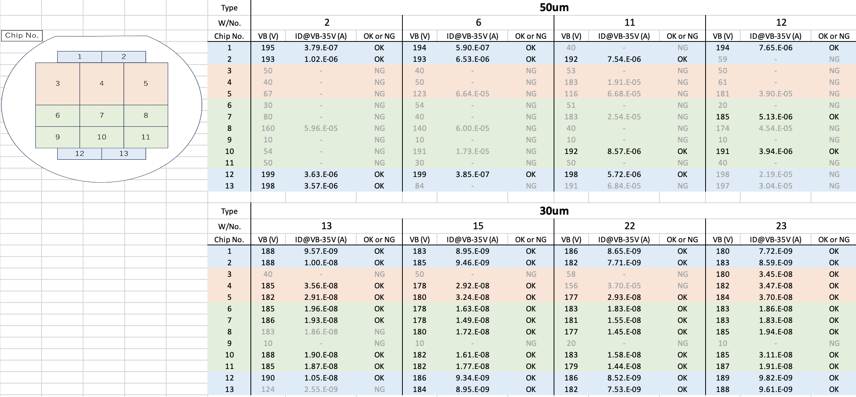
2024 HPK production
Q1, Q2
ePIC full-size production of strip AC-LGADs from HPK with devices up to 3.2x4 cm
  Nominal size 3.2x2.2 cm with 1cm strip ‘segments’
  Strip width: 50um, strip pitch 500, 750, 1000 um
First ever large prototype production of AC-LGAD
8 wafers in hand, four 50um thick and four 30um thick
  Low yield of 50 um has been solved
Produced a new 16ch discrete component board that can house larger sensors
Half sensors
Full sensors
Double sensors

Slide 7
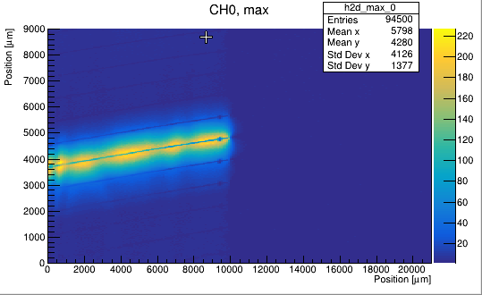

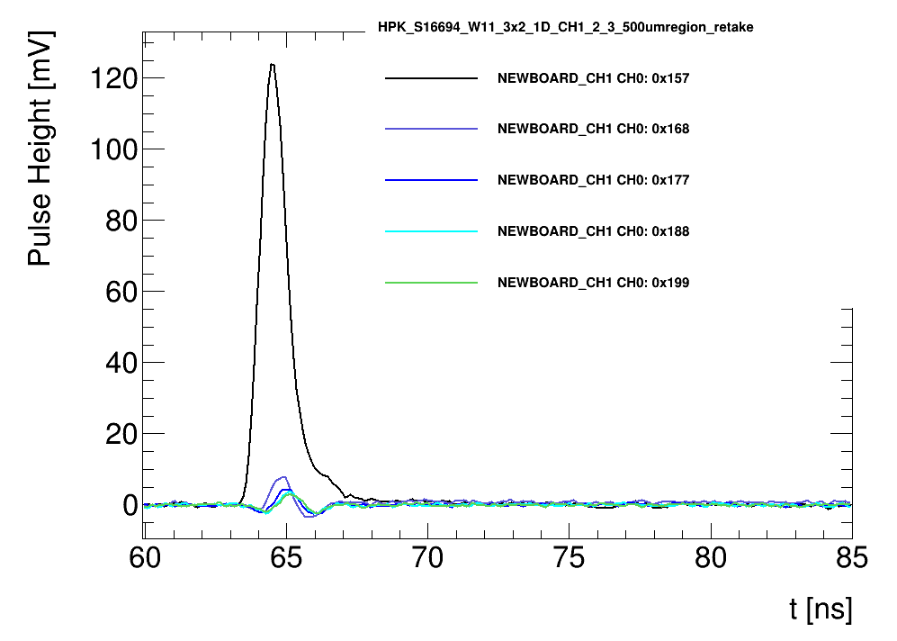
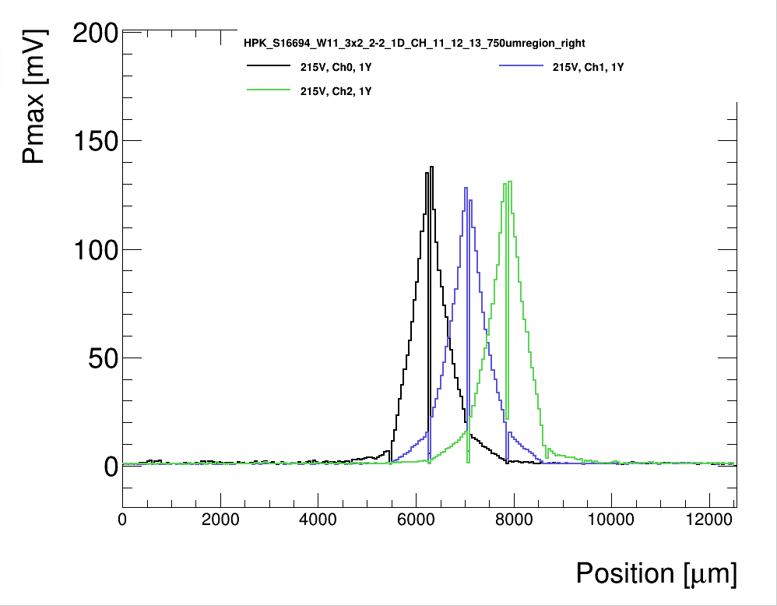
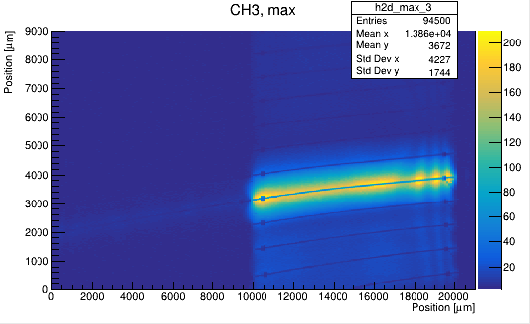
HPK production results - TCT
Q1, Q2
Full size sensors tested on a large board with laser TCT
  Both 50um and 30um thicknesses, show similar performance
Sensor works well, some gain variation across strip but it’s unclear if due to laser reflections, will verify at test beam
Pulse as expected with rise-time 600-700 ps
Signal for 1000um, 750um and 500um pitch is similar
  Higher S/N loss between strips for 1000um

Slide 8
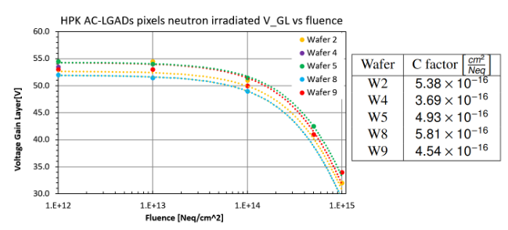
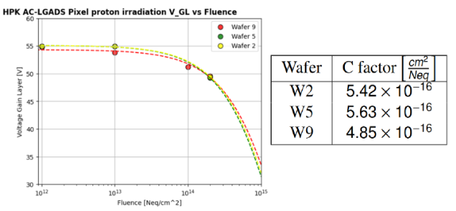
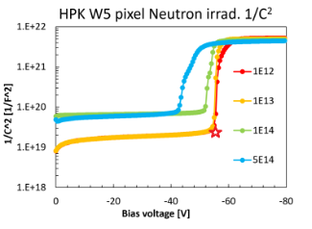
Irradiation effects on AC-LGADs
Q1, Q2
Up to 1e13 Neq, no significant change in sensor IV properties and gain layer doping
  Leakage current scales with bulk volume
  Current and breakdown voltage increases with fluence (as expected)
  Gain layer doping proportional to Vgl (gain layer depletion voltage) or ‘foot’ (star in the plot)
    Degradation parameter, ‘c’ factor, from fit on the distribution vs fluence
  Behavior across wafers is consistent
  Comparable results for protons and neutrons
Negligible gain
Layer change in ePIC
(10 years run)
Student: J. Ding, M. Davis

Slide 9
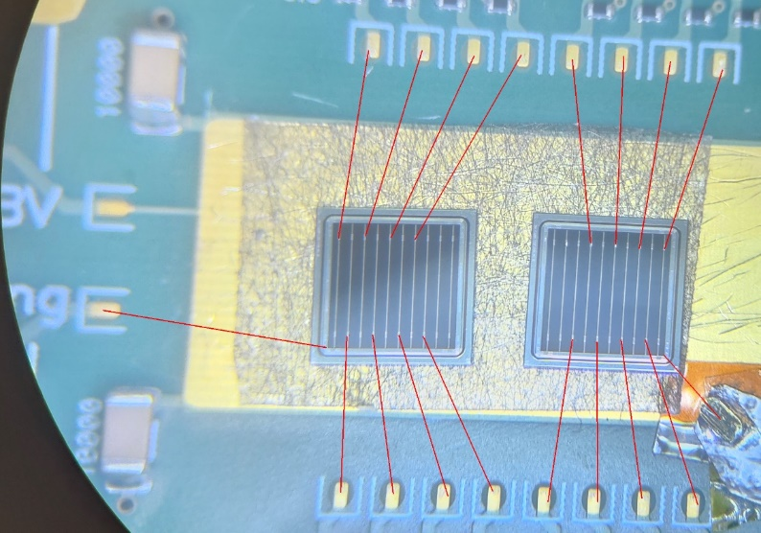
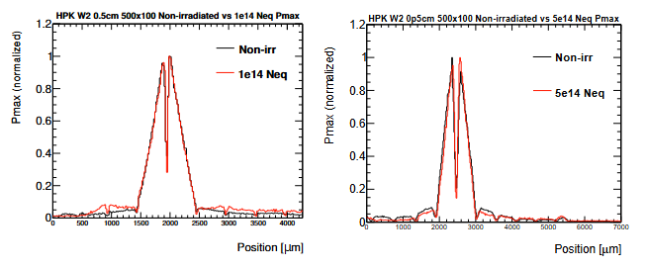
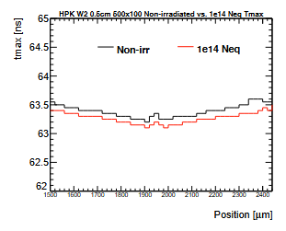
TCT laser studies - Neutrons
Q1, Q2
Using laser TCT setup with cooling plate and FNAL 16ch board
Direct AC-LGAD strips comparison non-irradiated and irradiated sensors
  Two sensors types at two neutron fluence points 1e14Neq and 5e14Neq
  Irradiated sensor was biased to higher voltages
At first order, the charge sharing distribution is unchanged
Signal propagation in resistive N+ is the same
Laser scan (20um spot)
Signal propagation
Student: G. Stage, A. Borgijin

Slide 10
Sensors plans
Q1, Q2, Q3
An additional HPK production with improved yield and optimize design is being organize with Japanese funds
Organizing a fraction of an FBK production (multi-institution, common RD50 funds)
  Strips and pixels
  Plan to have a ‘large’ 1x1cm strip sensor
Test beam plans this summer/fall at JLAB and KEK to characterize sensors

Slide 11
Electronics for the ePIC BTOF (frontend/backend)

Slide 12
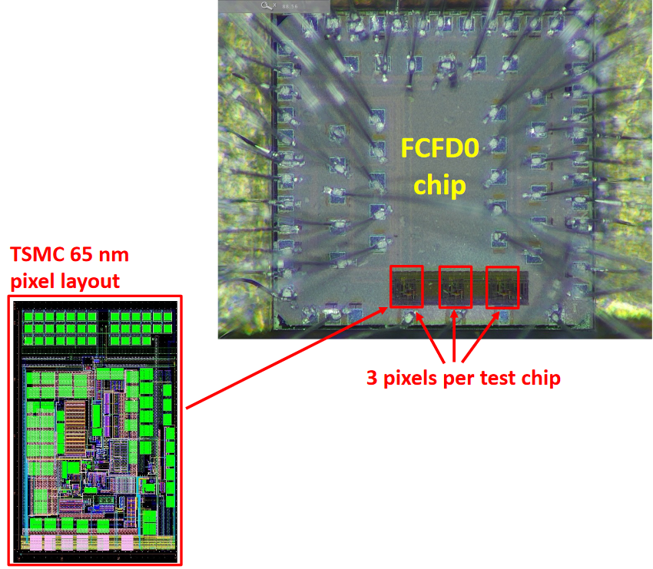
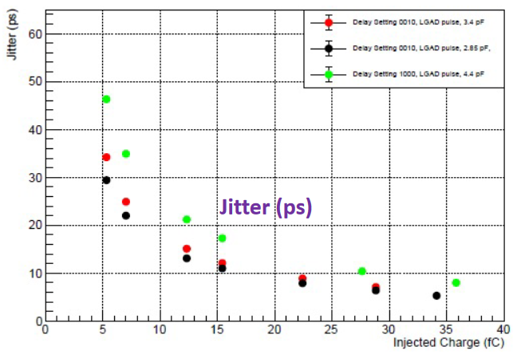
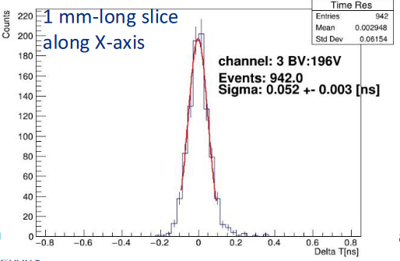
Q1, Q2, Q3
AC-LGAD strip readout – FCFD (FNAL)
EICROC being developed for pixel AC-LGADs: target capacitance few hundred fF
  But EICROC is not suitable for strips where capacitance can be o(10pF)
AC-LGAD strip readout developed at Fermilab: variation of FCFD (calo readout)
  Can accept higher input capacitance with target Jitter <10ps
FCFDv1 – 6 channel received Jan 2024: Tested at FNAL in May/June 2024, AC & DC-LGAD (1 mm)
  DC-LGAD @ 50 ps; AC-LGAD @ 52 ps
  AC-LGAD should get <35 ps with improved comparator
FCFDv1.1 with full-size sensor– TSMC May 2025; DESY tests in July 2025.
  FCFDv2 with digital block will be available in Summar 2026
  FCFDv3 (final design) will be available in 2027
12

Slide 13
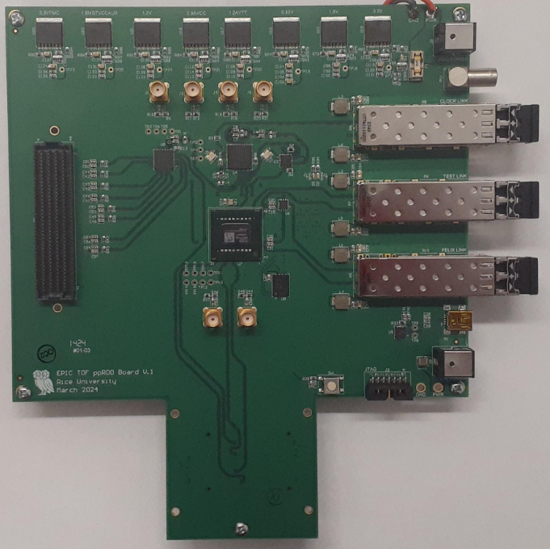
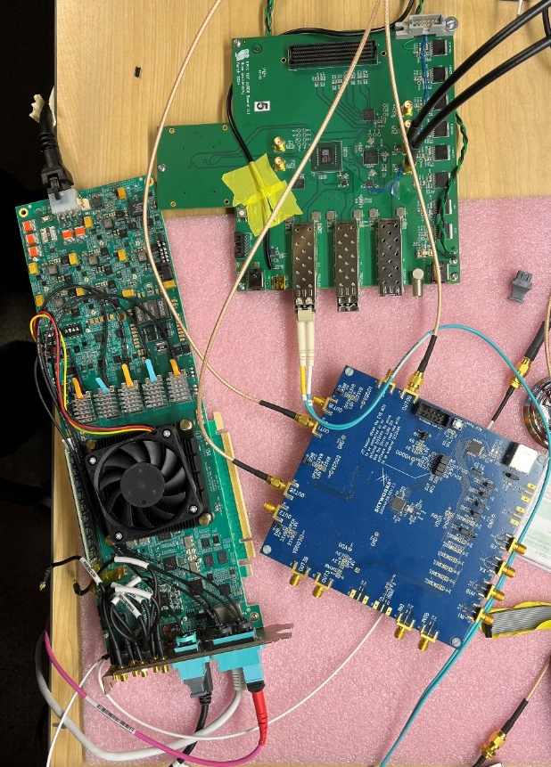
High Precision Clock Distribution
Q1, Q2, Q3
ppRDO – pre-prototype Readout Board:
  Generalized to allow readout from various ASICs – FMC connector
  Xilinx Artix+ FPGA (low cost, CERN TCLink compatible
  Clock Jitter cleaner – 5 ps
  Clock recovery on Rx of SFP or direct clock on dedicated fiber
  Establish procedures to readout ePIC’s ASICs prototype PCBs
  Develop common streaming readout scheme with DAQ’s protocols
  Platform for radiation tests (SEU measurement and handling)
Produced and tested 6 PCBs.
  Jitter measured at 3 ps (Ref clock – FLX182 Tx serializer – ppRDO)
ppRDO
(ADCLK944)
Si5344H
(ref Clock)
FLX182
13

Slide 14
Mechanics and assembly

Slide 15
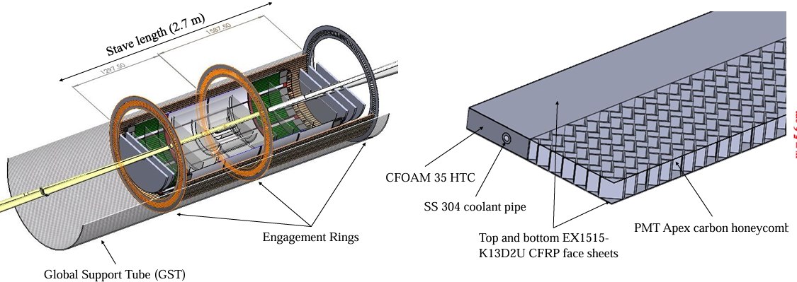
Q1, Q4
“Pinwheel” structure of the barrel, divided in two symmetric stave section
Support in carbon honeycomb with active pipe cooling
Modular ‘stavelets’ assembled separately and mounted
Peripheral board at the edge of the staves

Slide 16
asd
Q1, Q4
asd

Slide 17
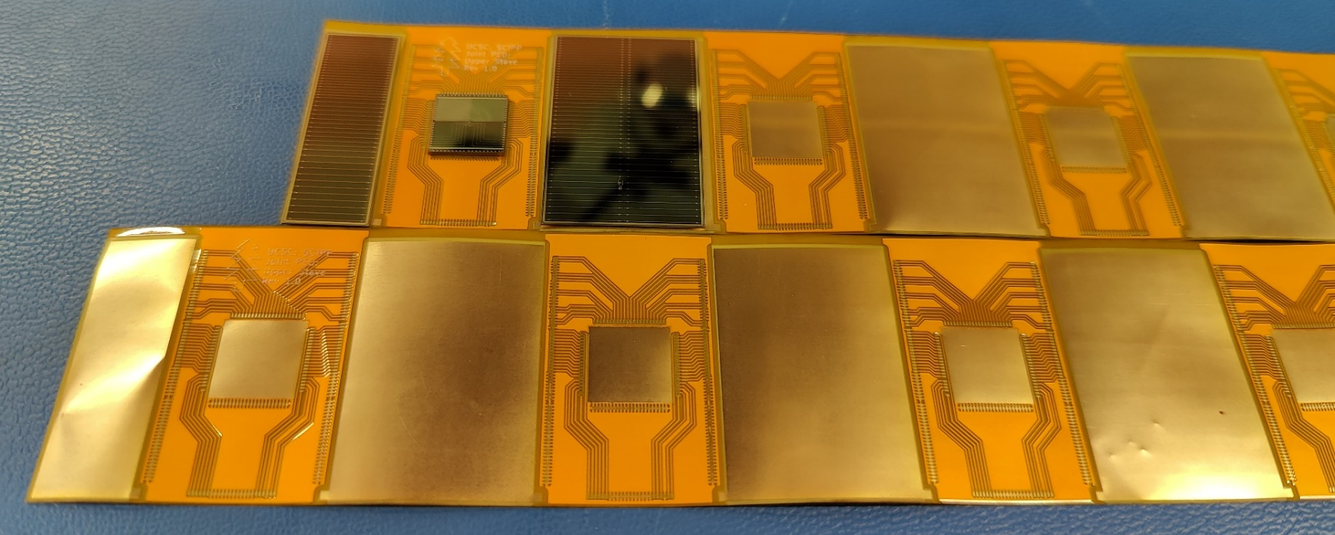
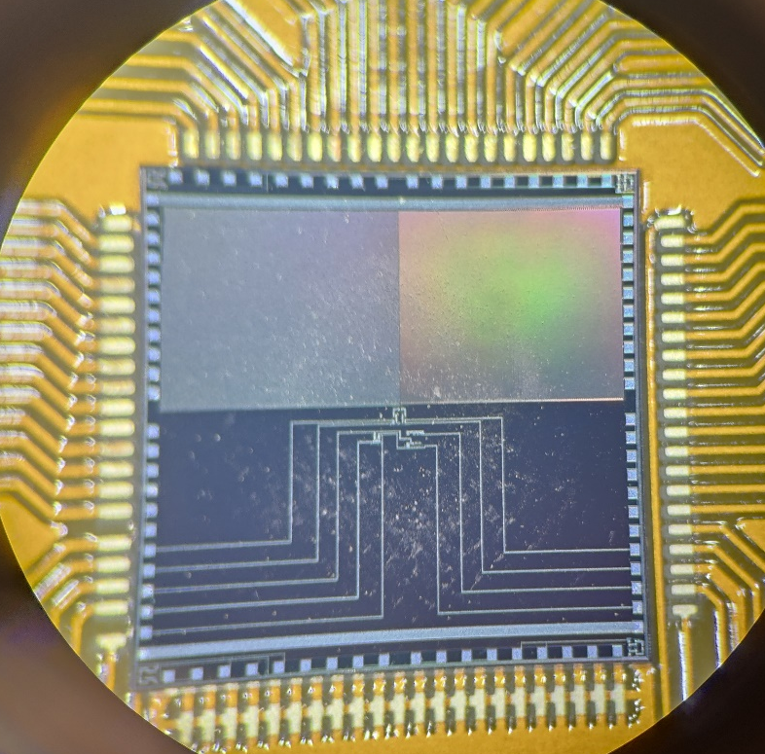
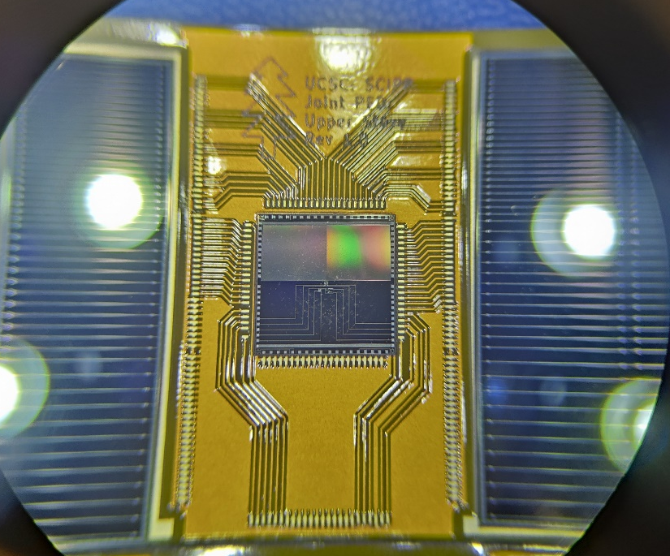
Demonstrator project
Q1, Q2, Q3, Q4
Plan to demonstrate the assembly procedure and study the thermal characteristic of a stavelet
First prototype of interposer board produced
Using non working full size detectors from the HPK production
Since no full-size ASIC available yet, using Si heaters
Fully load a double-sided stavelet with active pipe cooling and check thermal dissipation in prototype

Slide 18
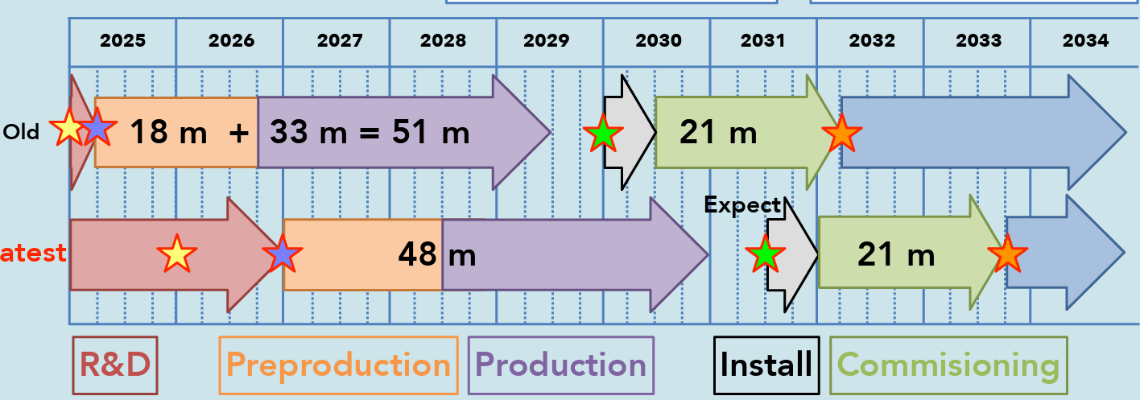
BTOF road-to-assembly
Demonstrator assembly
Develop tooling
Pre-production: assembly N stavelets
Full assembly
ITk (ATLAS) assembly

Slide 19


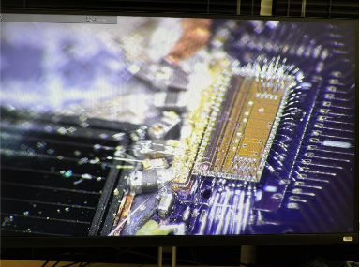

Conclusions
Components and design of the ePIC BTOF layer is reaching maturity: TDR expected by the end of the year
Ongoing development of AC-LGAD strips for the ePIC TOF layers
  Received first large-scale AC-LGAD production from HPK, first results are optimistic
  A FBK production is ongoing, an additional HPK production will start soon as well
Readout chips currently being designed and tested: FCFD for BTOF
  First test with full-size sensor and FCFD in July this year
  Test beam planned for full-size sensor testing and readout electronic testing this Autumn
Assembly procedure is being developed and organized
  “Stavelet” is baseline design to facilitate the assembly and more serviceable
  A thermo-mechanical demonstrator is expected by the end of summer

Slide 20
Charge questions
Is the design of the ePIC detector and its sub-systems appropriate and progressing well?
  Yes, the design of its subsystems is progressing well, with the main bottlenecks being the availability of ASICs. The results of the first full-size sensor test conducted in the lab showed no problems. First full-size sensor + FCFD (ASIC for BTOF) will be tested this year. Assembling procedure and several properties related to thermal and electrical will be tested by using demonstrator this year.
Are the remaining work and technical, cost and schedule risks adequately understood? Are there opportunities?
  Remaining work is well understood. Main schedule risks are related to availability of ASIC. FBK sensors will also be tested to reduce the risk of manufacturing the sensors that form the core of this detector.
Will the detector be technically ready for baselining by late 2025?
  The detector baseline is well established, and we aim to resolve the remaining open questions
Are the detector integration and planning for installation and maintenance progressing well? Are there areas where further ideas should be pursued?
  We have a plan for a set of demonstrator staves that will lead us to higher level integration steps. It is crucial that ASIC, Sensor production and mechanical design progress on schedule.
Will the detector be ready for start of construction by late 2026?
  YES, but correlated with ASIC availability

Slide 21



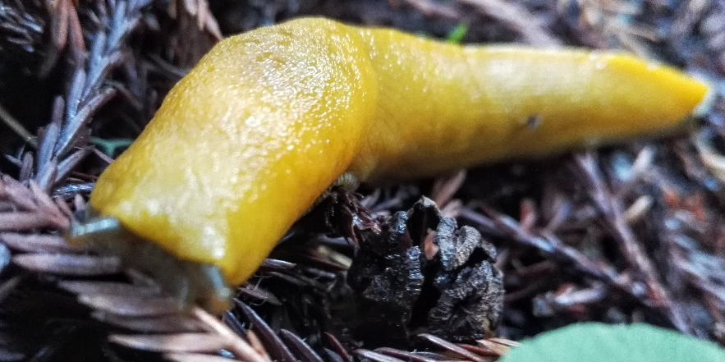



Thanks for the attention

Slide 22

Many thanks to the SCIPP group students and technicians!
In particular to students:
J. Ding, G. Stage, A. Borjigin, C. Altafulla, M. Davis, S. Beringer
Thanks to HPK for providing sensors for this study
This work was supported by the United States Department of Energy,
grant DE-FG02-04ER41286
This work was supported by eRD112 funds from EIC
Thanks to IJS (G. Kramberger, I. Mandic) and UNM (S. Seidel) for providing sensor irradiation at Lubjiana and FNAL ITA
This project has received funding from the European Union’s Horizon Europe Research and Innovation programme under Grant Agreement No 101057511 (EURO-LABS).

Slide 23
Backup

Slide 24
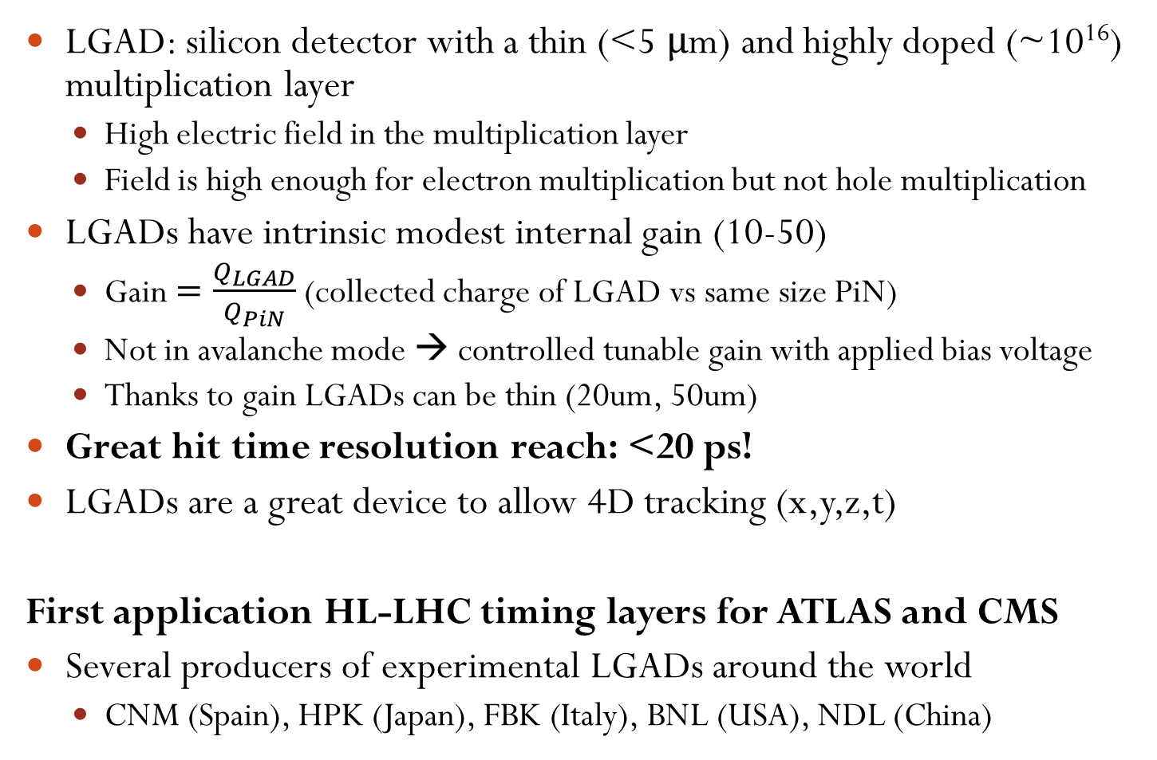
Low Gain Avalanche Detectors, LGADs
LGAD: silicon detector with a thin (<5 μm) and highly doped (~10¹⁶) multiplication layer
  High electric field in the multiplication layer
  Field is high enough for electron multiplication but not hole multiplication
LGADs have intrinsic modest internal gain (10-50)
  Gain $=\frac{Q_{LGAD}}{Q_{PiN}}$ (collected charge of LGAD vs same size PiN)
  Not in avalanche mode → controlled tunable gain with applied bias voltage
  Thanks to gain LGADs can be thin (20um, 50um)
Great hit time resolution reach: <20 ps!
LGADs are a great device to allow 4D tracking (x,y,z,t)
First application HL-LHC timing layers for ATLAS and CMS
Several producers of experimental LGADs around the world
  CNM (Spain), HPK (Japan), FBK (Italy), BNL (USA), NDL (China)
Nucl. Instrum. Meth. A765 (2014) 12 – 16.
Nucl. Instrum. Meth. A831 (2016) 18–23.
https://cds.cern.ch/record/2719855
  https://cds.cern.ch/record/2667167

Slide 25




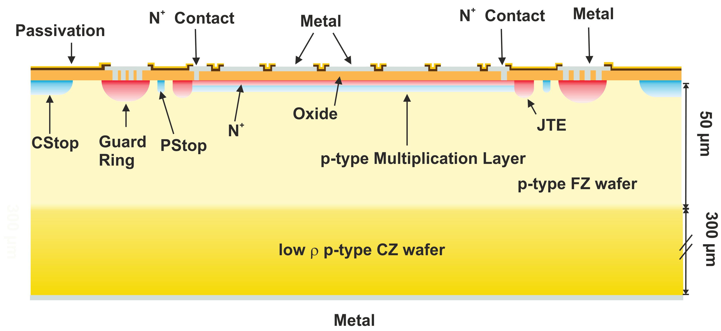

AC-LGADs
‘Standard’ LGADs has granularity limited to ~mm scale due to the high field on the surface
Most advanced high-granularity prototype is the AC-coupled LGAD
  Finer segmentation and easier implantation process
Continuous multiplication layer coupled with resistive (low doping) N+ layer
Readout pads are AC-coupled, insulator layer between N+ and pads
  Any surface metal geometry is possible

Slide 26
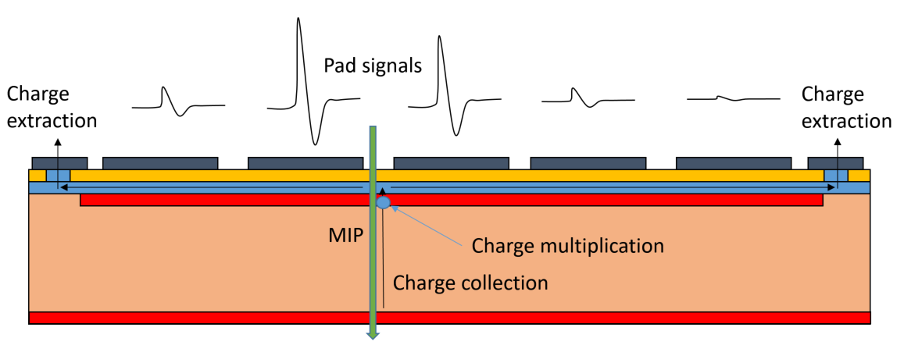
AC-LGAD hit reconstruction
AC-LGAD has intrinsic charge sharing
  Gain increases the S/N and allows for smaller metal pads
Charge sharing can be a great feature for low density tracking environment
  Using information from multiple pixels/strips for hit reconstruction
Sparse readout is extremely useful to reduce channel density and power dissipation (issue for fast timing) while maintaining good resolution

Slide 27
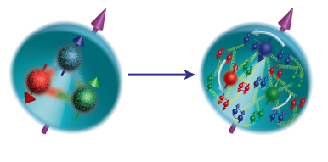
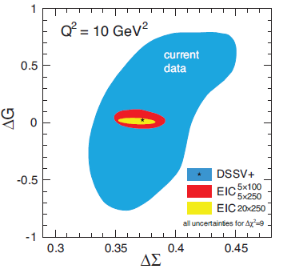
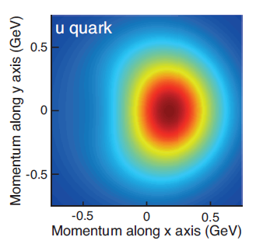
Electron-Ion collider
Electron-Ion collider will be the biggest NP effort in the U.S. at BNL
  Running conditions will be from 20-100 GeV c.d.m. to 140 GeV with polarized nucleon and electron beams and 10³⁴ cm⁻²s⁻¹ luminosity
ePIC is the detector 1 design currently under review
ePIC will provide key measurements:
Proton spin: decisive measurements on how much the intrinsic spin of quarks and gluons contribute to the proton spin. Only 30% proton spin is accounted for by quark-antiquark!
The motion of quarks and gluons in the proton: study the correlation between the spin of a fast-moving proton and the transverse motion of both quarks and gluons. Nothing is currently known about the spin and momentum correlations of the gluons and sea quarks.
The tomographic images of the proton: detailed images of the proton gluonic matter distribution as well as images of sea quarks. Reveal aspects of proton structure that are connected with QCD dynamics at large distances.
QCD matter at an extreme gluon density: first unambiguous evidence for a novel QCD matter of saturated gluons, Color Glass Condensate.
Gluon helicity contribution vs quark helicity contribution
X-Y u quark motion
For proton traveling in Z

Slide 28
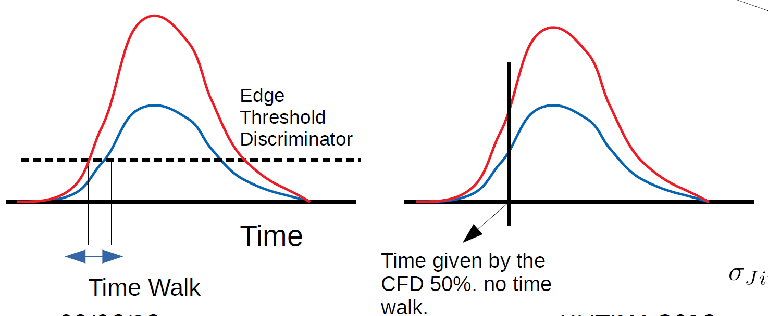
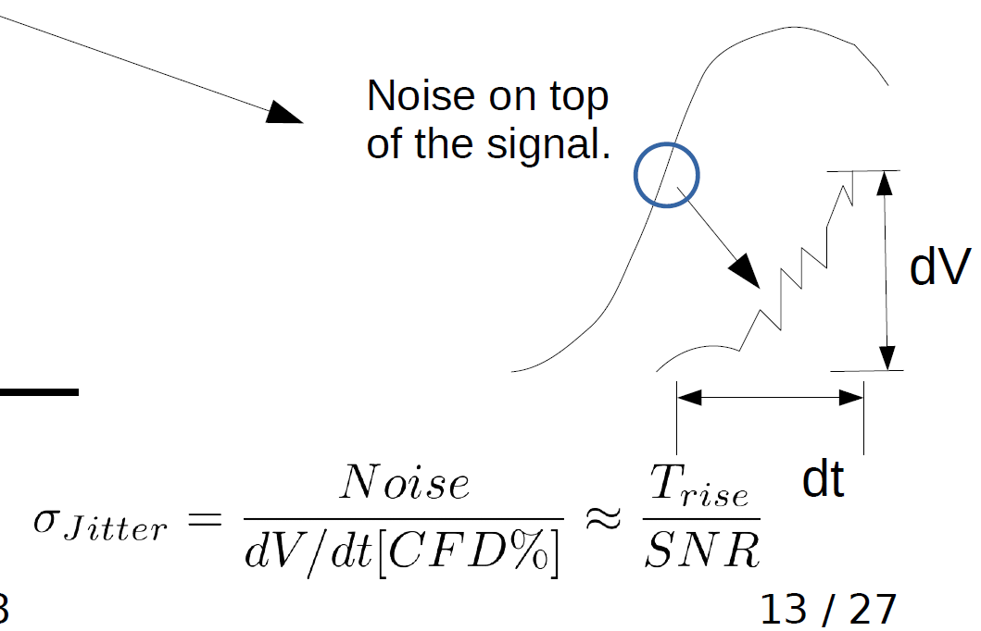
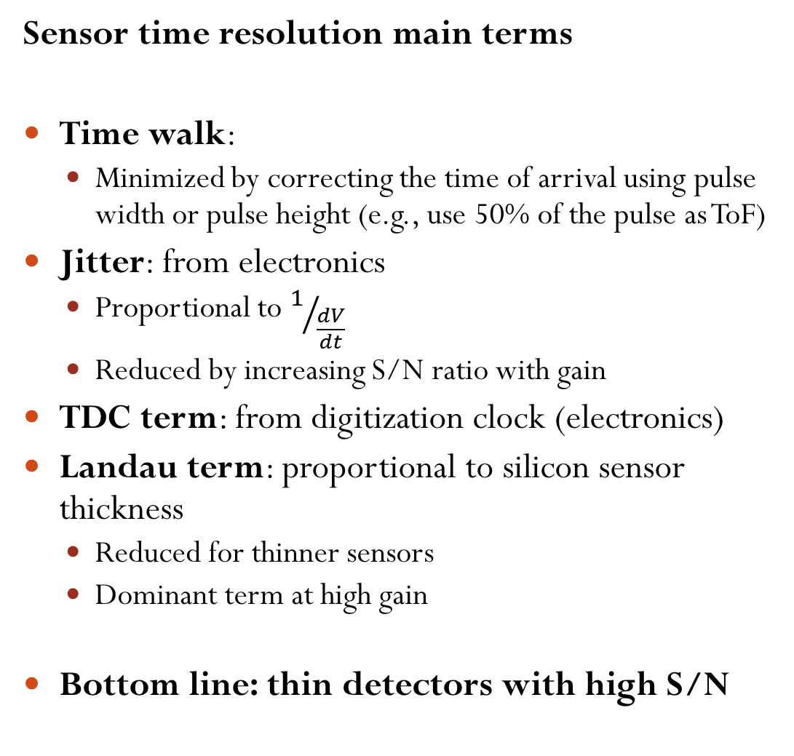
Time resolution
Sensor time resolution main terms
Time walk:
  Minimized by correcting the time of arrival using pulse width or pulse height (e.g., use 50% of the pulse as ToF)
Jitter: from electronics
  Proportional to $1/{\frac{dV}{dt}}$
  Reduced by increasing S/N ratio with gain
TDC term: from digitization clock (electronics)
Landau term: proportional to silicon sensor thickness
  Reduced for thinner sensors
  Dominant term at high gain
Bottom line: thin detectors with high S/N
Landau variations

Slide 29
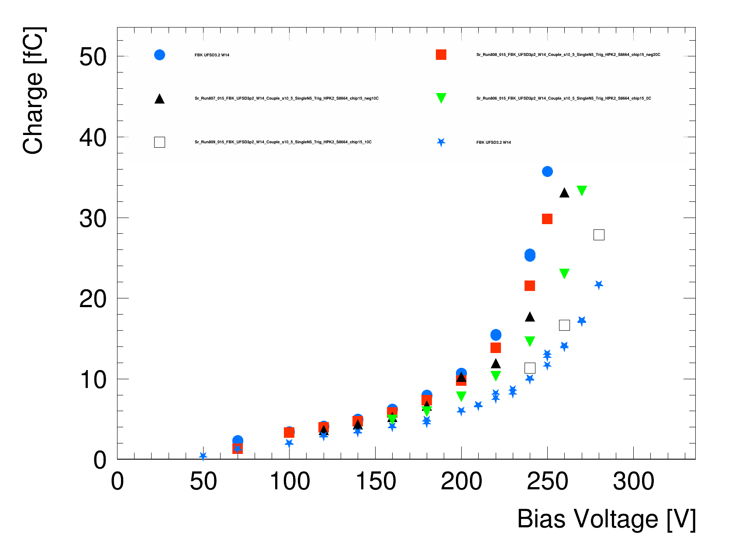
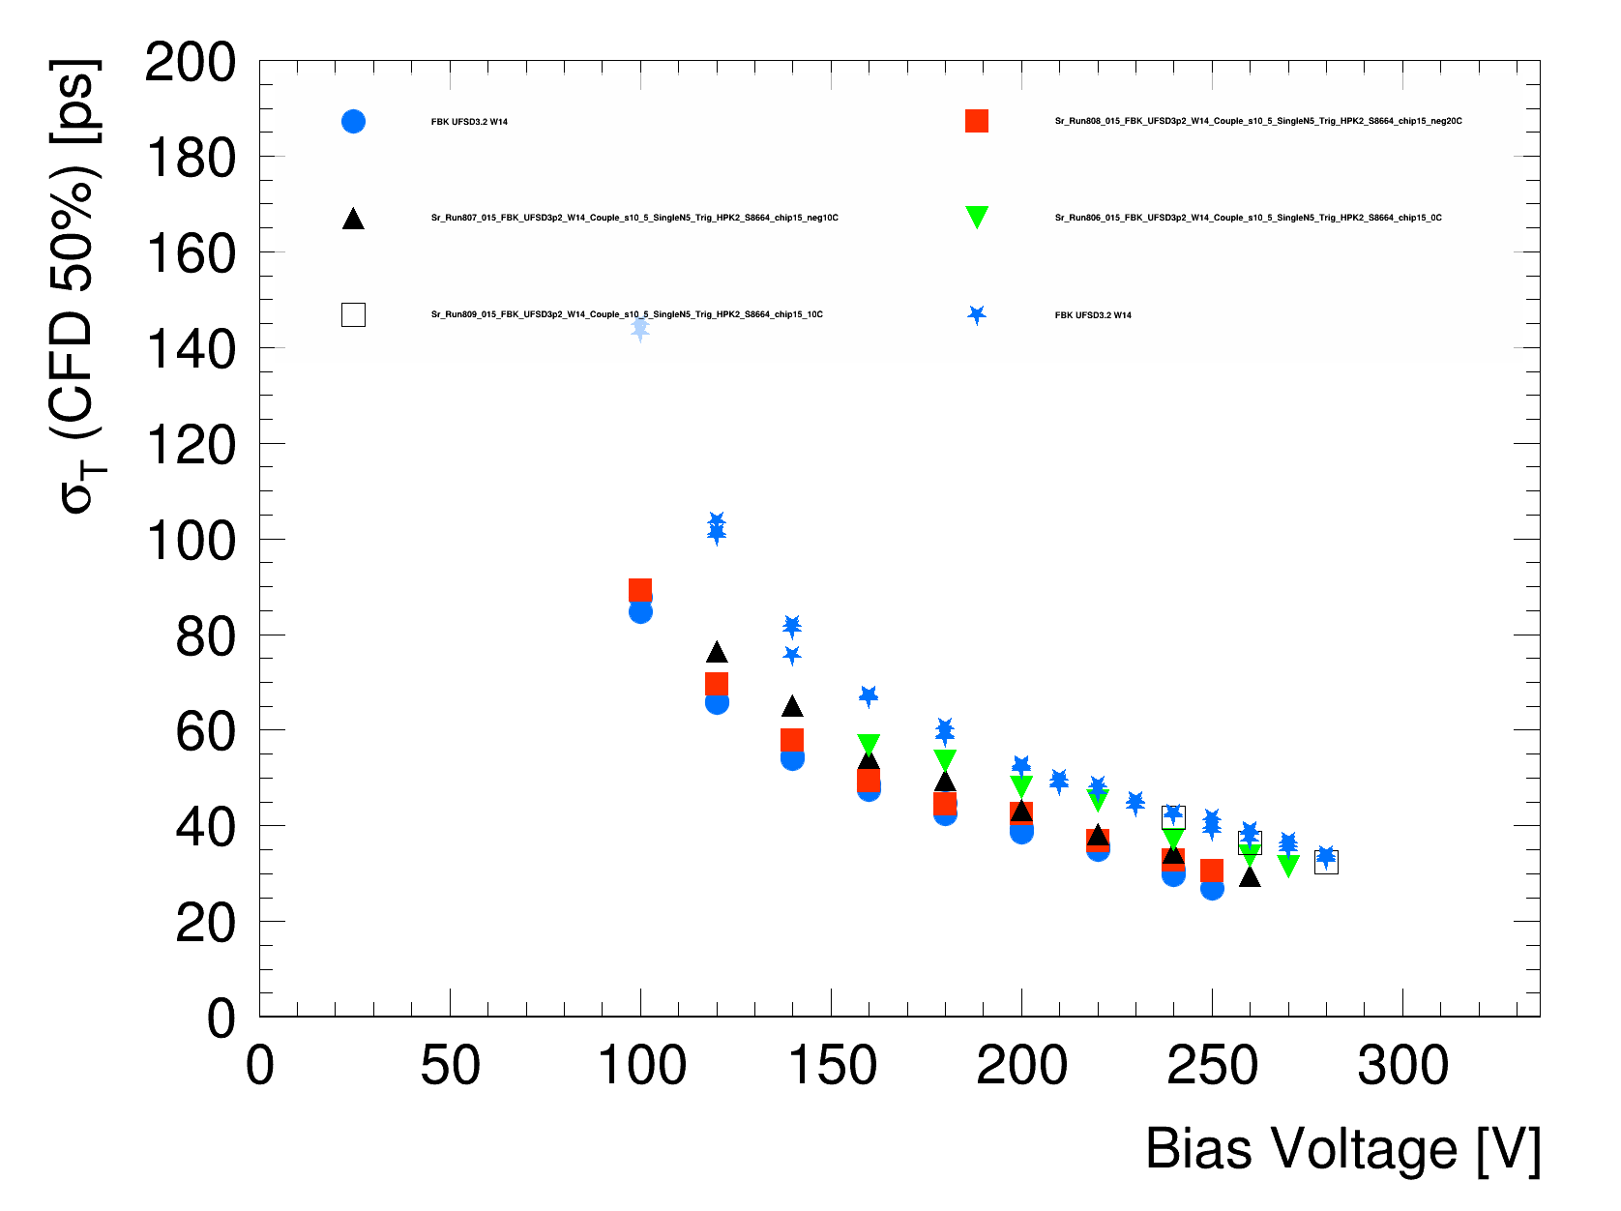
LGAD temperature dependence
-30C
-10C
10C
-20C
0C
20C
LGAD gain depends on temperature due to impact ionization dependence on e/h drift speed
On a large temperature range the effect is significant
  The same sensor has a ~50V breakdown variation over a 50C temperature change
  Data from ATLAS/CMS prototype UFSD3.2 (FBK)
  Similar study foreseen for ePIC AC-LGADs (laser station almost ready)
The time resolution suffers slightly from the non-saturated drift velocity if the breakdown is too early (5ps worse for -30C)
  Electric field in the bulk is too low between Gain layer depletion and breakdown
In the case of ePIC the running temperature and temperature variation should not as extreme
  However the breakdown voltage is <150V for most ePIC prototypes, (fairly low)
  Once the running temperature is set we should start testing devices at that temperature to measure realistic performance
  Then adjust the sensor design accordingly, a similar study happened for ATLAS with HPK (4 gain layer doping tunes)
-30C
-10C
10C
-20C
0C
20C
Student: J. Ding

Slide 30
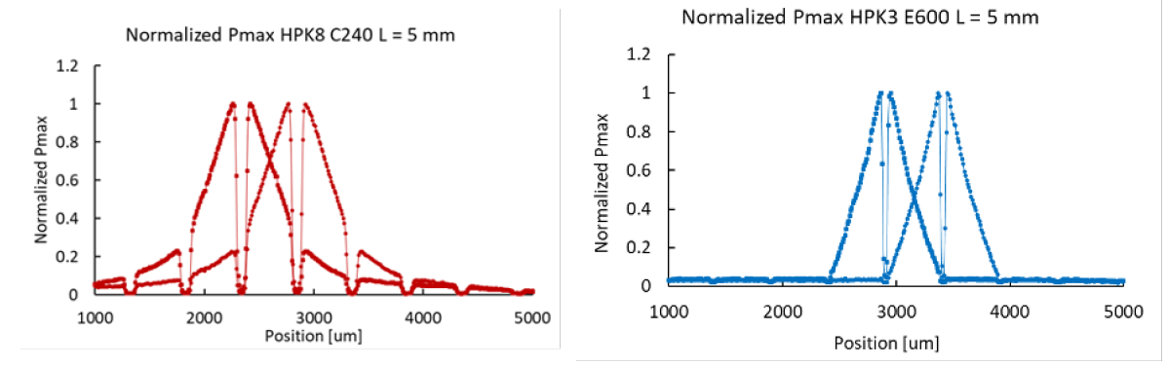
HPK 2023 lab studies
Previous lab results from 2023 HPK production
  https://doi.org/10.1016/j.nima.2024.169478
  Based on laser TCT studies
Conclusions:
  Type E strips (more resistive) perform much better, oxide thickness has less impact but thinner is better.
  Long strip length degrades both signal (rise time, Pmax) and has worse charge sharing. 1cm length was best compromise.
  Another issue is the input capacitance which degrade the ASIC performance
    20um strips were abandoned for now due to decreased signal and increased input capacitance
Pitch of 500um → ~20um hit precision (<5% of pitch)

Slide 31





HPK production results – IV/CV
Yield is not optimal, somehow better for 30um wafer
Capacitance of full detector scales with thickness
Measurement of strip capacitance (input capacitance to the amplifier) is not an easy task
  Significantly changing with probing frequency
  Several measurements ongoing with TCAD simulation support
  Final full sensor capacitance:
    W11: 0.725 nF
    W22: 1.24 nF
50um
30um
Student: G. Stage, A. Borgijin

Slide 32




Radiation levels at ePIC
Radiation hardness of LGADs has been studied and optimized extensively for the HL-LHC timing end cap upgrades in ATLAS and CMS
  Relatively large-pad, conventional (DC-coupled) LGADs
At the EIC radiation levels will be much lower than at the LHC (< 5e12 cm⁻² over their lifetime)
  AC-LGADs with resistive n⁺ layer, which may be susceptible to radiation damage by changes in the n ⁺⁺/n⁺ electrode and the coupling dielectric
HPK (and BNL) strip and pixel sensors were irradiated with reactor neutrons at JSI/Ljubljana and at FNAL ITA
Total fluences between 1e12 and 1e15 Neq – some much higher than envisioned at the EIC over the full time of life
Thanks to G. Kranberger and I. Mandic for the JSI irradiation
  Funded by EUROLABS
Thanks to S. Seidel and J. SI (UNM) for the proton irradiation

Slide 33



TCT laser studies - Protons
Beam
Graded irradiation on an HPK 2cm strip sensor (500um pitch, 50um)
  Fluence parallel to the strip each ~0.5cm: 4.4E+14Neq, 3.5E+14Neq, 1.8E+14Neq, 7.8E+13Neq
Circle in image and plot indicates the beam position
Effect of the irradiation clear in the gain layer signal degradation
  However, the charge sharing profile doesn’t change → good!
Not normalized
Student: G. Stage, A. Borgijin

Slide 34

FCFD
FCFDv1 – 6 channel received Jan 2024.
Tested at FNAL in May/June 2024, AC & DC-LGAD (1 mm):
  DC-LGAD @ 50 ps; AC-LGAD @ 52 ps
  AC-LGAD should get ~35 ps with improved comparator.
FCFDv1.1 – TSMC May 2025; DESY tests in July 2025.
128 ch strip readout
65 nm CMOS
Constant Fraction Discriminator
Plus TDC, ADC, interfaces
Cdin: <15 pF
Dynamic Range: 5-40 fC
Timing: 10-30 ps
Links: ~Gbps, multiple
Radiation tolerant.
FCFDv1 (6 ch): FY23 – FY24
FCFDv1.1 (6ch): May 2025
FCFDv2: FY25 – FY26
FCFDv3: FY27 Production
34

Slide 35
Sensor testing – IV/CV
Capacitance over voltage (CV)
  Study doping concentration profile and full depletion of the sensor
  Doping profile can be extracted from the 1/C² derivative
Study of the “foot” for LGADs on 1/C²
  1/C² is flat until depletion of multiplication layer because of the high doping concentration
  Proportional to gain layer active concentration
Bulk doping concentration proportional to the derivative of 1/C² before depletion
Full depletion
Multiplication
layer
P
N++
P++
Bulk
~45um sensor
P+

Slide 36


Sensor testing –Laser TCT setup
  Sensors are mounted on a multi-channel analog amplifier board with bandwidth ~1 GHz
    Response is readout by 2 GHz/20 Gs oscilloscope
  IR laser (1064 nm) mimics charge deposit of a Minimum Ionizing Particle (MiP)
    Focused laser beam with spot width ~20 um
  Amplifier board is mounted on X/Y moving stages
    Charge injection as a function of position
  Metal is not transparent to IR so no response can be seen when laser is on top of metal
    Only the sensor response in-between metal pads is visible
Focused laser
Sensor
Amplifier board
X/Y motors

Slide 37



Readout noise master formula
R_{B}
Noise level in equivalent electrons
Strictly speaking, applies to “lumped elements” (separate C, R_{S})
General rule of thumb: signal-to-noise of 12:1 for efficient operation
Define some quantities that are associated with sources of readout noise:
C = Sensor capacitance
R_{S} = electrode resistance
i_{na} = amplifier current noise
e_{na}= amplifier voltage noise
R_{B}= bias resistance
I_{d} = Sensor leakage current
4kT = temperature term
i_{na}
e_{na}
R_{S}
C
I_{d}
Sensor
Signal-shape parameters (of order 1)
Noise current sources
Noise voltage sources
Amplifier shaping time (1/Bandwidth)
(For a particular
set of parameters)
(F_{v}/τ) C² e²_{na} → Beware of sensor capacitance, esp. for fast signals!
From “Semiconductor detector systems”, H. Spieler

Slide 39





New HPK production
Full sensors
Capacitance of AC strips with backside measurements, test on edge strip near N+ connection
As always it’s tricky to pinpoint a number as result vary wildly with frequency
Final capacitance of the order of few pF for both wafers
  This seems suspiciously low, studies ongoing
Student: J. Ding

Slide 40




Angled charge injection
Strip modules in ePIC barrel-TOF are layered with a 18-degree tilt angle in the design baseline, forward disk region also get tracks with large incident angle (up to 30-degree)
  Laboratory characterization and beam tests so far have been conducted at normal incidence
  Added a angular stage to our TCT laser setup to study the effects of angle of incidence
Tested a strip AC-LGAD with the new setup (Pixel next)
  At larger angles, signal profile in neighboring strips also shows shift with rotational angle, but effect is small and can be corrected if angle is known
  Laser light is shone under strips
Differences in time-of-arrival and rise time are minimal for the angles measured
Student: J. Ding

