Slide 1
Forward TOF technical status
June 11th | 13th, 2025, 10th EIC DAC Review
Mathieu Benoit
TOF Technical coordinator

Slide 2
Charge Questions
Q1 : Is the design of the ePIC detector and its sub-systems appropriate and progressing well?
Q2 : Are the remaining work and technical, cost and schedule risks adequately understood? Are there opportunities?
Q3 : Will the detector be technically ready for baselining by late 2025?
Q4 : Are the detector integration and planning for installation and maintenance progressing well? Are there areas where further ideas should be pursued?
Q5 : Will the detector be ready for start of construction by late 2026?

Slide 3
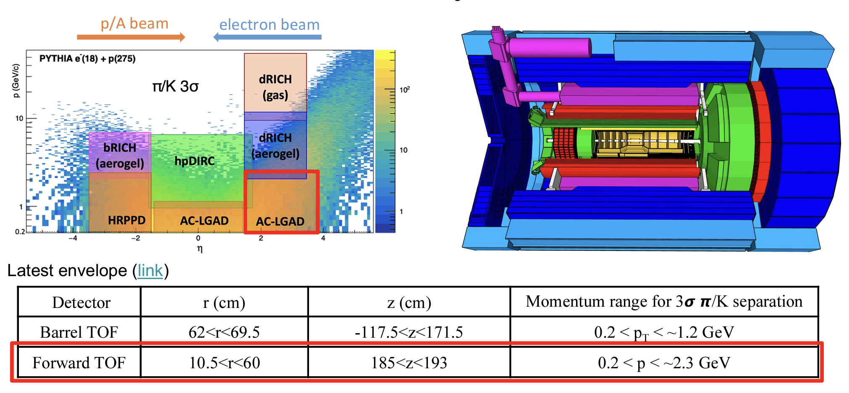
AC-LGADs TOF system for PID
Q1,Q2
185<z<193cm
Total fTOF Area ~ 1m²

Slide 4
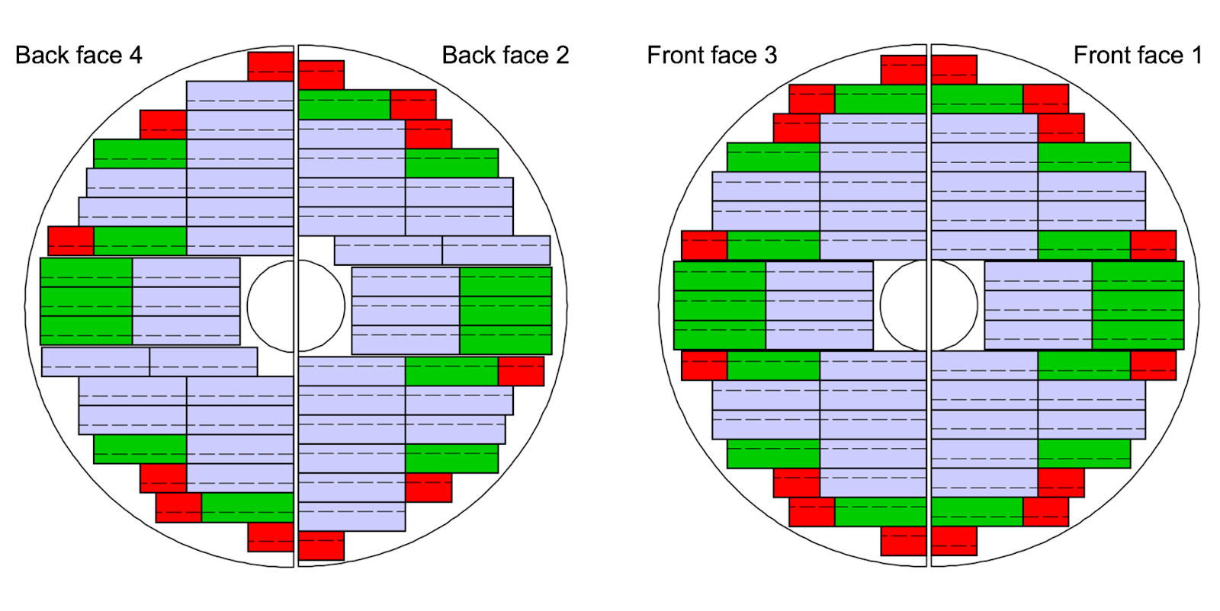
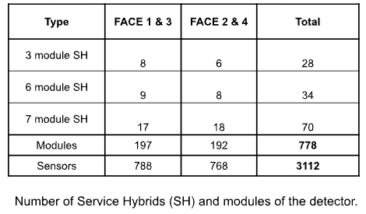
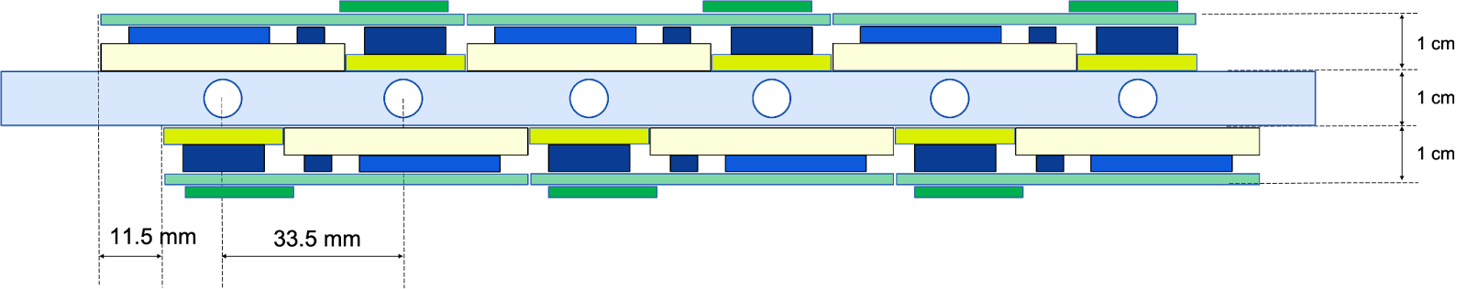
Forward TOF Detector Layout
Q1,Q2
To estimate the material budget, we consider the follow composition:
Sensor: 300 microns (0.3%X0)
ASICs: 400 microns (0.4%X0)
RB and PB PCB board: 2 mm kapton (0.7%X0)
Module PCB board: 0.6 mm kapton (0.2%X0)
Aluminium nitride (AIN) base plate: 0.5mm (1.1%X0)
Cooling and support: 5%X0 (Detailed design ongoing)
Total material budget is currently estimated to be: 7.7% X0

Slide 5
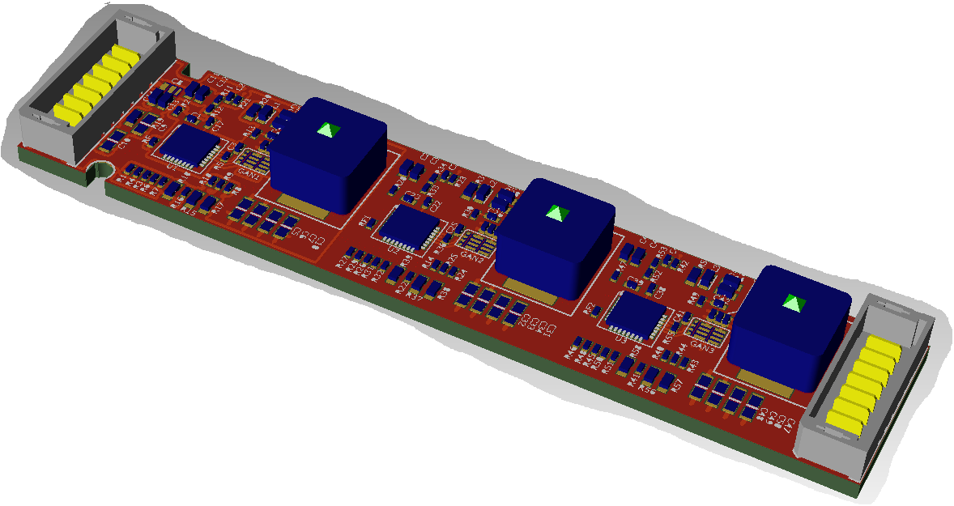
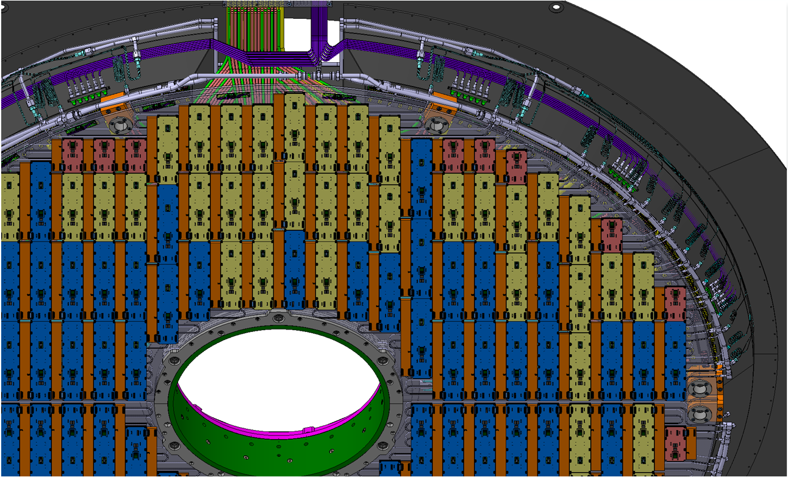
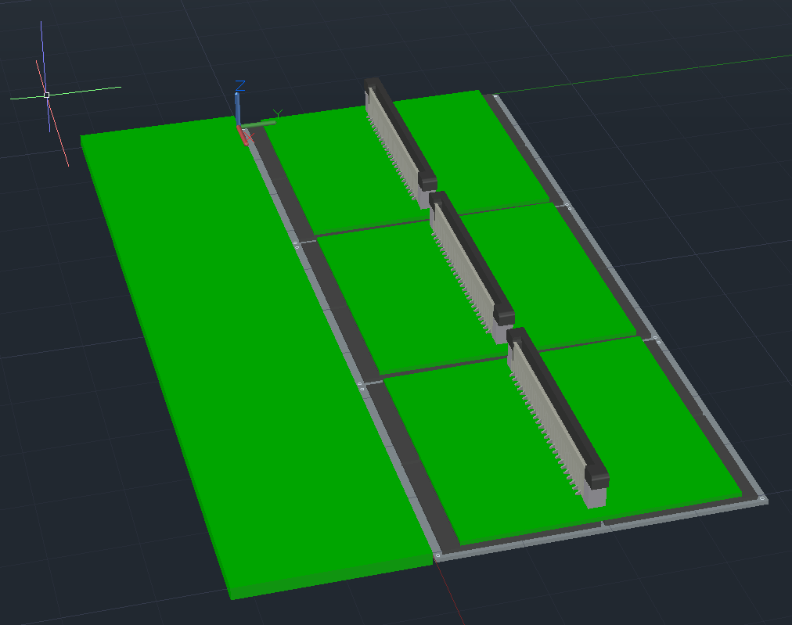
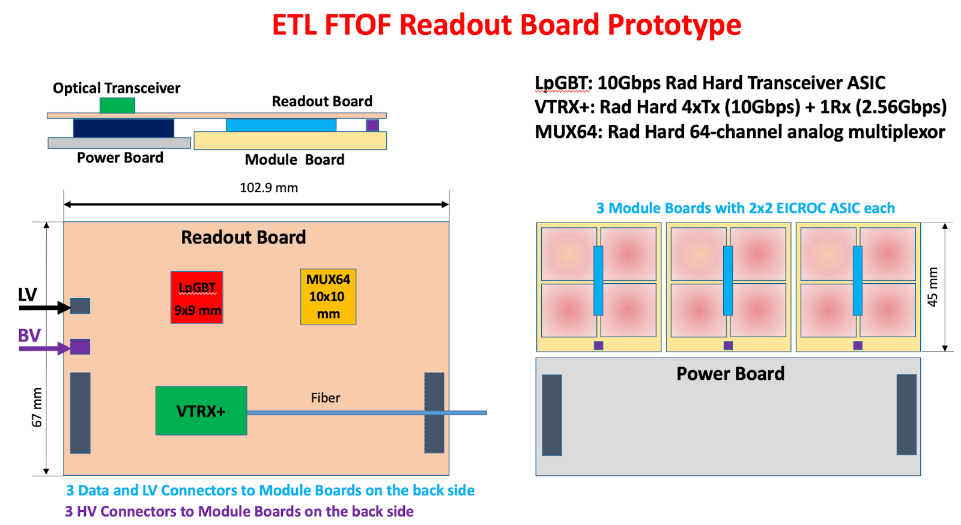
EIC fTOF Building Blocks
Modules
Service hybrids
Cooling and mechanical support

Slide 6
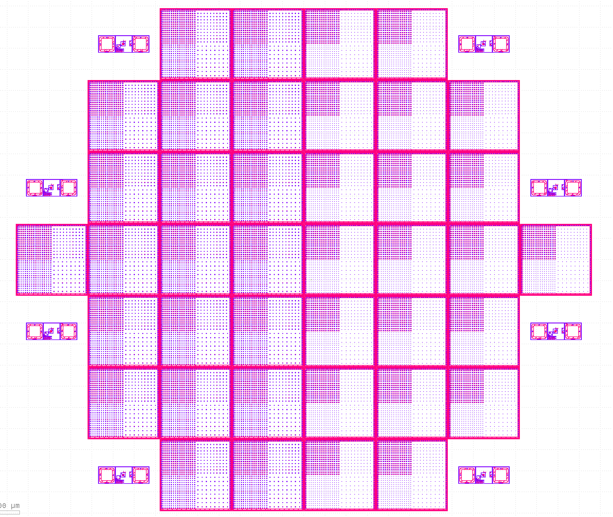
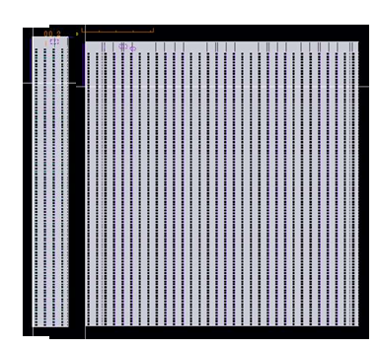
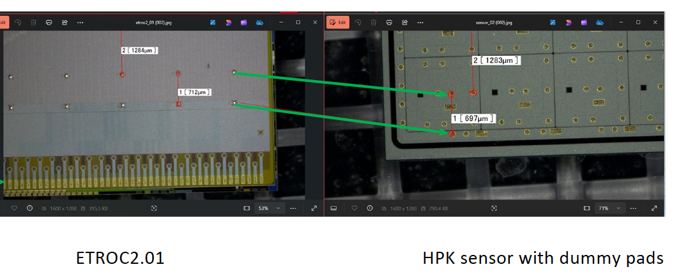
EIC fTOF modules
Q1,Q2
The EICROC will be the readout for the fTOF
EICROC1A(4x32)/1B(32x32) currently in design for submission this summer
EICROC0/A/B design completed (Frontend optimisation)
EICROC2 should be the final design for fTOF and far-forward, planned for tapeout in ~Q3 2026
HPK Sensor production for pixel ongoing, first trials with EICROC1 when available (Q4 2025)
We are following closely CMS ETL efforts in developing their bump-bonding process. ORNL actively involved in developing flip-chip process.

Slide 7
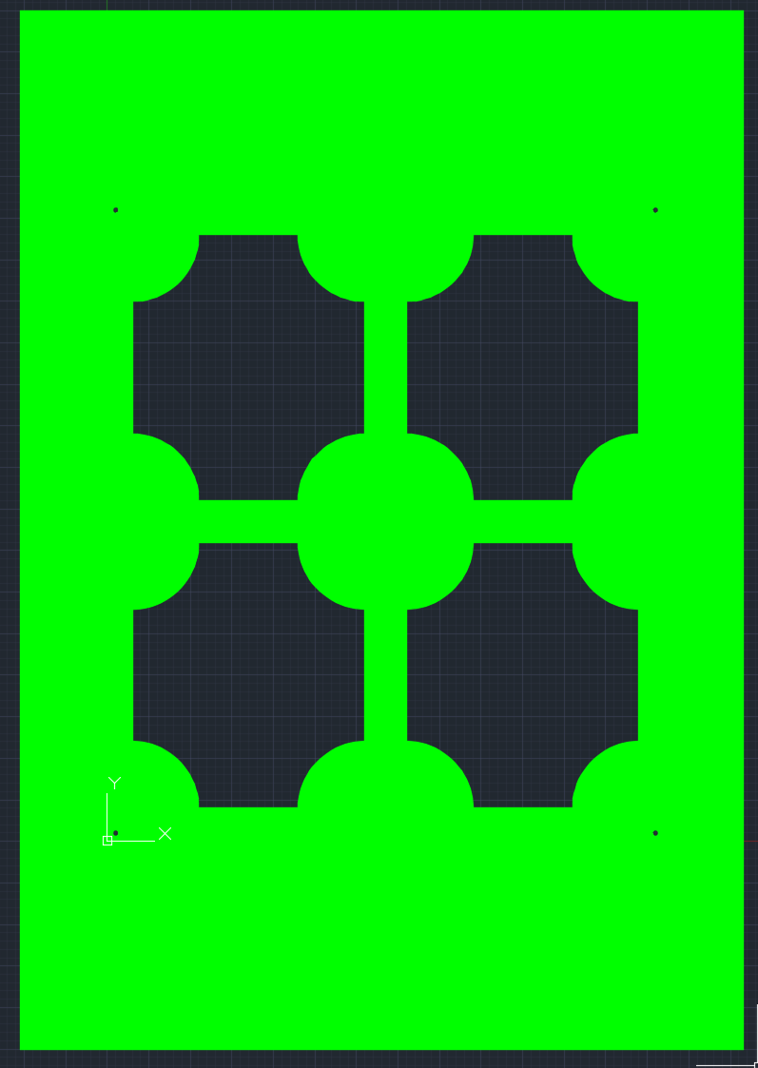
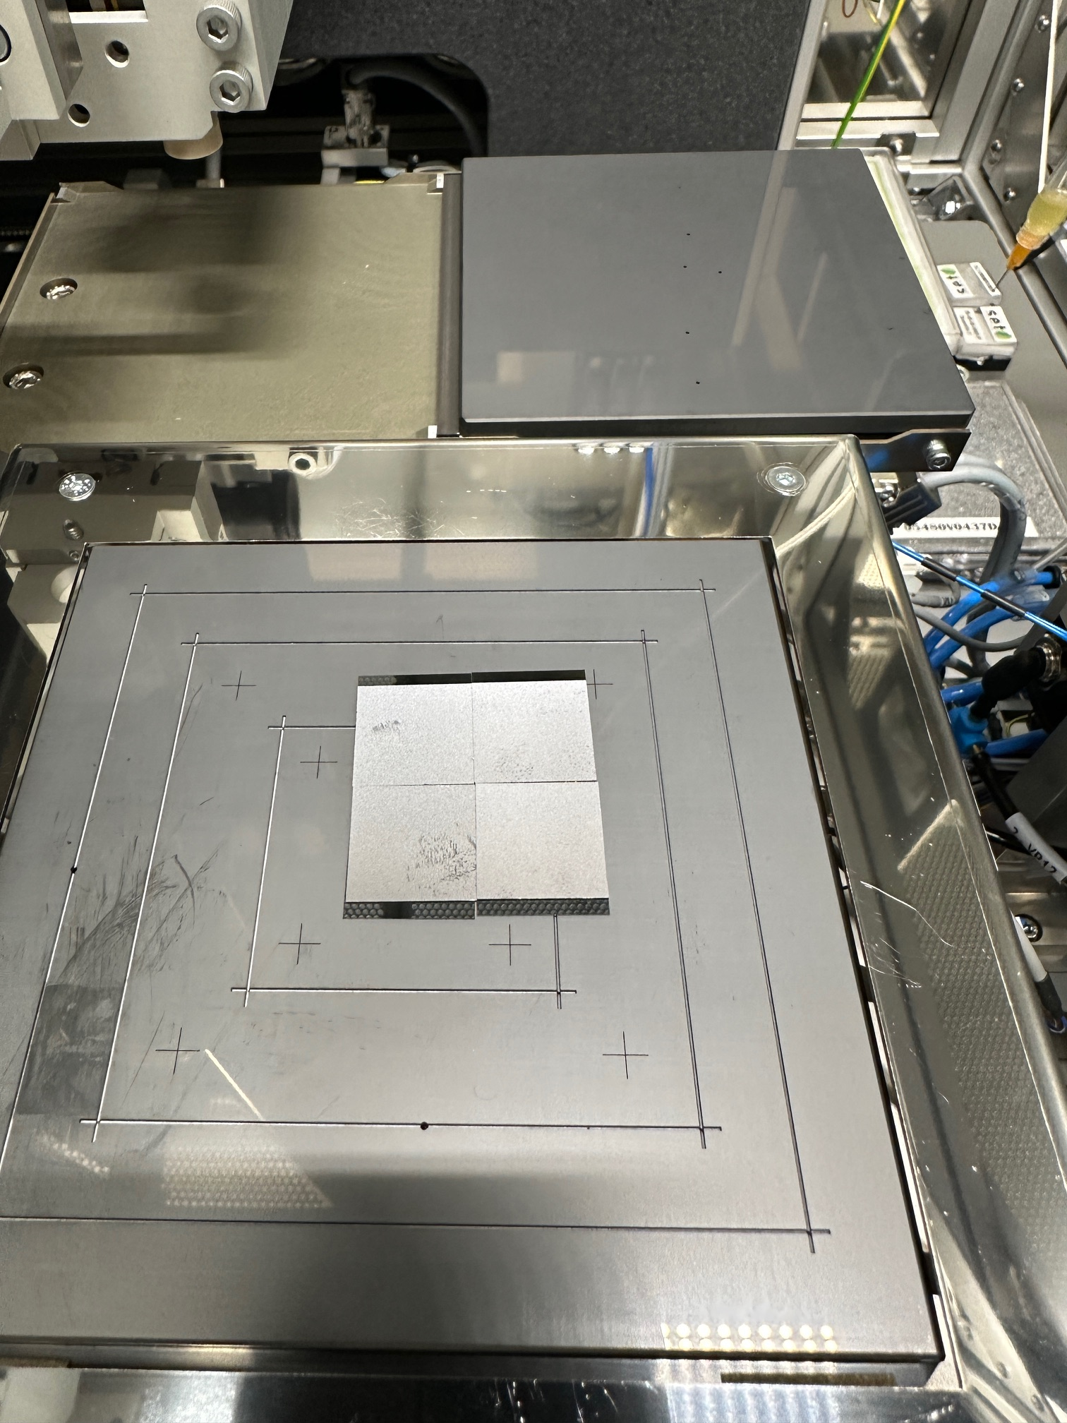
Module Assembly
Q1,Q2
Prototype 0 (Show and tell) Summer 2025
  We are assembling mechanical prototypes of assemblies at ORNL (1.6x1.6cm Sensor, 1.6x1.8cm ASIC)
  Rather quick to make , can make enough of a few modules
  Purchased AlN plates (0.3,0.5mm) that we will laser dice to hold assemblies
  Mounted with dummy PB&RB
Prototype 1 (Thermo-mecanical) Q4 2025
  We plan on doing lithography in-house to make ASIC and Sensor heaters that can be WB to flex/PCB
  Assemble following prototype 0 geometry for thermal testing on stave etc .
Prototype 2 (Functional EICROC1 + Dummy LGAD) Q2-3 2026
  Demonstrate power distribution, readout (even if not final scheme)
  Can be used for more realistic thermal testing

Slide 8
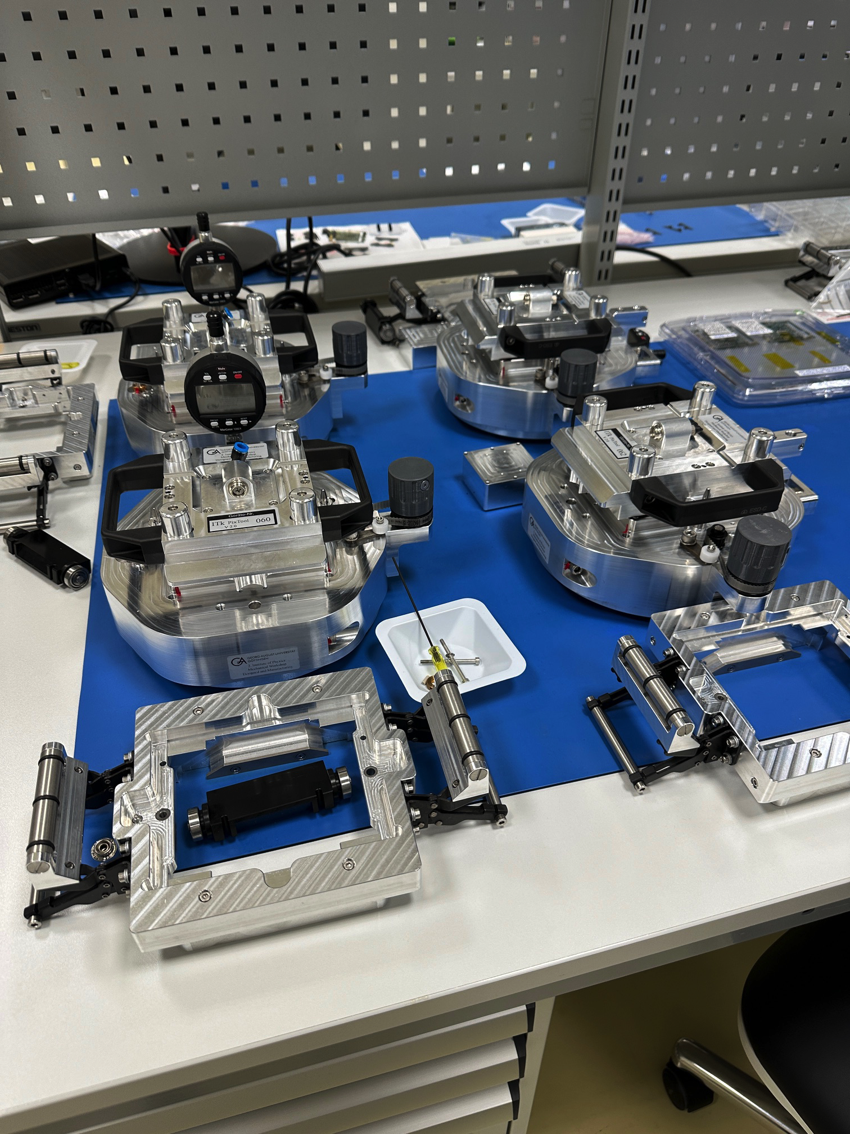
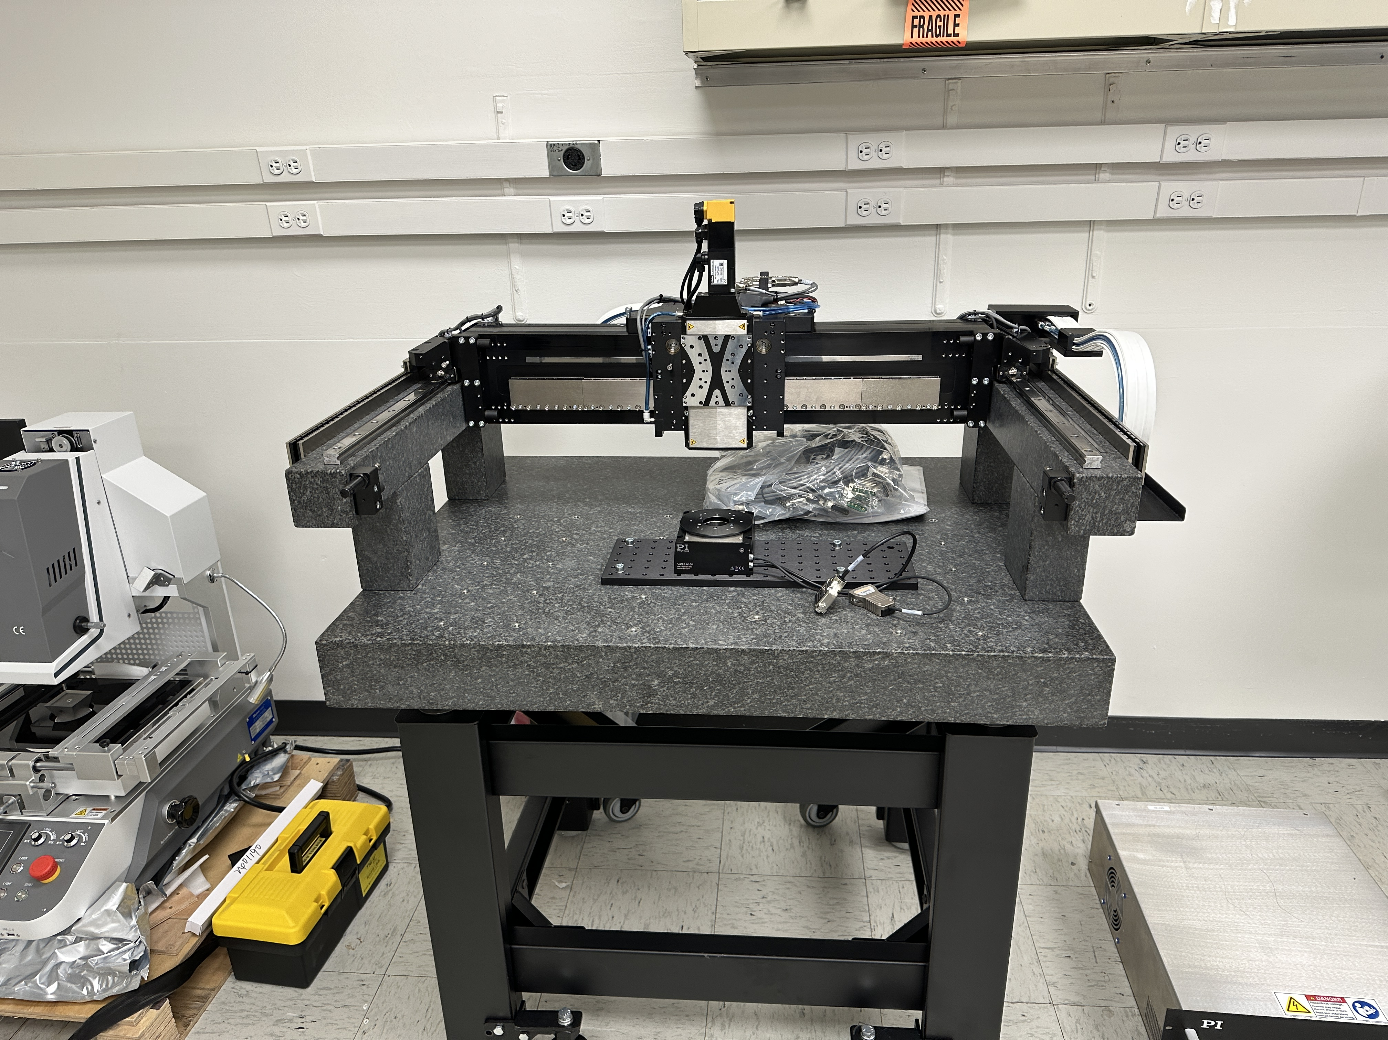
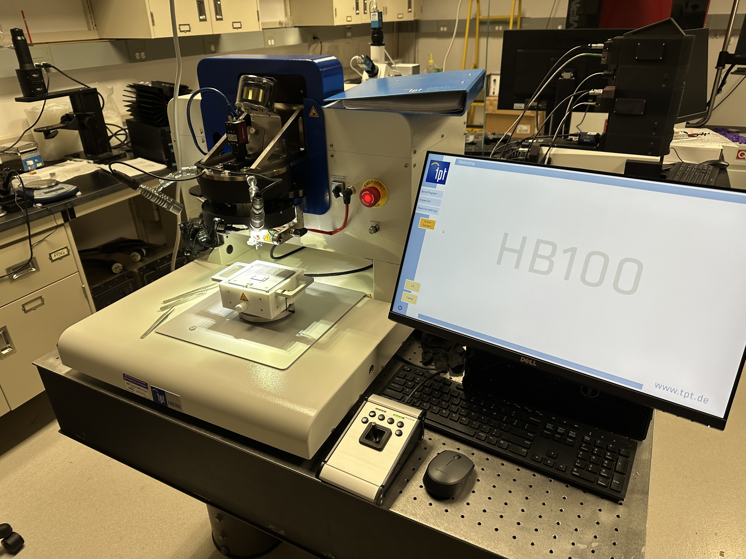
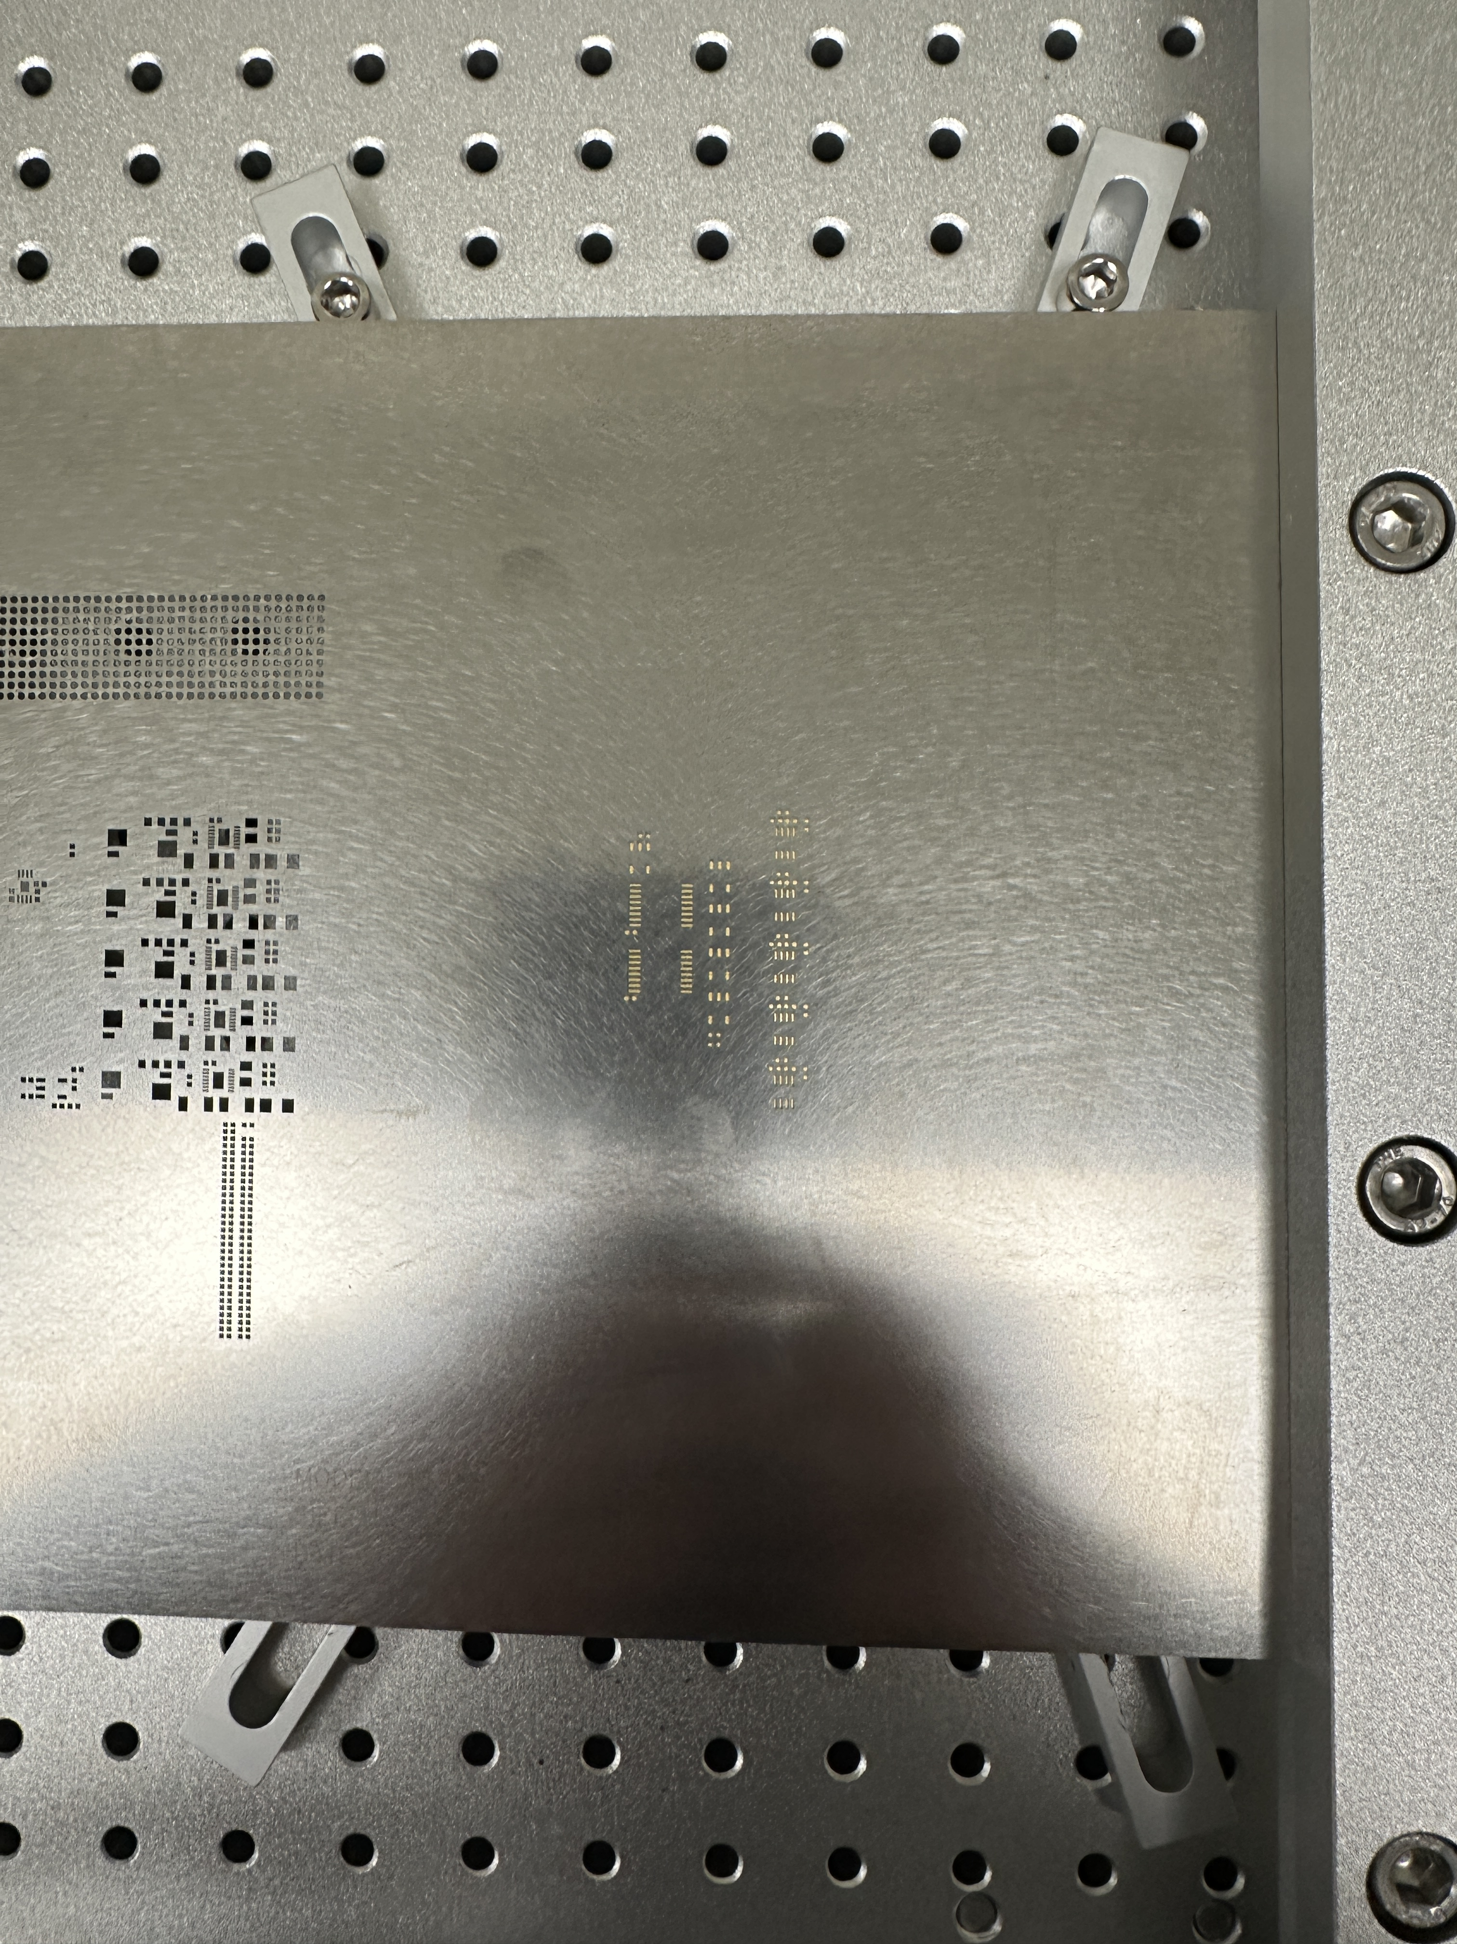
Module Assembly plans
Q2
We are investigating two module assembly path:
Jig-based assembly
  More labor intensive
  Lower cost of entry
Robotic Gantry-based assembly
  Less labor intensive and faster
  Higher cost of entry (gantry available with some collaborators)
Module production : 778 + 10% spare = 856 modules
2h per modules (Jig), 20 Modules a week -> 43-week production (for 1 site)
Jig method could speed this up by factor 2-4x

Slide 9
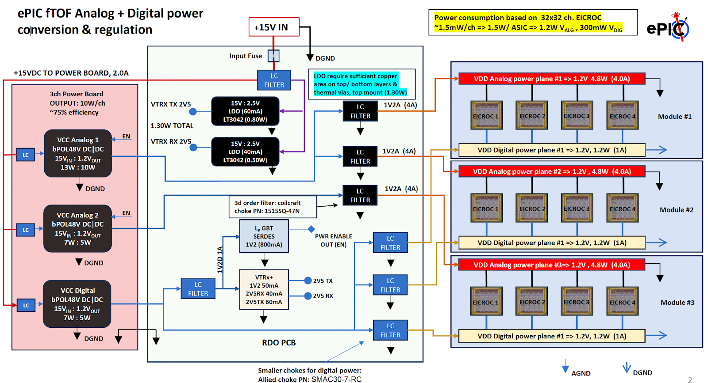
Service Hybrids
Q1,Q2
Power Board (PB):
Each PB consists of three CERN bPOL48V DC-DC converters to provide the necessary voltages for powering the RB and EICROC chips. The PB connects to the RB through board-to-board connectors.
First prototype in production
First test to be carried with dummy loads
Readout Board (RB):
Each RB includes:
  lpGBT for high-speed data transmission.
  VTRx+ optical transceiver.
  MUX64 multiplexer for monitoring
Design completed; PED request ongoing for production of first demonstrator

Slide 10
Mechanical integration and cooling
Q1,Q2
The mechanical supports for the fTOF will follow closely the CMS ETL design (ongoing). A double-sided disk base structure (Carbon) will support cooling tubes
SH + modules to be mechanically mounted on disk with thermal coupling and interconnected.
Service cabling from SH is routed to the outer radius for fanout to Patch Panel at the rim of the structure
Detailed design ongoing (Purdue)

Slide 11
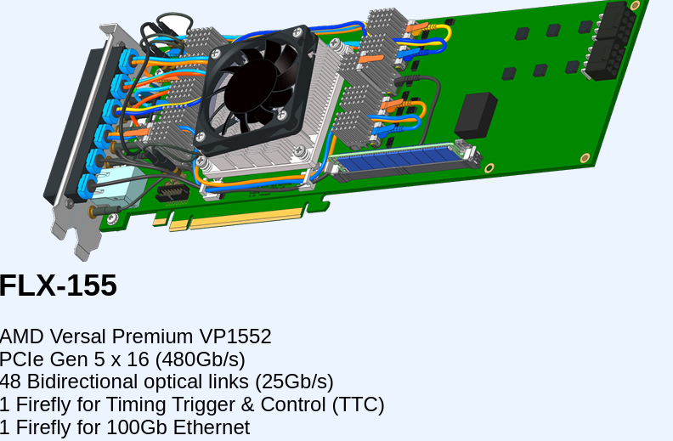
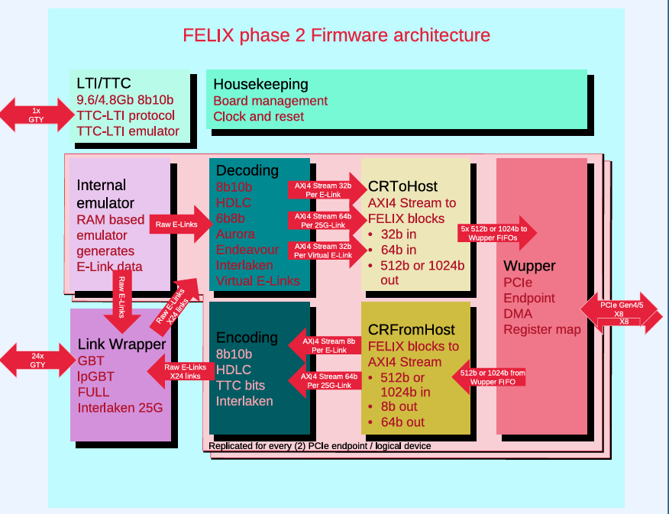
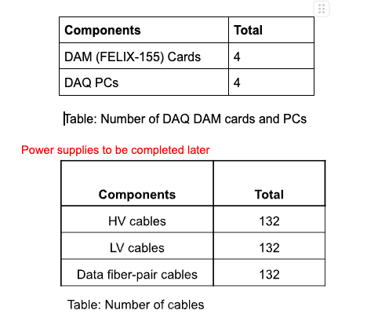
Readout architecture
The connection the to readout board optical links will be done using ATLAS Phase-II FELIX Card
4 DAM (FELIX-155) boards will each service a quarter of the disk’s sensors (left/right, front/back)
4 DAQ PCs needed for readout
Q1,Q2,Q3

Slide 12
Schedule and baselining
Q4,Q5
Modules
Service Hybrids and readout
Power board demonstrator in production
  Will allow to measure power consumption and heat dissipation
Readout board demonstrator designed, waiting for PED fund for production
  Will allow to test interface to FELIX, clock distribution etc.
EICROC2 digital interface specification will be required for the final design of the boards.
FLX-155 board identified for readout
Mechanical Integration
The module concept defines the granularity for integration to mechanical support
Design ramping up for disk support , first model expected Q4 2025
Assembly and integration kinematics to be established along the design of the support and refined in 2026.
A series of 3 demonstrators planned for module assembly. The demonstrator will allow to baseline module concept and assembly procedure
  Show-and-tell (summer 25)
  Thermo-mechanical (Q4 25)
  Functional (Q2-3 2026)
EICROC1A/B submission waiting for final EICROC1B design, we expect availability Q4 25. EICROC2 is baseline.
Sensor production with HPK ongoing to validate EICROC0B performance , next production aimed at final design baseline.

Slide 13
Charge Questions
Q1 : Is the design of the ePIC detector and its sub-systems appropriate and progressing well?
  Yes, the design of its subsystem are progressing well, wit the main bottlenecks being availability of ASIC, Sensors and the progress of the mechanical design. First full-size ASIC allowing module activities with electrical samples planned by end of 25. Mechanical support design efforts ramping up, shared with barrel TOF. Prototypes for Service hybrid are well under way.
Q2 : Are the remaining work and technical, cost and schedule risks adequately understood? Are there opportunities?
  Remaining work is well understood. Module demonstrator 0,1 and 2 will follow availability of components and demonstrate assembly procedures and determine how production will be carried (jig/robotic). Thermomechanical version will allow to settle sensor and ASIC placement in the module. Our main schedule risks are related to availability of ASIC and sensors. Cost risks are related to current geopolitical situation. We are pursuing possible opportunities for cost reduction (robotic assembly, low cost bump-bonding)
Q3 : Will the detector be technically ready for baselining by late 2025?
  The detector baseline is well established, and we hope to close the few open questions by end of FY25 (ASIC, sensor cooling in module, mechanical interface details), provided no geometry or other fundamental changes are imposed from the leadership.
Q4 : Are the detector integration and planning for installation and maintenance progressing well? Are there areas where further ideas should be pursued?
  We have a plan for a set of demonstrator modules and SH that will lead us to higher level integration steps. It is crucial that ASIC, Sensor production and mechanical design progress on schedule.
Q5 : Will the detector be ready for start of construction by late 2026?
  Provided the final EICROC2 ASIC is available in Q4 2026, as well as sensors, we can plan for the start of the bump-bonding campaign for the modules in Q1 2027. and the start of the qualification of module assembly sites. SH hybrid should be mature and ready for production by Q4 2026. Provided the ramp-up for mechanical integration for fTOF continue, we should be able to have a final design by Q1 2027 for production.

