Slide 1






Status of Ancillary ASIC Design
Iain Sedgwick
ePIC SVT WP1 Co-convener
10th EIC DAC Review
June 11th – 13th, 2025
Notes:
The abstract pattern can be removed or repositioned if required. Be careful to ‘Send to Back’ so that it does not obscure any important information.

Slide 2
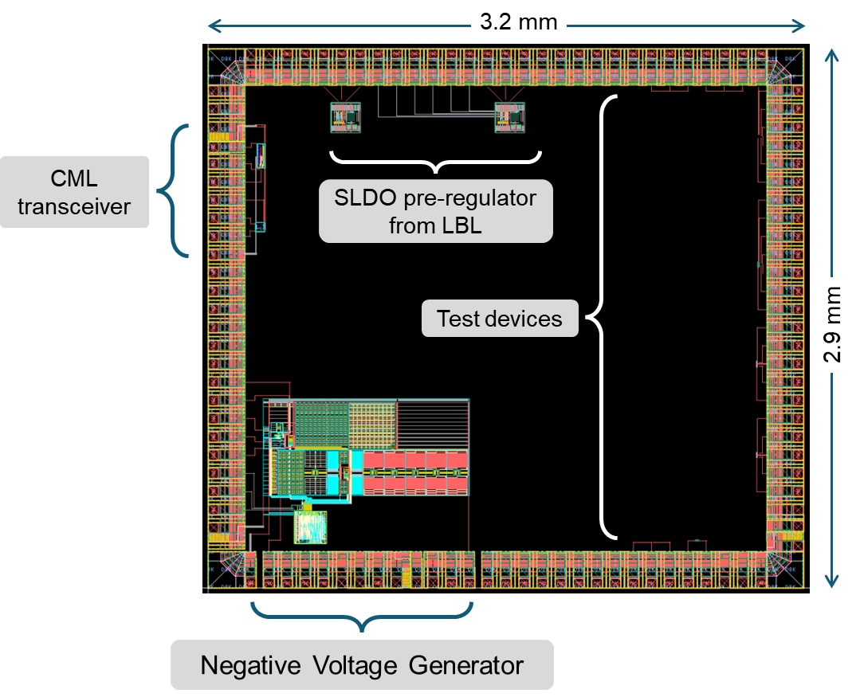
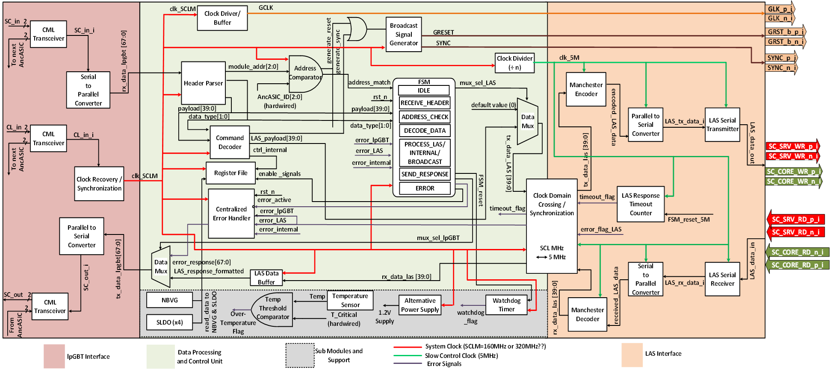
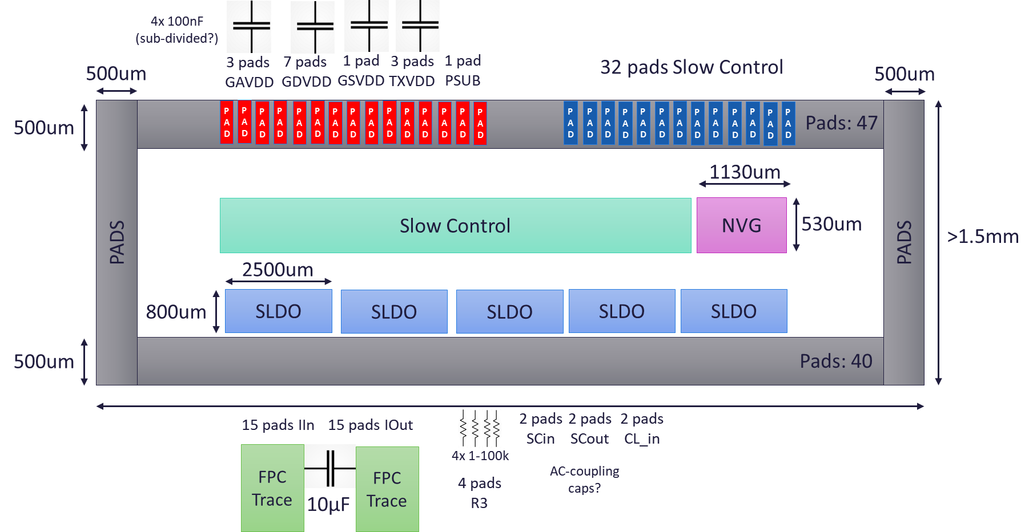
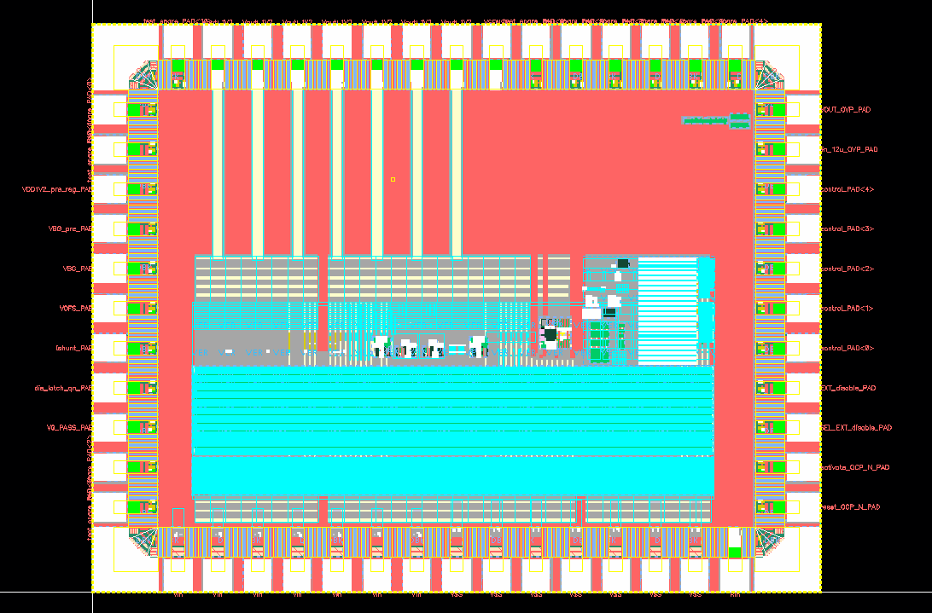
Introduction
SVT Silicon Scheme
Plans
Why AncASIC?
Design Overview
Technology Selection
Shunt LDO
Negative Voltage Generator
AncBrain
Overview
Progress, Next Steps and Ongoing Challenges
Progress to date
Current work and future plans
Ongoing challenges

Slide 3
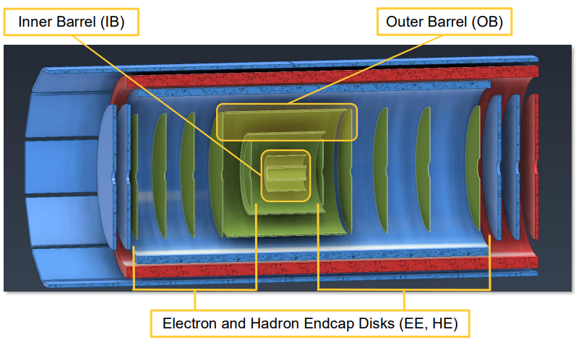
Introduction
Inner Barrel
SVT Silicon Scheme
Thinned silicon bent around beampipe
Use wafer-scale MOSAIX from ITS3
Outer Barrel and Discs
Smaller Version of MOSAIX with minimum necessary changes (EIC-LAS)
Supporting AncASIC

Slide 4
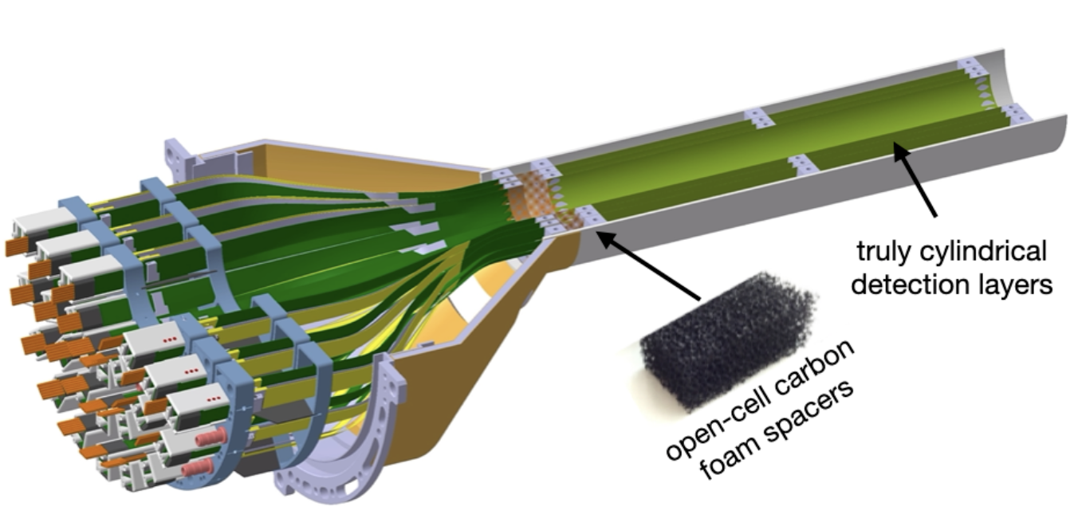
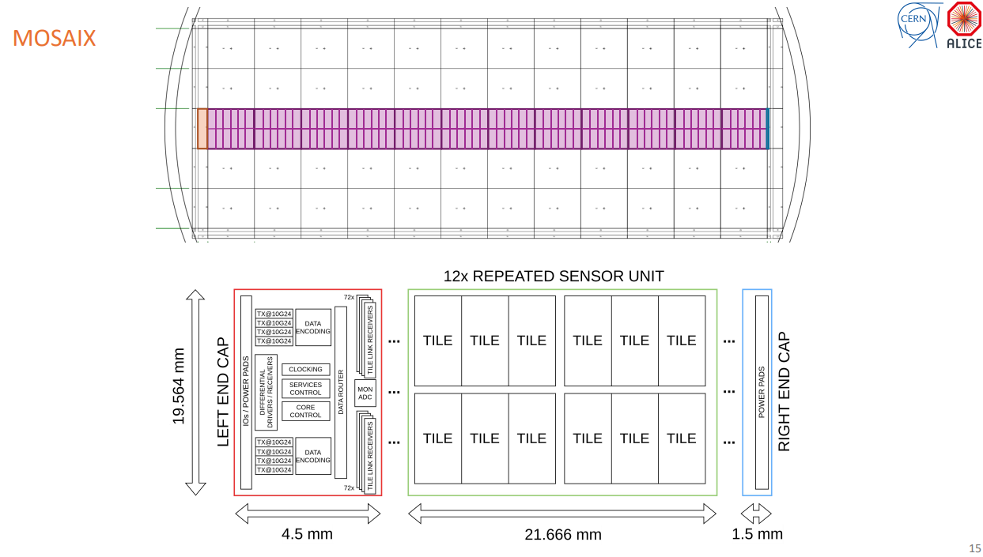
Ancillary ASIC
Why AncASIC?
Some MOSAIX/LAS features require adaptation to stave/disc operation:
Point-to-point slow control
Point-to-point powering
Precise negative back bias
May be technically unfeasible to integrate these features in the LAS
Limited prototyping
MOSAIX schedule is an external dependency
For these reasons, develop supporting ASIC instead
https://ep-news.web.cern.ch/content/alice-its3-clears-major-milestone
https://indico.cern.ch/event/1381495/contributions/5988486/attachments/2869319/5164357/TWEPP2024.PVL.v11.pdf

Slide 5
Ancillary ASIC
Why AncASIC?
Some MOSAIX/LAS features require adaptation to stave/disc operation:
Point-to-point slow control
Point-to-point powering
Precise negative sensor bias
May be technically unfeasible to integrate these features in the LAS
Limited prototyping
MOSAIX schedule is an external dependency
For these reasons, develop supporting ASIC instead
Serialised Slow Control interface from EIC-LAS to lpGBT
SLDO for serial powering
Local Negative Voltage Generator
Develop independent supporting chip
Development decoupled from MOSAIX availability
No modification of MOSAIX needed
110nm XFAB process
4 MPW runs a year
Cost effective

Slide 6
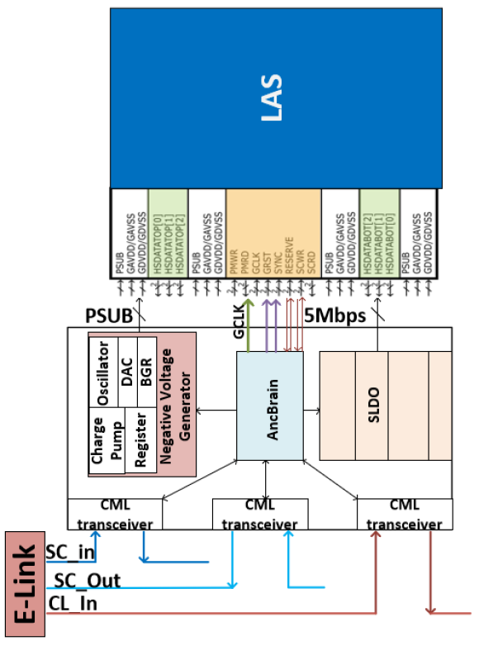
Ancillary ASIC
Why AncASIC?
Some MOSAIX/LAS features require adaptation to stave/disc operation:
Point-to-point slow control
Point-to-point powering
Precise negative back bias
May be technically unfeasible to integrate these features in the LAS
Limited prototyping
MOSAIX schedule is an external dependency
For these reasons, develop supporting ASIC instead

Slide 7


Design Overview
Notes:
The abstract pattern can be removed or repositioned if required. Be careful to ‘Send to Back’ so that it does not obscure any important information.

Slide 8
Technology Selection
XFAB XT011
110nm BCD-on-SOI Technology
SOI – permits floating grounds for negative voltage generation
Thick copper top layer – very low resistance for power dissipation
High gate density – suitable for AncBrain
All design sites have experience with XFAB
Radiation hardness untested
ePIC radiation requirement low [1]
Derived from a previously tested technology [2]
Test structures in fabrication

Slide 9
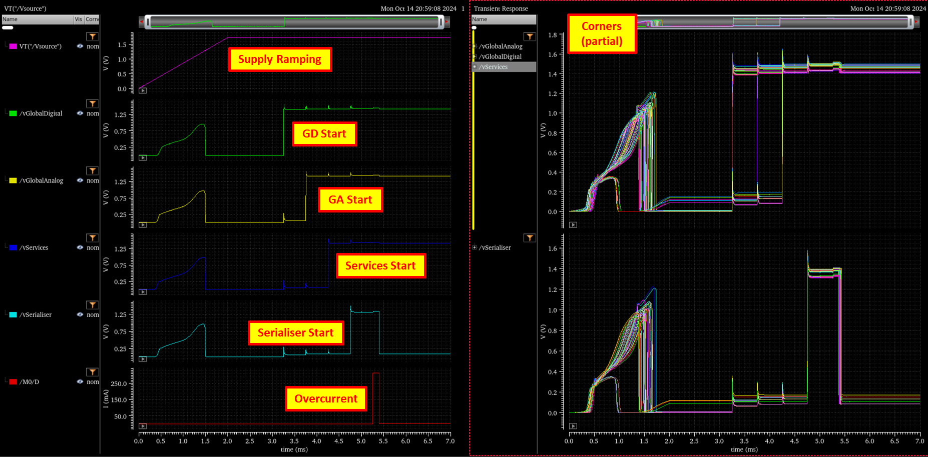
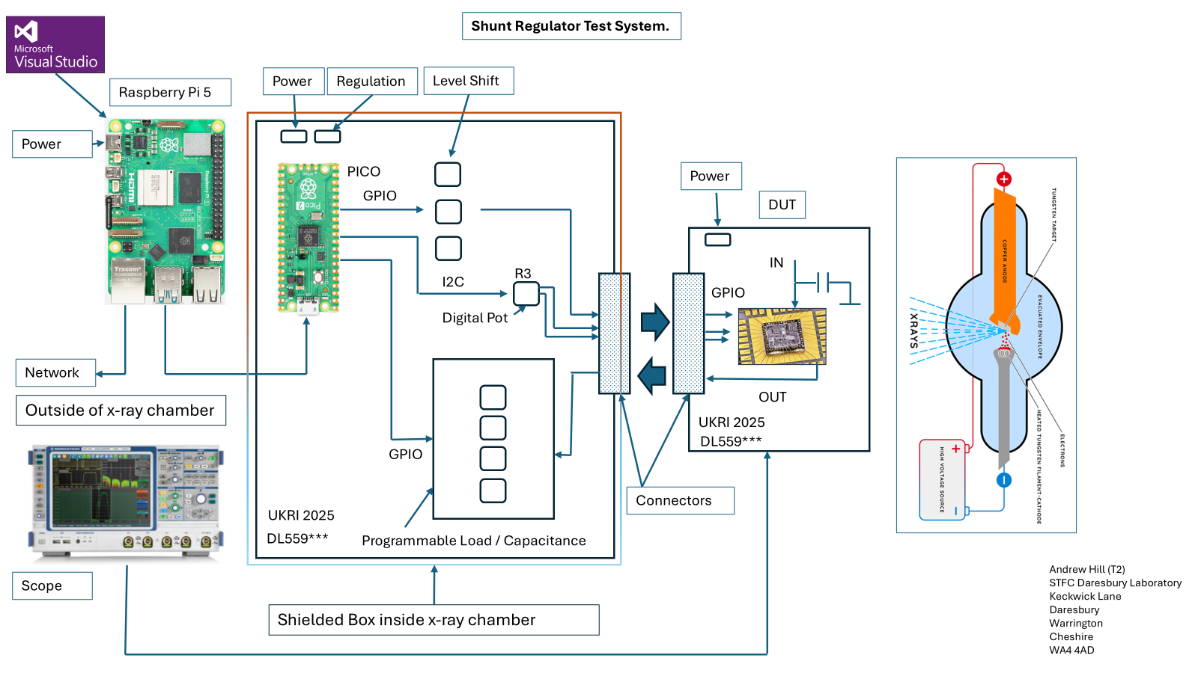
Shunt LDO
SLDO
Serial powering required for services reduction
Reviewed with external participants
SLDO test structure (including pre-regulator) submitted March 2025 (UK funded, submitted via Europractice)
Expected back September 2025
Test system in preparation
Prototype currently in fabrication!
SLDO Test System Plan, courtesy of Andrew Hill, UKRI-STFC Daresbury Laboratory

Slide 10
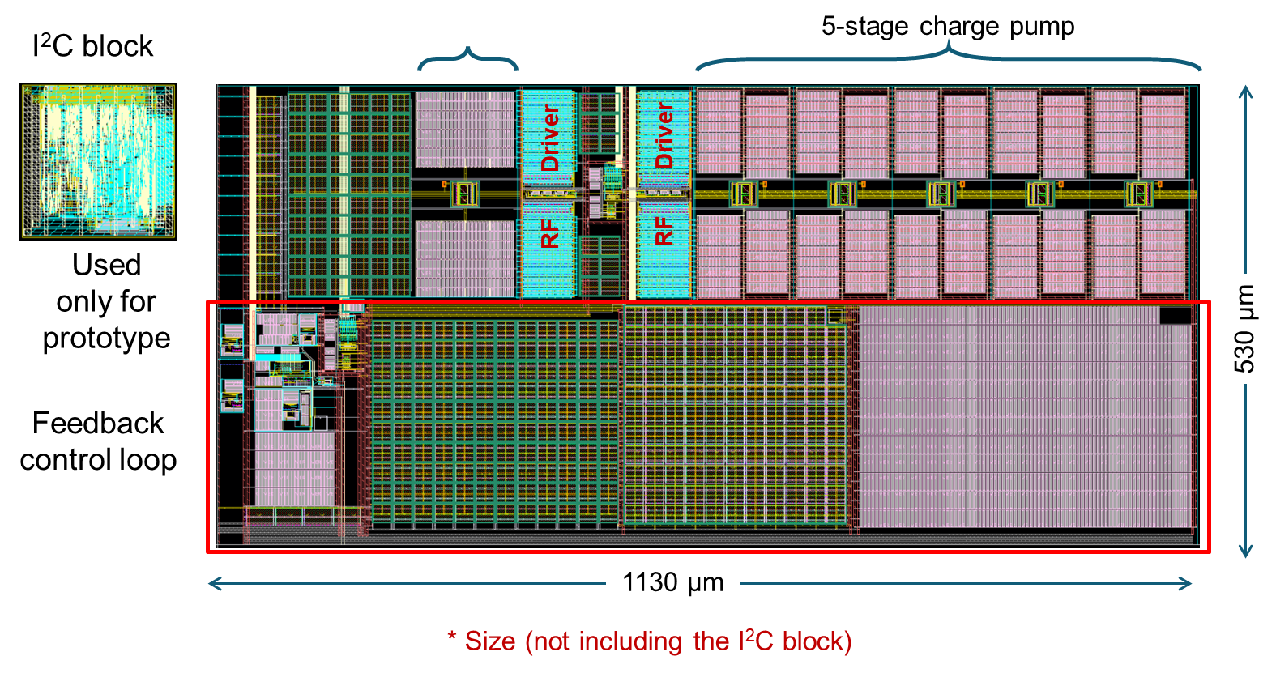
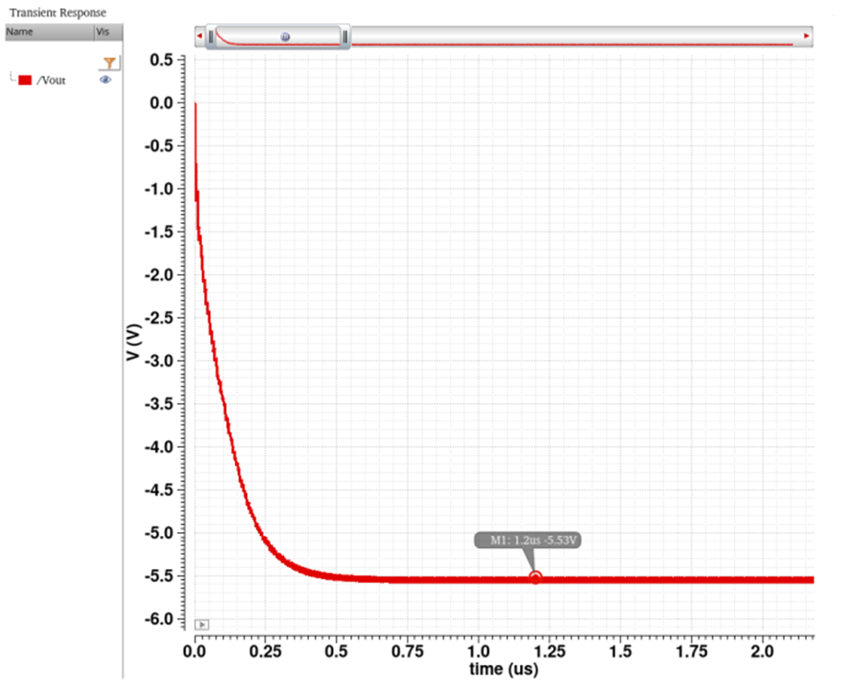
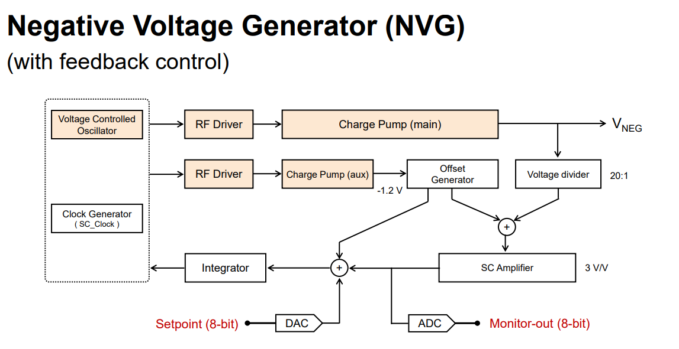
Negative Voltage Generator
NVG test structure layout, courtesy of Praful Purohit, BNL
NVG
Local generation of sensor bias voltage needed due to combination of serial powering and low bias level (~1V)
Reviewed with external participants
Test structure submitted March 2025
Also included transistor test structures and other blocks
Expected back September 2025
Test system in preparation
Prototype currently in fabrication!

Slide 11
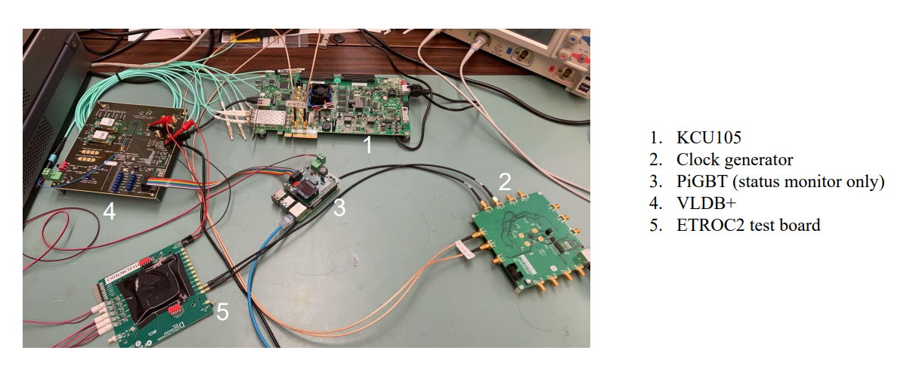
AncBrain
AncBrain Plan, courtesy of Arif Iqbal, BNL
AncBrain
Required for services reduction and control of NVG and SLDO
Core modules complete, working on tests with MOSAIX emulator
Plan to submit as part of first AncASIC
Hardware emulator in preparation between LBNL, ORNL and BNL
Hardware mockup, courtesy of Zhengwei Xue, LBNL

Slide 12

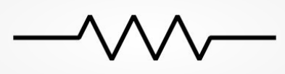
AncASIC Overview
4x 100nF (sub-divided?)
500um
3 pads
GAVDD
7 pads
GDVDD
1 pad GSVDD
3 pads TXVDD
1 pad
PSUB
32 pads Slow Control
500um
500um
PAD
PAD
PAD
PAD
PAD
PAD
PAD
PAD
PAD
PAD
PAD
PAD
PAD
PAD
PAD
PAD
PAD
PAD
PAD
PAD
PAD
PAD
PAD
PAD
PAD
PAD
PAD
PAD
Pads: 47
1130um
Slow Control
NVG
530um
>1.5mm
PADS
PADS
2500um
800um
SLDO
SLDO
SLDO
SLDO
SLDO
500um
PAD
PAD
PAD
PAD
PAD
PAD
PAD
PAD
PAD
PAD
PAD
PAD
PAD
PAD
PAD
PAD
PAD
PAD
PAD
PAD
PAD
PAD
Pads: 40
~15mm
15 pads IIn
15 pads IOut
2 pads
SCin
2 pads
SCout
2 pads
CL_in
FPC Trace
FPC Trace
4x 1-100k
Preliminary
4 pads R3
AC-coupling caps?
10µF

Slide 13
Progress, Next Steps and Ongoing Challenges
Notes:
The abstract pattern can be removed or repositioned if required. Be careful to ‘Send to Back’ so that it does not obscure any important information.

Slide 14



Progress, Next Steps and Challenges
Progress and Next Steps
AncASIC requires three main blocks. Prototypes for 2 have already been submitted:
MPW1 (NVG) March 2025
MPW2 (SLDO) March 2025
Work has started on the next components, and planning for further phases:
Complete MPW1/2 Test Systems September 2025 (to match out-of-fab date)
Complete MPW1/2 Testing March 2026
Complete AncBrain Design and Validation Q3 CY2025
Submit AncASIC V1 September/November 2025
Complete AncASIC V1 Test System March/June 2026
Complete AncASIC V1 Testing Aug/December 2026
Complete AncASIC V2 Design Modifications Q1 CY2027
AncASIC V2 Production Q1 CY2027
Complete
In Progress
Not started

Slide 15
Progress, Next Steps and Challenges
Ongoing Challenges
Lack of Design Sharing Agreement
Condition of academic licences
Cannot transfer designs from RAL to BNL
Process ongoing for more than a year
As a result, exploring workarounds:
MPW2: Fully UK submission (Infrastructure Fund, submitted via Europractice)
Future: Visiting scientists, commercial licencing, US re-design, still pursuing DSA
All time consuming, key reason for uncertainty in MPW3 timeline
Other (more usual) challenges
Long fab times, MPW cancellation, some specifications still evolving
Complex design

Slide 16
Conclusion
Notes:
The abstract pattern can be removed or repositioned if required. Be careful to ‘Send to Back’ so that it does not obscure any important information.

Slide 17
Conclusion
AncASIC Status
Design progressing well
First test structures in fabrication
AncBrain design under way
Next steps are testing, AncBrain completion and full integration
Technical progress is good. Challenges remain around schedule and agreements. Working to mitigate.

Slide 18


Notes:
The abstract pattern can be removed or repositioned if required. Be careful to ‘Send to Back’ so that it does not obscure any important information.

Slide 19
References
[1] Radiation and Rate Environment, Gonella L., ePIC Collaboration Meeting, Argonne, Jan 9 2024, https://indico.bnl.gov/event/20473/contributions/84983/
[2] S. Fernandez-Perez, M. Backhaus, H. Pernegger, T. Hemperek, T. Kishishita, H. Krüger, N. Wermes,
Radiation hardness of a 180nm SOI monolithic active pixel sensor, Nuclear Instruments and Methods in Physics Research Section A: Accelerators, Spectrometers, Detectors and Associated Equipment, Volume 796,
2015, Pages 13-18, ISSN 0168-9002, https://doi.org/10.1016/j.nima.2015.02.066.

