Slide 1
fEMCal Tolerance Concerns
Josh Harvey (BNL)

Slide 2
Overview
Introduction
  Problem Statement
  Exploded View & Tolerance List
Locations of Concern
  Location 1 – Connectors
  Location 2 – SiPMs
  Location 3 – Light Guide
  Location 4 – Sci-Fi Modules
Minimum Space Between Modules Needed
Options Moving Forward
  Single Vs. Double Panel Design
  Minimum Tolerance Requirements for Each Option

Slide 3
Problem Statement
The current fEMCal module design has a high likelihood of non-alignment and interference issues during assembly and installation. The purpose of this presentation is to state locations of concern and provide specific clearance, manufacturing, and design options/requirements moving forward.

Slide 4
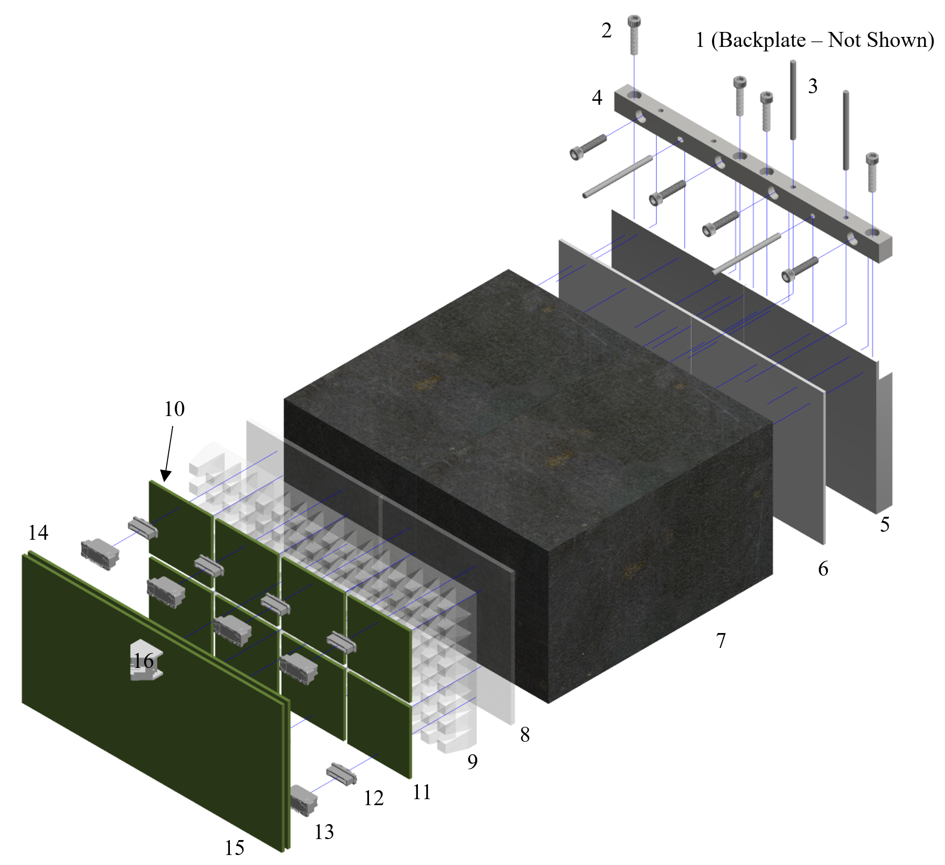
Exploded View
Part Number | Component | Feature | Typical/Expected Tolerances (in)
 |  |  | x | y | z
1 | Backplate | Hole Diameter | 0.002 | 0.002
 |  | Hole Location | 0.002 | 0.002
2 | 8-36 Screws
3 | 1/8” Dowels | Dowel Diameter | 0.0002 | 0.0002 | 0.0002
4 | Mounting Plate – Top | Profile | 0.005 | 0.005 | 0.005
 |  | Hole Diameter | 0.002 | 0.002 | 0.002
 |  | Hole Position | 0.002 | 0.002 | 0.002
5 | Mounting Plate – Bottom | Profile | 0.005 | 0.005 | 0.005
 |  | Hole Diameter | 0.002 | 0.002 | 0.002
 |  | Hole Position | 0.002 | 0.002 | 0.002
6 | Titanium Dioxide Epoxy | Profile | 0.005 | 0.005 | 0.005
7 | Tungsten Sci-Fi Block | Profile | 0.022 | 0.022 | 0.01
 | Tungsten Sci-Fi Individual Molds | Profile | 0.005 | 0.005 | 0.005
 | Glued Connection |  | 0.002 | 0.002 | 0.002
8 | Light Guide Face | Profile | 0.002 | 0.002 | 0.002
9 | Light Guide | Profile | 0.002 | 0.002 | 0.002
10 | SiPM | Position | 0.008 | 0.008 | 0.008
11 | SiPM Board | Profile | 0.005 | 0.005 | 0.005
12 | Connector 300 | Position | 0.005 | 0.005 | 0.005
13 | Connector 600 | Position | 0.005 | 0.005 | 0.005
14 | Pre-Amp Board | Profile | 0.005 | 0.005 | 0.005
15 | Bias Board | Profile | 0.005 | 0.005 | 0.005
16 | Ethernet | Position | 0.008 | 0.008 | 0.008
* | Assumed Tolerance of All Glued Connections |  | 0.002 | 0.002 | 0.002

Slide 5
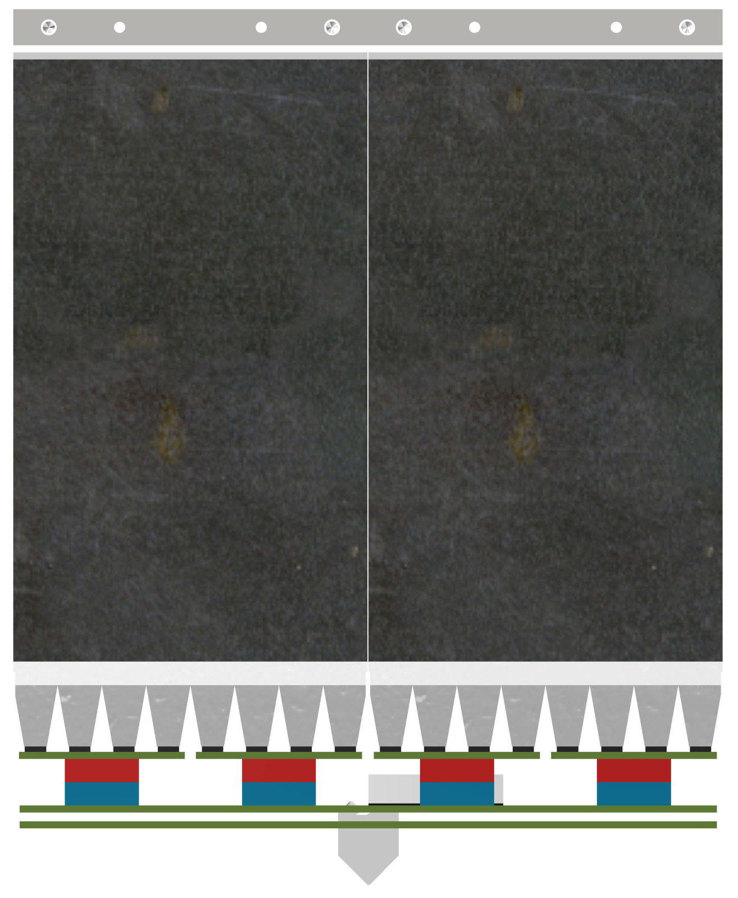

Location 1 - Connectors

Slide 6
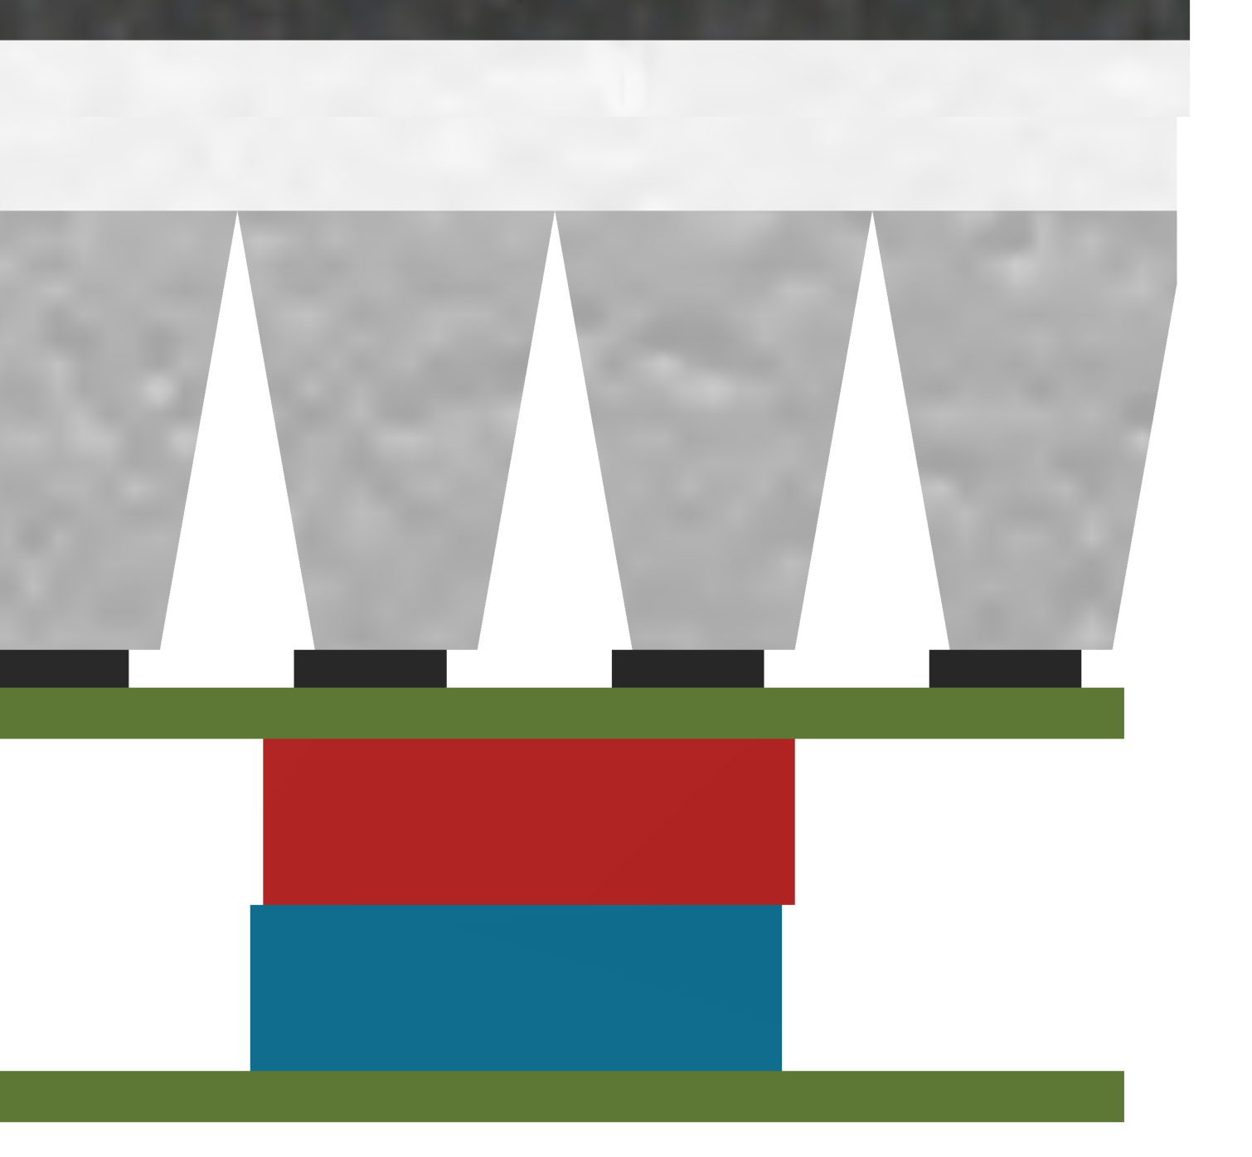
Location 2 - SiPMs

Slide 7
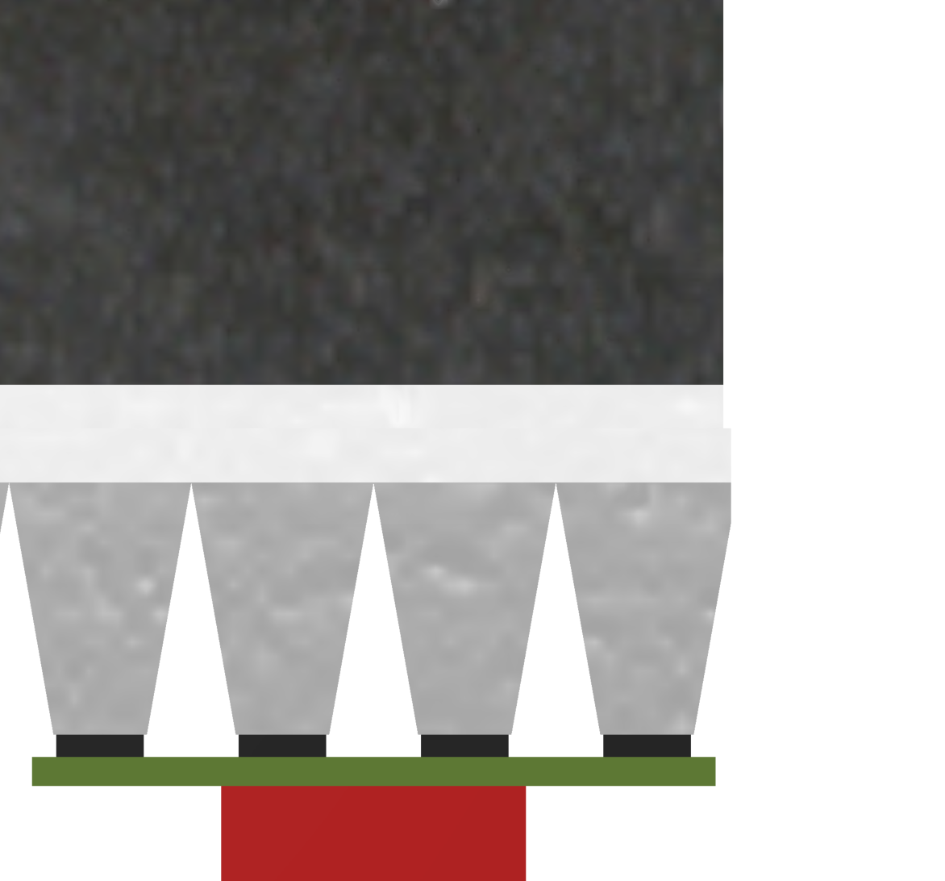
Location 3 – Light Guide

Slide 8
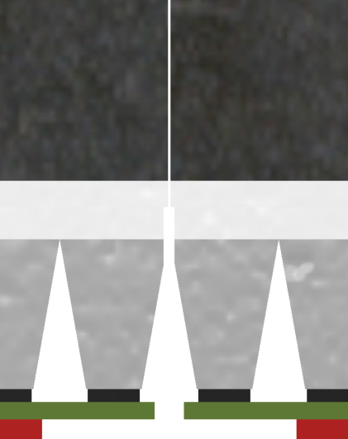
Location 4 – Sci-Fi Modules

Slide 9
Options Moving Forward
Single Panel Design
Minimum space needed at typical manufacturing and assembly tolerances
Estimated Cost
Double Panel Design
Minimum space needed at much tighter manufacturing and assembly tolerances
Estimated Cost

Slide 10
Questions and Concerns
Very concerned about assumption concerning placement tolerance of SiPMs. 0.002in, even 0.008in, seems extremely optimistic if operation is conducted by hand.

