Slide 1
Far-Forward / Far-Backward
Detector Integration
Jonathan Smith (JLAB), Ron Lassiter (JLAB),
and India Krehbiel (JLab), David Powell (JLAB)
February 18th, 2025

Slide 2
Primary Updates Outline
Far-Backward Region
Lumi Detector
Low Q² Tagger
Far-Forward Region
B0 Detector
Roman Pots
ZDC

Slide 3
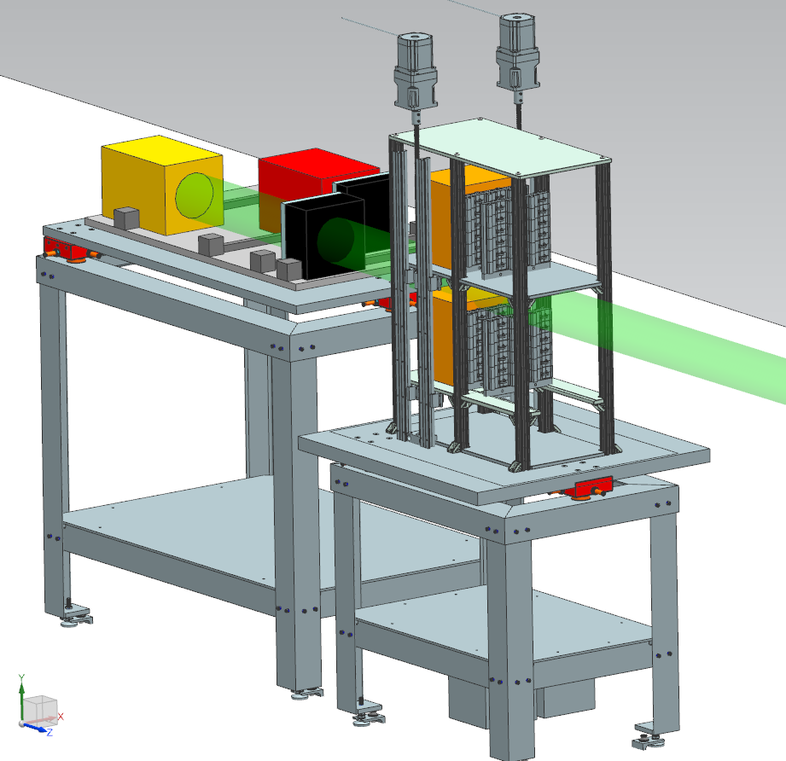
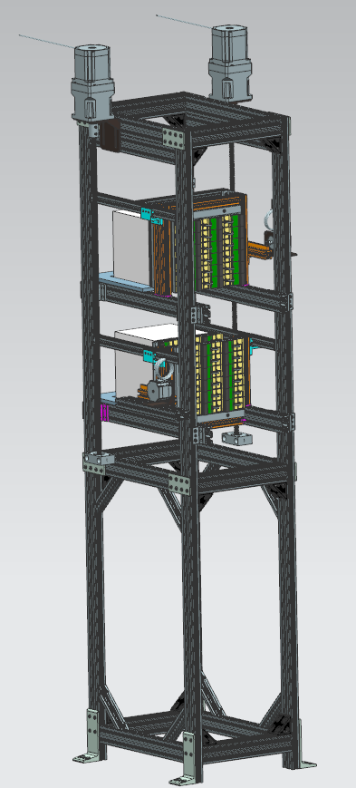
Lumi Detector Stand
Previous table design was a ‘stand-in’
New design requirements dictated the front detectors move independently 5cm in Z-Axis
Top and bottom shelves of calorimeters/detectors need 10cm of movement in Y-Axis
Old
New

Slide 4
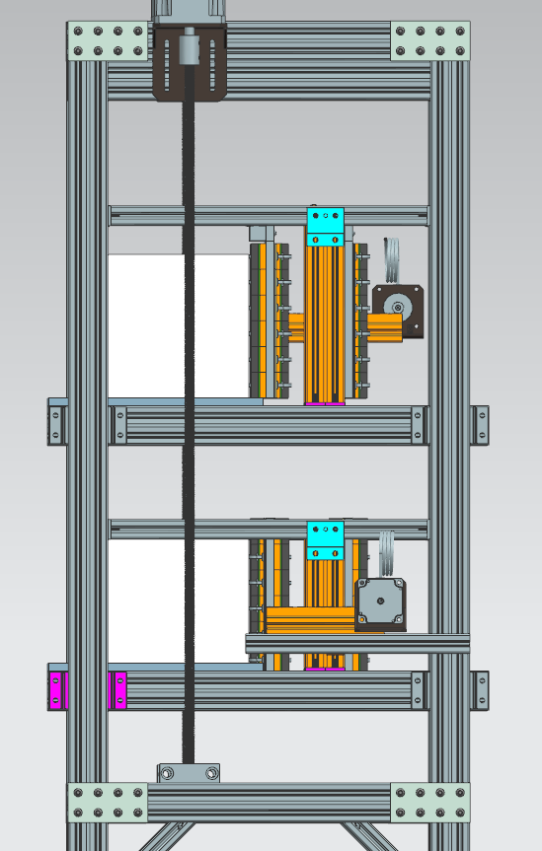
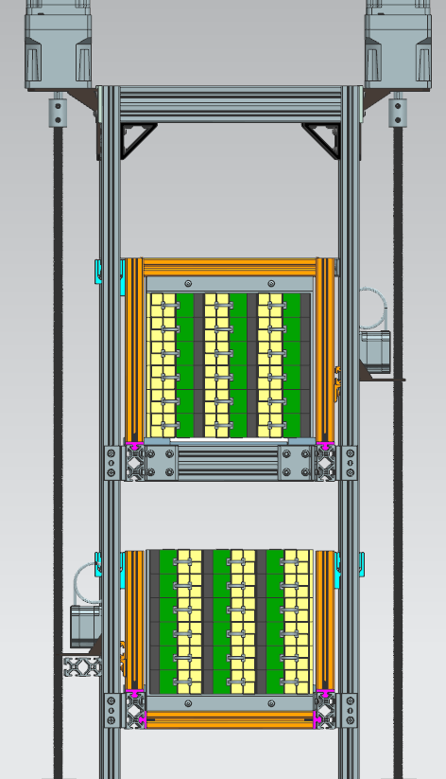
Lumi Detector Stand
5cm
10cm in +Y
Must remain clear in way of detectors
5cm
10cm in -Y
SIDE
FRONT

Slide 5
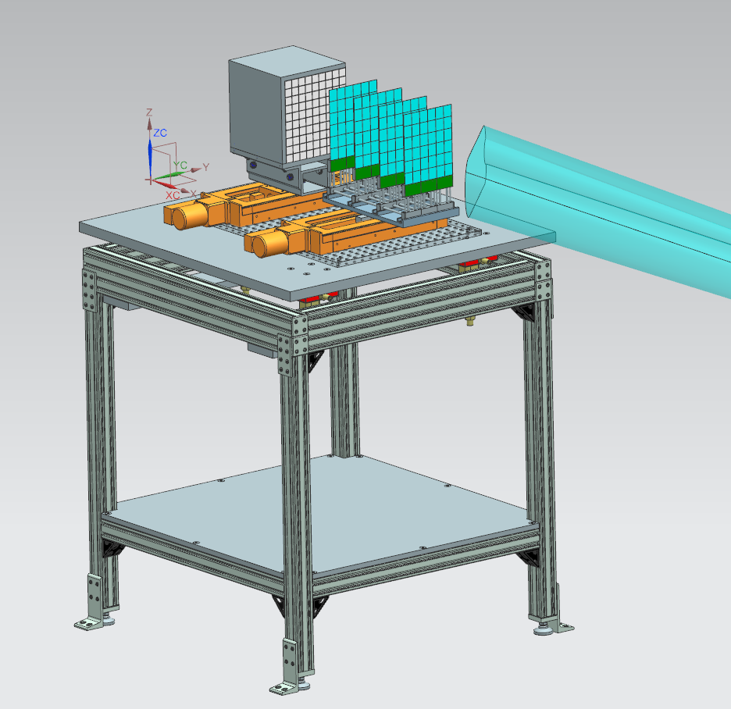
Low Q2 Tagger Stand
Latest design as of Fall 2024
No design update requirements at this time

Slide 6
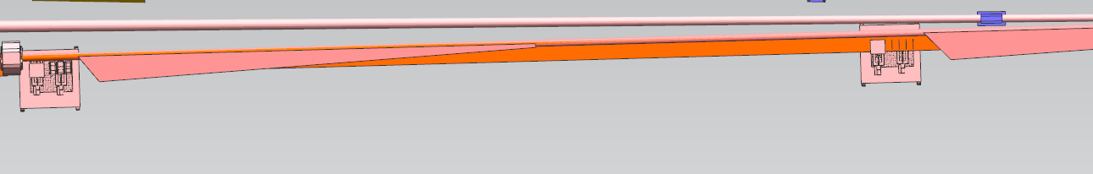
Low Q2 Tagger Stand
Latest beampipe update in Far-Backward may result in design. Yulia is investigating

Slide 7
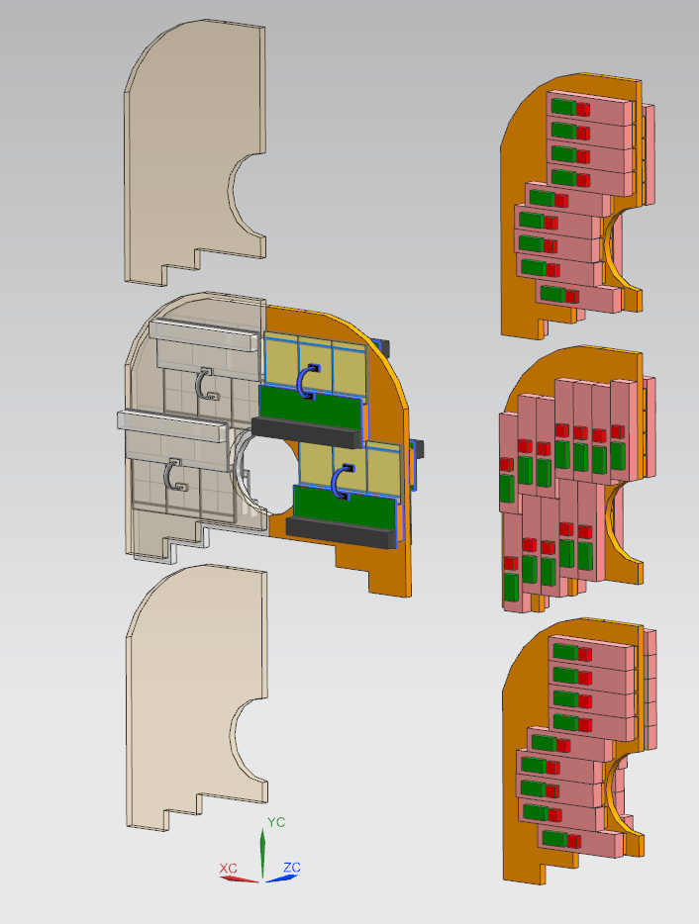
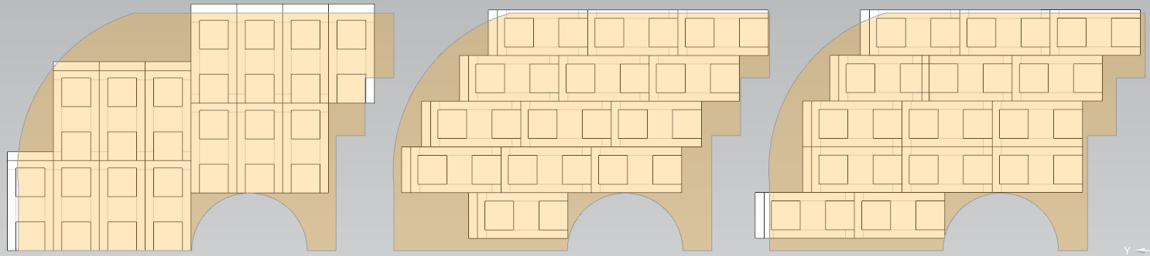
B0 Detector Layout
The B0 Detector Layout has undergone numerous changes since 2023.
Latest version is using Forward TOF detectors
Currently looking to replace TOF Detectors with Stave Detectors

Slide 8
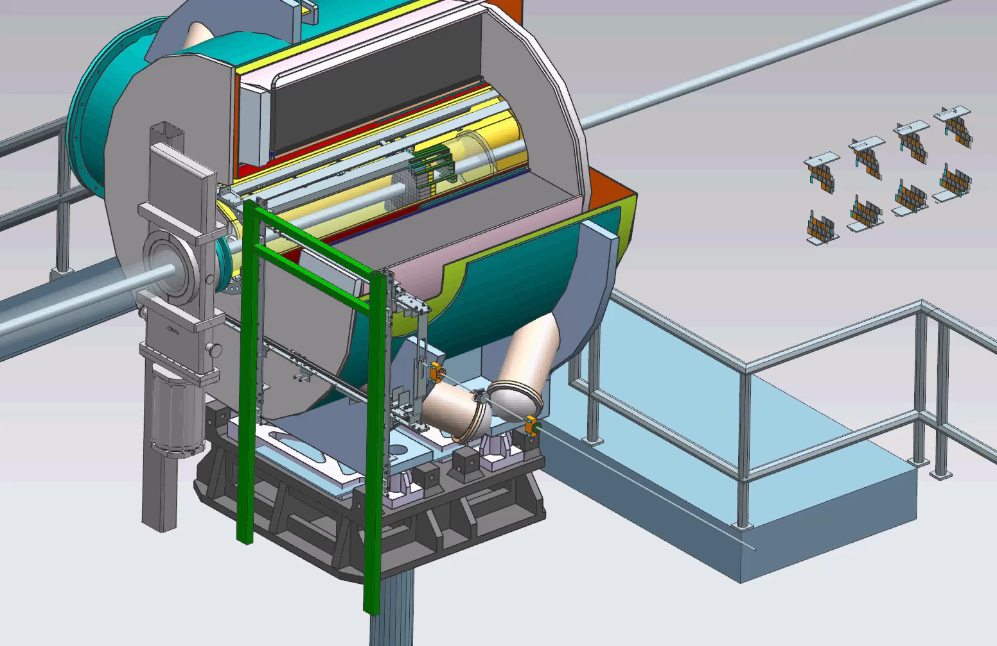
B0 Detector Removal/Install (Legacy)
New design direction requires the two halves of detectors must be separated from the outside, and combine from inside the B0 barrel
Current design has the two halves meeting outside the B0 barrel

Slide 9
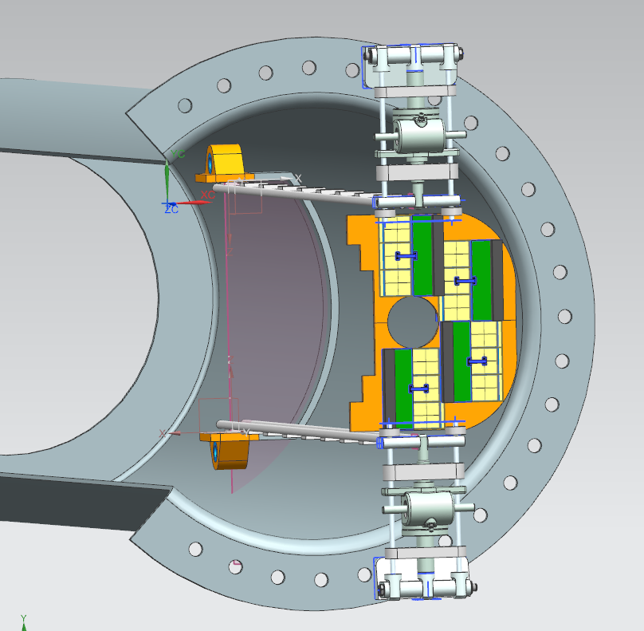
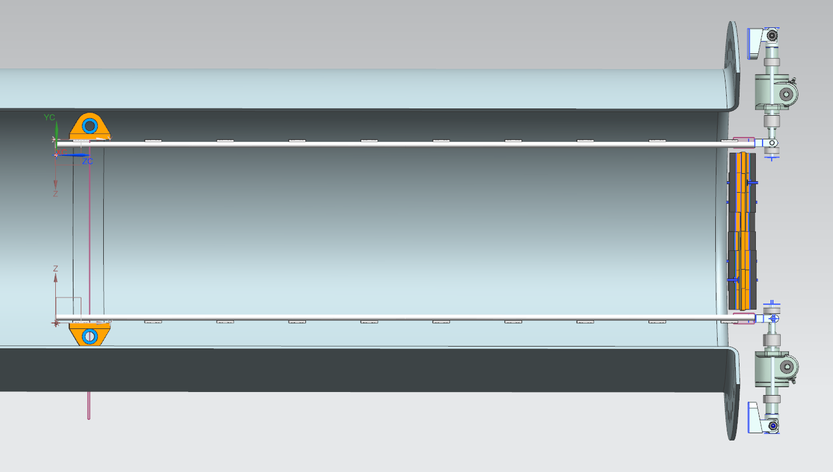
B0 Detector Removal/Install (Latest Concept)

Slide 10
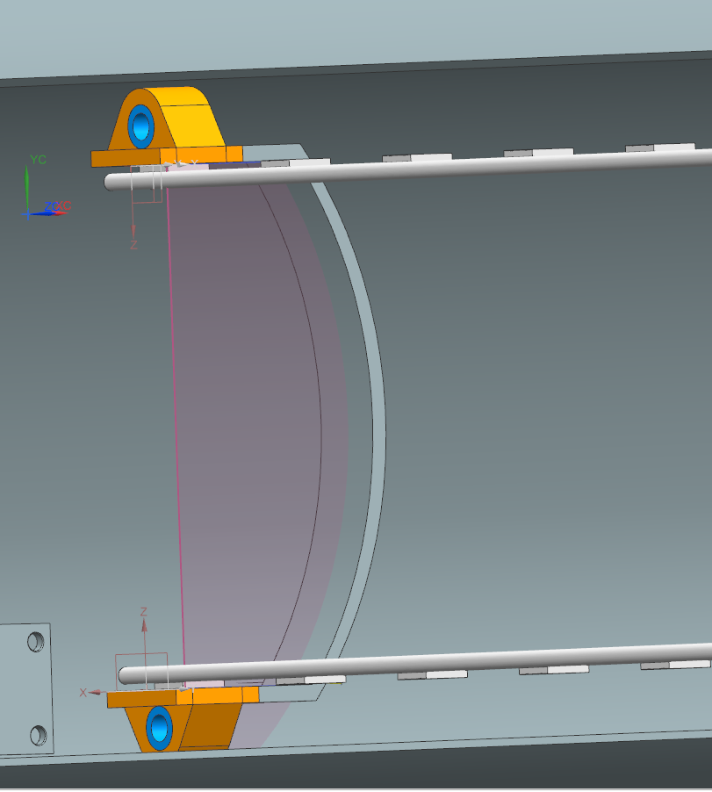
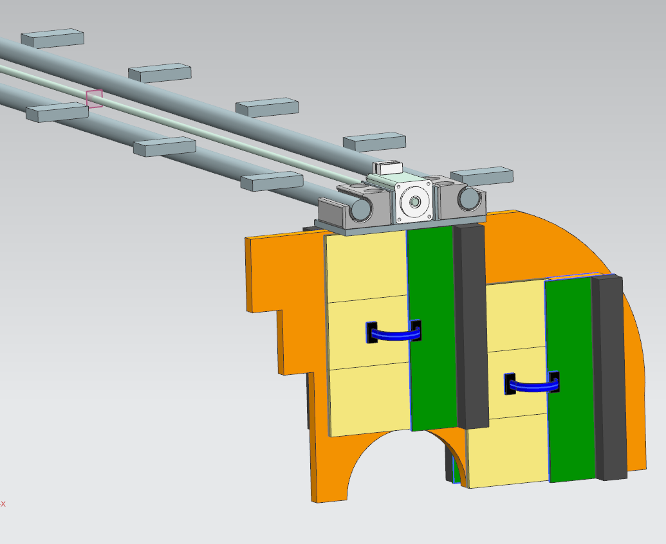
B0 Detector Removal/Install (Latest Concept)
New rail system allows for all detector halves to be separate until in fixed position. Once fixed, the rails will move in parallel position in Z-Axis
Carriages will use a non-captive motor on a fixed lead screw to individually ‘drive’ each detector half into position
Screw jacks will secure on the front face of the support barrel
Inside will likely require a jig for securing the top and bottom rail pivot point in precise location

Slide 11
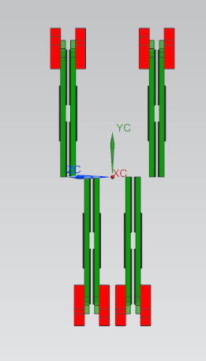
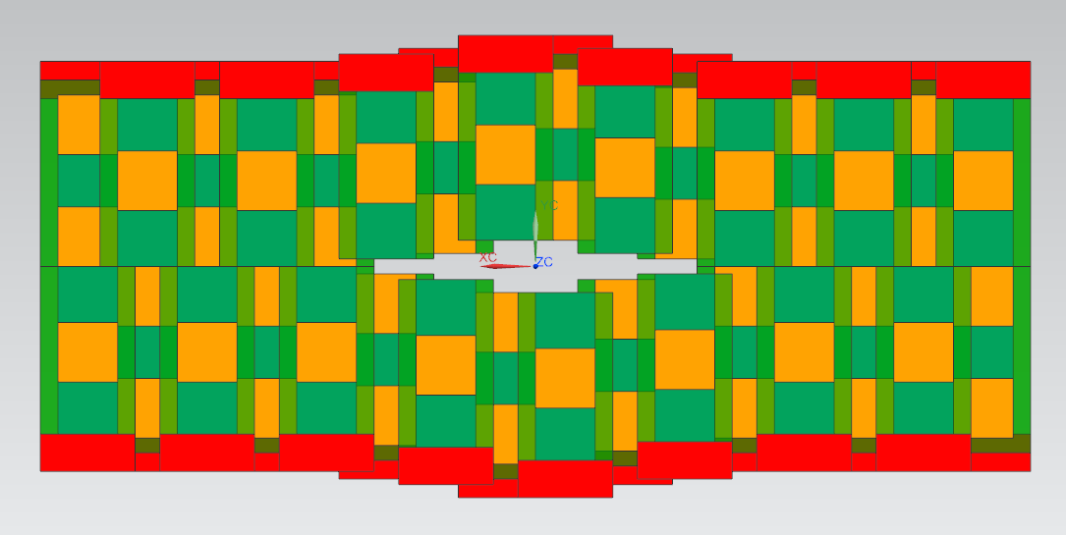
Roman Pot Detector Layout
Detector layers are double-sided with maximum coverage
Raphael Dupre (IJCLab, France) is currently simulating cooling methods
Detector layout will not fit in the current Roman Pot design in lattice. There will be an updated model design TBD.

Slide 12
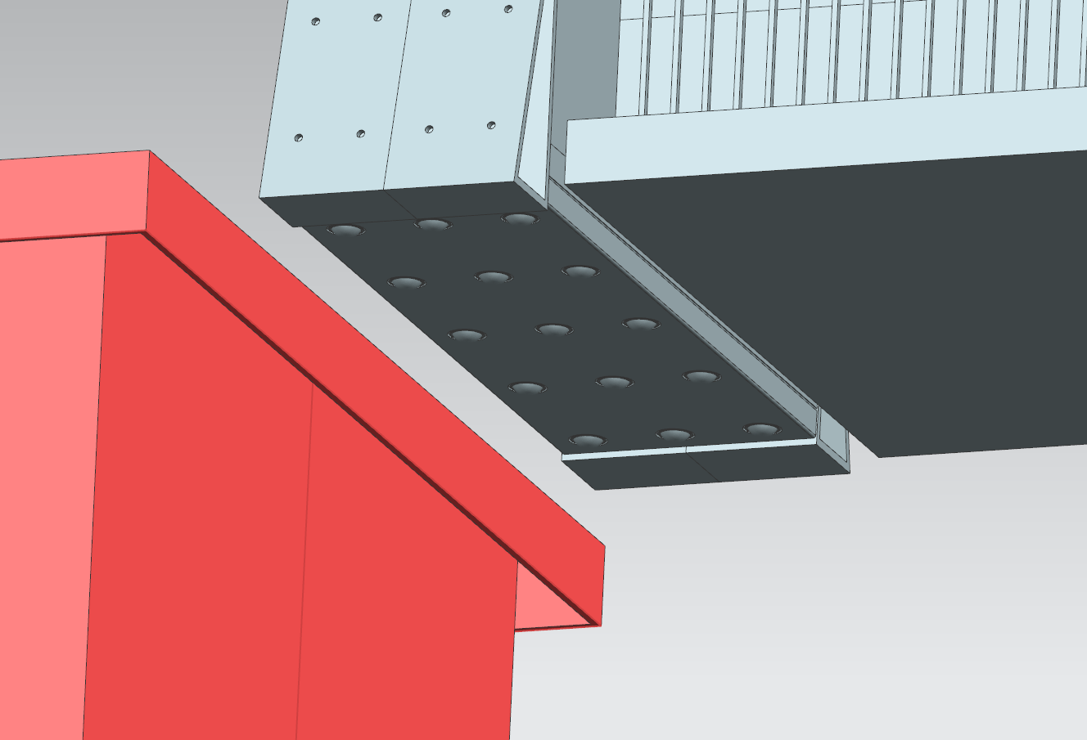
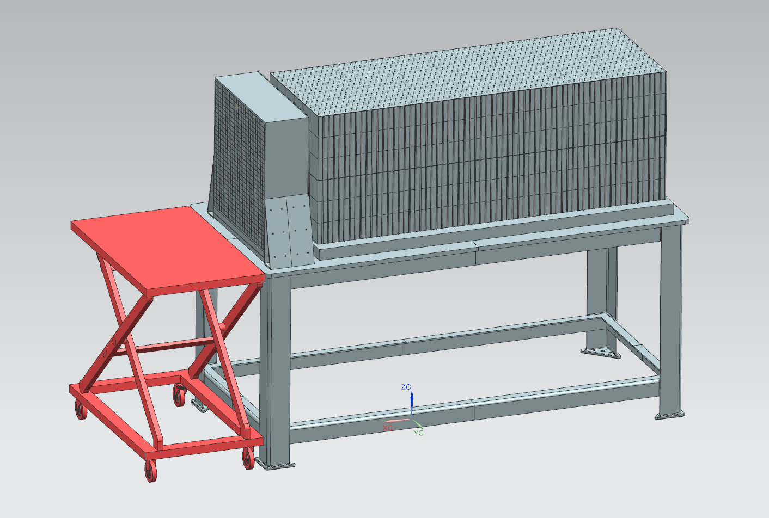
ZDC EMCAL Removal
EMCAL must be removable for maintenance.
Sourced a COTS lifting table to fit the allotted space in front of the ZDC
Secured the EMCAL on an array of ball transfers.

Slide 13
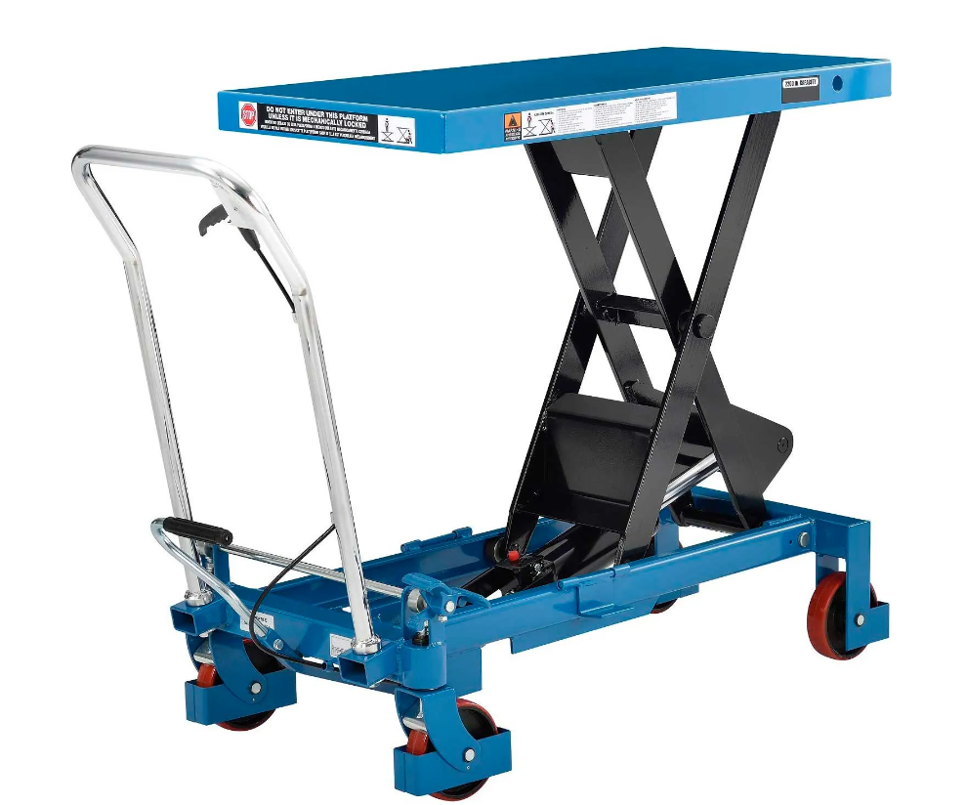
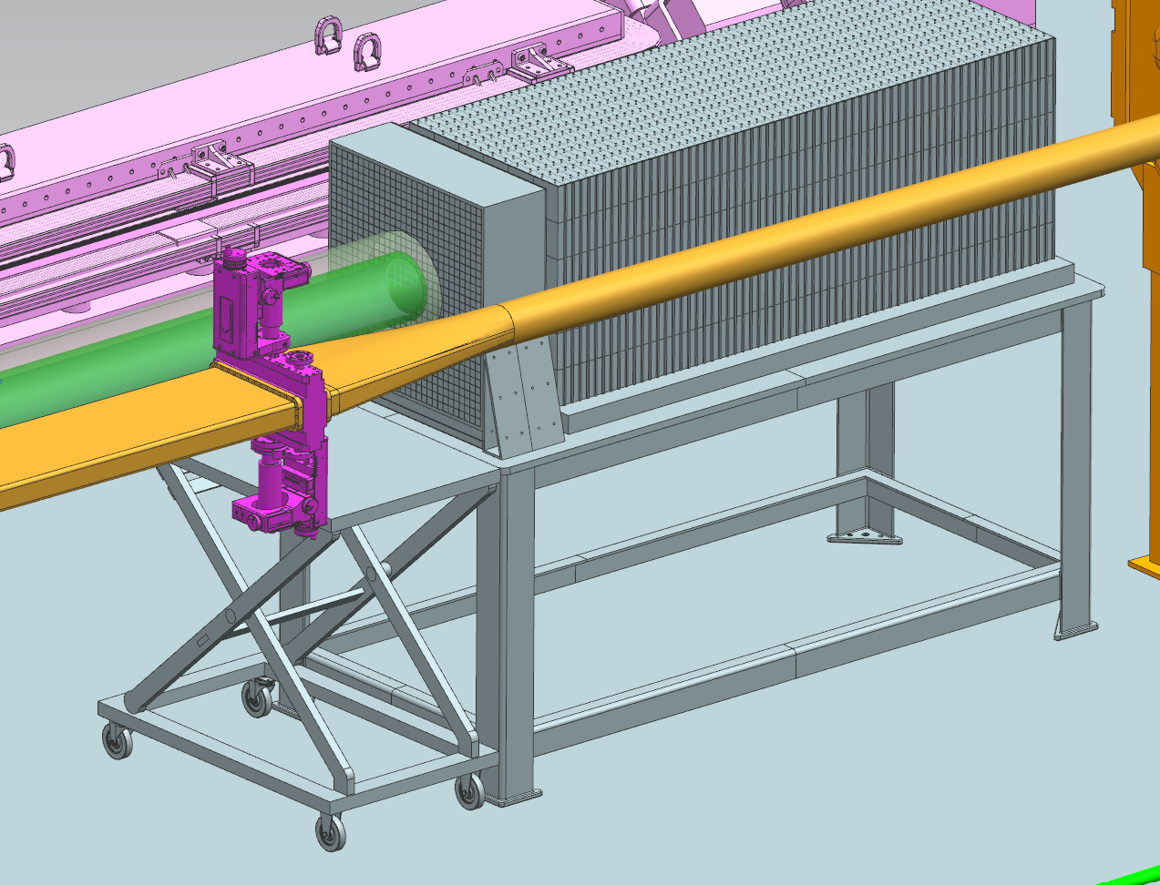
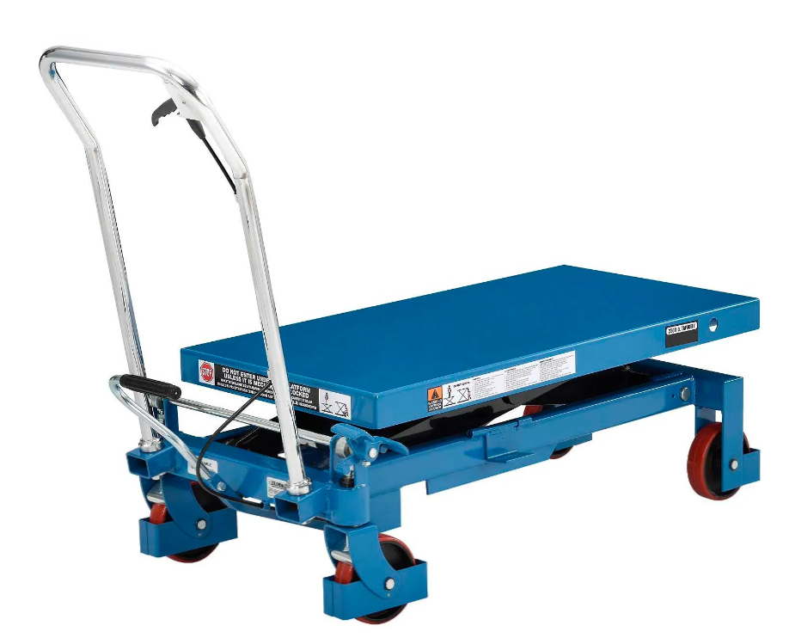
ZDC EMCAL Removal

