Slide 1
Ancillary Detectors / Vacuum
Triple I Engineering Meeting Update
Chang Jun (2/18/2024)

Slide 2
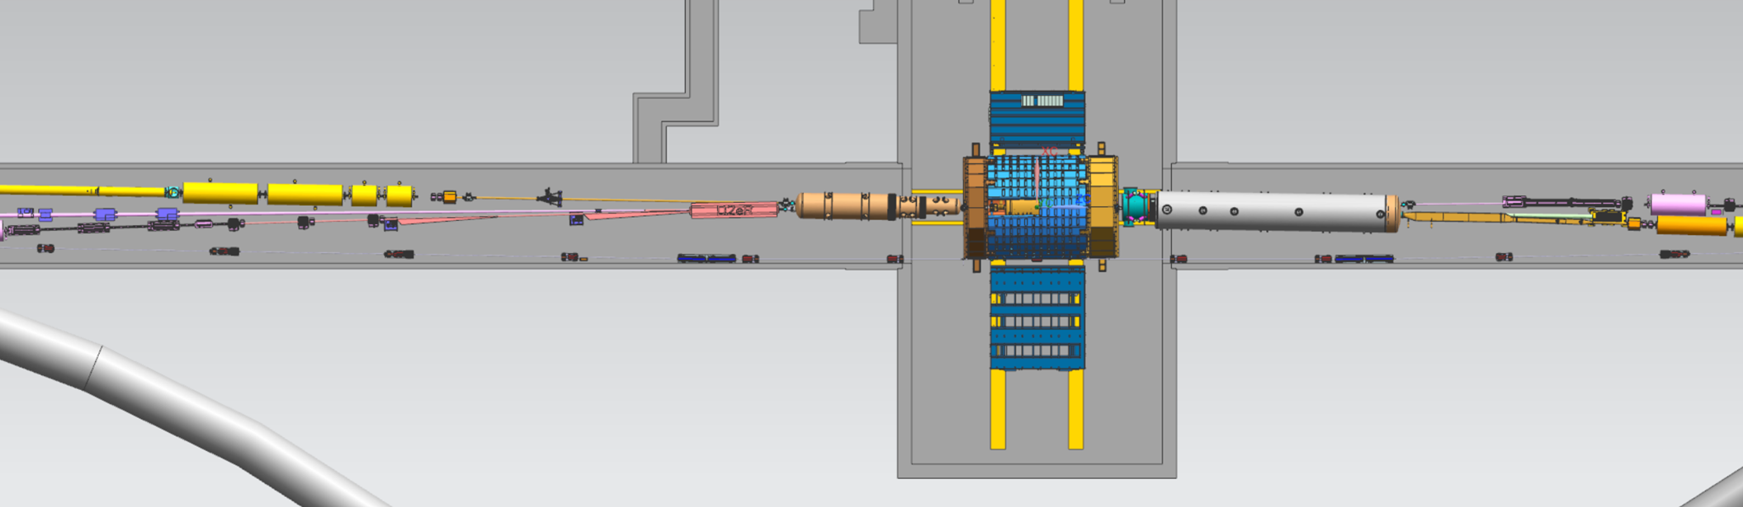
Far-Backward / Far-Forward Ancillary Detectors
Far-Backward (To detect Electron Beam Particles):
→ Low Q^2 Taggers (2 Stations: 14m apart), Luminosity System (Magnet+Conversion Foil+Magnet+3 Calorimeters)
Far-Forward: (To detect Hadron Beam Particles)
→ Zero Degree Calorimeter, Roman Pots (2 Stations: 1.5m apart), Off-Momentum Detectors (2 Stations : 1.5m apart)
Hadrons
Electrons
Far-Backward
Far-Forward

Slide 3
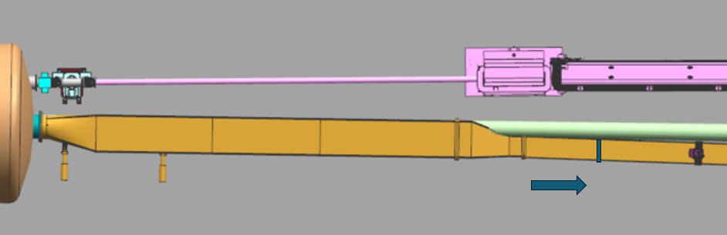
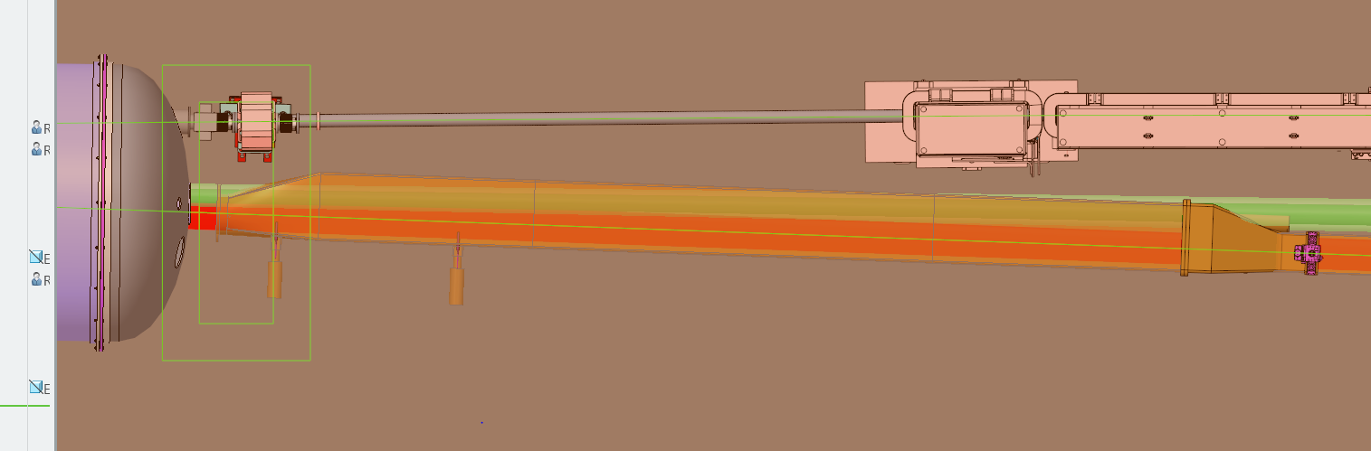
Far-Forward (Roman Pots & Off-Momentum Detectors)
[Updating: Preliminary]
B1apf (Left End) is extended to add cryostat dome.
OMD will be installed on Flat side wall of the Beam Duct.
Gate Valve (ID~16”) may be installed to connect a bellow to flange from B1apf.
B1apf
B1apf
Beam Duct Design will be Updated to avoid neutron path & to minimize the duct.

Slide 4
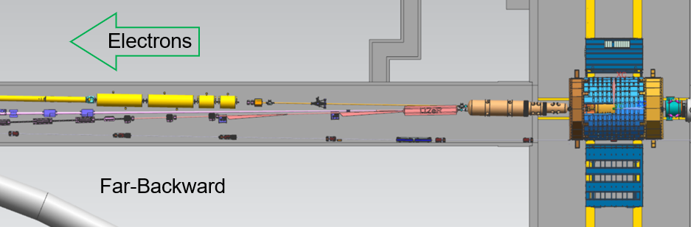
Far-Backward (Lower Q² Tagger Ante-Chamber)
~22 m
~27 m
~41 m

Slide 5
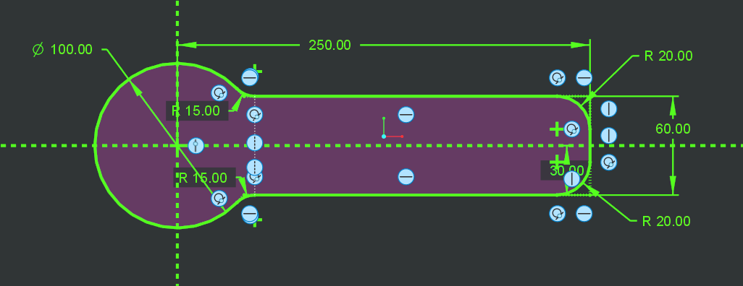
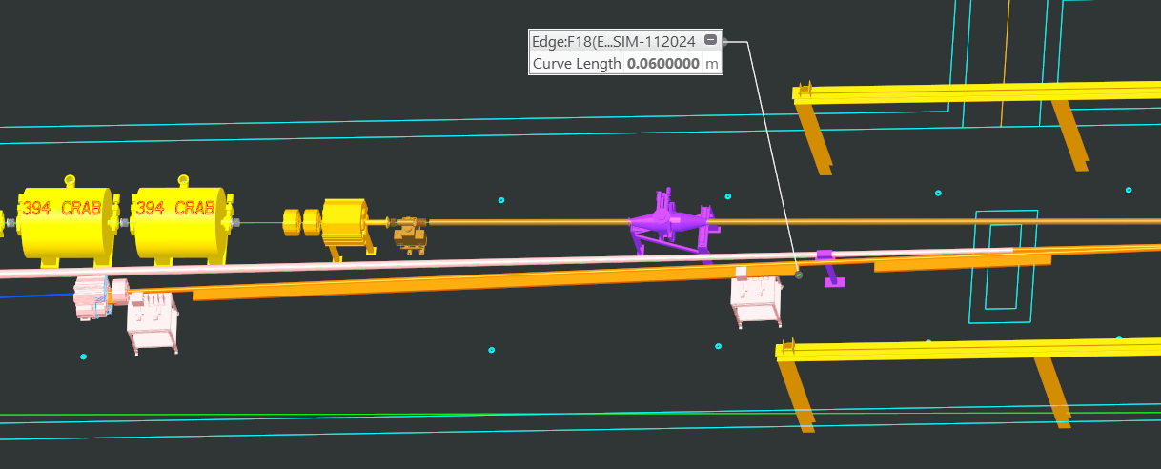
Far-Backward (Lower Q² Tagger Ante-Chamber)
[Details]
Material may be Stainless Steel.
(Inside circular part: copper coated)
Inside Space is in Vacuum
Rounds are allowed to help manufacturing.
W=250 should cover the sensor (180mm): 230mm < W < (bigger is OK)
H=60mmm: can be bigger, but not smaller.
W=250mm should be just before the sensors:
It can be tapered from exit to Q^2 sensor.
50 < W =< 250mm along Z.

Slide 6
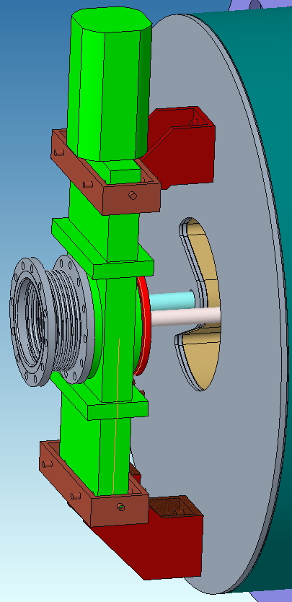
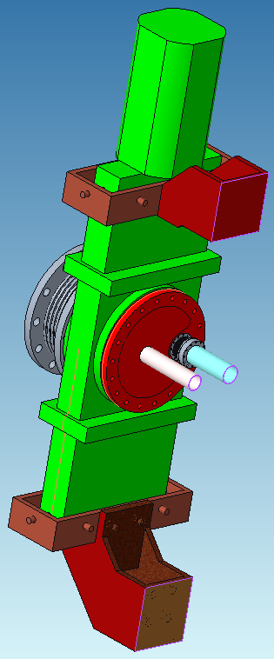
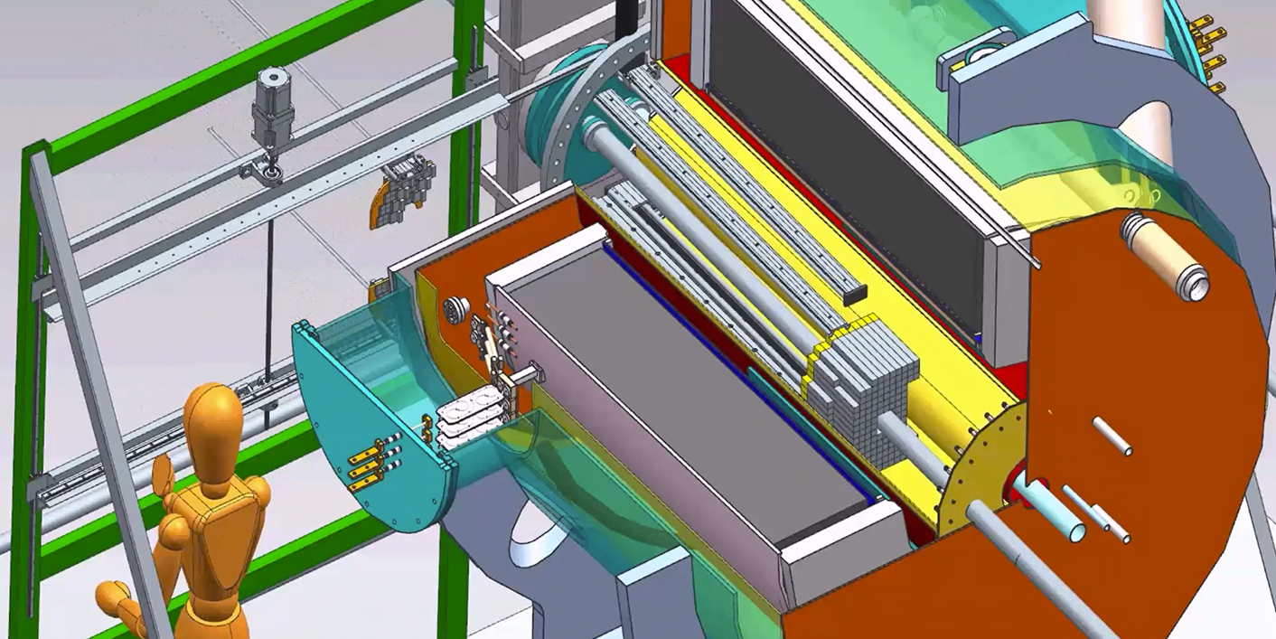
B0 Magnet Beam Pipe Connections (To Connect Central Detector)
Gate Valve
B0 Magnet

Slide 7
B0 Magnet Beam Pipe Connections
[Before]
IP Side: One big Gate Valve (ID=260mm) accommodates EB Pipe & Hadron Beam Pipe.
[Updating - Preliminary]: See Pictures on Next Page
IP Side: One small Gate Valve will accommodate EB Pipe.
Non-IP Side: Another small Gate Valve will accommodate Hadron Beam Pipe.
[Why ?]
To give more space on IP side to assemble 4 Silicon Detector disks & to have more adjustment.
To pump warm part: Hadron Beam Pipe inside B0 is warm.
[NOT Changed]
Except Detector Disks, all the parts will be assembled outside tunnel.
Lower Half Crystal Calorimeter → Hadron Pipe with Flanges → Upper Half Crystal Calorimeter.

Slide 8
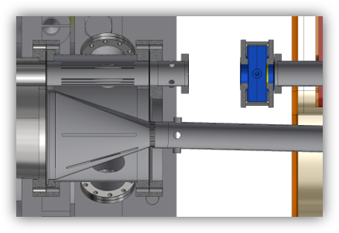
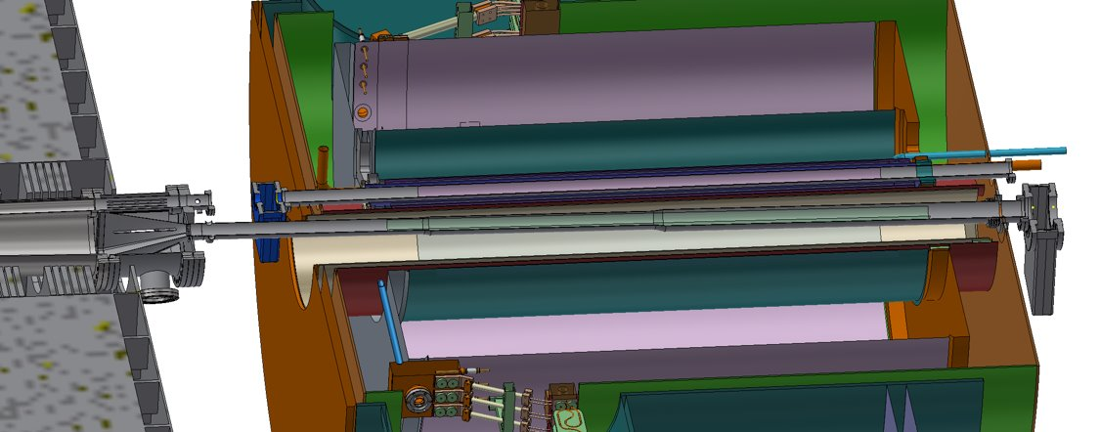
B0 Magnet Beam Pipe Connections

