Slide 1
Cradle, Barrel HCAL & Moving Mechanism
Triple I Engineering Meeting Update – 2/24/25
Nathaniel Speece-Moyer (BNL)

Slide 2
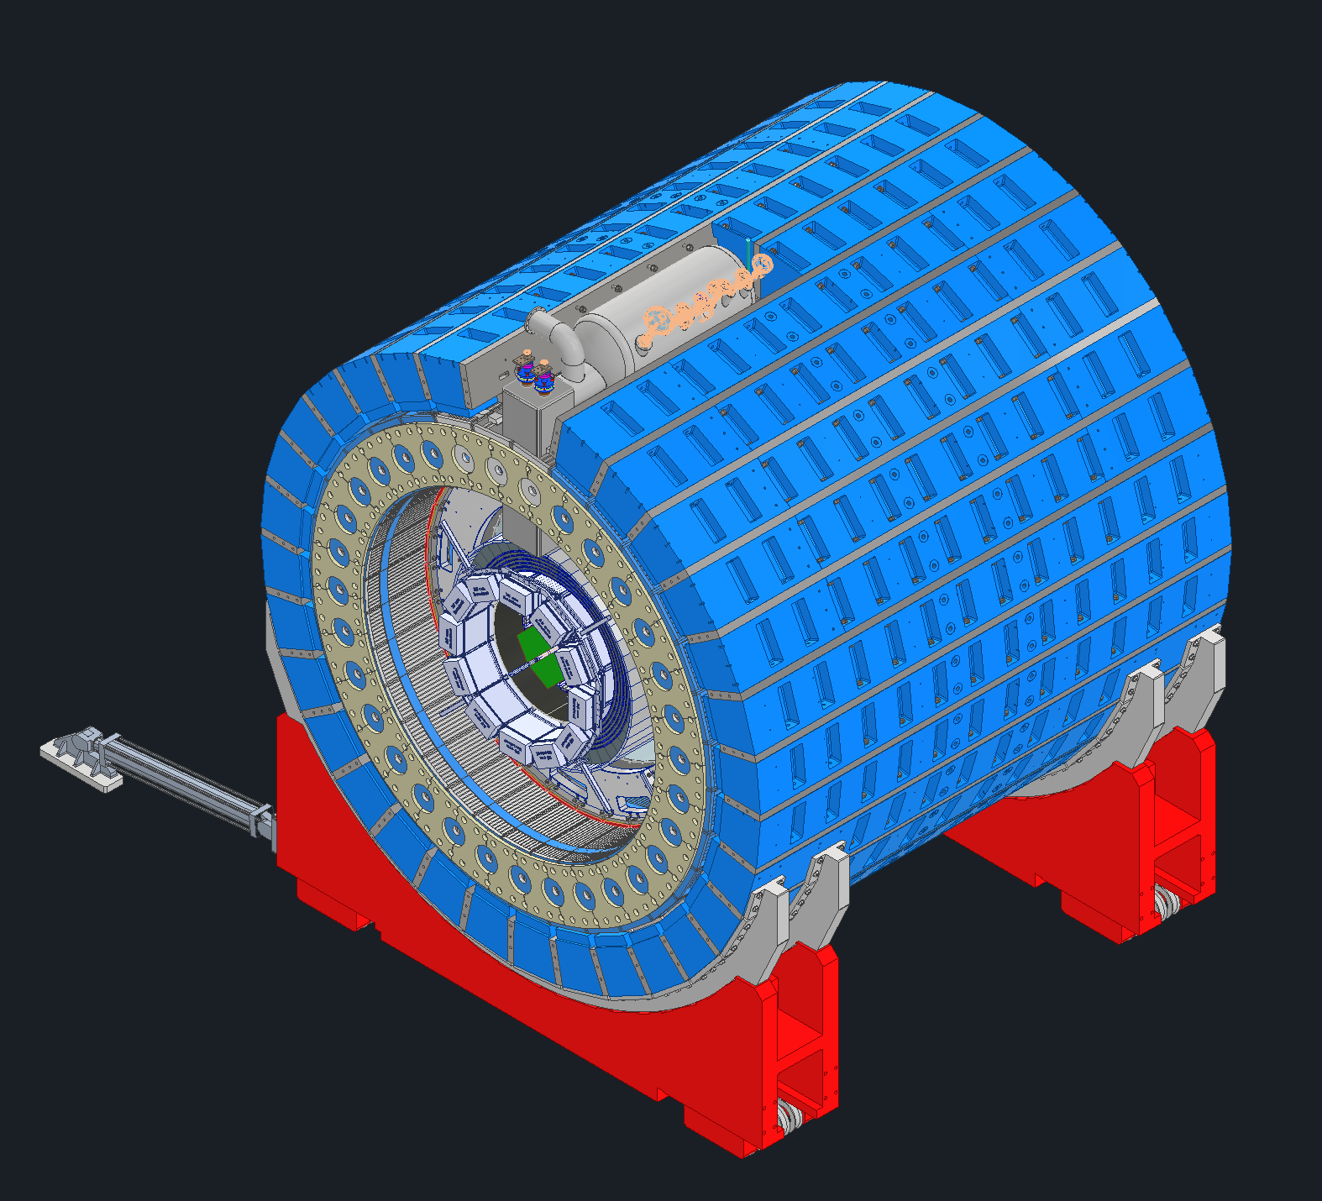
Intro and Background
Magnetic shielding is needed on the ePIC detector. This presentation gives a summary of the original plan and current design state, which uses flux return bars for magnetic shielding. This also discusses the support cradle assemblies.
Reusing flux return bars from the STAR detector: Flux return bars make a full ring (former design state, only included for reference)
Need to have magnetic shielding around the full barrel HCAL, which is reused from the sPHENIX detector at BNL.
Low external magnetic field constraints due to RCS magnet and beampipe in the experimental hall resulted in the need for substantial magnetic shielding (requirement removed, more on this later).
Plan to use flux return bars (also called backlegs) from the STAR detector.
Plan to reuse the cradle from the STAR detector.
Would require bars + spacers to form a full outer ring around the barrel HCAL. Spacers between flux return bars are needed due to difference in detector diameters between STAR and ePIC. The barrel HCAL would attach directly to the bottom half of the flux return bar ring but not be connected on the top half.
8 mrad rotation required to align the ePIC detector with the electron beampipe.
This rotation creates design complexity and assembly challenges, since this is 8 mrad of rotation from the existing cradle orientation and tracks used to move the detector.
Numerous design challenges: Alignment and assembly (biggest issue), weight of flux return bars and concrete floor load limits, unknown modifications or voids in existing bars, unknown internal stresses in bars resulting in possible part deformation during machining.
Flux return bars (blue) and spacers (gray)
HCAL
Cradle
Cradle adapter
Previous design state: Use STAR flux return bars and spacers in a full ring around the ePIC detector.

Slide 3
Intro and Background
STAR cradle re-use
Planning to reuse the STAR detector cradle.
STAR cradle requires modification to accommodate 8 mrad rotation of the ePIC detector. Not a straightforward design modification.
The STAR cradle interface does not match the diameter needed for the ePIC detector – modifications needed.
Requires machining the cradle and using a cradle adapter to attach flux return bars. Complex machining needed due to the angle and curved surfaces.
Attachment method not finalized. Likely welding.
Moving mechanisms
We plan to re-use the moving and lifting pistons from STAR.
Work on this has been limited since we are focusing on the flux return bars and cradle first.
Flux return bars (blue) and spacers (gray)
HCAL
Cradle
Cradle adapter
Previous design state: Use STAR flux return bars and spacers in a full ring around the ePIC detector.

Slide 4
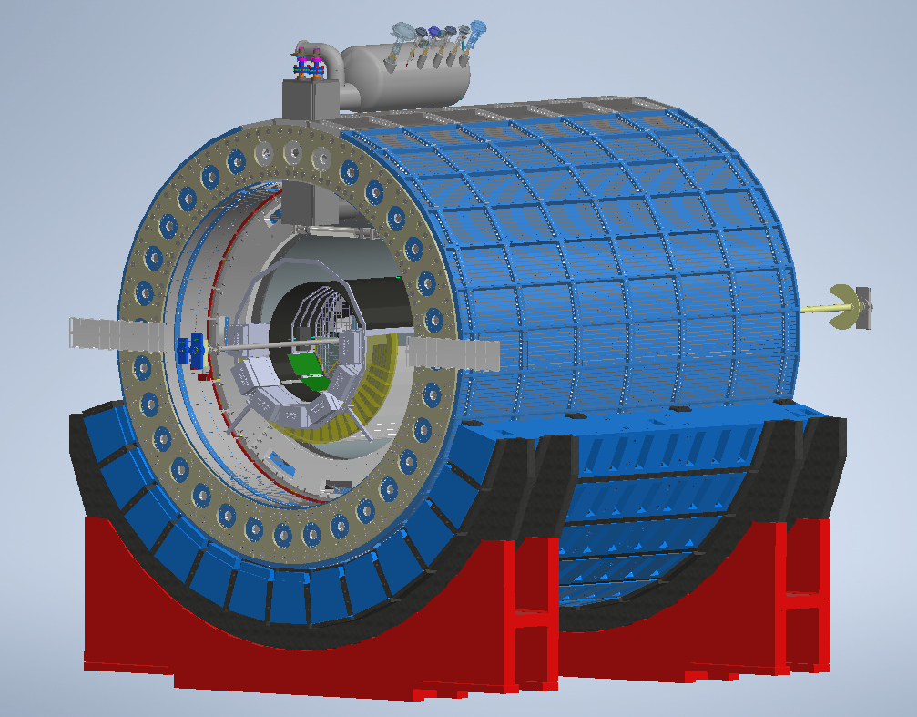
Intro and Background: Current Baseline Design
Magnetic shielding requirements reduced
RCS beampipe removed from experimental hall. Magnetic shielding requirements relaxed, so we don’t need a full ring of flux return bars around the ePIC detector.
Half ring of existing STAR flux return bars (current baseline design)
Pursuing design with half ring of existing STAR flux return bars, used to support the barrel HCAL and inner detectors.
HCAL sectors will be supported in the same location as they were on the sPHENIX detector.
Still reusing STAR cradle with the same design challenges listed earlier.
Half ring of new flux return bars (Possible option with new flux return bars)
Also looking at a half ring of new flux return bars with reduced steel.
Will reduce asymmetry of magnetic field. Differing opinions on whether this is needed.
The rest of this presentation covers a FEA analysis of this new flux return bar design.
Barrel HCAL
Flux return bars (blue) and spacers (gray)
Cradle
Cradle adapter
Current state showing a half ring of STAR flux return bars, STAR cradles, and new cradle adapters.

Slide 5
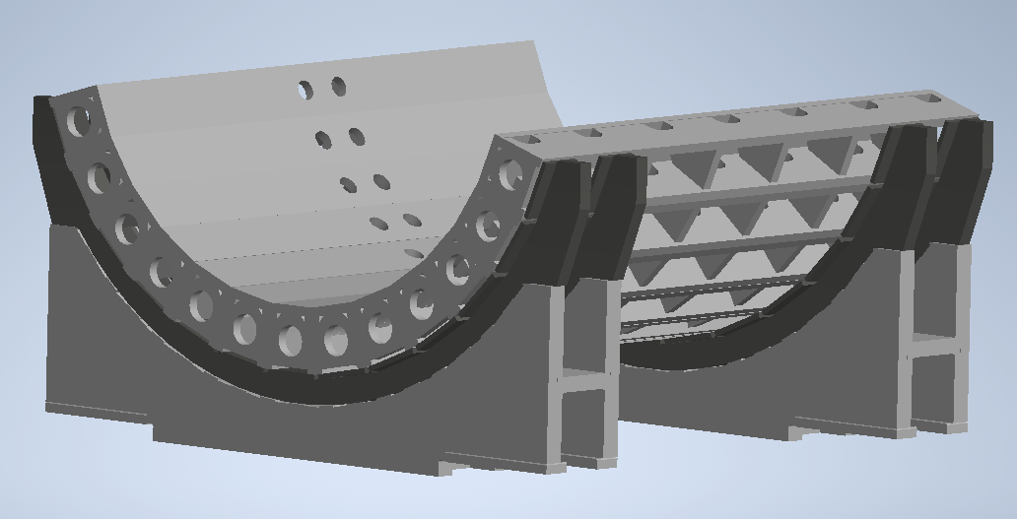
Update on recent work – cradle design concept
Half ring of new flux return bars - possible design option
In the past two weeks: Completed design and preliminary analysis of new flux return bars made with less steel.
Another similar concept (not shown) was created by Dan Cacace.
The interface to the carriage adapter still needs to be figured out and designed.
Alignment, shimming, and assembly of everything to meet the 8 mrad rotation will still be a challenge.

Slide 6
FEA Model – Loads, constraints, and mesh
All contacts simulated as perfectly bonded to save time. This is not conservative, and stress values will increase when fasteners, welded joints, and frictional contacts are modeled.
Loads simulating the weight of HCAL and inner detectors were applied to flux return bars.
Load included gravitational acceleration downward, plus 0.25 g acceleration simultaneously in X- and Y-directions parallel to the floor. This is believed to be conservative based on sPHENIX analysis – need to confirm and likely limit to the X- or Y- direction individually, not simultaneously.
Upper flux return bars loaded more heavily to account for weight from the upper half of the HCAL ring. Future FEA model will include a simplified HCAL structure.
Constraints: Cradle fixed in one corner at the location of rollers. Other corners were allowed to slide parallel to the ground. One corner had a constraint that further prevented the assembly from rotating under horizontal seismic loading.
Mesh: Started with a course mesh and used automatic refinement to decrease mesh size where needed.

Slide 7
FEA Results - Stress
Bonded contacts for all parts saved time in the analysis but will make stresses appear lower than in reality.
Stress will increase locally by fasteners and welded connections beyond what is shown here.
Stresses were typically low. We have not settled on a steel type for the new bars, but for reference, the minimum yield strength of A36 structural steel is 36,000 psi. A factor of safety of 2 is 18,000 psi, and a factor of safety of 4 is 9,000 psi.
Stress singularities continued to increase with mesh refinements. Therefore, the max stress shown in the screenshots should be ignored for now, but the location should be noted. More comprehensive analysis to be done on future iterations.
See backup slides for additional stress and deformation plots.

Slide 8
FEA Results - Deformation
Deformation plots shown are exaggerated.
Generally, deformation is low but will increase as the model is refined with fasteners and welded joints.
Plots indicate areas where more reinforcement may be needed.

Slide 9
Plans Towards PDR
We need to decide on the overall design strategy for the cradle and flux return bars.
Current most viable options:
1. Reuse STAR flux return bars and STAR cradle. Requires extensive machining, new spacer bars, and complex shimming and alignment.
2. Make new flux return bars and use with STAR cradle. Requires extensive machining and fabrication but uses less steel. Also requires complex shimming and alignment.
3. No flux return bars. HCAL supported directly by supports from sPHENIX. Make a new lower carriage assembly.
Looking like a more promising option. More investigation needed.
Don’t recommend re-using the full sPHENIX carriage assembly based on an earlier investigation, primarily due to track location differences and complexity of modifying the lower part of the carriage assembly.
Next steps
Will make a summary of pros/cons for different cradle options.
Need to discuss with BNL team before proceeding further.
Will complete a preliminary FEA of a design concept for option 3 above prior to BNL meeting.

Slide 10
Question & Comments

Slide 11
Additional Slides

Slide 12
Stress and refined mesh
Highly-refined mesh using automatic mesh convergence with multiple iterations.

Slide 13
Stress

Slide 14
Stress

Slide 15
Stress

Slide 16
Stress

Slide 17
Stress

Slide 18
Maximum Stress – Cross-sectional view

Slide 19
Maximum Stress – Cross-sectional view
This is a singularity that continued to get worse with mesh refinement. Currently ignoring the max value. Need to keep an eye on this region when updating the design.

Slide 20
Deformation, X-Axis

Slide 21
Deformation, Y-Axis

Slide 22
Deformation, Z-Axis

