Slide 1
Magnet
Triple I Engineering Meeting Update
Roland

Slide 2
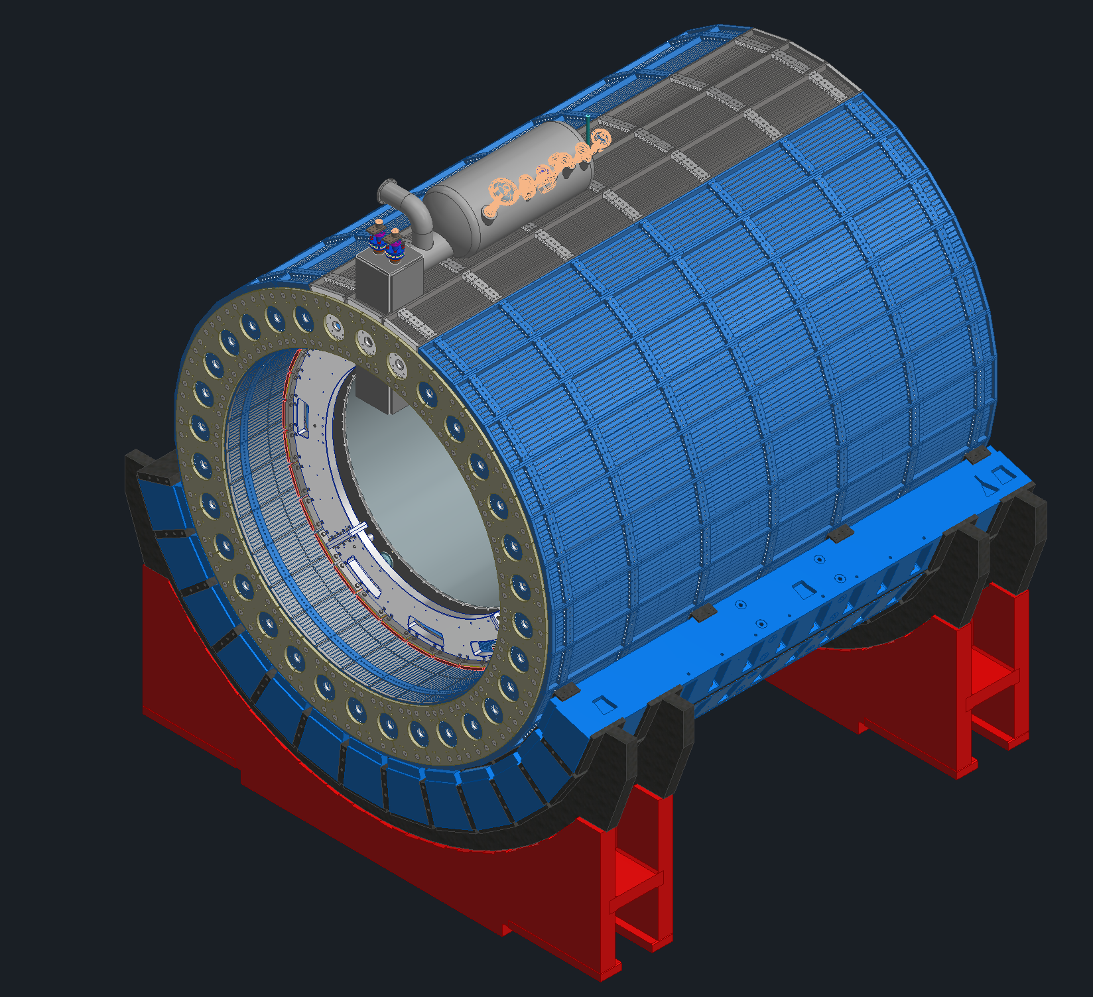
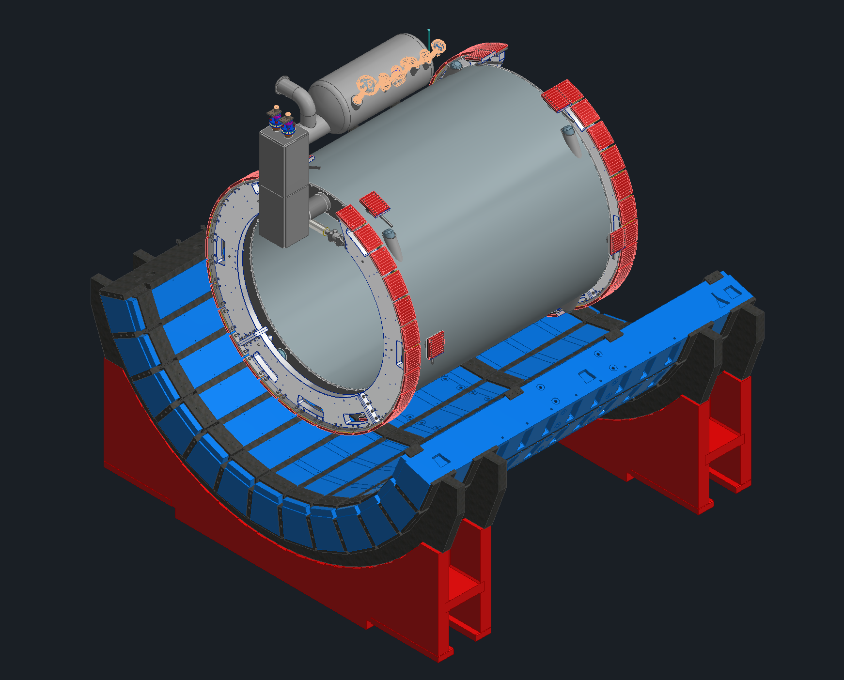
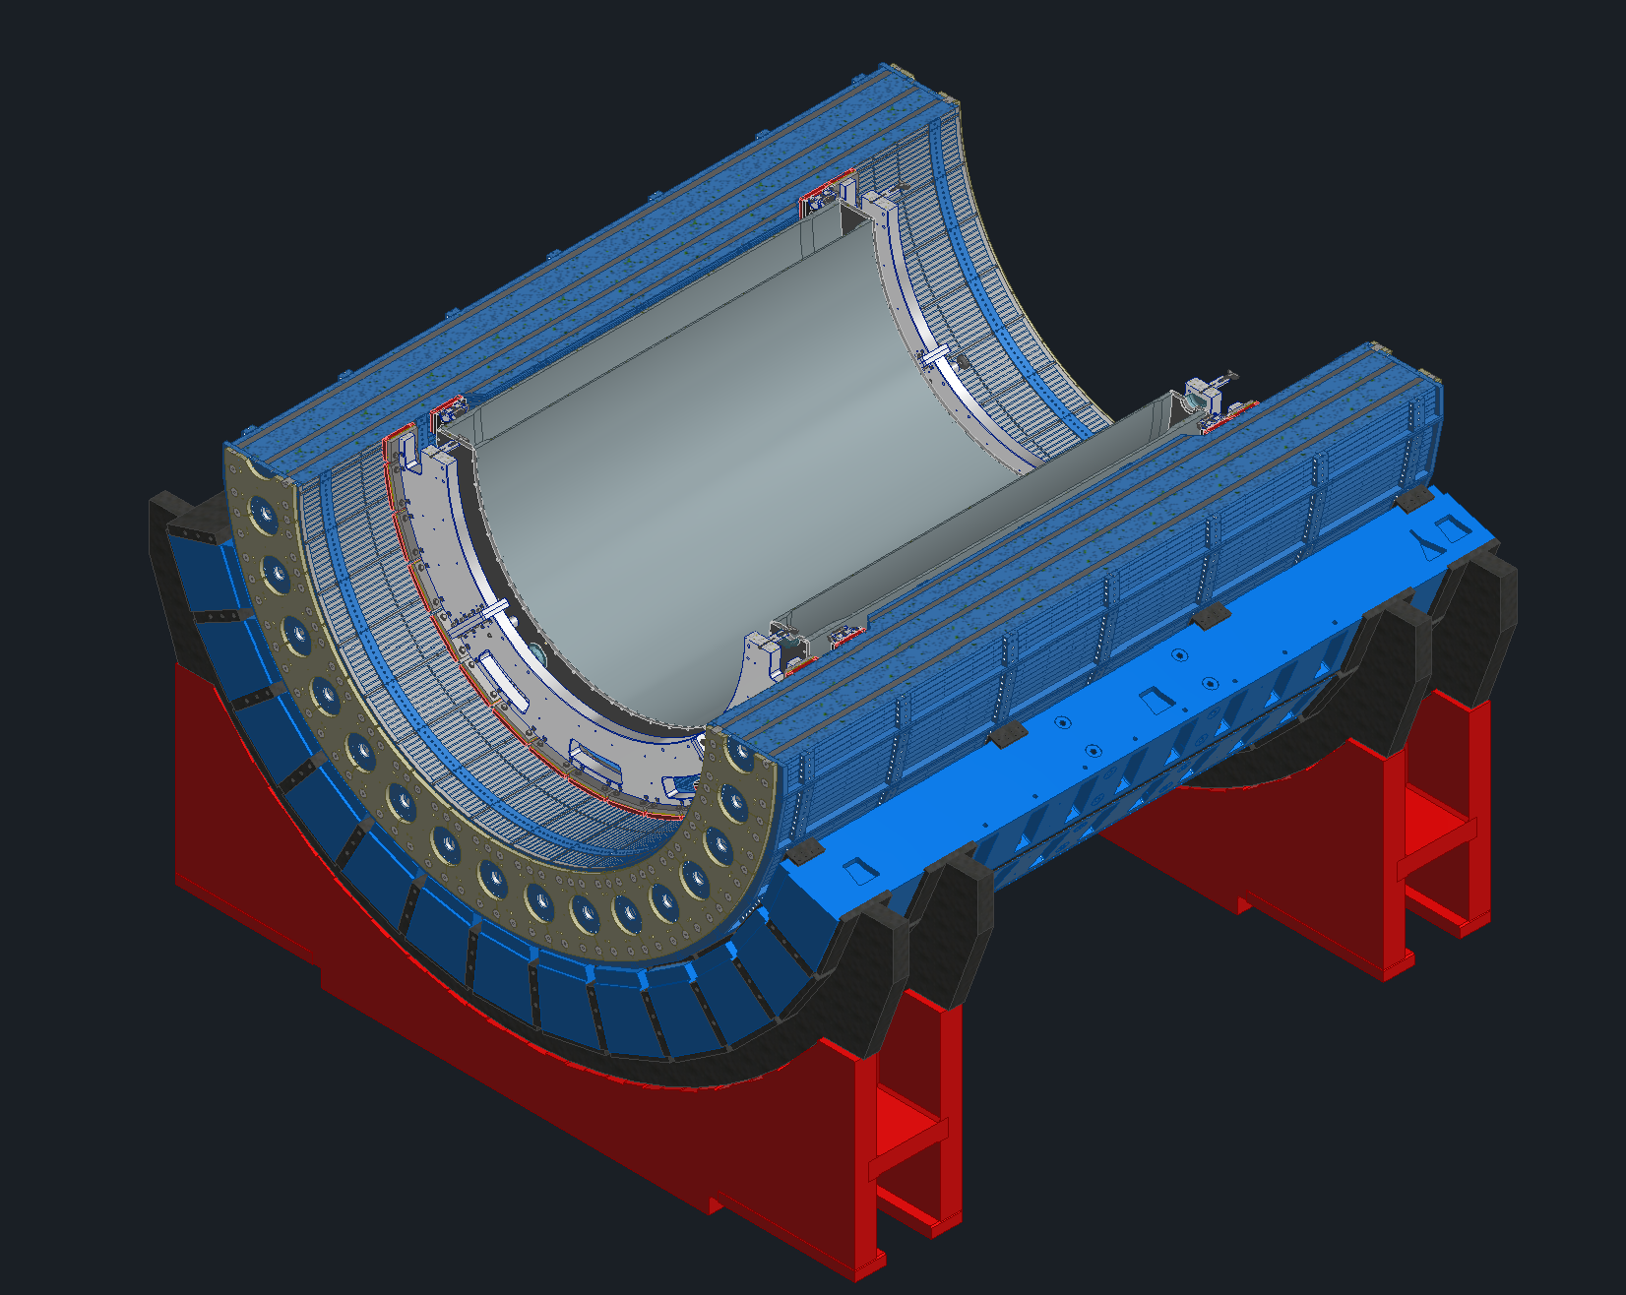
Detector Views

Slide 3
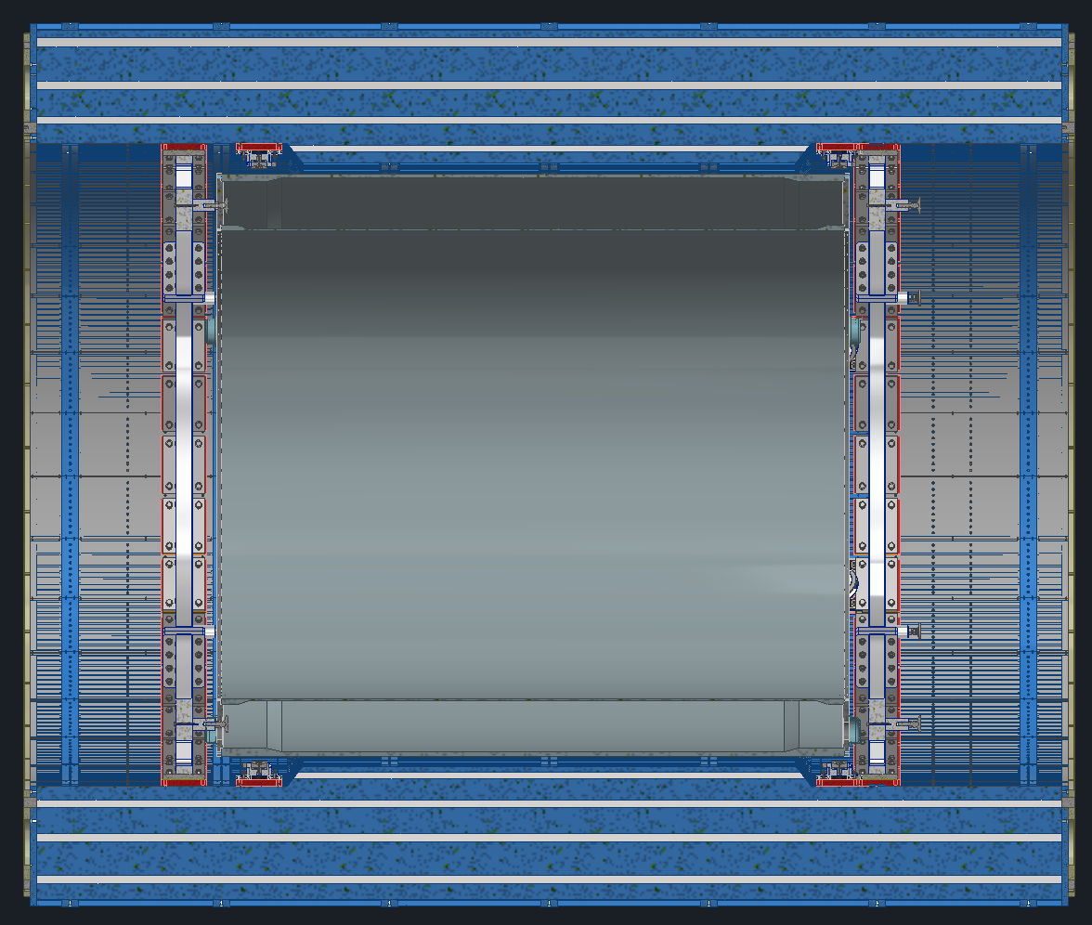
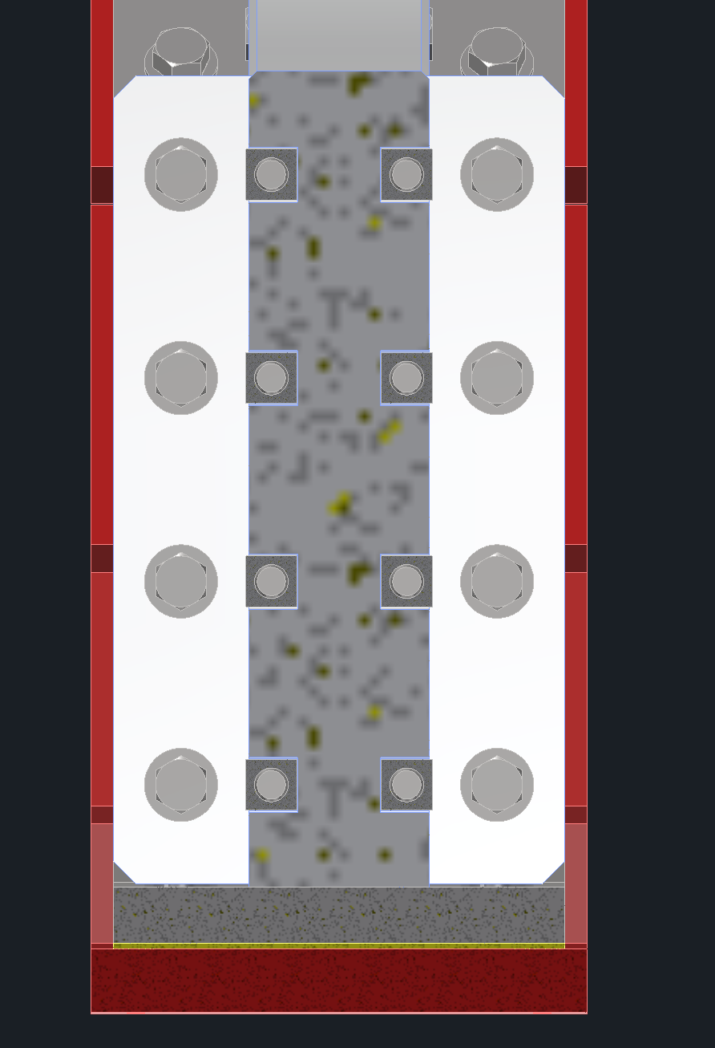
Detector Views
Magnet is 10cm offset from center plane
Due to the dRICH the forward inner support ring had to be shifted towards the IP
Magnet jack locations had to be revised to avoid interferences with the magnet tie-rods.
Due to the dRICH sensor boxes part of the support ring splice plates needs to be trimmed. The assembly will be reanalyzed

Slide 4
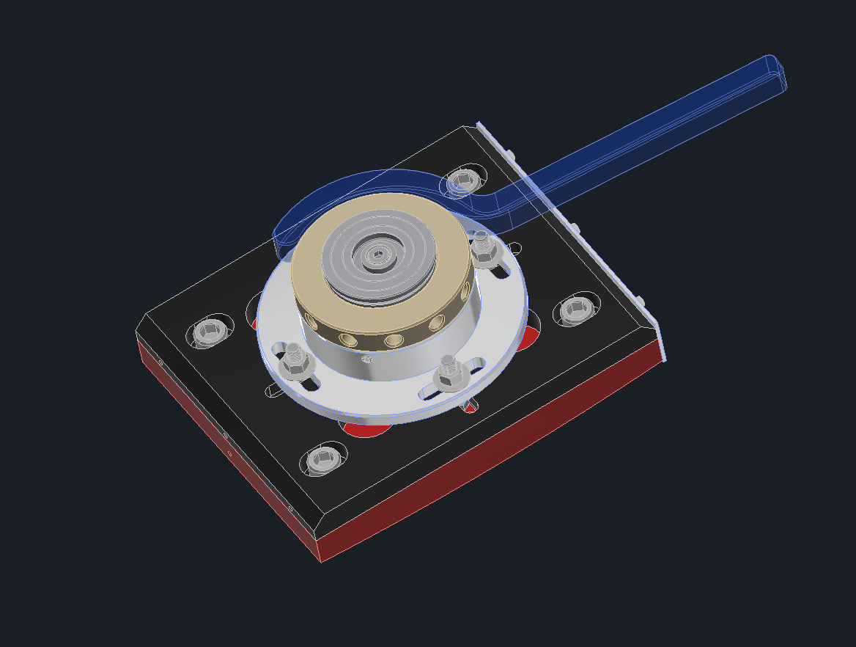
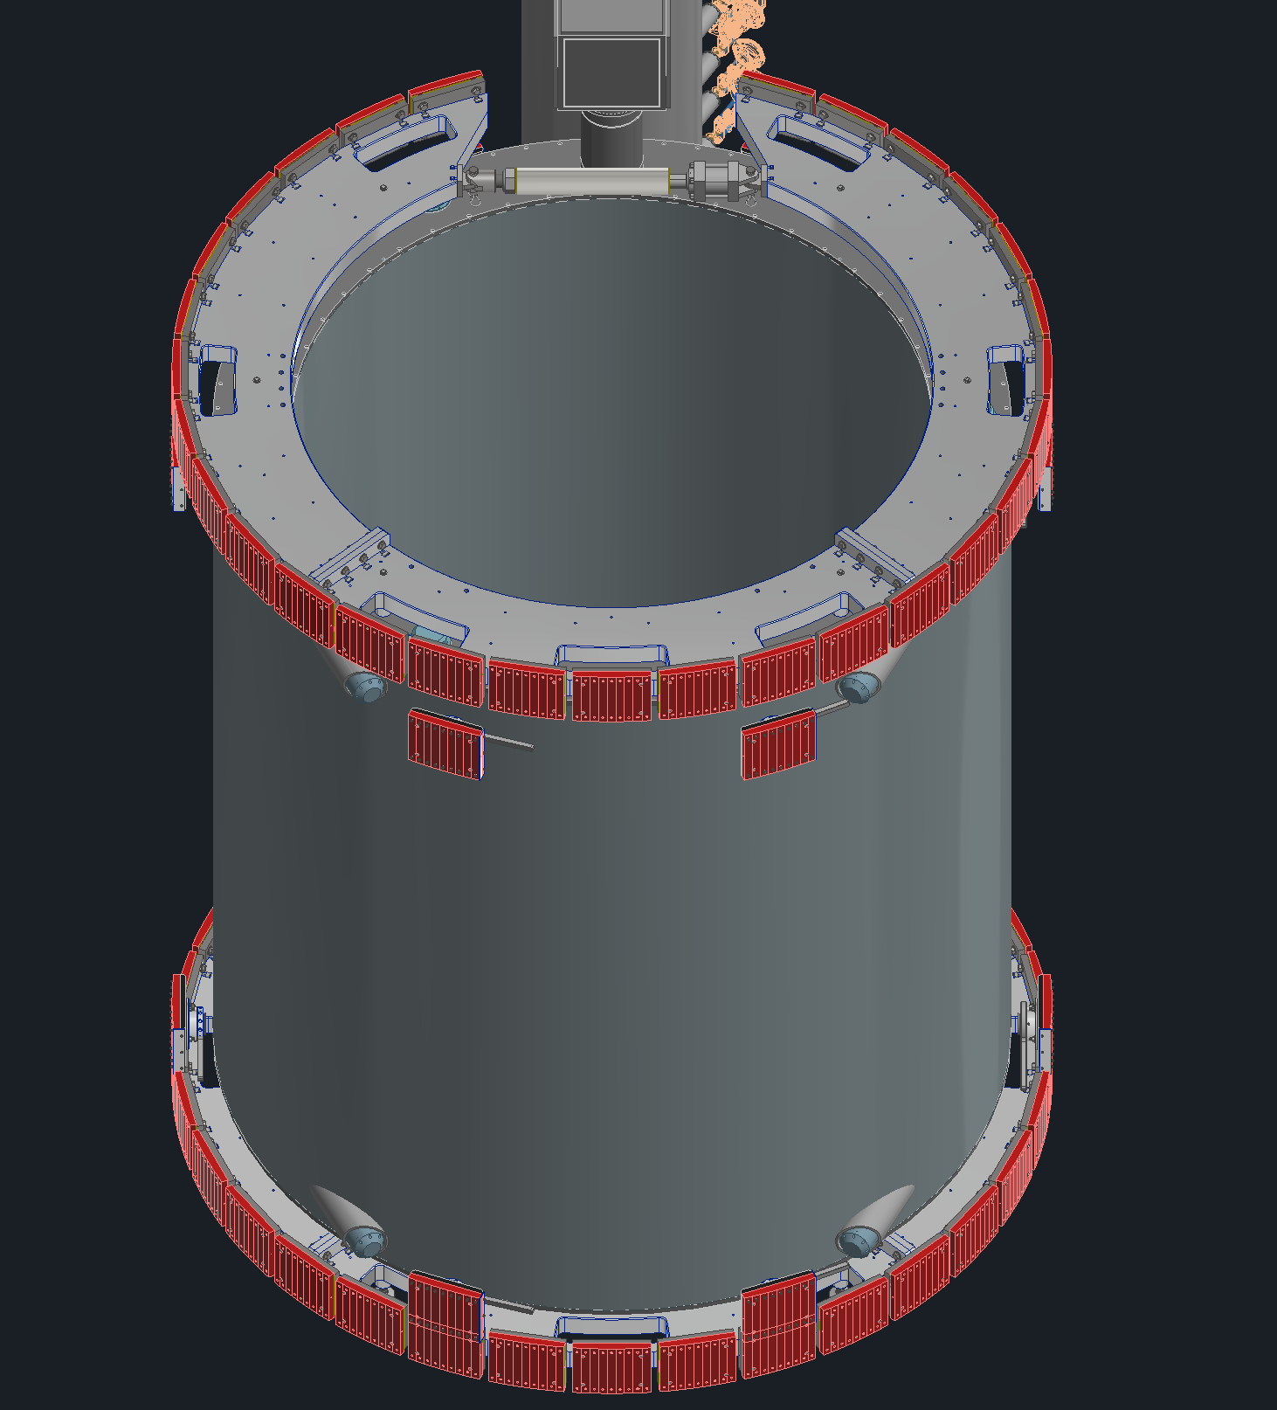
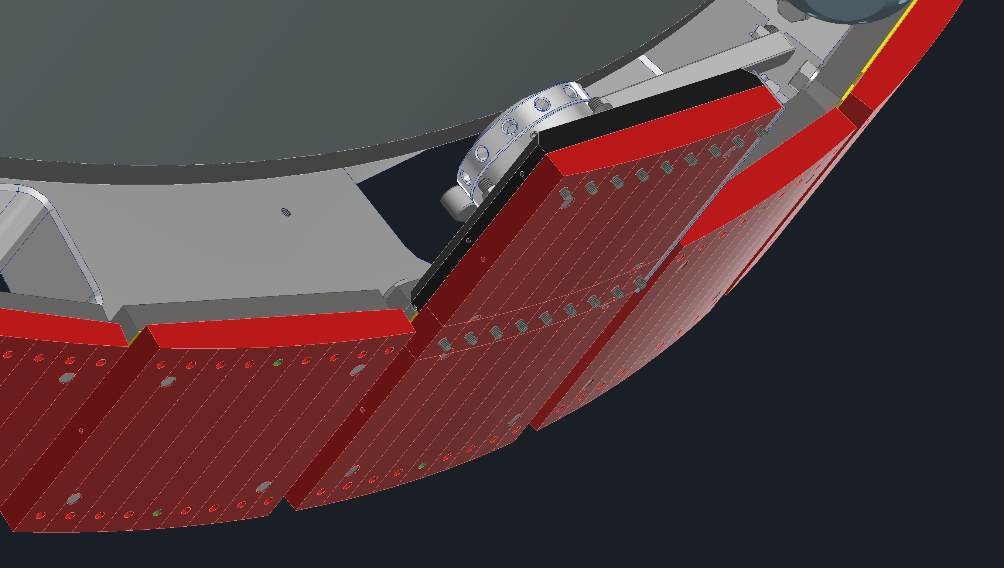
Support Rings & Jacks
Magnet is supported by 6 jacks on each end
In the forward direction the jacks and the support rings overlap and must share attachment points to the HCAL
Working on updating the pads in the forward direction

Slide 5
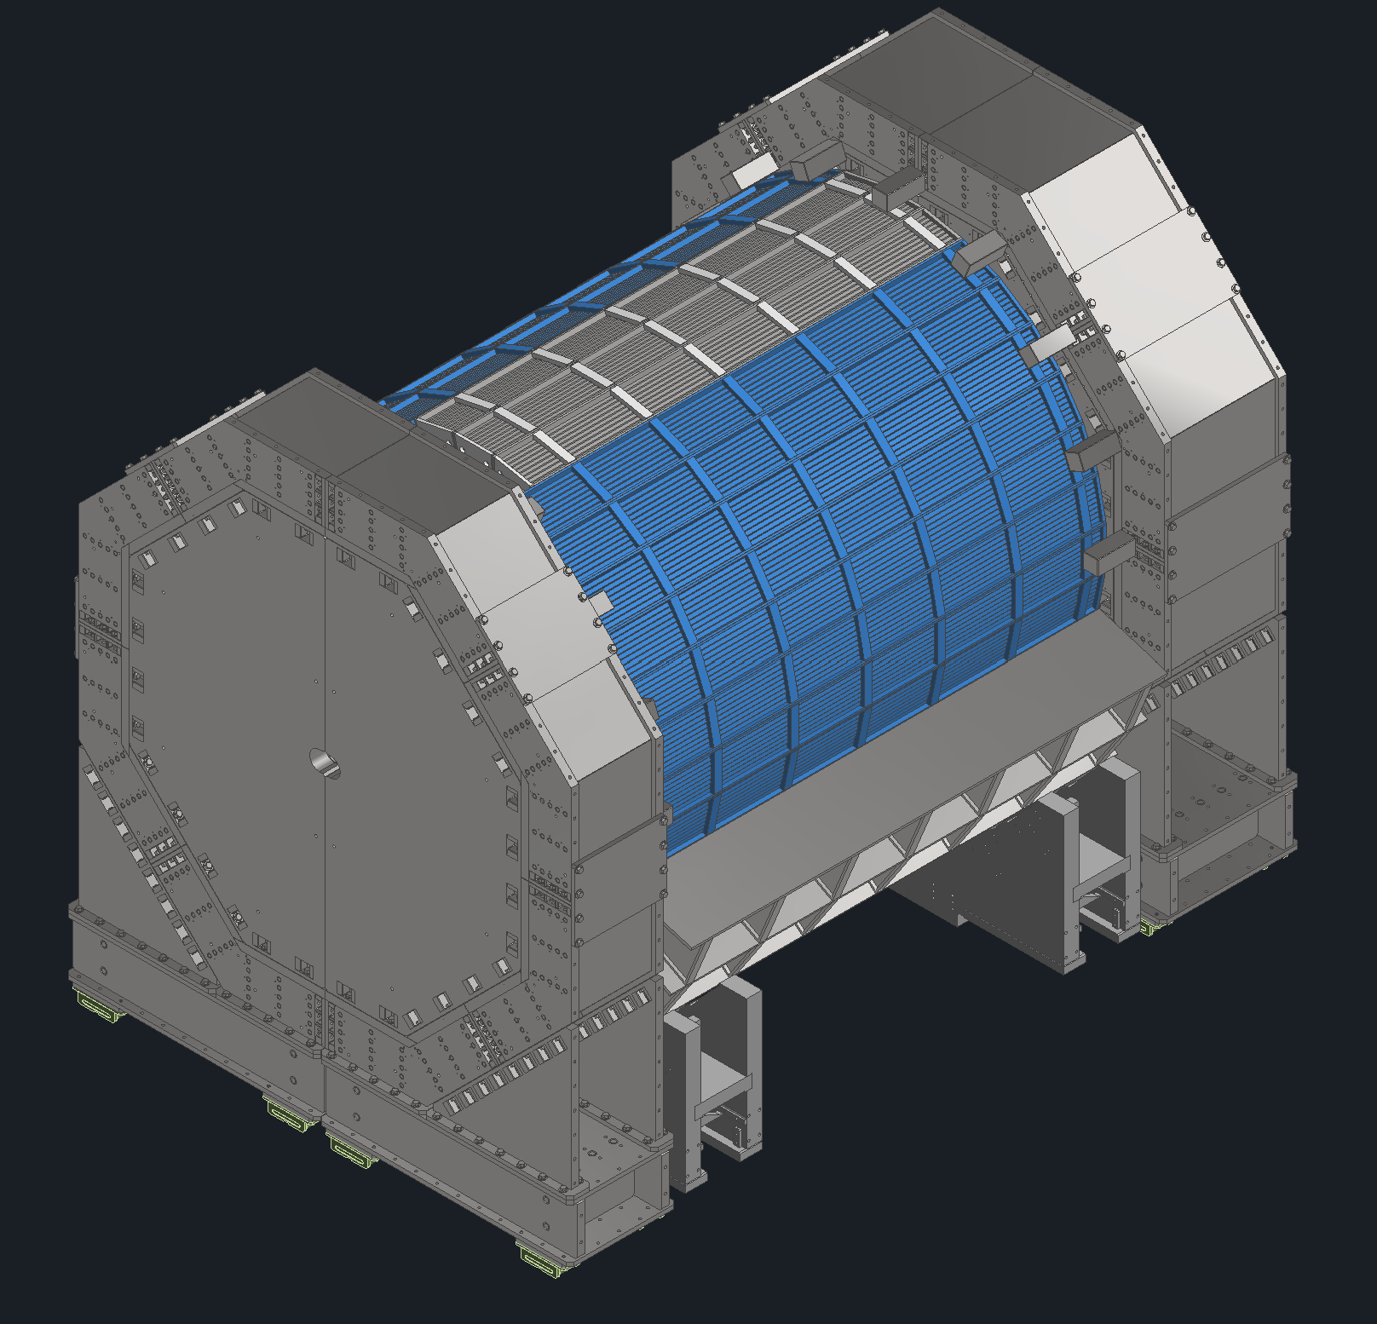
Simulations
We recently over a step file with the magnet jack supports to see if the magnet group is okay with the proposed locations.
Waiting on the magnet group to run a few simulations
  We have preliminary design ideas for the support steel from the HCAL to the carriage. We are waiting to hear back if there are issues tied to having substantially more steel on the bottom of the detector than the top.
  There are still some questions regarding the magnet link requirements.
  We want to know if we could remove some of the internal steel in the endcaps.

Slide 6
Plans Towards PDR
Will continue working on the magnet jack pad design updates.
Waiting on feedback from simulations to determine what more changes are needed.

Slide 7
Question & Comments

