Slide 1
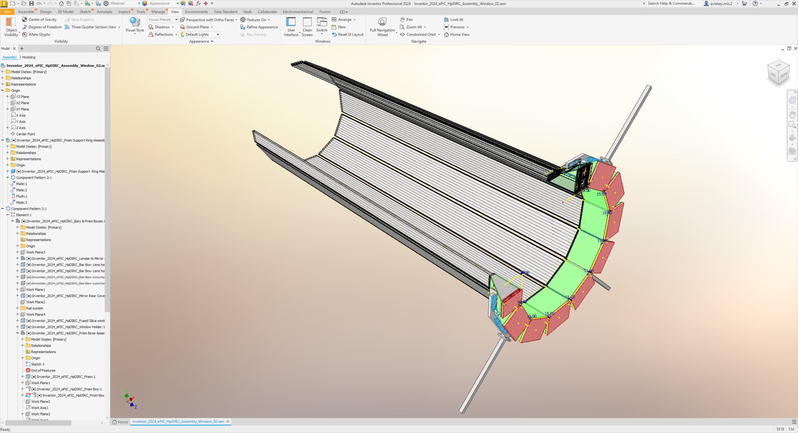








hpDIRC Mechanical Design Status Kris Cleveland Avishay Mizrahi
24/Feb/2025

Slide 2
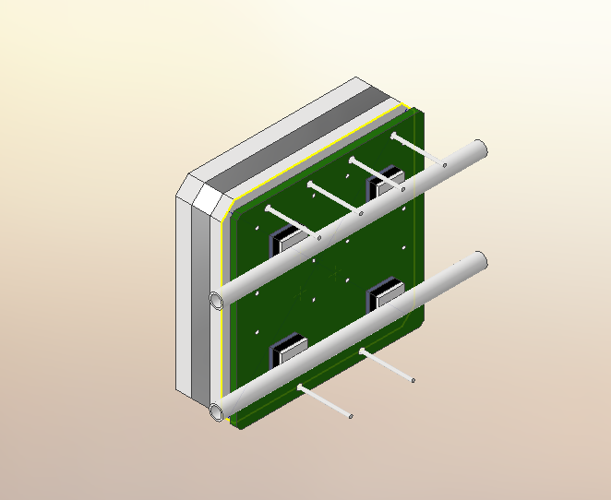
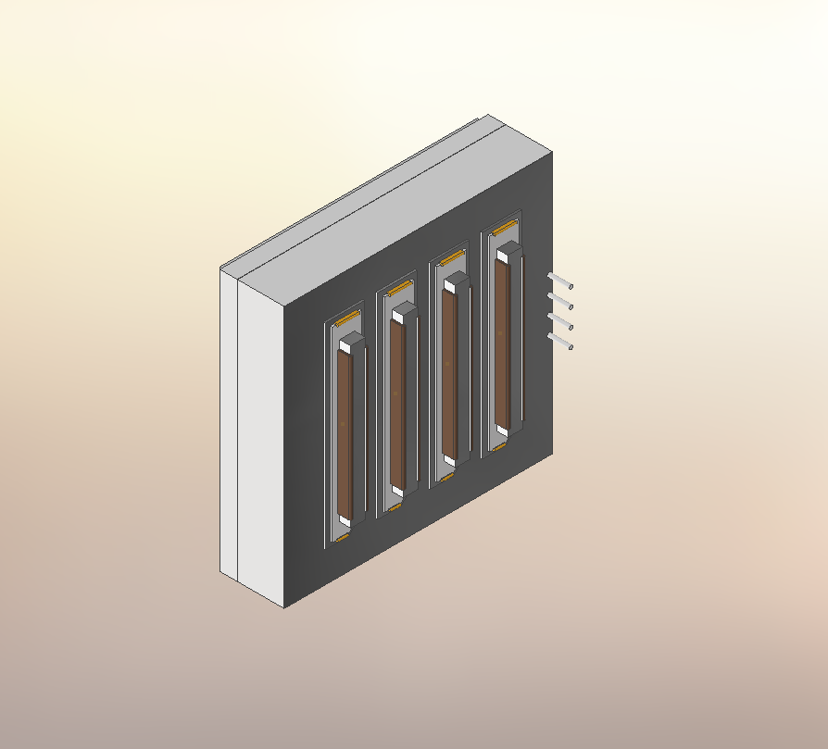
Prism Box Electronics options
120mm
Readout electronics Configuration:
HRPPD (High-rate Picosecond Photodetector)
MCP-PMT (Micro channel plate)
*Cooling data and accurate geometry model from the manufacturer is missing .
60mm

Slide 3
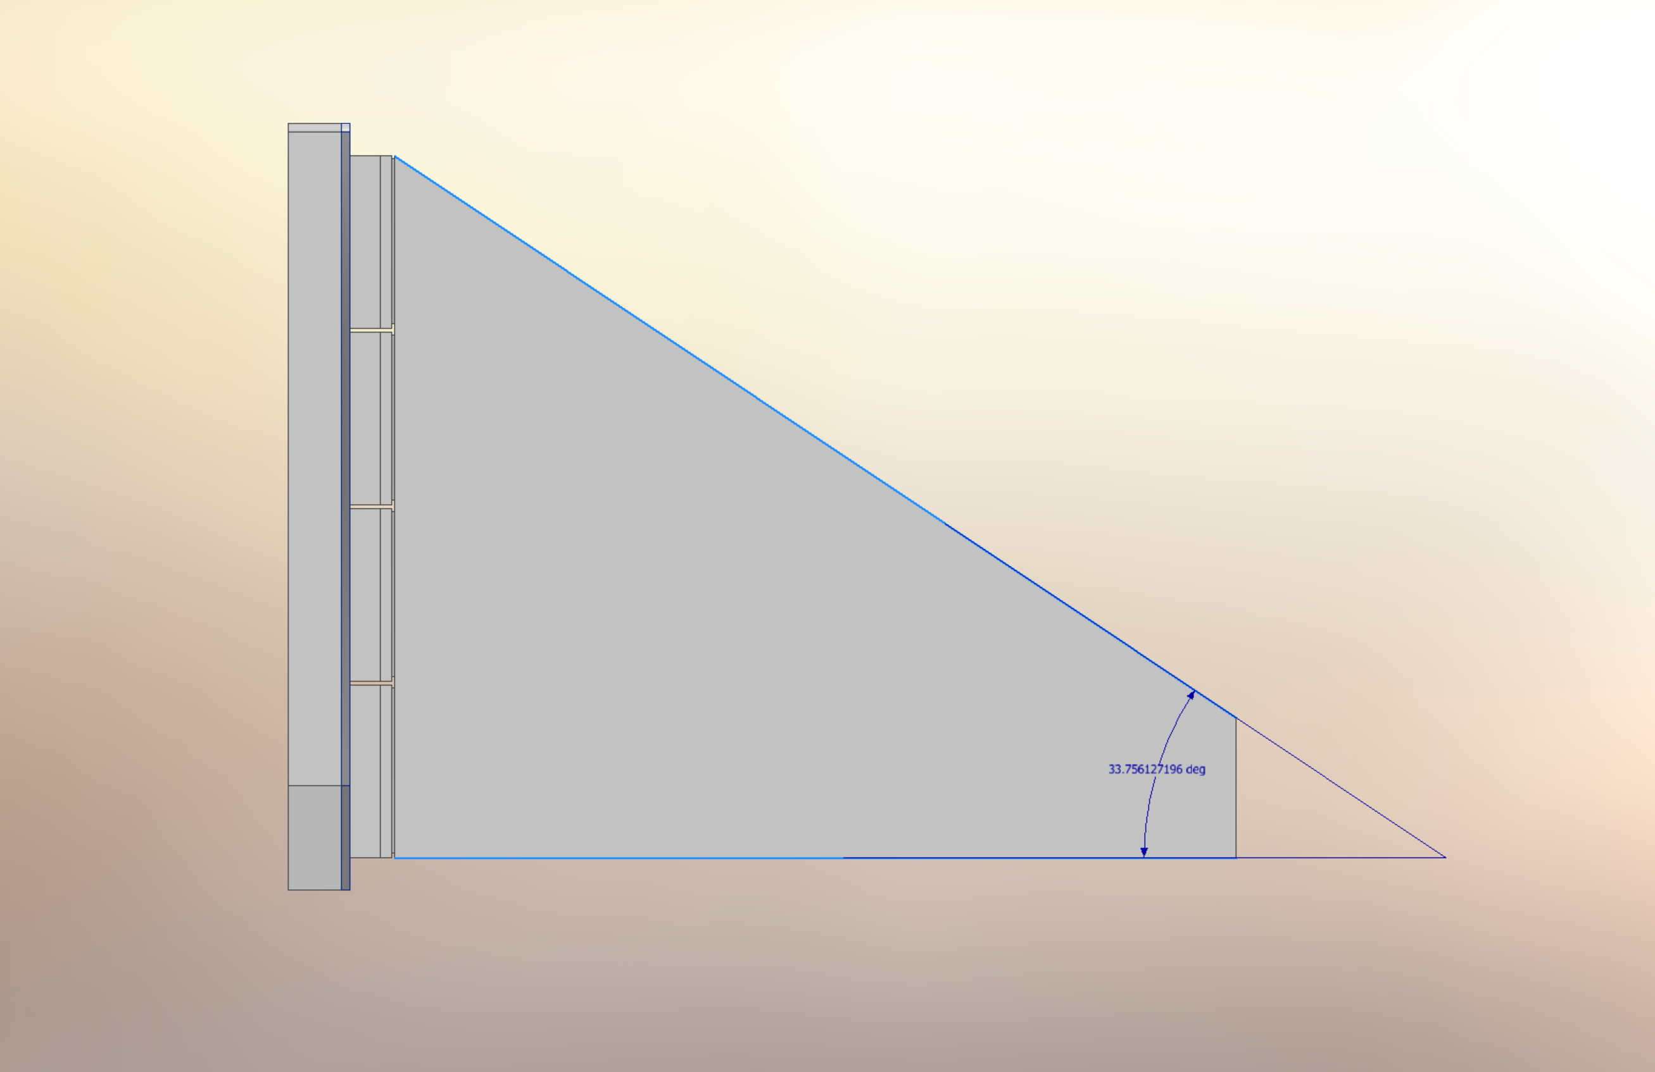
Prism Angle
Changing the angle from 32 degrees to 33.7 degrees to increase the height and accommodate 4 rows of photodetectors.
*The Prism box has not yet been adjusted to the MCP-PMT configuration.

Slide 4
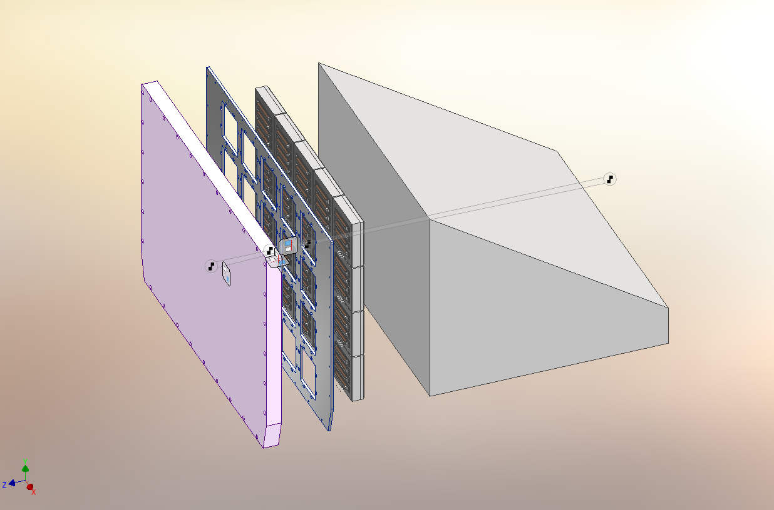
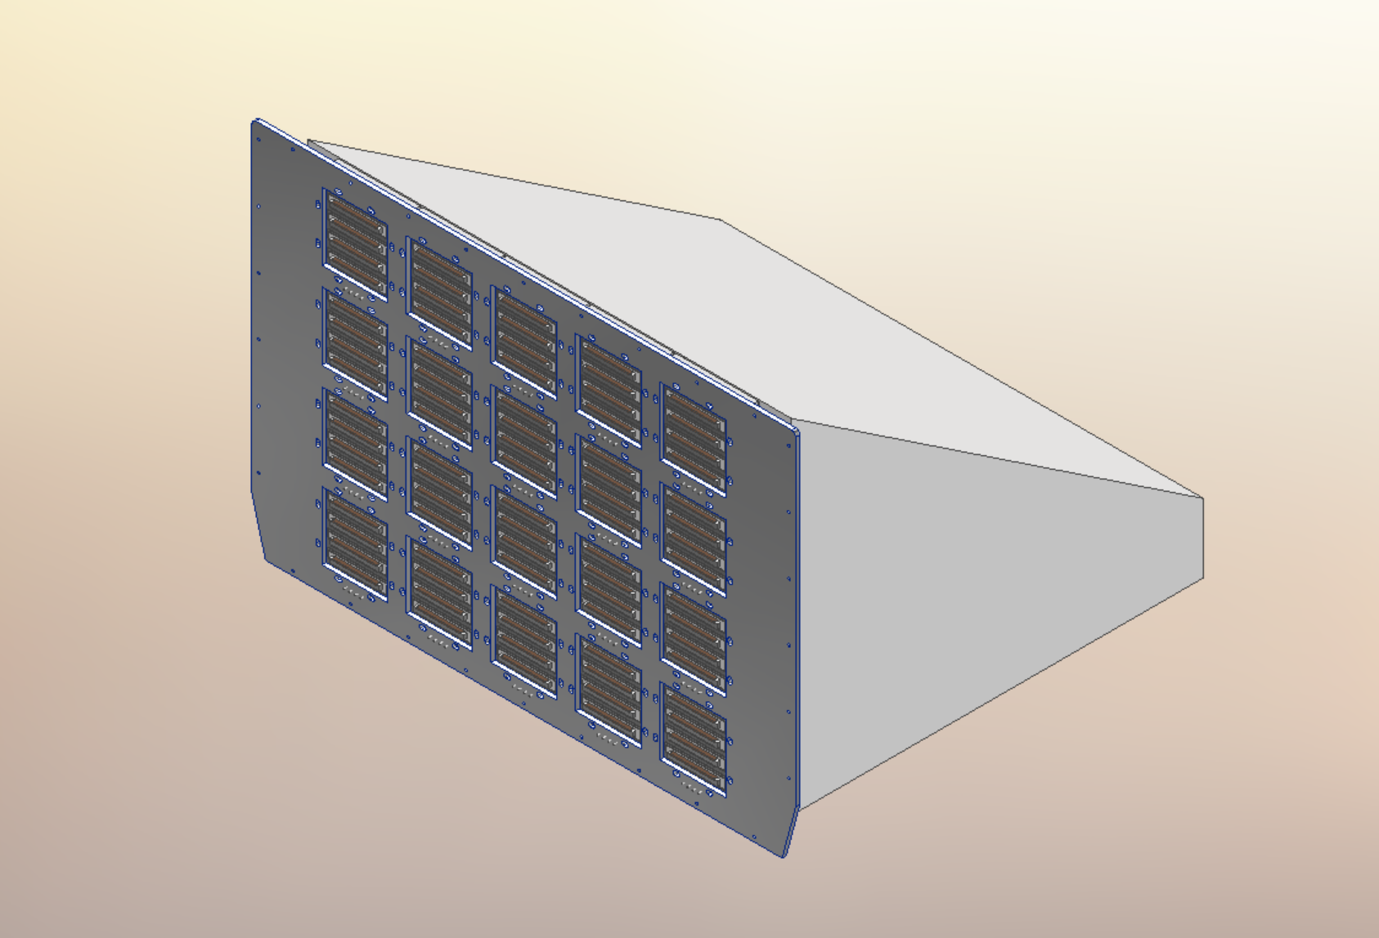
Positioning Grid
A positioning grid holds 20 photodetectors instead of 6 and is made of 3 mm thick aluminum.
Will be attached as one unit to the prism, without adhesives, with the option of detaching for maintenance purposes.

Slide 5
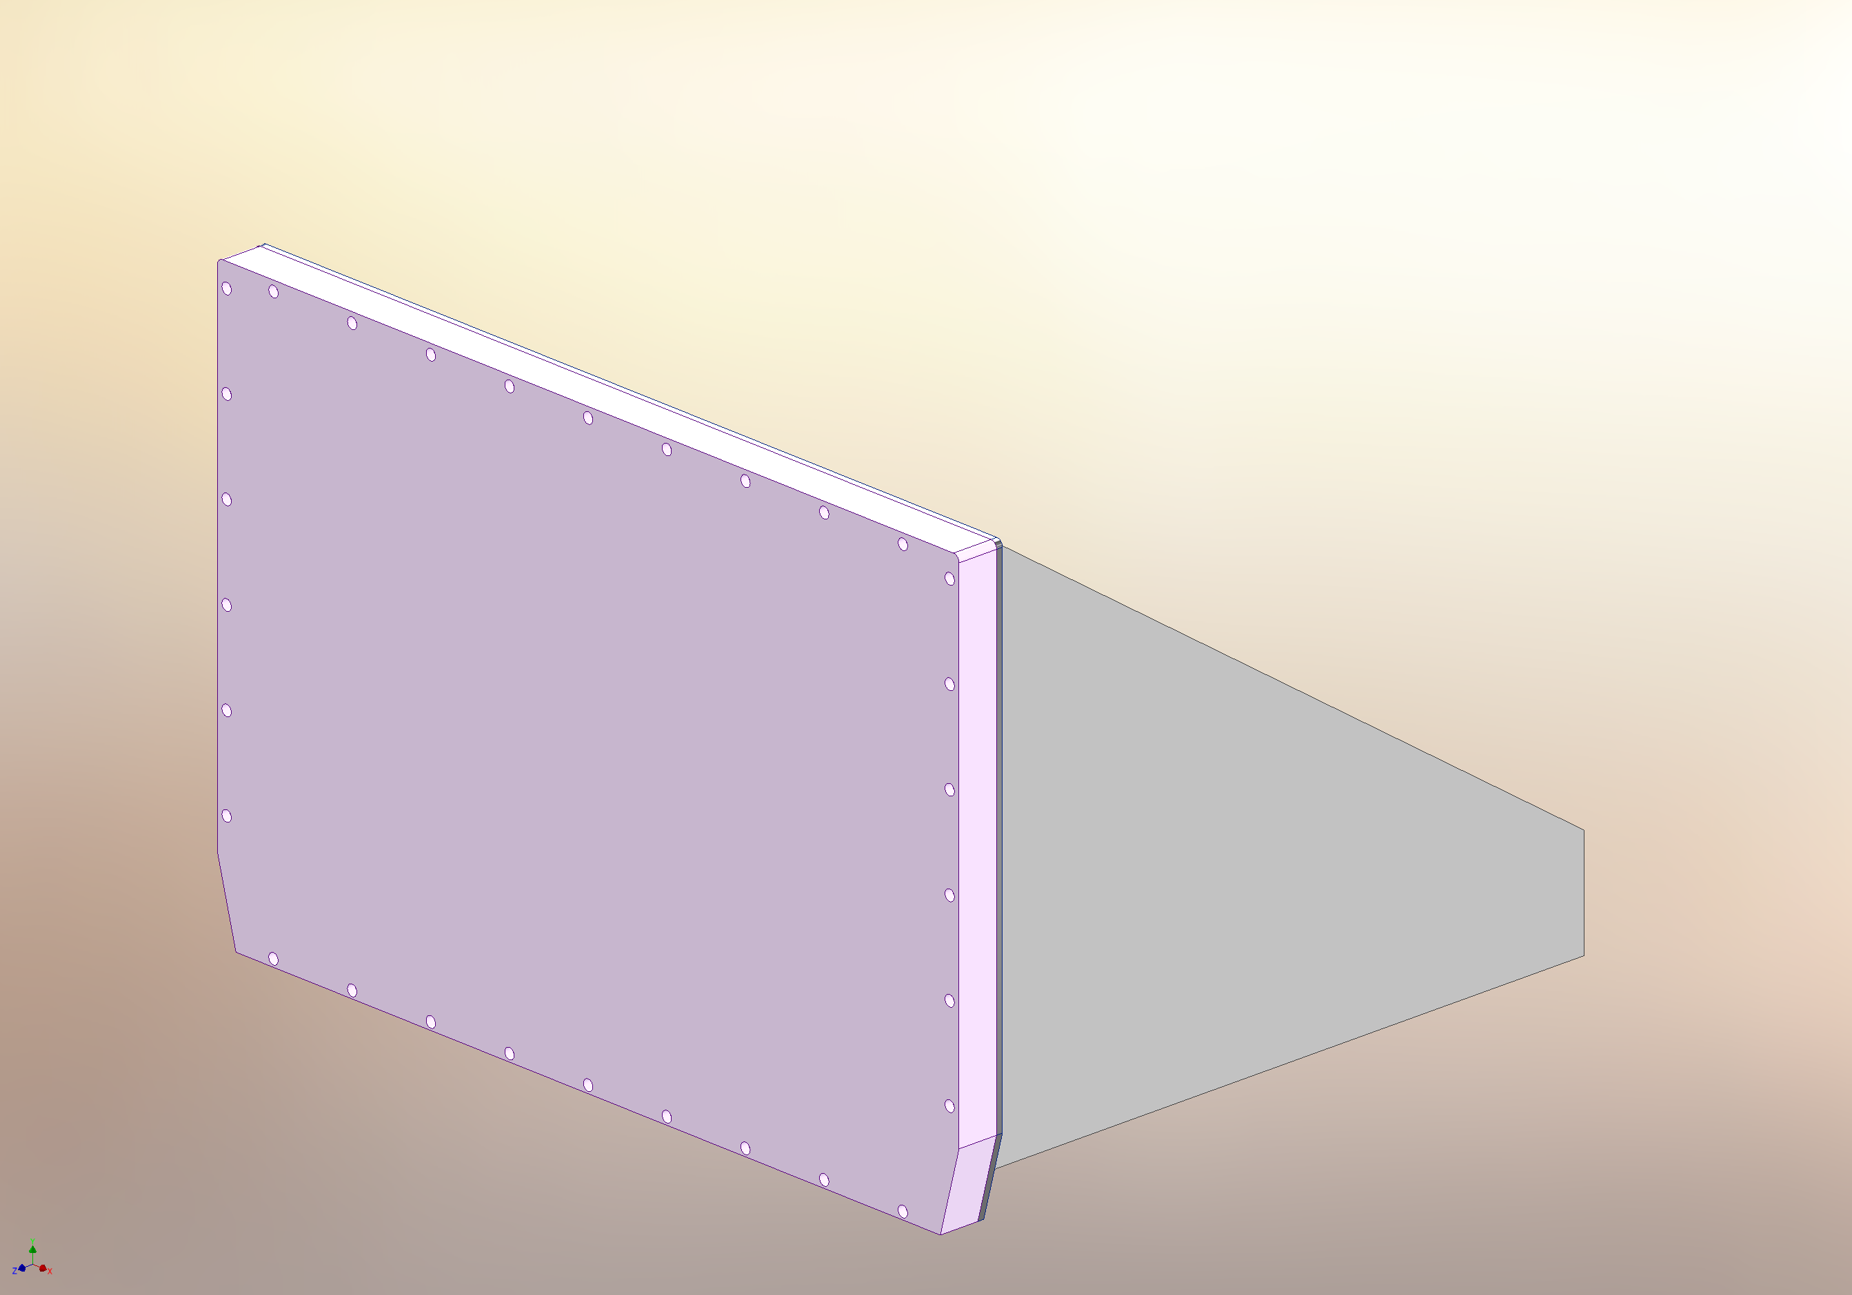
Light Tight Cover
The distance from the prism will change due to lack of information about the electronics.
The cuts in the corners have reached the maximum possible (15 deg).
Services inlet outlet and seal are not yet designed.

Slide 6
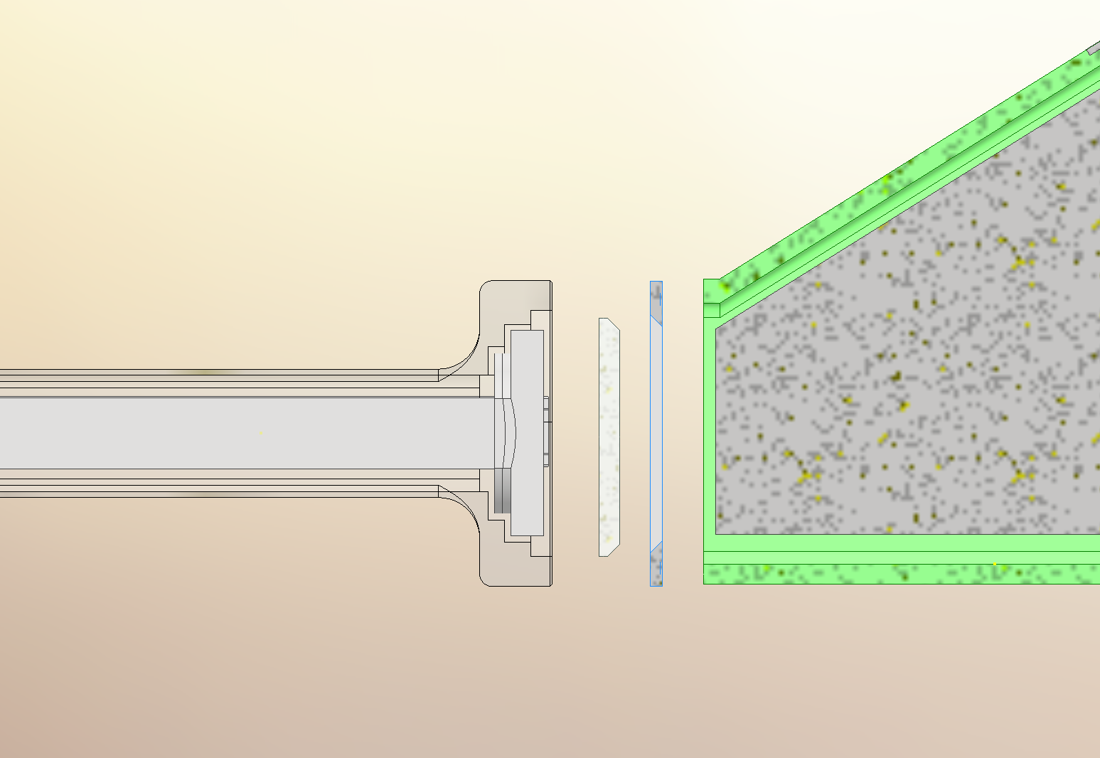
Window Configuration
Silica window
Window Holder
To overcome the force coming from the mirrors spring mechanism, a 5mm window was designed.
Next things to do:
Optimizing forces of spring-loaded screws.
Sealing design.
Removal mechanism designing.

Slide 7
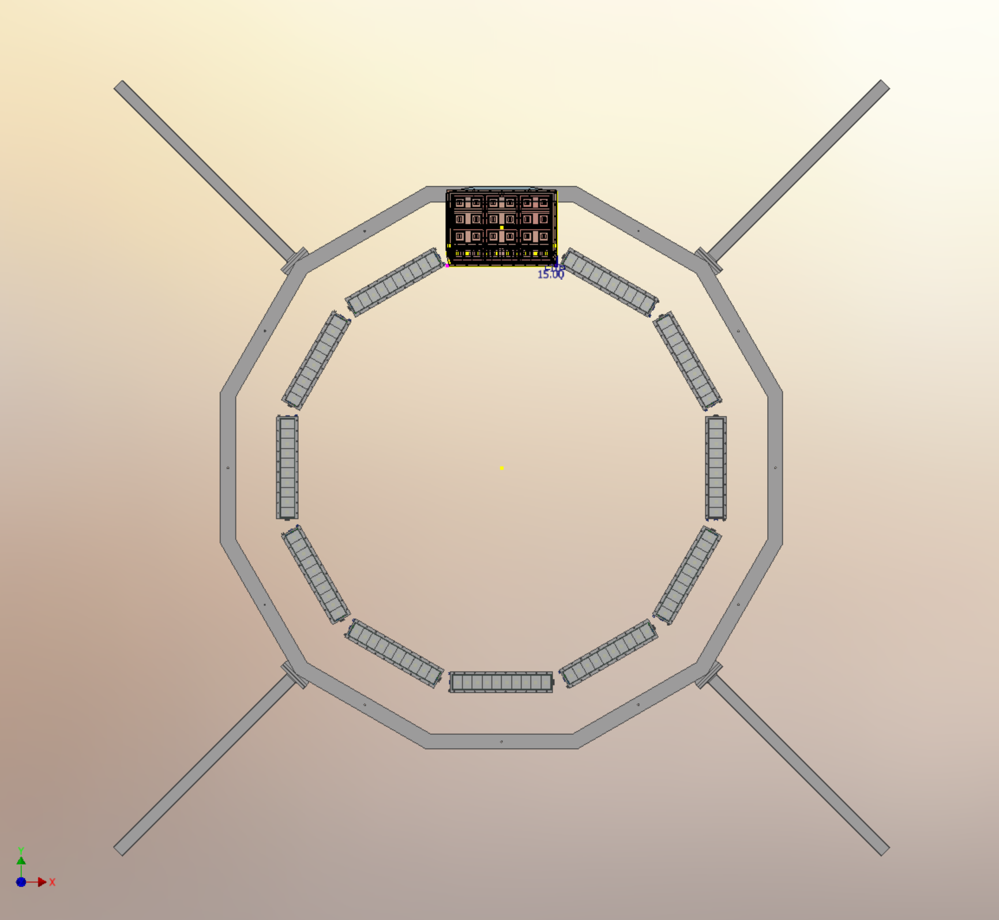
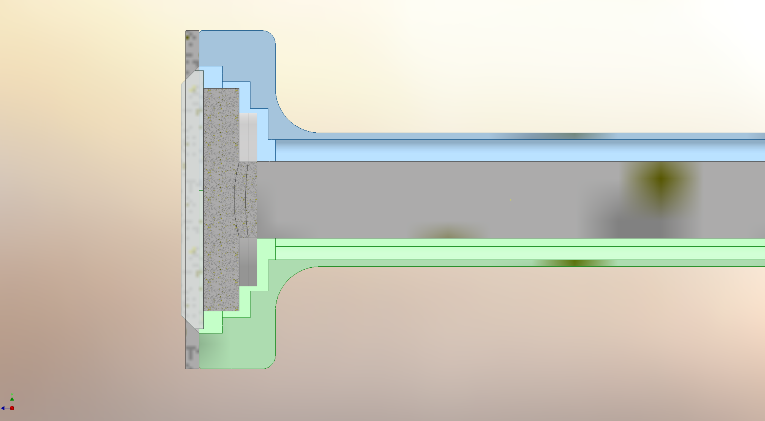
Bar boxes radial shift
Radial shift outward by 1.5 cm of the hpDIRC boxes and outer MPGD.
Change in box thickness due to change in radial position to 30 mm.
Next things to adjust:
Prism boxes carrier.
Support ring.

Slide 8
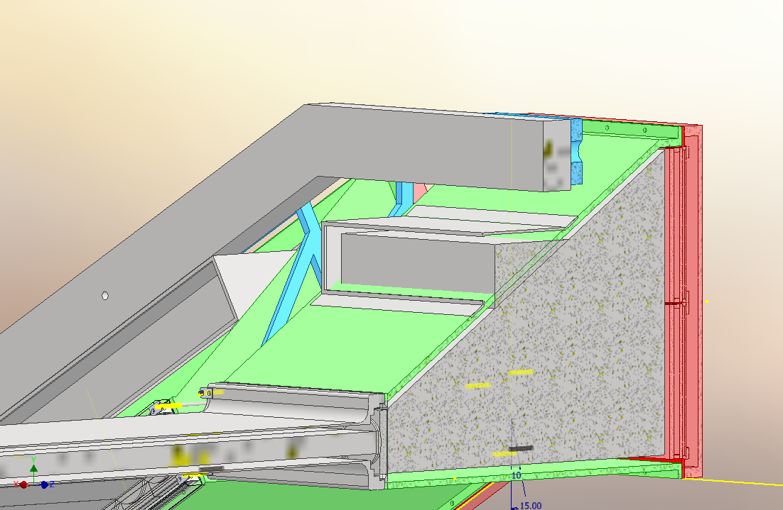
Upcoming:
Buttons Design (in progress).
1. Nitrogen piping design and sealing.
2. Designing the prism removal mechanism.
3. Optimizing forces of spring-loaded screws.
4. Calibration and System.

Slide 9
Questions?
.

