Slide 1
Integration, Installation and Infrastructure (Triple I Group)
TIC Update
Roland Wimmer

Slide 2
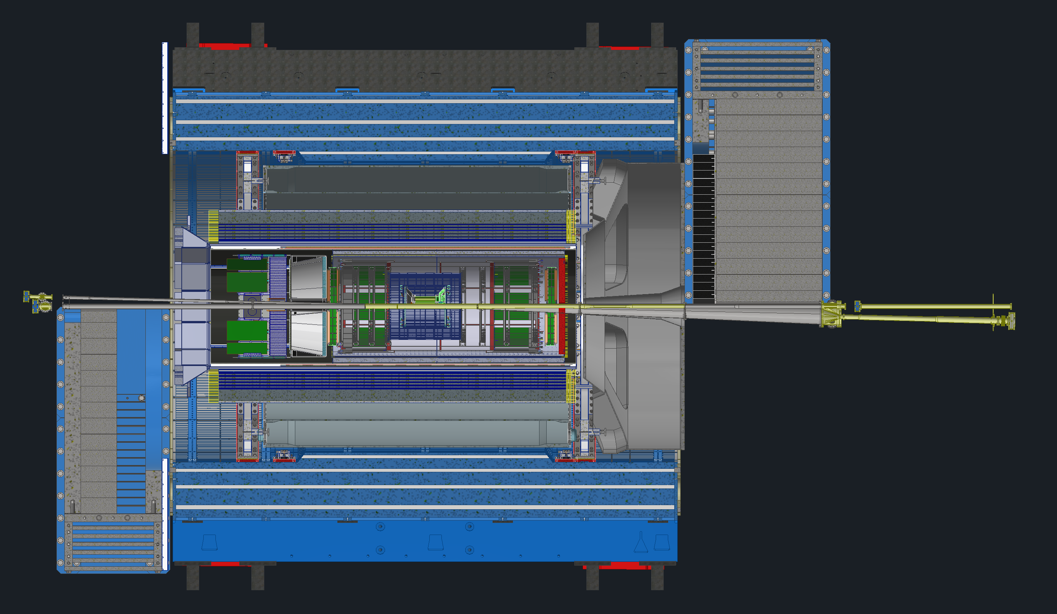
Detector Model Updates
New Models
  MPGDs
  ToF
  Beampipe
GST
DIRC Shift
Cradle Updates
  HCAL Modifications
Envelope Updates
Cooling Requirements
Summary

Slide 3
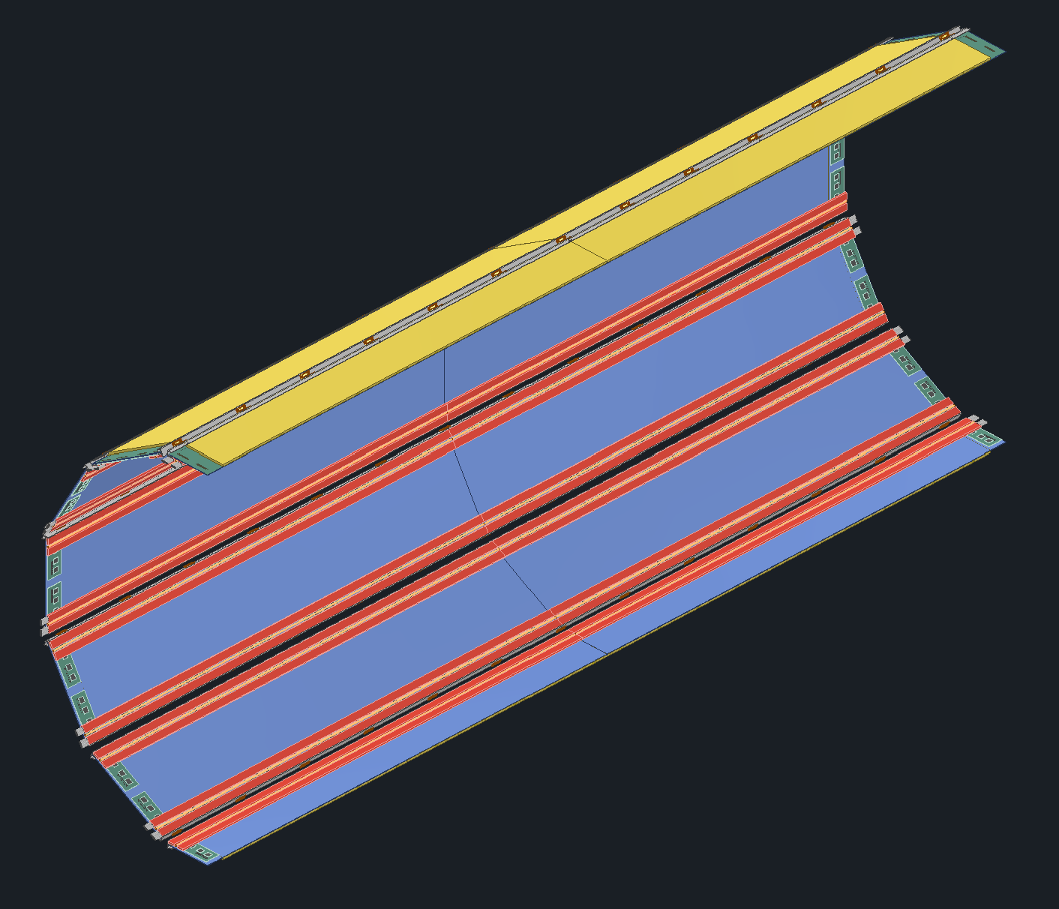
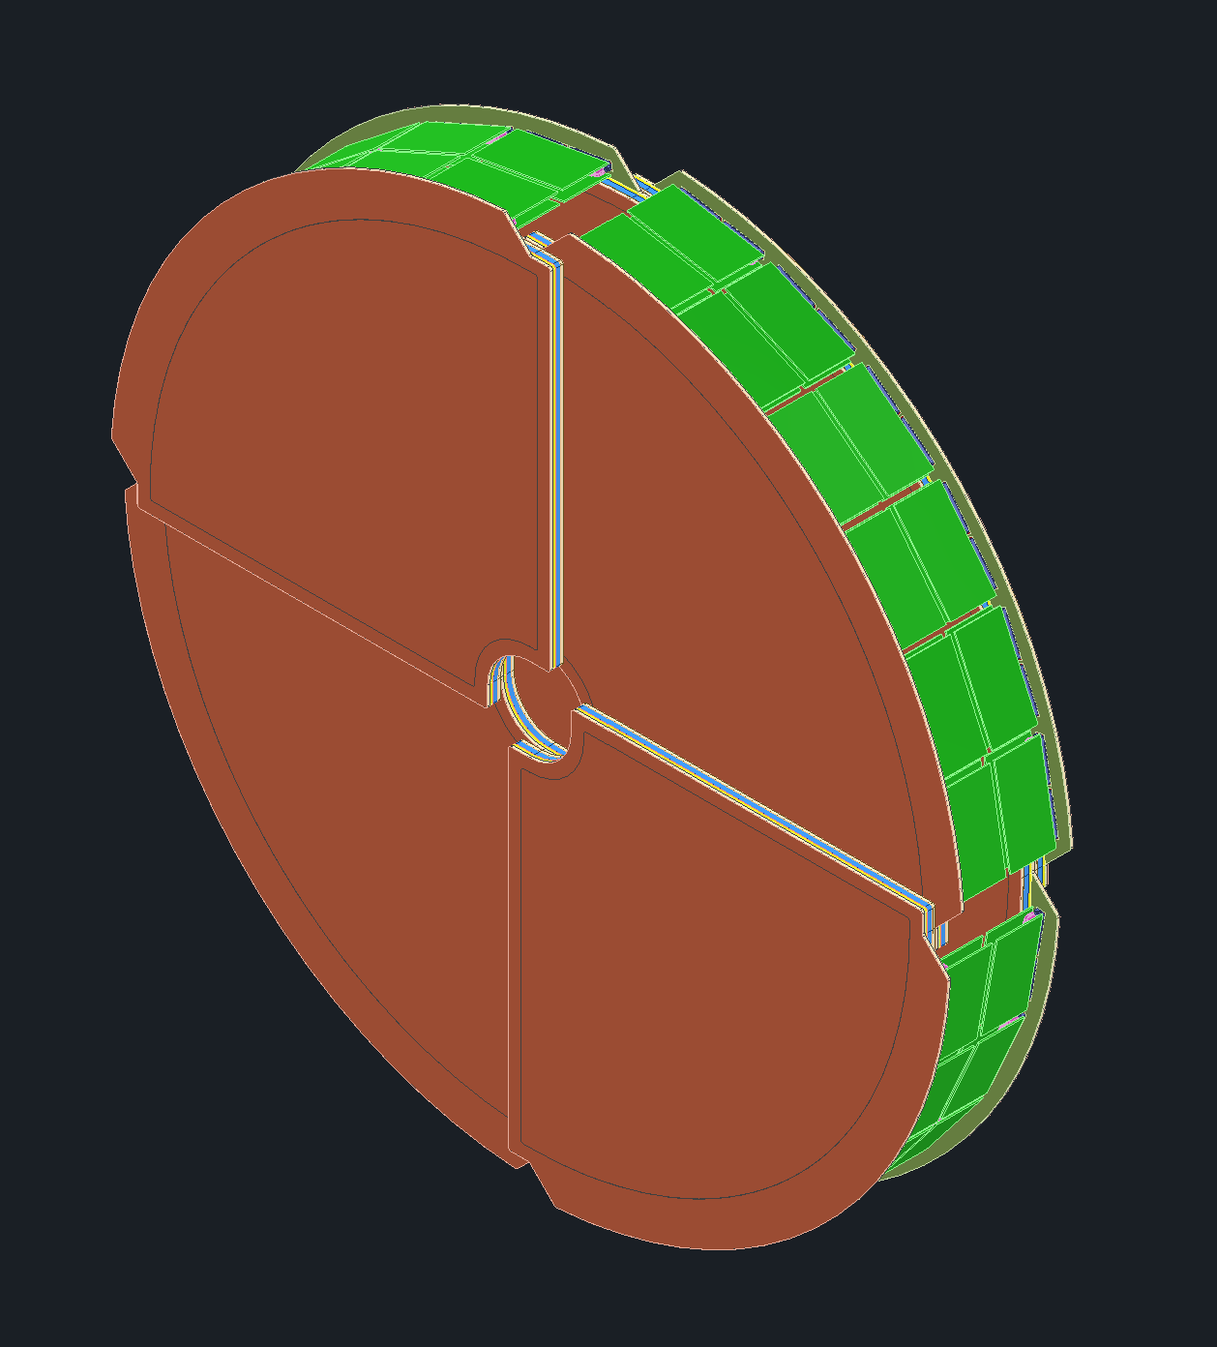
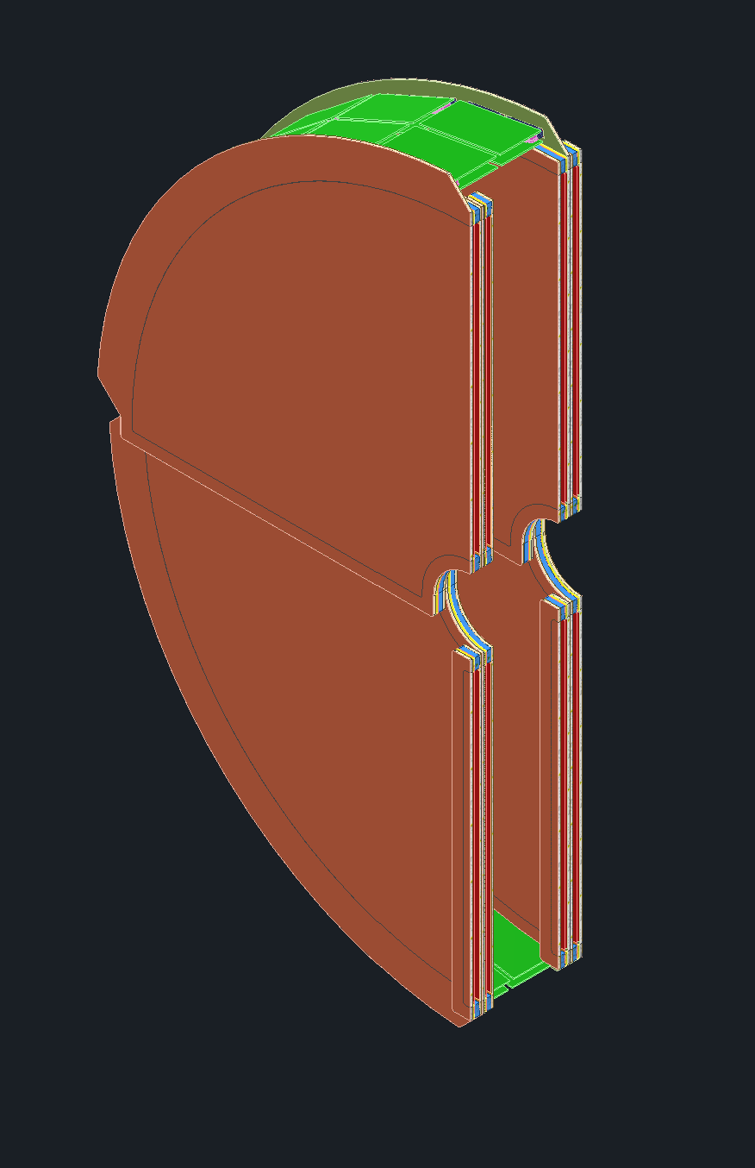
MPGDs
Received new updated models for the MPGD disks and the oMPGD sectors
No changes in size, mostly just an update

Slide 4
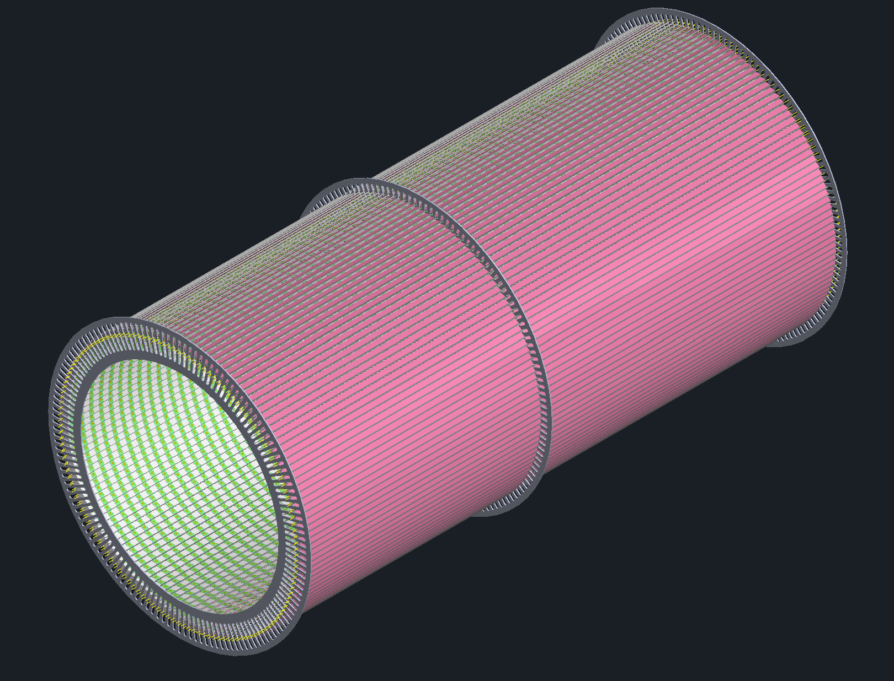
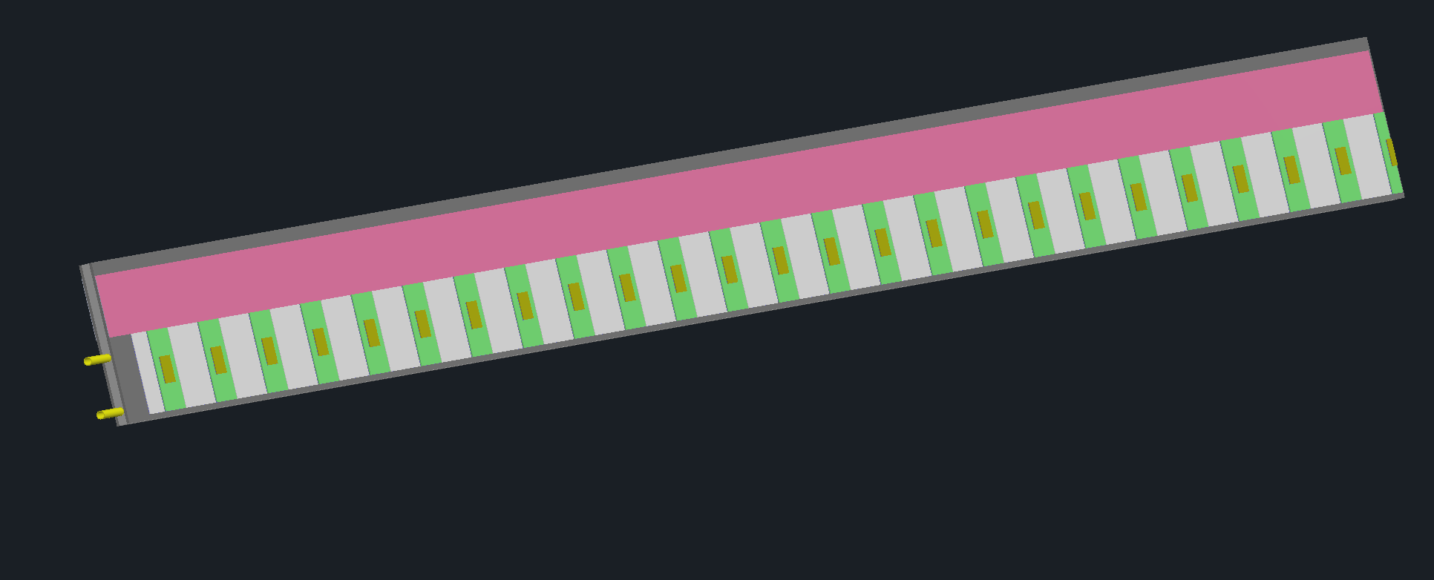
ToF Barrel
Received new ToF barrel model prior to the recent envelope shift.
Three engagement rings are shown though their locations are changing.
The model is currently being revised. The forward direction will be “shortened” such that the barrel shares a midplane with the inner MPGD barrel

Slide 5
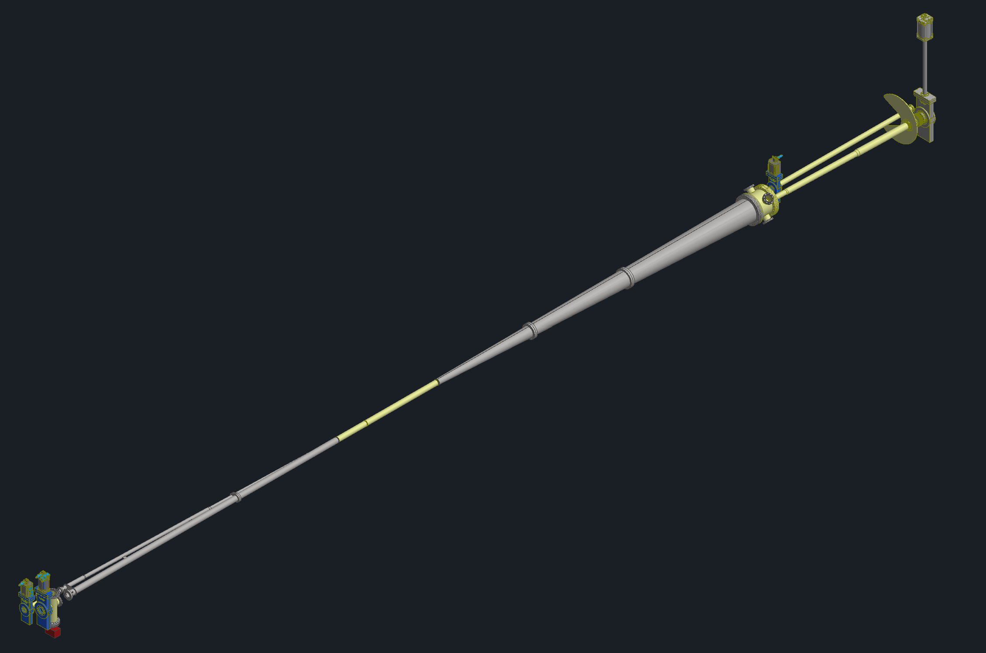
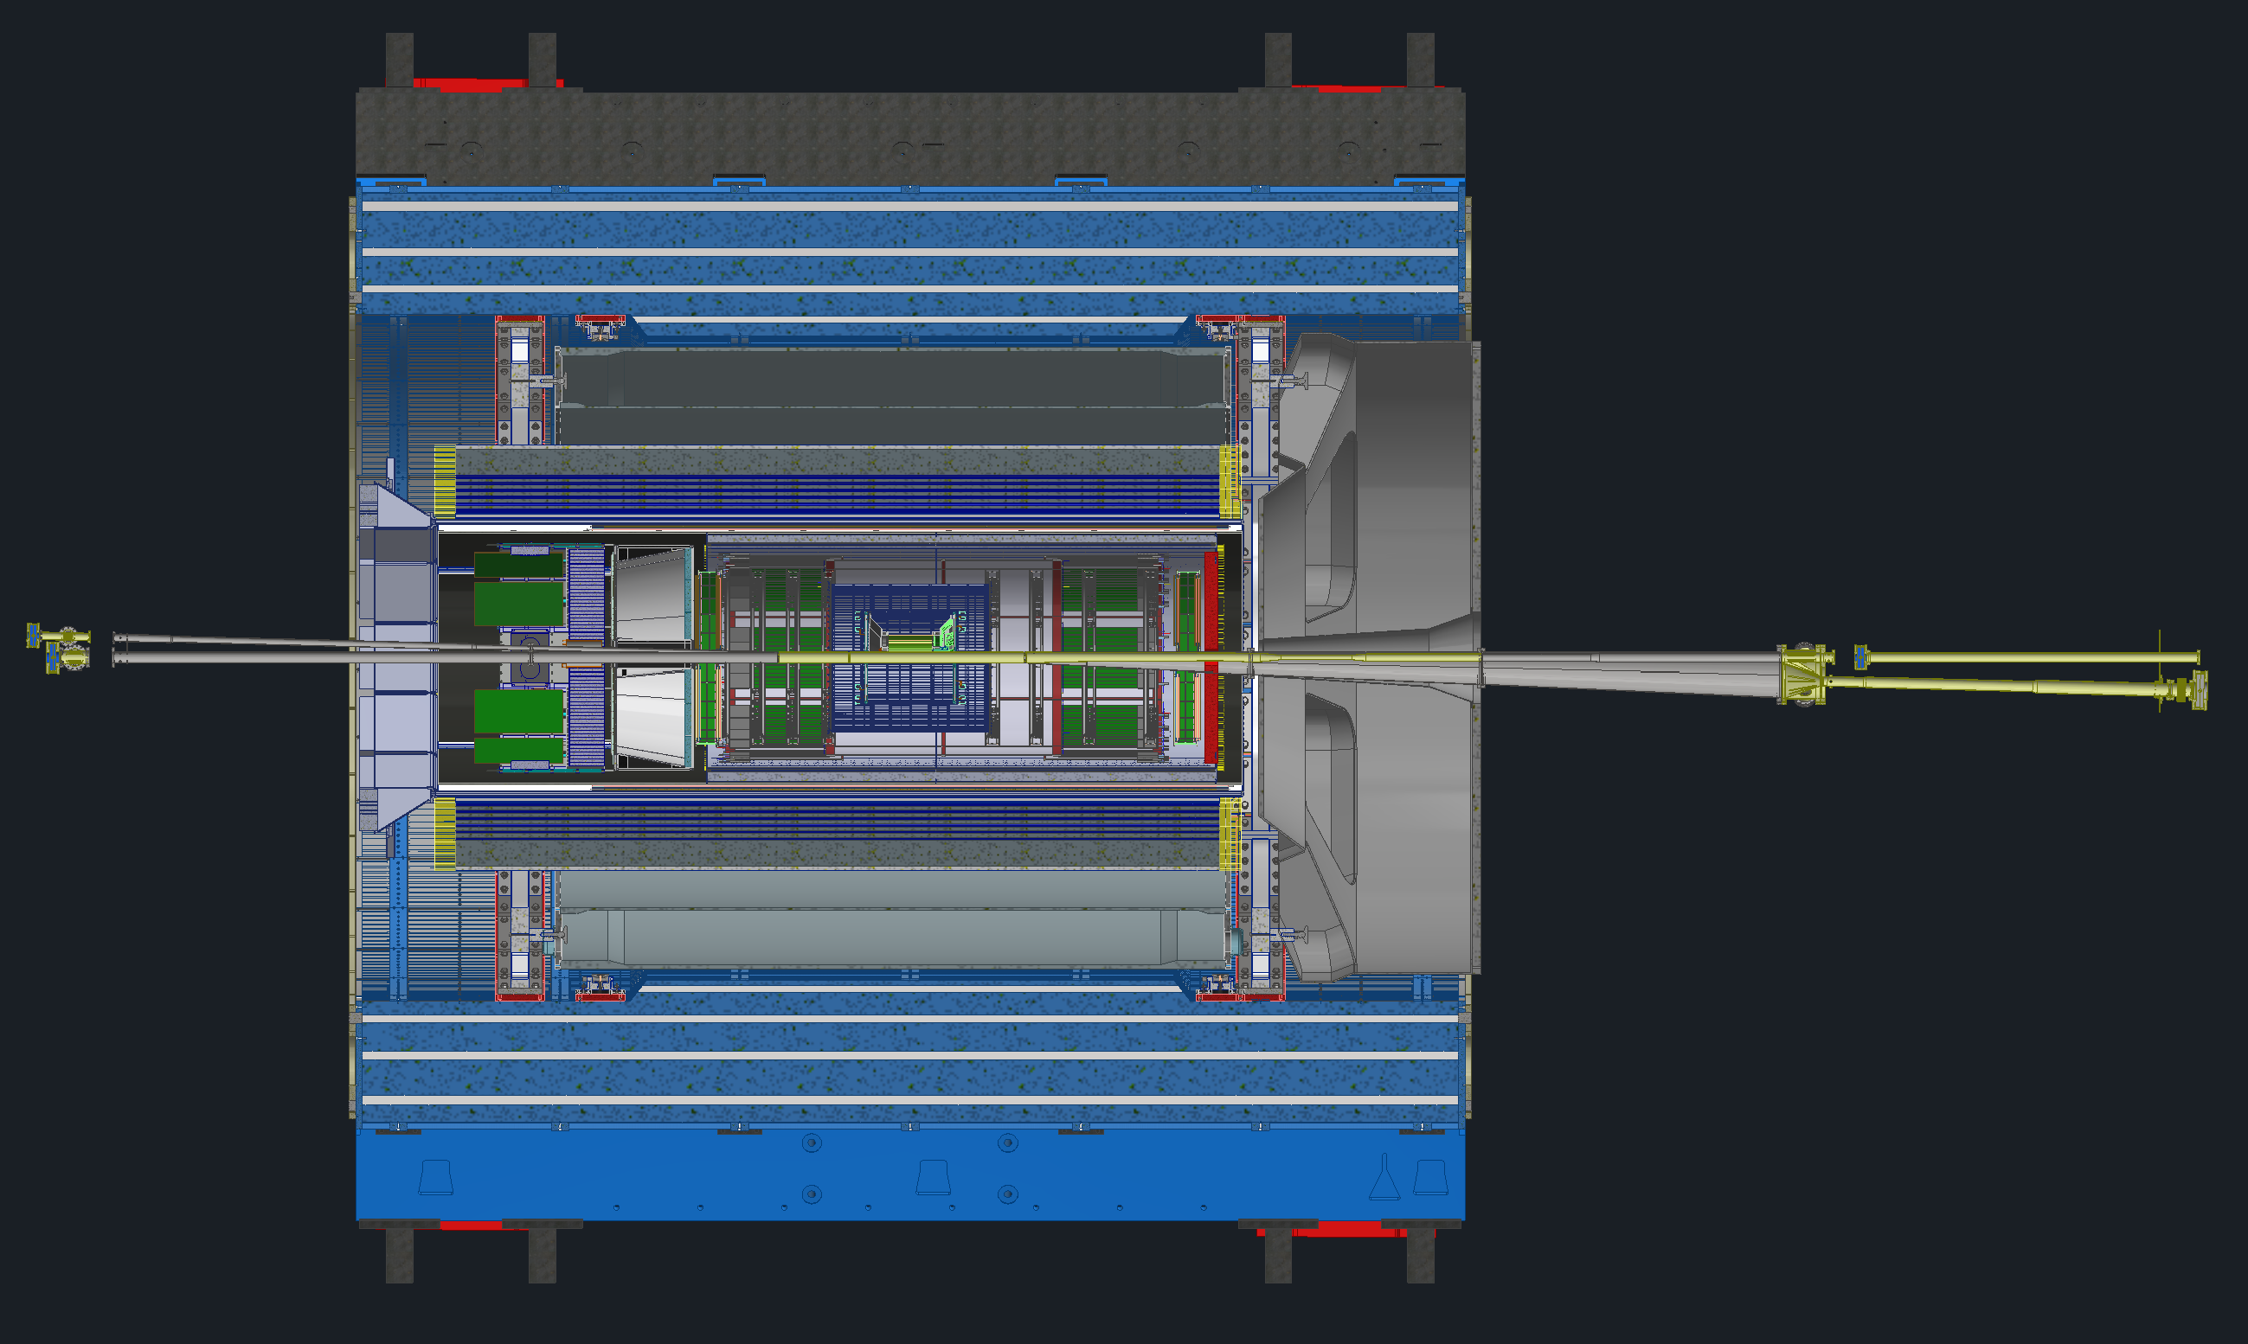
Beampipe
Received new beampipe model
Slight length update and added a flange at the orange circle. This flange will most likely go away.
The other flanges have stayed the same

Slide 6
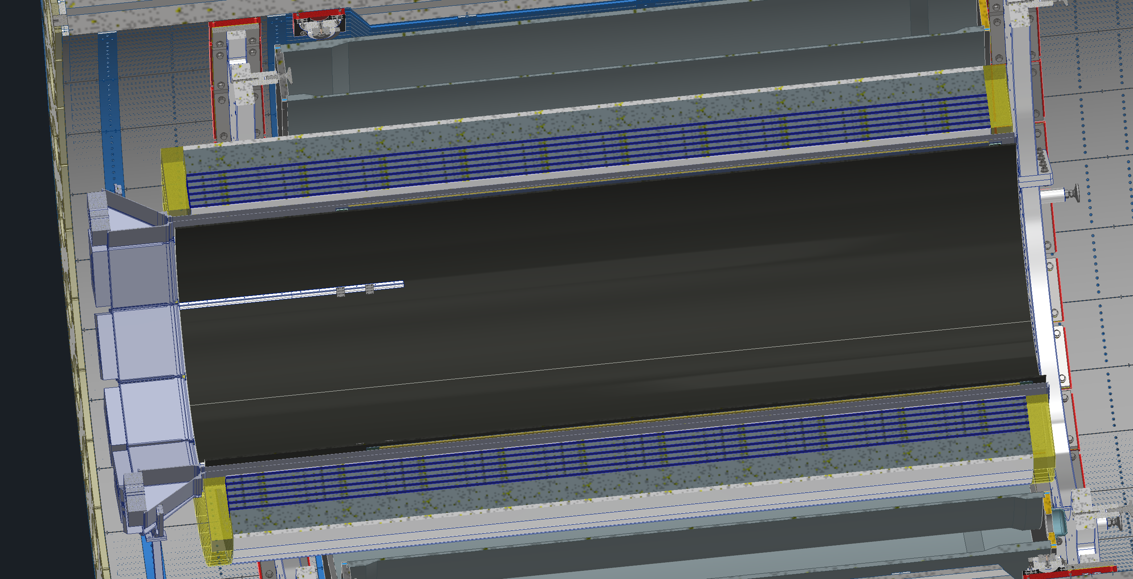
GST
(Don’t have current picture)
Continuing to work will the Purdue group on GST integration
  Working on services routing
  Figuring out engagement ring locations
  Determining appropriate amount of adjustment needed

Slide 7
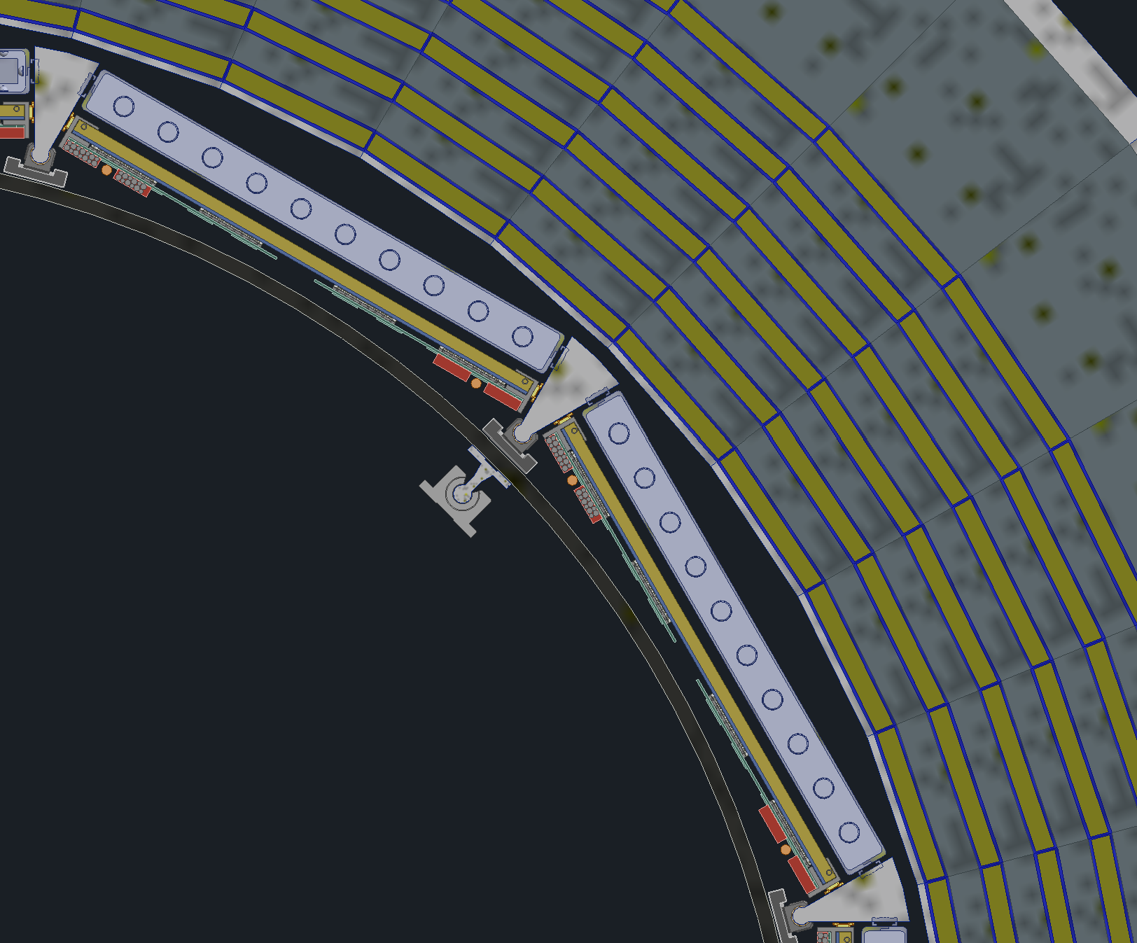
DIRC & oMPGD Shift
DIRC bars and oMPGD will be shifted 1cm radially outward
This comes from a need for more space for adjustment for the GST

Slide 8
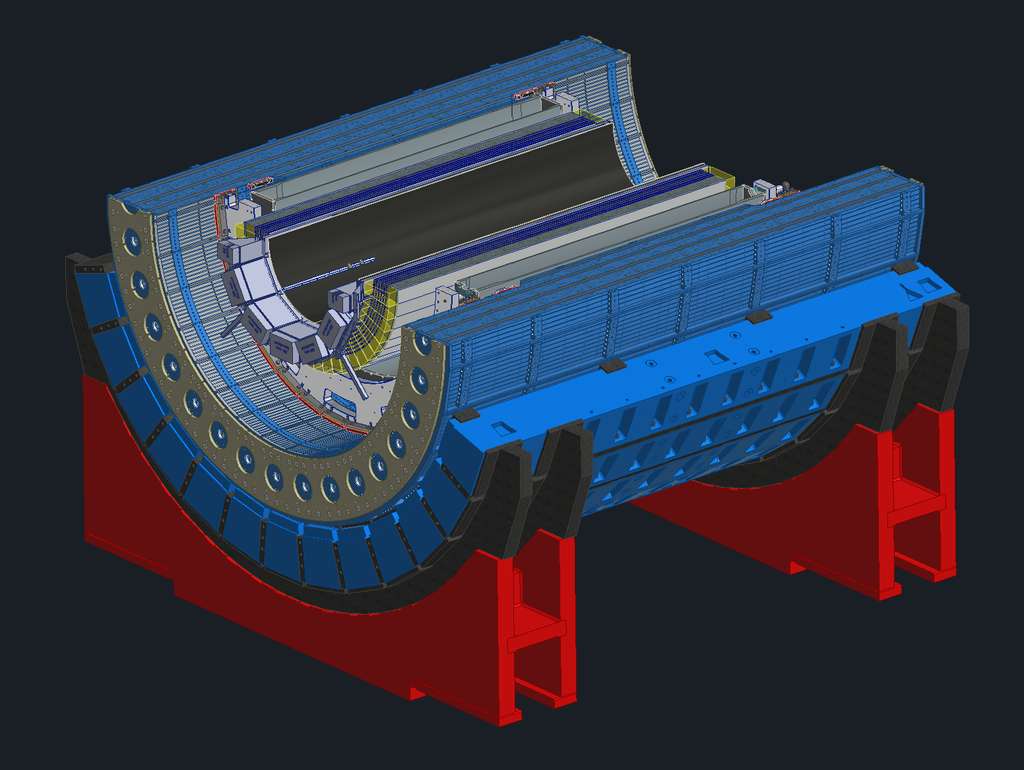
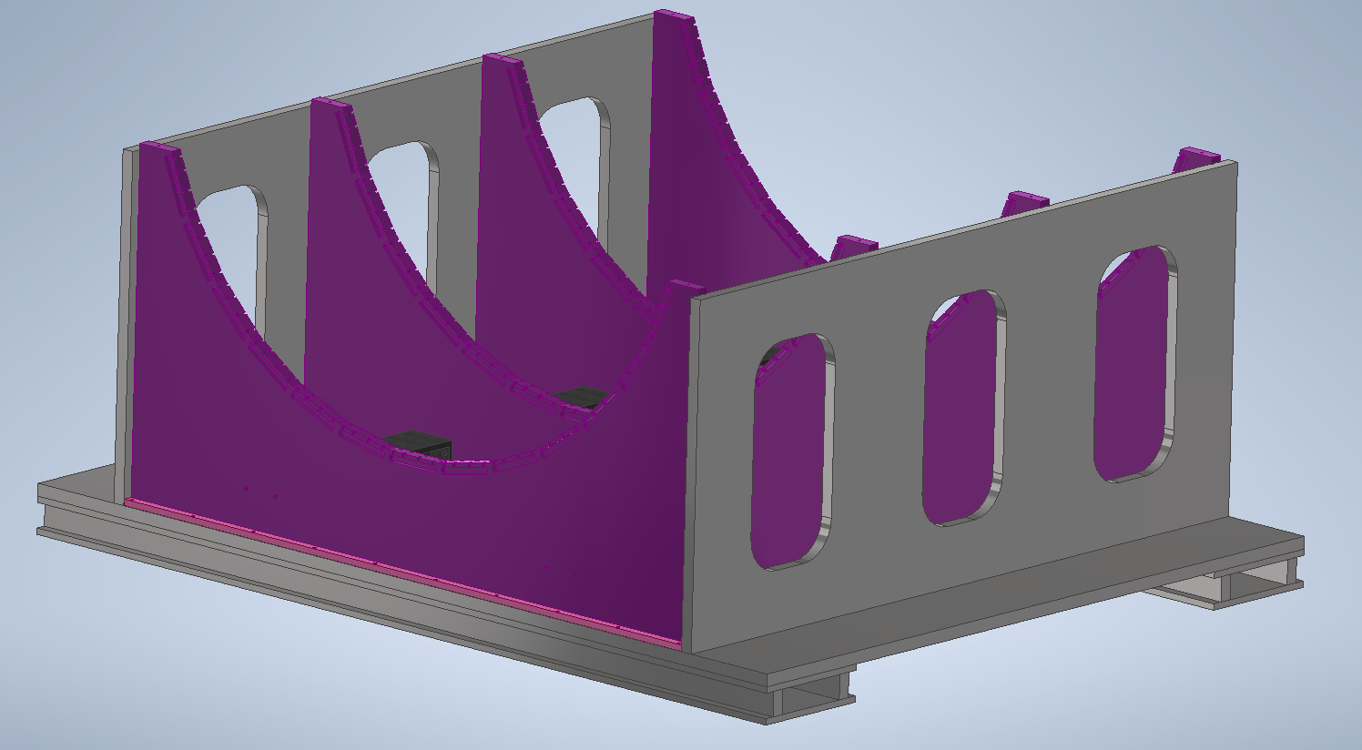
Cradle Updates
New proposed cradle design
Planning on reusing the sPHENIX support webs (shown in purple)
Will use new base, the old sPHENIX base wont work with our track setup
New design pros
  Incorporating 8mrad rotation will be much easier
  Much less weight due to less steel
  Magnet group had concerns about too much steel on the bottom of the detector
OLD
NEW

Slide 9

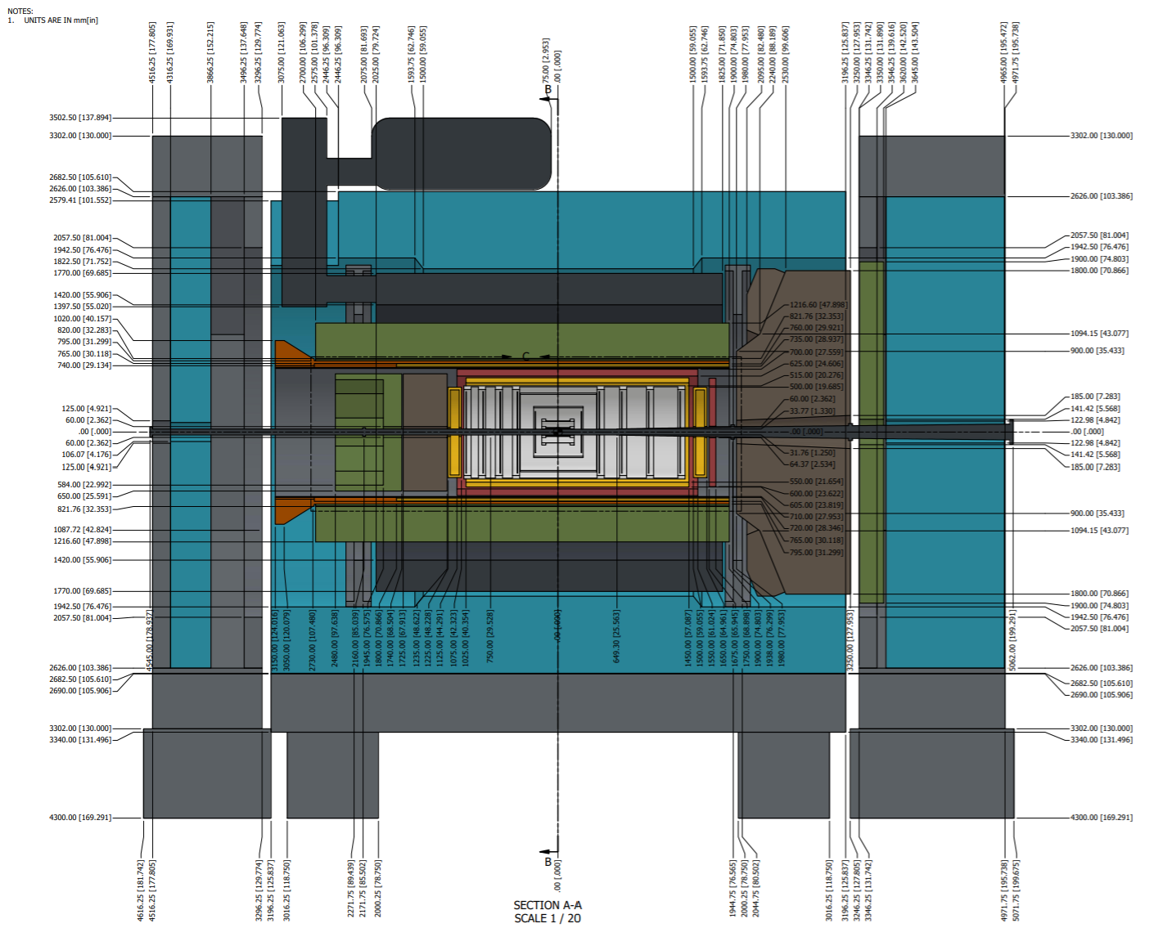
Envelope Updates
The model is current as of last Friday, however there are some recent changes that are not shown
This pdf is in Vault
Current updates include:
  MPGD disks and barrel slightly shifted
  ToF barrel was shortened such that it shares a centerline with the inner MPGD barrel
  ToF disk was moved closer to IP
  DIRC and oMPGD shifted outward radially
Pending Updates:
  The most backward SVT disk has an interference with the MPGD disks
  Potential changes to DIRC and oMPGD associated with the move out
EPIC Envelope - 03-03-2025.pdf

Slide 10
Cooling Requirements
Elke made an example of what we would like to see for the cooling for each subgroup.
Link to spreadsheet -
Some examples of information we would like:
  Heat sources and where they are located on your detector
    How are the heat sources distributed over your detector?
    How many heat sources are there? Are they FEBs, ASICs, RDOs, etc.
  What simulations have you done for heat distribution?
    What assumptions did you make for these simulations?
  What assumptions have you made about your cooling system?
  What are your requirements for a cooling?
    What is the required temperature stability?
    What is the operating temperature?
    Any limits on allowed vibration for the detector?
  Are there any other heat sources not in the detector volume which need cooling?
  Is there any other pertinent information we should know?
Detector Parameters and Services per Subsystem.xlsx

Slide 11
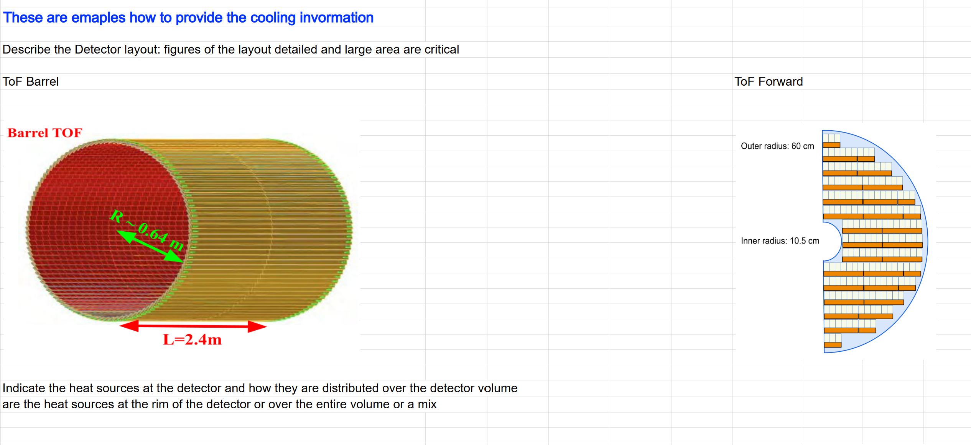
Cooling Requirements

Slide 12
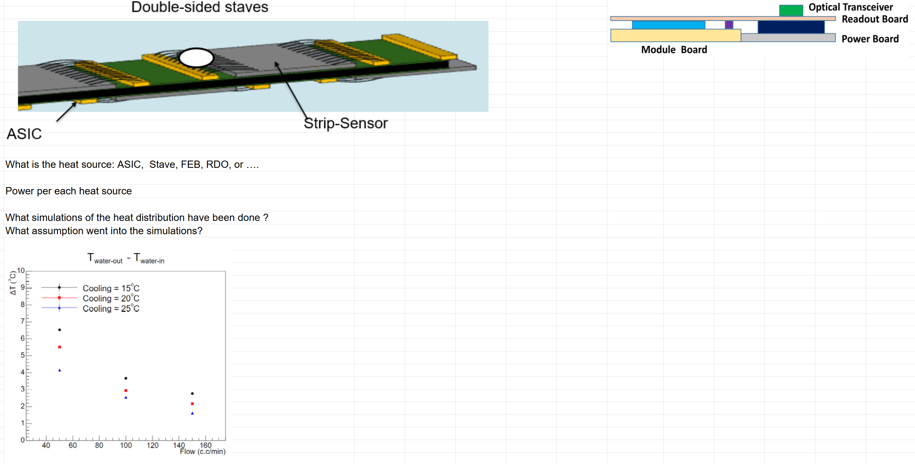
Cooling Requirements

Slide 13
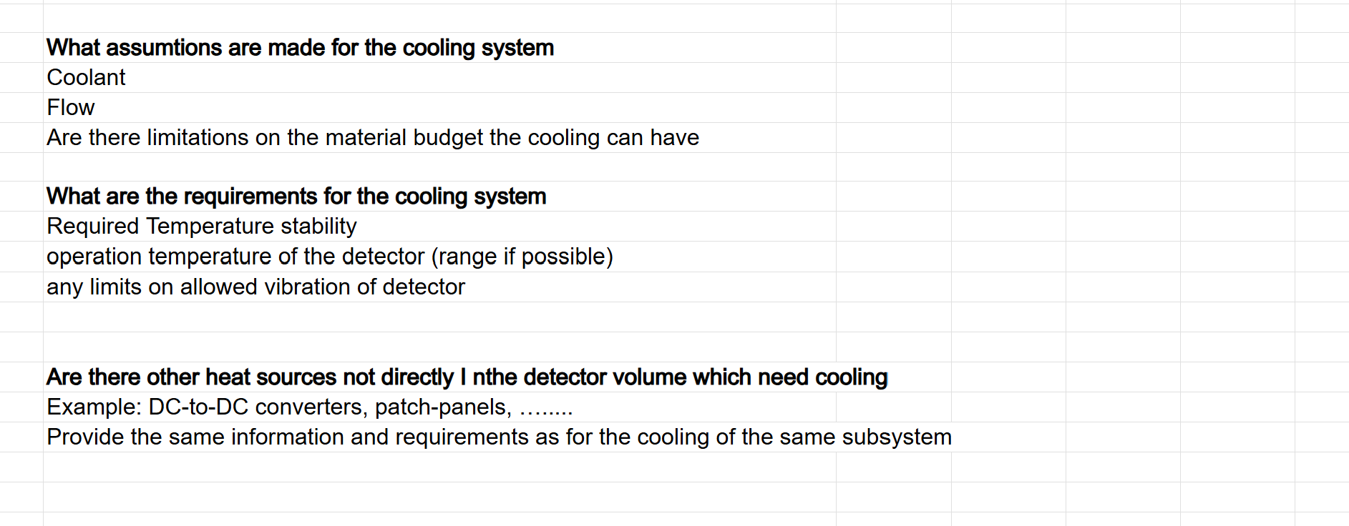
Cooling Requirements

Slide 14
Summary
Would like to meet with whoever implements the geometry to help with the recent envelope changes.
Few different model updates
Envelope pdf is current, barring small pending updates
PLEASE FILL OUT COOLING/ HEAT INFO!!!

Slide 15
Backup Slides

