Slide 1
GST TOF and SVT updates for Mechanical Engineering ePIC meeting
Sushrut Karmarkar, Ben Denos, Andy Jung
03 March 2025

Slide 2
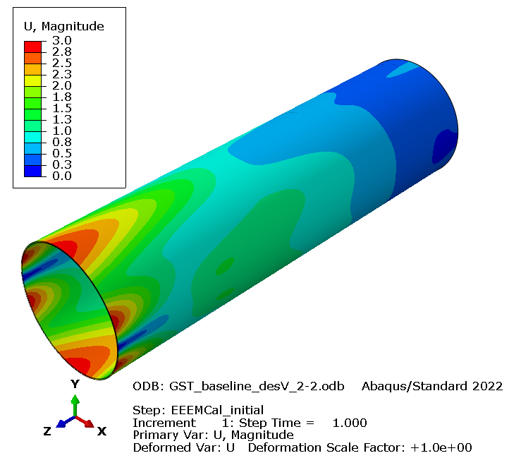
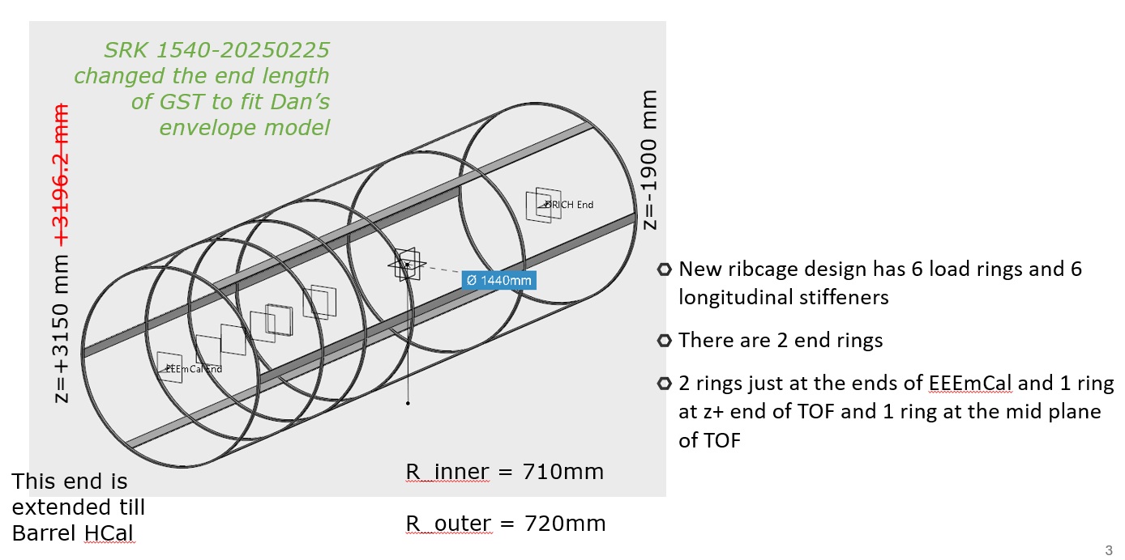
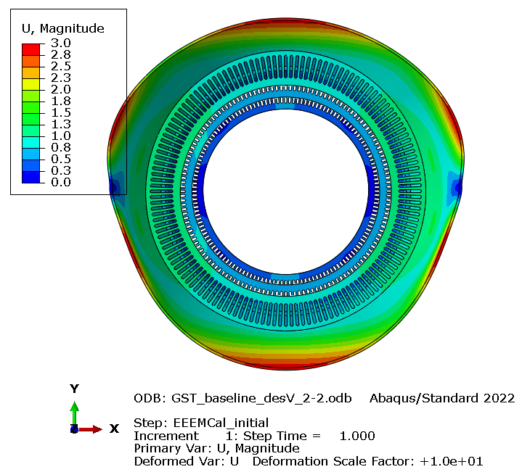
Recall from slides on 18 Feb 2025
Unit mm
Changes needed to this model
New weight estimate from EEEMCal group.
Unit mm
x100

Slide 3
GST summary
Working on updating the CAD model in the finite element simulation
Insertion and services dressing with SVT volume being internally discussed
Design iterations to beef up the end of the GST and reduce iterations on-going
Working to make a detailed presentation about integration and FEAs at the BNL meeting at the end of March 2025.
Meeting with Roland and Dan – they will present the GST adjustment needs and envelopes corresponding to this 1 milli radian adjustment wrt to beam alignment on March 24 meeting
Please can you point me to the latest quarter section model from MPGD discs inside GST – question – do you need kinematic support for both discs on fwd and backward side – or do you need one set of support per “package” ?

Slide 4
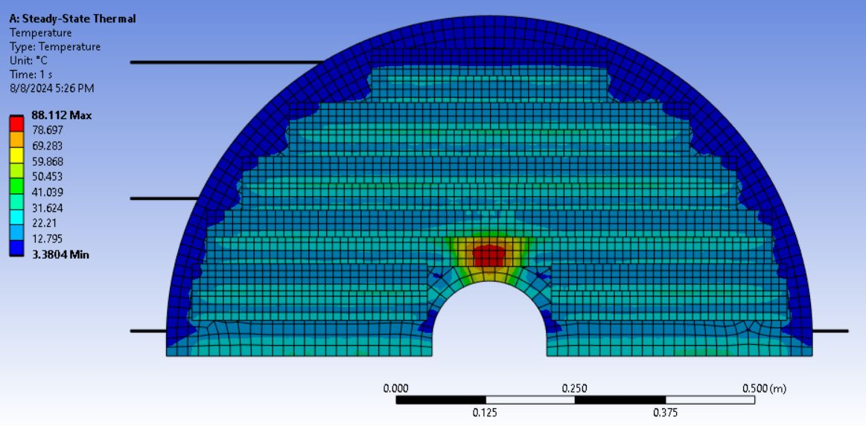
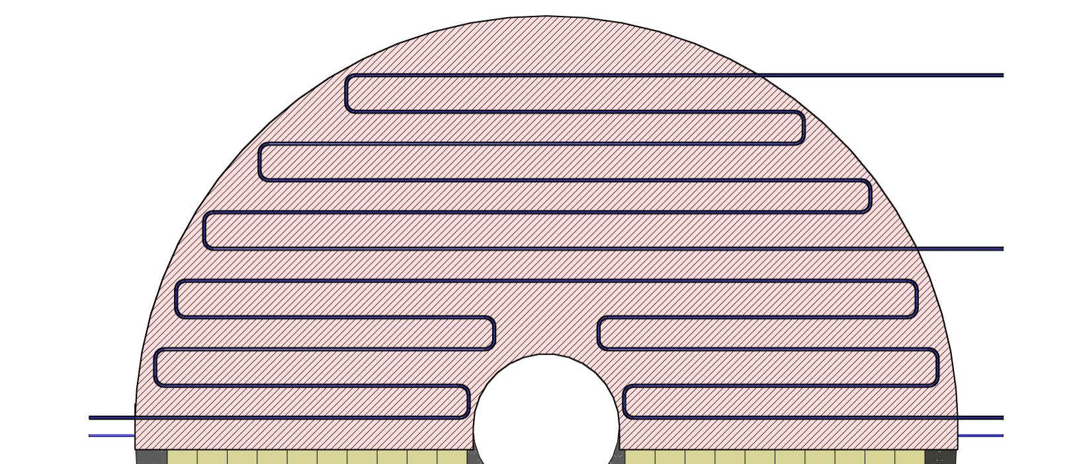
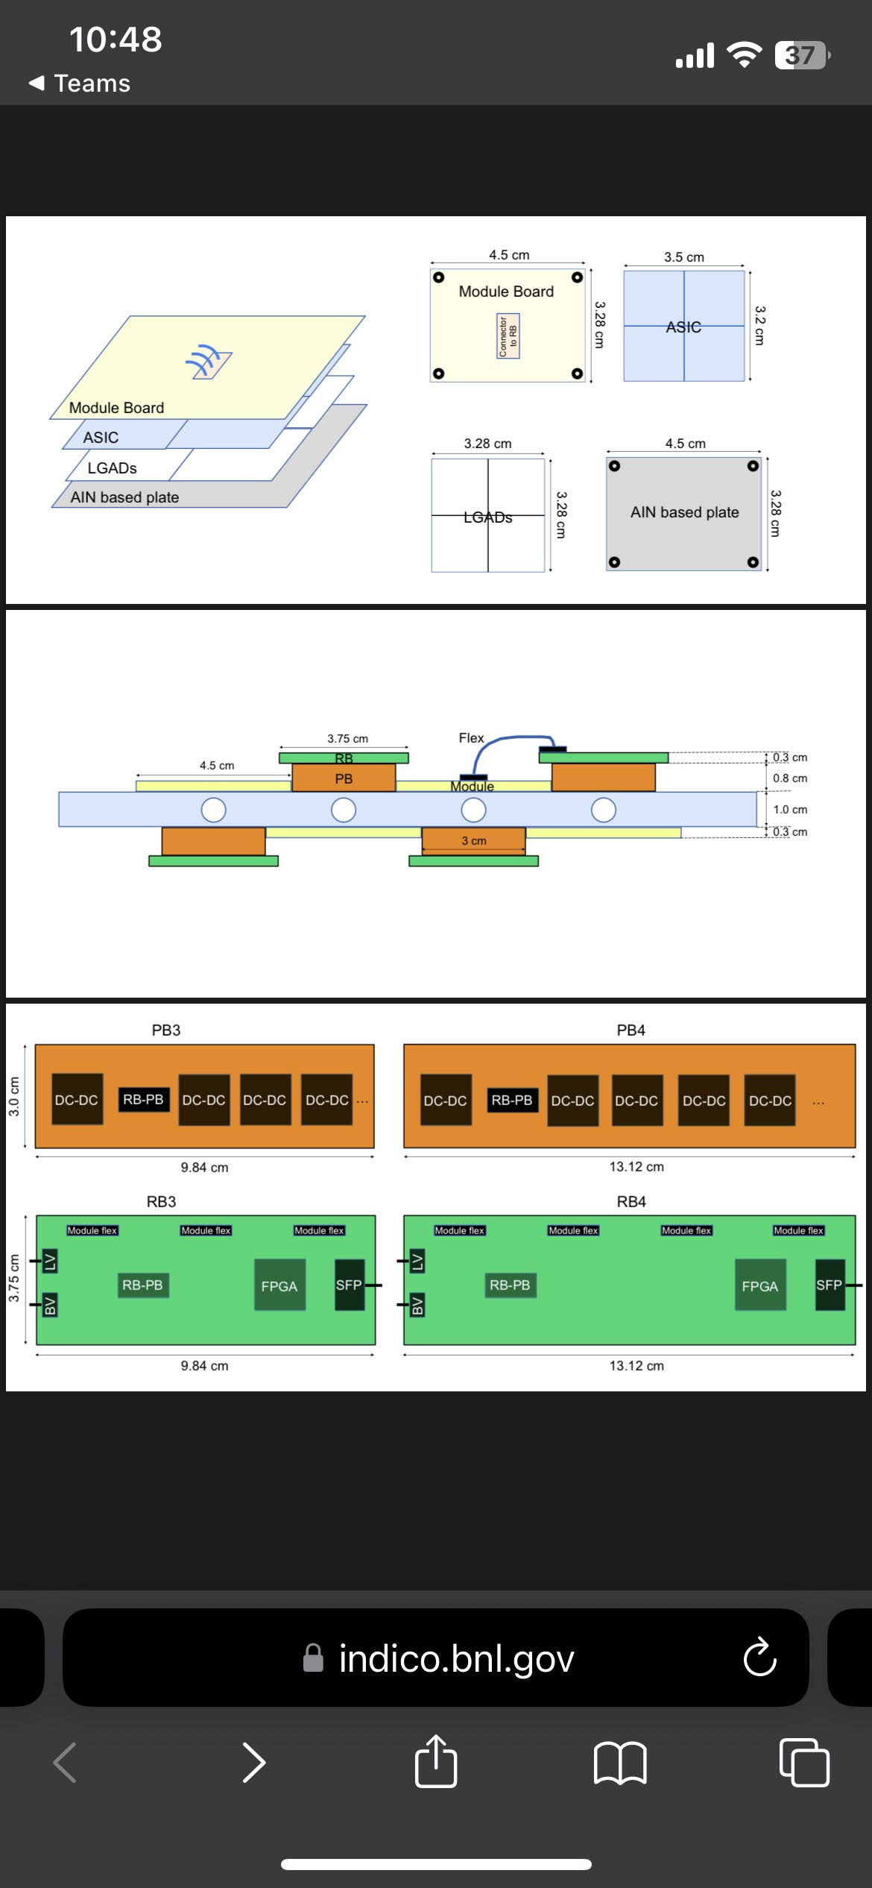
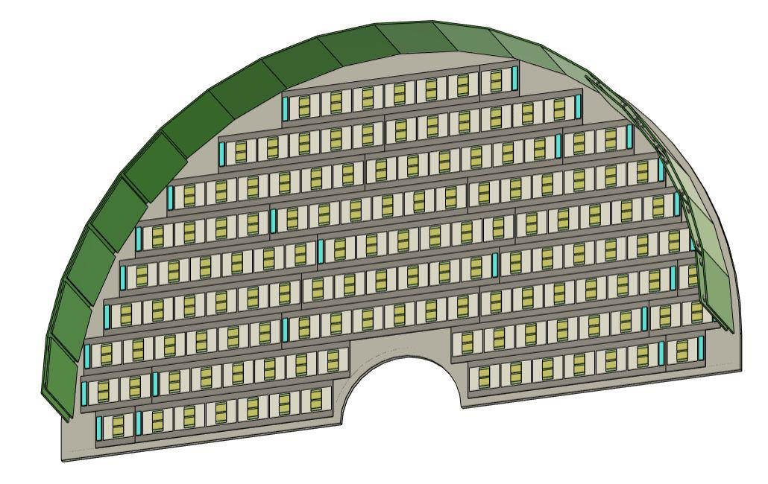
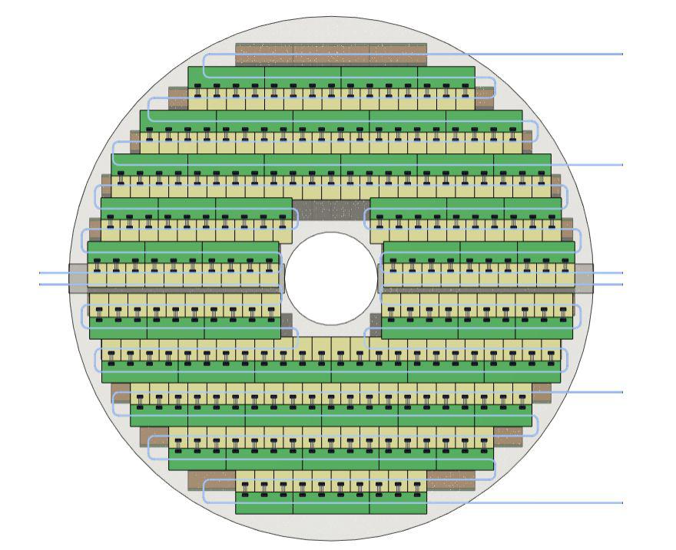
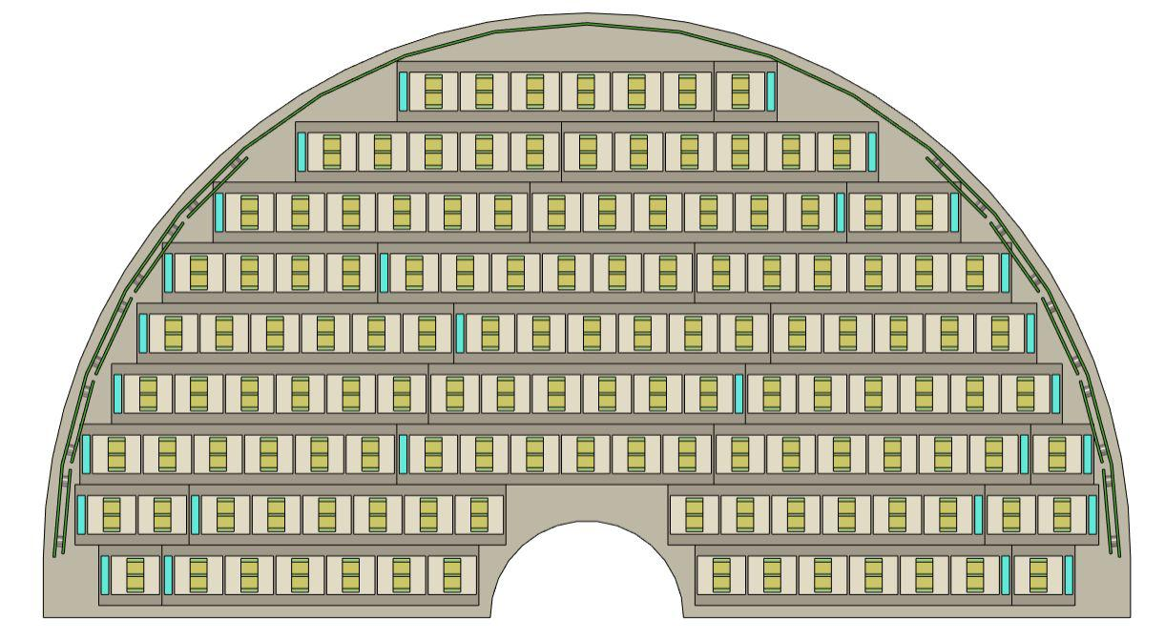
Preliminary fTOF mechanics design updates – latest fTOF tiling from 20 Feb 2025
Preliminary tiling update from Tommy (BNL) to match the latest GEANT simulation
Piping layout to estimate the amount of cooling needed per-fTOF disc

Slide 5
SVT Support Structure
Preliminary, Qualitative Design Study
Andy Jung, Ben Denos, Sushrut Karmarkar
PRELIMINARY, QUALITATIVE RESULTS

Slide 6
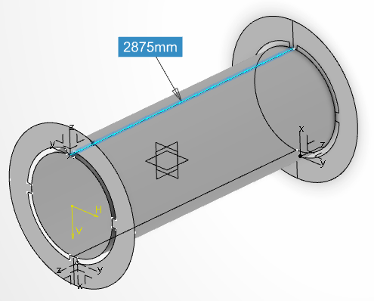
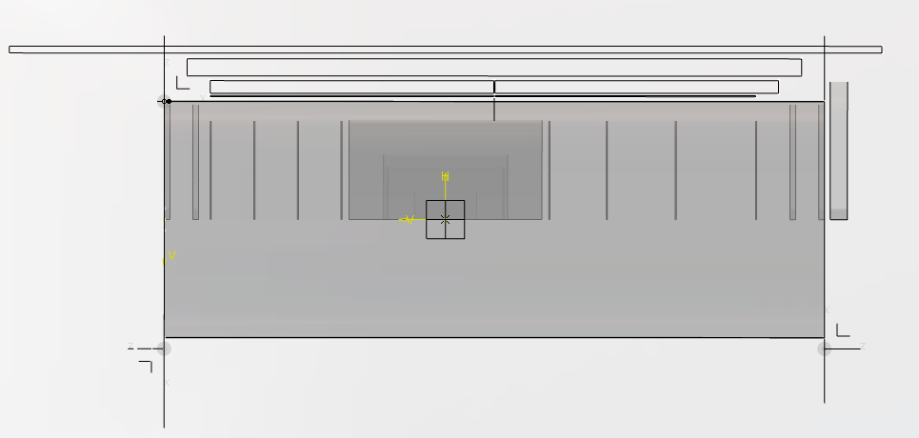
Preliminary Design Study of SVT Support
3 design approaches to determine structure/mass efficiency of designs
Generic tube of “correct” diameter 1028mm
  HR40/EX1515 UD properties
300kg spread inside tube surface
Engagement ring surrogate at each end
Max deflection goal: <1mm
Option 1: solid tube
Option 2: thinner solid tube with ribs
Option 3: skeleton of ribs/stringers
PRELIMINARY, QUALITATIVE RESULTS

Slide 7
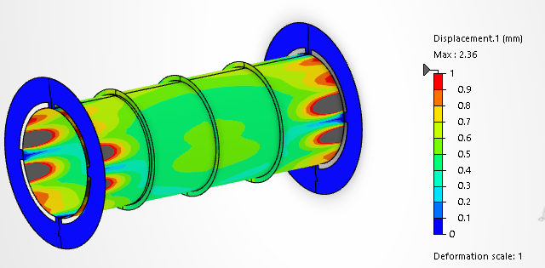
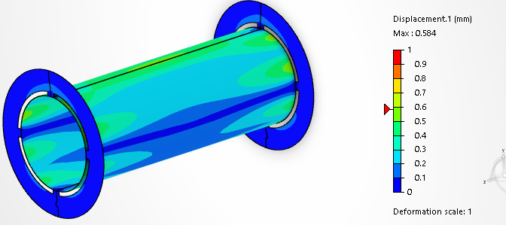
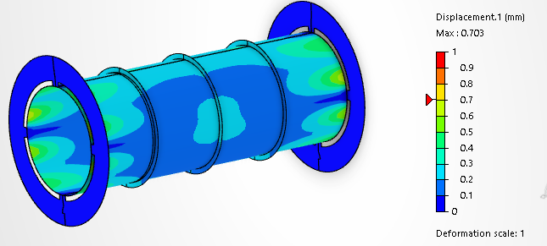
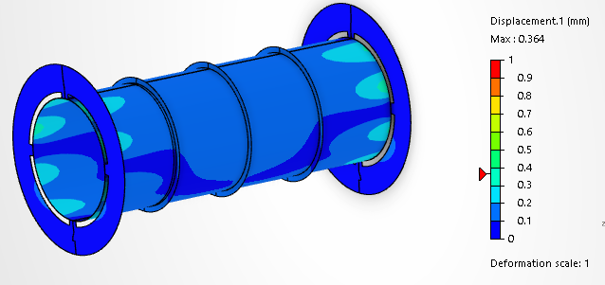
Option 1 VS 2 – Design iterations
1.14mm thick
2.4mm deflection
3.43mm thick
0.6mm deflection
2.28mm thick
0.7mm deflection
3.43mm thick
0.4mm deflection
PRELIMINARY, QUALITATIVE RESULTS

Slide 8
SVT Support FEA Plan
Basic requirements
  Support and connect ~300kg mass
    SVT disks
    SVT barrel “cone” with internal ribs
    MPGD disks
  Maximum deflection (<= ~0.5mm)
  Split along X-Z plane for SVT assembly
  Join cylinder halves mechanically prior to insertion
  Supported by engagement rings (at least end two)
  Pass through and support services
Input needed – iterating with Roland
  Service cross section data, sorted by
    Z position
    Radius min/max
    Phi targets for cutouts
    Total # of cutouts
  Service mass/location estimates
  Disk, barrel mass estimates
Design refinement
  Add preliminary services/disks mass
  Add preliminary services cutouts
  Use stress map to optimize material use

Slide 9
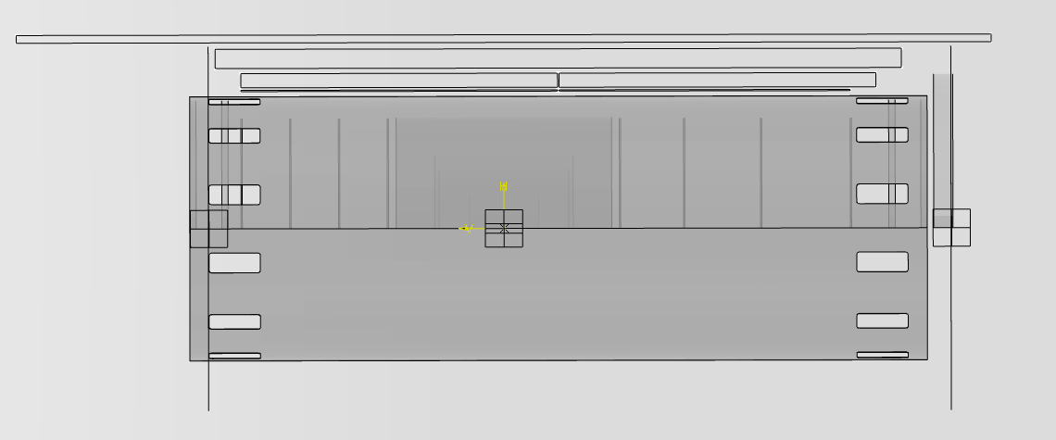
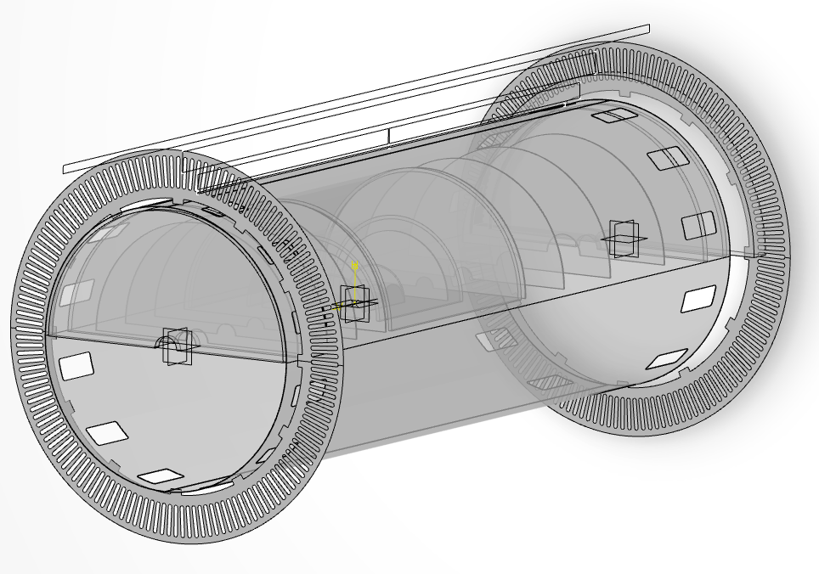
Services Totals Estimate – Roland Email 12 Feb 2025
>=120.4cm^2 per opening
Path 1 (+Z)
  ~20x8cm cutout
Path 2 (-Z)
  ~20x8cm cutout
Need cutouts for air cooling, mass reduction as possible

Slide 10
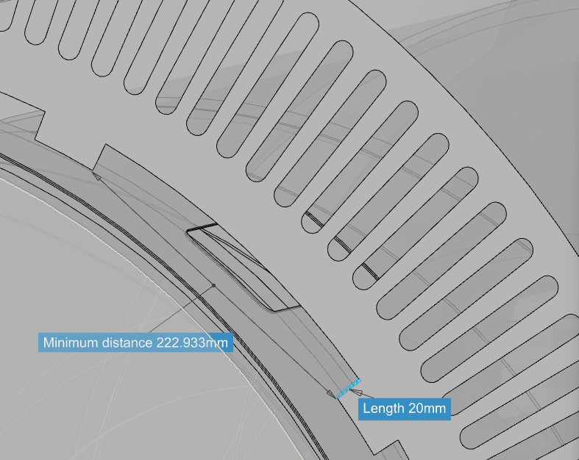
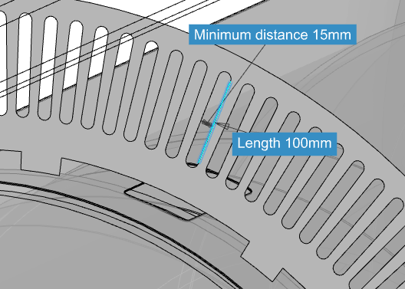
Services Passing from SVT out through Engagement Rings
Two openings in engagement ring for service pass through
Near SVT support: 23x2cm = 46cm^2
Long slots:
10x1.5cm = 15cm^2
  X 12 slots per region = 180cm^2
Need 120cm^2 per twelfth

Slide 11
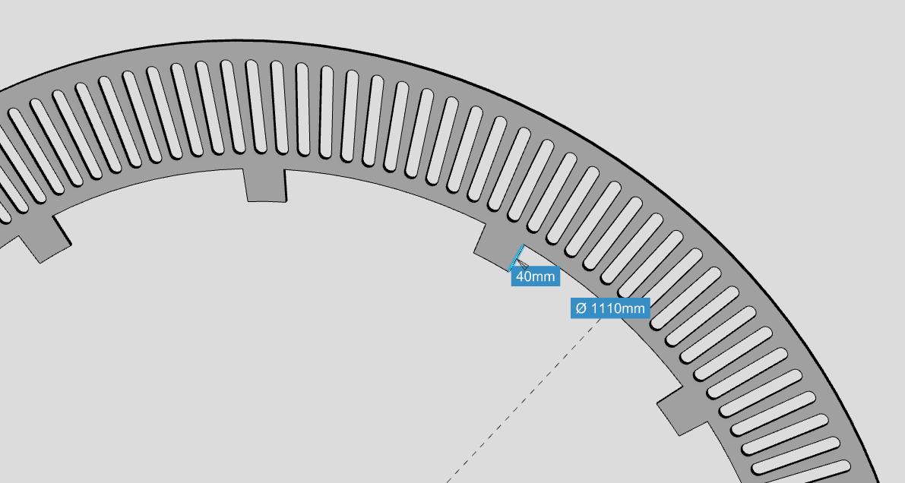
Engagement Ring Pass Through Space for SVT Services
Increase by making engagement ring IR larger
A_appx = 4*22.3 = 89cm^2 per twelfth
A_geom= (5°x12 / 360°) * pi* (55.5^2-51.5^2) = 1120.5cm^2 OR 93.3cm^2 per twelfth
Need 120cm^2 per twelfth….
Still not enough, must minimize connections?
  With no connections: 1344.6cm^2 or 112cm^2 per twelfth

Slide 12
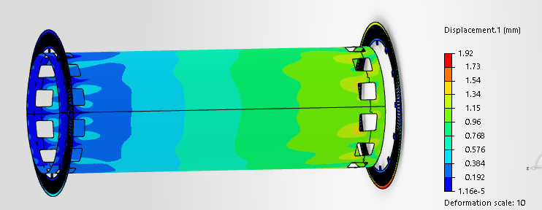
“Cartoon” Simulation – Need more Inputs
Qualitative Until Disk Positions and Service Paths More Defined
1mm thick cylinder
5mm engagement rings
  no center ring for now
  Positions relative to tube need update
Still 300kg distributed on tube surface
150x150mm service cutouts (x12) at each end of tube
  Pass through engagement ring more restricted – TOF side “impossible” in current position

Slide 13
SVT summary 26 February 2025
Must minimize engagement ring connection to SVT support
Cutouts in support “tube” should fan out in phi for better services management (balanced with structure)
Get updated location of SVT disk and MPGD disk for services bending/routing in latest CAD model from vault/Roland
Appx services exit locations and cross sections – Roland SHARED
Access to mass tables for discs and services - Ernst
Ben add better mass distribution, service cutouts

