Slide 1
Far-Forward / Far-Backward
Detector Integration
Jonathan Smith (JLAB), Ron Lassiter (JLAB),
and India Krehbiel (JLab), David Powell (JLAB)
March 10th, 2025

Slide 2
Primary Updates Outline
Far-Forward Region
B0 Detector
B0 Calorimeter
ZDC

Slide 3
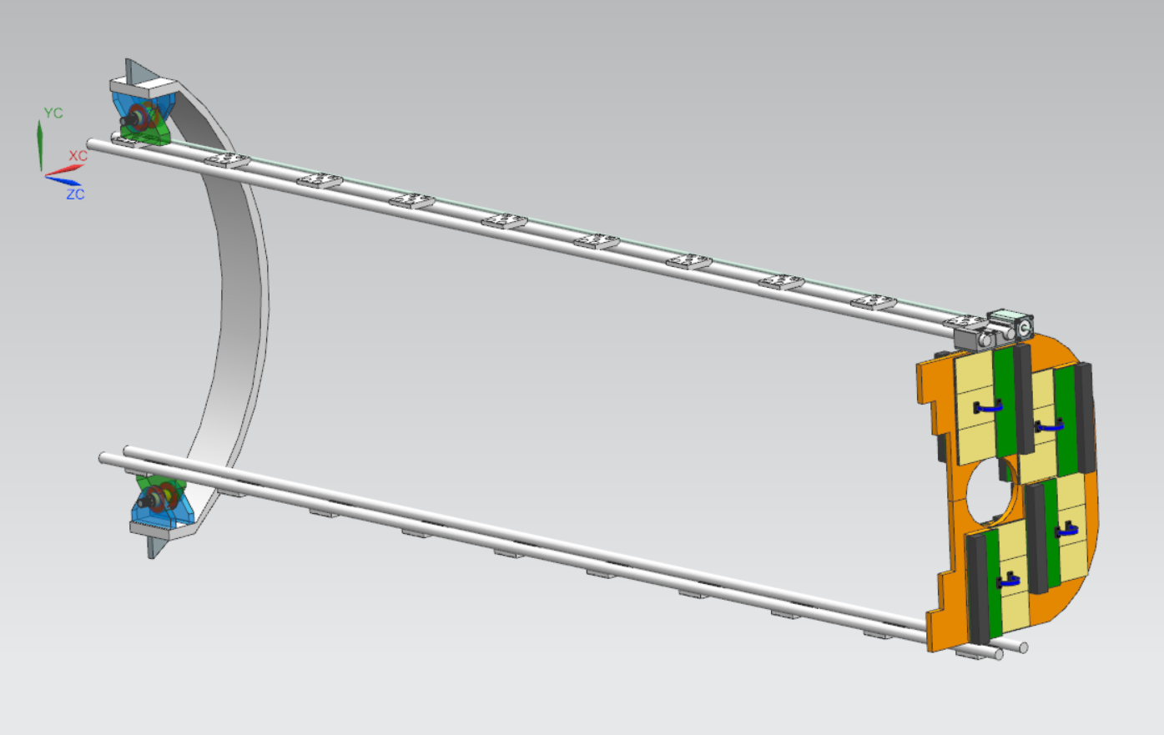
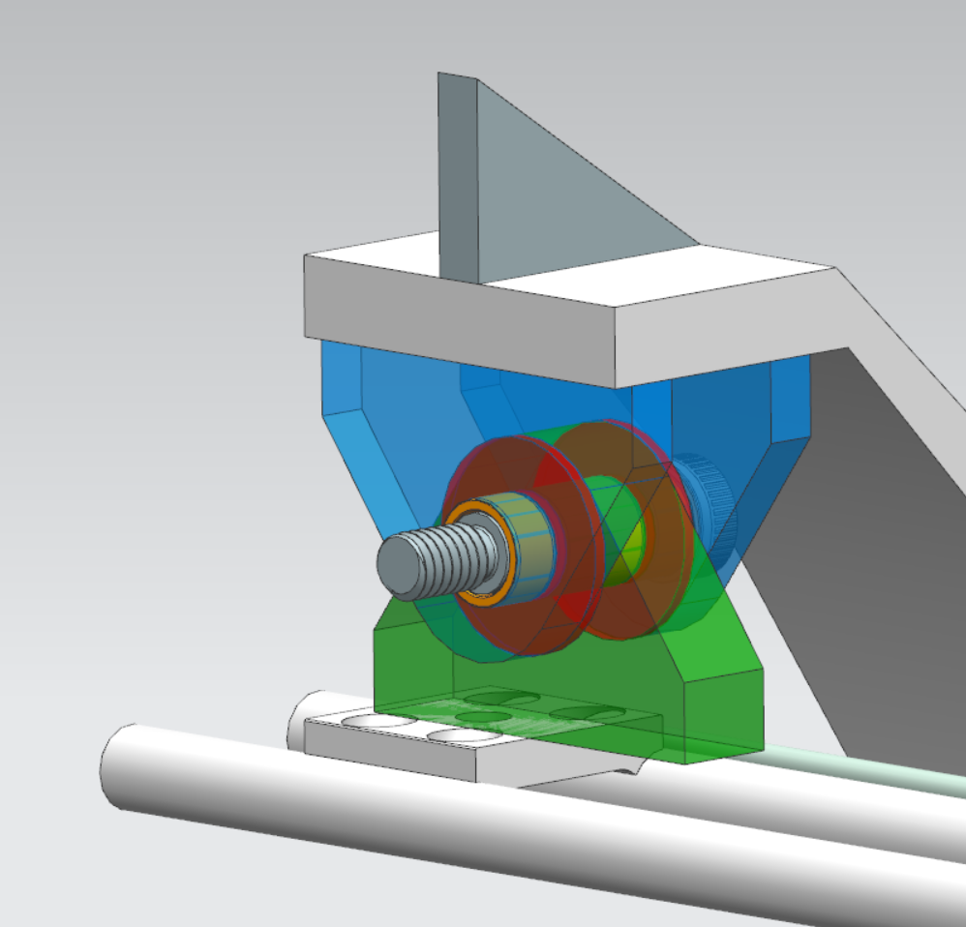
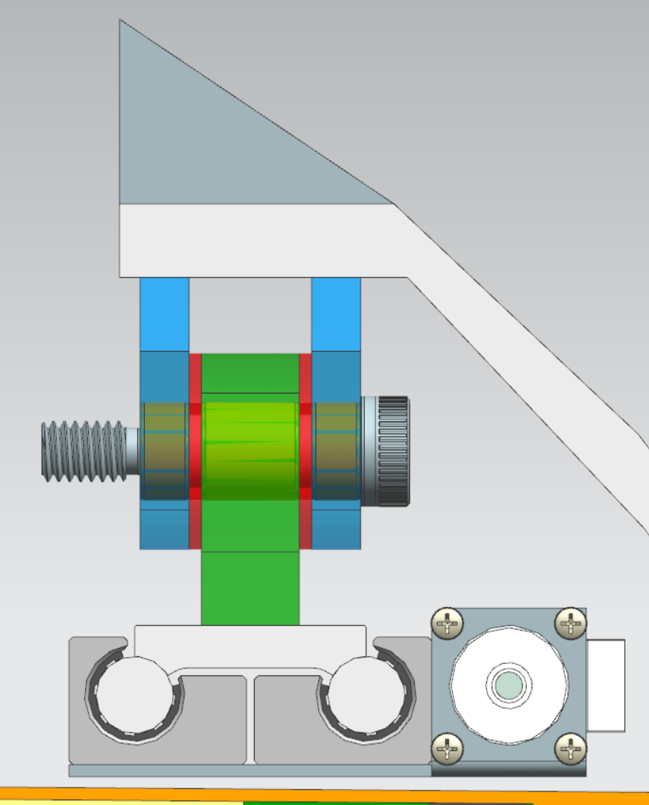
B0 Detector Hinge Update
Latest update uses (3) support ‘padeyes’ with bearing inserts, Teflon washers, and a shoulder bolt

Slide 4
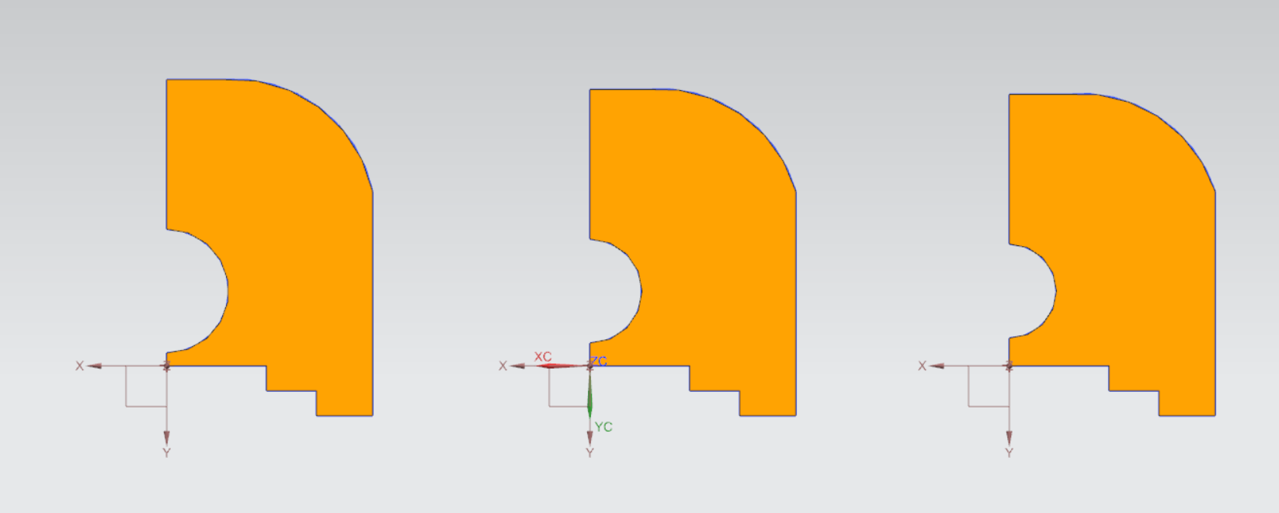
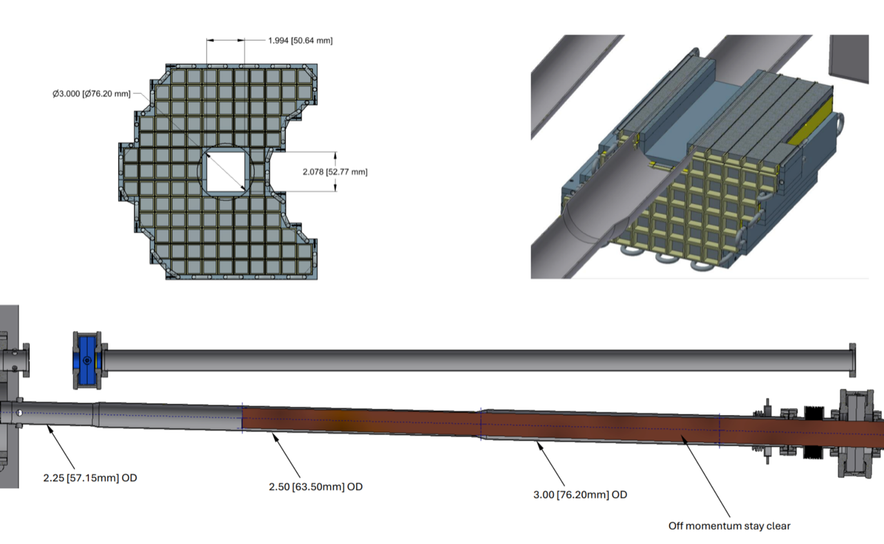
B0 Beampipe Update Design Impacts
We’re anticipating an update to the beampipe through the B0 Magnet.
Updating the Detector Layers and Calorimeter to suit
76.2mm OD
63.5mm OD
57.15mm OD

Slide 5
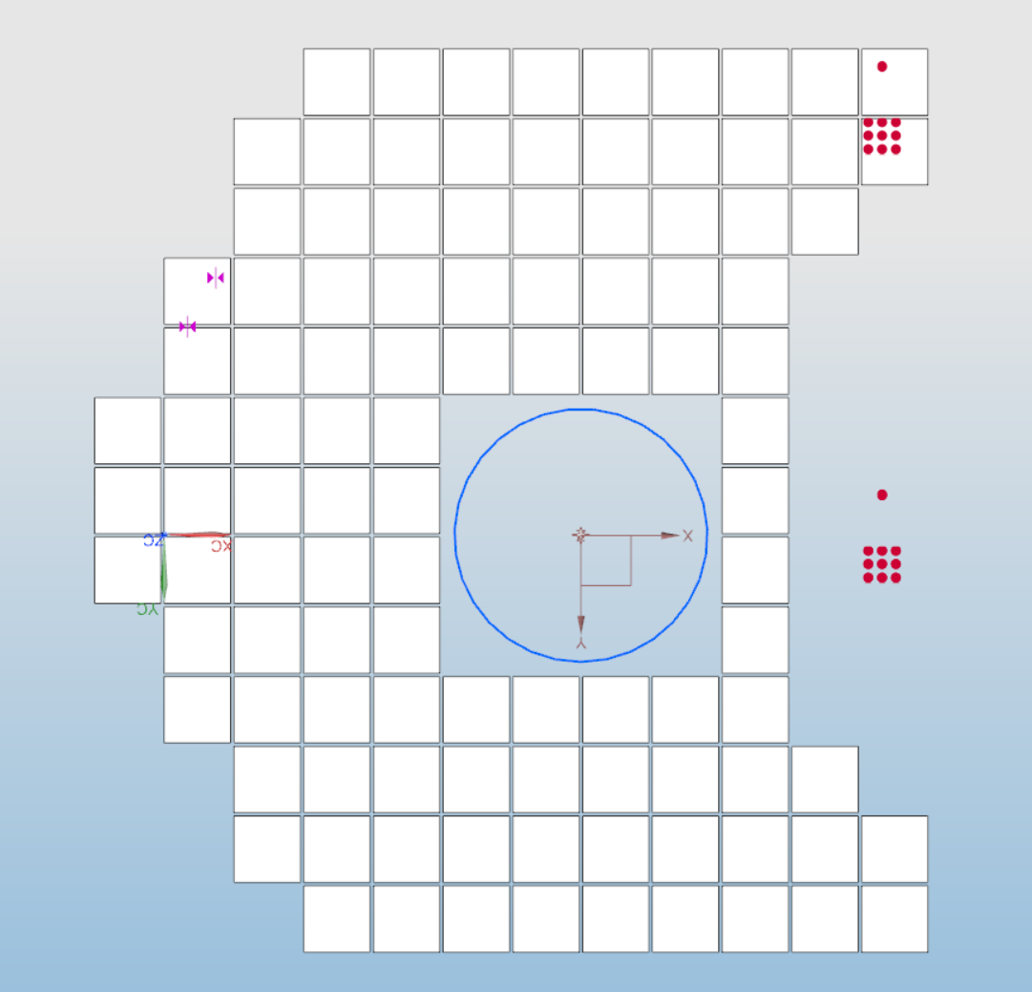
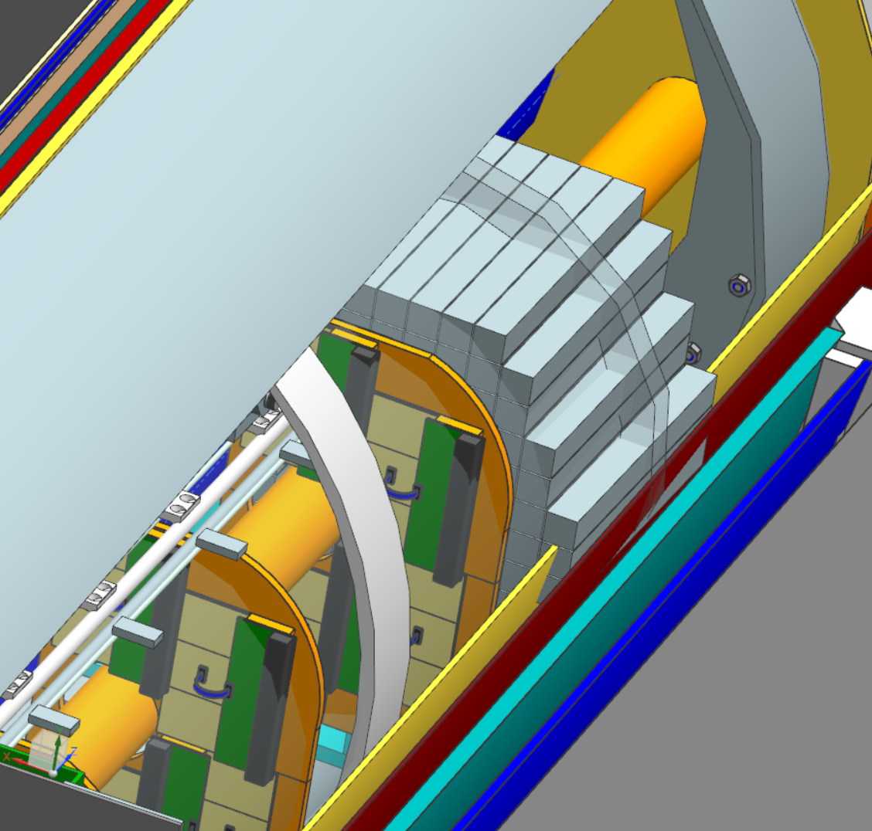
B0 Beampipe Update Design Impacts
Existing Calorimeter
Preliminary Calorimeter Concept
- Considerable fouling through B0 Internal Support Structure and Cryostat.
- Note: Model does not include wrapping, support structure, nor electrical/cooling interfaces

Slide 6
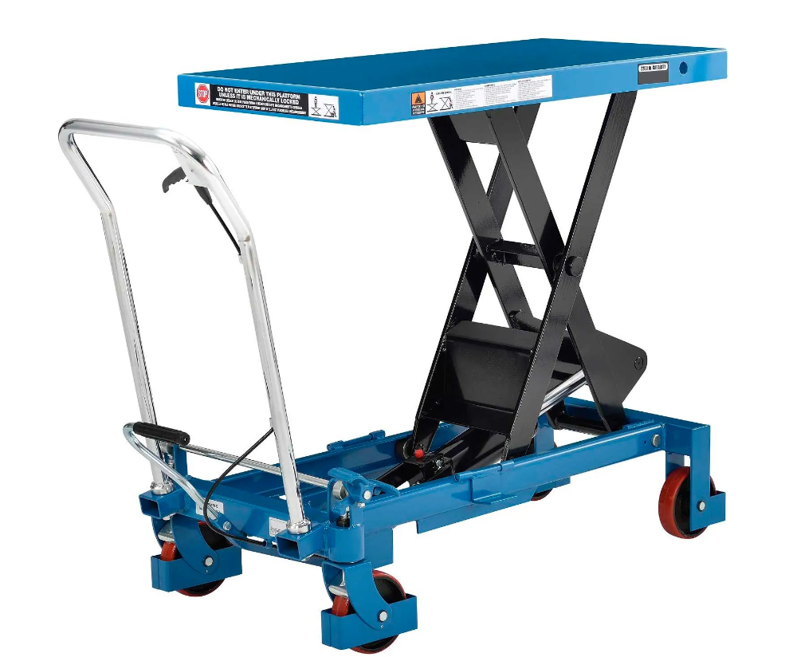
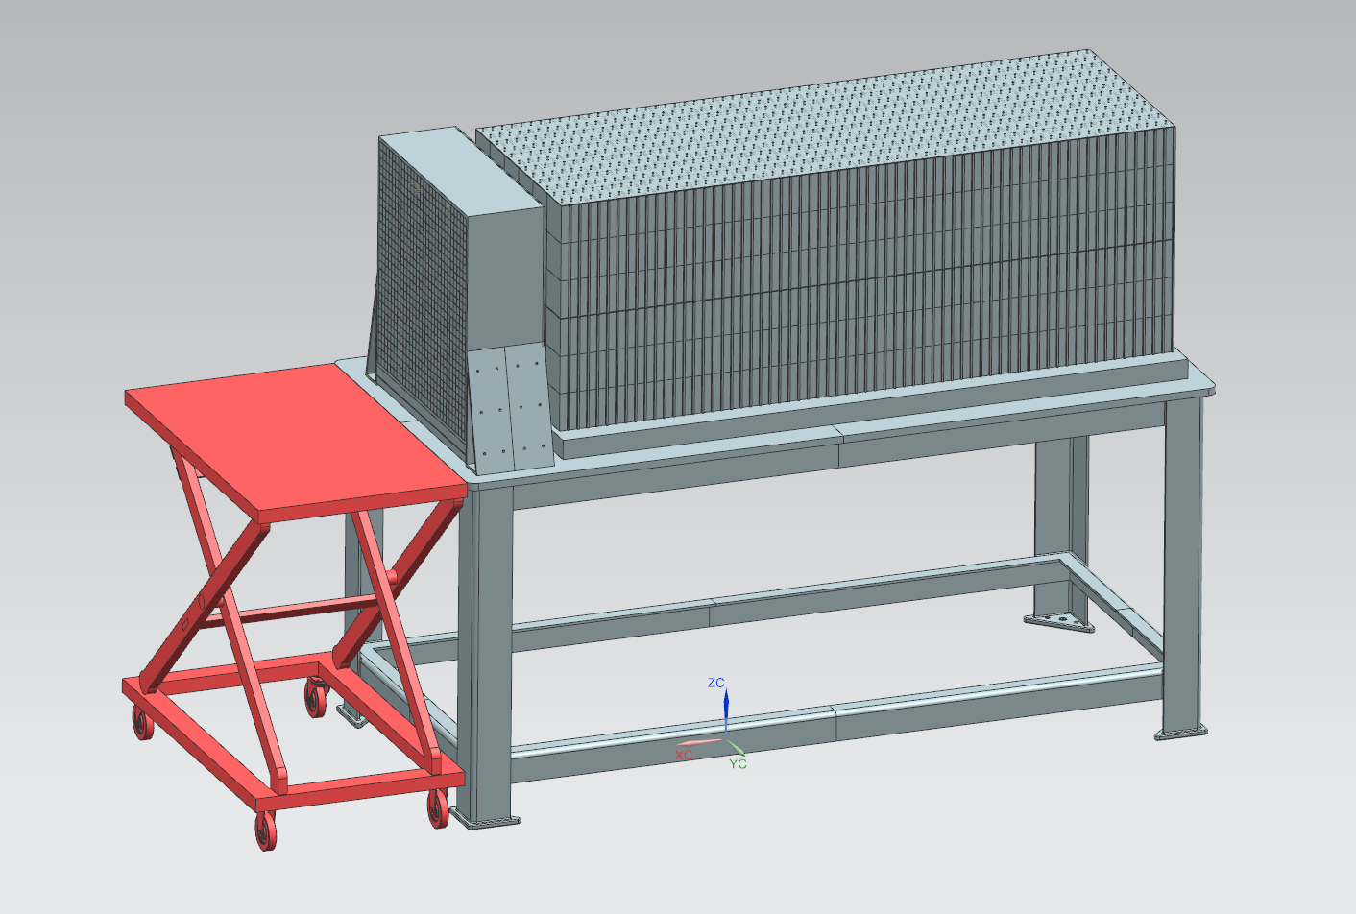
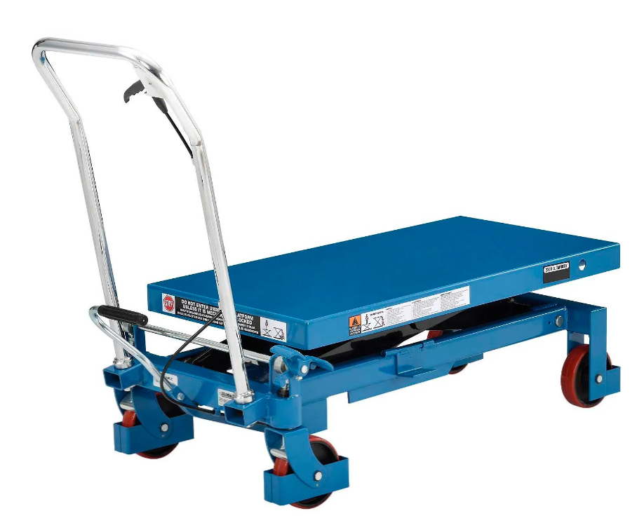
ZDC EMCAL Removal Lift Table
Current Lift-Table concept is not designed to be at lifted position for extended period of time without additional supports

Slide 7
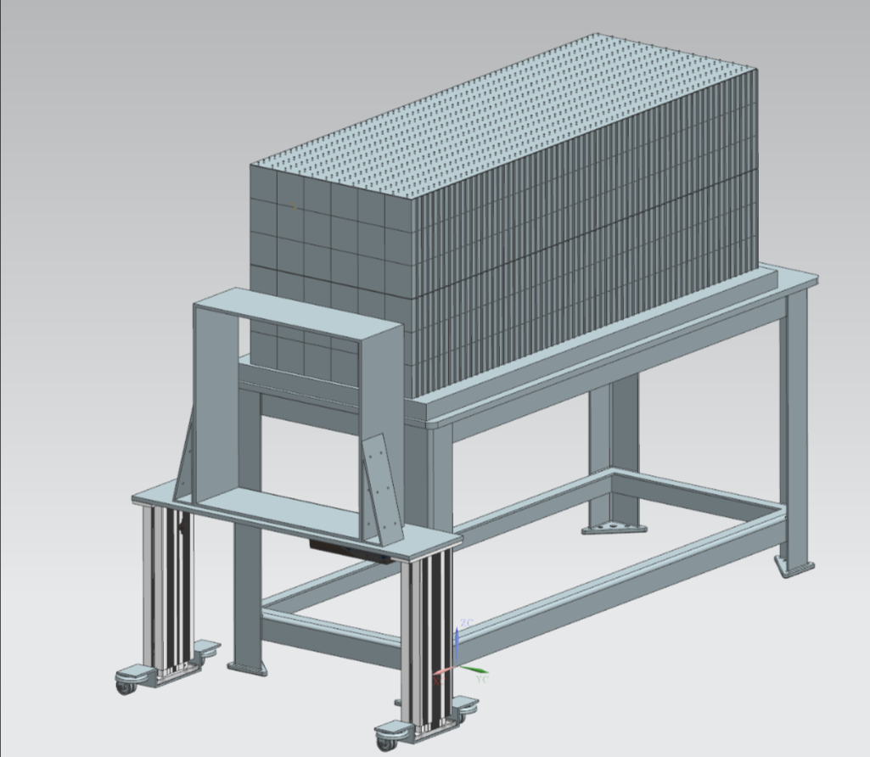
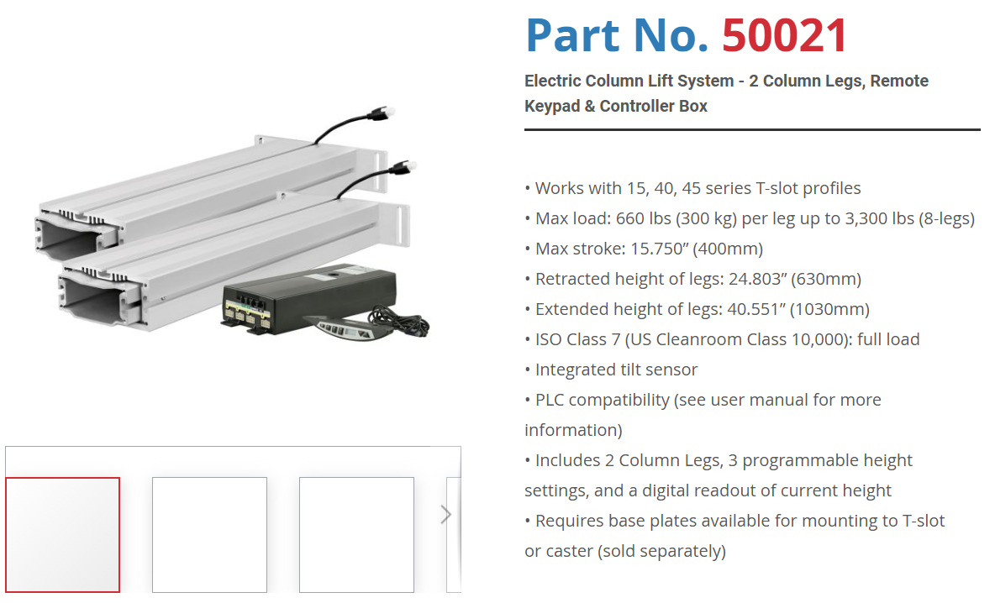
ZDC EMCAL Removal

Slide 8
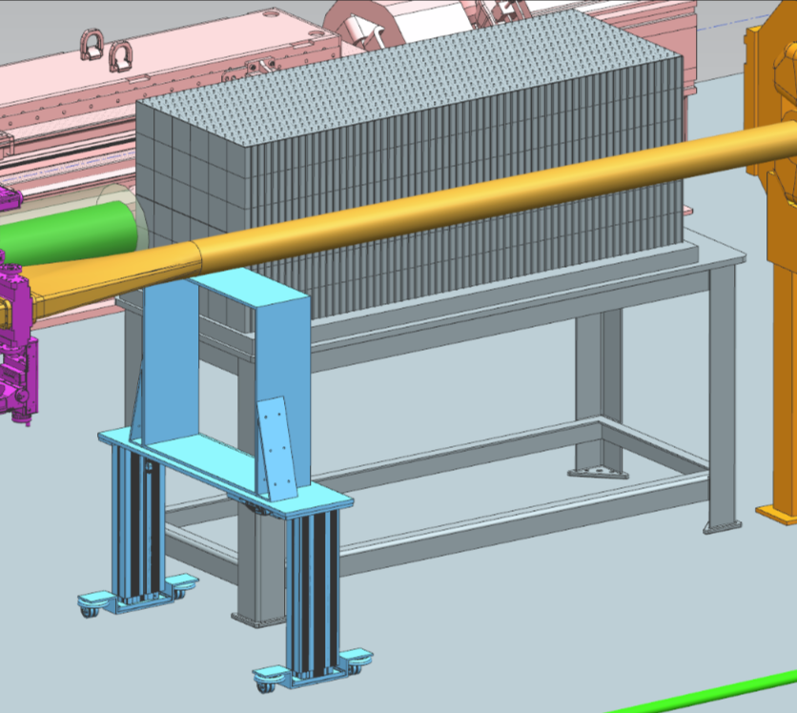
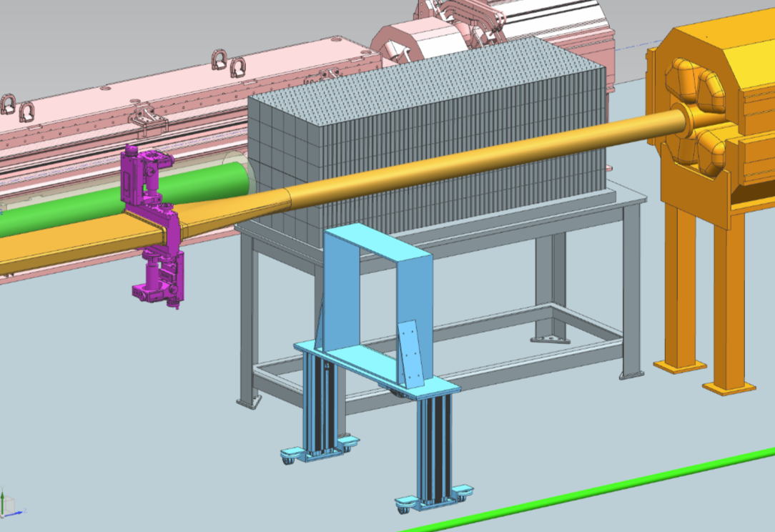
ZDC EMCAL Removal
Under Beamline
Cleared Beamline

