Slide 1
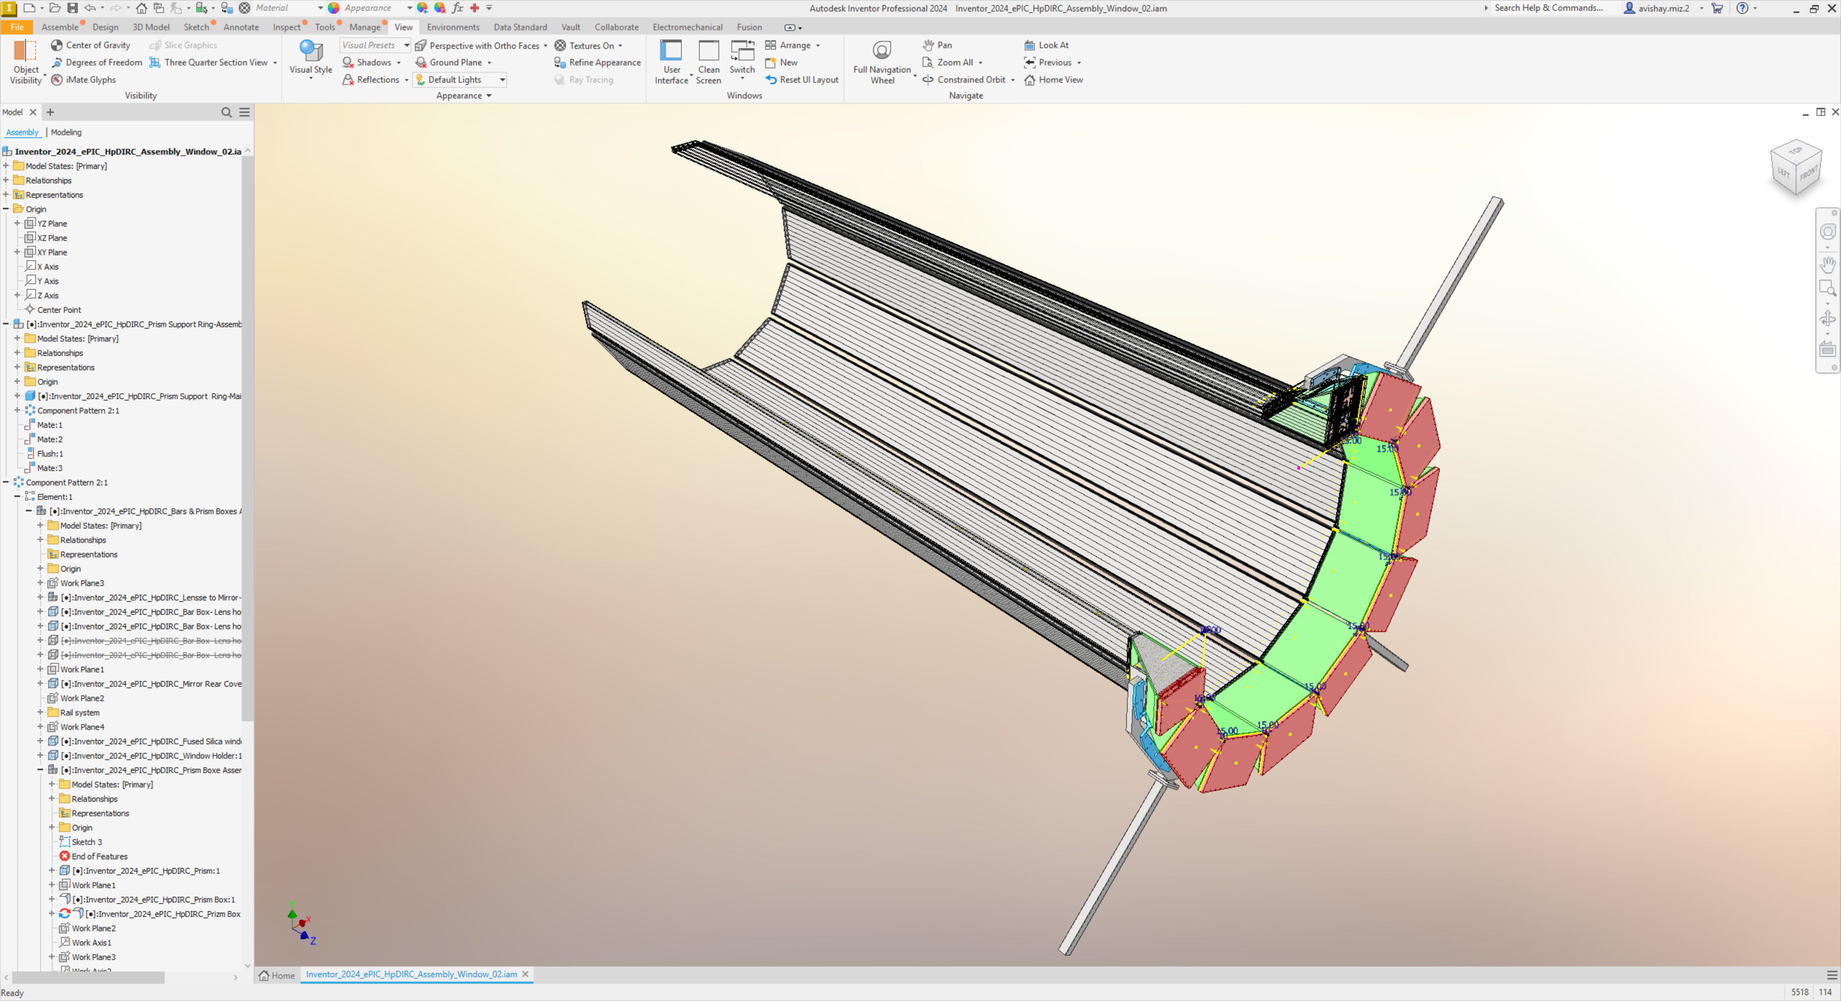








hpDIRC Mechanical Design Status
Kris Cleveland
Avishay Mizrahi
17/Mar/2025

Slide 2
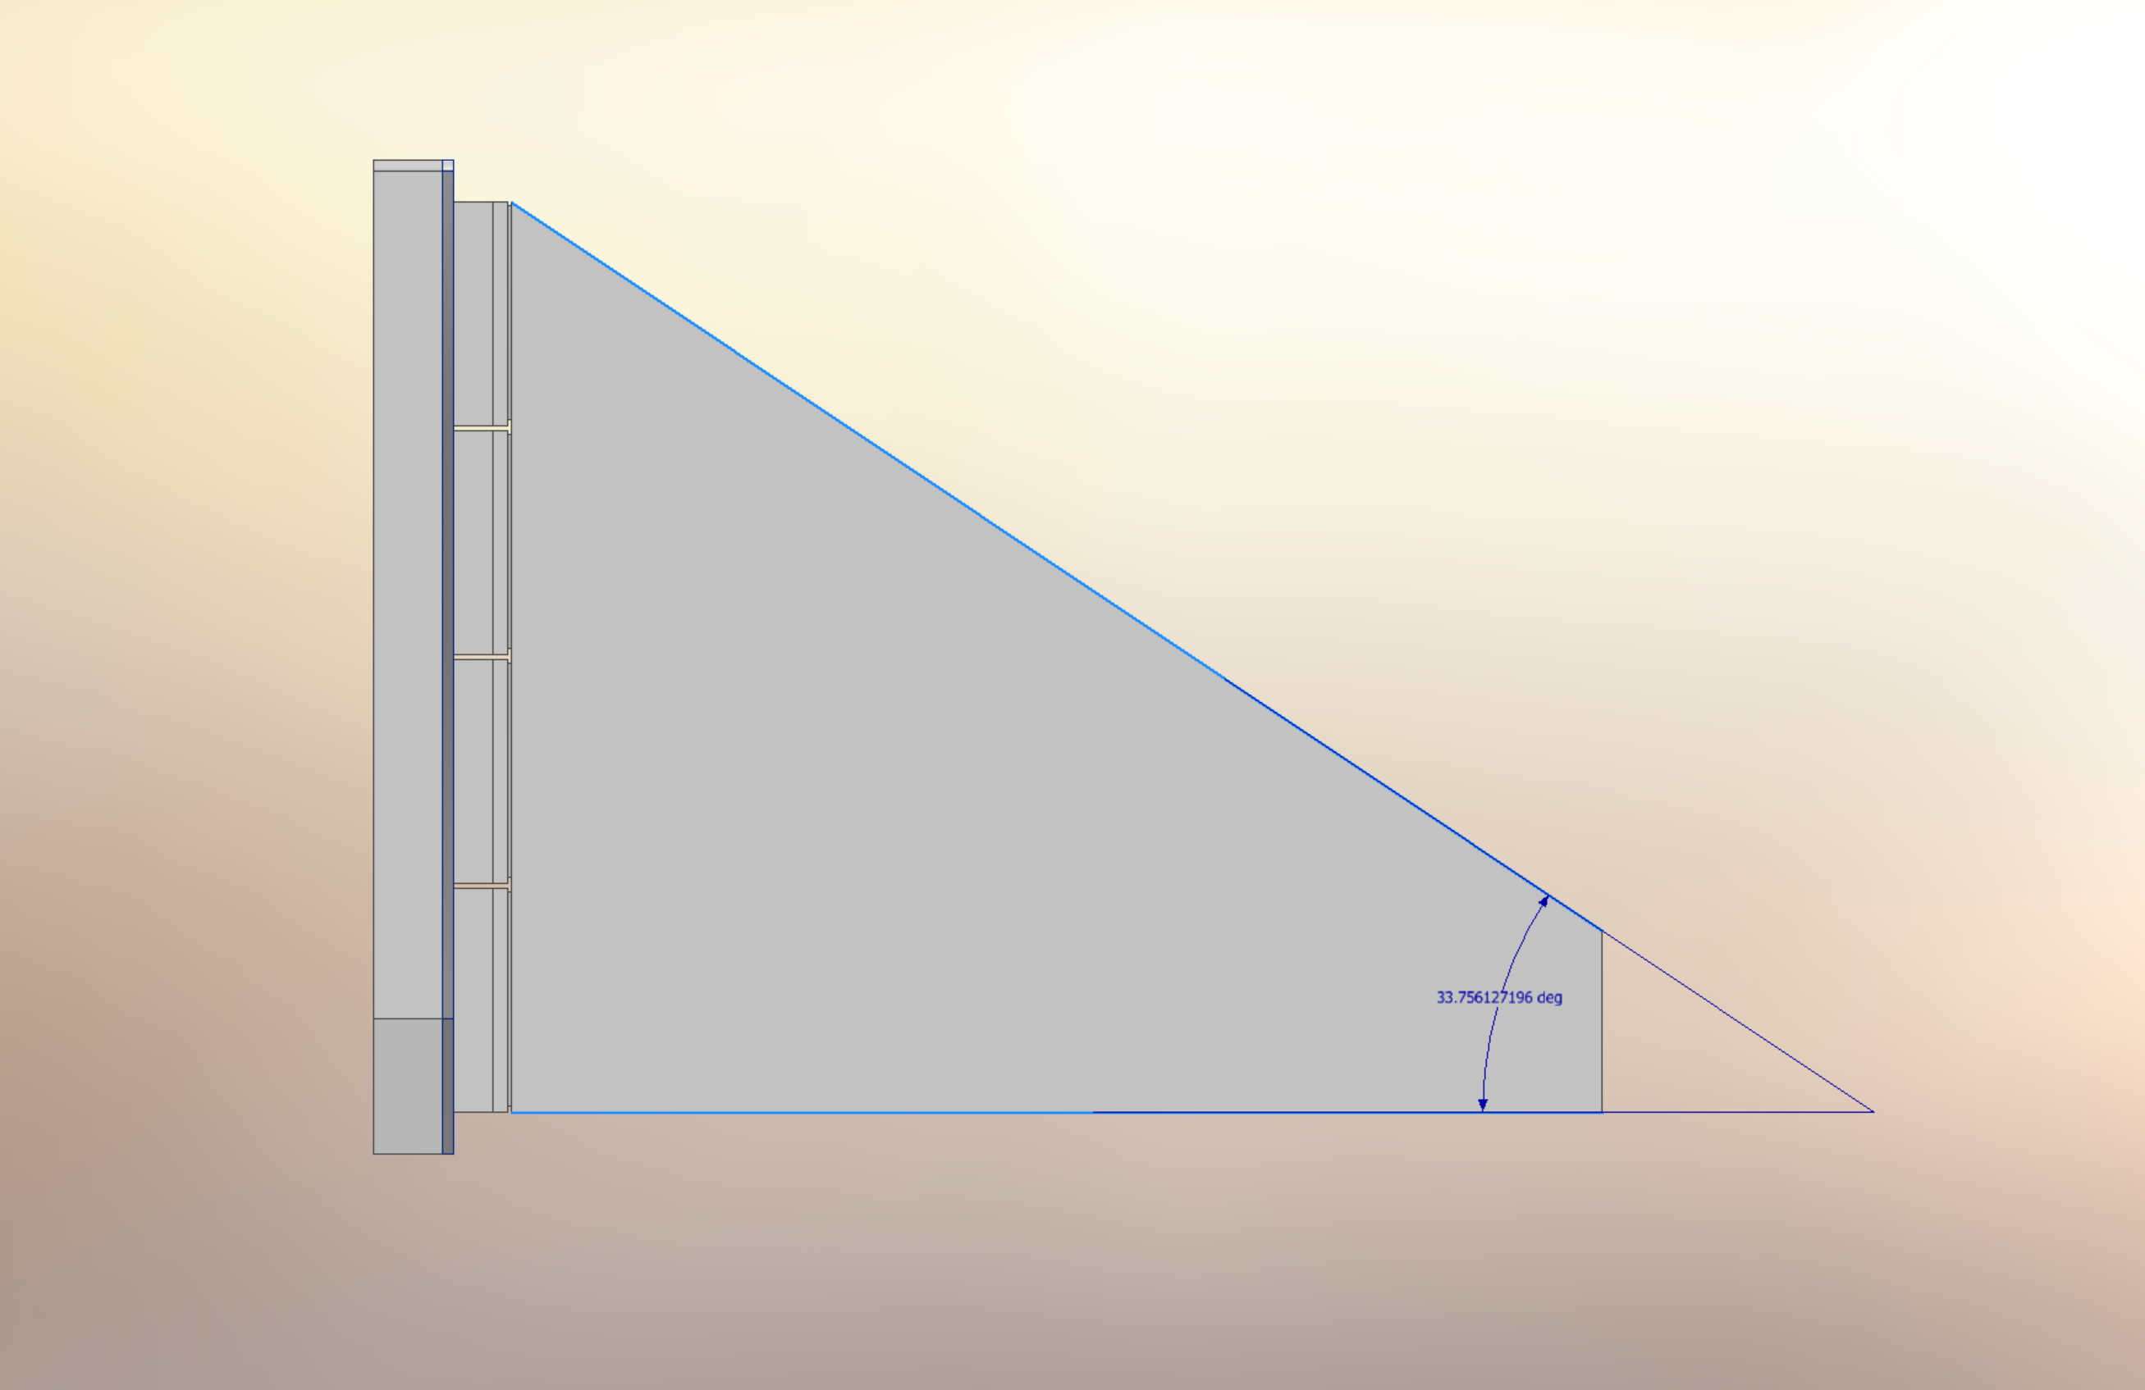
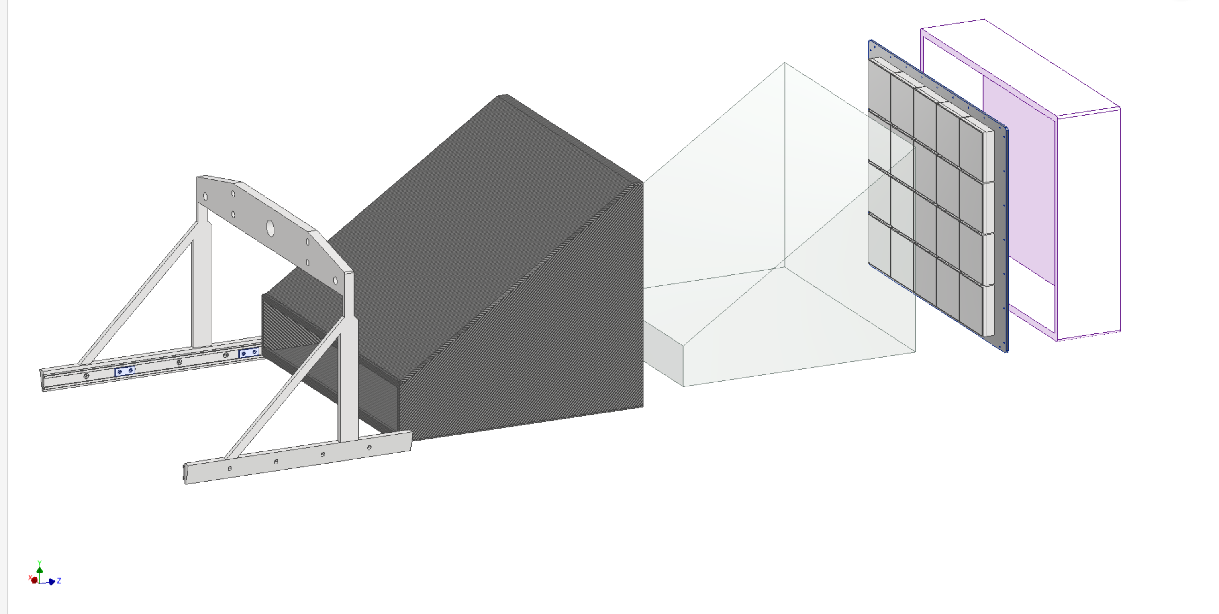
Prism Angle
Changing the angle from 32 degrees to 33.8 degrees to increase the height and accommodate 4 rows of photodetectors.
Light tight cover adapted.
Prism boxes carrier.
A new prism box adapted.

Slide 3
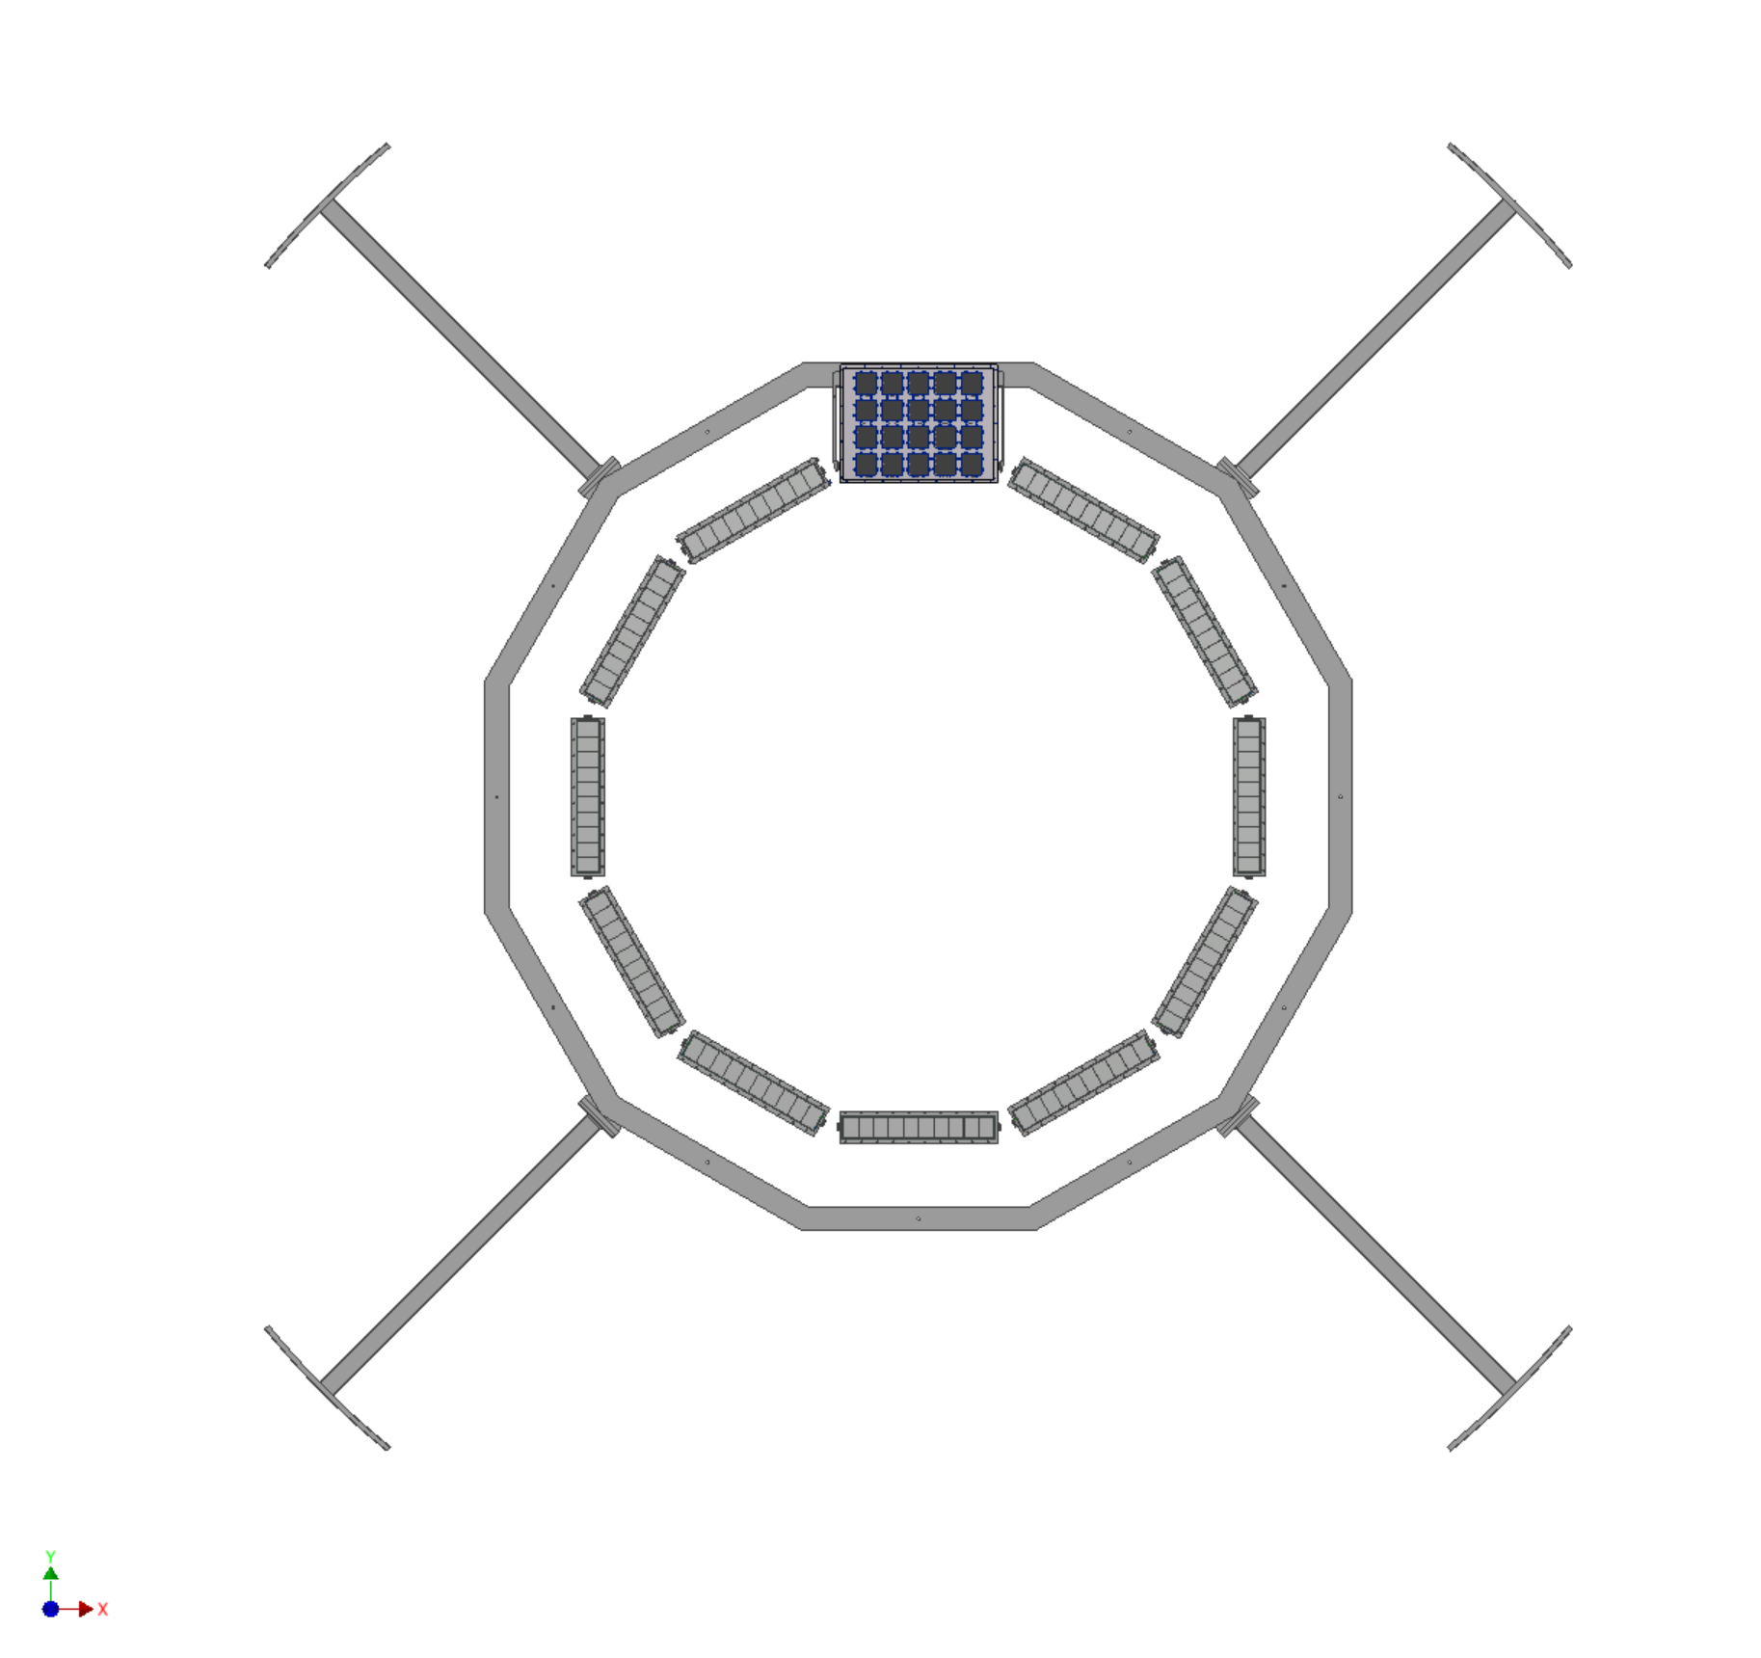
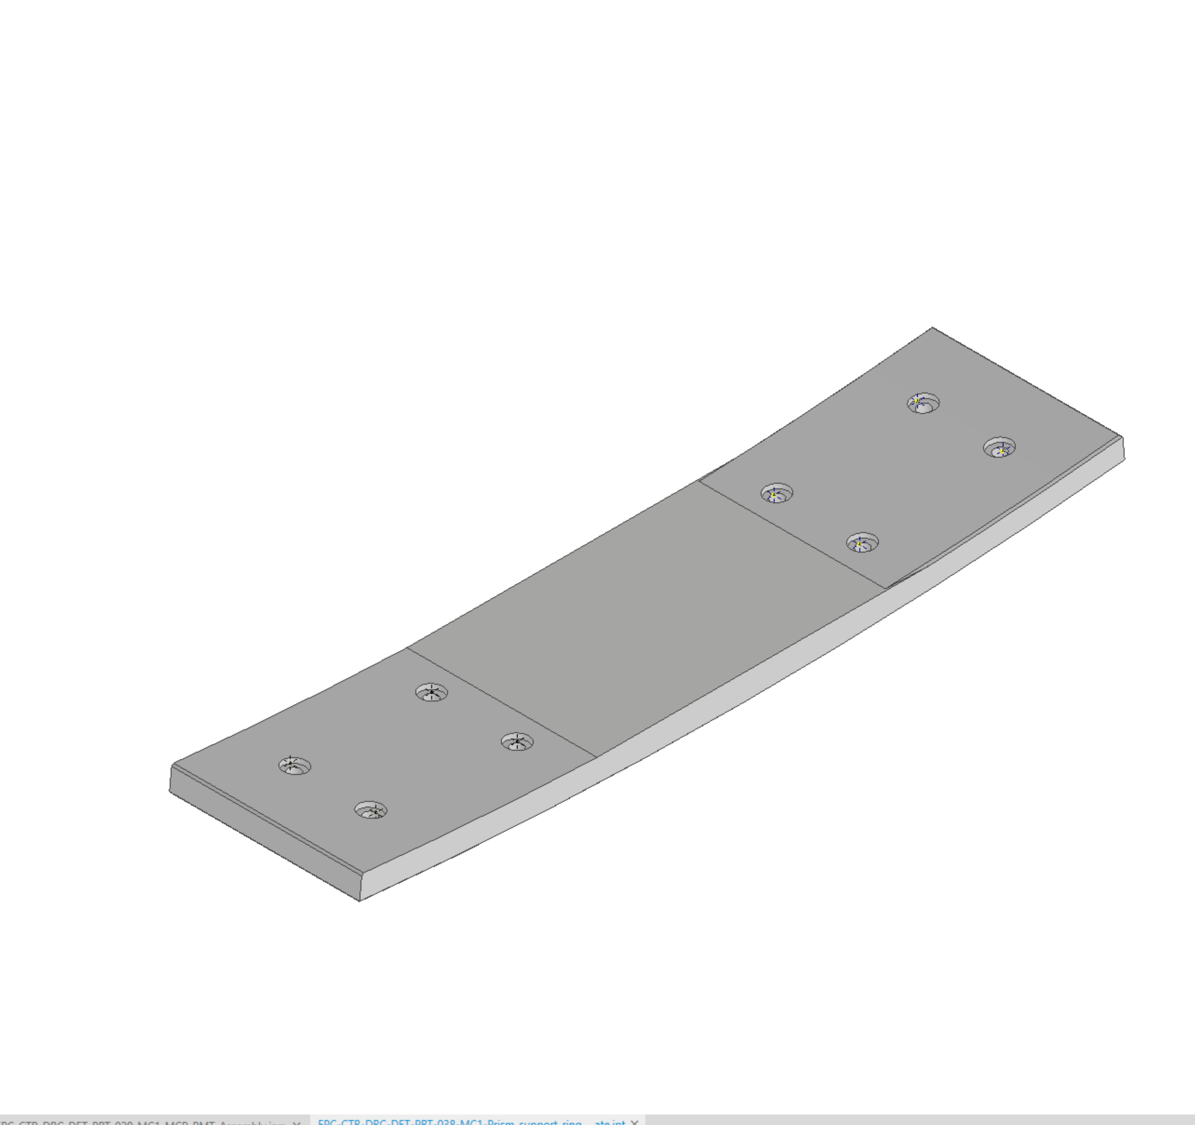
Updated support ring
and HCal plate
The connection plate was updated, the leg length was not updated.
Implementation in the Roland’s master model, needs to be done.

Slide 4
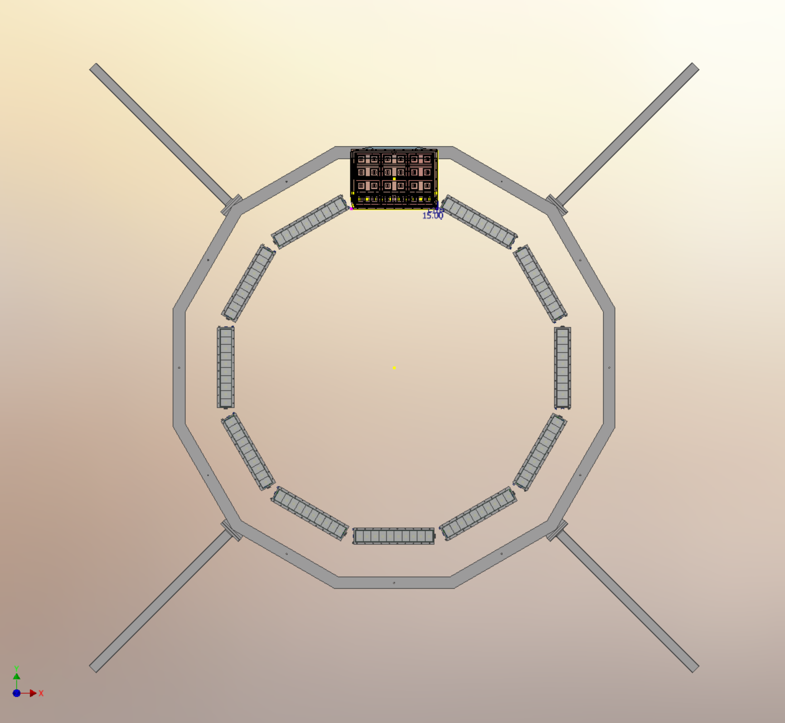

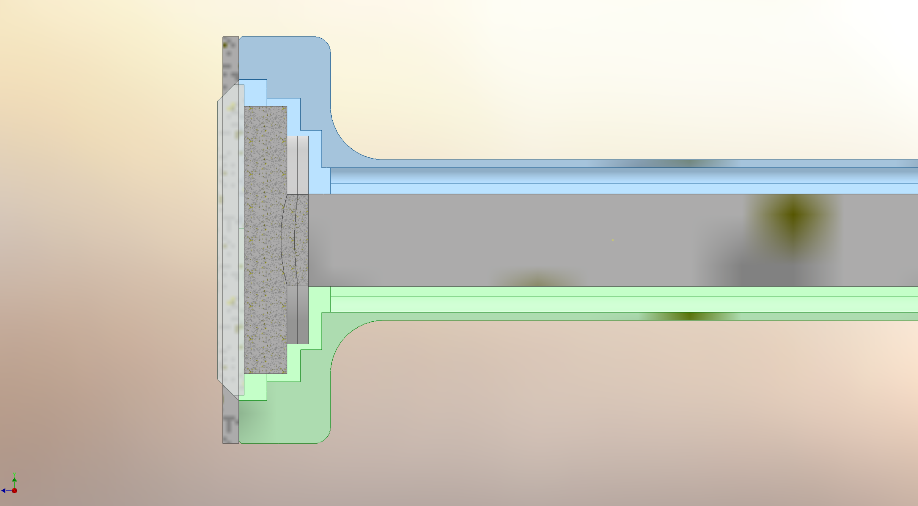
Bar boxes radial shift
Radial shift outward by 1 cm of the hpDIRC boxes and outer MPGD.
The hpDIRC group, want to see a physical justification
for the geometric change that will cause a decrease in the performance.

Slide 5
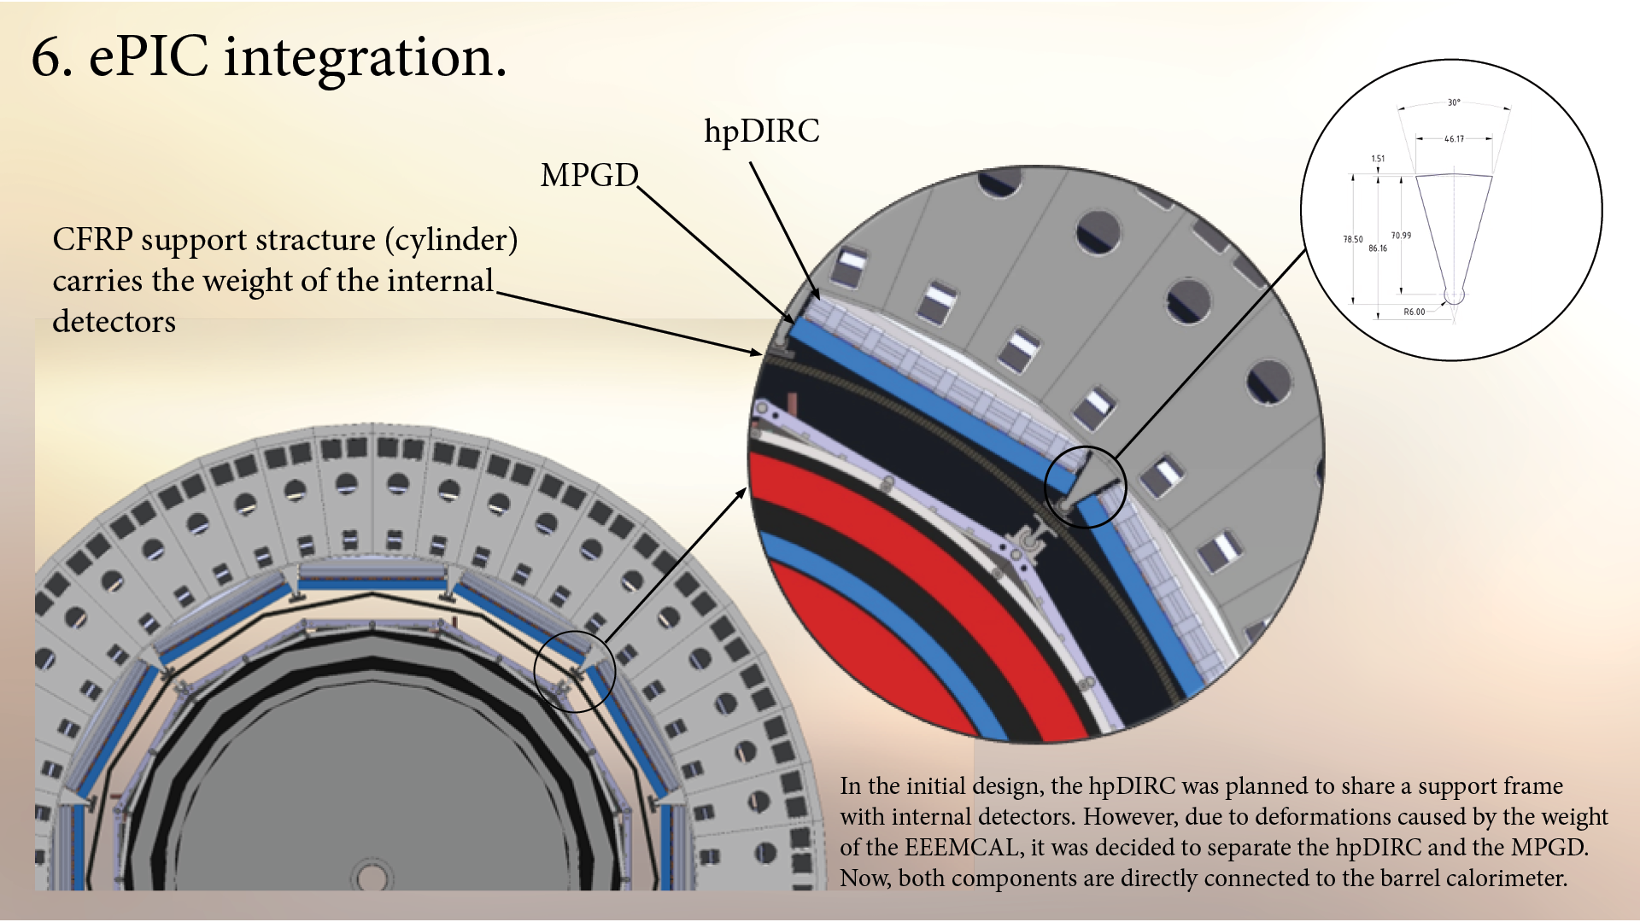

Slide 6
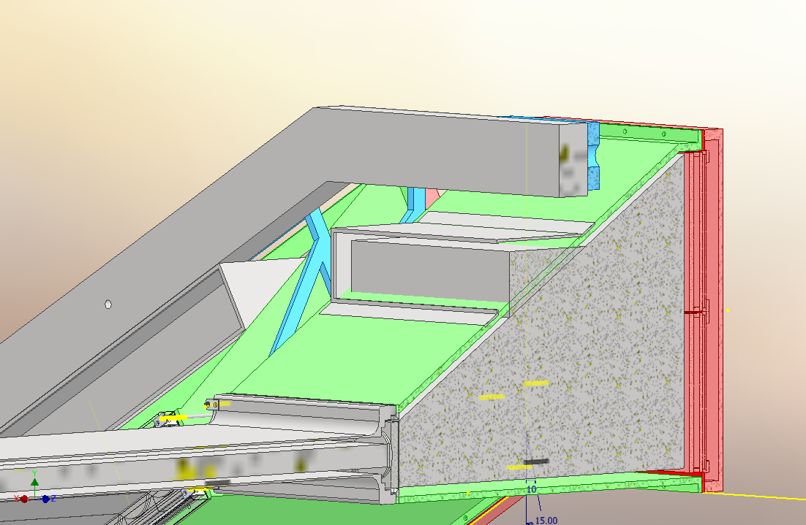
Upcoming:
Buttons Design (in progress).
1. Nitrogen piping design and sealing.
2. Optimizing forces of spring-loaded screws.
3. Calibration and System.

Slide 7
Questions?
.

